Slide 1
Even More Reductions
CSE 417 Fall 22
Lecture 25

Slide 2
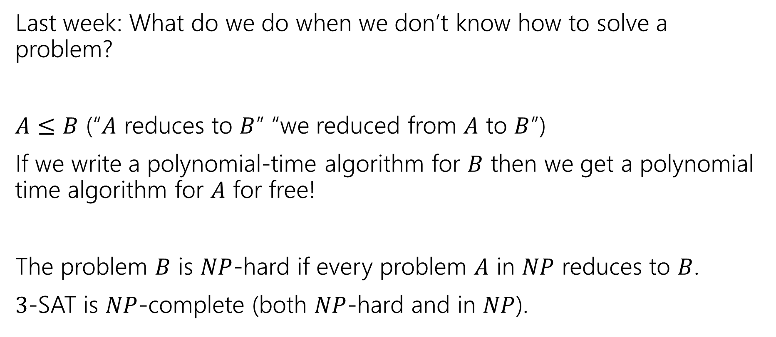
Where are we?
Last week: What do we do when we don’t know how to solve a problem?
$A≤B$ (“$A$ reduces to $B$” “we reduced from $A$ to $B$”)
If we write a polynomial-time algorithm for $B$ then we get a polynomial time algorithm for $A$ for free!
The problem $B$ is $NP$-hard if every problem $A$ in $NP$ reduces to $B$.
$3$-SAT is $NP$-complete (both $NP$-hard and in $NP$).

Slide 3
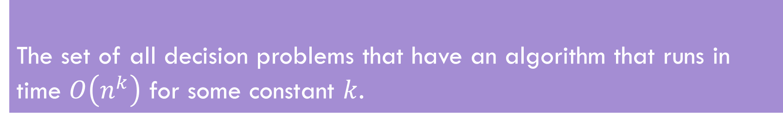
The set of all decision problems that have an algorithm that runs in time $O\left(n^{k}\right)$ for some constant $k$.
P (stands for “Polynomial”)
NP (stands for “nondeterministic polynomial”)
The set of all decision problems such that if the answer is YES, there is a proof of that which can be verified in polynomial time.
The problem B is NP-hard if for all problems A in NP, A reduces to B.
NP-hard
The problem B is NP-complete if B is in NP and B is NP-hard
NP-Complete

Slide 4
NP-Completeness
The problem B is NP-complete if B is in NP and B is NP-hard
NP-Complete
An NP-complete problem is a “hardest” problem in NP.
If you have an algorithm to solve an NP-complete problem, you have an algorithm for every problem in NP.
An NP-complete problem is a universal language for encoding “I’ll know it when I see it” problems.

Slide 5
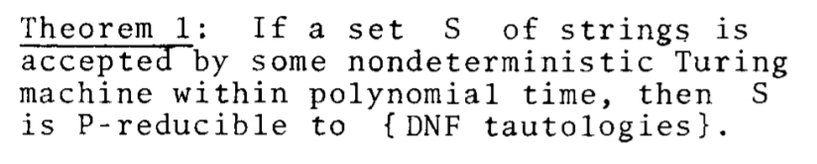
NP-Completeness
An NP-complete problem does exist!
3-SAT is NP-complete
Cook-Levin Theorem (1971)
This sentence (and the proof of it) won Cook the Turing Award.

Slide 6
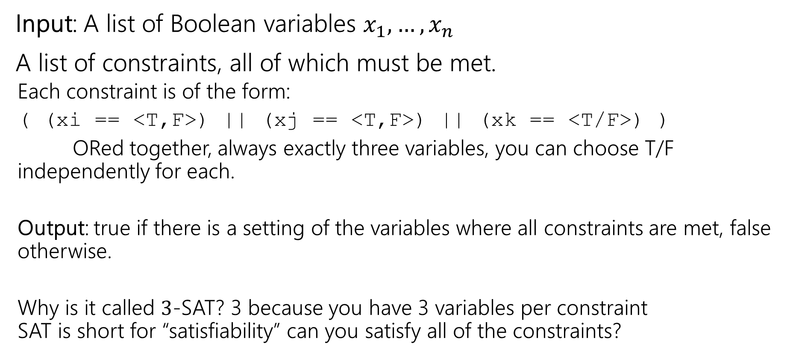
What’s 3-SAT?
Input: A list of Boolean variables $x_{1},…,x_{n}$
A list of constraints, all of which must be met.
Each constraint is of the form:
( (xi == <T,F>) || (xj == <T,F>) || (xk == <T/F>) )
ORed together, always exactly three variables, you can choose T/F independently for each.
Output: true if there is a setting of the variables where all constraints are met, false otherwise.
Why is it called $3$-SAT? 3 because you have 3 variables per constraint SAT is short for “satisfiability” can you satisfy all of the constraints?

Slide 7
Today
Today: More reduction examples.
Overarching Goal:
Even problems that look very different can be reduced to each other.
We’ll do a couple examples together, so you find it plausible.
What’s the significance of these reductions?
Later this week – what do you do when a problem you’re trying to solve is NP-hard?

Slide 8

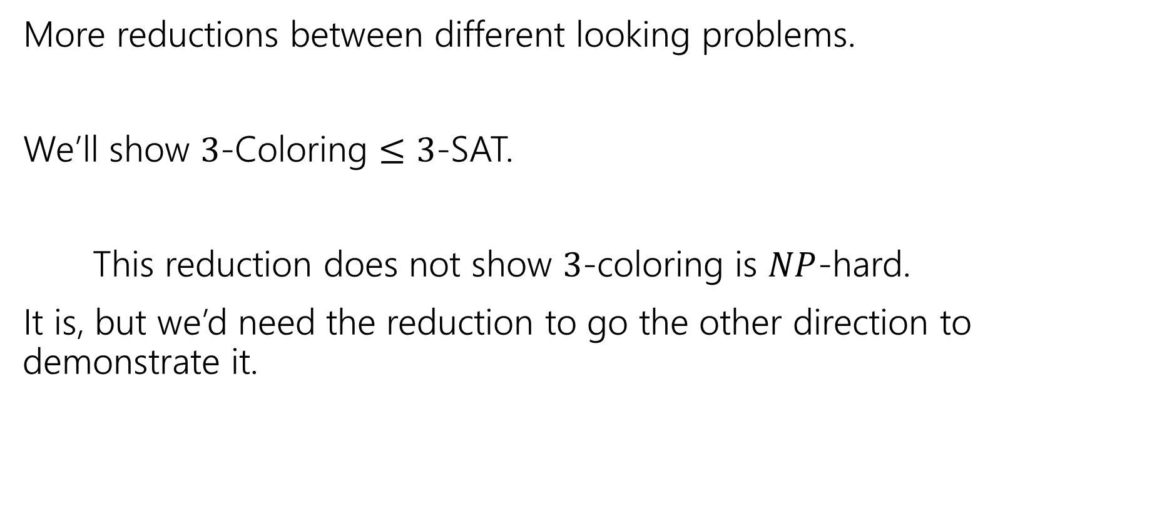
Another Reduction
More reductions between different looking problems.
We’ll show $3$-Coloring $≤$ $3$-SAT.
This reduction does not show $3$-coloring is $NP$-hard.
It is, but we’d need the reduction to go the other direction to demonstrate it.

Slide 9

3-Coloring $≤$3-SAT
Need to transform a 3-coloring instance (a problem about a graph)
To a 3-SAT instance (a problem about variables and constraints)
Those look very different!!
It’s going to take some creativity to make the conversion.
Your main takeaway from this lecture is not these particular reductions or these particular techniques.
Your takeaway is “wow, even if problems can look pretty different, they can be closely related!”

Slide 10
3-Coloring $≤$3-SAT
Need to transform a 3-coloring instance (a problem about a graph)
To a 3-SAT instance (a problem about variables and constraints).
3-SAT talks about Boolean variables and constraints.
What variables could we use to describe coloring?
What constraints would the coloring impose?

Slide 11
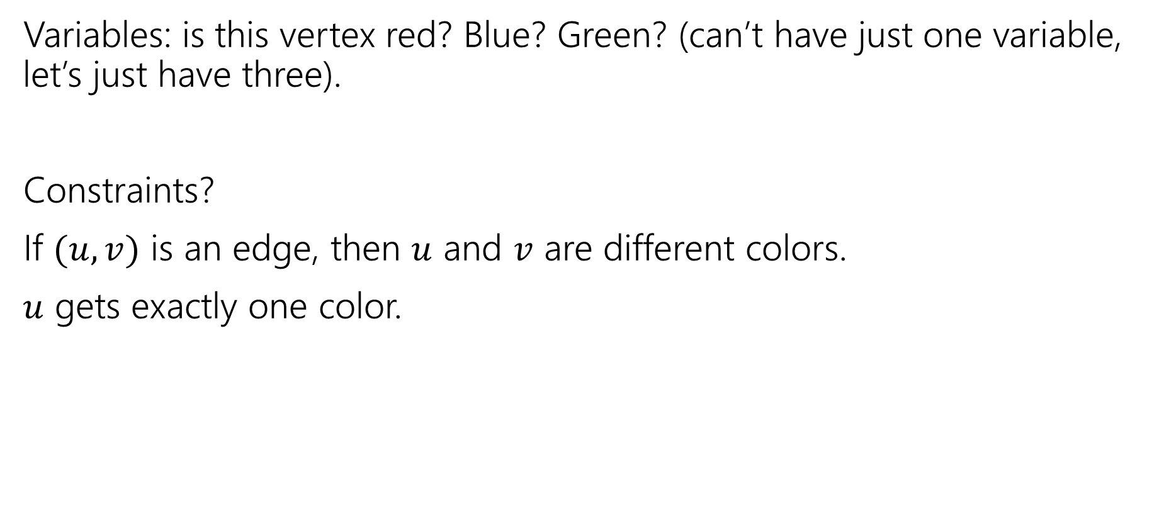

3-Coloring $≤$ 3-SAT
Variables: is this vertex red? Blue? Green? (can’t have just one variable, let’s just have three).
Constraints?
If $(u,v)$ is an edge, then $u$ and $v$ are different colors.
$u$ gets exactly one color.

Slide 12
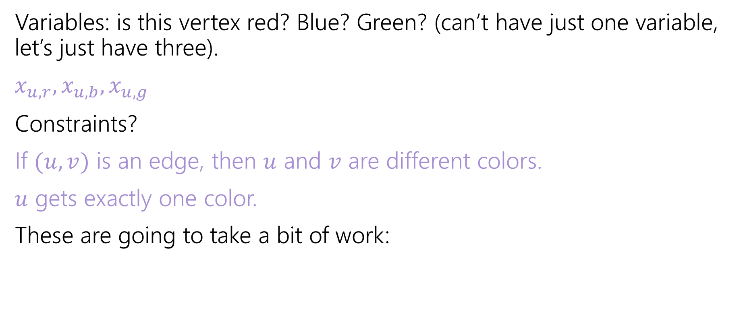
3-Coloring $≤$ 3-SAT
Variables: is this vertex red? Blue? Green? (can’t have just one variable, let’s just have three).
$x_{u,r},x_{u,b},x_{u,g}$
Constraints?
If $(u,v)$ is an edge, then $u$ and $v$ are different colors.
$u$ gets exactly one color.
These are going to take a bit of work:

Slide 13
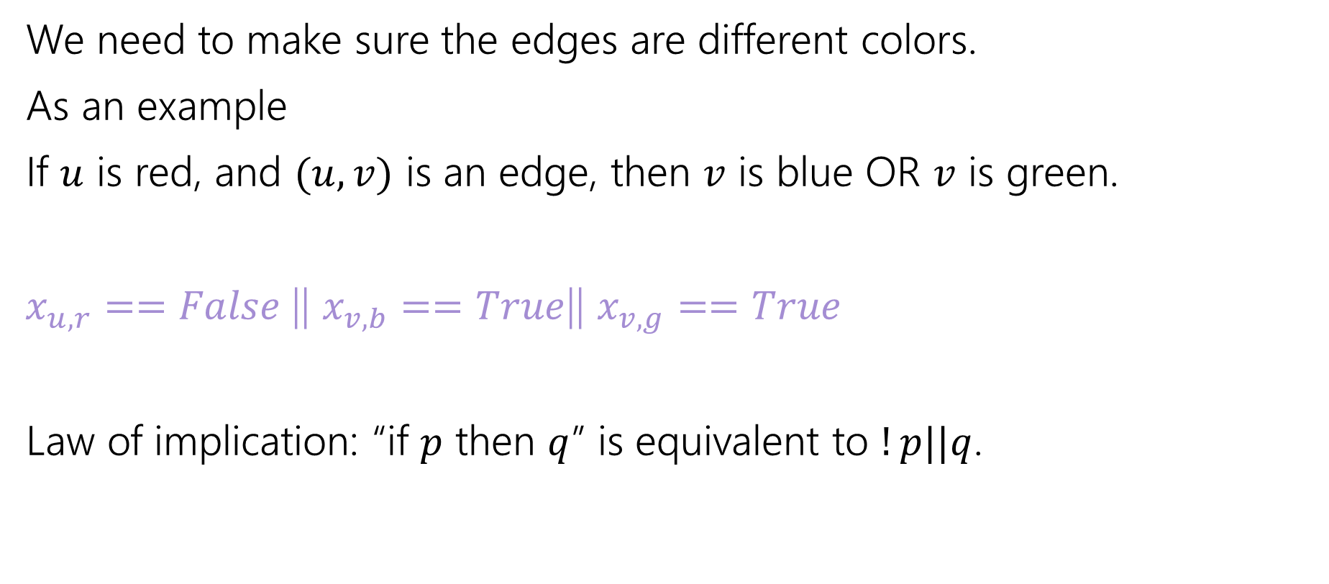
Edge Requirements
We need to make sure the edges are different colors.
As an example
If $u$ is red, and $(u,v)$ is an edge, then $v$ is blue OR $v$ is green.
$x_{u,r}==False$|| $x_{v,b}==True$|| $x_{v,g}==True$
Law of implication: “if $p$ then $q$” is equivalent to $!p||q$.

Slide 14
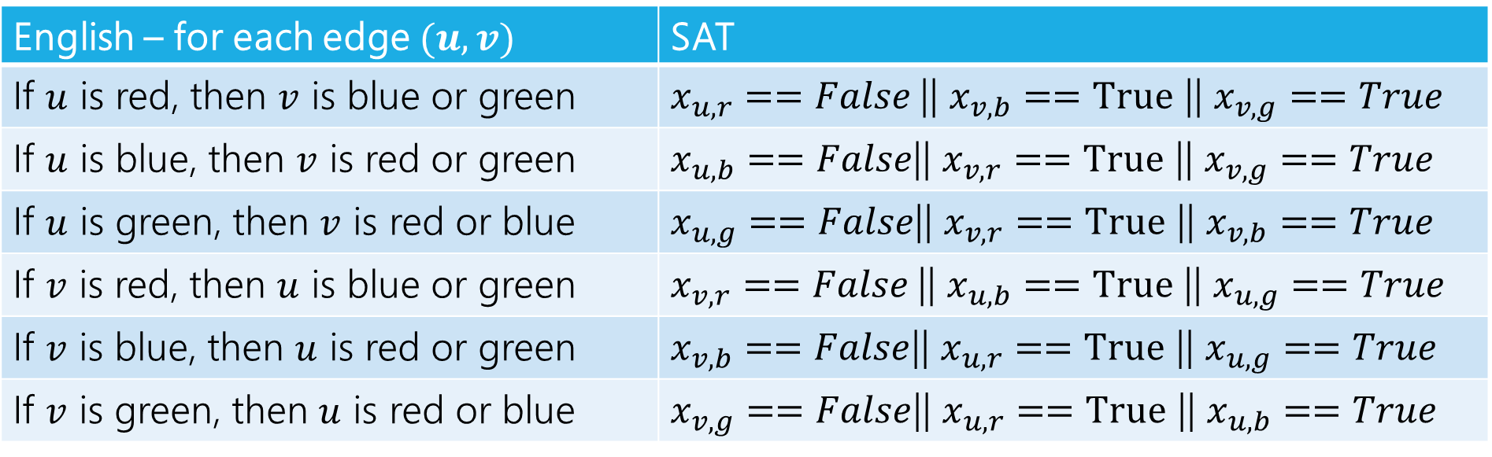
Edge Constraints
All combinations constraints:
English – for each edge $(u,v)$ | SAT
If $u$ is red, then $v$ is blue or green | $x_{u,r}==False$|| $x_{v,b}==True$ || $x_{v,g}==True$
If $u$ is blue, then $v$ is red or green | $x_{u,b}==False$|| $x_{v,r}==True$ || $x_{v,g}==True$
If $u$ is green, then $v$ is red or blue | $x_{u,g}==False$|| $x_{v,r}==True$ || $x_{v,b}==True$
If $v$ is red, then $u$ is blue or green | $x_{v,r}==False$|| $x_{u,b}==True$ || $x_{u,g}==True$
If $v$ is blue, then $u$ is red or green | $x_{v,b}==False$|| $x_{u,r}==True$ || $x_{u,g}==True$
If $v$ is green, then $u$ is red or blue | $x_{v,g}==False$|| $x_{u,r}==True$ || $x_{u,b}==True$
Some of these aren’t strictly necessary (are implied by the others) but better safe than sorry.

Slide 15
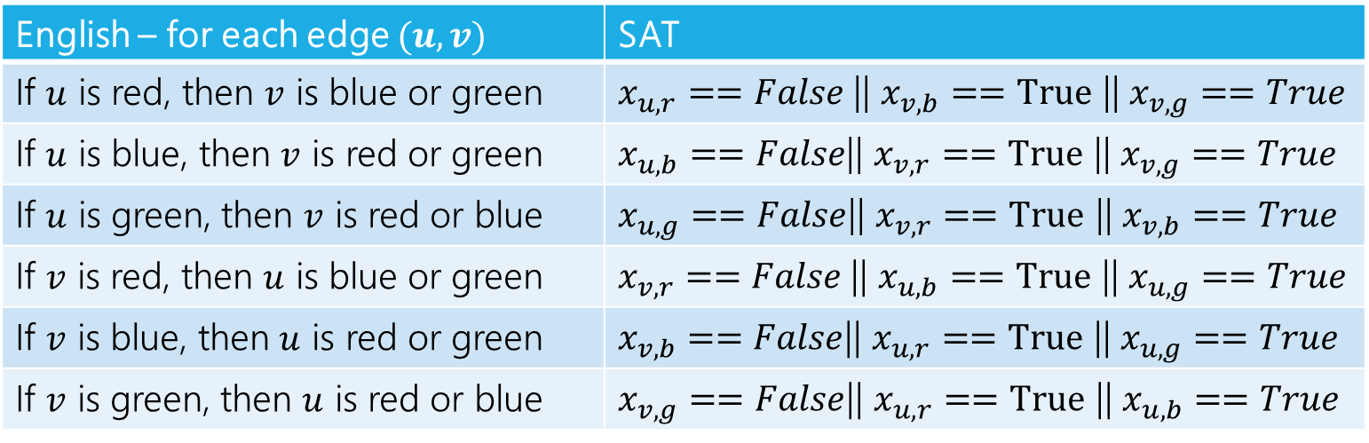
Are those constraints enough?
Suppose we used those constraints, ran the 3-SAT solver on these constraints, and just return what it says.
Are we done? If this reduction is correct, explain to each other why! If it’s not correct explain why not.
English – for each edge $(u,v)$ | SAT
If $u$ is red, then $v$ is blue or green | $x_{u,r}==False$|| $x_{v,b}==True$ || $x_{v,g}==True$
If $u$ is blue, then $v$ is red or green | $x_{u,b}==False$|| $x_{v,r}==True$ || $x_{v,g}==True$
If $u$ is green, then $v$ is red or blue | $x_{u,g}==False$|| $x_{v,r}==True$ || $x_{v,b}==True$
If $v$ is red, then $u$ is blue or green | $x_{v,r}==False$|| $x_{u,b}==True$ || $x_{u,g}==True$
If $v$ is blue, then $u$ is red or green | $x_{v,b}==False$|| $x_{u,r}==True$ || $x_{u,g}==True$
If $v$ is green, then $u$ is red or blue | $x_{v,g}==False$|| $x_{u,r}==True$ || $x_{u,b}==True$

Slide 16
Are those constraints enough?
Suppose we used those constraints, ran the 3-SAT solver on what we got.
If the graph is 3-colorable, then the 3-SAT instance has a solution (pick your favorite coloring and set the variables to match that coloring).
If the graph is not 3-colorable
The 3-SAT solver will still say there’s a solution for this instance. Just set every variable to false!

Slide 17
Consistency Constraints
Reductions often need extra constraints/structures.
When you say “I want this variable to mean X” you really need to force the variable to mean X.
So if you want a coloring, you need to make sure even “well, yeah of course that’s what I meant” requirements are explicit.
What are we missing? Every vertex needs exactly one color.

Slide 18
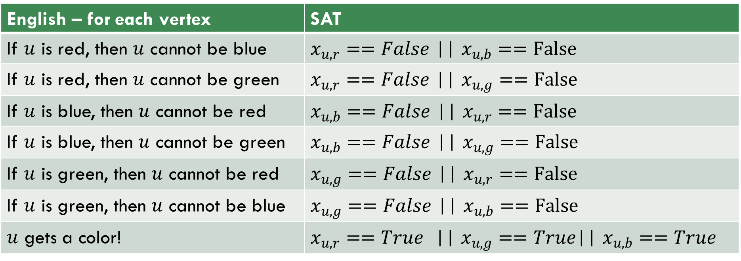
Consistency
More constraints:
English – for each vertex | SAT
If $u$ is red, then $u$ cannot be blue | $x_{u,r}==False$ || $x_{u,b}==False$
If $u$ is red, then $u$ cannot be green | $x_{u,r}==False$ || $x_{u,g}==False$
If $u$ is blue, then $u$ cannot be red | $x_{u,b}==False$ || $x_{u,r}==False$
If $u$ is blue, then $u$ cannot be green | $x_{u,b}==False$ || $x_{u,g}==False$
If $u$ is green, then $u$ cannot be red | $x_{u,g}==False$ || $x_{u,r}==False$
If $u$ is green, then $u$ cannot be blue | $x_{u,g}==False$ || $x_{u,b}==False$
$u$ gets a color! | $x_{u,r}==True$ || $x_{u,g}==True$|| $x_{u,b}==True$

Slide 19
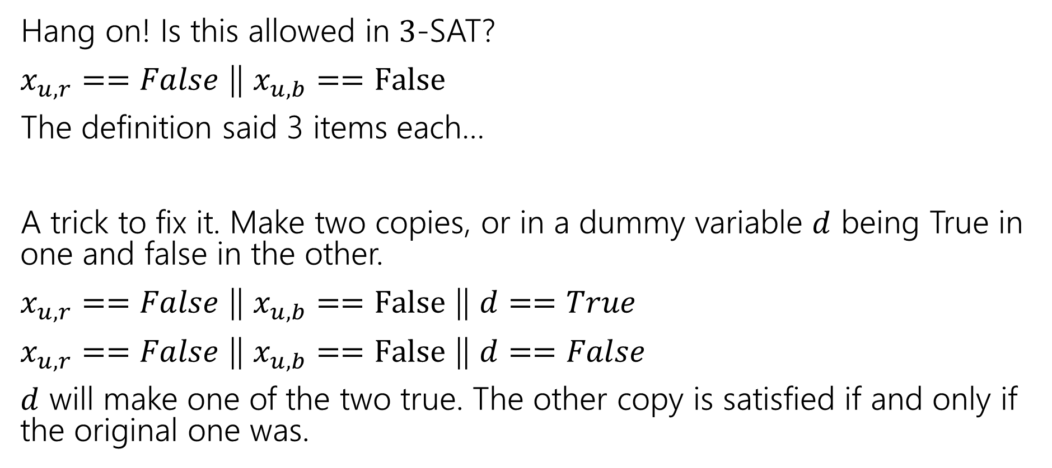

From $2$ to $3$.
Hang on! Is this allowed in $3$-SAT?
$x_{u,r}==False$ || $x_{u,b}==False$
The definition said 3 items each…
A trick to fix it. Make two copies, or in a dummy variable $d$ being True in one and false in the other.
$x_{u,r}==False$ || $x_{u,b}==False$ || $d==True$
$x_{u,r}==False$ || $x_{u,b}==False$ || $d==False$
$d$ will make one of the two true. The other copy is satisfied if and only if the original one was.

Slide 20
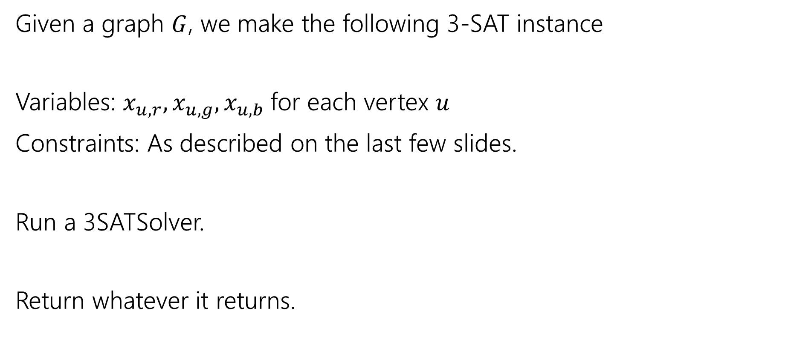
Reduction
Given a graph $G$, we make the following 3-SAT instance
Variables: $x_{u,r},x_{u,g},x_{u,b}$for each vertex $u$
Constraints: As described on the last few slides.
Run a 3SATSolver.
Return whatever it returns.

Slide 21

Running Time?
We need $n$ variables and $6m+13n$ constraints.
Making them is mechanical, definitely polynomial time.

Slide 22
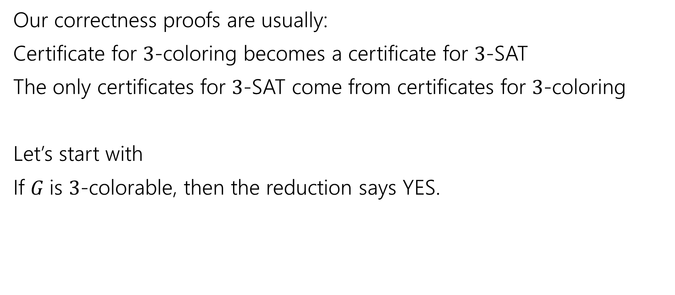
Correctness
Our correctness proofs are usually:
Certificate for $3$-coloring becomes a certificate for $3$-SAT
The only certificates for $3$-SAT come from certificates for $3$-coloring
Let’s start with
If $G$is $3$-colorable, then the reduction says YES.

Slide 23
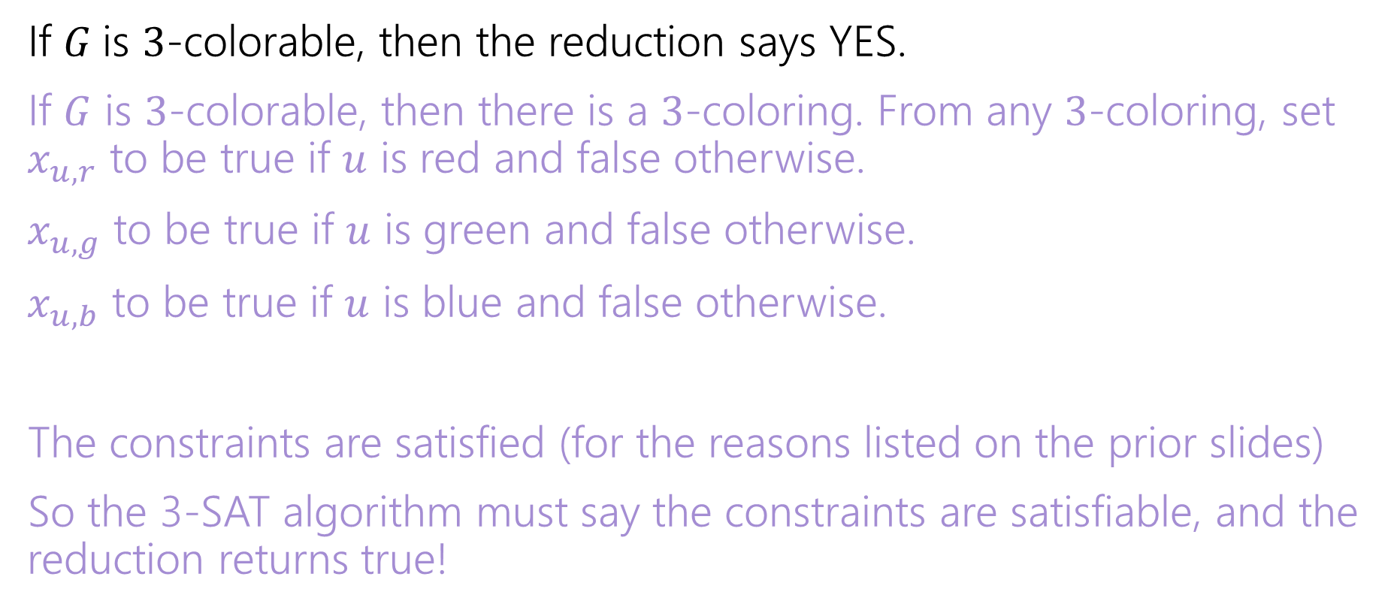
Correctness
If $G$is $3$-colorable, then the reduction says YES.
If $G$ is $3$-colorable, then there is a $3$-coloring. From any $3$-coloring, set $x_{u,r}$ to be true if $u$ is red and false otherwise.
$x_{u,g}$ to be true if $u$ is green and false otherwise.
$x_{u,b}$ to be true if $u$ is blue and false otherwise.
The constraints are satisfied (for the reasons listed on the prior slides)
So the 3-SAT algorithm must say the constraints are satisfiable, and the reduction returns true!

Slide 24

Correctness
If the reduction returns YES, then $G$was $3$-colorable.

Slide 25
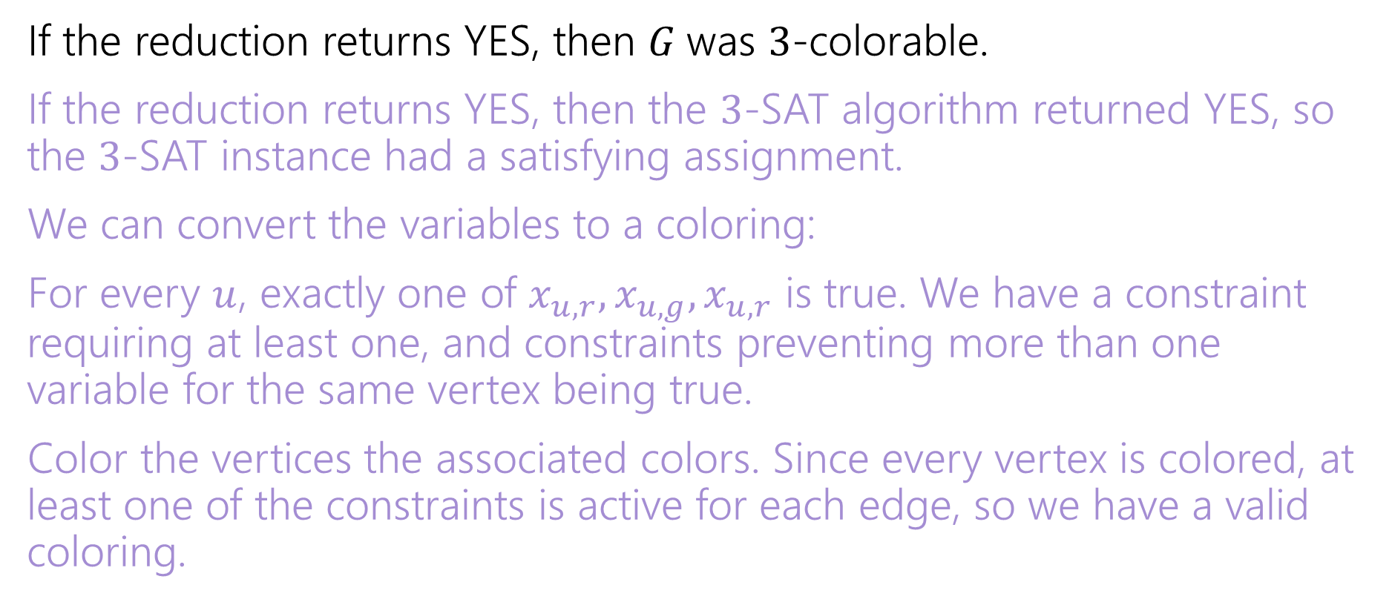
Correctness
If the reduction returns YES, then $G$was $3$-colorable.
If the reduction returns YES, then the $3$-SAT algorithm returned YES, so the $3$-SAT instance had a satisfying assignment.
We can convert the variables to a coloring:
For every $u$, exactly one of $x_{u,r},x_{u,g},x_{u,r}$ is true. We have a constraint requiring at least one, and constraints preventing more than one variable for the same vertex being true.
Color the vertices the associated colors. Since every vertex is colored, at least one of the constraints is active for each edge, so we have a valid coloring.

Slide 26
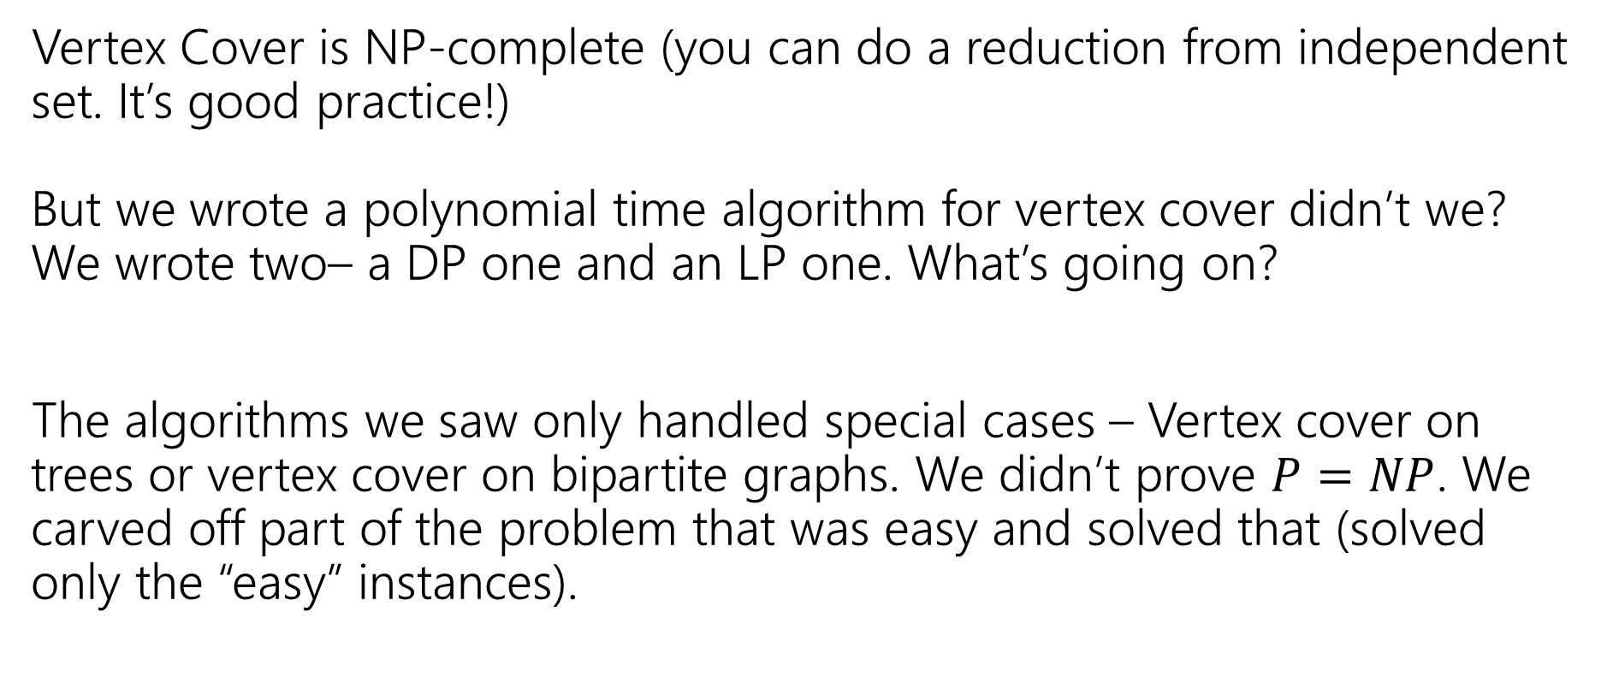
One More Thought
Vertex Cover is NP-complete (you can do a reduction from independent set. It’s good practice!) But we wrote a polynomial time algorithm for vertex cover didn’t we? We wrote two– a DP one and an LP one. What’s going on?
The algorithms we saw only handled special cases – Vertex cover on trees or vertex cover on bipartite graphs. We didn’t prove $P=NP$. We carved off part of the problem that was easy and solved that (solved only the “easy” instances).

Slide 27
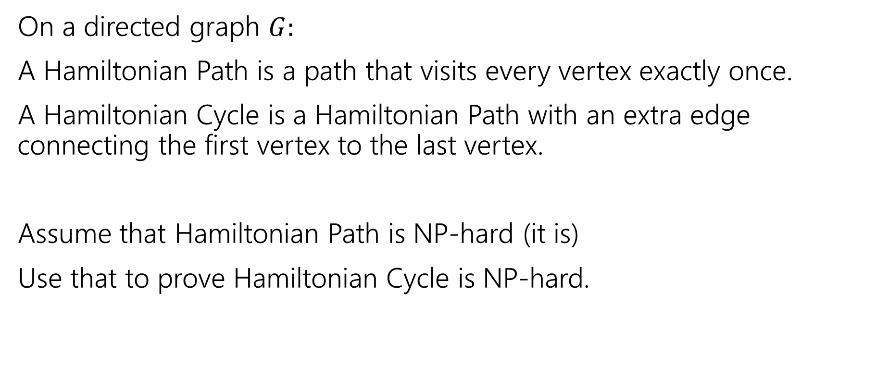
Hamilton
On a directed graph $G:$
A Hamiltonian Path is a path that visits every vertex exactly once.
A Hamiltonian Cycle is a Hamiltonian Path with an extra edge connecting the first vertex to the last vertex.
Assume that Hamiltonian Path is NP-hard (it is)
Use that to prove Hamiltonian Cycle is NP-hard.
Pollev.com/robbie

Slide 28

Which direction?
Reduce FROM the known hard problem TO the new problem.
Want to show Hamiltonian Path $≤$ Hamiltonian Cycle.

Slide 29
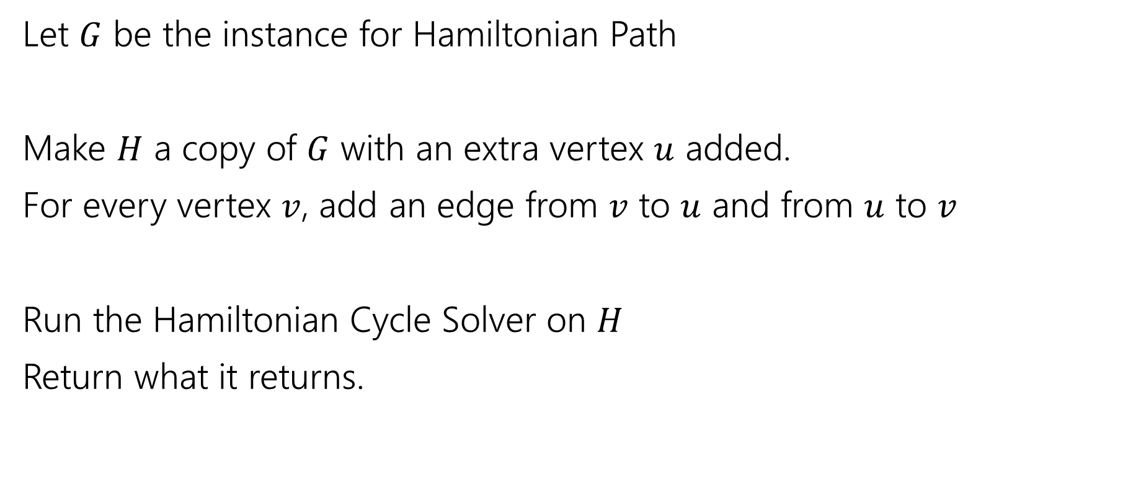
Reduction
Let $G$ be the instance for Hamiltonian Path
Make $H$ a copy of $G$ with an extra vertex $u$ added.
For every vertex $v$, add an edge from $v$ to $u$ and from $u$ to $v$
Run the Hamiltonian Cycle Solver on $H$
Return what it returns.

Slide 30

Correctness
If $G$ has a Hamiltonian Path,
Then there is a Hamiltonian Cycle in $H$ by following the path in $G$ going to $u$ and going back to the start.
So we correctly return YES.

Slide 31
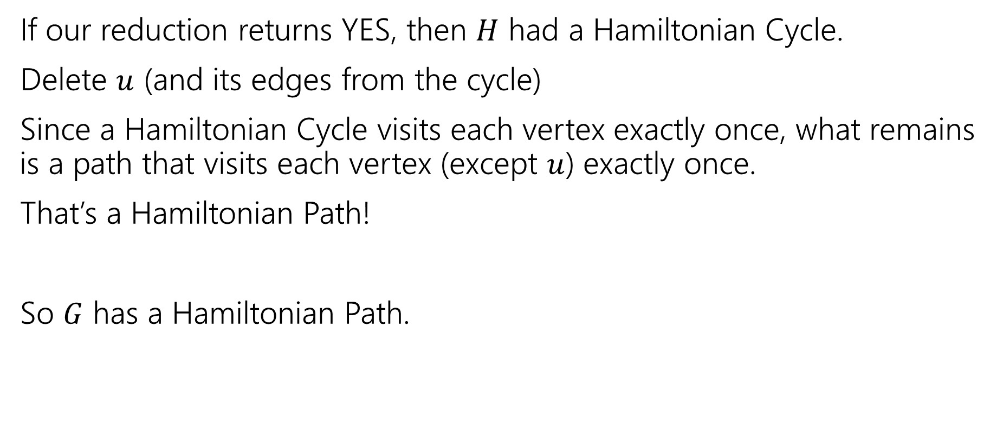
Correctness
If our reduction returns YES, then $H$ had a Hamiltonian Cycle.
Delete $u$ (and its edges from the cycle)
Since a Hamiltonian Cycle visits each vertex exactly once, what remains is a path that visits each vertex (except $u$) exactly once.
That’s a Hamiltonian Path!
So $G$ has a Hamiltonian Path.

Slide 32
Reductions
We saw a reduction between two very similar (on the surface) problems when we reduced from 2-coloring to 3-coloring.
The real power of reductions is when problems look very different on the surface but you can still reduce from one to the other.
We’re going to do a couple more reductions with varying levels of differences between the problems.

Slide 33
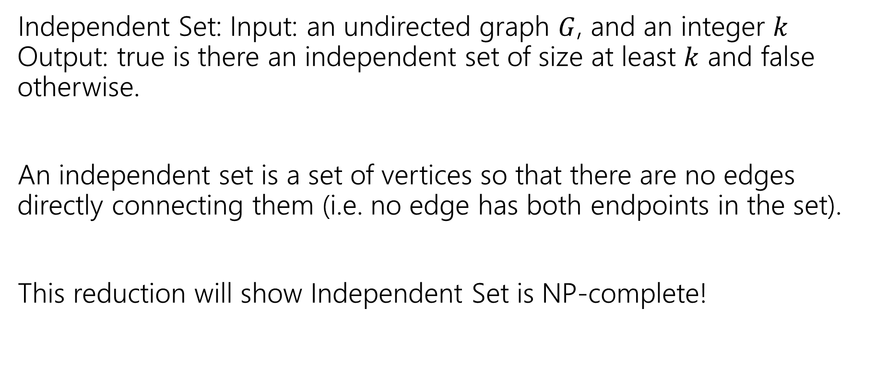

3-SAT $≤$ Independent Set
Independent Set: Input: an undirected graph $G$, and an integer $k$ Output: true is there an independent set of size at least $k$ and false otherwise.
An independent set is a set of vertices so that there are no edges directly connecting them (i.e. no edge has both endpoints in the set).
This reduction will show Independent Set is NP-complete!

Slide 34
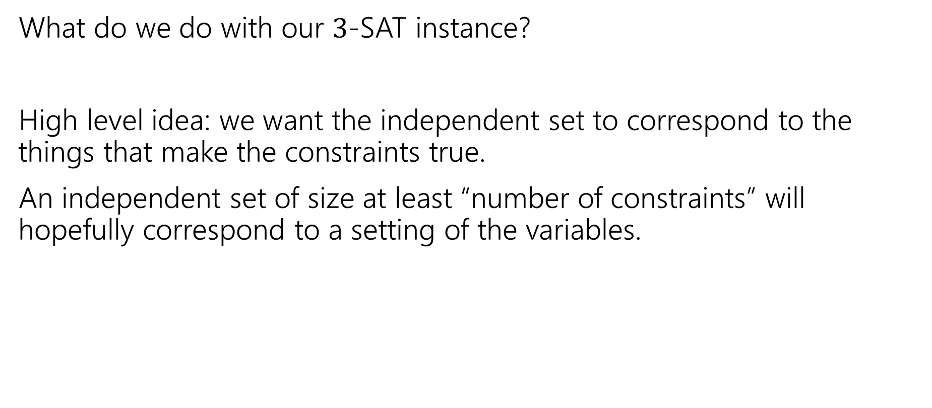
The Reduction
What do we do with our $3$-SAT instance?
High level idea: we want the independent set to correspond to the things that make the constraints true.
An independent set of size at least “number of constraints” will hopefully correspond to a setting of the variables.

Slide 35
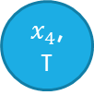
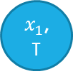
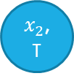
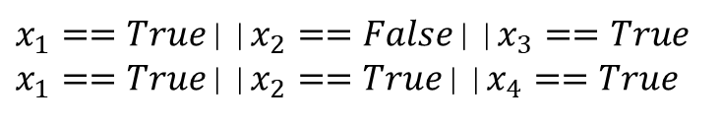
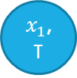

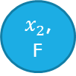
Reduction Idea
Connecting two vertices by an edge means we can have at most one in our independent set.
Have the vertices correspond to the pieces of the constraints.
$x_{1}$, T
$x_{3}$, T
$x_{1}==True$||$x_{2}==False$||$x_{3}==True$
$x_{1}==True$||$x_{2}==True$||$x_{4}==True$
$x_{2}$, F
Which Booleans can’t we have both of?
I.e. which pairs don’t make sense together?
$x_{1}$, T
$x_{4}$, T
Add edges between the same variable set to opposite values.
$x_{2}$, T

Slide 36
Reduction Idea Step 2
Connecting two vertices by an edge means we can have at most one in our independent set.
How big of an independent set do we want? Would be nice to count how many constraints are satisfied…need to make sure we take only one vertex per constraint.
$x_{1}$, T
$x_{3}$, T
$x_{1}==True$||$x_{2}==False$||$x_{3}==True$
$x_{1}==True$||$x_{2}==True$||$x_{4}==True$
$x_{2}$, F
Need only one vertex per constraint.
$x_{1}$, T
$x_{4}$, T
Add edges between all vertices coming from one constraint.
$x_{2}$, T

Slide 37
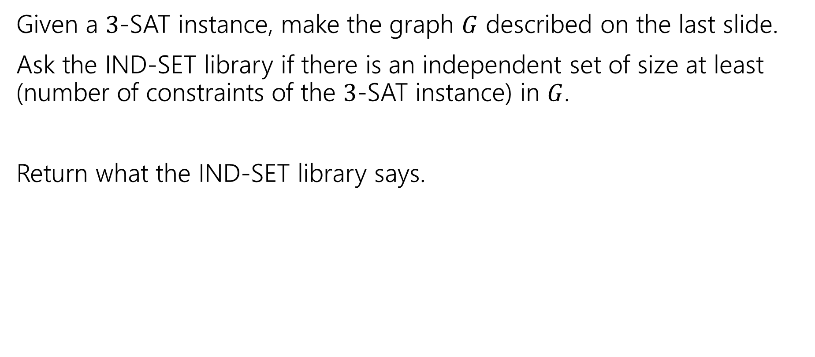
Reduction
Given a $3$-SAT instance, make the graph $G$ described on the last slide.
Ask the IND-SET library if there is an independent set of size at least (number of constraints of the $3$-SAT instance) in $G$.
Return what the IND-SET library says.

Slide 38
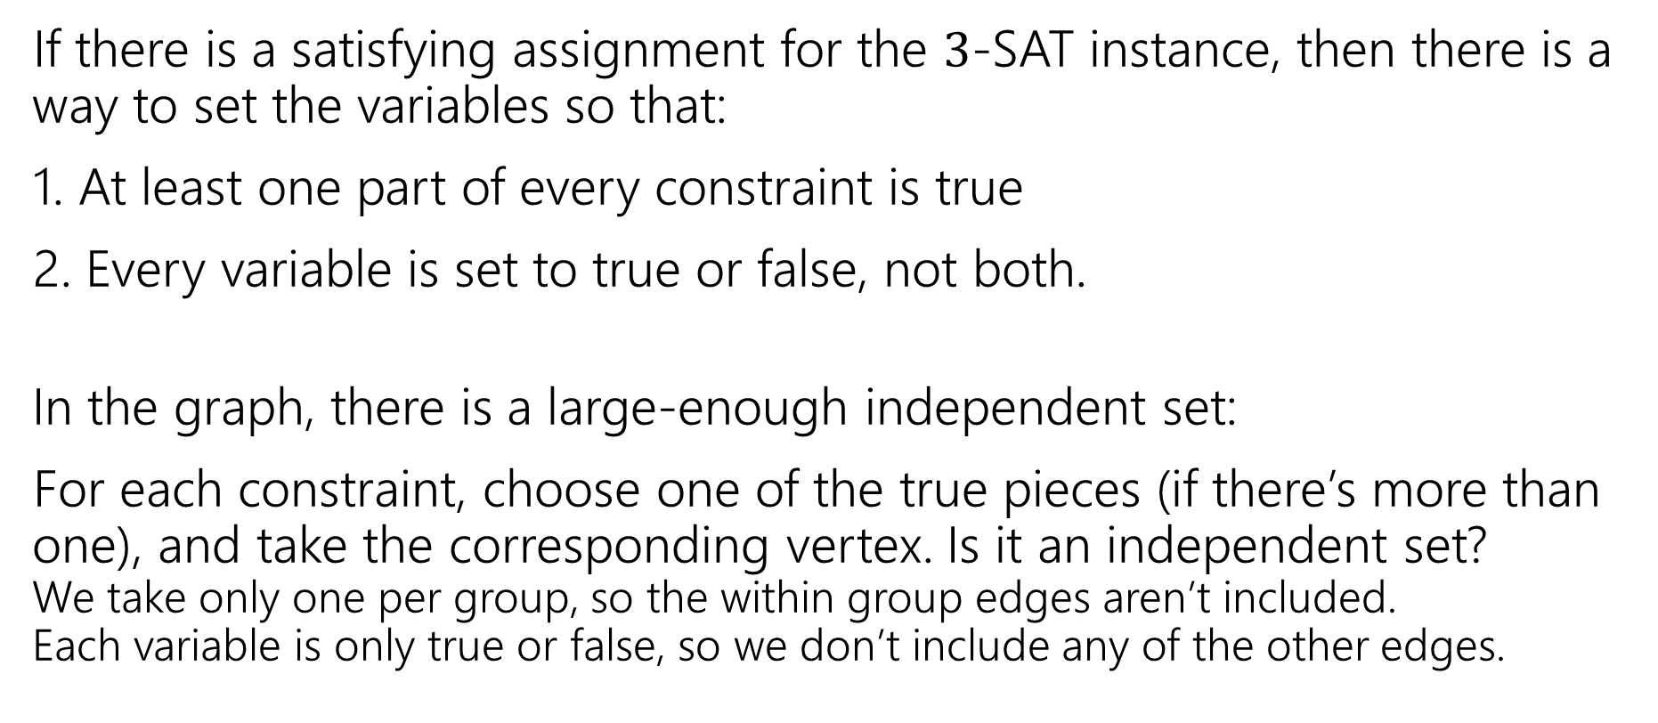
Correctness
If there is a satisfying assignment for the $3$-SAT instance, then there is a way to set the variables so that:
1. At least one part of every constraint is true
2. Every variable is set to true or false, not both.
In the graph, there is a large-enough independent set:
For each constraint, choose one of the true pieces (if there’s more than one), and take the corresponding vertex. Is it an independent set? We take only one per group, so the within group edges aren’t included. Each variable is only true or false, so we don’t include any of the other edges.

Slide 39
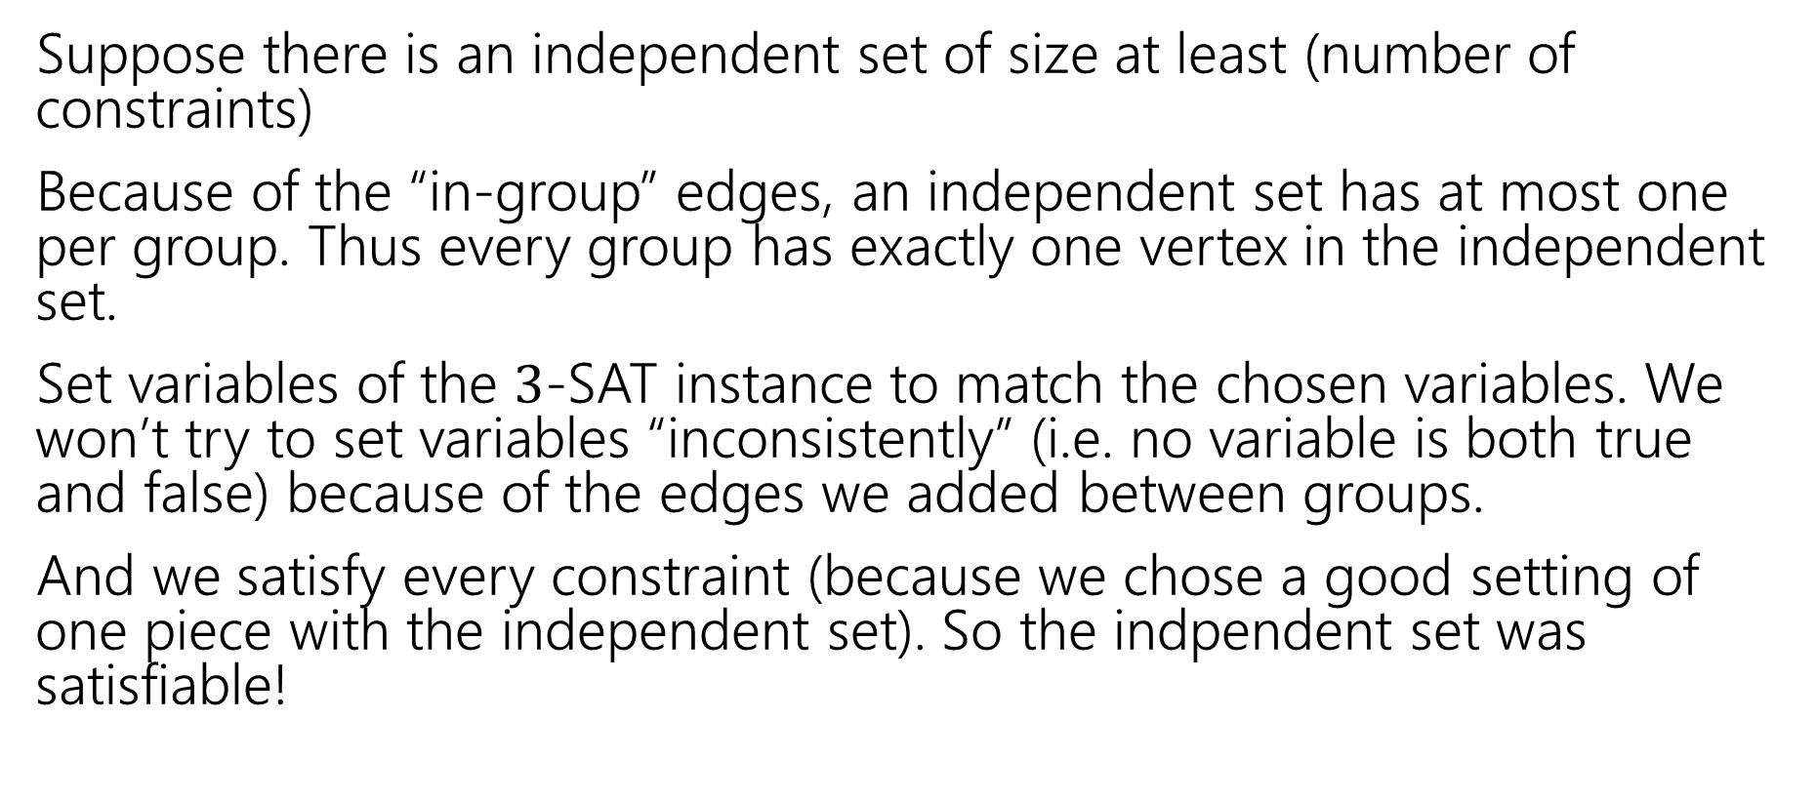
Correctness, Part 2
Suppose there is an independent set of size at least (number of constraints)
Because of the “in-group” edges, an independent set has at most one per group. Thus every group has exactly one vertex in the independent set.
Set variables of the $3$-SAT instance to match the chosen variables. We won’t try to set variables “inconsistently” (i.e. no variable is both true and false) because of the edges we added between groups.
And we satisfy every constraint (because we chose a good setting of one piece with the independent set). So the indpendent set was satisfiable!

Slide 40
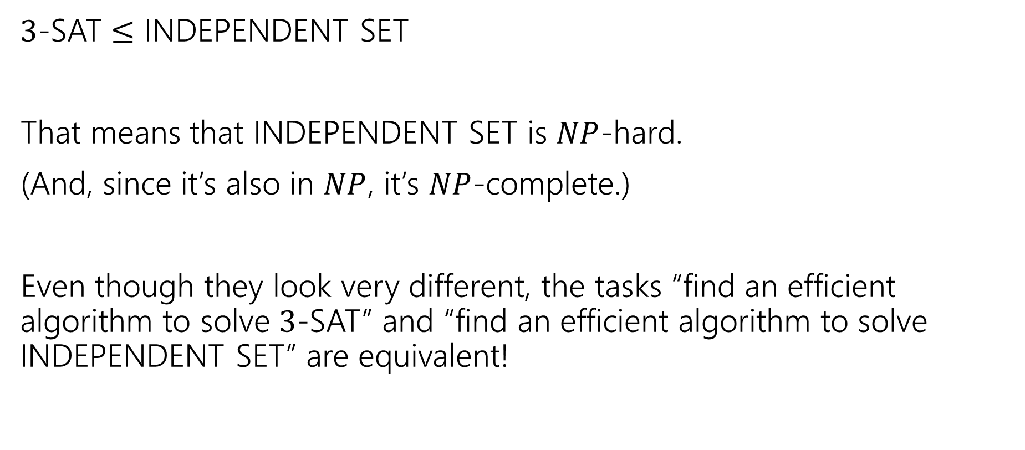
So…
$3$-SAT $≤$ INDEPENDENT SET
That means that INDEPENDENT SET is $NP$-hard.
(And, since it’s also in $NP$, it’s $NP$-complete.)
Even though they look very different, the tasks “find an efficient algorithm to solve $3$-SAT” and “find an efficient algorithm to solve INDEPENDENT SET” are equivalent!

Slide 41
Why are P and NP interesting?

Slide 42
Why do we care?
We’ve seen a few NP-complete problems.
But why should we care about those few?
Just memorize them and avoid them, right?
It’s more than just a few…

Slide 43
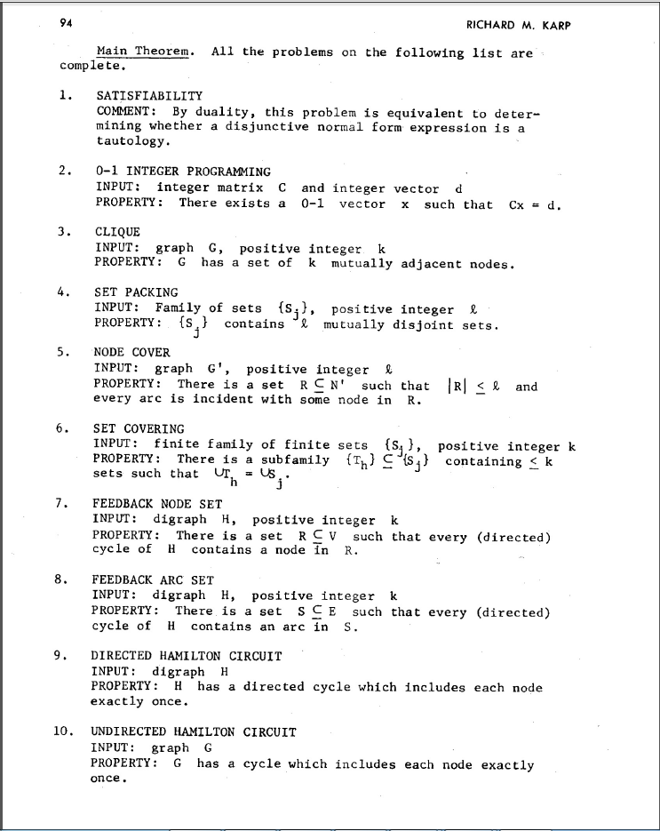
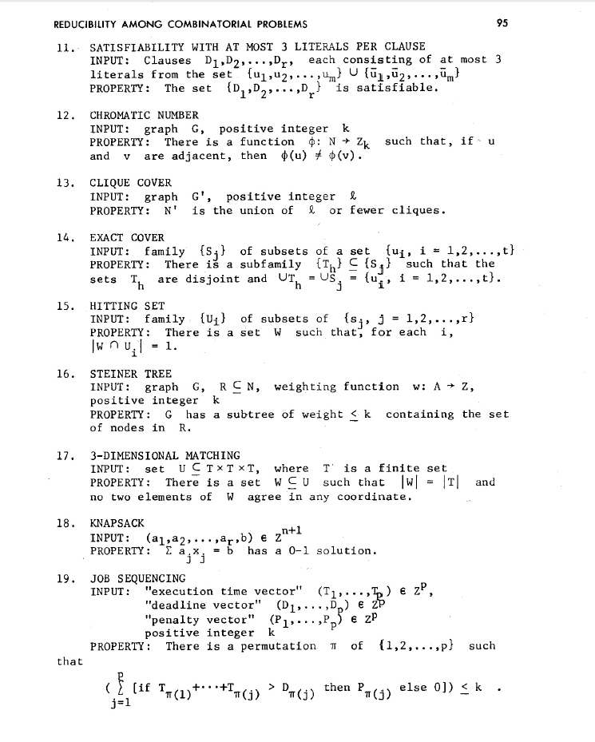
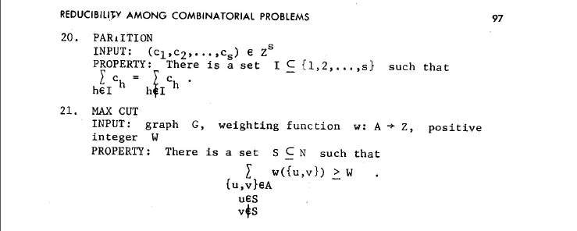
NP-Complete Problems
But Wait! There’s more!
A lot of problems are NP-complete
Karp’s Theorem (1972)

Slide 44

NP-Complete Problems
But Wait! There’s more!
By 1979, at least 300 problems had been proven NP-complete.
Garey and Johnson put a list of all the NP-complete problems they could find in this textbook.
Took almost 100 pages to just list them all.
No one has made a comprehensive list since.

Slide 45
NP-Complete Problems
But Wait! There’s more!
In December 2018, mathematicians and computer scientists put papers on the arXiv claiming to show (at least) 25 more problems are NP-complete.
There are literally thousands of NP-complete problems known.

Slide 46
Examples
There are literally thousands of NP-complete problems.
And some of them look weirdly similar to problems we do know efficient algorithms for.
In P
NP-Complete
Given a directed graph, report if there is a path from s to t of length at most $k$.
Short Path
Given a directed graph, report if there is a path from s to t of length at least$k$.
Long Path

Slide 47
Examples
In P
NP-Complete
Given a weighted graph, find a spanning tree (a set of edges that connect all vertices) of weight at most $k$.
Light Spanning Tree
Given a weighted graph, find a tour (a walk that visits every vertex and returns to its start) of weight at most $k$.
Traveling Salesperson
The electric company just needs a greedy algorithm to lay its wires.
Amazon doesn’t know a way to optimally route its delivery trucks.

Slide 48
Examples
In P
NP-Complete
Given an undirected graph, can the vertices be labeled red and blue with no edge having the same colors on both endpoints?
2-Coloring
Given an undirected graph, can the vertices be labeled red, blue, and green with no edge having the same colors on both endpoints?
3-Coloring
Just changing a number by one takes us from one of the first problems we solved (and one of the fastest algorithms we’ve seen) to something we don’t know how to solve efficiently at all.

Slide 49
Dealing with NP-completeness
Thousands of times someone has wanted to find an efficient algorithm for a problem…
…only to realize that the problem was NP-complete.
Sooner or later it will happen to one of you.
What do you do if you think your problem is NP-complete?
We’ll discuss options later this week!

