Slide 1
Problem Solving and
Tech Interview Practice
CSE 417 21AU
Lecture 24

Slide 2
We’re doing two things at once
1. Practicing a problem solving process.
Sooner or later, you’re going to get stuck (on homework or in real life).
Sitting there saying “I don’t know the answer yet” is frustrating.
Giving yourself specific questions and techniques makes your life easier.
2. Give advice for technical interviews
It turns out, they’re trying to evaluate whether you’ll be able to solve problems. And watching your process is a big part of what they’re doing.

Slide 3
Take all industry advice with a grain of salt
I’ve spent essentially my entire career in academia
I’m relying on a combination of what I’ve heard from colleagues and problem-solving strategies that work in my experience.

Slide 4
Resources
Cracking the Coding Interview (McDowell) or another book like it.
  Copies are at the library!
General Advice from Kasey Champion
Leetcode (we…borrowed…more than one homework problem from there).
General resume advice (and other resources). Some specific to Allen School.

Slide 5
Technical Questions
Your interviewer wants to see
  1. What you know
  2. Can you communicate technical ideas
  3. Can you problem-solve
  Getting the “right” solution helps with point 1. Not points 2 and 3.
  You also need to talk through what you see in the problem/how you solve it.
  The best way is to practice. Find a friend, a set of interview questions, and a whiteboard and practice.

Slide 6
Technical Questions
Show you can problem-solve.
It’s tempting to “skip” the problem-solving steps if you know the answer. It’s a good idea to still do all of them.
  You can go quicker, but give them something.
  Don’t feel obligated to use this exact method – others exist, but you should hit these points. Even if you know the best algorithm from the time you read the problem statement.

Slide 7
A sample Problem: https://leetcode.com/problems/house-robber/
You are a professional robber planning to rob houses along a street. Each house has a certain amount of money stashed, the only constraint stopping you from robbing each of them is that adjacent houses have security systems connected and it will automatically contact the police if two adjacent houses were broken into on the same night.
Given an integer array nums representing the amount of money of each house, return the maximum amount of money you can rob tonight without alerting the police.

Slide 8

TEBOW IT
Talk
Example
Baseline (aka Brute Force)
Optimize
Walk-Through
Implement
Test
https://commons.wikimedia.org/wiki/File:Tim_Tebow_in_the_dugout.jpg
Tim Tebow:
Football player turned football analyst turned simultaneous-baseball-player-and-football-analyst turned football player turned football analyst again.
Acronym from Kasey Champion; similar process in Cracking the Coding Interview

Slide 9
Talk
Give you time to take deep breaths
Confirm you haven’t missed anything
Can sometimes get a simplifying assumption added.
Make sure you understand every technical term in the prompt (if any).
Ask questions to make sure you’ve got the idea.
Ask about simplifying assumptions.
Pick out any key pieces of the problem
You are a professional robber planning to rob houses along a street. Each house has a certain amount of money stashed, the only constraint stopping you from robbing each of them is that adjacent houses have security systems connected and it will automatically contact the police if two adjacent houses were broken into on the same night.
Given an integer array nums representing the amount of money of each house, return the maximum amount of money you can rob tonight without alerting the police.

Slide 10
Talk
If I enter houses 2 and 4 only, I don’t set off an alarm, right?
The houses are just in a line, I’m only worrying about “one side” of the street?
I’m planning just one night?
The amount of money is an integer? Can it be negative?
I don’t have to record which houses, just the final number?
You are a professional robber planning to rob houses along a street. Each house has a certain amount of money stashed, the only constraint stopping you from robbing each of them is that adjacent houses have security systems connected and it will automatically contact the police if two adjacent houses were broken into on the same night.
Given an integer array nums representing the amount of money of each house, return the maximum amount of money you can rob tonight without alerting the police.

Slide 11
Talk
Self-checks
Do I know the method signature (inputs and return type)?
Is there any information in the prompt that I feel is useless?
  There usually isn’t any, so maybe ask a question about that

Slide 12
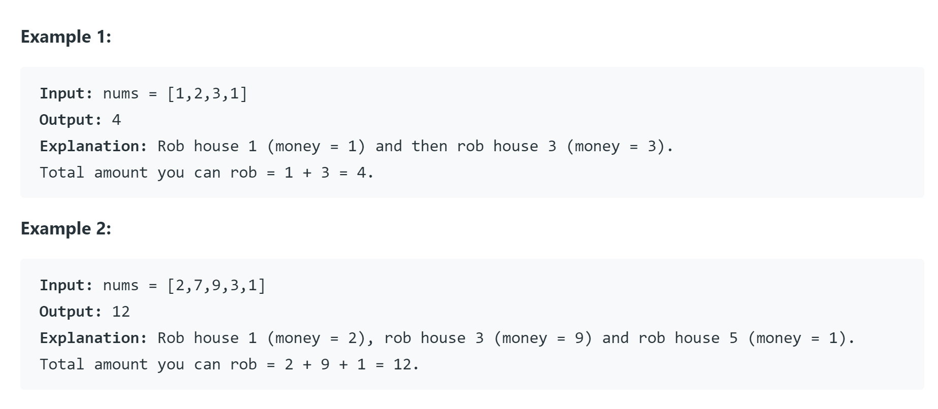
Example
You’ll need these later!
Make a sample input or two, find the answer and confirm it’s right with the interviewer

Slide 13
Baseline
Finally, designing the algorithm.
What we came here for.
First algorithm that comes to mind.
Doesn’t matter how slow.[1]
This is a good problem solving technique, sometimes you want to optimize the first thing you think of.
Sometimes you don’t, but it’s still useful for you as a human.
You’re going to be nervous. It’s a lot easier to think creatively with the baseline in your back pocket. You won’t end this interview having written no code.
[1] ok, it does matter how slow, but that’s not the point yet

Slide 14
Baseline
If you see what to do right away that’s fine! You can short-circuit this step. But if it doesn’t work come back here! I don’t like to spend more than a few minutes with no back-up plan.
Remember the examples you did! Those can help now. Were you doing a brute force on those to solve them?

Slide 15

Baseline
Well I guess we could check all $2^{n}$ sets of houses.
Will be really slow, but will work.
Let’s try to do better.

Slide 16
Optimize
Sometimes you’re going to speed up the baseline (say with better data structures).
Other times you’re starting from scracth
Now, let’s get a better algorithm.
What did you see in your examples?
What does this remind you of?
We’re finding the maximum something in an array, that might remind you of maximum subarray sum. Maybe DP?
Let’s start there…

Slide 17

Optimize
Let’s think recursively. Start with the last house.
We’re currently thinking about house $i$.
If we want to include $i,$then we want…
If we want to exclude $i$ then we want…

Slide 18
Optimize
Let’s think recursively. Start with the last house.
We’re currently thinking about house $i$.
If we want to include $i,$then we want…
If we want to exclude $i$ then we want…

Slide 19
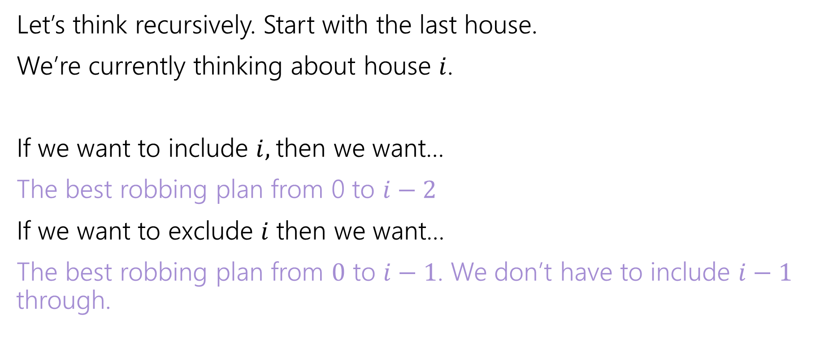
Optimize
Let’s think recursively. Start with the last house.
We’re currently thinking about house $i$.
If we want to include $i,$then we want…
The best robbing plan from 0 to $i−2$
If we want to exclude $i$ then we want…
The best robbing plan from $0$ to $i−1$. We don’t have to include $i−1$ through.
Let OPT be the value of the best robbing plan for the array from $0$ to $i$.

Slide 20
Optimize
You could also get an
OPT/Include split like we’ve often seen if you jump right there.

Slide 21
Walk-Through
Now we’ve got our idea…time for a very quick check
What happens on one of your small examples?
nums
0 | 1 | 2 | 3 | 4
2 | 7 | 9 | 3 | 1
OPT
0 | 1 | 2 | 3 | 4

Slide 22
Walk-Through
You might notice bugs or edge cases (like the base cases here!) if you go slowly
Now we’ve got our idea…time for a very quick check
What happens on one of your small examples?
nums
0 | 1 | 2 | 3 | 4
2 | 7 | 9 | 3 | 1
OPT
0 | 1 | 2 | 3 | 4
2 | 7 | 11 | 11 | 12

Slide 23
Implement
Tips: Use default data structures.
Your interviewer probably doesn’t remember all the tiny details of java default libraries either, so feel free to say “I’m going to assume the library has an X method” or “it works in this way” if you can’t remember whether it’s the Java or C++ version that works a certain way.
You might never have written code on a whiteboard (or typed without an IDE auto-completing things). You should practice those skills!!
Use comments and break-off easy methods/repeated code.
  If you’re running out of time, your interviewer might let you skip it.

Slide 24
Notes:
Method header: return type int, input int[]
Define int[] opt
Write for-loop, don’t worry about base cases yet.
Go back and handle base cases.
Wrap-up return.

Slide 25
int robbingNumber(int[] input){
int[] opt = new int[input.size]; //opt robbing number where we can access homes 0,…,i.
opt[0] = input[0];
opt[1] = Math.max(input[0], input[1]);
for(int i=0; i < input.size; i++){
opt[i] = Math.max( opt[i-1], opt[i-2]+input[i]);
}
return opt[input.size-1];

Slide 26
Test
If you haven’t already, do your big-O analysis
Then test your code!
  Use the examples you made early on
  Think about small cases (empty input, null input)
  Think about edge cases (repeated numbers)
  Double-check you’ve used all assumptions

Slide 27
Another Problem
Drive, a new rideshare company, focuses on getting their customers long-distances by having many individual drivers take them through separate parts of the journey. Drive has decided on a set of specific locations where pickups and drop-offs can happen, and they have the cost to ride between every pair of locations.
To incentivize you to try the system, Drive has given you a token for one free ride. Because the system is new, they haven’t mapped out how you’ll go long distances. It’s up to you to decide which locations to visit on the way from your starting point to the end point and which one you will use your coupon on.
Describe an algorithm that will let you get from your given start and end points while spending the minimum amount of money (with your token).

Slide 28
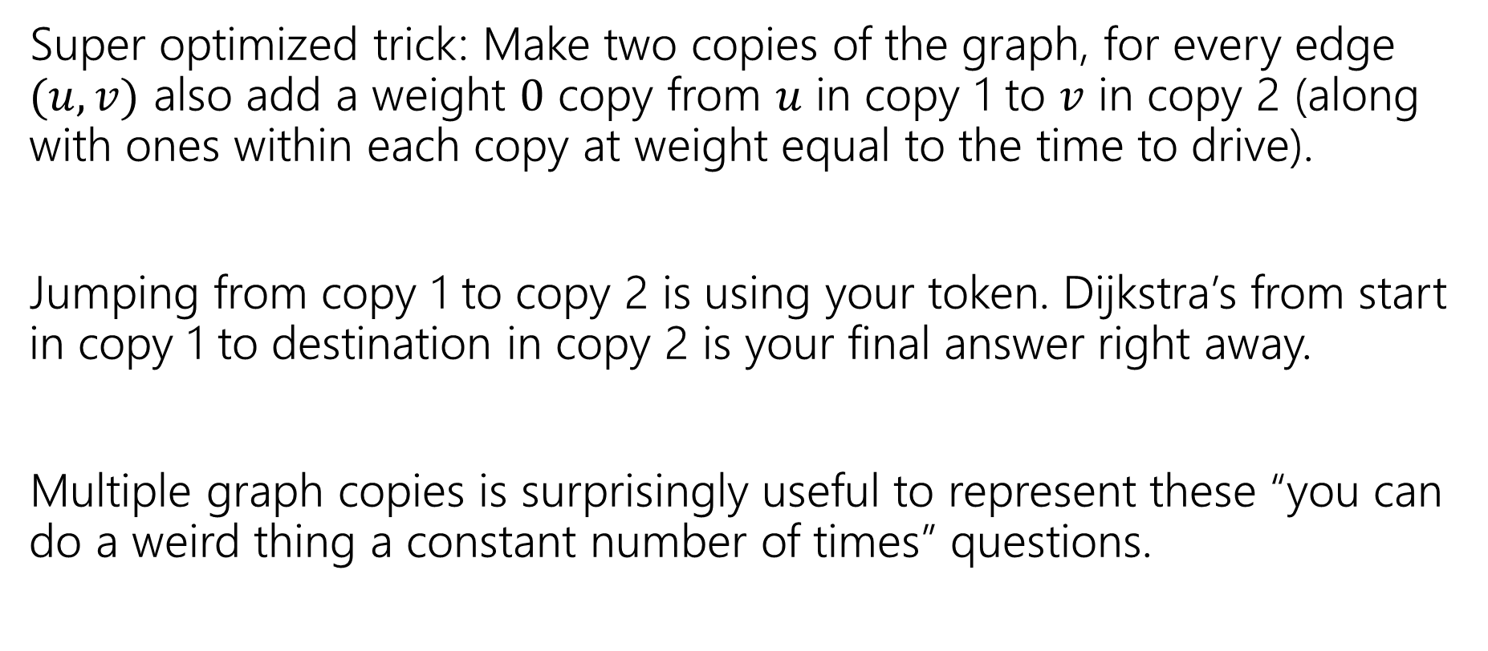
A Very Fun Trick
Super optimized trick: Make two copies of the graph, for every edge $(u,v)$ also add a weight $0$ copy from $u$ in copy 1 to $v$ in copy 2 (along with ones within each copy at weight equal to the time to drive).
Jumping from copy 1 to copy 2 is using your token. Dijkstra’s from start in copy 1 to destination in copy 2 is your final answer right away.
Multiple graph copies is surprisingly useful to represent these “you can do a weird thing a constant number of times” questions.

Slide 29
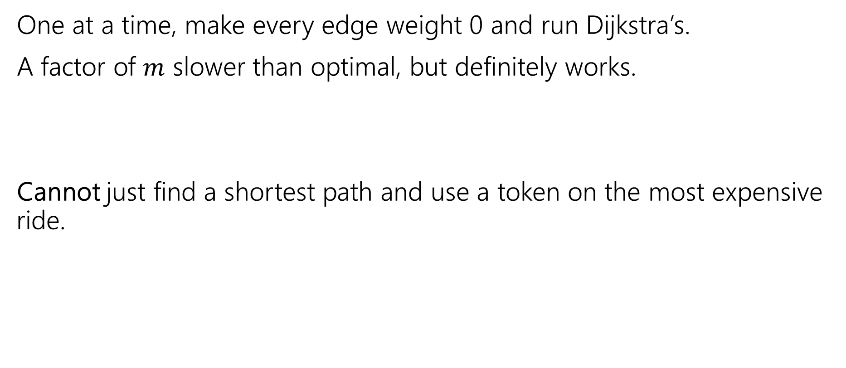
Other options
One at a time, make every edge weight 0 and run Dijkstra’s.
A factor of $m$ slower than optimal, but definitely works.
Cannot just find a shortest path and use a token on the most expensive ride.
3
3
3
s
t
10
1

Slide 30

One More For the Road
Given a list of integers, list all pairs $(A[i],A[j])$ such that $A\left[i\right]+A\left[j\right]=10$.

Slide 31
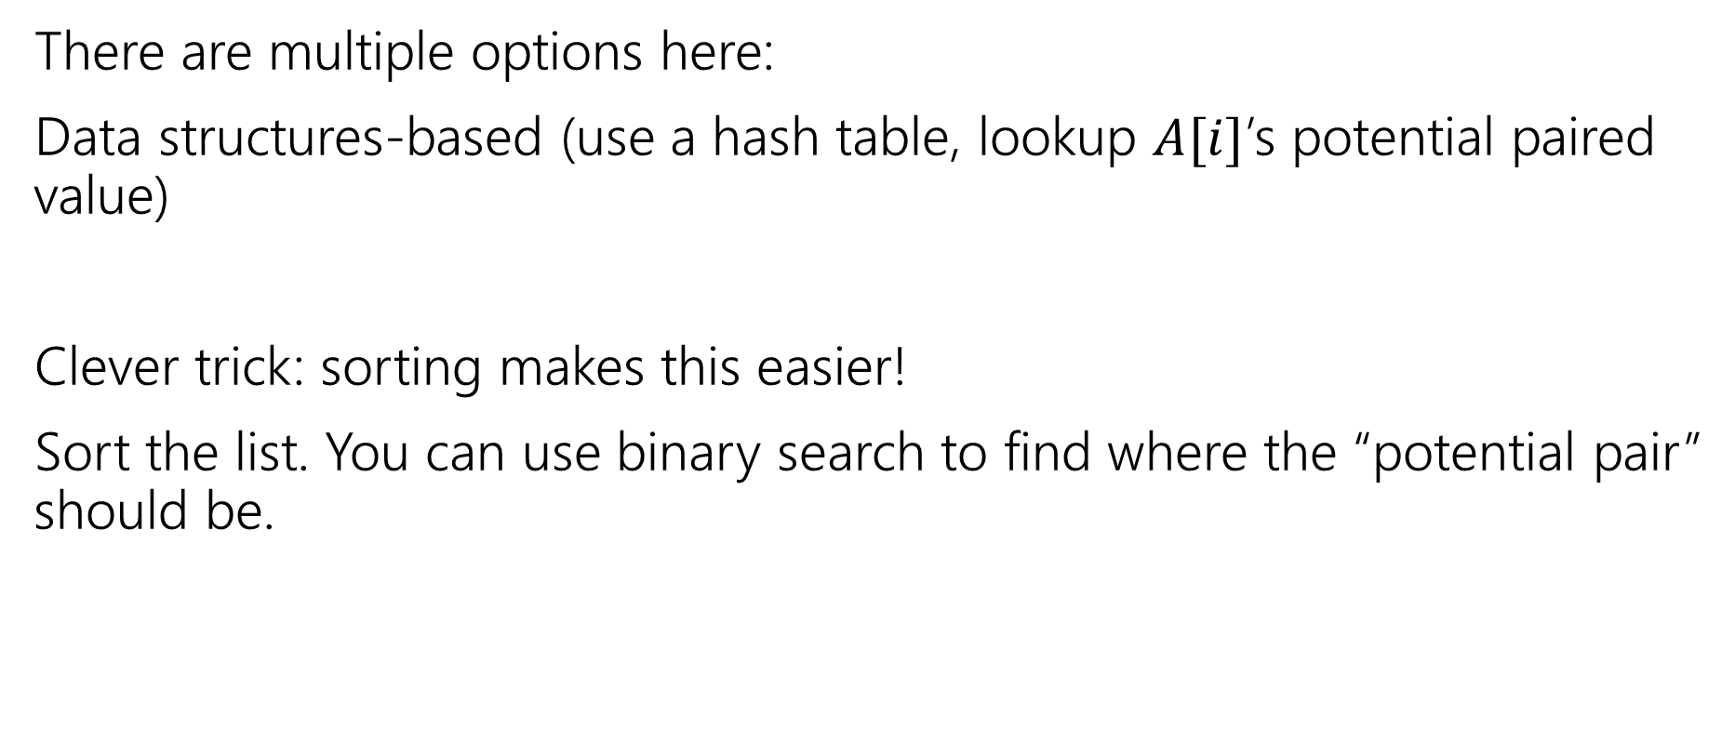
Optimized options
There are multiple options here:
Data structures-based (use a hash table, lookup $A[i]$’s potential paired value)
Clever trick: sorting makes this easier!
Sort the list. You can use binary search to find where the “potential pair” should be.

