Slide 1
Linear Programming
CSE 417 Fall 22
Lecture 18

Slide 2
Last Time
Bellman-Ford; a DP-inspired algorithm for shortest-paths.
Ended up with pseudocode very similar to Dijkstra’s…
…but slower.
Why? Handle negative edge weights.

Slide 3
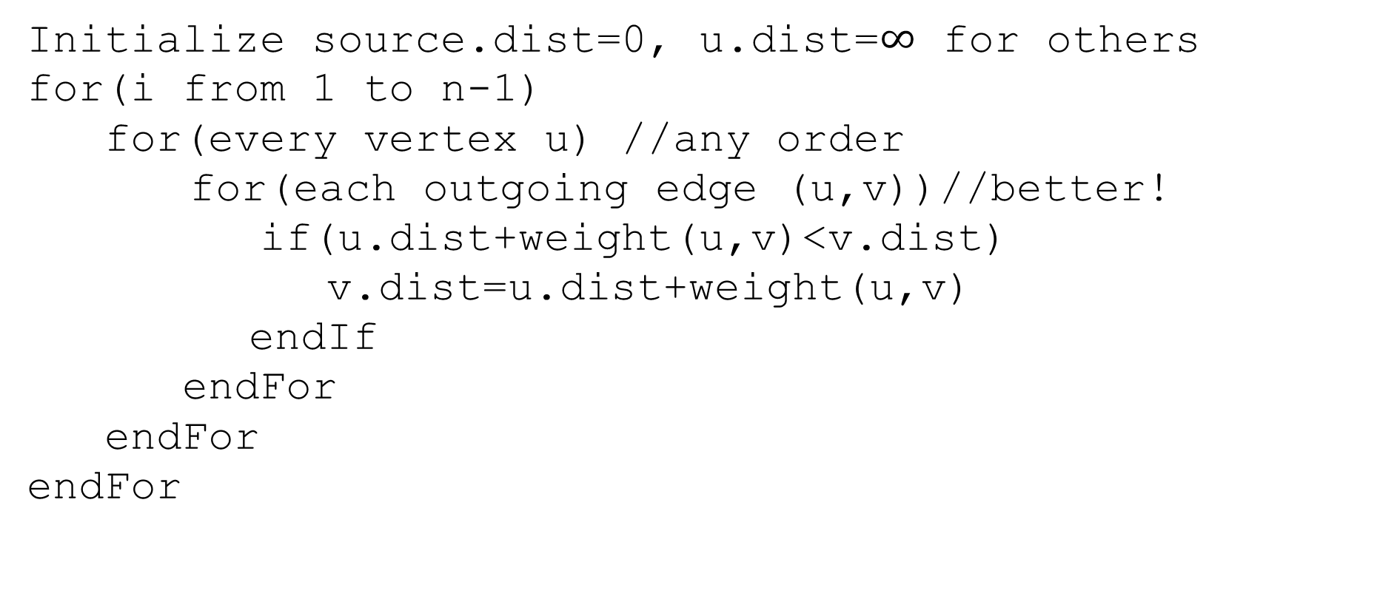
Pseudocode
Initialize source.dist=0, u.dist=$∞$ for others
for(i from 1 to n-1)
for(every vertex u) //any order
for(each outgoing edge (u,v))//better!
if(u.dist+weight(u,v)<v.dist)
v.dist=u.dist+weight(u,v)
endIf
endFor
endFor
endFor

Slide 4
Negative Edge Weights
Why would you want a negative edge weight anyway?
If your graph is a representation of roads on google maps, edge weights are probably time to drive across the road.
No negative edge weights here
Why negative edge weights?
1. In a video game, every time you take a step, you lose one hit point; you want to see if there is a route from your current spot to the healing house without your hit points hitting 0.
Somewhere along the way, there’s a potion that heals you 20 hit points.
2. Arbitrage cycles (a “classic” “real-world” example)
3. Reductions

Slide 5
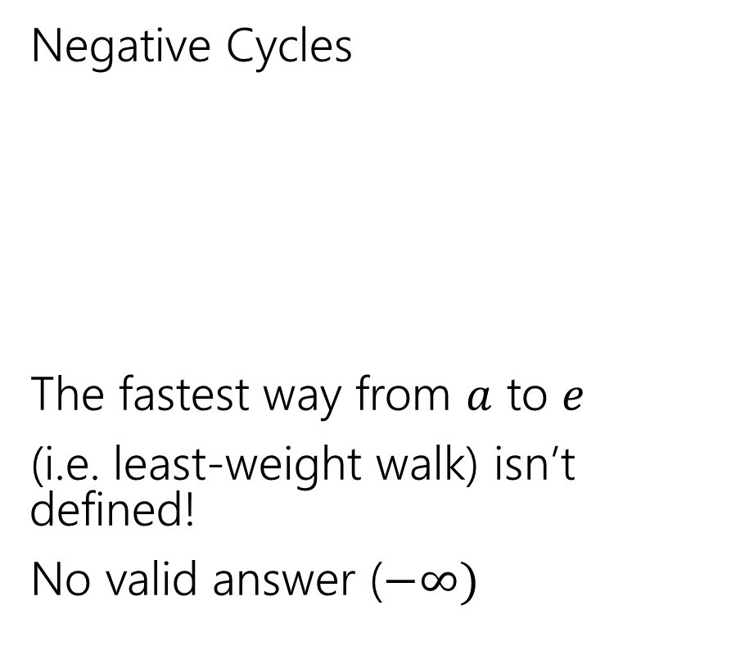
Negative Edges
Negative Cycles
The fastest way from $a$ to $e$
(i.e. least-weight walk) isn’t defined!
No valid answer ($−∞)$
Negative edges, but only non-negative cycles
Dijkstra’s might fail
But the shortest path IS defined.
There is an answer
a
6
5
c
e
a
6
5
c
e
3
2
3
2
1
b
d
1
-8
b
d
-3

Slide 6
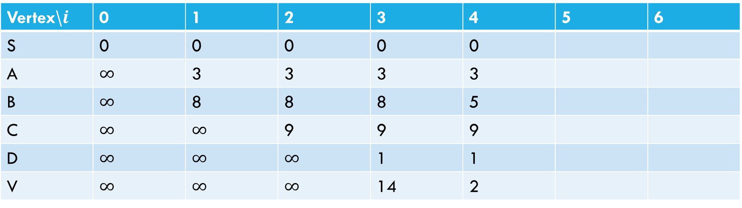
Negative Cycle
Pollev.com/Robbie
6
a
5
3
c
v
3
-8
s
1
8
b
d
4
Vertex\$i$ | 0 | 1 | 2 | 3 | 4 | 5 | 6
S | 0 | 0 | 0 | 0 | 0
A | $∞$ | 3 | 3 | 3 | 3
B | $∞$ | 8 | 8 | 8 | 5
C | $∞$ | $∞$ | 9 | 9 | 9
D | $∞$ | $∞$ | $∞$ | 1 | 1
V | $∞$ | $∞$ | $∞$ | 14 | 2

Slide 7
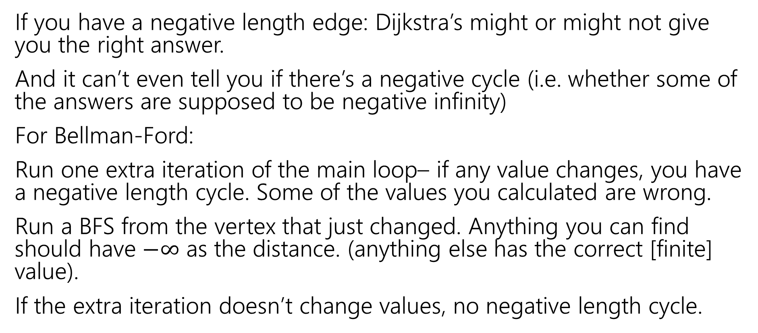
Negative Cycles
If you have a negative length edge: Dijkstra’s might or might not give you the right answer.
And it can’t even tell you if there’s a negative cycle (i.e. whether some of the answers are supposed to be negative infinity)
For Bellman-Ford:
Run one extra iteration of the main loop– if any value changes, you have a negative length cycle. Some of the values you calculated are wrong.
Run a BFS from the vertex that just changed. Anything you can find should have $−∞$ as the distance. (anything else has the correct [finite] value).
If the extra iteration doesn’t change values, no negative length cycle.

Slide 8
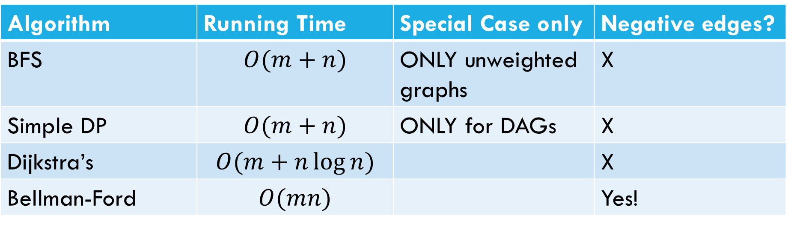
Laundry List of shortest pairs (so far)
Algorithm | Running Time | Special Case only | Negative edges?
BFS | $$O(m+n)$$ | ONLY unweighted graphs | X
Simple DP | $$O(m+n)$$ | ONLY for DAGs | X
Dijkstra’s | $$O(m+n\log{n)}$$ |  | X
Bellman-Ford | $$O(mn)$$ |  | Yes!

Slide 9
All Pairs Shortest Paths

Slide 10
All Pairs
For Dijkstra’s or Bellman-Ford we got the distances from the source to every vertex.
What if we want the distances from every vertex to every other vertex?
Why? Most commonly pre-computation.
Imagine you’re google maps – you could run Dijkstra’s every time anyone anywhere asks for directions…
Or store how to get between transit hubs and only use Dijkstra’s locally.

Slide 11
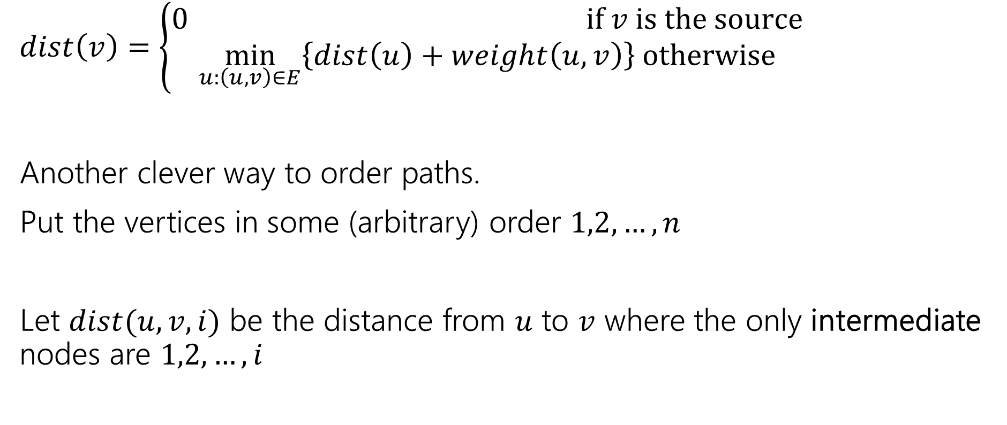
Another Recurrence
$dist\left(v\right)=\left\{\begin{aligned}0 if v is the source \\ \min_{u:\left(u,v\right)∈E}\left\{dist\left(u\right)+weight\left(u,v\right)\right\} otherwise\end{aligned}\right.$
Another clever way to order paths.
Put the vertices in some (arbitrary) order $1,2,…,n$
Let $dist(u,v,i)$ be the distance from $u$ to $v$ where the only intermediate nodes are $1,2,…,i$

Slide 12
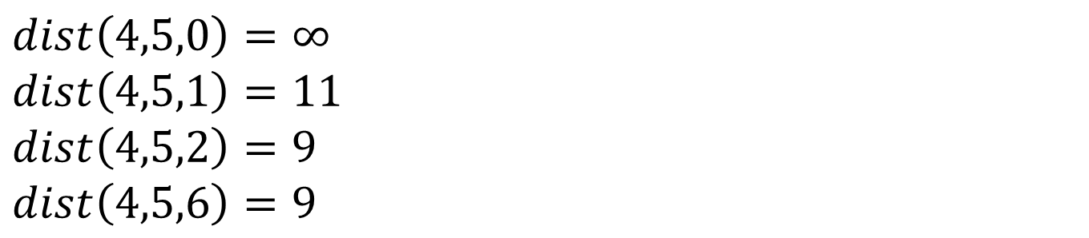
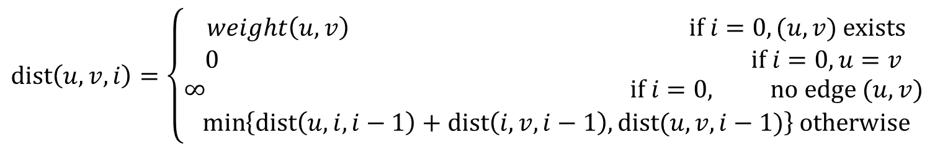
$dist(u,v,i)$
6
4
5
3
1
5
3
2
3
1
8
6
2
4
$dist\left(4,5,0\right)=∞$
$dist\left(4,5,1\right)=11$
$dist\left(4,5,2\right)=9$
$dist\left(4,5,6\right)=9$
$$dist\left(u,v,i\right)=\left\{\begin{aligned}weight\left(u,v\right) if i=0, (u,v) exists \\ 0 if i=0, u=v \\ ∞ if i=0, no edge (u,v) \\ \min\left\{dist\left(u,i,i−1\right)+dist\left(i,v,i−1\right), dist(u,v,i−1)\right\} otherwise\end{aligned}\right.$$

Slide 13
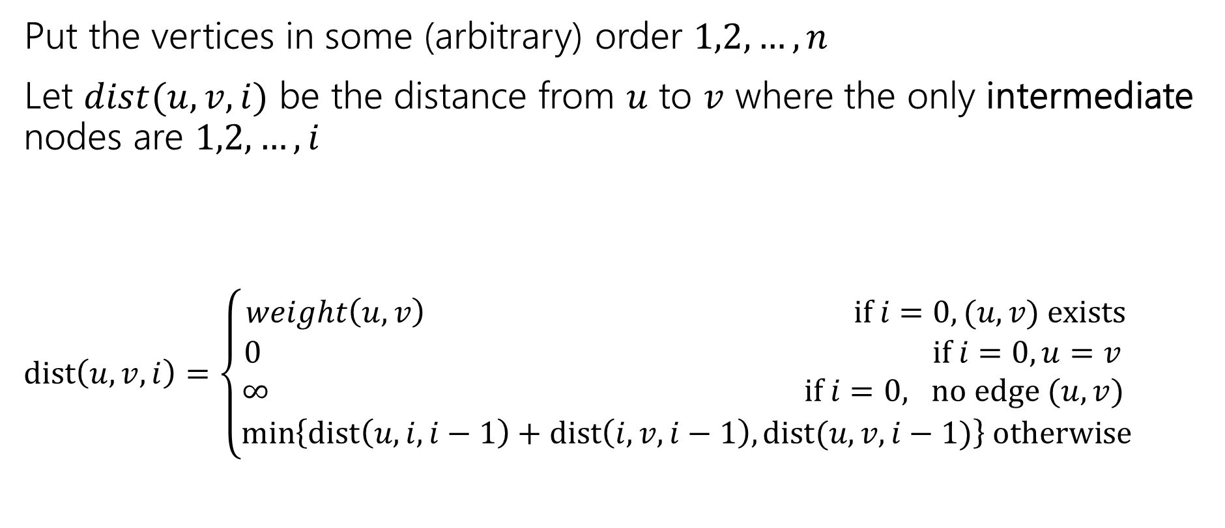
Another Recurrence
Put the vertices in some (arbitrary) order $1,2,…,n$
Let $dist(u,v,i)$ be the distance from $u$ to $v$ where the only intermediate nodes are $1,2,…,i$
$dist\left(u,v,i\right)=\left\{\begin{aligned}weight\left(u,v\right) if i=0, (u,v) exists \\ 0 if i=0, u=v \\ ∞ if i=0, no edge (u,v) \\ \min\left\{dist\left(u,i,i−1\right)+dist\left(i,v,i−1\right), dist(u,v,i−1)\right\} otherwise\end{aligned}\right.$

Slide 14

Pseudocode
dist[][] = new int[n-1][n-1]
for(int i=0; i<n; i++)
for(int j=0; j<n; j++)
dist[i][j] = edge(i,j) ? weight(i,j) : $∞$
for(int i=0; i<n; i++)
dist[i][i] = 0
for every vertex $r$
for every vertex $u$
for every vertex $v$
if(dist[u][r] + dist[r][v] < dist[u][v])
dist[u][v]=dist[u][r] + dist[r][v]
“standard” form of the “Floyd-Warshall” algorithm. Similar to Bellman-Ford, you can get rid of the last entry of the recurrence (only need 2D array, not 3D array).

Slide 15

Running Time
$O\left(n^{3}\right)$
How does that compare to Dijkstra’s?

Slide 16
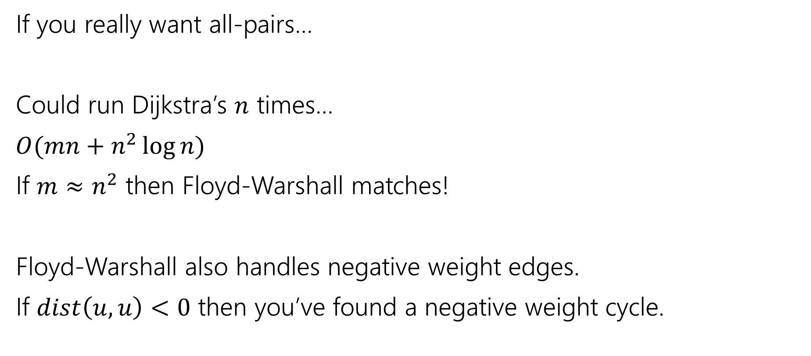
Running Time
If you really want all-pairs…
Could run Dijkstra’s $n$ times…
$O(mn+n^{2}\log{n})$
If $m≈n^{2}$ then Floyd-Warshall matches!
Floyd-Warshall also handles negative weight edges.
If $dist\left(u,u\right)<0$ then you’ve found a negative weight cycle.

Slide 17
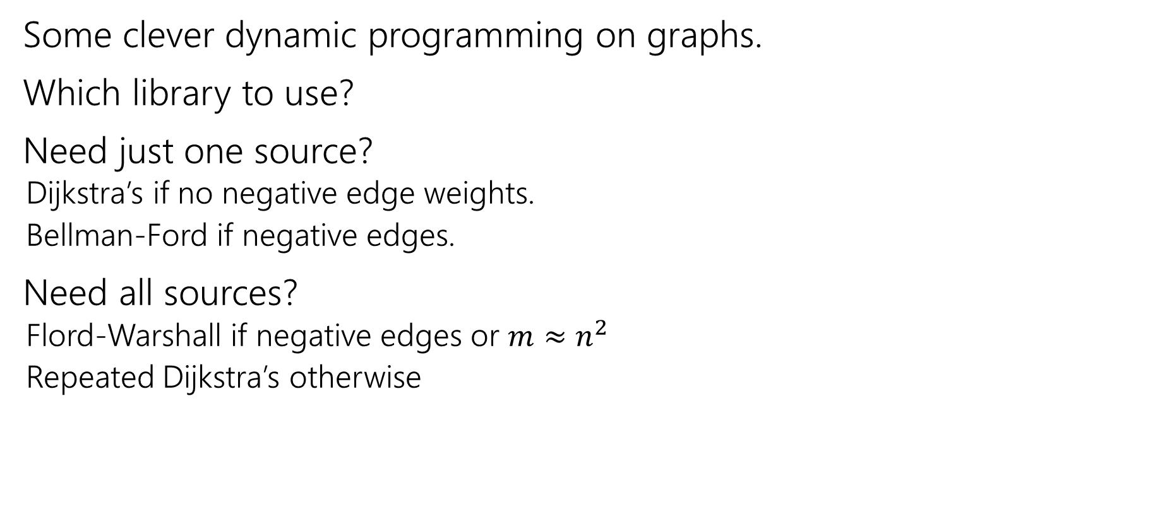
Takeaways
Some clever dynamic programming on graphs.
Which library to use?
Need just one source?
Dijkstra’s if no negative edge weights.
Bellman-Ford if negative edges.
Need all sources?
Flord-Warshall if negative edges or $m≈n^{2}$
Repeated Dijkstra’s otherwise

Slide 18
Linear Programming

Slide 19
Linear Programming
Used WIDELY in business and operations research.
Excel has a linear program solver.
A very expressive language for problem-solving
Can represent a wide-variety of problems, including some we’ve already seen.
Deep, beautiful theory…that we do not have time to cover.

Slide 20
Outline of LPs
What is a linear program?
A simple example LP
Computational Issues
An application – Vertex Cover on trees (again)
In a few weeks, we’ll return to LPs as a method of approximating NP-hard problems.

Slide 21
Example Problem
You’re laying down soil for a bunch of new gardens. You got a few big piles of soil delivered (more than enough to cover the gardens)
$1.5/unit
1.5
$2/unit
7
5
$4/unit
$4/unit
10
$1.5/unit
$3/unit
$8/unit
4
$2/unit
2.5
3
$4.5/unit

Slide 22
Example Problem
What variables should we use?
$1.5/unit
1.5
$2/unit
7
5
$4/unit
$4/unit
10
$1.5/unit
$3/unit
$8/unit
4
$2/unit
2.5
3
$4.5/unit

Slide 23

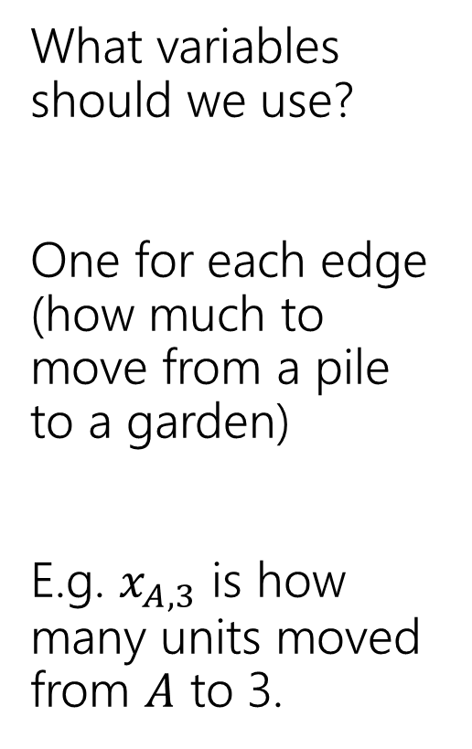
Example Problem
What variables should we use?
One for each edge (how much to move from a pile to a garden)
E.g. $x_{A,3}$ is how many units moved from $A$ to 3.
3
$$x_{A,3}$$
$1.5/unit
1.5
A
$2/unit
7
5
C
$4/unit
$4/unit
2
10
$1.5/unit
$3/unit
$8/unit
4
4
$2/unit
2.5
1
3
B
$4.5/unit

Slide 24
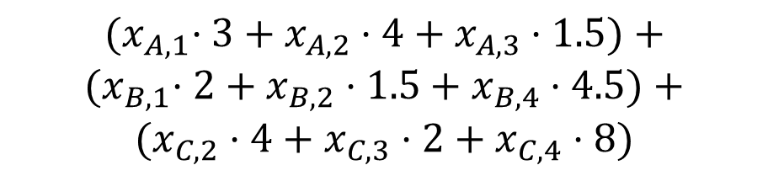
Example Problem
$${(x}_{A,1}⋅3+x_{A,2}⋅4+x_{A,3}⋅1.5)+$$
$${(x}_{B,1}⋅2+x_{B,2}⋅1.5+x_{B,4}⋅4.5)+$$
$$(x_{C,2}⋅4+x_{C,3}⋅2+x_{C,4}⋅8)$$
What’s the cost (in terms of the variables)?
Sum cost*var for all the variables
3
$$x_{A,3}$$
$1.5/unit
1.5
A
$2/unit
7
5
C
$4/unit
$4/unit
2
10
$1.5/unit
$3/unit
$8/unit
4
4
$2/unit
2.5
1
3
B
$4.5/unit

Slide 25
Example Problem
What constraints are there on the variables?
3
$$x_{A,3}$$
$1.5/unit
1.5
A
$2/unit
7
5
C
$4/unit
$4/unit
2
10
$1.5/unit
$3/unit
$8/unit
4
4
$2/unit
2.5
1
3
B
$4.5/unit

Slide 26
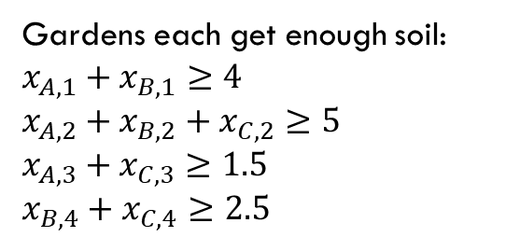
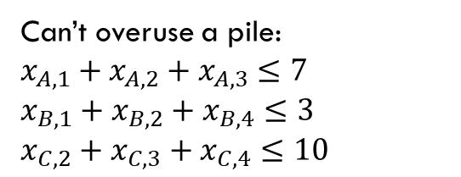
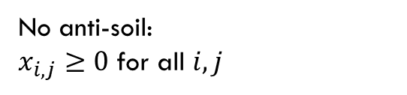
Example Problem
Gardens each get enough soil:
$x_{A,1}+x_{B,1}≥4$
$x_{A,2}+x_{B,2}+x_{C,2}≥5$
$x_{A,3}+x_{C,3}≥1.5$
$x_{B,4}+x_{C,4}≥2.5$
No anti-soil:
$x_{i,j}≥0$ for all $i,j$
What constraints are there on the variables?
Can’t overuse a pile:
$x_{A,1}+x_{A,2}+x_{A,3}≤7$
$x_{B,1}+x_{B,2}+x_{B,4}≤3$
$x_{C,2}+x_{C,3}+x_{C,4}≤10$
3
$$x_{A,3}$$
$1.5/unit
1.5
A
$2/unit
7
5
C
$4/unit
$4/unit
2
10
$1.5/unit
$3/unit
$8/unit
4
4
$2/unit
2.5
1
3
B
$4.5/unit

Slide 27

Full Definition
Minimize: ${(x}_{A,1}⋅3+x_{A,2}⋅4+x_{A,3}⋅1.5)+{(x}_{B,1}⋅2+x_{B,2}⋅1.5+x_{B,4}⋅4.5)+(x_{C,2}⋅4+x_{C,3}⋅2+x_{C,4}⋅8)$
Subject To:
$x_{A,1}+x_{B,1}≥4$
$x_{A,2}+x_{B,2}+x_{C,2}≥5$
$x_{A,3}+x_{C,3}≥1.5$
$x_{B,4}+x_{C,4}≥2.5$
$x_{A,1}+x_{A,2}+x_{A,3}≤7$
$x_{B,1}+x_{B,2}+x_{B,4}≤3$
$x_{C,2}+x_{C,3}+x_{C,4}≤10$
$x_{i,j}≥0$ for all $i,j$

Slide 28


A Linear Program
A linear program is defined by:
Real-valued variables
Subject to satisfying everything in a list of linear constraints
Maximizing or minimizing a linear objective function
A linear constraint is a statement of the form: $∑a_{i}x_{i}≤c_{i}$
where $a_{i}$ are constants, the $x_{i}$ are variables and $c_{i}$ is a constant.
A linear objective function is a function of the form: $∑b_{i}x_{i}$
where $b_{i}$ are constants and the $x_{i}$ are variables.

Slide 29

Linear constraints
Pollev.com/robbie
Can you write each of these requirements as linear constraint(s)?
Some of these are tricks…
$x_{i}$ times $x_{j}$ is at least $5$
${5x}_{i}$ is equal to $1$
$x_{i}≤5$ OR $x_{i}≥7$
$x_{i}$ is non-negative.
$x_{i}$ is an integer.

Slide 30
Linear constraints
Pollev.com/robbie
Can you write each of these requirements as linear constraint(s)?
Some of these are tricks…
$x_{i}$ times $x_{j}$ is at least $5$
${5x}_{i}$ is equal to $1$
$x_{i}≤5$ OR $x_{i}≥7$
$x_{i}$ is non-negative.
$x_{i}$ is an integer.

Slide 31
What are we looking for?
A solution (or “point”) is a setting of all the variables
A feasible point is a point that satisfies all the constraints.
An optimal point is a point that is feasible and has at least as good of an objective value as every other feasible point.

Slide 32
Example Problem
Gardens each get enough soil:
$x_{A,1}+x_{B,1}≥4$
$x_{A,2}+x_{B,2}+x_{C,2}≥5$
$x_{A,3}+x_{C,3}≥1.5$
$x_{B,4}+x_{C,4}≥2.5$
No anti-soil:
$x_{i,j}≥0$ for all $i,j$
Can’t overuse a pile:
$x_{A,1}+x_{A,2}+x_{A,3}≤7$
$x_{B,1}+x_{B,2}+x_{B,4}≤3$
$x_{C,2}+x_{C,3}+x_{C,4}≤10$
3
A
$1.5/unit
1.5
1.5
A feasible point.
Objective: 55
$2/unit
7
5
5
C
$4/unit
$4/unit
2
10
$1.5/unit
$3/unit
2.5
$8/unit
4
4
4
$2/unit
2.5
1
3
B
$4.5/unit

Slide 33
Example Problem
Gardens each get enough soil:
$x_{A,1}+x_{B,1}≥4$
$x_{A,2}+x_{B,2}+x_{C,2}≥5$
$x_{A,3}+x_{C,3}≥1.5$
$x_{B,4}+x_{C,4}≥2.5$
No anti-soil:
$x_{i,j}≥0$ for all $i,j$
Can’t overuse a pile:
$x_{A,1}+x_{A,2}+x_{A,3}≤7$
$x_{B,1}+x_{B,2}+x_{B,4}≤3$
$x_{C,2}+x_{C,3}+x_{C,4}≤10$
3
1.5
$1.5/unit
1.5
A
A feasible point.
Objective: 44.25
$2/unit
7
5
C
$4/unit
$4/unit
2
10
0.5
4.5
This is an optimal point. There are others!
$1.5/unit
$3/unit
$8/unit
4
4
4
$2/unit
2.5
2.5
1
3
B
$4.5/unit

Slide 34
Another Question
Change the problem
Instead of infinitely divisible dirt…
What if instead we’re moving whole unit things (the dirt is in bags we can’t open or we’re moving bikes or plants or anything else that can’t be split)
Well, the constraints will change (your “demand” and “supplies” will be integers)

Slide 35
Non-Integrality
Some linear programs have optimal solutions that have some (or all) variables as non-integers (even with only integers in the objective function and constraints) .
For dirt or water or anything arbitrarily divisible, no big deal!
For cell phones or bicycles…possibly a big deal! (also possibly not!)

Slide 36
What do you do if you need integers?
Integer Programs are linear programs where you can mark some variables as needing to be integers.
In practice – often still solvable (Excel also has a solver for these problems). But no longer guaranteed to be efficient.
And “just rounding” an LP answer often gets you really close.
In theory – lots of theory has been done for when the best answer will be an integer
But sometimes there’s just not a lot to be done…

Slide 37
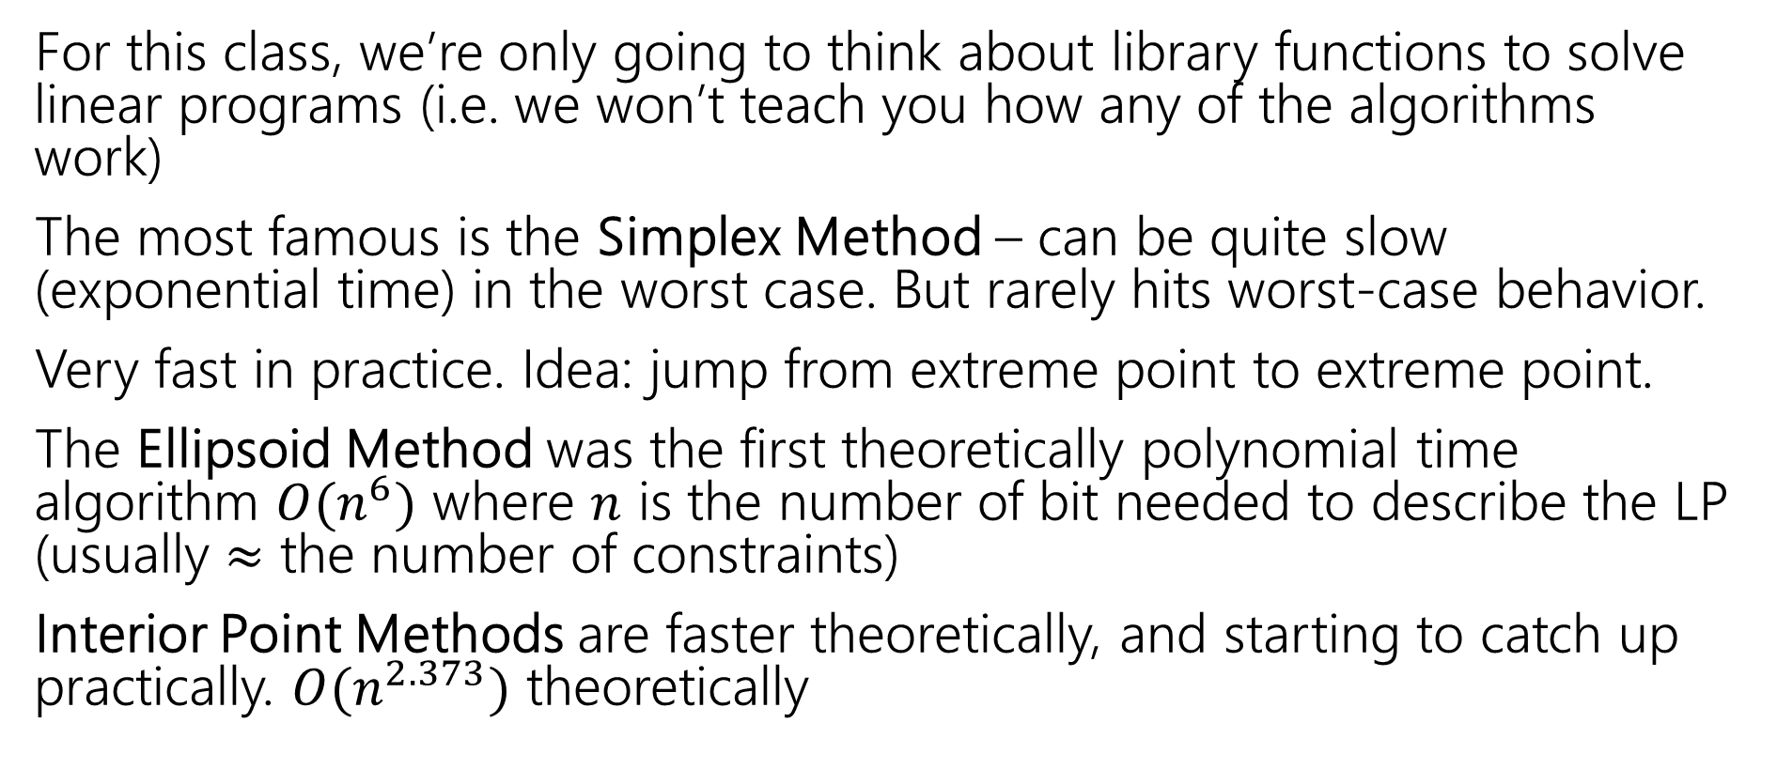
Solving LPs
For this class, we’re only going to think about library functions to solve linear programs (i.e. we won’t teach you how any of the algorithms work)
The most famous is the Simplex Method – can be quite slow (exponential time) in the worst case. But rarely hits worst-case behavior.
Very fast in practice. Idea: jump from extreme point to extreme point.
The Ellipsoid Method was the first theoretically polynomial time algorithm $O(n^{6})$ where $n$ is the number of bit needed to describe the LP (usually $≈$ the number of constraints)
Interior Point Methods are faster theoretically, and starting to catch up practically. $O(n^{2.373})$ theoretically

Slide 38
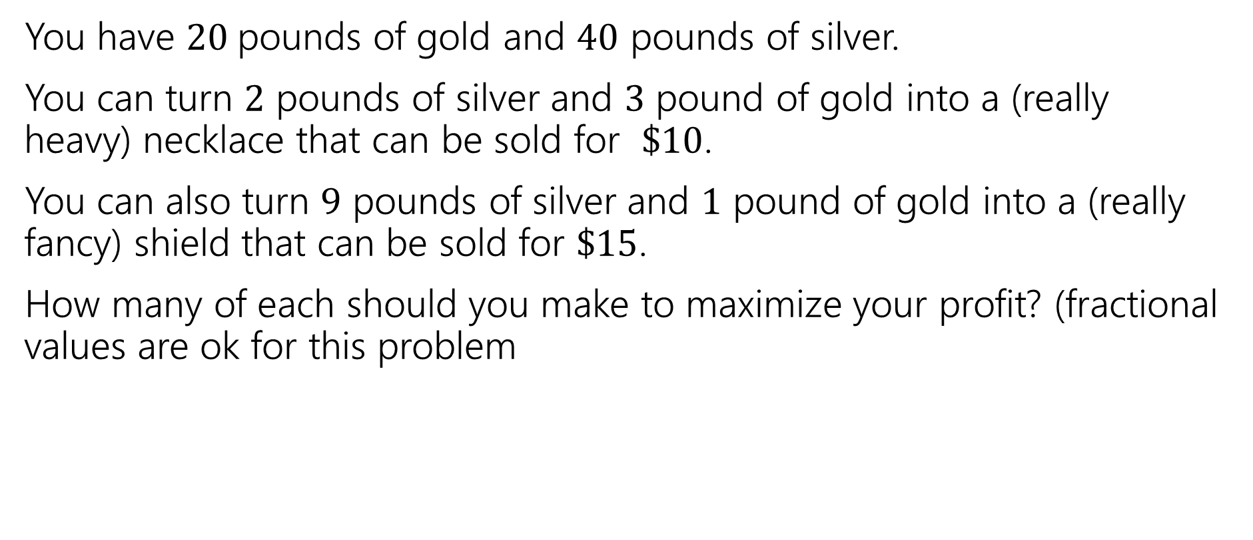
Extra Practice
You have $20$pounds of gold and $40$ pounds of silver.
You can turn $2$ pounds of silver and $3$ pound of gold into a (really heavy) necklace that can be sold for $\$10$.
You can also turn $9$ pounds of silver and $1$ pound of gold into a (really fancy) shield that can be sold for $\$15$.
How many of each should you make to maximize your profit? (fractional values are ok for this problem

Slide 39
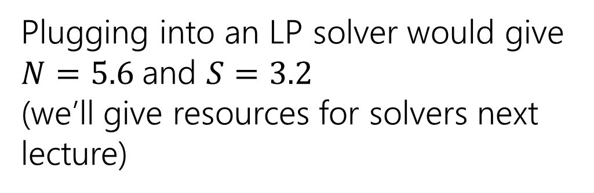
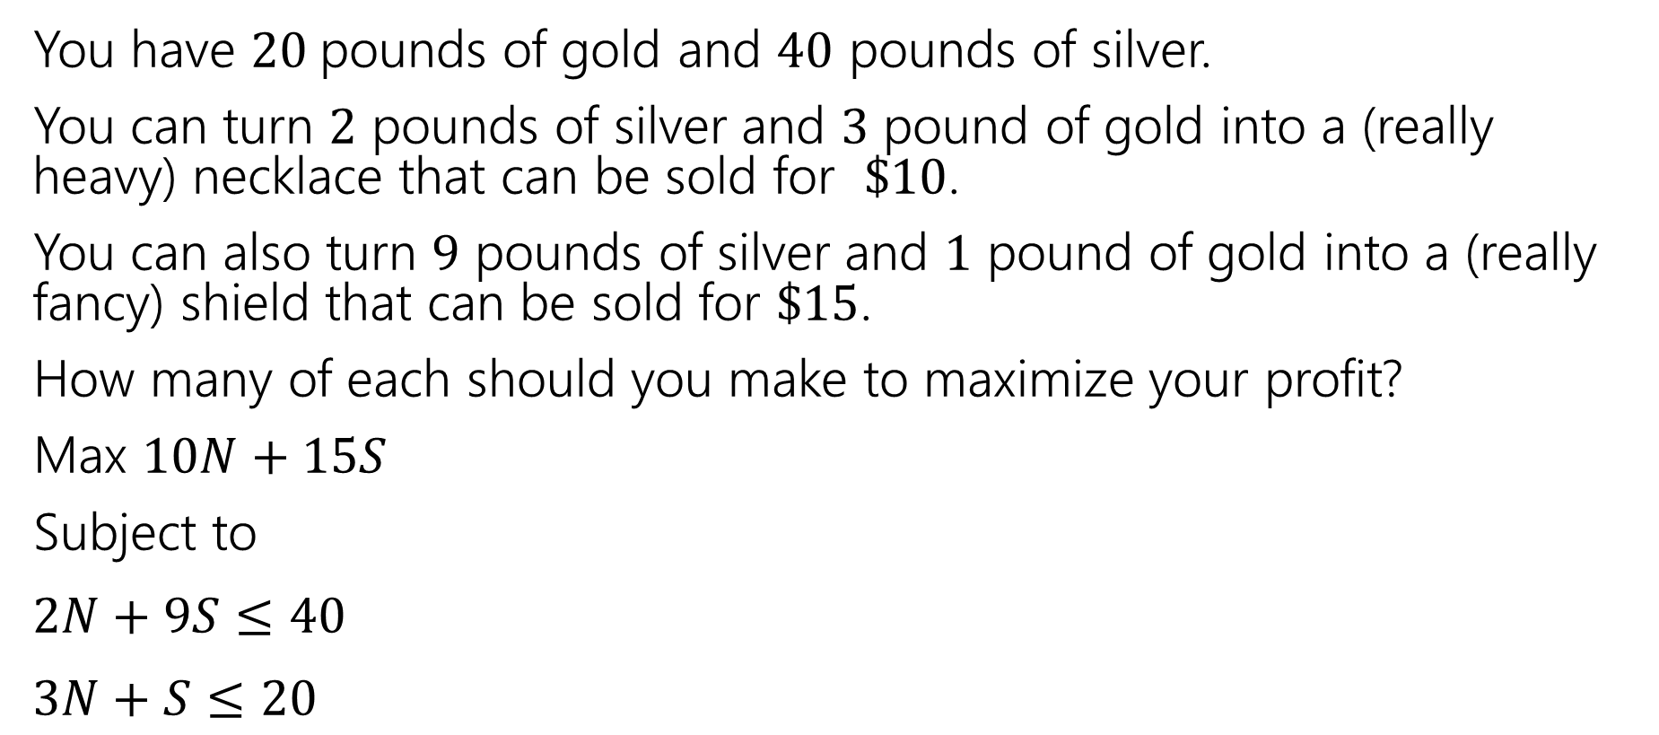
Extra Practice
You have $20$pounds of gold and $40$ pounds of silver.
You can turn $2$ pounds of silver and $3$ pound of gold into a (really heavy) necklace that can be sold for $\$10$.
You can also turn $9$ pounds of silver and $1$ pound of gold into a (really fancy) shield that can be sold for $\$15$.
How many of each should you make to maximize your profit?
Max $10N+15S$
Subject to
$2N+9S≤40$
$3N+S≤20$
Plugging into an LP solver would give $N=5.6$and $S=3.2$
(we’ll give resources for solvers next lecture)

