Slide 1
Bellman-Ford
CSE 417 Autumn 22
Lecture 17

Slide 2
Today
Dynamic Programming on Graphs
We’re building up to “Bellman-Ford” and “Floyd-Warshall”
Two very clever algorithms – we won’t ask you to be as clever.
But they’re standard library functions, so it’s good to know.
And deriving them together is good for practicing DP skills.

Slide 3
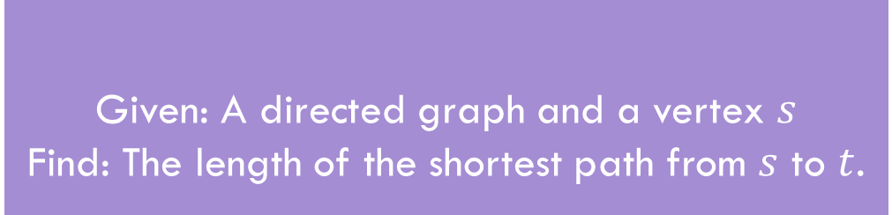
Shortest Paths
Given: A directed graph and a vertex $s$
Find: The length of the shortest path from $s$ to $t$.
Shortest Path Problem
The length of a path is the sum of the edge weights.
Baseline: Dijkstra’s Algorithm

Slide 4
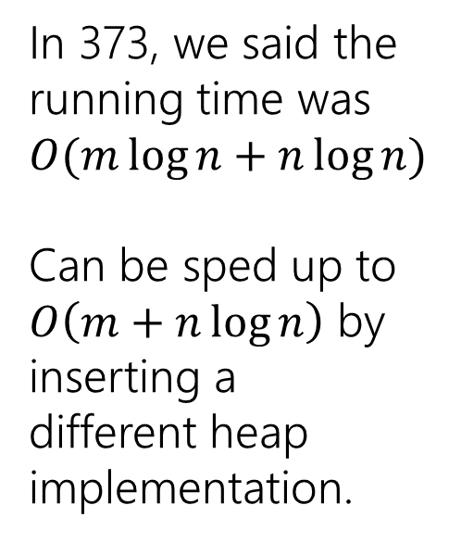
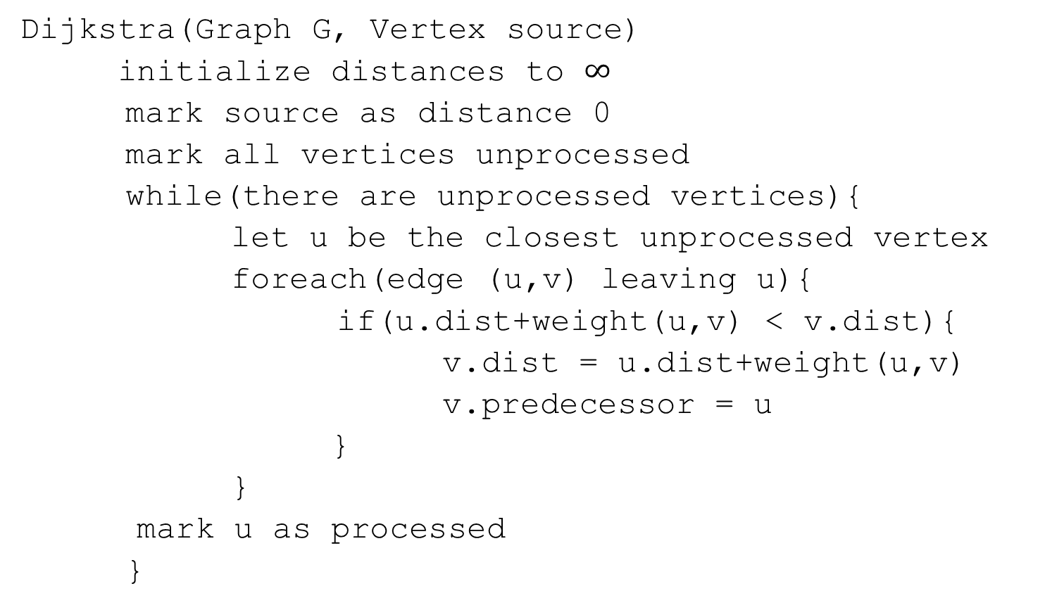
Dijkstra’s Algorithm
Dijkstra(Graph G, Vertex source)
initialize distances to $∞$
mark source as distance 0
mark all vertices unprocessed
while(there are unprocessed vertices){
let u be the closest unprocessed vertex
foreach(edge (u,v) leaving u){
if(u.dist+weight(u,v) < v.dist){
v.dist = u.dist+weight(u,v)
v.predecessor = u
}
}
mark u as processed
}
In 373, we said the running time was $O(m\log{n+n\log{n)}}$
Can be sped up to
$O\left(m+n\log{n}\right)$ by inserting a different heap implementation.

Slide 5

A recurrence
Suppose you have a directed acyclic graph $G$.
How could you find distances from $s$?
What’s one step in this problem?

Slide 6
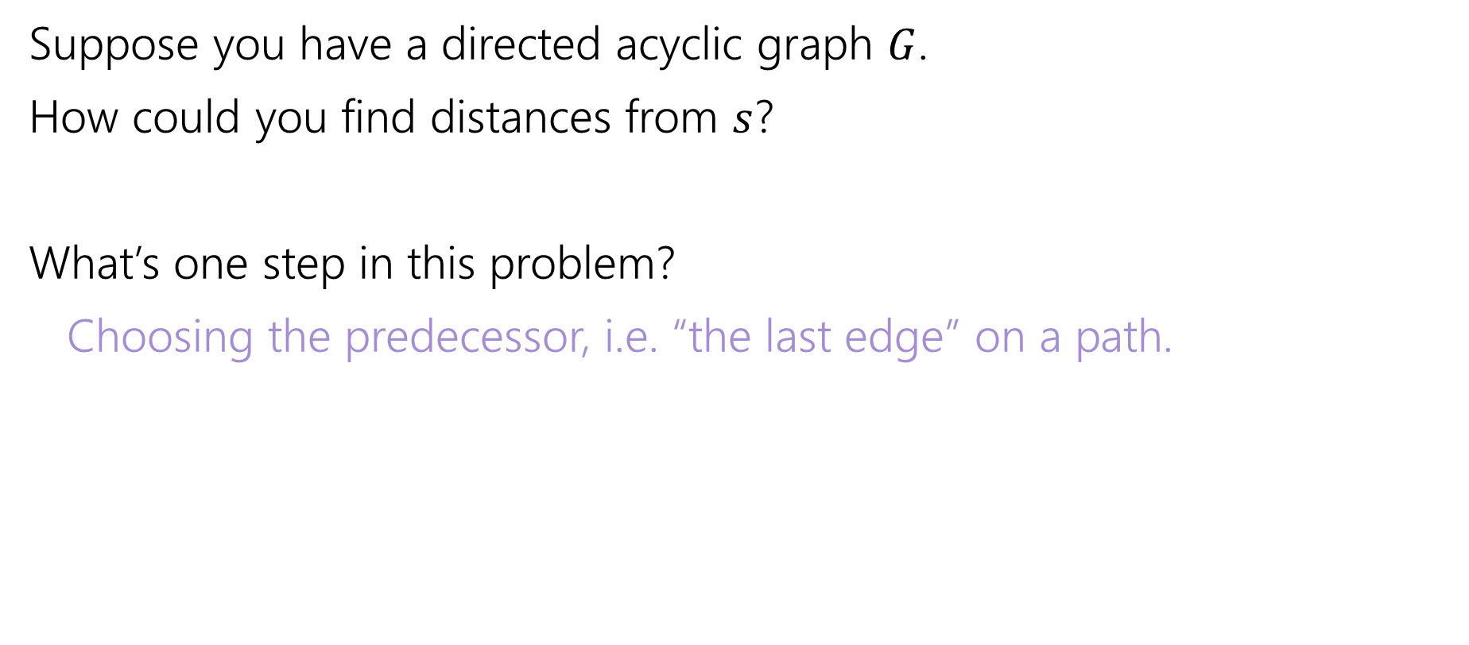
A recurrence
Suppose you have a directed acyclic graph $G$.
How could you find distances from $s$?
What’s one step in this problem?
Choosing the predecessor, i.e. “the last edge” on a path.

Slide 7
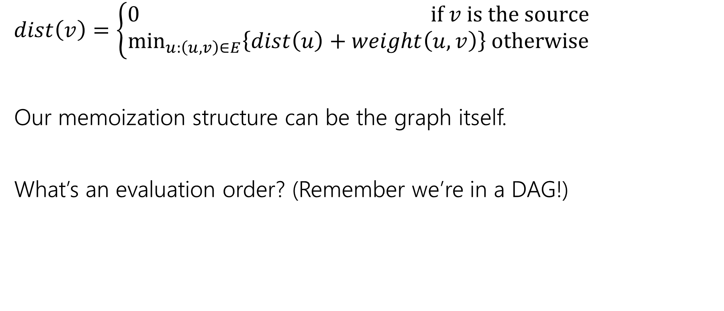
A recurrence
$dist\left(v\right)=\left\{\begin{aligned}0 if v is the source \\ \min_{u:\left(u,v\right)∈E}\left\{dist\left(u\right)+weight\left(u,v\right)\right\} otherwise\end{aligned}\right.$
Our memoization structure can be the graph itself.
What’s an evaluation order? (Remember we’re in a DAG!)

Slide 8
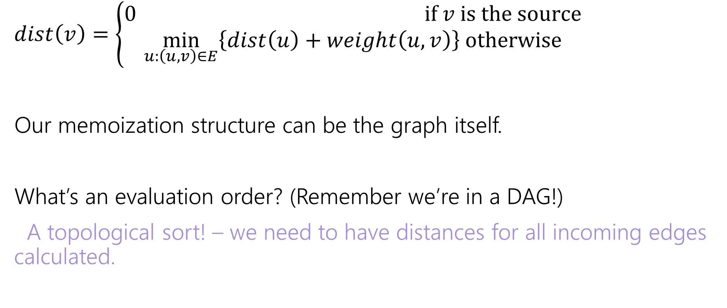
A recurrence
$dist\left(v\right)=\left\{\begin{aligned}0 if v is the source \\ \min_{u:\left(u,v\right)∈E}\left\{dist\left(u\right)+weight\left(u,v\right)\right\} otherwise\end{aligned}\right.$
Our memoization structure can be the graph itself.
What’s an evaluation order? (Remember we’re in a DAG!)
A topological sort! – we need to have distances for all incoming edges calculated.

Slide 9
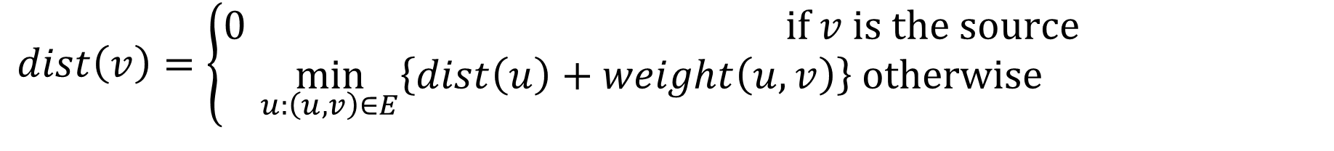
In a DAG
$dist\left(v\right)=\left\{\begin{aligned}0 if v is the source \\ \min_{u:\left(u,v\right)∈E}\left\{dist\left(u\right)+weight\left(u,v\right)\right\} otherwise\end{aligned}\right.$
6
3
5
3
2
1
8

Slide 10
What about cycles?
$dist\left(v\right)=\left\{\begin{aligned}0 if v is the source \\ \min_{u:\left(u,v\right)∈E}\left\{dist\left(u\right)+weight\left(u,v\right)\right\} otherwise\end{aligned}\right.$
6
3
5
3
2
1
8
4

Slide 11
Cycles
We need some way to “order” the paths.
I.e. we need to be sure we always have something to look up.
It doesn’t have to be the perfect distance necessarily…
As long as we’ll realize it and update later
And as long as we can fix it to the true distance eventually.

Slide 12
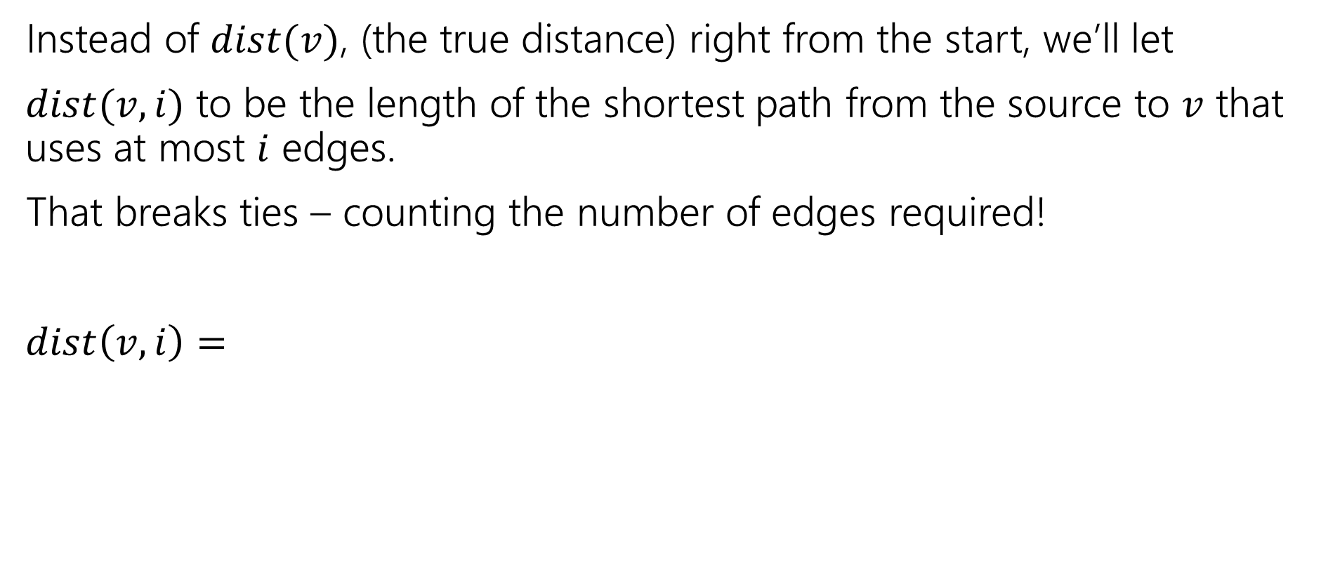
Ordering
Instead of $dist(v)$, (the true distance) right from the start, we’ll let
$dist(v,i)$ to be the length of the shortest path from the source to $v$ that uses at most $i$ edges.
That breaks ties – counting the number of edges required!
$dist\left(v,i\right)=$

Slide 13
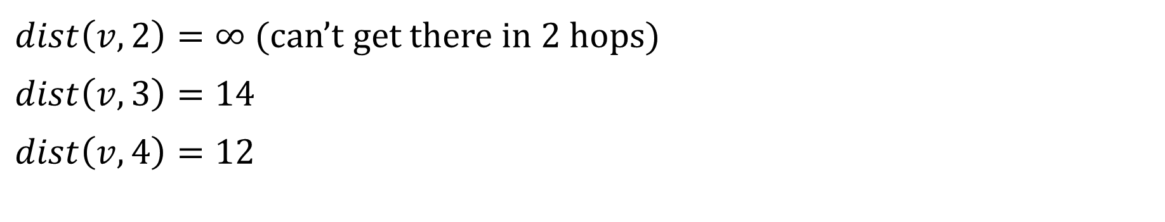
Distances
6
3
5
v
3
2
s
1
8
4
$dist\left(v,2\right)=∞$ (can’t get there in $2$ hops)
$dist\left(v,3\right)=14$
$dist\left(v,4\right)=12$

Slide 14
Ordering
Instead of $dist(v)$, (the true distance) right from the start, we’ll let
$dist(v,i)$ to be the length of the shortest path from the source to $v$ that uses at most $i$ edges.
That breaks ties – counting the number of edges required!
$dist\left(v,i\right)=$

Slide 15
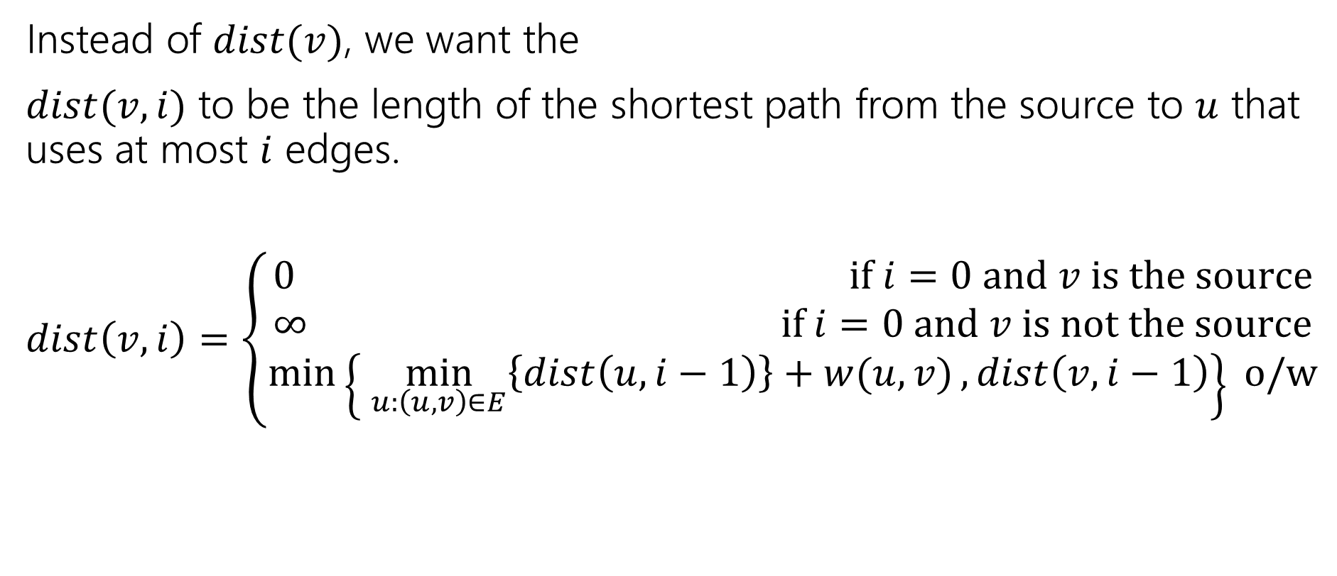
Ordering
Instead of $dist(v)$, we want the
$dist(v,i)$ to be the length of the shortest path from the source to $u$ that uses at most $i$ edges.
$dist\left(v,i\right)=\left\{\begin{aligned}0 if i=0 and v is the source \\ ∞ if i=0 and v is not the source \\ \min\left\{\min_{u:\left(u,v\right)∈E}\left\{dist\left(u,i−1\right)\right\}+w(u,v), dist\left(v,i−1\right)\right\} o/w\end{aligned}\right.$

Slide 16
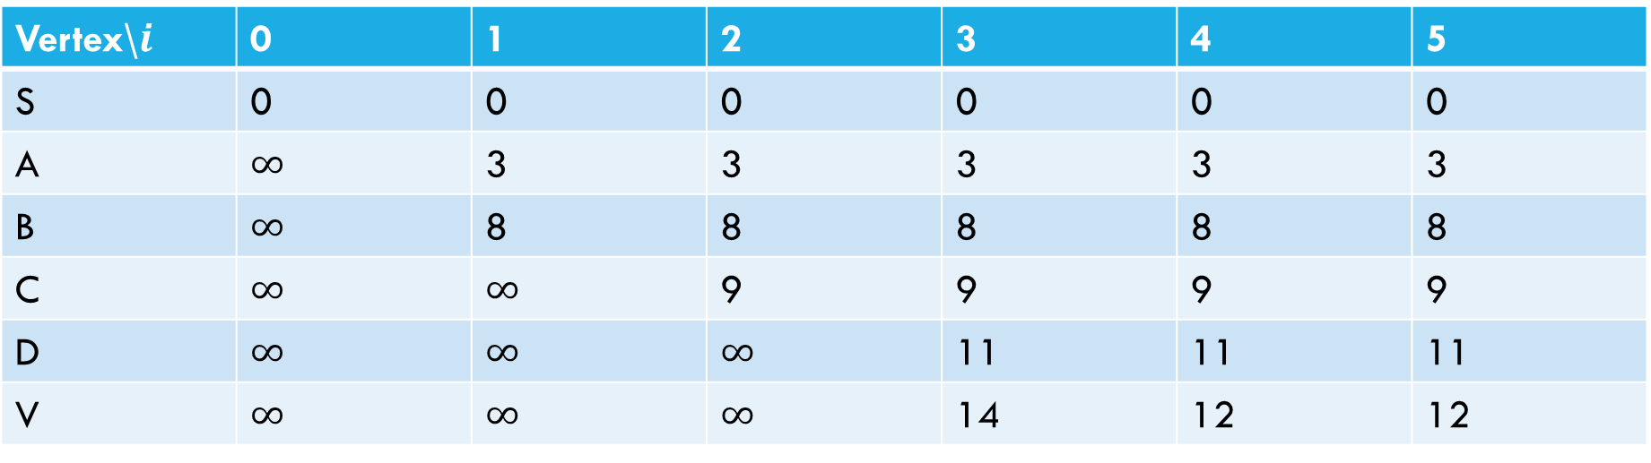
Sample calculation
6
a
5
3
c
v
3
2
s
1
8
b
d
4
Vertex\$i$ | 0 | 1 | 2 | 3 | 4 | 5
S | 0 | 0 | 0 | 0 | 0 | 0
A | $∞$ | 3 | 3 | 3 | 3 | 3
B | $∞$ | 8 | 8 | 8 | 8 | 8
C | $∞$ | $∞$ | 9 | 9 | 9 | 9
D | $∞$ | $∞$ | $∞$ | 11 | 11 | 11
V | $∞$ | $∞$ | $∞$ | 14 | 12 | 12

Slide 17
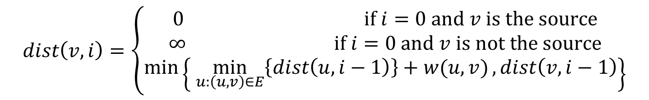
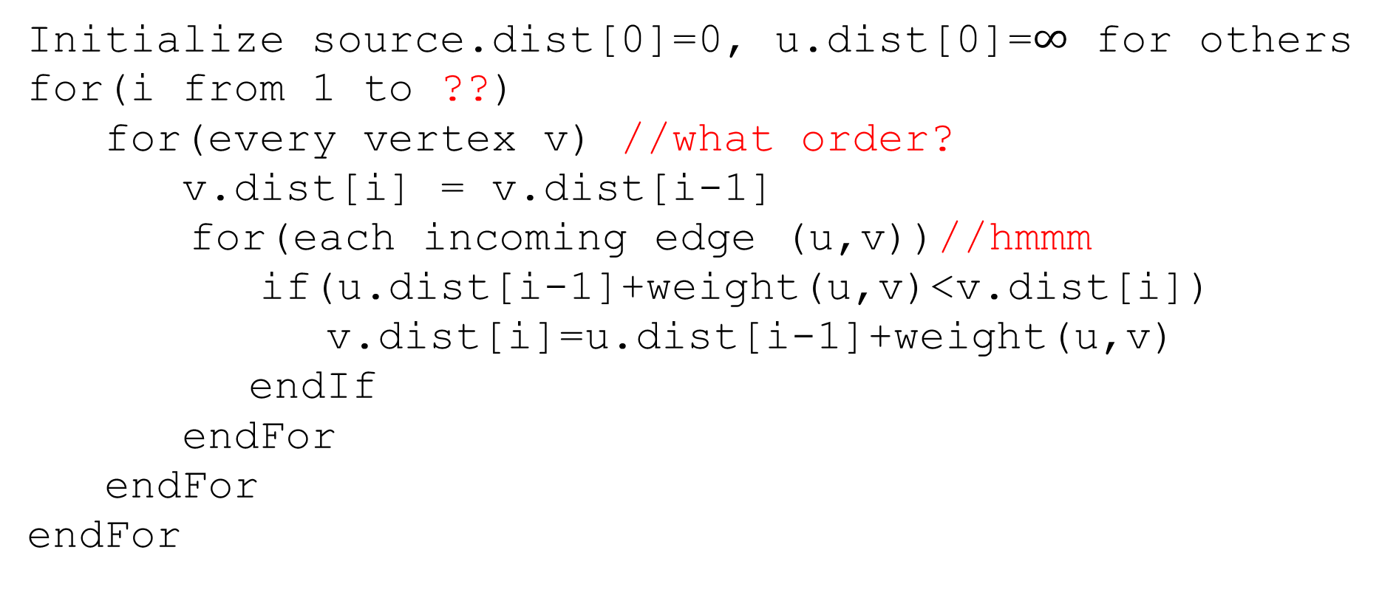
Pseudocode
Initialize source.dist[0]=0, u.dist[0]=$∞$ for others
for(i from 1 to ??)
for(every vertex v) //what order?
v.dist[i] = v.dist[i-1]
for(each incoming edge (u,v))//hmmm
if(u.dist[i-1]+weight(u,v)<v.dist[i])
v.dist[i]=u.dist[i-1]+weight(u,v)
endIf
endFor
endFor
endFor
$$dist\left(v,i\right)=\left\{\begin{aligned}0 if i=0 and v is the source \\ ∞ if i=0 and v is not the source \\ \min\left\{\min_{u:\left(u,v\right)∈E}\left\{dist\left(u,i−1\right)\right\}+w(u,v), dist\left(v,i−1\right)\right\}\end{aligned}\right.$$

Slide 18

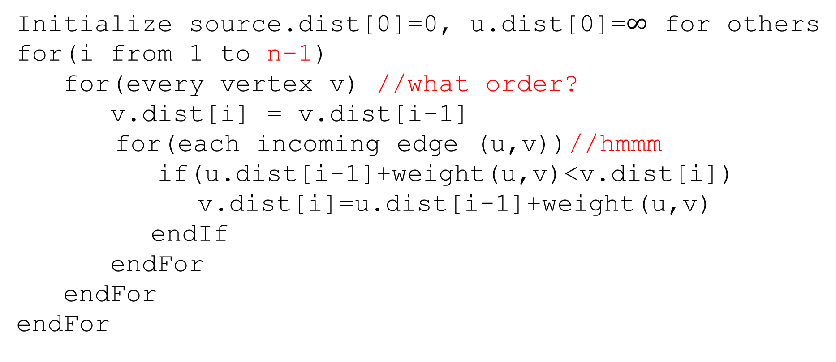
Pseudocode
Initialize source.dist[0]=0, u.dist[0]=$∞$ for others
for(i from 1 to n-1)
for(every vertex v) //what order?
v.dist[i] = v.dist[i-1]
for(each incoming edge (u,v))//hmmm
if(u.dist[i-1]+weight(u,v)<v.dist[i])
v.dist[i]=u.dist[i-1]+weight(u,v)
endIf
endFor
endFor
endFor
The shortest path will never need more than $n−1$ edges
(more than that and you’ve got a cycle)

Slide 19
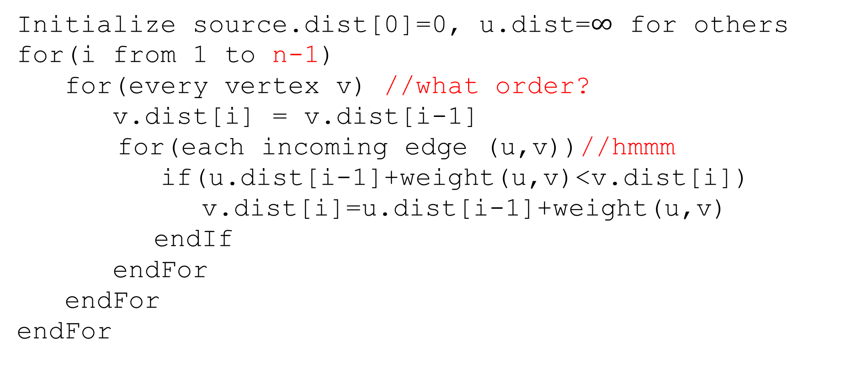
Pseudocode
Only ever need values from the last iteration
Order doesn’t matter!!
Initialize source.dist[0]=0, u.dist=$∞$ for others
for(i from 1 to n-1)
for(every vertex v) //what order?
v.dist[i] = v.dist[i-1]
for(each incoming edge (u,v))//hmmm
if(u.dist[i-1]+weight(u,v)<v.dist[i])
v.dist[i]=u.dist[i-1]+weight(u,v)
endIf
endFor
endFor
endFor

Slide 20
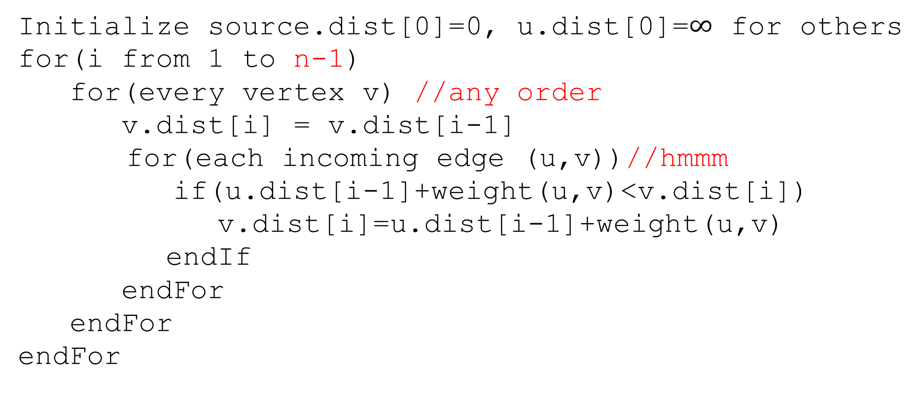
Pseudocode
Initialize source.dist[0]=0, u.dist[0]=$∞$ for others
for(i from 1 to n-1)
for(every vertex v) //any order
v.dist[i] = v.dist[i-1]
for(each incoming edge (u,v))//hmmm
if(u.dist[i-1]+weight(u,v)<v.dist[i])
v.dist[i]=u.dist[i-1]+weight(u,v)
endIf
endFor
endFor
endFor
Graphs don’t usually have easy access to their incoming edges (just the outgoing ones)

Slide 21
Pseudocode
Initialize source.dist[0]=0, u.dist[0]=$∞$ for others
for(i from 1 to n-1)
for(every vertex v) //any order
v.dist[i] = v.dist[i-1]
for(each incoming edge (u,v))//hmmm
if(u.dist[i-1]+weight(u,v)<v.dist[i])
v.dist[i]=u.dist[i-1]+weight(u,v)
endIf
endFor
endFor
endFor
But the order doesn’t matter – as long as we check every edge, the processing order is irrelevant.
So if we only have access to outgoing edges…

Slide 22
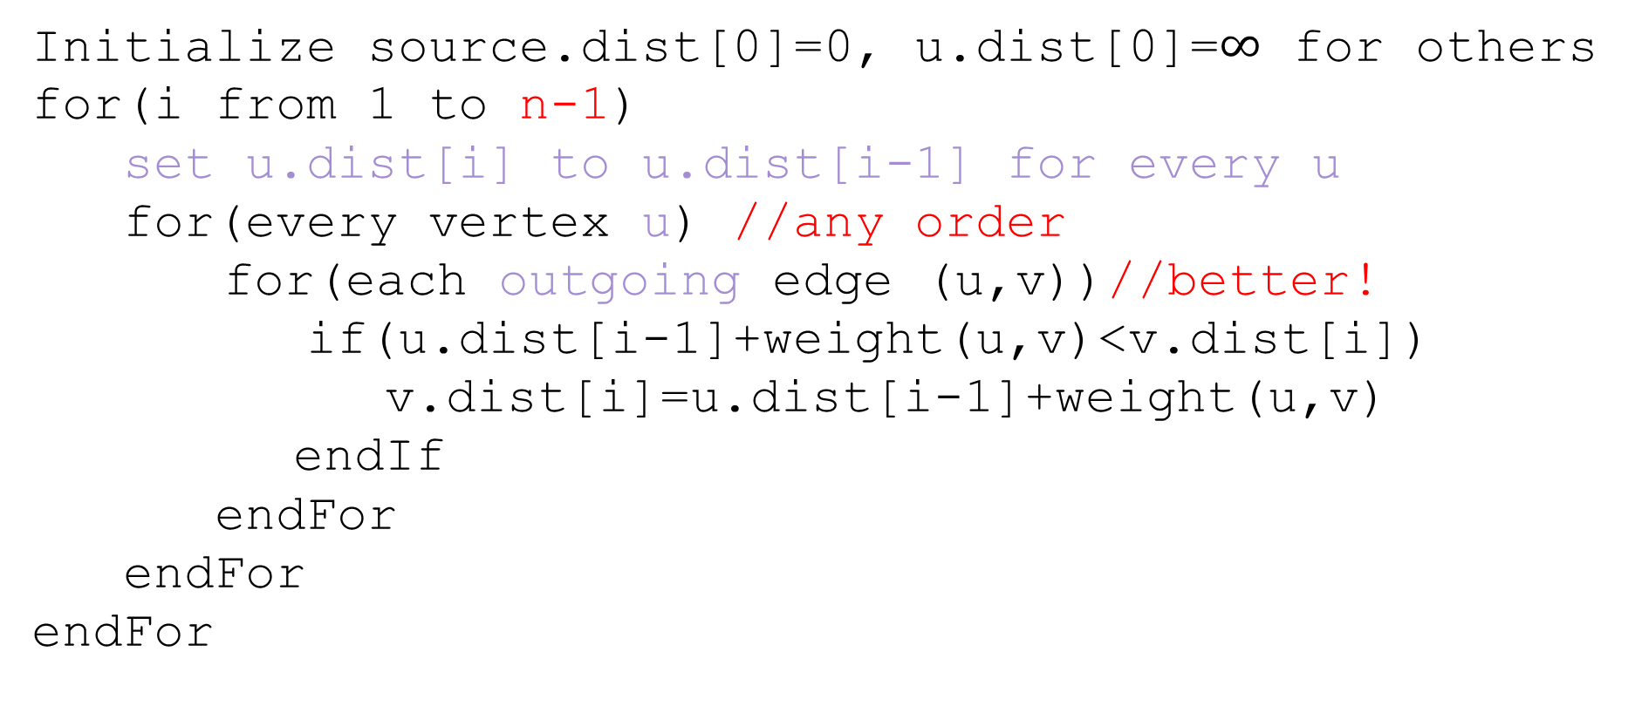
Pseudocode
Initialize source.dist[0]=0, u.dist[0]=$∞$ for others
for(i from 1 to n-1)
set u.dist[i] to u.dist[i-1] for every u
for(every vertex u) //any order
for(each outgoing edge (u,v))//better!
if(u.dist[i-1]+weight(u,v)<v.dist[i])
v.dist[i]=u.dist[i-1]+weight(u,v)
endIf
endFor
endFor
endFor

Slide 23
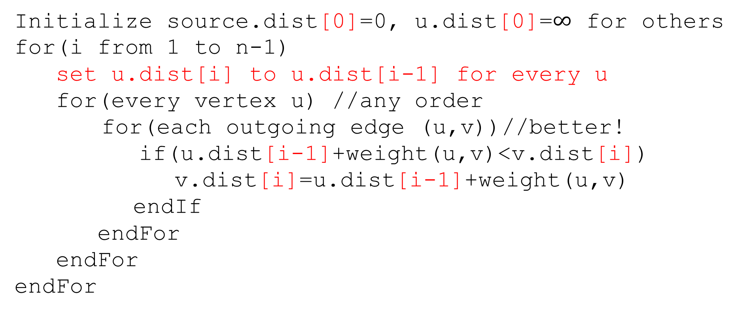
Pseudocode
Initialize source.dist[0]=0, u.dist[0]=$∞$ for others
for(i from 1 to n-1)
set u.dist[i] to u.dist[i-1] for every u
for(every vertex u) //any order
for(each outgoing edge (u,v))//better!
if(u.dist[i-1]+weight(u,v)<v.dist[i])
v.dist[i]=u.dist[i-1]+weight(u,v)
endIf
endFor
endFor
endFor
We don’t really need all the different values…
Just the most recent value.

Slide 24
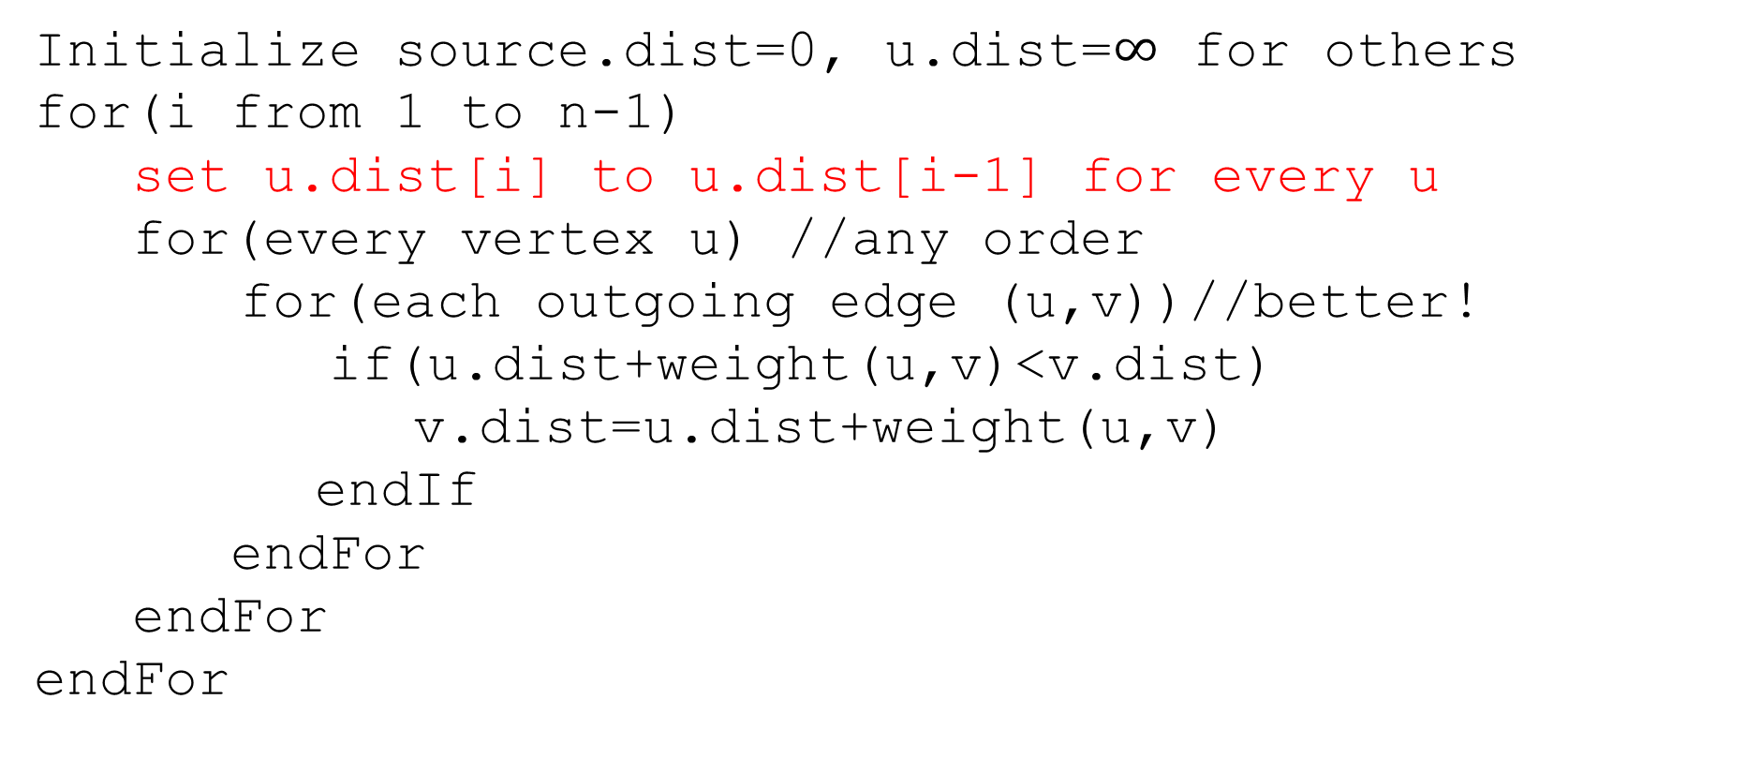
Pseudocode
Initialize source.dist=0, u.dist=$∞$ for others
for(i from 1 to n-1)
set u.dist[i] to u.dist[i-1] for every u
for(every vertex u) //any order
for(each outgoing edge (u,v))//better!
if(u.dist+weight(u,v)<v.dist)
v.dist=u.dist+weight(u,v)
endIf
endFor
endFor
endFor
We don’t really need all the different values…
Just the most recent value.

Slide 25
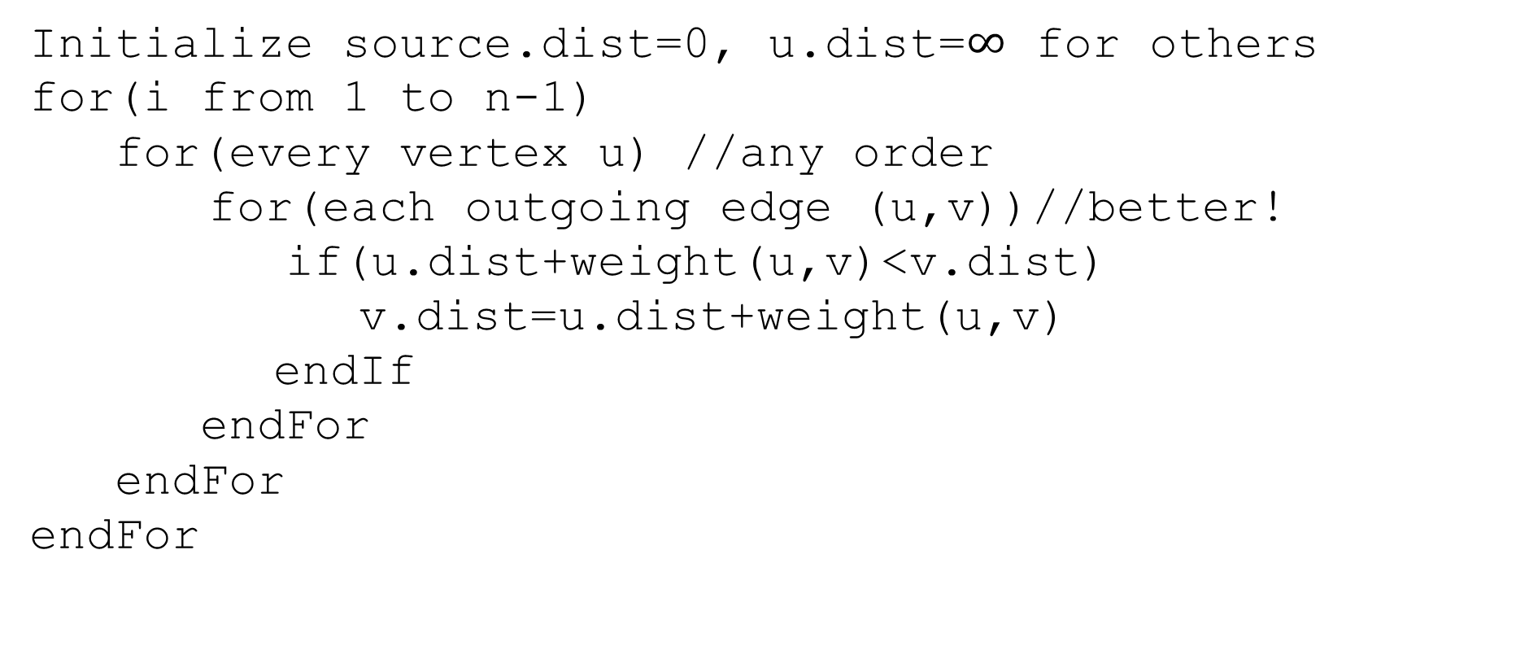
Pseudocode
Initialize source.dist=0, u.dist=$∞$ for others
for(i from 1 to n-1)
for(every vertex u) //any order
for(each outgoing edge (u,v))//better!
if(u.dist+weight(u,v)<v.dist)
v.dist=u.dist+weight(u,v)
endIf
endFor
endFor
endFor
We don’t really need all the different values…
Just the most recent value.

Slide 26
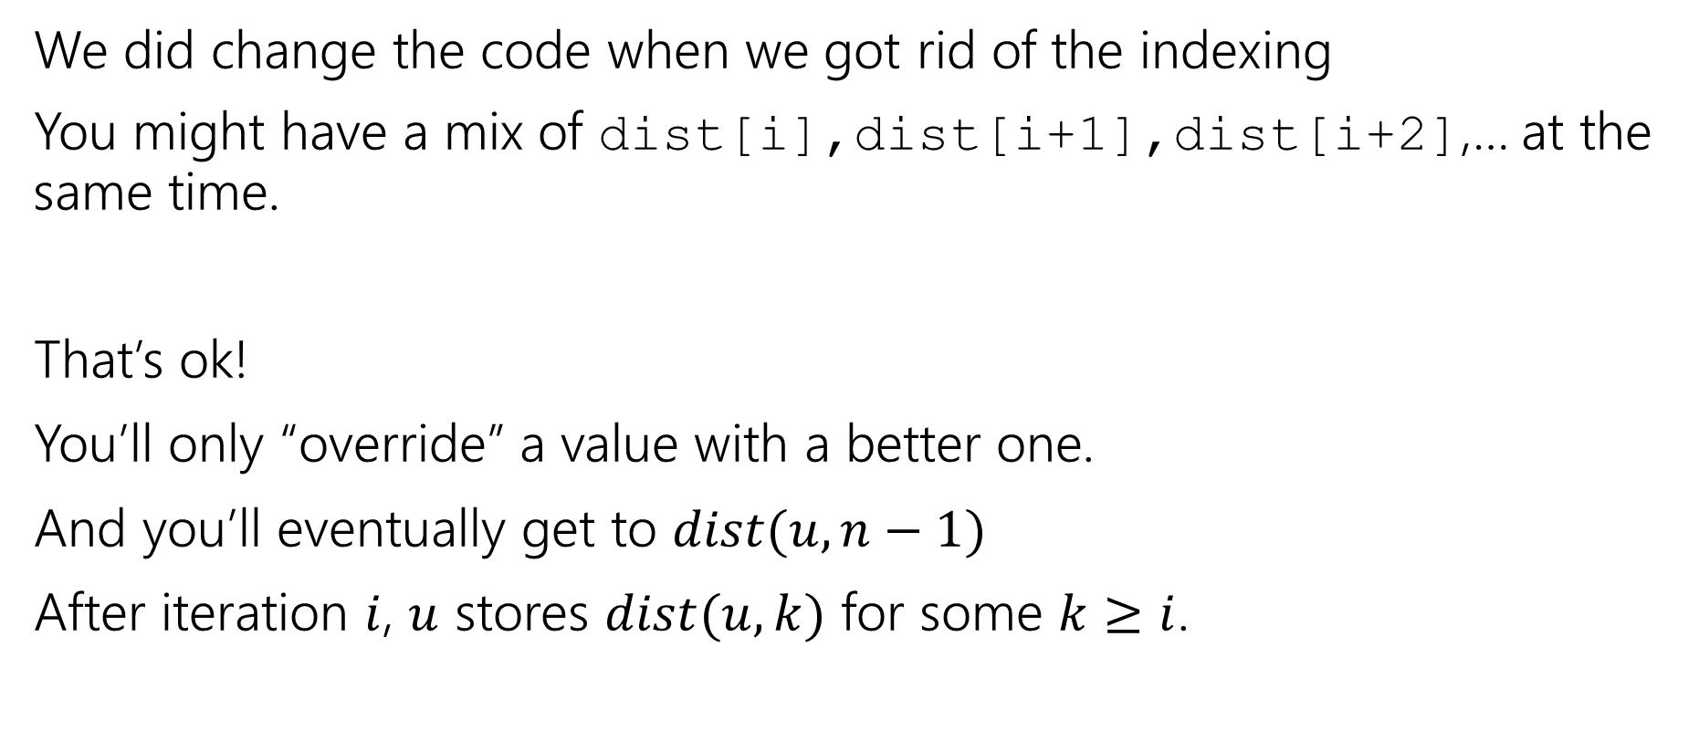
A Caution
We did change the code when we got rid of the indexing
You might have a mix of dist[i],dist[i+1],dist[i+2],… at the same time.
That’s ok!
You’ll only “override” a value with a better one.
And you’ll eventually get to $dist(u,n−1)$
After iteration $i$, $u$ stores $dist(u,k)$ for some $k≥i$.

Slide 27
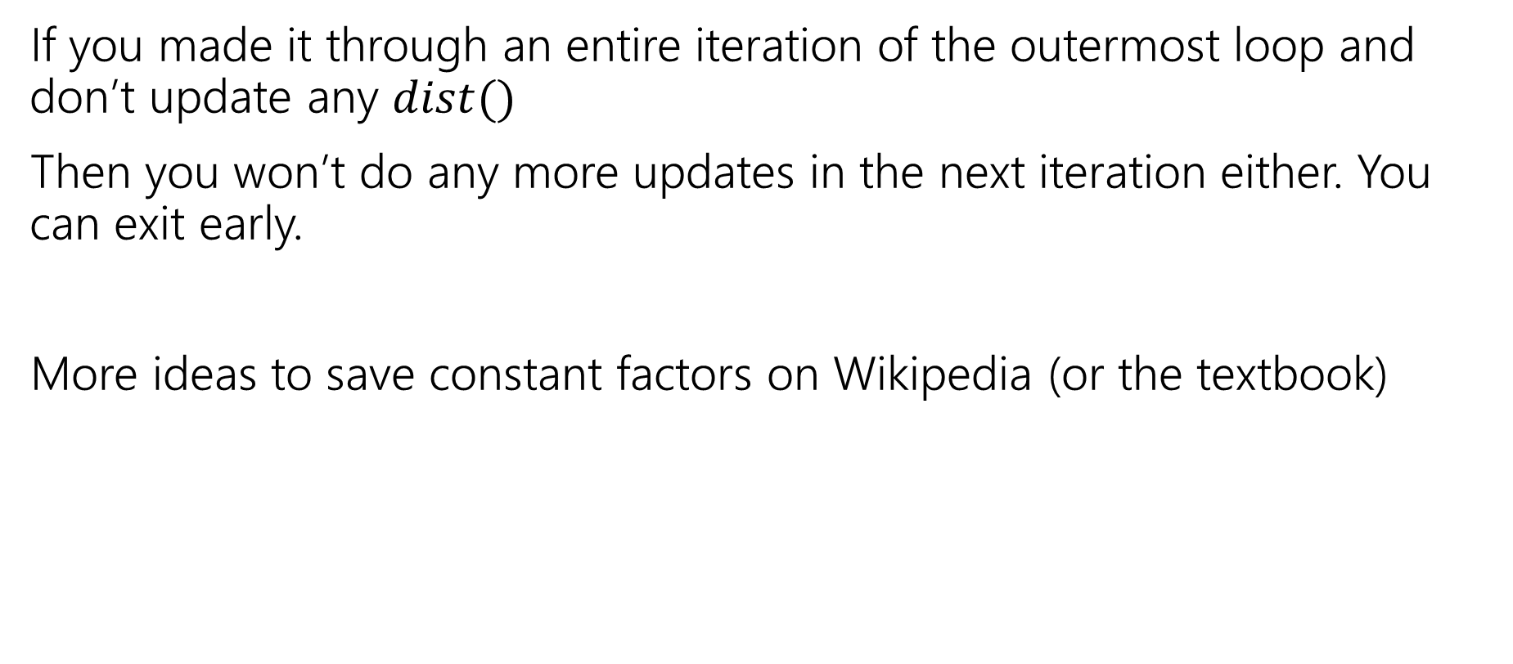
Exit early
If you made it through an entire iteration of the outermost loop and don’t update any $dist()$
Then you won’t do any more updates in the next iteration either. You can exit early.
More ideas to save constant factors on Wikipedia (or the textbook)
Notes:
Observe that if v’s distance doesn’t change then we don’t need to check (v,w) for any w. Some other clever ideas on Wikipedia.

Slide 28
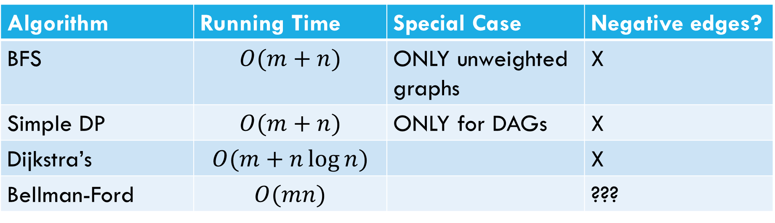
Laundry List of shortest pairs (so far)
Algorithm | Running Time | Special Case | Negative edges?
BFS | $$O(m+n)$$ | ONLY unweighted graphs | X
Simple DP | $$O(m+n)$$ | ONLY for DAGs | X
Dijkstra’s | $$O(m+n\log{n)}$$ |  | X
Bellman-Ford | $$O(mn)$$ |  | ???

Slide 29
Pseudocode
Initialize source.dist=0, u.dist=$∞$ for others
for(i from 1 to n-1)
for(every vertex u) //any order
for(each outgoing edge (u,v))//better!
if(u.dist+weight(u,v)<v.dist)
v.dist=u.dist+weight(u,v)
endIf
endFor
endFor
endFor
What happens if there’s a negative cycle?

Slide 30
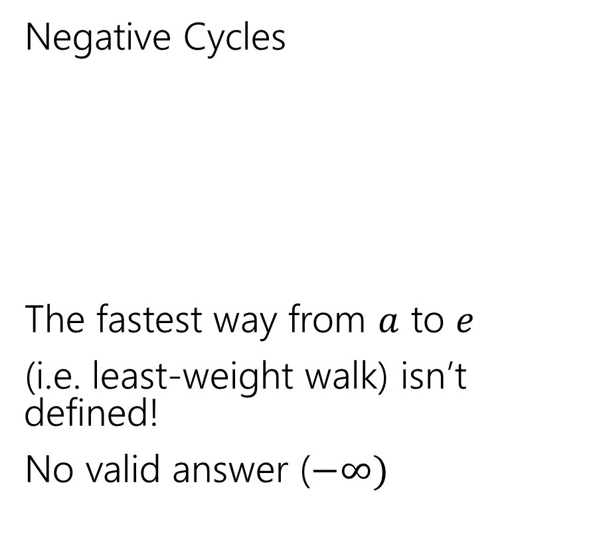
Negative Edges
Negative Cycles
The fastest way from $a$ to $e$
(i.e. least-weight walk) isn’t defined!
No valid answer ($−∞)$
Negative edges, but only non-negative cycles
Dijkstra’s might fail
But the shortest path IS defined.
There is an answer
a
6
5
c
e
a
6
5
c
e
3
2
3
2
1
b
d
1
-8
b
d
-3

Slide 31
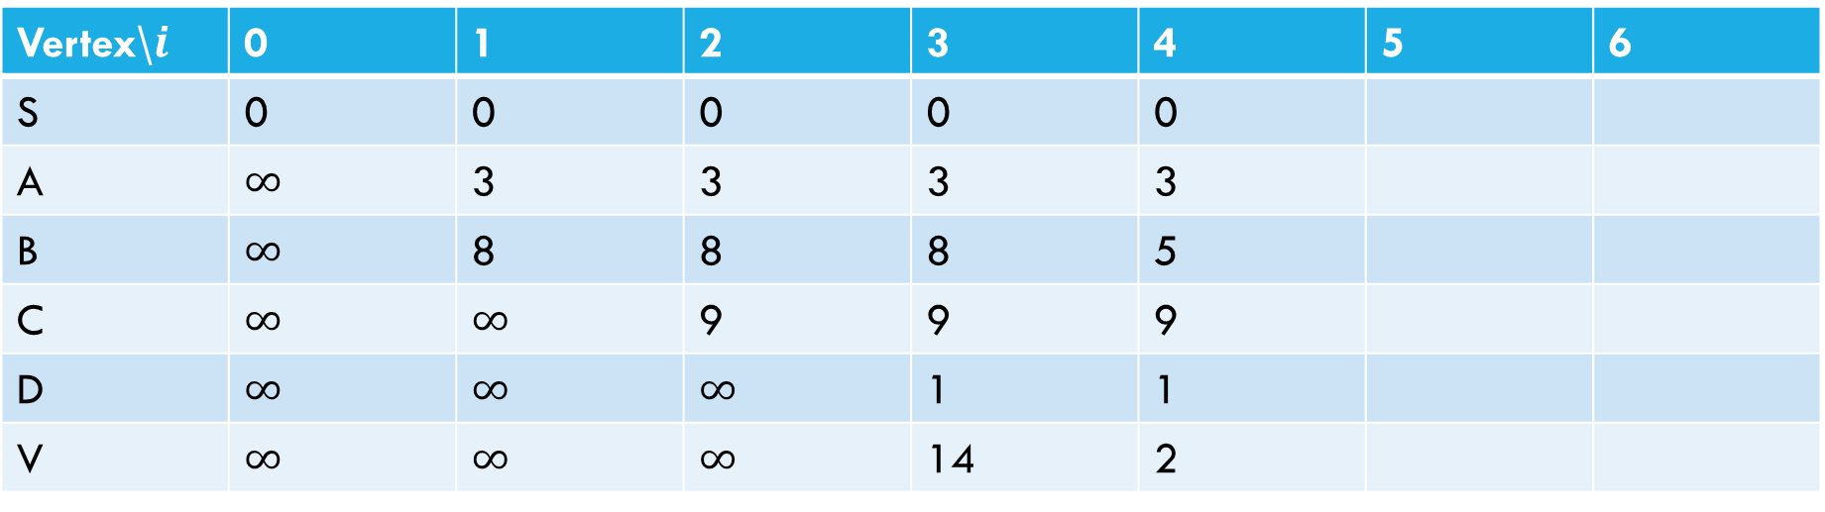
Negative Cycle
Pollev.com/Robbie
6
a
5
3
c
v
3
-8
s
1
8
b
d
4
Vertex\$i$ | 0 | 1 | 2 | 3 | 4 | 5 | 6
S | 0 | 0 | 0 | 0 | 0
A | $∞$ | 3 | 3 | 3 | 3
B | $∞$ | 8 | 8 | 8 | 5
C | $∞$ | $∞$ | 9 | 9 | 9
D | $∞$ | $∞$ | $∞$ | 1 | 1
V | $∞$ | $∞$ | $∞$ | 14 | 2

Slide 32
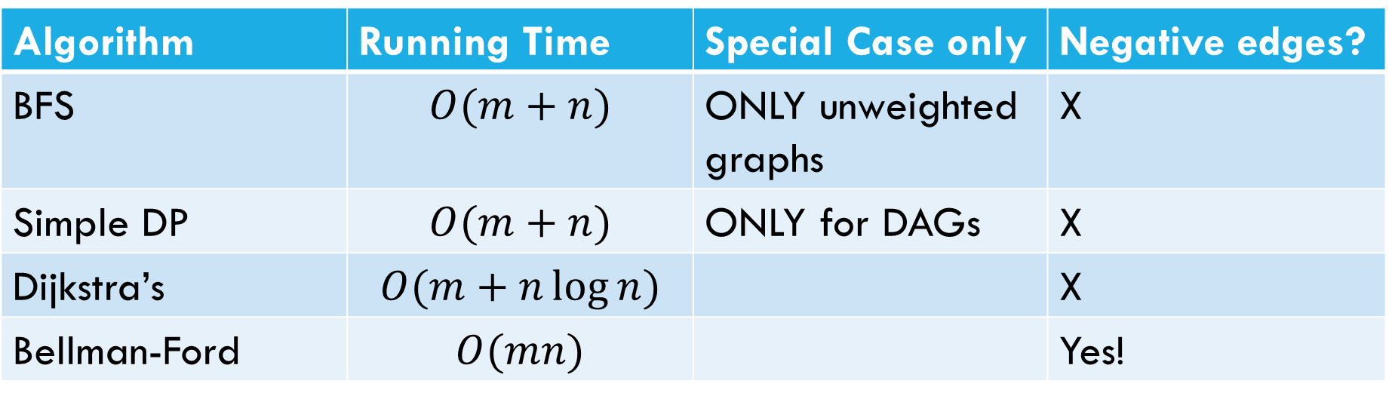
Laundry List of shortest pairs (so far)
Algorithm | Running Time | Special Case only | Negative edges?
BFS | $$O(m+n)$$ | ONLY unweighted graphs | X
Simple DP | $$O(m+n)$$ | ONLY for DAGs | X
Dijkstra’s | $$O(m+n\log{n)}$$ |  | X
Bellman-Ford | $$O(mn)$$ |  | Yes!

Slide 33
All Pairs Shortest Paths

Slide 34
All Pairs
For Dijkstra’s or Bellman-Ford we got the distances from the source to every vertex.
What if we want the distances from every vertex to every other vertex?

Slide 35
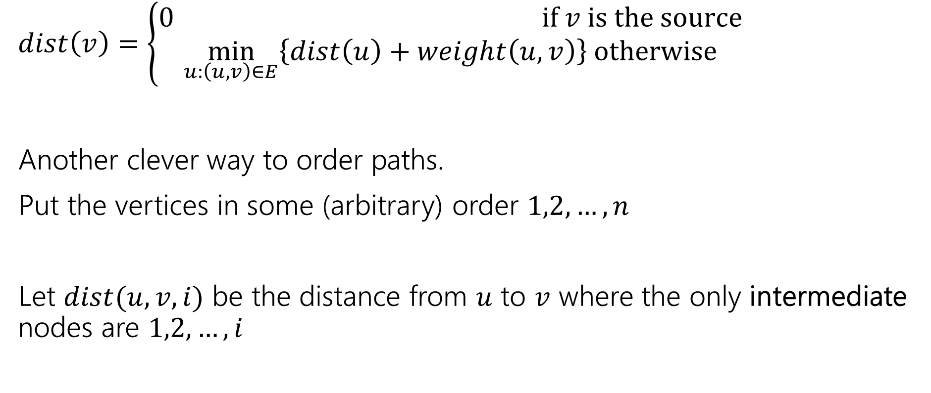
Another Recurrence
$dist\left(v\right)=\left\{\begin{aligned}0 if v is the source \\ \min_{u:\left(u,v\right)∈E}\left\{dist\left(u\right)+weight\left(u,v\right)\right\} otherwise\end{aligned}\right.$
Another clever way to order paths.
Put the vertices in some (arbitrary) order $1,2,…,n$
Let $dist(u,v,i)$ be the distance from $u$ to $v$ where the only intermediate nodes are $1,2,…,i$

Slide 36
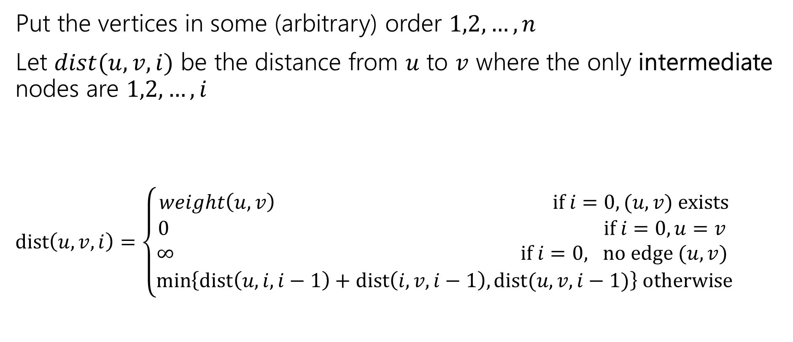
Another Recurrence
Put the vertices in some (arbitrary) order $1,2,…,n$
Let $dist(u,v,i)$ be the distance from $u$ to $v$ where the only intermediate nodes are $1,2,…,i$
$dist\left(u,v,i\right)=\left\{\begin{aligned}weight\left(u,v\right) if i=0, (u,v) exists \\ 0 if i=0, u=v \\ ∞ if i=0, no edge (u,v) \\ \min\left\{dist\left(u,i,i−1\right)+dist\left(i,v,i−1\right), dist(u,v,i−1)\right\} otherwise\end{aligned}\right.$

Slide 37

Pseudocode
dist[][] = new int[n-1][n-1]
for(int i=0; i<n; i++)
for(int j=0; j<n; j++)
dist[i][j] = edge(i,j) ? weight(i,j) : $∞$
for(int i=0; i<n; i++)
dist[i][i] = 0
for every vertex $r$
for every vertex $u$
for every vertex $v$
if(dist[u][r] + dist[r][v] < dist[u][v])
dist[u][v]=dist[u][r] + dist[r][v]
“standard” form of the “Floyd-Warshall” algorithm. Similar to Bellman-Ford, you can get rid of the last entry of the recurrence (only need 2D array, not 3D array).

Slide 38

Running Time
$O\left(n^{3}\right)$
How does that compare to Dijkstra’s?

Slide 39
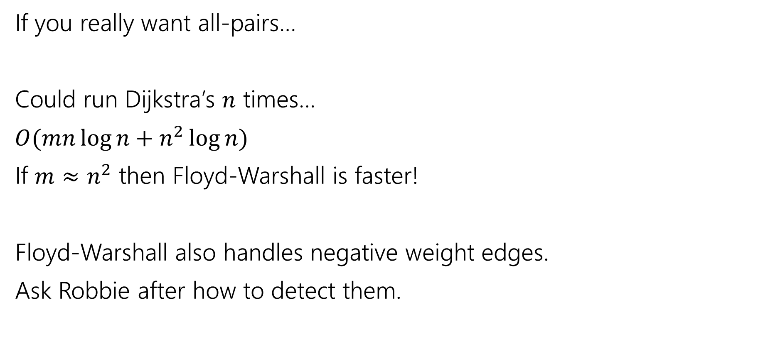
Running Time
If you really want all-pairs…
Could run Dijkstra’s $n$ times…
$O(mn\log{n}+n^{2}\log{n})$
If $m≈n^{2}$ then Floyd-Warshall is faster!
Floyd-Warshall also handles negative weight edges.
Ask Robbie after how to detect them.

Slide 40
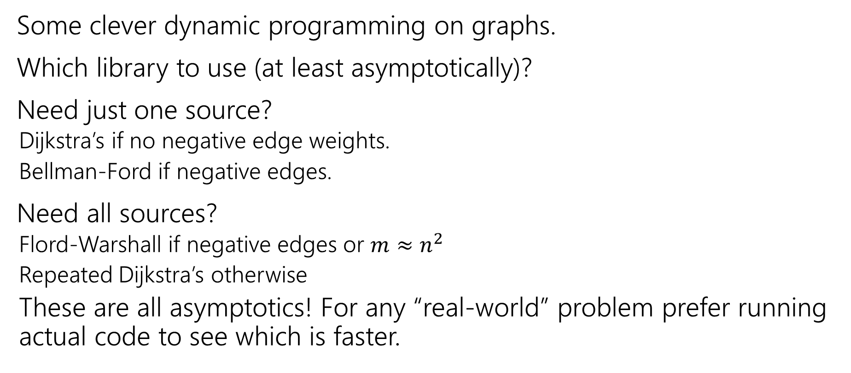
Takeaways
Some clever dynamic programming on graphs.
Which library to use (at least asymptotically)?
Need just one source?
Dijkstra’s if no negative edge weights.
Bellman-Ford if negative edges.
Need all sources?
Flord-Warshall if negative edges or $m≈n^{2}$
Repeated Dijkstra’s otherwise
These are all asymptotics! For any “real-world” problem prefer running actual code to see which is faster.

