Slide 1
DP Practice!
CSE 417 22AU
Lecture 16

Slide 2
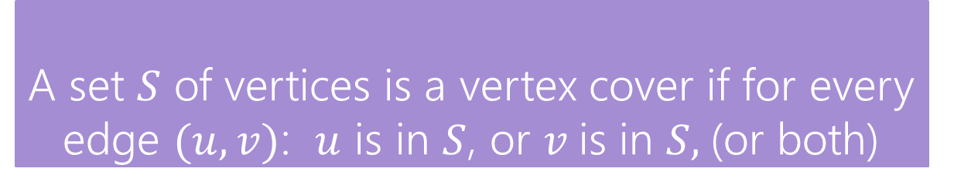
Vertex Cover
Vertex Cover
A set $S$ of vertices is a vertex cover if for every edge $(u,v)$: $u$ is in $S$, or $v$is in $S,$(or both)
Notice, the minimum weight vertex cover might have both endpoints of some edges
Even though only one of 1, 8 is required on the edge between them, they are both required for other edges.
1
10
8
5
3
20

Slide 3
Step 1: Formulate your problem recursively
Try top down and bottom up thinking.
Top down: For one particular “element” of the input, what do I need to decide? What are all the possibilities?
Bottom up: What is a smaller version of the problem?
What information do we need to solve the problem recursively?

Slide 4
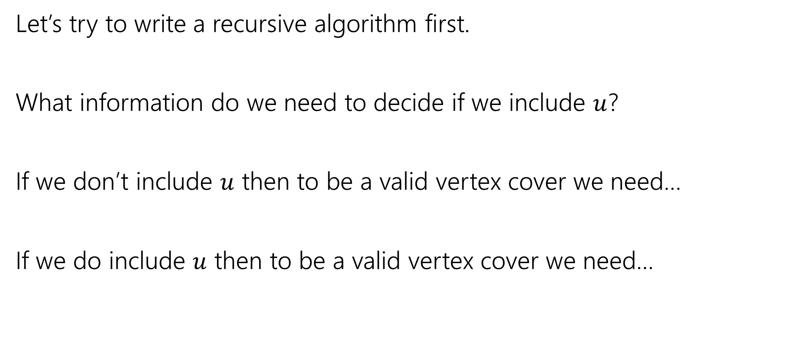
Vertex Cover – Recursively
Let’s try to write a recursive algorithm first.
What information do we need to decide if we include $u$?
If we don’t include $u$ then to be a valid vertex cover we need…
If we do include $u$ then to be a valid vertex cover we need…

Slide 5
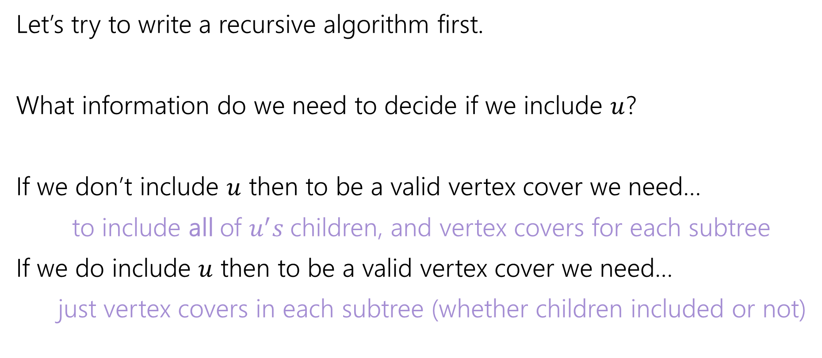
Vertex Cover – Recursively
Let’s try to write a recursive algorithm first.
What information do we need to decide if we include $u$?
If we don’t include $u$ then to be a valid vertex cover we need…
to include all of $u^{′}s$children, and vertex covers for each subtree
If we do include $u$ then to be a valid vertex cover we need…
just vertex covers in each subtree (whether children included or not)

Slide 6
Step 2: What do you need recursively
Write in English (not math. English.) what exactly the recursive call is giving you.
I know this sounds silly. Every time I am trying to solve a DP problem from scratch (or just remember how one worked) and can’t do it, it’s because I haven’t written it down in English.
If you realize “I need an extra parameter” update the English description with that extra parameter.

Slide 7
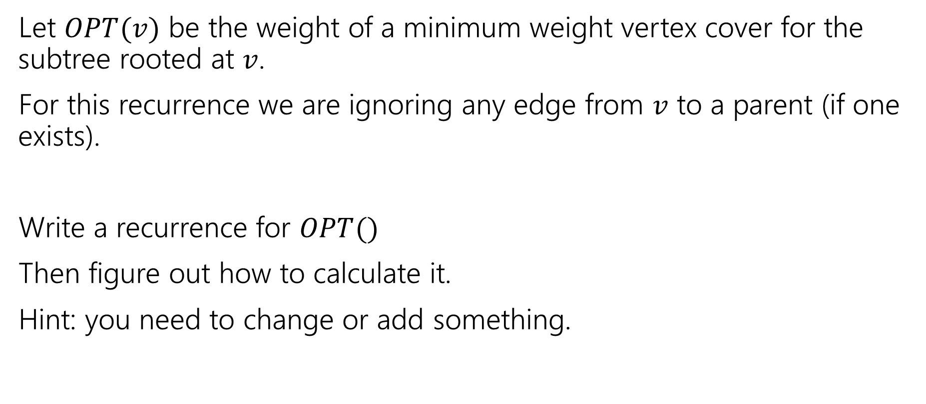
Recurrence
Let $OPT(v)$ be the weight of a minimum weight vertex cover for the subtree rooted at $v$.
For this recurrence we are ignoring any edge from $v$ to a parent (if one exists).
Write a recurrence for $OPT()$
Then figure out how to calculate it.
Hint: you need to change or add something.

Slide 8
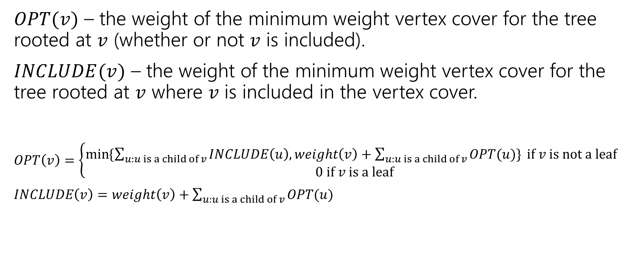
Recurrence
$OPT(v)$ – the weight of the minimum weight vertex cover for the tree rooted at $v$ (whether or not $v$ is included).
$INCLUDE(v)$ – the weight of the minimum weight vertex cover for the tree rooted at $v$ where $v$ is included in the vertex cover.
$OPT\left(v\right)=\left\{\begin{aligned}\min{⁡\{\sum_{u:u is a child of v}{INCLUDE\left(u\right), weight\left(v\right)+\sum_{u:u is a child of v}{OPT(u)\}} if v is not a leaf} } \\ 0 if v is a leaf\end{aligned}\right.$
$INCLUDE\left(v\right)=weight\left(v\right)+\sum_{u:u is a child of v}{OPT(u)}$

Slide 9
Vertex Cover Dynamic Program
What memoization structure should we use?
What code should we write?
What’s the running time?

Slide 10
Vertex Cover Dynamic Program
What memoization structure should we use?
the tree itself!
What code should we write?
What’s the running time?

Slide 11
Vertex Cover
What order do we do the calculation?
1
10
8
5
3
20

Slide 12
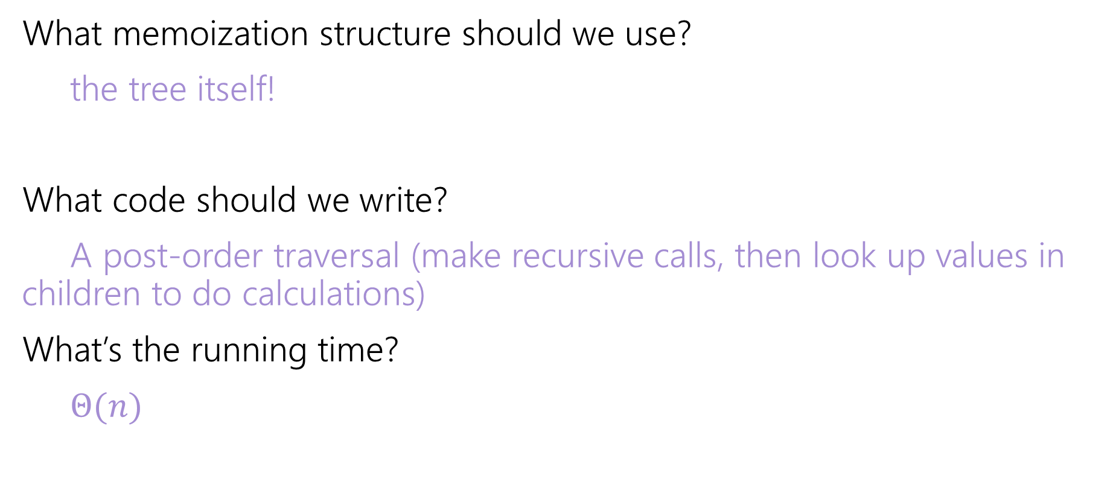
Vertex Cover Dynamic Program
What memoization structure should we use?
the tree itself!
What code should we write?
A post-order traversal (make recursive calls, then look up values in children to do calculations)
What’s the running time?
$Θ(n)$

Slide 13
More Practice

Slide 14
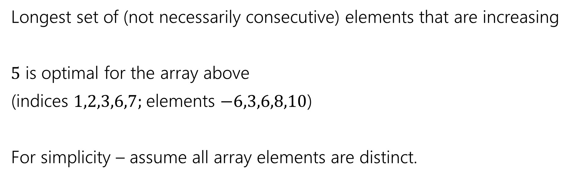
Longest Increasing Subsequence
0 | 1 | 2 | 3 | 4 | 5 | 6 | 7
5 | -6 | 3 | 6 | -5 | 2 | 8 | 10
Longest set of (not necessarily consecutive) elements that are increasing
$5$ is optimal for the array above
(indices $1,2,3,6,7;$elements $−6,3,6,8,10$)
For simplicity – assume all array elements are distinct.
Try it again!
But mirrored

Slide 15

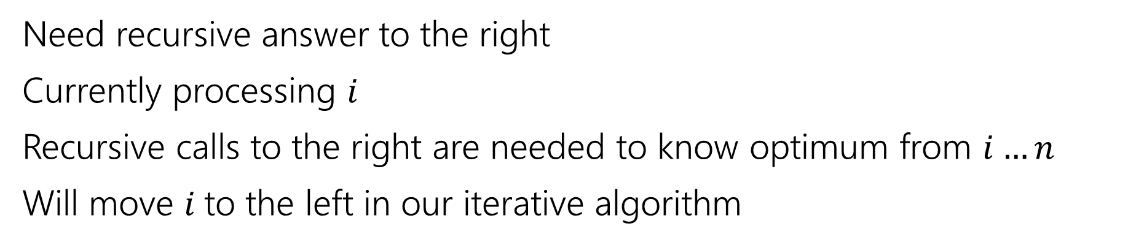
Recurrence
0 | 1 | 2 | 3 | 4 | 5 | 6 | 7
5 | -6 | 3 | 6 | -5 | 2 | 8 | 10
Parent recursive calls
Current $i$
Recursive call is best value in this area
Need recursive answer to the right
Currently processing $i$
Recursive calls to the right are needed to know optimum from $i…n$
Will move $i$to the left in our iterative algorithm

Slide 16
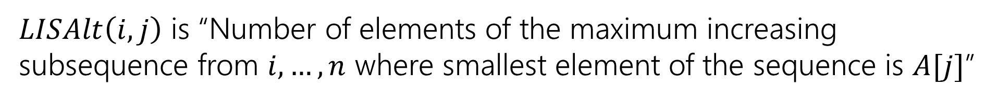
Recurrence
0 | 1 | 2 | 3 | 4 | 5 | 6 | 7
5 | -6 | 3 | 6 | -5 | 2 | 8 | 10
Parent recursive calls
Current $i$
Recursive call is best value in this area
pollev.com/robbie
Try to write a different recurrence for longest increasing subsequence.
$LISAlt\left(i,j\right)$ is “Number of elements of the maximum increasing subsequence from $i,…,n$ where smallest element of the sequence is $A[j]$”

Slide 17
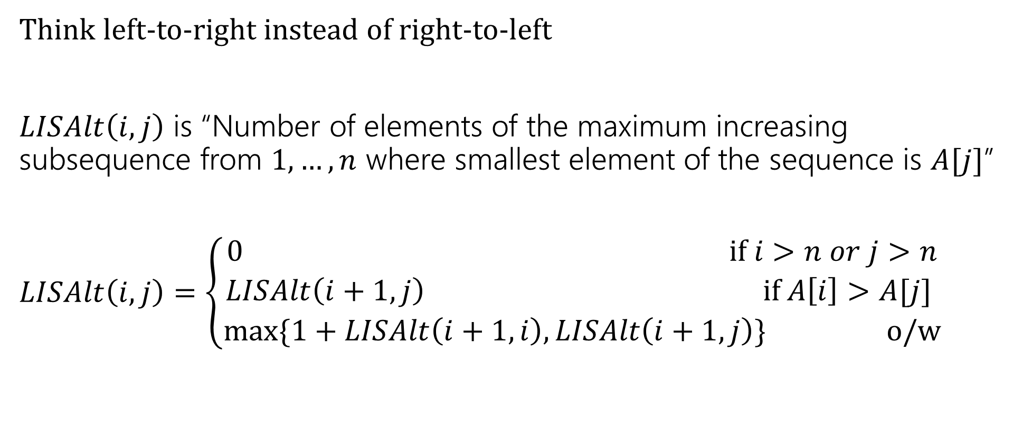
Longest Increasing Subsequence
Think left-to-right instead of right-to-left
$LISAlt\left(i,j\right)$ is “Number of elements of the maximum increasing subsequence from $1,…,n$ where smallest element of the sequence is $A[j]$”
$LISAlt\left(i,j\right)=\left\{\begin{aligned}0 if i>n or j>n \\ LISAlt\left(i+1,j\right) if A\left[i\right]>A[j] \\ \max{\{1+LISAlt\left(i+1,i\right), LISAlt\left(i+1,j\right)\}} o/w\end{aligned}\right.$

Slide 18
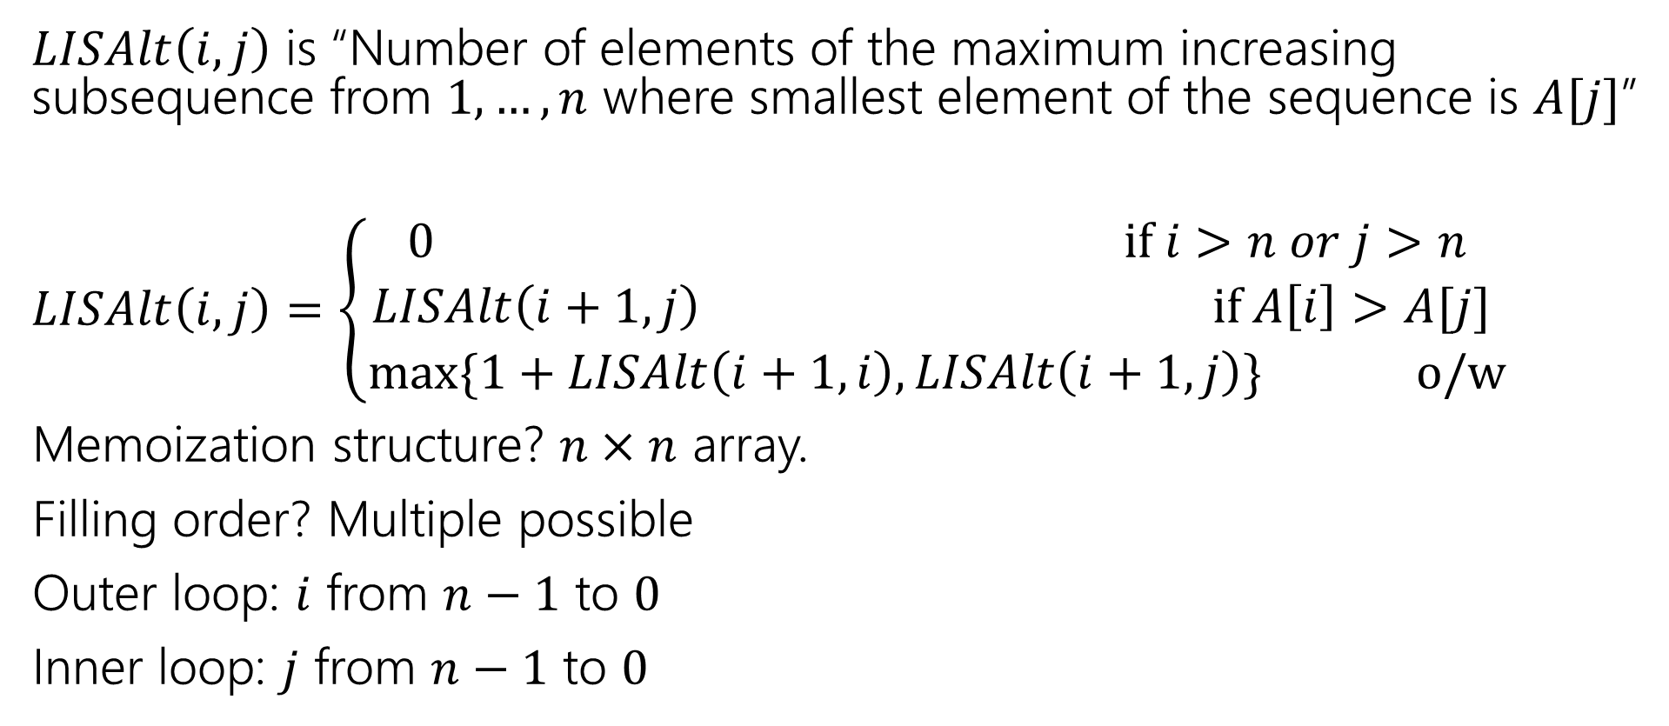
Longest Increasing Subsequence
$LISAlt\left(i,j\right)$ is “Number of elements of the maximum increasing subsequence from $1,…,n$ where smallest element of the sequence is $A[j]$”
$LISAlt\left(i,j\right)=\left\{\begin{aligned}0 if i>n or j>n \\ LISAlt\left(i+1,j\right) if A\left[i\right]>A[j] \\ \max{\{1+LISAlt\left(i+1,i\right), LISAlt\left(i+1,j\right)\}} o/w\end{aligned}\right.$
Memoization structure? $n×n$ array.
Filling order? Multiple possible
Outer loop: $i$ from $n−1$ to $0$
Inner loop: $j$ from $n−1$ to $0$

Slide 19
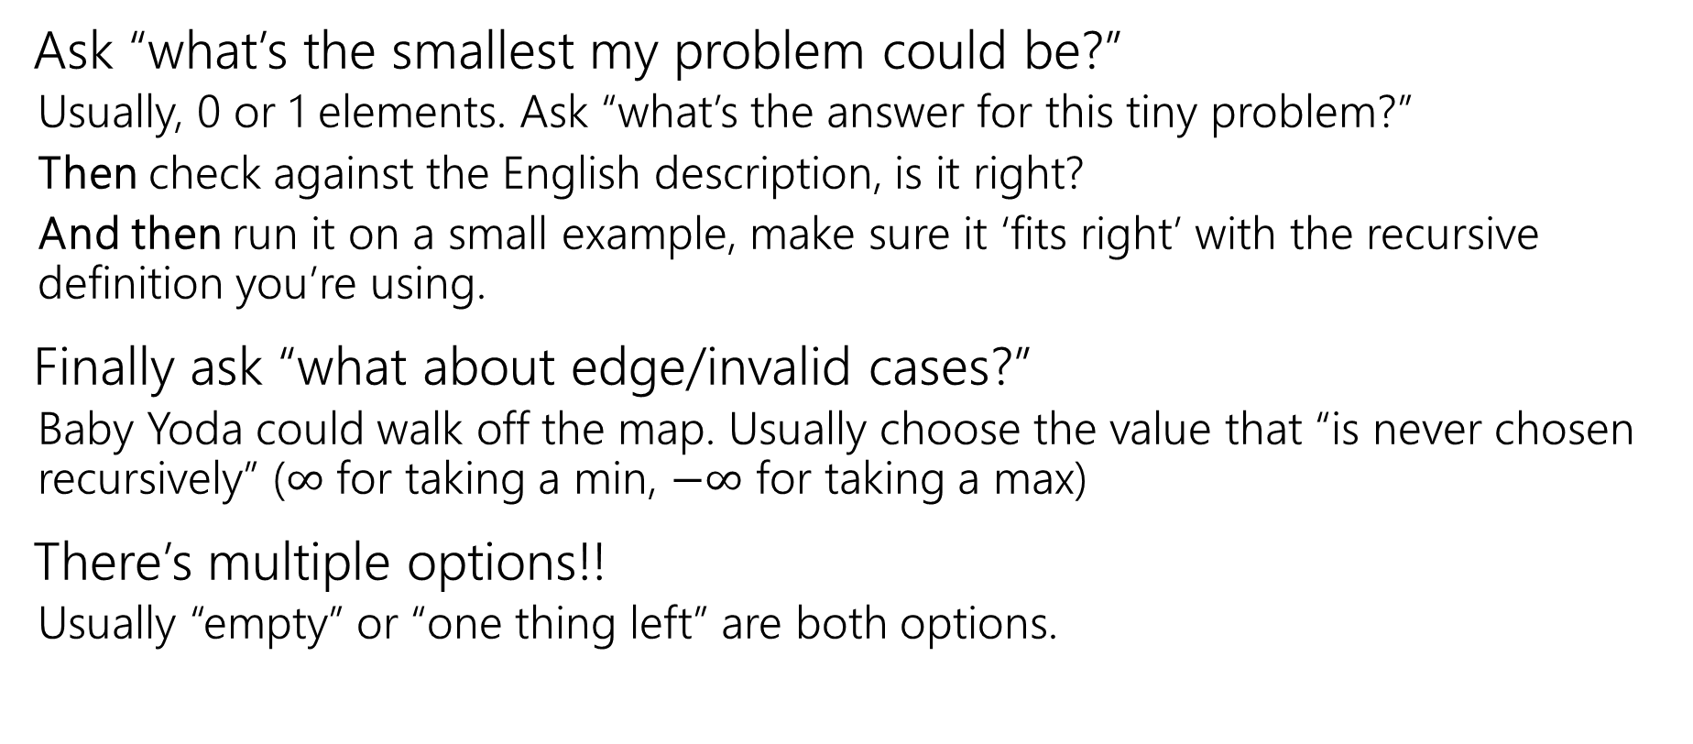
How do you choose your base cases?
Ask “what’s the smallest my problem could be?”
  Usually, 0 or 1 elements. Ask “what’s the answer for this tiny problem?”
  Then check against the English description, is it right?
  And then run it on a small example, make sure it ‘fits right’ with the recursive definition you’re using.
Finally ask “what about edge/invalid cases?”
  Baby Yoda could walk off the map. Usually choose the value that “is never chosen recursively” ($∞$ for taking a min, $−∞$ for taking a max)
There’s multiple options!!
  Usually “empty” or “one thing left” are both options.

Slide 20
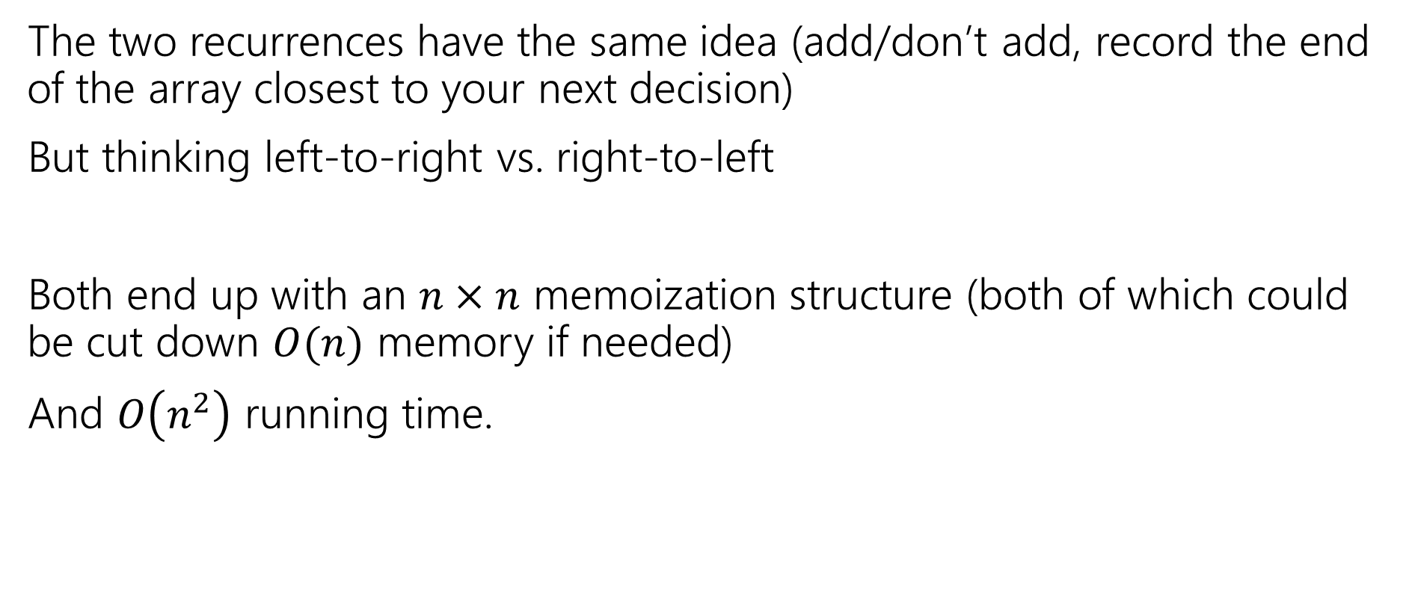
Summing Up
The two recurrences have the same idea (add/don’t add, record the end of the array closest to your next decision)
But thinking left-to-right vs. right-to-left
Both end up with an $n×n$ memoization structure (both of which could be cut down $O(n)$ memory if needed)
And $O\left(n^{2}\right)$ running time.

Slide 21
But Wait! There’s more
Another recurrence at the end of these slides for more practice.
Instead of thinking “do I include this element or not?” for each element,
Ask “what’s the next element” or equivalently “what’s the longest subsequence starting from me”
Get a different recurrence, but not a better running time.

Slide 22
Takeaways
When designing a dynamic program, we sometimes need to introduce a second variable, that doesn’t appear in the program
Or a second recurrence that mixes with the first if other decisions affect what’s optimal (beyond which problem you look at)
There might be more than one program available.

Slide 23
Extra Practice

Slide 24
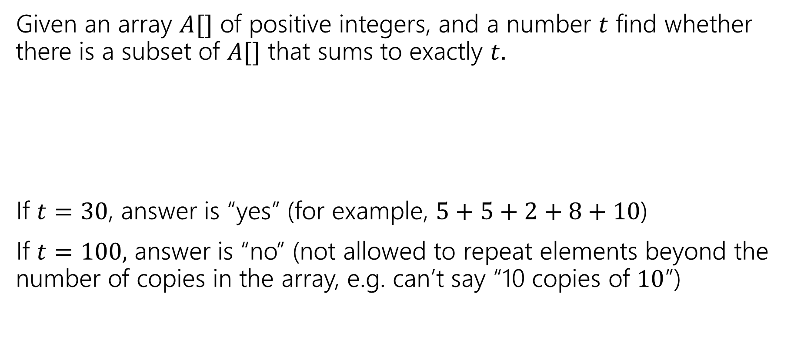
Subset Sum
Given an array $A[]$ of positive integers, and a number $t$ find whether there is a subset of $A[]$ that sums to exactly $t.$
If $t=30$, answer is “yes” (for example, $5+5+2+8+10$)
If $t=100,$ answer is “no” (not allowed to repeat elements beyond the number of copies in the array, e.g. can’t say “10 copies of $10$”)
0 | 1 | 2 | 3 | 4 | 5 | 6 | 7
5 | 6 | 3 | 6 | 5 | 2 | 8 | 10

Slide 25
Subset Sum
Write an English description of what you want to calculate
Write a recurrence
Give a sentence or two (in English) of why your recurrence should work.

Slide 26
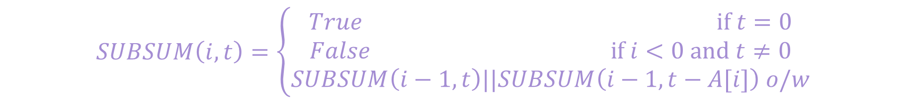
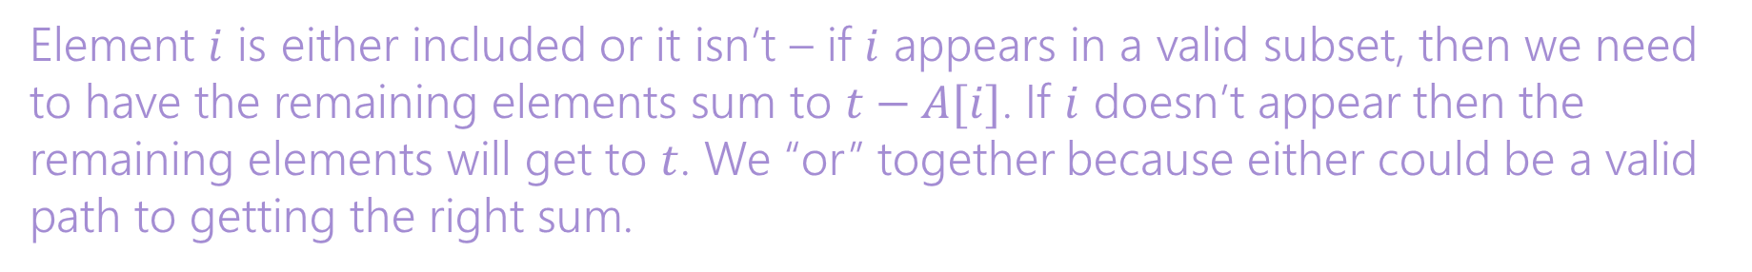
Subset Sum
Write an English description of what you want to calculate
Write a recurrence
Give a sentence or two (in English) of why your recurrence should work.
Let $SUBSUM(i,t)$ be true if and only if a subset of $A\left[0\right],…,A[i]$ can sum to $t$.
$$SUBSUM\left(i,t\right)=\left\{\begin{aligned}True if t=0 \\ False if i<0 and t≠0 \\ SUBSUM\left(i−1,t\right)||SUBSUM\left(i−1,t−A[i]\right) o/w\end{aligned}\right.$$
Element $i$ is either included or it isn’t – if $i$ appears in a valid subset, then we need to have the remaining elements sum to $t−A[i]$. If $i$ doesn’t appear then the remaining elements will get to $t$. We “or” together because either could be a valid path to getting the right sum.

Slide 27
Subset Sum
What memorization structure will you use?
Write the pseudocode to fill up the structure iteratively.
A 2D Boolean array SUBSUM($i,j$). Array will be $n×T$
SubSum(int[] A, int T)
Bool[][] SubSum = new Bool[n][T+1]
for(int j=0;j<T+1;j++){ SubSum[0][j]=False;}
SubSum[0][A[0]]=True;
for(int i=1; i<n;i++){
for(int j=0; j<T+1; j++){
if(SubSum[i-1][j]){
SubSum[i][j]=True;
SubSum[i][j+A[i]]=True;//need to catch Array index errors. Don’t do
//this in real code.
}
}
}
return SubSum[n][T-1];

Slide 28
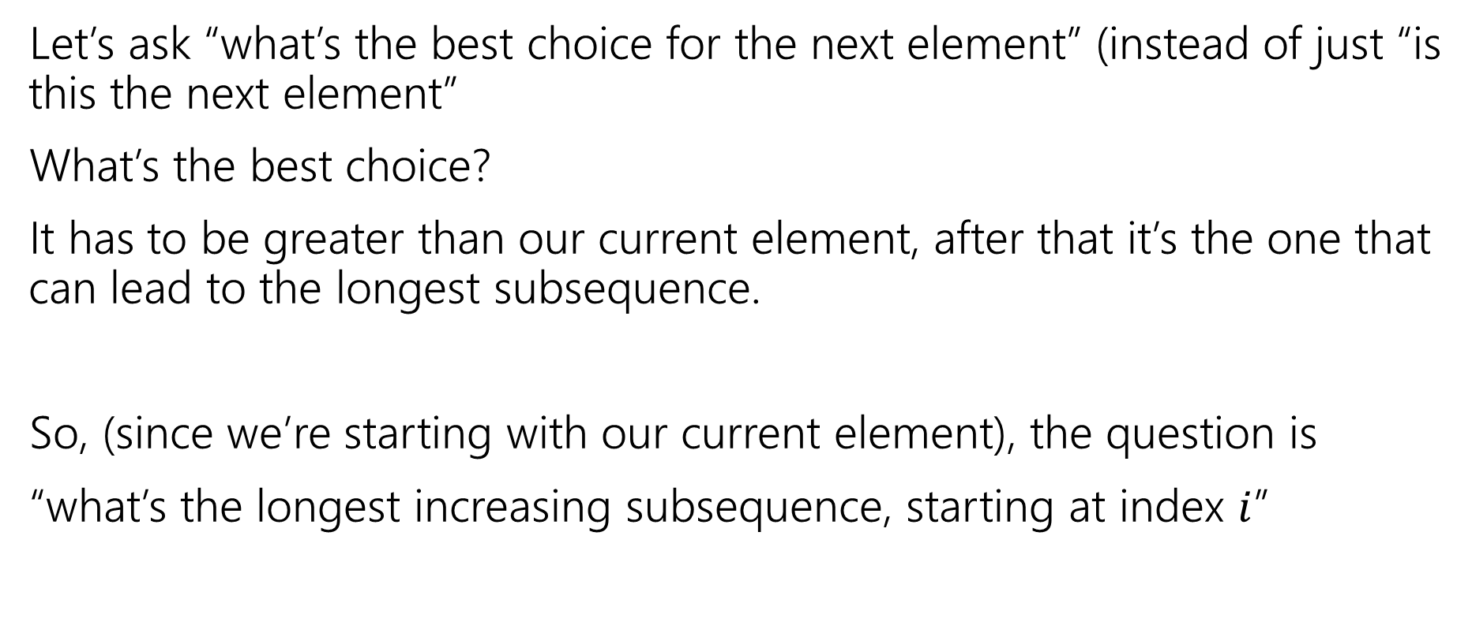
Longest Increasing Subsequence, Round 3
Let’s ask “what’s the best choice for the next element” (instead of just “is this the next element”
What’s the best choice?
It has to be greater than our current element, after that it’s the one that can lead to the longest subsequence.
So, (since we’re starting with our current element), the question is
“what’s the longest increasing subsequence, starting at index $i$”

Slide 29
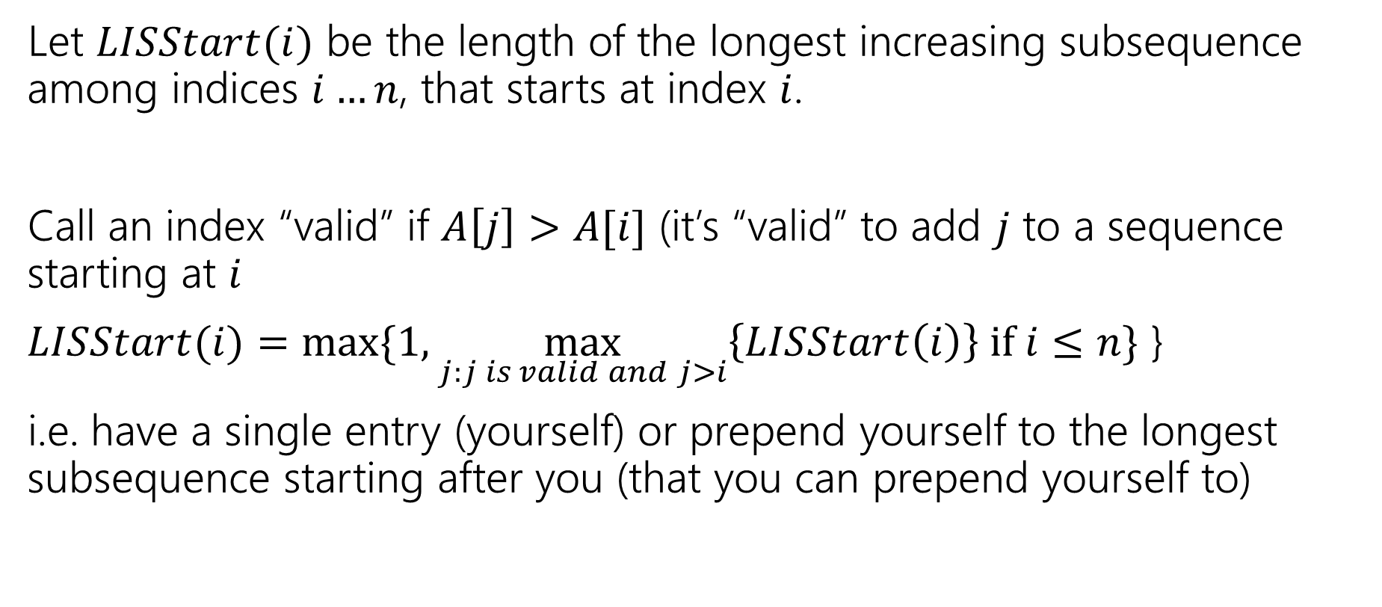
Longest Increasing Subsequence, Round 3
Let $LISStart(i)$ be the length of the longest increasing subsequence among indices $i…n$, that starts at index $i$.
Call an index “valid” if $A\left[j\right]>A[i]$ (it’s “valid” to add $j$ to a sequence starting at $i$
$LISStart(i)=max⁡\{1,\max_{j:j is valid and j>i}\left\{LISStart\left(i\right)\right\} if i≤n\}$ }
i.e. have a single entry (yourself) or prepend yourself to the longest subsequence starting after you (that you can prepend yourself to)

Slide 30
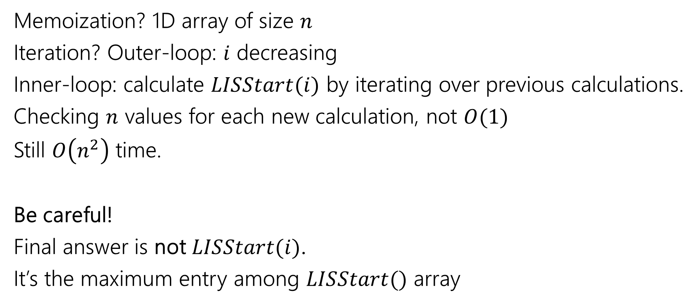
Longest Increasing Subsequence, Round 3
Memoization? 1D array of size $n$
Iteration? Outer-loop: $i$ decreasing
Inner-loop: calculate $LISStart(i)$ by iterating over previous calculations.
Checking $n$ values for each new calculation, not $O(1)$
Still $O\left(n^{2}\right)$ time.
Be careful!
Final answer is not $LISStart(i)$.
It’s the maximum entry among $LISStart()$ array

