Slide 1
Dynamic Programming Hidden Parameters and on Trees
CSE 417 22AU
Lecture 15

Slide 2
Plan For This Week
Today
I’ll walk through 2 more examples with you, and maybe a little history.
Wednesday
Practice Day; it’s hard to learn just by watching, we’ll have you work through a problem or two in full detail.
Friday (and a bit next Monday)
Two “advanced” DP applications; see really clever ideas (that we wouldn’t expect you to find on your own, but are good to see).

Slide 3
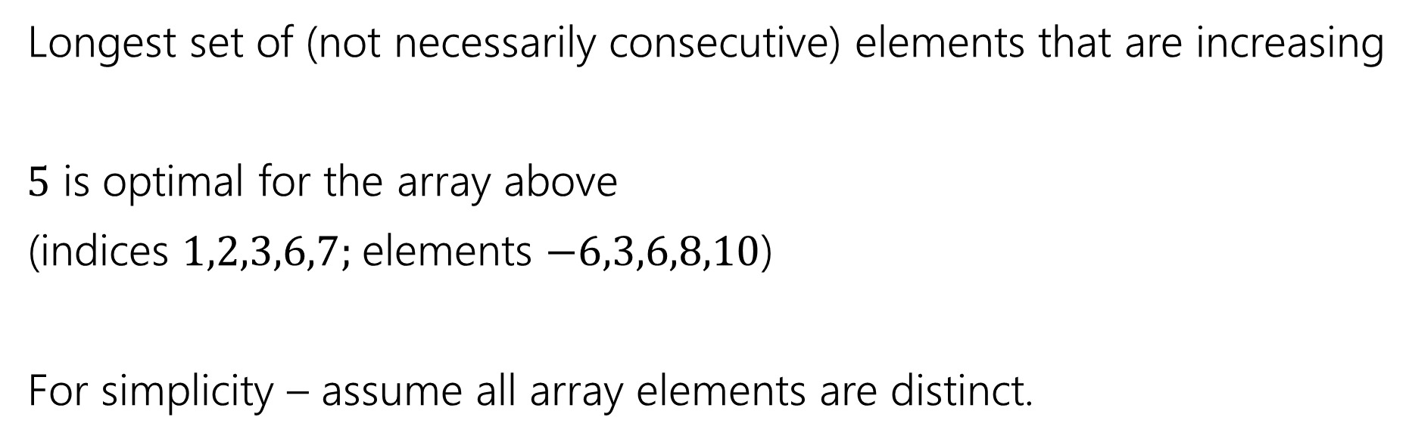
Longest Increasing Subsequence
0 | 1 | 2 | 3 | 4 | 5 | 6 | 7
5 | -6 | 3 | 6 | -5 | 2 | 8 | 10
Longest set of (not necessarily consecutive) elements that are increasing
$5$ is optimal for the array above
(indices $1,2,3,6,7;$elements $−6,3,6,8,10$)
For simplicity – assume all array elements are distinct.

Slide 4
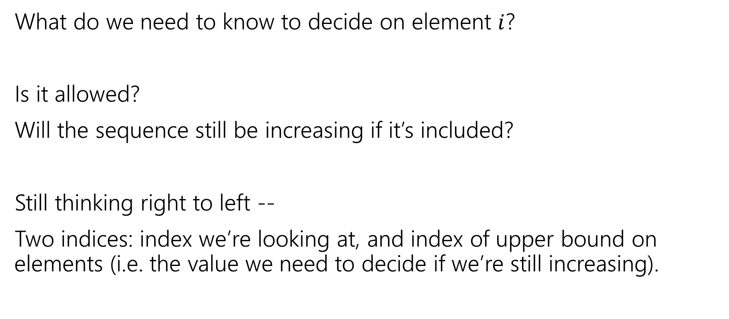
Longest Increasing Subsequence
What do we need to know to decide on element $i$?
Is it allowed?
Will the sequence still be increasing if it’s included?
Still thinking right to left --
Two indices: index we’re looking at, and index of upper bound on elements (i.e. the value we need to decide if we’re still increasing).

Slide 5

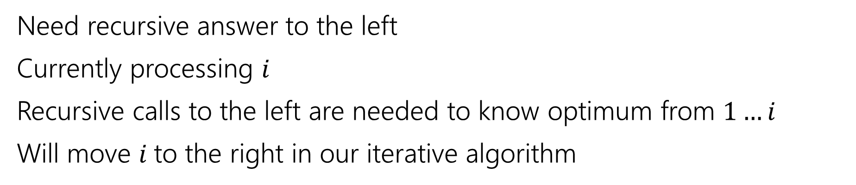
Recurrence
0 | 1 | 2 | 3 | 4 | 5 | 6 | 7
5 | -6 | 3 | 6 | -5 | 2 | 8 | 10
Recursive call is best value in this area
Current $i$
Ignored for now.
Need recursive answer to the left
Currently processing $i$
Recursive calls to the left are needed to know optimum from $1…i$
Will move $i$to the right in our iterative algorithm

Slide 6
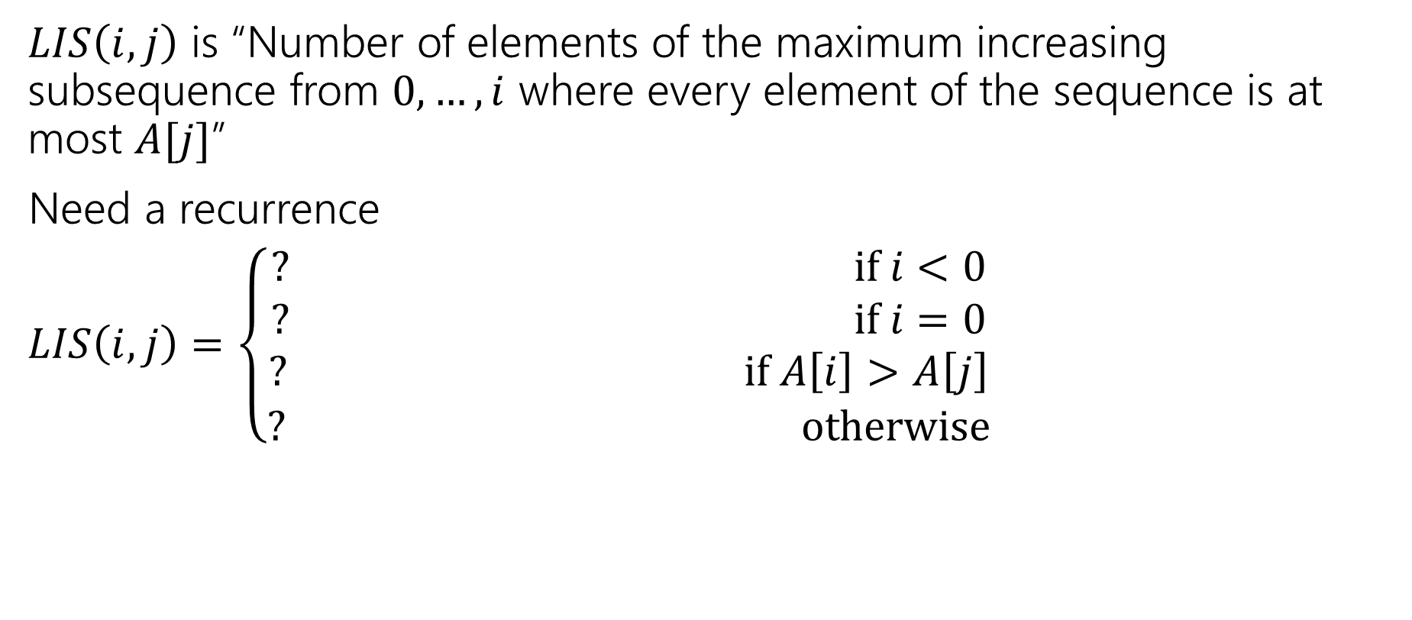
Longest Increasing Subsequence
$LIS\left(i,j\right)$ is “Number of elements of the maximum increasing subsequence from $0,…,i$ where every element of the sequence is at most $A[j]$”
Need a recurrence
$LIS\left(i,j\right)=\left\{\begin{aligned}? if i<0 \\ ? if i=0 \\ ? if A\left[i\right]>A\left[j\right] \\ ? otherwise\end{aligned}\right.$

Slide 7
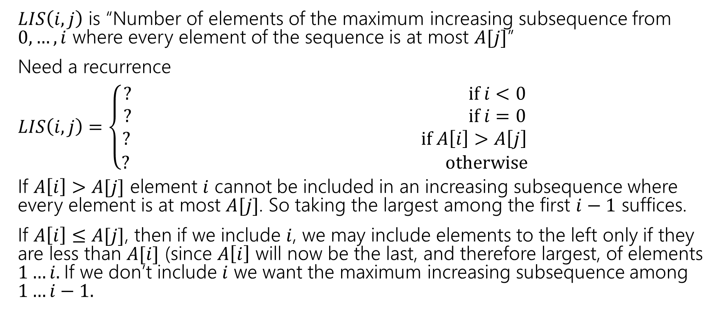
Longest Increasing Subsequence
$LIS\left(i,j\right)$ is “Number of elements of the maximum increasing subsequence from $0,…,i$ where every element of the sequence is at most $A[j]$”
Need a recurrence
$LIS\left(i,j\right)=\left\{\begin{aligned}? if i<0 \\ ? if i=0 \\ ? if A\left[i\right]>A\left[j\right] \\ ? otherwise\end{aligned}\right.$
If $A\left[i\right]>A[j]$ element $i$ cannot be included in an increasing subsequence where every element is at most $A[j]$. So taking the largest among the first $i−1$ suffices.
If $A\left[i\right]≤A[j]$, then if we include $i$, we may include elements to the left only if they are less than $A[i]$ (since $A\left[i\right]$ will now be the last, and therefore largest, of elements $1…i.$If we don’t include $i$ we want the maximum increasing subsequence among $1…i−1.$

Slide 8
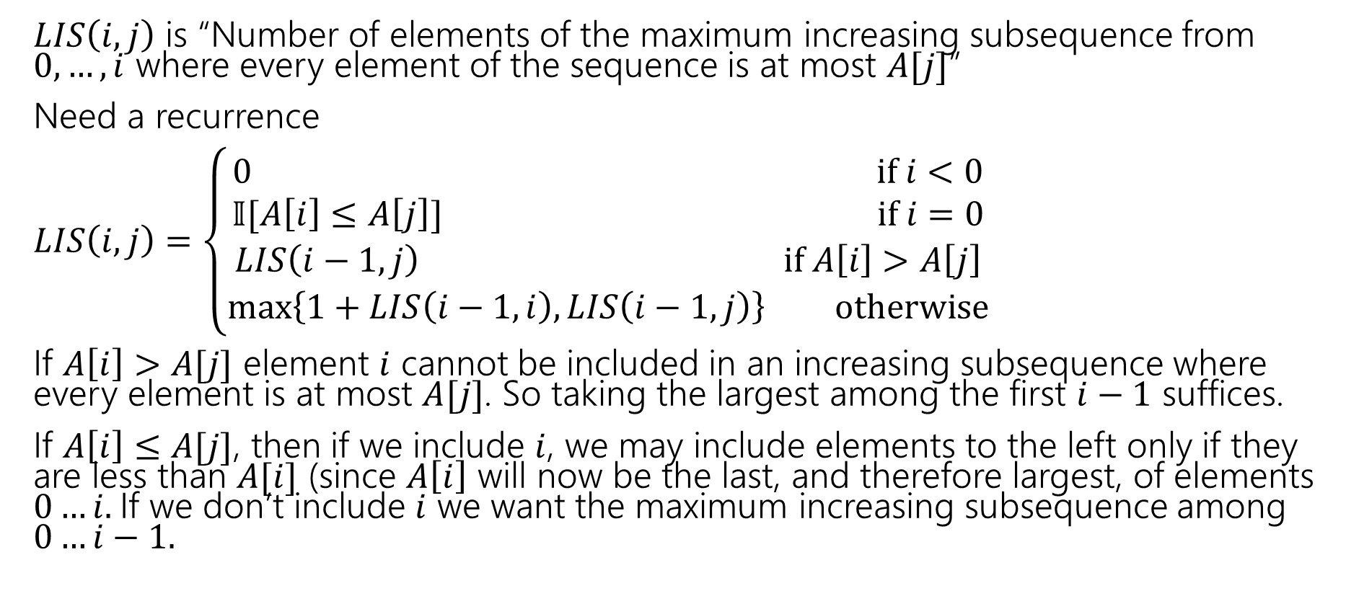
Longest Increasing Subsequence
$LIS\left(i,j\right)$ is “Number of elements of the maximum increasing subsequence from $0,…,i$ where every element of the sequence is at most $A[j]$”
Need a recurrence
$LIS\left(i,j\right)=\left\{\begin{aligned}0 if i<0 \\ 𝕀[A\left[i\right]≤A\left[j\right]] if i=0 \\ LIS\left(i−1,j\right) if A\left[i\right]>A\left[j\right] \\ \max\left\{1+LIS\left(i−1,i\right), LIS\left(i−1,j\right)\right\} otherwise\end{aligned}\right.$
If $A\left[i\right]>A[j]$ element $i$ cannot be included in an increasing subsequence where every element is at most $A[j]$. So taking the largest among the first $i−1$ suffices.
If $A\left[i\right]≤A[j]$, then if we include $i$, we may include elements to the left only if they are less than $A[i]$ (since $A\left[i\right]$ will now be the last, and therefore largest, of elements $0…i.$If we don’t include $i$ we want the maximum increasing subsequence among $0…i−1.$

Slide 9

Longest Increasing Subsequence
$LIS\left(i,j\right)=\left\{\begin{aligned}0 if i<0 \\ 𝕀[A\left[i\right]≤A\left[j\right]] if i=0 \\ LIS\left(i−1,j\right) if A\left[i\right]>A\left[j\right] \\ \max\left\{1+LIS\left(i−1,i\right), LIS\left(i−1,j\right)\right\} otherwise\end{aligned}\right.$
Memoization structure? $n×n$ array.
Filling order?

Slide 10


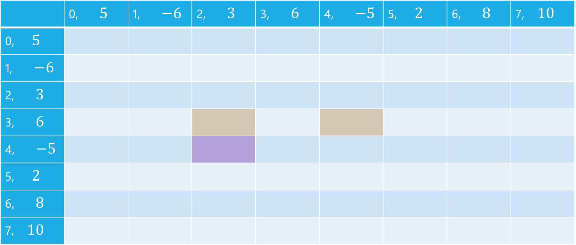


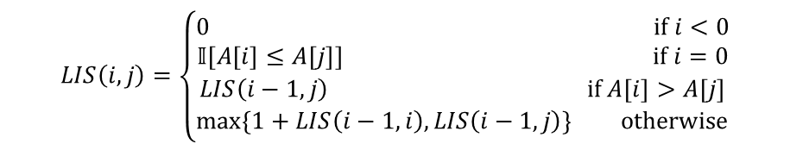
LIS
$$LIS\left(i,j\right)=\left\{\begin{aligned}0 if i<0 \\ 𝕀[A\left[i\right]≤A\left[j\right]] if i=0 \\ LIS\left(i−1,j\right) if A\left[i\right]>A\left[j\right] \\ \max\left\{1+LIS\left(i−1,i\right), LIS\left(i−1,j\right)\right\} otherwise\end{aligned}\right.$$
$$j$$
 | 0, $5$ | 1, $−6$ | 2, $3$ | 3, $6$ | 4, $−5$ | 5, $2$ | 6, $8$ | 7, $10$
0, $5$
1, $−6$
2, $3$
3, $6$
4, $−5$
5, $2$
6, $8$
7, $10$
$$i$$

Slide 11
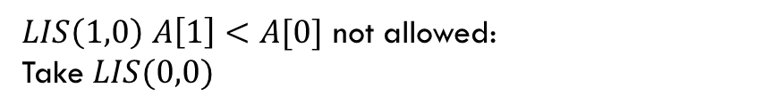
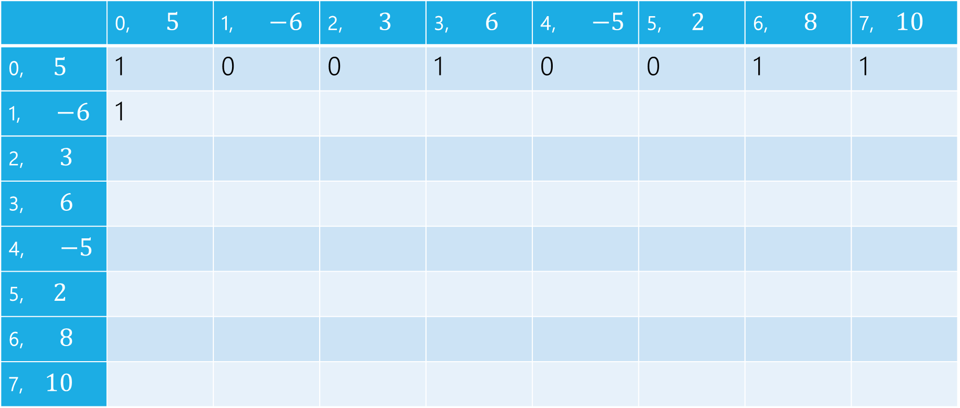
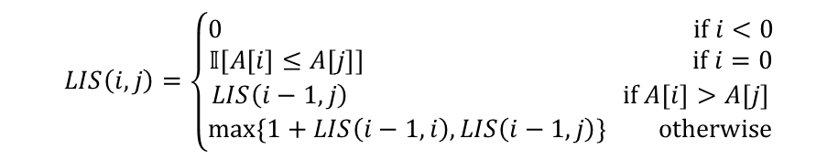
LIS
$LIS\left(1,0\right)$ $A\left[1\right]<A[0]$ not allowed:
Take $LIS(0,0)$
$$LIS\left(i,j\right)=\left\{\begin{aligned}0 if i<0 \\ 𝕀[A\left[i\right]≤A\left[j\right]] if i=0 \\ LIS\left(i−1,j\right) if A\left[i\right]>A\left[j\right] \\ \max\left\{1+LIS\left(i−1,i\right), LIS\left(i−1,j\right)\right\} otherwise\end{aligned}\right.$$
$$j$$
 | 0, $5$ | 1, $−6$ | 2, $3$ | 3, $6$ | 4, $−5$ | 5, $2$ | 6, $8$ | 7, $10$
0, $5$ | 1 | 0 | 0 | 1 | 0 | 0 | 1 | 1
1, $−6$ | 1
2, $3$
3, $6$
4, $−5$
5, $2$
6, $8$
7, $10$
$$i$$

Slide 12

LIS
$LIS\left(1,1\right)$ $A\left[1\right]≤A[1]$ can add, $1+LIS(0,1)$ or $LIS(0,1)$
$$LIS\left(i,j\right)=\left\{\begin{aligned}0 if i<0 \\ 𝕀[A\left[i\right]≤A\left[j\right]] if i=0 \\ LIS\left(i−1,j\right) if A\left[i\right]>A\left[j\right] \\ \max\left\{1+LIS\left(i−1,i\right), LIS\left(i−1,j\right)\right\} otherwise\end{aligned}\right.$$
$$j$$
 | 0, $5$ | 1, $−6$ | 2, $3$ | 3, $6$ | 4, $−5$ | 5, $2$ | 6, $8$ | 7, $10$
0, $5$ | 1 | 0 | 0 | 1 | 0 | 0 | 1 | 1
1, $−6$ | 1 | 1
2, $3$
3, $6$
4, $−5$
5, $2$
6, $8$
7, $10$
$$i$$

Slide 13

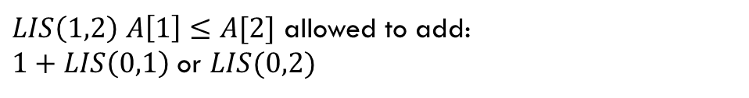
LIS
$LIS\left(1,2\right)$ $A\left[1\right]≤A[2]$ allowed to add:
$1+LIS\left(0,1\right)$ or $LIS(0,2)$
$$LIS\left(i,j\right)=\left\{\begin{aligned}0 if i<0 \\ 𝕀[A\left[i\right]≤A\left[j\right]] if i=0 \\ LIS\left(i−1,j\right) if A\left[i\right]>A\left[j\right] \\ \max\left\{1+LIS\left(i−1,i\right), LIS\left(i−1,j\right)\right\} otherwise\end{aligned}\right.$$
$$j$$
 | 0, $5$ | 1, $−6$ | 2, $3$ | 3, $6$ | 4, $−5$ | 5, $2$ | 6, $8$ | 7, $10$
0, $5$ | 1 | 0 | 0 | 1 | 0 | 0 | 1 | 1
1, $−6$ | 1 | 1 | 1
2, $3$
3, $6$
4, $−5$
5, $2$
6, $8$
7, $10$
$$i$$

Slide 14
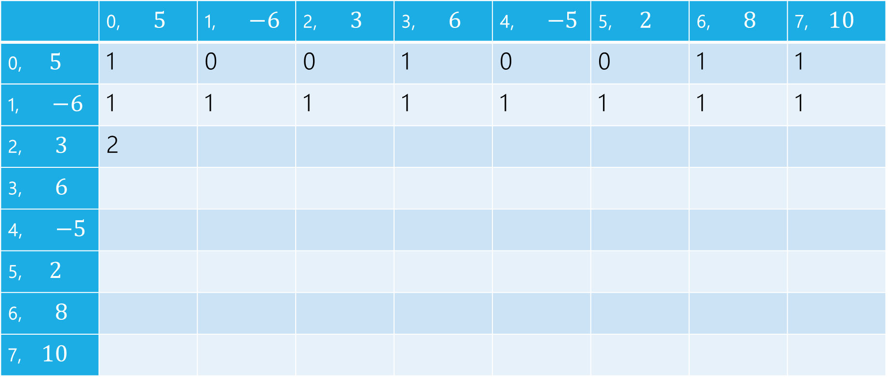
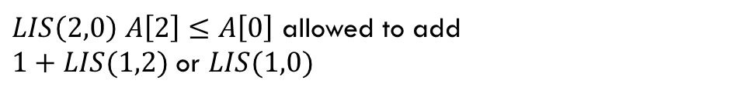
LIS
$LIS\left(2,0\right)$ $A\left[2\right]≤A\left[0\right]$ allowed to add
$1+LIS(1,2)$ or $LIS(1,0)$
$$LIS\left(i,j\right)=\left\{\begin{aligned}0 if i<0 \\ 𝕀[A\left[i\right]≤A\left[j\right]] if i=0 \\ LIS\left(i−1,j\right) if A\left[i\right]>A\left[j\right] \\ \max\left\{1+LIS\left(i−1,i\right), LIS\left(i−1,j\right)\right\} otherwise\end{aligned}\right.$$
$$j$$
 | 0, $5$ | 1, $−6$ | 2, $3$ | 3, $6$ | 4, $−5$ | 5, $2$ | 6, $8$ | 7, $10$
0, $5$ | 1 | 0 | 0 | 1 | 0 | 0 | 1 | 1
1, $−6$ | 1 | 1 | 1 | 1 | 1 | 1 | 1 | 1
2, $3$ | 2
3, $6$
4, $−5$
5, $2$
6, $8$
7, $10$
$$i$$

Slide 15
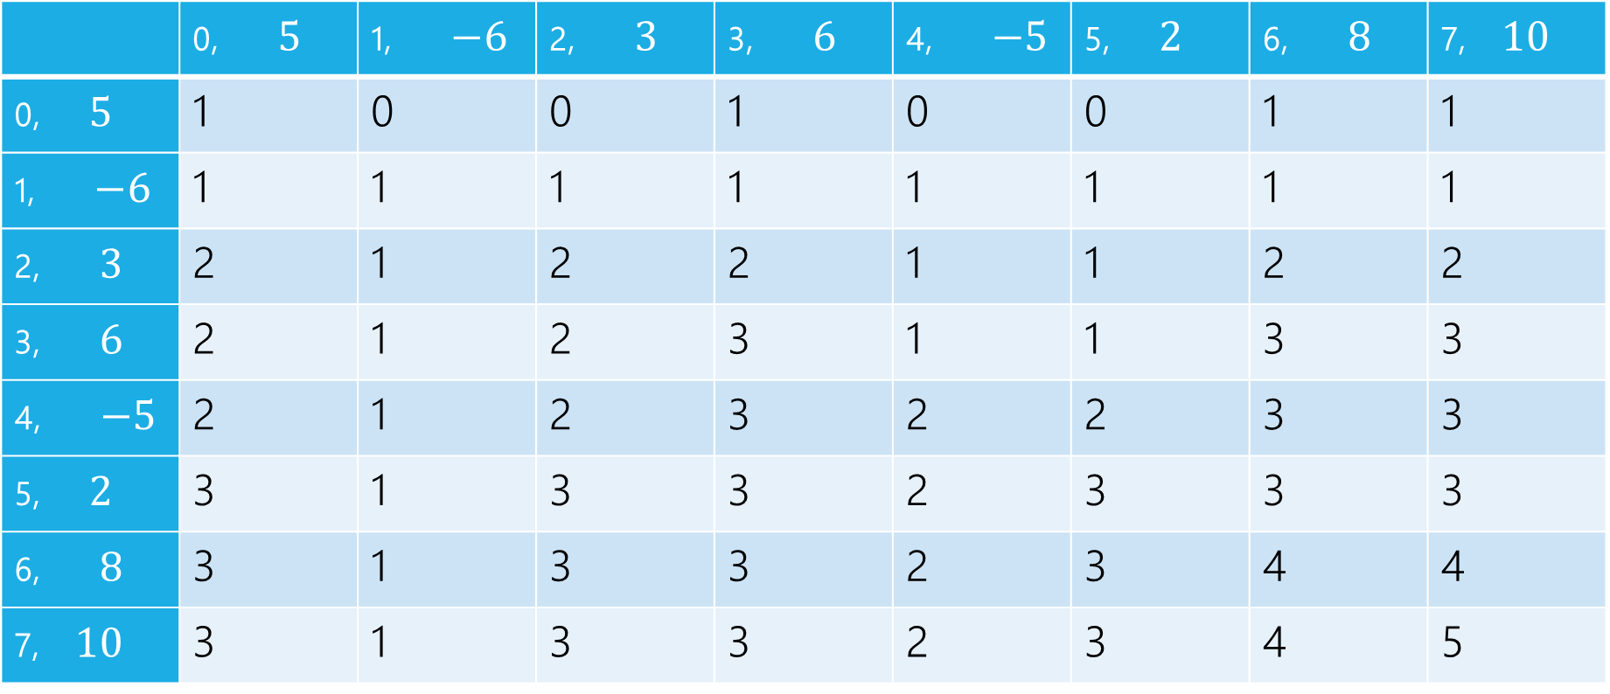
LIS
$$LIS\left(i,j\right)=\left\{\begin{aligned}0 if i<0 \\ 𝕀[A\left[i\right]≤A\left[j\right]] if i=0 \\ LIS\left(i−1,j\right) if A\left[i\right]>A\left[j\right] \\ \max\left\{1+LIS\left(i−1,i\right), LIS\left(i−1,j\right)\right\} otherwise\end{aligned}\right.$$
$$j$$
 | 0, $5$ | 1, $−6$ | 2, $3$ | 3, $6$ | 4, $−5$ | 5, $2$ | 6, $8$ | 7, $10$
0, $5$ | 1 | 0 | 0 | 1 | 0 | 0 | 1 | 1
1, $−6$ | 1 | 1 | 1 | 1 | 1 | 1 | 1 | 1
2, $3$ | 2 | 1 | 2 | 2 | 1 | 1 | 2 | 2
3, $6$ | 2 | 1 | 2 | 3 | 1 | 1 | 3 | 3
4, $−5$ | 2 | 1 | 2 | 3 | 2 | 2 | 3 | 3
5, $2$ | 3 | 1 | 3 | 3 | 2 | 3 | 3 | 3
6, $8$ | 3 | 1 | 3 | 3 | 2 | 3 | 4 | 4
7, $10$ | 3 | 1 | 3 | 3 | 2 | 3 | 4 | 5
$$i$$

Slide 16
pseudocode
//real code snippet that actually generated the table on the last slide
for(int j=0; j < n; j++){
vals[0][j] = (A[0] <= A[j]) ? 1 : 0;
}
for(int i = 1; i < 8; i++){
for(int j = 0; j < n; j++){
if(A[i] > A[j])
vals[i][j] = vals[i-1][j];
else{
vals[i][j] = Math.max(1+vals[i-1][i], vals[i-1][j]);
}
}
}

Slide 17
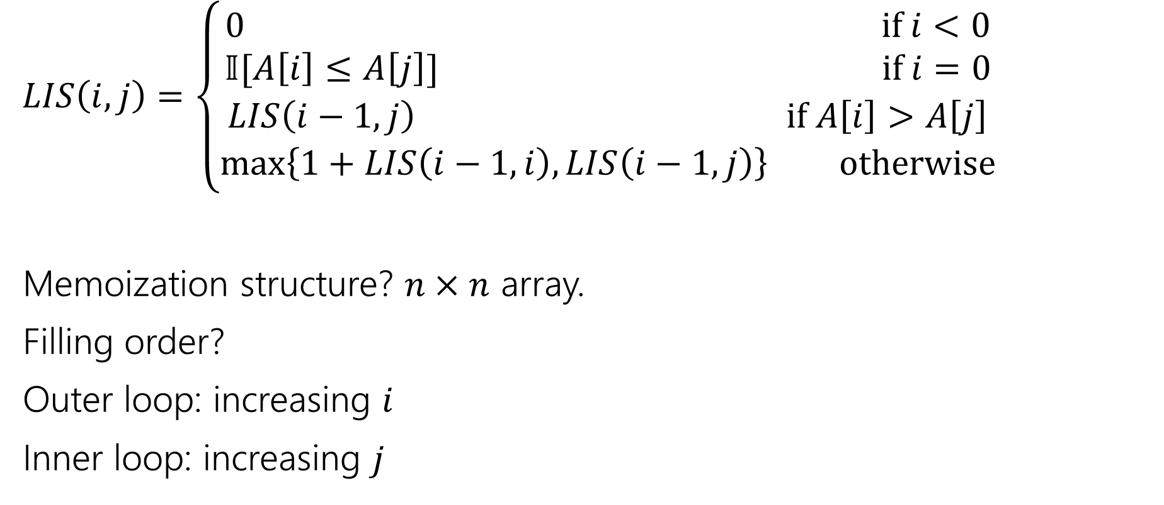
Longest Increasing Subsequence
$LIS\left(i,j\right)=\left\{\begin{aligned}0 if i<0 \\ 𝕀[A\left[i\right]≤A\left[j\right]] if i=0 \\ LIS\left(i−1,j\right) if A\left[i\right]>A\left[j\right] \\ \max\left\{1+LIS\left(i−1,i\right), LIS\left(i−1,j\right)\right\} otherwise\end{aligned}\right.$
Memoization structure? $n×n$ array.
Filling order?
Outer loop: increasing $i$
Inner loop: increasing $j$

Slide 18
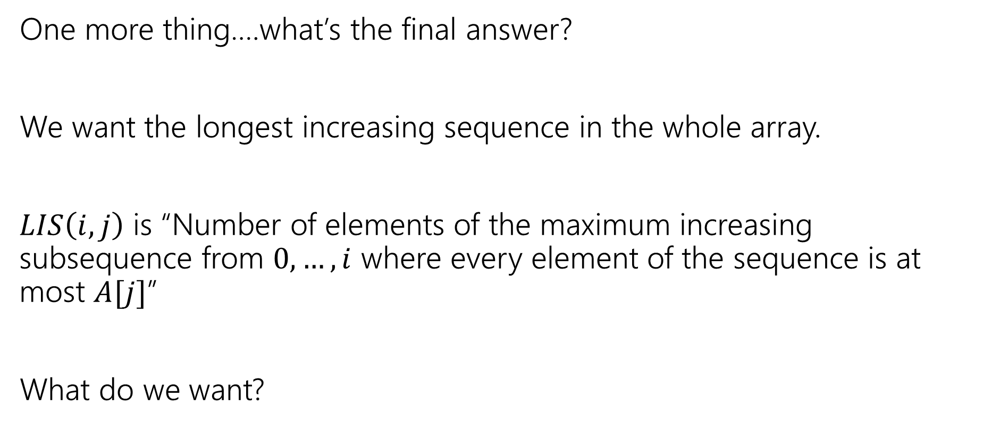
LIS
One more thing….what’s the final answer?
We want the longest increasing sequence in the whole array.
$LIS\left(i,j\right)$ is “Number of elements of the maximum increasing subsequence from $0,…,i$ where every element of the sequence is at most $A[j]$”
What do we want?

Slide 19
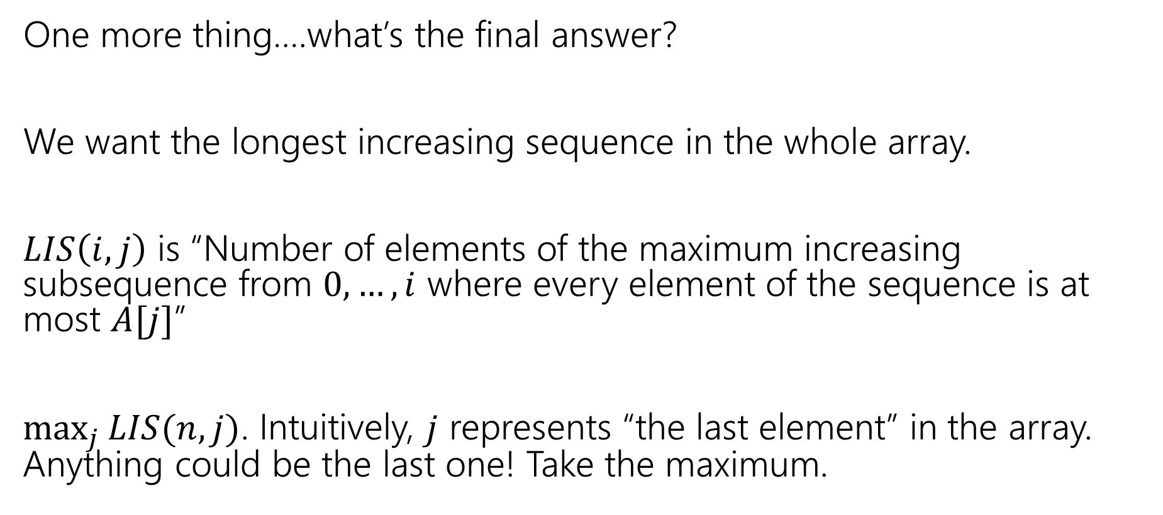
LIS
One more thing….what’s the final answer?
We want the longest increasing sequence in the whole array.
$LIS\left(i,j\right)$ is “Number of elements of the maximum increasing subsequence from $0,…,i$ where every element of the sequence is at most $A[j]$”
$\max_{j}{LIS(n,j)}$. Intuitively, $j$ represents “the last element” in the array. Anything could be the last one! Take the maximum.

Slide 20
DP on Trees

Slide 21
DP on Trees
Trees are recursive structures
A tree is a root node, with zero or more children
Each of which are roots of trees
Since DP is “smart recursion” (recursion where we save values)
Recursive functions/calculations are really common.

Slide 22
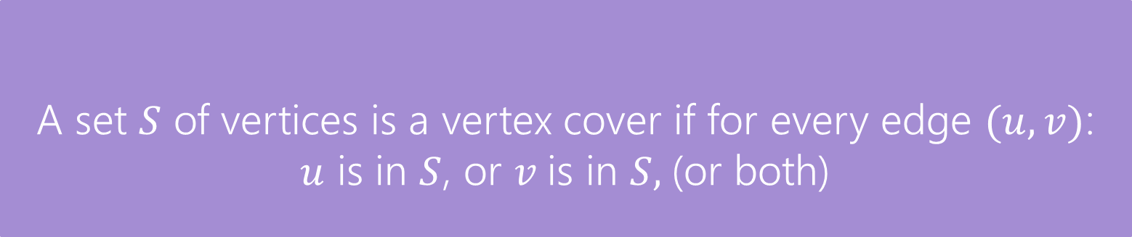
DP on Trees
Find the minimum vertex cover in a tree.
Give every vertex a weight, find the minimum weight vertex cover
Vertex Cover
A set $S$ of vertices is a vertex cover if for every edge $(u,v)$:
$u$ is in $S$, or $v$is in $S,$(or both)
The weight of a vertex cover is just the sum of the weights of the vertices in the set.
We want to find the minimum weight vertex cover.

Slide 23
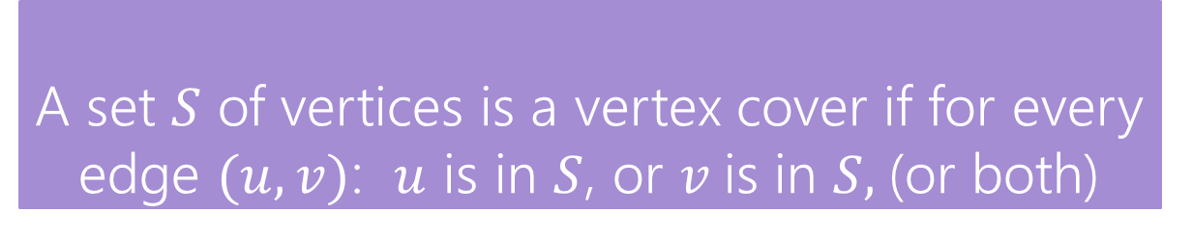
Vertex Cover
Vertex Cover
A set $S$ of vertices is a vertex cover if for every edge $(u,v)$: $u$ is in $S$, or $v$is in $S,$(or both)
Find the minimum vertex cover in a tree.
Give every vertex a weight, find the minimum weight vertex cover
1
10
8
5
3
20

Slide 24
Vertex Cover
Vertex Cover
A set $S$ of vertices is a vertex cover if for every edge $(u,v)$: $u$ is in $S$, or $v$is in $S,$(or both)
Find the minimum vertex cover in a tree.
Give every vertex a weight, find the minimum weight vertex cover
1
10
8
A valid vertex cover! (just take everything)
Definitely not the minimum though.
5
3
20

Slide 25
Vertex Cover
Vertex Cover
A set $S$ of vertices is a vertex cover if for every edge $(u,v)$: $u$ is in $S$, or $v$is in $S,$(or both)
Find the minimum vertex cover in a tree.
Give every vertex a weight, find the minimum weight vertex cover
1
10
8
A better vertex cover – weight 18
5
3
20

Slide 26
Vertex Cover
Vertex Cover
A set $S$ of vertices is a vertex cover if for every edge $(u,v)$: $u$ is in $S$, or $v$is in $S,$(or both)
Find the minimum vertex cover in a tree.
Give every vertex a weight, find the minimum weight vertex cover
1
10
8
The minimum vertex cover: weight 17
5
3
20

Slide 27
Vertex Cover
Vertex Cover
A set $S$ of vertices is a vertex cover if for every edge $(u,v)$: $u$ is in $S$, or $v$is in $S,$(or both)
Notice, the minimum weight vertex cover might have both endpoints of some edges
Even though only one of 1, 8 is required on the edge between them, they are both required for other edges.
1
10
8
5
3
20

Slide 28
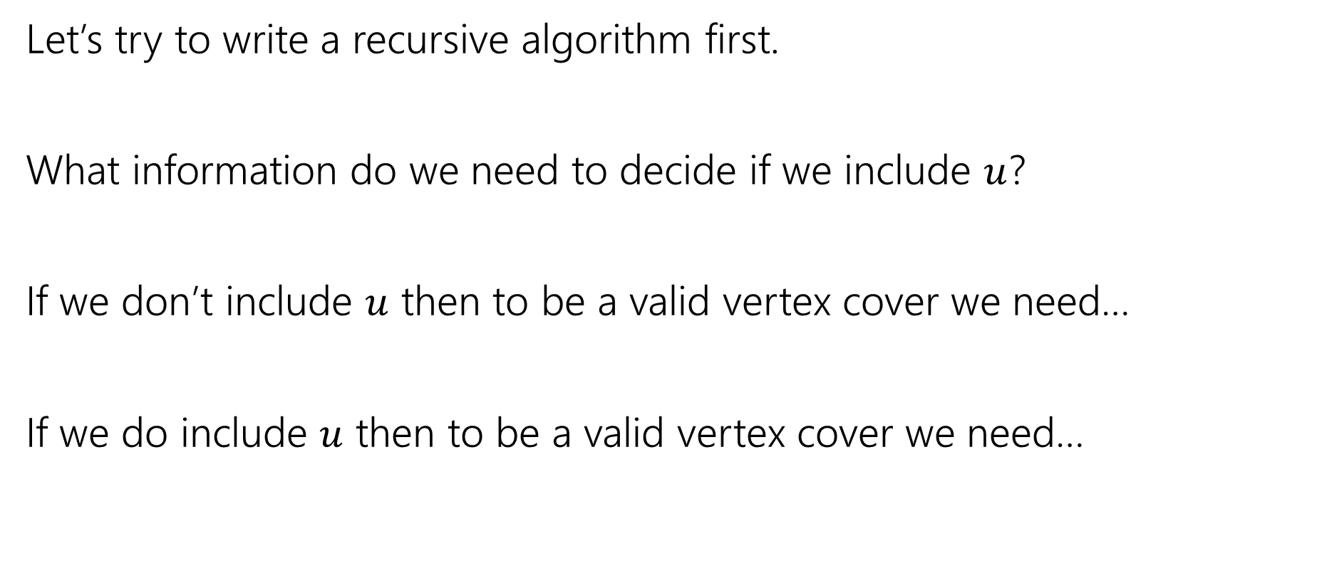
Vertex Cover – Recursively
Let’s try to write a recursive algorithm first.
What information do we need to decide if we include $u$?
If we don’t include $u$ then to be a valid vertex cover we need…
If we do include $u$ then to be a valid vertex cover we need…

Slide 29
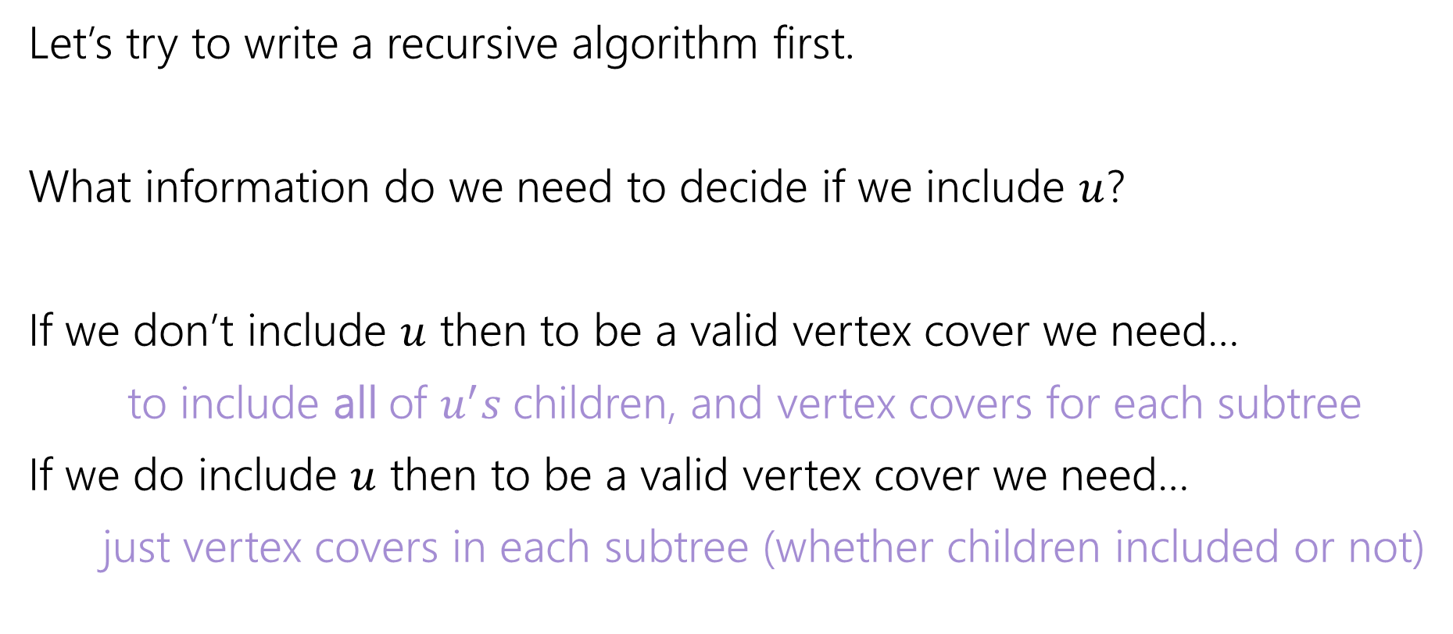
Vertex Cover – Recursively
Let’s try to write a recursive algorithm first.
What information do we need to decide if we include $u$?
If we don’t include $u$ then to be a valid vertex cover we need…
to include all of $u^{′}s$children, and vertex covers for each subtree
If we do include $u$ then to be a valid vertex cover we need…
just vertex covers in each subtree (whether children included or not)

Slide 30

Recurrence
Let $OPT(v)$ be the weight of a minimum weight vertex cover for the subtree rooted at $v$.
Write a recurrence for $OPT()$
Then figure out how to calculate it

Slide 31
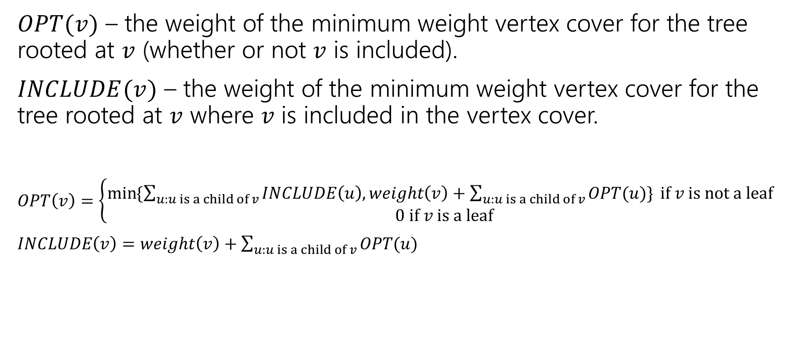
Recurrence
$OPT(v)$ – the weight of the minimum weight vertex cover for the tree rooted at $v$ (whether or not $v$ is included).
$INCLUDE(v)$ – the weight of the minimum weight vertex cover for the tree rooted at $v$ where $v$ is included in the vertex cover.
$OPT\left(v\right)=\left\{\begin{aligned}\min{⁡\{\sum_{u:u is a child of v}{INCLUDE\left(u\right), weight\left(v\right)+\sum_{u:u is a child of v}{OPT(u)\}} if v is not a leaf} } \\ 0 if v is a leaf\end{aligned}\right.$
$INCLUDE\left(v\right)=weight\left(v\right)+\sum_{u:u is a child of v}{OPT(u)}$

Slide 32
Vertex Cover Dynamic Program
What memoization structure should we use?
What code should we write?
What’s the running time?

Slide 33
Vertex Cover Dynamic Program
What memoization structure should we use?
the tree itself!
What code should we write?
What’s the running time?

Slide 34
Vertex Cover
What order do we do the calculation?
1
10
8
5
3
20

Slide 35
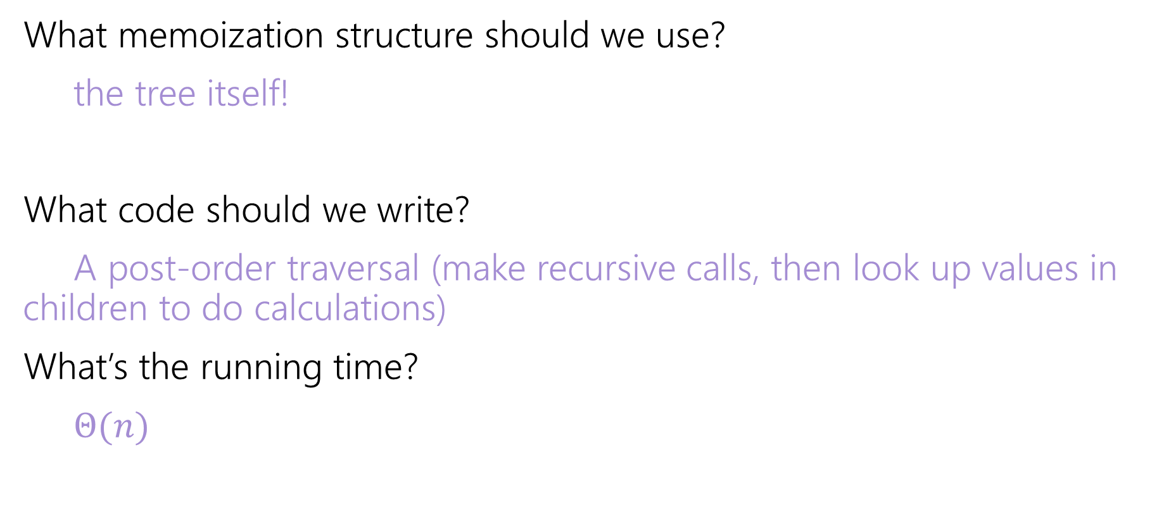
Vertex Cover Dynamic Program
What memoization structure should we use?
the tree itself!
What code should we write?
A post-order traversal (make recursive calls, then look up values in children to do calculations)
What’s the running time?
$Θ(n)$

Slide 36
DP Context

Slide 37
DP Design Notes
We haven’t done a single proof for DP…
We won’t ask you to do one.
DP proofs are almost always just “the code does the recurrence”
But that just moves the correctness question – why is the recurrence correct?
And the proof of the recurrence being correct is almost always “I included all the cases”
I’d rather you focus on checking it than trying to explain it.

Slide 38
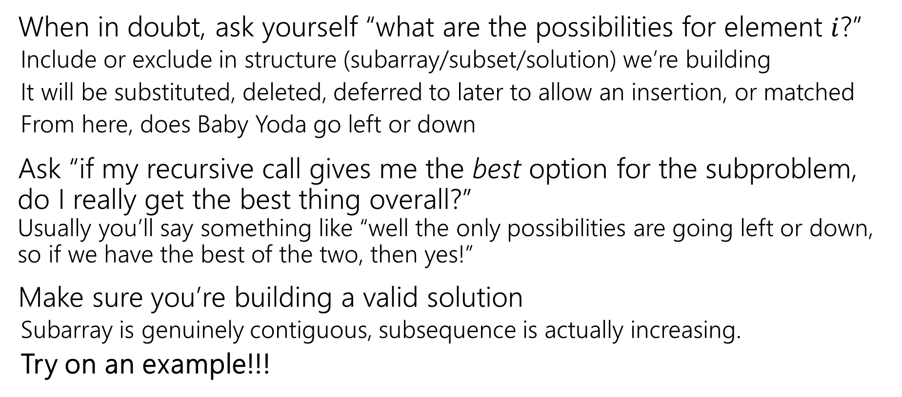
DP Design Notes
When in doubt, ask yourself “what are the possibilities for element $i$?”
Include or exclude in structure (subarray/subset/solution) we’re building
It will be substituted, deleted, deferred to later to allow an insertion, or matched
From here, does Baby Yoda go left or down
Ask “if my recursive call gives me the best option for the subproblem, do I really get the best thing overall?” Usually you’ll say something like “well the only possibilities are going left or down, so if we have the best of the two, then yes!”
Make sure you’re building a valid solution
Subarray is genuinely contiguous, subsequence is actually increasing.
Try on an example!!!

Slide 39
DP history
So…why is it called “dynamic programming?”
“programming” is an old-timey meaning of the word.
It means “scheduling”
Like a conference has a “program” of who speaks where when. Or a television executive decides on the nightly programming (what show airs when).

Slide 40
DP history
So…dynamic?
The phrase “dynamic programming” was popularized by Richard Bellman (we’ll see one of his algorithms on Wednesday)
He was a researcher, funded by the U.S. military….
But the Secretary of Defense [as Bellman tells it] hated research. And hated math even more.
So Bellman needed a description of his research that everyone would approve of.

Slide 41
DP history
Dynamic
Is actually an accurate adjective – what we think is the best option (include/exclude) can change over time.
Even better
“It’s impossible to use the word ‘dynamic’ in a pejorative sense”
“It was something not even a Congressman could object to.”

