Slide 1
Even More DP Multiple recurrences, hidden parameters
CSE 417 Fall 22
Lecture 14

Slide 2
Announcements
There were typos in the lecture 9 slides for mergeAndCount.
Corrected versions on the webpage now.
HW2 initial submissions are back on gradescope.
We’ll get through the resubmissions as soon as we can, but it’ll take a few more days.

Slide 3
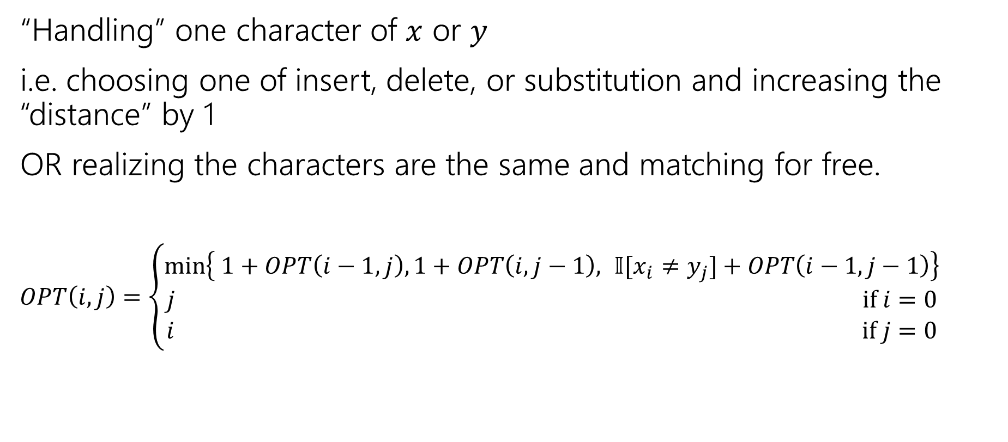
The recurrence
“Handling” one character of $x$ or $y$
i.e. choosing one of insert, delete, or substitution and increasing the “distance” by 1
OR realizing the characters are the same and matching for free.
$OPT\left(i,j\right)=\left\{\begin{aligned}\min\left\{ 1+OPT\left(i−1,j\right), 1+OPT\left(i,j−1\right), 𝕀[x_{i}≠y_{j}]+OPT\left(i−1,j−1\right)\right\} \\ j if i=0 \\ i if j=0\end{aligned}\right.$
Delete
Insert
Sub and matching
“Indicator” – math for “cast bool to int”

Slide 4
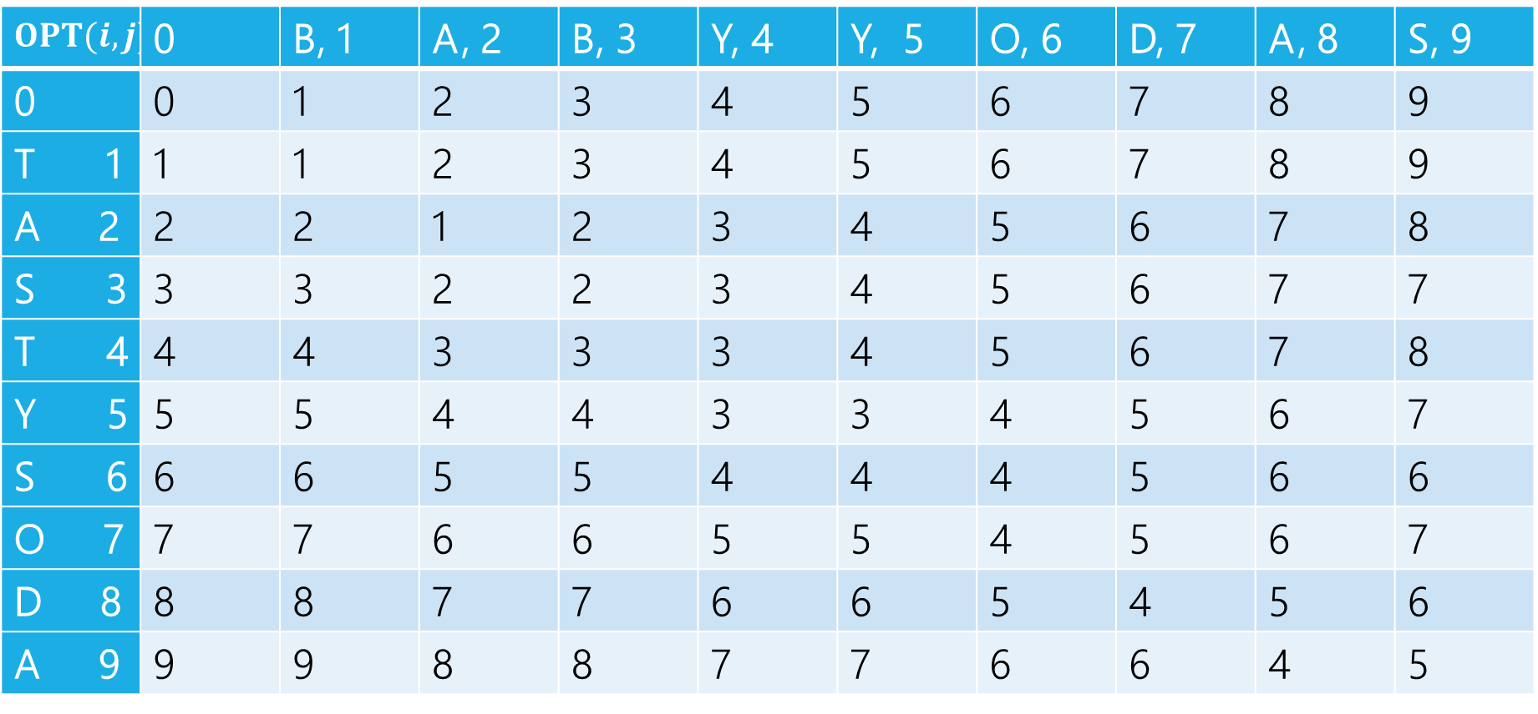
Edit Distance
$$OPT(i,j)$$ | 0 | B, 1 | A, 2 | B, 3 | Y, 4 | Y, 5 | O, 6 | D, 7 | A, 8 | S, 9
0 | 0 | 1 | 2 | 3 | 4 | 5 | 6 | 7 | 8 | 9
T 1 | 1 | 1 | 2 | 3 | 4 | 5 | 6 | 7 | 8 | 9
A 2 | 2 | 2 | 1 | 2 | 3 | 4 | 5 | 6 | 7 | 8
S 3 | 3 | 3 | 2 | 2 | 3 | 4 | 5 | 6 | 7 | 7
T 4 | 4 | 4 | 3 | 3 | 3 | 4 | 5 | 6 | 7 | 8
Y 5 | 5 | 5 | 4 | 4 | 3 | 3 | 4 | 5 | 6 | 7
S 6 | 6 | 6 | 5 | 5 | 4 | 4 | 4 | 5 | 6 | 6
O 7 | 7 | 7 | 6 | 6 | 5 | 5 | 4 | 5 | 6 | 7
D 8 | 8 | 8 | 7 | 7 | 6 | 6 | 5 | 4 | 5 | 6
A 9 | 9 | 9 | 8 | 8 | 7 | 7 | 6 | 6 | 4 | 5

Slide 5
Edit Distance
$$OPT(i,j)$$ | 0 | B, 1 | A, 2 | B, 3 | Y, 4 | Y, 5 | O, 6 | D, 7 | A, 8 | S, 9
0 | 0 | 1 | 2 | 3 | 4 | 5 | 6 | 7 | 8 | 9
T 1 | 1 | 1 | 2 | 3 | 4 | 5 | 6 | 7 | 8 | 9
A 2 | 2 | 2 | 1 | 2 | 3 | 4 | 5 | 6 | 7 | 8
S 3 | 3 | 3 | 2 | 2 | 3 | 4 | 5 | 6 | 7 | 7
T 4 | 4 | 4 | 3 | 3 | 3 | 4 | 5 | 6 | 7 | 8
Y 5 | 5 | 5 | 4 | 4 | 3 | 3 | 4 | 5 | 6 | 7
S 6 | 6 | 6 | 5 | 5 | 4 | 4 | 4 | 5 | 6 | 6
O 7 | 7 | 7 | 6 | 6 | 5 | 5 | 4 | 5 | 6 | 7
D 8 | 8 | 8 | 7 | 7 | 6 | 6 | 5 | 4 | 5 | 6
A 9 | 9 | 9 | 8 | 8 | 7 | 7 | 6 | 6 | 4 | 5

Slide 6
Edit Distance
$$OPT(i,j)$$ | 0 | B, 1 | A, 2 | B, 3 | Y, 4 | Y, 5 | O, 6 | D, 7 | A, 8 | S, 9
0 | 0 | 1 | 2 | 3 | 4 | 5 | 6 | 7 | 8 | 9
T 1 | 1 | 1 | 2 | 3 | 4 | 5 | 6 | 7 | 8 | 9
A 2 | 2 | 2 | 1 | 2 | 3 | 4 | 5 | 6 | 7 | 8
S 3 | 3 | 3 | 2 | 2 | 3 | 4 | 5 | 6 | 7 | 7
T 4 | 4 | 4 | 3 | 3 | 3 | 4 | 5 | 6 | 7 | 8
Y 5 | 5 | 5 | 4 | 4 | 3 | 3 | 4 | 5 | 6 | 7
S 6 | 6 | 6 | 5 | 5 | 4 | 4 | 4 | 5 | 6 | 6
O 7 | 7 | 7 | 6 | 6 | 5 | 5 | 4 | 5 | 6 | 7
D 8 | 8 | 8 | 7 | 7 | 6 | 6 | 5 | 4 | 5 | 6
A 9 | 9 | 9 | 8 | 8 | 7 | 7 | 6 | 6 | 4 | 5

Slide 7

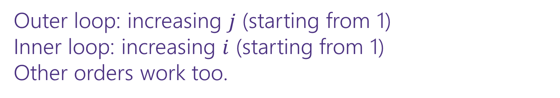
Dynamic Programming Process
1. Define the object you’re looking for
2. Write a recurrence to say how to find it
3. Design a memoization structure
4. Write an iterative algorithm
Edit Distance between $x$ and $y$; $OPT(i,j)$ is the minimum number of insertions, deletions, substitutions needed to convert $x$ to $y$
✅
$m×n$ Array
Outer loop: increasing $j$ (starting from 1)
Inner loop: increasing $i$ (starting from 1)
Other orders work too.

Slide 8
More Problems

Slide 9

Maximum Contiguous Subarray Sum
We saw an $O(n\log{n)}$divide and conquer algorithm.
Can we do better with DP?
Given: Array $A$[]
Output: $i,j$ such that $A\left[i\right]+A\left[i+1\right]+…+A[j]$ is maximized.

Slide 10
Dynamic Programming Process
1. Define the object you’re looking for
2. Write a recurrence to say how to find it
3. Design a memoization structure
4. Write an iterative algorithm

Slide 11
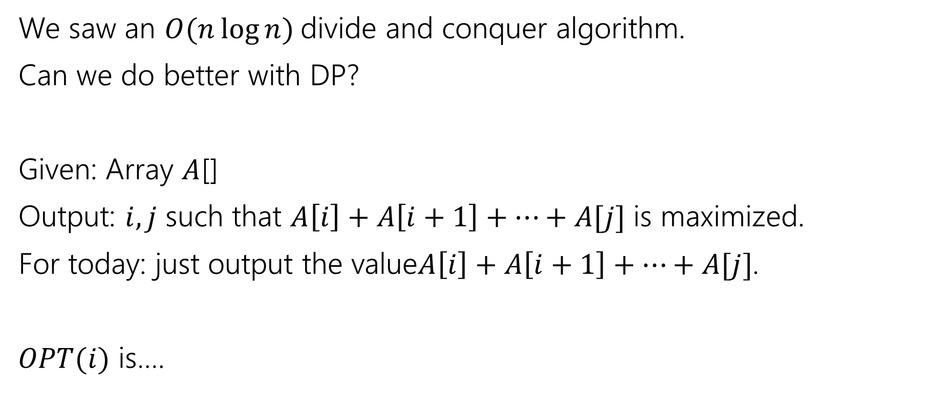
Maximum Contiguous Subarray Sum
We saw an $O(n\log{n)}$divide and conquer algorithm.
Can we do better with DP?
Given: Array $A$[]
Output: $i,j$ such that $A\left[i\right]+A\left[i+1\right]+…+A[j]$ is maximized.
For today: just output the value$A\left[i\right]+A\left[i+1\right]+…+A[j]$.
$OPT(i)$ is….

Slide 12
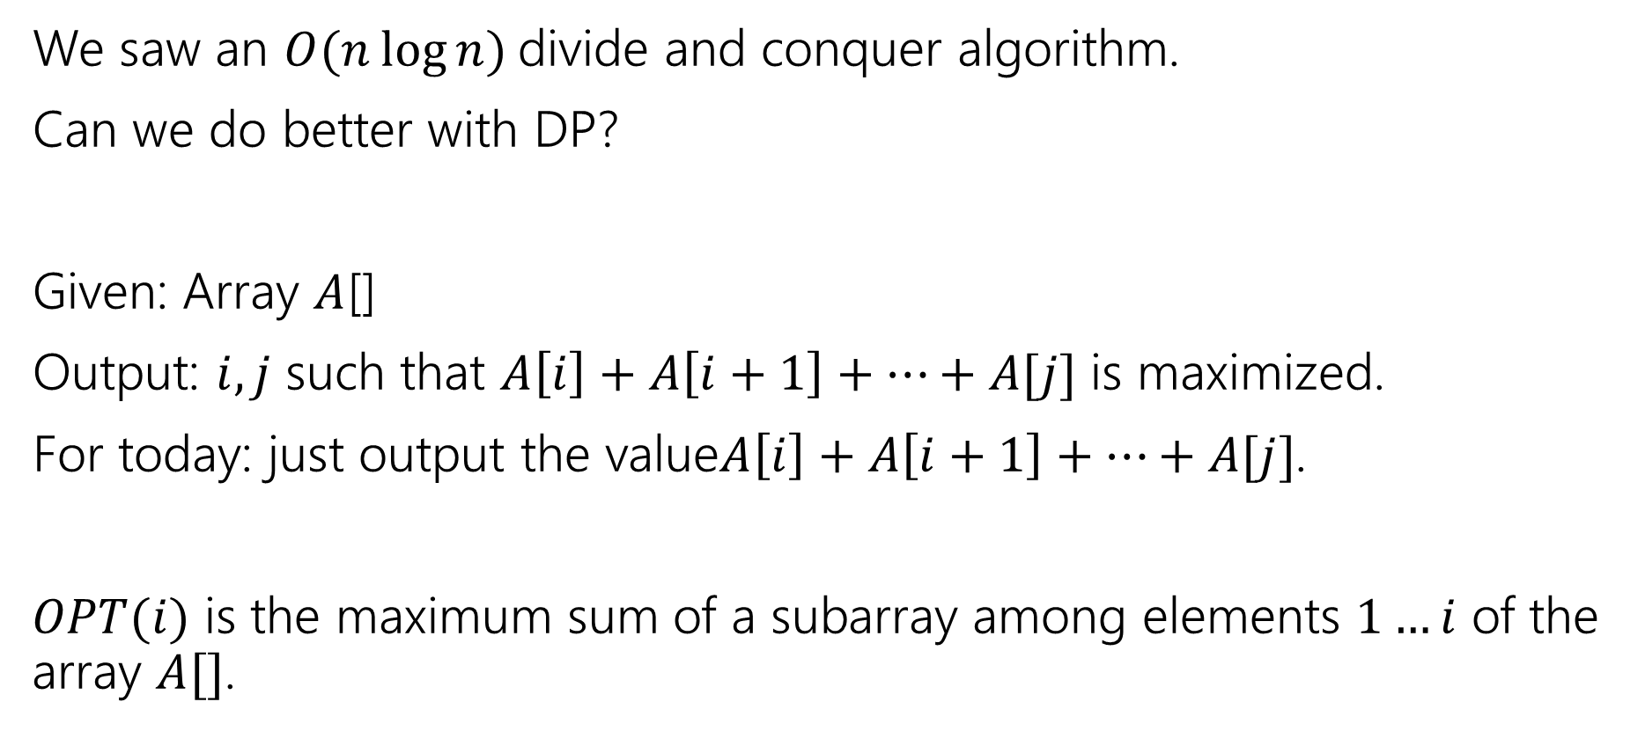
Maximum Contiguous Subarray Sum
We saw an $O(n\log{n)}$divide and conquer algorithm.
Can we do better with DP?
Given: Array $A$[]
Output: $i,j$ such that $A\left[i\right]+A\left[i+1\right]+…+A[j]$ is maximized.
For today: just output the value$A\left[i\right]+A\left[i+1\right]+…+A[j]$.
$OPT(i)$ is the maximum sum of a subarray among elements $1…i$ of the array $A[]$.

Slide 13
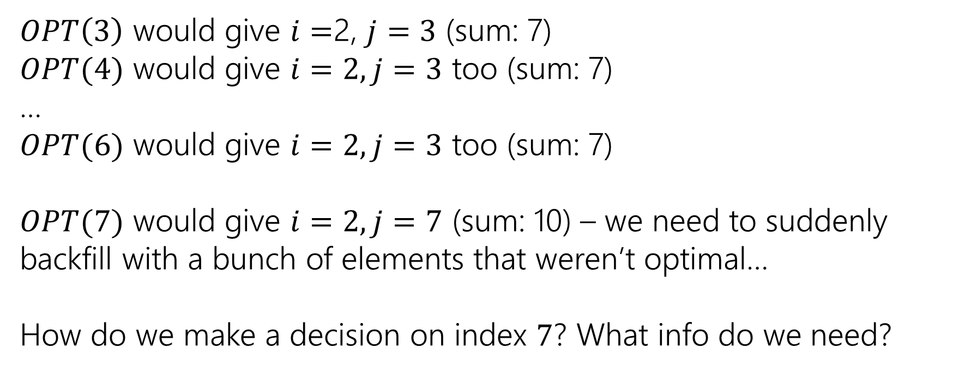
Trying to Recurse
0 | 1 | 2 | 3 | 4 | 5 | 6 | 7
5 | -6 | 3 | 4 | -5 | 2 | 2 | 4
$OPT\left(3\right)$ would give $i=$2, $j=3$ (sum: 7)
$OPT(4)$ would give $i=2, j=3$ too (sum: 7)
…
$OPT(6)$ would give $i=2,j=3$ too (sum: 7)
$OPT(7)$ would give $i=2, j=7$ (sum: 10) – we need to suddenly backfill with a bunch of elements that weren’t optimal…
How do we make a decision on index $7$? What info do we need?

Slide 14
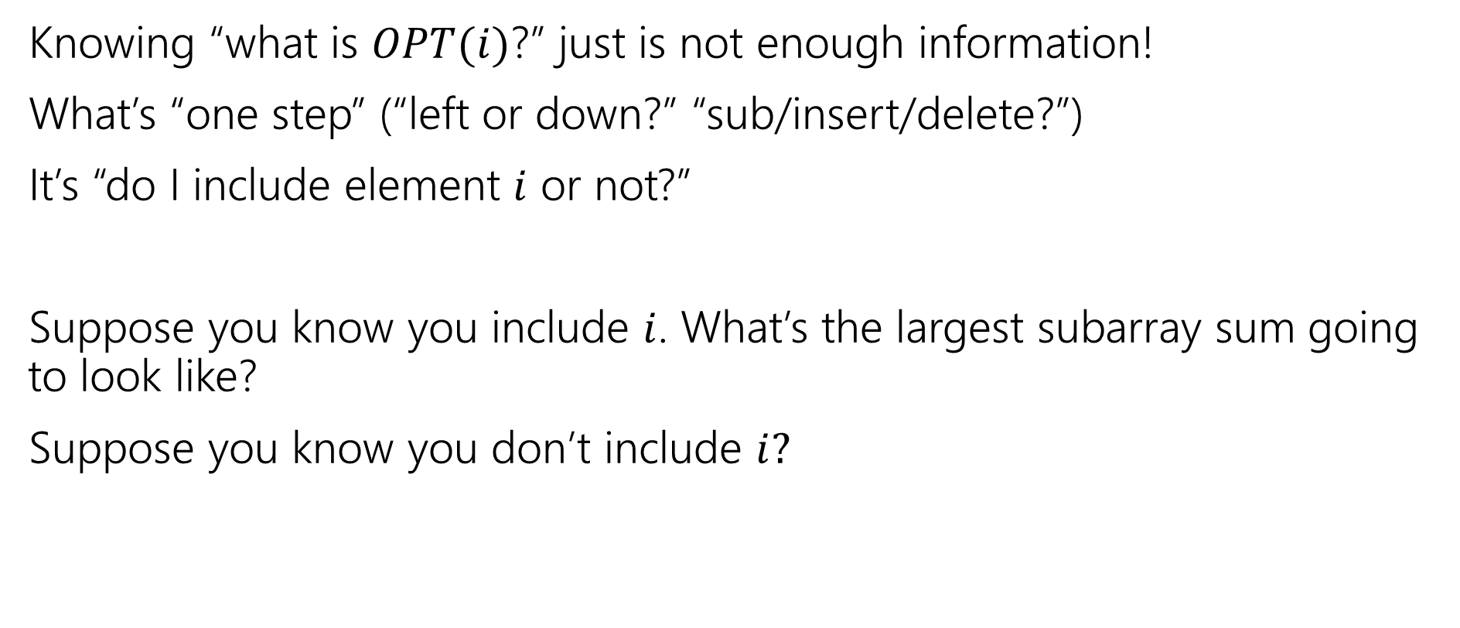
Trying to Recurse
Knowing “what is $OPT(i)$?” just is not enough information!
What’s “one step” (“left or down?” “sub/insert/delete?”)
It’s “do I include element $i$ or not?”
Suppose you know you include $i$. What’s the largest subarray sum going to look like?
Suppose you know you don’t include $i?$

Slide 15
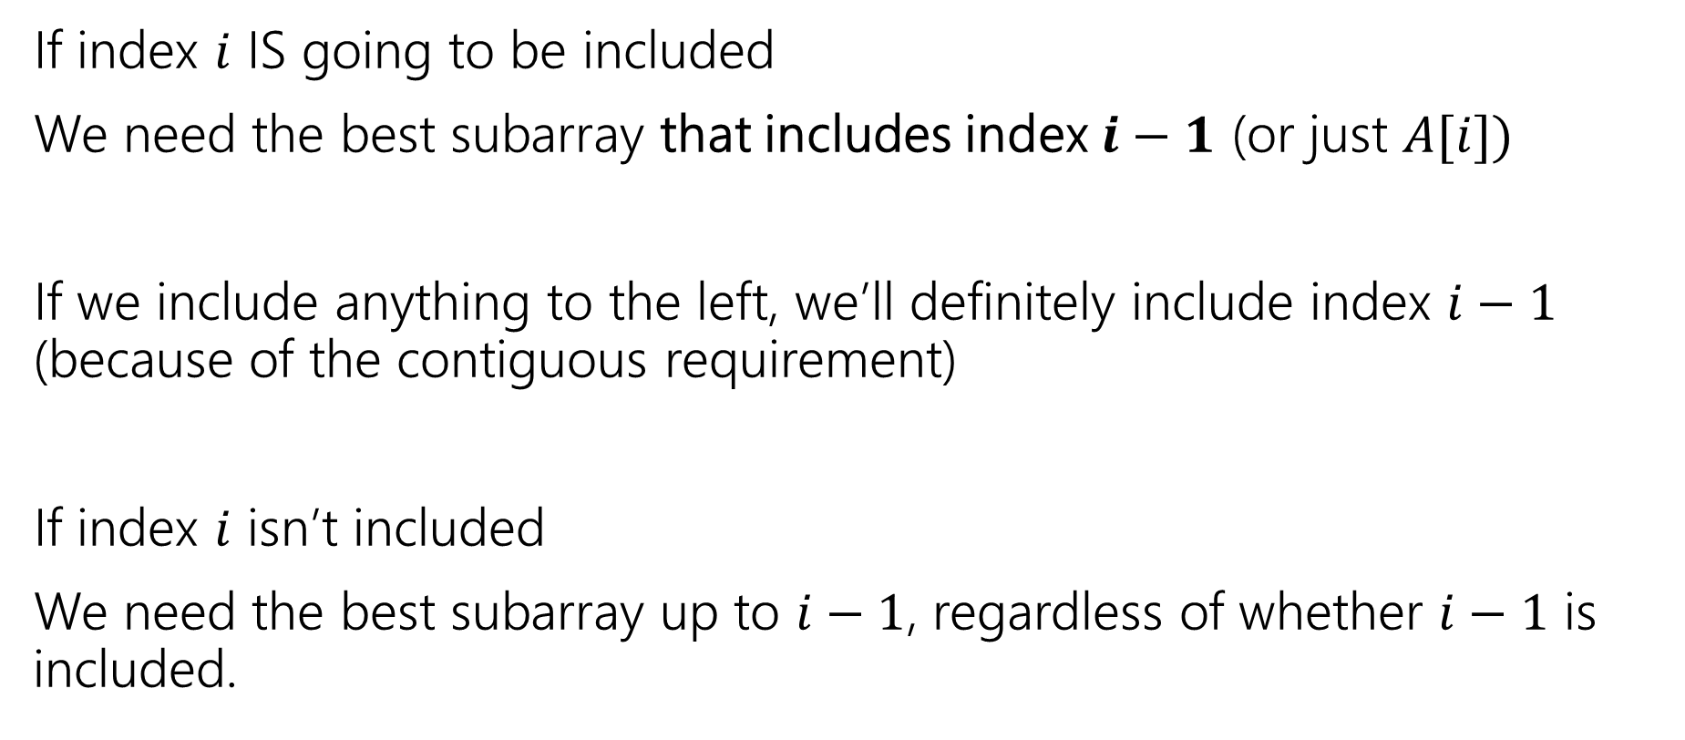
What do we need for recursion?
If index $i$ IS going to be included
We need the best subarray that includes index $i−1$ (or just $A[i])$
If we include anything to the left, we’ll definitely include index $i−1$ (because of the contiguous requirement)
If index $i$ isn’t included
We need the best subarray up to $i−1$, regardless of whether $i−1$ is included.

Slide 16
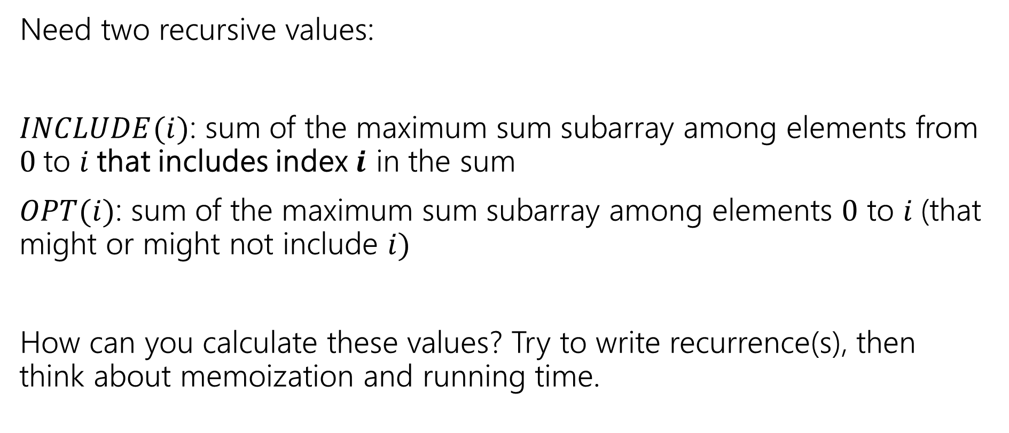
Two Values
Pollev.com/robbie
Need two recursive values:
$INCLUDE(i)$: sum of the maximum sum subarray among elements from $0$to $i$that includes index $i$ in the sum
$OPT(i)$: sum of the maximum sum subarray among elements $0$ to $i$(that might or might not include $i)$
How can you calculate these values? Try to write recurrence(s), then think about memoization and running time.

Slide 17
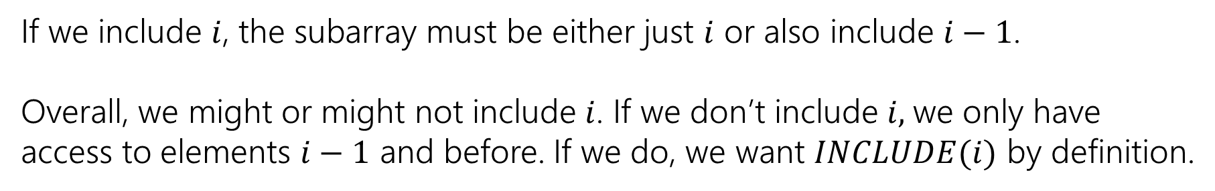

Recurrences
$INCLUDE\left(i\right)=\left\{\begin{aligned}\max\left\{A\left[i\right], A\left[i\right]+INLCUDE\left(i−1\right)\right\} if i≥0 \\ 0 otherwise\end{aligned}\right.$
$OPT\left(i\right)=\left\{\begin{aligned}\max\left\{INCLUDE\left(i\right),OPT\left(i−1\right)\right\} if i≥0 \\ 0 otherwise\end{aligned}\right.$
If we include $i$, the subarray must be either just $i$ or also include $i−1$.
Overall, we might or might not include $i$. If we don’t include $i,$we only have access to elements $i−1$ and before. If we do, we want $INCLUDE(i)$ by definition.

Slide 18



Example
$$A$$
0 | 1 | 2 | 3 | 4 | 5 | 6 | 7
5 | -6 | 3 | 4 | -5 | 2 | 2 | 4
$$OPT(i)$$
0 | 1 | 2 | 3 | 4 | 5 | 6 | 7
5
0 | 1 | 2 | 3 | 4 | 5 | 6 | 7
5
$$INCLUDE(i)$$

Slide 19
Example
$$A$$
0 | 1 | 2 | 3 | 4 | 5 | 6 | 7
5 | -6 | 3 | 4 | -5 | 2 | 2 | 4
$$OPT(i)$$
0 | 1 | 2 | 3 | 4 | 5 | 6 | 7
5 | 5
0 | 1 | 2 | 3 | 4 | 5 | 6 | 7
5 | -1
$$INCLUDE(i)$$

Slide 20
Example
$$A$$
0 | 1 | 2 | 3 | 4 | 5 | 6 | 7
5 | -6 | 3 | 4 | -5 | 2 | 2 | 4
$$OPT(i)$$
0 | 1 | 2 | 3 | 4 | 5 | 6 | 7
5 | 5 | 5 | 7 | 7 | 7 | 7 | 10
0 | 1 | 2 | 3 | 4 | 5 | 6 | 7
5 | -1 | 3 | 7 | 2 | 4 | 6 | 10
$$INCLUDE(i)$$

Slide 21
Pseudocode
int maxSubarraySum(int[] A)
int n=A.length
int[] OPT = new int[n]
int[] Inc = new int[n]
inc[0]=A[0]; OPT[0] = max{A[0],0}
for(int i=0;i<n;i++)
inc[i]=max{A[i], A[i]+inc[i-1]}
OPT[i]=max{inc[i], opt[i-1]}
endFor
return OPT[n-1]

Slide 22
Recursive Thinking In General
As before, the hardest part is designing the recurrence.
It sometimes helps to think from multiple different angles.
Top-down: What’s the first step to take?
Baby Yoda will first go left or down. Use recursion to find out which of left or down is better.
The farthest right operation in the string transformation will be one of insert, delete, substitute, match for free. Use recursion to find out which is best.

Slide 23
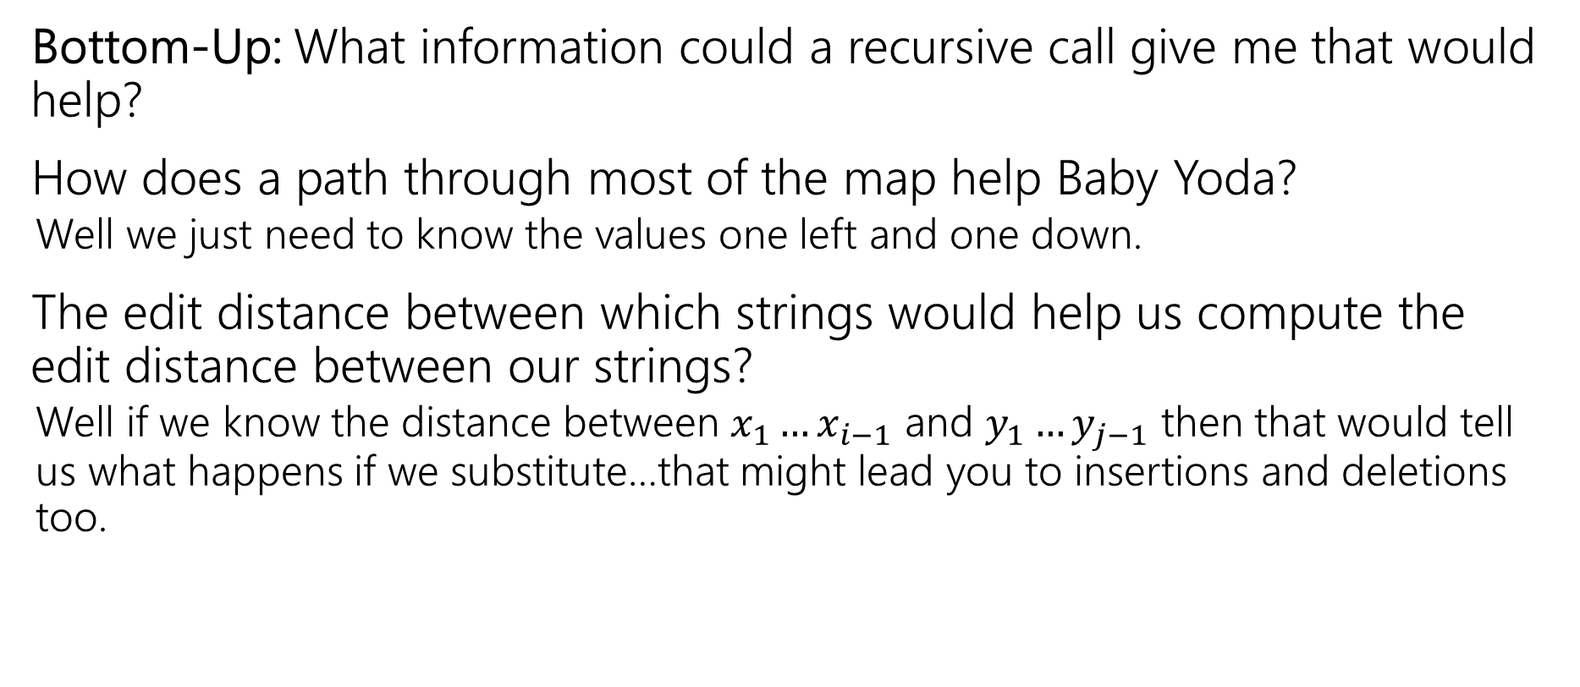
Recursive Thinking In General
Bottom-Up: What information could a recursive call give me that would help?
How does a path through most of the map help Baby Yoda?
Well we just need to know the values one left and one down.
The edit distance between which strings would help us compute the edit distance between our strings?
Well if we know the distance between $x_{1}…x_{i−1}$ and $y_{1}…y_{j−1}$ then that would tell us what happens if we substitute…that might lead you to insertions and deletions too.

Slide 24
Recursive Thinking In General
Some people refer to the “Optimal Substructure Property”
From the optimum (most eggs, fewest number of string operations) for a slightly smaller problem (Baby Yoda starting closer to the end, slightly smaller strings), we need to be able to build up the optimum for the full problem.

Slide 25
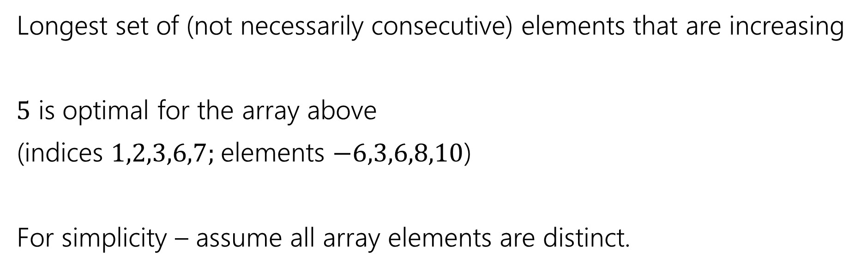
Longest Increasing Subsequence
0 | 1 | 2 | 3 | 4 | 5 | 6 | 7
5 | -6 | 3 | 6 | -5 | 2 | 8 | 10
Longest set of (not necessarily consecutive) elements that are increasing
$5$ is optimal for the array above
(indices $1,2,3,6,7;$elements $−6,3,6,8,10$)
For simplicity – assume all array elements are distinct.

Slide 26
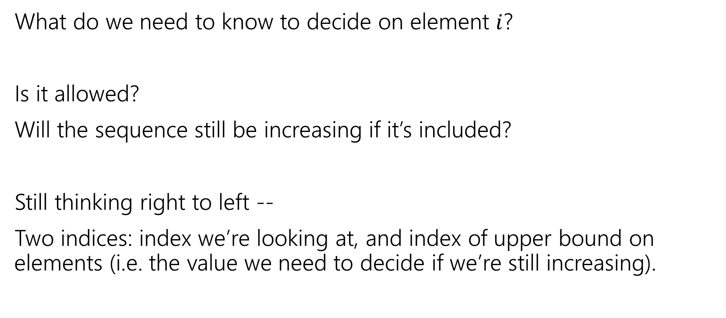
Longest Increasing Subsequence
What do we need to know to decide on element $i$?
Is it allowed?
Will the sequence still be increasing if it’s included?
Still thinking right to left --
Two indices: index we’re looking at, and index of upper bound on elements (i.e. the value we need to decide if we’re still increasing).

Slide 27

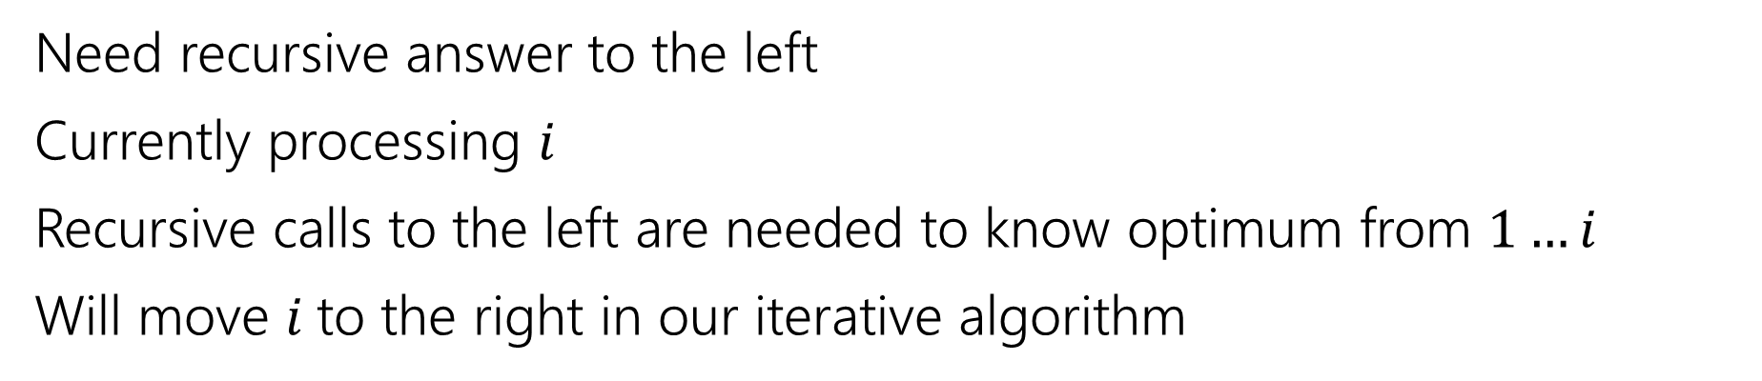
Recurrence
0 | 1 | 2 | 3 | 4 | 5 | 6 | 7
5 | -6 | 3 | 6 | -5 | 2 | 8 | 10
Recursive call is best value in this area
Current $i$
Ignored for now.
Need recursive answer to the left
Currently processing $i$
Recursive calls to the left are needed to know optimum from $1…i$
Will move $i$to the right in our iterative algorithm

Slide 28
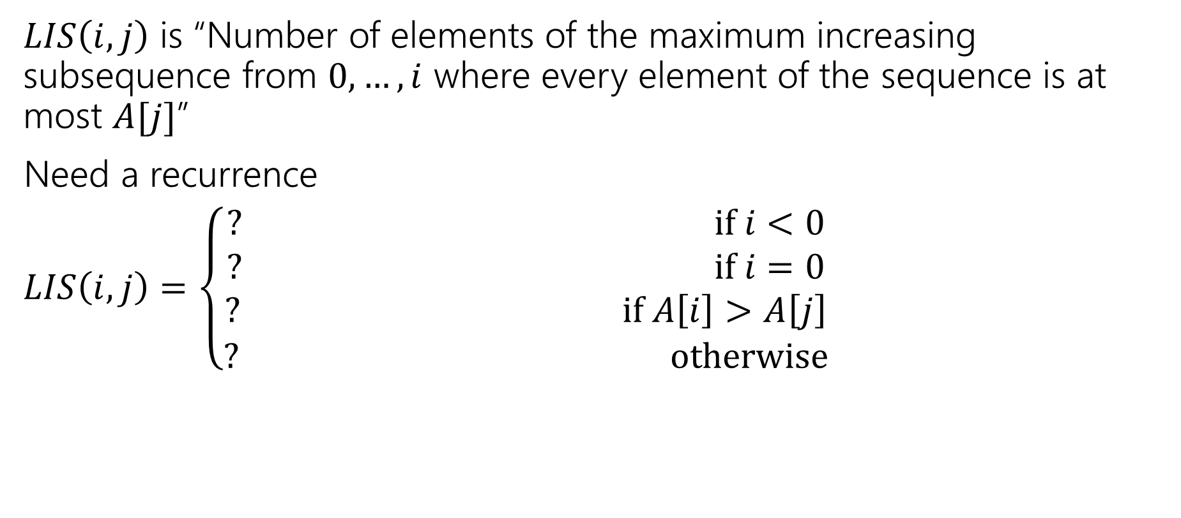
Longest Increasing Subsequence
$LIS\left(i,j\right)$ is “Number of elements of the maximum increasing subsequence from $0,…,i$ where every element of the sequence is at most $A[j]$”
Need a recurrence
$LIS\left(i,j\right)=\left\{\begin{aligned}? if i<0 \\ ? if i=0 \\ ? if A\left[i\right]>A\left[j\right] \\ ? otherwise\end{aligned}\right.$

Slide 29
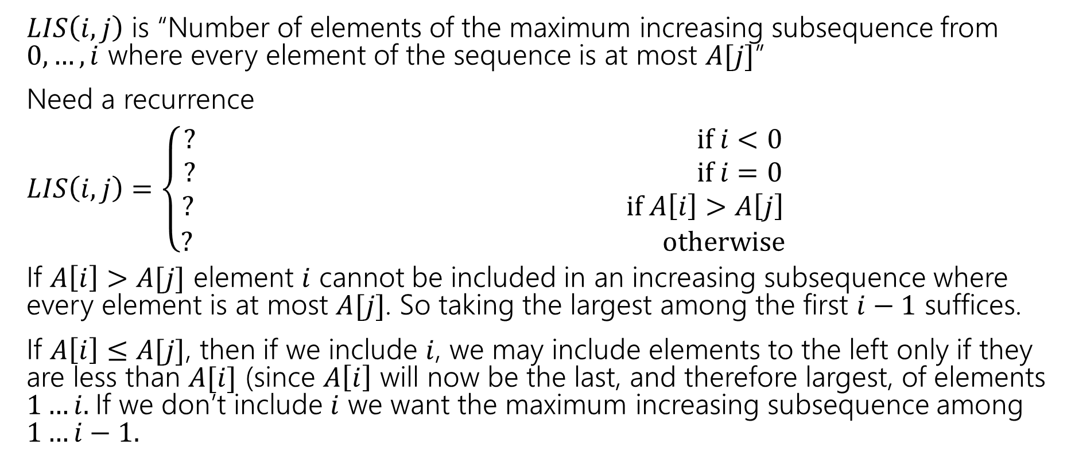
Longest Increasing Subsequence
$LIS\left(i,j\right)$ is “Number of elements of the maximum increasing subsequence from $0,…,i$ where every element of the sequence is at most $A[j]$”
Need a recurrence
$LIS\left(i,j\right)=\left\{\begin{aligned}? if i<0 \\ ? if i=0 \\ ? if A\left[i\right]>A\left[j\right] \\ ? otherwise\end{aligned}\right.$
If $A\left[i\right]>A[j]$ element $i$ cannot be included in an increasing subsequence where every element is at most $A[j]$. So taking the largest among the first $i−1$ suffices.
If $A\left[i\right]≤A[j]$, then if we include $i$, we may include elements to the left only if they are less than $A[i]$ (since $A\left[i\right]$ will now be the last, and therefore largest, of elements $1…i.$If we don’t include $i$ we want the maximum increasing subsequence among $1…i−1.$

Slide 30
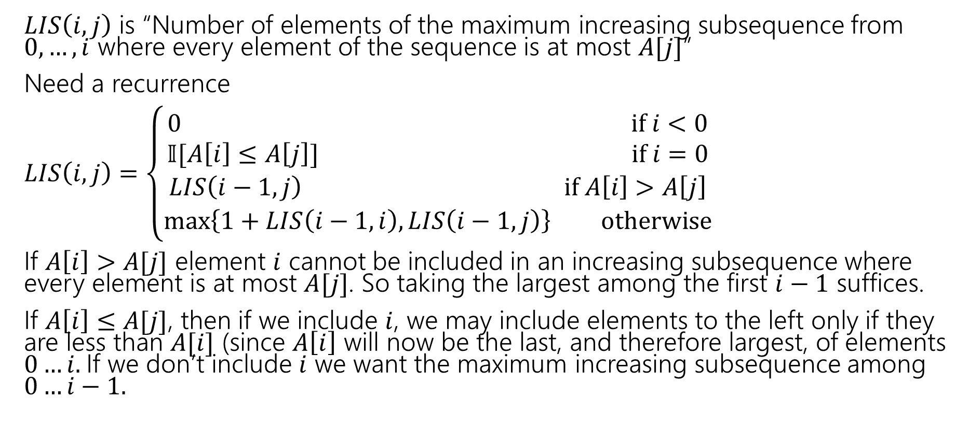
Longest Increasing Subsequence
$LIS\left(i,j\right)$ is “Number of elements of the maximum increasing subsequence from $0,…,i$ where every element of the sequence is at most $A[j]$”
Need a recurrence
$LIS\left(i,j\right)=\left\{\begin{aligned}0 if i<0 \\ 𝕀[A\left[i\right]≤A\left[j\right]] if i=0 \\ LIS\left(i−1,j\right) if A\left[i\right]>A\left[j\right] \\ \max\left\{1+LIS\left(i−1,i\right), LIS\left(i−1,j\right)\right\} otherwise\end{aligned}\right.$
If $A\left[i\right]>A[j]$ element $i$ cannot be included in an increasing subsequence where every element is at most $A[j]$. So taking the largest among the first $i−1$ suffices.
If $A\left[i\right]≤A[j]$, then if we include $i$, we may include elements to the left only if they are less than $A[i]$ (since $A\left[i\right]$ will now be the last, and therefore largest, of elements $0…i.$If we don’t include $i$ we want the maximum increasing subsequence among $0…i−1.$

Slide 31

Longest Increasing Subsequence
$LIS\left(i,j\right)=\left\{\begin{aligned}0 if i<0 \\ 𝕀[A\left[i\right]≤A\left[j\right]] if i=0 \\ LIS\left(i−1,j\right) if A\left[i\right]>A\left[j\right] \\ \max\left\{1+LIS\left(i−1,i\right), LIS\left(i−1,j\right)\right\} otherwise\end{aligned}\right.$
Memoization structure? $n×n$ array.
Filling order?

Slide 32


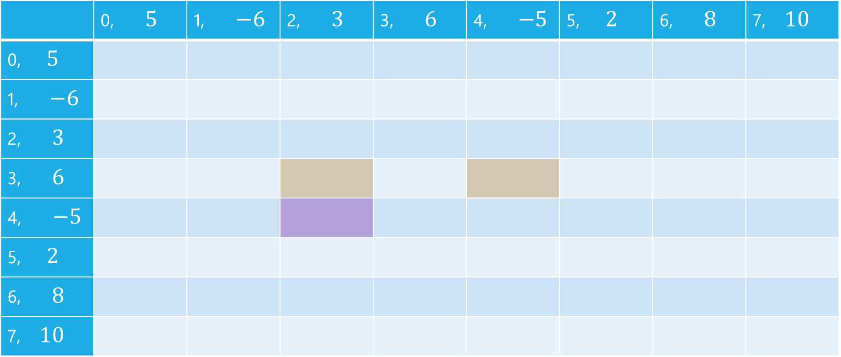


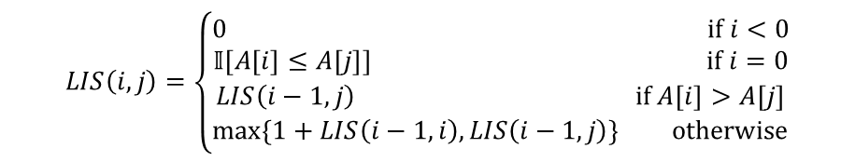
LIS
$$LIS\left(i,j\right)=\left\{\begin{aligned}0 if i<0 \\ 𝕀[A\left[i\right]≤A\left[j\right]] if i=0 \\ LIS\left(i−1,j\right) if A\left[i\right]>A\left[j\right] \\ \max\left\{1+LIS\left(i−1,i\right), LIS\left(i−1,j\right)\right\} otherwise\end{aligned}\right.$$
$$j$$
 | 0, $5$ | 1, $−6$ | 2, $3$ | 3, $6$ | 4, $−5$ | 5, $2$ | 6, $8$ | 7, $10$
0, $5$
1, $−6$
2, $3$
3, $6$
4, $−5$
5, $2$
6, $8$
7, $10$
$$i$$

Slide 33
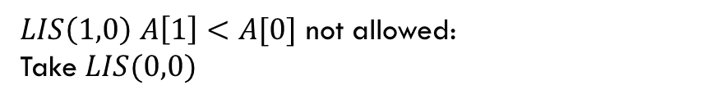
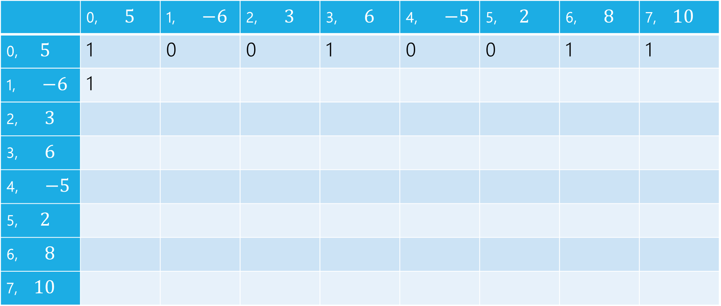
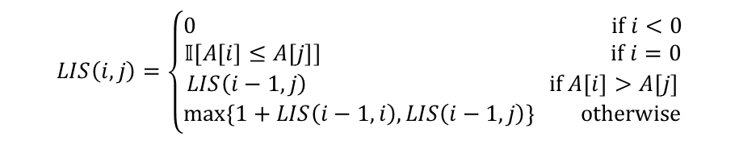
LIS
$LIS\left(1,0\right)$ $A\left[1\right]<A[0]$ not allowed:
Take $LIS(0,0)$
$$LIS\left(i,j\right)=\left\{\begin{aligned}0 if i<0 \\ 𝕀[A\left[i\right]≤A\left[j\right]] if i=0 \\ LIS\left(i−1,j\right) if A\left[i\right]>A\left[j\right] \\ \max\left\{1+LIS\left(i−1,i\right), LIS\left(i−1,j\right)\right\} otherwise\end{aligned}\right.$$
$$j$$
 | 0, $5$ | 1, $−6$ | 2, $3$ | 3, $6$ | 4, $−5$ | 5, $2$ | 6, $8$ | 7, $10$
0, $5$ | 1 | 0 | 0 | 1 | 0 | 0 | 1 | 1
1, $−6$ | 1
2, $3$
3, $6$
4, $−5$
5, $2$
6, $8$
7, $10$
$$i$$

Slide 34

LIS
$LIS\left(1,1\right)$ $A\left[1\right]≤A[1]$ can add, $1+LIS(0,1)$ or $LIS(0,1)$
$$LIS\left(i,j\right)=\left\{\begin{aligned}0 if i<0 \\ 𝕀[A\left[i\right]≤A\left[j\right]] if i=0 \\ LIS\left(i−1,j\right) if A\left[i\right]>A\left[j\right] \\ \max\left\{1+LIS\left(i−1,i\right), LIS\left(i−1,j\right)\right\} otherwise\end{aligned}\right.$$
$$j$$
 | 0, $5$ | 1, $−6$ | 2, $3$ | 3, $6$ | 4, $−5$ | 5, $2$ | 6, $8$ | 7, $10$
0, $5$ | 1 | 0 | 0 | 1 | 0 | 0 | 1 | 1
1, $−6$ | 1 | 1
2, $3$
3, $6$
4, $−5$
5, $2$
6, $8$
7, $10$
$$i$$

Slide 35

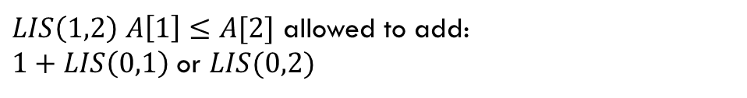
LIS
$LIS\left(1,2\right)$ $A\left[1\right]≤A[2]$ allowed to add:
$1+LIS\left(0,1\right)$ or $LIS(0,2)$
$$LIS\left(i,j\right)=\left\{\begin{aligned}0 if i<0 \\ 𝕀[A\left[i\right]≤A\left[j\right]] if i=0 \\ LIS\left(i−1,j\right) if A\left[i\right]>A\left[j\right] \\ \max\left\{1+LIS\left(i−1,i\right), LIS\left(i−1,j\right)\right\} otherwise\end{aligned}\right.$$
$$j$$
 | 0, $5$ | 1, $−6$ | 2, $3$ | 3, $6$ | 4, $−5$ | 5, $2$ | 6, $8$ | 7, $10$
0, $5$ | 1 | 0 | 0 | 1 | 0 | 0 | 1 | 1
1, $−6$ | 1 | 1 | 1
2, $3$
3, $6$
4, $−5$
5, $2$
6, $8$
7, $10$
$$i$$

Slide 36
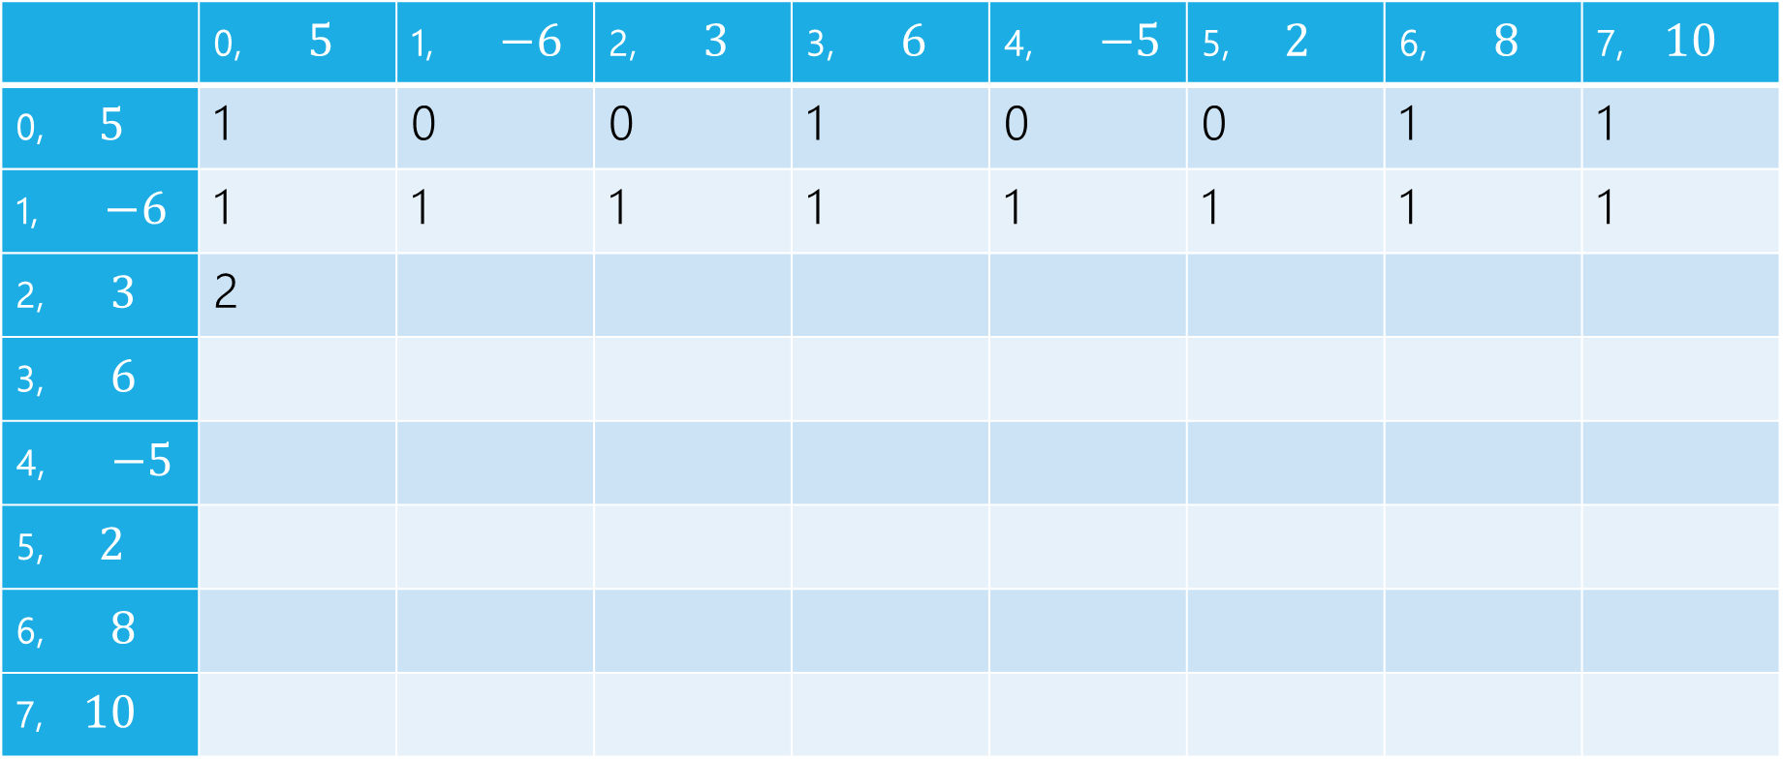
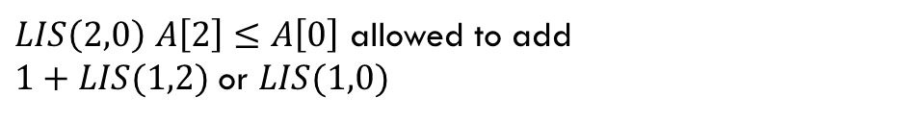
LIS
$LIS\left(2,0\right)$ $A\left[2\right]≤A\left[0\right]$ allowed to add
$1+LIS(1,2)$ or $LIS(1,0)$
$$LIS\left(i,j\right)=\left\{\begin{aligned}0 if i<0 \\ 𝕀[A\left[i\right]≤A\left[j\right]] if i=0 \\ LIS\left(i−1,j\right) if A\left[i\right]>A\left[j\right] \\ \max\left\{1+LIS\left(i−1,i\right), LIS\left(i−1,j\right)\right\} otherwise\end{aligned}\right.$$
$$j$$
 | 0, $5$ | 1, $−6$ | 2, $3$ | 3, $6$ | 4, $−5$ | 5, $2$ | 6, $8$ | 7, $10$
0, $5$ | 1 | 0 | 0 | 1 | 0 | 0 | 1 | 1
1, $−6$ | 1 | 1 | 1 | 1 | 1 | 1 | 1 | 1
2, $3$ | 2
3, $6$
4, $−5$
5, $2$
6, $8$
7, $10$
$$i$$

Slide 37
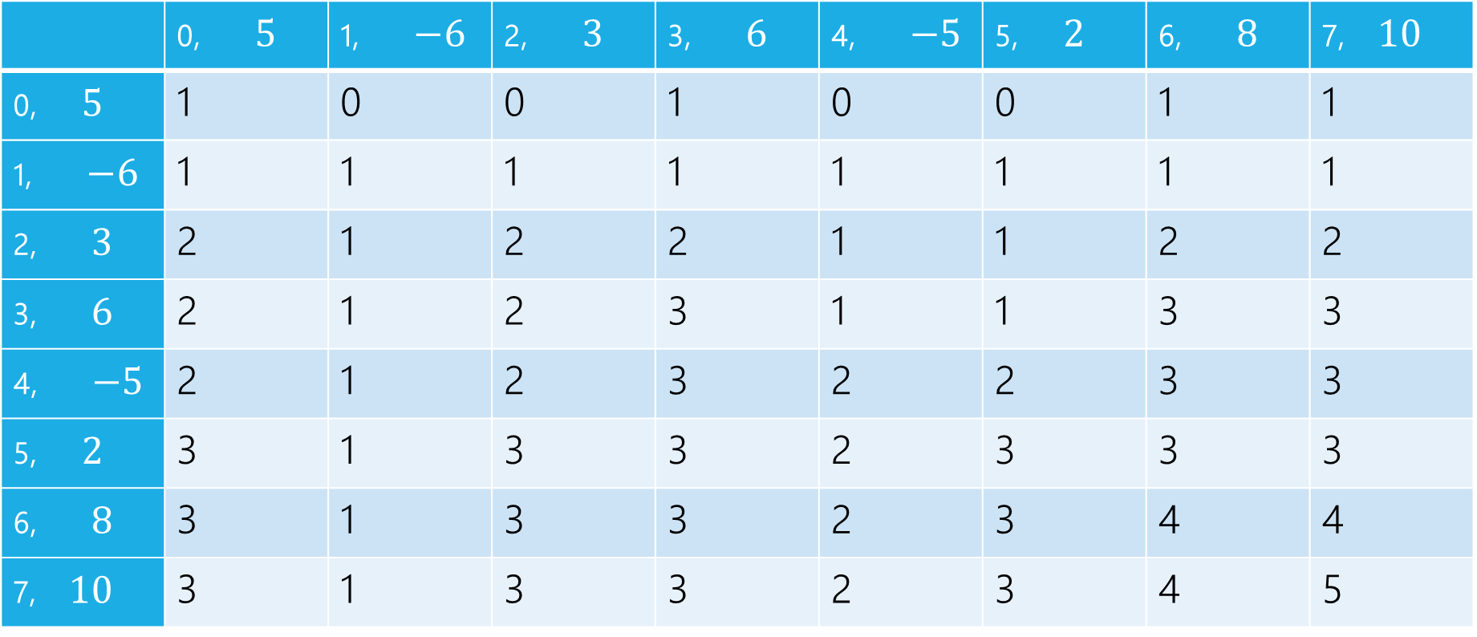
LIS
$$LIS\left(i,j\right)=\left\{\begin{aligned}0 if i<0 \\ 𝕀[A\left[i\right]≤A\left[j\right]] if i=0 \\ LIS\left(i−1,j\right) if A\left[i\right]>A\left[j\right] \\ \max\left\{1+LIS\left(i−1,i\right), LIS\left(i−1,j\right)\right\} otherwise\end{aligned}\right.$$
$$j$$
 | 0, $5$ | 1, $−6$ | 2, $3$ | 3, $6$ | 4, $−5$ | 5, $2$ | 6, $8$ | 7, $10$
0, $5$ | 1 | 0 | 0 | 1 | 0 | 0 | 1 | 1
1, $−6$ | 1 | 1 | 1 | 1 | 1 | 1 | 1 | 1
2, $3$ | 2 | 1 | 2 | 2 | 1 | 1 | 2 | 2
3, $6$ | 2 | 1 | 2 | 3 | 1 | 1 | 3 | 3
4, $−5$ | 2 | 1 | 2 | 3 | 2 | 2 | 3 | 3
5, $2$ | 3 | 1 | 3 | 3 | 2 | 3 | 3 | 3
6, $8$ | 3 | 1 | 3 | 3 | 2 | 3 | 4 | 4
7, $10$ | 3 | 1 | 3 | 3 | 2 | 3 | 4 | 5
$$i$$

Slide 38
pseudocode
//real code snippet that actually generated the table on the last slide
for(int j=0; j < n; j++){
vals[0][j] = (A[0] <= A[j]) ? 1 : 0;
}
for(int i = 1; i < 8; i++){
for(int j = 0; j < n; j++){
if(A[i] > A[j])
vals[i][j] = vals[i-1][j];
else{
vals[i][j] = Math.max(1+vals[i-1][i], vals[i-1][j]);
}
}
}

Slide 39
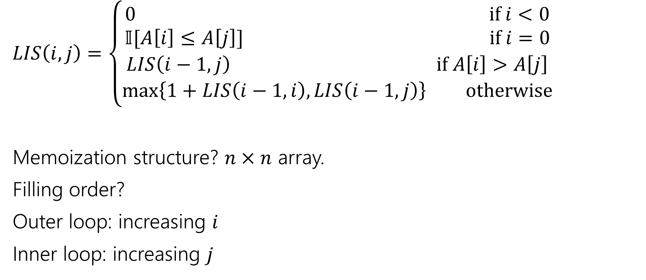
Longest Increasing Subsequence
$LIS\left(i,j\right)=\left\{\begin{aligned}0 if i<0 \\ 𝕀[A\left[i\right]≤A\left[j\right]] if i=0 \\ LIS\left(i−1,j\right) if A\left[i\right]>A\left[j\right] \\ \max\left\{1+LIS\left(i−1,i\right), LIS\left(i−1,j\right)\right\} otherwise\end{aligned}\right.$
Memoization structure? $n×n$ array.
Filling order?
Outer loop: increasing $i$
Inner loop: increasing $j$

Slide 40
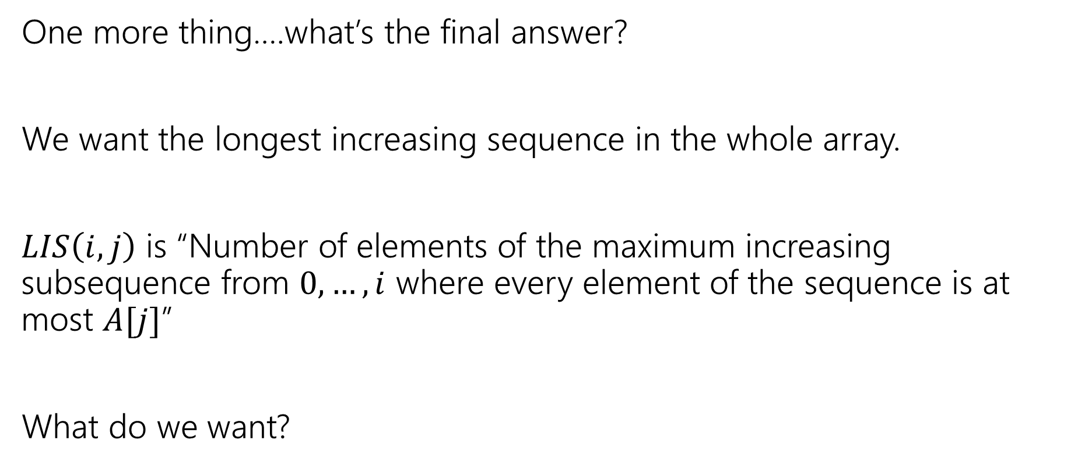
LIS
One more thing….what’s the final answer?
We want the longest increasing sequence in the whole array.
$LIS\left(i,j\right)$ is “Number of elements of the maximum increasing subsequence from $0,…,i$ where every element of the sequence is at most $A[j]$”
What do we want?

Slide 41
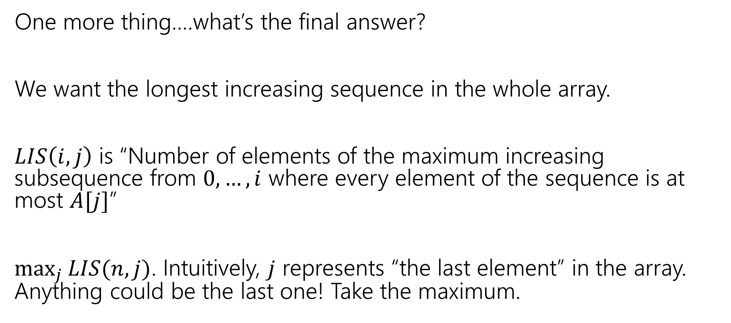
LIS
One more thing….what’s the final answer?
We want the longest increasing sequence in the whole array.
$LIS\left(i,j\right)$ is “Number of elements of the maximum increasing subsequence from $0,…,i$ where every element of the sequence is at most $A[j]$”
$\max_{j}{LIS(n,j)}$. Intuitively, $j$ represents “the last element” in the array. Anything could be the last one! Take the maximum.

