Slide 1
Even More
Dynamic Programming
CSE 417 21AU
Lecture 13

Slide 2
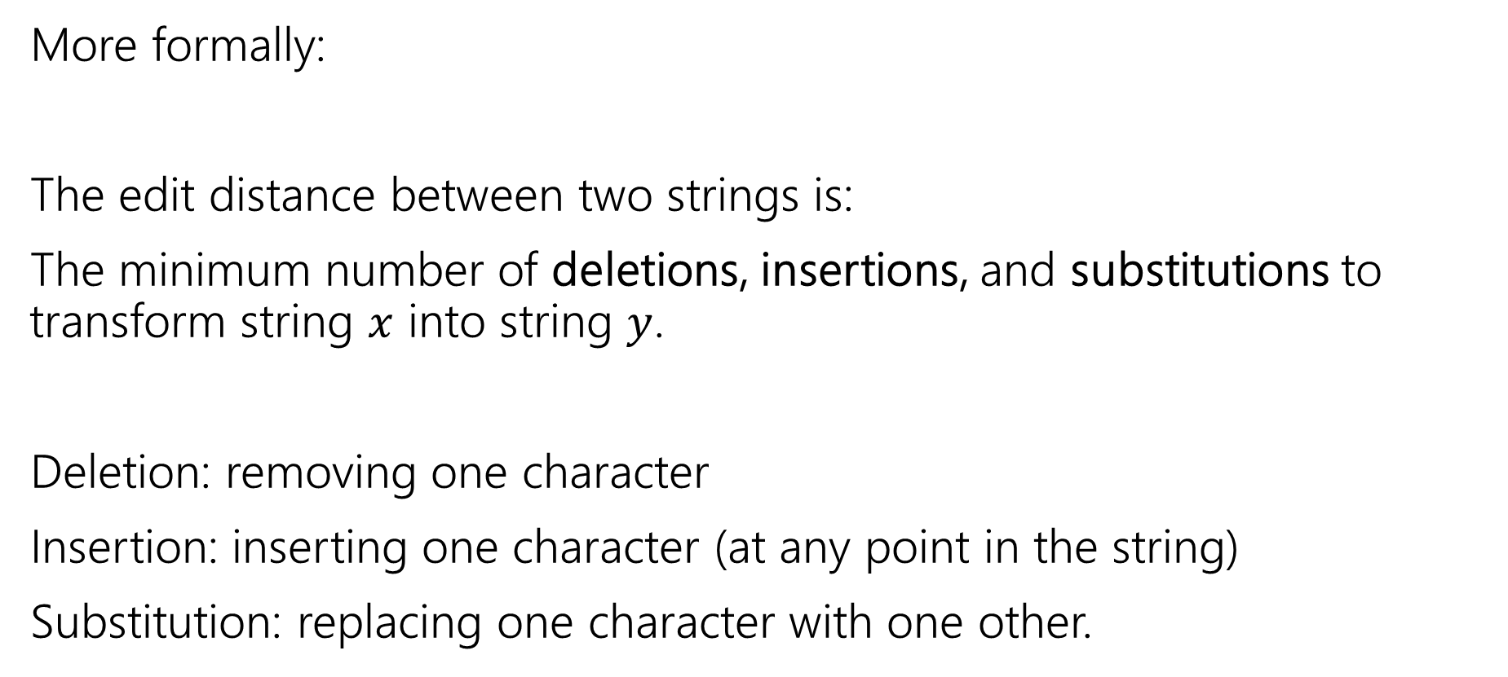
Edit Distance
More formally:
The edit distance between two strings is:
The minimum number of deletions, insertions, and substitutions to transform string $x$ into string $y$.
Deletion: removing one character
Insertion: inserting one character (at any point in the string)
Substitution: replacing one character with one other.

Slide 3
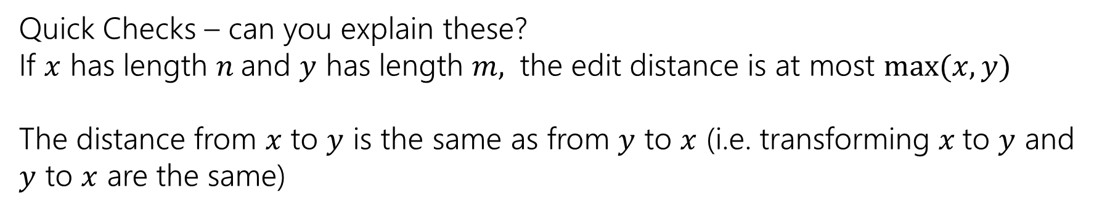
Example
What’s the distance between babyyodas and tastysoda?
B | A | B |  | Y | Y | O | D | A | S
sub |  | sub | ins |  | sub |  |  |  | del
T | A | S | T | Y | S | O | D | A
Distance: 5, one point for each colored box
Quick Checks – can you explain these?
If $x$ has length $n$and $y$ has length $m,$ the edit distance is at most $\max{(x,y)}$
The distance from $x$ to $y$ is the same as from $y$ to $x$ (i.e. transforming $x$to $y$ and $y$ to $x$ are the same)

Slide 4
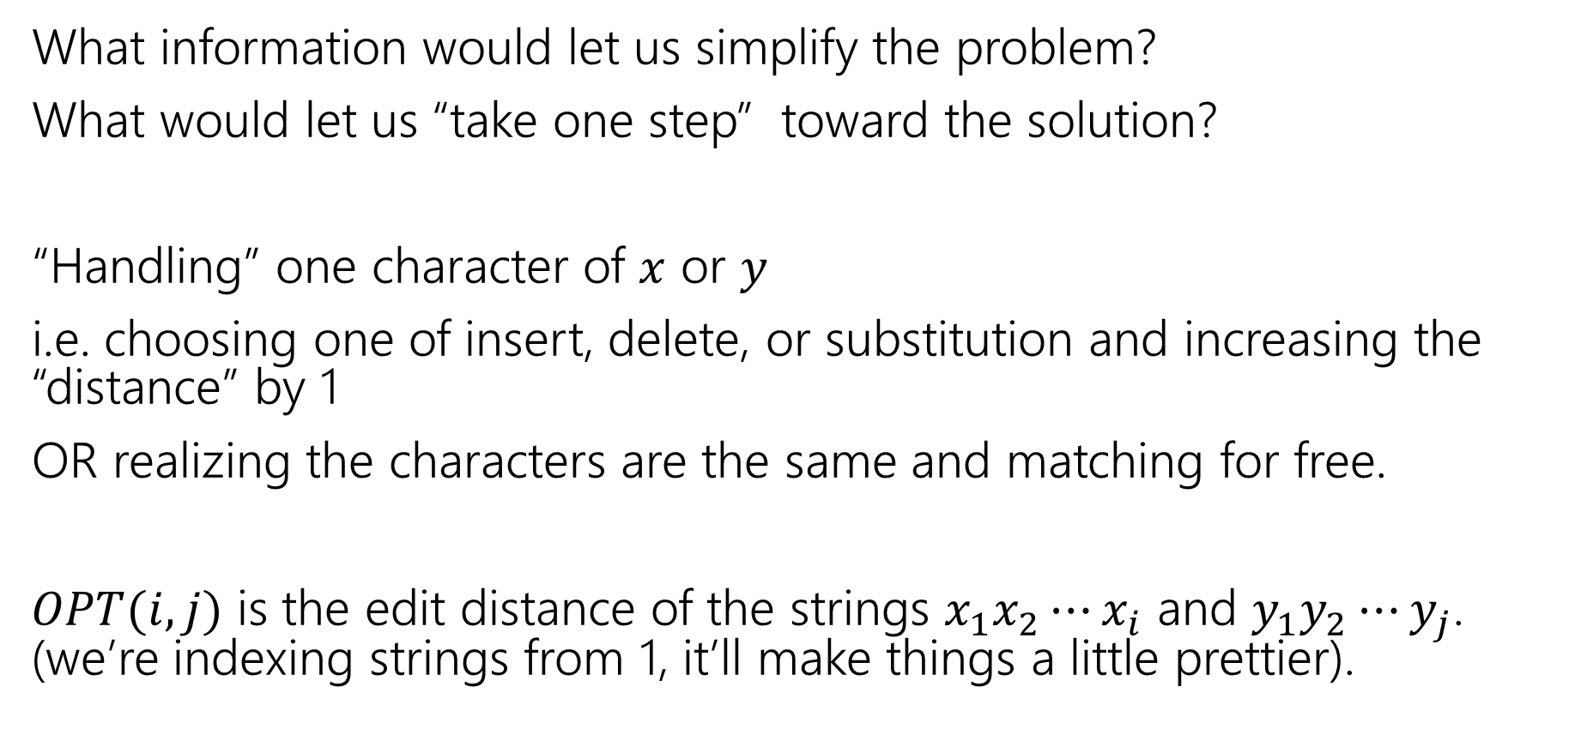
Finding a recurrence
What information would let us simplify the problem?
What would let us “take one step” toward the solution?
“Handling” one character of $x$ or $y$
i.e. choosing one of insert, delete, or substitution and increasing the “distance” by 1
OR realizing the characters are the same and matching for free.
$OPT(i,j)$ is the edit distance of the strings $x_{1}x_{2}⋯x_{i}$ and $y_{1}y_{2}⋯y_{j}$. (we’re indexing strings from 1, it’ll make things a little prettier).

Slide 5
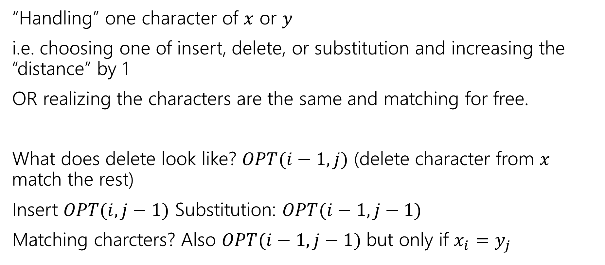
The recurrence
“Handling” one character of $x$ or $y$
i.e. choosing one of insert, delete, or substitution and increasing the “distance” by 1
OR realizing the characters are the same and matching for free.
What does delete look like? $OPT(i−1, j)$ (delete character from $x$ match the rest)
Insert $OPT(i,j−1)$ Substitution: $OPT(i−1,j−1)$
Matching charcters? Also $OPT(i−1,j−1)$ but only if $x_{i}=y_{j}$

Slide 6
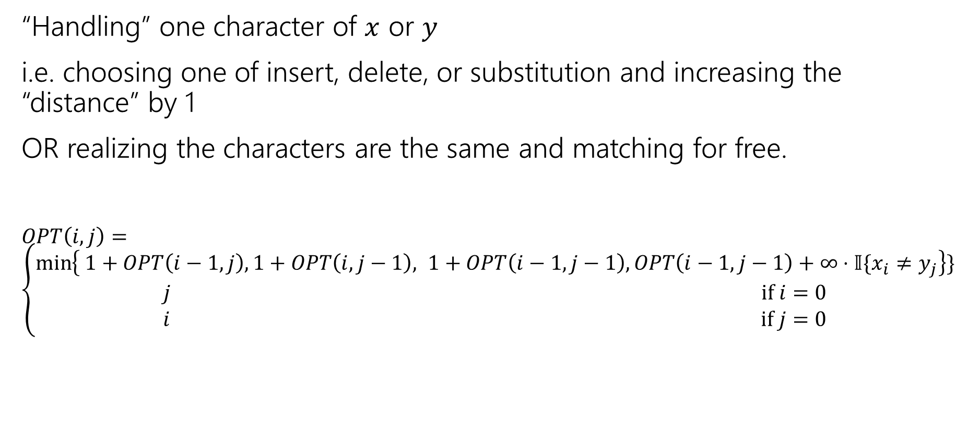
The recurrence (v1, we’ll improve soon)
“Handling” one character of $x$ or $y$
i.e. choosing one of insert, delete, or substitution and increasing the “distance” by 1
OR realizing the characters are the same and matching for free.
$OPT\left(i,j\right)=\left\{\begin{aligned}\min\left\{ 1+OPT\left(i−1,j\right), 1+OPT\left(i,j−1\right), 1+OPT\left(i−1,j−1\right), OPT\left(i−1,j−1\right)+∞⋅𝕀\{x_{i}≠y_{j}\right\}\} \\ j if i=0 \\ i if j=0\end{aligned}\right.$
Delete
Insert
Substitution
TODO: Just Match

Slide 7
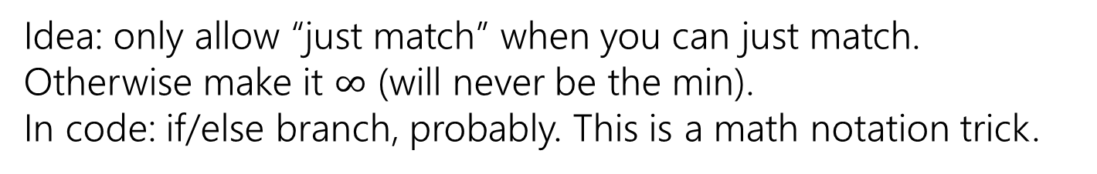
The recurrence (v1, we’ll improve soon)
“Handling” one character of $x$ or $y$
i.e. choosing one of insert, delete, or substitution and increasing the “distance” by 1
OR realizing the characters are the same and matching for free.
$OPT\left(i,j\right)=\left\{\begin{aligned}\min\left\{ 1+OPT\left(i−1,j\right), 1+OPT\left(i,j−1\right), 1+OPT\left(i−1,j−1\right), OPT\left(i−1,j−1\right)+∞⋅𝕀\{x_{i}≠y_{j}\right\}\} \\ j if i=0 \\ i if j=0\end{aligned}\right.$
Delete
Insert
Substitution
Just Match
Idea: only allow “just match” when you can just match. Otherwise make it $∞$ (will never be the min).
In code: if/else branch, probably. This is a math notation trick.
“Indicator” – math for “cast bool to int”

Slide 8
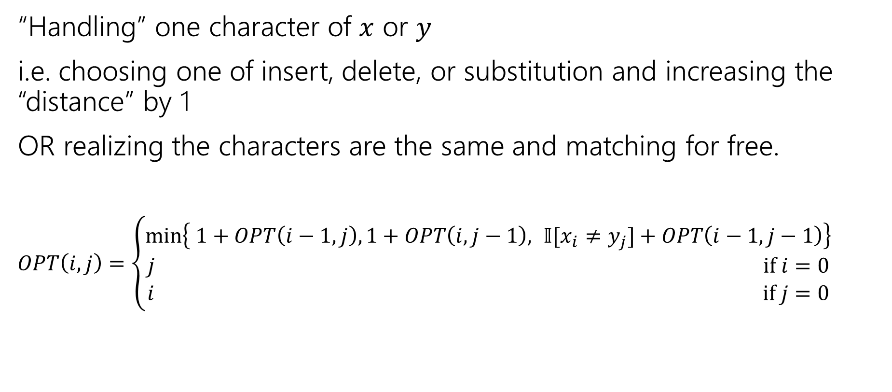
The recurrence
“Handling” one character of $x$ or $y$
i.e. choosing one of insert, delete, or substitution and increasing the “distance” by 1
OR realizing the characters are the same and matching for free.
$OPT\left(i,j\right)=\left\{\begin{aligned}\min\left\{ 1+OPT\left(i−1,j\right), 1+OPT\left(i,j−1\right), 𝕀[x_{i}≠y_{j}]+OPT\left(i−1,j−1\right)\right\} \\ j if i=0 \\ i if j=0\end{aligned}\right.$
Delete
Insert
Sub and matching
“Indicator” – math for “cast bool to int”
When we could match, we will never substitute; matching will always give us a better score! Still have to check delete, insert (those could be better).

Slide 9
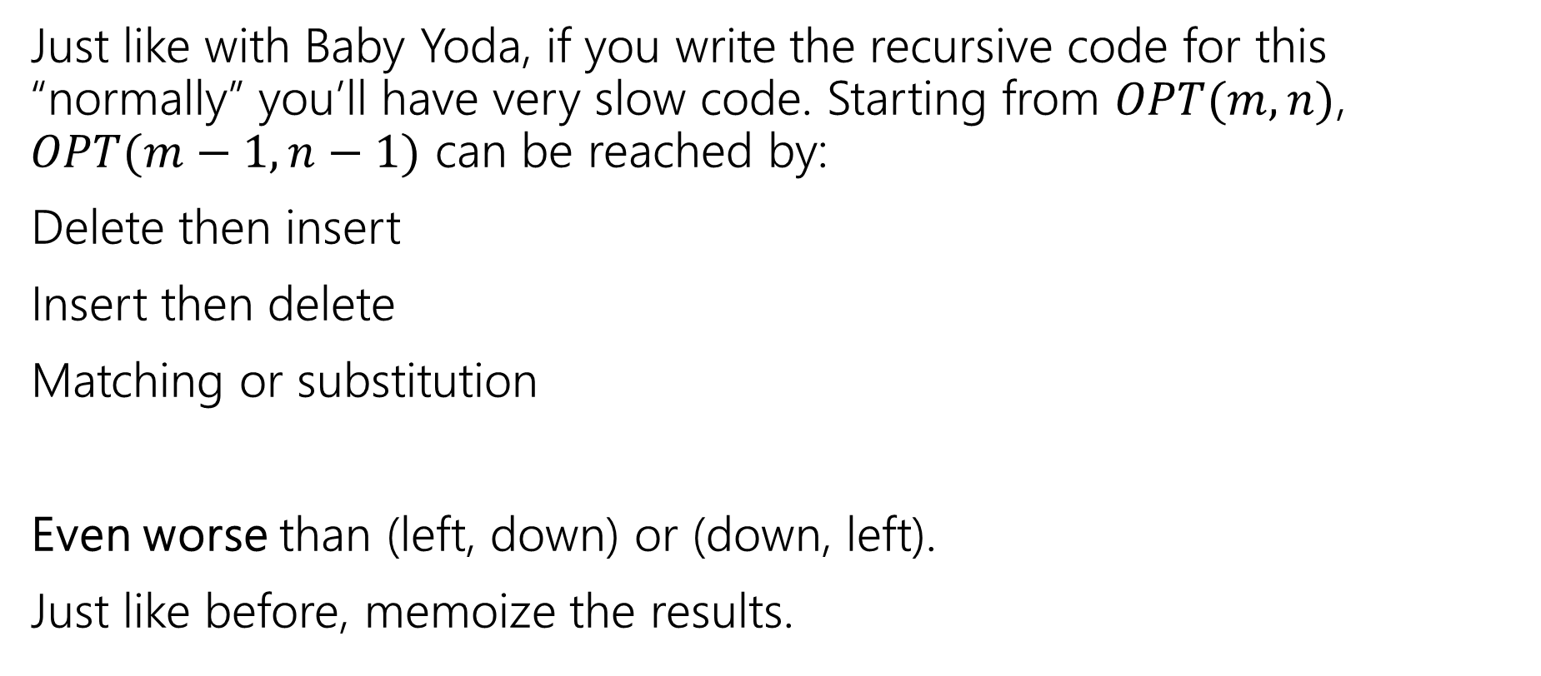
Recurrence to Code
Just like with Baby Yoda, if you write the recursive code for this “normally” you’ll have very slow code. Starting from $OPT(m,n)$, $OPT(m−1,n−1)$ can be reached by:
Delete then insert
Insert then delete
Matching or substitution
Even worse than (left, down) or (down, left).
Just like before, memoize the results.
Not a typo! It’s memoize, not memorize.
Notes:
Memoize as in “leave yourself a memo” DP was developed in the 50s and 60s (Wikipedia says term coined in 68 by Michie). To communicate with co-workers they didn’t use slack/discord or even email (which didn’t develop until the early 70s). They sent each other memos! So they made MEMO tables
thus “MEMOizing”

Slide 10
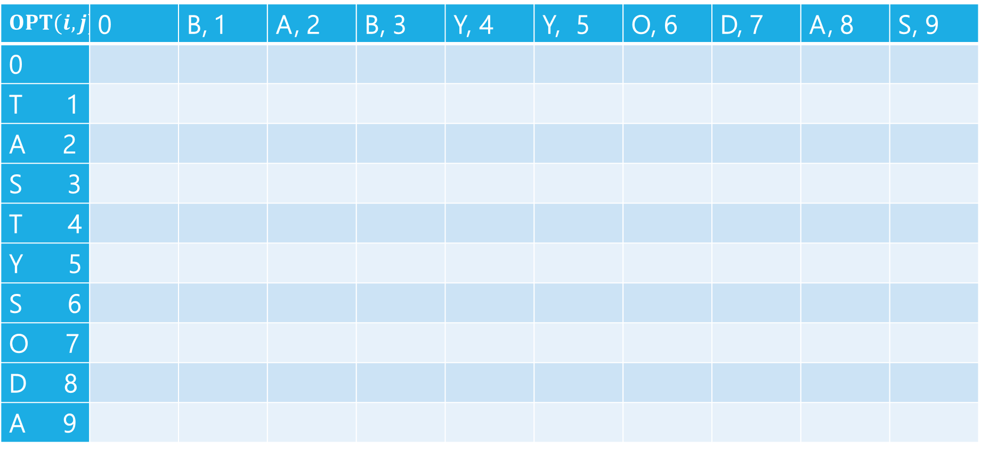
Edit Distance
$$OPT(i,j)$$ | 0 | B, 1 | A, 2 | B, 3 | Y, 4 | Y, 5 | O, 6 | D, 7 | A, 8 | S, 9
0
T 1
A 2
S 3
T 4
Y 5
S 6
O 7
D 8
A 9

Slide 11
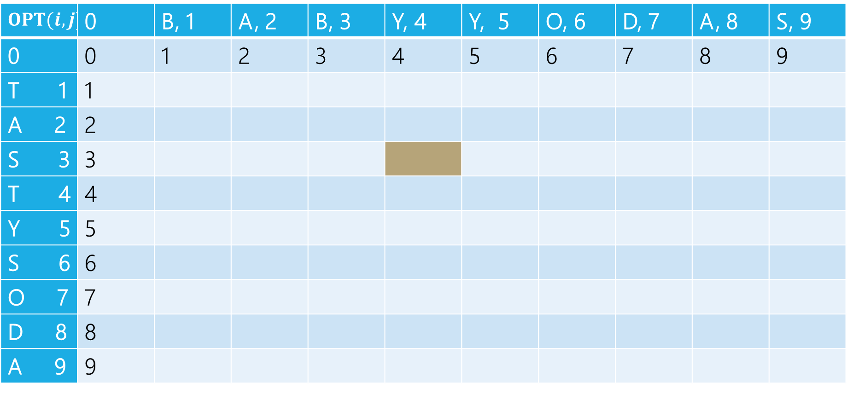
Edit Distance
B | A | B | Y
T | A | S
Current subproblem: edit dist between BABY and TAS
$$OPT(i,j)$$ | 0 | B, 1 | A, 2 | B, 3 | Y, 4 | Y, 5 | O, 6 | D, 7 | A, 8 | S, 9
0 | 0 | 1 | 2 | 3 | 4 | 5 | 6 | 7 | 8 | 9
T 1 | 1
A 2 | 2
S 3 | 3
T 4 | 4
Y 5 | 5
S 6 | 6
O 7 | 7
D 8 | 8
A 9 | 9

Slide 12
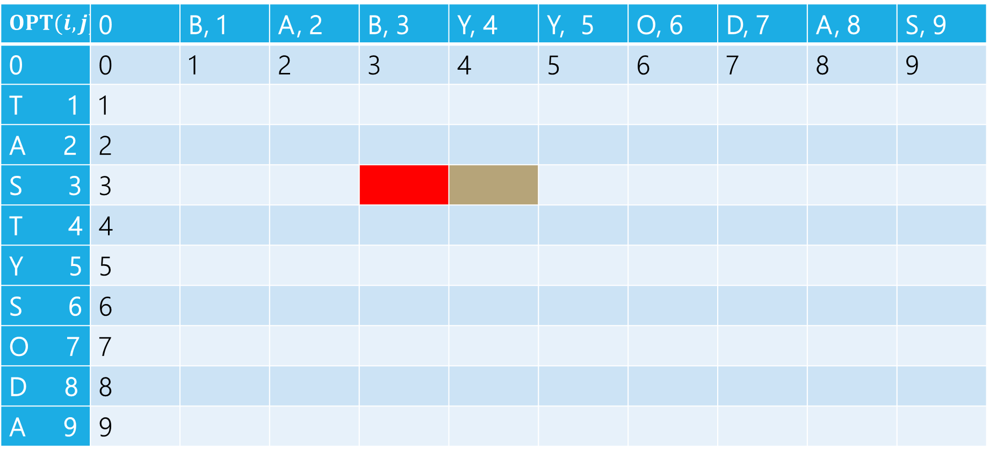
Edit Distance
B | A | B | Y
T | A | S
Delete: get rid of Y (cost 1)
BAB
TAS
$$OPT(i,j)$$ | 0 | B, 1 | A, 2 | B, 3 | Y, 4 | Y, 5 | O, 6 | D, 7 | A, 8 | S, 9
0 | 0 | 1 | 2 | 3 | 4 | 5 | 6 | 7 | 8 | 9
T 1 | 1
A 2 | 2
S 3 | 3
T 4 | 4
Y 5 | 5
S 6 | 6
O 7 | 7
D 8 | 8
A 9 | 9

Slide 13
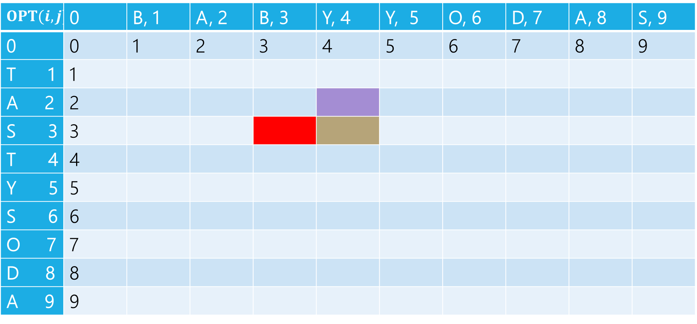
Edit Distance
B | A | B | Y
T | A | S
Insert: insert S (cost 1)
BABY
TA
$$OPT(i,j)$$ | 0 | B, 1 | A, 2 | B, 3 | Y, 4 | Y, 5 | O, 6 | D, 7 | A, 8 | S, 9
0 | 0 | 1 | 2 | 3 | 4 | 5 | 6 | 7 | 8 | 9
T 1 | 1
A 2 | 2
S 3 | 3
T 4 | 4
Y 5 | 5
S 6 | 6
O 7 | 7
D 8 | 8
A 9 | 9

Slide 14
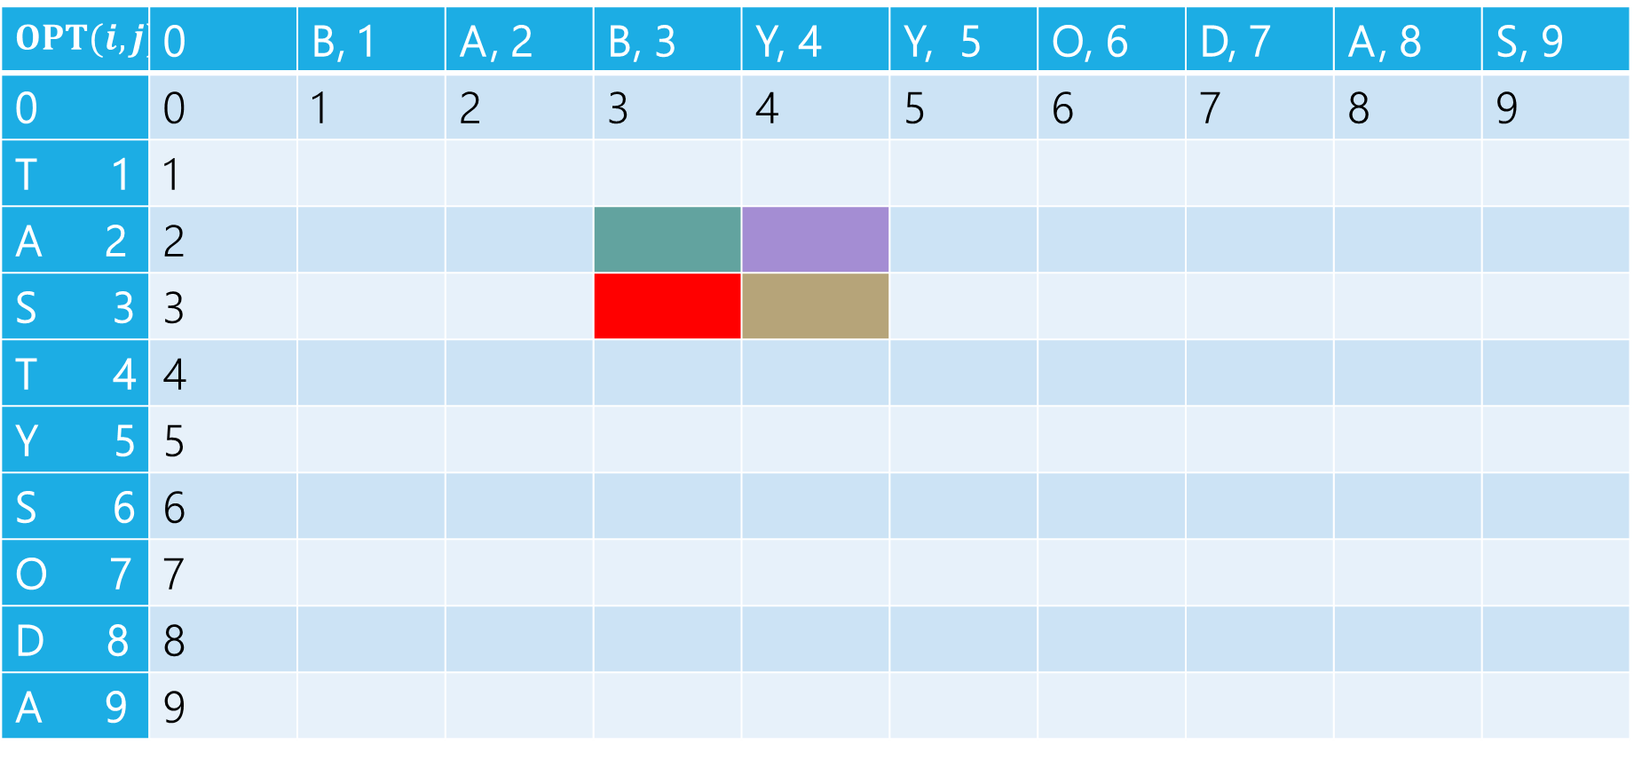
Edit Distance
B | A | B | Y
T | A | S
Sub: Transform Y to S (cost 1)
BAB
TA
$$OPT(i,j)$$ | 0 | B, 1 | A, 2 | B, 3 | Y, 4 | Y, 5 | O, 6 | D, 7 | A, 8 | S, 9
0 | 0 | 1 | 2 | 3 | 4 | 5 | 6 | 7 | 8 | 9
T 1 | 1
A 2 | 2
S 3 | 3
T 4 | 4
Y 5 | 5
S 6 | 6
O 7 | 7
D 8 | 8
A 9 | 9

Slide 15
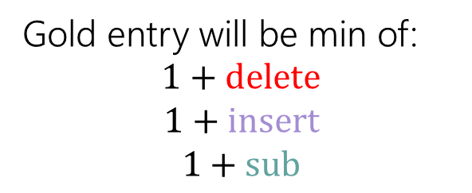
Edit Distance
Gold entry will be min of:
$$1+delete$$
$$1+insert$$
$$1+sub$$
B | A | B | Y
T | A | S
$$OPT(i,j)$$ | 0 | B, 1 | A, 2 | B, 3 | Y, 4 | Y, 5 | O, 6 | D, 7 | A, 8 | S, 9
0 | 0 | 1 | 2 | 3 | 4 | 5 | 6 | 7 | 8 | 9
T 1 | 1
A 2 | 2
S 3 | 3
T 4 | 4
Y 5 | 5
S 6 | 6
O 7 | 7
D 8 | 8
A 9 | 9

Slide 16
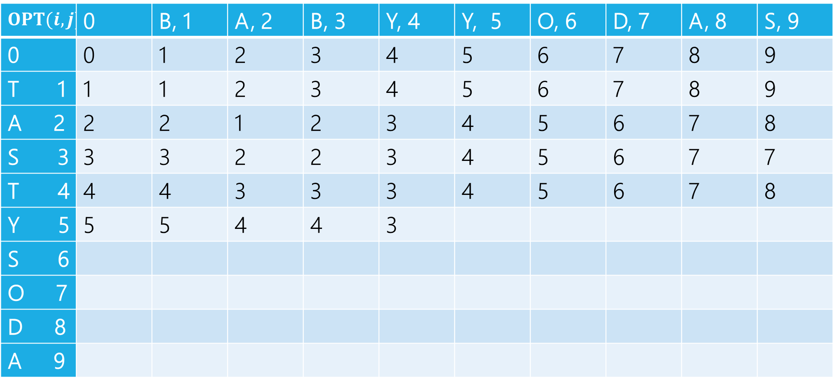

Edit Distance
$$1+2$$
$$1+3$$
$$1+2$$
Min: $3$
Gold entry will be min of:
$$1+delete$$
$$1+insert$$
$$1+sub$$
$$OPT(i,j)$$ | 0 | B, 1 | A, 2 | B, 3 | Y, 4 | Y, 5 | O, 6 | D, 7 | A, 8 | S, 9
0 | 0 | 1 | 2 | 3 | 4 | 5 | 6 | 7 | 8 | 9
T 1 | 1 | 1 | 2 | 3 | 4 | 5 | 6 | 7 | 8 | 9
A 2 | 2 | 2 | 1 | 2 | 3 | 4 | 5 | 6 | 7 | 8
S 3 | 3 | 3 | 2 | 2 | 3 | 4 | 5 | 6 | 7 | 7
T 4 | 4 | 4 | 3 | 3 | 3 | 4 | 5 | 6 | 7 | 8
Y 5 | 5 | 5 | 4 | 4 | 3
S 6
O 7
D 8
A 9

Slide 17
Edit Distance
Fill in the next two entries. Be careful with the sub/match distinction!
$$OPT(i,j)$$ | 0 | B, 1 | A, 2 | B, 3 | Y, 4 | Y, 5 | O, 6 | D, 7 | A, 8 | S, 9
0 | 0 | 1 | 2 | 3 | 4 | 5 | 6 | 7 | 8 | 9
T 1 | 1 | 1 | 2 | 3 | 4 | 5 | 6 | 7 | 8 | 9
A 2 | 2 | 2 | 1 | 2 | 3 | 4 | 5 | 6 | 7 | 8
S 3 | 3 | 3 | 2 | 2 | 3 | 4 | 5 | 6 | 7 | 7
T 4 | 4 | 4 | 3 | 3 | 3 | 4 | 5 | 6 | 7 | 8
Y 5 | 5 | 5 | 4 | 4 | 3
S 6
O 7
D 8
A 9

Slide 18
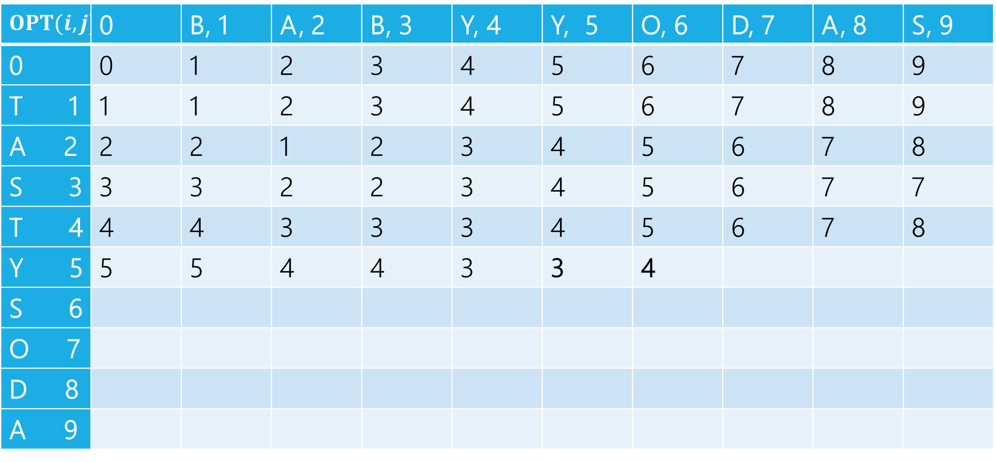
Edit Distance
Fill in the next two entries. Be careful with the sub/match distinction!
$$OPT(i,j)$$ | 0 | B, 1 | A, 2 | B, 3 | Y, 4 | Y, 5 | O, 6 | D, 7 | A, 8 | S, 9
0 | 0 | 1 | 2 | 3 | 4 | 5 | 6 | 7 | 8 | 9
T 1 | 1 | 1 | 2 | 3 | 4 | 5 | 6 | 7 | 8 | 9
A 2 | 2 | 2 | 1 | 2 | 3 | 4 | 5 | 6 | 7 | 8
S 3 | 3 | 3 | 2 | 2 | 3 | 4 | 5 | 6 | 7 | 7
T 4 | 4 | 4 | 3 | 3 | 3 | 4 | 5 | 6 | 7 | 8
Y 5 | 5 | 5 | 4 | 4 | 3 | 3 | 4
S 6
O 7
D 8
A 9
Y’s match, so sub is free!

Slide 19
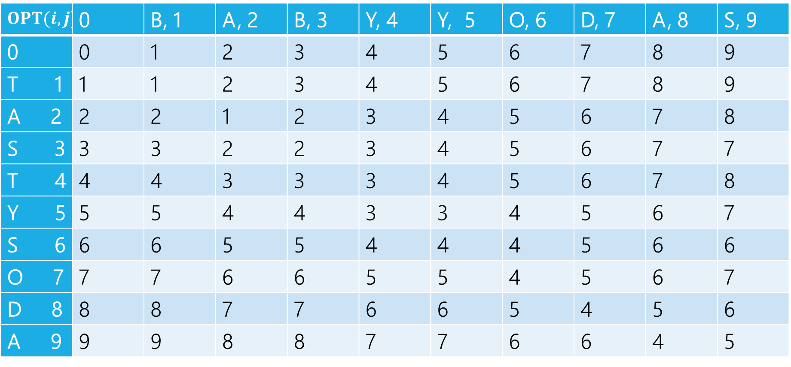
Edit Distance
$$OPT(i,j)$$ | 0 | B, 1 | A, 2 | B, 3 | Y, 4 | Y, 5 | O, 6 | D, 7 | A, 8 | S, 9
0 | 0 | 1 | 2 | 3 | 4 | 5 | 6 | 7 | 8 | 9
T 1 | 1 | 1 | 2 | 3 | 4 | 5 | 6 | 7 | 8 | 9
A 2 | 2 | 2 | 1 | 2 | 3 | 4 | 5 | 6 | 7 | 8
S 3 | 3 | 3 | 2 | 2 | 3 | 4 | 5 | 6 | 7 | 7
T 4 | 4 | 4 | 3 | 3 | 3 | 4 | 5 | 6 | 7 | 8
Y 5 | 5 | 5 | 4 | 4 | 3 | 3 | 4 | 5 | 6 | 7
S 6 | 6 | 6 | 5 | 5 | 4 | 4 | 4 | 5 | 6 | 6
O 7 | 7 | 7 | 6 | 6 | 5 | 5 | 4 | 5 | 6 | 7
D 8 | 8 | 8 | 7 | 7 | 6 | 6 | 5 | 4 | 5 | 6
A 9 | 9 | 9 | 8 | 8 | 7 | 7 | 6 | 6 | 4 | 5

Slide 20
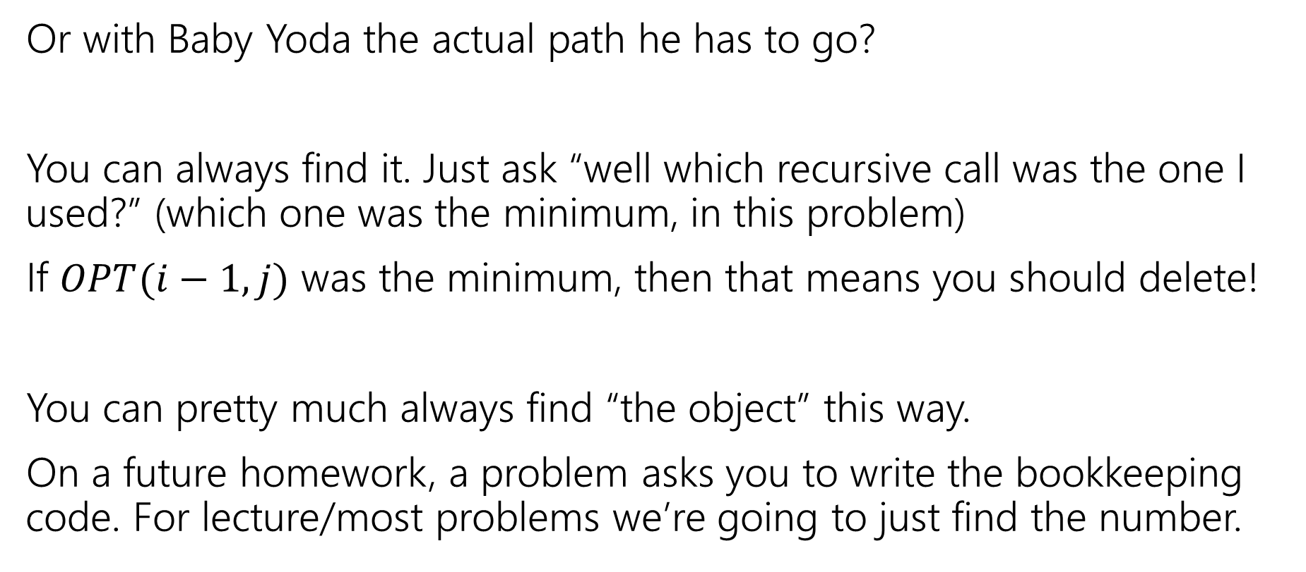
What if we want the list if inserts,delete,subs?
Or with Baby Yoda the actual path he has to go?
You can always find it. Just ask “well which recursive call was the one I used?” (which one was the minimum, in this problem)
If $OPT(i−1,j)$ was the minimum, then that means you should delete!
You can pretty much always find “the object” this way.
On a future homework, a problem asks you to write the bookkeeping code. For lecture/most problems we’re going to just find the number.

Slide 21
Edit Distance
$$OPT(i,j)$$ | 0 | B, 1 | A, 2 | B, 3 | Y, 4 | Y, 5 | O, 6 | D, 7 | A, 8 | S, 9
0 | 0 | 1 | 2 | 3 | 4 | 5 | 6 | 7 | 8 | 9
T 1 | 1 | 1 | 2 | 3 | 4 | 5 | 6 | 7 | 8 | 9
A 2 | 2 | 2 | 1 | 2 | 3 | 4 | 5 | 6 | 7 | 8
S 3 | 3 | 3 | 2 | 2 | 3 | 4 | 5 | 6 | 7 | 7
T 4 | 4 | 4 | 3 | 3 | 3 | 4 | 5 | 6 | 7 | 8
Y 5 | 5 | 5 | 4 | 4 | 3 | 3 | 4 | 5 | 6 | 7
S 6 | 6 | 6 | 5 | 5 | 4 | 4 | 4 | 5 | 6 | 6
O 7 | 7 | 7 | 6 | 6 | 5 | 5 | 4 | 5 | 6 | 7
D 8 | 8 | 8 | 7 | 7 | 6 | 6 | 5 | 4 | 5 | 6
A 9 | 9 | 9 | 8 | 8 | 7 | 7 | 6 | 6 | 4 | 5

Slide 22
Edit Distance
$$OPT(i,j)$$ | 0 | B, 1 | A, 2 | B, 3 | Y, 4 | Y, 5 | O, 6 | D, 7 | A, 8 | S, 9
0 | 0 | 1 | 2 | 3 | 4 | 5 | 6 | 7 | 8 | 9
T 1 | 1 | 1 | 2 | 3 | 4 | 5 | 6 | 7 | 8 | 9
A 2 | 2 | 2 | 1 | 2 | 3 | 4 | 5 | 6 | 7 | 8
S 3 | 3 | 3 | 2 | 2 | 3 | 4 | 5 | 6 | 7 | 7
T 4 | 4 | 4 | 3 | 3 | 3 | 4 | 5 | 6 | 7 | 8
Y 5 | 5 | 5 | 4 | 4 | 3 | 3 | 4 | 5 | 6 | 7
S 6 | 6 | 6 | 5 | 5 | 4 | 4 | 4 | 5 | 6 | 6
O 7 | 7 | 7 | 6 | 6 | 5 | 5 | 4 | 5 | 6 | 7
D 8 | 8 | 8 | 7 | 7 | 6 | 6 | 5 | 4 | 5 | 6
A 9 | 9 | 9 | 8 | 8 | 7 | 7 | 6 | 6 | 4 | 5

Slide 23
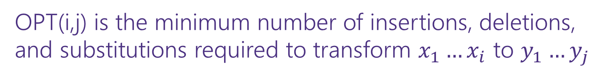
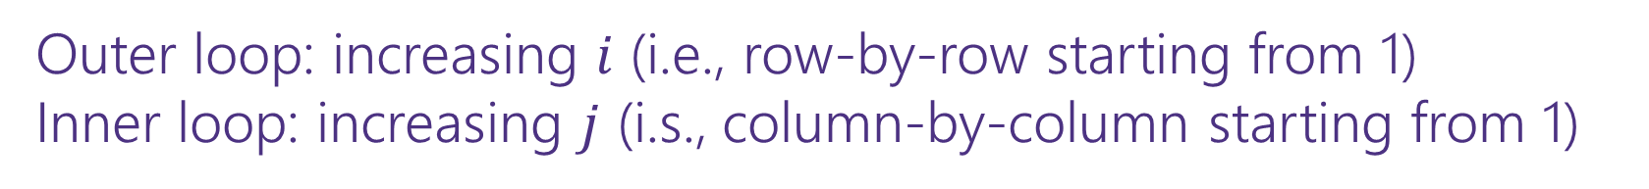
Dynamic Programming Process
1. Define the object you’re looking for
2. Write a recurrence to say how to find it
3. Design a memoization structure
4. Write an iterative algorithm
OPT(i,j) is the minimum number of insertions, deletions, and substitutions required to transform $x_{1}…x_{i}$ to $y_{1}…y_{j}$
✅
$m×n$ Array
Outer loop: increasing $i$ (i.e., row-by-row starting from 1)
Inner loop: increasing $j$ (i.s., column-by-column starting from 1)

Slide 24
More Problems

Slide 25

Maximum Contiguous Subarray Sum
We saw an $O(n\log{n)}$divide and conquer algorithm.
Can we do better with DP?
Given: Array $A$[]
Output: $i,j$ such that $A\left[i\right]+A\left[i+1\right]+…+A[j]$ is maximized.

Slide 26
Dynamic Programming Process
1. Define the object you’re looking for
2. Write a recurrence to say how to find it
3. Design a memoization structure
4. Write an iterative algorithm

Slide 27
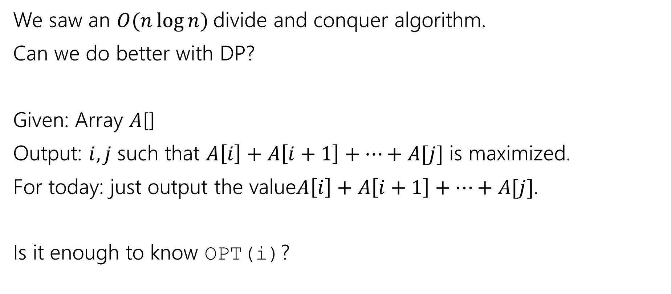
Maximum Contiguous Subarray Sum
We saw an $O(n\log{n)}$divide and conquer algorithm.
Can we do better with DP?
Given: Array $A$[]
Output: $i,j$ such that $A\left[i\right]+A\left[i+1\right]+…+A[j]$ is maximized.
For today: just output the value$A\left[i\right]+A\left[i+1\right]+…+A[j]$.
Is it enough to know OPT(i)?

Slide 28
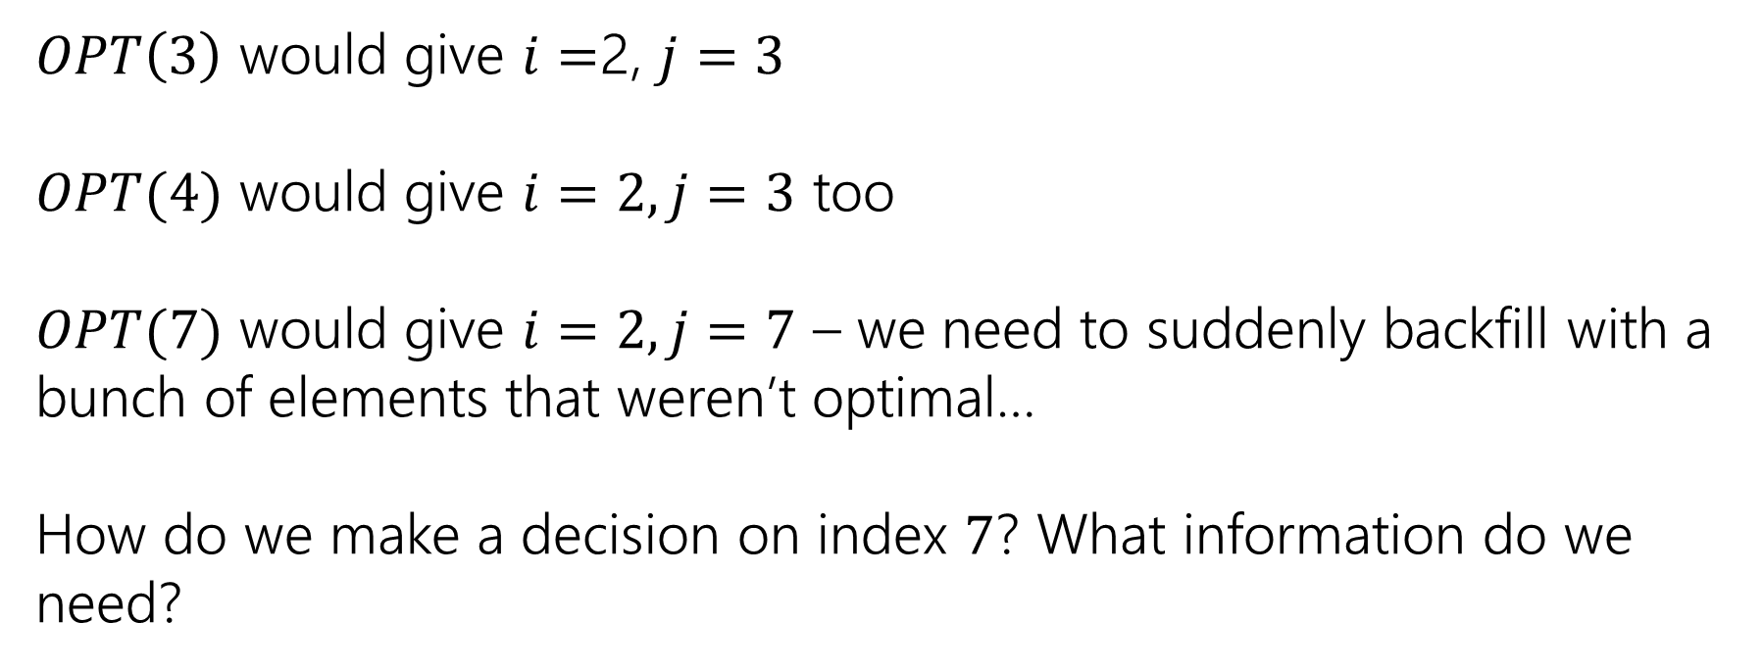
Trying to Recurse
0 | 1 | 2 | 3 | 4 | 5 | 6 | 7
5 | -6 | 3 | 4 | -5 | 2 | 2 | 4
$OPT\left(3\right)$ would give $i=$2, $j=3$
$OPT(4)$ would give $i=2, j=3$ too
$OPT(7)$ would give $i=2, j=7$ – we need to suddenly backfill with a bunch of elements that weren’t optimal…
How do we make a decision on index $7$? What information do we need?

Slide 29
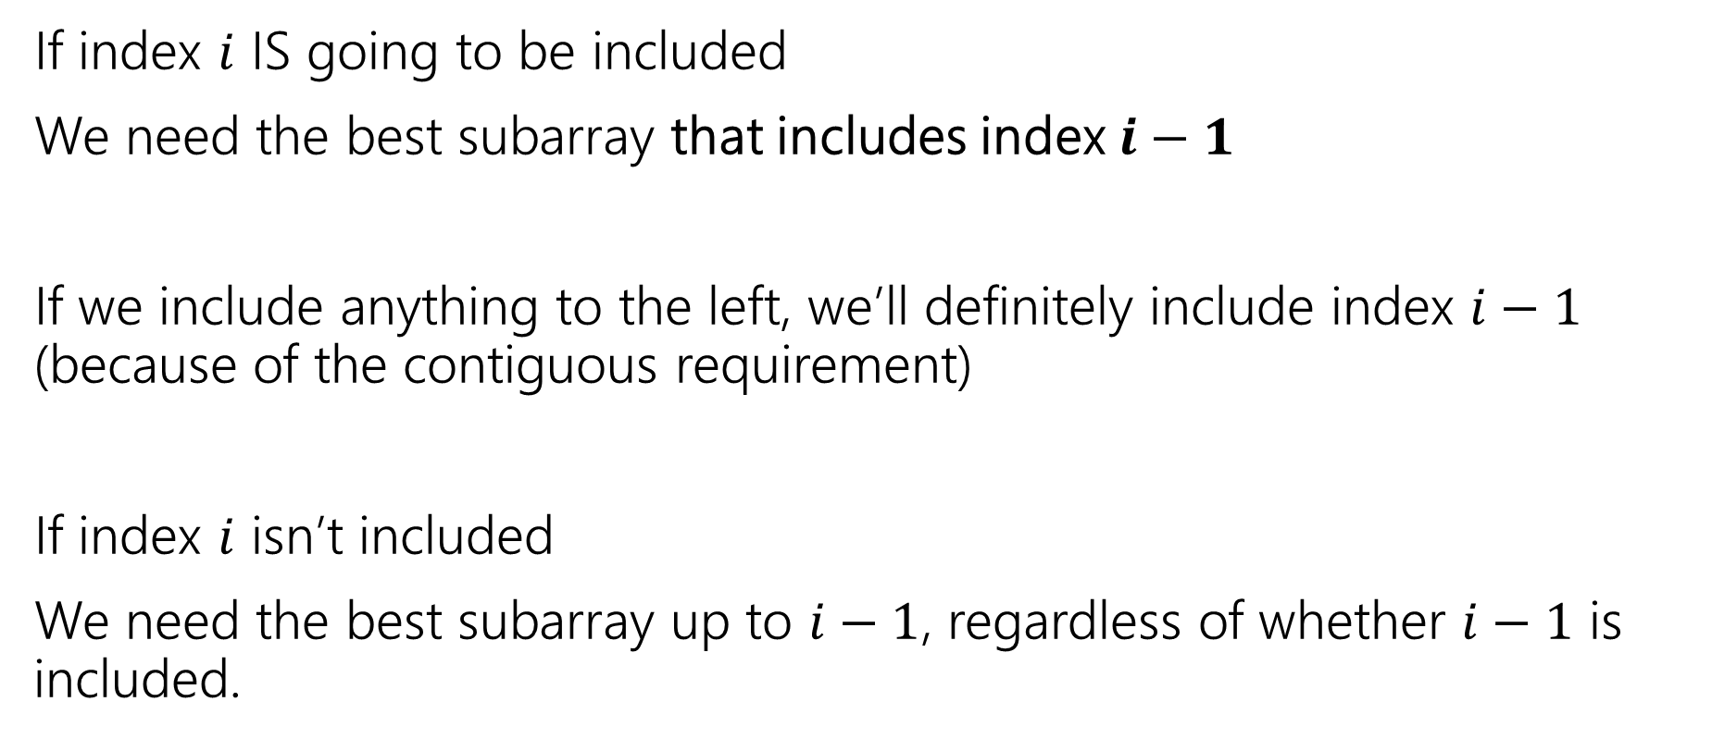
What do we need for recursion?
If index $i$ IS going to be included
We need the best subarray that includes index $i−1$
If we include anything to the left, we’ll definitely include index $i−1$ (because of the contiguous requirement)
If index $i$ isn’t included
We need the best subarray up to $i−1$, regardless of whether $i−1$ is included.

Slide 30
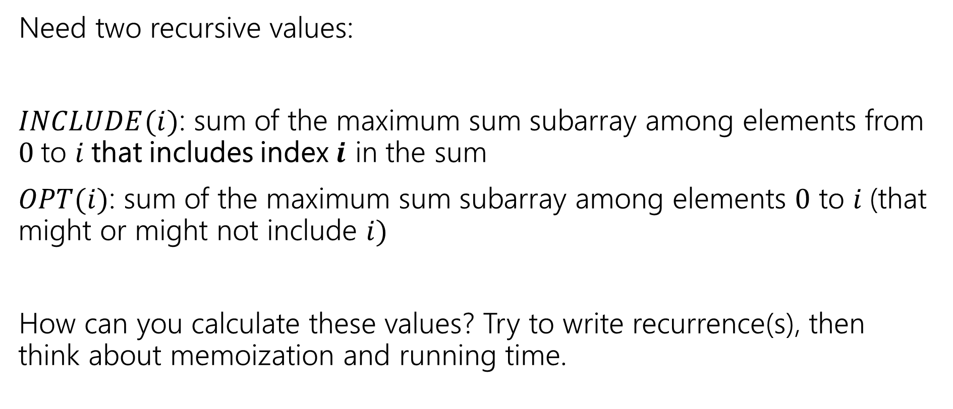
Two Values
Pollev.com/robbie
Need two recursive values:
$INCLUDE(i)$: sum of the maximum sum subarray among elements from $0$to $i$that includes index $i$ in the sum
$OPT(i)$: sum of the maximum sum subarray among elements $0$ to $i$(that might or might not include $i)$
How can you calculate these values? Try to write recurrence(s), then think about memoization and running time.

Slide 31
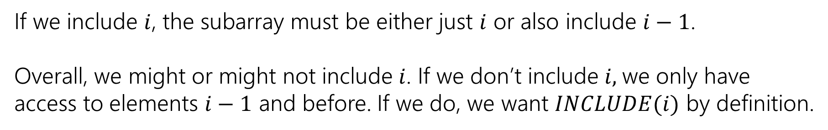

Recurrences
$INCLUDE\left(i\right)=\left\{\begin{aligned}\max\left\{A\left[i\right], A\left[i\right]+INLCUDE\left(i−1\right)\right\} if i≥0 \\ 0 otherwise\end{aligned}\right.$
$OPT\left(i\right)=\left\{\begin{aligned}\max\left\{INCLUDE\left(i\right),OPT\left(i−1\right)\right\} if i≥0 \\ 0 otherwise\end{aligned}\right.$
If we include $i$, the subarray must be either just $i$ or also include $i−1$.
Overall, we might or might not include $i$. If we don’t include $i,$we only have access to elements $i−1$ and before. If we do, we want $INCLUDE(i)$ by definition.

Slide 32



Example
$$A$$
0 | 1 | 2 | 3 | 4 | 5 | 6 | 7
5 | -6 | 3 | 4 | -5 | 2 | 2 | 4
$$OPT(i)$$
0 | 1 | 2 | 3 | 4 | 5 | 6 | 7
5
0 | 1 | 2 | 3 | 4 | 5 | 6 | 7
5
$$INCLUDE(i)$$

Slide 33
Example
$$A$$
0 | 1 | 2 | 3 | 4 | 5 | 6 | 7
5 | -6 | 3 | 4 | -5 | 2 | 2 | 4
$$OPT(i)$$
0 | 1 | 2 | 3 | 4 | 5 | 6 | 7
5 | 5
0 | 1 | 2 | 3 | 4 | 5 | 6 | 7
5 | -1
$$INCLUDE(i)$$

Slide 34
Example
$$A$$
0 | 1 | 2 | 3 | 4 | 5 | 6 | 7
5 | -6 | 3 | 4 | -5 | 2 | 2 | 4
$$OPT(i)$$
0 | 1 | 2 | 3 | 4 | 5 | 6 | 7
5 | 5 | 5 | 7 | 7 | 7 | 7 | 10
0 | 1 | 2 | 3 | 4 | 5 | 6 | 7
5 | -1 | 3 | 7 | 2 | 4 | 6 | 10
$$INCLUDE(i)$$

Slide 35
Pseudocode
int maxSubarraySum(int[] A)
int n=A.length
int[] OPT = new int[n]
int[] Inc = new int[n]
inc[0]=A[0]; OPT[0] = max{A[0],0}
for(int i=0;i<n;i++)
inc[i]=max{A[i], A[i]+inc[i-1]}
OPT[i]=max{inc[i], opt[i-1]}
endFor
return OPT[n-1]

Slide 36
Recursive Thinking In General
As before, the hardest part is designing the recurrence.
It sometimes helps to think from multiple different angles.
Top-down: What’s the first step to take?
Baby Yoda will first go left or down. Use recursion to find out which of left or down is better.
The farthest right operation in the string transformation will be one of insert, delete, substitute, match for free. Use recursion to find out which is best.

Slide 37
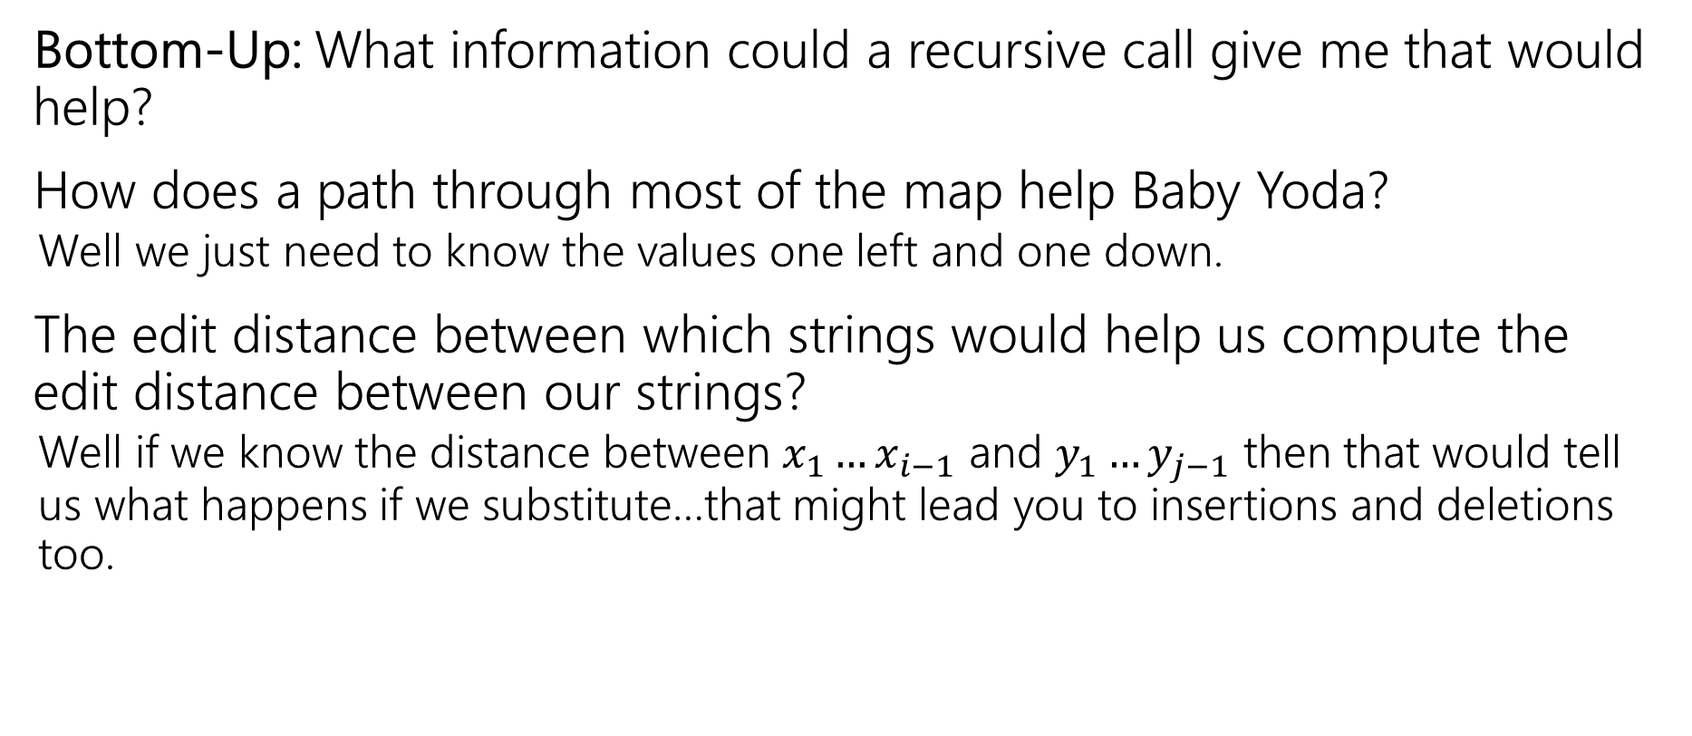
Recursive Thinking In General
Bottom-Up: What information could a recursive call give me that would help?
How does a path through most of the map help Baby Yoda?
  Well we just need to know the values one left and one down.
The edit distance between which strings would help us compute the edit distance between our strings?
  Well if we know the distance between $x_{1}…x_{i−1}$ and $y_{1}…y_{j−1}$ then that would tell us what happens if we substitute…that might lead you to insertions and deletions too.

Slide 38
Recursive Thinking In General
Some people refer to the “Optimal Substructure Property”
From the optimum (most eggs, fewest number of string operations) for a slightly smaller problem (Baby Yoda starting closer to the end, slightly smaller strings), we need to be able to build up the optimum for the full problem.

Slide 39
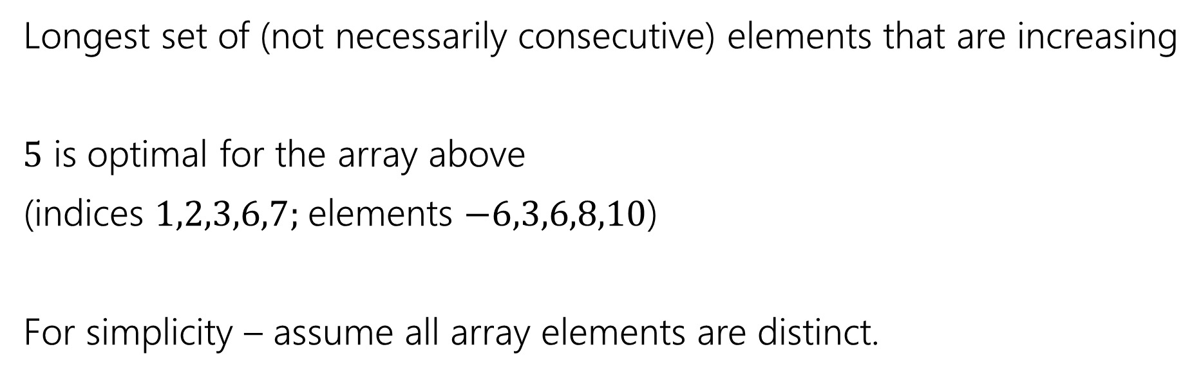
Longest Increasing Subsequence
0 | 1 | 2 | 3 | 4 | 5 | 6 | 7
5 | -6 | 3 | 6 | -5 | 2 | 8 | 10
Longest set of (not necessarily consecutive) elements that are increasing
$5$ is optimal for the array above
(indices $1,2,3,6,7;$elements $−6,3,6,8,10$)
For simplicity – assume all array elements are distinct.

