Slide 1
More Dynamic Programming
CSE 417 Fall 22
Lecture 12

Slide 2
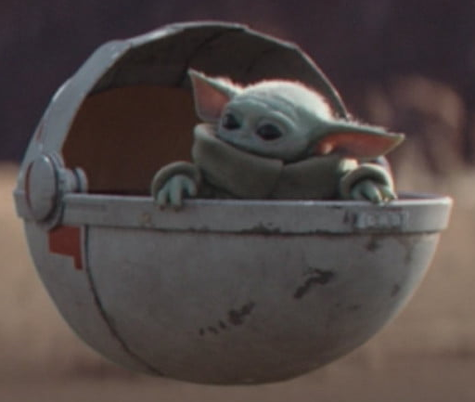
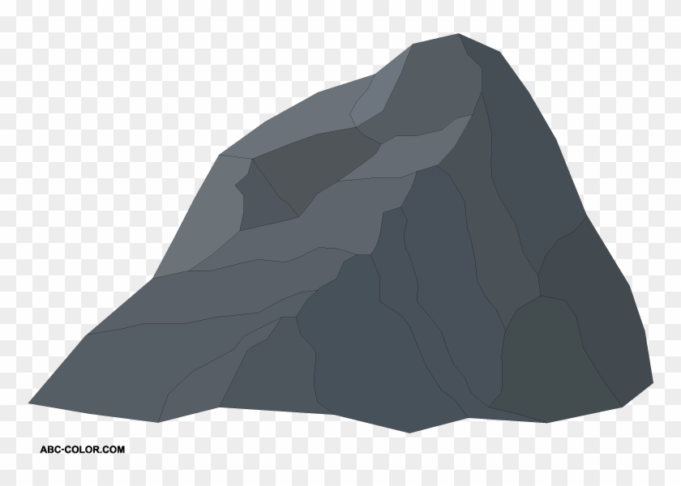
Baby Yoda Searching
Baby Yoda has to get from the upper-right corner to the lower left.
His cradle will only let him go left and down.
He can’t get past the rocks (too high) – he has to go around them (but still only going left and down)
As usual…he’s hungry.
He wants to eat as many frog eggs as possible on the way.

Slide 3
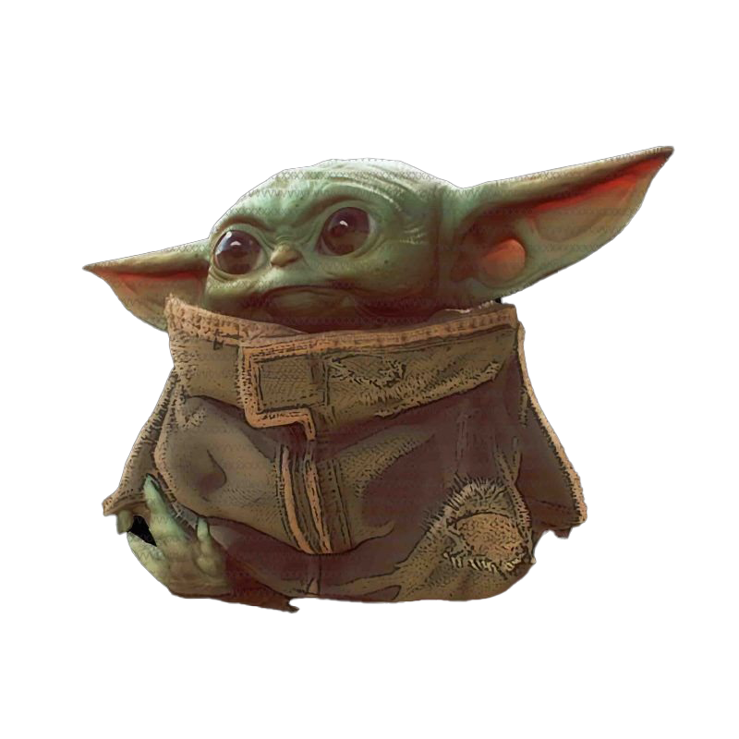
Baby Yoda Searching
(c-1,r-1)
r-1
Y-coordinate
(0,2)
(0,1)
(1,1)
0
(0,0)
X-coordinate
0
c-1
Notes:
https://1.bp.blogspot.com/-XxfNI65zLnU/Xc98O96LVnI/AAAAAAAAGFY/Xsmd7IMlIrEltYONCdGKk1hqPw1BgL3ggCLcBGAsYHQ/s1600/Mandalorian.jpg
http://www.pngmart.com/image/161116/png/161115
https://www.pikpng.com/pngvi/hiTxbbR_clip-art-rock-rock-clipart-transparent-background-png-download/

Slide 4
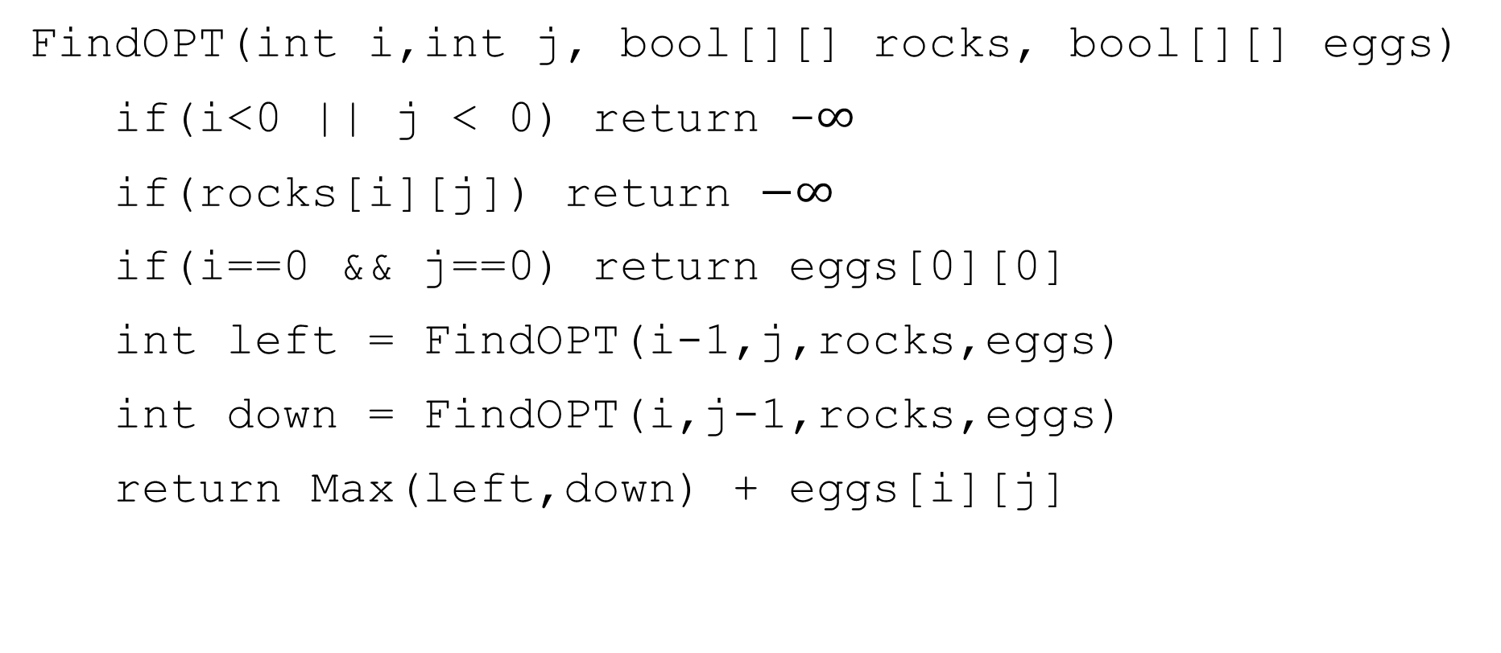
A Recursive Function
FindOPT(int i,int j, bool[][] rocks, bool[][] eggs)
if(i<0 || j < 0) return -$∞$
if(rocks[i][j]) return $−∞$
if(i==0 && j==0) return eggs[0][0]
int left = FindOPT(i-1,j,rocks,eggs)
int down = FindOPT(i,j-1,rocks,eggs)
return Max(left,down) + eggs[i][j]

Slide 5
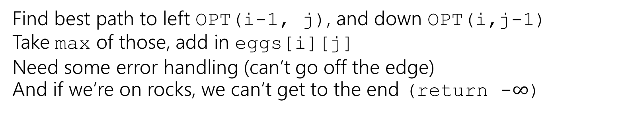
Recursive Baby Yoda
Let OPT(i,j) be the maximum number of eggs we can get on a legal path from (i,j) to (0,0)(including the egg in (i,j) if there is one)
Base Case?
Recursive case?
At (0,0), nowhere to go, return eggs[0][0]
Find best path to left OPT(i-1, j), and down OPT(i,j-1)
Take max of those, add in eggs[i][j]
Need some error handling (can’t go off the edge)
And if we’re on rocks, we can’t get to the end (return -$∞$)

Slide 6
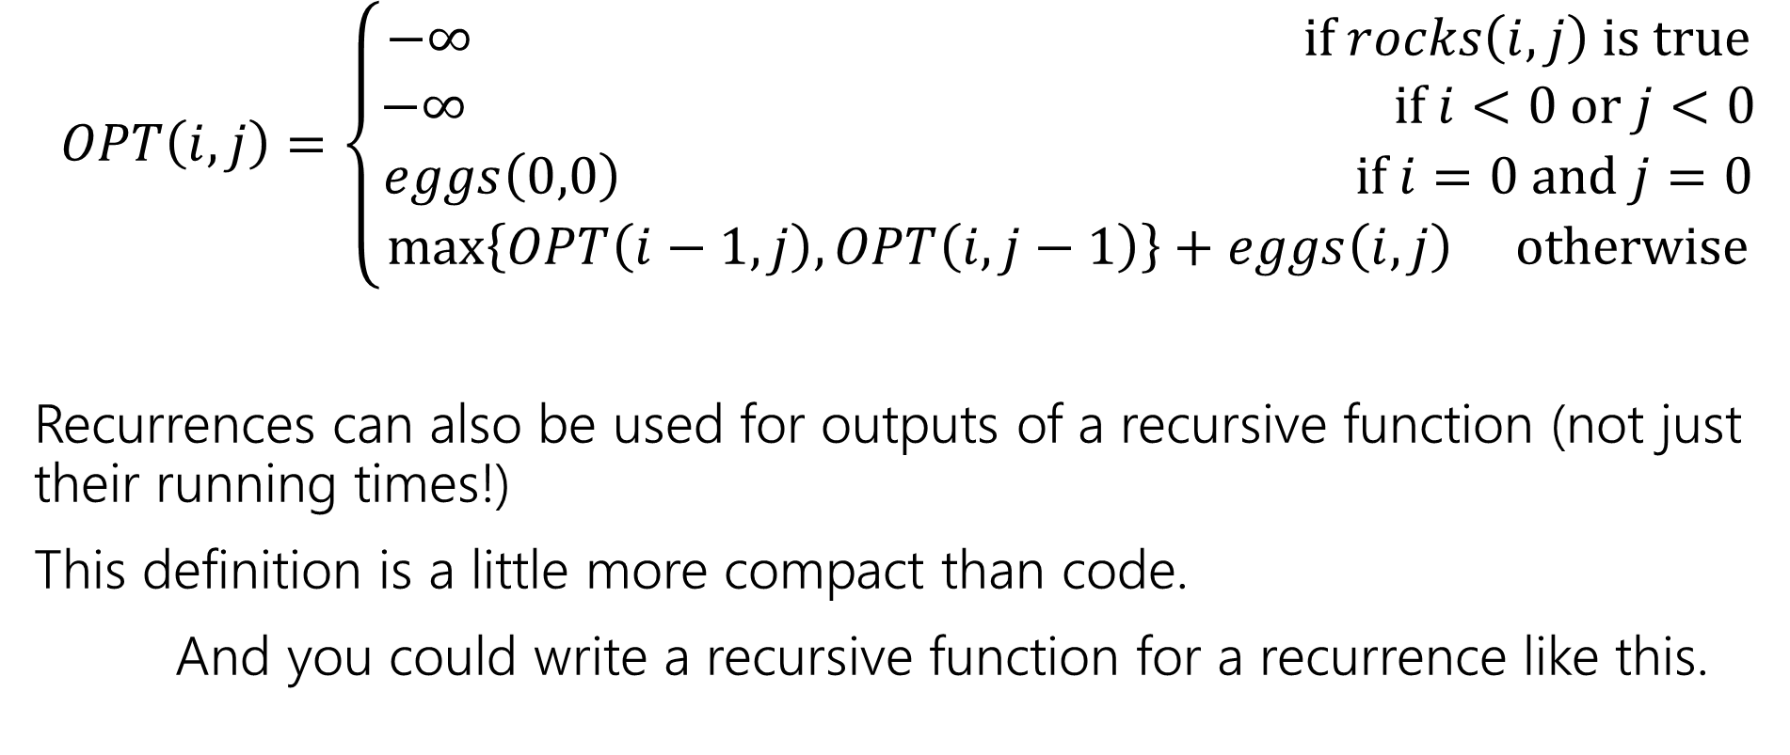
Recurrence Form
$$OPT\left(i,j\right)=\left\{\begin{aligned}−∞ if rocks\left(i,j\right) is true \\ −∞ if i<0 or j<0 \\ eggs\left(0,0\right) if i=0 and j=0 \\ \max\left\{OPT\left(i−1,j\right), OPT\left(i,j−1\right)\right\}+eggs\left(i,j\right) otherwise\end{aligned}\right.$$
Recurrences can also be used for outputs of a recursive function (not just their running times!)
This definition is a little more compact than code.
And you could write a recursive function for a recurrence like this.

Slide 7

Analyzing the recursive function
So…how does the code work? What’s its running time?
$T\left(c,r\right)=\left\{\begin{aligned}T\left(c−1,r\right)+T\left(c,r−1\right)+Θ\left(n\right) if r≥0 and c≥0 \\ Θ\left(1\right) otherwise\end{aligned}\right.$
Master Theorem says…

Slide 8
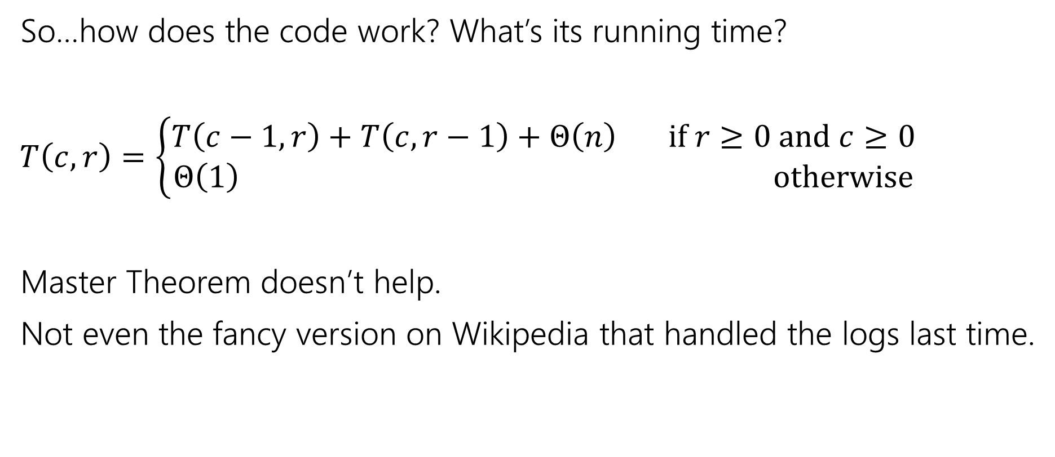
Analyzing the recursive function
So…how does the code work? What’s its running time?
$T\left(c,r\right)=\left\{\begin{aligned}T\left(c−1,r\right)+T\left(c,r−1\right)+Θ\left(n\right) if r≥0 and c≥0 \\ Θ\left(1\right) otherwise\end{aligned}\right.$
Master Theorem doesn’t help.
Not even the fancy version on Wikipedia that handled the logs last time.

Slide 9
Recurrence Form
$$OPT\left(i,j\right)=\left\{\begin{aligned}−∞ if rocks\left(i,j\right) is true \\ −∞ if i<0 or j<0 \\ eggs\left(0,0\right) if i=0 and j=0 \\ \max\left\{OPT\left(i−1,j\right), OPT\left(i,j−1\right)\right\}+eggs\left(i,j\right) otherwise\end{aligned}\right.$$
Recurrences can also be used for outputs of a recursive function (not just their running times!)
This definition is a little more compact than code.
And you could write a recursive function for a recurrence like this.

Slide 10



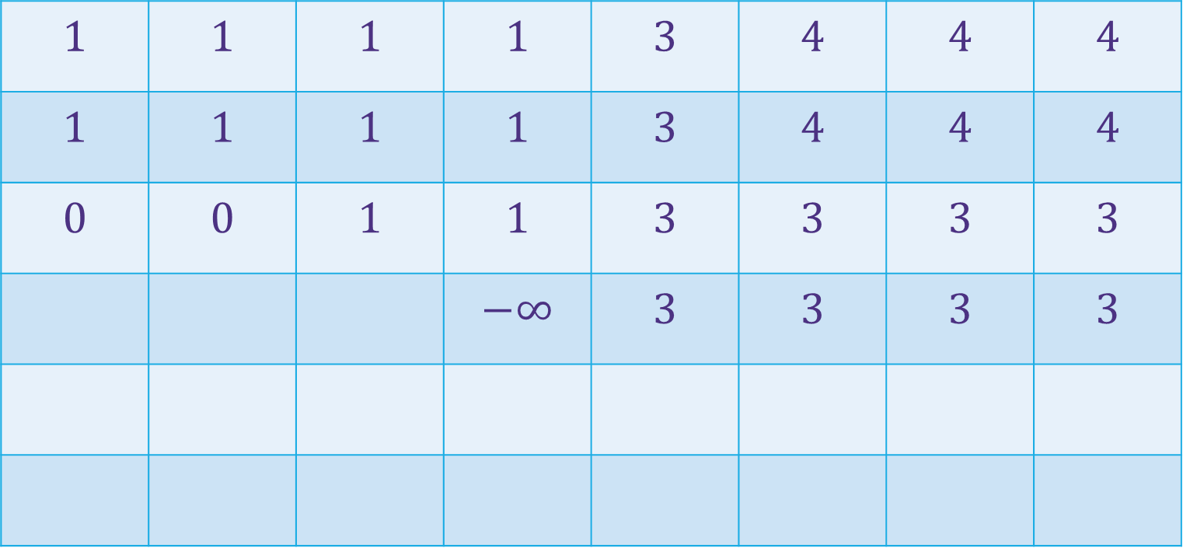
















Baby Yoda Searching
(c-1,r-1)
$$1$$ | $$1$$ | $$1$$ | $$1$$ | $$3$$ | $$4$$ | $$4$$ | $$4$$
$$1$$ | $$1$$ | $$1$$ | $$1$$ | $$3$$ | $$4$$ | $$4$$ | $$4$$
$$0$$ | $$0$$ | $$1$$ | $$1$$ | $$3$$ | $$3$$ | $$3$$ | $$3$$
 |  |  | $$−∞$$ | $$3$$ | $$3$$ | $$3$$ | $$3$$
r-1
Where’s the final answer?
In the top right. Where Baby Yoda starts.
Y-coordinate
$$0$$
$$−∞$$
$$−∞$$
$$0$$
$$1$$
$$−∞$$
$$2$$
$$2$$
$$2$$
$$2$$
$$2$$
0
$$0$$
$$1$$
$$2$$
$$2$$
$$2$$
$$2$$
$$2$$
$$2$$
X-coordinate
0
c-1
Notes:
https://1.bp.blogspot.com/-XxfNI65zLnU/Xc98O96LVnI/AAAAAAAAGFY/Xsmd7IMlIrEltYONCdGKk1hqPw1BgL3ggCLcBGAsYHQ/s1600/Mandalorian.jpg
http://www.pngmart.com/image/161116/png/161115
https://www.pikpng.com/pngvi/hiTxbbR_clip-art-rock-rock-clipart-transparent-background-png-download/

Slide 11
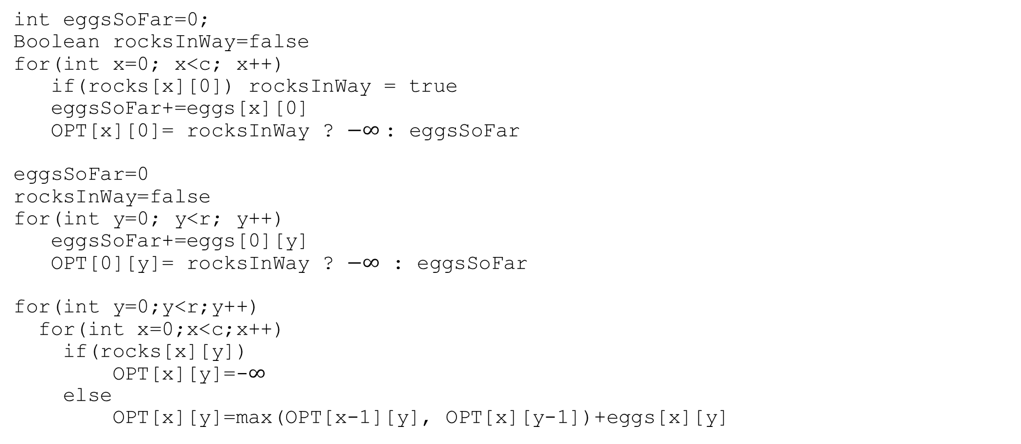
Pseudocode
int eggsSoFar=0;
Boolean rocksInWay=false
for(int x=0; x<c; x++)
if(rocks[x][0]) rocksInWay = true
eggsSoFar+=eggs[x][0]
OPT[x][0]= rocksInWay ? $−∞$: eggsSoFar
eggsSoFar=0
rocksInWay=false
for(int y=0; y<r; y++)
eggsSoFar+=eggs[0][y]
OPT[0][y]= rocksInWay ? $−∞$ : eggsSoFar
for(int y=0;y<r;y++)
for(int x=0;x<c;x++)
if(rocks[x][y])
OPT[x][y]=-$∞$
else
OPT[x][y]=max(OPT[x-1][y], OPT[x][y-1])+eggs[x][y]

Slide 12
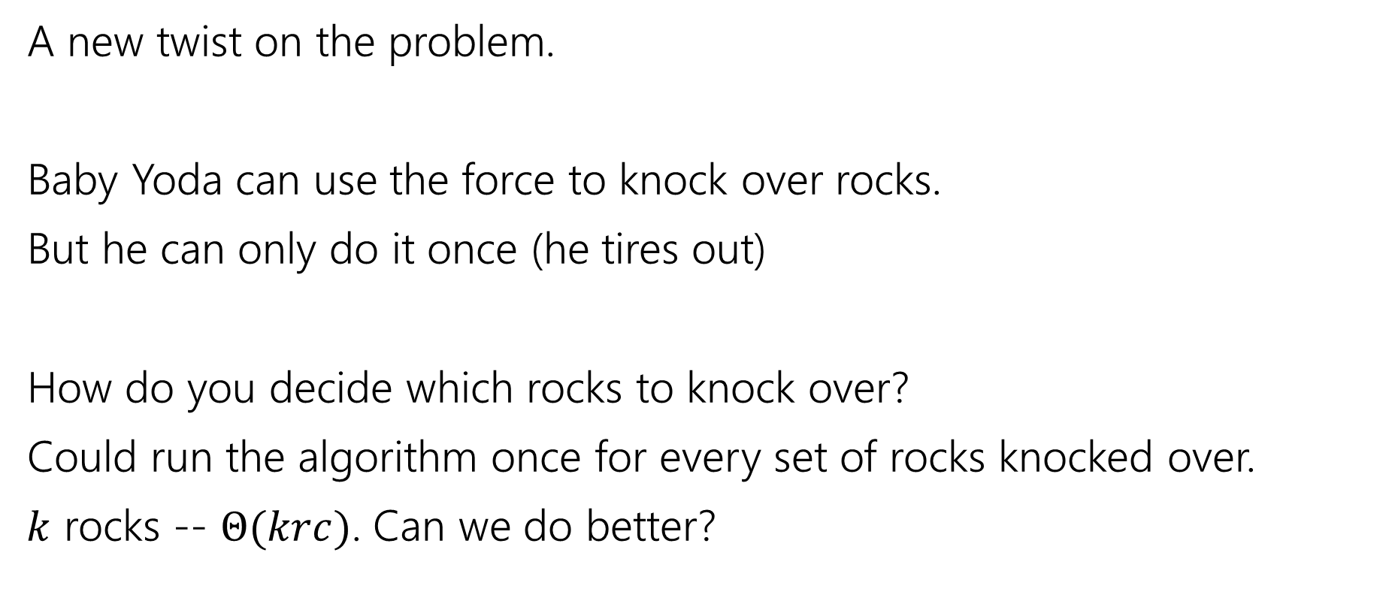
Updating the Problem
A new twist on the problem.
Baby Yoda can use the force to knock over rocks.
But he can only do it once (he tires out)
How do you decide which rocks to knock over?
Could run the algorithm once for every set of rocks knocked over.
$k$ rocks -- $Θ(krc)$. Can we do better?

Slide 13
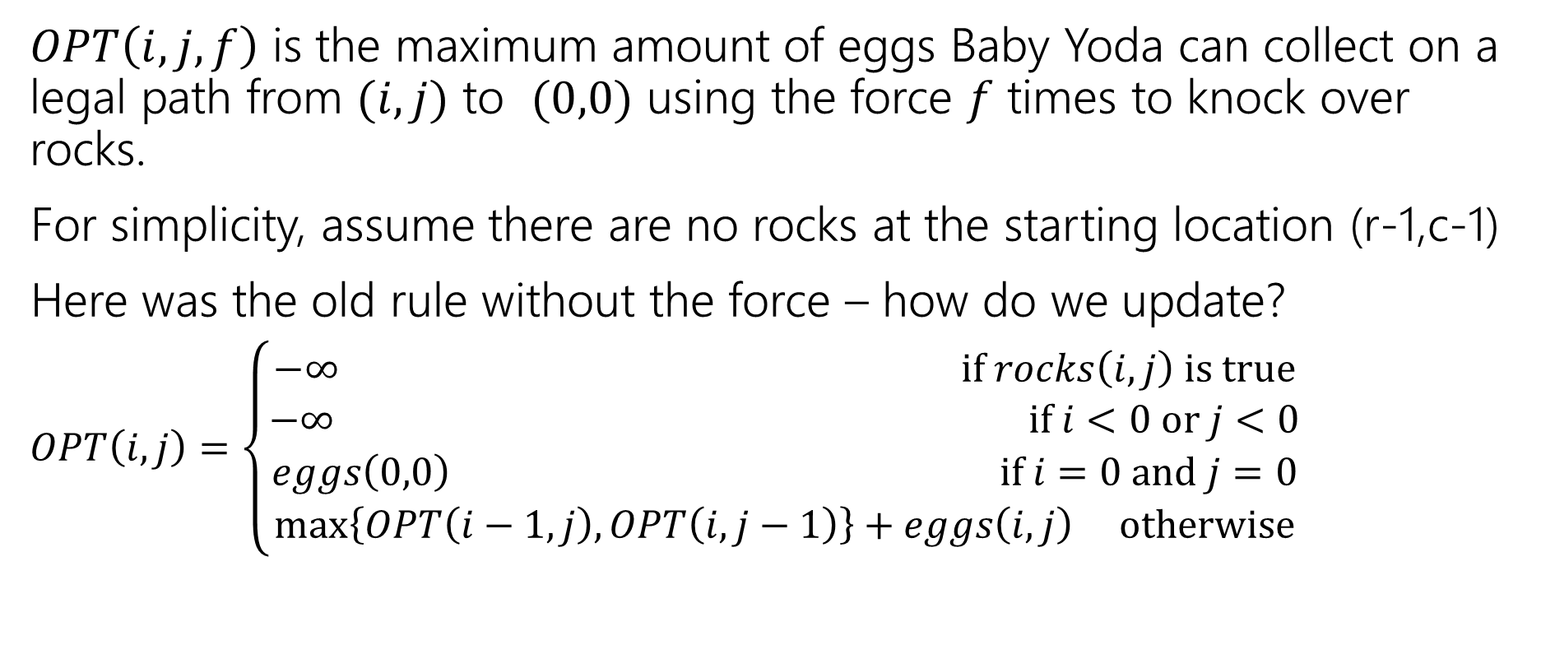
Updating the Problem
$OPT\left(i,j,f\right)$ is the maximum amount of eggs Baby Yoda can collect on a legal path from $(i,j)$ to $(0,0)$ using the force $f$ times to knock over rocks.
For simplicity, assume there are no rocks at the starting location (r-1,c-1)
Here was the old rule without the force – how do we update?
$OPT\left(i,j\right)=\left\{\begin{aligned}−∞ if rocks\left(i,j\right) is true \\ −∞ if i<0 or j<0 \\ eggs\left(0,0\right) if i=0 and j=0 \\ \max\left\{OPT\left(i−1,j\right), OPT\left(i,j−1\right)\right\}+eggs\left(i,j\right) otherwise\end{aligned}\right.$

Slide 14
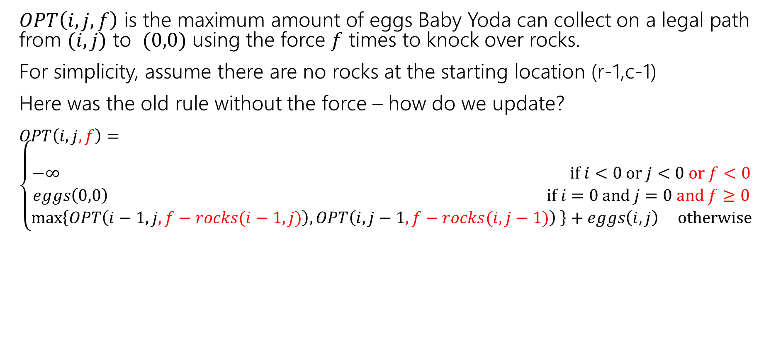
Updating the Problem
$OPT\left(i,j,f\right)$ is the maximum amount of eggs Baby Yoda can collect on a legal path from $(i,j)$ to $(0,0)$ using the force $f$ times to knock over rocks.
For simplicity, assume there are no rocks at the starting location (r-1,c-1)
Here was the old rule without the force – how do we update?
$OPT\left(i,j,f\right)=\left\{\begin{aligned} \\ −∞ if i<0 or j<0 or f<0 \\ eggs\left(0,0\right) if i=0 and j=0 and f≥0 \\ \max\left\{OPT\left(i−1,j,f−rocks(i−1,j)\right), OPT\left(i,j−1,f−rocks(i,j−1)\right) \right\}+eggs\left(i,j\right) otherwise\end{aligned}\right.$
Casting Boolean as an integer
(subtract 1 if you would need to knock over rocks)

Slide 15
Updating the Problem
$OPT\left(i,j,f\right)$ is the maximum amount of eggs Baby Yoda can collect on a legal path from $(i,j)$ to $(0,0)$ using the force $f$ times to knock over rocks.
For simplicity, assume there are no rocks at the starting location (r-1,c-1)
Here was the old rule without the force – how do we update?
$OPT\left(i,j,f\right)=\left\{\begin{aligned} \\ −∞ if i<0 or j<0 or f<0 \\ eggs\left(0,0\right) if i=0 and j=0 and f≥0 \\ \max\left\{OPT\left(i−1,j,f−rocks(i−1,j)\right), OPT\left(i,j−1,f−rocks(i,j−1)\right) \right\}+eggs\left(i,j\right) otherwise\end{aligned}\right.$
rocks(i,j) doesn’t guarantee $−∞$ anymore. Only if you were out of force uses before trying to jump onto that location.

Slide 16
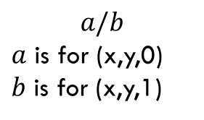
Baby Yoda Searching
(c-1,r-1)
r-1
What can we fill in?
Y-coordinate
$$a/b$$
$a$ is for (x,y,0) $b$ is for (x,y,1)
0
X-coordinate
0
c-1
Notes:
https://1.bp.blogspot.com/-XxfNI65zLnU/Xc98O96LVnI/AAAAAAAAGFY/Xsmd7IMlIrEltYONCdGKk1hqPw1BgL3ggCLcBGAsYHQ/s1600/Mandalorian.jpg
http://www.pngmart.com/image/161116/png/161115
https://www.pikpng.com/pngvi/hiTxbbR_clip-art-rock-rock-clipart-transparent-background-png-download/

Slide 17








Baby Yoda Searching
(c-1,r-1)
r-1
What can we fill in?
Y-coordinate
$$a/b$$
$a$ is for (x,y,0) $b$ is for (x,y,1)
0
$$0/?$$
$$1/?$$
$$2/?$$
$$2/?$$
$$2/?$$
$$2/?$$
$$2/?$$
$$2/?$$
X-coordinate
0
c-1
Notes:
https://1.bp.blogspot.com/-XxfNI65zLnU/Xc98O96LVnI/AAAAAAAAGFY/Xsmd7IMlIrEltYONCdGKk1hqPw1BgL3ggCLcBGAsYHQ/s1600/Mandalorian.jpg
http://www.pngmart.com/image/161116/png/161115
https://www.pikpng.com/pngvi/hiTxbbR_clip-art-rock-rock-clipart-transparent-background-png-download/

Slide 18


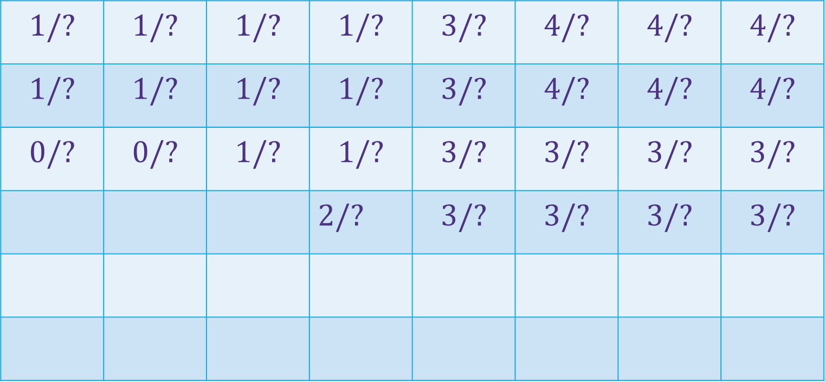





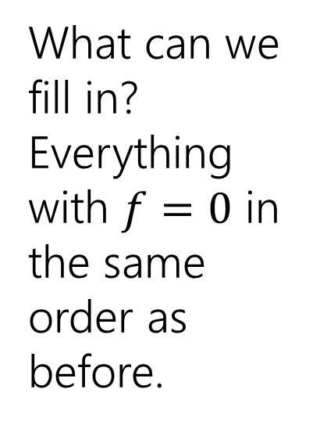







Baby Yoda Searching
(c-1,r-1)
$$1/?$$ | $$1/?$$ | $$1/?$$ | $$1/?$$ | $$3/?$$ | $$4/?$$ | $$4/?$$ | $$4/?$$
$$1/?$$ | $$1/?$$ | $$1/?$$ | $$1/?$$ | $$3/?$$ | $$4/?$$ | $$4/?$$ | $$4/?$$
$$0/?$$ | $$0/?$$ | $$1/?$$ | $$1/?$$ | $$3/?$$ | $$3/?$$ | $$3/?$$ | $$3/?$$
 |  |  | $2/?$ | $$3/?$$ | $$3/?$$ | $$3/?$$ | $$3/?$$
r-1
What can we fill in?
Everything with $f=0$ in the same order as before.
Y-coordinate
$$0/?$$
$$1/?$$
$$−∞/?$$
$$0/?$$
$$1/?$$
$$2/?$$
$$2/?$$
$$2/?$$
$$2/?$$
$$2/?$$
$$2/?$$
0
$$0/?$$
$$1/?$$
$$2/?$$
$$2/?$$
$$2/?$$
$$2/?$$
$$2/?$$
$$2/?$$
Entries are slightly different – we’re handling rocks differently.
X-coordinate
0
c-1
Notes:
https://1.bp.blogspot.com/-XxfNI65zLnU/Xc98O96LVnI/AAAAAAAAGFY/Xsmd7IMlIrEltYONCdGKk1hqPw1BgL3ggCLcBGAsYHQ/s1600/Mandalorian.jpg
http://www.pngmart.com/image/161116/png/161115
https://www.pikpng.com/pngvi/hiTxbbR_clip-art-rock-rock-clipart-transparent-background-png-download/

Slide 19
Baby Yoda Searching
(c-1,r-1)
$$1/?$$ | $$1/?$$ | $$1/?$$ | $$1/?$$ | $$3/?$$ | $$4/?$$ | $$4/?$$ | $$4/?$$
$$1/?$$ | $$1/?$$ | $$1/?$$ | $$1/?$$ | $$3/?$$ | $$4/?$$ | $$4/?$$ | $$4/?$$
$$0/?$$ | $$0/?$$ | $$1/?$$ | $$1/?$$ | $$3/?$$ | $$3/?$$ | $$3/?$$ | $$3/?$$
 |  |  | $2/?$ | $$3/?$$ | $$3/?$$ | $$3/?$$ | $$3/?$$
r-1
What can we fill in?
Again from left to right, bottom to top, now filling in
Y-coordinate
$$0/?$$
$$1/?$$
$$−∞/?$$
$$0/?$$
$$1/?$$
$$2/?$$
$$2/?$$
$$2/?$$
$$2/?$$
$$2/?$$
$$2/?$$
0
$$0/?$$
$$1/?$$
$$2/?$$
$$2/?$$
$$2/?$$
$$2/?$$
$$2/?$$
$$2/?$$
X-coordinate
0
c-1
Notes:
https://1.bp.blogspot.com/-XxfNI65zLnU/Xc98O96LVnI/AAAAAAAAGFY/Xsmd7IMlIrEltYONCdGKk1hqPw1BgL3ggCLcBGAsYHQ/s1600/Mandalorian.jpg
http://www.pngmart.com/image/161116/png/161115
https://www.pikpng.com/pngvi/hiTxbbR_clip-art-rock-rock-clipart-transparent-background-png-download/

Slide 20



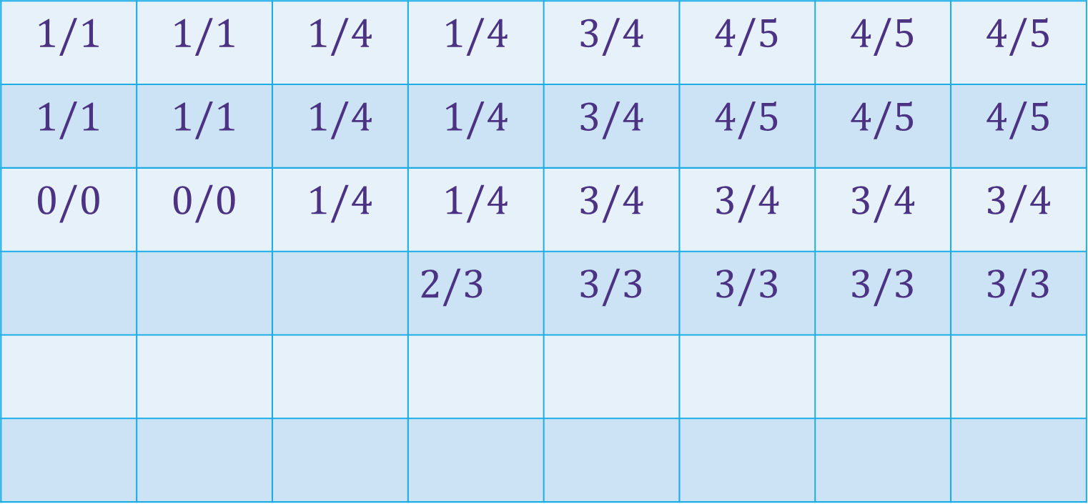
















Baby Yoda Searching
(c-1,r-1)
$$1/1$$ | $$1/1$$ | $$1/4$$ | $$1/4$$ | $$3/4$$ | $$4/5$$ | $$4/5$$ | $$4/5$$
$$1/1$$ | $$1/1$$ | $$1/4$$ | $$1/4$$ | $$3/4$$ | $$4/5$$ | $$4/5$$ | $$4/5$$
$$0/0$$ | $$0/0$$ | $$1/4$$ | $$1/4$$ | $$3/4$$ | $$3/4$$ | $$3/4$$ | $$3/4$$
 |  |  | $2/3$ | $$3/3$$ | $$3/3$$ | $$3/3$$ | $$3/3$$
r-1
What can we fill in?
Again from left to right, bottom to top, now filling in
Y-coordinate
$$0/0$$
$$1/1$$
$$−∞/3$$
$$0/0$$
$$1/1$$
$$2/2$$
$$2/2$$
$$2/2$$
$$2/2$$
$$2/2$$
$$2/2$$
0
$$0/0$$
$$1/1$$
$$2/2$$
$$2/2$$
$$2/2$$
$$2/2$$
$$2/2$$
$$2/2$$
X-coordinate
0
c-1
Notes:
https://1.bp.blogspot.com/-XxfNI65zLnU/Xc98O96LVnI/AAAAAAAAGFY/Xsmd7IMlIrEltYONCdGKk1hqPw1BgL3ggCLcBGAsYHQ/s1600/Mandalorian.jpg
http://www.pngmart.com/image/161116/png/161115
https://www.pikpng.com/pngvi/hiTxbbR_clip-art-rock-rock-clipart-transparent-background-png-download/

Slide 21
Dynamic Programming Process
1. Define the object you’re looking for
2. Write a recurrence to say how to find it
3. Design a memoization structure
4. Write an iterative algorithm

Slide 22
Bells,Whistles, and optimiziation

Slide 23
Baby Yoda Searching
(c-1,r-1)
$$1/1$$ | $$1/1$$ | $$1/4$$ | $$1/4$$ | $$3/4$$ | $$4/5$$ | $$4/5$$ | $$4/5$$
$$1/1$$ | $$1/1$$ | $$1/4$$ | $$1/4$$ | $$3/4$$ | $$4/5$$ | $$4/5$$ | $$4/5$$
$$0/0$$ | $$0/0$$ | $$1/4$$ | $$1/4$$ | $$3/4$$ | $$3/4$$ | $$3/4$$ | $$3/4$$
 |  |  | $2/3$ | $$3/3$$ | $$3/3$$ | $$3/3$$ | $$3/3$$
r-1
So should Baby Yoda go left or down?
Y-coordinate
$$0/0$$
$$1/1$$
$$−∞/3$$
$$0/0$$
$$1/1$$
$$2/2$$
$$2/2$$
$$2/2$$
$$2/2$$
$$2/2$$
$$2/2$$
0
$$0/0$$
$$1/1$$
$$2/2$$
$$2/2$$
$$2/2$$
$$2/2$$
$$2/2$$
$$2/2$$
X-coordinate
0
c-1
Notes:
https://1.bp.blogspot.com/-XxfNI65zLnU/Xc98O96LVnI/AAAAAAAAGFY/Xsmd7IMlIrEltYONCdGKk1hqPw1BgL3ggCLcBGAsYHQ/s1600/Mandalorian.jpg
http://www.pngmart.com/image/161116/png/161115
https://www.pikpng.com/pngvi/hiTxbbR_clip-art-rock-rock-clipart-transparent-background-png-download/

Slide 24
Which Way to Go
When you’re taking the max in the recursive case, you can also record which option gave you the max.
That’s the way to go.
We’ll ask you to do that once…but for the most part we’ll just have you find the number.

Slide 25
Optimizing
Do we need all that memory?
Let’s go back to the simple version (no using the Force)

Slide 26
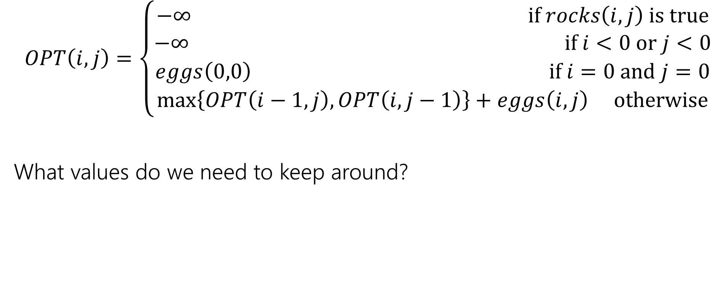
Recurrence Form
$$OPT\left(i,j\right)=\left\{\begin{aligned}−∞ if rocks\left(i,j\right) is true \\ −∞ if i<0 or j<0 \\ eggs\left(0,0\right) if i=0 and j=0 \\ \max\left\{OPT\left(i−1,j\right), OPT\left(i,j−1\right)\right\}+eggs\left(i,j\right) otherwise\end{aligned}\right.$$
What values do we need to keep around?

Slide 27
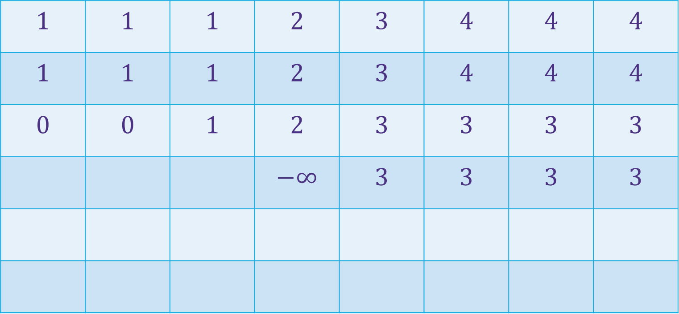
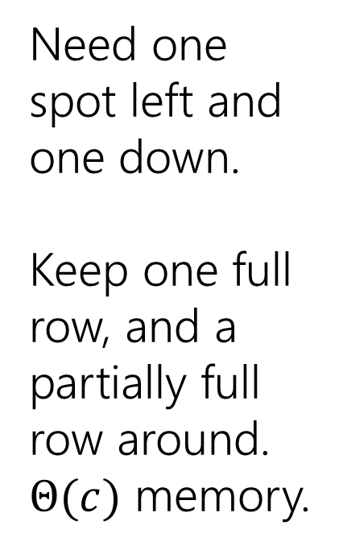
Baby Yoda Searching
(c-1,r-1)
$$1$$ | $$1$$ | $$1$$ | $$2$$ | $$3$$ | $$4$$ | $$4$$ | $$4$$
$$1$$ | $$1$$ | $$1$$ | $$2$$ | $$3$$ | $$4$$ | $$4$$ | $$4$$
$$0$$ | $$0$$ | $$1$$ | $$2$$ | $$3$$ | $$3$$ | $$3$$ | $$3$$
 |  |  | $$−∞$$ | $$3$$ | $$3$$ | $$3$$ | $$3$$
r-1
Need one spot left and one down.
Keep one full row, and a partially full row around.
$Θ(c)$ memory.
Y-coordinate
$$0$$
$$−∞$$
$$−∞$$
$$0$$
$$1$$
$$−∞$$
$$2$$
$$2$$
$$2$$
$$2$$
$$2$$
0
$$0$$
$$1$$
$$2$$
$$2$$
$$2$$
$$2$$
$$2$$
$$2$$
X-coordinate
0
c-1
Notes:
https://1.bp.blogspot.com/-XxfNI65zLnU/Xc98O96LVnI/AAAAAAAAGFY/Xsmd7IMlIrEltYONCdGKk1hqPw1BgL3ggCLcBGAsYHQ/s1600/Mandalorian.jpg
http://www.pngmart.com/image/161116/png/161115
https://www.pikpng.com/pngvi/hiTxbbR_clip-art-rock-rock-clipart-transparent-background-png-download/

Slide 28
More Practical Problems

Slide 29

Edit Distance
Given two strings $x$ and $y,$we’d like to tell how close they are.
Applications?
Spelling suggestions
DNA comparison

Slide 30
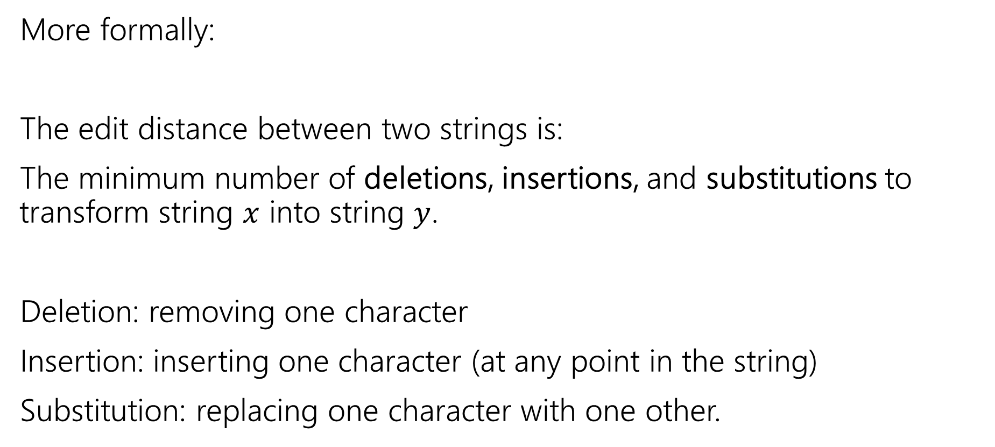
Edit Distance
More formally:
The edit distance between two strings is:
The minimum number of deletions, insertions, and substitutions to transform string $x$ into string $y$.
Deletion: removing one character
Insertion: inserting one character (at any point in the string)
Substitution: replacing one character with one other.

Slide 31
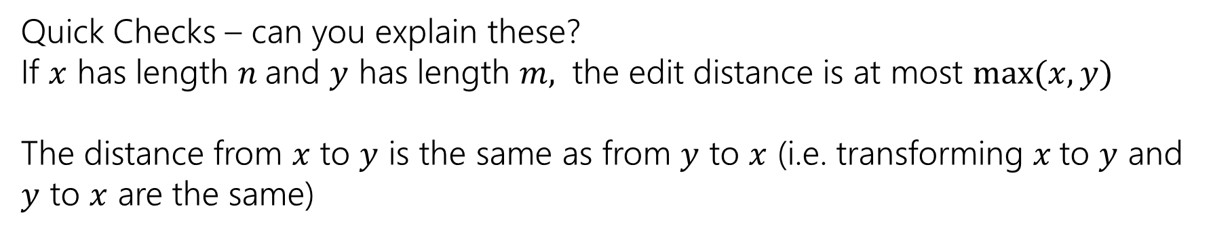
Example
What’s the distance between babyyodas and tastysoda?
B | A | B |  | Y | Y | O | D | A | S
sub |  | sub | ins |  | sub |  |  |  | del
T | A | S | T | Y | S | O | D | A
Distance: 5, one point for each colored box
Quick Checks – can you explain these?
If $x$ has length $n$and $y$ has length $m,$ the edit distance is at most $\max{(x,y)}$
The distance from $x$ to $y$ is the same as from $y$ to $x$ (i.e. transforming $x$to $y$ and $y$ to $x$ are the same)

Slide 32
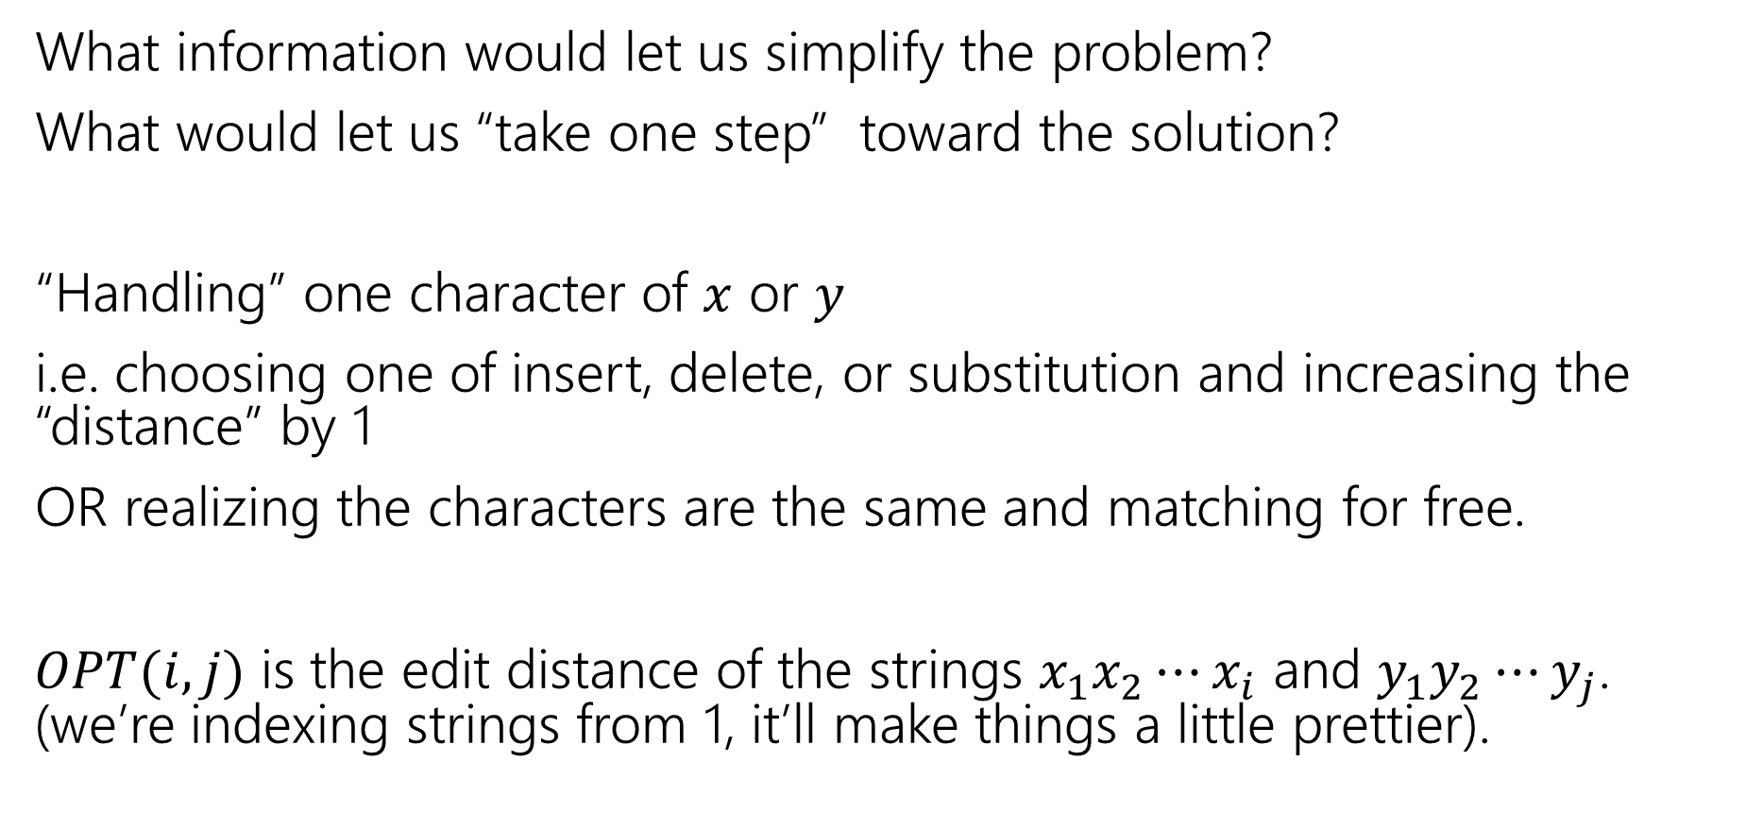
Finding a recurrence
What information would let us simplify the problem?
What would let us “take one step” toward the solution?
“Handling” one character of $x$ or $y$
i.e. choosing one of insert, delete, or substitution and increasing the “distance” by 1
OR realizing the characters are the same and matching for free.
$OPT(i,j)$ is the edit distance of the strings $x_{1}x_{2}⋯x_{i}$ and $y_{1}y_{2}⋯y_{j}$. (we’re indexing strings from 1, it’ll make things a little prettier).

Slide 33
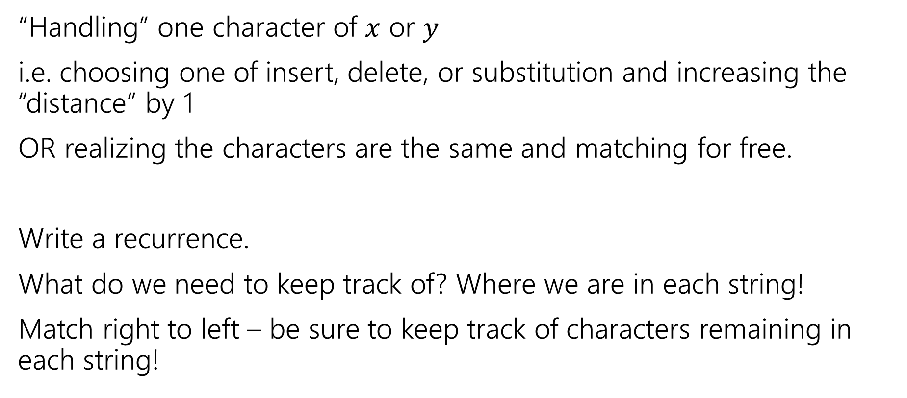
The recurrence
Poll at Pollev.com/robbie
“Handling” one character of $x$ or $y$
i.e. choosing one of insert, delete, or substitution and increasing the “distance” by 1
OR realizing the characters are the same and matching for free.
Write a recurrence.
What do we need to keep track of? Where we are in each string!
Match right to left – be sure to keep track of characters remaining in each string!

Slide 34
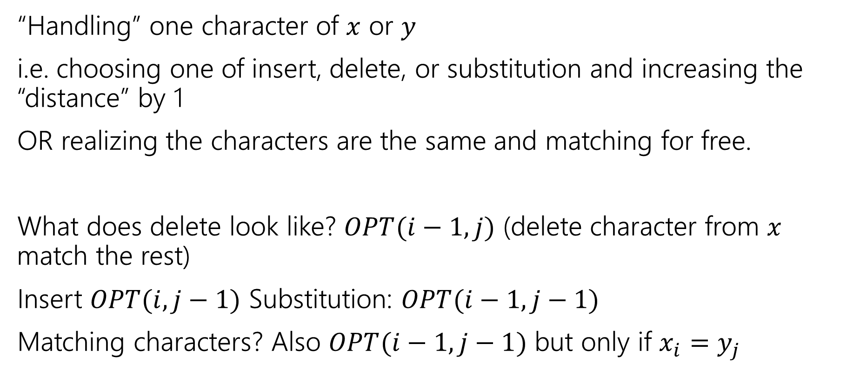
The recurrence
“Handling” one character of $x$ or $y$
i.e. choosing one of insert, delete, or substitution and increasing the “distance” by 1
OR realizing the characters are the same and matching for free.
What does delete look like? $OPT(i−1, j)$ (delete character from $x$ match the rest)
Insert $OPT(i,j−1)$ Substitution: $OPT(i−1,j−1)$
Matching characters? Also $OPT(i−1,j−1)$ but only if $x_{i}=y_{j}$

Slide 35
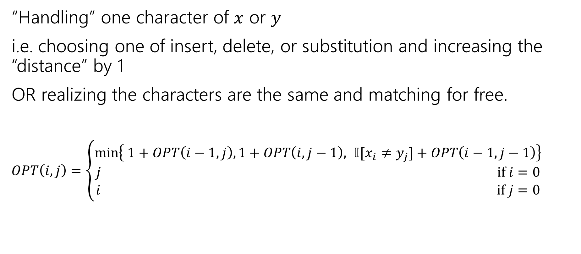
The recurrence
“Handling” one character of $x$ or $y$
i.e. choosing one of insert, delete, or substitution and increasing the “distance” by 1
OR realizing the characters are the same and matching for free.
$OPT\left(i,j\right)=\left\{\begin{aligned}\min\left\{ 1+OPT\left(i−1,j\right), 1+OPT\left(i,j−1\right), 𝕀[x_{i}≠y_{j}]+OPT\left(i−1,j−1\right)\right\} \\ j if i=0 \\ i if j=0\end{aligned}\right.$
Delete
Insert
Sub and matching
“Indicator” – math for “cast bool to int”

Slide 36
Dynamic Programming Process
1. Define the object you’re looking for
2. Write a recurrence to say how to find it
3. Design a memoization structure
4. Write an iterative algorithm
Minimum Edit Distance between $x$ and $y$
✅

Slide 37

Memoization
$OPT\left(i,j\right)=\left\{\begin{aligned}\min\left\{ 1+OPT\left(i−1,j\right), 1+OPT\left(i,j−1\right), 𝕀[x_{i}≠y_{j}]+OPT\left(i−1,j−1\right)\right\} \\ j if i=0 \\ i if j=0\end{aligned}\right.$
2D array $n$ by $m$
OPT[i][j] is $OPT(i,j)$

Slide 38
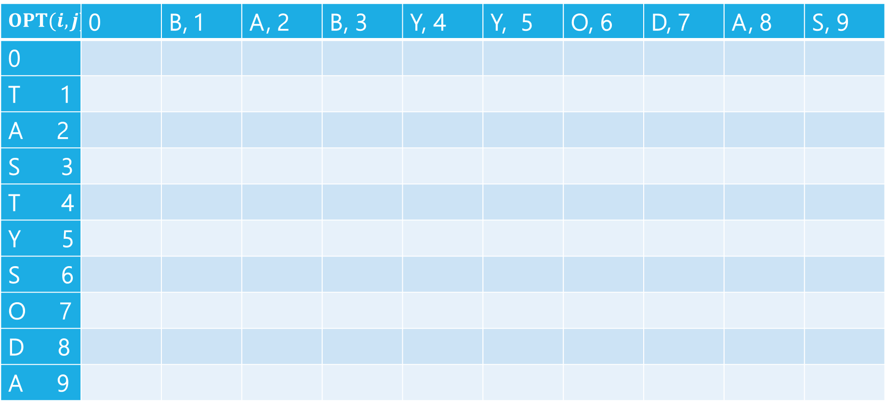
Edit Distance
$$OPT(i,j)$$ | 0 | B, 1 | A, 2 | B, 3 | Y, 4 | Y, 5 | O, 6 | D, 7 | A, 8 | S, 9
0
T 1
A 2
S 3
T 4
Y 5
S 6
O 7
D 8
A 9

Slide 39
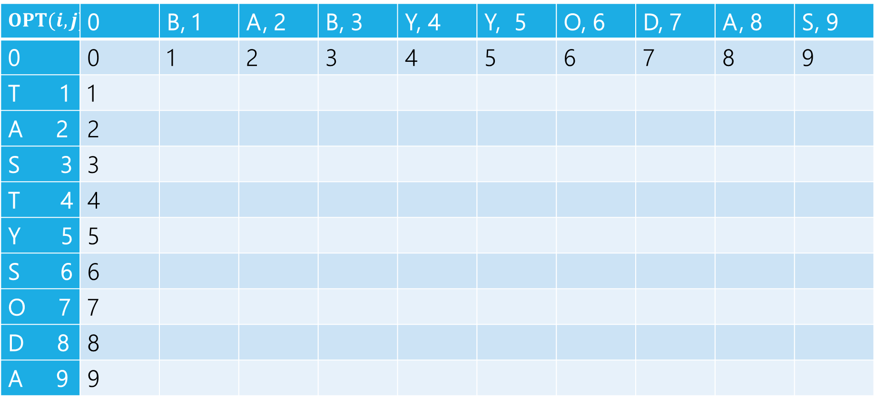
Edit Distance
$$OPT(i,j)$$ | 0 | B, 1 | A, 2 | B, 3 | Y, 4 | Y, 5 | O, 6 | D, 7 | A, 8 | S, 9
0 | 0 | 1 | 2 | 3 | 4 | 5 | 6 | 7 | 8 | 9
T 1 | 1
A 2 | 2
S 3 | 3
T 4 | 4
Y 5 | 5
S 6 | 6
O 7 | 7
D 8 | 8
A 9 | 9

Slide 40

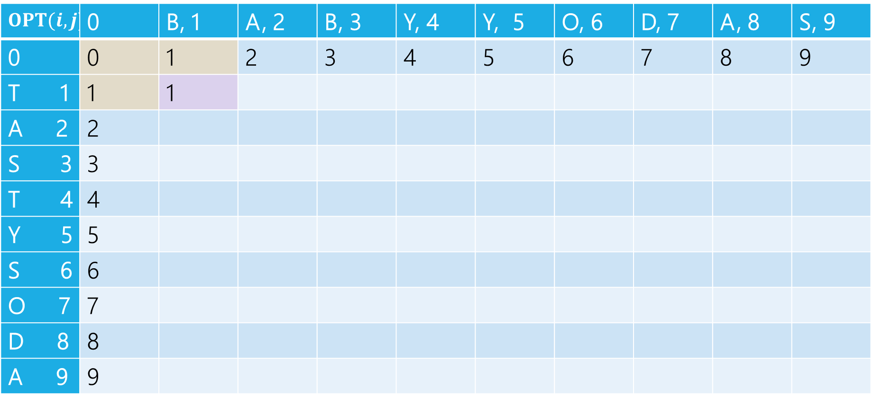
Edit Distance
$$OPT(i,j)$$ | 0 | B, 1 | A, 2 | B, 3 | Y, 4 | Y, 5 | O, 6 | D, 7 | A, 8 | S, 9
0 | 0 | 1 | 2 | 3 | 4 | 5 | 6 | 7 | 8 | 9
T 1 | 1 | 1
A 2 | 2
S 3 | 3
T 4 | 4
Y 5 | 5
S 6 | 6
O 7 | 7
D 8 | 8
A 9 | 9
$1+1 \left(left, delete\right)$
$1+1\left(up, insert\right)$
$0+1(diag,sub)$

Slide 41

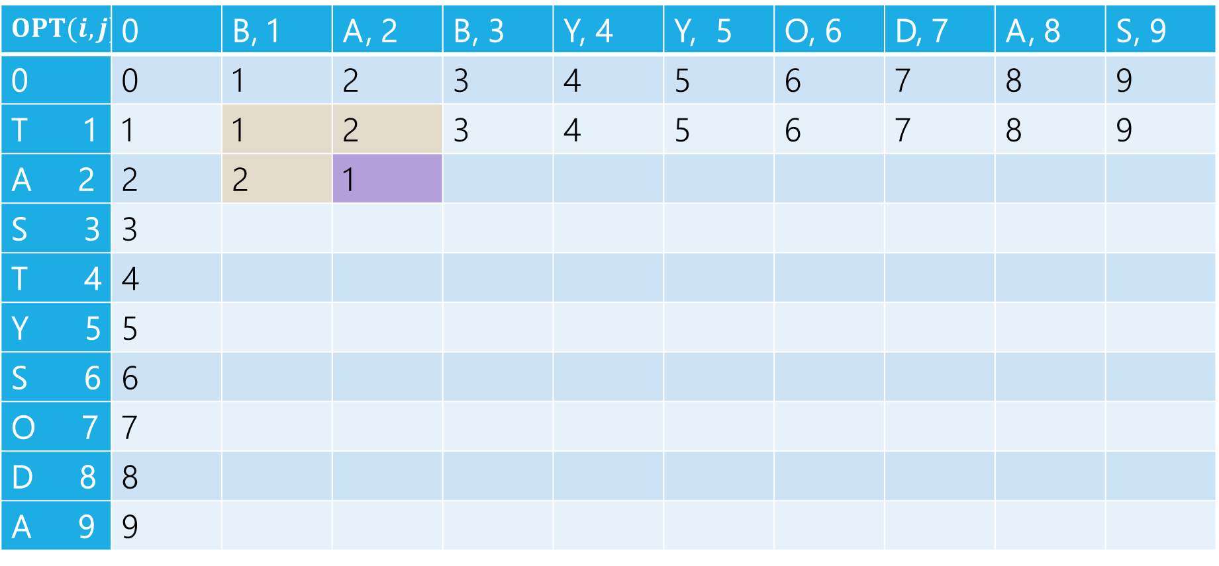
Edit Distance
$$OPT(i,j)$$ | 0 | B, 1 | A, 2 | B, 3 | Y, 4 | Y, 5 | O, 6 | D, 7 | A, 8 | S, 9
0 | 0 | 1 | 2 | 3 | 4 | 5 | 6 | 7 | 8 | 9
T 1 | 1 | 1 | 2 | 3 | 4 | 5 | 6 | 7 | 8 | 9
A 2 | 2 | 2 | 1
S 3 | 3
T 4 | 4
Y 5 | 5
S 6 | 6
O 7 | 7
D 8 | 8
A 9 | 9
$2+1 \left(left, delete\right)$
$2+1\left(up, insert\right)$
$1+0(diag,sub)$

Slide 42
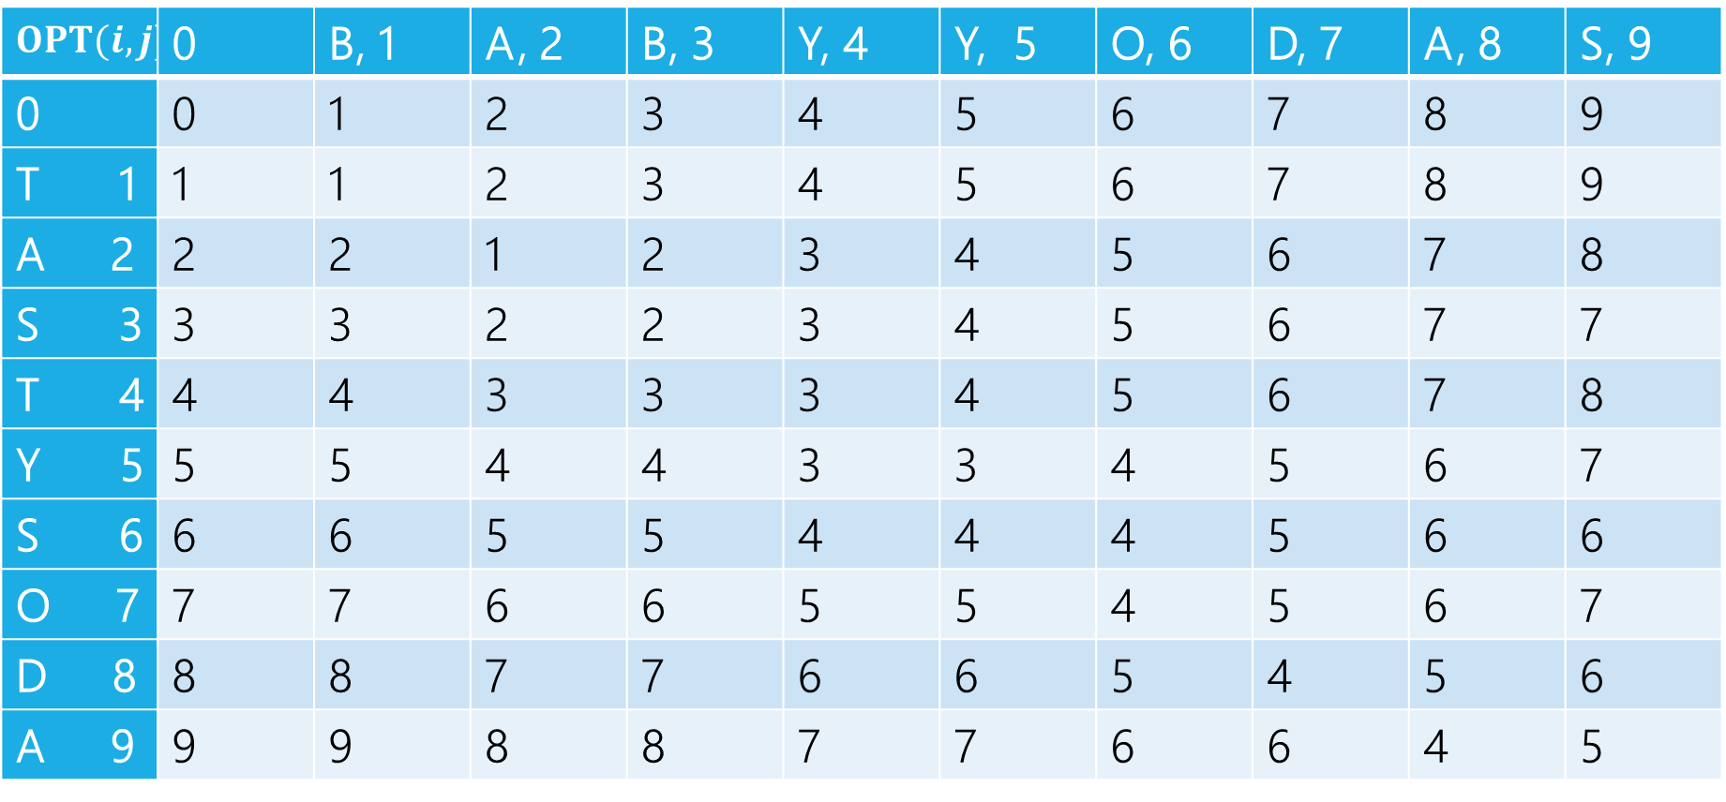
Edit Distance
$$OPT(i,j)$$ | 0 | B, 1 | A, 2 | B, 3 | Y, 4 | Y, 5 | O, 6 | D, 7 | A, 8 | S, 9
0 | 0 | 1 | 2 | 3 | 4 | 5 | 6 | 7 | 8 | 9
T 1 | 1 | 1 | 2 | 3 | 4 | 5 | 6 | 7 | 8 | 9
A 2 | 2 | 2 | 1 | 2 | 3 | 4 | 5 | 6 | 7 | 8
S 3 | 3 | 3 | 2 | 2 | 3 | 4 | 5 | 6 | 7 | 7
T 4 | 4 | 4 | 3 | 3 | 3 | 4 | 5 | 6 | 7 | 8
Y 5 | 5 | 5 | 4 | 4 | 3 | 3 | 4 | 5 | 6 | 7
S 6 | 6 | 6 | 5 | 5 | 4 | 4 | 4 | 5 | 6 | 6
O 7 | 7 | 7 | 6 | 6 | 5 | 5 | 4 | 5 | 6 | 7
D 8 | 8 | 8 | 7 | 7 | 6 | 6 | 5 | 4 | 5 | 6
A 9 | 9 | 9 | 8 | 8 | 7 | 7 | 6 | 6 | 4 | 5

Slide 43
Edit Distance
$$OPT(i,j)$$ | 0 | B, 1 | A, 2 | B, 3 | Y, 4 | Y, 5 | O, 6 | D, 7 | A, 8 | S, 9
0 | 0 | 1 | 2 | 3 | 4 | 5 | 6 | 7 | 8 | 9
T 1 | 1 | 1 | 2 | 3 | 4 | 5 | 6 | 7 | 8 | 9
A 2 | 2 | 2 | 1 | 2 | 3 | 4 | 5 | 6 | 7 | 8
S 3 | 3 | 3 | 2 | 2 | 3 | 4 | 5 | 6 | 7 | 7
T 4 | 4 | 4 | 3 | 3 | 3 | 4 | 5 | 6 | 7 | 8
Y 5 | 5 | 5 | 4 | 4 | 3 | 3 | 4 | 5 | 6 | 7
S 6 | 6 | 6 | 5 | 5 | 4 | 4 | 4 | 5 | 6 | 6
O 7 | 7 | 7 | 6 | 6 | 5 | 5 | 4 | 5 | 6 | 7
D 8 | 8 | 8 | 7 | 7 | 6 | 6 | 5 | 4 | 5 | 6
A 9 | 9 | 9 | 8 | 8 | 7 | 7 | 6 | 6 | 4 | 5

Slide 44
Edit Distance
$$OPT(i,j)$$ | 0 | B, 1 | A, 2 | B, 3 | Y, 4 | Y, 5 | O, 6 | D, 7 | A, 8 | S, 9
0 | 0 | 1 | 2 | 3 | 4 | 5 | 6 | 7 | 8 | 9
T 1 | 1 | 1 | 2 | 3 | 4 | 5 | 6 | 7 | 8 | 9
A 2 | 2 | 2 | 1 | 2 | 3 | 4 | 5 | 6 | 7 | 8
S 3 | 3 | 3 | 2 | 2 | 3 | 4 | 5 | 6 | 7 | 7
T 4 | 4 | 4 | 3 | 3 | 3 | 4 | 5 | 6 | 7 | 8
Y 5 | 5 | 5 | 4 | 4 | 3 | 3 | 4 | 5 | 6 | 7
S 6 | 6 | 6 | 5 | 5 | 4 | 4 | 4 | 5 | 6 | 6
O 7 | 7 | 7 | 6 | 6 | 5 | 5 | 4 | 5 | 6 | 7
D 8 | 8 | 8 | 7 | 7 | 6 | 6 | 5 | 4 | 5 | 6
A 9 | 9 | 9 | 8 | 8 | 7 | 7 | 6 | 6 | 4 | 5

Slide 45
Dynamic Programming Process
1. Define the object you’re looking for
2. Write a recurrence to say how to find it
3. Design a memoization structure
4. Write an iterative algorithm
Minimum Edit Distance between $x$ and $y$
✅
$m×n$ Array
Outer loop: increasing rows (starting from 1)
Inner loop: increasing column (starting from 1)

