Slide 1
Divide & Conquer 2
CSE 417 Fall 22
Lecture 10

Slide 2
Announcements
Boxes also available for the resubmit of old problems – when you submit, please also fill out the google form(s) on the assignments page.
To resubmit HW1, problem 3, you don’t put it in the old HW1 P3 gradescope box; that one is closed anyway!
If we made an error in grading, that’s when to use gradescope’s regrade requests. We don’t release solutions (since you can resubmit those problems) but feel free to ask questions at office hours.
You don’t have to include your name on submissions (TAs use anonymized grading via gradescope).

Slide 3
Announcements
HW1 grades will come back soon (in the next day or so)
Gradescope doesn’t support E/S/N/U directly, so: E will be represented as 3, S as 2, N as 1, U as 0.
Don’t “add up” problems and get a percentage. That percentage doesn’t mean anything! We’re counting number of E’s and S’s and using the tables in the syllabus.
Be sure to read the individual feedback the TAs wrote for you.
Consider typesetting (word or LaTeX). If we can’t read your submission easily it won’t be graded.

Slide 4
Announcements
The grading system is different…
You’ll have to adjust “how you think about” feedback.
An ‘S’ isn’t a (“2 out of 3” 67%) it’s “counts for a bunch, but there’s some edge case or analysis to fix to be completely right.
An ‘N’ doesn’t count for much of anything in the gradebook, but…
If you got an N, you’ve probably still made substantial progress, you’ve thought about the problem, and it should be easier now than if you saw the problem for the first time.
We are usually “more helpful” with hints/explanations in office hours after the initial due date.

Slide 5
Today
A Divide & Conquer Algorithm that we’ll design together
Two “classical” D&C results

Slide 6

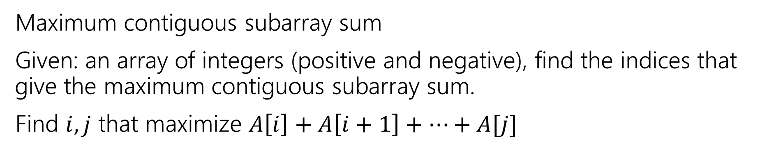
Another divide and conquer
Maximum contiguous subarray sum
Given: an array of integers (positive and negative), find the indices that give the maximum contiguous subarray sum.
Find $i,j$ that maximize $A\left[i\right]+A\left[i+1\right]+…+A[j]$
0 | 1 | 2 | 3 | 4 | 5 | 6 | 7
-3 | 2 | 4 | -1 | 3 | -10 | 6 | -4
Sum: $8$

Slide 7
Another divide and conquer
Notice, it’s sometimes a good idea to include negative numbers! They might let you access larger positive numbers and give you a net increase.
0 | 1 | 2 | 3 | 4 | 5 | 6 | 7
-3 | 2 | 4 | -1 | 3 | -10 | 6 | -4
Sum: $8$

Slide 8


Edge Cases
We’ll allow for $i=j$. In that case, $A[i]$ is the sum.
We’ll also allow for $j<i$. In that case the sum is $0$.
This is the best option if and only if all the entries are negative.
0 | 1 | 2 | 3 | 4 | 5 | 6 | 7
-3 | -2 | -4 | -1 | -3 | -10 | -6 | -4
Sum: $0$

Slide 9
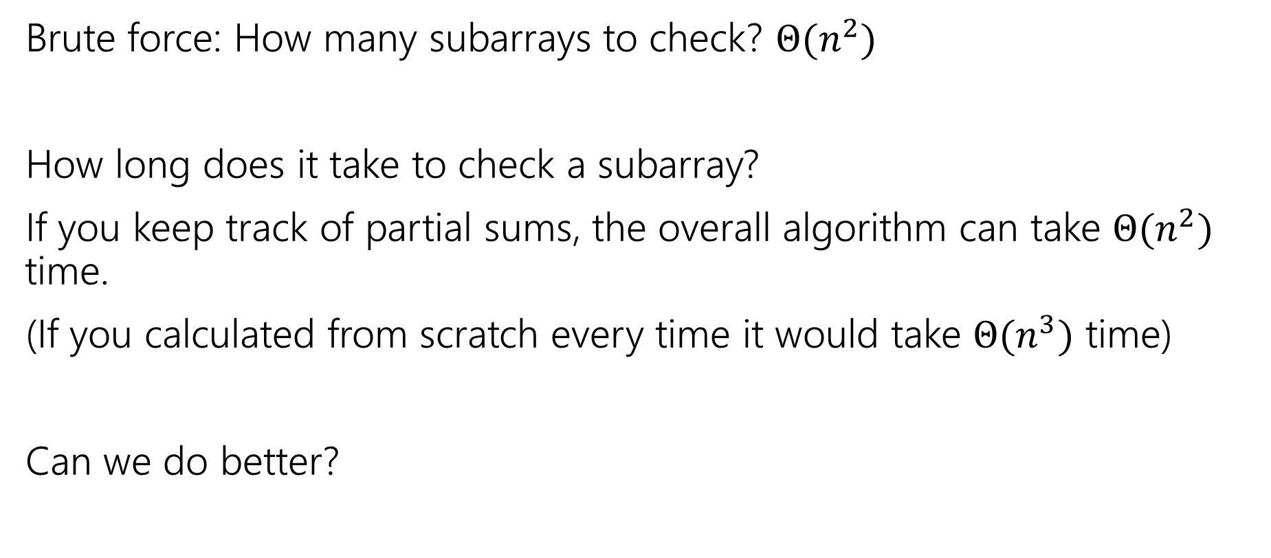
Maximum Contiguous Subarray Sum
Brute force: How many subarrays to check? $Θ(n^{2})$
How long does it take to check a subarray?
If you keep track of partial sums, the overall algorithm can take $Θ(n^{2})$ time.
(If you calculated from scratch every time it would take $Θ(n^{3})$ time)
Can we do better?

Slide 10
Maximum Contiguous Subarray
1. Divide instance into subparts.
2. Solve the parts recursively.
3. Conquer by combining the answers
1. Split the array in half
2. Solve the parts recursively.
3. Just take the max?

Slide 11
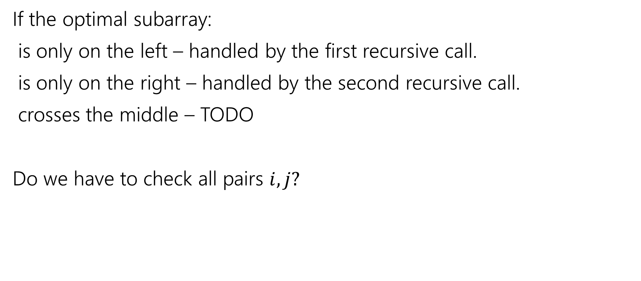
Conquer
If the optimal subarray:
is only on the left – handled by the first recursive call.
is only on the right – handled by the second recursive call.
crosses the middle – TODO
Do we have to check all pairs $i,j?$
0 | 1 | 2 | 3 | 4 | 5 | 6 | 7
-3 | 2 | 4 | -1 | 3 | -10 | 6 | -4

Slide 12
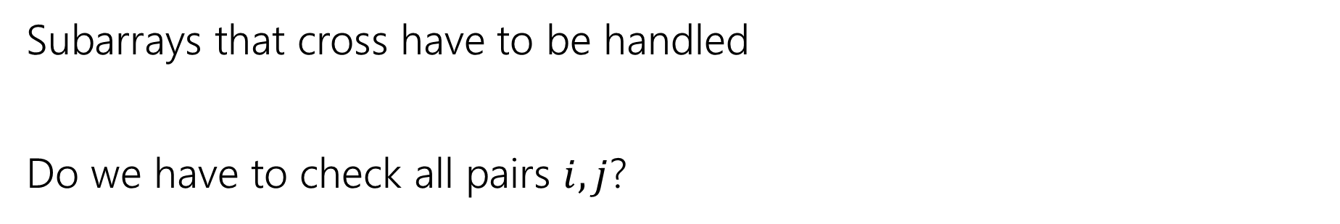
Conquer
0 | 1 | 2 | 3 | 4 | 5 | 6 | 7
-3 | 2 | 4 | -1 | 3 | -10 | 6 | -4
Subarrays that cross have to be handled
Do we have to check all pairs $i,j$?

Slide 13
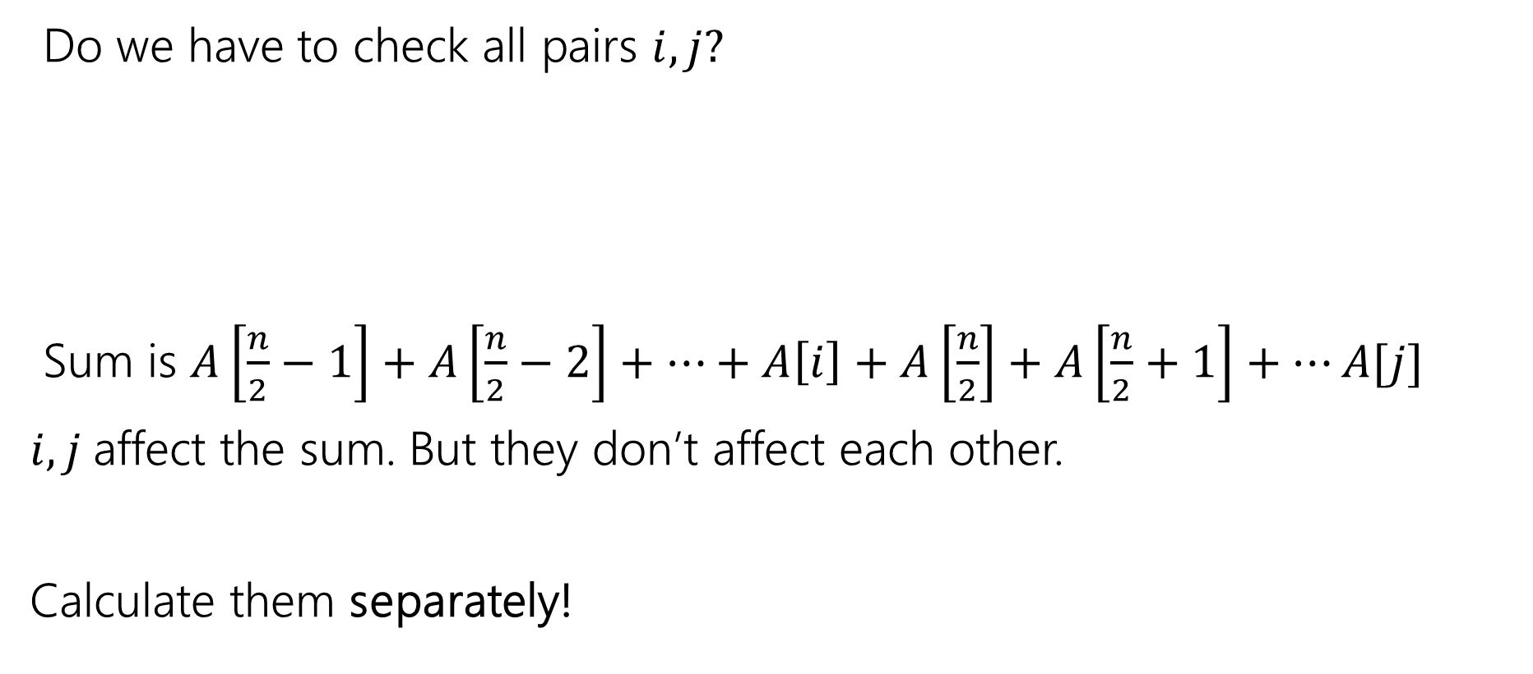
Crossing Subarrays
Do we have to check all pairs $i,j?$
Sum is $A\left[\frac{n}{2}−1\right]+A\left[\frac{n}{2}−2\right]+…+A\left[i\right]+A\left[\frac{n}{2}\right]+A\left[\frac{n}{2}+1\right]+…A[j]$
$i,j$affect the sum. But they don’t affect each other.
Calculate them separately!
0 | 1 | 2 | 3 | 4 | 5 | 6 | 7
-3 | 2 | 4 | -1 | 3 | -10 | 6 | -4

Slide 14

Crossing Subarrays
Do we have to check all pairs $i,j?$
Best $i$? Iterate with $i$ decreasing, find the maximum. $i=1$ has sum $5.$
Time to find $i$? $Θ(n)$
0 | 1 | 2 | 3 | 4 | 5 | 6 | 7
-3 | 2 | 4 | -1 | 3 | -10 | 6 | -4

Slide 15

Crossing Subarrays
Do we have to check all pairs $i,j?$
Best $j$? Iterate with $j$ increasing, find the maximum. $j=4$ has sum $3.$
Time to find $j$? $Θ(n)$
0 | 1 | 2 | 3 | 4 | 5 | 6 | 7
-3 | 2 | 4 | -1 | 3 | -10 | 6 | -4

Slide 16

Crossing Subarrays
Do we have to check all pairs $i,j?$
Best crossing array From the $i$you found to the $j$you found.
Time to find? $Θ(n)$ total.
0 | 1 | 2 | 3 | 4 | 5 | 6 | 7
-3 | 2 | 4 | -1 | 3 | -10 | 6 | -4

Slide 17

Finishing the recursive call
Overall:
Compare sums from recursive calls and $A\left[i\right]+…+A[j]$, take max.
0 | 1 | 2 | 3 | 4 | 5 | 6 | 7
-3 | 2 | 4 | -1 | 3 | -10 | 6 | -4

Slide 18
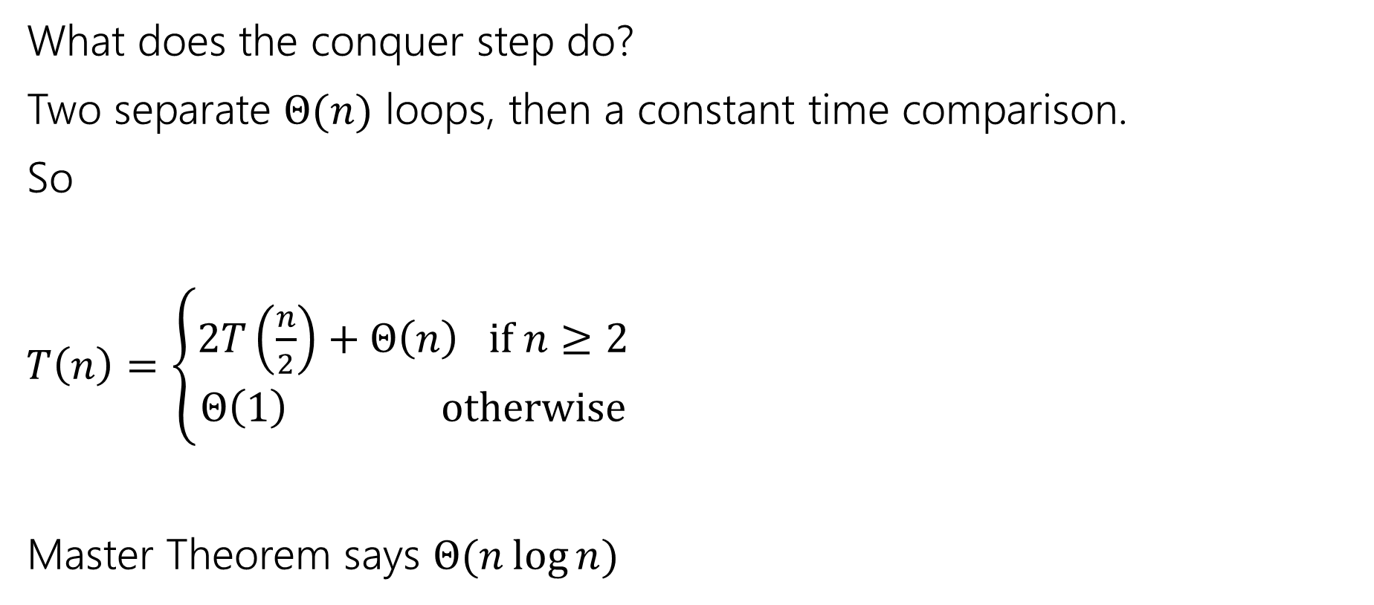
Running Time
What does the conquer step do?
Two separate $Θ(n)$ loops, then a constant time comparison.
So
$T\left(n\right)=\left\{\begin{aligned}2T\left(\frac{n}{2}\right)+Θ\left(n\right) if n≥2 \\ Θ\left(1\right) otherwise\end{aligned}\right.$
Master Theorem says $Θ(n\log{n)}$

Slide 19
MaxContigSubarraySum(int[] A, int start, int end)
if(end – start < 0) //no elements
return 0
else if(end == start) //one element
return max(A[start], 0) //allow for empty
int mid = start + (start – end)/2
int leftSum = MaxContigSubarraySum(A, start, mid)
int rightSum = MaxContigSubarraySum(A, mid+1, end)
//find best split sum
int bestSumSoFar=0; int bestISoFar = mid+1; int runningSum=0;
for(int i=mid; i >= start; i--)
runningSum+=A[i];
if(runningSum > bestSumSoFar)
bestISoFar=i;
bestSumSoFar=runningSum;
endIf
endFor
bestSumSoFar=0; int bestJSoFar=mid; runningSum=0;
for(int j=mid+1; j <= end; j++_
runningSum+=A[j];
if(runningSum > bestSumSoFar)
bestJSoFar=j
bestSumSoFar=runningSum
EndIf
EndFor
EndIf
splitSum = 0; for(int k = bestISoFar; k <= bestJSoFar; k++) splitSum+=A[k];
return max(leftSum, rightSum, splitSum)

Slide 20
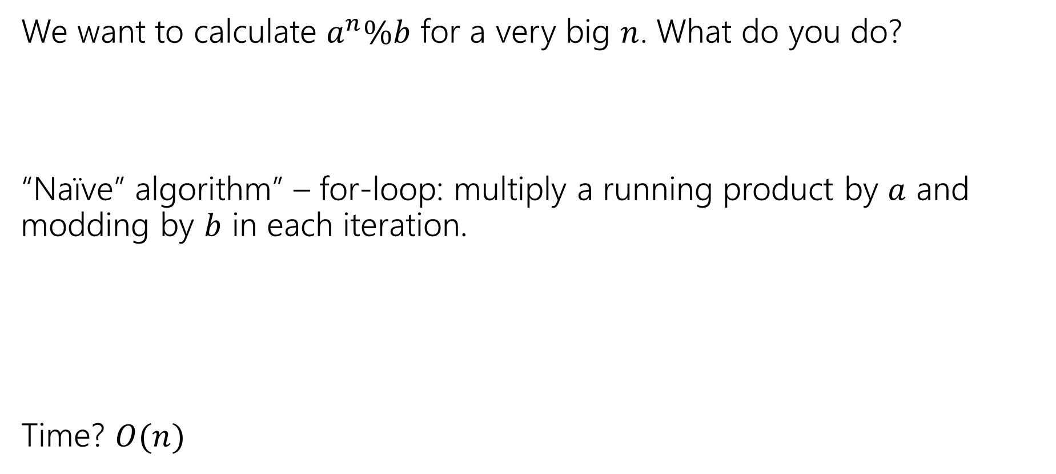
One More problem
We want to calculate $a^{n}\%b$ for a very big $n$. What do you do?
“Naïve” algorithm” – for-loop: multiply a running product by $a$ and modding by $b$ in each iteration.
Time? $O(n)$
“Naïve” is computer-scientist-speak for “first algorithm you’d think of.”
Thinking of it doesn’t mean you’re naïve. It means you know your fundamentals. And no one told you the secret magic speedup trick.

Slide 21

A better plan
What’s about half of the work?
$a^{n/2}\%b$ is about half.
DivConqExponentiation(int a, int b, int n)
if(n==0) return 1
if(n==1) return a%b
int k = divConqExponentiation(a,b,n/2) /*int div*/
if(n%2==1) return (k*k*a)%b
return (k*k)%b

Slide 22
Activity
Write a recurrence to describe the running time of this code. What’s the big-O?
DivConqExponentiation(int a, int b, int n)
if(n==0) return 1
if(n==1) return a%b
int k = divConqExponentiation(a,b,n/2) /*int div*/
if(n%2==1) return (k*k*a)%b
return (k*k)%b
Go to pollev.com/Robbie so I know how long to explain

Slide 23

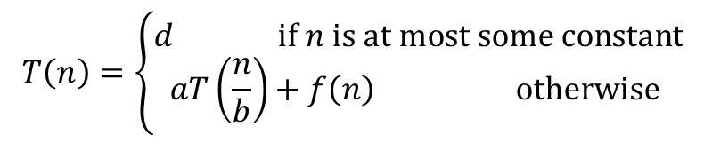

Master Theorem
Given a recurrence of the following form, where $a,b,c,$ and $d$ are constants:
$$T\left(n\right)=\left\{\begin{aligned}d if n is at most some constant \\ aT\left(\frac{n}{b}\right)+f\left(n\right) otherwise \end{aligned}\right.$$
Where $f\left(n\right)$ is $Θ\left(n^{c}\right)$
If
$$\log_{b}{a}<c$$
then
$$T\left(n\right)∈Θ\left(n^{c}\right)$$
If
$$\log_{b}{a}=c$$
then
$$T\left(n\right)∈Θ\left(n^{c}\log{n}\right)$$
If
$$\log_{b}{a}>c$$
then
$$T\left(n\right)∈Θ\left(n^{\log_{b}{a}}\right)$$

Slide 24
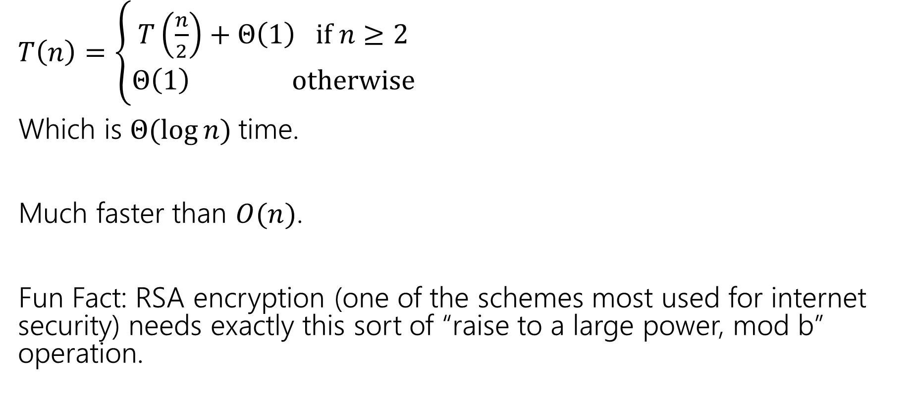
Running Time?
$T\left(n\right)=\left\{\begin{aligned}T\left(\frac{n}{2}\right)+Θ\left(1\right) if n≥2 \\ Θ\left(1\right) otherwise\end{aligned}\right.$
Which is $Θ(\log{n)}$time.
Much faster than $O(n)$.
Fun Fact: RSA encryption (one of the schemes most used for internet security) needs exactly this sort of “raise to a large power, mod b” operation.

Slide 25
When to use Divide & Conquer
Your problem has a structure that makes it easy to split up
Usually in half, but not always…
You can split “what you’re looking for” (subarrays, inversions, etc.) into “just in one of the parts” and “split across parts”
The “split” ones can be studied faster than brute force.

Slide 26
Classic Divide & Conquer

Slide 27
Classic Applications
There are a few really famous divide & conquer algorithms where the way to recurse is very clever.
The point of the next few examples is not to teach you really useful tricks (they often don’t generalize to new problems).
It’s partially to show you that sometimes being really clever gives you a really big improvement
And partially because these are “standard” in algorithms classes, so you should at least have heard of these algorithms.

Slide 28
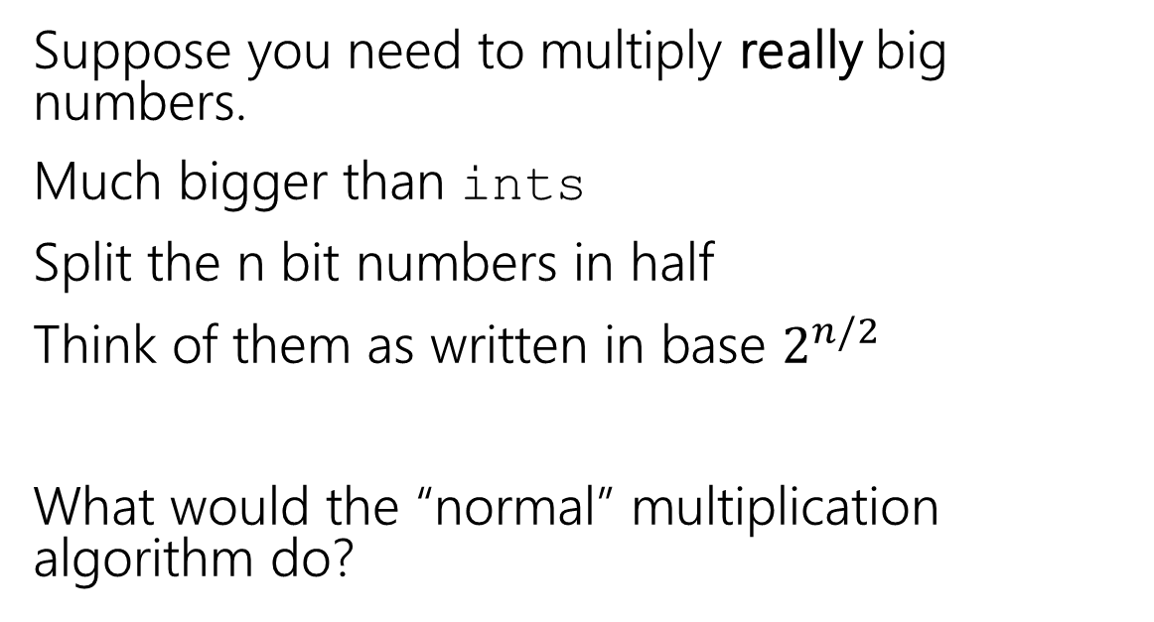
Classic Application
Suppose you need to multiply really big numbers.
Much bigger than ints
Split the n bit numbers in half
Think of them as written in base $2^{n/2}$
What would the “normal” multiplication algorithm do?
x_1
x_0
y_1
y_0
x_1y_0
x_0y_0
4 multiplications, i.e. 4 recursive calls.
x_1y_1
x_0y_1

Slide 29
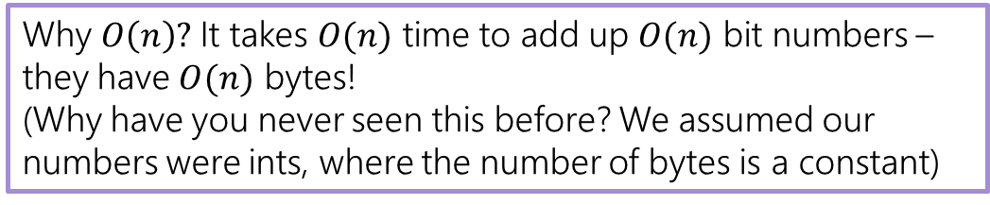
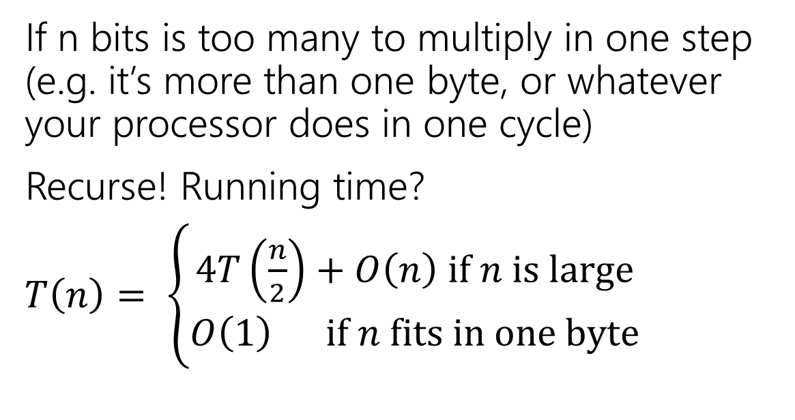
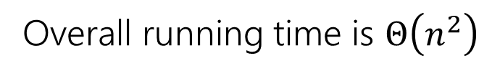
Classic Application
If n bits is too many to multiply in one step (e.g. it’s more than one byte, or whatever your processor does in one cycle)
Recurse! Running time?
$T\left(n\right)= \left\{\begin{aligned}4T\left(\frac{n}{2}\right)+O\left(n\right) if n is large \\ O\left(1\right) if n fits in one byte\end{aligned}\right.$
x_1
x_0
y_1
y_0
x_1y_0
x_0y_0
x_1y_1
x_0y_1
Why $O\left(n\right)?$ It takes $O(n)$ time to add up $O(n)$ bit numbers – they have $O(n)$ bytes!
(Why have you never seen this before? We assumed our numbers were ints, where the number of bytes is a constant)
Overall running time is $Θ\left(n^{2}\right)$

Slide 30
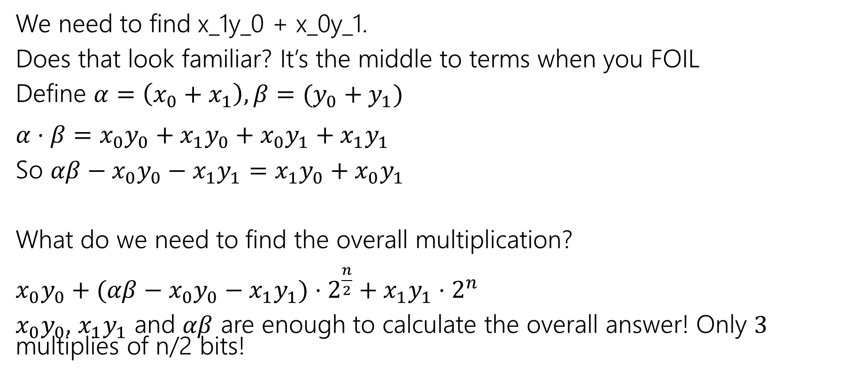
Clever Trick
We need to find x_1y_0 + x_0y_1.
Does that look familiar? It’s the middle to terms when you FOIL
Define $α=\left(x_{0}+x_{1}\right), β=(y_{0}+y_{1})$
$α⋅β=x_{0}y_{0}+x_{1}y_{0}+x_{0}y_{1}+x_{1}y_{1}$
So $αβ−x_{0}y_{0}−x_{1}y_{1}=$ $x_{1}y_{0}+x_{0}y_{1}$
What do we need to find the overall multiplication?
$x_{0}y_{0}+(αβ−x_{0}y_{0}−x_{1}y_{1})⋅2^{\frac{n}{2}}+x_{1}y_{1}⋅2^{n}$
$x_{0}y_{0},$ $x_{1}y_{1}$ and $αβ$ are enough to calculate the overall answer! Only $3$ multiplies of n/2 bits!

Slide 31

Running Time
$T\left(n\right)= \left\{\begin{aligned}3T\left(\frac{n}{2}\right)+O\left(n\right) if n is large \\ O\left(1\right) if n fits in one byte\end{aligned}\right.$
$\log_{2}\left(3\right)>1$,
So running time is $O\left(n^{\log_{2}\left(3\right)}\right)$
Or about $O\left(n^{1.585}\right)$

Slide 32
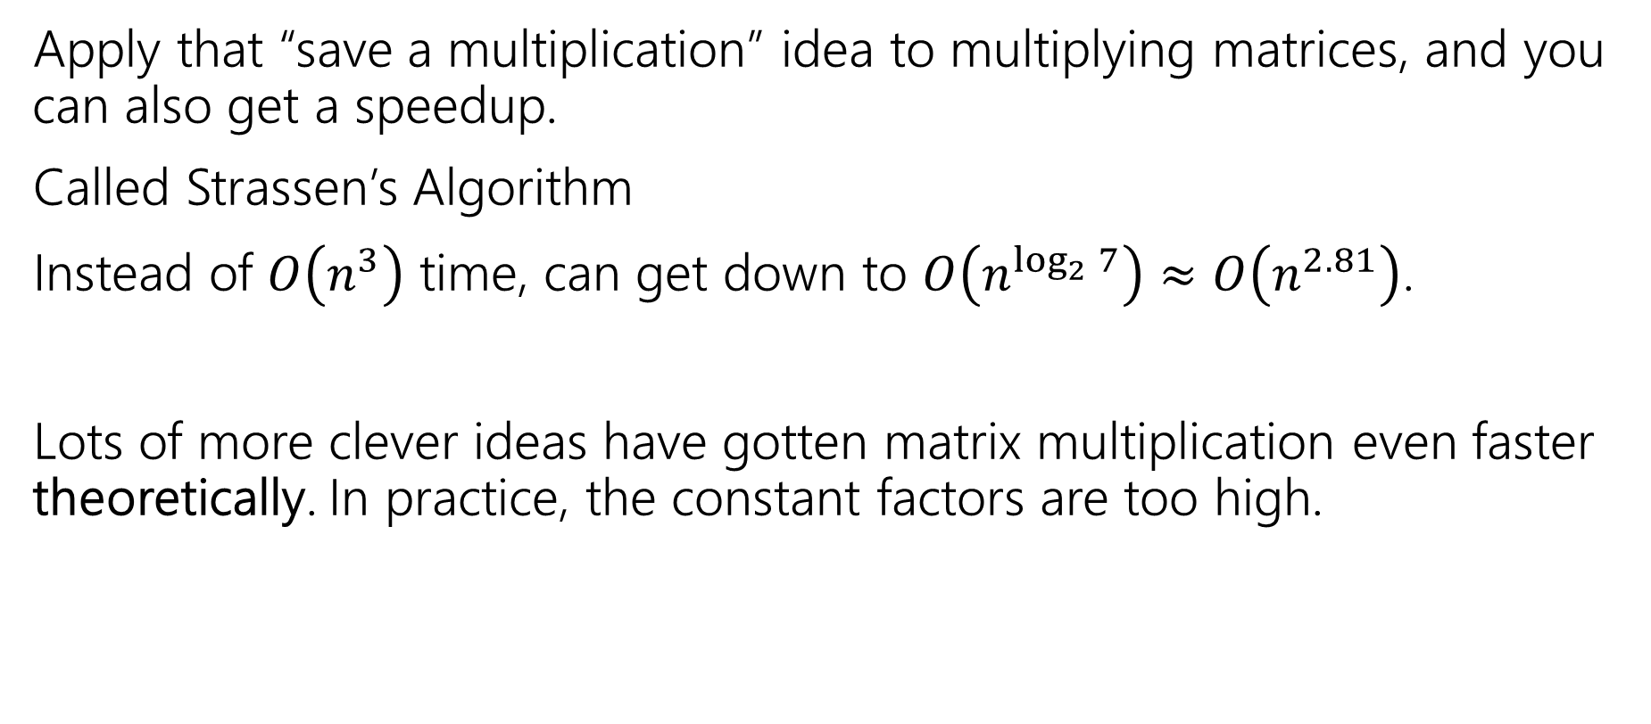
Strassen’s Algorithm
Apply that “save a multiplication” idea to multiplying matrices, and you can also get a speedup.
Called Strassen’s Algorithm
Instead of $O\left(n^{3}\right)$ time, can get down to $O\left(n^{\log_{2}{7}}\right)≈O\left(n^{2.81}\right)$.
Lots of more clever ideas have gotten matrix multiplication even faster theoretically. In practice, the constant factors are too high.

