Slide 1
Graph Modeling
CSE 417 22AU
Lecture 8

Slide 2
Announcements
HW1 is due tonight.
  Remember that there is a separate submission box for each problem; give yourself more time to submit.
  Please check that you have gradescope access; I “resynced” this morning.
HW2 is going to go up on the webpage this evening, due in a week.
HW2 (and every homework after) will have two resubmission slots for any problems from prior homeworks.
  No limit on resubs per problem, except the total number of slots.
  Resubmissions count with the hw on which the problem originally appeared.
Programming questions don’t use resubmission slots.

Slide 3
Summary – Graph Search Applications
BFS
dfs
Shortest Paths (unweighted) graphs)
Cycle detection (directed graphs)
Topological sort
Strongly connected components
Cut edges (on homework)
EITHER
2-coloring
Connected components (undirected)
Usually use BFS – easier to understand.

Slide 4
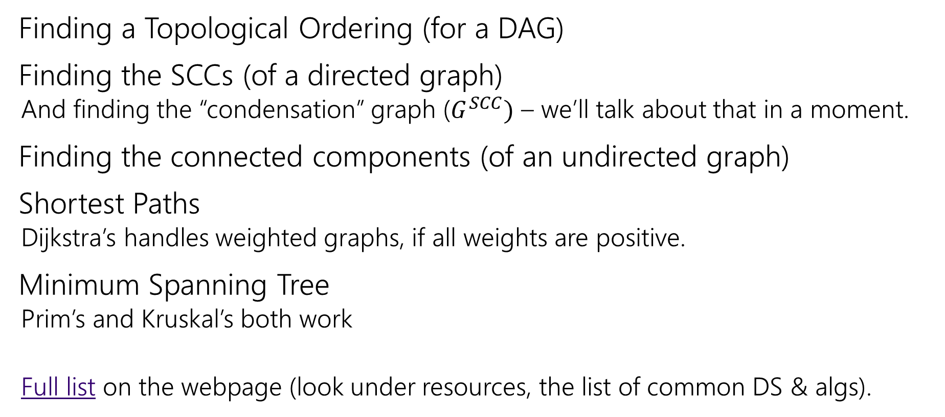
Other Graph Algorithms You’ve Seen
Finding a Topological Ordering (for a DAG)
Finding the SCCs (of a directed graph)
  And finding the “condensation” graph ($G^{SCC})$ – we’ll talk about that in a moment.
Finding the connected components (of an undirected graph)
Shortest Paths
  Dijkstra’s handles weighted graphs, if all weights are positive.
Minimum Spanning Tree
  Prim’s and Kruskal’s both work
  Full list on the webpage (look under resources, the list of common DS & algs).

Slide 5
Problem 1: Ordering Dependencies
Given a directed graph G, where we have an edge from u to v if u must happen before v.
We can only do things one at a time, can we find an order that respects dependencies?
Given: a directed graph G
Find: an ordering of the vertices so all edges go from left to right.
Topological Sort (aka Topological Ordering)
Uses:
Compiling multiple files
Graduating

Slide 6
Topological Ordering
A course prerequisite chart and a possible topological ordering.
Math 126
CSE 374
CSE 143
CSE 142
CSE 373
CSE 417
Math 126
CSE 142
CSE 143
CSE 373
CSE 374
CSE 417

Slide 7
Problem 2
Given a graph, find its strongly connected components
A
B
D
E
K
1
2
C
F
J
3
4

Slide 8
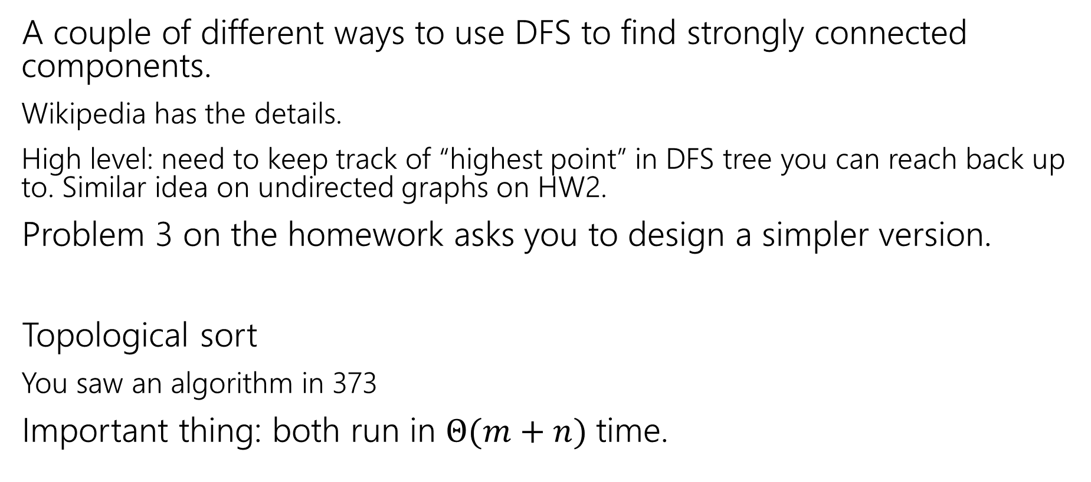
How do these work?
A couple of different ways to use DFS to find strongly connected components.
Wikipedia has the details.
High level: need to keep track of “highest point” in DFS tree you can reach back up to. Similar idea on undirected graphs on HW2.
Problem 3 on the homework asks you to design a simpler version.
Topological sort
You saw an algorithm in 373
Important thing: both run in $Θ(m+n)$ time.

Slide 9
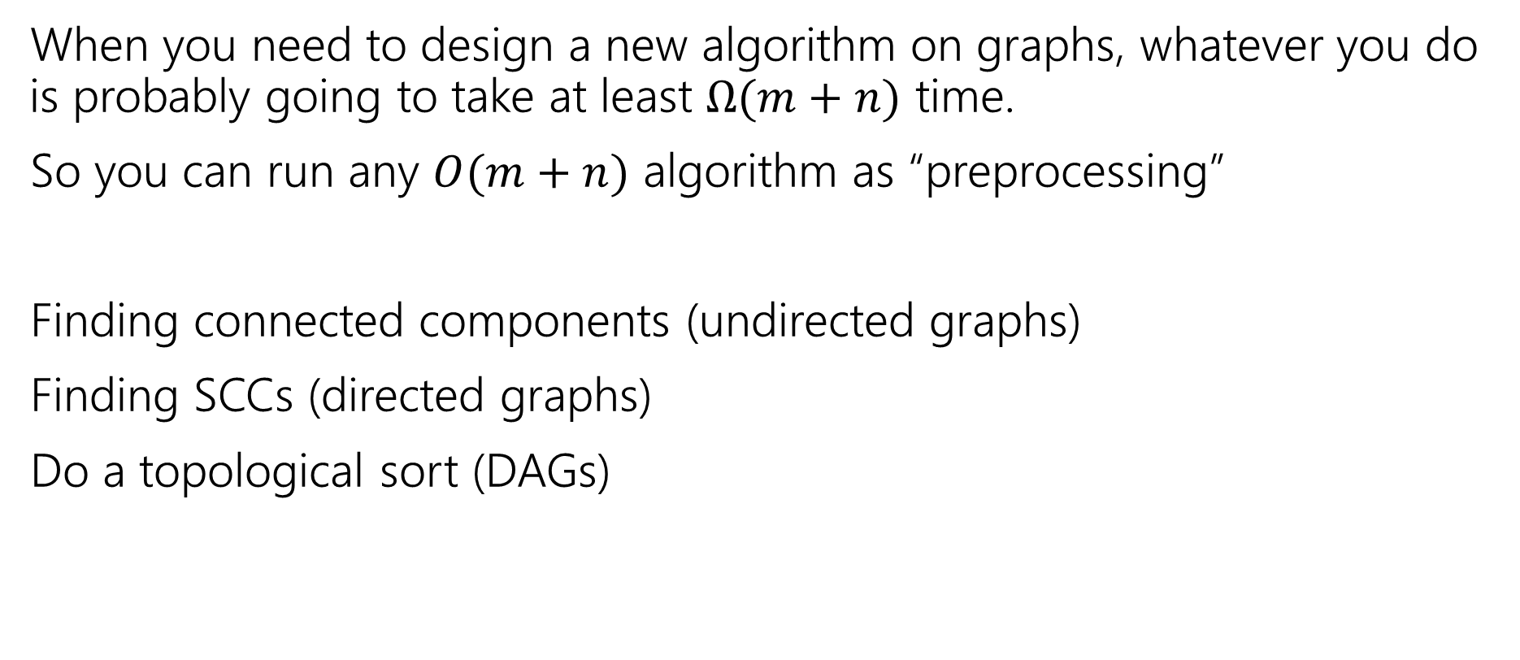
Designing New Algorithms
When you need to design a new algorithm on graphs, whatever you do is probably going to take at least $Ω(m+n)$ time.
So you can run any $O(m+n)$ algorithm as “preprocessing”
Finding connected components (undirected graphs)
Finding SCCs (directed graphs)
Do a topological sort (DAGs)

Slide 10
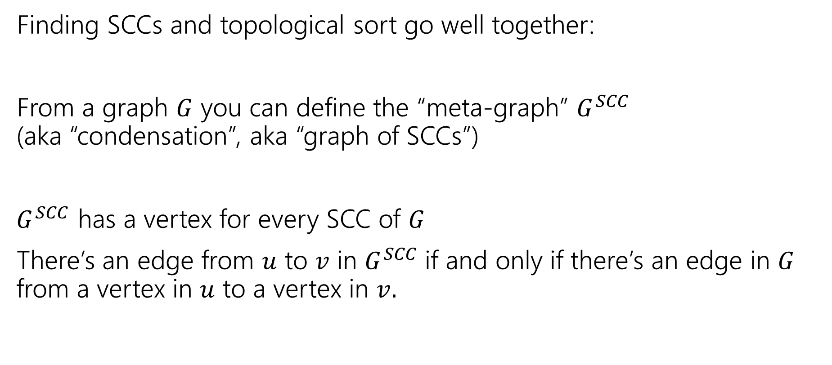
Designing New Algorithms
Finding SCCs and topological sort go well together:
From a graph $G$ you can define the “meta-graph” $G^{SCC}$
(aka “condensation”, aka “graph of SCCs”)
$G^{SCC}$ has a vertex for every SCC of $G$
There’s an edge from $u$ to $v$ in $G^{SCC}$if and only if there’s an edge in $G$ from a vertex in $u$ to a vertex in $v.$

Slide 11
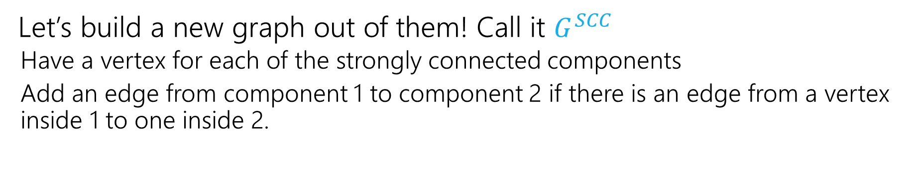
Why Find SCCs?
Let’s build a new graph out of them! Call it $G^{SCC}$
  Have a vertex for each of the strongly connected components
  Add an edge from component 1 to component 2 if there is an edge from a vertex inside 1 to one inside 2.
A
B
D
E
K
1
2
C
F
J
3
4

Slide 12
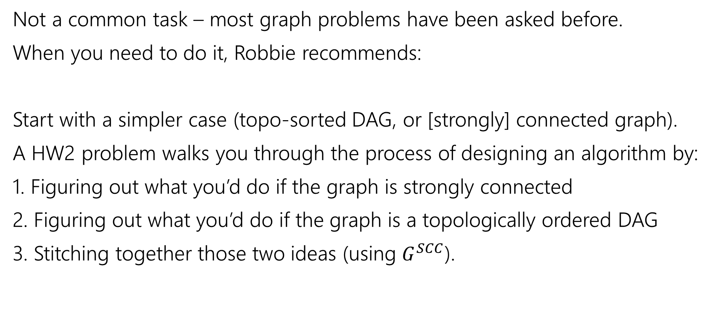
Designing New Graph Algorithms
Not a common task – most graph problems have been asked before.
When you need to do it, Robbie recommends:
Start with a simpler case (topo-sorted DAG, or [strongly] connected graph).
A HW2 problem walks you through the process of designing an algorithm by:
1. Figuring out what you’d do if the graph is strongly connected
2. Figuring out what you’d do if the graph is a topologically ordered DAG
3. Stitching together those two ideas (using $G^{SCC}$).

Slide 13
Graph Modeling
But…Most of the time you don’t need a new graph algorithm.
What you need is to figure out what graph to make and which graph algorithm to run.
“Graph modeling”
Going from word problem to graph algorithm.
Often finding a clever way to turn your requirements into graph features.
Mix of “standard bag of tricks” and new creativity.

Slide 14
Problem Solving Suggestions
Read the problem carefully.
  Are there any technical terms in the question? Any formulas?
  What kind of object will you get as input? What type is your output?
Do you understand it? Write sample inputs and outputs
  We’ll often give you samples, but it helps to add your own.
Now start thinking about solutions
  On those examples, how would you get the solution?
  Does this remind you of any algorithms from class?
  Can you think of a new idea?
  It’s ok to start with slow solutions and try to speed them up!
  Try the graph modeling process.

Slide 15
Graph Modeling Process
1. What are your fundamental objects?
  Those will probably become your vertices.
2. How are those objects related?
  Represent those relationships with edges.
3. How is what I’m looking for encoded in the graph?
  Do I need a path from s to t? The shortest path from s to t? A minimum spanning tree? Something else?
4. Do I know how to find what I’m looking for?
  Then run that algorithm/combination of algorithms
  Otherwise go back to step 1 and try again.

Slide 16
Scenario #1
You’ve made a new social networking app, Convrs. Users on Convrs can have “asymmetric” following (I can follow you, without you following me). You decide to allow people to form multi-user direct messages, but only if people are probably in similar social circles (to avoid spamming).
You’ll allow a messaging channel to form only if for every pair of users a,b in the channel: a must follow b or follow someone who follows b or follow someone who follows someone who follows b, or …
And the same for b to a.
You’d like to be able to quickly check for any new proposed channel whether it meets this condition.
What are the vertices?
What are the edges?
What are we looking for?
What do we run?

Slide 17
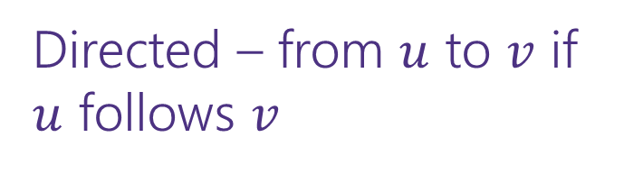
Scenario #1
You’ve made a new social networking app, Convrs. Users on Convrs can have “asymmetric” following (I can follow you, without you following me). You decide to allow people to form multi-user direct messages, but only if people are probably in similar social circles (to avoid spamming).
You’ll allow a messaging channel to form only if for every pair of users a,b in the channel: a must follow b or follow someone who follows b or follow someone who follows someone who follows b, or …
And the same for b to a.
You’d like to be able to quickly check for any new proposed channel whether it meets this condition.
What are the vertices?
What are the edges?
What are we looking for?
What do we run?
Users
Directed – from $u$ to $v$ if $u$ follows $v$
If everyone in the channel is in the same SCC.
Find SCCs, to test a new channel, make sure all are in same component.

Slide 18
Scenario #2
Sports fans often use the “transitive law” to predict sports outcomes.
In general, if you think A is better than B, and B is also better than C, then you expect that A is better than C.
Teams don’t all play each other – from data of games that have been played, determine if the “transitive law” is realistic, or misleading about at least one outcome.
What are the vertices?
What are the edges?
What are we looking for?
What do we run?

Slide 19
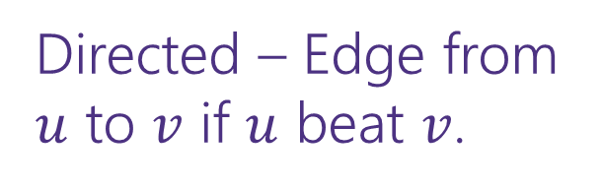
Scenario #2
What are the vertices?
What are the edges?
What are we looking for?
What do we run?
Sports fans often use the “transitive law” to predict sports outcomes -- .
In general, if you think A is better than B, and B is also better than C, then you expect that A is better than C.
Teams don’t all play each other – from data of games that have been played, determine if the “transitive law” is realistic, or misleading about at least one outcome.
Teams
Directed – Edge from $u$ to $v$ if $u$ beat $v$.
A cycle would say it’s not realistic.
OR a topological sort would say it is.
Cycle-detection DFS.
a topological sort algorithm (with error detection)

Slide 20
Scenario #3
It’s a
small
world
6
4
7
You are at Splash Mountain. Your best friend is at Space Mountain. You have to tell each other about your experiences in person as soon as possible. Where do you meet and how quickly can you get there?
What are the vertices?
What are the edges?
What are we looking for?
What do we run?
Dumbo
6
16
12
10
8
5
Matter-
horn
14
Thunder
Mtn
4
5
1
13
Splash
Mtn
Castle
9
7
15
17
11
9
3
Space
Mtn
Indiana
Jones
8
10
0
Star
Tours
1
2
Flag
Pole
2
Jungle
Cruise
3

Slide 21
Scenario #3
19
It’s a
small
world
15
6
4
7
You are at Splash Mountain. Your best friend is at Space Mountain. You have to tell each other about your experiences in person as soon as possible. Where do you meet and how quickly can you get there?
What are the vertices?
  Rides
What are the edges?
  Walkways with how long it would take to walk
What are we looking for?
  The “midpoint”
What do we run?
  Run Dijkstra’s from Splash Mountain, store distances
  Run Dijkstra’s from Space Mountain, store distances
  Iterate over vertices, for each vertex remember max of two
  Iterate over vertices, find minimum of remembered numbers
Dumbo
33
29
6
16
12
10
8
9
5
22
Matter-
horn
14
Thunder
Mtn
14
32
4
5
1
17
13
Splash
Mtn
Castle
36
19
9
0
7
15
17
0
11
9
3
29
Space
Mtn
Indiana
Jones
8
10
1
15
0
Star
Tours
Flag
Pole
28
1
36
2
2
31
Jungle
Cruise
20
3
37
17

Slide 22
Scenario #4
You’re a Disneyland employee, working the front of the Splash Mountain line. Suddenly, the crowd-control gates fall over and the line degrades into an unordered mass of people.
Sometimes you can tell who was in line before who; for other groups you aren’t quite sure.
You need to restore the line, while ensuring if you knew A came before B before the incident, they will still be in the right order afterward.
What are the vertices?
  People
What are the edges?
  Edges are directed, have an edge from X to Y if you know X came before Y.
What are we looking for?
  A total ordering consistent with all the ordering we do know.
What do we run?
  Topological Sort!

