Slide 1
Depth First Search
CSE 417 22AU
Lecture 7

Slide 2
Some Graph Vocabulary
A walk is a list of vertices where you can get from each vertex to the next along an edge. (repeats allowed).
A path is a list of vertices where you can get from each vertex to the next, and there are no repeats.
In an undirected graph a connected component is a “piece” of the graph, it’s a vertex and anything you can reach on a walk starting at that vertex.
F
A
G
E
B
D
C

Slide 3
DFS vs. BFS
In BFS, we explored a graph “level-wise”
We explored everything next to the starting vertex.
Then we explored everything one step further away.
Then everything one step further
…

Slide 4
DFS vs. BFS
In DFS, we explore deep into the graph.
We try to find new (undiscovered) nodes, then “backtrack” when we’re out of new ones.

Slide 5
DFS – pseudocode
In 373, you probably took your BFS code, replaced the queue with a stack and said “that’s the pseudocode.”
That’s a really nice object lesson in stacks.
No one actually writes DFS that way (except in data structures courses).
You’ll basically always see the recursive version instead. (using the call stack instead of the data structure stack)

Slide 6
DFS – pseudocode
Instead of using an explicit stack, we’re going to use recursion
The call stack is going to be our stack.
We want to explore as deeply as possible from each of our outgoing edges
DFS(u)
Mark u as “seen”
For each edge (u,v) //leaving u
If v is not “seen”
DFS(v)
End If
End For

Slide 7
DFS – pseudocode
Both the explicit stack version and the recursive version “are” DFS.
For example, they can both traverse through the graph in the same fundamental way. You can use them for similar applications.
But they’re not identical – they actually use the stack in different ways. If you’re trying to convert from one to the other, you’ll have to think carefully to do it.

Slide 8
Running DFS
DFS(u)
Mark u as “seen”
For each edge (u,v) //leaving u
If v is not “seen”
DFS(v)
End If
End For
Start from A
F
G
A
Vertex: D
Last edge used: --
Vertex: D
Last edge used: (D,B)
Vertex: F
Last edge used: ---
E
Vertex: F
Last edge used: (F,D)
Vertex: E
Last edge used: (E,F)
Vertex: C
Last edge used: (C,D)
Vertex: E
Last edge used: ---
Vertex: C
Last edge used: --
B
Vertex: B
Last edge used: --
Vertex: B
Last edge used: (B,C)
Vertex: B
Last edge used: (B,E)
D
C
Vertex: A
Last edge used: (A,F)
Vertex: A
Last edge used: ---
Vertex: A
Last edge used: (A,B)

Slide 9
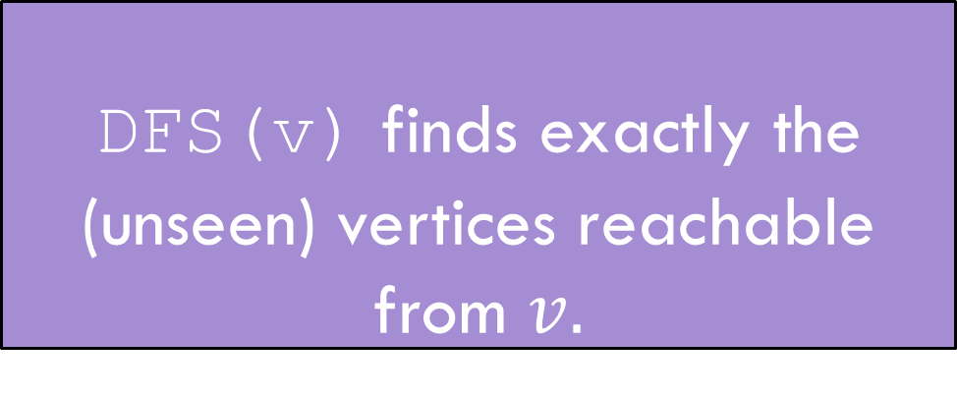
Running DFS
DFS(u)
Mark u as “seen”
For each edge (u,v) //leaving u
If v is not “seen”
DFS(v)
End If
End For
F
G
HEY! We missed something!
A
E
DFS(v) finds exactly the (unseen) vertices reachable from $v.$
DFS discovery
B
D
C

Slide 10
Reaching Everything
One possible use of DFS is visiting every vertex
How can we make sure that happens?
What did you do for BFS when you had this problem?
Add a while loop, and call DFS from each vertex.
DFSWrapper(G)
For each vertex u of G
If u is not “seen”
DFS(u)
End If
End For
DFS(u)
Mark u as “seen”
For each edge (u,v) //leaving u
If v is not “seen”
DFS(v)
End If
End For

Slide 11
Bells and Whistles
Depending on your application, you may add a few extra lines to the DFS code to compute the thing you want.
Usually just an extra variable or two per vertex.
For today’s application, we need to know what order vertices come onto and off of the stack.
DFS(u)
Mark u as “seen”
u.start = counter++
For each edge (u,v) //leaving u
If v is not “seen”
DFS(v)
End If
End For
u.end = counter++
DFSWrapper(G)
counter = 1
For each vertex u of G
If u is not “seen”
DFS(u)
End If
End For

Slide 12
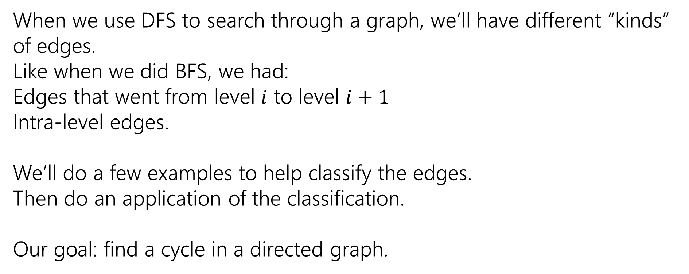
Edge Classification
When we use DFS to search through a graph, we’ll have different “kinds” of edges.
Like when we did BFS, we had:
Edges that went from level $i$ to level $i+1$
Intra-level edges.
We’ll do a few examples to help classify the edges.
Then do an application of the classification.
Our goal: find a cycle in a directed graph.

Slide 13
Running DFS
DFS(u)
Mark u as “seen”
u.start = counter++
For each edge (u,v) //leaving u
If v is not “seen”
DFS(v)
End If
End For
u.end = counter++
Start from A
F
G
A
E
B
D
C

Slide 14
Running DFS
DFS(u)
Mark u as “seen”
u.start = counter++
For each edge (u,v) //leaving u
If v is not “seen”
DFS(v)
End If
End For
u.end = counter++
8
9
Start from A
F
G
1
12
A
Vertex: D
Last edge used: --
Vertex: D
Last edge used: (D,B)
Vertex: F
Last edge used: ---
E
Vertex: F
Last edge used: (F,D)
7
10
Vertex: E
Last edge used: (E,F)
Vertex: C
Last edge used: (C,D)
Vertex: E
Last edge used: ---
Vertex: C
Last edge used: --
B
Vertex: B
Last edge used: --
Vertex: B
Last edge used: (B,C)
Vertex: B
Last edge used: (B,E)
2
11
D
C
Vertex: A
Last edge used: (A,F)
Vertex: A
Last edge used: ---
4
5
Vertex: A
Last edge used: (A,B)
3
6

Slide 15
DFS(u)
Mark u as “seen”
u.start = counter++
For each edge (u,v) //leaving u
If v is not “seen”
DFS(v)
End If
End For
u.end = counter++
F
G
A
E
B
D
C

Slide 16
A
The orange edges (the ones where we discovered a new vertex) form a tree!*
We call them tree edges.
That blue edge went from a descendent to an ancestor
B was still on the stack when we found (B,D).
We call them back edges.
The green edge went from an ancestor to a descendant
F was put on and come off the stack between putting A on the stack and finding (A,F)
We call them forward edges.
The purple edge went…some other way.
D had been on and come off the stack before we found F or (F,D)
We call those cross edges.
1
12
2
11
B
3
6
C
E
4
5
D
7
10
F
*Conditions apply. Sometimes the graph is a forest. But we call them tree edges no matter what.
G
8
9

Slide 17
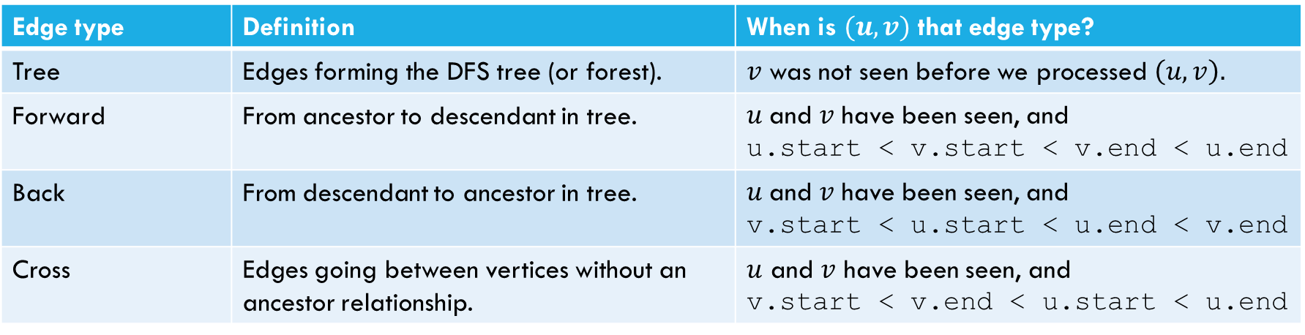
Edge Classification (for DFS on directed graphs)
Edge type | Definition | When is $(u,v)$ that edge type?
Tree | Edges forming the DFS tree (or forest). | $v$ was not seen before we processed $\left(u,v\right).$
Forward | From ancestor to descendant in tree. | $u$and $v$ have been seen, and u.start < v.start < v.end < u.end
Back | From descendant to ancestor in tree. | $u$and $v$ have been seen, and v.start < u.start < u.end < v.end
Cross | Edges going between vertices without an ancestor relationship. | $u$ and $v$ have been seen, and v.start < v.end < u.start < u.end
The third column doesn’t look like it encompasses all possibilities.
It does – the fact that we’re using a stack limits the possibilities:
e.g. u.start < v.start < u.end < v.end is impossible.
And the rules of the algorithm eliminate some other possibilities.

Slide 18
Try it Yourselves!
DFSWrapper(G)
counter = 0
For each vertex u of G
If u is not “seen”
DFS(u)
End If
End For
1
12
A
back
2
B
C
7
8
11
forward
4
5
3
10
D
cross
DFS(u)
Mark u as “seen”
u.start = counter++
For each edge (u,v) //leaving u
If v is not “seen”
DFS(v)
End If
End For
u.end = counter++
F
E
6
9

Slide 19
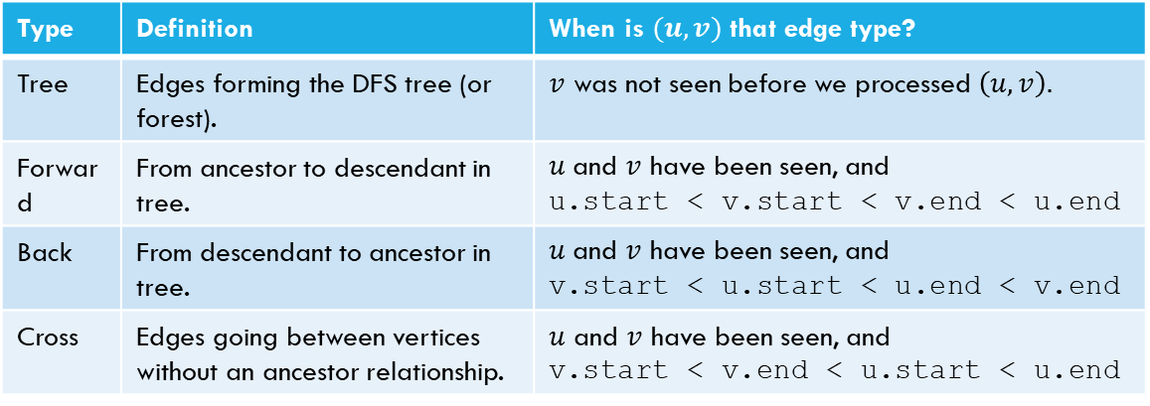
Try it Yourselves!
Type | Definition | When is $(u,v)$ that edge type?
Tree | Edges forming the DFS tree (or forest). | $v$ was not seen before we processed $\left(u,v\right).$
Forward | From ancestor to descendant in tree. | $u$and $v$ have been seen, and u.start < v.start < v.end < u.end
Back | From descendant to ancestor in tree. | $u$and $v$ have been seen, and v.start < u.start < u.end < v.end
Cross | Edges going between vertices without an ancestor relationship. | $u$ and $v$ have been seen, and v.start < v.end < u.start < u.end
DFSWrapper(G)
counter = 0
For each vertex u of G
If u is not “seen”
DFS(u)
End If
End For
A
DFS(u)
Mark u as “seen”
u.start = counter++
For each edge (u,v) //leaving u
If v is not “seen”
DFS(v)
End If
End For
u.end = counter++
B
C
D
F
E

Slide 20
Actually Using DFS
Here’s a claim that will let us use DFS for something!
DFS run on a directed graph has a back edge if and only if it has a cycle.
Back Edge Characterization

Slide 21
Forward Direction
If DFS on a graph has a back edge then it has a cycle.

Slide 22
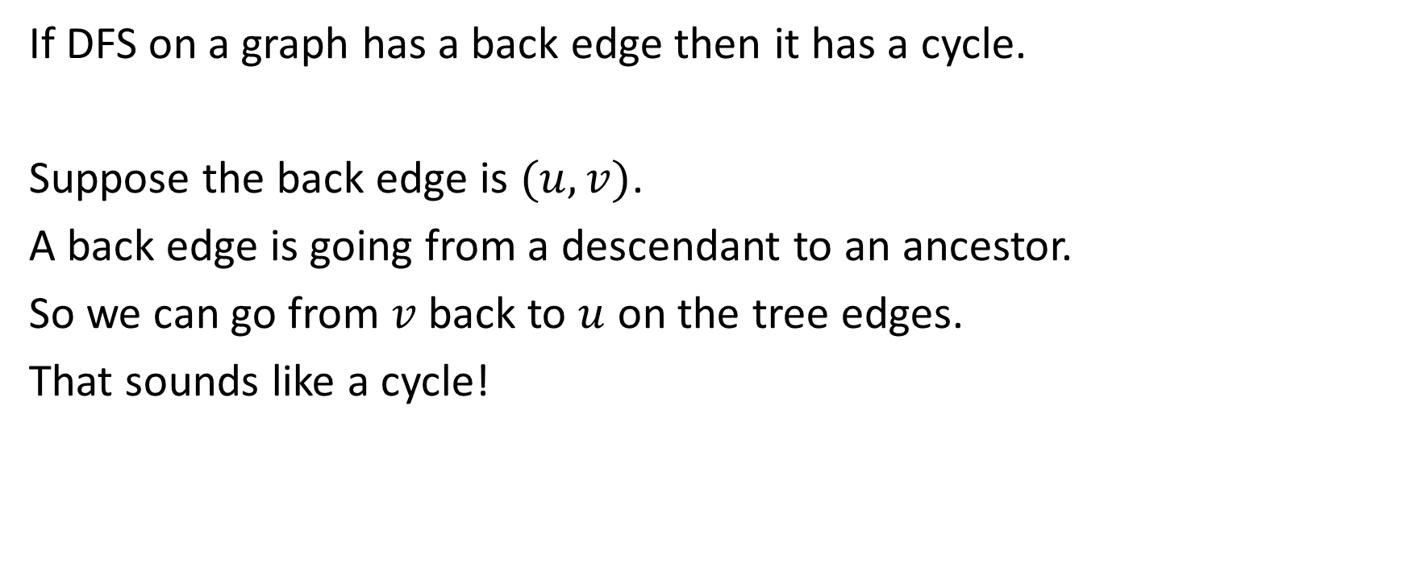
Forward Direction
If DFS on a graph has a back edge then it has a cycle.
Suppose the back edge is $(u,v)$.
A back edge is going from a descendant to an ancestor.
So we can go from $v$ back to $u$ on the tree edges.
That sounds like a cycle!

Slide 23
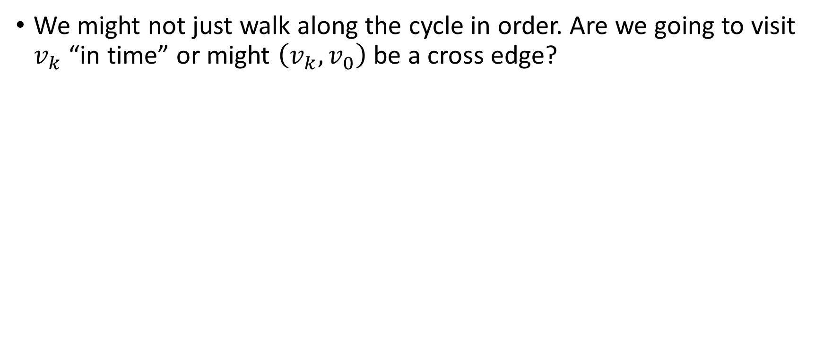
Fixing the Backward Direction
We might not just walk along the cycle in order. Are we going to visit $v_{k}$ “in time” or might $\left(v_{k}, v_{0}\right)$ be a cross edge?
DFS(v) finds exactly the (unseen) vertices reachable from $v.$
DFS discovery

Slide 24
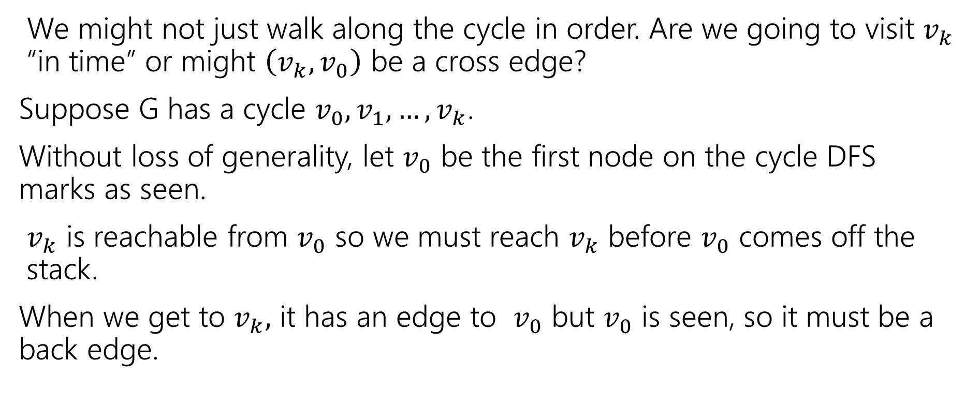
Fixing the Backward Direction
We might not just walk along the cycle in order. Are we going to visit $v_{k}$ “in time” or might $\left(v_{k}, v_{0}\right)$ be a cross edge?
Suppose G has a cycle $v_{0},v_{1},…,v_{k}$.
Without loss of generality, let $v_{0}$ be the first node on the cycle DFS marks as seen.
$v_{k}$ is reachable from $v_{0}$ so we must reach $v_{k}$ before $v_{0}$ comes off the stack.
When we get to $v_{k},$ it has an edge to $v_{0}$ but $v_{0}$ is seen, so it must be a back edge.

Slide 25
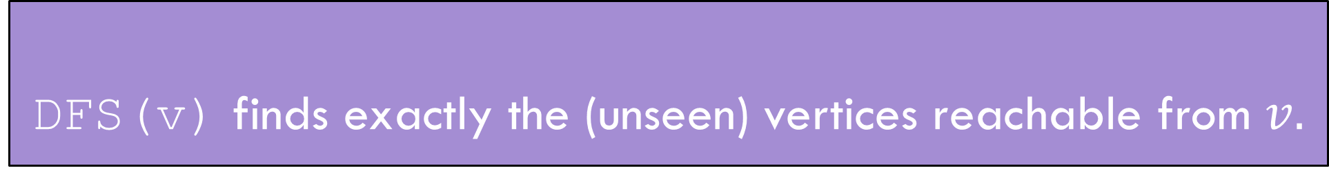
Summary
DFS(v) finds exactly the (unseen) vertices reachable from $v.$
DFS discovery
A directed graph has a back edge if and only if it has a cycle.
Back Edge Characterization

Slide 26
Edge Classification (for DFS on directed graphs)
Edge type | Definition | When is $(u,v)$ that edge type?
Tree | Edges forming the DFS tree (or forest). | $v$ was not seen before we processed $\left(u,v\right).$
Forward | From ancestor to descendant in tree. | $u$and $v$ have been seen, and u.start < v.start < v.end < u.end
Back | From descendant to ancestor in tree. | $u$and $v$ have been seen, and v.start < u.start < u.end < v.end
Cross | Edges going between vertices without an ancestor relationship. | $u$ and $v$ have been seen, and v.start < v.end < u.start < u.end
The third column doesn’t look like it encompasses all possibilities.
It does – the fact that we’re using a stack limits the possibilities:
e.g. u.start < v.start < u.end < v.end is impossible.
And the rules of the algorithm eliminate some other possibilities.

Slide 27
BFS/DFS caveats and cautions
Edge classifications are different for directed graphs and undirected graphs.
DFS in undirected graphs don’t have cross edges.
BFS in directed graphs can have edges skipping levels (only as back edges, skipping levels up though!)

Slide 28
Summary – Graph Search Applications
BFS
dfs
Shortest Paths (unweighted) graphs)
Cycle detection (directed graphs)
Topological sort
Strongly connected components
Cut edges (on homework)
EITHER
2-coloring
Connected components (undirected)
Usually use BFS – easier to understand.

Slide 29
Graph Modeling

Slide 30
Your turn: Find Strongly Connected Components
A
B
D
E
K
C
F
J
A subgraph C such that every pair of vertices in C is connected via some walk in both directions, and there is no other vertex which is connected to every vertex of C in both directions.
Strongly Connected Component
{A}, {B}, {C,D,E,F}, {J,K}

Slide 31
Problem 1: Ordering Dependencies
Given a directed graph G, where we have an edge from u to v if u must happen before v.
We can only do things one at a time, can we find an order that respects dependencies?
Given: a directed graph G
Find: an ordering of the vertices so all edges go from left to right.
Topological Sort (aka Topological Ordering)
Uses:
Compiling multiple files
Graduating

Slide 32
Topological Ordering
A course prerequisite chart and a possible topological ordering.
Math 126
CSE 374
CSE 143
CSE 142
CSE 373
CSE 417
Math 126
CSE 142
CSE 143
CSE 373
CSE 374
CSE 417

Slide 33
Problem 2
Given a graph, find its strongly connected components
A
B
D
E
K
1
2
C
F
J
3
4

Slide 34
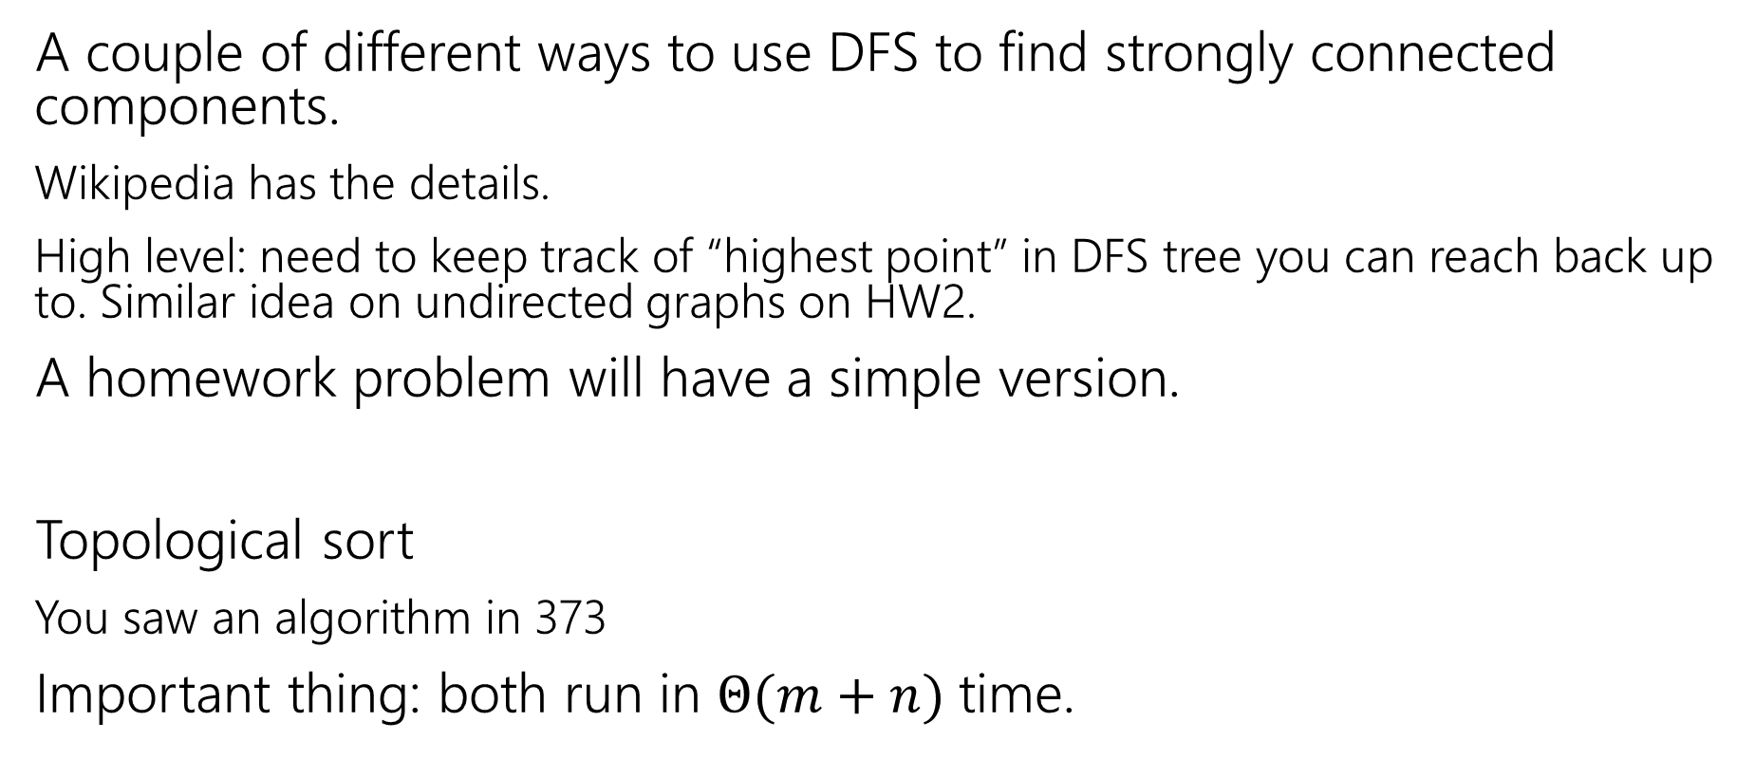
How do these work?
A couple of different ways to use DFS to find strongly connected components.
Wikipedia has the details.
High level: need to keep track of “highest point” in DFS tree you can reach back up to. Similar idea on undirected graphs on HW2.
A homework problem will have a simple version.
Topological sort
You saw an algorithm in 373
Important thing: both run in $Θ(m+n)$ time.

Slide 35
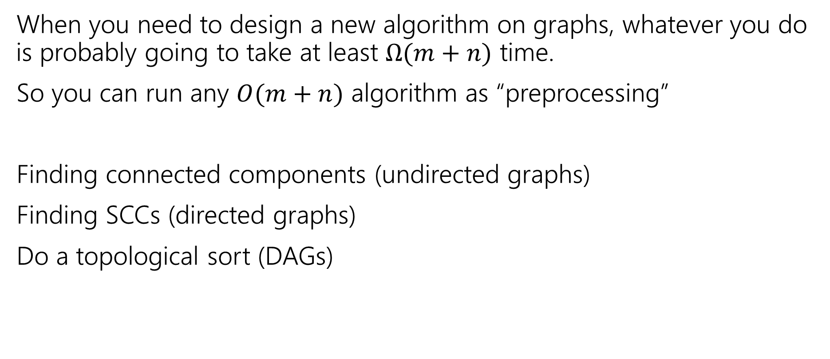
Designing New Algorithms
When you need to design a new algorithm on graphs, whatever you do is probably going to take at least $Ω(m+n)$ time.
So you can run any $O(m+n)$ algorithm as “preprocessing”
Finding connected components (undirected graphs)
Finding SCCs (directed graphs)
Do a topological sort (DAGs)

Slide 36
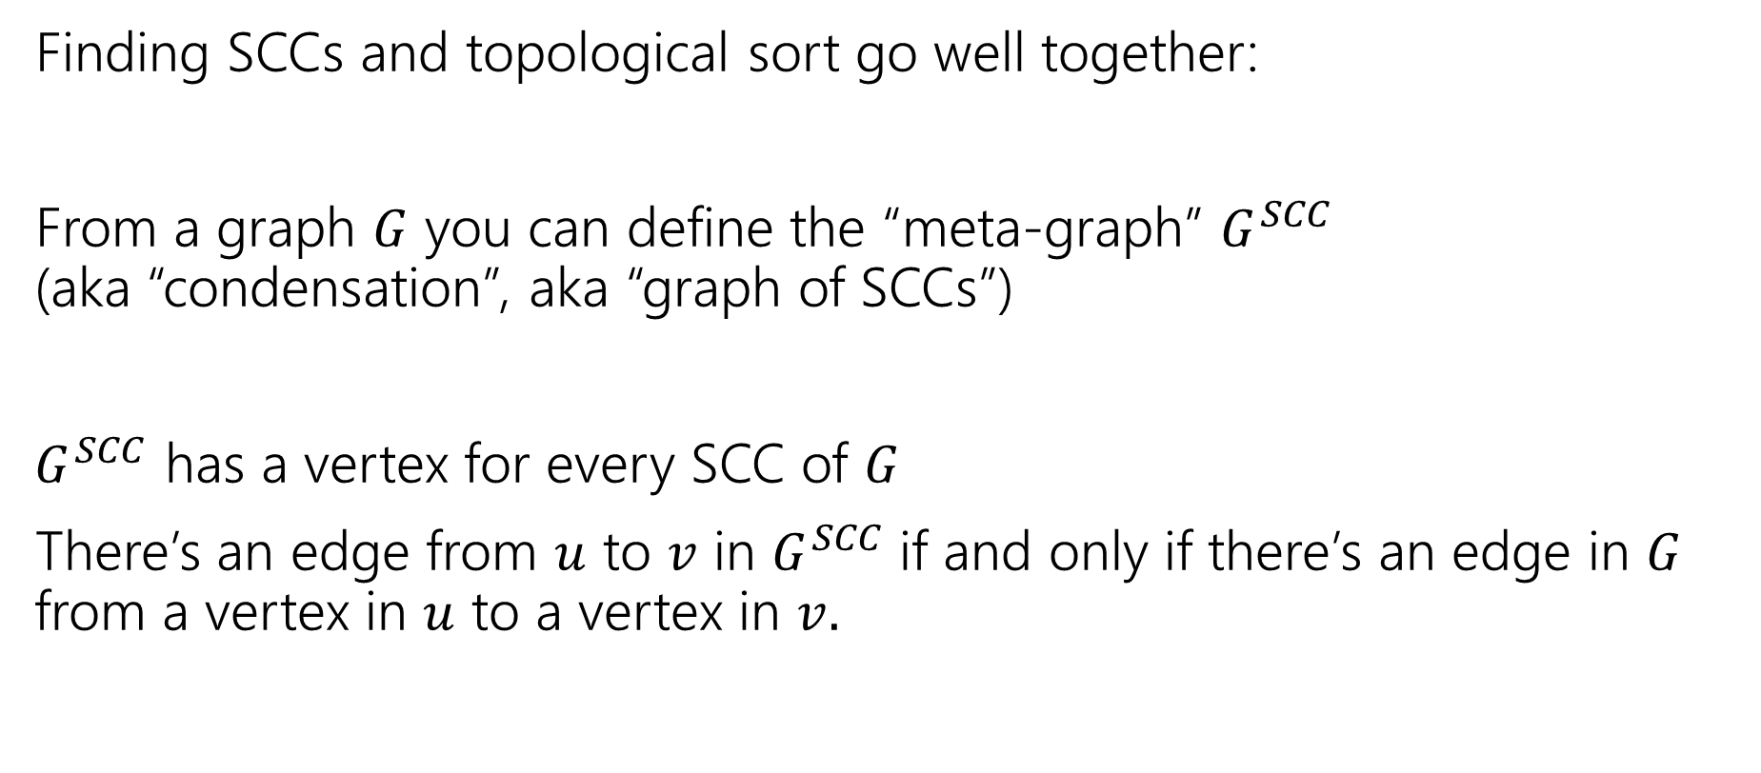
Designing New Algorithms
Finding SCCs and topological sort go well together:
From a graph $G$ you can define the “meta-graph” $G^{SCC}$ (aka “condensation”, aka “graph of SCCs”)
$G^{SCC}$ has a vertex for every SCC of $G$
There’s an edge from $u$ to $v$ in $G^{SCC}$if and only if there’s an edge in $G$ from a vertex in $u$ to a vertex in $v.$

Slide 37
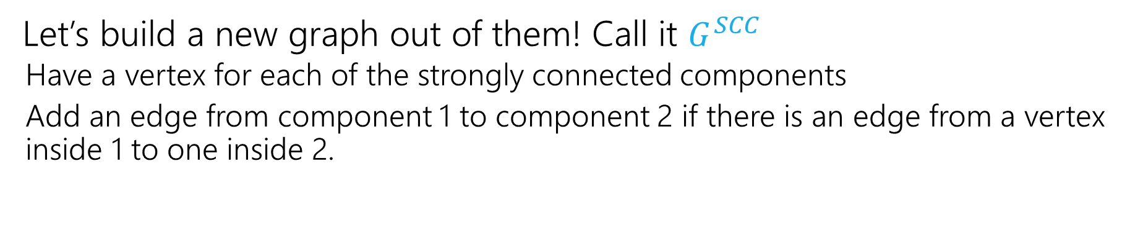
Why Find SCCs?
Let’s build a new graph out of them! Call it $G^{SCC}$
Have a vertex for each of the strongly connected components
Add an edge from component 1 to component 2 if there is an edge from a vertex inside 1 to one inside 2.
A
B
D
E
K
1
2
C
F
J
3
4

Slide 38
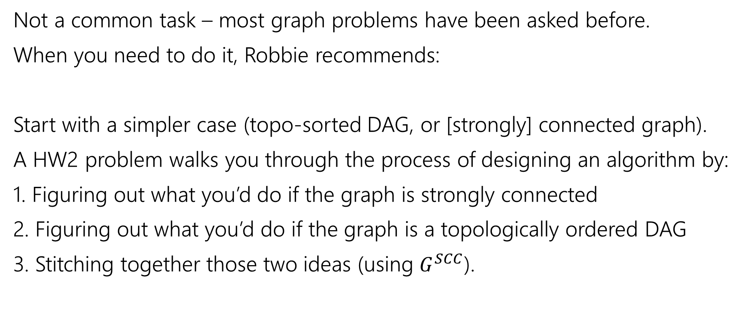
Designing New Graph Algorithms
Not a common task – most graph problems have been asked before.
When you need to do it, Robbie recommends:
Start with a simpler case (topo-sorted DAG, or [strongly] connected graph).
A HW2 problem walks you through the process of designing an algorithm by:
1. Figuring out what you’d do if the graph is strongly connected
2. Figuring out what you’d do if the graph is a topologically ordered DAG
3. Stitching together those two ideas (using $G^{SCC}$).

