Slide 1
Running Times, BFS
CSE 417 Fall 22
Lecture 5

Slide 2
Today
What running times are good?
Review some graph terms
BFS and applications

Slide 3
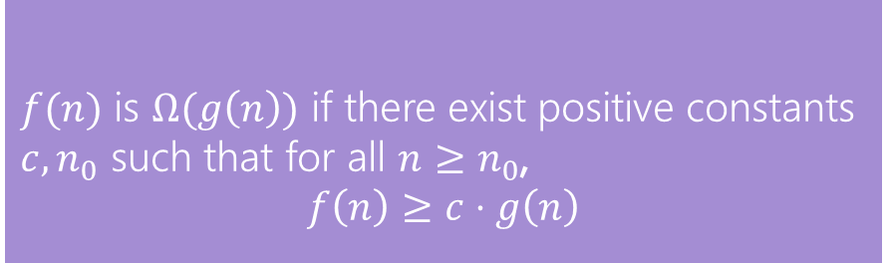
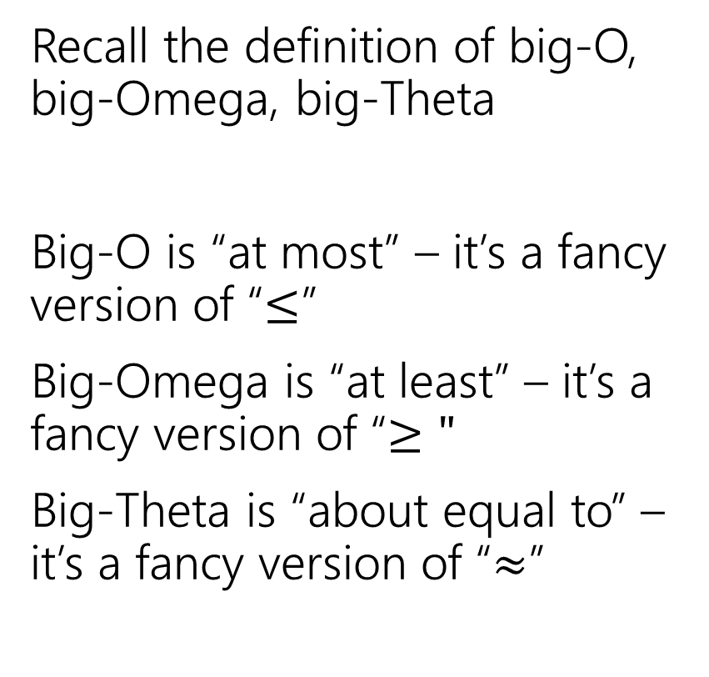
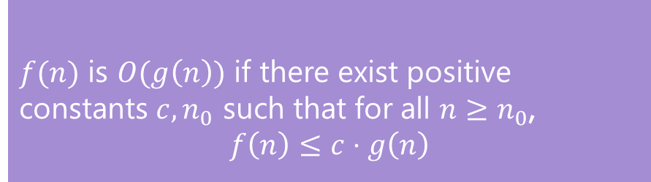
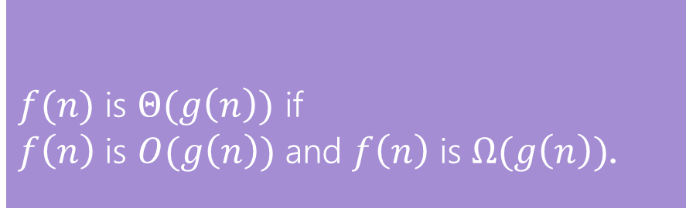
Running Times
$f(n)$ is $O(g\left(n\right))$ if there exist positive constants $c, n_{0}$ such that for all $n≥n_{0}$,
$$f\left(n\right)≤c⋅g\left(n\right)$$
Big-O
Recall the definition of big-O, big-Omega, big-Theta
Big-O is “at most” – it’s a fancy version of “$≤$”
Big-Omega is “at least” – it’s a fancy version of “$≥"$
Big-Theta is “about equal to” – it’s a fancy version of “$≈$”
$f(n)$ is $Ω(g\left(n\right))$ if there exist positive constants $c, n_{0}$ such that for all $n≥n_{0}$,
$$f\left(n\right)≥c⋅g\left(n\right)$$
Big-Omega
$f(n)$ is $Θ(g\left(n\right))$ if
$f\left(n\right)$ is $O(g\left(n\right))$ and $f\left(n\right)$ is $Ω(g\left(n\right))$.
Big-Theta

Slide 4
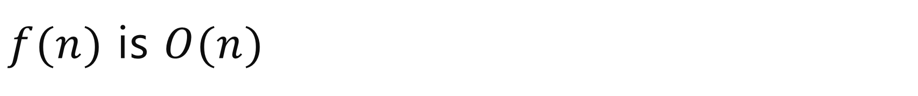
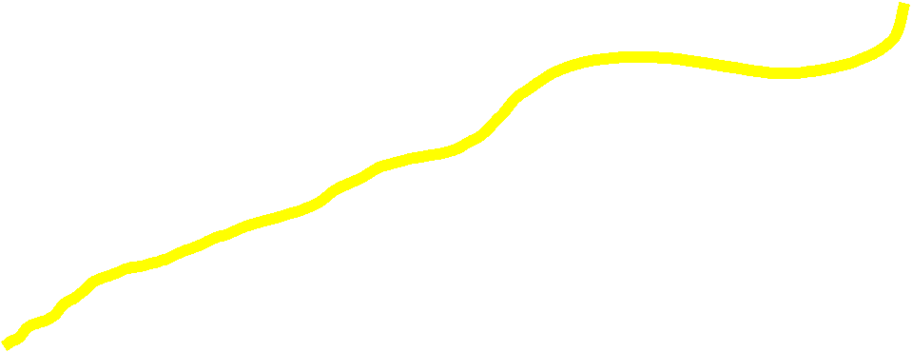
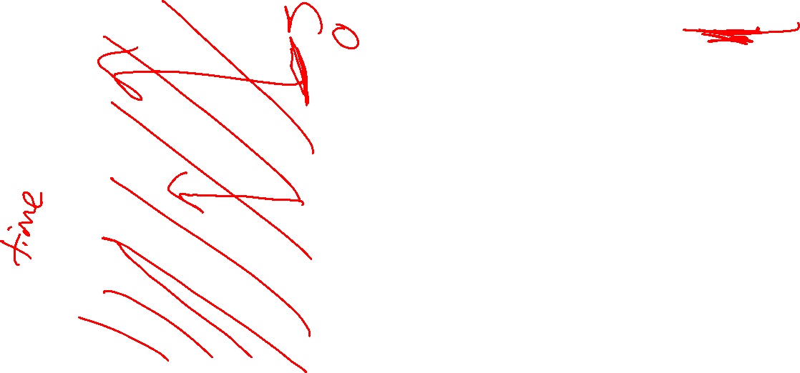
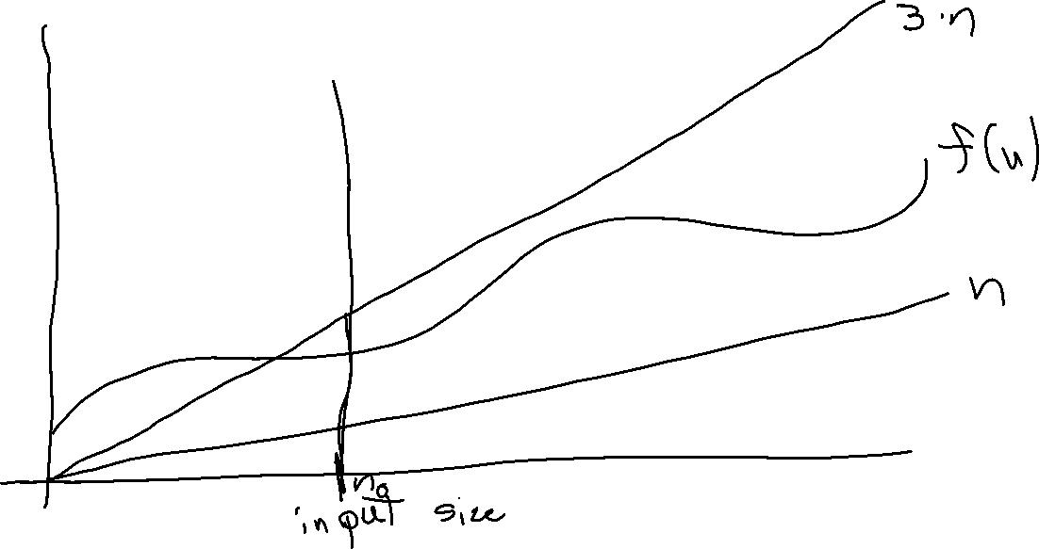
$f(n)$ is $O(n)$

Slide 5
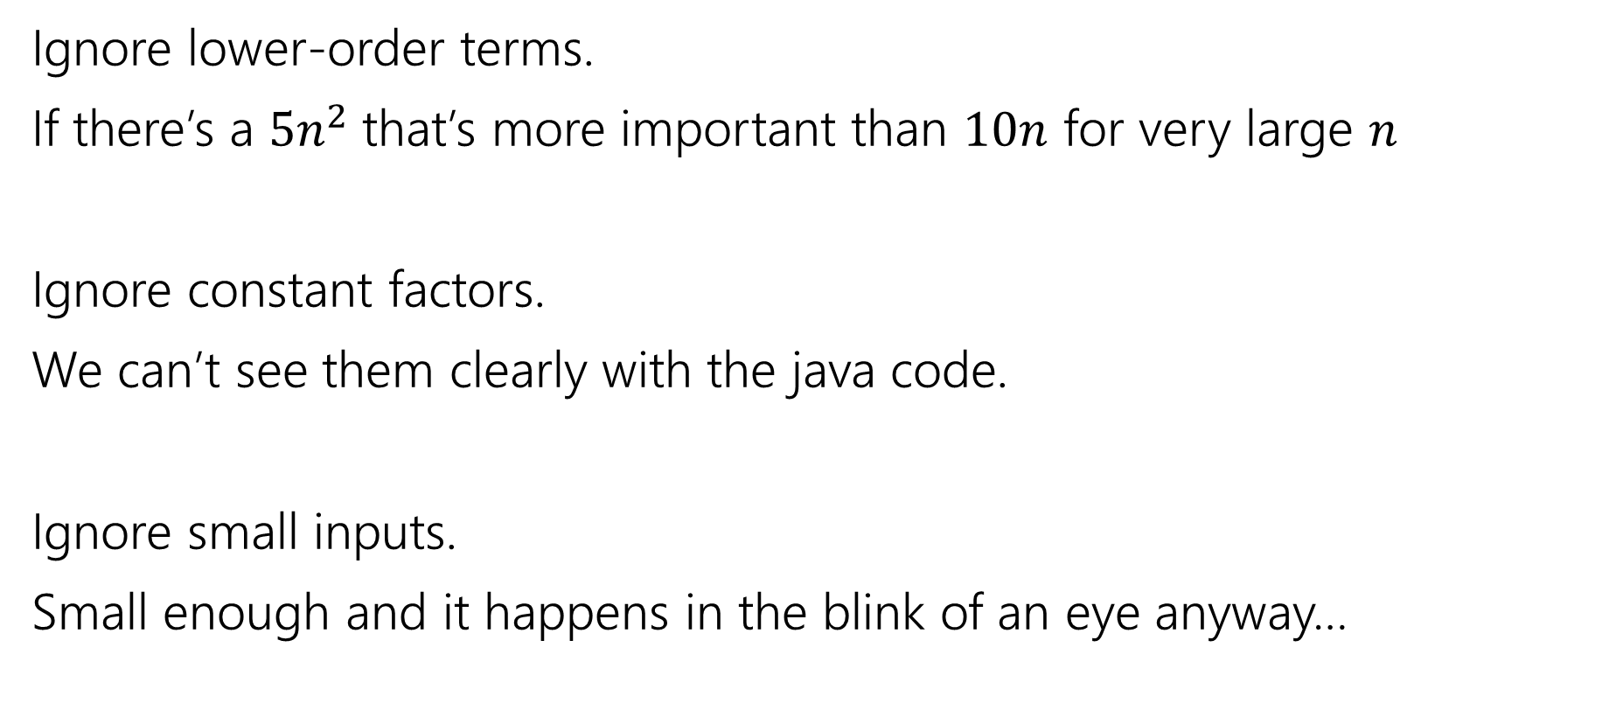
What don’t we care about?
Ignore lower-order terms.
If there’s a $5n^{2}$that’s more important than $10n$ for very large $n$
Ignore constant factors.
We can’t see them clearly with the java code.
Ignore small inputs.
Small enough and it happens in the blink of an eye anyway…

Slide 6

Big-O isn’t perfect!
$f\left(n\right)=1,000,000,000,000,000,000,000n$ is slower than $g\left(n\right)=2n^{2}$ for “practical” sizes of $n$. (but big-$O,Ω,Θ$ says treat $f$ as faster)
$f\left(n\right)=n$ and $g\left(n\right)=1000000n$ aren’t the same for practical purposes. But big-$O,Ω,Θ$ treat them identically.

Slide 7
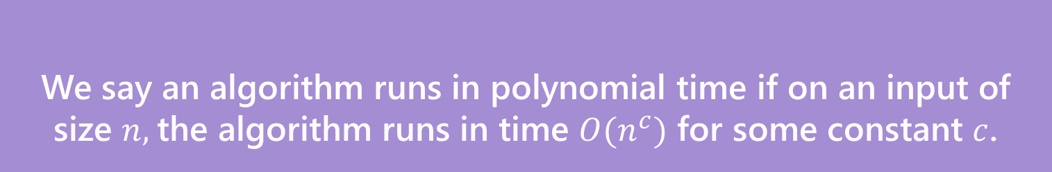

Polynomial vs. Exponential
We’ll say an algorithm is “efficient” if it runs in polynomial time
Sorting algorithms (e.g. the $Θ\left(n\log{n}\right)$ ones) – polynomial time.
Graph algorithms from 373 – polynomial time
We say an algorithm runs in polynomial time if on an input of size $n,$the algorithm runs in time $O(n^{c})$ for some constant $c$.
Polynomial Time

Slide 8
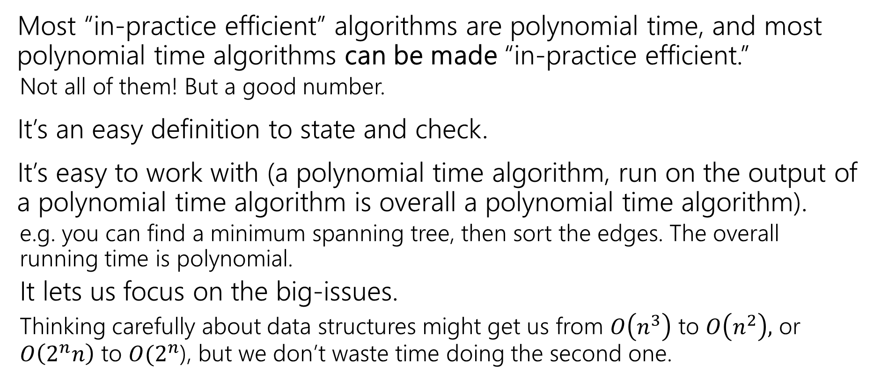
Why Polynomial Time?
Most “in-practice efficient” algorithms are polynomial time, and most polynomial time algorithms can be made “in-practice efficient.”
Not all of them! But a good number.
It’s an easy definition to state and check.
It’s easy to work with (a polynomial time algorithm, run on the output of a polynomial time algorithm is overall a polynomial time algorithm).
e.g. you can find a minimum spanning tree, then sort the edges. The overall running time is polynomial.
It lets us focus on the big-issues.
Thinking carefully about data structures might get us from $O\left(n^{3}\right)$ to $O\left(n^{2}\right),$ or $O\left(2^{n}n\right)$ to $O(2^{n}$), but we don’t waste time doing the second one.

Slide 9
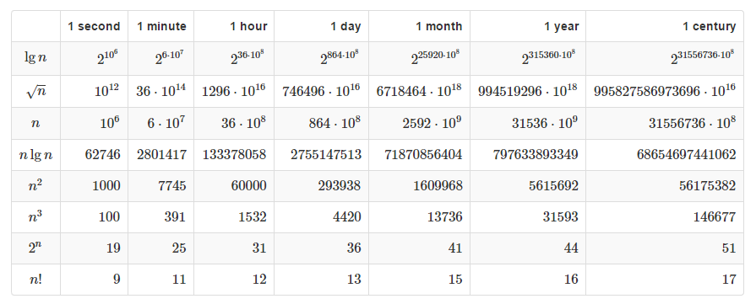

Polynomial vs. Exponential
If you have an algorithm that takes exactly $f(n)$ microseconds, how large of an $n$ can you handle in the given time?

Slide 10
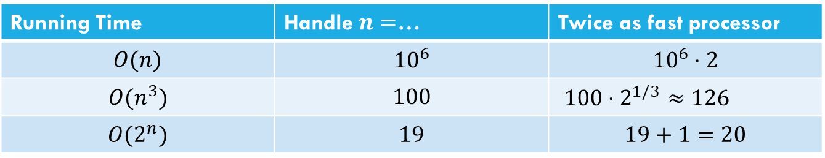
Polynomial vs. Exponential
For polynomial time, throwing (a lot) more time/compute power can make a significant difference. For exponential (or worse) time, the improvement is minimal.
Running Time | Handle $n=$… | Twice as fast processor
$$O(n)$$ | $${10}^{6}$$ | $${10}^{6}⋅2$$
$$O(n^{3})$$ | $$100$$ | $100⋅2^{1/3}$ $≈126$
$$O(2^{n})$$ | $$19$$ | $$19+1=20$$

Slide 11
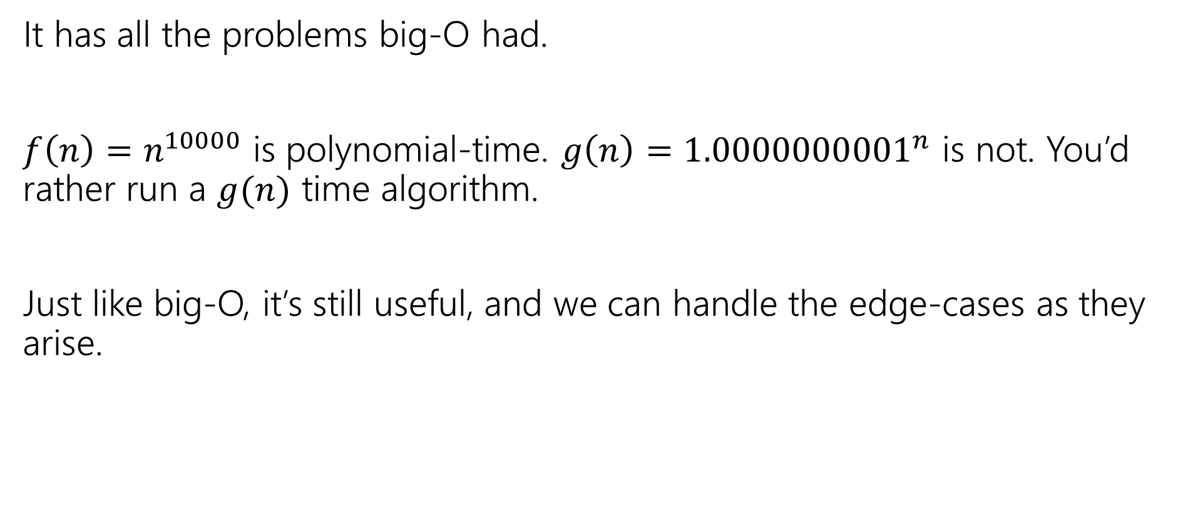
Polynomial Time isn’t perfect.
It has all the problems big-O had.
$f\left(n\right)=n^{10000}$ is polynomial-time. $g\left(n\right)={1.0000000001}^{n}$ is not. You’d rather run a $g(n)$ time algorithm.
Just like big-O, it’s still useful, and we can handle the edge-cases as they arise.

Slide 12
Tools for running time analysis
Recurrences
Solved with Master Theorem, tree method, or unrolling
Facts from 373
Known running times of data structures from that course– just use those as facts.
We have a reference for you on the webpage
Style of analysis you did in 373
How many iterations do loops need, and what’s the running time of each?
Occasionally, summations to answer those questions.

Slide 13
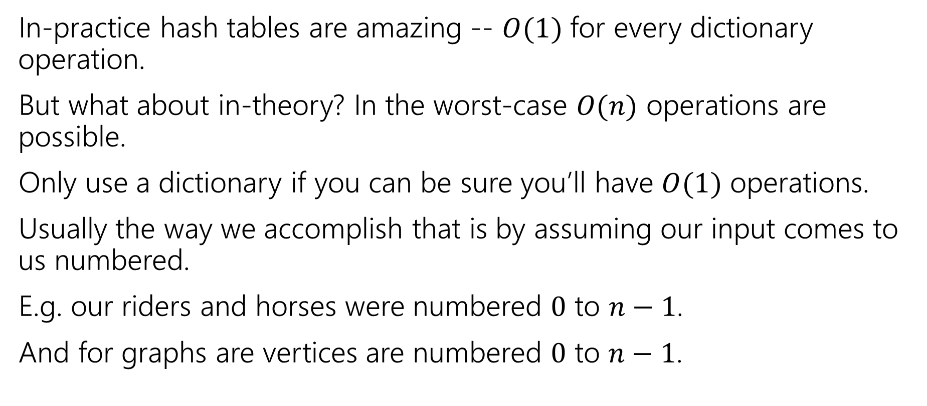
Be Careful with hash tables
In-practice hash tables are amazing -- $O(1)$ for every dictionary operation.
But what about in-theory? In the worst-case $O(n)$ operations are possible.
Only use a dictionary if you can be sure you’ll have $O(1)$ operations.
Usually the way we accomplish that is by assuming our input comes to us numbered.
E.g. our riders and horses were numbered $0$ to $n−1$.
And for graphs are vertices are numbered $0$ to $n−1$.

Slide 14
Graphs

Slide 15


Graphs
Represent data points and the relationships between them.
That’s vague.
Formally:
A graph is a pair: G = (V,E)
V: set of vertices (aka nodes)
E: set of edges
Each edge is a pair of vertices.
B
D
A
C
$$\{A,B,C,D\}$$
$$\{(A,B), (B,C), (B,D), (C,D)\}$$

Slide 16

Graph Terms
This graph is disconnected.
Graphs can be directed or undirected.
Degree: 2
Following on twitter.
A
A
Robbie
Outdegree: 2
Robbie
B
B
Degree: 0
Indegree: 2
Friendships on Facebook.

Slide 17
Making Graphs
If your problem has data and relationships, you might want to represent it as a graph
How do you choose a representation?
Usually:
Think about what your “fundamental” objects are
Those become your vertices.
Then think about how they’re related
Those become your edges.

Slide 18






Adjacency Matrix
4
0
1
5
6
2
3
In an adjacency matrix a[u][v] is 1 if there is an edge (u,v), and 0 otherwise.
Worst-case Time Complexity (|V| = n, |E| = m):
Add Edge:
Remove Edge:
Check edge exists from (u,v):
Get outneighbors of u:
Get inneighbors of u:
Space Complexity:
 | 0 | 1 | 2 | 3 | 4 | 5 | 6
0 | 0 | 1 | 1 | 0 | 0 | 0 | 0
1 | 1 | 0 | 0 | 1 | 0 | 0 | 0
2 | 1 | 0 | 0 | 1 | 0 | 0 | 0
3 | 0 | 1 | 1 | 0 | 0 | 1 | 0
4 | 0 | 0 | 0 | 0 | 0 | 1 | 0
5 | 0 | 0 | 0 | 1 | 1 | 0 | 0
6 | 0 | 0 | 0 | 0 | 0 | 0 | 0
$$Θ(1)$$
$$Θ(1)$$
$$Θ(1)$$
$$Θ(n)$$
$$Θ(n)$$
$$Θ(n^{2})$$
Notes:
It is usual to write |V| = n and |E| = m, though sometimes we’ll abuse notation and just use V and E.

Slide 19



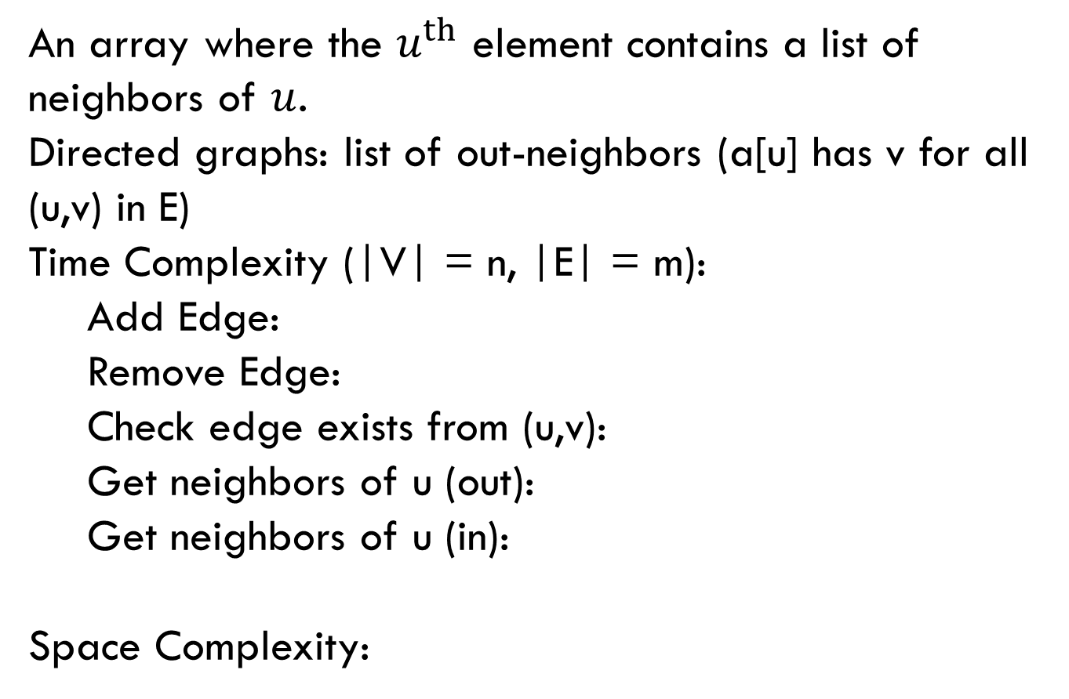



Adjacency List
0
1
4
5
6
2
3
An array where the $u^{th}$ element contains a list of neighbors of $u$.
Directed graphs: list of out-neighbors (a[u] has v for all (u,v) in E)
Time Complexity (|V| = n, |E| = m):
Add Edge:
Remove Edge:
Check edge exists from (u,v):
Get neighbors of u (out):
Get neighbors of u (in):
Space Complexity:
0
1
2
3
4
5
6
1 → 2
0 → 3
0 → 3
$$Θ(1)$$
1 → 2 → 5
5
$$Θ( 1 )$$
3 → 4
$$Θ( 1 )$$
$Θ(deg⁡(u))$
Assume we have hash tables AND linked lists
$$Θ(n )$$
$$Θ(n + m)$$

Slide 20
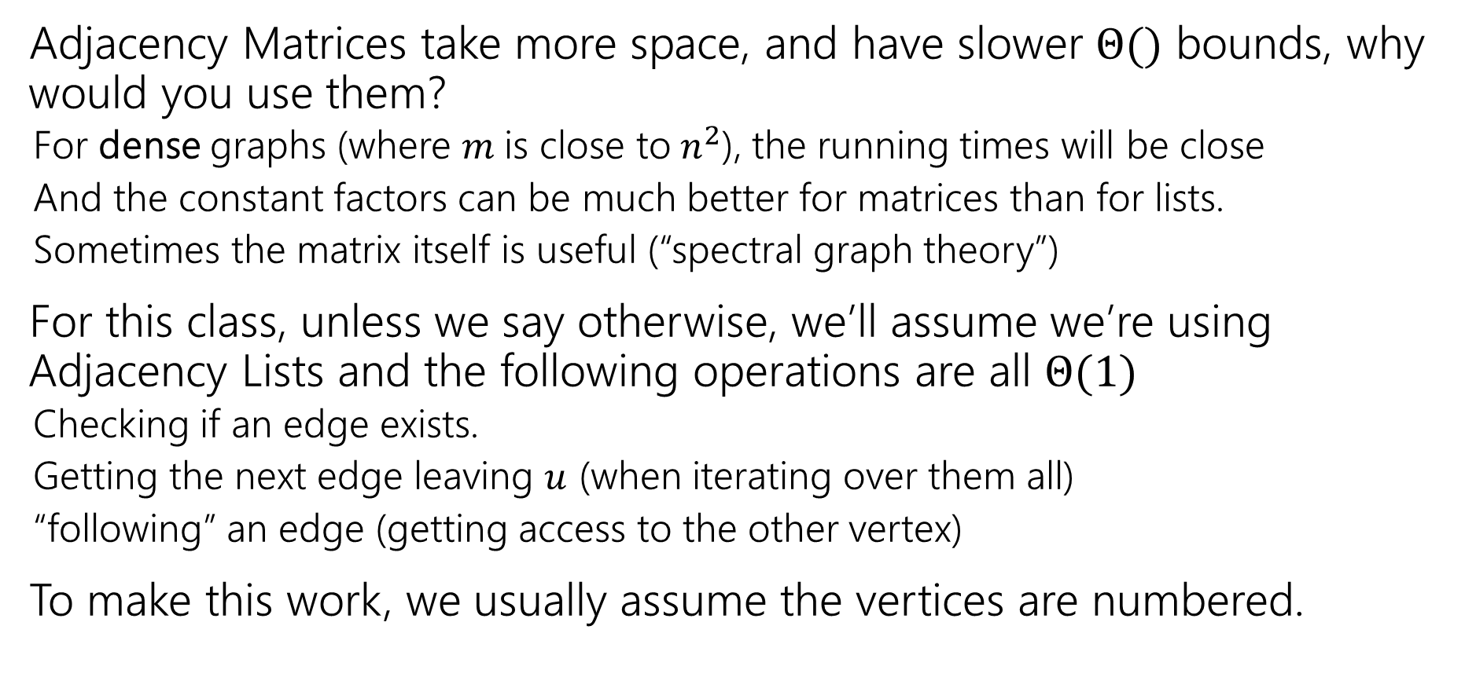
Tradeoffs
Adjacency Matrices take more space, and have slower $Θ()$ bounds, why would you use them?
For dense graphs (where $m$is close to$n^{2}$), the running times will be close
And the constant factors can be much better for matrices than for lists.
Sometimes the matrix itself is useful (“spectral graph theory”)
For this class, unless we say otherwise, we’ll assume we’re using Adjacency Lists and the following operations are all $Θ(1)$
Checking if an edge exists.
Getting the next edge leaving $u$ (when iterating over them all)
“following” an edge (getting access to the other vertex)
To make this work, we usually assume the vertices are numbered.

Slide 21
Traversals

Slide 22
Breadth First Search
search(graph)
toVisit.enqueue(first vertex)
mark first vertex as seen
while(toVisit is not empty)
current = toVisit.dequeue()
for (v : current.neighbors())
if (v is not seen)
mark v as seen
toVisit.enqueue(v)
F
J
G
D
A
I
H
E
B
C
H
Current node:
Queue:
Finished:
I
A
E
D
B
G
F
C
G
B
D
E
C
F
G
H
I
A
B
D
E
C
F
G
H
I

Slide 23
Breadth First Search
search(graph)
toVisit.enqueue(first vertex)
mark first vertex as seen
while(toVisit is not empty)
current = toVisit.dequeue()
for (v : current.neighbors())
if (v is not seen)
mark v as seen
toVisit.enqueue(v)
F
J
G
D
A
I
H
E
B
C
Hey we missed something…
We’re only going to find vertices we can “reach” from our starting point.
If you need to visit everything, just start BFS again somewhere you haven’t visited until you’ve found everything.

Slide 24
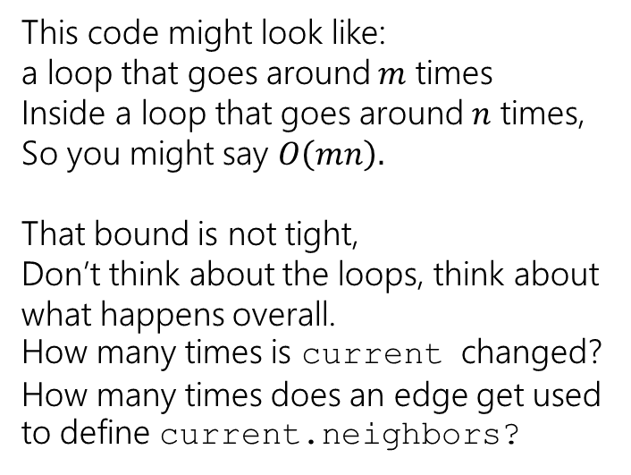
Running Time
search(graph)
toVisit.enqueue(first vertex)
mark first vertex as seen
while(toVisit is not empty)
current = toVisit.dequeue()
for (v : current.neighbors())
if (v is not seen)
mark v as seen
toVisit.enqueue(v)
This code might look like: a loop that goes around $m$ times
Inside a loop that goes around $n$ times,
So you might say $O\left(mn\right).$
That bound is not tight,
Don’t think about the loops, think about what happens overall. How many times is current changed? How many times does an edge get used to define current.neighbors?
We visit each vertex at most twice, and each edge at most once: $Θ(|V| + |E|)$

Slide 25
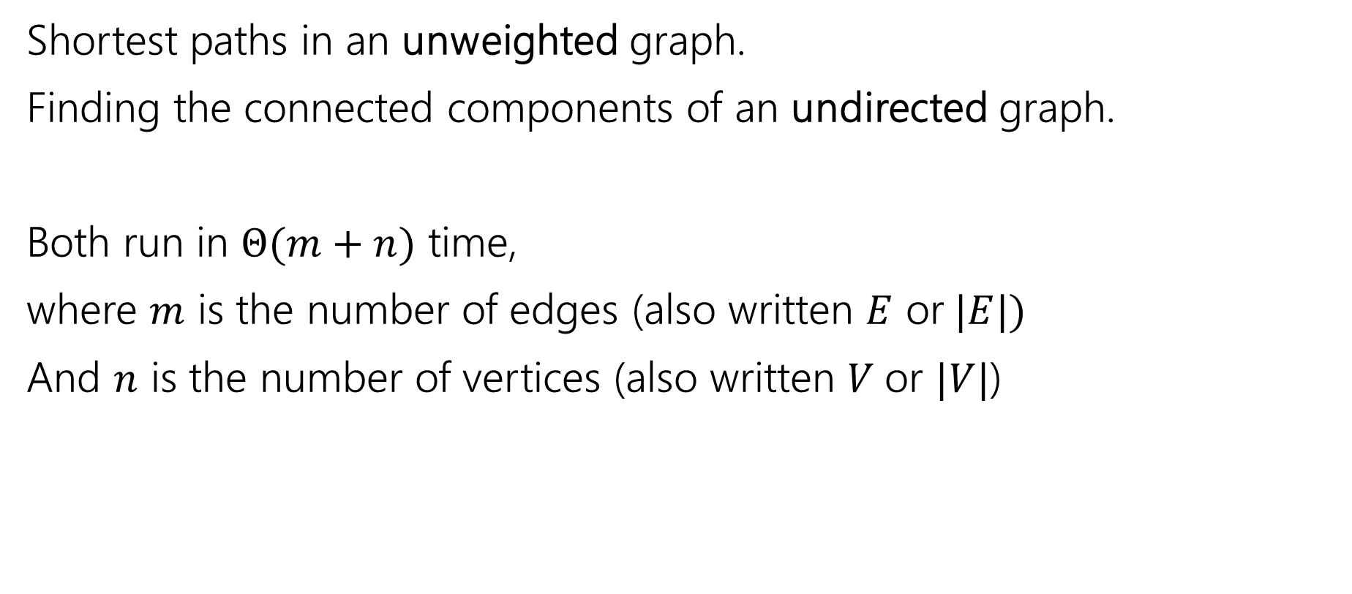
Old Breadth-First Search Application
Shortest paths in an unweighted graph.
Finding the connected components of an undirected graph.
Both run in $Θ(m+n)$ time,
where $m$ is the number of edges (also written $E$ or$|E|)$
And $n$ is the number of vertices (also written $V$or $|V|$)

Slide 26
Unweighted Graphs
If the graph is unweighted, how do we find a shortest paths?
What’s the shortest path from s to s?
Well….we’re already there.
What’s the shortest path from s to u or v?
Just go on the edge from s
From s to w,x, or y?
Can’t get there directly from s, if we want a length 2 path, have to go through u or v.
u
w
s
y
t
v
x

Slide 27
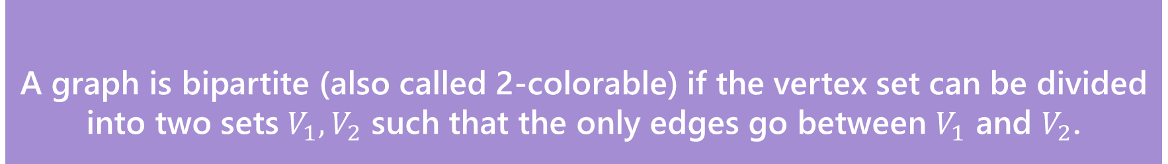
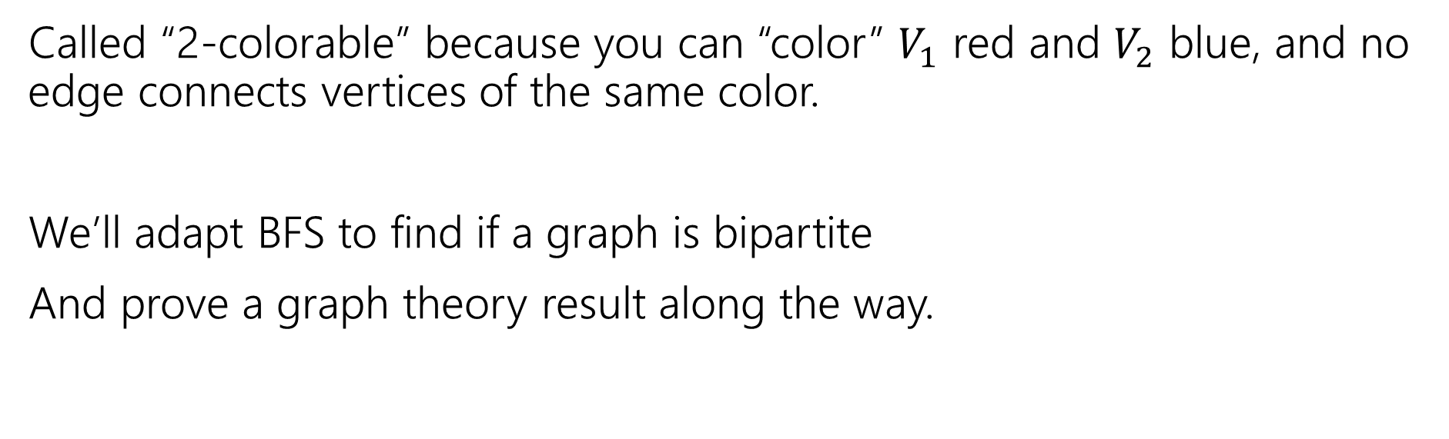
A new application
A graph is bipartite (also called 2-colorable) if the vertex set can be divided into two sets $V_{1},V_{2}$ such that the only edges go between $V_{1}$ and $V_{2}$.
Bipartite (also called “2-colorable”)
Called “2-colorable” because you can “color” $V_{1}$ red and $V_{2}$ blue, and no edge connects vertices of the same color.
We’ll adapt BFS to find if a graph is bipartite
And prove a graph theory result along the way.

Slide 28
A new application
A graph is bipartite (also called 2-colorable) if the vertex set can be divided into two sets $V_{1},V_{2}$ such that the only edges go between $V_{1}$ and $V_{2}$.
Bipartite (also called “2-colorable”)
Called “2-colorable” because you can “color” $V_{1}$ red and $V_{2}$ blue, and no edge connects vertices of the same color.
If a graph contains an odd cycle, then it is not bipartite.
Try the example on the right, then proving the general theorem in the light purple box.
Help Robbie figure out how long to make the explanation
Pollev.com/robbie

Slide 29
Lemma 1
If a graph contains an odd cycle, then it is not bipartite.
Start from any vertex, and give it either color.
Its neighbors must be the other color.
Their neighbors must be the first color
…
The last two vertices (which are adjacent) must be the same color.
Uh-oh.

Slide 30
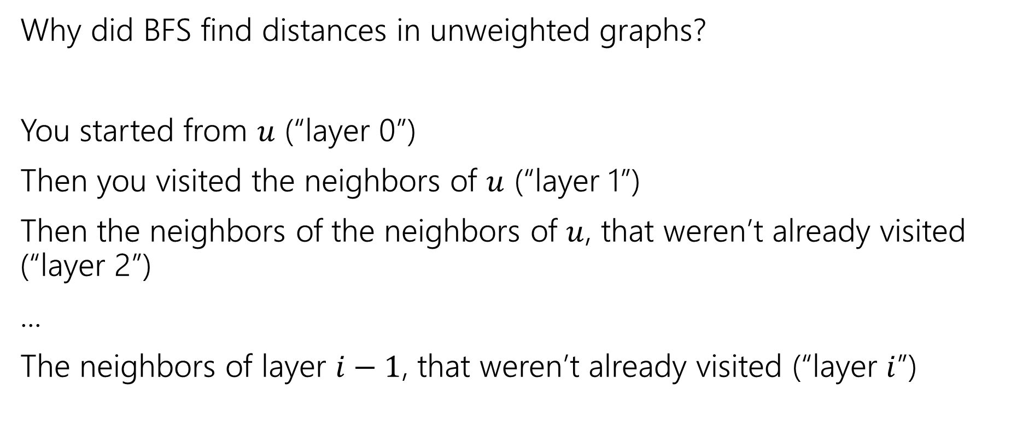
BFS with Layers
Why did BFS find distances in unweighted graphs?
You started from $u$ (“layer 0”)
Then you visited the neighbors of $u$ (“layer 1”)
Then the neighbors of the neighbors of $u$, that weren’t already visited (“layer 2”)
...
The neighbors of layer $i−1$, that weren’t already visited (“layer $i$”)

Slide 31
Unweighted Graphs
If the graph is unweighted, how do we find a shortest paths?
What’s the shortest path from s to s?
Well….we’re already there.
What’s the shortest path from s to u or v?
Just go on the edge from s
From s to w,x, or y?
Can’t get there directly from s, if we want a length 2 path, have to go through u or v.
u
w
s
y
t
v
x

Slide 32
BFS With Layers
search(graph)
toVisit.enqueue(first vertex)
mark first vertex as seen
toVisit.enqueue(end-of-layer-marker)
l=1
while(toVisit is not empty)
current = toVisit.dequeue()
if(current == end-of-layer-marker)
l++
toVisit.enqueue(end-of-layer-marker)
current.layer = l
for (v : current.neighbors())
if (v is not seen)
mark v as seen
toVisit.enqueue(v)
It’s just BFS!
With some extra bells and whistles.

Slide 33
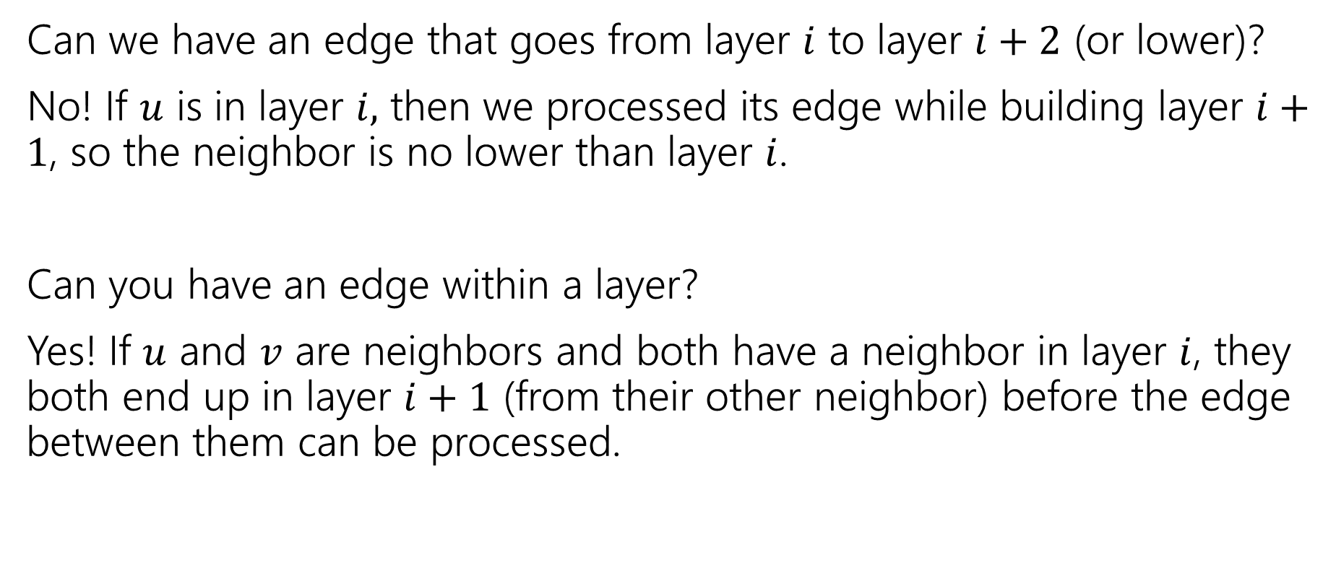
Layers
Can we have an edge that goes from layer $i$ to layer $i+2$ (or lower)?
No! If $u$ is in layer $i,$ then we processed its edge while building layer $i+1$, so the neighbor is no lower than layer $i$.
Can you have an edge within a layer?
Yes! If $u$ and $v$ are neighbors and both have a neighbor in layer $i$, they both end up in layer $i+1$ (from their other neighbor) before the edge between them can be processed.

Slide 34
Testing Bipartiteness
How can we use BFS with layers to check if a graph is 2-colorable?
Well, neighbors have to be “the other color”
Where are your neighbors?
Hopefully in the next layer or previous layer…
Color all the odd layers red and even layers blue.
Does this work?

Slide 35
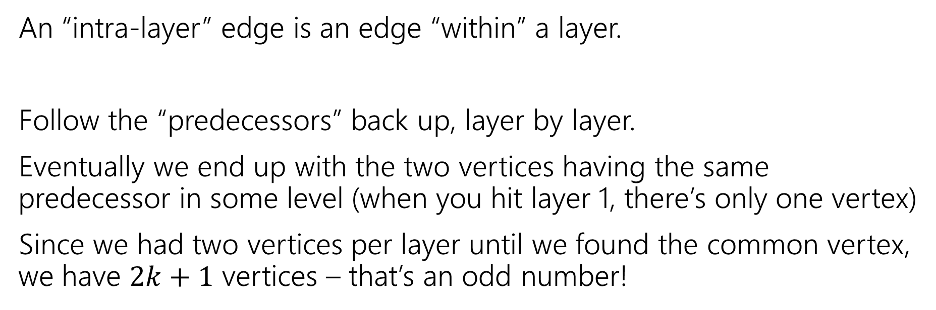
Lemma 2
If BFS has an intra-layer edge, then the graph has an odd-length cycle.
An “intra-layer” edge is an edge “within” a layer.
Follow the “predecessors” back up, layer by layer.
Eventually we end up with the two vertices having the same predecessor in some level (when you hit layer 1, there’s only one vertex)
Since we had two vertices per layer until we found the common vertex, we have $2k+1$ vertices – that’s an odd number!

Slide 36
Lemma 3
If a graph has no odd-length cycles, then it is bipartite.
Prove it by contrapositive
The contrapositive implication is “the same one” prove that instead!

Slide 37
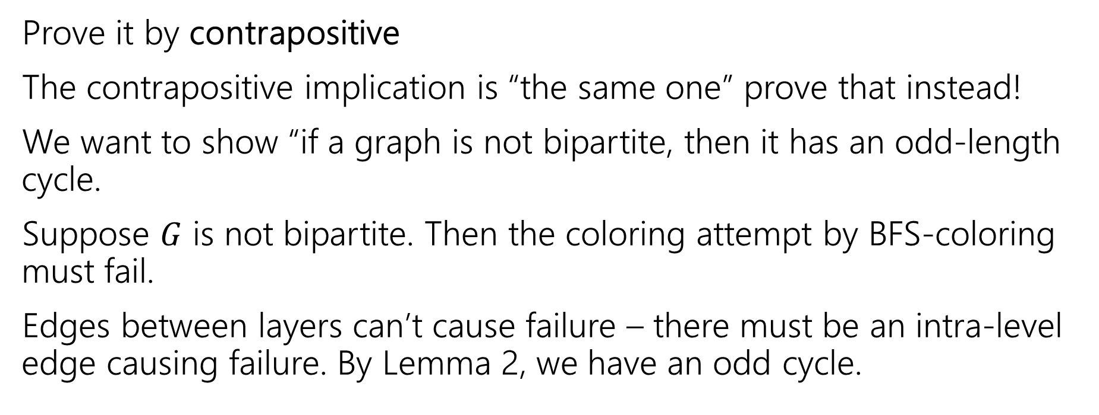
Lemma 3
If a graph has no odd-length cycles, then it is bipartite.
Prove it by contrapositive
The contrapositive implication is “the same one” prove that instead!
We want to show “if a graph is not bipartite, then it has an odd-length cycle.
Suppose $G$ is not bipartite. Then the coloring attempt by BFS-coloring must fail.
Edges between layers can’t cause failure – there must be an intra-level edge causing failure. By Lemma 2, we have an odd cycle.

Slide 38
The Big Result
A graph is bipartite if and only if it has no odd cycles.
Bipartite (also called “2-colorable”)
Proof: Lemma 1 says if a graph has an odd cycle, then it’s not bipartite (or in contrapositive form, if a graph is bipartite, then it has no odd cycles)
Lemma 3 says if a graph has no odd cycles then it is bipartite.

Slide 39
The Big Result
The final theorem statement doesn’t know about the algorithm – we used the algorithm to prove a graph theory fact!

Slide 40
Wrapping it up
BipartiteCheck(graph) //assumes graph is connected!
toVisit.enqueue(first vertex)
mark first vertex as seen
toVisit.enqueue(end-of-layer-marker)
l=“odd”
while(toVisit is not empty)
current = toVisit.dequeue()
if(current == end-of-layer-marker)
l++
toVisit.enqueue(end-of-layer-marker)
current.layer = l
for (v : current.neighbors())
if (v is not seen)
mark v as seen
toVisit.enqueue(v)
else //v is seen
if(v.layer == current.layer)
return “not bipartite” //intra-level edge
return “bipartite” //no intra-level edges

Slide 41
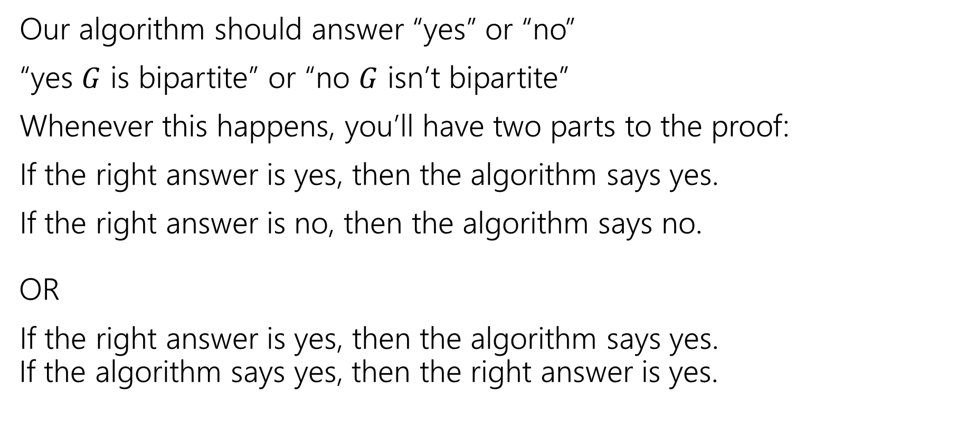
Testing Bipartiteness
Our algorithm should answer “yes” or “no”
“yes $G$ is bipartite” or “no $G$ isn’t bipartite”
Whenever this happens, you’ll have two parts to the proof:
If the right answer is yes, then the algorithm says yes.
If the right answer is no, then the algorithm says no. OR
If the right answer is yes, then the algorithm says yes. If the algorithm says yes, then the right answer is yes.

Slide 42
Proving Algorithm Correct
If the graph is bipartite, then by Lemma 1 there is no odd cycle. So by the contrapositive of lemma 2, we get no intra-level edges when we run BFS, thus the algorithm (correctly) returns the graph is bipartite.
If the algorithm returns that the graph is bipartite, then we have found a bipartition. We cannot have any intra-level edges (since we check every edge in the course of the algorithm). We proved earlier that there are no edges skipping more than one level. So if we assign odd levels to “red” and even levels to “blue” the algorithm has verified that there are no edges between vertices of the same color.

