Slide 1
More Stable Matchings, Contrapositives
CSE 417 AU21
Lecture 3

Slide 2
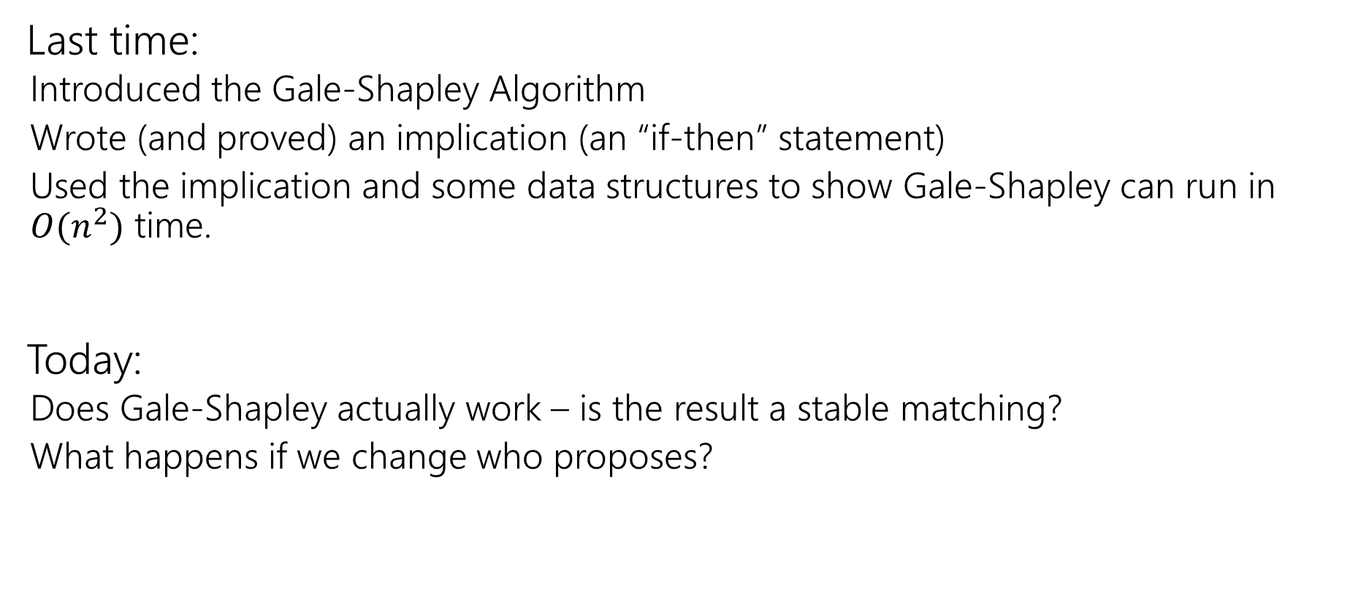
Where Were We?
Last time:
Introduced the Gale-Shapley Algorithm
Wrote (and proved) an implication (an “if-then” statement)
Used the implication and some data structures to show Gale-Shapley can run in $O(n^{2})$ time.
Today:
Does Gale-Shapley actually work – is the result a stable matching?
What happens if we change who proposes?

Slide 3
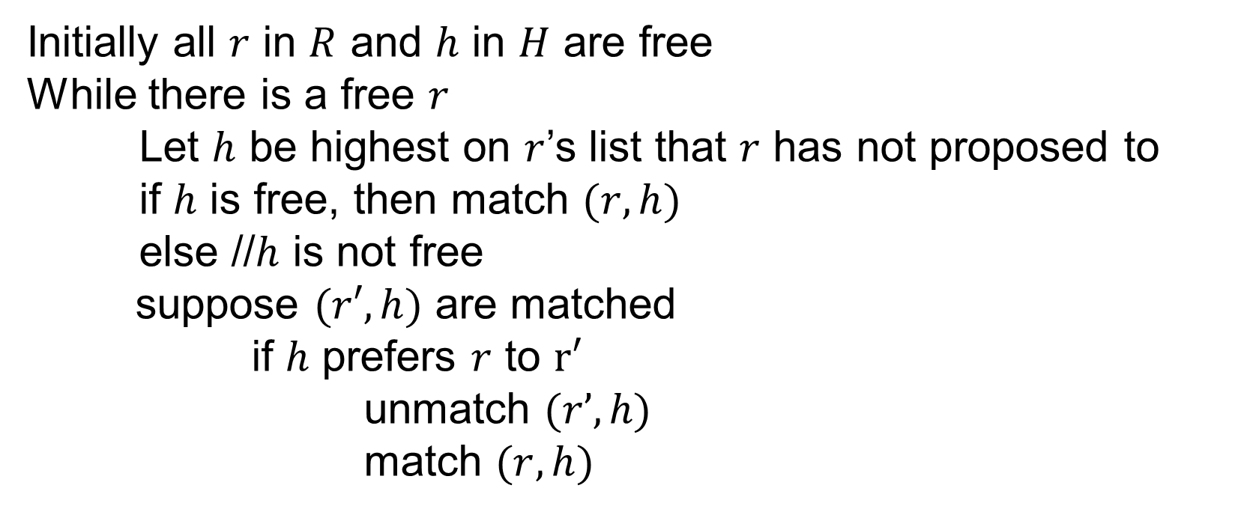
Gale-Shapley Algorithm
Initially all $r$ in $R$ and $h$ in $H$ are free
While there is a free $r$
Let $h$ be highest on $r$’s list that $r$ has not proposed to
if $h$ is free, then match $(r, h)$
else //$h$ is not free
suppose $(r′, h)$ are matched
if $h$ prefers $r$ to $r′$
unmatch $(r’, h)$
match $(r, h)$

Slide 4
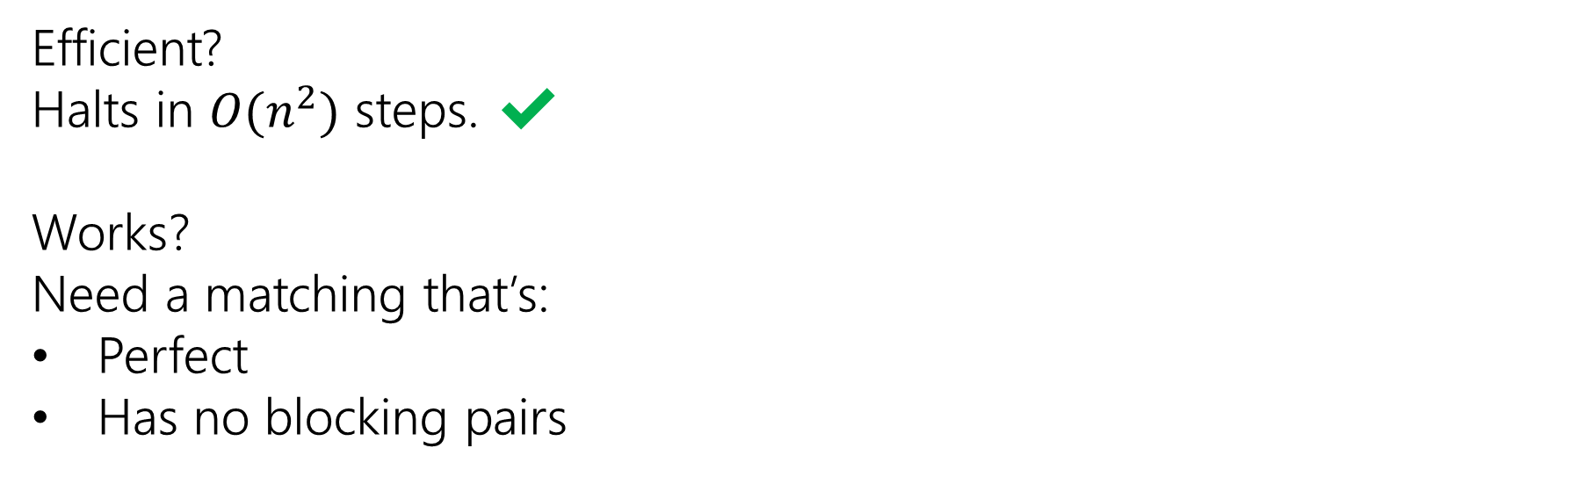
Analyzing Gale-Shapley
Efficient?
Halts in $O(n^{2})$ steps. ✔
Works?
Need a matching that’s:
Perfect
Has no blocking pairs

Slide 5
Claim 3: The algorithm identifies a perfect matching.
Why?
We know the algorithm halts. Which means when it halts every rider is matched.
But we have the same number of horses and riders, and we matched them one-to-one.
Hence, the algorithm finds a perfect matching.
Invariant: partial matching
What happens when some m reaches its last choice?
exactly n-1 w’s much be matched
last choice must be available

Slide 6
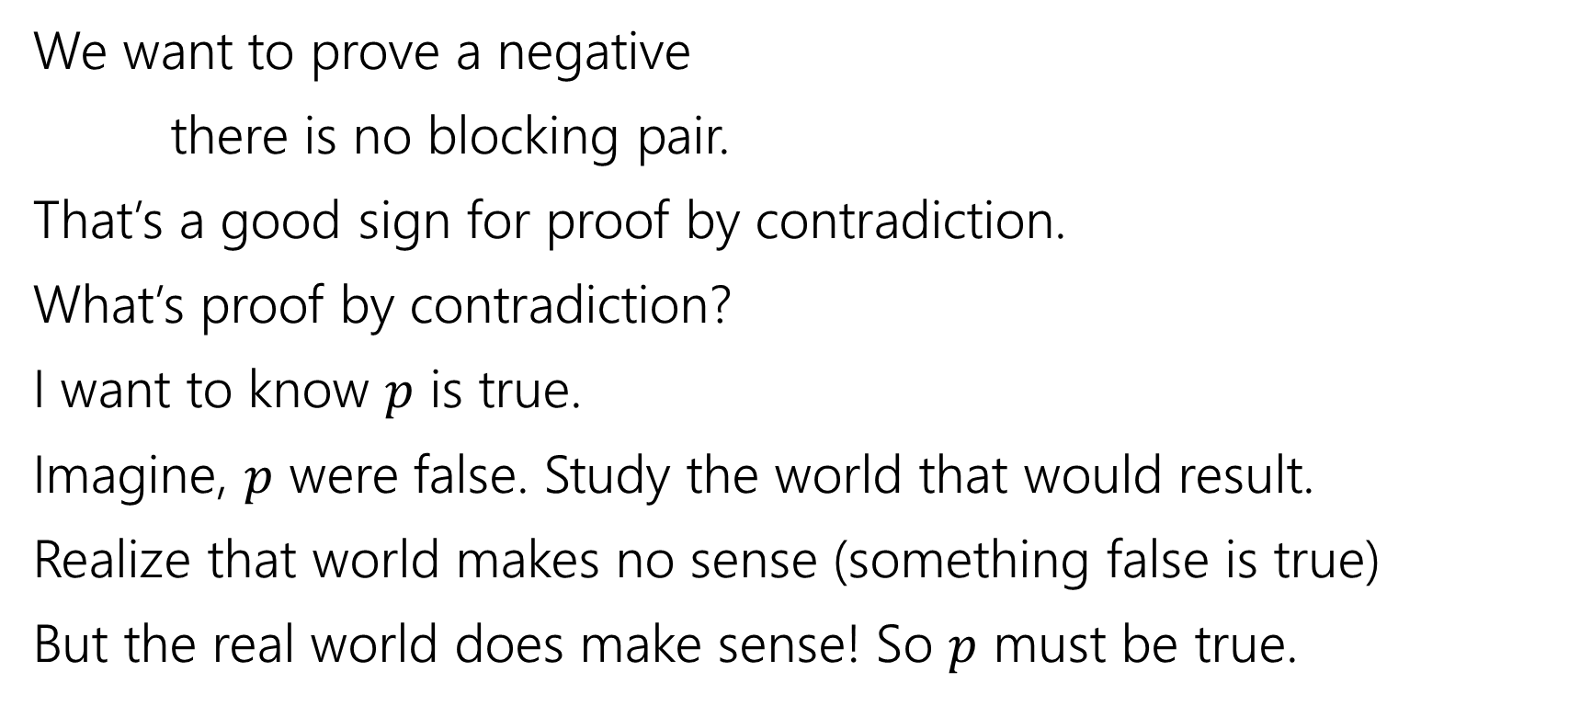
Claim 4: The matching has no blocking pairs.
We want to prove a negative
there is no blocking pair.
That’s a good sign for proof by contradiction.
What’s proof by contradiction?
I want to know $p$ is true.
Imagine, $p$ were false. Study the world that would result.
Realize that world makes no sense (something false is true)
But the real world does make sense! So $p$ must be true.
m₁ proposed to w₂ before w₁
w₂ rejected m₁ for m₃
w₂ prefers m₃ to m₁
w₂ prefers m₂ to m₃

Slide 7
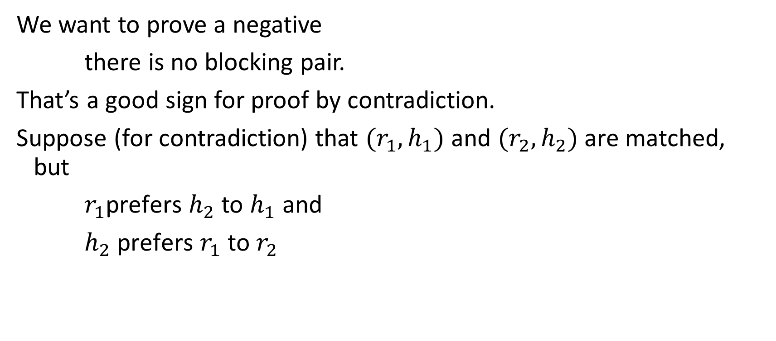






Claim 4: The matching has no blocking pairs.
We want to prove a negative
there is no blocking pair.
That’s a good sign for proof by contradiction.
Suppose (for contradiction) that $(r_{1},h_{1})$ and $(r_{2},h_{2})$ are matched, but
$r_{1}$prefers $h_{2}$ to $h_{1}$ and
$h_{2}$ prefers $r_{1}$ to $r_{2}$
$$…h_{2} …h_{1}…$$
$$r_{1}$$
$$h_{1}$$
m₁ proposed to w₂ before w₁
w₂ rejected m₁ for m₃
w₂ prefers m₃ to m₁
w₂ prefers m₂ to m₃
Whenever you use contradiction in a proof, make sure you say you’re doing proof by contradiction.
Otherwise it’s very confusing to the reader.
$$r_{2}$$
$$h_{2}$$
$${…r}_{1} …{ r}_{2}…$$

Slide 8







Claim 4: The matching has no blocking pairs.
$$…h_{2} …h_{1}…$$
$$r_{1}$$
$$h_{1}$$
$$r_{2}$$
$$h_{2}$$
$${…r}_{1} …{ r}_{2}…$$
How did $r_{1}$ end up matched to $h_{1}$?

Slide 9
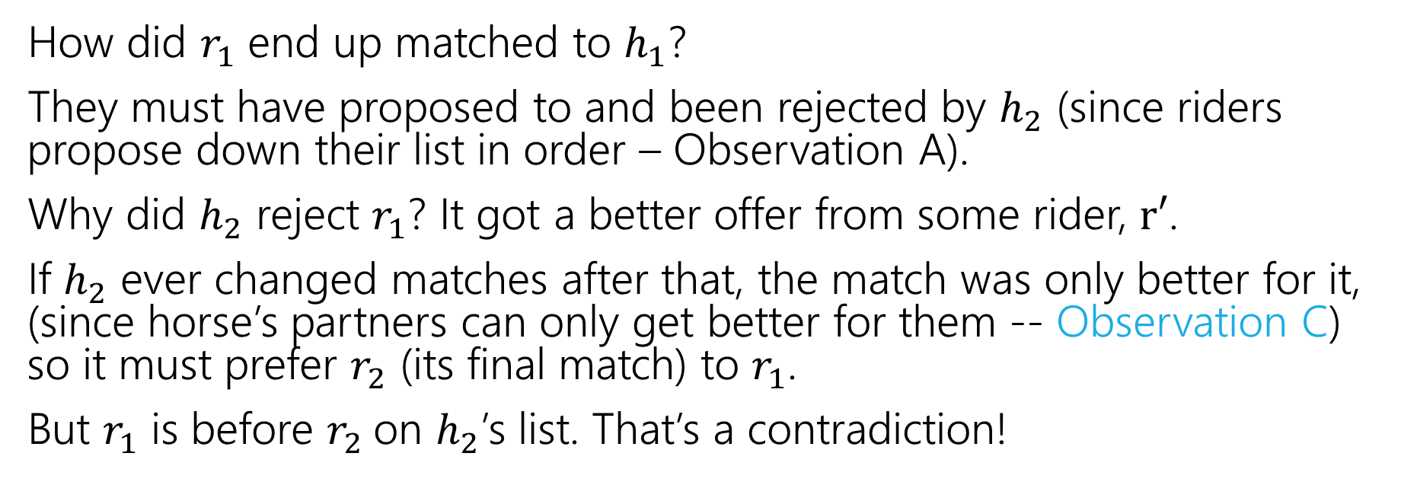
Claim 4: The matching has no blocking pairs.
$$…h_{2} …h_{1}…$$
$$r_{1}$$
$$h_{1}$$
$$r_{2}$$
$$h_{2}$$
$${…r}_{1} …{ r}_{2}…$$
How did $r_{1}$ end up matched to $h_{1}$?
They must have proposed to and been rejected by $h_{2}$ (since riders propose down their list in order – Observation A).
Why did $h_{2}$ reject $r_{1}$? It got a better offer from some rider, $r′$.
If $h_{2}$ ever changed matches after that, the match was only better for it, (since horse’s partners can only get better for them -- Observation C) so it must prefer $r_{2}$ (its final match) to $r_{1}$.
But $r_{1}$ is before $r_{2}$on $h_{2}$’s list. That’s a contradiction!

Slide 10
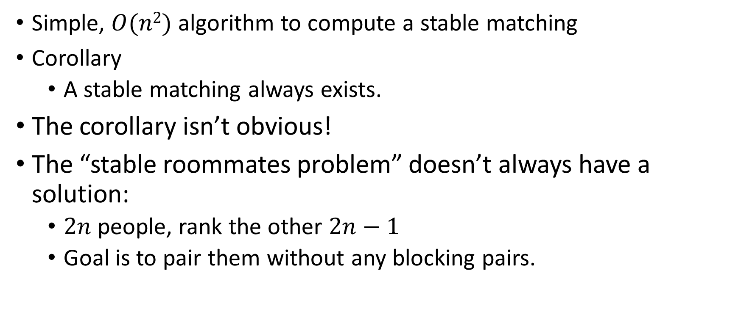
Result
Simple, $O(n2)$ algorithm to compute a stable matching
Corollary
A stable matching always exists.
The corollary isn’t obvious!
The “stable roommates problem” doesn’t always have a solution:
$2n$people, rank the other $2n−1$
Goal is to pair them without any blocking pairs.
A “corollary” is a small fact that is easy to see from a big fact.

Slide 11








Multiple Stable Matchings
Suppose we take our algorithm and let the horses do the “proposing” instead.
$$h_{1} , h_{2}$$
$$r_{1}$$
$$h_{1}$$
$$r_{2} , r_{1}$$
$$h_{2} , h_{1}$$
$$r_{2}$$
$$h_{2}$$
$$r_{1} , r_{2}$$
We got a different answer…
What does that mean?

Slide 12
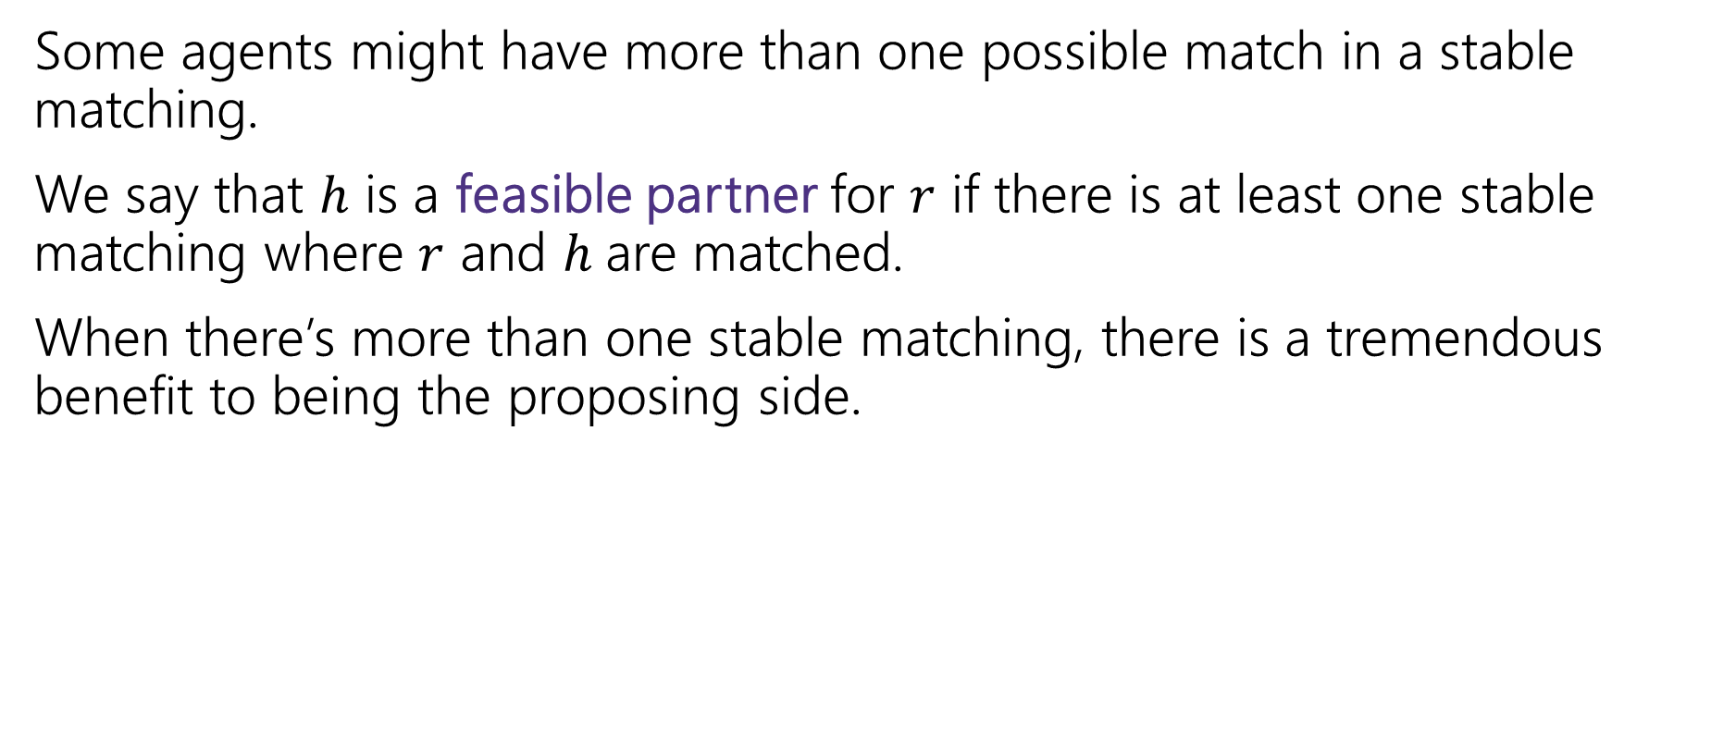
Proposer-Optimality
Some agents might have more than one possible match in a stable matching.
We say that $h$ is a feasible partner for $r$ if there is at least one stable matching where $r$ and $h$are matched.
When there’s more than one stable matching, there is a tremendous benefit to being the proposing side.
Every member of the proposing side is matched to their favorite of their feasible partners.
Proposer-Optimality

Slide 13



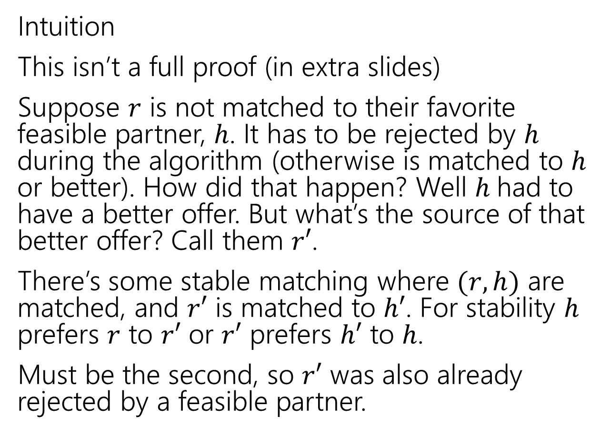






Proposer-Optimality
Intuition
This isn’t a full proof (in extra slides)
Suppose $r$ is not matched to their favorite feasible partner, $h$. It has to be rejected by $h$ during the algorithm (otherwise is matched to $h$ or better). How did that happen? Well $h$had to have a better offer. But what’s the source of that better offer? Call them $r′$.
There’s some stable matching where $(r,h)$ are matched, and $r′$ is matched to $h′$. For stability $h$ prefers $r$ to $r′$ or $r′$ prefers $h′$ to $h$.
Must be the second, so $r′$ was also already rejected by a feasible partner.
$$r$$
$$h′$$
$$r′$$
$$h$$
$$r$$
$$h′$$
$$r′$$
$$h$$

Slide 14
Implications of Proposer Optimality
Every member of the proposing side is matched to their favorite of their feasible partners.
Proposer-Optimality
We didn’t specify which rider proposes when more than one is free
Proposer-optimality says it doesn’t matter! You always get the proposer-optimal matching.
So what happens to the other side?

Slide 15
Chooser-Pessimality
A similar argument (it’s a quite tricky proof-by-contradiction, but very similar to proposer-optimality), will show that choosing among proposals is a much worse position to be in.
Every member of the choosing (non-proposing) side is matched to their least favorite of their feasible partners.
Chooser-Pessimality

Slide 16
Some More Context and Takeaways
Stable Matching has another common name: “Stable Marriage”
The metaphor used there is “men” and “women” getting married.
When choosing or analyzing an algorithm, or choosing which parts of a problem to model and which ones to ignore, think about everyone involved, not just the people you’re optimizing for; you might not be able to have it all.

Slide 17
Takeaways
Stable Matchings always exist, and we can find them efficiently.
The GS Algorithm gives proposers their best possible partner
At the expense of those receiving proposals getting their worst possible.

Slide 18
More Implications

Slide 19
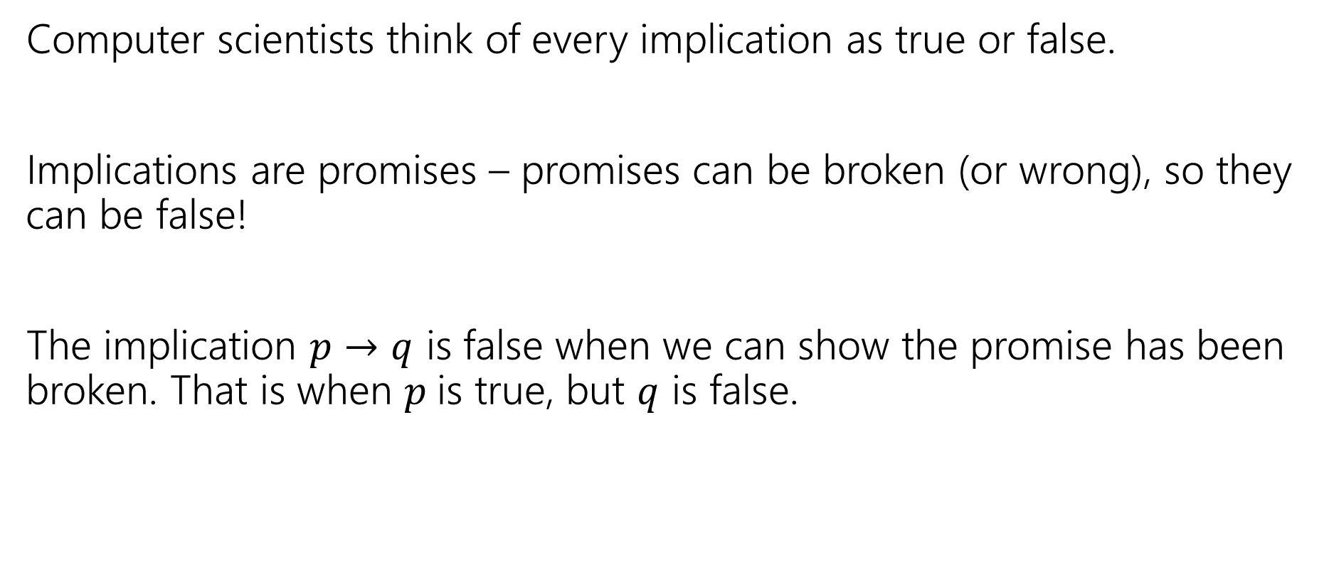
When is an implication false?
Computer scientists think of every implication as true or false.
Implications are promises – promises can be broken (or wrong), so they can be false!
The implication $p→q$ is false when we can show the promise has been broken. That is when $p$is true, but $q$ is false.

Slide 20
True or False?
For the purposes of this slide, Alice always carries an umbrella, Bob never carries an umbrella, and it is sunny out right now.
If it is sunny right now, then Alice has her umbrella.
If it is raining right now, then Alice has her umbrella.
If Bob has his umbrella, then it is raining right now.
If it is raining right now, then Bob has his umbrella.

Slide 21
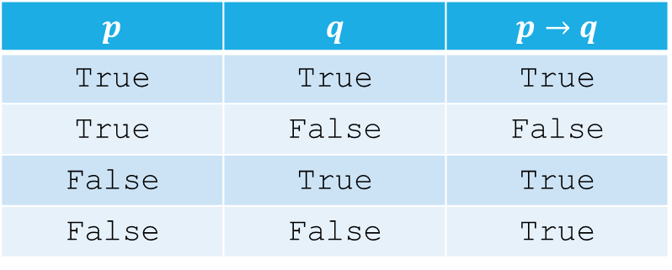
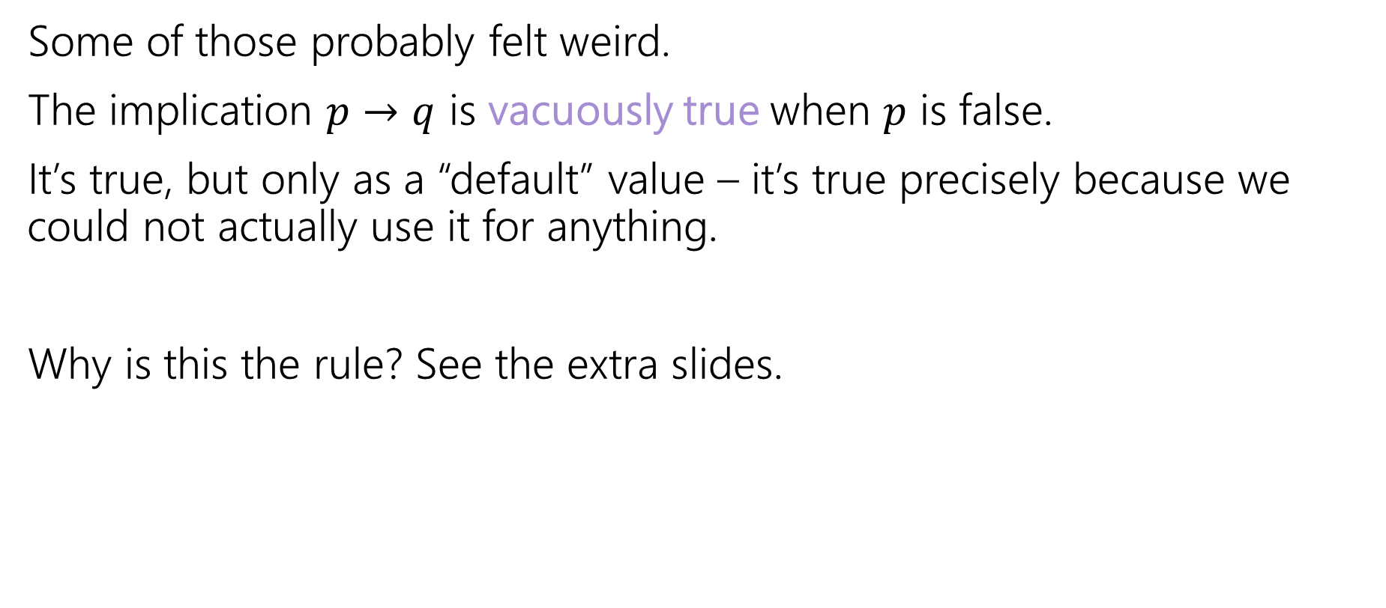
Vacuous Truth
Some of those probably felt weird.
The implication $p→q$ is vacuously true when $p$ is false.
It’s true, but only as a “default” value – it’s true precisely because we could not actually use it for anything.
Why is this the rule? See the extra slides.
$$p$$ | $$q$$ | $$p→q$$
True | True | True
True | False | False
False | True | True
False | False | True

Slide 22

Contrapositives
There are two equivalent ways to write an implication
$p→q$ and $¬q→¬p$

Slide 23
Contrapositives
To take a contrapositive, switch the “if-part” and “then-part” and negate them both.
If it is raining, then I have my umbrella.
If I do not have my umbrella, then it is not raining
Try it yourself:
If I’m on campus, then I have my Husky card.

Slide 24
Why take contrapositives?
Some implications are easier to prove in their contrapositive form.
We’ll get more practice on Wednesday.

Slide 25
Optional: more context

Slide 26

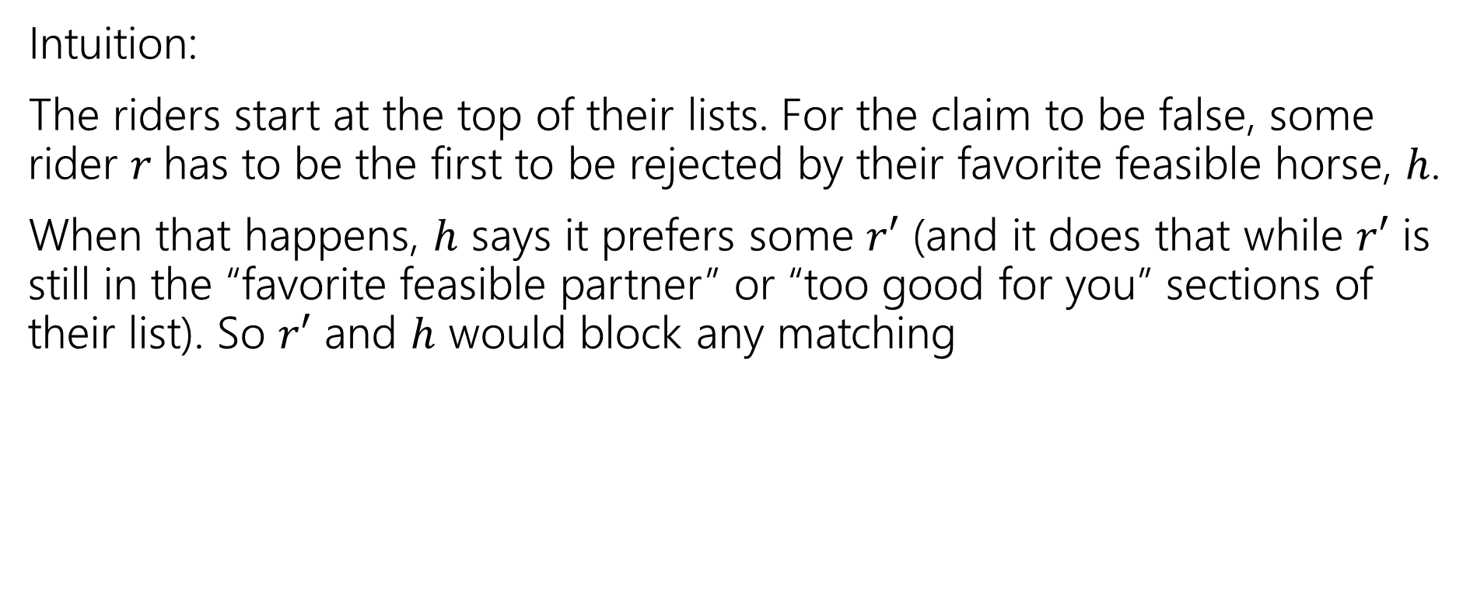



Proposer-Optimality
Every member of the proposing side is matched to the favorite of their feasible partners.
Proposer-Optimality
$$r$$
$$h′$$
$$r′$$
$$h$$
Intuition:
The riders start at the top of their lists. For the claim to be false, some rider $r$has to be the first to be rejected by their favorite feasible horse, $h$.
When that happens, $h$ says it prefers some $r′$ (and it does that while $r′$ is still in the “favorite feasible partner” or “too good for you” sections of their list). So $r′$ and $h$ would block any matching
$$r$$
$$h′$$
$$r′$$
$$h$$

Slide 27
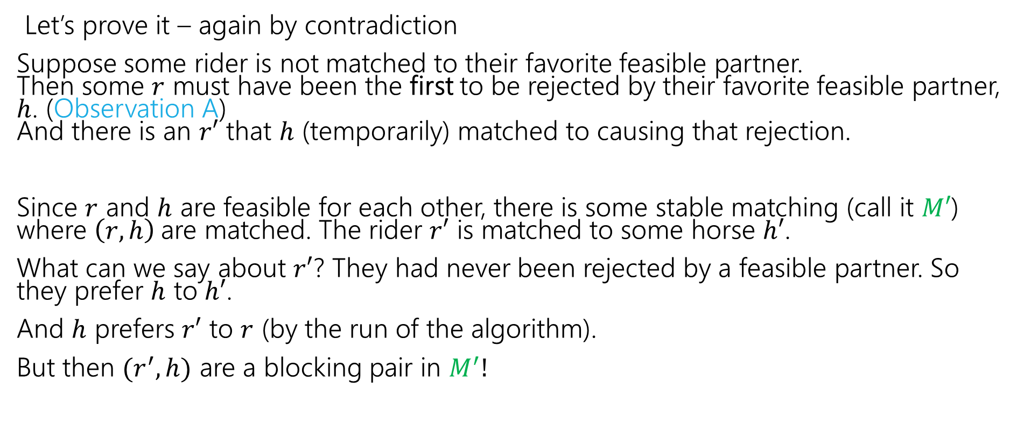
Proposer-Optimality
Every member of the proposing side is matched to the favorite of their feasible partners.
Proposer-Optimality
$$r$$
$$h′$$
$$r′$$
$$h$$
Let’s prove it – again by contradiction
Suppose some rider is not matched to their favorite feasible partner. Then some $r$ must have been the first to be rejected by their favorite feasible partner, $h$. (Observation A) And there is an $r′$ that $h$ (temporarily) matched to causing that rejection.
Since $r$ and $h$ are feasible for each other, there is some stable matching (call it $M′$) where $\left(r,h\right)$are matched. The rider $r′$ is matched to some horse $h′$.
What can we say about $r′$? They had never been rejected by a feasible partner. So they prefer $h$ to $h′$.
And $h$ prefers $r′$ to $r$ (by the run of the algorithm).
But then $(r^{′},h)$ are a blocking pair in $M^{′}!$
$$r$$
$$h′$$
$$r′$$
$$h$$

Slide 28
Why vacuous truth?
Why do we call vacuous implications true? Why not call them “false”? Or “neither true nor false”?
Answer 1: It’s the convention. Everyone else does it; if you try to call it something else, everyone else will be very confused.
Answer 2: Implications can be general enough to be sometimes vacuous and sometimes not. Consider “If a number is even and prime, then it is equal to 2” Depending on what you choose for “number” the implication might be vacuous or not!
We’d really rather not think of the implication as “sometimes true, and sometimes neither true nor false” or worse yet “sometimes true and sometimes false” – “true” is the only realistic choice.

