Slide 1
Stable Matchings
CSE 417 22AU
Lecture 2

Slide 2



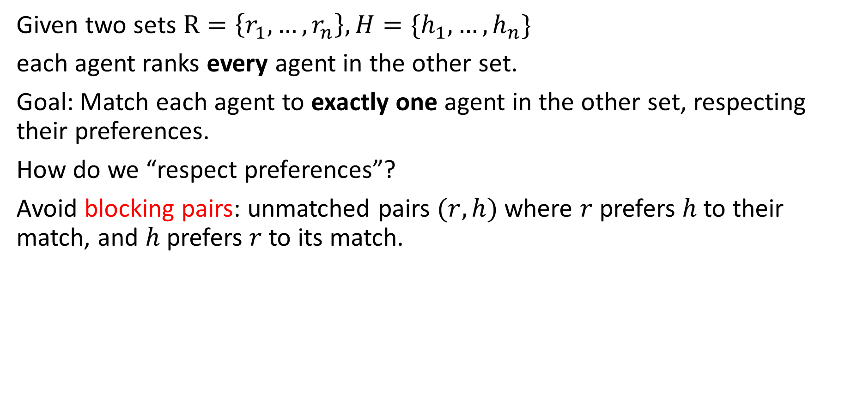



Stable Matching Problem
Given two sets $R=\left\{r_{1}, …,r_{n}\right\}, H=\{h_{1},…,h_{n}\}$
each agent ranks every agent in the other set.
Goal: Match each agent to exactly one agent in the other set, respecting their preferences.
How do we “respect preferences”?
Avoid blocking pairs: unmatched pairs $(r,h)$ where $r$prefers $h$ to their match, and $h$ prefers $r$to its match.
$$h$$
$$h , h’$$
$$r, r’$$
$$r$$
$$r′$$
$$h′$$

Slide 3
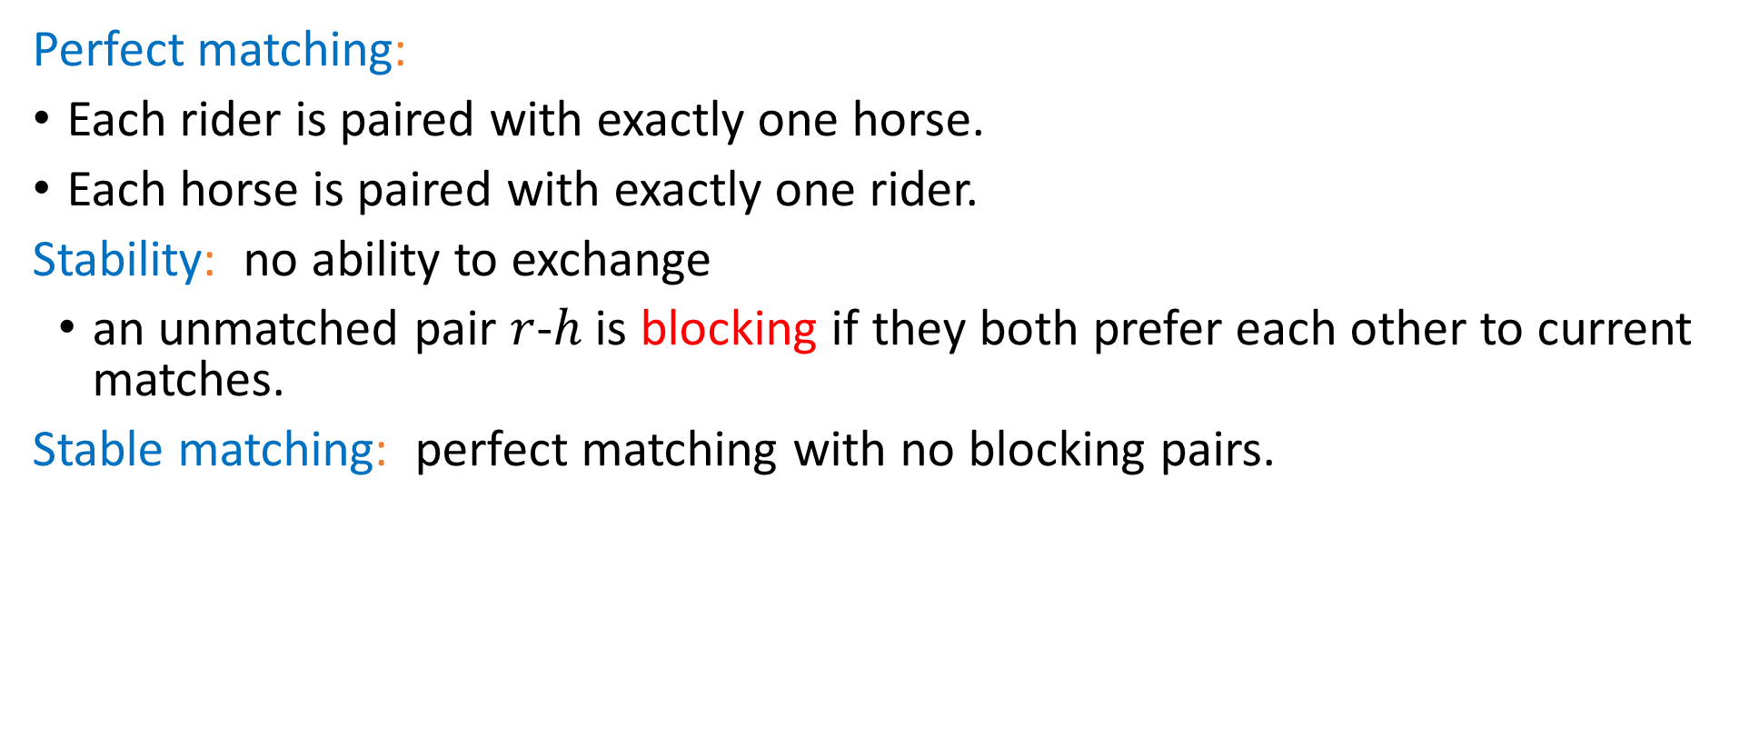
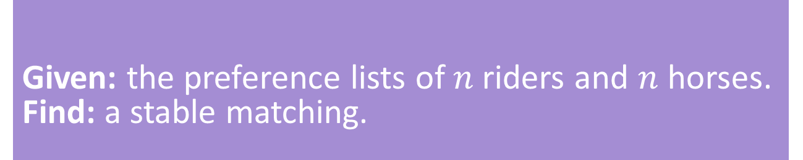
Stable Matching, More Formally
Perfect matching:
Each rider is paired with exactly one horse.
Each horse is paired with exactly one rider.
Stability: no ability to exchange
an unmatched pair $r$-$h$ is blocking if they both prefer each other to current matches.
Stable matching: perfect matching with no blocking pairs.
Stable Matching Problem
Given: the preference lists of $n$riders and $n$ horses. Find: a stable matching.

Slide 4
Questions
Does a stable matching always exist?
Can we find a stable matching efficiently?
We’ll answer both of those questions in the next few lectures.
Let’s start with the second one.

Slide 5
Idea for an Algorithm
Key idea
Unmatched riders “propose” to the highest horse on their preference list that they have not already proposed to. Send in a rider to walk up to their favorite horse.
Everyone in front of a different horse? Done!
If more than one rider is at the same horse, let the horse decide its favorite.
Rejected riders go back outside.
Repeat until you have a perfect matching.

Slide 6
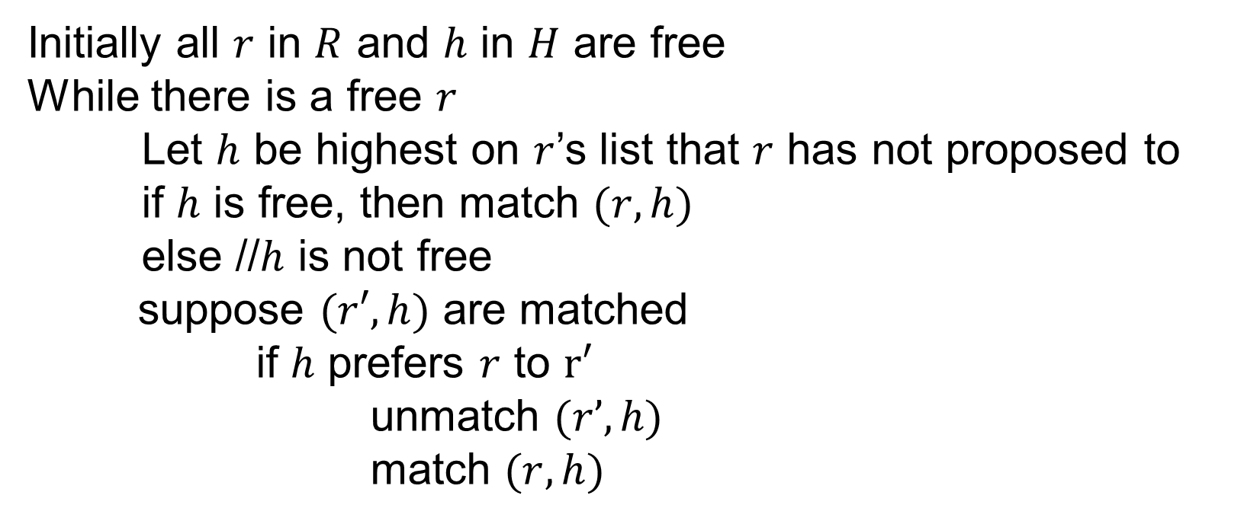
Gale-Shapley Algorithm
Initially all $r$ in $R$ and $h$ in $H$ are free
While there is a free $r$
Let $h$ be highest on $r$’s list that $r$ has not proposed to
if $h$ is free, then match $(r, h)$
else //$h$ is not free
suppose $(r′, h)$ are matched
if $h$ prefers $r$ to $r′$
unmatch $(r’, h)$
match $(r, h)$

Slide 7












Algorithm Example
$$h_{1} , h_{2},h_{3}$$
$$r_{1}$$
$$h_{1}$$
$$r_{2} , r_{3},r_{1}$$
$$h_{1} , h_{3}, h_{2}$$
$$r_{2}$$
$$h_{2}$$
$$r_{3} , r_{1}, r_{2}$$
$$h_{1} , h_{2},h_{3}$$
$$r_{3}$$
$$h_{3}$$
$$r_{3} , r_{1},r_{2}$$
Proposals: $r_{1},r_{2},r_{1},r_{3},r_{3},r_{1}$

Slide 8
Does this algorithm work?
Want to show two things:
1. The code produces the right output (i.e., you get a stable matching)
2. The code runs in a reasonable amount of time.
We’ll start with question 2, but we need a detour first…

Slide 9
How do we convince someone of a fact about our algorithm?
In 373 we usually used tests to convince ourselves our algorithm worked. But that’s only helpful if we actually write the code.
You’ll write code in this class, but you’ll do at least as much writing of algorithms in “pseudocode.” There’s no auto-runnable tests for pseudocode.
Besides tests don’t test everything.
What we want is to convince another person “if you implemented this algorithm, it would pass the tests you write.”
Even if they make slightly different decisions than you would…

Slide 10
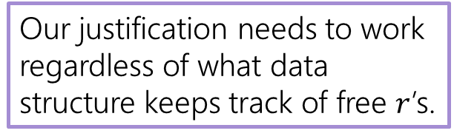
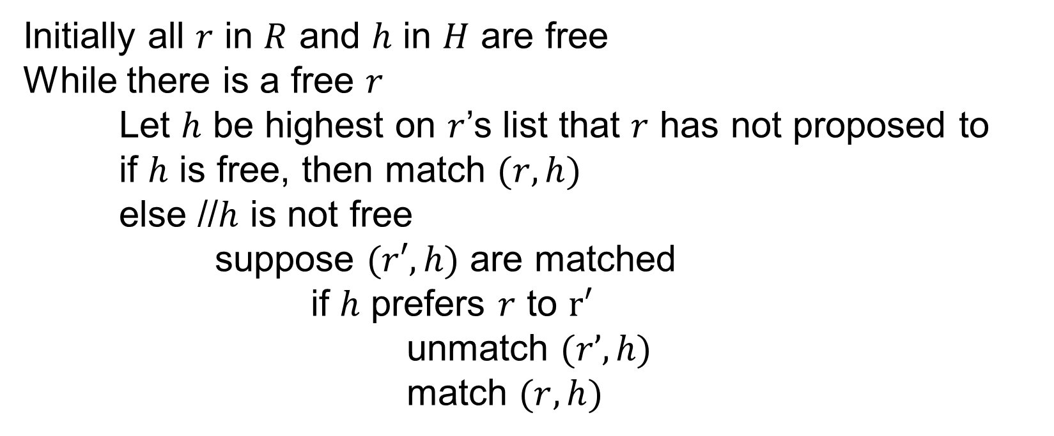
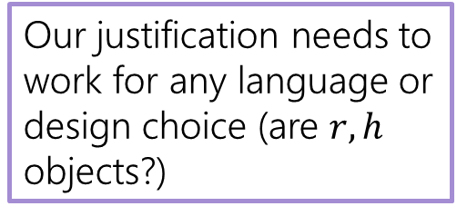
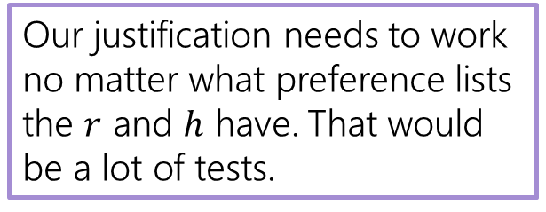
Different Decisions?
Our justification needs to work regardless of what data structure keeps track of free $r$’s.
Initially all $r$ in $R$ and $h$ in $H$ are free
While there is a free $r$
Let $h$ be highest on $r$’s list that $r$ has not proposed to
if $h$ is free, then match $(r, h)$
else //$h$ is not free
suppose $(r′, h)$ are matched
if $h$ prefers $r$ to $r′$
unmatch $(r’, h)$
match $(r, h)$
Our justification needs to work for any language or design choice (are $r,h$ objects?)
Our justification needs to work no matter what preference lists the $r$ and $h$ have. That would be a lot of tests.
For this class, our hope is that the algorithm ideas will be useful in other contexts (with doctors and hospitals or TAs and courses not just horses and riders). The more general we keep our analysis, the more likely it can be applied to new contexts!

Slide 11
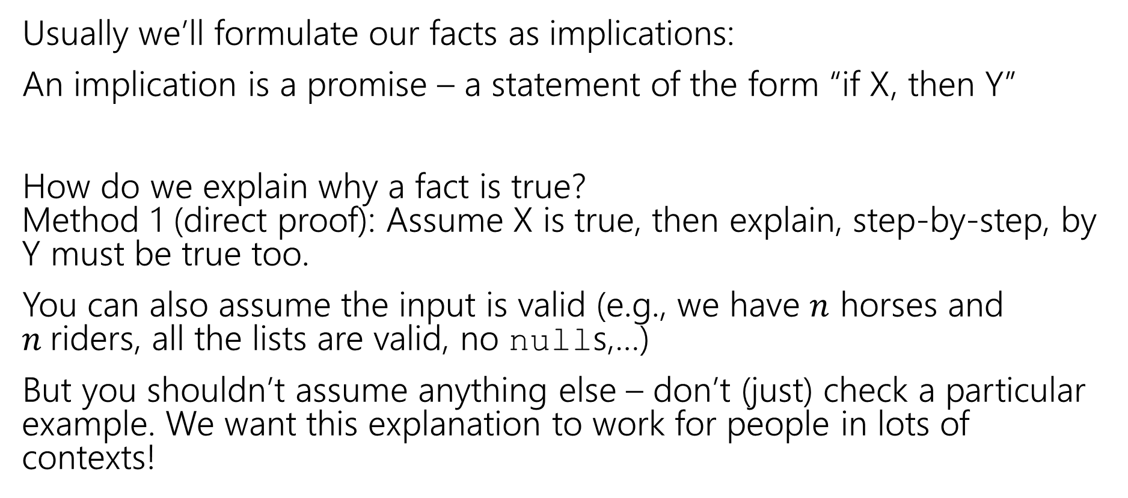
How do we show facts about our algorithms?
Usually we’ll formulate our facts as implications:
An implication is a promise – a statement of the form “if X, then Y”
How do we explain why a fact is true? Method 1 (direct proof): Assume X is true, then explain, step-by-step, by Y must be true too.
You can also assume the input is valid (e.g., we have $n$ horses and $n$riders, all the lists are valid, no nulls,…)
But you shouldn’t assume anything else – don’t (just) check a particular example. We want this explanation to work for people in lots of contexts!

Slide 12
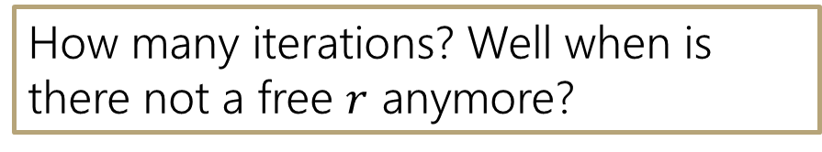
Gale-Shapley Algorithm
Initially all $r$ in $R$ and $h$ in $H$ are free
While there is a free $r$
Let $h$ be highest on $r$’s list that $r$ has not proposed to
if $h$ is free, then match $(r, h)$
else //$h$ is not free
suppose $(r′, h)$ are matched
if $h$ prefers $r$ to $r′$
unmatch $(r’, h)$
match $(r, h)$
In 373 we’d figure out:
How many steps there are per iteration
How many iterations we need
Get the running time (with a summation or multiplying)
How many iterations? Well when is there not a free $r$ anymore?

Slide 13

Claim 1: If $r$ proposed to the last horse on their list, then all the horses are matched.

Slide 14
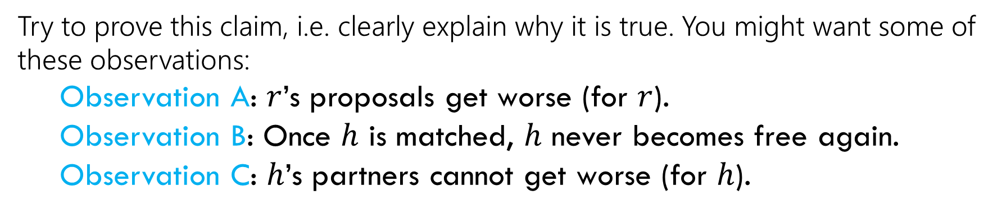
Claim 1: If $r$ proposed to the last horse on their list, then all the horses are matched.
Try to prove this claim, i.e. clearly explain why it is true. You might want some of these observations:
Observation A: $r$’s proposals get worse (for $r$).
Observation B: Once $h$ is matched, $h$ never becomes free again.
Observation C: $h$’s partners cannot get worse (for $h$).
Hint: $r$ must have been rejected a lot – what does that mean?

Slide 15
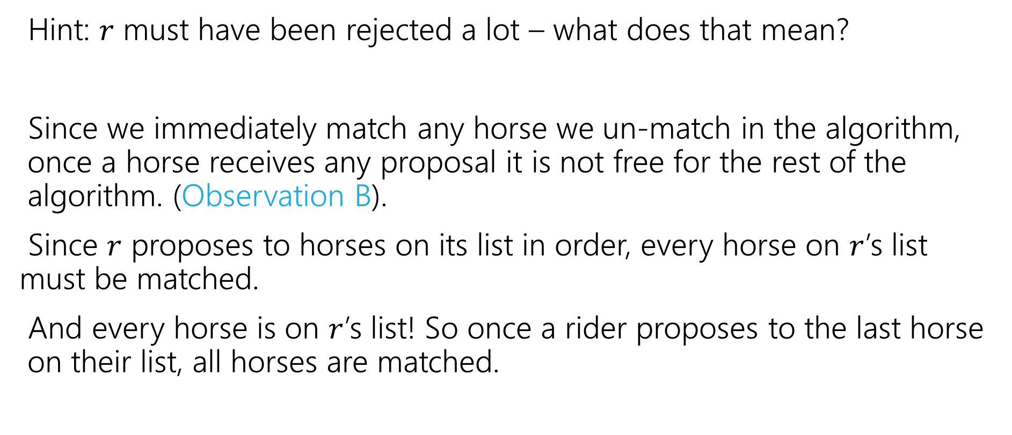
Claim 1: If $r$ proposed to the last horse on their list, then all the horses are matched.
Hint: $r$ must have been rejected a lot – what does that mean?
Since we immediately match any horse we un-match in the algorithm, once a horse receives any proposal it is not free for the rest of the algorithm. (Observation B).
Since $r$ proposes to horses on its list in order, every horse on $r$’s list must be matched.
And every horse is on $r$’s list! So once a rider proposes to the last horse on their list, all horses are matched.

Slide 16


Claim 2: The algorithm stops after $O\left(n^{2}\right)$ iterations.
Hint: When do we exit the loop? (Use claim 1).
If every horse is matched, every rider must be matched too.
Because each horse is matched to exactly one rider and there are an equal number of riders and horses.
Since we don’t repeat a proposal, and each of the $n$ riders have lists of length $n$, It takes at most $O\left(n^{2}\right)$ proposals to get to the end of some rider’s list.
Claim 2 now follows from Claim 1.
That’s the number of iterations. What about time per iteration?
Each m asks each w at most once

Slide 17

Wrapping up the running time
We need $O(n^{2})$ proposals. But how many steps does the full algorithm execute?
Depends on how we implement it…we’re going to need some data structures.

Slide 18

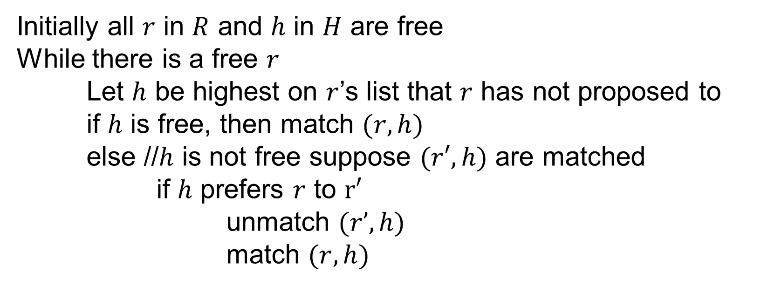
Gale-Shapley Algorithm
Initially all $r$ in $R$ and $h$ in $H$ are free
While there is a free $r$
Let $h$ be highest on $r$’s list that $r$ has not proposed to
if $h$ is free, then match $(r, h)$
else //$h$ is not free suppose $(r′, h)$ are matched
if $h$ prefers $r$ to $r′$
unmatch $(r’, h)$
match $(r, h)$
Are each of these operations really $O(1)$?
Assume that you get two int[][] with the preferences.

Slide 19
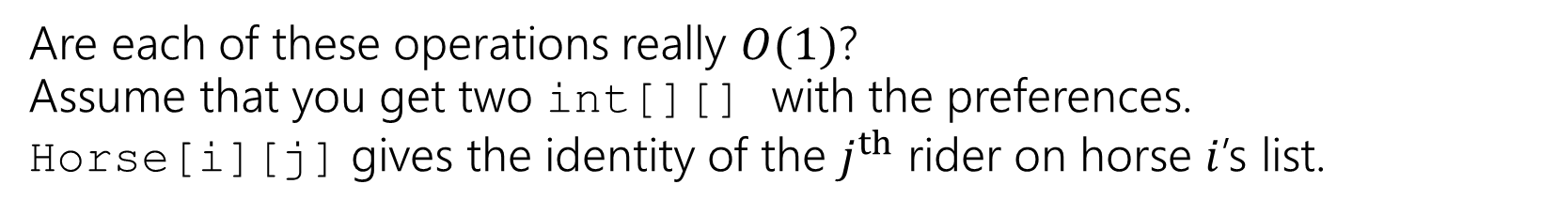
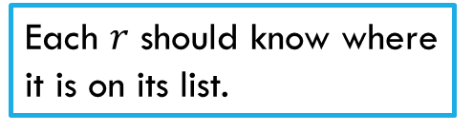
Gale-Shapley Algorithm
Initially all $r$ in $R$ and $h$ in $H$ are free
While there is a free $r$
Let $h$ be highest on $r$’s list that $r$ has not proposed to
if $h$ is free, then match $(r, h)$
else //$h$ is not free suppose $(r′, h)$ are matched
if $h$ prefers $r$ to $r′$
unmatch $(r’, h)$
match $(r, h)$
Need to maintain free $r$. What can insert and remove in $O\left(1\right)$ time?
Maintain partial matching
Each $r$ should know where it is on its list.
Given two riders, which horse is preferred?
Maintain partial matching
Are each of these operations really $O(1)$?
Assume that you get two int[][] with the preferences.
Horse[i][j] gives the identity of the $j^{th}$ rider on horse $i$’s list.

Slide 20
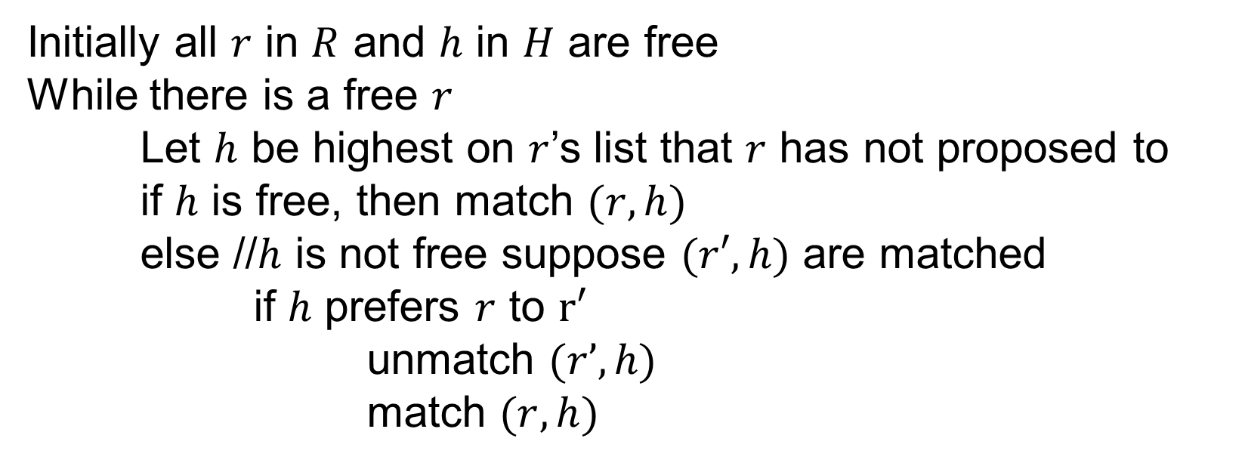
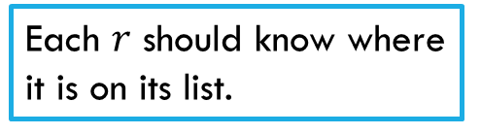
What data structures should you use?
Initially all $r$ in $R$ and $h$ in $H$ are free
While there is a free $r$
Let $h$ be highest on $r$’s list that $r$ has not proposed to
if $h$ is free, then match $(r, h)$
else //$h$ is not free suppose $(r′, h)$ are matched
if $h$ prefers $r$ to $r′$
unmatch $(r’, h)$
match $(r, h)$
Need to maintain free $r$. What can insert and remove in $O\left(1\right)$ time?
Maintain partial matching
Each $r$ should know where it is on its list.
Given two riders, which horse is preferred?
Maintain partial matching
Fill out the poll everywhere
Go to pollev.com/robbie and login with your UW identity

Slide 21

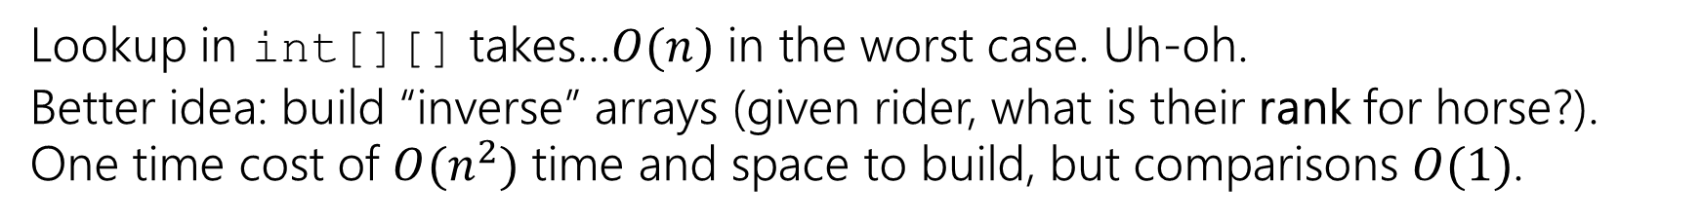
What data structures?
Need to maintain free $r$. What can insert and remove in $O\left(1\right)$ time?
Queue, stack, or list (inserting at end) all would be fine.
Maintain partial matching
Two arrays (index i has number for partner of agent i.
Each $r$ should know where it is on its list.
int for each rider (likely store in an array)
Given two riders, which is preferred?
Lookup in int[][] takes…$O(n)$ in the worst case. Uh-oh.
Better idea: build “inverse” arrays (given rider, what is their rank for horse?).
One time cost of $O(n^{2})$ time and space to build, but comparisons $O(1)$.

Slide 22
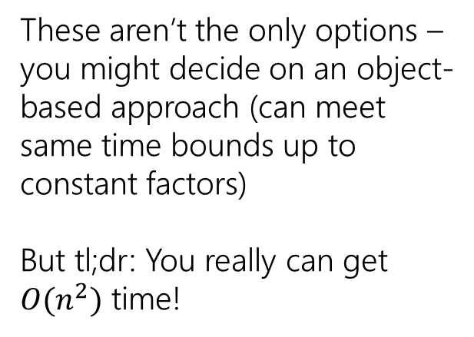
What data structures?
These aren’t the only options – you might decide on an object-based approach (can meet same time bounds up to constant factors)
But tl;dr: You really can get $O(n^{2})$ time!
Need to maintain free $r$. What can insert and remove in $O\left(1\right)$ time?
Queue, stack, or list (inserting at end) all would be fine.
Maintain partial matching
Two arrays (index i has number for partner of agent i.
Each $r$ should know where it is on its list.
int for each rider (likely store in an array)
Given two riders, which is preferred?
Lookup in int[][] takes…$O(n)$ in the worst case. Uh-oh.
Better idea: build “inverse” arrays (given rider, what is their rank for horse?).
One time cost of $O(n^{2})$ time and space to build, but comparisons $O(1)$.
Notes:
Object approach adds a lot of dictionaries, but since we have ID numbers for everyone, operations really can be O(1).

Slide 23
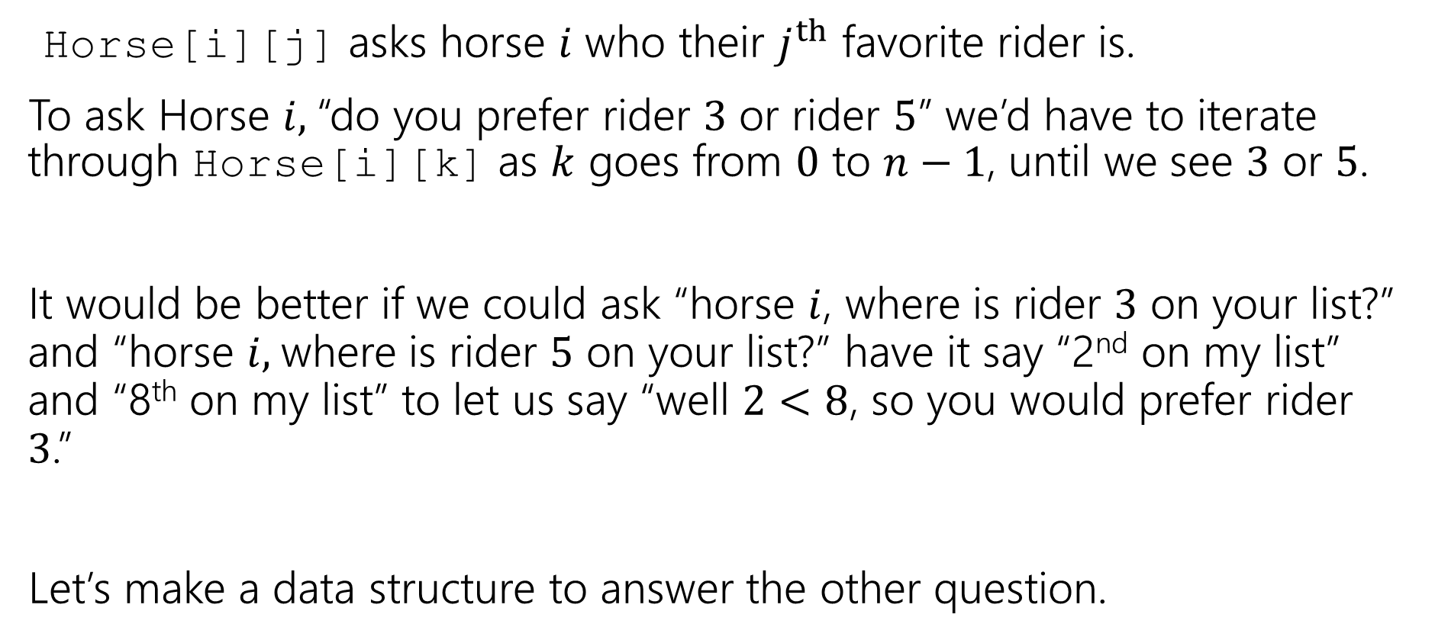
Changing The Question
Horse[i][j] asks horse $i$ who their $j^{th}$ favorite rider is.
To ask Horse $i,$“do you prefer rider $3$ or rider $5$” we’d have to iterate through Horse[i][k] as $k$ goes from $0$ to $n−1$, until we see $3$ or $5$.
It would be better if we could ask “horse $i$, where is rider $3$ on your list?” and “horse $i,$where is rider $5$ on your list?” have it say “2nd on my list” and “8th on my list” to let us say “well $2<8$, so you would prefer rider $3$.”
Let’s make a data structure to answer the other question.

Slide 24
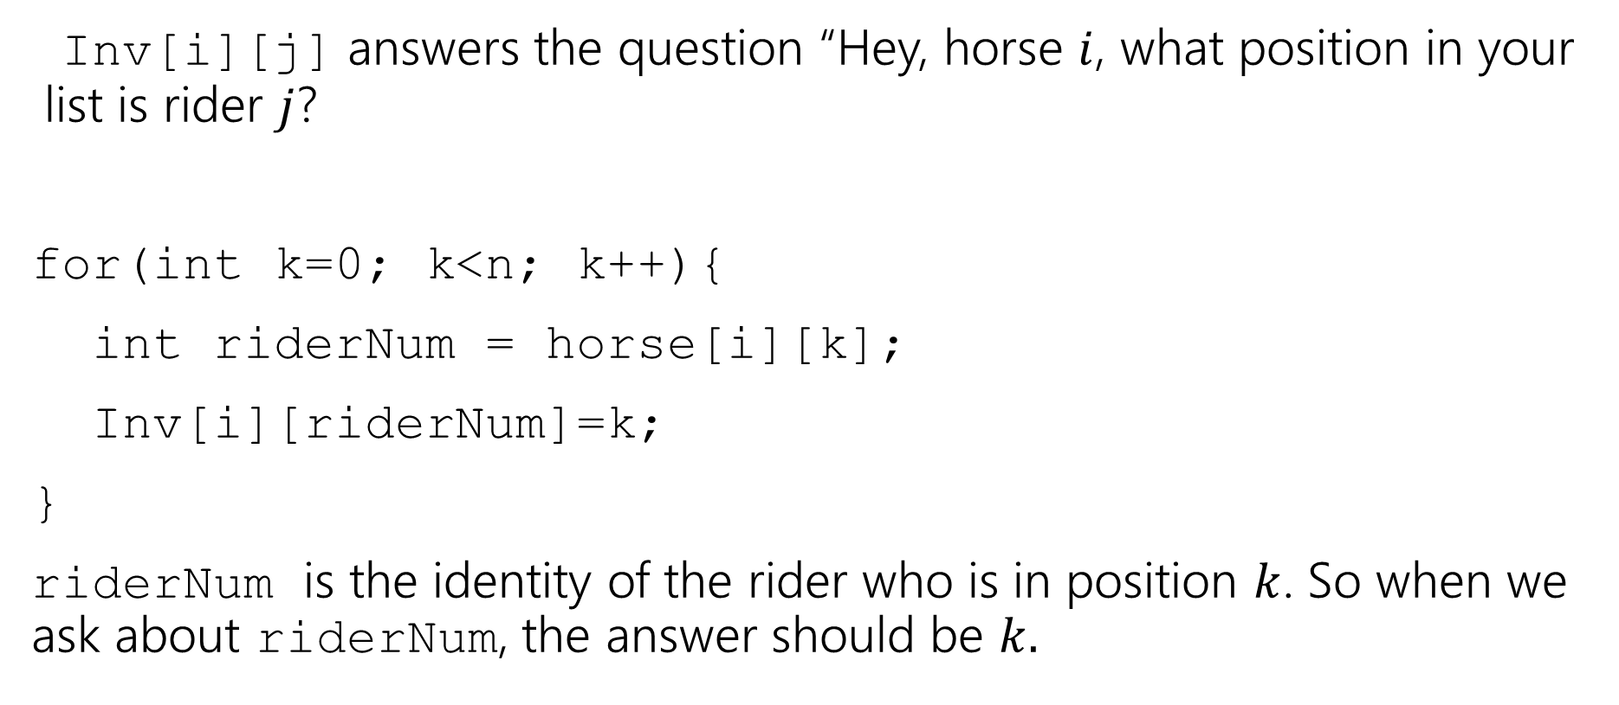
Inverse Array
Inv[i][j] answers the question “Hey, horse $i$, what position in your list is rider $j$?
for(int k=0; k<n; k++){
int riderNum = horse[i][k];
Inv[i][riderNum]=k;
}
riderNum is the identity of the rider who is in position $k$. So when we ask about riderNum, the answer should be $k.$

Slide 25
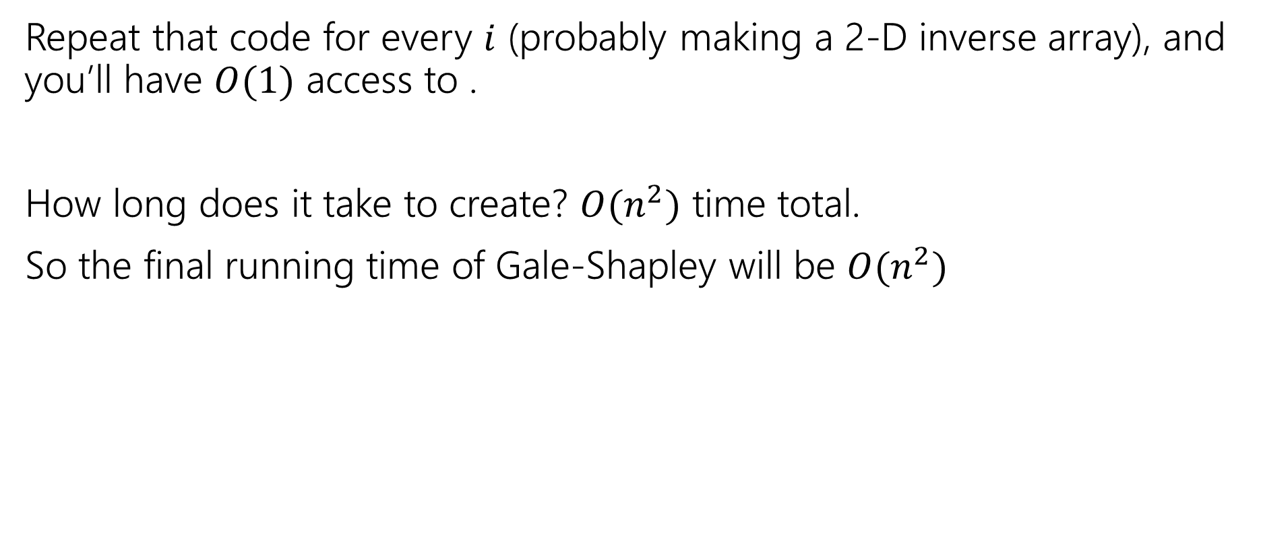
Inverse Array
Repeat that code for every $i$ (probably making a 2-D inverse array), and you’ll have $O(1)$ access to .
How long does it take to create? $O(n^{2})$ time total.
So the final running time of Gale-Shapley will be $O(n^{2})$

Slide 26
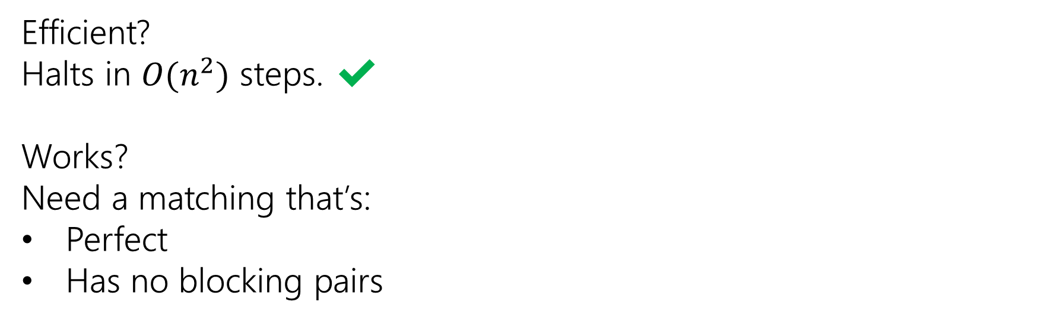
Analyzing Gale-Shapley
Efficient?
Halts in $O(n^{2})$ steps. ✔
Works?
Need a matching that’s:
Perfect
Has no blocking pairs

Slide 27
Claim 3: The algorithm identifies a perfect matching.
Why?
We know the algorithm halts. Which means when it halts every rider is matched.
But we have the same number of horses and riders, and we matched them one-to-one.
Hence, the algorithm finds a perfect matching.
Invariant: partial matching
What happens when some m reaches its last choice?
exactly n-1 w’s much be matched
last choice must be available

Slide 28
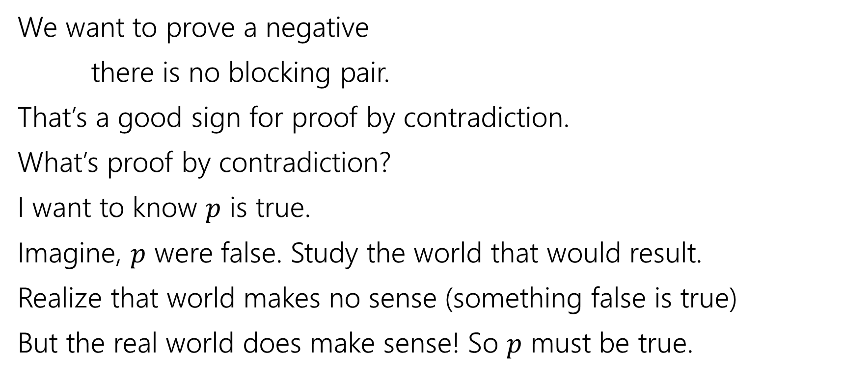
Claim 4: The matching has no blocking pairs.
We want to prove a negative
there is no blocking pair.
That’s a good sign for proof by contradiction.
What’s proof by contradiction?
I want to know $p$ is true.
Imagine, $p$ were false. Study the world that would result.
Realize that world makes no sense (something false is true)
But the real world does make sense! So $p$ must be true.
m₁ proposed to w₂ before w₁
w₂ rejected m₁ for m₃
w₂ prefers m₃ to m₁
w₂ prefers m₂ to m₃

Slide 29
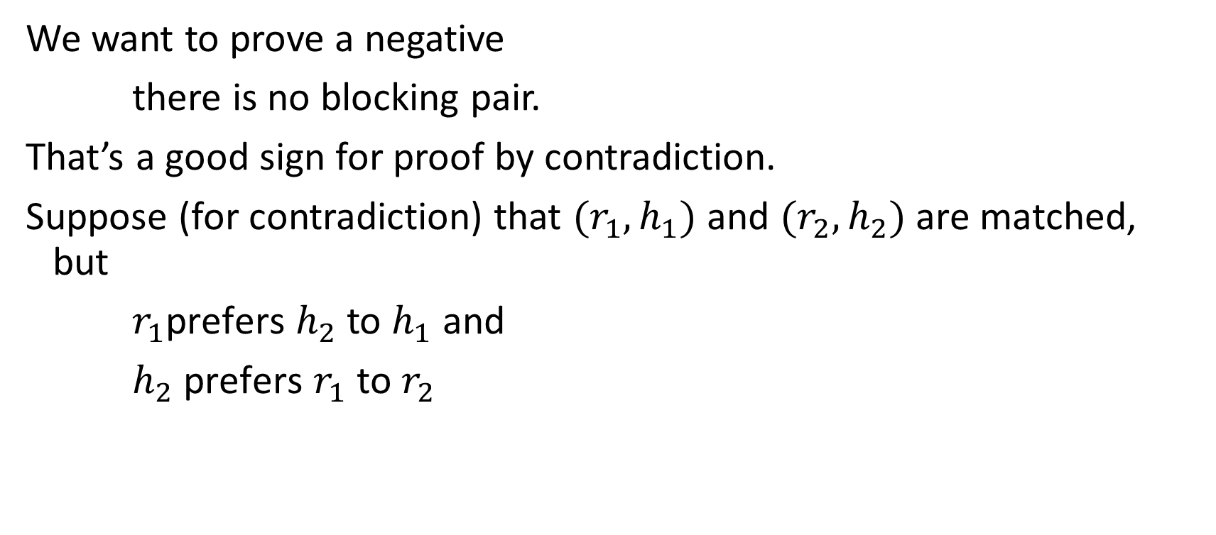






Claim 4: The matching has no blocking pairs.
We want to prove a negative
there is no blocking pair.
That’s a good sign for proof by contradiction.
Suppose (for contradiction) that $(r_{1},h_{1})$ and $(r_{2},h_{2})$ are matched, but
$r_{1}$prefers $h_{2}$ to $h_{1}$ and
$h_{2}$ prefers $r_{1}$ to $r_{2}$
$$…h_{2} …h_{1}…$$
$$r_{1}$$
$$h_{1}$$
m₁ proposed to w₂ before w₁
w₂ rejected m₁ for m₃
w₂ prefers m₃ to m₁
w₂ prefers m₂ to m₃
$$r_{2}$$
$$h_{2}$$
$${…r}_{1} …{ r}_{2}…$$

Slide 30



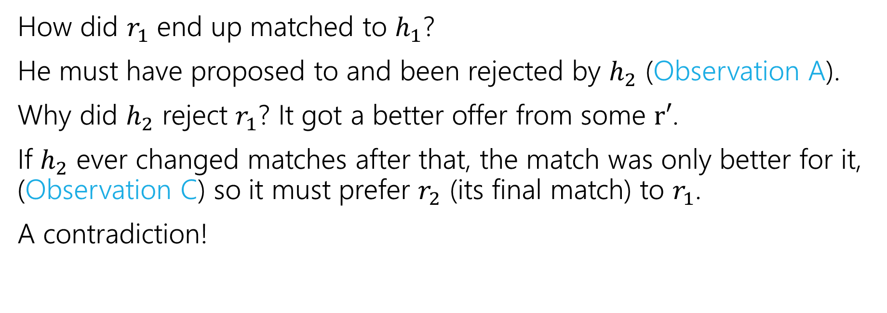



Claim 4: The matching has no blocking pairs.
$$…h_{2} …h_{1}…$$
$$r_{1}$$
$$h_{1}$$
$$r_{2}$$
$$h_{2}$$
$${…r}_{1} …{ r}_{2}…$$
How did $r_{1}$ end up matched to $h_{1}$?
He must have proposed to and been rejected by $h_{2}$ (Observation A).
Why did $h_{2}$ reject $r_{1}$? It got a better offer from some $r′$.
If $h_{2}$ ever changed matches after that, the match was only better for it, (Observation C) so it must prefer $r_{2}$ (its final match) to $r_{1}$.
A contradiction!

Slide 31
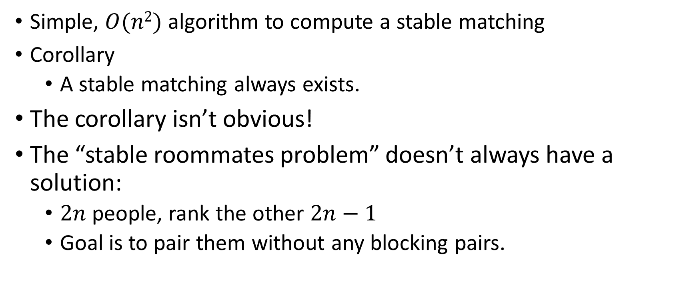
Result
Simple, $O(n2)$ algorithm to compute a stable matching
Corollary
A stable matching always exists.
The corollary isn’t obvious!
The “stable roommates problem” doesn’t always have a solution:
$2n$people, rank the other $2n−1$
Goal is to pair them without any blocking pairs.

