Slide 1
Here Early?
Here for CSE 417?
Welcome! You’re early!
Want a copy of these slides to take notes?
  You can download them from the webpage cs.uw.edu/417
  Want to be ready for the end of the lecture?
  Grab a handout OR download a copy from the webpage if you want to save paper.

Slide 2
Welcome
CSE 417 Fall 22
Lecture 1

Slide 3
Today
Logistics
What is this course?
Start of the content

Slide 4

Staff
TAs
Xiaoning Bu
Anna Kuznetsova
Nickolay Perezhogin
Sashu Shankar
Tom Tian
Michael Wen
Albert Weng
Kenneth Wu
Instructor: Robbie Weber
Ph.D. from UW CSE in theory
Third year as teaching faculty
Office: CSE2 311
Email: rtweber2@cs.washington.edu

Slide 5
Classroom Logistics
We’re in-person :D
The university “strongly recommends” wearing masks, but they are not required.
Please speak loudly for questions
I’ll repeat questions into the microphone (so everyone can hear/for the recording).

Slide 6
TODO List
Make sure you’re on Ed! (check your spam folder for an invite, if not there send an email to Robbie).
Look at Homework 0 and 373 review materials.

Slide 7
Syllabus
It’s all on the webpage: https://courses.cs.washington.edu/courses/cse417/22au/
In general, we’re designing lecture to be synchronous (taking questions live, time for student discussions).
But we’re trying to make sure if you need to stay home for a few days on short notice the effect will be minimal.
We won’t have exams, and lectures are recorded, so there’s no requirement to come in-person.

Slide 8
Textbook
Optional: Algorithm Design by Kleinberg & Tardos
It’s a good introduction, and nice as a reference.
There are lots of other books:
  Introduction to algorithms by Cormen, Leiserson, Rivest, Stein
  One free reference: Algorithms by Jeff Erickson Algorithms.wtf
  All are theoretical (expect more math background than 373).
  Additional resource:
  Lecture videos by Tim Roughgarden (Algorithms Illuminated)
  Not a perfect match of topics, but math background matches.

Slide 9
Logistics – Work
Your grade will be based (only) on homework assignments. We won’t have any exams.

Slide 10
Logistics – Work
This quarter we’re using “mastery grading” for assignments
Basic idea: Don’t grade for “points”
Every assignment will have a few more problems on it than we expect you to do. You’ll choose which to do.
Instead of assigning exact points, Every problem gets a score of:
Excellent | Main idea and edge cases are all correct. Would have gotten full credit (or extremely close) with points-based grading.
Satisfactory | Main idea is correct, but some edge cases or follow-up questions are wrong or missing. Would have gotten about 80-90% on points-based grading.
Not Satisfactory | Some important error is made, but substantial progress toward a solution. Would have gotten above 50% on points-based grading.
Ungraded | Directions not followed (e.g., used a library that isn’t permitted) or otherwise shows no substantial progress.

Slide 11
Logistics – Work
Minimums for grade breaks are already posted.
Why? We care if you understand the content by the end of the quarter, not right away. We’d like to give you more chances to show your understanding.
But we also need to make sure the TAs have enough time to grade everything.
Switching from points to E/S/N/U lets them grade faster, and therefore to regrade submissions. Every week you can submit up to two problems, and you’ll get the better grade.

Slide 12
Logistics – Lecture Activities
I’m going to be teaching with active learning in this course.
  Why? Because it works.
  https://www.pnas.org/content/111/23/8410 a meta-analysis of 225 studies.
  Just listening to me isn’t as good for you as listening to me then trying problems on your own and with each other.
The answers live help me adjust explanations.
There aren’t points associated with completing the activities.

Slide 13
Logistics – where to go?
Slides, homework problems, etc. go up on the webpage
Homework submission on gradescope
Live lecture activities on polleverywhere
Questions on Ed discussion board
Don’t trust canvas – we won’t be updating frequently. We’ll tell you when we’re using it for specific purposes.

Slide 14
Late Policy
The resubmit option is the late policy – it’s intended to help with “normal” in-quarter difficulties (you might do one or two fewer problems the week you have a midterm in another course, for example).
If you have an unexpected situation that is going to interfere with your ability to work for an extended period of time (e.g., extended illness or family responsibilities) please send Robbie an email as soon as possible and we’ll figure out what to do.

Slide 15
We’re (still) in a pandemic
The staff is going to do our best to help you learn.
Real life is going to get in the way. If it does, tell us as soon as possible, and we’ll work with you.
I don’t need to know private details, just enough to know it’s an emergency and how to help.
We will endeavor not to make any substantial changes to the syllabus.
  But if something extremely unexpected happens we reserve the right to make changes.
  Generally prefer individual accommodations, rather than course-wide ones.

Slide 16
What is this course?
Algorithms and Computational Complexity
themes:
“Design Techniques” – not just “here’s an algorithm” but “here’s a way of thinking about a class of algorithms”
“Modeling” – In the real world, no one will say “I need you to run Prim’s algorithm on this graph” they will say “I need you to choose where to build electrical wires so every town is connected to the power plant as cheaply as possible
“Set realistic expectations” – there are some things we (think/know) computers can’t do efficiently. How do you recognize these problems?
“Reductions” – if you’ve already solved a problem, don’t solve it again (reuse ideas) and if you know you can’t solve a problem, what else can’t you solve.

Slide 17
What is this course not
NOT: A list of the fastest-known algorithms for common problems.
I’m not concerned with which library is best.
  The best library changes over time and by language.
  I’m not qualified to keep a list.
  I want you to find this course useful 5 years from now.
And the best theoretical algorithms probably aren’t practical…
  and when they are, it’s often clever combinations/complicated variants of big ideas that we’ll see.

Slide 18
Course Topics (Tentative)
Stable Matchings
Graph Algorithms from 373 (BFS/DFS, MST algorithms, shortest paths)
Divide & Conquer
Dynamic Programming
Network Flow
Linear Programming
P/NP
Approximation Algorithms (applications of all the prior big ideas)

Slide 19
What’s Coming Up
This week: An extremely useful algorithm.
That has had lots of effect on the real world.
Along the way: what constitutes a convincing argument that my algorithm works?
We’ll learn: direct arguments, proof by contradiction, and some fundamental logic.
Already know that? You’ll get to learn a fun algorithm along the way!
Don’t know them yet? The introduction will be fast! More resources on the webpage, and practice on the first assignment.

Slide 20
Stable Matchings

Slide 21
Stable Matchings
Motivation:
You have to assign TAs to instructors.
Two groups of people you need to pair off, with preferences about their matches.
You can’t make everyone happy…so at least ensure that everyone listens to you.
There are lots of other similar applications
  Assign doctors to the hospitals where they do residency.
  Assign high schoolers to magnet schools.
  Among many, many other applications.
Purpose of the example: new, interesting problem, show how different ideas apply

Slide 22
Motivation
The real world is complicated.
  Students shouldn’t TA a course they haven’t taken.
  Instructors need varying numbers of TAs.
  There are more TA applicants than positions.
  Doctors might want to be in the same city as their partner.
We’re going to simplify away the real world constraints.
  The core ideas have been adapted to all of these scenarios.

Slide 23



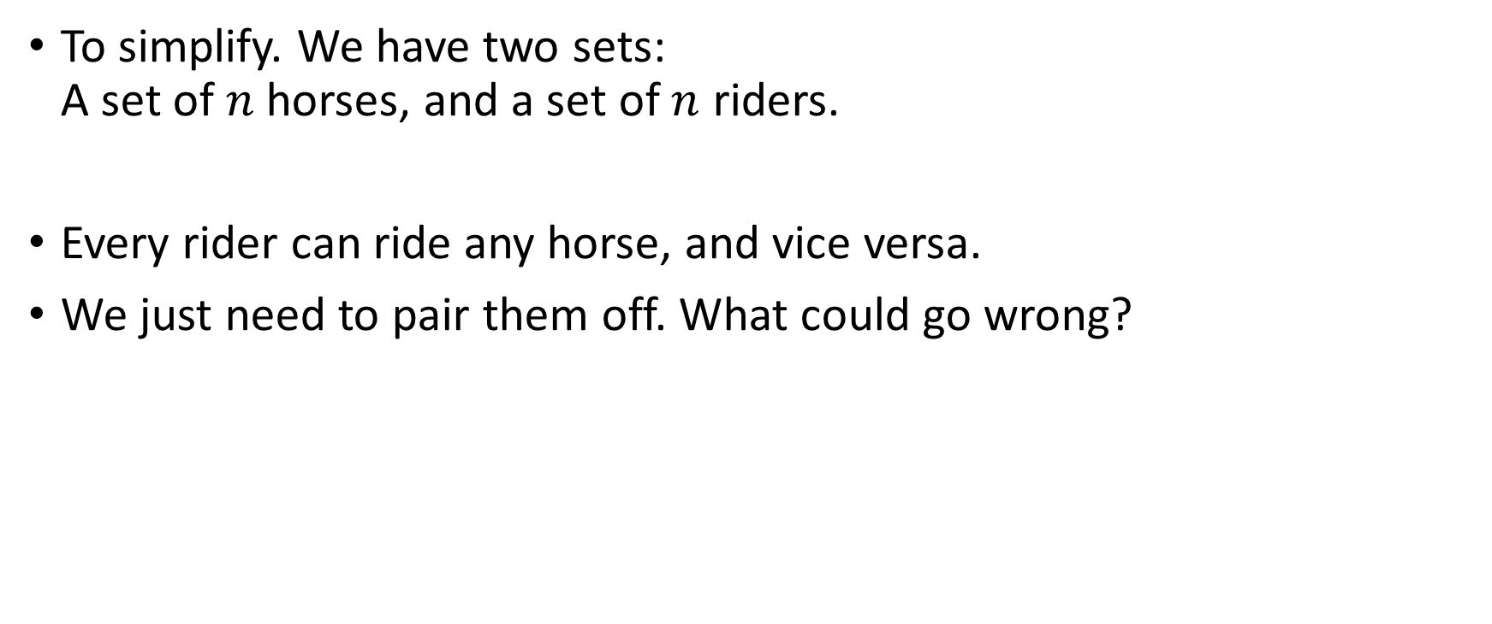
Stable Matching Problem
To simplify. We have two sets:
A set of $n$horses, and a set of $n$ riders.
Every rider can ride any horse, and vice versa.
We just need to pair them off. What could go wrong?

Slide 24



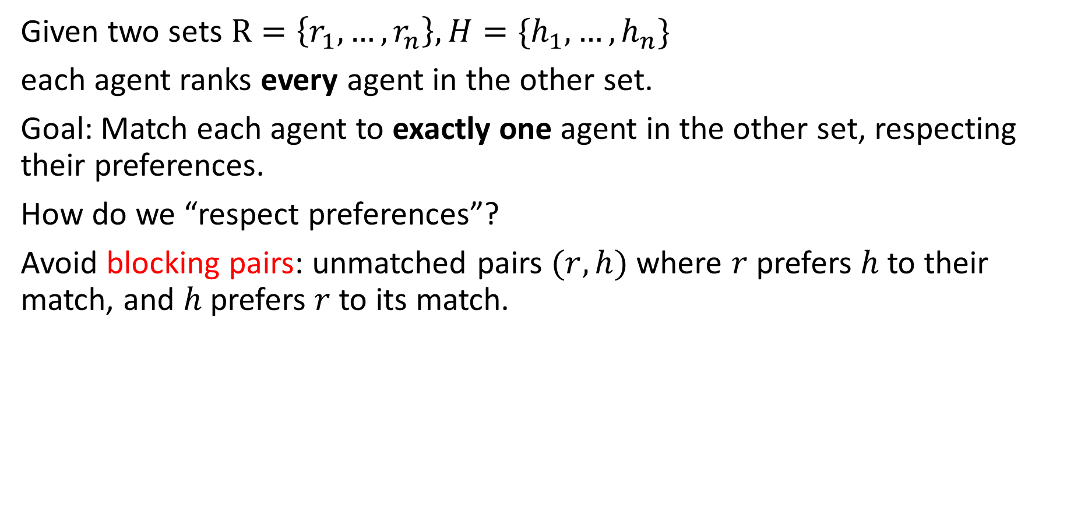



Stable Matching Problem
Given two sets $R=\left\{r_{1}, …,r_{n}\right\}, H=\{h_{1},…,h_{n}\}$
each agent ranks every agent in the other set.
Goal: Match each agent to exactly one agent in the other set, respecting their preferences.
How do we “respect preferences”?
Avoid blocking pairs: unmatched pairs $(r,h)$ where $r$prefers $h$ to their match, and $h$ prefers $r$to its match.
$$h$$
$$h , h’$$
$$r, r’$$
$$r$$
$$r′$$
$$h′$$

Slide 25
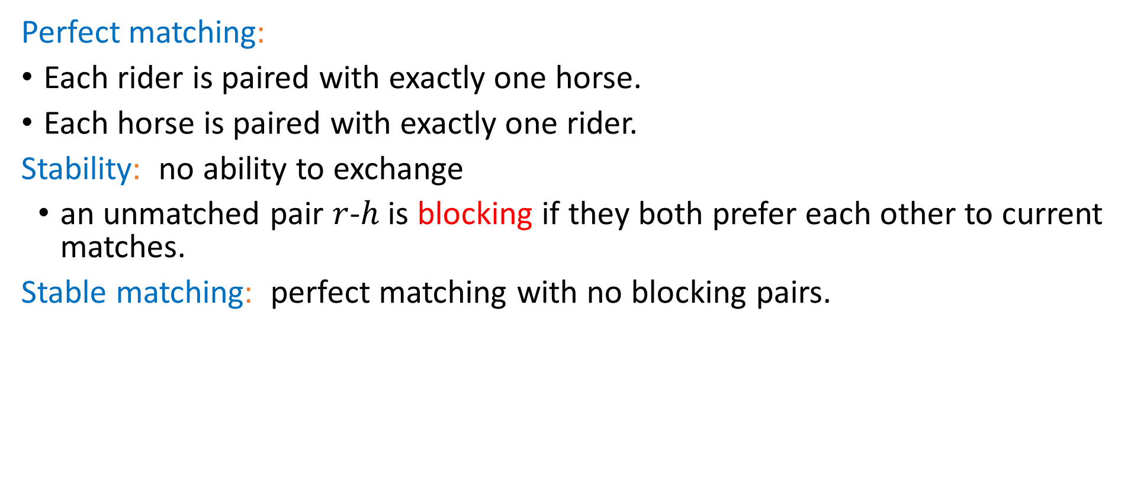

Stable Matching, More Formally
Perfect matching:
Each rider is paired with exactly one horse.
Each horse is paired with exactly one rider.
Stability: no ability to exchange
an unmatched pair $r$-$h$ is blocking if they both prefer each other to current matches.
Stable matching: perfect matching with no blocking pairs.
Stable Matching Problem
Given: the preference lists of $n$riders and $n$ horses.
Find: a stable matching.

Slide 26
Lecture Activity
To make sure you’ve got the definition:
1. Download the activity pdf from the webpage (it’s just the next slide in this slide deck) or look at the physical handout.
2. Introduce yourself to those around you.
3. Try the problem.
4. Fill out the polleverywhere

Slide 27




























Try it!
Why are these not stable matchings?
$$h_{1} , h_{2}$$
$$r_{1}$$
$$h_{1}$$
$$r_{1} , r_{2}$$
$$h_{1} , h_{2}$$
$$r_{1}$$
$$h_{1}$$
$$r_{1} , r_{2}$$
$$h_{1} , h_{2}$$
$$r_{2}$$
$$h_{2}$$
$$r_{1} , r_{2}$$
$$h_{1} , h_{2}$$
$$r_{2}$$
$$h_{2}$$
$$r_{1} , r_{2}$$
Find a stable matching for this instance.
$$h_{1} , h_{2},h_{3}$$
$$r_{1}$$
$$h_{1}$$
$$r_{1} , r_{2},r_{3}$$
$$h_{2} , h_{1}, h_{3}$$
$$r_{2}$$
$$h_{2}$$
$$r_{1} , r_{2}, r_{3}$$
$$h_{1} , h_{2},h_{3}$$
$$r_{3}$$
$$h_{3}$$
$$r_{1} , r_{2},r_{3}$$
Pollev.com/robbie

Slide 28
Questions
Does a stable matching always exist?
Can we find a stable matching efficiently?
We’ll answer both of those questions in the next few lectures.
Let’s start with the second one.

Slide 29
Idea for an Algorithm
Key idea
Unmatched riders “propose” to the highest horse on their preference list that they have not already proposed to.
Send in a rider to walk up to their favorite horse.
Everyone in front of a different horse? Done!
If more than one rider is at the same horse, let the horse decide its favorite.
Rejected riders go back outside.
Repeat until you have a perfect matching.

Slide 30
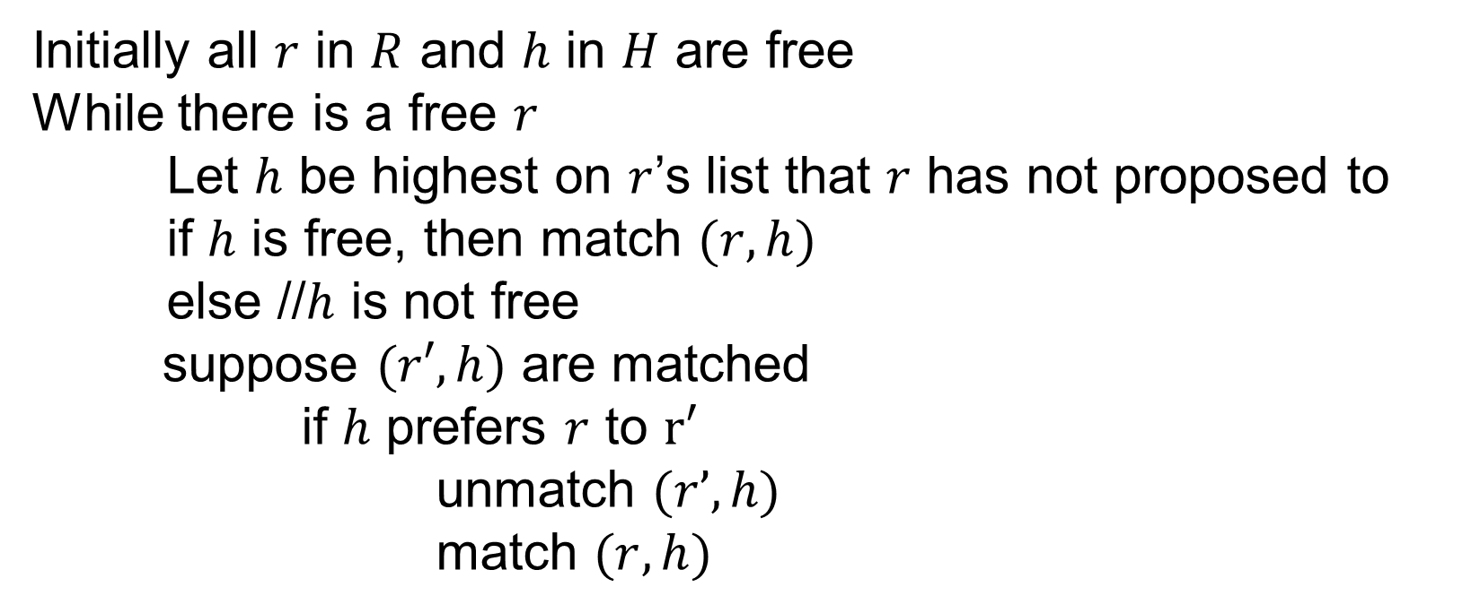
Gale-Shapley Algorithm
Initially all $r$ in $R$ and $h$ in $H$ are free
While there is a free $r$
Let $h$ be highest on $r$’s list that $r$ has not proposed to
if $h$ is free, then match $(r, h)$
else //$h$ is not free
suppose $(r′, h)$ are matched
if $h$ prefers $r$ to $r′$
unmatch $(r’, h)$
match $(r, h)$

Slide 31












Algorithm Example
$$h_{1} , h_{2},h_{3}$$
$$r_{1}$$
$$h_{1}$$
$$r_{2} , r_{3},r_{1}$$
$$h_{1} , h_{3}, h_{2}$$
$$r_{2}$$
$$h_{2}$$
$$r_{3} , r_{1}, r_{2}$$
$$h_{1} , h_{2},h_{3}$$
$$r_{3}$$
$$h_{3}$$
$$r_{3} , r_{1},r_{2}$$
Proposals: $r_{1},r_{2},r_{1},r_{3},r_{3},r_{1}$

Slide 32
Does this algorithm work?
Does it run in a reasonable amount of time?
Is the result correct (i.e. a stable matching)?
Begin by identifying invariants and measures of progress
  Observation A: r’s proposals get worse for them.
  Observation B: Once h is matched, h stays matched.
  Observation C: h’s partners get better.
How do we justify these? A one-sentence explanation would suffice for each of these on the homework.
How did we know these were the right observations? Practice. And editing – we wouldn’t have found these the first time, but after reading through early proof attempts.

Slide 33
TODO List
Make sure you’re on Ed! (check your spam folder for an invite, if not there send an email to Robbie).
Look at Homework 0 and 373 review materials.

