Slide 1
Wrapping Up Reductions
CSE 417 Winter 21
Lecture 24

Slide 2
Announcements
We’re (probably) going to get through the content I’ve planned a lecture-or-two before the end of the quarter.
I’ve listed a couple of possible topics on this Ed thread
“Heart” the ones you like.

Slide 3
Logistics for the final
Going up on the webpage soon (hopefully tonight)
Along with practice material
Big thing you need to know:
Planning to release final 11:59 PM Sunday of finals week, due 11:59 PM Wednesday of Finals week
You’d have the full 3 days to work if you want to (but goal when writing it will be something that could be done in a “normal” 2 hour exam)
If you have some reason that you really need to offset that by a day, let me know as soon as possible (email or private Ed post).

Slide 4
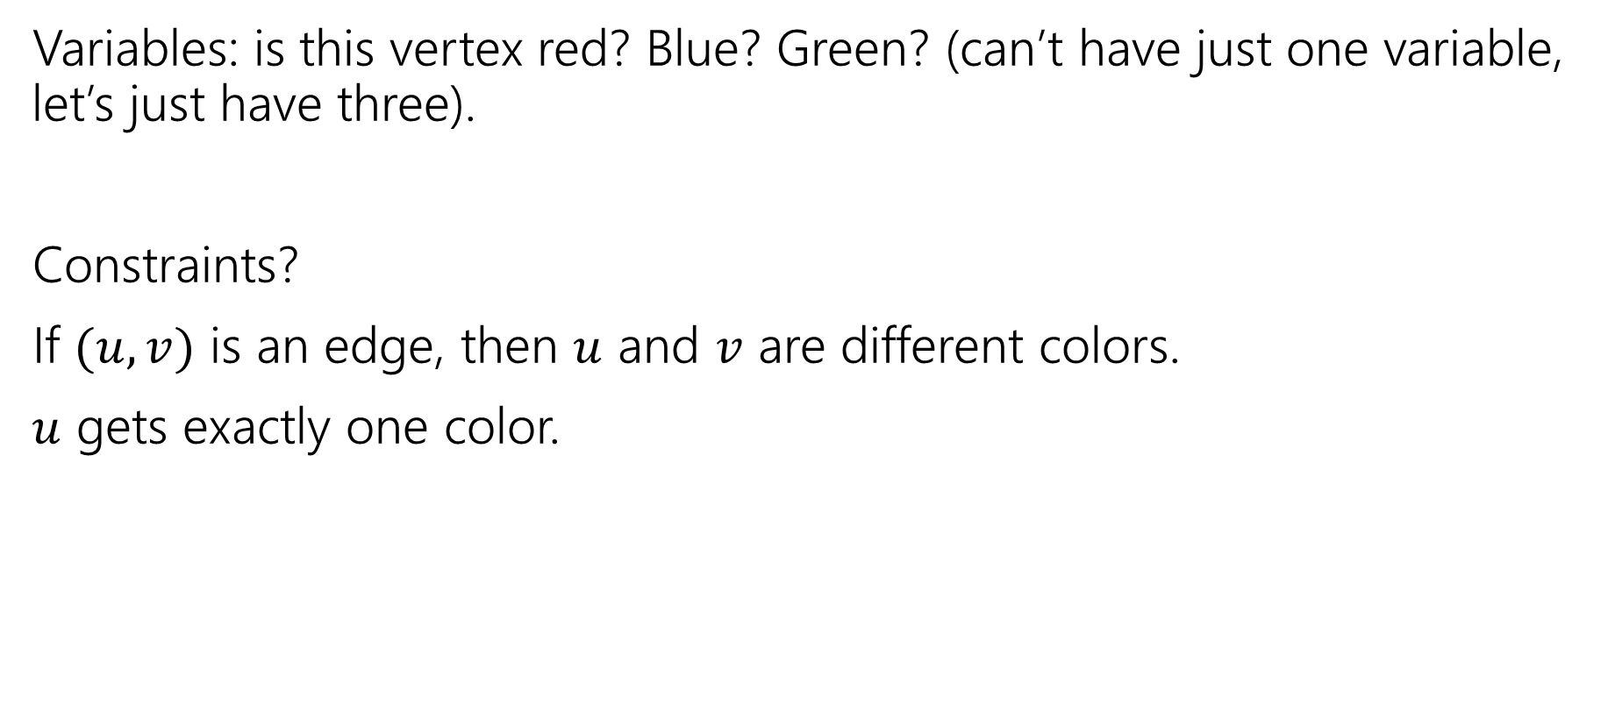

3-Coloring $≤$ 3-SAT
Variables: is this vertex red? Blue? Green? (can’t have just one variable, let’s just have three).
Constraints?
If $(u,v)$ is an edge, then $u$ and $v$ are different colors.
$u$ gets exactly one color.

Slide 5
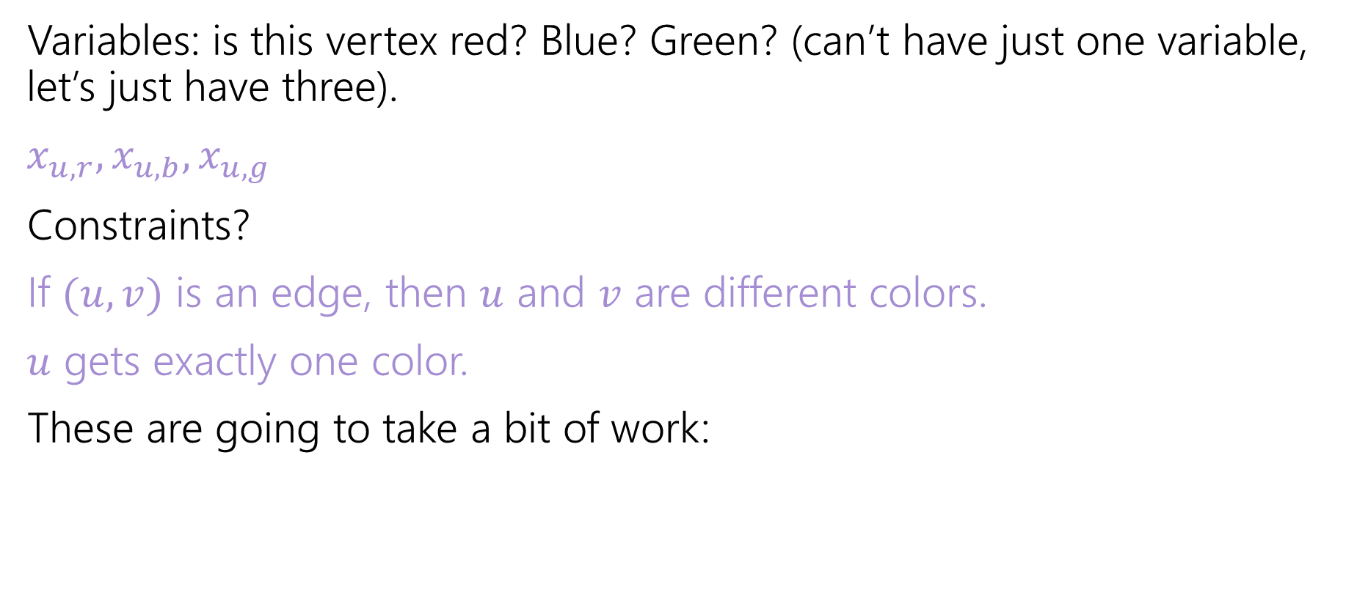
3-Coloring $≤$ 3-SAT
Variables: is this vertex red? Blue? Green? (can’t have just one variable, let’s just have three).
$x_{u,r},x_{u,b},x_{u,g}$
Constraints?
If $(u,v)$ is an edge, then $u$ and $v$ are different colors.
$u$ gets exactly one color.
These are going to take a bit of work:

Slide 6
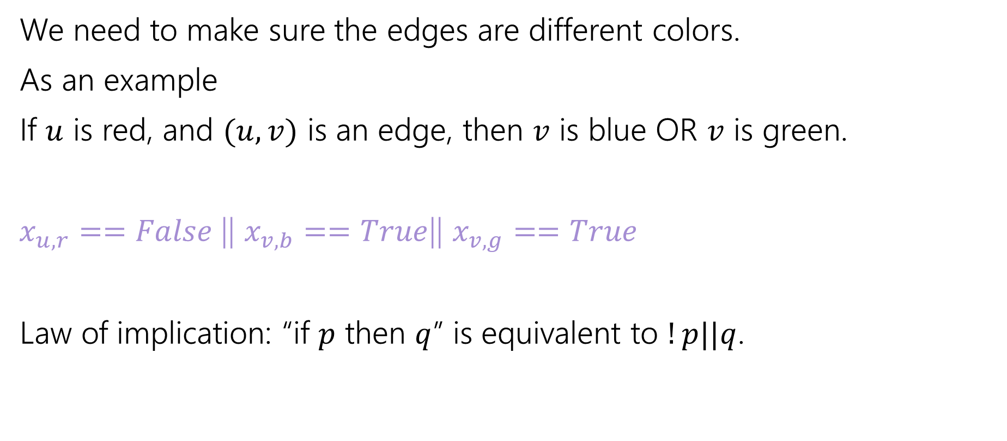

Edge Requirements
We need to make sure the edges are different colors.
As an example
If $u$ is red, and $(u,v)$ is an edge, then $v$ is blue OR $v$ is green.
$x_{u,r}==False$|| $x_{v,b}==True$|| $x_{v,g}==True$
Law of implication: “if $p$ then $q$” is equivalent to $!p||q$.

Slide 7
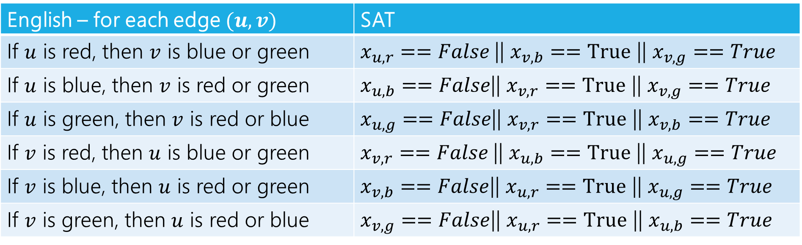

Edge Constraints
All combinations constraints:
English – for each edge $(u,v)$ | SAT
If $u$ is red, then $v$ is blue or green | $x_{u,r}==False$|| $x_{v,b}==True$ || $x_{v,g}==True$
If $u$ is blue, then $v$ is red or green | $x_{u,b}==False$|| $x_{v,r}==True$ || $x_{v,g}==True$
If $u$ is green, then $v$ is red or blue | $x_{u,g}==False$|| $x_{v,r}==True$ || $x_{v,b}==True$
If $v$ is red, then $u$ is blue or green | $x_{v,r}==False$|| $x_{u,b}==True$ || $x_{u,g}==True$
If $v$ is blue, then $u$ is red or green | $x_{v,b}==False$|| $x_{u,r}==True$ || $x_{u,g}==True$
If $v$ is green, then $u$ is red or blue | $x_{v,g}==False$|| $x_{u,r}==True$ || $x_{u,b}==True$
Some of these aren’t strictly necessary (are implied by the others) but better safe than sorry.

Slide 8
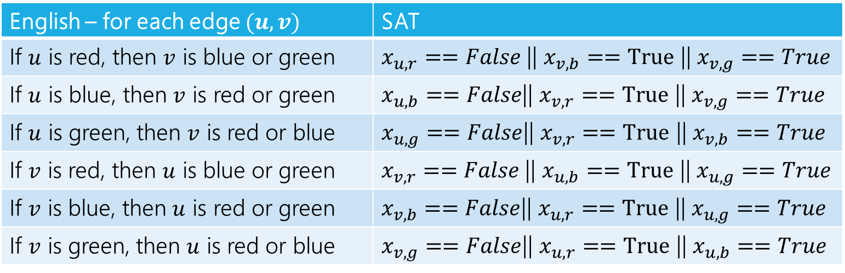

Are those constraints enough?
Fill out the poll everywhere for Activity Credit!
Go to pollev.com/cse417 and login with your UW identity
Suppose we used those constraints, ran the 3-SAT solver on these constraints, and just return what it says.
Are we done? If this reduction is correct, explain to each other why!
If it’s not correct explain why not.
English – for each edge $(u,v)$ | SAT
If $u$ is red, then $v$ is blue or green | $x_{u,r}==False$|| $x_{v,b}==True$ || $x_{v,g}==True$
If $u$ is blue, then $v$ is red or green | $x_{u,b}==False$|| $x_{v,r}==True$ || $x_{v,g}==True$
If $u$ is green, then $v$ is red or blue | $x_{u,g}==False$|| $x_{v,r}==True$ || $x_{v,b}==True$
If $v$ is red, then $u$ is blue or green | $x_{v,r}==False$|| $x_{u,b}==True$ || $x_{u,g}==True$
If $v$ is blue, then $u$ is red or green | $x_{v,b}==False$|| $x_{u,r}==True$ || $x_{u,g}==True$
If $v$ is green, then $u$ is red or blue | $x_{v,g}==False$|| $x_{u,r}==True$ || $x_{u,b}==True$

Slide 9
Are those constraints enough?
Suppose we used those constraints, ran the 3-SAT solver on what we got.
If the graph is 3-colorable, then the 3-SAT instance has a solution (pick your favorite coloring and set the variables to match that coloring).
If the graph is not 3-colorable
The 3-SAT solver will still say there’s a solution for this instance. Just set every variable to false!

Slide 10
Consistency Constraints
Reductions often need extra constraints/structures.
When you say “I want this variable to mean X” you really need to force the variable to mean X.
So if you want a coloring, you need to make sure even “well, yeah of course that’s what I meant” requirements are explicit.
What are we missing? Every vertex needs exactly one color.

Slide 11
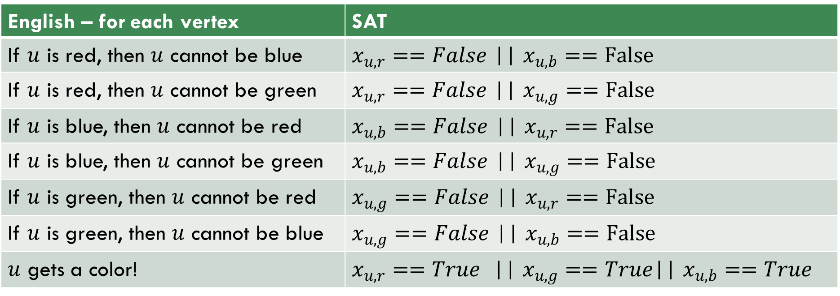
Consistency
More constraints:
English – for each vertex | SAT
If $u$ is red, then $u$ cannot be blue | $x_{u,r}==False$ || $x_{u,b}==False$
If $u$ is red, then $u$ cannot be green | $x_{u,r}==False$ || $x_{u,g}==False$
If $u$ is blue, then $u$ cannot be red | $x_{u,b}==False$ || $x_{u,r}==False$
If $u$ is blue, then $u$ cannot be green | $x_{u,b}==False$ || $x_{u,g}==False$
If $u$ is green, then $u$ cannot be red | $x_{u,g}==False$ || $x_{u,r}==False$
If $u$ is green, then $u$ cannot be blue | $x_{u,g}==False$ || $x_{u,b}==False$
$u$ gets a color! | $x_{u,r}==True$ || $x_{u,g}==True$|| $x_{u,b}==True$

Slide 12
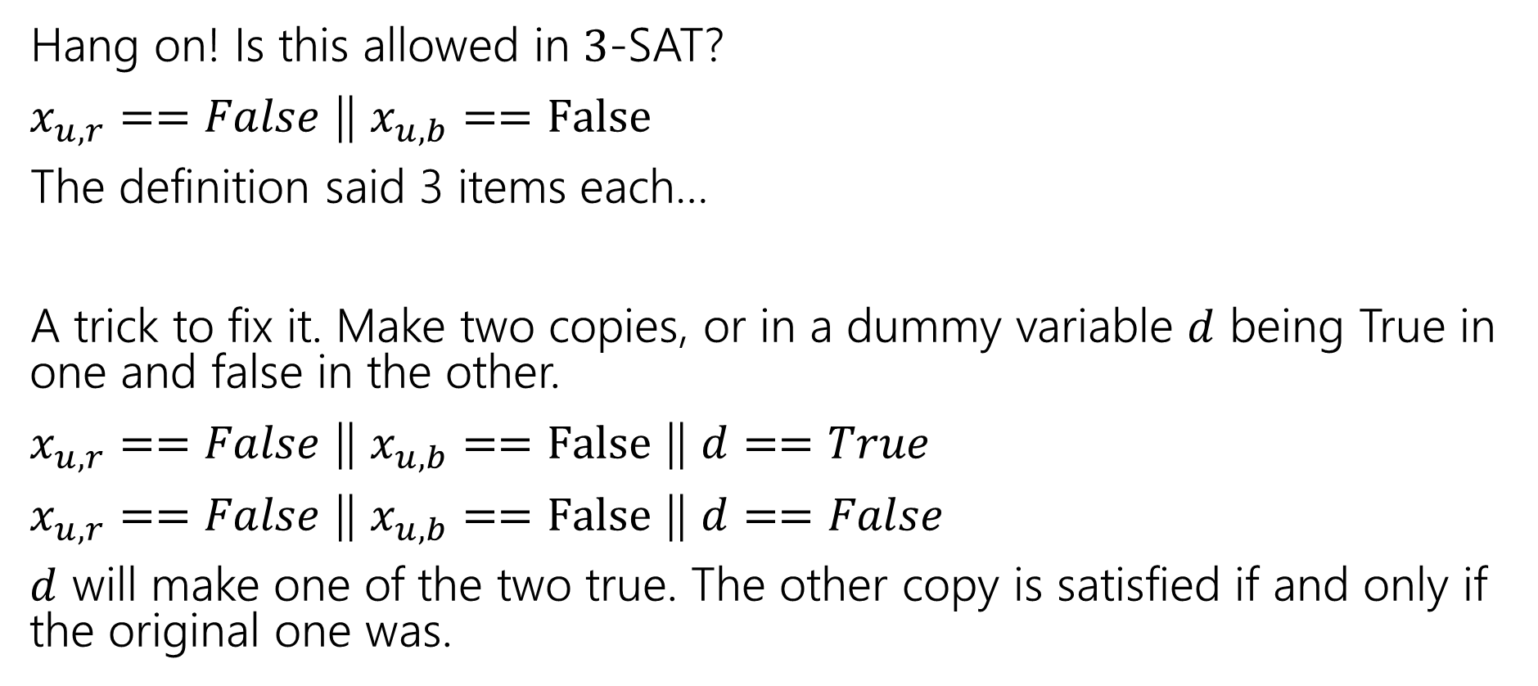

From $2$ to $3$.
Hang on! Is this allowed in $3$-SAT?
$x_{u,r}==False$ || $x_{u,b}==False$
The definition said 3 items each…
A trick to fix it. Make two copies, or in a dummy variable $d$ being True in one and false in the other.
$x_{u,r}==False$ || $x_{u,b}==False$ || $d==True$
$x_{u,r}==False$ || $x_{u,b}==False$ || $d==False$
$d$ will make one of the two true. The other copy is satisfied if and only if the original one was.

Slide 13
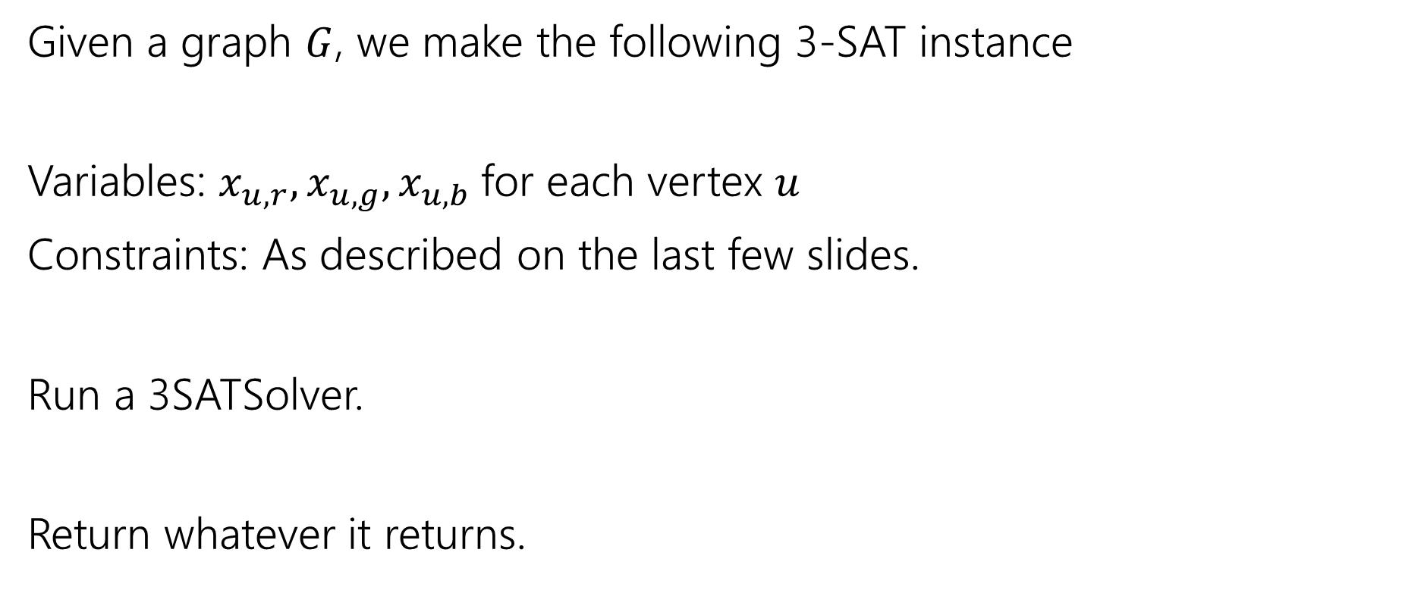
Reduction
Given a graph $G$, we make the following 3-SAT instance
Variables: $x_{u,r},x_{u,g},x_{u,b}$for each vertex $u$
Constraints: As described on the last few slides.
Run a 3SATSolver.
Return whatever it returns.

Slide 14

Running Time?
We need $n$ variables and $6m+13n$ constraints.
Making them is mechanical, definitely polynomial time.

Slide 15
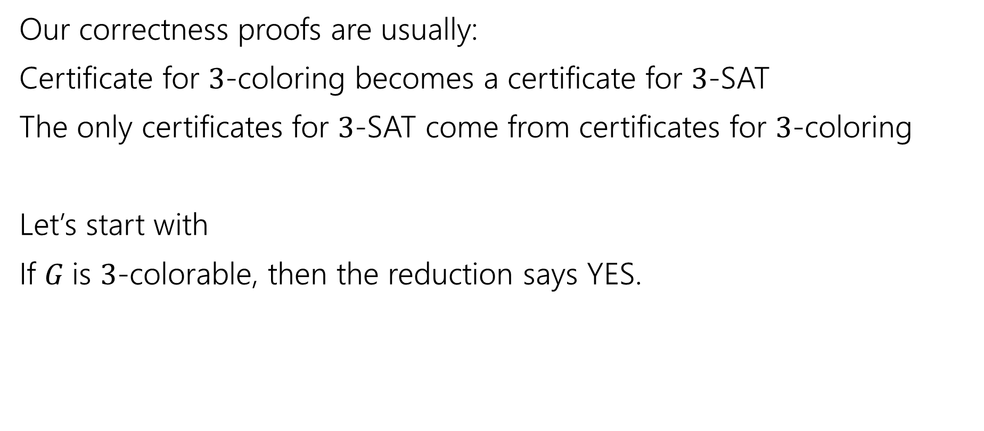
Correctness
Our correctness proofs are usually:
Certificate for $3$-coloring becomes a certificate for $3$-SAT
The only certificates for $3$-SAT come from certificates for $3$-coloring
Let’s start with
If $G$is $3$-colorable, then the reduction says YES.

Slide 16
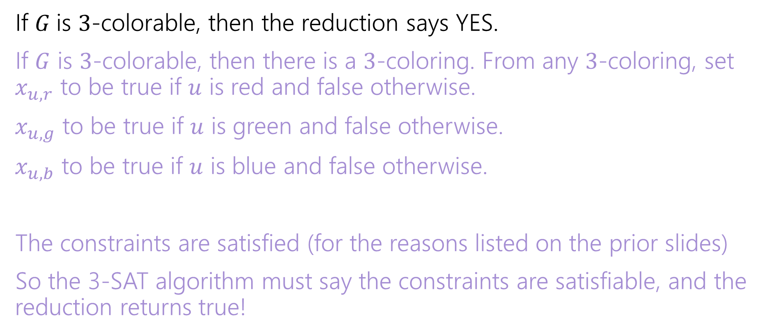
Correctness
If $G$is $3$-colorable, then the reduction says YES.
If $G$ is $3$-colorable, then there is a $3$-coloring. From any $3$-coloring, set $x_{u,r}$ to be true if $u$ is red and false otherwise.
$x_{u,g}$ to be true if $u$ is green and false otherwise.
$x_{u,b}$ to be true if $u$ is blue and false otherwise.
The constraints are satisfied (for the reasons listed on the prior slides)
So the 3-SAT algorithm must say the constraints are satisfiable, and the reduction returns true!

Slide 17
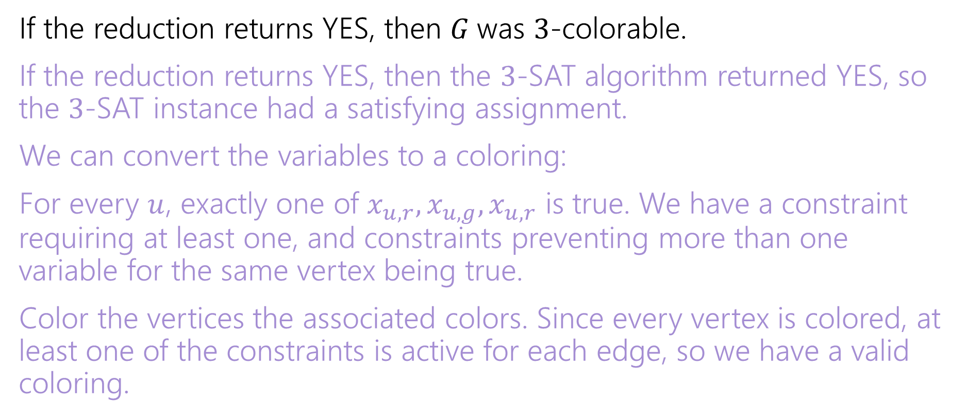
Correctness
If the reduction returns YES, then $G$was $3$-colorable.
If the reduction returns YES, then the $3$-SAT algorithm returned YES, so the $3$-SAT instance had a satisfying assignment.
We can convert the variables to a coloring:
For every $u$, exactly one of $x_{u,r},x_{u,g},x_{u,r}$ is true. We have a constraint requiring at least one, and constraints preventing more than one variable for the same vertex being true.
Color the vertices the associated colors. Since every vertex is colored, at least one of the constraints is active for each edge, so we have a valid coloring.

Slide 18
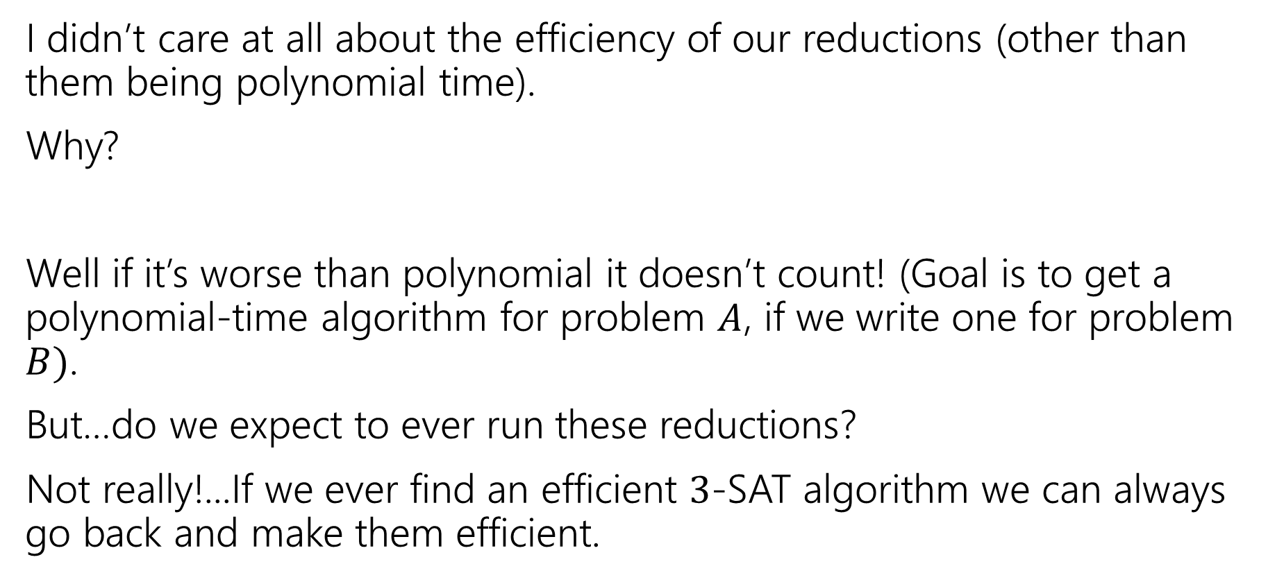
Two Last Thoughts
I didn’t care at all about the efficiency of our reductions (other than them being polynomial time).
Why?
Well if it’s worse than polynomial it doesn’t count! (Goal is to get a polynomial-time algorithm for problem $A$, if we write one for problem $B)$.
But…do we expect to ever run these reductions?
Not really!...If we ever find an efficient $3$-SAT algorithm we can always go back and make them efficient.

Slide 19
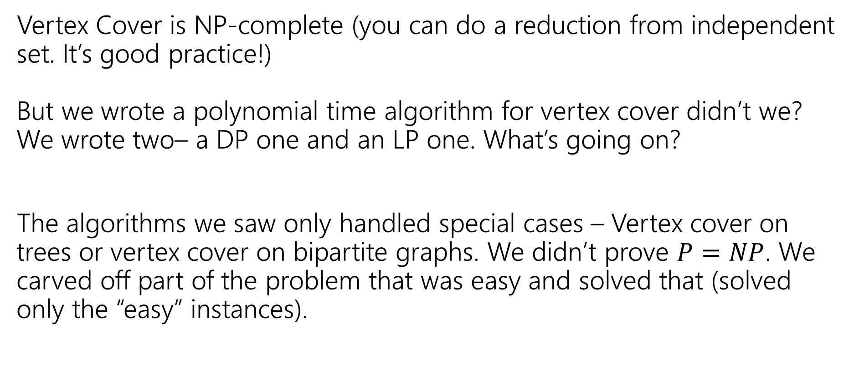
Two Last Thoughts
Vertex Cover is NP-complete (you can do a reduction from independent set. It’s good practice!)
But we wrote a polynomial time algorithm for vertex cover didn’t we? We wrote two– a DP one and an LP one. What’s going on?
The algorithms we saw only handled special cases – Vertex cover on trees or vertex cover on bipartite graphs. We didn’t prove $P=NP$. We carved off part of the problem that was easy and solved that (solved only the “easy” instances).

Slide 20
Why are P and NP interesting?

Slide 21
Why do we care?
We’ve seen a few NP-complete problems.
3-SAT, 3-coloring, Hamiltonian Path/Cycle, Independent Set.
But why should we care about those few?
Just memorize them and avoid them, right?
It’s more than just a few…

Slide 22
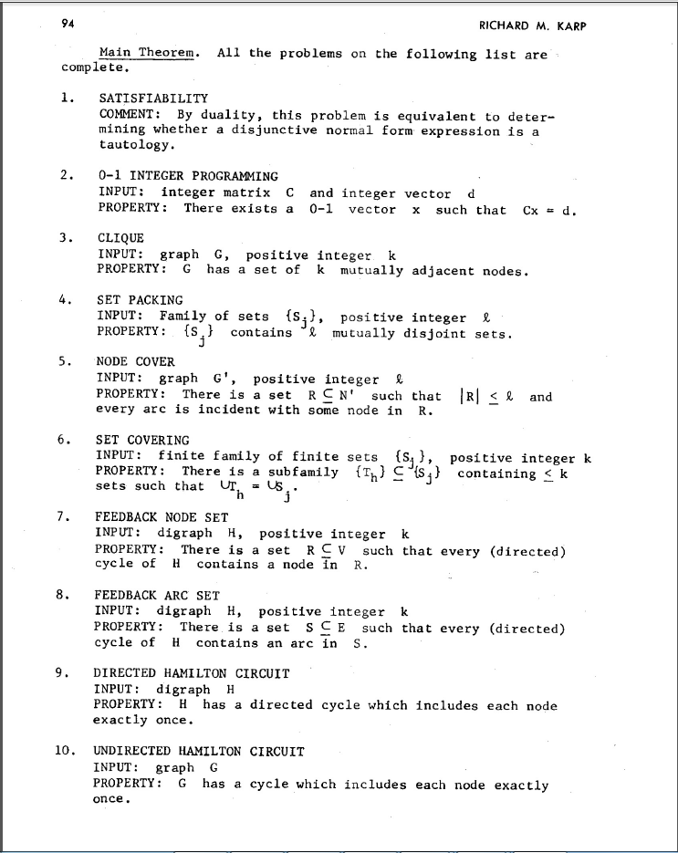
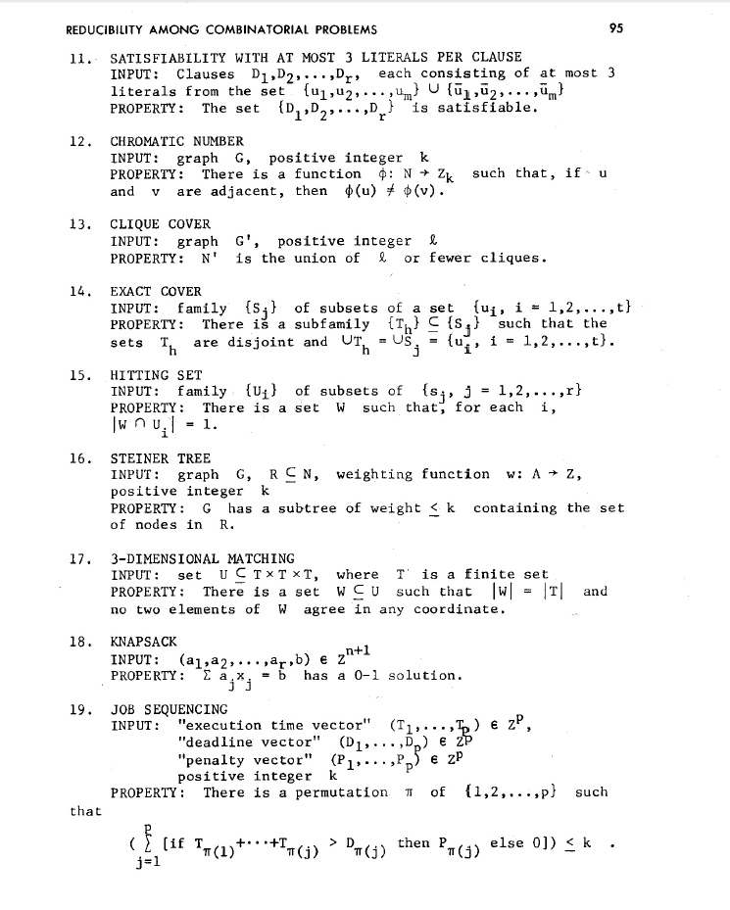
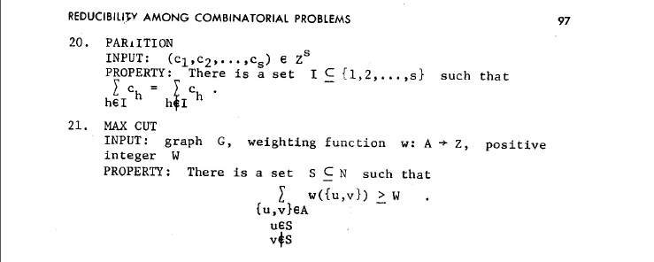
NP-Complete Problems
But Wait! There’s more!
A lot of problems are NP-complete
Karp’s Theorem (1972)

Slide 23
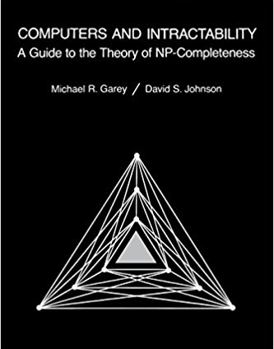
NP-Complete Problems
But Wait! There’s more!
By 1979, at least 300 problems had been proven NP-complete.
Garey and Johnson put a list of all the NP-complete problems they could find in this textbook.
Took almost 100 pages to just list them all.
No one has made a comprehensive list since.

Slide 24
NP-Complete Problems
But Wait! There’s more!
In December 2018, mathematicians and computer scientists put papers on the arXiv claiming to show (at least) 25 more problems are NP-complete.
There are literally thousands of NP-complete problems known.

Slide 25
Examples
There are literally thousands of NP-complete problems.
And some of them look weirdly similar to problems we do know efficient algorithms for.
In P
NP-Complete
Given a directed graph, report if there is a path from s to t of length at most $k$.
Short Path
Given a directed graph, report if there is a path from s to t of length at least$k$.
Long Path

Slide 26
Examples
In P
NP-Complete
Given a weighted graph, find a spanning tree (a set of edges that connect all vertices) of weight at most $k$.
Light Spanning Tree
Given a weighted graph, find a tour (a walk that visits every vertex and returns to its start) of weight at most $k$.
Traveling Salesperson
The electric company just needs a greedy algorithm to lay its wires.
Amazon doesn’t know a way to optimally route its delivery trucks.

Slide 27
Examples
In P
NP-Complete
Given an undirected graph, can the vertices be labeled red and blue with no edge having the same colors on both endpoints?
2-Coloring
Given an undirected graph, can the vertices be labeled red, blue, and green with no edge having the same colors on both endpoints?
3-Coloring
Just changing a number by one takes us from one of the first problems we solved (and one of the fastest algorithms we’ve seen) to something we don’t know how to solve efficiently at all.

Slide 28
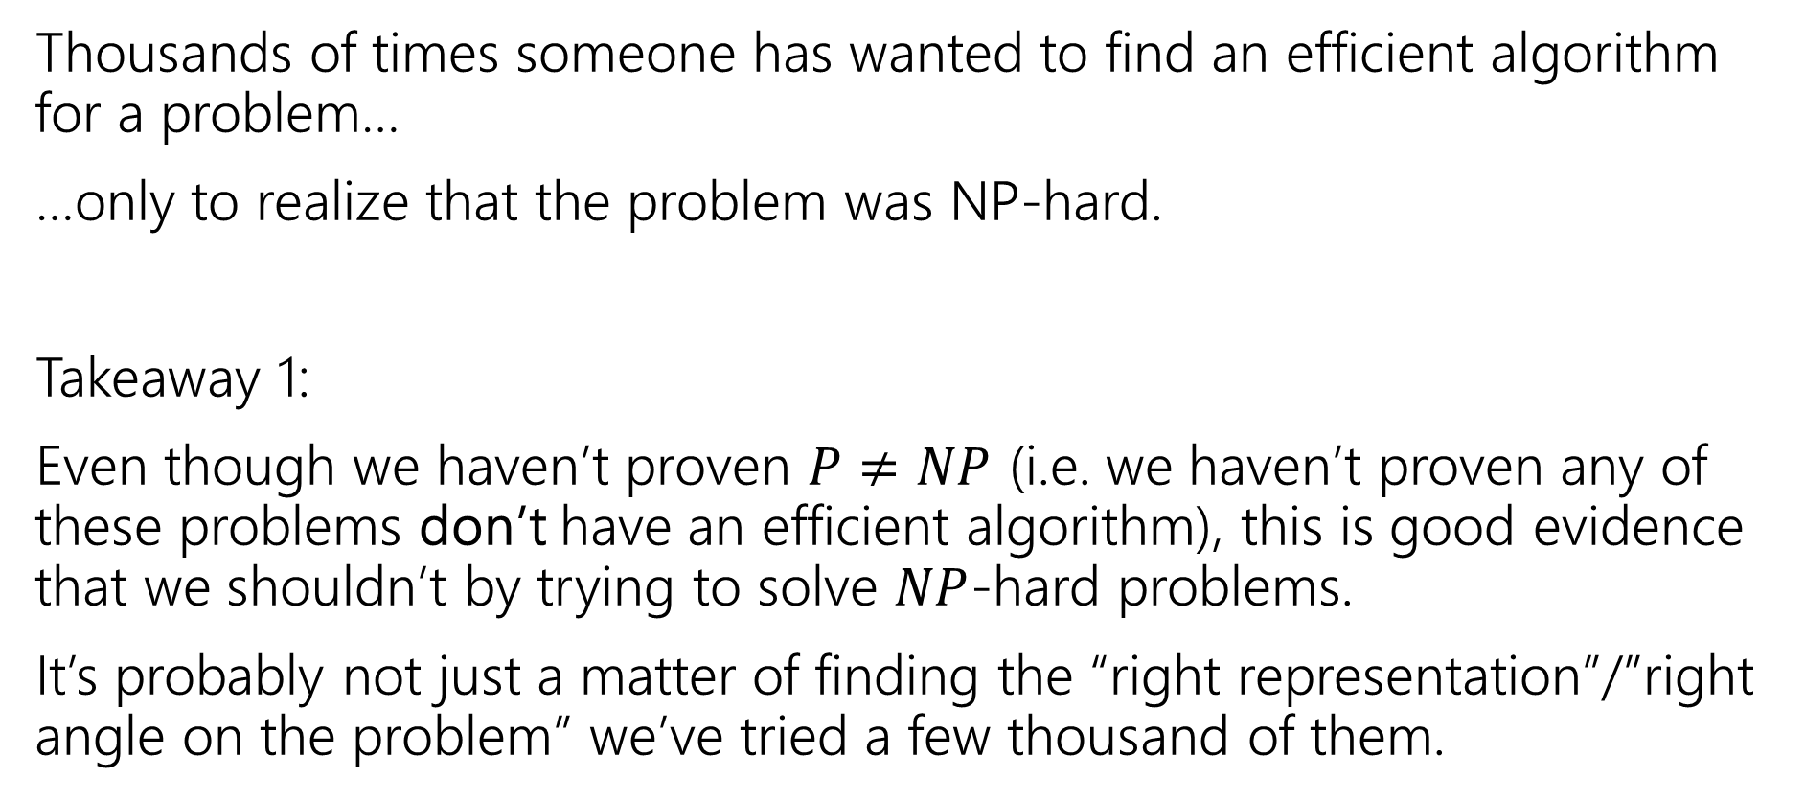
Dealing with NP-hardness
Thousands of times someone has wanted to find an efficient algorithm for a problem…
…only to realize that the problem was NP-hard.
Takeaway 1:
Even though we haven’t proven $P≠NP$ (i.e. we haven’t proven any of these problems don’t have an efficient algorithm), this is good evidence that we shouldn’t by trying to solve $NP$-hard problems.
It’s probably not just a matter of finding the “right representation”/”right angle on the problem” we’ve tried a few thousand of them.

Slide 29
Why Should you care?

Slide 30
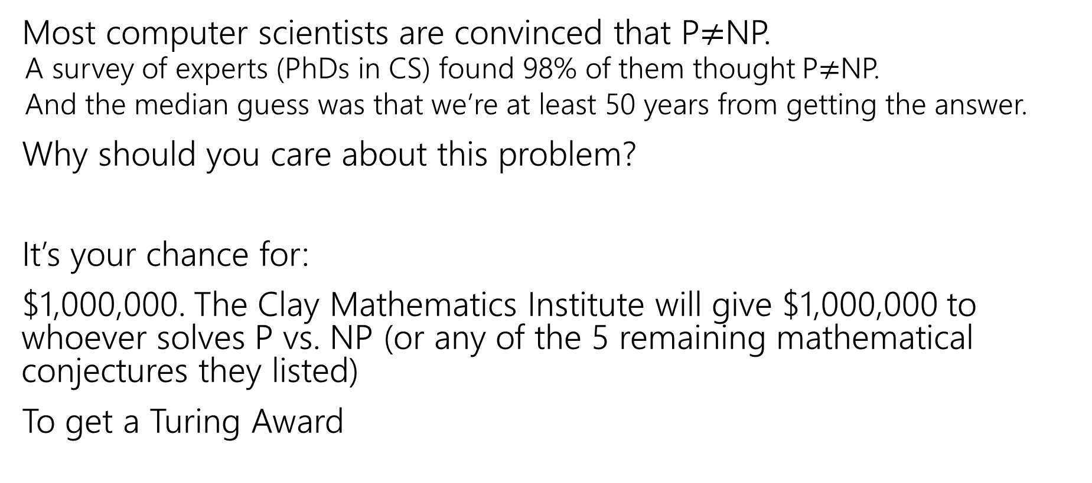
Why should you care about P vs. NP
Most computer scientists are convinced that P$≠$NP.
  A survey of experts (PhDs in CS) found 98% of them thought P$≠$NP.
  And the median guess was that we’re at least 50 years from getting the answer.
Why should you care about this problem?
It’s your chance for:
$1,000,000. The Clay Mathematics Institute will give $1,000,000 to whoever solves P vs. NP (or any of the 5 remaining mathematical conjectures they listed)
To get a Turing Award

Slide 31
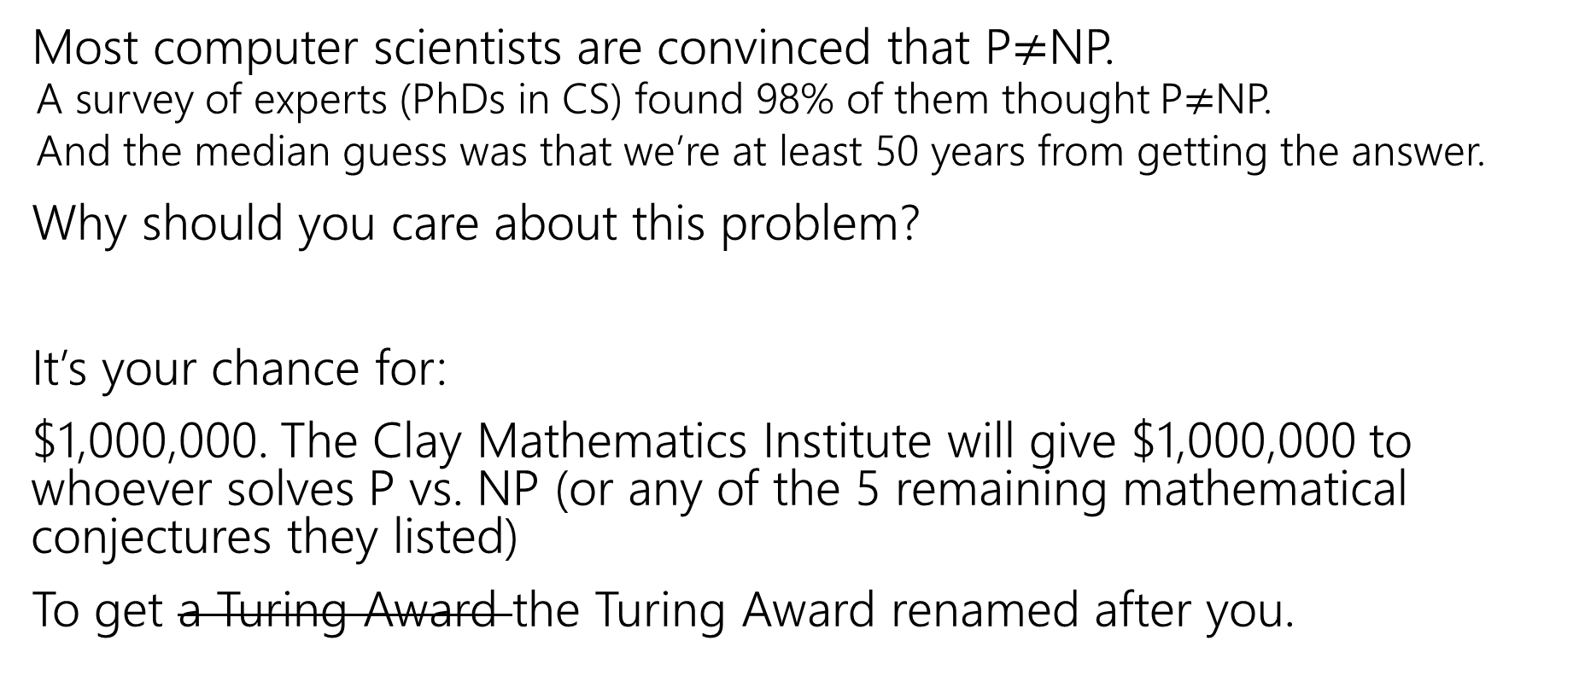
Why should you care about P vs. NP
Most computer scientists are convinced that P$≠$NP.
  A survey of experts (PhDs in CS) found 98% of them thought P$≠$NP.
  And the median guess was that we’re at least 50 years from getting the answer.
Why should you care about this problem?
It’s your chance for:
$1,000,000. The Clay Mathematics Institute will give $1,000,000 to whoever solves P vs. NP (or any of the 5 remaining mathematical conjectures they listed)
To get a Turing Award the Turing Award renamed after you.

Slide 32
Why Should You Care if P=NP?
Suppose P=NP.
Specifically that we found a genuinely in-practice efficient algorithm for an NP-complete problem. What would you do?
  $1,000,000 from the Clay Math Institute obviously, but what’s next?

Slide 33
Why Should You Care if P=NP?
We found a genuinely in-practice efficient algorithm for an NP-complete problem. What would you do?
  Another $5,000,000 from the Clay Math Institute
  Put mathematicians out of work?
  Decrypt (essentially) all current internet communication. See your ethics project.
  A world where P=NP is a very very different place from the world we live in now.

Slide 34
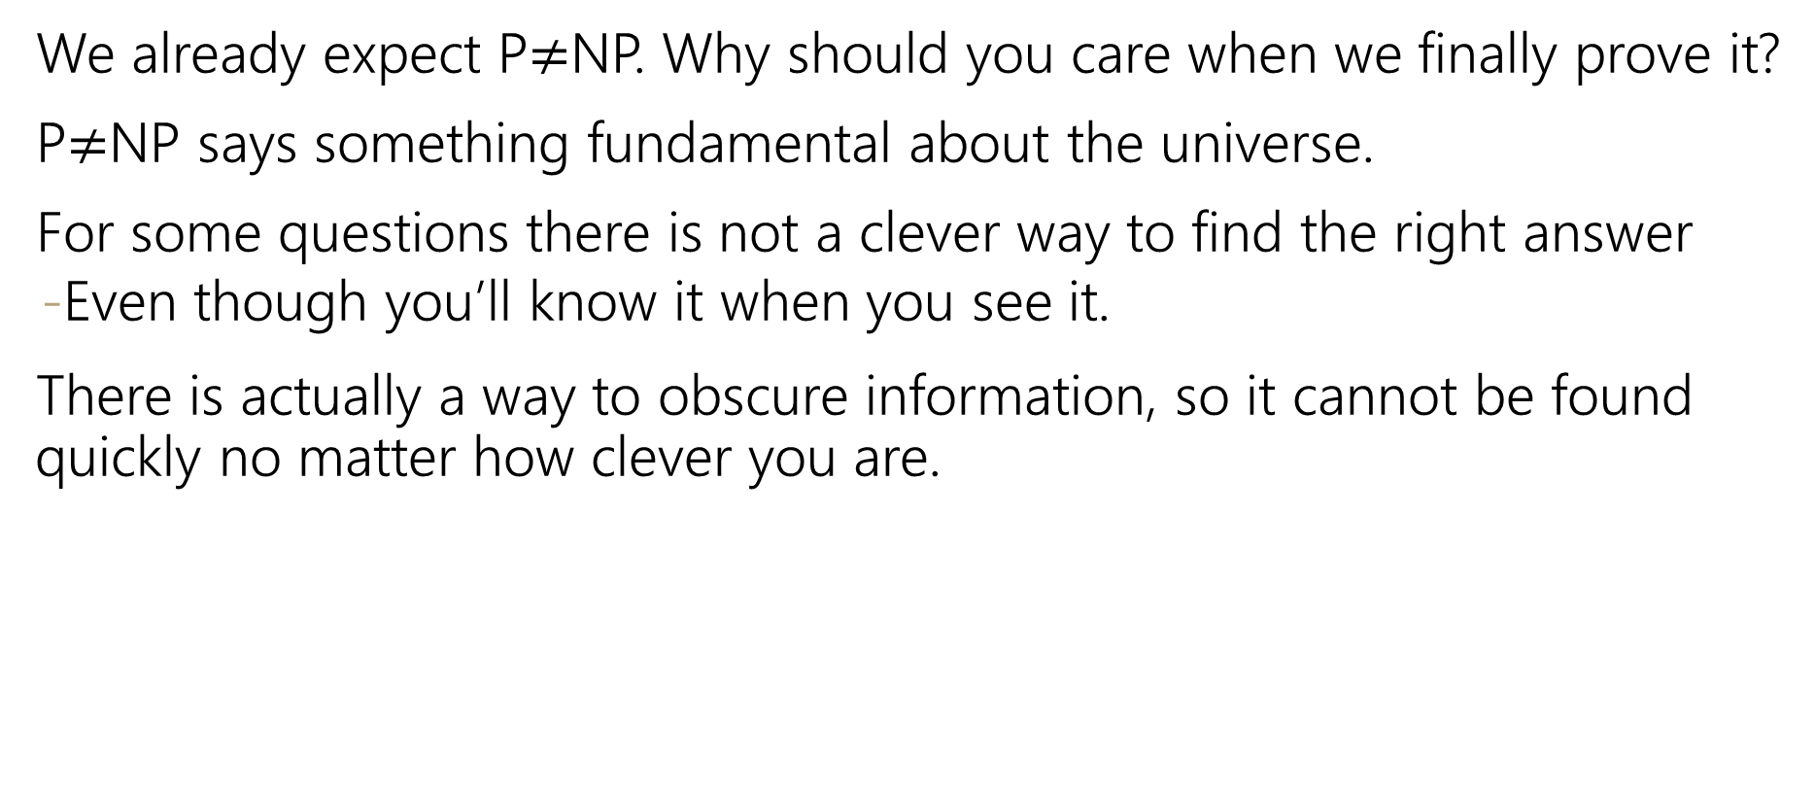
Why Should You Care if P$≠$NP?
We already expect P$≠$NP. Why should you care when we finally prove it?
P$≠$NP says something fundamental about the universe.
For some questions there is not a clever way to find the right answer
  Even though you’ll know it when you see it.
There is actually a way to obscure information, so it cannot be found quickly no matter how clever you are.

Slide 35
Why Should You Care if P$≠$NP?
To prove P$≠$NP we need to better understand the differences between problems.
  Why do some problems allow easy solutions and others don’t?
  What is the structure of these problems?
We don’t care about P vs NP just because it has a huge effect about what the world looks like.
We will learn a lot about computation along the way.

Slide 36
Dealing With NP-hardness

Slide 37
Dealing with NP-hardness
Thousands of times someone has wanted to find an efficient algorithm for a problem…
…only to realize that the problem was NP-hard.
Takeaway 2:
Sooner or later it will happen to one of you.
What do you do if you think your problem is NP-complete?

Slide 38

Dealing with NP-completeness
You just started your new job at Amazon. Your boss asks you to look into the following problem
You have a graph, each vertex is where a specific truck has to do a delivery.
Starting from the warehouse, how do you make all the deliveries and return to the warehouse using the minimum amount of gas.
Given a weighted graph, find a tour (a walk that visits every vertex and returns to its start) of weight at most $k$.
Traveling Salesperson

Slide 39
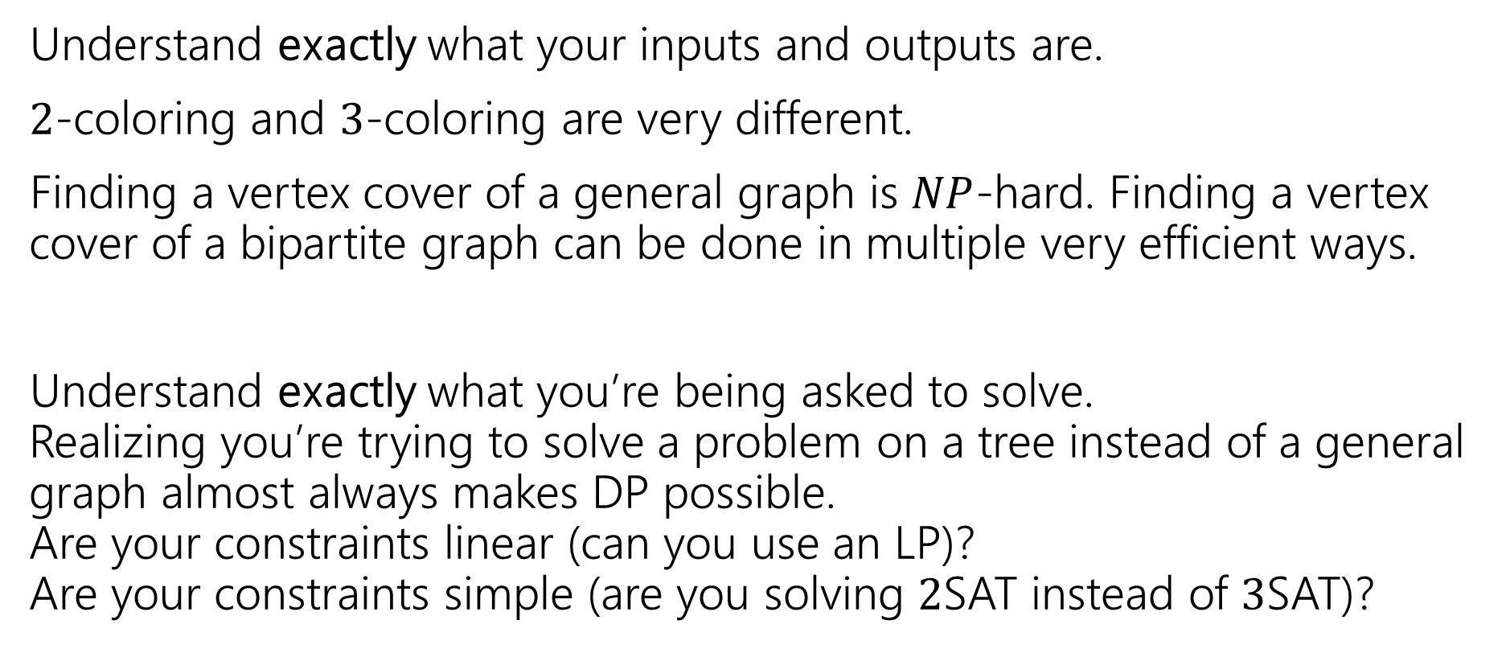
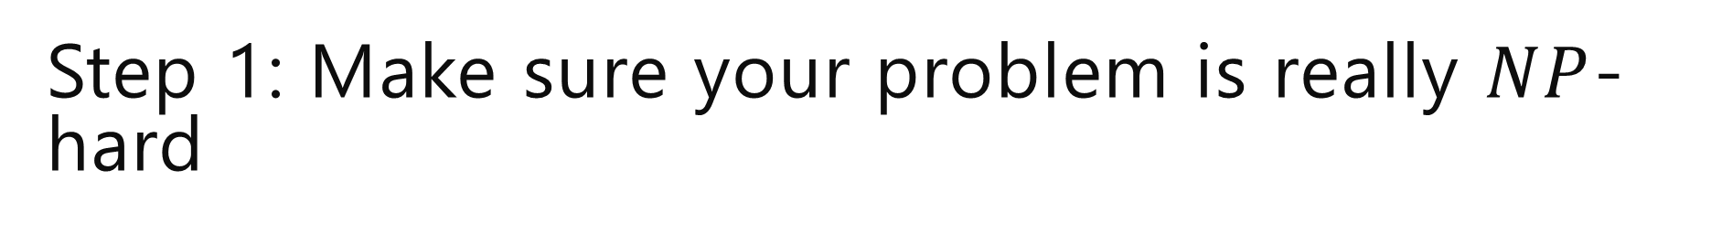
Step 1: Make sure your problem is really $NP$-hard
Understand exactly what your inputs and outputs are.
$2$-coloring and $3$-coloring are very different.
Finding a vertex cover of a general graph is $NP$-hard. Finding a vertex cover of a bipartite graph can be done in multiple very efficient ways.
Understand exactly what you’re being asked to solve.
Realizing you’re trying to solve a problem on a tree instead of a general graph almost always makes DP possible.
Are your constraints linear (can you use an LP)?
Are your constraints simple (are you solving $2$SAT instead of $3$SAT)?

Slide 40
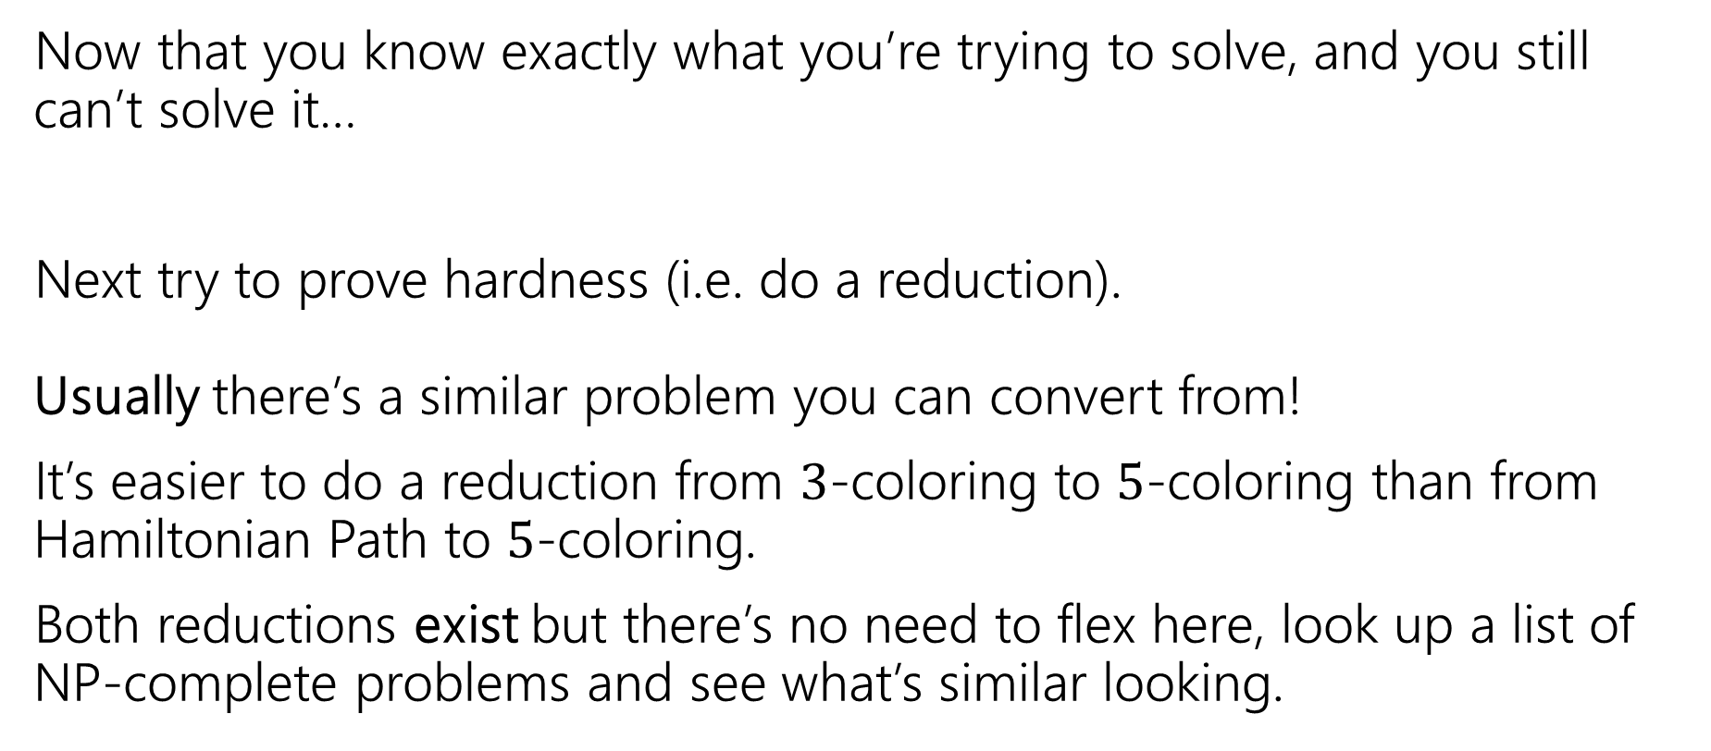
Step 2: It still looks hard
Now that you know exactly what you’re trying to solve, and you still can’t solve it…
Next try to prove hardness (i.e. do a reduction).
Usually there’s a similar problem you can convert from!
It’s easier to do a reduction from $3$-coloring to $5$-coloring than from Hamiltonian Path to $5$-coloring.
Both reductions exist but there’s no need to flex here, look up a list of NP-complete problems and see what’s similar looking.

Slide 41
Step 3: ???
So you go to your boss and say
“Sorry, problem’s NP-hard. I proved it.”
And your boss says:
“that’s a cool proof and all, but really. We need to tell the drivers where to go tomorrow…and we need to use less gas.

Slide 42
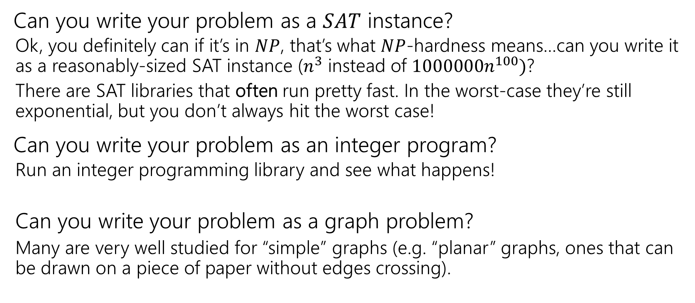

Step $3$…wellllll, maybe not
Can you write your problem as a $SAT$ instance?
  Ok, you definitely can if it’s in $NP$, that’s what $NP$-hardness means…can you write it as a reasonably-sized SAT instance ($n^{3}$ instead of $1000000n^{100})$?
  There are SAT libraries that often run pretty fast. In the worst-case they’re still exponential, but you don’t always hit the worst case!
Can you write your problem as an integer program?
  Run an integer programming library and see what happens!
  Can you write your problem as a graph problem?
  Many are very well studied for “simple” graphs (e.g. “planar” graphs, ones that can be drawn on a piece of paper without edges crossing).

Slide 43
Step 4 – Permanent Solutions
Those exponential time algorithms are great as band-aids.
If it’s a one-time thing, or just a “we’ll run this about once a week, if it takes too long once in a while no big deal” these are fine.
But what if you need a guarantee!
Your code is running every night, and you need an answer by 6 AM or the delivery trucks don’t go out.

Slide 44
Step 4 – Permanent Solutions
Two good options:
Exponential algorithms that aren’t-as-slow-as-others
  Give you an exact answer; won’t take polynomial time but will be guaranteed take you less time than brute force.
Approximation algorithms
  Don’t give you the best answer, but guarantees a reasonable amount of time, and a guaranteed-pretty-good-answer.
  We’ll learn about these next time!

