Slide 1
More Linear Programming
CSE 417 Winter 21
Lecture 17

Slide 2
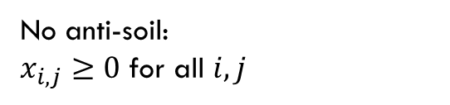
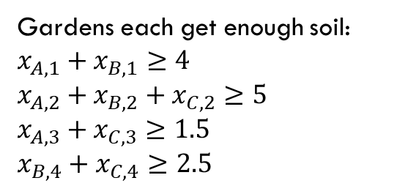
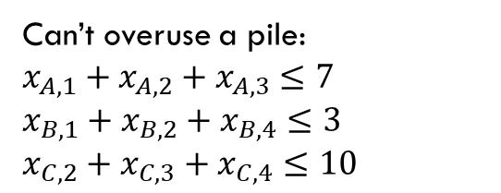
Example Problem
Gardens each get enough soil:
$x_{A,1}+x_{B,1}≥4$
$x_{A,2}+x_{B,2}+x_{C,2}≥5$
$x_{A,3}+x_{C,3}≥1.5$
$x_{B,4}+x_{C,4}≥2.5$
No anti-soil:
$x_{i,j}≥0$ for all $i,j$
Can’t overuse a pile:
$x_{A,1}+x_{A,2}+x_{A,3}≤7$
$x_{B,1}+x_{B,2}+x_{B,4}≤3$
$x_{C,2}+x_{C,3}+x_{C,4}≤10$
3
A
$1.5/unit
1.5
$2/unit
7
5
C
$4/unit
$4/unit
2
10
$1.5/unit
$3/unit
$8/unit
4
4
$2/unit
2.5
1
3
B
$4.5/unit

Slide 3

Full Definition
Minimize: ${(x}_{A,1}⋅3+x_{A,2}⋅4+x_{A,3}⋅1.5)+{(x}_{B,1}⋅2+x_{B,2}⋅1.5+x_{B,4}⋅4.5)+(x_{C,2}⋅4+x_{C,3}⋅2+x_{C,4}⋅8)$
Subject To:
$x_{A,1}+x_{B,1}≥4$
$x_{A,2}+x_{B,2}+x_{C,2}≥5$
$x_{A,3}+x_{C,3}≥1.5$
$x_{B,4}+x_{C,4}≥2.5$
$x_{A,1}+x_{A,2}+x_{A,3}≤7$
$x_{B,1}+x_{B,2}+x_{B,4}≤3$
$x_{C,2}+x_{C,3}+x_{C,4}≤10$
$x_{i,j}≥0$ for all $i,j$

Slide 4


A Linear Program
A linear program is defined by:
Real-valued variables
Subject to a list of linear constraints
Maximizing or minimizing a linear objective function
A linear constraint is a statement of the form: $∑a_{i}x_{i}≤c_{i}$
where $a_{i}$ are constants, the $x_{i}$ are variables and $c_{i}$ is a constant.
A linear objective function is a function of the form: $∑b_{i}x_{i}$
where $b_{i}$ are constants and the $x_{i}$ are variables.

Slide 5
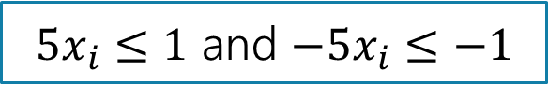


Linear constraints
Can you write each of these requirements as linear constraint(s)?
Some of these are tricks…
$x_{i}$ times $x_{j}$ is at least $5$
${5x}_{i}$ is equal to $1$
$x_{i}≤5$ OR $x_{i}≥7$
$x_{i}$ is non-negative.
$x_{i}$ is an integer.
No way to represent ☹
$5x_{i}≤1$ and $−5x_{i}≤−1$
No way to represent ☹
$$x_{i}≥0$$
No way to represent ☹

Slide 6
Full Definition
Minimize: ${(x}_{A,1}⋅3+x_{A,2}⋅4+x_{A,3}⋅1.5)+{(x}_{B,1}⋅2+x_{B,2}⋅1.5+x_{B,4}⋅4.5)+(x_{C,2}⋅4+x_{C,3}⋅2+x_{C,4}⋅8)$
Subject To:
$x_{A,1}+x_{B,1}≥4$
$x_{A,2}+x_{B,2}+x_{C,2}≥5$
$x_{A,3}+x_{C,3}≥1.5$
$x_{B,4}+x_{C,4}≥2.5$
$x_{A,1}+x_{A,2}+x_{A,3}≤7$
$x_{B,1}+x_{B,2}+x_{B,4}≤3$
$x_{C,2}+x_{C,3}+x_{C,4}≤10$
$x_{i,j}≥0$ for all $i,j$

Slide 7
What are we looking for?
A solution (or point) is a setting of all the variables
A feasible point is a point that satisfies all the constraints.
An optimal point is a point that is feasible and has at least as good of an objective value as every other feasible point.

Slide 8
Example Problem
Gardens each get enough soil:
$x_{A,1}+x_{B,1}≥4$
$x_{A,2}+x_{B,2}+x_{C,2}≥5$
$x_{A,3}+x_{C,3}≥1.5$
$x_{B,4}+x_{C,4}≥2.5$
No anti-soil:
$x_{i,j}≥0$ for all $i,j$
Can’t overuse a pile:
$x_{A,1}+x_{A,2}+x_{A,3}≤7$
$x_{B,1}+x_{B,2}+x_{B,4}≤3$
$x_{C,2}+x_{C,3}+x_{C,4}≤10$
3
A
$1.5/unit
1.5
1.5
A feasible point.
Objective: 55
$2/unit
7
5
5
C
$4/unit
$4/unit
2
10
$1.5/unit
$3/unit
2.5
$8/unit
4
4
4
$2/unit
2.5
1
3
B
$4.5/unit

Slide 9
Example Problem
Gardens each get enough soil:
$x_{A,1}+x_{B,1}≥4$
$x_{A,2}+x_{B,2}+x_{C,2}≥5$
$x_{A,3}+x_{C,3}≥1.5$
$x_{B,4}+x_{C,4}≥2.5$
No anti-soil:
$x_{i,j}≥0$ for all $i,j$
Can’t overuse a pile:
$x_{A,1}+x_{A,2}+x_{A,3}≤7$
$x_{B,1}+x_{B,2}+x_{B,4}≤3$
$x_{C,2}+x_{C,3}+x_{C,4}≤10$
3
1.5
$1.5/unit
1.5
A
A feasible point.
Objective: 44.25
$2/unit
7
5
C
$4/unit
$4/unit
2
10
0.5
4.5
This is an optimal point. There are others!
$1.5/unit
$3/unit
$8/unit
4
4
4
$2/unit
2.5
2.5
1
3
B
$4.5/unit

Slide 10
Example Problem
Gardens each get enough soil:
$x_{A,1}+x_{B,1}≥4$
$x_{A,2}+x_{B,2}+x_{C,2}≥5$
$x_{A,3}+x_{C,3}≥1.5$
$x_{B,4}+x_{C,4}≥2.5$
No anti-soil:
$x_{i,j}≥0$ for all $i,j$
Can’t overuse a pile:
$x_{A,1}+x_{A,2}+x_{A,3}≤7$
$x_{B,1}+x_{B,2}+x_{B,4}≤3$
$x_{C,2}+x_{C,3}+x_{C,4}≤10$
3
1.5
$1.5/unit
1.5
A
A feasible point.
Objective: 44.25
$2/unit
7
1
5
C
$4/unit
$4/unit
2
10
0.5
3.5
Here’s another optimal point!!
$1.5/unit
$3/unit
$8/unit
4
4
4
$2/unit
2.5
2.5
1
3
B
$4.5/unit

Slide 11
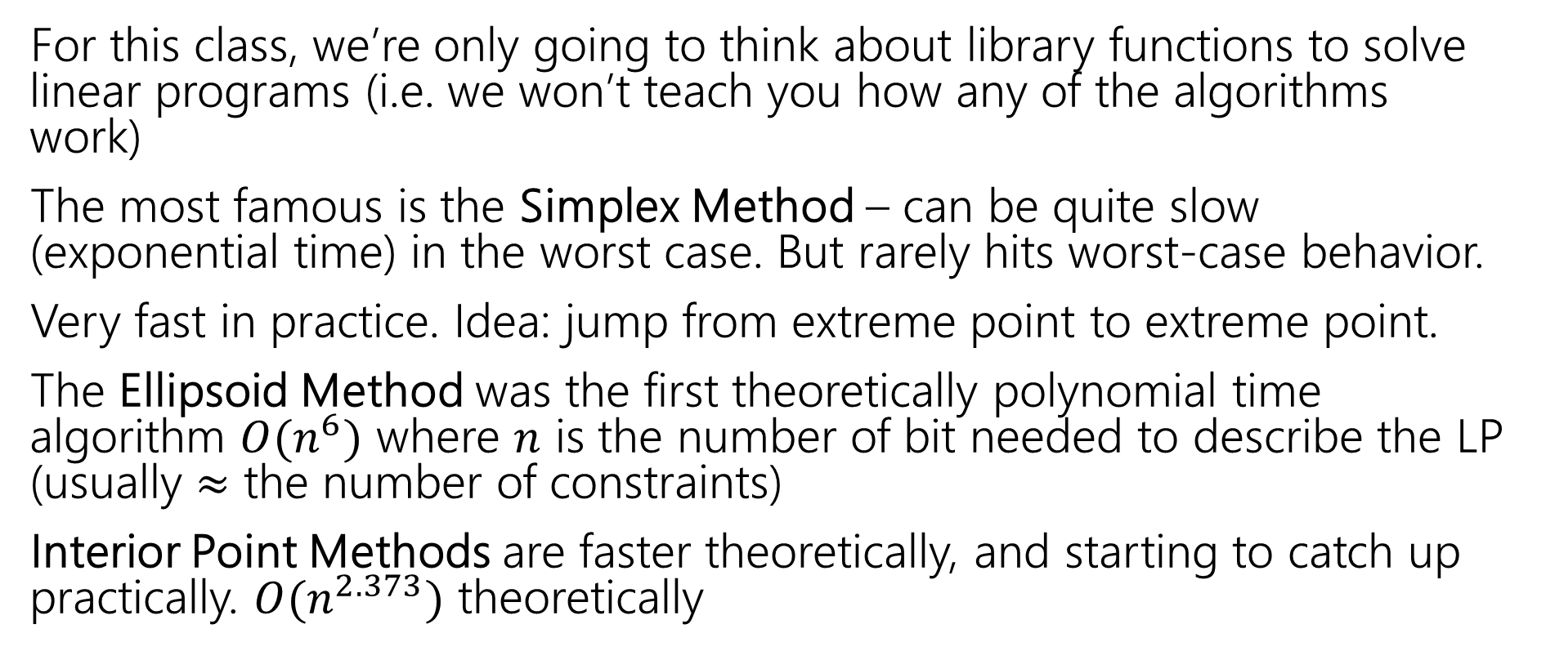
Solving LPs
For this class, we’re only going to think about library functions to solve linear programs (i.e. we won’t teach you how any of the algorithms work)
The most famous is the Simplex Method – can be quite slow (exponential time) in the worst case. But rarely hits worst-case behavior.
Very fast in practice. Idea: jump from extreme point to extreme point.
The Ellipsoid Method was the first theoretically polynomial time algorithm $O(n^{6})$ where $n$ is the number of bit needed to describe the LP (usually $≈$ the number of constraints)
Interior Point Methods are faster theoretically, and starting to catch up practically. $O(n^{2.373})$ theoretically

Slide 12
Another Question
Change the problem
Instead of infinitely divisible dirt…
What if instead we’re moving whole unit things (the dirt is in bags we can’t open or we’re moving bikes or plants or anything else that can’t be split)
Or if we’re assigning people to shifts (can have 1/3 of a person on a shift)
Well, the constraints will change (your “demand” and “supplies” will be integers)

Slide 13
Non-Integrality
Some linear programs only have optimal solutions that have some (or all) variables as non-integers (even with only integers in the objective function and constraints).
For dirt or water or anything arbitrarily divisible, no big deal!
For cell phones or bicycles…only possibly a big deal!
  In practice: if the optimal thing to manufacture 999,999.8 widgets per day, rounding up or down probably isn’t going to make a huge difference in your profits.
  But sometimes rounding isn’t ok…

Slide 14
What do you do if you need integers?
Integer Programs are linear programs where you can mark some variables as needing to be integers.
In practice – often still solvable (Excel also has a solver for these problems). But no longer guaranteed to be efficient.
Lots of theory has been done for when the optimum will be all integers. (MATH 407 or MATH 514)
But sometimes you get a fractional solution…what can you do?

Slide 15
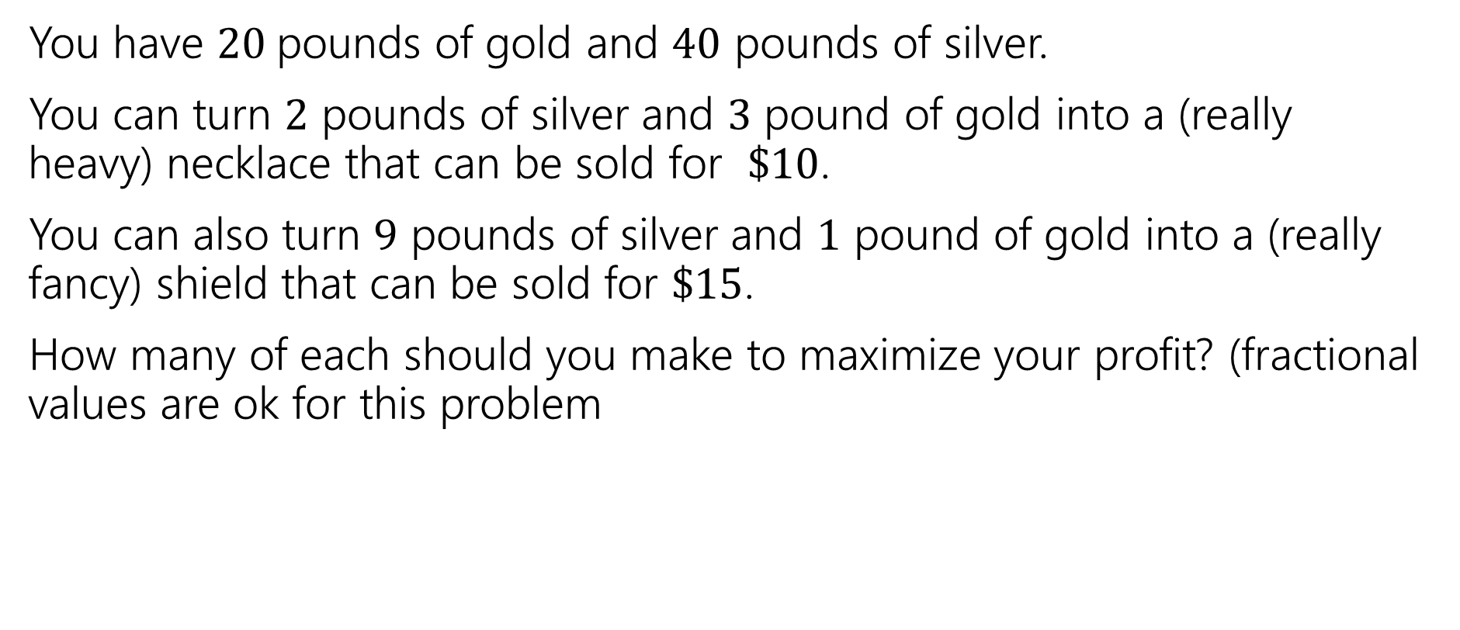
Extra Practice
You have $20$pounds of gold and $40$ pounds of silver.
You can turn $2$ pounds of silver and $3$ pound of gold into a (really heavy) necklace that can be sold for $\$10$.
You can also turn $9$ pounds of silver and $1$ pound of gold into a (really fancy) shield that can be sold for $\$15$.
How many of each should you make to maximize your profit? (fractional values are ok for this problem

Slide 16
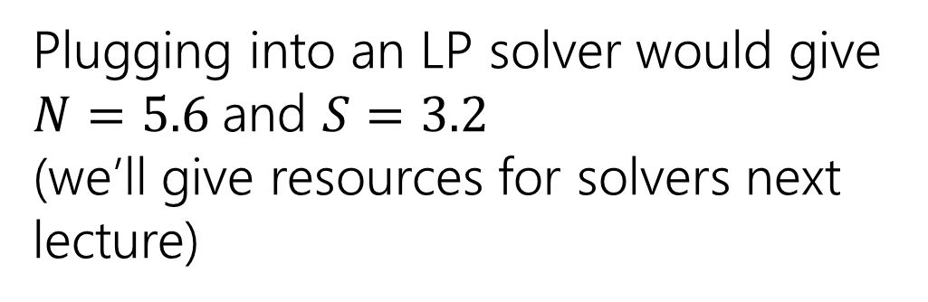
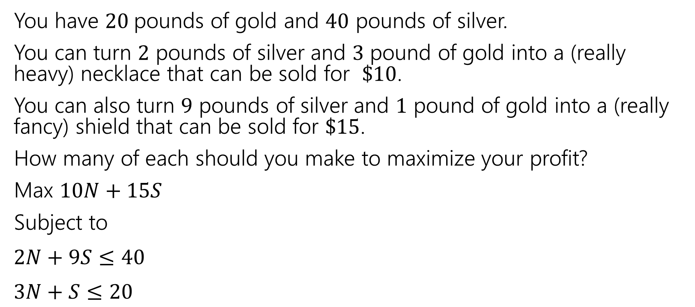
Extra Practice
You have $20$pounds of gold and $40$ pounds of silver.
You can turn $2$ pounds of silver and $3$ pound of gold into a (really heavy) necklace that can be sold for $\$10$.
You can also turn $9$ pounds of silver and $1$ pound of gold into a (really fancy) shield that can be sold for $\$15$.
How many of each should you make to maximize your profit?
Max $10N+15S$
Subject to
$2N+9S≤40$
$3N+S≤20$
Plugging into an LP solver would give $N=5.6$and $S=3.2$
(we’ll give resources for solvers next lecture)

Slide 17
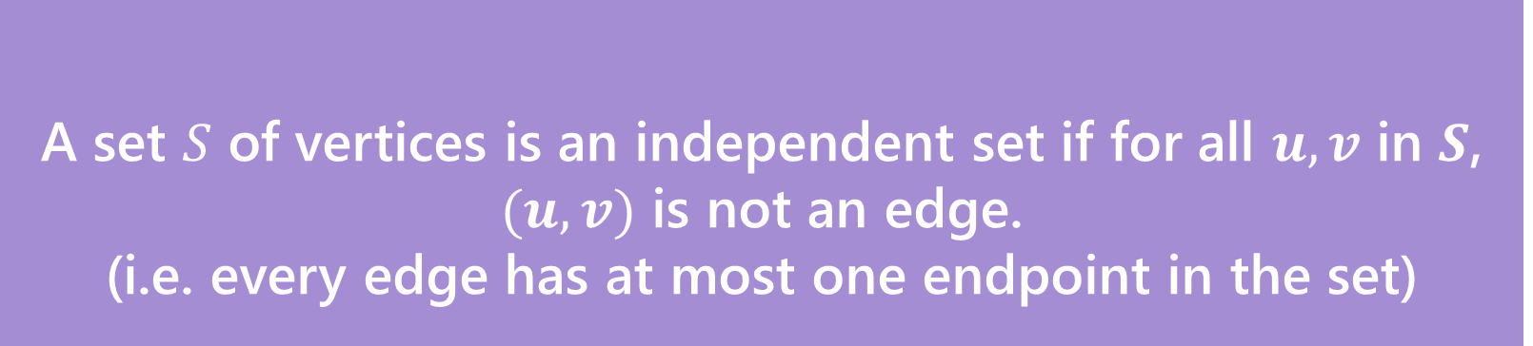
An Example Where things go wrong
A set $S$ of vertices is an independent set if for all $u,v$ in $S$, $(u,v)$ is not an edge.
(i.e. every edge has at most one endpoint in the set)
Independent Set
Sound familiar?
This isn’t a vertex cover – that was at least on endpoint per edge.
A 2-coloring divides vertices into two independent sets (i.e. all the “red” vertices are an independent set, all the “blue” vertices are another independent set).

Slide 18
Independent Set
A set $S$ of vertices is an independent set if for all $u,v$ in $S$, $(u,v)$ is not an edge.
(i.e. every edge has at most one endpoint in the set)
Independent Set
An independent set of size 2.

Slide 19
Independent Set
A set $S$ of vertices is an independent set if for all $u,v$ in $S$, $(u,v)$ is not an edge.
(i.e. every edge has at most one endpoint in the set)
Independent Set
Not an independent set.

Slide 20
Independent Set
A set $S$ of vertices is an independent set if for all $u,v$ in $S$, $(u,v)$ is not an edge.
(i.e. every edge has at most one endpoint in the set)
Independent Set
An independent set of size 1.

Slide 21
Write an LP for independent set
What do you want your variables to be?
How do you ensure that you don’t have two adjacent vertices in the set?

Slide 22
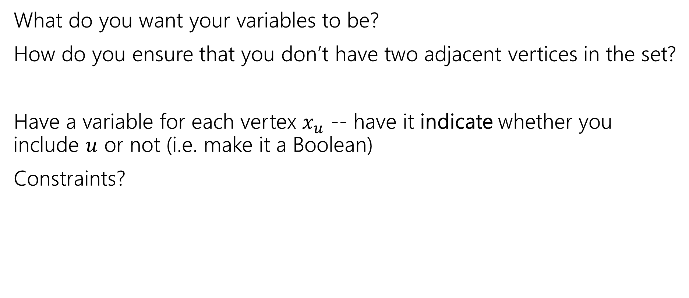
Write an LP for independent set
What do you want your variables to be?
How do you ensure that you don’t have two adjacent vertices in the set?
Have a variable for each vertex $x_{u}$ -- have it indicate whether you include $u$ or not (i.e. make it a Boolean)
Constraints?

Slide 23
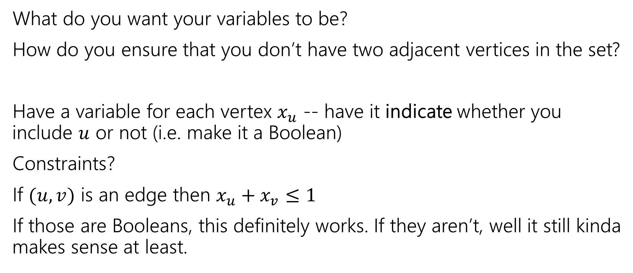
Write an LP for independent set
What do you want your variables to be?
How do you ensure that you don’t have two adjacent vertices in the set?
Have a variable for each vertex $x_{u}$ -- have it indicate whether you include $u$ or not (i.e. make it a Boolean)
Constraints?
If $(u,v)$ is an edge then $x_{u}+x_{v}≤1$
If those are Booleans, this definitely works. If they aren’t, well it still kinda makes sense at least.

Slide 24
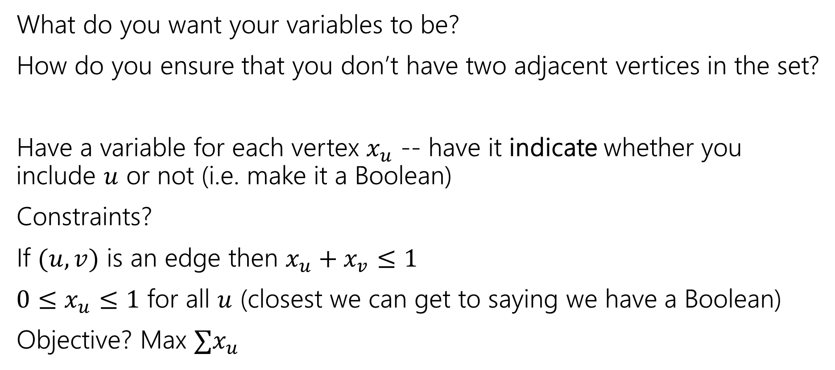
Write an LP for independent set
What do you want your variables to be?
How do you ensure that you don’t have two adjacent vertices in the set?
Have a variable for each vertex $x_{u}$ -- have it indicate whether you include $u$ or not (i.e. make it a Boolean)
Constraints?
If $(u,v)$ is an edge then $x_{u}+x_{v}≤1$
$0≤x_{u}≤1$ for all $u$ (closest we can get to saying we have a Boolean)
Objective? Max $∑x_{u}$

Slide 25






LP for Independent set
$$x_{u}=1/2$$
$$x_{u}=1/2$$
Max: $∑x_{u}$
Subject to:
$x_{u}+x_{v}≤1$ for all $\left(u,v\right)∈E$
$0≤x_{u}≤1$ for all $u$
$$x_{u}=1/2$$
How big is the biggest independent set?
1
$$x_{u}=1/2$$
$$x_{u}=1/2$$
What does the LP find
2.5 – there’s no “real” independent set this corresponds to.

Slide 26
LP for Independent set
Max: $∑x_{u}$
Subject to:
$x_{u}+x_{v}≤1$ for all $\left(u,v\right)∈E$
$0≤x_{u}≤1$ for all $u$
For this problem an LP is not a useful tool.
If you get a fractional solution, there’s no known process to turn it into an integral one without ending up far from the real best.

Slide 27

A nicer example
Sometimes we can round fractional solutions into integral ones.
Minimum Weight Vertex Cover
We’ve seen how to solve the problem with DP on trees.
Let’s try it now with linear programming.
A set $S$ of vertices is a vertex cover if for every edge $\left(u,v\right), u$ is in $S$, $v$is in $S$ or both are in $S.$

Slide 28

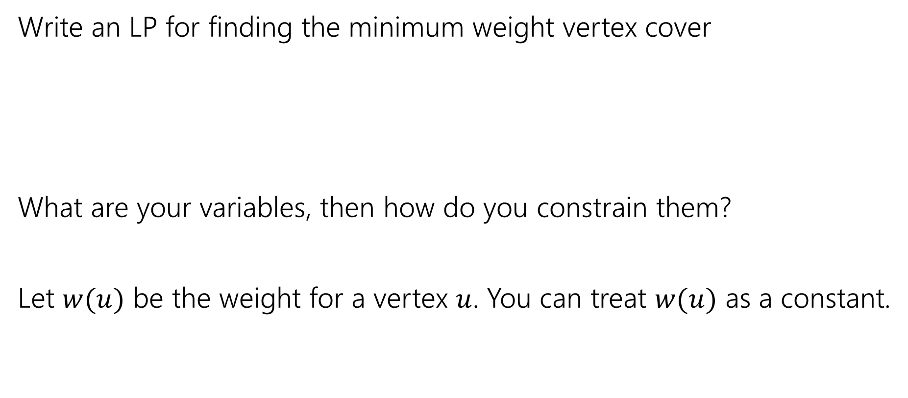
Vertex Cover LP
Fill out the poll everywhere for Activity Credit!
Go to pollev.com/cse417 and login with your UW identity
Write an LP for finding the minimum weight vertex cover
What are your variables, then how do you constrain them?
Let $w(u)$ be the weight for a vertex $u$. You can treat $w(u)$ as a constant.
A set $S$ of vertices is a vertex cover if for every edge $\left(u,v\right), u$ is in $S$, $v$is in $S$ or both are in $S.$

Slide 29

Vertex Cover LP
Minimize $∑w\left(u\right)⋅x_{u}$
Subject to:
$x_{u}+x_{v}≥1$ for all $\left(u,v\right)∈E$
$0≤x_{u}≤1$ for all $u$.

Slide 30

Integrality
We need an integral solution
Having $\frac{1}{3}$ of $u$ in the set doesn’t make sense.
How do we make the variables integral?

Slide 31
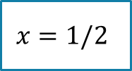



What do we do
Let’s try an example first
Suppose your LP gave you this solution on this graph. How would you round it (i.e. convert to a valid vertex cover)?
1
1
1
1
$$x=1/2$$
$$x=1/2$$
$$x=1/2$$
$$x=1/2$$

Slide 32
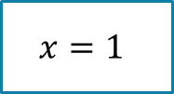
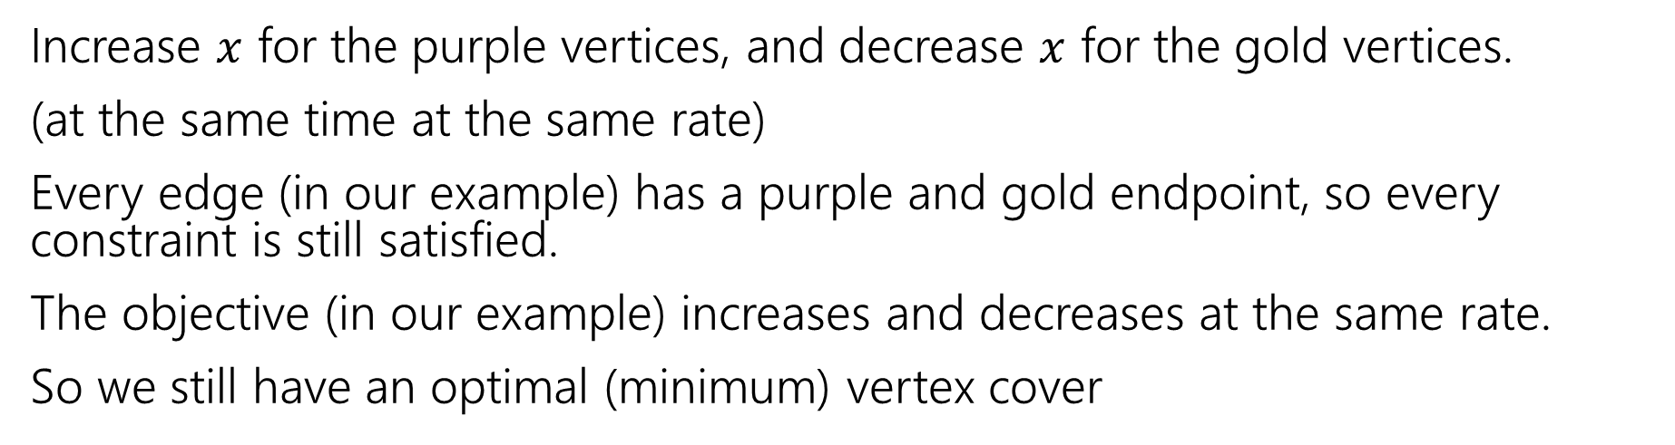
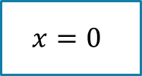
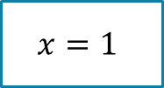

What do we do
Increase $x$ for the purple vertices, and decrease $x$ for the gold vertices.
(at the same time at the same rate)
Every edge (in our example) has a purple and gold endpoint, so every constraint is still satisfied.
The objective (in our example) increases and decreases at the same rate.
So we still have an optimal (minimum) vertex cover
1
1
1
1
$$x=1$$
$$x=0$$
$$x=1$$
$$x=0$$

Slide 33
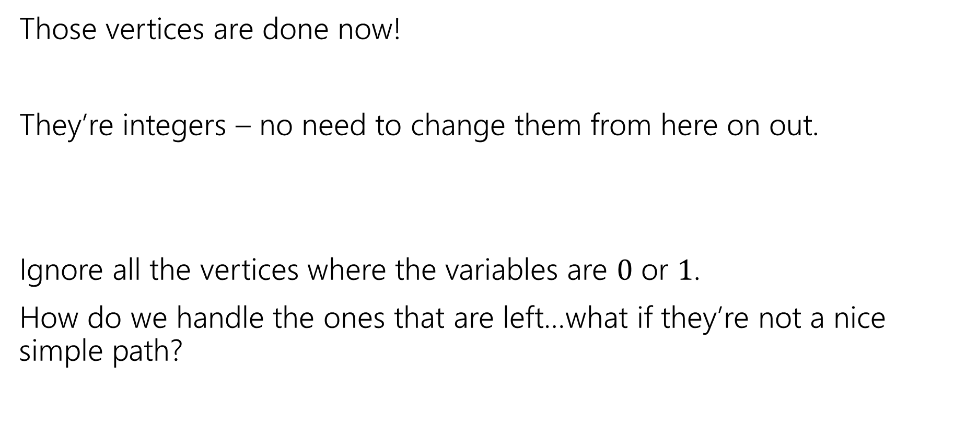
What do we do
Those vertices are done now!
They’re integers – no need to change them from here on out.
Ignore all the vertices where the variables are $0$ or $1$.
How do we handle the ones that are left…what if they’re not a nice simple path?

Slide 34
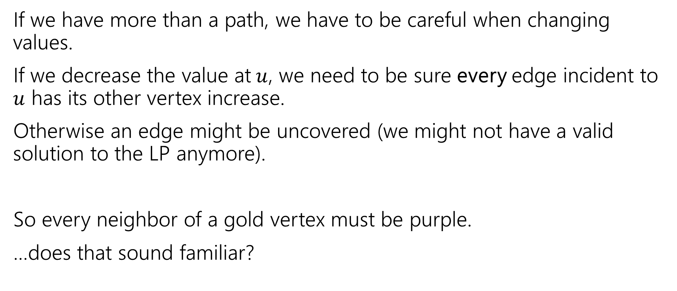
In General
If we have more than a path, we have to be careful when changing values.
If we decrease the value at$u$, we need to be sure every edge incident to $u$ has its other vertex increase.
Otherwise an edge might be uncovered (we might not have a valid solution to the LP anymore).
So every neighbor of a gold vertex must be purple.
…does that sound familiar?

Slide 35
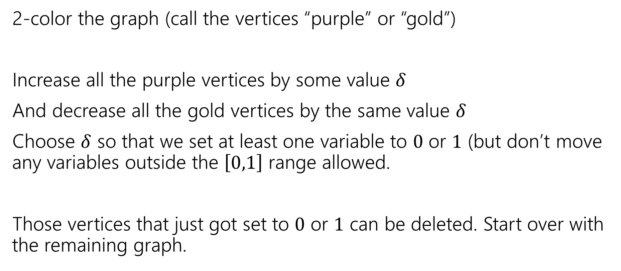
In General…
2-color the graph (call the vertices “purple” or “gold”)
Increase all the purple vertices by some value $δ$
And decrease all the gold vertices by the same value $δ$
Choose $δ$ so that we set at least one variable to $0$ or $1$ (but don’t move any variables outside the $\left[0,1\right]$ range allowed.
Those vertices that just got set to $0$ or $1$ can be deleted. Start over with the remaining graph.

Slide 36
In General…
But wait!
What if we’re increasing the objective value? (i.e. what if there’s more weight on the purple vertices than gold).
We won’t increase:
If we were, then switch purple and gold. Then we’d be decreasing the objective…but we were at the minimum!
So we’re really getting a minimum vertex cover.

Slide 37
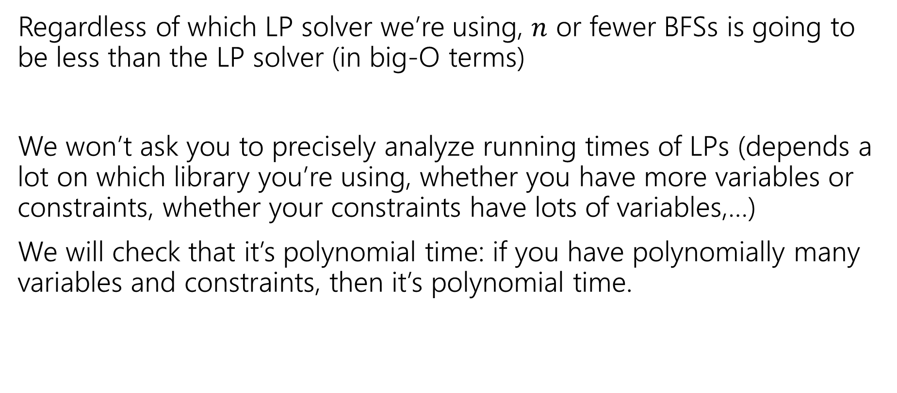
Running Time
Regardless of which LP solver we’re using, $n$ or fewer BFSs is going to be less than the LP solver (in big-O terms)
We won’t ask you to precisely analyze running times of LPs (depends a lot on which library you’re using, whether you have more variables or constraints, whether your constraints have lots of variables,…)
We will check that it’s polynomial time: if you have polynomially many variables and constraints, then it’s polynomial time.

Slide 38

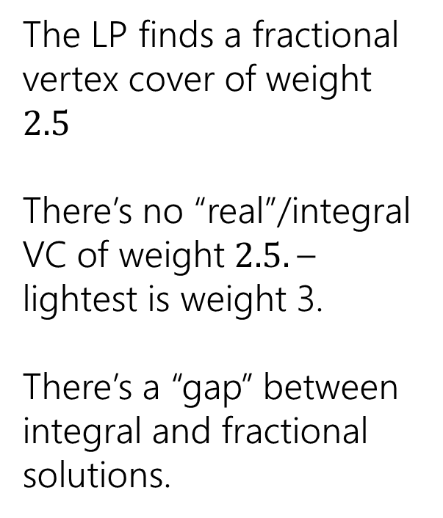
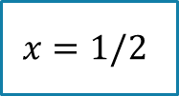

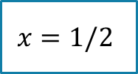

Non-Bipartite
We needed the graph to be bipartite to be able to 2-color it.
What if our original graph isn’t bipartite?
The LP finds a fractional vertex cover of weight $2.5$
There’s no “real”/integral VC of weight $2.5.$– lightest is weight 3.
There’s a “gap” between integral and fractional solutions.
1
1
$$x=1/2$$
1
$$x=1/2$$
$$x=1/2$$
1
1
$$x=1/2$$
$$x=1/2$$

Slide 39
Summary
With dynamic programming, we could find the minimum weight vertex cover on trees.
With linear programming, we can find the minimum weight vertex cover on any bipartite graph (trees and other graphs!).
But LPs don’t always give you a fractional solution that’s helpful for finding an integral one. On non-bipartite graphs, we’ll need to do something else. (More in a few weeks).

Slide 40
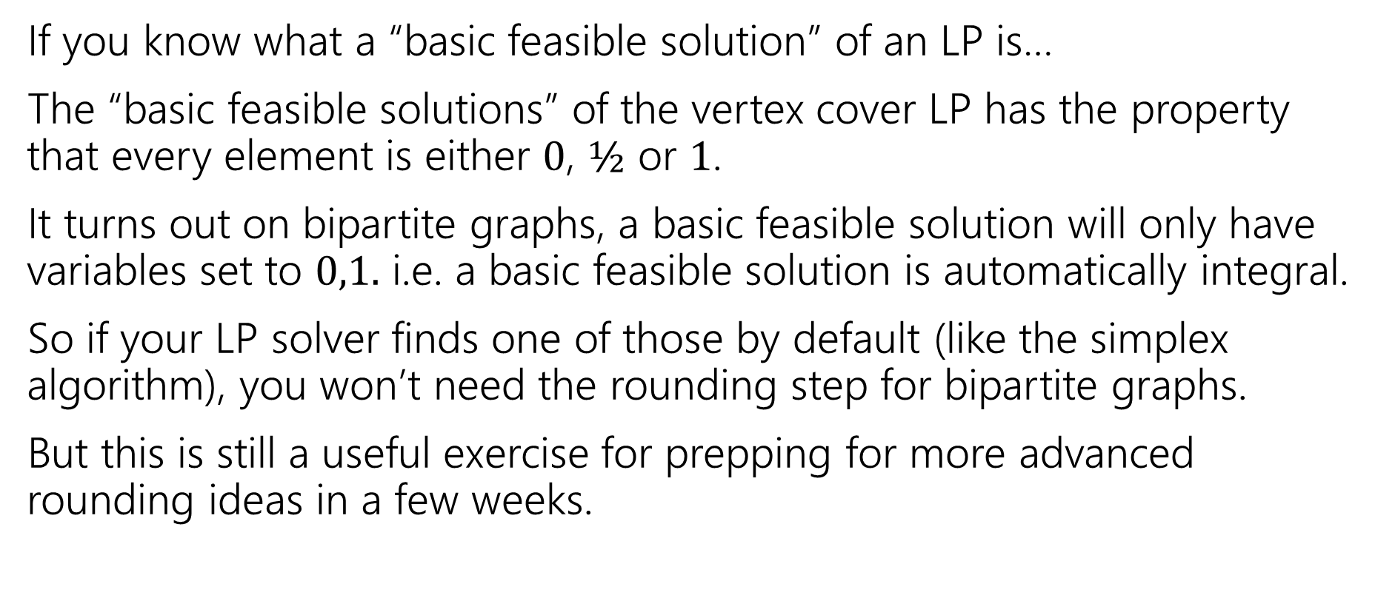
Side Note for Those with deep LP knowledge
If you know what a “basic feasible solution” of an LP is…
The “basic feasible solutions” of the vertex cover LP has the property that every element is either $0$, $½$ or $1$.
It turns out on bipartite graphs, a basic feasible solution will only have variables set to $0,1.$ i.e. a basic feasible solution is automatically integral.
So if your LP solver finds one of those by default (like the simplex algorithm), you won’t need the rounding step for bipartite graphs.
But this is still a useful exercise for prepping for more advanced rounding ideas in a few weeks.

Slide 41
Flows

Slide 42
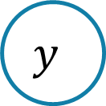



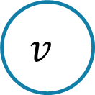


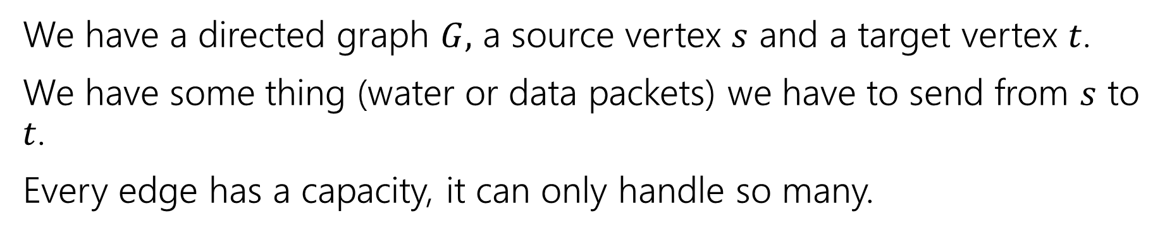

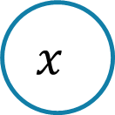








Max Flow
We have a directed graph $G,$ a source vertex $s$ and a target vertex $t$.
We have some thing (water or data packets) we have to send from $s$ to $t$.
Every edge has a capacity, it can only handle so many.
$$2$$
$$v$$
$$4$$
$$1$$
$$t$$
$$2$$
$$s$$
$$x$$
$$2$$
$$2$$
$$1$$
$$5$$
$$4$$
$$u$$
$$w$$
$$y$$
$$2$$

Slide 43

Flows
A flow moves units of water from $s$ to $t.$
Water can only be created at $s$ and only disappear at $t$.
And you cannot move more water than the capacity on any edge.
$$2$$
$$v$$
$$4$$
$$1$$
$$t$$
$$2$$
$$s$$
$$x$$
$$2$$
$$2$$
$$1$$
$$5$$
$$4$$
$$u$$
$$w$$
$$y$$
$$2$$

Slide 44










Flows
A flow moves units of water from $s$ to $t.$
Water can only be created at $s$ and only disappear at $t$.
And you cannot move more water than the capacity on any edge.
$$1/2$$
$$v$$
$$2/4$$
$$1/1$$
$$t$$
$$2/2$$
$$s$$
$$x$$
$$0/2$$
$$1/2$$
$$1/1$$
$$2/5$$
$$2/4$$
$$u$$
$$w$$
$$y$$
$$1/2$$

Slide 45

Write an LP for finding the biggest flow
Let $c\left(e\right)$ be the capacity on edge $e$

Slide 46

Write an LP for finding the biggest flow
Let $c\left(e\right)$ be the capacity on edge $e$
Max $\sum_{e:e enters t}{x_{e}}$
Subject to:
$\sum_{e:e enters u}{x_{e}}=\sum_{e:e leaves u}{x_{e}}$ for every $u$ other than $s$ and $t$
$0≤x_{e}≤c(e)$ for every edge $e$

Slide 47
Next Time
How to solve this problem without linear programming (an algorithm that runs directly on the graph)

