Slide 1
Linear Programming
CSE 417 Winter 21
Lecture 16

Slide 2
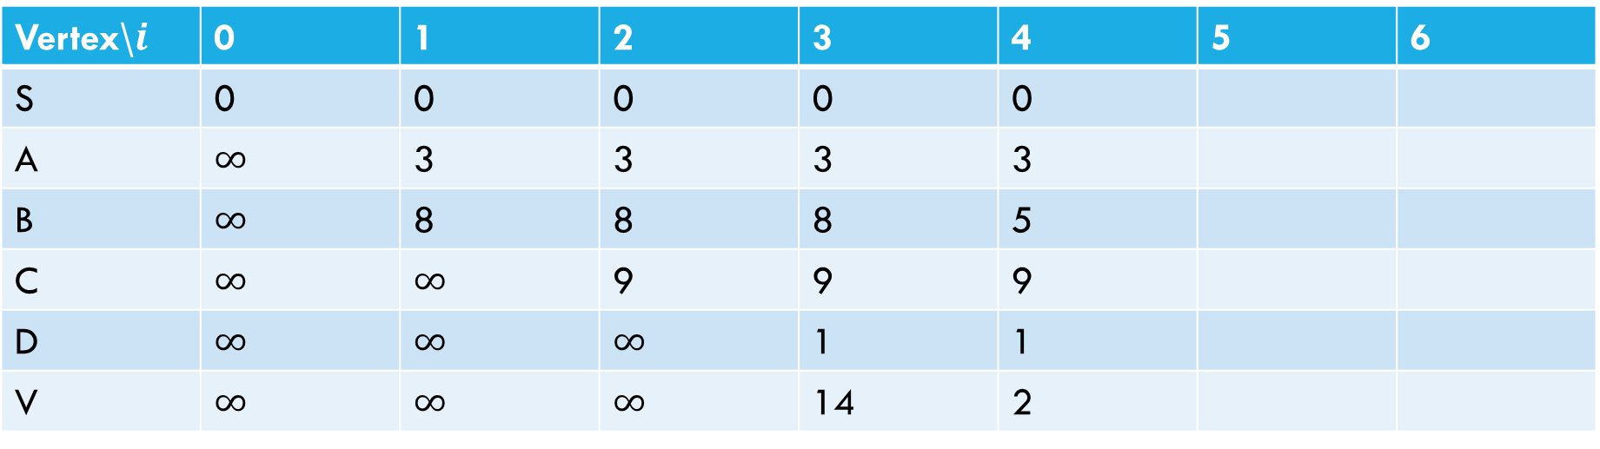
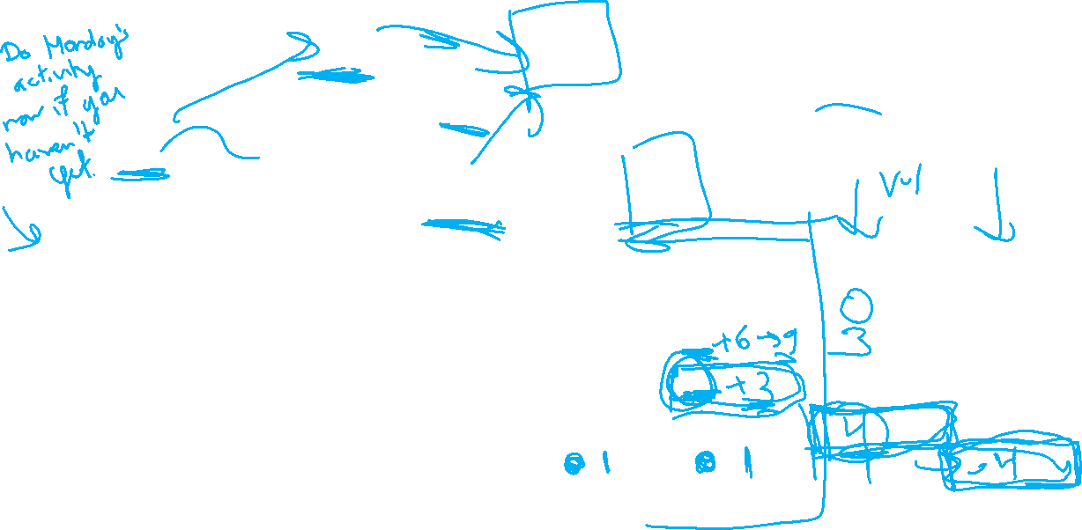

Negative Cycle
Fill out the poll everywhere for Activity Credit!
Go to pollev.com/cse417 and login with your UW identity
6
a
5
3
c
v
3
-8
s
1
8
b
d
4
Vertex\$i$ | 0 | 1 | 2 | 3 | 4 | 5 | 6
S | 0 | 0 | 0 | 0 | 0
A | $∞$ | 3 | 3 | 3 | 3
B | $∞$ | 8 | 8 | 8 | 5
C | $∞$ | $∞$ | 9 | 9 | 9
D | $∞$ | $∞$ | $∞$ | 1 | 1
V | $∞$ | $∞$ | $∞$ | 14 | 2

Slide 3
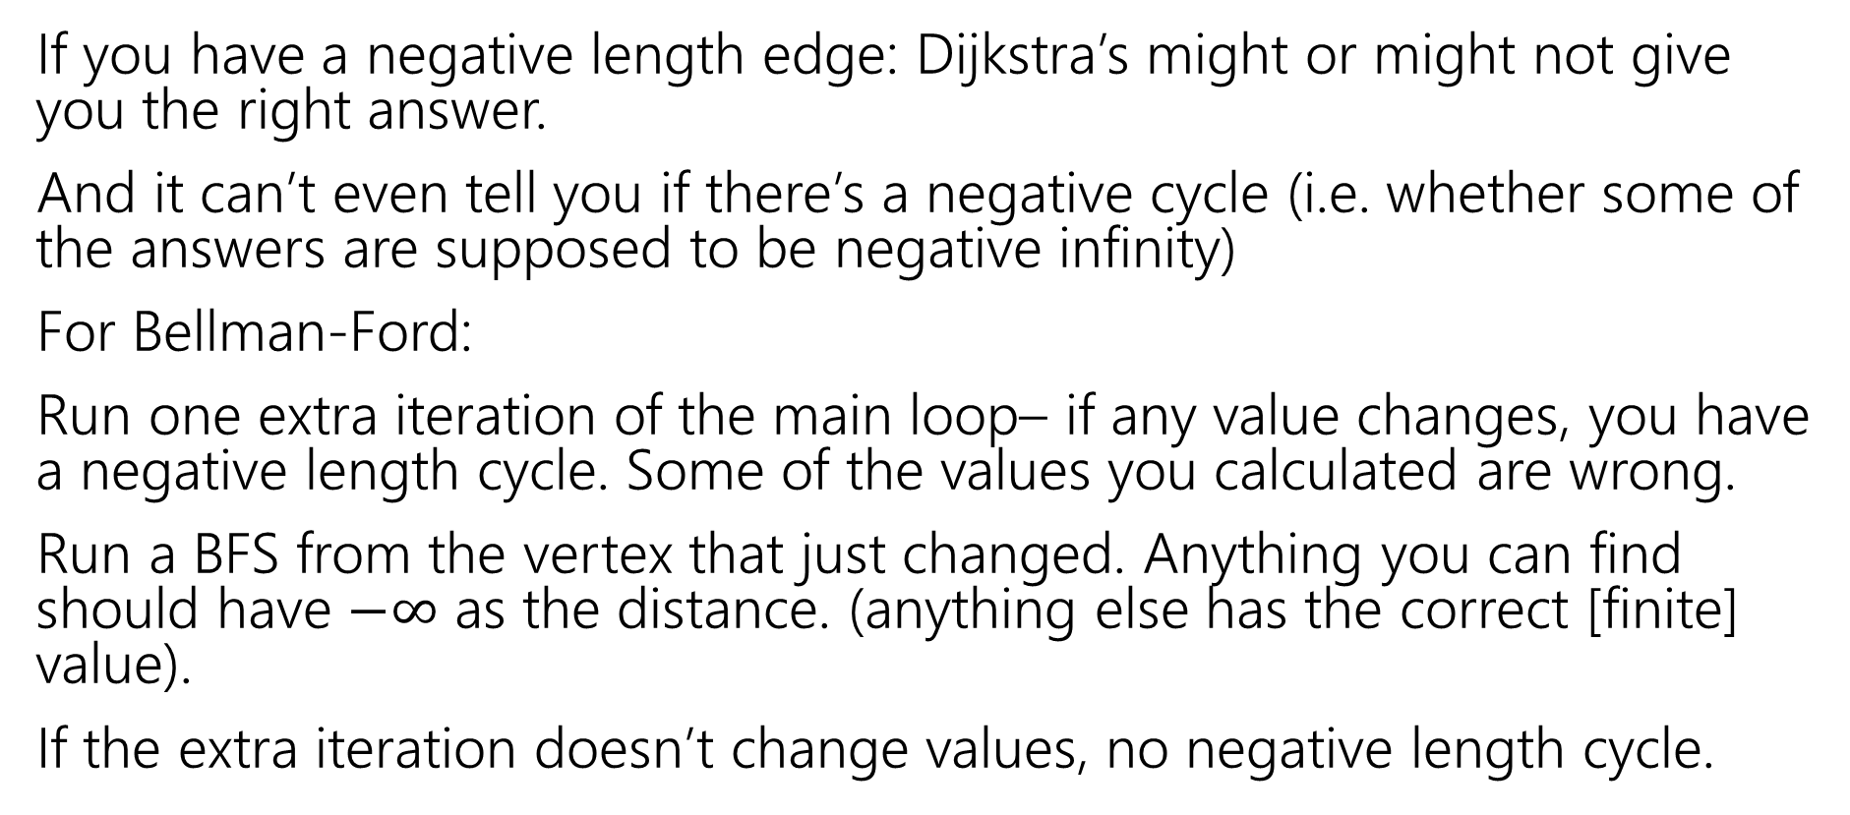
Negative Cycles
If you have a negative length edge: Dijkstra’s might or might not give you the right answer.
And it can’t even tell you if there’s a negative cycle (i.e. whether some of the answers are supposed to be negative infinity)
For Bellman-Ford:
Run one extra iteration of the main loop– if any value changes, you have a negative length cycle. Some of the values you calculated are wrong.
Run a BFS from the vertex that just changed. Anything you can find should have $−∞$ as the distance. (anything else has the correct [finite] value).
If the extra iteration doesn’t change values, no negative length cycle.

Slide 4
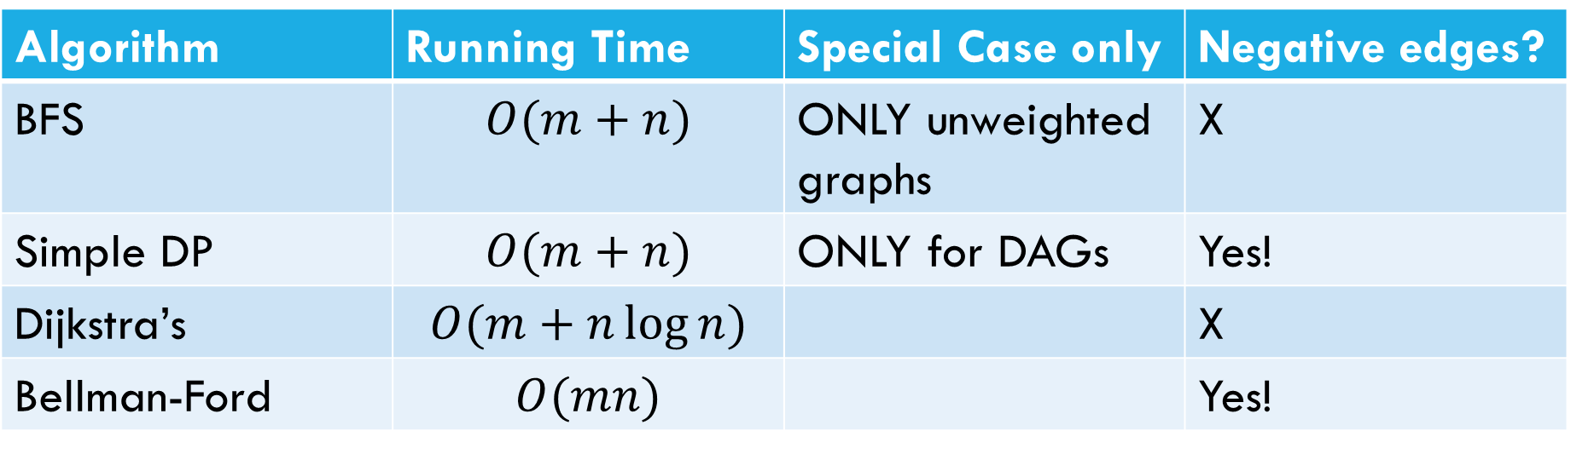
Laundry List of shortest pairs (so far)
Algorithm | Running Time | Special Case only | Negative edges?
BFS | $$O(m+n)$$ | ONLY unweighted graphs | X
Simple DP | $$O(m+n)$$ | ONLY for DAGs | Yes!
Dijkstra’s | $$O(m+n\log{n)}$$ |  | X
Bellman-Ford | $$O(mn)$$ |  | Yes!

Slide 5
All Pairs Shortest Paths

Slide 6
All Pairs
For Dijkstra’s or Bellman-Ford we got the distances from the source to every vertex.
What if we want the distances from every vertex to every other vertex?
Why? Most commonly pre-computation.
Imagine you’re google maps – you could run Dijkstra’s every time anyone anywhere asks for directions…
Or store how to get between transit hubs and only use Dijkstra’s locally.

Slide 7
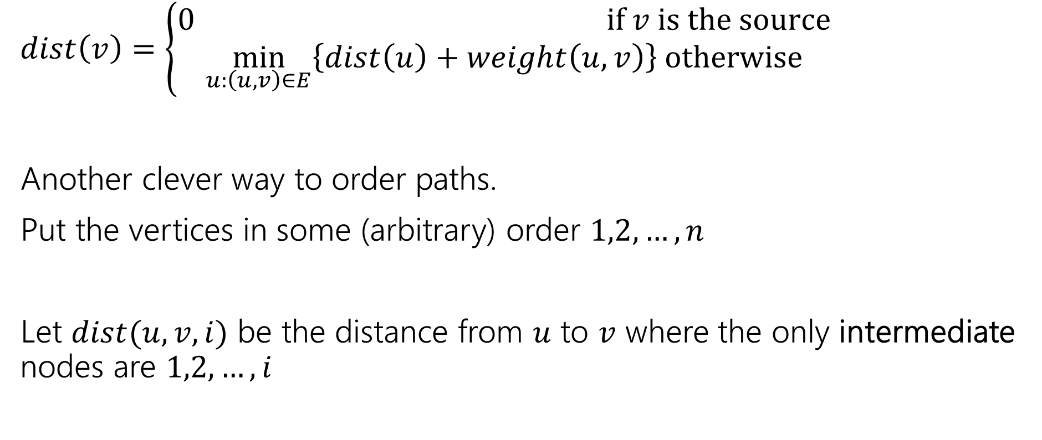
Another Recurrence
$dist\left(v\right)=\left\{\begin{aligned}0 if v is the source \\ \min_{u:\left(u,v\right)∈E}\left\{dist\left(u\right)+weight\left(u,v\right)\right\} otherwise\end{aligned}\right.$
Another clever way to order paths.
Put the vertices in some (arbitrary) order $1,2,…,n$
Let $dist(u,v,i)$ be the distance from $u$ to $v$ where the only intermediate nodes are $1,2,…,i$

Slide 8
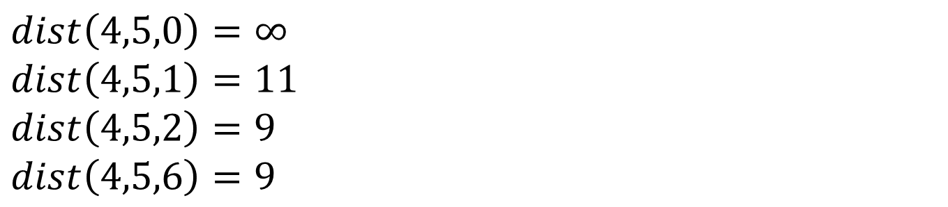
$dist(u,v,i)$
6
4
5
3
1
5
3
2
3
1
8
6
2
4
$dist\left(4,5,0\right)=∞$
$dist\left(4,5,1\right)=11$
$dist\left(4,5,2\right)=9$
$dist\left(4,5,6\right)=9$

Slide 9
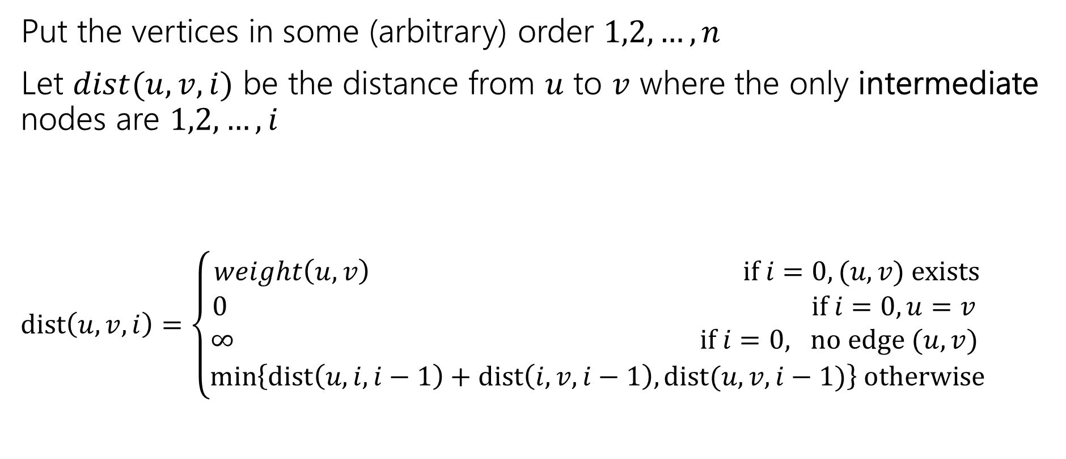
Another Recurrence
Put the vertices in some (arbitrary) order $1,2,…,n$
Let $dist(u,v,i)$ be the distance from $u$ to $v$ where the only intermediate nodes are $1,2,…,i$
$dist\left(u,v,i\right)=\left\{\begin{aligned}weight\left(u,v\right) if i=0, (u,v) exists \\ 0 if i=0, u=v \\ ∞ if i=0, no edge (u,v) \\ \min\left\{dist\left(u,i,i−1\right)+dist\left(i,v,i−1\right), dist(u,v,i−1)\right\} otherwise\end{aligned}\right.$

Slide 10

Pseudocode
dist[][] = new int[n-1][n-1]
for(int i=0; i<n; i++)
for(int j=0; j<n; j++)
dist[i][j] = edge(i,j) ? weight(i,j) : $∞$
for(int i=0; i<n; i++)
dist[i][i] = 0
for every vertex $r$
for every vertex $u$
for every vertex $v$
if(dist[u][r] + dist[r][v] < dist[u][v])
  dist[u][v]=dist[u][r] + dist[r][v]
“standard” form of the “Floyd-Warshall” algorithm. Similar to Bellman-Ford, you can get rid of the last entry of the recurrence (only need 2D array, not 3D array).

Slide 11

Running Time
$O\left(n^{3}\right)$
How does that compare to Dijkstra’s?

Slide 12
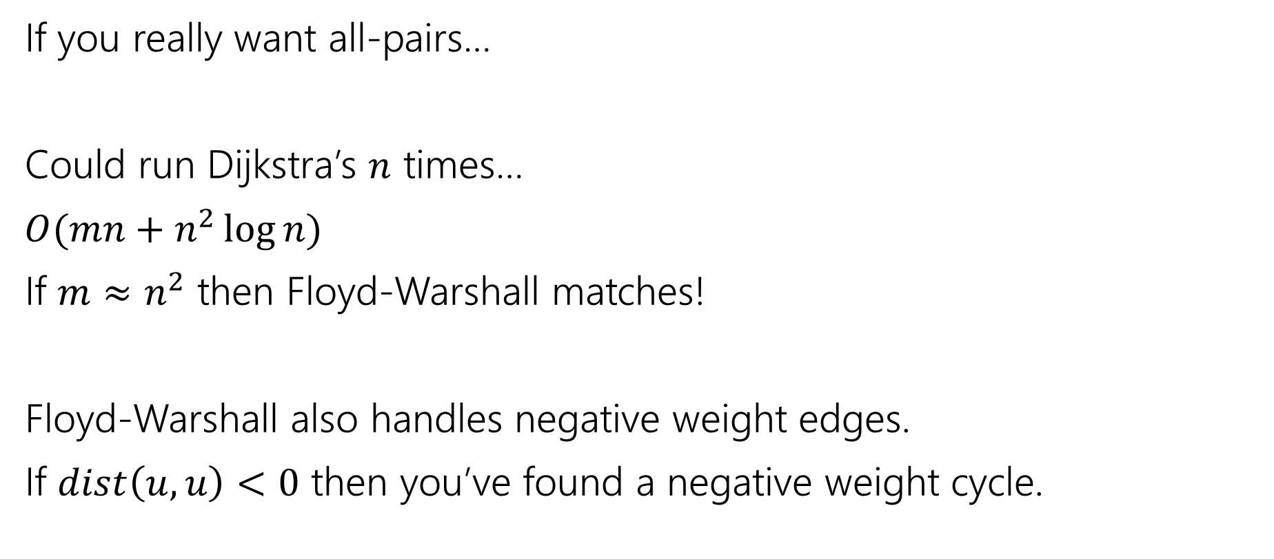
Running Time
If you really want all-pairs…
Could run Dijkstra’s $n$ times…
$O(mn+n^{2}\log{n})$
If $m≈n^{2}$ then Floyd-Warshall matches!
Floyd-Warshall also handles negative weight edges.
If $dist\left(u,u\right)<0$ then you’ve found a negative weight cycle.

Slide 13
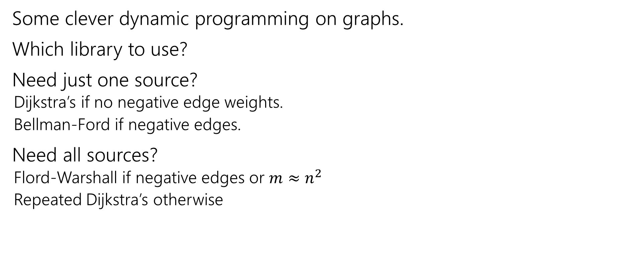
Takeaways
Some clever dynamic programming on graphs.
Which library to use?
Need just one source?
  Dijkstra’s if no negative edge weights.
  Bellman-Ford if negative edges.
Need all sources?
  Flord-Warshall if negative edges or $m≈n^{2}$
  Repeated Dijkstra’s otherwise

Slide 14
Linear Programming

Slide 15
Linear Programming
Used WIDELY in business and operations research.
Excel has a linear program solver.
A very expressive language for problem-solving
Can represent a wide-variety of problems, including some we’ve already seen.
Deep, beautiful theory…that we do not have time to cover.

Slide 16
Outline of rest of the week
What is a linear program?
A simple example LP
Computational Issues
An application – Vertex Cover on trees (again)
In a few weeks, we’ll return to LPs as a method of approximating NP-hard problems.

Slide 17
Example Problem
You’re laying down soil for a bunch of new gardens. You got a few big piles of soil delivered (more than enough to cover the gardens)
$1.5/unit
1.5
$2/unit
7
5
$4/unit
$4/unit
10
$1.5/unit
$3/unit
$8/unit
4
$2/unit
2.5
3
$4.5/unit

Slide 18
Example Problem
What variables should we use?
$1.5/unit
1.5
$2/unit
7
5
$4/unit
$4/unit
10
$1.5/unit
$3/unit
$8/unit
4
$2/unit
2.5
3
$4.5/unit

Slide 19

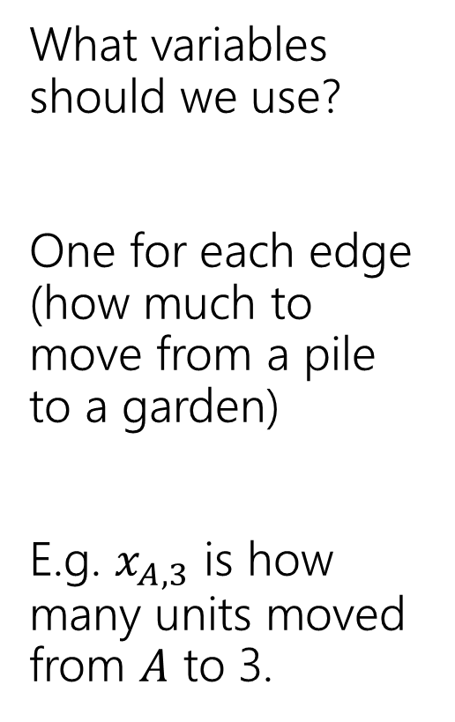
Example Problem
What variables should we use?
One for each edge (how much to move from a pile to a garden)
E.g. $x_{A,3}$ is how many units moved from $A$ to 3.
3
$$x_{A,3}$$
$1.5/unit
1.5
A
$2/unit
7
5
C
$4/unit
$4/unit
2
10
$1.5/unit
$3/unit
$8/unit
4
4
$2/unit
2.5
1
3
B
$4.5/unit

Slide 20
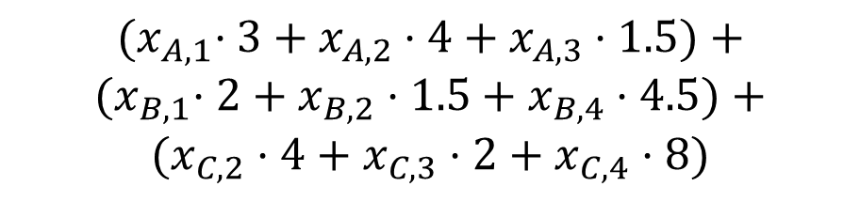
Example Problem
$${(x}_{A,1}⋅3+x_{A,2}⋅4+x_{A,3}⋅1.5)+$$
$${(x}_{B,1}⋅2+x_{B,2}⋅1.5+x_{B,4}⋅4.5)+$$
$$(x_{C,2}⋅4+x_{C,3}⋅2+x_{C,4}⋅8)$$
What’s the cost (in terms of the variables)?
Sum cost*var for all the variables
3
$$x_{A,3}$$
$1.5/unit
1.5
A
$2/unit
7
5
C
$4/unit
$4/unit
2
10
$1.5/unit
$3/unit
$8/unit
4
4
$2/unit
2.5
1
3
B
$4.5/unit

Slide 21
Example Problem
What constraints are there on the variables?
3
$$x_{A,3}$$
$1.5/unit
1.5
A
$2/unit
7
5
C
$4/unit
$4/unit
2
10
$1.5/unit
$3/unit
$8/unit
4
4
$2/unit
2.5
1
3
B
$4.5/unit

Slide 22
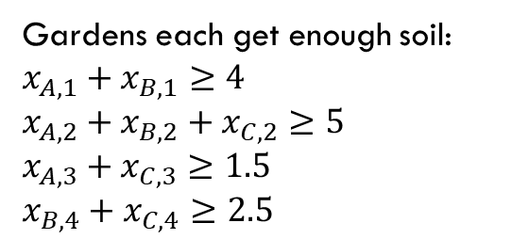
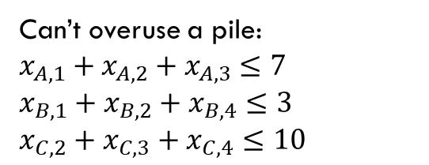
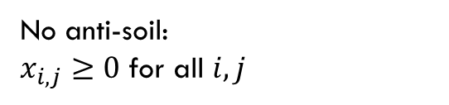
Example Problem
Gardens each get enough soil:
$x_{A,1}+x_{B,1}≥4$
$x_{A,2}+x_{B,2}+x_{C,2}≥5$
$x_{A,3}+x_{C,3}≥1.5$
$x_{B,4}+x_{C,4}≥2.5$
No anti-soil:
$x_{i,j}≥0$ for all $i,j$
What constraints are there on the variables?
Can’t overuse a pile:
$x_{A,1}+x_{A,2}+x_{A,3}≤7$
$x_{B,1}+x_{B,2}+x_{B,4}≤3$
$x_{C,2}+x_{C,3}+x_{C,4}≤10$
3
$$x_{A,3}$$
$1.5/unit
1.5
A
$2/unit
7
5
C
$4/unit
$4/unit
2
10
$1.5/unit
$3/unit
$8/unit
4
4
$2/unit
2.5
1
3
B
$4.5/unit

Slide 23

Full Definition
Minimize: ${(x}_{A,1}⋅3+x_{A,2}⋅4+x_{A,3}⋅1.5)+{(x}_{B,1}⋅2+x_{B,2}⋅1.5+x_{B,4}⋅4.5)+(x_{C,2}⋅4+x_{C,3}⋅2+x_{C,4}⋅8)$
Subject To:
$x_{A,1}+x_{B,1}≥4$
$x_{A,2}+x_{B,2}+x_{C,2}≥5$
$x_{A,3}+x_{C,3}≥1.5$
$x_{B,4}+x_{C,4}≥2.5$
$x_{A,1}+x_{A,2}+x_{A,3}≤7$
$x_{B,1}+x_{B,2}+x_{B,4}≤3$
$x_{C,2}+x_{C,3}+x_{C,4}≤10$
$x_{i,j}≥0$ for all $i,j$

Slide 24


A Linear Program
A linear program is defined by:
Real-valued variables
Subject to a list of linear constraints
Maximizing or minimizing a linear objective function
A linear constraint is a statement of the form: $∑a_{i}x_{i}≤c_{i}$
where $a_{i}$ are constants, the $x_{i}$ are variables and $c_{i}$ is a constant.
A linear objective function is a function of the form: $∑b_{i}x_{i}$
where $b_{i}$ are constants and the $x_{i}$ are variables.

Slide 25

Linear constraints
Fill out the poll everywhere for Activity Credit!
Go to pollev.com/cse417 and login with your UW identity
Can you write each of these requirements as linear constraint(s)?
Some of these are tricks…
$x_{i}$ times $x_{j}$ is at least $5$
${5x}_{i}$ is equal to $1$
$x_{i}≤5$ OR $x_{i}≥7$
$x_{i}$ is non-negative.
$x_{i}$ is an integer.

Slide 26
Linear constraints
Fill out the poll everywhere for Activity Credit!
Go to pollev.com/cse417 and login with your UW identity
Can you write each of these requirements as linear constraint(s)?
Some of these are tricks…
$x_{i}$ times $x_{j}$ is at least $5$
${5x}_{i}$ is equal to $1$
$x_{i}≤5$ OR $x_{i}≥7$
$x_{i}$ is non-negative.
$x_{i}$ is an integer.

Slide 27
What are we looking for?
A solution (or point) is a setting of all the variables
A feasible point is a point that satisfies all the constraints.
An optimal point is a point that is feasible and has at least as good of an objective value as every other feasible point.

Slide 28
Example Problem
Gardens each get enough soil:
$x_{A,1}+x_{B,1}≥4$
$x_{A,2}+x_{B,2}+x_{C,2}≥5$
$x_{A,3}+x_{C,3}≥1.5$
$x_{B,4}+x_{C,4}≥2.5$
No anti-soil:
$x_{i,j}≥0$ for all $i,j$
Can’t overuse a pile:
$x_{A,1}+x_{A,2}+x_{A,3}≤7$
$x_{B,1}+x_{B,2}+x_{B,4}≤3$
$x_{C,2}+x_{C,3}+x_{C,4}≤10$
3
A
$1.5/unit
1.5
1.5
A feasible point.
Objective: 55
$2/unit
7
5
5
C
$4/unit
$4/unit
2
10
$1.5/unit
$3/unit
2.5
$8/unit
4
4
4
$2/unit
2.5
1
3
B
$4.5/unit

Slide 29
Example Problem
Gardens each get enough soil:
$x_{A,1}+x_{B,1}≥4$
$x_{A,2}+x_{B,2}+x_{C,2}≥5$
$x_{A,3}+x_{C,3}≥1.5$
$x_{B,4}+x_{C,4}≥2.5$
No anti-soil:
$x_{i,j}≥0$ for all $i,j$
Can’t overuse a pile:
$x_{A,1}+x_{A,2}+x_{A,3}≤7$
$x_{B,1}+x_{B,2}+x_{B,4}≤3$
$x_{C,2}+x_{C,3}+x_{C,4}≤10$
3
1.5
$1.5/unit
1.5
A
A feasible point.
Objective: 44.25
$2/unit
7
5
C
$4/unit
$4/unit
2
10
0.5
4.5
This is an optimal point. There are others!
$1.5/unit
$3/unit
$8/unit
4
4
4
$2/unit
2.5
2.5
1
3
B
$4.5/unit

Slide 30
Another Question
Change the problem
Instead of infinitely divisible dirt…
What if instead we’re moving whole unit things (the dirt is in bags we can’t open or we’re moving bikes or plants or anything else that can’t be split)
Well, the constraints will change (your “demand” and “supplies” will be integers)

Slide 31
Non-Integrality
Some linear programs have optimal solutions that have some (or all) variables as non-integers (even with only integers in the objective function and constraints) .
For dirt or water or anything arbitrarily divisible, no big deal!
For cell phones or bicycles…possibly a big deal! (also possibly not!)

Slide 32
What do you do if you need integers?
Integer Programs are linear programs where you can mark some variables as needing to be integers.
In practice – often still solvable (Excel also has a solver for these problems). But no longer guaranteed to be efficient.
And “just rounding” an LP answer often gets you really close.
In theory – lots of theory has been done for when the best answer will be an integer
But sometimes there’s just not a lot to be done…

Slide 33
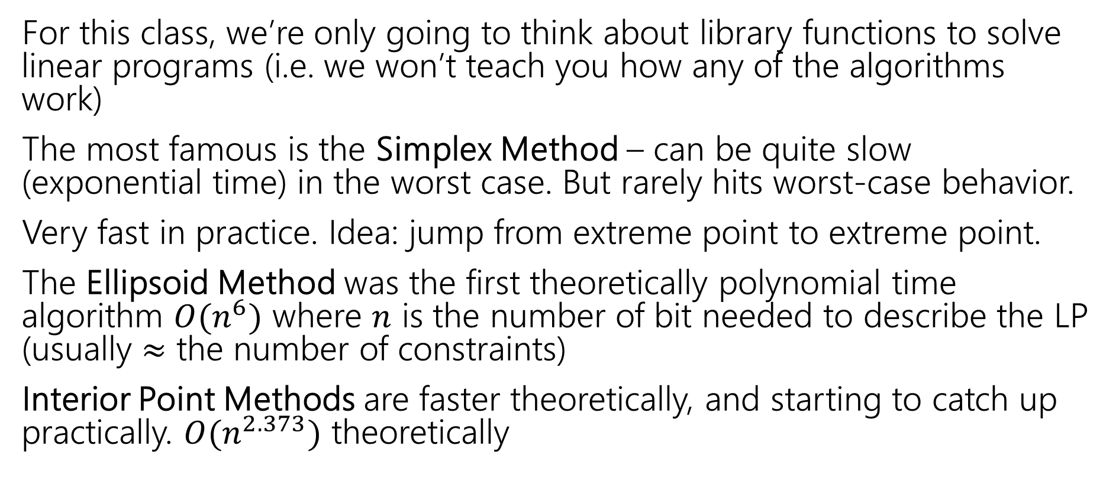
Solving LPs
For this class, we’re only going to think about library functions to solve linear programs (i.e. we won’t teach you how any of the algorithms work)
The most famous is the Simplex Method – can be quite slow (exponential time) in the worst case. But rarely hits worst-case behavior.
Very fast in practice. Idea: jump from extreme point to extreme point.
The Ellipsoid Method was the first theoretically polynomial time algorithm $O(n^{6})$ where $n$ is the number of bit needed to describe the LP (usually $≈$ the number of constraints)
Interior Point Methods are faster theoretically, and starting to catch up practically. $O(n^{2.373})$ theoretically

Slide 34
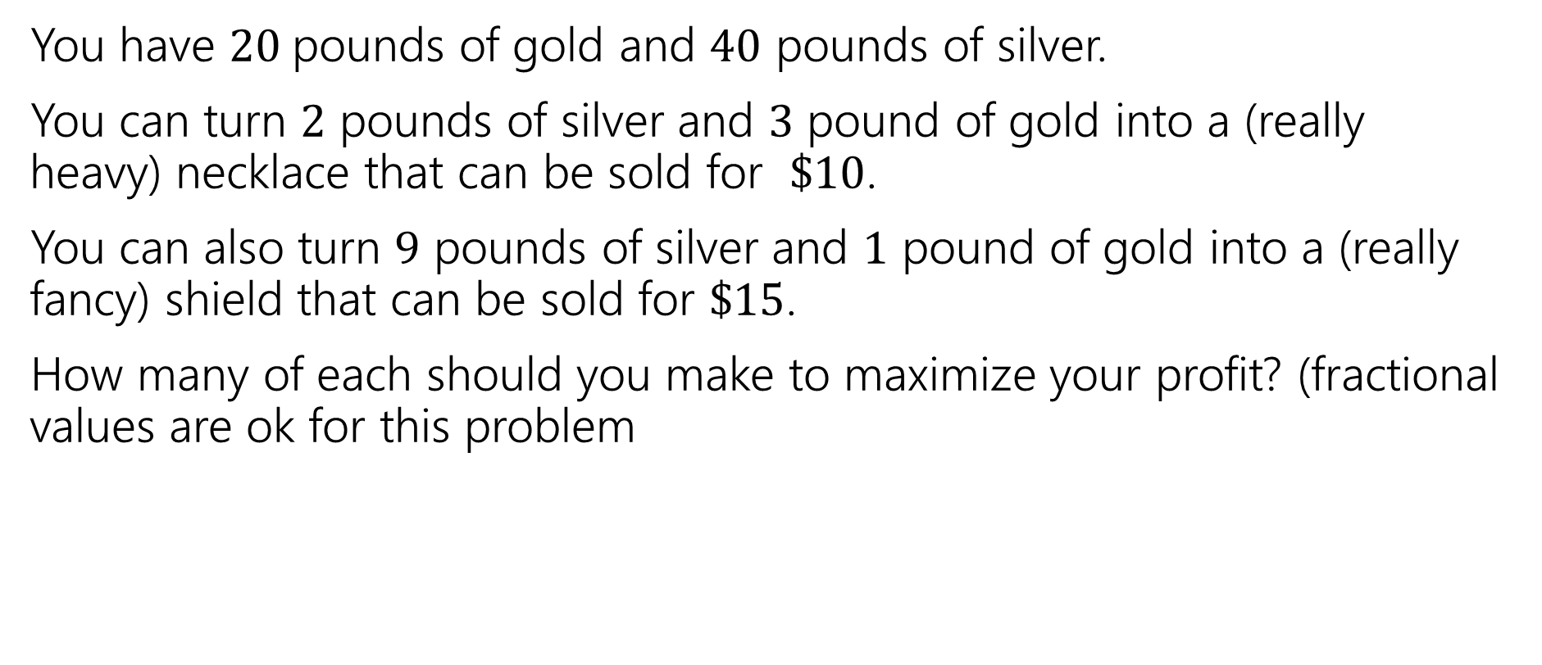
Extra Practice
You have $20$pounds of gold and $40$ pounds of silver.
You can turn $2$ pounds of silver and $3$ pound of gold into a (really heavy) necklace that can be sold for $\$10$.
You can also turn $9$ pounds of silver and $1$ pound of gold into a (really fancy) shield that can be sold for $\$15$.
How many of each should you make to maximize your profit? (fractional values are ok for this problem

Slide 35
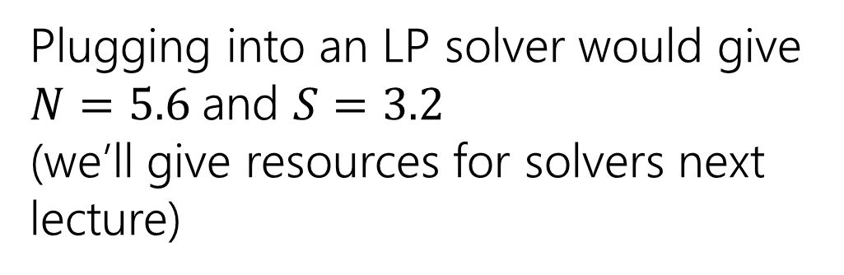
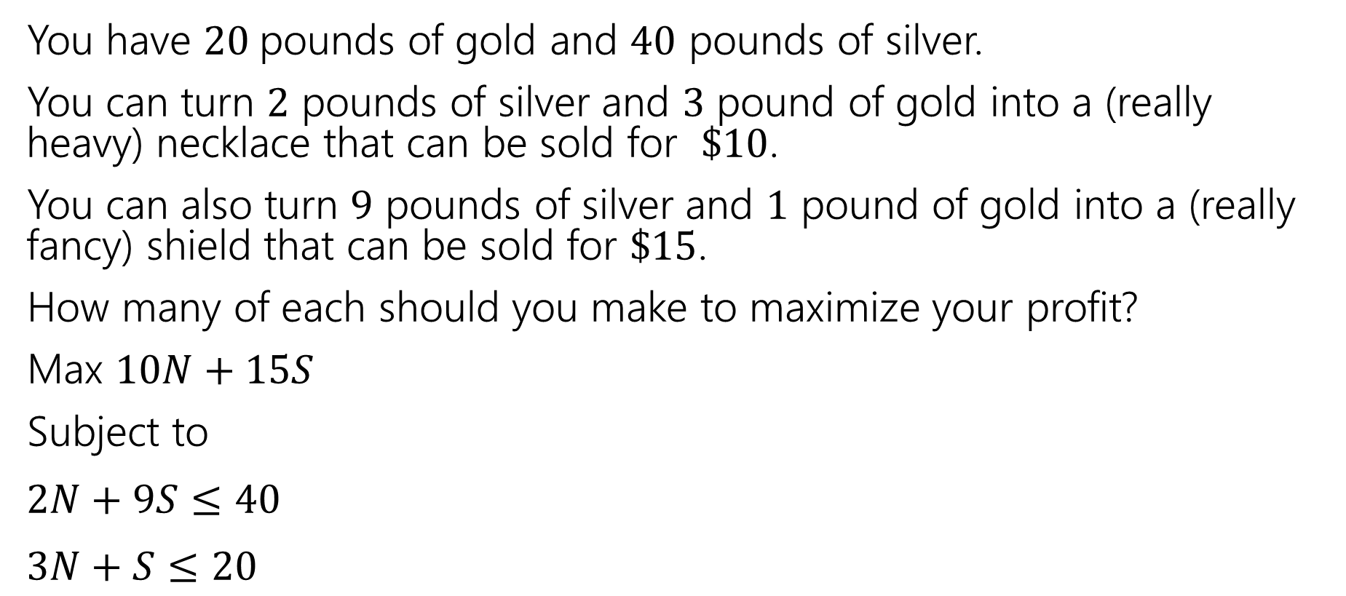
Extra Practice
You have $20$pounds of gold and $40$ pounds of silver.
You can turn $2$ pounds of silver and $3$ pound of gold into a (really heavy) necklace that can be sold for $\$10$.
You can also turn $9$ pounds of silver and $1$ pound of gold into a (really fancy) shield that can be sold for $\$15$.
How many of each should you make to maximize your profit?
Max $10N+15S$
Subject to
$2N+9S≤40$
$3N+S≤20$
Plugging into an LP solver would give $N=5.6$and $S=3.2$
(we’ll give resources for solvers next lecture)

