Slide 1
More Dynamic Programming
CSE 417 Winter 21
Lecture 12

Slide 2
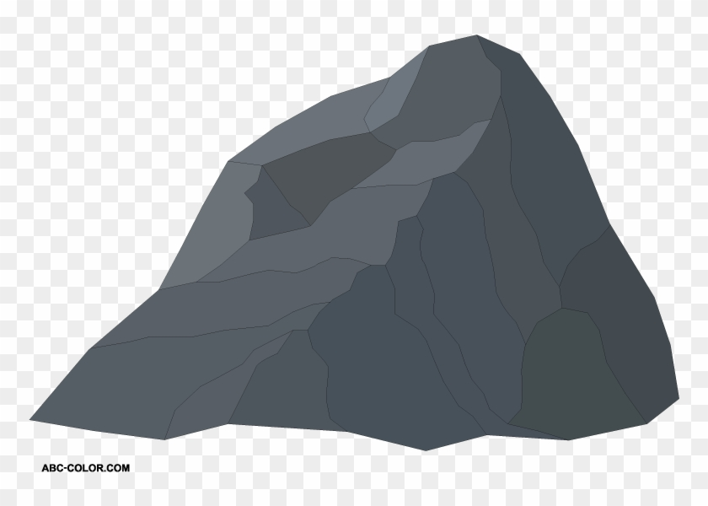
Baby Yoda Searching
Baby Yoda has to get from the upper-right corner to the lower left.
His cradle will only let him go left and down.
He can’t get past the rocks (too high) – he has to go around them (but still only going left and down)
As usual…he’s hungry.
He wants to eat as many frog eggs as possible on the way.

Slide 3
A Recursive Function
FindOPT(int i,int j, bool[][] rocks, bool[][] eggs)
if(i<0 || j < 0) return -$∞$
if(rocks[i][j]) return $−∞$
if(i==0 && j==0) return eggs[0][0]
int left = FindOPT(i-1,j,rocks,eggs)
int down = FindOPT(i,j-1,rocks,eggs)
return Max(left,down) + eggs[i][j]

Slide 4
Recurrence Form
$$OPT\left(i,j\right)=\left\{\begin{aligned}−∞ if rocks\left(i,j\right) is true \\ −∞ if i<0 or j<0 \\ eggs\left(0,0\right) if i=0 and j=0 \\ \max\left\{OPT\left(i−1,j\right), OPT\left(i,j−1\right)\right\}+eggs\left(i,j\right) otherwise\end{aligned}\right.$$
Recurrences can also be used for outputs of a recursive function (not just their running times!)
This definition is a little more compact than code.
And you could write a recursive function for a recurrence like this.

Slide 5
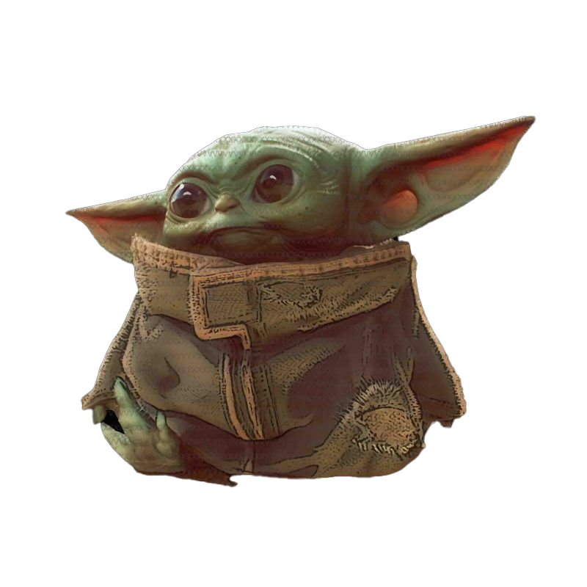
Baby Yoda Searching
(c-1,r-1)
$$1$$ | $$1$$ | $$1$$ | $$2$$ | $$3$$ | $$4$$ | $$4$$ | $$4$$
$$1$$ | $$1$$ | $$1$$ | $$2$$ | $$3$$ | $$4$$ | $$4$$ | $$4$$
$$0$$ | $$0$$ | $$1$$ | $$2$$ | $$3$$ | $$3$$ | $$3$$ | $$3$$
 |  |  | $$−∞$$ | $$3$$ | $$3$$ | $$3$$ | $$3$$
r-1
Where’s the final answer?
In the top right. Where Baby Yoda starts.
Y-coordinate
$$0$$
$$−∞$$
$$−∞$$
$$0$$
$$1$$
$$−∞$$
$$2$$
$$2$$
$$2$$
$$2$$
$$2$$
0
$$0$$
$$1$$
$$2$$
$$2$$
$$2$$
$$2$$
$$2$$
$$2$$
X-coordinate
0
c-1
Notes:
https://1.bp.blogspot.com/-XxfNI65zLnU/Xc98O96LVnI/AAAAAAAAGFY/Xsmd7IMlIrEltYONCdGKk1hqPw1BgL3ggCLcBGAsYHQ/s1600/Mandalorian.jpg
http://www.pngmart.com/image/161116/png/161115
https://www.pikpng.com/pngvi/hiTxbbR_clip-art-rock-rock-clipart-transparent-background-png-download/

Slide 6
Pseudocode
int eggsSoFar=0;
Boolean rocksInWay=false
for(int x=0; x<c; x++)
if(rocks[x][0]) rocksInWay = true
eggsSoFar+=eggs[x][0]
OPT[x][0]= rocksInWay ? $−∞$: eggsSoFar
eggsSoFar=0
rocksInWay=false
for(int y=0; y<r; y++)
eggsSoFar+=eggs[0][y]
OPT[0][y]= rocksInWay ? $−∞$ : eggsSoFar
for(int y=0;y<r;y++)
for(int x=0;x<c;x++)
if(rocks[x][y])
OPT[x][y]=-$∞$
else
OPT[x][y]=max(OPT[x-1][y], OPT[x][y-1])+eggs[x][y]

Slide 7
Updating the Problem
A new twist on the problem.
Baby Yoda can use the force to knock over rocks.
But he can only do it once (he tires out)
How do you decide which rocks to knock over?
Could run the algorithm once for every set of rocks knocked over.
$k$ rocks -- $Θ(krc)$. Can we do better?

Slide 8
Updating the Problem
$OPT\left(i,j,f\right)$ is the maximum amount of eggs Baby Yoda can collect on a legal path from $(i,j)$ to $(0,0)$ using the force $f$ times to knock over rocks.
For simplicity, assume there are no rocks at the starting location (r-1,c-1)
Here was the old rule without the force – how do we update?
$OPT\left(i,j\right)=\left\{\begin{aligned}−∞ if rocks\left(i,j\right) is true \\ −∞ if i<0 or j<0 \\ eggs\left(0,0\right) if i=0 and j=0 \\ \max\left\{OPT\left(i−1,j\right), OPT\left(i,j−1\right)\right\}+eggs\left(i,j\right) otherwise\end{aligned}\right.$

Slide 9
Updating the Problem
$OPT\left(i,j,f\right)$ is the maximum amount of eggs Baby Yoda can collect on a legal path from $(i,j)$ to $(0,0)$ using the force $f$ times to knock over rocks.
For simplicity, assume there are no rocks at the starting location (r-1,c-1)
Here was the old rule without the force – how do we update?
$OPT\left(i,j,f\right)=\left\{\begin{aligned} \\ −∞ if i<0 or j<0 or f<0 \\ eggs\left(0,0\right) if i=0 and j=0 and f≥0 \\ \max\left\{OPT\left(i−1,j,f−rocks(i−1,j)\right), OPT\left(i,j−1,f−rocks(i,j−1)\right) \right\}+eggs\left(i,j\right) otherwise\end{aligned}\right.$
Casting Boolean as an integer
(subtract 1 if you would need to knock over rocks)

Slide 10
Updating the Problem
$OPT\left(i,j,f\right)$ is the maximum amount of eggs Baby Yoda can collect on a legal path from $(i,j)$ to $(0,0)$ using the force $f$ times to knock over rocks.
For simplicity, assume there are no rocks at the starting location (r-1,c-1)
Here was the old rule without the force – how do we update?
$OPT\left(i,j,f\right)=\left\{\begin{aligned} \\ −∞ if i<0 or j<0 or f<0 \\ eggs\left(0,0\right) if i=0 and j=0 and f≥0 \\ \max\left\{OPT\left(i−1,j,f−rocks(i−1,j)\right), OPT\left(i,j−1,f−rocks(i,j−1)\right) \right\}+eggs\left(i,j\right) otherwise\end{aligned}\right.$
rocks(i,j) doesn’t guarantee $−∞$ anymore. Only if you were out of force uses before trying to jump onto that location.

Slide 11
Baby Yoda Searching
(c-1,r-1)
r-1
What can we fill in?
Y-coordinate
$$a/b$$
$a$ is for (x,y,0) $b$ is for (x,y,1)
0
X-coordinate
0
c-1
Notes:
https://1.bp.blogspot.com/-XxfNI65zLnU/Xc98O96LVnI/AAAAAAAAGFY/Xsmd7IMlIrEltYONCdGKk1hqPw1BgL3ggCLcBGAsYHQ/s1600/Mandalorian.jpg
http://www.pngmart.com/image/161116/png/161115
https://www.pikpng.com/pngvi/hiTxbbR_clip-art-rock-rock-clipart-transparent-background-png-download/

Slide 12
Baby Yoda Searching
(c-1,r-1)
r-1
What can we fill in?
Y-coordinate
$$a/b$$
$a$ is for (x,y,0) $b$ is for (x,y,1)
0
$$0/?$$
$$1/?$$
$$2/?$$
$$2/?$$
$$2/?$$
$$2/?$$
$$2/?$$
$$2/?$$
X-coordinate
0
c-1
Notes:
https://1.bp.blogspot.com/-XxfNI65zLnU/Xc98O96LVnI/AAAAAAAAGFY/Xsmd7IMlIrEltYONCdGKk1hqPw1BgL3ggCLcBGAsYHQ/s1600/Mandalorian.jpg
http://www.pngmart.com/image/161116/png/161115
https://www.pikpng.com/pngvi/hiTxbbR_clip-art-rock-rock-clipart-transparent-background-png-download/

Slide 13
Baby Yoda Searching
(c-1,r-1)
$$1/?$$ | $$1/?$$ | $$1/?$$ | $$1/?$$ | $$3/?$$ | $$4/?$$ | $$4/?$$ | $$4/?$$
$$1/?$$ | $$1/?$$ | $$1/?$$ | $$1/?$$ | $$3/?$$ | $$4/?$$ | $$4/?$$ | $$4/?$$
$$0/?$$ | $$0/?$$ | $$1/?$$ | $$1/?$$ | $$3/?$$ | $$3/?$$ | $$3/?$$ | $$3/?$$
 |  |  | $2/?$ | $$3/?$$ | $$3/?$$ | $$3/?$$ | $$3/?$$
r-1
What can we fill in?
Everything with $f=0$ in the same order as before.
Y-coordinate
$$0/?$$
$$1/?$$
$$−∞/?$$
$$0/?$$
$$1/?$$
$$2/?$$
$$2/?$$
$$2/?$$
$$2/?$$
$$2/?$$
$$2/?$$
0
$$0/?$$
$$1/?$$
$$2/?$$
$$2/?$$
$$2/?$$
$$2/?$$
$$2/?$$
$$2/?$$
Entries are slightly different – we’re handling rocks differently.
X-coordinate
0
c-1
Notes:
https://1.bp.blogspot.com/-XxfNI65zLnU/Xc98O96LVnI/AAAAAAAAGFY/Xsmd7IMlIrEltYONCdGKk1hqPw1BgL3ggCLcBGAsYHQ/s1600/Mandalorian.jpg
http://www.pngmart.com/image/161116/png/161115
https://www.pikpng.com/pngvi/hiTxbbR_clip-art-rock-rock-clipart-transparent-background-png-download/

Slide 14
Baby Yoda Searching
(c-1,r-1)
$$1/?$$ | $$1/?$$ | $$1/?$$ | $$1/?$$ | $$3/?$$ | $$4/?$$ | $$4/?$$ | $$4/?$$
$$1/?$$ | $$1/?$$ | $$1/?$$ | $$1/?$$ | $$3/?$$ | $$4/?$$ | $$4/?$$ | $$4/?$$
$$0/?$$ | $$0/?$$ | $$1/?$$ | $$1/?$$ | $$3/?$$ | $$3/?$$ | $$3/?$$ | $$3/?$$
 |  |  | $2/?$ | $$3/?$$ | $$3/?$$ | $$3/?$$ | $$3/?$$
r-1
What can we fill in?
Again from left to right, bottom to top, now filling in
Y-coordinate
$$0/?$$
$$1/?$$
$$−∞/?$$
$$0/?$$
$$1/?$$
$$2/?$$
$$2/?$$
$$2/?$$
$$2/?$$
$$2/?$$
$$2/?$$
0
$$0/?$$
$$1/?$$
$$2/?$$
$$2/?$$
$$2/?$$
$$2/?$$
$$2/?$$
$$2/?$$
X-coordinate
0
c-1
Notes:
https://1.bp.blogspot.com/-XxfNI65zLnU/Xc98O96LVnI/AAAAAAAAGFY/Xsmd7IMlIrEltYONCdGKk1hqPw1BgL3ggCLcBGAsYHQ/s1600/Mandalorian.jpg
http://www.pngmart.com/image/161116/png/161115
https://www.pikpng.com/pngvi/hiTxbbR_clip-art-rock-rock-clipart-transparent-background-png-download/

Slide 15
Baby Yoda Searching
(c-1,r-1)
$$1/1$$ | $$1/1$$ | $$1/4$$ | $$1/4$$ | $$3/4$$ | $$4/5$$ | $$4/5$$ | $$4/5$$
$$1/1$$ | $$1/1$$ | $$1/4$$ | $$1/4$$ | $$3/4$$ | $$4/5$$ | $$4/5$$ | $$4/5$$
$$0/0$$ | $$0/0$$ | $$1/4$$ | $$1/4$$ | $$3/4$$ | $$3/4$$ | $$3/4$$ | $$3/4$$
 |  |  | $2/3$ | $$3/3$$ | $$3/3$$ | $$3/3$$ | $$3/3$$
r-1
What can we fill in?
Again from left to right, bottom to top, now filling in
Y-coordinate
$$0/0$$
$$1/1$$
$$−∞/3$$
$$0/0$$
$$1/1$$
$$2/2$$
$$2/2$$
$$2/2$$
$$2/2$$
$$2/2$$
$$2/2$$
0
$$0/0$$
$$1/1$$
$$2/2$$
$$2/2$$
$$2/2$$
$$2/2$$
$$2/2$$
$$2/2$$
X-coordinate
0
c-1
Notes:
https://1.bp.blogspot.com/-XxfNI65zLnU/Xc98O96LVnI/AAAAAAAAGFY/Xsmd7IMlIrEltYONCdGKk1hqPw1BgL3ggCLcBGAsYHQ/s1600/Mandalorian.jpg
http://www.pngmart.com/image/161116/png/161115
https://www.pikpng.com/pngvi/hiTxbbR_clip-art-rock-rock-clipart-transparent-background-png-download/

Slide 16
Dynamic Programming Process
1. Define the object you’re looking for
2. Write a recurrence to say how to find it
3. Design a memoization structure
4. Write an iterative algorithm

Slide 17
Bells,Whistles, and optimiziation

Slide 18
Baby Yoda Searching
(c-1,r-1)
$$1/1$$ | $$1/1$$ | $$1/4$$ | $$1/4$$ | $$3/4$$ | $$4/5$$ | $$4/5$$ | $$4/5$$
$$1/1$$ | $$1/1$$ | $$1/4$$ | $$1/4$$ | $$3/4$$ | $$4/5$$ | $$4/5$$ | $$4/5$$
$$0/0$$ | $$0/0$$ | $$1/4$$ | $$1/4$$ | $$3/4$$ | $$3/4$$ | $$3/4$$ | $$3/4$$
 |  |  | $2/3$ | $$3/3$$ | $$3/3$$ | $$3/3$$ | $$3/3$$
r-1
So should Baby Yoda go left or down?
Y-coordinate
$$0/0$$
$$1/1$$
$$−∞/3$$
$$0/0$$
$$1/1$$
$$2/2$$
$$2/2$$
$$2/2$$
$$2/2$$
$$2/2$$
$$2/2$$
0
$$0/0$$
$$1/1$$
$$2/2$$
$$2/2$$
$$2/2$$
$$2/2$$
$$2/2$$
$$2/2$$
X-coordinate
0
c-1
Notes:
https://1.bp.blogspot.com/-XxfNI65zLnU/Xc98O96LVnI/AAAAAAAAGFY/Xsmd7IMlIrEltYONCdGKk1hqPw1BgL3ggCLcBGAsYHQ/s1600/Mandalorian.jpg
http://www.pngmart.com/image/161116/png/161115
https://www.pikpng.com/pngvi/hiTxbbR_clip-art-rock-rock-clipart-transparent-background-png-download/

Slide 19
Which Way to Go
When you’re taking the max in the recursive case, you can also record which option gave you the max.
That’s the way to go.
We’ll ask you to do that once in HW4…but for the most part we’ll just have you find the number.

Slide 20
Optimizing
Do we need all that memory?
Let’s go back to the simple version (no using the Force)

Slide 21
Recurrence Form
$$OPT\left(i,j\right)=\left\{\begin{aligned}−∞ if rocks\left(i,j\right) is true \\ −∞ if i<0 or j<0 \\ eggs\left(0,0\right) if i=0 and j=0 \\ \max\left\{OPT\left(i−1,j\right), OPT\left(i,j−1\right)\right\}+eggs\left(i,j\right) otherwise\end{aligned}\right.$$
What values do we need to keep around?

Slide 22
Baby Yoda Searching
(c-1,r-1)
$$1$$ | $$1$$ | $$1$$ | $$2$$ | $$3$$ | $$4$$ | $$4$$ | $$4$$
$$1$$ | $$1$$ | $$1$$ | $$2$$ | $$3$$ | $$4$$ | $$4$$ | $$4$$
$$0$$ | $$0$$ | $$1$$ | $$2$$ | $$3$$ | $$3$$ | $$3$$ | $$3$$
 |  |  | $$−∞$$ | $$3$$ | $$3$$ | $$3$$ | $$3$$
r-1
Need one spot left and one down.
Keep one full row, and a partially full row around.
$Θ(c)$ memory.
Y-coordinate
$$0$$
$$−∞$$
$$−∞$$
$$0$$
$$1$$
$$−∞$$
$$2$$
$$2$$
$$2$$
$$2$$
$$2$$
0
$$0$$
$$1$$
$$2$$
$$2$$
$$2$$
$$2$$
$$2$$
$$2$$
X-coordinate
0
c-1
Notes:
https://1.bp.blogspot.com/-XxfNI65zLnU/Xc98O96LVnI/AAAAAAAAGFY/Xsmd7IMlIrEltYONCdGKk1hqPw1BgL3ggCLcBGAsYHQ/s1600/Mandalorian.jpg
http://www.pngmart.com/image/161116/png/161115
https://www.pikpng.com/pngvi/hiTxbbR_clip-art-rock-rock-clipart-transparent-background-png-download/

Slide 23
More Practical Problems

Slide 24
Edit Distance
Given two strings $x$ and $y,$we’d like to tell how close they are.
Applications?
Spelling suggestions
DNA comparison

Slide 25
Edit Distance
More formally:
The edit distance between two strings is:
The minimum number of deletions, insertions, and substitutions to transform string $x$ into string $y$.
Deletion: removing one character
Insertion: inserting one character (at any point in the string)
Substitution: replacing one character with one other.

Slide 26
Example
What’s the distance between babyyodas and tastysoda?
B | A | B |  | Y | Y | O | D | A | S
sub |  | sub | ins |  | sub |  |  |  | del
T | A | S | T | Y | S | O | D | A
Distance: 5, one point for each colored box
Quick Checks – can you explain these?
If $x$ has length $n$and $y$ has length $m,$ the edit distance is at most $\max{(x,y)}$
The distance from $x$ to $y$ is the same as from $y$ to $x$ (i.e. transforming $x$to $y$ and $y$ to $x$ are the same)

Slide 27
Finding a recurrence
What information would let us simplify the problem?
What would let us “take one step” toward the solution?
“Handling” one character of $x$ or $y$
i.e. choosing one of insert, delete, or substitution and increasing the “distance” by 1
OR realizing the characters are the same and matching for free.
$OPT(i,j)$ is the edit distance of the strings $x_{1}x_{2}⋯x_{i}$ and $y_{1}y_{2}⋯y_{j}$. (we’re indexing strings from 1, it’ll make things a little prettier).

Slide 28
The recurrence
Fill out the poll everywhere for Activity Credit!
Go to pollev.com/cse417 and login with your UW identity
“Handling” one character of $x$ or $y$
i.e. choosing one of insert, delete, or substitution and increasing the “distance” by 1
OR realizing the characters are the same and matching for free.
Write a recurrence.
What do we need to keep track of? Where we are in each string!
Match right to left – be sure to keep track of characters remaining in each string!

Slide 29
The recurrence
“Handling” one character of $x$ or $y$
i.e. choosing one of insert, delete, or substitution and increasing the “distance” by 1
OR realizing the characters are the same and matching for free.
What does delete look like? $OPT(i−1, j)$ (delete character from $x$ match the rest)
Insert $OPT(i,j−1)$ Substitution: $OPT(i−1,j−1)$
Matching charcters? Also $OPT(i−1,j−1)$ but only if $x_{i}=y_{j}$

Slide 30
The recurrence
“Handling” one character of $x$ or $y$
i.e. choosing one of insert, delete, or substitution and increasing the “distance” by 1
OR realizing the characters are the same and matching for free.
$OPT\left(i,j\right)=\left\{\begin{aligned}\min\left\{ 1+OPT\left(i−1,j\right), 1+OPT\left(i,j−1\right), 𝕀[x_{i}≠y_{j}]+OPT\left(i−1,j−1\right)\right\} \\ j if i=0 \\ i if j=0\end{aligned}\right.$
Delete
Insert
Sub and matching
“Indicator” – math for “cast bool to int”

Slide 31
Dynamic Programming Process
1. Define the object you’re looking for
2. Write a recurrence to say how to find it
3. Design a memoization structure
4. Write an iterative algorithm
Minimum Edit Distance between $x$ and $y$
✅

Slide 32
Memoization
$OPT\left(i,j\right)=\left\{\begin{aligned}\min\left\{ 1+OPT\left(i−1,j\right), 1+OPT\left(i,j−1\right), 𝕀[x_{i}≠y_{j}]+OPT\left(i−1,j−1\right)\right\} \\ j if i=0 \\ i if j=0\end{aligned}\right.$
2D array $n$ by $m$
OPT[i][j] is $OPT(i,j)$

Slide 33
Edit Distance
$$OPT(i,j)$$ | 0 | B, 1 | A, 2 | B, 3 | Y, 4 | Y, 5 | O, 6 | D, 7 | A, 8 | S, 9
0
T 1
A 2
S 3
T 4
Y 5
S 6
O 7
D 8
A 9

Slide 34
Edit Distance
$$OPT(i,j)$$ | 0 | B, 1 | A, 2 | B, 3 | Y, 4 | Y, 5 | O, 6 | D, 7 | A, 8 | S, 9
0 | 0 | 1 | 2 | 3 | 4 | 5 | 6 | 7 | 8 | 9
T 1 | 1
A 2 | 2
S 3 | 3
T 4 | 4
Y 5 | 5
S 6 | 6
O 7 | 7
D 8 | 8
A 9 | 9

Slide 35
Edit Distance
$$OPT(i,j)$$ | 0 | B, 1 | A, 2 | B, 3 | Y, 4 | Y, 5 | O, 6 | D, 7 | A, 8 | S, 9
0 | 0 | 1 | 2 | 3 | 4 | 5 | 6 | 7 | 8 | 9
T 1 | 1 | 1
A 2 | 2
S 3 | 3
T 4 | 4
Y 5 | 5
S 6 | 6
O 7 | 7
D 8 | 8
A 9 | 9
$1+1 \left(left, delete\right)$
$1+1\left(up, insert\right)$
$0+1(diag,sub)$

Slide 36
Edit Distance
$$OPT(i,j)$$ | 0 | B, 1 | A, 2 | B, 3 | Y, 4 | Y, 5 | O, 6 | D, 7 | A, 8 | S, 9
0 | 0 | 1 | 2 | 3 | 4 | 5 | 6 | 7 | 8 | 9
T 1 | 1 | 1 | 2 | 3 | 4 | 5 | 6 | 7 | 8 | 9
A 2 | 2 | 2 | 1
S 3 | 3
T 4 | 4
Y 5 | 5
S 6 | 6
O 7 | 7
D 8 | 8
A 9 | 9
$2+1 \left(left, delete\right)$
$2+1\left(up, insert\right)$
$1+0(diag,sub)$

Slide 37
Edit Distance
$$OPT(i,j)$$ | 0 | B, 1 | A, 2 | B, 3 | Y, 4 | Y, 5 | O, 6 | D, 7 | A, 8 | S, 9
0 | 0 | 1 | 2 | 3 | 4 | 5 | 6 | 7 | 8 | 9
T 1 | 1 | 1 | 2 | 3 | 4 | 5 | 6 | 7 | 8 | 9
A 2 | 2 | 2 | 1 | 2 | 3 | 4 | 5 | 6 | 7 | 8
S 3 | 3 | 3 | 2 | 2 | 3 | 4 | 5 | 6 | 7 | 7
T 4 | 4 | 4 | 3 | 3 | 3 | 4 | 5 | 6 | 7 | 8
Y 5 | 5 | 5 | 4 | 4 | 3 | 3 | 4 | 5 | 6 | 7
S 6 | 6 | 6 | 5 | 5 | 4 | 4 | 4 | 5 | 6 | 6
O 7 | 7 | 7 | 6 | 6 | 5 | 5 | 4 | 5 | 6 | 7
D 8 | 8 | 8 | 7 | 7 | 6 | 6 | 5 | 4 | 5 | 6
A 9 | 9 | 9 | 8 | 8 | 7 | 7 | 6 | 6 | 4 | 5

Slide 38
Edit Distance
$$OPT(i,j)$$ | 0 | B, 1 | A, 2 | B, 3 | Y, 4 | Y, 5 | O, 6 | D, 7 | A, 8 | S, 9
0 | 0 | 1 | 2 | 3 | 4 | 5 | 6 | 7 | 8 | 9
T 1 | 1 | 1 | 2 | 3 | 4 | 5 | 6 | 7 | 8 | 9
A 2 | 2 | 2 | 1 | 2 | 3 | 4 | 5 | 6 | 7 | 8
S 3 | 3 | 3 | 2 | 2 | 3 | 4 | 5 | 6 | 7 | 7
T 4 | 4 | 4 | 3 | 3 | 3 | 4 | 5 | 6 | 7 | 8
Y 5 | 5 | 5 | 4 | 4 | 3 | 3 | 4 | 5 | 6 | 7
S 6 | 6 | 6 | 5 | 5 | 4 | 4 | 4 | 5 | 6 | 6
O 7 | 7 | 7 | 6 | 6 | 5 | 5 | 4 | 5 | 6 | 7
D 8 | 8 | 8 | 7 | 7 | 6 | 6 | 5 | 4 | 5 | 6
A 9 | 9 | 9 | 8 | 8 | 7 | 7 | 6 | 6 | 4 | 5

Slide 39
Edit Distance
$$OPT(i,j)$$ | 0 | B, 1 | A, 2 | B, 3 | Y, 4 | Y, 5 | O, 6 | D, 7 | A, 8 | S, 9
0 | 0 | 1 | 2 | 3 | 4 | 5 | 6 | 7 | 8 | 9
T 1 | 1 | 1 | 2 | 3 | 4 | 5 | 6 | 7 | 8 | 9
A 2 | 2 | 2 | 1 | 2 | 3 | 4 | 5 | 6 | 7 | 8
S 3 | 3 | 3 | 2 | 2 | 3 | 4 | 5 | 6 | 7 | 7
T 4 | 4 | 4 | 3 | 3 | 3 | 4 | 5 | 6 | 7 | 8
Y 5 | 5 | 5 | 4 | 4 | 3 | 3 | 4 | 5 | 6 | 7
S 6 | 6 | 6 | 5 | 5 | 4 | 4 | 4 | 5 | 6 | 6
O 7 | 7 | 7 | 6 | 6 | 5 | 5 | 4 | 5 | 6 | 7
D 8 | 8 | 8 | 7 | 7 | 6 | 6 | 5 | 4 | 5 | 6
A 9 | 9 | 9 | 8 | 8 | 7 | 7 | 6 | 6 | 4 | 5

Slide 40
Dynamic Programming Process
1. Define the object you’re looking for
2. Write a recurrence to say how to find it
3. Design a memoization structure
4. Write an iterative algorithm
Minimum Edit Distance between $x$ and $y$
✅
$m×n$ Array
Outer loop: increasing rows (starting from 1)
Inner loop: increasing column (starting from 1)

Slide 41
More Problems

Slide 42
Maximum Subarray Sum
We saw an $O(n\log{n)}$divide and conquer algorithm.
Can we do better with DP?
Given: Array $A$[]
Output: $i,j$ such that $A\left[i\right]+A\left[i+1\right]+…+A[j]$ is maximized.

Slide 43
Dynamic Programming Process
1. Define the object you’re looking for
2. Write a recurrence to say how to find it
3. Design a memoization structure
4. Write an iterative algorithm

Slide 44
Maximum Subarray Sum
We saw an $O(n\log{n)}$divide and conquer algorithm.
Can we do better with DP?
Given: Array $A$[]
Output: $i,j$ such that $A\left[i\right]+A\left[i+1\right]+…+A[j]$ is maximized.
Is it enough to know OPT(i)?

Slide 45
5 | -6 | 3 | 4 | -5 | 2 | 2 | 4
$OPT\left(3\right)$ would give $i=$2, $j=3$
$OPT(4)$ would give $i=2, j=3$ too
$OPT(7)$ would give $i=2, j=7$ – we need to suddenly backfill with a bunch of elements that weren’t optimal…
How do we make a decision on index $7$? What information do we need?

Slide 46
If index $i$ IS going to be included
We need the best subarray that includes index $i−1$
If we include anything to the left, we’ll definitely include index $i−1$ (because of the contiguous requirement)
If index $i$ isn’t included
We need the best subarray up to $i−1$, regardless of whether $i−1$ is included.

Slide 47
Need two recursive values:
$INCLUDE(i)$: largest subarray that includes index $i$
$OPT(i)$: largest subarray among elements $0$ to $i$(that might or might not include $i)$

Slide 48
Recurrences
$INCLUDE\left(i\right)=\left\{\begin{aligned}\max\left\{A\left[i\right], A\left[i\right]+INLCUDE\left(i−1\right)\right\} if i≥0 \\ 0 otherwise\end{aligned}\right.$
$OPT\left(i\right)=\left\{\begin{aligned}\max\left\{INCLUDE\left(i\right),OPT\left(i−1\right)\right\} if i≥0 \\ 0 otherwise\end{aligned}\right.$

Slide 49
$$A$$
0 | 1 | 2 | 3 | 4 | 5 | 6 | 7
5 | -6 | 3 | 4 | -5 | 2 | 2 | 4
$$OPT(i)$$
0 | 1 | 2 | 3 | 4 | 5 | 6 | 7
5
0 | 1 | 2 | 3 | 4 | 5 | 6 | 7
5
$$INCLUDE(i)$$

Slide 50
$$A$$
0 | 1 | 2 | 3 | 4 | 5 | 6 | 7
5 | -6 | 3 | 4 | -5 | 2 | 2 | 4
$$OPT(i)$$
0 | 1 | 2 | 3 | 4 | 5 | 6 | 7
5 | 5
0 | 1 | 2 | 3 | 4 | 5 | 6 | 7
5 | -1
$$INCLUDE(i)$$

Slide 51
$$A$$
0 | 1 | 2 | 3 | 4 | 5 | 6 | 7
5 | -6 | 3 | 4 | -5 | 2 | 2 | 4
$$OPT(i)$$
0 | 1 | 2 | 3 | 4 | 5 | 6 | 7
5 | 5 | 5 | 7 | 7 | 7 | 7 | 10
0 | 1 | 2 | 3 | 4 | 5 | 6 | 7
5 | -1 | 3 | 7 | 2 | 4 | 6 | 10
$$INCLUDE(i)$$

Slide 52
Longest Increasing Subsequence
0 | 1 | 2 | 3 | 4 | 5 | 6 | 7
5 | -6 | 3 | 6 | -5 | 2 | 8 | 10
Longest set of (not necessarily consecutive) elements that are increasing
$4$ is optimal for the array above
(indices $2,3,6,7;$elements $3,6,8,10$)

Slide 53
Longest Increasing Subsequence
What do we need to know to decide on element $i$?
Is it allowed?
Will the sequence still be increasing if it’s included?
Still thinking right to left --
Two indices: index we’re looking at, and index of min to its right.

Slide 54
$LIS\left(i,j\right)$ is “Number of elements of the maximum increasing subsequence from $i,…,n$ where the minimum element of the sequence is $A[j]$”
Need a recurrence
$LIS\left(i,j\right)=\left\{\begin{aligned}0 if i>n or j>n \\ LIS\left(i+1,j\right) if A\left[i\right]>A[j] \\ \max{\{1+LIS\left(i+1,i\right), LIS\left(i+1,j\right)\}} o/w\end{aligned}\right.$

