Slide 1
More Greedy Algorithms
CSE 417 Winter 21
Lecture 8

Slide 2
Trip Planning
Your goal is to follow a pre-set route from New York to Los Angeles.
You can drive 500 miles in a day, but you need to make sure you can stop at a hotel every night (all possibilities premarked on your map)
You’d like to stop for the fewest number of nights possible – what should you plan?
Greedy: Go as far as you can every night.
Is greedy optimal?
Or is there some reason to “stop short” that might let you go further the next night?

Slide 3
Trip Planning
Greedy works!
Because “greedy stays ahead”
Let $g_{i}$ be the hotel you stop at on night $i$ in the greedy algorithm.
Let $OPT_{i}$ be the hotel you stop at in the optimal plan (the fewest nights plan).
Claim: $g_{i}$ is always at least as far along as $OPT_{i}$.
Base Case: $i=1$, OPT and the algorithm choose between the same set of hotels (all at most 500 miles from the start), $g_{i}$ is the farthest of those by the algorithm definition, so $g_{i}$ is at least as far as $OPT_{i}$.

Slide 4
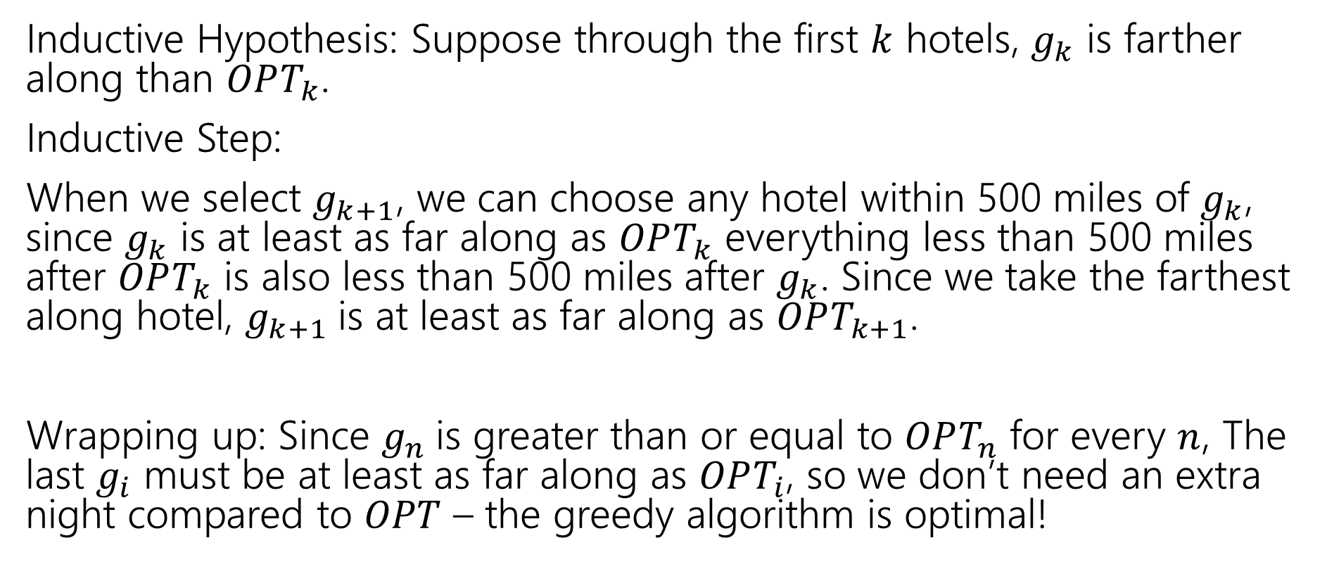
Trip Planning
Inductive Hypothesis: Suppose through the first $k$ hotels, $g_{k}$ is farther along than $OPT_{k}$.
Inductive Step:
When we select $g_{k+1}$, we can choose any hotel within 500 miles of $g_{k}$, since $g_{k}$ is at least as far along as $OPT_{k}$ everything less than 500 miles after $OPT_{k}$ is also less than 500 miles after $g_{k}$. Since we take the farthest along hotel, $g_{k+1}$is at least as far along as $OPT_{k+1}$.
Wrapping up: Since $g_{n}$is greater than or equal to $OPT_{n}$ for every $n$, The last $g_{i}$ must be at least as far along as $OPT_{i}$, so we don’t need an extra night compared to $OPT$ – the greedy algorithm is optimal!

Slide 5
Wrapping MSTs

Slide 6
Other MST Algorithms
You know Prim’s and Kruskal’s already.
Option 3: Reverse-Delete algorithm
Start from the full graph
Sort edges in decreasing order, delete an edge if it won’t disconnect the graph.
NOT practical (Prim’s and Kruskal’s are at least as fast, and conceptually easier), but fun fact!

Slide 7
Other MST Algorithms
How would you prove Reverse-Delete works?
Structural Proof?
Exchange Argument?
Greedy Stays Ahead?
Fill out the poll everywhere for Activity Credit!
Go to pollev.com/cse417 and login with your UW identity

Slide 8
Other MST Algorithms
Option 4: Boruvka’s Algorithm (also called Sollin’s Algorithm)
Start with empty graph, use BFS to find lightest edge leaving each component.
Add ALL such edges found (they’re all safe edges)
Recurse until the graph is all one component (i.e. a tree)
Consider it for your practical applications!
It naturally parallelizes (unlike the other MST algorithms),
Has same worst case running time as Prim’s/Kruskal’s!

Slide 9
More Greedy

Slide 10
Change-Making
Suppose you need to “make change” with the fewest number of coins possible.
Greedy algorithm:
Is the greedy algorithm optimal if you have
1 cent coins, 10 cent coins, and 15 cent coins?
What about for U.S. coinage (1, 5, 10, 25, 50, 100)
Take the biggest coin less than the change remaining.

Slide 11
Change-Making
Suppose you need to “make change” with the fewest number of coins possible.
Is the greedy algorithm optimal if you have
1 cent coins, 10 cent coins, and 15 cent coins?
What about for U.S. coinage (1, 5, 10, 25, 50, 100)
Take the biggest coin less than the change remaining.
Introduce yourselves!
If you can turn your video on, please do.
If you can’t, please unmute and say hi.
If you can’t do either, say “hi” in chat.
Choose someone to share screen, showing this pdf.
Fill out the poll everywhere for Activity Credit!
Go to pollev.com/cse417 and login with your UW identity

Slide 12
Interval Scheduling
You have a single processor, and a set of jobs with fixed start and end times.
Your goal is to maximize the number of jobs you can process.
I.e. choose the maximum number of non-overlapping intervals.

Slide 13
Interval Scheduling
You have a single processor, and a set of jobs with fixed start and end times.
Your goal is to maximize the number of jobs you can process.
I.e. choose the maximum number of non-overlapping intervals.
3 non-overlapping intervals

Slide 14
Interval Scheduling
You have a single processor, and a set of jobs with fixed start and end times.
Your goal is to maximize the number of jobs you can process.
I.e. choose the maximum number of non-overlapping intervals.
3 other non-overlapping intervals

Slide 15
Interval Scheduling
You have a single processor, and a set of jobs with fixed start and end times.
Your goal is to maximize the number of jobs you can process.
I.e. choose the maximum number of non-overlapping intervals.
OPT is 3 – there is no way to have $4$ non-overlapping intervals; both the red and purple solutions are equally good.

Slide 16
Greedy Ideas
To specify a greedy algorithm, we need to:
Order the elements (intervals)
Choose a rule for deciding whether to add. Rule: Add interval as long as it doesn’t overlap with those we’ve already selected.
What ordering should we use?
Think of at least two orderings you think might work.

Slide 17
Greedy Algorithm
Some possibilities
Earliest end time (add if no overlap with previous selected)
Latest end time
Earliest start time
Latest start time
Shortest interval
Fewest overlaps (with remaining intervals)

Slide 18
Greedy
That list slide is the real difficulty with greedy algorithms.
All of those look at least somewhat plausible at first glance.
With MSTs that was fine – those ideas all worked!
It’s not fine here.
They don’t all work.
As a first step – try to find counter-examples to narrow down

Slide 19
Greedy Algorithm
Earliest end time
Latest end time
Earliest start time
Latest start time
Shortest interval
Fewest overlaps (with remaining intervals)

Slide 20
Take Earliest Start Time – Counter Example

Slide 21
Take Earliest Start Time – Counter Example
Algorithm finds
Optimum
Taking the one with the earliest start time doesn’t give us the best answer.

Slide 22
Shortest Interval

Slide 23
Shortest Interval
Algorithm finds
Optimum
Taking the shortest interval first doesn’t give us the best answer

Slide 24
Greedy Algorithm
Earliest end time
Latest end time
Earliest start time
Latest start time
Shortest interval
Fewest overlaps (with remaining intervals)

Slide 25
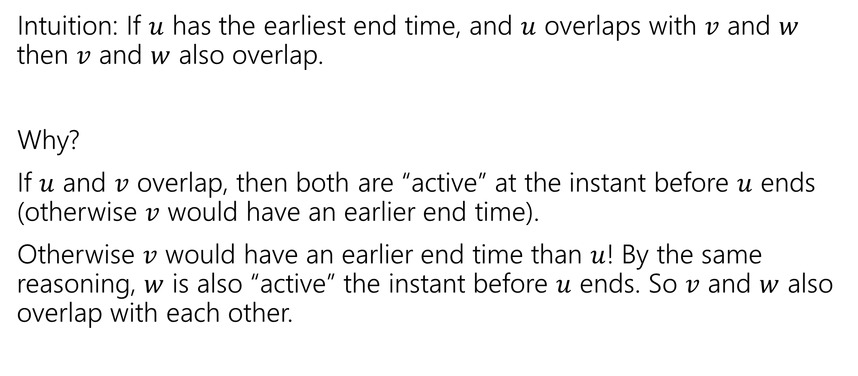
Earliest End Time
Intuition: If $u$ has the earliest end time, and $u$ overlaps with $v$ and $w$ then $v$ and $w$ also overlap.
Why?
If $u$ and $v$ overlap, then both are “active” at the instant before $u$ ends (otherwise $v$ would have an earlier end time).
Otherwise $v$ would have an earlier end time than $u$! By the same reasoning, $w$ is also “active” the instant before $u$ ends. So $v$ and $w$ also overlap with each other.

Slide 26
Earliest End Time
Can you prove it correct?
Do you want to use
Structural Result
Exchange Argument
Greedy Stays Ahead

Slide 27
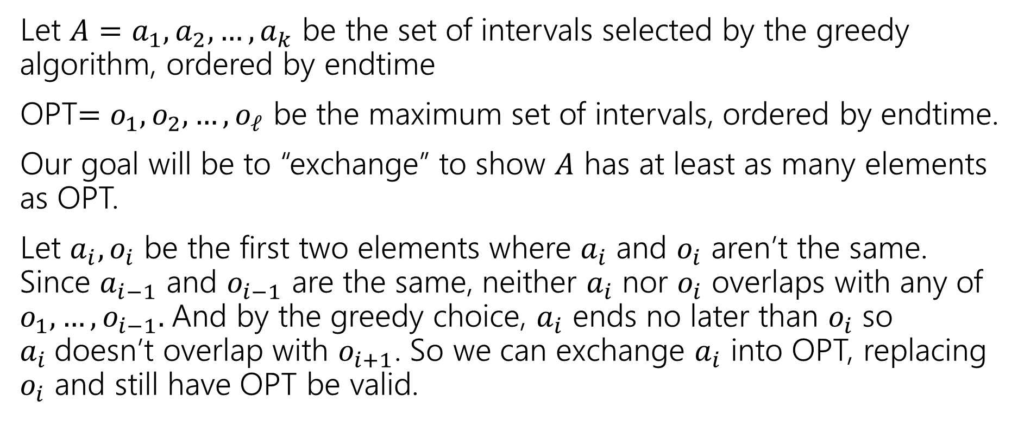
Exchange Argument
Let $A=a_{1},a_{2},…,a_{k}$ be the set of intervals selected by the greedy algorithm, ordered by endtime
OPT$=o_{1},o_{2},…,o_{ℓ}$ be the maximum set of intervals, ordered by endtime.
Our goal will be to “exchange” to show $A$ has at least as many elements as OPT.
Let $a_{i},o_{i}$ be the first two elements where $a_{i}$ and $o_{i}$ aren’t the same. Since $a_{i−1}$ and $o_{i−1}$ are the same, neither $a_{i}$ nor $o_{i}$ overlaps with any of $o_{1},…,o_{i−1}.$And by the greedy choice, $a_{i}$ ends no later than $o_{i}$ so $a_{i}$doesn’t overlap with $o_{i+1}$. So we can exchange $a_{i}$ into OPT, replacing $o_{i}$ and still have OPT be valid.

Slide 28
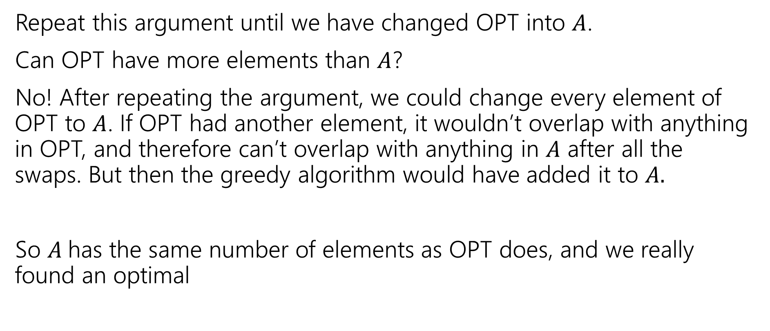
Exchange Argument
Repeat this argument until we have changed OPT into $A$.
Can OPT have more elements than $A$?
No! After repeating the argument, we could change every element of OPT to $A$. If OPT had another element, it wouldn’t overlap with anything in OPT, and therefore can’t overlap with anything in $A$ after all the swaps. But then the greedy algorithm would have added it to $A.$
So $A$has the same number of elements as OPT does, and we really found an optimal

Slide 29
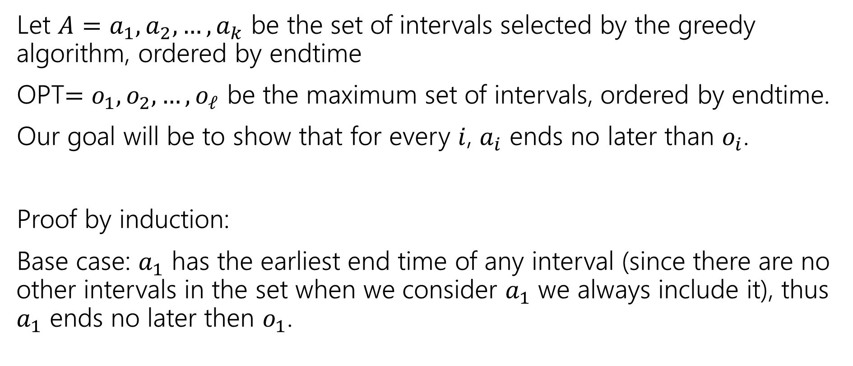
Greedy Stays Ahead
Let $A=a_{1},a_{2},…,a_{k}$ be the set of intervals selected by the greedy algorithm, ordered by endtime
OPT$=o_{1},o_{2},…,o_{ℓ}$ be the maximum set of intervals, ordered by endtime.
Our goal will be to show that for every $i$, $a_{i}$ ends no later than $o_{i}$.
Proof by induction:
Base case: $a_{1}$ has the earliest end time of any interval (since there are no other intervals in the set when we consider $a_{1}$ we always include it), thus $a_{1}$ ends no later then $o_{1}$.

Slide 30
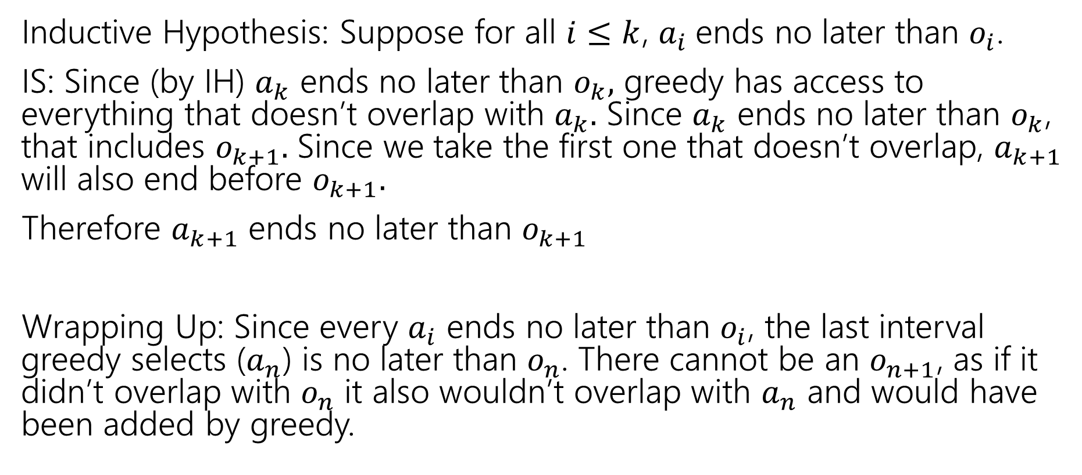
Greedy Stays Ahead
Inductive Hypothesis: Suppose for all $i≤k$, $a_{i}$ends no later than $o_{i}$.
IS: Since (by IH) $a_{k}$ ends no later than $o_{k},$ greedy has access to everything that doesn’t overlap with $a_{k}.$ Since $a_{k}$ ends no later than $o_{k}$, that includes $o_{k+1}.$ Since we take the first one that doesn’t overlap, $a_{k+1}$ will also end before $o_{k+1}.$
Therefore $a_{k+1}$ ends no later than $o_{k+1}$
Wrapping Up: Since every $a_{i}$ ends no later than $o_{i}$, the last interval greedy selects ($a_{n}$) is no later than $o_{n}$. There cannot be an $o_{n+1}$, as if it didn’t overlap with $o_{n}$ it also wouldn’t overlap with $a_{n}$ and would have been added by greedy.

Slide 31
Greedy Algorithm
Earliest end time
Latest end time
Earliest start time
Latest start time
Shortest interval
Fewest overlaps (with remaining intervals)

Slide 32
Other Greedy Algorithms
It turns out latest start time and fewest overlaps also work.
Latest start time is actually the same as earliest end time (imagine “reflecting” all the jobs along the time axis – the one with the earliest end time ends up having the last start time).
What about fewest overlaps?
Easiest proof Robbie knows observes that fewest overlaps means you have the earliest finish time (among a certain subset of the intervals)

Slide 33
Greedy Algorithm
Earliest end time
Latest end time
Earliest start time
Latest start time
Shortest interval
Fewest overlaps (with remaining intervals)

Slide 34
Summary
Greedy algorithms
You’ll probably have 2 (or 3…or 6) ideas for greedy algorithms. Check some simple examples before you implement! Greedy algorithms rarely work.
When they work AND you can prove they work, they’re great!
Proofs are often tricky
Structural results are the hardest to come up with, but the most versatile.
Greedy stays ahead usually use induction
Exchange start with the first difference between greedy and optimal.

