Slide 1
Dynamic Programming

Slide 2
Dynamic Programming
The most robust algorithm design paradigm we’ll study this quarter.
Small changes in the problem usually lead to small changes in the algorithm.
Also the one you’re most likely to be asked about in a tech interview.

Slide 3
Classic DP
This problem is going to look silly (and it is)
But it is going to make it much easier to do the hard DP problems next week.

Slide 4
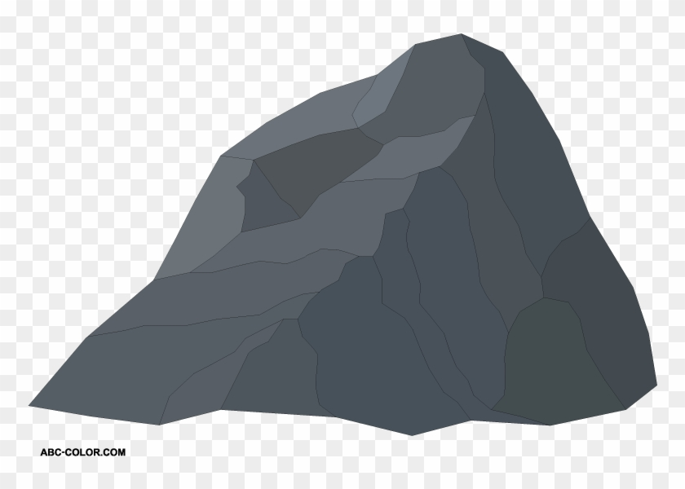
Baby Yoda Searching
Baby Yoda has to get from the upper-right corner to the lower left.
His cradle will only let him go left and down.
He can’t get past the rocks (too high) – he has to go around them (but still only going left and down)
As usual…he’s hungry.
He wants to eat as many frog eggs as possible on the way.

Slide 5
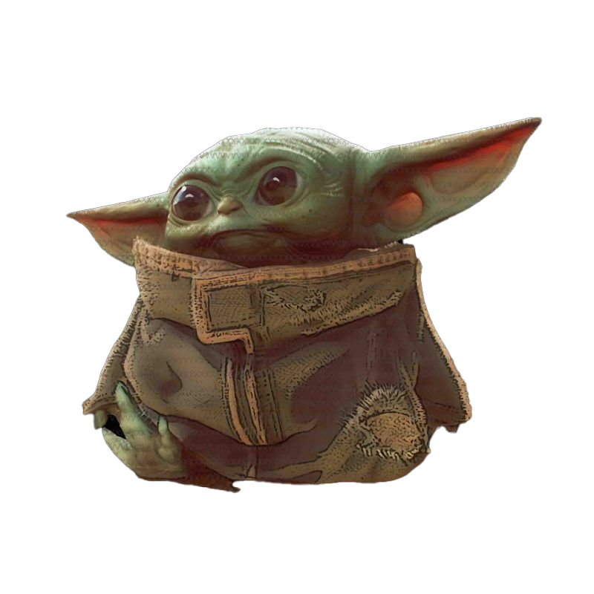
Baby Yoda Searching
Black path: get stuck. Invalid.
Red path: valid! And optimal (no path collects more than $4$ eggs.)
Notes:
https://1.bp.blogspot.com/-XxfNI65zLnU/Xc98O96LVnI/AAAAAAAAGFY/Xsmd7IMlIrEltYONCdGKk1hqPw1BgL3ggCLcBGAsYHQ/s1600/Mandalorian.jpg
http://www.pngmart.com/image/161116/png/161115
https://www.pikpng.com/pngvi/hiTxbbR_clip-art-rock-rock-clipart-transparent-background-png-download/

Slide 6
Baby Yoda Searching
Might get us stuck between rocks. Or pass up a series of eggs we can’t see.
Can we greedily head to the next accessible egg?
Notes:
https://1.bp.blogspot.com/-XxfNI65zLnU/Xc98O96LVnI/AAAAAAAAGFY/Xsmd7IMlIrEltYONCdGKk1hqPw1BgL3ggCLcBGAsYHQ/s1600/Mandalorian.jpg
http://www.pngmart.com/image/161116/png/161115
https://www.pikpng.com/pngvi/hiTxbbR_clip-art-rock-rock-clipart-transparent-background-png-download/

Slide 7
Baby Yoda Searching
Best left-side path might start at a place inaccessible to end of best right-side path.
Could make a subproblem for each start and ending spot?
Can we divide and conquer?
Notes:
https://1.bp.blogspot.com/-XxfNI65zLnU/Xc98O96LVnI/AAAAAAAAGFY/Xsmd7IMlIrEltYONCdGKk1hqPw1BgL3ggCLcBGAsYHQ/s1600/Mandalorian.jpg
http://www.pngmart.com/image/161116/png/161115
https://www.pikpng.com/pngvi/hiTxbbR_clip-art-rock-rock-clipart-transparent-background-png-download/

Slide 8
Baby Yoda Searching
Notes:
https://1.bp.blogspot.com/-XxfNI65zLnU/Xc98O96LVnI/AAAAAAAAGFY/Xsmd7IMlIrEltYONCdGKk1hqPw1BgL3ggCLcBGAsYHQ/s1600/Mandalorian.jpg
http://www.pngmart.com/image/161116/png/161115
https://www.pikpng.com/pngvi/hiTxbbR_clip-art-rock-rock-clipart-transparent-background-png-download/

Slide 9
Baby Yoda Searching
So what should we do?
Let’s try to use recursion.
What should our recursive calls be finding?
What recursive calls do we need?

Slide 10
Let OPT(i,j) be the maximum number of eggs we can get on a legal path from (i,j) to (0,0)(including the egg in (i,j) if there is one)
What recursive calls do we need?
Don’t try to divide & conquer, think closer to home…
We have to decide whether to go down or left…

Slide 11
Baby Yoda Searching
(c-1,r-1)
r-1
Y-coordinate
(0,2)
(0,1)
(1,1)
0
(0,0)
X-coordinate
0
c-1
Notes:
https://1.bp.blogspot.com/-XxfNI65zLnU/Xc98O96LVnI/AAAAAAAAGFY/Xsmd7IMlIrEltYONCdGKk1hqPw1BgL3ggCLcBGAsYHQ/s1600/Mandalorian.jpg
http://www.pngmart.com/image/161116/png/161115
https://www.pikpng.com/pngvi/hiTxbbR_clip-art-rock-rock-clipart-transparent-background-png-download/

Slide 12
Recursive Baby Yoda
Let OPT(i,j) be the maximum number of eggs we can get on a legal path from (i,j) to (0,0)(including the egg in (i,j) if there is one)
Base Case?
Recursive case?
At (0,0), nowhere to go, return eggs[0][0]
Find best path to left OPT(i-1, j), and down OPT(i,j-1)
Take max of those, add in eggs[i][j]
Need some error handling (can’t go off the edge)
And if we’re on rocks, we can’t get to the end (return -$∞$)

Slide 13
A Recursive Function
FindOPT(int i,int j, bool[][] rocks, bool[][] eggs)
if(i<0 || j < 0) return -$∞$
if(rocks[i][j]) return $−∞$
if(i==0 && j==0) return eggs[0][0]
int left = FindOPT(i-1,j,rocks,eggs)
int down = FindOPT(i,j-1,rocks,eggs)
return Max(left,down) + eggs[i][j]

Slide 14
Recurrence Form
$$OPT\left(i,j\right)=\left\{\begin{aligned}−∞ if rocks\left(i,j\right) is true \\ −∞ if i<0 or j<0 \\ eggs\left(0,0\right) if i=0 and j=0 \\ \max\left\{OPT\left(i−1,j\right), OPT\left(i,j−1\right)\right\}+eggs\left(i,j\right) otherwise\end{aligned}\right.$$
Recurrences can also be used for outputs of a recursive function (not just their running times!)
This definition is a little more compact than code.
And you could write a recursive function for a recurrence like this.

Slide 15
Analyzing the recursive function
So…how does the code work? What’s its running time?
$T\left(c,r\right)=\left\{\begin{aligned}T\left(c−1,r\right)+T\left(c,r−1\right)+Θ\left(n\right) if r≥0 and c≥0 \\ Θ\left(1\right) otherwise\end{aligned}\right.$
Master Theorem says…

Slide 16
Analyzing the recursive function
So…how does the code work? What’s its running time?
$T\left(c,r\right)=\left\{\begin{aligned}T\left(c−1,r\right)+T\left(c,r−1\right)+Θ\left(n\right) if r≥0 and c≥0 \\ Θ\left(1\right) otherwise\end{aligned}\right.$
Master Theorem doesn’t help.
Not even the fancy version on Wikipedia that handled the logs last time.

Slide 17
Tree Method, Maybe…
OPT
(r,c)
OPT
(r-1,c)
OPT
(r,c-1)
OPT
(r-2,c)
OPT
(r-1,c-1)
OPT
(r-1,c-1)
OPT
(r,c-2)
…
…
…
…
When do we hit the base case?
Sometime between $min⁡(r,c)$ and $r+c$ levels.

Slide 18
Tree Method
Nodes at level $i$ | $$2^{i}$$
Work/node | $$Θ(1)$$
Work at level $i$ | $$Θ\left(2^{i}\right)$$
Base Case level | At least $min⁡(r,c)$ | At most $r+c$
Work at base case | $$Ω\left(2^{\min\left(r,c\right)}\right)$$ | $$O\left(2^{r+c}\right)$$
Total work | $Ω\left(2^{\min\left(r,c\right)}\right)$ | $$O(2^{r+c })$$
Overall work is sum over all levels – each level has twice the work as the last, so the last level is about half the total work.
Tight big-O depends on relationship between $r$ and $c$…but regardless – it’s slow.

Slide 19
Speedup
That’s way too slow…but it doesn’t have to be.
OPT
(r,c)
OPT
(r-1,c)
OPT
(r,c-1)
OPT
(r-2,c)
OPT
(r-1,c-1)
OPT
(r-1,c-1)
OPT
(r,c-2)
…
…
…
…

Slide 20
Activity
Fill out the question at pollev.com/robbie
Figure out how to take advantage of the repeated calculation.
What do you think the running time will be of your new algorithm?
FindOPT(int i,int j, bool[][] rocks, bool[][] eggs)
if(i<0 || j < 0) return -$∞$
if(rocks[i][j]) return $−∞$
if(i==0 && j==0) return eggs[0][0]
int left = FindOPT(i-1,j,rocks,eggs)
int down = FindOPT(i,j-1,rocks,eggs)
return Max(left,down) + eggs[i][j]

Slide 21
Speedup
How do we go faster? Don’t recalculate! memoize
Once you know $OPT(i,j)$ put it in an array OPT[i][j]
Have some initial value (null?) to mark as uninitialized
If initialized, return that.
Otherwise do the algorithm from the last slide.
How fast? Now $Θ(rc)$. A little harder to analyze – ask Robbie after

Slide 22
Baby Yoda Searching
(c-1,r-1)
r-1
Y-coordinate
(0,2)
(0,1)
(1,1)
0
(0,0)
X-coordinate
0
c-1
Notes:
https://1.bp.blogspot.com/-XxfNI65zLnU/Xc98O96LVnI/AAAAAAAAGFY/Xsmd7IMlIrEltYONCdGKk1hqPw1BgL3ggCLcBGAsYHQ/s1600/Mandalorian.jpg
http://www.pngmart.com/image/161116/png/161115
https://www.pikpng.com/pngvi/hiTxbbR_clip-art-rock-rock-clipart-transparent-background-png-download/

Slide 23
Going Bottom-up
So how does that recursion work?
What’s the first entry of the table that we fill?
OPT[0][0]
Why not just start filling in there?

Slide 24
Baby Yoda Searching
(c-1,r-1)
r-1
What else can we fill in?
Y-coordinate
(0,2)
(0,1)
(1,1)
0
$$0$$
$$1$$
$$2$$
$$2$$
$$2$$
$$2$$
$$2$$
$$2$$
(0,0)
X-coordinate
0
c-1
Notes:
https://1.bp.blogspot.com/-XxfNI65zLnU/Xc98O96LVnI/AAAAAAAAGFY/Xsmd7IMlIrEltYONCdGKk1hqPw1BgL3ggCLcBGAsYHQ/s1600/Mandalorian.jpg
http://www.pngmart.com/image/161116/png/161115
https://www.pikpng.com/pngvi/hiTxbbR_clip-art-rock-rock-clipart-transparent-background-png-download/

Slide 25
Baby Yoda Searching
(c-1,r-1)
r-1
What else can we fill in?
Y-coordinate
(0,2)
$$0$$
$$1$$
$$−∞$$
$$2$$
$$2$$
$$2$$
$$2$$
$$2$$
(0,1)
(1,1)
0
$$0$$
$$1$$
$$2$$
$$2$$
$$2$$
$$2$$
$$2$$
$$2$$
X-coordinate
0
c-1
Notes:
https://1.bp.blogspot.com/-XxfNI65zLnU/Xc98O96LVnI/AAAAAAAAGFY/Xsmd7IMlIrEltYONCdGKk1hqPw1BgL3ggCLcBGAsYHQ/s1600/Mandalorian.jpg
http://www.pngmart.com/image/161116/png/161115
https://www.pikpng.com/pngvi/hiTxbbR_clip-art-rock-rock-clipart-transparent-background-png-download/

Slide 26
Baby Yoda Searching
(c-1,r-1)
r-1
What else can we fill in?
Y-coordinate
$$0$$
$$−∞$$
$$0$$
$$1$$
$$−∞$$
$$2$$
$$2$$
$$2$$
$$2$$
$$2$$
0
$$0$$
$$1$$
$$2$$
$$2$$
$$2$$
$$2$$
$$2$$
$$2$$
X-coordinate
0
c-1
Notes:
https://1.bp.blogspot.com/-XxfNI65zLnU/Xc98O96LVnI/AAAAAAAAGFY/Xsmd7IMlIrEltYONCdGKk1hqPw1BgL3ggCLcBGAsYHQ/s1600/Mandalorian.jpg
http://www.pngmart.com/image/161116/png/161115
https://www.pikpng.com/pngvi/hiTxbbR_clip-art-rock-rock-clipart-transparent-background-png-download/

Slide 27
Baby Yoda Searching
(c-1,r-1)
$$1$$ | $$1$$ | $$1$$ | $$2$$ | $$3$$ | $$4$$ | $$4$$ | $$4$$
$$1$$ | $$1$$ | $$1$$ | $$2$$ | $$3$$ | $$4$$ | $$4$$ | $$4$$
$$0$$ | $$0$$ | $$1$$ | $$2$$ | $$3$$ | $$3$$ | $$3$$ | $$3$$
 |  |  | $$−∞$$ | $$3$$ | $$3$$ | $$3$$ | $$3$$
r-1
Where’s the final answer?
In the top right. Where Baby Yoda starts.
Y-coordinate
$$0$$
$$−∞$$
$$−∞$$
$$0$$
$$1$$
$$−∞$$
$$2$$
$$2$$
$$2$$
$$2$$
$$2$$
0
$$0$$
$$1$$
$$2$$
$$2$$
$$2$$
$$2$$
$$2$$
$$2$$
X-coordinate
0
c-1
Notes:
https://1.bp.blogspot.com/-XxfNI65zLnU/Xc98O96LVnI/AAAAAAAAGFY/Xsmd7IMlIrEltYONCdGKk1hqPw1BgL3ggCLcBGAsYHQ/s1600/Mandalorian.jpg
http://www.pngmart.com/image/161116/png/161115
https://www.pikpng.com/pngvi/hiTxbbR_clip-art-rock-rock-clipart-transparent-background-png-download/

Slide 28
What order?
Fill in a row at a time (left to right)
Going up to the next row once a level is done.
In actual code, probably easier to handle edges first
Avoid the index-out-of-bound exceptions.

Slide 29
Pseudocode
int eggsSoFar=0;
Boolean rocksInWay=false
for(int x=0; x<c; x++)
if(rocks[x][0]) rocksInWay = true
eggsSoFar+=eggs[x][0]
OPT[x][0]= rocksInWay ? $−∞$: eggsSoFar
eggsSoFar=0
rocksInWay=false
for(int y=0; y<r; y++)
if(rocks[0][y]) rocksInWay = true
eggsSoFar+=eggs[0][y]
OPT[0][y]= rocksInWay ? $−∞$ : eggsSoFar
for(int y=0;y<r;y++)
for(int x=0;x<c;x++)
if(rocks[x][y])
OPT[x][y]=-$∞$
else
OPT[x][y]=max(OPT[x-1][y], OPT[x][y-1])+eggs[x][y]

Slide 30
Why Switch To Iterative?
It does the same thing…
It’s easier to analyze (no need to imagine a recursion tree)
Saves constant factors (recursive version puts a lot on the call stack)
Will let you optimize memory (next week)
Recursive version is often a little more intuitive, though…

Slide 31
Updating the Problem
A new twist on the problem.
Baby Yoda can use the force to knock over rocks.
But he can only do it once (he tires out)
How do you decide which rocks to knock over?
Could run the algorithm once for every set of rocks knocked over.
$k$ rocks -- $Θ(krc)$. Can we do better?

Slide 32
Updating the Problem
$OPT\left(i,j,f\right)$ is the maximum amount of eggs Baby Yoda can collect on a legal path from $(i,j)$ to $(0,0)$ using the force $f$ times to knock over rocks.
For simplicity, assume there are no rocks at the starting location (r-1,c-1)
Here was the old rule without the force – how do we update?
$OPT\left(i,j\right)=\left\{\begin{aligned}−∞ if rocks\left(i,j\right) is true \\ −∞ if i<0 or j<0 \\ eggs\left(0,0\right) if i=0 and j=0 \\ \max\left\{OPT\left(i−1,j\right), OPT\left(i,j−1\right)\right\}+eggs\left(i,j\right) otherwise\end{aligned}\right.$

Slide 33
Updating the Problem
$OPT\left(i,j,f\right)$ is the maximum amount of eggs Baby Yoda can collect on a legal path from $(i,j)$ to $(0,0)$ using the force $f$ times to knock over rocks.
For simplicity, assume there are no rocks at the starting location (r-1,c-1)
Here was the old rule without the force – how do we update?
$OPT\left(i,j,f\right)=\left\{\begin{aligned} \\ −∞ if i<0 or j<0 or f<0 \\ eggs\left(0,0\right) if i=0 and j=0 and f≥0 \\ \max\left\{OPT\left(i−1,j,f−rocks(i−1,j)\right), OPT\left(i,j−1,f−rocks(i,j−1)\right) \right\}+eggs\left(i,j\right) otherwise\end{aligned}\right.$
Casting Boolean as an integer
(subtract 1 if you would need to knock over rocks)

Slide 34
Updating the Problem
$OPT\left(i,j,f\right)$ is the maximum amount of eggs Baby Yoda can collect on a legal path from $(i,j)$ to $(0,0)$ using the force $f$ times to knock over rocks.
For simplicity, assume there are no rocks at the starting location (r-1,c-1)
Here was the old rule without the force – how do we update?
$OPT\left(i,j,f\right)=\left\{\begin{aligned} \\ −∞ if i<0 or j<0 or f<0 \\ eggs\left(0,0\right) if i=0 and j=0 and f≥0 \\ \max\left\{OPT\left(i−1,j,f−rocks(i−1,j)\right), OPT\left(i,j−1,f−rocks(i,j−1)\right) \right\}+eggs\left(i,j\right) otherwise\end{aligned}\right.$
rocks(i,j) doesn’t guarantee $−∞$ anymore. Only if you were out of force uses before trying to jump onto that location.

Slide 35
Baby Yoda Searching
(c-1,r-1)
r-1
What can we fill in?
Y-coordinate
$$a/b$$
$a$ is for (x,y,0) $b$ is for (x,y,1)
0
X-coordinate
0
c-1
Notes:
https://1.bp.blogspot.com/-XxfNI65zLnU/Xc98O96LVnI/AAAAAAAAGFY/Xsmd7IMlIrEltYONCdGKk1hqPw1BgL3ggCLcBGAsYHQ/s1600/Mandalorian.jpg
http://www.pngmart.com/image/161116/png/161115
https://www.pikpng.com/pngvi/hiTxbbR_clip-art-rock-rock-clipart-transparent-background-png-download/

Slide 36
Baby Yoda Searching
(c-1,r-1)
r-1
What can we fill in?
Y-coordinate
$$a/b$$
$a$ is for (x,y,0) $b$ is for (x,y,1)
0
$$0/?$$
$$1/?$$
$$2/?$$
$$2/?$$
$$2/?$$
$$2/?$$
$$2/?$$
$$2/?$$
X-coordinate
0
c-1
Notes:
https://1.bp.blogspot.com/-XxfNI65zLnU/Xc98O96LVnI/AAAAAAAAGFY/Xsmd7IMlIrEltYONCdGKk1hqPw1BgL3ggCLcBGAsYHQ/s1600/Mandalorian.jpg
http://www.pngmart.com/image/161116/png/161115
https://www.pikpng.com/pngvi/hiTxbbR_clip-art-rock-rock-clipart-transparent-background-png-download/

Slide 37
Baby Yoda Searching
(c-1,r-1)
$$1/?$$ | $$1/?$$ | $$1/?$$ | $$1/?$$ | $$3/?$$ | $$4/?$$ | $$4/?$$ | $$4/?$$
$$1/?$$ | $$1/?$$ | $$1/?$$ | $$1/?$$ | $$3/?$$ | $$4/?$$ | $$4/?$$ | $$4/?$$
$$0/?$$ | $$0/?$$ | $$1/?$$ | $$1/?$$ | $$3/?$$ | $$3/?$$ | $$3/?$$ | $$3/?$$
 |  |  | $2/?$ | $$3/?$$ | $$3/?$$ | $$3/?$$ | $$3/?$$
r-1
What can we fill in?
Everything with $f=0$ in the same order as before.
Y-coordinate
$$0/?$$
$$1/?$$
$$−∞/?$$
$$0/?$$
$$1/?$$
$$2/?$$
$$2/?$$
$$2/?$$
$$2/?$$
$$2/?$$
$$2/?$$
0
$$0/?$$
$$1/?$$
$$2/?$$
$$2/?$$
$$2/?$$
$$2/?$$
$$2/?$$
$$2/?$$
Entries are slightly different – we’re handling rocks differently.
X-coordinate
0
c-1
Notes:
https://1.bp.blogspot.com/-XxfNI65zLnU/Xc98O96LVnI/AAAAAAAAGFY/Xsmd7IMlIrEltYONCdGKk1hqPw1BgL3ggCLcBGAsYHQ/s1600/Mandalorian.jpg
http://www.pngmart.com/image/161116/png/161115
https://www.pikpng.com/pngvi/hiTxbbR_clip-art-rock-rock-clipart-transparent-background-png-download/

Slide 38
Baby Yoda Searching
(c-1,r-1)
$$1/?$$ | $$1/?$$ | $$1/?$$ | $$1/?$$ | $$3/?$$ | $$4/?$$ | $$4/?$$ | $$4/?$$
$$1/?$$ | $$1/?$$ | $$1/?$$ | $$1/?$$ | $$3/?$$ | $$4/?$$ | $$4/?$$ | $$4/?$$
$$0/?$$ | $$0/?$$ | $$1/?$$ | $$1/?$$ | $$3/?$$ | $$3/?$$ | $$3/?$$ | $$3/?$$
 |  |  | $2/?$ | $$3/?$$ | $$3/?$$ | $$3/?$$ | $$3/?$$
r-1
What can we fill in?
Again from left to right, bottom to top, now filling in
Y-coordinate
$$0/?$$
$$1/?$$
$$−∞/?$$
$$0/?$$
$$1/?$$
$$2/?$$
$$2/?$$
$$2/?$$
$$2/?$$
$$2/?$$
$$2/?$$
0
$$0/?$$
$$1/?$$
$$2/?$$
$$2/?$$
$$2/?$$
$$2/?$$
$$2/?$$
$$2/?$$
X-coordinate
0
c-1
Notes:
https://1.bp.blogspot.com/-XxfNI65zLnU/Xc98O96LVnI/AAAAAAAAGFY/Xsmd7IMlIrEltYONCdGKk1hqPw1BgL3ggCLcBGAsYHQ/s1600/Mandalorian.jpg
http://www.pngmart.com/image/161116/png/161115
https://www.pikpng.com/pngvi/hiTxbbR_clip-art-rock-rock-clipart-transparent-background-png-download/

Slide 39
Baby Yoda Searching
(c-1,r-1)
$$1/1$$ | $$1/1$$ | $$1/4$$ | $$1/4$$ | $$3/4$$ | $$4/5$$ | $$4/5$$ | $$4/5$$
$$1/1$$ | $$1/1$$ | $$1/4$$ | $$1/4$$ | $$3/4$$ | $$4/5$$ | $$4/5$$ | $$4/5$$
$$0/0$$ | $$0/0$$ | $$1/4$$ | $$1/4$$ | $$3/4$$ | $$3/4$$ | $$3/4$$ | $$3/4$$
 |  |  | $2/3$ | $$3/3$$ | $$3/3$$ | $$3/3$$ | $$3/3$$
r-1
What can we fill in?
Again from left to right, bottom to top, now filling in
Y-coordinate
$$0/0$$
$$1/1$$
$$−∞/3$$
$$0/0$$
$$1/1$$
$$2/2$$
$$2/2$$
$$2/2$$
$$2/2$$
$$2/2$$
$$2/2$$
0
$$0/0$$
$$1/1$$
$$2/2$$
$$2/2$$
$$2/2$$
$$2/2$$
$$2/2$$
$$2/2$$
X-coordinate
0
c-1
Notes:
https://1.bp.blogspot.com/-XxfNI65zLnU/Xc98O96LVnI/AAAAAAAAGFY/Xsmd7IMlIrEltYONCdGKk1hqPw1BgL3ggCLcBGAsYHQ/s1600/Mandalorian.jpg
http://www.pngmart.com/image/161116/png/161115
https://www.pikpng.com/pngvi/hiTxbbR_clip-art-rock-rock-clipart-transparent-background-png-download/

Slide 40
Dynamic Programming Process
1. Define the object you’re looking for
2. Write a recurrence to say how to find it
3. Design a memoization structure
4. Write an iterative algorithm

Slide 41
Bells,Whistles, and optimiziation

Slide 42
Baby Yoda Searching
(c-1,r-1)
$$1/1$$ | $$1/1$$ | $$1/4$$ | $$1/4$$ | $$3/4$$ | $$4/5$$ | $$4/5$$ | $$4/5$$
$$1/1$$ | $$1/1$$ | $$1/4$$ | $$1/4$$ | $$3/4$$ | $$4/5$$ | $$4/5$$ | $$4/5$$
$$0/0$$ | $$0/0$$ | $$1/4$$ | $$1/4$$ | $$3/4$$ | $$3/4$$ | $$3/4$$ | $$3/4$$
 |  |  | $2/3$ | $$3/3$$ | $$3/3$$ | $$3/3$$ | $$3/3$$
r-1
What can we fill in?
Again from left to right, bottom to top, now filling in
Y-coordinate
$$0/0$$
$$1/1$$
$$−∞/3$$
$$0/0$$
$$1/1$$
$$2/2$$
$$2/2$$
$$2/2$$
$$2/2$$
$$2/2$$
$$2/2$$
0
$$0/0$$
$$1/1$$
$$2/2$$
$$2/2$$
$$2/2$$
$$2/2$$
$$2/2$$
$$2/2$$
X-coordinate
0
c-1
Notes:
https://1.bp.blogspot.com/-XxfNI65zLnU/Xc98O96LVnI/AAAAAAAAGFY/Xsmd7IMlIrEltYONCdGKk1hqPw1BgL3ggCLcBGAsYHQ/s1600/Mandalorian.jpg
http://www.pngmart.com/image/161116/png/161115
https://www.pikpng.com/pngvi/hiTxbbR_clip-art-rock-rock-clipart-transparent-background-png-download/

Slide 43
Which Way to Go
When you’re taking the max in the recursive case, you can also record which option gave you the max.
That’s the way to go.
We’ll ask you to do that once on a homework…but for the most part we’ll just have you find the number.

Slide 44
Optimizing
Do we need all that memory?
Let’s go back to the simple version (no using the force)

Slide 45
Recurrence Form
$$OPT\left(i,j\right)=\left\{\begin{aligned}−∞ if rocks\left(i,j\right) is true \\ −∞ if i<0 or j<0 \\ eggs\left(0,0\right) if i=0 and j=0 \\ \max\left\{OPT\left(i−1,j\right), OPT\left(i,j−1\right)\right\}+eggs\left(i,j\right) otherwise\end{aligned}\right.$$
What values do we need to keep around?

Slide 46
Baby Yoda Searching
(c-1,r-1)
$$1$$ | $$1$$ | $$1$$ | $$2$$ | $$3$$ | $$4$$ | $$4$$ | $$4$$
$$1$$ | $$1$$ | $$1$$ | $$2$$ | $$3$$ | $$4$$ | $$4$$ | $$4$$
$$0$$ | $$0$$ | $$1$$ | $$2$$ | $$3$$ | $$3$$ | $$3$$ | $$3$$
 |  |  | $$−∞$$ | $$3$$ | $$3$$ | $$3$$ | $$3$$
r-1
Need one spot left and one down.
Keep one full row, and a partially full row around.
$Θ(c)$ memory.
Y-coordinate
$$0$$
$$−∞$$
$$−∞$$
$$0$$
$$1$$
$$−∞$$
$$2$$
$$2$$
$$2$$
$$2$$
$$2$$
0
$$0$$
$$1$$
$$2$$
$$2$$
$$2$$
$$2$$
$$2$$
$$2$$
X-coordinate
0
c-1
Notes:
https://1.bp.blogspot.com/-XxfNI65zLnU/Xc98O96LVnI/AAAAAAAAGFY/Xsmd7IMlIrEltYONCdGKk1hqPw1BgL3ggCLcBGAsYHQ/s1600/Mandalorian.jpg
http://www.pngmart.com/image/161116/png/161115
https://www.pikpng.com/pngvi/hiTxbbR_clip-art-rock-rock-clipart-transparent-background-png-download/

