Slide 1
CSE 417 Algorithms and Complexity
NP-Complete
P
Richard Anderson - Lecture 27
Coping with NP-Completeness and Beyond

Slide 2
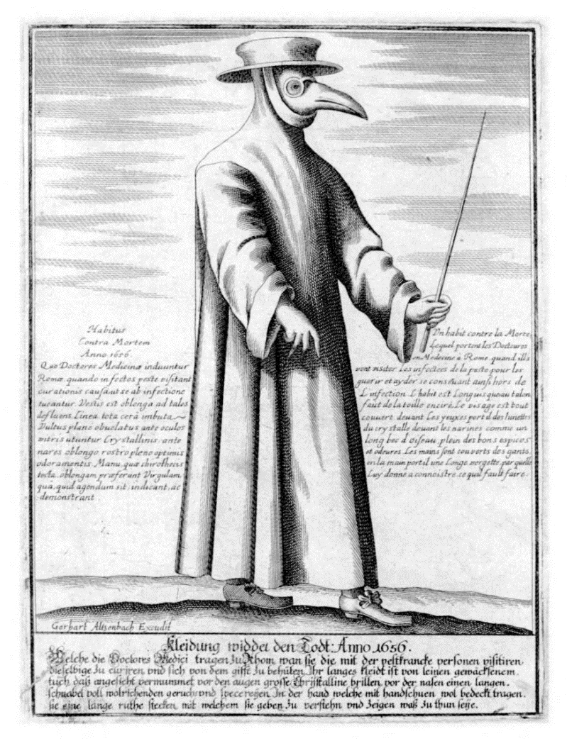
Announcements
No final exam
Homework 9
Due March 13, 5:00 pm
Homework 10
Due March 18, 5:00 pm
NP-Completeness
Counts as a regular HW
Office hours by zoom

Slide 3
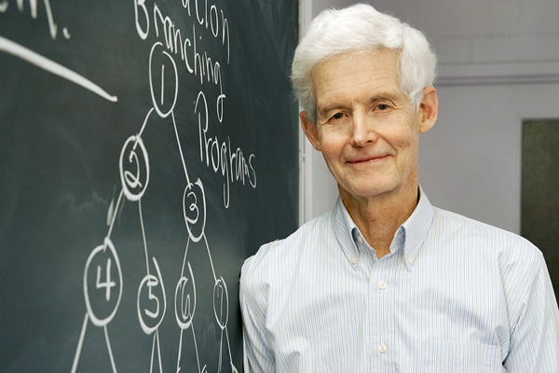
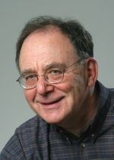
NP Completeness: The story so far
There are a whole bunch of other important problems which are NP-Complete
Circuit Satisfiability is NP-Complete

Slide 4
Populating the NP-Completeness Universe
NP-Complete
Circuit Sat <_{P} 3-SAT
3-SAT <_{P} Independent Set
3-SAT <_{P} Vertex Cover
Independent Set <_{P} Clique
3-SAT <_{P} Hamiltonian Circuit
Hamiltonian Circuit <_{P} Traveling Salesman
3-SAT <_{P} Integer Linear Programming
3-SAT <_{P} Graph Coloring
3-SAT <_{P} Subset Sum
Subset Sum <_{P} Scheduling with Release times and deadlines
NP
P

Slide 5
Satisfiability
Literal: A Boolean variable or its negation.
Clause: A disjunction of literals.
Conjunctive normal form: A propositional formula Φ that is the conjunction of clauses.
SAT: Given CNF formula Φ, does it have a satisfying truth assignment?
3-SAT: SAT where each clause contains exactly 3 literals.
Ex:
Yes: x₁ = true, x₂ = true x₃ = false.
Notes:
Any logical formula can be expressed in CNF.

Slide 6
Matching
Two dimensional matching
Three dimensional matching (3DM)

Slide 7
3-SAT <_{P} 3DM
X
X
X
X
X
X
X
X
X True
X False
Truth Setting Gadget

Slide 8
3-SAT <_{P} 3DM
X
Y
Z
Clause gadget for (X OR Y OR Z)
Garbage Collection Gadget (Many copies)

Slide 9
Exact Cover (sets of size 3) XC3
Given a collection of sets of size 3 of a domain of size 3N, is there a sub-collection of N sets that cover the sets
(A, B, C), (D, E, F), (A, B, G), (A, C, I), (B, E, G), (A, G, I), (B, D, F), (C, E, I), (C, D, H), (D, G, I), (D, F, H), (E, H, I),
(F, G, H), (F, H, I)
3DM <_{P} XC3

Slide 10
Graph Coloring
NP-Complete
Graph K-coloring
Graph 3-coloring
Polynomial
Graph 2-Coloring

Slide 11
3-SAT <_{P} 3 Colorability
T
F
B
X
X
Y
Y
Y
Z
Z
X
T
Z
F
Truth Setting Gadget
Clause Testing Gadget
(Can be colored if at least one input is T)

Slide 12
Number Problems
Subset sum problem
Given natural numbers w₁,. . ., w_{n} and a target number W, is there a subset that adds up to exactly W?
Subset sum problem is NP-Complete
Subset Sum problem can be solved in O(nW) time

Slide 13
XC3 <_{P} SUBSET SUM
Idea: Represent each set as a large integer, where the element x_{i} is encoded as D^{i} where D is an integer
{x₃, x₅, x₉} => D³ + D⁵ + D⁹
Does there exist a subset that sums to exactly D¹ + D² + D³ + . . . + D^{n-1} + D^{n}
Detail: How large is D? We need to make sure that we do not have any carries, so we can choose D = m+1, where m is the number of sets.

Slide 14
Integer Linear Programming
Linear Programming – maximize a linear function subject to linear constraints
Integer Linear Programming – require an integer solution
NP Completeness reduction from 3-SAT
Use 0-1 variables for x_{i}’s
Constraint for clause
x₁ + (1 – x₂) + (1-x₃) > 0

Slide 15
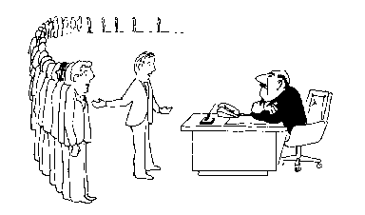
Coping with NP-Completeness
Approximation Algorithms
Exact solution via Branch and Bound
Local Search
I can’t find an efficient algorithm, but neither can all these famous people.

Slide 16
Multiprocessor Scheduling
Unit execution tasks
Precedence graph
K-Processors
Polynomial time for k=2
Open for k = constant
NP-complete is k is part of the problem

Slide 17
Highest level first is 2-Optimal
Choose k items on the highest level
Claim: number of rounds is at least twice the optimal.

Slide 18
Christofides TSP Algorithm
Undirected graph satisfying triangle inequality
Find MST
Add additional edges so that all vertices have even degree
Build Eulerian Tour
4
3
4
1
2
5
5
3/2 Approximation
3
6
4
3
4
3
2
5
6

Slide 19
Christofides Algorithm
4
3
4
3
4
1
4
1
2
2
5
5
5
3
5
3
6
6
4
4
3
3
4
3
4
3
2
2
5
6
5
6
3
4
1
2
5
3
4
4
3
2
6

Slide 20
Bin Packing
Given N items with weight w_{i}, pack the items into as few unit capacity bins as possible
Example: .3, .3, .3, .3, .4, .4

Slide 21
First Fit Packing
First Fit
Theorem: FF(I) is at most 17/10 Opt(I) + 2
First Fit Decreasing
Theorem: FFD(I) is at most 11/9 Opt (I) + 4

Slide 22
Branch and Bound
Brute force search – tree of all possible solutions
Branch and bound – compute a lower bound on all possible extensions
Prune sub-trees that cannot be better than optimal

Slide 23
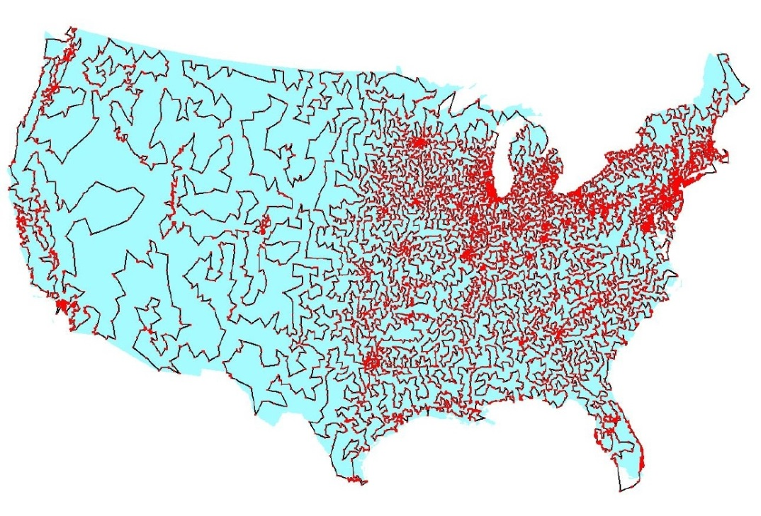
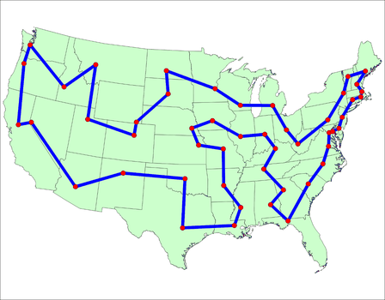
Branch and Bound for TSP
Enumerate all possible paths
Lower bound, Current path cost plus MST of remaining points
Euclidean TSP
Points on the plane with Euclidean Distance
Sample data set: State Capitals

Slide 24
Local Optimization
Improve an optimization problem by local improvement
Neighborhood structure on solutions
Travelling Salesman 2-Opt (or K-Opt)
Independent Set Local Replacement

Slide 25
What we don’t know
P vs. NP
NP-Complete
P = NP
P

Slide 26
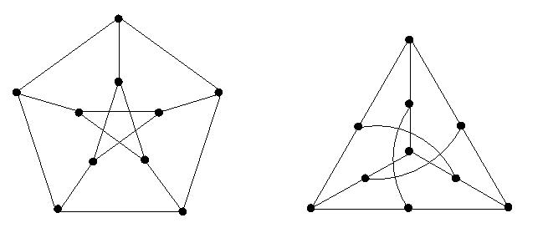
If P != NP, is there anything in between
Yes, Ladner [1975]
Problems not known to be in P or NP Complete
Factorization
Discrete Log
Graph Isomorphism
Solve g^{k} = b over a finite group

Slide 27
Complexity Theory
Computational requirements to recognize languages
Models of Computation
Resources
Hierarchies
All Languages
Decidable Languages
Context Free Languages
Regular Languages

Slide 28
Time complexity
P: (Deterministic) Polynomial Time
NP: Non-deterministic Polynomial Time
EXP: Exponential Time

Slide 29
Space Complexity
Amount of Space (Exclusive of Input)
L: Logspace, problems that can be solved in O(log n) space for input of size n
Related to Parallel Complexity
PSPACE, problems that can be required in a polynomial amount of space

Slide 30
So what is beyond NP?

Slide 31
NP vs. Co-NP
Given a Boolean formula, is it true for some choice of inputs
Given a Boolean formula, is it true for all choices of inputs

Slide 32
Problems beyond NP
Exact TSP, Given a graph with edge lengths and an integer K, does the minimum tour have length K
Minimum circuit, Given a circuit C, is it true that there is no smaller circuit that computes the same function a C

Slide 33
Polynomial Hierarchy
Level 1
∃X₁ Φ(X₁), ∀X₁ Φ(X₁)
Level 2
∀X₁∃X₂ Φ(X₁,X₂), ∃X₁∀X₂ Φ(X₁,X₂)
Level 3
∀X₁∃X₂∀X₃ Φ(X₁,X₂,X₃), ∃X₁∀X₂∃X₃ Φ(X₁,X₂,X₃)

Slide 34
Polynomial Space
Quantified Boolean Expressions
∃X₁∀X₂∃X₃...∃X_{n-1}∀X_{n} Φ(X₁,X₂,X₃…X_{n-1}X_{n})
Space bounded games
Competitive Facility Location Problem
N x N Chess
Counting problems
The number of Hamiltonian Circuits
PSpace-Complete
Log Space
P

