Slide 1
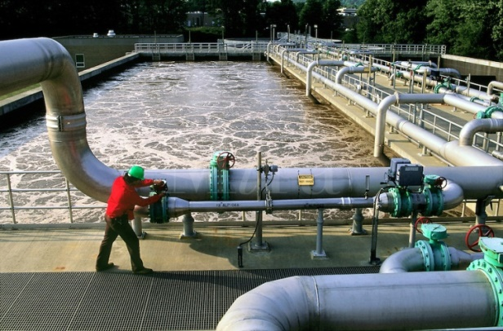
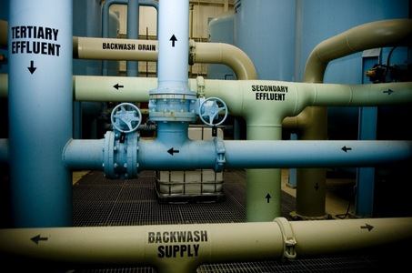
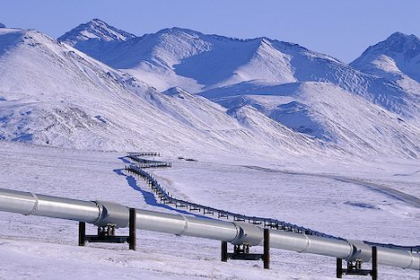
CSE 417 Algorithms and Complexity
Winter 2020
Lecture 24
Network Flow Applications

Slide 2
Announcements
Homework 9: Due Friday, March 13
Exam practice problems: Available next week
Final Exam: Wednesday, March 18
Fri, March 6 | Net Flow Applications
Mon, March 9 | Net Flow Applications
Wed, March 11 | NP-Completeness
Fri, March 13 | Holiday
 | NP-Completeness
Wed, March 18 | Final Exam

Slide 3
Outline
Network flow definitions
Flow examples
Augmenting Paths
Residual Graph
Ford Fulkerson Algorithm
Cuts
Maxflow-MinCut Theorem
Maxflow Algorithms
Simple applications of Max Flow
Non-simple applications of Max Flow

Slide 4
Cuts in a graph
Cut: Partition of V into disjoint sets S, T with s in S and t in T.
Cap(S,T): sum of the capacities of edges from S to T
Problem: Find the s-t Cut with minimum capacity
s
t

Slide 5
Max Flow / Min Cut
Review
20/20
20/30
a
d
g
0/5
0/5
20/20
20/30
5/5
0/5
0/5
5/5
0/20
s
25/30
b
20/20
e
h
30/30
t
20/20
0/5
5/5
20/25
0/5
0/5
15/20
15/25
c
f
i
20/20
10/10

Slide 6
Max Flow - Min Cut Theorem
There exists a cut S, T such that Flow(S,T) = Cap(S,T)
Proof also shows that Ford Fulkerson algorithm finds a maximum flow

Slide 7
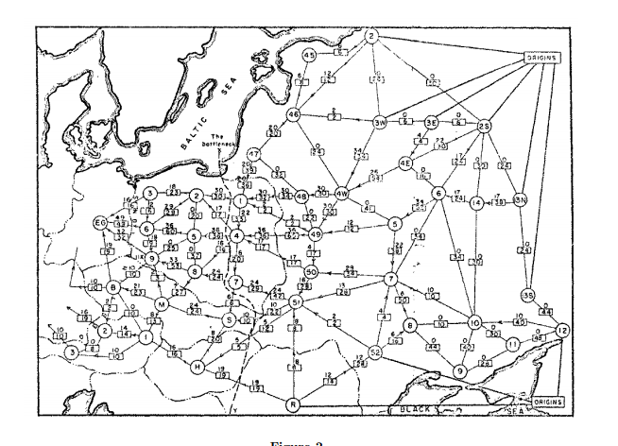
History
Ford / Fulkerson studied network flow in the context of the Soviet Rail Network

Slide 8
Ford Fulkerson Runtime
Cost per phase X number of phases
Phases
Capacity leaving source: C
Add at least one unit per phase
Cost per phase
Build residual graph: O(m)
Find s-t path in residual: O(m)

Slide 9
Performance
The worst case performance of the Ford-Fulkerson algorithm is horrible
u
1000
1000
s
1
t
1000
1000
v

Slide 10
Better methods of finding augmenting paths
Find the maximum capacity augmenting path
O(m²log(C)) time algorithm for network flow
Find the shortest augmenting path
O(m²n) time algorithm for network flow
Find a blocking flow in the residual graph
O(mnlog n) time algorithm for network flow

Slide 11
Problem Reduction
Reduce Problem A to Problem B
Convert an instance of Problem A to an instance of Problem B
Use a solution of Problem B to get a solution to Problem A
Practical
Use a program for Problem B to solve Problem A
Theoretical
Show that Problem B is at least as hard as Problem A

Slide 12
Problem Reduction Examples
Reduce the problem of finding the Maximum of a set of integers to finding the Minimum of a set of integers
Find the maximum of: 8, -3, 2, 12, 1, -6
Construct an equivalent minimization problem

Slide 13
Undirected Network Flow
Undirected graph with edge capacities
Flow may go either direction along the edges (subject to the capacity constraints)
u
10
20
s
5
t
20
10
v
Construct an equivalent flow problem

Slide 14
Bipartite Matching
A graph G=(V,E) is bipartite if the vertices can be partitioned into disjoints sets X,Y
A matching M is a subset of the edges that does not share any vertices
Find a matching as large as possible

Slide 15
Application
A collection of teachers
A collection of courses
And a graph showing which teachers can teach which courses
RA
311
PB
331
ME
332
DG
401
AK
421

Slide 16
Converting Matching to Network Flow
s
t

Slide 17
Multi-source network flow
Multi-source network flow
Sources s₁, s₂, . . ., s_{k}
Sinks t₁, t₂, . . . , t_{j}
Solve with Single source network flow

Slide 18
Resource Allocation: Assignment of reviewers
A set of papers P₁, . . ., P_{n}
A set of reviewers R₁, . . ., R_{m}
Paper P_{i} requires A_{i} reviewers
Reviewer R_{j} can review B_{j} papers
For each reviewer R_{j}, there is a list of paper L_{j1}, . . ., L_{jk} that R_{j} is qualified to review

Slide 19
Baseball elimination
Can the Dinosaurs win the league?
Remaining games:
AB, AC, AD, AD, AD, BC, BC, BC, BD, CD
 | W | L
Ants | 4 | 2
Bees | 4 | 2
Cockroaches | 3 | 3
Dinosaurs | 1 | 5
A team wins the league if it has strictly more wins than any other team at the end of the season
A team ties for first place if no team has more wins, and there is some other team with the same
number of wins

Slide 20
Baseball elimination
Can the Fruit Flies win or tie the league?
Remaining games:
AC, AD, AD, AD, AF, BC, BC, BC, BC, BC, BD, BE, BE, BE, BE, BF, CE, CE, CE, CF, CF, DE, DF, EF, EF
 | W | L
Ants | 17 | 12
Bees | 16 | 7
Cockroaches | 16 | 7
Dinosaurs | 14 | 13
Earthworms | 14 | 10
Fruit Flies | 12 | 15

Slide 21
Assume Fruit Flies win remaining games
Fruit Flies are tied for first place if no team wins more than 19 games
Allowable wins
Ants (2)
Bees (3)
Cockroaches (3)
Dinosaurs (5)
Earthworms (5)
18 games to play
AC, AD, AD, AD, BC, BC, BC, BC, BC, BD, BE, BE, BE, BE, CE, CE, CE, DE
 | W | L
Ants | 17 | 13
Bees | 16 | 8
Cockroaches | 16 | 9
Dinosaurs | 14 | 14
Earthworms | 14 | 12
Fruit Flies | 19 | 15

Slide 22
Remaining games
AC, AD, AD, AD, BC, BC, BC, BC, BC, BD, BE, BE, BE, BE, CE, CE, CE, DE
s
AC
AD
BC
BD
BE
CE
DE
A
B
C
D
E
t

Slide 23
Minimum Cut Applications
Image Segmentation
Open Pit Mining / Task Selection Problem
Reduction to Min Cut problem
S, T is a cut if S, T is a partition of the vertices with
s in S and t in T
The capacity of an S, T cut is the sum of the capacities of
all edges going from S to T

Slide 24
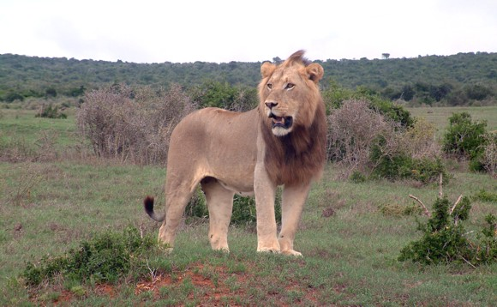
Image Segmentation
Separate foreground from background

Slide 25
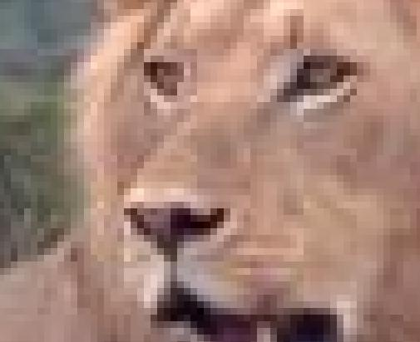

Slide 26
Image analysis
a_{i}: value of assigning pixel i to the foreground
b_{i}: value of assigning pixel i to the background
p_{ij}: penalty for assigning i to the foreground, j to the background or vice versa
A: foreground, B: background
Q(A,B) = Σ_{{i in A}}a_{i} + Σ_{{j in B}}b_{j} - Σ_{{(i,j) in E, i in A, j in} _{B}}p_{ij}

Slide 27
Pixel graph to flow graph
s
t

Slide 28
Mincut Construction
s
a_{v}
p_{vu}
u
v
p_{uv}
b_{v}
t

