Slide 1
CSE 417 Algorithms and Complexity
Richard Anderson - Lecture 21
Longest Common Subsequence and Shortest Paths

Slide 2
Longest Common Subsequence
C=c₁…c_{g} is a subsequence of A=a₁…a_{m} if C can be obtained by removing elements from A (but retaining order)
LCS(A, B): A maximum length sequence that is a subsequence of both A and B
LCS(BARTHOLEMEWSIMPSON, KRUSTYTHECLOWN)
= RTHOWN

Slide 3
LCS Optimization
A = a₁a₂…a_{m,} B = b₁b₂…b_{n}
Opt[ j, k] is the length of LCS(a₁a₂…a_{j}, b₁b₂…b_{k})
Optimization Recurrence:
If a_{j} = b_{k}, Opt[ j,k ] = 1 + Opt[ j-1, k-1 ]
If a_{j} != b_{k}, Opt[ j,k] = max(Opt[ j-1,k], Opt[ j,k-1])

Slide 4
Dynamic Programming Computation

Slide 5
Code to compute Opt[ n, m]
for (int i = 0; i < n; i++)
for (int j = 0; j < m; j++)
if (A[ i ] == B[ j ] )
Opt[ i,j ] = Opt[ i-1, j-1 ] + 1;
else if (Opt[ i-1, j ] >= Opt[ i, j-1 ])
Opt[ i, j ] := Opt[ i-1, j ];
else
Opt[ i, j ] := Opt[ i, j-1];

Slide 6
Storing the path information
A[1..m], B[1..n]
for i := 1 to m Opt[i, 0] := 0;
for j := 1 to n Opt[0,j] := 0;
Opt[0,0] := 0;
for i := 1 to m
for j := 1 to n
if A[i] = B[j] { Opt[i,j] := 1 + Opt[i-1,j-1]; Best[i,j] := Diag; }
else if Opt[i-1, j] >= Opt[i, j-1]
{ Opt[i, j] := Opt[i-1, j], Best[i,j] := Left; }
else { Opt[i, j] := Opt[i, j-1], Best[i,j] := Down; }
b₁…b_{n}
a₁…a_{m}

Slide 7
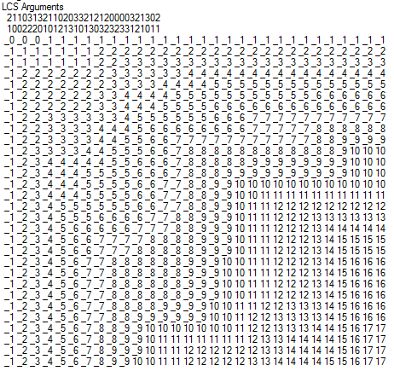
Reconstructing Path from Distances

Slide 8
How good is this algorithm?
Is it feasible to compute the LCS of two strings of length 300,000 on a standard desktop PC? Why or why not.

Slide 9
Implementation 1
public int ComputeLCS() {
int n = str1.Length;
int m = str2.Length;
int[,] opt = new int[n + 1, m + 1];
for (int i = 0; i <= n; i++)
opt[i, 0] = 0;
for (int j = 0; j <= m; j++)
opt[0, j] = 0;
for (int i = 1; i <= n; i++)
for (int j = 1; j <= m; j++)
if (str1[i-1] == str2[j-1])
opt[i, j] = opt[i - 1, j - 1] + 1;
else if (opt[i - 1, j] >= opt[i, j - 1])
opt[i, j] = opt[i - 1, j];
else
opt[i, j] = opt[i, j - 1];
return opt[n,m];
}

Slide 10
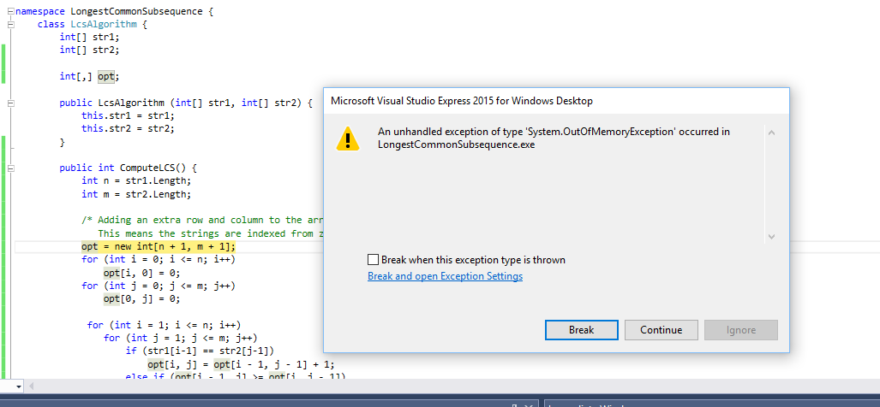
N = 17000
Runtime should be about 5 seconds*
* Personal PC, 6 years old

Slide 11
Implementation 2
public int SpaceEfficientLCS() {
int n = str1.Length;
int m = str2.Length;
int[] prevRow = new int[m + 1];
int[] currRow = new int[m + 1];
for (int j = 0; j <= m; j++)
prevRow[j] = 0;
for (int i = 1; i <= n; i++) {
currRow[0] = 0;
for (int j = 1; j <= m; j++) {
if (str1[i - 1] == str2[j - 1])
currRow[j] = prevRow[j - 1] + 1;
else if (prevRow[j] >= currRow[j - 1])
currRow[j] = prevRow[j];
else
currRow[j] = currRow[j - 1];
}
for (int j = 1; j <= m; j++)
prevRow[j] = currRow[j];
}
return currRow[m];
}

Slide 12
N = 300000
N: 10000 Base 2 Length: 8096 Gamma: 0.8096 Runtime:00:00:01.86
N: 20000 Base 2 Length: 16231 Gamma: 0.81155 Runtime:00:00:07.45
N: 30000 Base 2 Length: 24317 Gamma: 0.8105667 Runtime:00:00:16.82
N: 40000 Base 2 Length: 32510 Gamma: 0.81275 Runtime:00:00:29.84
N: 50000 Base 2 Length: 40563 Gamma: 0.81126 Runtime:00:00:46.78
N: 60000 Base 2 Length: 48700 Gamma: 0.8116667 Runtime:00:01:08.06
N: 70000 Base 2 Length: 56824 Gamma: 0.8117715 Runtime:00:01:33.36
N: 300000 Base 2 Length: 243605 Gamma: 0.8120167 Runtime:00:28:07.32

Slide 13
Observations about the Algorithm
The computation can be done in O(m+n) space if we only need one column of the Opt values or Best Values
The computation requires O(nm) space if we store all of the string information

Slide 14
Computing LCS in O(nm) time and O(n+m) space
Divide and conquer algorithm
Recomputing values used to save space
Section 6.7 of the text, but we will not have time to cover in detail (so you are not responsible for section 6.7)

Slide 15
Divide and Conquer Algorithm
Where does the best path cross the middle column?
For a fixed i, and for each j, compute the LCS that has a_{i} matched with b_{j}

Slide 16
Algorithm Analysis
T(m,n) = T(m/2, j) + T(m/2, n-j) + cnm
Solution: T(m,n) <= 2cnm

Slide 17
Shortest Paths with Dynamic Programming

Slide 18
Shortest Path Problem
Dijkstra’s Single Source Shortest Paths Algorithm
O(mlog n) time, positive cost edges
Bellman-Ford Algorithm
O(mn) time for graphs which can have negative cost edges

Slide 19
Lemma
If a graph has no negative cost cycles, then the shortest paths are simple paths
Shortest paths have at most n-1 edges

Slide 20
Shortest paths with a fixed number of edges
Find the shortest path from s to w with exactly k edges

Slide 21
Express as a recurrence
Compute distance from starting vertex s
Opt_{k}(w) = min_{x} [Opt_{k-1}(x) + c_{xw}]
Opt₀(w) = 0 if w = s and infinity otherwise

Slide 22
Algorithm, Version 1
for each w
M[0, w] = infinity;
M[0, s] = 0;
for i = 1 to n-1
for each w
M[i, w] = min_{x}(M[i-1,x] + cost[x,w]);

Slide 23
Algorithm, Version 2
for each w
M[0, w] = infinity;
M[0, s] = 0;
for i = 1 to n-1
for each w
M[i, w] = min(M[i-1, w], min_{x}(M[i-1,x] + cost[x,w]));

Slide 24
Algorithm, Version 3
for each w
M[w] = infinity;
M[s] = 0;
for i = 1 to n-1
for each w
M[w] = min(M[w], min_{x}(M[x] + cost[x,w]));

Slide 25
Example:
A
B
C
1
2

Slide 26
Correctness Proof for Algorithm 3
Key lemma – at the end of iteration i, for all w, M[w] <= M[i, w];

Slide 27
Algorithm, Version 4
for each w
M[w] = infinity;
M[s] = 0;
for i = 1 to n-1
for each w
for each x
if (M[w] > M[x] + cost[x,w])
P[w] = x;
M[w] = M[x] + cost[x,w] ;

Slide 28
Theorem
If the pointer graph has a cycle, then the graph has a negative cost cycle
v₁
v₄
v₂
v₃
Proof: See text.

Slide 29
Negative Cycles
If the pointer graph has a cycle, then the graph has a negative cycle
Therefore: if the graph has no negative cycles, then the pointer graph has no negative cycles

Slide 30
Finding negative cost cycles
What if you want to find negative cost cycles?
2
-2
3
5
2
-3
2
1
6
2
2
-5
2
4

Slide 31
What about finding Longest Paths
Can we just change Min to Max?

Slide 32
Foreign Exchange Arbitrage
USD
1.2
1.2
 | USD | EUR | CAD
USD | ------ | 0.8 | 1.2
EUR | 1.2 | ------ | 1.6
CAD | 0.8 | 0.6 | -----
EUR
CAD
0.6
USD
0.8
0.8
EUR
CAD
1.6

