Slide 1
CSE 417 Algorithms and Complexity
Richard Anderson
Lecture 20
Dynamic Programming

Slide 2
One dimensional dynamic programming: Interval scheduling
Opt[ j ] = max (Opt[ j – 1], w_{j} + Opt[ p[ j ] ])

Slide 3
Billboard Placement
Maximize income in placing billboards
b_{i} = (p_{i}, v_{i}), v_{i}: value of placing billboard at position p_{i}
Constraint:
At most one billboard every five miles
Example
{(6,5), (8,6), (12, 5), (14, 1)}

Slide 4
Design a Dynamic Programming Algorithm for Billboard Placement
Compute Opt[1], Opt[2], . . ., Opt[n]
What is Opt[k]?
Input b₁, …, b_{n}, where b_{i} = (p_{i}, v_{i}), position and value of billboard i

Slide 5
Opt[k] = fun(Opt[0],…,Opt[k-1])
How is the solution determined from sub problems?
Input b₁, …, b_{n}, where b_{i} = (p_{i}, v_{i}), position and value of billboard i

Slide 6
Solution
j = 0; // j is five miles behind the current position
// the last valid location for a billboard, if one placed at P[k]
for k := 1 to n
while (P[ j ] < P[ k ] – 5)
j := j + 1;
j := j – 1;
Opt[ k ] := Max(Opt[ k-1 ] , V[ k ] + Opt[ j ]);

Slide 7
Two dimensional dynamic programming
K-segment linear approximation
Opt_{k}[ j ] = min _{i} { Opt_{k-1}[ i ] + E_{i,j} } for 0 < i < j
4
3
2
1
 | 0 | 0 | 0 | 0 | 0 | 0 | 0 | 0 | 0 | 0 | 0 | 0 | 0 | 0 | 0 | 0 | 0

Slide 8
Two dimensional dynamic programming
Subset sum and knapsack
Opt[ j, K] = max(Opt[ j – 1, K], Opt[ j – 1, K – w_{j}] + w_{j})
Opt[ j, K] = max(Opt[ j – 1, K], Opt[ j – 1, K – w_{j}] + v_{j})
4 | 0
3 | 0
2 | 0
1 | 0
 | 0 | 0 | 0 | 0 | 0 | 0 | 0 | 0 | 0 | 0 | 0 | 0 | 0 | 0 | 0 | 0 | 0

Slide 9
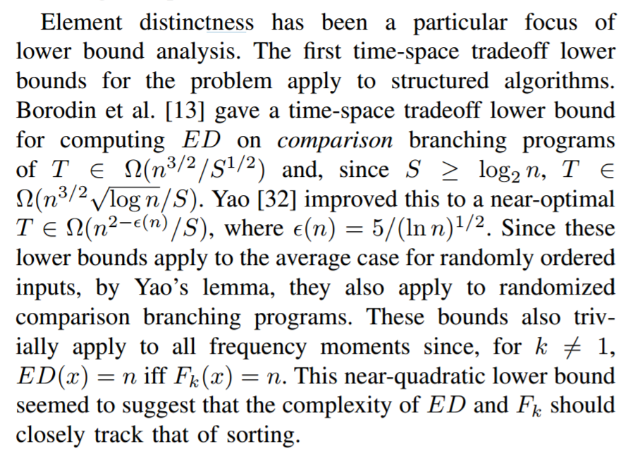
Optimal line breaking

Slide 10
Optimal Line Breaking
Words have length w_{i}, line length L
Penalty related to white space or overflow of the line
Quadratic measure often used
Pen(i, j): Penalty for putting w_{i}, w_{i+1},…,w_{j} on the same line
Opt[k, m]: minimum penalty for ending line k with w_{m}

Slide 11
Optimal Line Breaking
Optimal score for ending line k on w_{m}
Opt_{k}[m] = min _{i} { Opt_{k-1}[ i ] + Pen(i+1,m)} for 0 < i < m
4
3
2
1
 | 0 | 0 | 0 | 0 | 0 | 0 | 0 | 0 | 0 | 0 | 0 | 0 | 0 | 0 | 0 | 0 | 0

Slide 12
Longest Common Subsequence
C=c₁…c_{g} is a subsequence of A=a₁…a_{m} if C can be obtained by removing elements from A (but retaining order)
LCS(A, B): A maximum length sequence that is a subsequence of both A and B
ocurranec
occurrence
attacggct
tacgacca

Slide 13
Determine the LCS of the following strings
BARTHOLEMEWSIMPSON
KRUSTYTHECLOWN

Slide 14
String Alignment Problem
Align sequences with gaps
Charge δ_{x} if character x is unmatched
Charge γ_{xy} if character x is matched to character y
CAT TGA AT
CAGAT AGGA
Note: the problem is often expressed as a minimization problem,
with γ_{xx} = 0 and δ_{x} > 0

Slide 15
LCS Optimization
A = a₁a₂…a_{m}
B = b₁b₂…b_{n}
Opt[ j, k] is the length of LCS(a₁a₂…a_{j}, b₁b₂…b_{k})

Slide 16
Optimization recurrence
If a_{j} = b_{k}, Opt[ j,k ] = 1 + Opt[ j-1, k-1 ]
If a_{j} != b_{k}, Opt[ j,k] = max(Opt[ j-1,k], Opt[ j,k-1])

Slide 17
Give the Optimization Recurrence for the String Alignment Problem
Charge δ_{x} if character x is unmatched
Charge γ_{xy} if character x is matched to character y
Opt[ j, k] =
Let a_{j} = x and b_{k} = y
Express as minimization
Opt[j,k] = max(γ_{xy} + Opt[j-1,k-1], δ_{x} + Opt[j-1, k], δ_{y} + Opt[j, k-1])

Slide 18
String edit with Typo Distance
Find closest dictionary word to typed word
Dist(‘a’, ‘s’) = 1
Dist(‘a’, ‘u’) = 6
Capture the likelihood of mistyping characters
Different distance model for T9 on basic mobile phone

Slide 19
Dynamic Programming Computation

Slide 20
Code to compute Opt[ n, m]
for (int i = 0; i < n; i++)
for (int j = 0; j < m; j++)
if (A[ i ] == B[ j ] )
Opt[ i,j ] = Opt[ i-1, j-1 ] + 1;
else if (Opt[ i-1, j ] >= Opt[ i, j-1 ])
Opt[ i, j ] := Opt[ i-1, j ];
else
Opt[ i, j ] := Opt[ i, j-1];

Slide 21
Storing the path information
A[1..m], B[1..n]
for i := 1 to m Opt[i, 0] := 0;
for j := 1 to n Opt[0,j] := 0;
Opt[0,0] := 0;
for i := 1 to m
for j := 1 to n
if A[i] = B[j] { Opt[i,j] := 1 + Opt[i-1,j-1]; Best[i,j] := Diag; }
else if Opt[i-1, j] >= Opt[i, j-1]
{ Opt[i, j] := Opt[i-1, j], Best[i,j] := Left; }
else { Opt[i, j] := Opt[i, j-1], Best[i,j] := Down; }
b₁…b_{n}
a₁…a_{m}

Slide 22
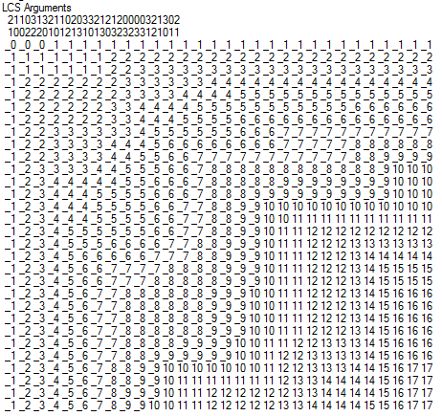
Reconstructing Path from Distances

Slide 23
How good is this algorithm?
Is it feasible to compute the LCS of two strings of length 300,000 on a standard desktop PC? Why or why not.

