Slide 1
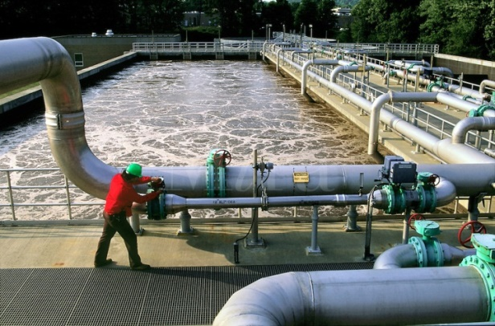
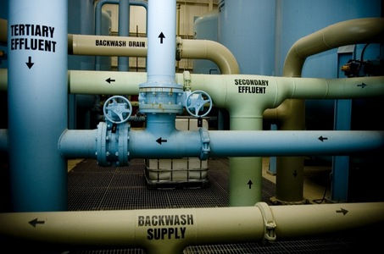
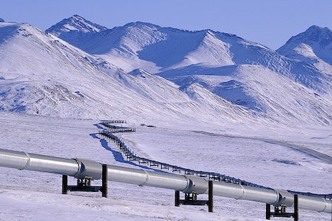
CSE 417 Algorithms and Complexity
Autumn 2020
Lecture 27
Network Flow Applications
NP-Completeness

Slide 2
Announcements
Homework 9
Exam practice problems on course homepage
Final Exam: Monday, December 14
24 hour take home exam
Target: 2 to 4 hours of work time
Wed, Dec 2 | Net Flow Applications
Fri, Dec 4 | Net Flow Applications + NP-Completeness
Mon, Dec 7 | NP-Completeness
Wed, Dec 9 | NP-Completeness
Fri, Dec 11 | Beyond NP-Completeness
Mon, Dec 14 | Final Exam

Slide 3
Problem Reduction
Reduce Problem A to Problem B
Convert an instance of Problem A to an instance of Problem B
Use a solution of Problem B to get a solution to Problem A
Practical
Use a program for Problem B to solve Problem A
Theoretical
Show that Problem B is at least as hard as Problem A

Slide 4
Minimum Cut Applications
Image Segmentation
Open Pit Mining / Task Selection Problem
Reduction to Min Cut problem
S, T is a cut if S, T is a partition of the vertices with
s in S and t in T
The capacity of an S, T cut is the sum of the capacities of
all edges going from S to T

Slide 5
Image Segmentation
Separate foreground from background

Slide 7
Image analysis
a_{i}: value of assigning pixel i to the foreground
b_{i}: value of assigning pixel i to the background
p_{ij}: penalty for assigning i to the foreground, j to the background or vice versa
A: foreground, B: background
Q(A,B) = Σ_{{i in A}}a_{i} + Σ_{{j in B}}b_{j} - Σ_{{(i,j) in E, i in A, j in} _{B}}p_{ij}

Slide 8
Pixel graph to flow graph
s
t

Slide 9
Mincut Construction
s
a_{v}
p_{vu}
u
v
p_{uv}
b_{v}
t

Slide 10
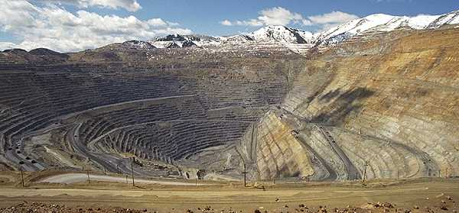
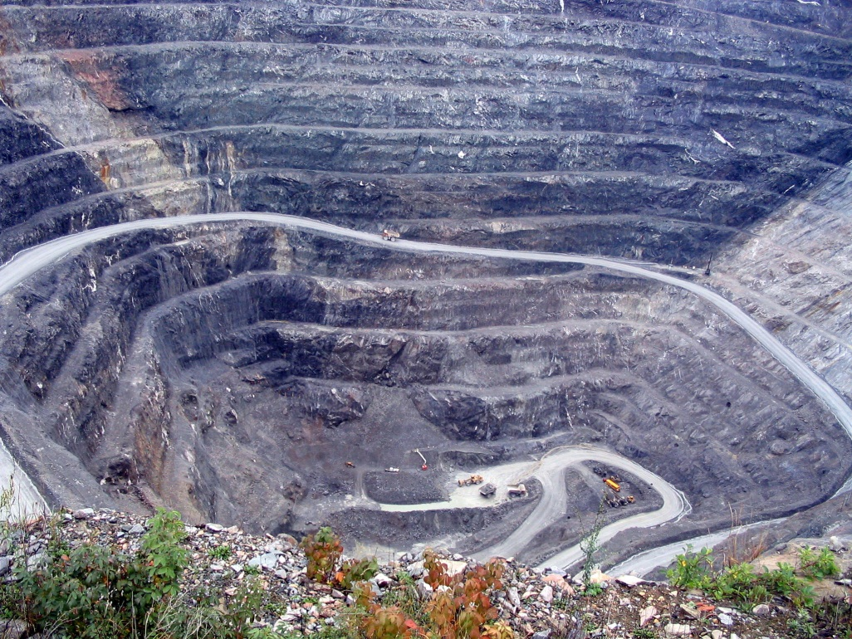
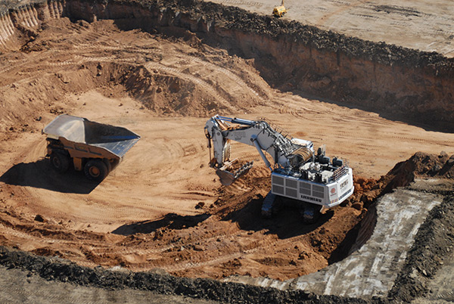
Open Pit Mining (Task selection)

Slide 11
Open Pit Mining
Each unit of earth has a profit (possibly negative)
Getting to the ore below the surface requires removing the dirt above
Test drilling gives reasonable estimates of costs
Plan an optimal mining operation

Slide 12
Mine Graph
-4
-3
-2
-1
-1
-3
3
-1
4
-7
-10
-2
8
3
-10

Slide 13
Determine an optimal mine
-5
-3
-4
-4
2
-4
3
-1
-7
-10
-1
-3
-3
3
4
4
-3
-10
-10
-10
4
7
-2
-10
3
-10
-10
-10
-10
6
8
6
-3
-10
-10
-10
-10
-10
-10
1
4
4
-10
-10
-10
-10
-10
-10
-10
-10
-10
-10
-10
-10

Slide 14
Generalization
Precedence graph G=(V,E)
Each v in V has a profit p(v)
A set F is feasible if when w in F, and (v,w) in E, then v in F.
Find a feasible set to maximize the profit
6
-4
-2
-3
5
-1
-10
4

Slide 15
Min cut algorithm for profit maximization
Construct a flow graph where the minimum cut identifies a feasible set that maximizes profit

Slide 16
Precedence graph construction
Precedence graph G=(V,E)
Each edge in E has infinite capacity
Add vertices s, t
Each vertex in V is attached to s and t with finite capacity edges

Slide 17
Find a finite value cut with at least two vertices on each side of the cut
s
Infinite
Finite
t

Slide 18
The sink side of a finite cut is a feasible set
No edges permitted from S to T
If a vertex is in T, all of its ancestors are in T

Slide 19
Setting the costs
s
If p(v) > 0,
cap(v,t) = p(v)
cap(s,v) = 0
If p(v) < 0
cap(s,v) = -p(v)
cap(v,t) = 0
If p(v) = 0
cap(s,v) = 0
cap(v,t) = 0
3
3
1
1
-3
-3
-1
0
2
3
2
1
3
t

Slide 20
Minimum cut gives optimal solution Why?
s
2
2
-2
1
2
-2
1
1
2
1
t

Slide 21
Computing the Profit
Cost(W) = Σ_{{w in W; p(w) < 0}}-p(w)
Benefit(W) = Σ_{{w in W; p(w) > 0}} p(w)
Profit(W) = Benefit(W) – Cost(W)
Maximum cost and benefit
C = Cost(V)
B = Benefit(V)

Slide 22
Express Cap(S,T) in terms of B, C, Cost(T), Benefit(T), and Profit(T)
Cap(S,T) = Cost(T) + Ben(S) = Cost(T) + Ben(S) + Ben(T) – Ben(T)
= B + Cost(T) – Ben(T) = B – Profit(T)

Slide 23
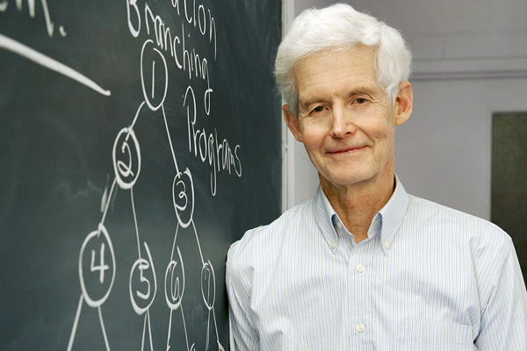
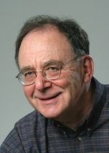
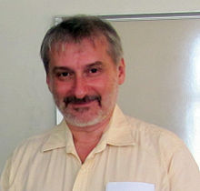
NP-Completeness

Slide 24
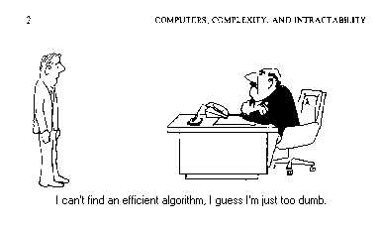
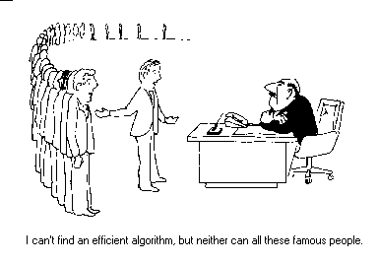
NP Completeness

Slide 25
Algorithms vs. Lower bounds
Algorithmic Theory
What we can compute
I can solve problem X with resources R
Proofs are almost always to give an algorithm that meets the resource bounds
Lower bounds
How do we show that something can’t be done?

Slide 26
Theory of NP Completeness
Most significant mathematical theory associated with computing

Slide 27
The Universe
NP-Complete
NP
P

Slide 28
Polynomial Time
P: Class of problems that can be solved in polynomial time
Corresponds with problems that can be solved efficiently in practice
Right class to work with “theoretically”

Slide 29
Decision Problems
Theory developed in terms of yes/no problems
Independent set
Given a graph G and an integer K, does G have an independent set of size at least K
Network Flow
Given a graph G with edge capacities, a source vertex s, and sink vertex t, and an integer K, does the graph have flow function with value at least K

Slide 30
Definition of P
Decision problems for which there is a polynomial time algorithm
Problem | Description | Algorithm | Yes | No
MULTIPLE | Is x a multiple of y? | Grade school division | 51, 17 | 51, 16
RELPRIME | Are x and y relatively prime? | Euclid’s algorithm | 34, 39 | 34, 51
PRIMES | Is x prime? | Agrawal, Kayal, Saxena (2002) | 53 | 51
EDIT-DISTANCE | Is the edit distance between x and y less than 5? | Dynamic programming | niether neither | acgggt ttttta
LSOLVE | Is there a vector x that satisfies Ax = b? | Gaussian elimination

Slide 31
What is NP?
Problems solvable in non-deterministic polynomial time . . .
Problems where “yes” instances have polynomial time checkable certificates

Slide 32
Certificate examples
Independent set of size K
The Independent Set
Satifisfiable formula
Truth assignment to the variables
Hamiltonian Circuit Problem
A cycle including all of the vertices
K-coloring a graph
Assignment of colors to the vertices

Slide 33
Certifiers and Certificates: 3-Satisfiability
SAT: Does a given CNF formula have a satisfying formula
Certificate: An assignment of truth values to the n boolean variables
Certifier: Check that each clause has at least one true literal,
instance s
certificate t

Slide 34
Certifiers and Certificates: Hamiltonian Cycle
HAM-CYCLE. Given an undirected graph G = (V, E), does there exist a simple cycle C that visits every node?
Certificate. A permutation of the n nodes.
Certifier. Check that the permutation contains each node in V exactly once, and that there is an edge between each pair of adjacent nodes in the permutation.
instance s
certificate t

Slide 35
Polynomial time reductions
Y is Polynomial Time Reducible to X
Solve problem Y with a polynomial number of computation steps and a polynomial number of calls to a black box that solves X
Notations: Y <_{P} X

Slide 36
Composability Lemma
If X <_{P} Y and Y <_{P} Z then X <_{P} Z

Slide 37
Lemmas
Suppose Y <_{P} X. If X can be solved in polynomial time, then Y can be solved in polynomial time.
Suppose Y <_{P} X. If Y cannot be solved in polynomial time, then X cannot be solved in polynomial time.

Slide 38
NP-Completeness
A problem X is NP-complete if
X is in NP
For every Y in NP, Y <_{P} X
X is a “hardest” problem in NP
If X is NP-Complete, Z is in NP and X <_{P} Z
Then Z is NP-Complete

Slide 39
Cook’s Theorem
The Circuit Satisfiability Problem is NP-Complete

Slide 40
Circuit SAT
AND
Satisfying assignment
x₁ = T, x₂ = F, x₃ = F
x₄ = T, x₅ = T
OR
OR
Find a satisfying assignment
AND
AND
AND
AND
NOT
OR
NOT
OR
AND
NOT
OR
AND
AND
NOT
OR
NOT
AND
x₁
x₂
x₃
x₄
x₅

Slide 41
Garey and Johnson

Slide 42
History
Jack Edmonds
Identified NP
Steve Cook
Cook’s Theorem – NP-Completeness
Dick Karp
Identified the “standard” collection of NP-Complete Problems
Leonid Levin
Independent discovery of NP-Completeness in USSR

Slide 43
P vs. NP Question
NP-Complete
NP
P NP
P

