Slide 1
CSE 417 Algorithms
Lecture 21, Autumn 2020
Dynamic Programming
Subset Sum etc.

Slide 2
Announcements
Final exam, Monday, December 14
Tentatively, 24 hour take-home exam

Slide 3
Reading
Dynamic Programming Examples:
6.1-6.2, Weighted Interval Scheduling
6.3 Segmented Least Squares
6.4 Knapsack and Subset Sum
Exercises: Billboard placement, Paragraphing
6.6 String Alignment
6.7* String Alignment in linear space
6.8 Shortest Paths (again)
6.9 Negative cost cycles
How to make an infinite amount of money

Slide 4
Subset Sum Problem
Given integers {w₁,…,w_{n}} and an integer K
Find a subset that is as large as possible that does not exceed K
Opt[ j, K ] the largest subset of {w₁, …, w_{j}} that sums to at most K
Opt[ j, K] = max(Opt[ j – 1, K], Opt[ j – 1, K – w_{j}] + w_{j})
6, 8, 9, 11, 16

Slide 5
Subset Sum Grid
Opt[ j, K] = max(Opt[ j – 1, K], Opt[ j – 1, K – w_{j}] + w_{j})
4 | 0 | 2 | 2 | 4 | 4 | 6 | 7 | 7 | 9 | 10 | 11 | 12 | 13 | 14 | 14 | 16 | 17
3 | 0 | 2 | 2 | 4 | 4 | 6 | 7 | 7 | 9 | 9 | 11 | 11 | 13 | 13 | 13 | 13 | 13
2 | 0 | 2 | 2 | 4 | 4 | 6 | 6 | 6 | 6 | 6 | 6 | 6 | 6 | 6 | 6 | 6 | 6
1 | 0 | 2 | 2 | 2 | 2 | 2 | 2 | 2 | 2 | 2 | 2 | 2 | 2 | 2 | 2 | 2 | 2
 | 0 | 0 | 0 | 0 | 0 | 0 | 0 | 0 | 0 | 0 | 0 | 0 | 0 | 0 | 0 | 0 | 0
{2, 4, 7, 10}

Slide 6
Subset Sum Code
for j = 1 to n
for k = 1 to W
Opt[j, k] = max(Opt[j-1, k], Opt[j-1, k-w_{j}] + w_{j})
Opt[ j, K] = max(Opt[ j – 1, K], Opt[ j – 1, K – w_{j}] + w_{j})

Slide 7
Knapsack Problem
Items have weights and values
The problem is to maximize total value subject to a bound on weght
Items {I₁, I₂, … I_{n}}
Weights {w₁, w₂, …,w_{n}}
Values {v₁, v₂, …, v_{n}}
Bound K
Find set S of indices to:
Maximize Σ_{iεS}v_{i} such that Σ_{iεS}w_{i} <= K

Slide 8
Knapsack Recurrence
Subset Sum Recurrence:
Opt[ j, K] = max(Opt[ j – 1, K], Opt[ j – 1, K – w_{j}] + w_{j})
Knapsack Recurrence:

Slide 9
Knapsack Grid
Opt[ j, K] = max(Opt[ j – 1, K], Opt[ j – 1, K – w_{j}] + v_{j})
4
3
2
1
 | 0 | 0 | 0 | 0 | 0 | 0 | 0 | 0 | 0 | 0 | 0 | 0 | 0 | 0 | 0 | 0 | 0
Weights {2, 4, 7, 10} Values: {3, 5, 9, 16}

Slide 10
Knapsack Grid
Opt[ j, K] = max(Opt[ j – 1, K], Opt[ j – 1, K – w_{j}] + v_{j})
4 | 0 | 3 | 3 | 5 | 5 | 8 | 9 | 9 | 12 | 16 | 16 | 18 | 18 | 21 | 21 | 24 | 25
3 | 0 | 3 | 3 | 5 | 5 | 8 | 9 | 9 | 12 | 12 | 14 | 14 | 17 | 17 | 17 | 17 | 17
2 | 0 | 3 | 3 | 5 | 5 | 8 | 8 | 8 | 8 | 8 | 8 | 8 | 8 | 8 | 8 | 8 | 8
1 | 0 | 3 | 3 | 3 | 3 | 3 | 3 | 3 | 3 | 3 | 3 | 3 | 3 | 3 | 3 | 3 | 3
 | 0 | 0 | 0 | 0 | 0 | 0 | 0 | 0 | 0 | 0 | 0 | 0 | 0 | 0 | 0 | 0 | 0
Weights {2, 4, 7, 10} Values: {3, 5, 9, 16}

Slide 11
Alternate approach for Subset Sum
Alternate formulation of Subset Sum dynamic programming algorithm
Sum[i, K] = true if there is a subset of {w₁,…w_{i}} that sums to exactly K, false otherwise
Sum [i, K] = Sum [i -1, K] OR Sum[i - 1, K - w_{i}]
Sum [0, 0] = true; Sum[i, 0] = false for i != 0
To allow for negative numbers, we need to fill in the array between K_{min} and K_{max}

Slide 12
Run time for Subset Sum
With n items and target sum K, the run time is O(nK)
If K is 1,000,000,000,000,000,000,000,000 this is very slow
Alternate brute force algorithm: examine all subsets: O(n2^{n})

Slide 13
One dimensional dynamic programming: Interval scheduling
Opt[ j ] = max (Opt[ j – 1], w_{j} + Opt[ p[ j ] ])

Slide 14
Billboard Placement
Maximize income in placing billboards
b_{i} = (p_{i}, v_{i}), v_{i}: value of placing billboard at position p_{i}
Constraint:
At most one billboard every five miles
Example
{(6,5), (8,6), (12, 5), (14, 1)}

Slide 15
Design a Dynamic Programming Algorithm for Billboard Placement
Compute Opt[1], Opt[2], . . ., Opt[n]
What is Opt[k]?
Input b₁, …, b_{n}, where b_{i} = (p_{i}, v_{i}), position and value of billboard i

Slide 16
Opt[k] = fun(Opt[0],…,Opt[k-1])
How is the solution determined from sub problems?
Input b₁, …, b_{n}, where b_{i} = (p_{i}, v_{i}), position and value of billboard i

Slide 17
Solution
j = 0; // j is five miles behind the current position
// the last valid location for a billboard, if one placed at P[k]
for k := 1 to n
while (P[ j ] < P[ k ] – 5)
j := j + 1;
j := j – 1;
Opt[ k ] := Max(Opt[ k-1 ] , V[ k ] + Opt[ j ]);

Slide 18
Two dimensional dynamic programming
Subset sum and knapsack
Opt[ j, K] = max(Opt[ j – 1, K], Opt[ j – 1, K – w_{j}] + w_{j})
Opt[ j, K] = max(Opt[ j – 1, K], Opt[ j – 1, K – w_{j}] + v_{j})
4 | 0
3 | 0
2 | 0
1 | 0
 | 0 | 0 | 0 | 0 | 0 | 0 | 0 | 0 | 0 | 0 | 0 | 0 | 0 | 0 | 0 | 0 | 0

Slide 19
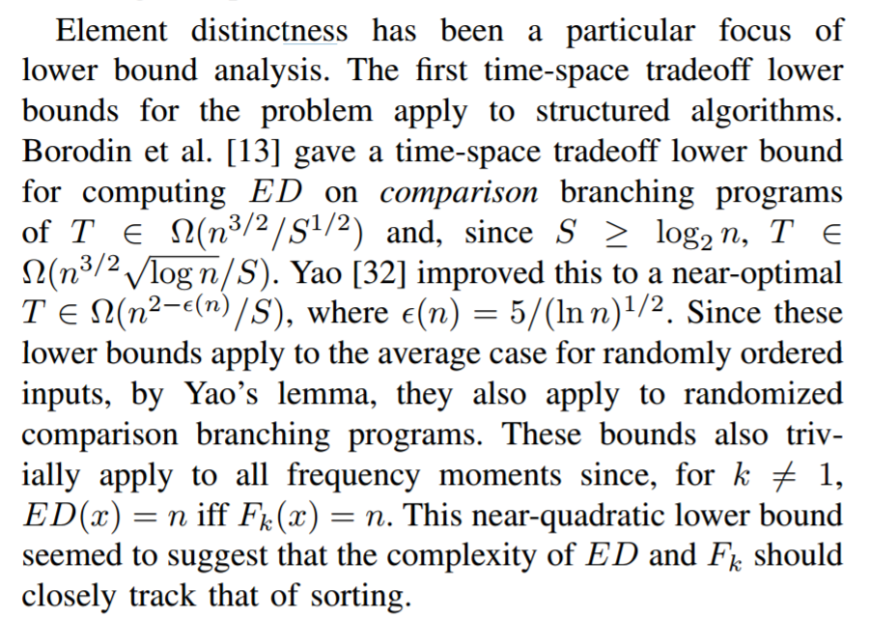
Optimal line breaking

Slide 20
Optimal Line Breaking
Words have length w_{i}, line length L
Penalty related to white space or overflow of the line
Quadratic measure often used
Pen(i, j): Penalty for putting w_{i}, w_{i+1},…,w_{j} on the same line
Opt[k, m]: minimum penalty for ending line k with w_{m}

Slide 21
Optimal Line Breaking
Optimal score for ending line k on w_{m}
Opt_{k}[m] = min _{i} { Opt_{k-1}[ i ] + Pen(i+1,m)} for 0 < i < m
4
3
2
1
 | 0 | 0 | 0 | 0 | 0 | 0 | 0 | 0 | 0 | 0 | 0 | 0 | 0 | 0 | 0 | 0 | 0

