Slide 1
CSE 417 Algorithms and Complexity
Autumn 2020
Lecture 15
Recurrences

Slide 2
Announcements
Homework 5, Due Friday

Slide 3
Divide and Conquer - MergeSort
Array Mergesort(Array a){
n = a.Length;
if (n <= 1)
return a;
b = Mergesort(a[0 .. n/2]);
c = Mergesort(a[n/2+1 .. n-1]);
return Merge(b, c);
}
Analysis: Cost of Merge, Cost of Mergesort
MS(n) = MS(n/2) + n; MS(1) = 1;
Solution: MS(n) = n (log₂ n + 1)

Slide 4
A better mergesort (?)
Divide into 3 subarrays and recursively sort
Apply 3-way merge
What is the recurrence?

Slide 5
Unroll recurrence for T(n) = 3T(n/3) + n

Slide 6
T(n) = aT(n/b) + f(n)

Slide 7
T(n) = T(n/2) + cn
Where does this recurrence arise?

Slide 8
Solving the recurrence exactly

Slide 9
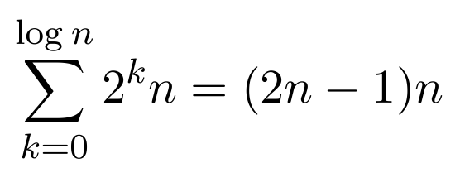
T(n) = 4T(n/2) + n
Total Work
n
n/2
n/2
n/2
n/2
n/4
n/4
n/4
n/4
n/4
n/4
n/4
n/4
n/4
n/4
n/4
n/4
n/4
n/4
n/4
n/4

Slide 10
T(n) = 2T(n/2) + n²

Slide 11
T(n) = 2T(n/2) + n^{1/2}

Slide 12
Recurrences
Three basic behaviors
Dominated by initial case
Dominated by base case
All cases equal – we care about the depth

Slide 13
What you really need to know about recurrences
Work per level changes geometrically with the level
Geometrically increasing (x > 1)
The bottom level wins
Geometrically decreasing (x < 1)
The top level wins
Balanced (x = 1)
Equal contribution

Slide 14
Classify the following recurrences (Increasing, Decreasing, Balanced)
T(n) = n + 5T(n/8)
T(n) = n + 9T(n/8)
T(n) = n² + 4T(n/2)
T(n) = n³ + 7T(n/2)
T(n) = n^{1/2} + 3T(n/4)

Slide 15
Recursive Matrix Multiplication
Multiply 2 x 2 Matrices:
| r s | | a b| |e g|
| t u | | c d| | f h|
r = ae + bf
s = ag + bh
t = ce + df
u = cg + dh
A N x N matrix can be viewed as a 2 x 2 matrix with entries that are (N/2) x (N/2) matrices.
The recursive matrix multiplication algorithm recursively multiplies the (N/2) x (N/2) matrices and combines them using the equations for multiplying 2 x 2 matrices
=

Slide 16
Recursive Matrix Multiplication
How many recursive calls are made at each level?
How much work in combining the results?
What is the recurrence?

Slide 17
What is the run time for the recursive Matrix Multiplication Algorithm?
Recurrence:

Slide 18
Strassen’s Algorithm
Where:
p₁ = (b – d)(f + h)
p₂= (a + d)(e + h)
p₃= (a – c)(e + g)
p₄= (a + b)h
p₅= a(g – h)
p₆= d(f – e)
p₇= (c + d)e
Multiply 2 x 2 Matrices:
| r s | | a b| |e g|
| t u| | c d| | f h|
=
r = p₁ + p₂ – p₄ + p₆
s = p₄ + p₅
t = p₆ + p₇
u = p₂ - p₃ + p₅ - p₇
From AHU 1974

Slide 19
Recurrence for Strassen’s Algorithms
T(n) = 7 T(n/2) + cn²
What is the runtime?
log₂ 7 = 2.8073549221

Slide 20
BFPRT Recurrence
T(n) <= T(3n/4) + T(n/5) + 20 n
What bound do you expect?

