Slide 1
CSE 417 Algorithms and Complexity
Richard Anderson
Autumn 2020
Lecture 8

Slide 2
Announcements
Reading
For today, sections 4.1, 4.2,
For next week sections 4.4, 4.5, 4.7, 4.8
Homework 3 is available
Random Graphs

Slide 3
Stable Matching Results
Averages of 5 runs
Much better for M than W
Why is it better for M?
What is the growth of m-rank and w-rank as a function of n?
n | m-rank | w-rank
500 | 5.10 | 98.05
500 | 7.52 | 66.95
500 | 8.57 | 58.18
500 | 6.32 | 75.87
500 | 5.25 | 90.73
500 | 6.55 | 77.95
1000 | 6.80 | 146.93
1000 | 6.50 | 154.71
1000 | 7.14 | 133.53
1000 | 7.44 | 128.96
1000 | 7.36 | 137.85
1000 | 7.04 | 140.40
2000 | 7.83 | 257.79
2000 | 7.50 | 263.78
2000 | 11.42 | 175.17
2000 | 7.16 | 274.76
2000 | 7.54 | 261.60
2000 | 8.29 | 246.62

Slide 4
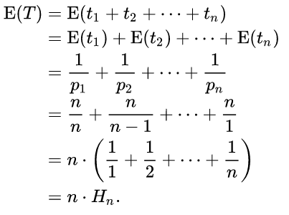
Coupon Collector Problem
n types of coupons
Each round you receive a random coupon
How many rounds until you have received all types of coupons
p_{i} is the probability of getting a new coupon after i-1 have been collected
t_{i} is the time to receive the i-th type of coupon after i-1 have been received

Slide 5
Stable Matching and Coupon Collecting
Assume random preference lists
Runtime of algorithm determined by number of proposals until all w’s are matched
Each proposal can be viewed¹ as asking a random w
Number of proposals corresponds to number of steps in coupon collector problem
¹There are some technicalities here that are being ignored

Slide 6
Highlight from last lecture: Topological Sort Algorithm
While there exists a vertex v with in-degree 0
Output vertex v
Delete the vertex v and all out going edges
3
H
1
4
2
E
I
A
6
5
D
G
12
7
J
C
9
F
10
8
K
B
L
11

Slide 7
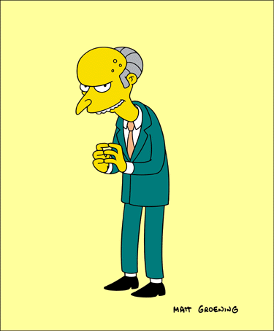
Greedy Algorithms

Slide 8
Greedy Algorithms
Solve problems with the simplest possible algorithm
The hard part: showing that something simple actually works
Pseudo-definition
An algorithm is Greedy if it builds its solution by adding elements one at a time using a simple rule

Slide 9
Scheduling Theory
Tasks
Processing requirements, release times, deadlines
Processors
Precedence constraints
Objective function
Jobs scheduled, lateness, total execution time

Slide 10
Interval Scheduling
Tasks occur at fixed times
Single processor
Maximize number of tasks completed
Tasks {1, 2, . . . N}
Start and finish times, s(i), f(i)

Slide 11
What is the largest solution?

Slide 12
Greedy Algorithm for Scheduling
Let T be the set of tasks, construct a set of independent tasks I, A is the rule determining the greedy algorithm
I = { }
While (T is not empty)
Select a task t from T by a rule A
Add t to I
Remove t and all tasks incompatible with t from T

Slide 13
Simulate the greedy algorithm for each of these heuristics
Schedule earliest starting task
Schedule shortest available task
Schedule task with fewest conflicting tasks

Slide 14
Greedy solution based on earliest finishing time
Example 1
Example 2
Example 3

Slide 15
Theorem: Earliest Finish Algorithm is Optimal
Key idea: Earliest Finish Algorithm stays ahead
Let A = {i₁, . . ., i_{k}} be the set of tasks found by EFA in increasing order of finish times
Let B = {j₁, . . ., j_{m}} be the set of tasks found by a different algorithm in increasing order of finish times
Show that for r<= min(k, m), f(i_{r}) <= f(j_{r})

Slide 16
Stay ahead lemma
A always stays ahead of B, f(i_{r}) <= f(j_{r})
Induction argument
f(i₁) <= f(j₁)
If f(i_{r-1}) <= f(j_{r-1}) then f(i_{r}) <= f(j_{r})
Since f(i_{r-1}) <= f(j_{r-1}), both i_{r} and j_{r} are available for the Earliest Finish Algorithm

Slide 17
Completing the proof
Let A = {i₁, . . ., i_{k}} be the set of tasks found by EFA in increasing order of finish times
Let O = {j₁, . . ., j_{m}} be the set of tasks found by an optimal algorithm in increasing order of finish times
If k < m, then the Earliest Finish Algorithm stopped before it ran out of tasks

Slide 18
Scheduling all intervals
Minimize number of processors to schedule all intervals

Slide 19
How many processors are needed for this example?

Slide 20
Prove that you cannot schedule this set of intervals with two processors

Slide 21
Depth: maximum number of intervals active

Slide 22
Algorithm
Sort by start times
Suppose maximum depth is d, create d slots
Schedule items in increasing order, assign each item to an open slot
Correctness proof: When we reach an item, we always have an open slot

Slide 23
Greedy Graph Coloring
Theorem: An undirected graph with maximum degree K can be colored with K+1 colors

Slide 24
Coloring Algorithm, Version 1
Let k be the largest vertex degree
Choose k colors
for each vertex v
Color[v] = uncolored
for each vertex v
Let c be a color not used in N[v]
Color[v] = c

Slide 25
Coloring Algorithm, Version 2
for each vertex v
Color[v] = uncolored
for each vertex v
Let c be the smallest color not used in N[v]
Color[v] = c

Slide 26
Scheduling tasks
Each task has a length t_{i} and a deadline d_{i}
All tasks are available at the start
One task may be worked on at a time
All tasks must be completed
Goal minimize maximum lateness
Lateness = f_{i} – d_{i} if f_{i} >= d_{i}

Slide 27
Example
Time
Deadline
2
2
3
4
2
3
Lateness 1
3
2
Lateness 3

Slide 28
Determine the minimum lateness
Show the schedule 2, 3, 4, 5 first and compute lateness
Time
Deadline
2
6
3
4
4
5
5
12

