Slide 1
CSE 417 Algorithms and Computational Complexity
Richard Anderson
Autumn 2020
Lecture 1

Slide 2
CSE 417 Course Introduction
CSE 417, Algorithms and Computational Complexity
MWF 1:30-2:20 pm
Zoomistan
Instructor
Richard Anderson, anderson@cs.washington.edu
Office hours:
Zoom
Office hours: TBD
Teaching Assistants
Josh Curtis, Anny Kong, Alon Milchgrub, Ivy Wang

Slide 3
Announcements
It’s on the course website
Homework weekly
Usually due Wednesdays
HW 1, Due Wednesday October 7, 2020
It’s on the website (or will be soon)
Homework is to be submitted electronically
Due at 1:30 PM. No late days.
You should be on the course mailing list
But it will probably go to your uw.edu account

Slide 4
Teaching on Zoom
This is my first time teaching Algorithms on Zoom
My concerns
How do I interact with the class
To get cues on how the material is coming across
To support my teaching style of quick questions
To allow questions and clarifications
I encourage questions
Chat is available, and will be moderated by TAs
Will try to use classroom activities and breakout rooms

Slide 5
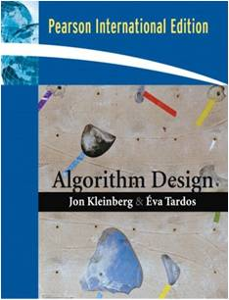
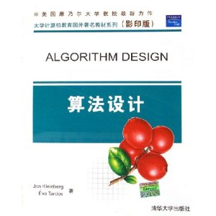
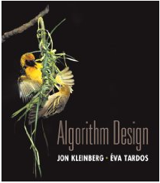
Textbook
Algorithm Design
Jon Kleinberg, Eva Tardos
Only one edition
Read Chapters 1 & 2
Expected coverage:
Chapter 1 through 7
Book available at:
UW Bookstore ($171.25/$128.45)
Ebay ($12.96 to $307.10)
Amazon ($19.18 and up)
Electronic ($59.99 / $39.99)
PDF

Slide 6
Course Mechanics
Homework
Due Wednesdays
Mix of written problems and programming
Target: 1-week turnaround on grading
Exams
Midterm, Tentatively, Monday, November 2
Final, Monday, December 14, 2:30-4:20 pm
Approximate grade weighting:
HW: 50, MT: 15, Final: 35
Course web
Slides, Handouts, Piazza Discussion Board

Slide 7
All of Computer Science is the Study of Algorithms

Slide 8
How to study algorithms
Zoology
Mine is faster than yours is
Algorithmic ideas
Where algorithms apply
What makes an algorithm work
Algorithmic thinking
Algorithm practice

Slide 9
Introductory Problem: Stable Matching
Setting:
Assign TAs to Instructors
Avoid having TAs and Instructors wanting changes
E.g., Prof A. would rather have student X than her current TA, and student X would rather work for Prof A. than his current instructor.
Purpose of the example: new, interesting problem, show how different ideas apply

Slide 10
Formal notions
Perfect matching
Ranked preference lists
Stability
m₁
w₁
m₂
w₂

Slide 11
Example (1 of 3)
m₁: w₁ w₂
m₂: w₂ w₁
w₁: m₁ m₂
w₂: m₂ m₁
m₁
w₁
m₂
w₂

Slide 12
Example (2 of 3)
m₁: w₁ w₂
m₂: w₁ w₂
w₁: m₁ m₂
w₂: m₁ m₂
m₁
w₁
m₂
w₂

Slide 13
Example (3 of 3)
m₁: w₁ w₂
m₂: w₂ w₁
w₁: m₂ m₁
w₂: m₁ m₂
m₁
w₁
m₂
w₂

Slide 14
Formal Problem
Input
Preference lists for m₁, m₂, …, m_{n}
Preference lists for w₁, w₂, …, w_{n}
Output
Perfect matching M satisfying stability property:
∀ m’, w’’, (m’, w’’) is NOT an instability
If (m’, w’) ∈ M and (m’’, w’’) ∈ M then
(m’ prefers w’ to w’’) or (w’’ prefers m’’ to m’)

Slide 15
Idea for an Algorithm
m proposes to w
If w is unmatched, w accepts
If w is matched to m₂
If w prefers m to m₂ w accepts m, dumping m₂
If w prefers m₂ to m, w rejects m
Unmatched m proposes to the highest w on its preference list that it has not already proposed to

Slide 16
Algorithm
Initially all m in M and w in W are free
While there is a free m
w highest on m’s list that m has not proposed to
if w is free, then match (m, w)
else
suppose (m₂, w) is matched
if w prefers m to m₂
unmatch (m₂, w)
match (m, w)

Slide 17
Example
m₁: w₁ w₂ w₃
m₂: w₁ w₃ w₂
m₃: w₁ w₂ w₃
w₁: m₂ m₃ m₁
w₂: m₃ m₁ m₂
w₃: m₃ m₁ m₂
m₁
w₁
m₂
w₂
m₃
w₃
Order: m₁, m₂, m₃, m₁, m₃, m₁

Slide 18
Does this work?
Does it terminate?
Is the result a stable matching?
Begin by identifying invariants and measures of progress
m’s proposals get worse (have higher m-rank)
Once w is matched, w stays matched
w’s partners get better (have lower w-rank)

Slide 19
Claim: If an m reaches the end of its list, then all the w’s are matched

Slide 20
Claim: The algorithm stops in at most n² steps
Each m asks each w at most once

Slide 21
When the algorithms halts, every w is matched
Why?
Hence, the algorithm finds a perfect matching
Invariant: partial matching
What happens when some m reaches its last choice?
exactly n-1 w’s much be matched
last choice must be available

Slide 22
The resulting matching is stable
Suppose
(m₁, w₁) ∈ M, (m₂, w₂) ∈ M
m₁ prefers w₂ to w₁
How could this happen?
m₁
w₁
m₂
w₂
m₁ proposed to w₂ before w₁
w₂ rejected m₁ for m₃
w₂ prefers m₃ to m₁
w₂ prefers m₂ to m₃

Slide 23
Result
Simple, O(n²) algorithm to compute a stable matching
Corollary
A stable matching always exists

