Slide 1
CSE/STAT 416
Neural Networks
Pre-Lecture Videos
Tanmay Shah
Paul G. Allen School of Computer Science & Engineering
University of Washington
July 17 , 2024

Slide 2
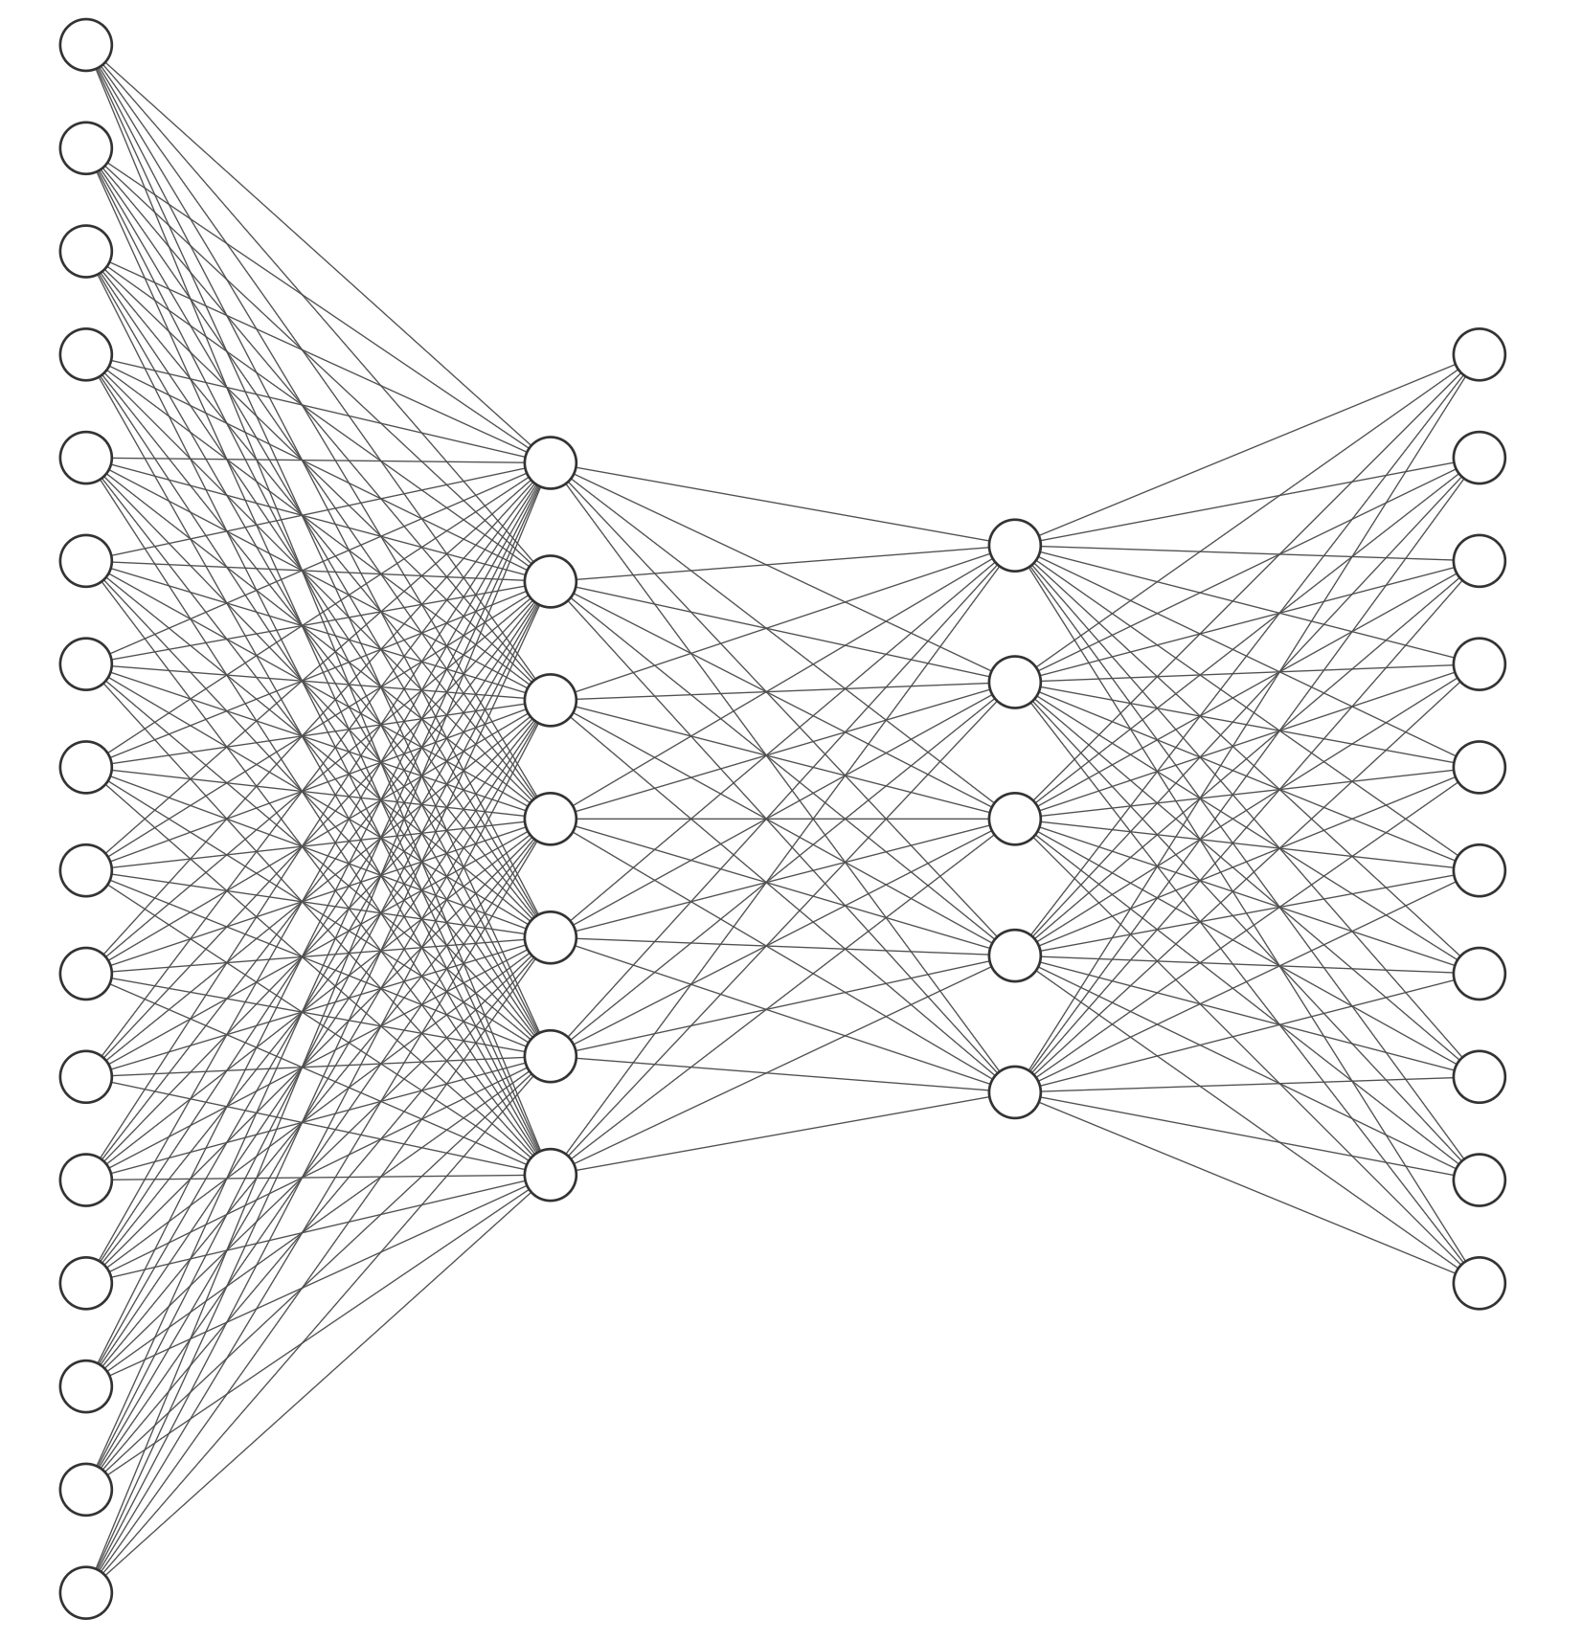
Deep Learning
A lot of the buzz about ML recently has come from recent advancements in deep learning.
When people talk about “deep learning” they are generally talking about a class of models called neural networks that are a loose approximation of how our brains work.
Notes:
WOS:
Input Layer
Hidden Layers
Output Layer

Slide 3
Recall:
Linear Classifier
Remember the linear classifier based on score

Slide 4
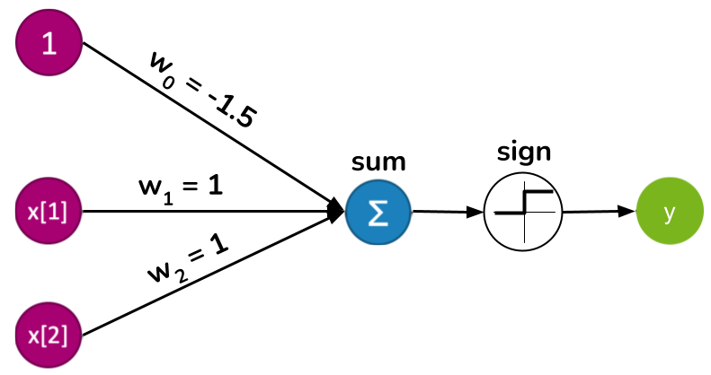
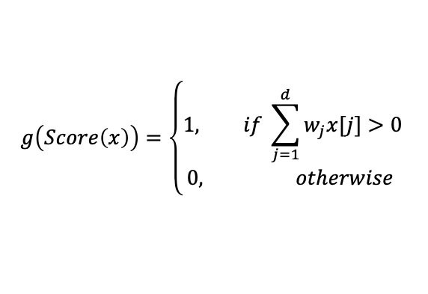
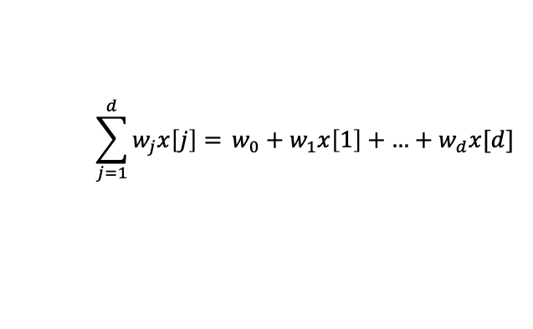
Perceptron
Graphical representation of this same classifier
This is called a perceptron
Input
Output
$$\sum_{j=1}^{d}{w_{j}x\left[j\right]= }w_{0}+w_{1}x\left[1\right]+\text{…}+w_{d}x[d]$$
$$g\left(Score\left(x\right)\right)=\left\{\begin{aligned}1, if \sum_{j=1}^{d}{w_{j}x[j]}>0 \\ 0, otherwise \end{aligned}\right.$$
Notes:
Write ”Score” next to sum
Write “Activation function” next to g
Circle last 3 bits
Write sign(score(x))
Draw it with the bias on the node

Slide 5
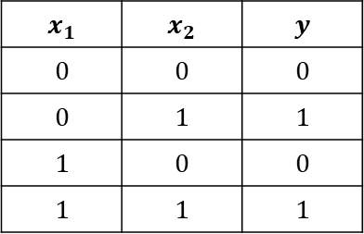
XOR
The perceptron can learn most boolean functions, but XOR always has to ruin the fun.
This data is not linearly separable, therefore can’t be learned with the perceptron
$$x_{1}$$ | $$x_{2}$$ | $$y$$
$$0$$ | $$0$$ | $$0$$
$$0$$ | $$1$$ | $$1$$
$$1$$ | $$0$$ | $$0$$
$$1$$ | $$1$$ | $$1$$
Notes:
Recall that a single-layer perceptron is another way to code up the linear classifier you learned. So it can learn a line in this 2D space that separates positives from negatives. And and or are linearly separable (draw them)
WOS:
AND and OR
Draw the line for AND w2 = 1.5 – w1
Draw the line for OR w2 = 0.5 – w1

Slide 6
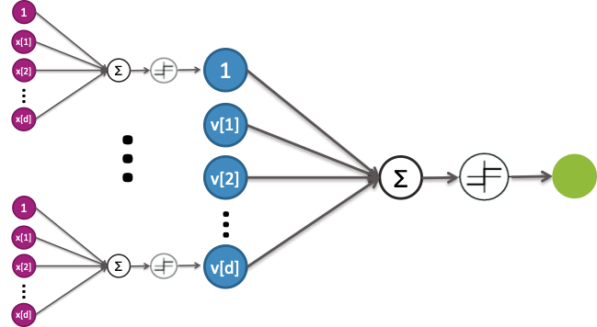
Multi-Layer Perceptron (Neural Network)
Idea: Combine these perceptrons in layers to learn more complex functions.
Notes:
The mechanics are the same as before, but we use the outputs of the magenta layer as the input to the blue layer, and the outputs of the blue layer as the inputs to the green layer
WOS:
w_i^{(d)} on the input layers
v[k] = sign(\sum_{j=1}^d w_j^(k)x[j])

Slide 7
Neural Network Diagram Simplified
Since the inputs are the same, typically we combine them in the diagram, with multiple arrows coming out.
We don’t explicitly show the sum and activation function – that is implicitly a part of each node.

Slide 8
Neural Network Diagram Simplified Further
Oftentimes, the bias is not explicitly shown as another input, and instead written on top of a node.
You will see both types of diagrams in this course.
b₁
b₂
b_{d}

Slide 9

XOR
Notice that we can represent
$$x\left[1\right] XOR x\left[2\right]=\left(x\left[1\right] AND !x[2]\right) OR (!x\left[1\right] AND x\left[2\right])$$
Notes:
On the equation, write v1 or v2
Draw v[1] and v[2] under each clause
Walk through example of (1, 0)

Slide 10
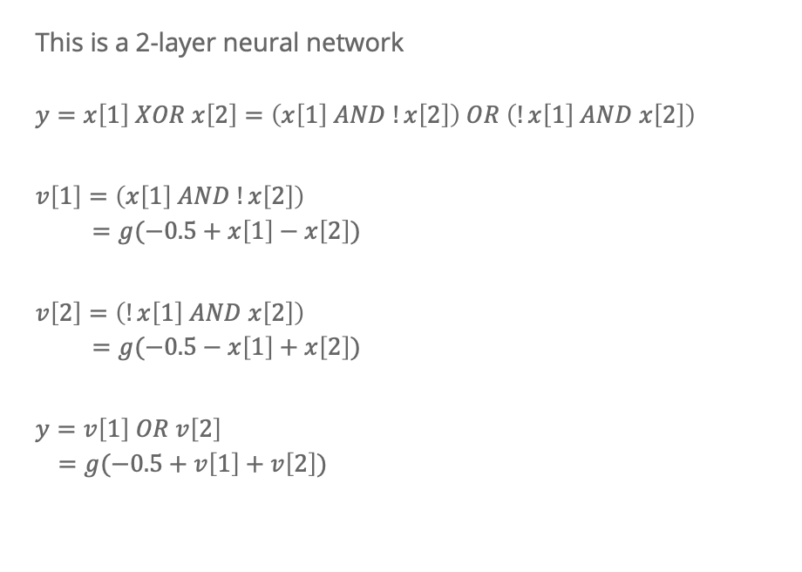
XOR
This is a 2-layer neural network
$$y=x\left[1\right] XOR x\left[2\right]=\left(x\left[1\right] AND !x\left[2\right]\right) OR \left(!x\left[1\right] AND x\left[2\right]\right)$$
$$v\left[1\right]=\left(x\left[1\right] AND !x\left[2\right]\right) \\ =g(−0.5+x\left[1\right]−x\left[2\right])$$
$$v\left[2\right]=\left(!x\left[1\right] AND x\left[2\right]\right) \\ =g(−0.5−x\left[1\right]+x\left[2\right])$$
$$y=v\left[1\right] OR v\left[2\right] \\ =g(−0.5+v\left[1\right]+v\left[2\right])$$

Slide 11
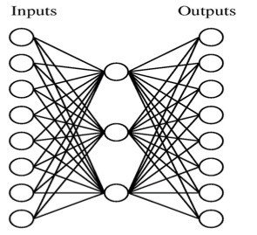
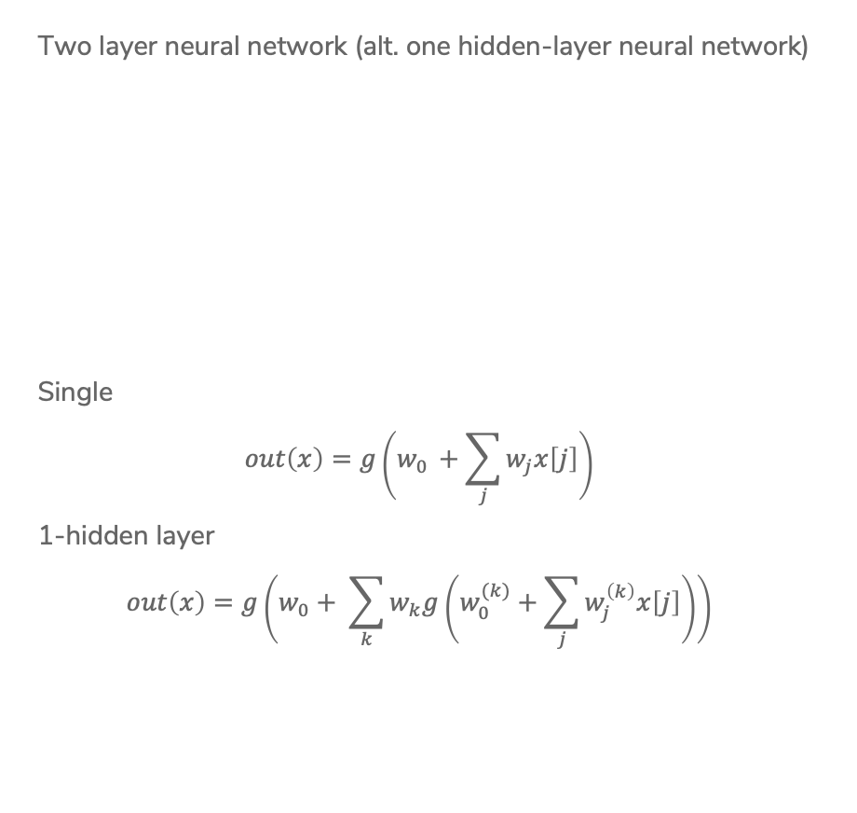
Neural Network
Two layer neural network (alt. one hidden-layer neural network)
Single
$$out\left(x\right)=g\left(w_{0 }+\sum_{j}{w_{j}x\left[j\right]}\right)$$
1-hidden layer
$$out\left(x\right)=g\left(w_{0}+ \sum_{k}{w_{k}g\left(w_{0 }^{(k)}+\sum_{j}{w_{j}^{\left(k\right)}x\left[j\right]}\right)}\right)$$
Notes:
Highlight inside is v[k]
G is activation function

Slide 12
Power of 2-layer NN
A surprising fact is that a 2-layer network can represent any function, if we allow enough nodes in hidden layer.
For this example, consider regression function with one input.
See more here: http://neuralnetworksanddeeplearning.com/chap4.html
Notes:
In regression, the output layer often doesn’t have an activation function.
WOS:
Draw step function for each and how to combine them
Draw fancy function with step approximation
Potentially show the demo?

Slide 13
CSE/STAT 416
Neural Networks
Tanmay Shah
Paul G. Allen School of Computer Science & Engineering
University of Washington
July 17 , 2024
❓ Questions? Raise hand or sli.do #cs416
🎵 Listening to: Lady Lamb

Slide 14
Aside: Missing Data

Slide 15
Missing Data: Idea 1
Idea 1: Remove rows (datapoints) with missing values.
Train Set
Test Set
Credit | Term | Income | Loan Safety
fair | 5 yrs | $100K | Safe
excellent | 3 yrs |  | Risky
poor | 5 yrs | $75K | Risky
Credit | Term | Income | Prediction
excellent | 3 yrs | $100K
fair | 5 yrs | $20K
poor | 3 yrs
Notes:
WOS: BAD IDEA

Slide 16
Missing Data: Idea 2
Idea 2: Remove columns (features) with missing values.
Train Set
Test Set
Credit | Term | Income | Loan Safety
fair | 5 yrs | $100K | Safe
excellent | 3 yrs |  | Risky
poor | 5 yrs | $75K | Risky
Credit | Term | Income | Prediction
excellent | 3 yrs | $100K
fair | 5 yrs | $20K
poor | 3 yrs

Slide 17
Missing Data: Idea 3
Idea 3: Treat missing values as a separate value of the feature (only Decision Trees)
Train Set
Test Set
Credit | Term | Income | Loan Safety
fair | 5 yrs | $100K | Safe
excellent | 3 yrs |  | Risky
poor | 5 yrs | $75K | Risky
Credit | Term | Income | Prediction
excellent | 3 yrs | $100K
fair | 5 yrs | $20K
poor | 3 yrs

Slide 18
Missing Data: Idea 4
Idea 4: Replace missing values with a reasonable statistic (Imputation)
Train Set
Test Set
Credit | Term | Income | Loan Safety
fair | 5 yrs | $100K | Safe
excellent | 3 yrs |  | Risky
poor | 5 yrs | $75K | Risky
Credit | Term | Income | Prediction
excellent | 3 yrs | $100K
fair | 5 yrs | $20K
poor | 3 yrs
(Most Commonly Used!)
Notes:
WOS: star, most commonly used

Slide 19
Introduction to Neural Networks

Slide 20
Roadmap
So Far
Housing Prices - Regression
  Regression Model
  Assessing Performance
  Ridge Regression
  LASSO
Sentiment Analysis – Classification
  Classification Overview
  Logistic Regression
  Naïve Bayes
  Decision Trees
  Ensemble Methods
Neural Networks – Image Classification
  Neural Networks
  Convolutional Neural Networks

Slide 21
History of Neural Networks
Generally layers and layers of linear models and non-linearities (activation functions).
Have been around for about 50 years
Fell in “disfavor” in the 90s when simpler models were doing well
In the last decade(s), have had a huge resurgence
Impressive accuracy on several benchmark problems
Have risen in popularity due to huge datasets, GPUs, and improvements to

Slide 22
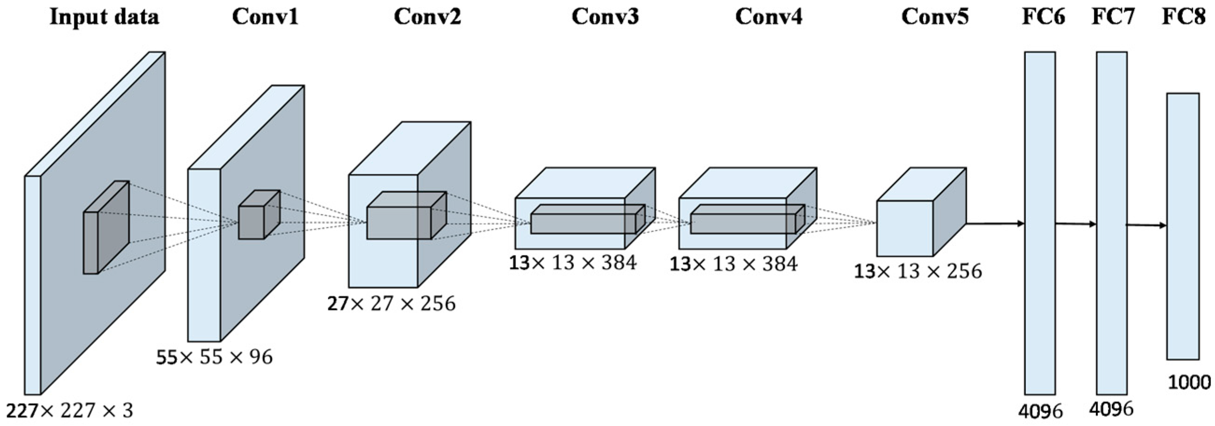
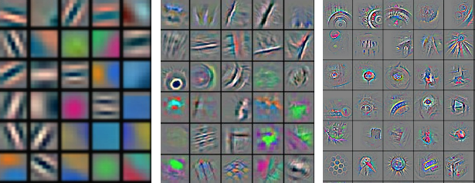
Popular Neural Network Architectures: CNNs
Convolutional Neural Networks (CNNs) are commonly used in Computer Vision. We’ll learn about these on Wed!
Notes:
WOS
R,G,B, 3 features
96 low-level features
Arrow between intermediate features and the conv layers
Sources:
https://www.mdpi.com/2072-4292/9/8/848/htm
https://engineering.flipboard.com/2015/05/scaling-convnets
From https://cs.nyu.edu/~yann/talks/lecun-ranzato-icml2013.pdf
From https://arxiv.org/pdf/1311.2901.pdf

Slide 23
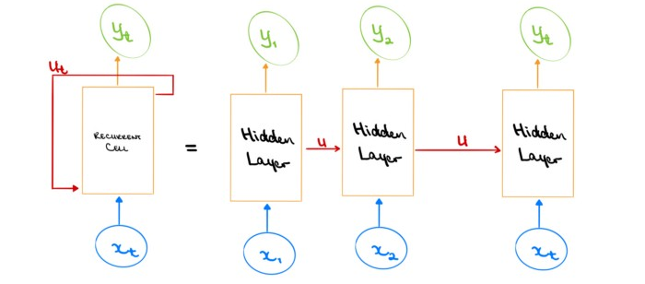
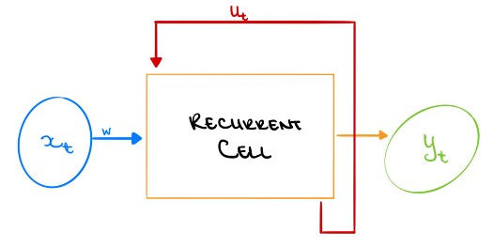
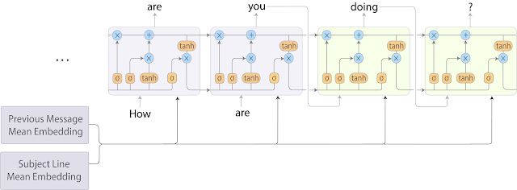
Popular Neural Network Architectures: RNNs
Recurrent Neural Networks(RNNs) are commonly used in Natural Language Processing, where the model must remember context from earlier in the text.
Notes:
WOS:
Gmail Diagram: Input, Predicted Output
Source:
https://towardsdatascience.com/introducing-recurrent-neural-networks-f359653d7020
https://ai.googleblog.com/2018/05/smart-compose-using-neural-networks-to.html

Slide 24
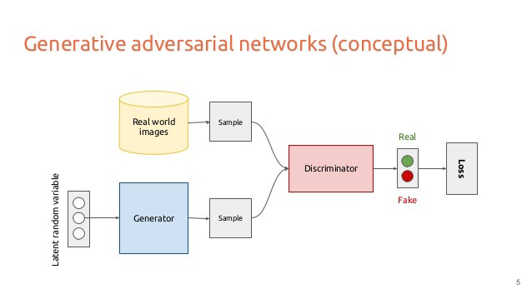
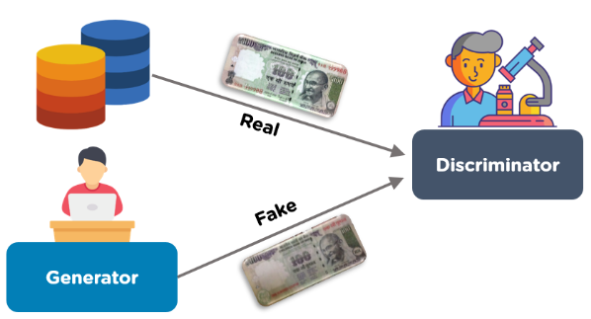
Popular Neural Network Architectures: GANs
Train two networks together:
  Generator Network: generate fake images
  Discriminator Network: given a real image and a fake image, determine which is fake
https://thispersondoesnotexist.com/
Notes:
Source:
https://www.simplilearn.com/tutorials/deep-learning-tutorial/generative-adversarial-networks-gans
https://medium.com/@saibharath897/generative-adversarial-networks-gans-560c5c988128

Slide 25

Notes:
From “Progressive Growing of GANs for Improved Quality, Stability, and Variation” https://www.youtube.com/watch?v=G06dEcZ-QTg&ab_channel=TeroKarrasFI

Slide 26
Neural Network Details

Slide 27
XOR
This is a 2-layer neural network
$$y=x\left[1\right] XOR x\left[2\right]=\left(x\left[1\right] AND !x\left[2\right]\right) OR \left(!x\left[1\right] AND x\left[2\right]\right)$$
$$v\left[1\right]=\left(x\left[1\right] AND !x\left[2\right]\right) \\ =g(−0.5+x\left[1\right]−x\left[2\right])$$
$$v\left[2\right]=\left(!x\left[1\right] AND x\left[2\right]\right) \\ =g(−0.5−x\left[1\right]+x\left[2\right])$$
$$y=v\left[1\right] OR v\left[2\right] \\ =g(−0.5+v\left[1\right]+v\left[2\right])$$

Slide 28
2 mins
Compute the output for input (0, 1). There is a sign activation function on the hidden layers and output layer.
2
2
2
3
-1
1
3
1
-2
Notes:
Clarify that -1 is the bias on the final layer

Slide 29
2 mins
Compute the output for input (0, 1). There is a sign activation function on the hidden layers and output layer.
2
2
2
3
-1
1
3
1
-2
Notes:
First hidden: sign(2*0+3*1+2) = sign(5) = 1
Second hidden: sign(1*0-2*1+1) = sign(-1) = 0
Output: sign(2*1+3*0-1) = sign(1) = 1

Slide 30
Activation Function
Before, we were using the sign activation function.
This is not generally used in practice.
  Not differentiable
  No notion of confidence
What if we use the logistic function instead?
Notes:
Draw picture: sign vs. logistic
Write the logistic equation: g(z) = 1/(1+e^{-z})

Slide 31
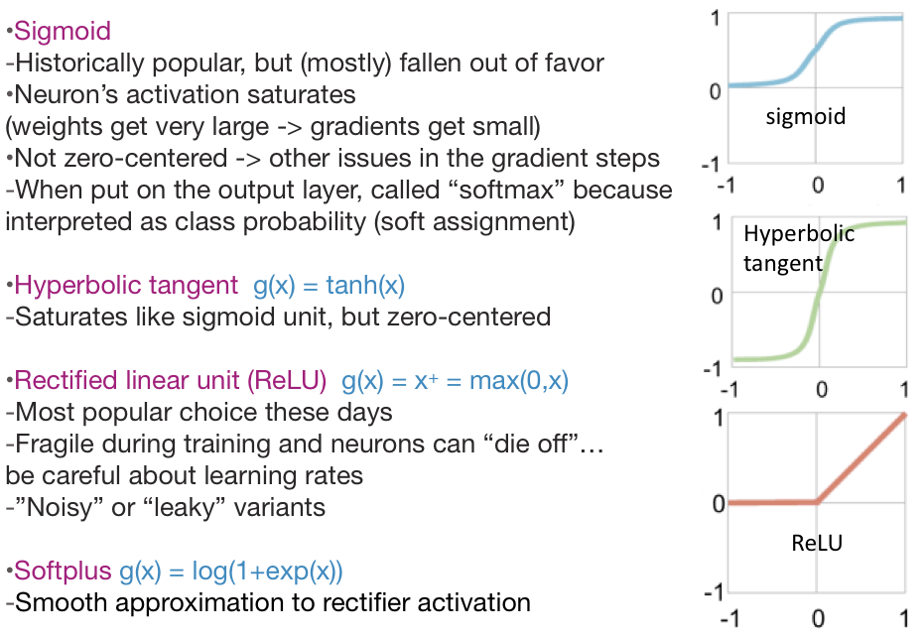
Activation Functions
Notes:
Very important: These are considered hyperparameters to the model. Choosing which non-linearity you use affects your results! You sometimes have to try many to see which one works best

Slide 32
Classification or Regression
You can use neural networks for classification and regression!
Regression
The output layer will generally have one node that is the output (outputs a single number). Don’t apply activation to the last layer.
Classification
The output layer will have one node per class. Usually take the node with the highest score as the prediction for an example. Can also use the logistic function (softmax) to turn scores into probabilities!
Notes:
Draw a classification versus regression neural network.

Slide 33
Overfitting NNs
Are NNs likely to overfit? YES.
Consequence of being able to fit any function!
How to avoid overfitting?
Get more training data
Few hidden nodes / better architecture
  Rule of thumb: 3-layer NNs outperform 2-layer NNs, but going deeper only helps if you are very careful (different story next time with convolutional neural networks)
Regularization
  Dropout
Early stopping

Slide 34


Slide 35
Application to Computer Vision

Slide 36
Image Features
Features in computer vision are local detectors
Combine features to make prediction
In reality, these features are much more low level (e.g. Corner?)

Slide 37
The Past
A popular approach to computer vision was to make hand-crafted features for object detection
Relies on coming up with these features by hand (yuck!)

Slide 38
NNs to the Rescue
Neural Networks implicitly find these low level features for us!
Each layer learns more and more complex features

Slide 39
Training Neural Networks

Slide 40
Learning Coefficients
So the idea of neural networks might make sense, but how do we actually go about learning the coefficients in the layers?
First we need to define a quality metric or cost function
For regression, generally use MSE or RMSE
For classification, generally use something call the Cross Entropy loss.
Can we use gradient descent here? Actually yes!
How do we take the derivative of a network?
Are there convergence guarantees?

Slide 41
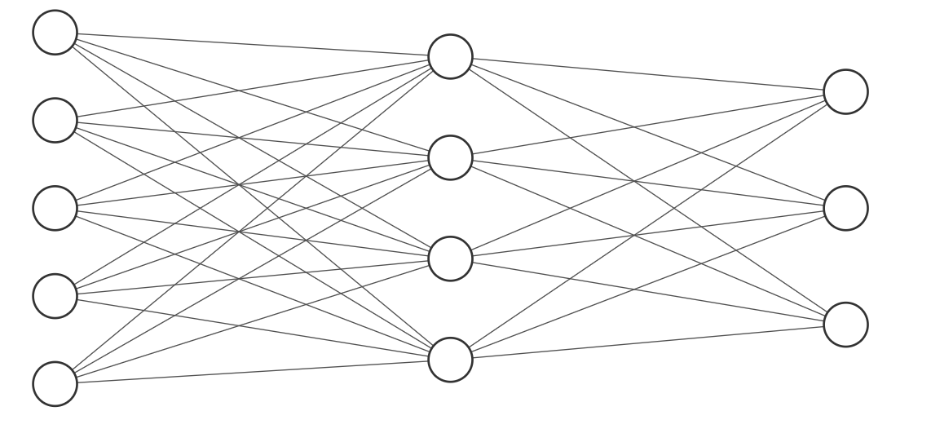
Backpropagation
What does gradient descent do in general? Have the model make predictions and update the model in a special way such that the new weights have lower error.
To do gradient descent with neural networks, we generally use backpropagation.
Do a forward pass of the data through the network to get predictions
Compare predictions to true values
Backpropagate errors so the weights make better predictions
Notes:
Show input image with label dog
Draw forward pass and prediction
Draw compare and actual
Draw backwards pass

Slide 42
Training a NN
It’s pretty expensive to do this update for the entire dataset at once, so it’s common to break it up into small batches to process individually.
However, processing each batch only once isn’t enough. You generally have to repeatedly update the model parameters. We call an iteration that goes over every batch once an epoch.
for i in range(num_epochs):
for batch in batches(training_data):
preds = model.predict(batch.data) # Forward pass
diffs = compare(preds, batch.labels) # Compare
model.backprop(diffs) # Backpropagation
Notes:
Draw a training set broken up into batches

Slide 43
NN Convergence
In general, loss functions with neural networks are not convex.
This means the backprop algorithm for gradient descent will only converge to a local optima.
This means that how you initialize the weights is really important and can impact the final result.
How should you initialize weights?
Usually people do random initialization
People also use adaptive ways of changing the learning rate to reduce the empirical likelihood of getting stuck in local minima.
¯\_(ツ)_/¯
Notes:
Draw a convex vs. non-convex function

Slide 44

1 mins
Consider the below neural network, used for regression (hence, no activation on the last layer).
The input, prediction, and actual label are shown.
To move the prediction slightly closer to the label, would you (increase / decrease) $w_{1}$?
Input
1
Prediction
Label
3
-5.5
1
-7
Notes:
WOS: show the math
Mention that its not just binary increase or decrease, it is how much to increase or decrease relative to others.
Mention that in reality, you aren’t computing the gradient for one input separately. You’re computing the gradient on a whole batch. So your error is not just the error of one input, but rather the average error across inputs.
WOS: In reality: MSE

Slide 45
Backpropogation Intuition on Multiple Layers
b₁
b₂
b_{d}
Notes:
Draw the weights
Draw the error
For each weight on the last layer, write an up arrow with a question mark and a down arrow with a question mark.
Same with bias.
For some of the other weights, write arrows with question marks, but mention it is more complicated because for one node it might have to go down but for another node it might have to go up.

Slide 46
Hyper-parameter Tuning

Slide 47
Training NN
Neural Networks have MANY hyperparameters
How many hidden layers and hidden neurons?
What activation function?
What is the learning rate for gradient descent?
What is the batch size?
How many epochs to train?
And much much more!
How do you decide these values should be?
The most frustrating thing is that we don’t have a great grasp on how these things impact performance, so you generally have to try them all.
¯\_(ツ)_/¯

Slide 48
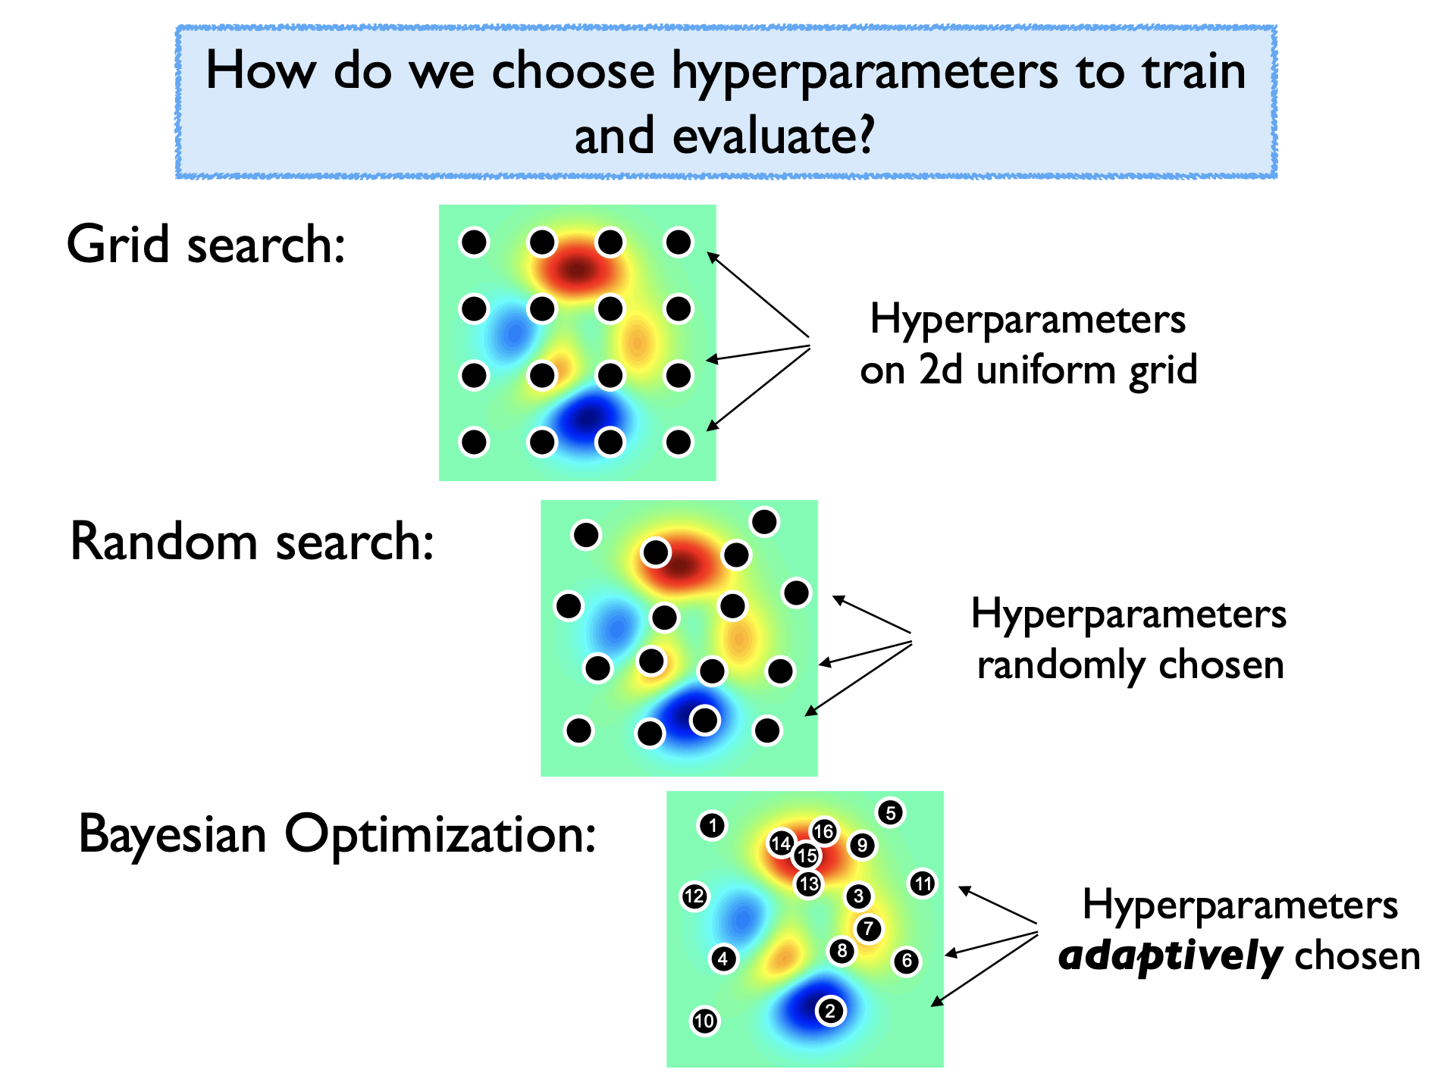
Hyperparameter Optimization
Notes:
Write lambda 1 and lambda 2 with options
The graph shows the validation error after training the model with those hyperaprameters. Of course, we would never generate this graph because we wouldn’t be able to train it with every single hyperparameter, so instead we use a few combinations.

Slide 49
Hyperparameter Optimization
Notes:
Circle points that are different

Slide 50
Hyperparameter Optimization
Notes:
Bayesian optimization tries to model the function that maps hyperparameter choices to validation error. It uses the model to predict which hyperparameter is likely to have the best performance, when you try that and get the validation error, it improves its performance.

Slide 51
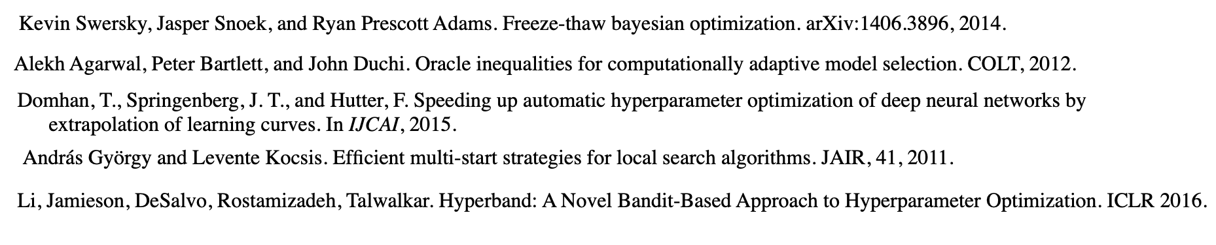
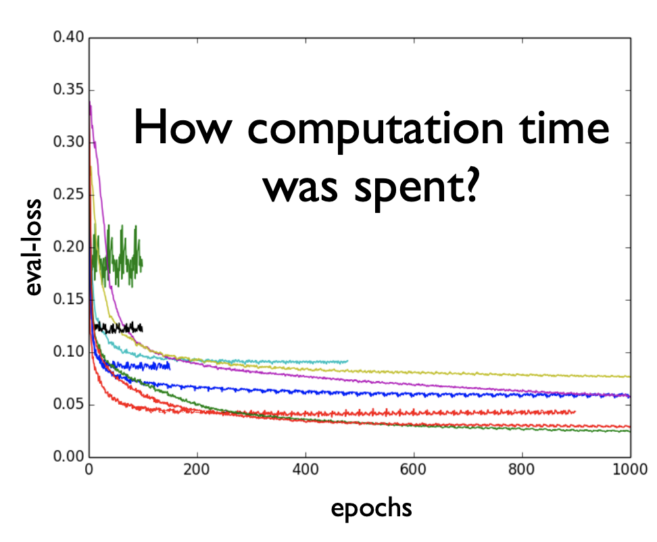
Hyperparameter Optimization
Recent work attempts to speed up hyperparameter evaluation by stopping poor performing settings before they are fully trained.

Slide 52
Tips on Hyperparameter Optimization
In general, hyperparameter optimization is a non-convex optimization problem where we know very little about how the function behaves.
Your time is valuable and compute time is cheap. Write your code to be modular so you can use compute time to try a range of values.
Tools for different purposes
Very few evaluations: use random search (and pray)
Few evaluations and long-run computations: See last slide
Moderate number of evaluations: Bayesian optimization
Many evaluations possible: Use random search. Why overthink it?
Notes:
Use grad student descent

Slide 53
Recap
Theme: Details of neural networks and how to train them
Ideas:
Perceptron (Single-Layer Neural Network)
Neural Networks
Activation functions
Neural Networks and Overfitting
Backpropagation idea
NN Hyperparameters
Hyperparameter optimization
NN Convergence guarantees

