Slide 1
CSE/STAT 416
Naïve Bayes and Decision Trees
Pre-Class Videos
Tanmay Shah
Paul G. Allen School of Computer Science & Engineering
University of Washington
July 10, 2024

Slide 2
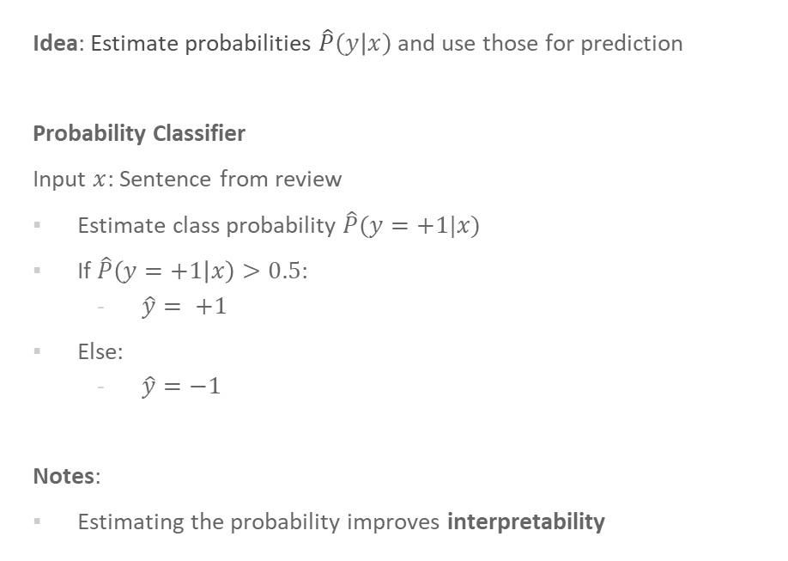
Probability Classifier
Idea: Estimate probabilities $\hat{P}\left(y | x\right)$ and use those for prediction
Probability Classifier
Input $x$: Sentence from review
Estimate class probability $\hat{P}(y=+1|x)$
If $\hat{P}\left(y=+1 | x\right)>0.5$:
  $\hat{y}= +1$
Else:
  $\hat{y}=−1$
Notes:
Estimating the probability improves interpretability

Slide 3















Interpreting Score
$$Score\left(x_{i}\right)=w^{T}h\left(x_{i}\right)$$
$$−∞$$
$${\hat{y}}_{i}=−1$$
$$0$$
$${\hat{y}}_{i}=+1$$
$$∞$$
Very sure
$${\hat{y}}_{i}=−1$$
Not sure if
$${\hat{y}}_{i}=−1 or {\hat{y}}_{i}=+1$$
Very sure
$${\hat{y}}_{i}=+1$$
$$\hat{P}\left(y_{i}=+1|x_{i}\right)=0$$
$$\hat{P}\left(y_{i}=+1|x_{i}\right)=0.5$$
$$\hat{P}\left(y_{i}=+1|x_{i}\right)=1$$
$$0$$
$$\hat{P}(y=+1 |x)$$
$$1$$

Slide 4

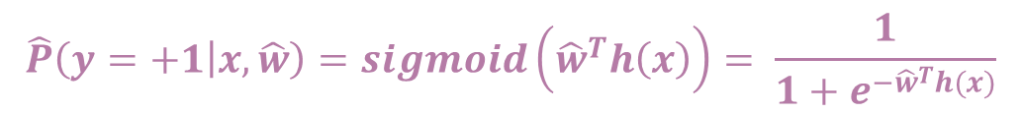



$$\hat{P}\left(y=+1 | x, \hat{w}\right)=sigmoid\left({\hat{w}}^{T}h\left(x\right)\right)= \frac{1}{1+e^{−{\hat{w}}^{T}h(x)}}$$
Training
Data
$$x$$
Feature
extraction
$$h(x)$$
ML
model
$$y$$
$$\hat{w}$$
ML algorithm
Quality
metric

Slide 5
Naïve Bayes

Slide 6
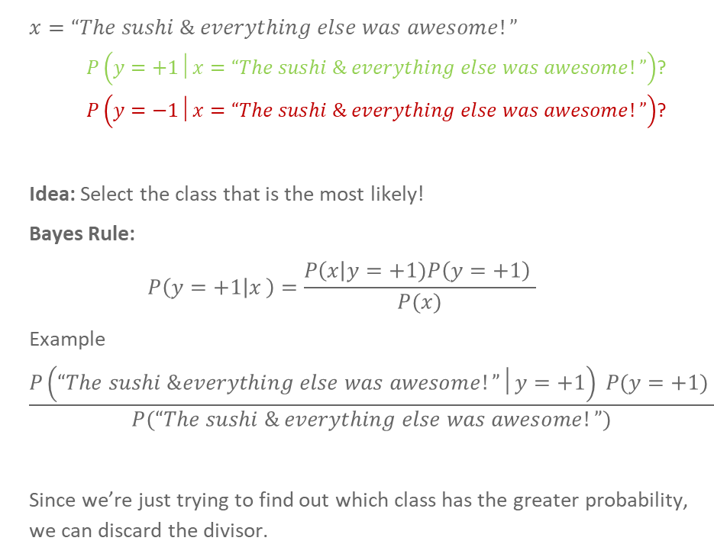
Idea:
Naïve Bayes
$$x=“The sushi \& everything else was awesome!”$$
  $P\left(y=+1│x=“The sushi \& everything else was awesome!”\right)$?
  $P\left(y=−1│x=“The sushi \& everything else was awesome!”\right)$?
Idea: Select the class that is the most likely!
Bayes Rule:
$$P\left(y=+1 | x_{ }\right)=\frac{P\left(x\right|y=+1)P\left(y=+1\right) }{P(x)}$$
Example
$$\frac{P\left(“The sushi \&everything else was awesome!”│y=+1\right) P(y=+1) }{P(“The sushi \& everything else was awesome!”)}$$
Since we’re just trying to find out which class has the greater probability, we can discard the divisor.

Slide 7
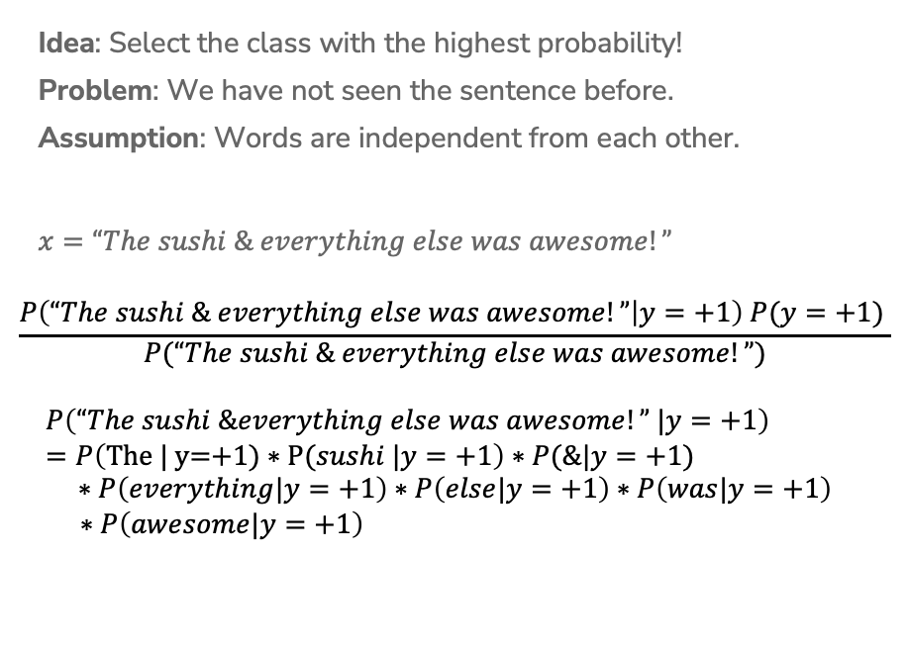
Naïve Assumption
Idea: Select the class with the highest probability!
Problem: We have not seen the sentence before.
Assumption: Words are independent from each other.
$$x=“The sushi \& everything else was awesome!”$$
$$\frac{P\left(“The sushi \& everything else was awesome!” | y=+1\right) P(y=+1) }{P(“The sushi \& everything else was awesome!”)}$$
$$P\left(“The sushi \&everything else was awesome!” |y=+1\right)=P\left(\text{The}\text{ | }\text{y}\text{=+1) ∗ }\text{P}\text{(}sushi |y=+1\right)∗P(\&|y=+1) \\ ∗P\left(everything|y=+1\right)∗P\left(else|y=+1\right)∗P\left(was|y=+1\right)$$
$∗P\left(awesome|y=+1\right)$

Slide 8

Compute Probabilities
How do we compute something like
$$P\left(y=+1\right)?$$
How do we compute something like
$$P\left(“awesome” |y=+1\right)?$$

Slide 9
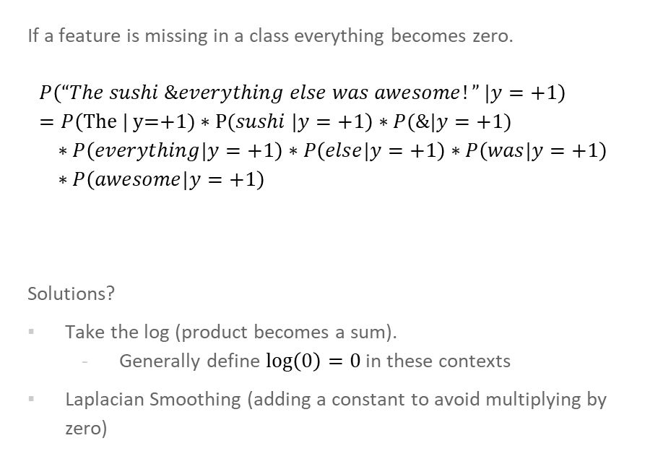
Zeros
If a feature is missing in a class everything becomes zero.
$$P\left(“The sushi \&everything else was awesome!” |y=+1\right)=P\left(\text{The}\text{ | }\text{y}\text{=+1) ∗ }\text{P}\text{(}sushi |y=+1\right)∗P(\&|y=+1) \\ ∗P\left(everything|y=+1\right)∗P\left(else|y=+1\right)∗P\left(was|y=+1\right) \\ ∗P\left(awesome|y=+1\right)$$
Solutions?
Take the log (product becomes a sum).
  Generally define $\log\left(0\right)=0$ in these contexts
Laplacian Smoothing (adding a constant to avoid multiplying by zero)

Slide 10

Compare Models
Logistic Regression:
$$P\left(y=+1 | x,w\right)=\frac{1}{1+e^{−w^{T}h(x)}}$$
Naïve Bayes:
$$P\left(y | x_{1},x_{2},…, x_{d}\right)=\prod_{j=1}^{d}{P(x_{j}|y)} P(y)$$

Slide 11
Compare Models
Generative: defines a model for generating x (e.g. Naïve Bayes)
Discriminative: only cares about defining and optimizing a decision boundary (e.g. Logistic Regression)
Notes:
Generative classifiers
Assume some functional form for P(Y), P(X|Y)
Estimate parameters of P(X|Y), P(Y) directly from training data
Use Bayes rule to calculate P(Y |X)
Discriminative Classifiers
Assume some functional form for P(Y|X)
Estimate parameters of P(Y|X) directly from training data

Slide 12
CSE/STAT 416
Naïve Bayes and Decision Trees
Tanmay Shah
Paul G. Allen School of Computer Science & Engineering
University of Washington
July 10, 2024
❓ Questions? Raise hand or sli.do #cs416
💬 Before Class: Pro-rain or anti-rain person?
🎵 Listening to: Alvvays

Slide 13
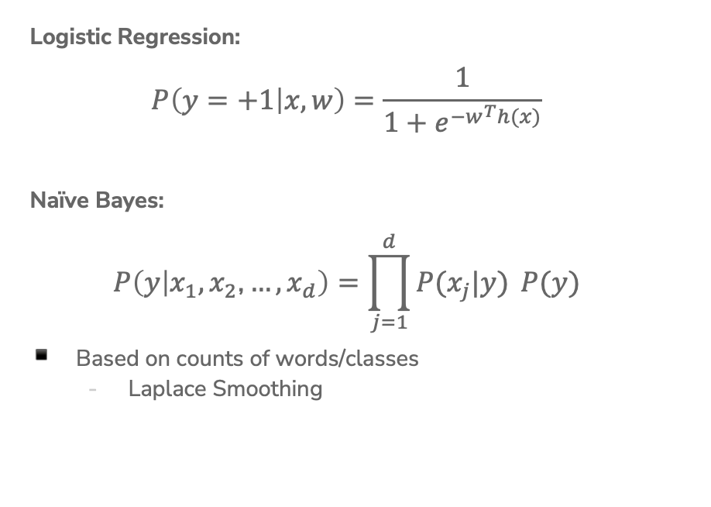
Compare Models
Logistic Regression:
$$P\left(y=+1 | x,w\right)=\frac{1}{1+e^{−w^{T}h(x)}}$$
Naïve Bayes:
$$P\left(y | x_{1}, x_{2}\text{,}…, x_{d}\right)=\prod_{j=1}^{d}{P(x_{j}|y)} P(y)$$
Based on counts of words/classes
  Laplace Smoothing

Slide 14
Compare Models
Generative: defines a model for generating x (e.g. Naïve Bayes)
Discriminative: only cares about defining and optimizing a decision boundary (e.g. Logistic Regression)
Notes:
Generative classifiers
Assume some functional form for P(Y), P(X|Y)
Estimate parameters of P(X|Y), P(Y) directly from training data
Use Bayes rule to calculate P(Y |X)
Discriminative Classifiers
Assume some functional form for P(Y|X)
Estimate parameters of P(Y|X) directly from training data

Slide 15
2 min
Recap: What is the predicted class for this sentence assuming we have the following training set (no Laplace Smoothing).
“he is not cool”
Sentence | Label
this dog is cute | Positive
he does not like dogs | Negative
he is not bad he is cool | Positive
Notes:
P(y=+1|x) \prop P(x | y=+1)P(y=+1)
P(y=+1) = 2/3
P(x|y=+1) = (2/11)(3/11)(1/11)(1/11)

Slide 16
Decision Trees

Slide 17

Humans often make decisions based on
Flow Charts
or
Decision Trees

Slide 18
Parametric vs. Non-Parametric Methods
Parametric Methods: make assumptions about the data distribution
Linear Regression ⇒ assume the data is linear
Logistic Regression ⇒ assume probability has the shape of of a logistic curve and linear decision boundary
Non-Parametric Methods: (mostly) don’t make assumptions about the data distribution
Decision Trees, k-NN (soon)
We’re still learning something, but not the parameters to a function family that we’re assuming describes the data.
Useful when you don’t want to (or can’t) make assumptions about the data distribution.
Those assumptions result in a parameterized function family. Our learning task is to learn the parameters.
Notes:
Mention: Often times with non-parametric rules, you can’t write the prediction equation down as a simple mathematical formula

Slide 19
XOR
A line might not always support our decisions.

Slide 20
What makes a loan risky?
I want to buy a new house!
Credit History
★★★★
Income
★★★
Term
★★★★★
Personal Info
★★★
Loan
Application
Notes:
Notes for Carlos:
Capital : Your capital is comprised of your savings, investments, and other assets that you can use to repay the loan. Capital can be helpful if you lose your job or experience other setbacks.
Capacity : Lenders will gauge your ability to repay the loan you’re applying for based on your current situation, and the amount of debt and expenses you currently have. Lenders will typically calculate your debt-to-income ratio – or how much you owe vs. how much you earn – to gauge your risk. The lower your ratio, the less risky lending to you may seem.
Collateral : With some loans, you’re required to offer an asset (for example, a home or car) that the lender can take possession of in the event that you are unable to make loan payments. Some lenders may require a guarantee in addition to collateral, which means that you or a third party must agree to repay the loan if the collateral cannot cover the amount.
Conditions : These are outside circumstances, such as the economy and job market, that can influence your ability to repay a loan. However, this category also includes how you intend to use the loan. For instance, obtaining a loan to pay for graduate school would seem less risky than a loan being used for a family vacation, since the degree would most likely improve your profitability in the long run.
Credit history : Lenders will check your credit report and score. Together they show lenders your credit accounts, payment history, and level of risk.

Slide 21
Credit history explained
Did I pay previous loans on time?
Example: excellent, good, or fair
Credit History
★★★★
Income
★★★
Term
★★★★★
Personal Info
★★★

Slide 22
Income
What’s my income?
Example:
$80K per year
Credit History
★★★★
Income
★★★
Term
★★★★★
Personal Info
★★★

Slide 23
Loan terms
How soon do I need to pay the loan?
Example: 3 years,
5 years,…
Credit History
★★★★
Income
★★★
Term
★★★★★
Personal Info
★★★

Slide 24
Personal information
Credit History
★★★★
Age, reason for the loan, marital status,…
Example: Home loan for a married couple
Income
★★★
Term
★★★★★
Personal Info
★★★

Slide 25
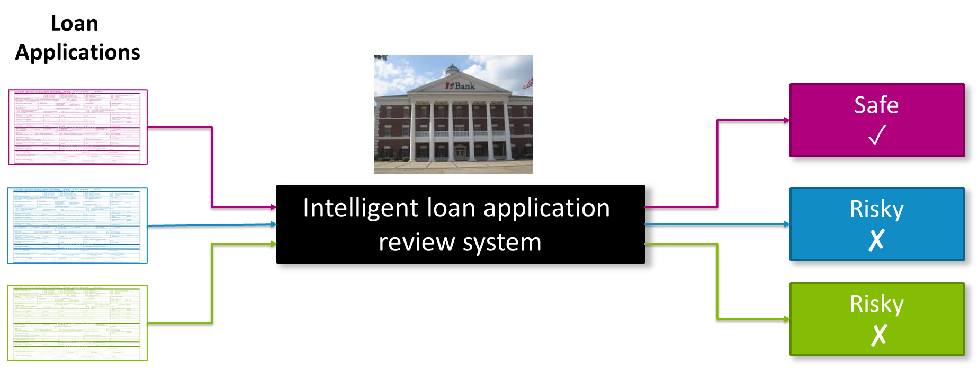
Intelligent application

Slide 26
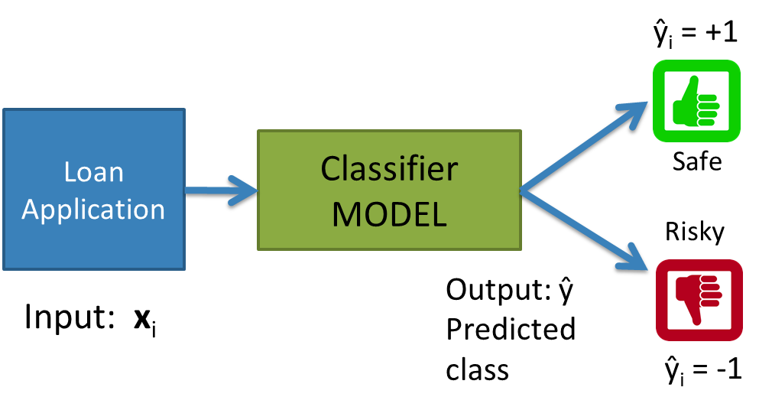
Classifier review

Slide 27
Setup
Data (N observations, 3 features)
Evaluation: classification error
Many possible decisions: number of trees grows exponentially!
Credit | Term | Income | y
excellent | 3 yrs | high | safe
fair | 5 yrs | low | risky
fair | 3 yrs | high | safe
poor | 5 yrs | high | risky
excellent | 3 yrs | low | safe
fair | 5 yrs | low | safe
poor | 3 yrs | high | risky
poor | 5 yrs | low | safe
fair | 3 yrs | high | safe
Notes:
- Switch this to the new figure

Slide 28
2 min
With our discussion of bias and fairness from last week, discuss the potential biases and fairness concerns that might be present in our dataset about loan safety.
No poll

Slide 29
Decision Trees
Start
excellent
Credit?
poor
fair
Income?
Safe
Term?
high
Low
3 years
5 years
Risky
Safe
Term?
Risky
3 years
5 years
Risky
Safe
Branch/Internal node: splits into possible values of a feature
Leaf node: final decision (the class value)

Slide 30


Slide 31
Growing Trees
Notes:
WOS:
Start with root, add one split at a time.
Which features are “good”?
When to stop growing the tree?

Slide 32
Visual Notation
Loan status: Safe Risky
Root
6 3
# of Risky loans
# of Safe loans
N = 9 examples
Notes:
Relate this to histogram

Slide 33
Decision stump:
1 level
Loan status:
Safe Risky
Root
6 3
Split on Credit
Credit | Term | Income | y
excellent | 3 yrs | high | safe
fair | 5 yrs | low | risky
fair | 3 yrs | high | safe
poor | 5 yrs | high | risky
excellent | 3 yrs | low | safe
fair | 5 yrs | low | safe
poor | 3 yrs | high | risky
poor | 5 yrs | low | safe
fair | 3 yrs | high | safe
Credit?
excellent
2 0
fair
3 1
poor
1 2
Subset of data with Credit = excellent
Subset of data with Credit = fair
Subset of data with Credit = poor
Notes:
Split on credit

Slide 34

Making predictions
For each leaf node, set $\hat{y}$ = majority value
Loan status:
Safe Risky
Root
6 3
credit?
excellent
2 0
fair
3 1
poor
1 2
Safe
Safe
Risky

Slide 35
How do we select the best feature?
Select the split with lowest classification error
Choice 1: Split on Credit
Choice 2: Split on Term
Loan status:
Safe Risky
Loan status:
Safe Risky
Root
6 3
Root
6 3
Credit?
Term?
excellent
2 0
fair
3 1
poor
1 2
3 years
4 1
5 years
2 1

Slide 36
Calculate the node values.
Choice 2: Split on Term
Credit | Term | Income | y
excellent | 3 yrs | high | safe
fair | 5 yrs | low | risky
fair | 3 yrs | high | safe
poor | 5 yrs | high | risky
excellent | 3 yrs | low | safe
fair | 5 yrs | low | safe
poor | 3 yrs | high | risky
poor | 5 yrs | low | safe
fair | 3 yrs | high | safe
Loan status:
Safe Risky
Root
6 3
Term?
3 years
5 years
Notes:
4 1, 2 2

Slide 37
How do we select the best feature?
Select the split with lowest classification error
Choice 1: Split on Credit
Choice 2: Split on Term
Loan status:
Safe Risky
Loan status:
Safe Risky
Root
6 3
Root
6 3
Credit?
Term?
excellent
2 0
fair
3 1
poor
1 2
3 years
4 1
5 years
2 2

Slide 38
How do we measure effectiveness of a split?
Loan status:
Safe Risky
Root
6 3
Idea: Calculate classification error of this decision stump
Credit?
Error = # mistakes
# data points
excellent
2 0
fair
3 1
poor
1 2

Slide 39
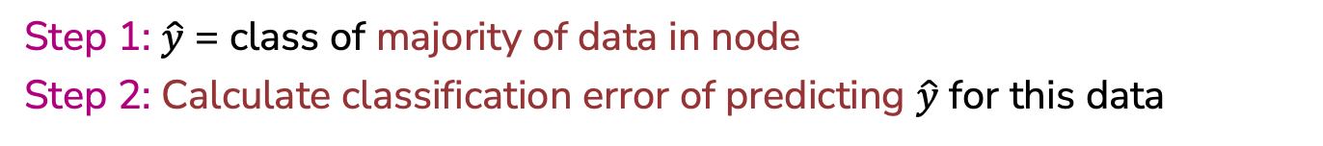
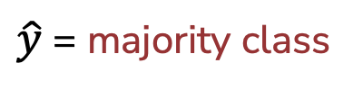
Calculating classification error
Step 1: $\hat{y}$ = class of majority of data in node
Step 2: Calculate classification error of predicting $\hat{y}$ for this data
Loan status:
Safe Risky
Error =
=
Root
6 3
6 correct
3 mistakes
Safe
Tree | Classification error
(root) | 0.33
$\hat{y}$ = majority class
Notes:
error = 18
22 + 18
= 0.45

Slide 40
Choice 1: Split on Credit history?
Choice 1: Split on Credit
Does a split on Credit reduce classification error below 0.33?
Loan status:
Safe Risky
Root
6 3
Credit?
excellent
2 0
fair
3 1
poor
1 2

Slide 41
Split on Credit: Classification error
Choice 1: Split on Credit
Loan status:
Safe Risky
Root
6 3
Error = .
=
Credit?
excellent
2 0
fair
3 1
poor
1 2
Tree | Classification error
(root) | 0.33
Split on credit | 0.22
Safe
Safe
Risky
0 mistakes
1 mistake
1 mistake
Notes:
error = 2
9
= 0.22

Slide 42
Choice 2: Split on Term?
Choice 2: Split on Term
Loan status:
Safe Risky
Root
6 3
Term?
3 years
4 1
5 years
2 2
Safe
Risky

Slide 43
Evaluating the split on Term
Choice 2: Split on Term
Loan status:
Safe Risky
Root
6 3
Error = .
=
Term?
3 years
4 1
5 years
2 2
Tree | Classification error
(root) | 0.33
Split on credit | 0.22
Split on term | 0.33
Safe
Risky
1 mistake
2 mistakes

Slide 44
Choice 1 vs Choice 2:
Comparing split on credit vs term
Tree | Classification error
(root) | 0.33
split on credit | 0.22
split on loan term | 0.33
Choice 1: Split on Credit
Choice 2: Split on Term
Loan status:
Safe Risky
Root
6 3
Loan status:
Safe Risky
Root
6 3
Credit?
Term?
excellent
2 0
fair
3 1
poor
1 2
3 years
4 1
5 years
2 2
WINNER

Slide 45
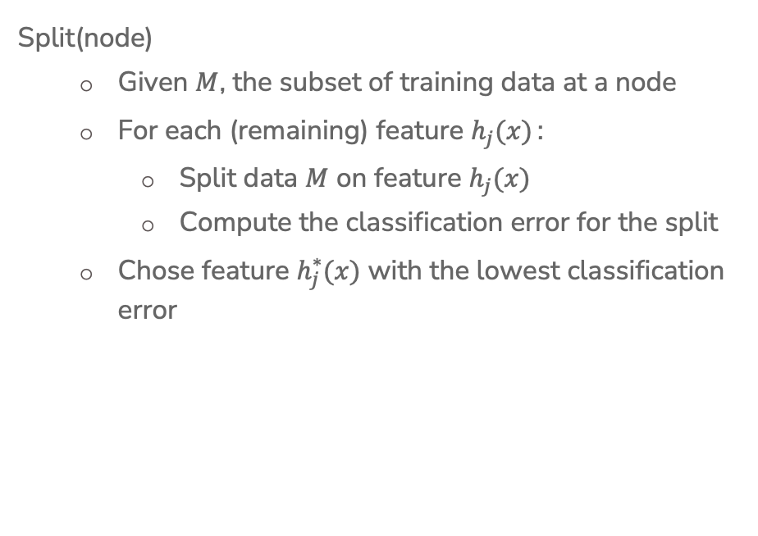
Split Selection
Split(node)
  Given $M$, the subset of training data at a node
  For each (remaining) feature $h_{j}(x)$ :
    Split data $M$ on feature $h_{j}(x)$
    Compute the classification error for the split
  Chose feature $h_{j}^{∗}(x)$ with the lowest classification error

Slide 46
Greedy
& Recursive Algorithm
BuildTree(node)
If termination criterion is met:
  Stop
Else:
  Split(node)
  For child in node:
    BuildTree(child)
Notes:
WOS:
Greedy = take the best action in the moment
Recursive = a function that calls itself

Slide 47
Decision stump:
1 level
Loan status:
Safe Risky
Root
6 3
Split on Credit
Credit?
excellent
2 0
fair
3 1
poor
1 2
Subset of data with Credit = excellent
Subset of data with Credit = fair
Subset of data with Credit = poor
Notes:
Split on credit

Slide 48
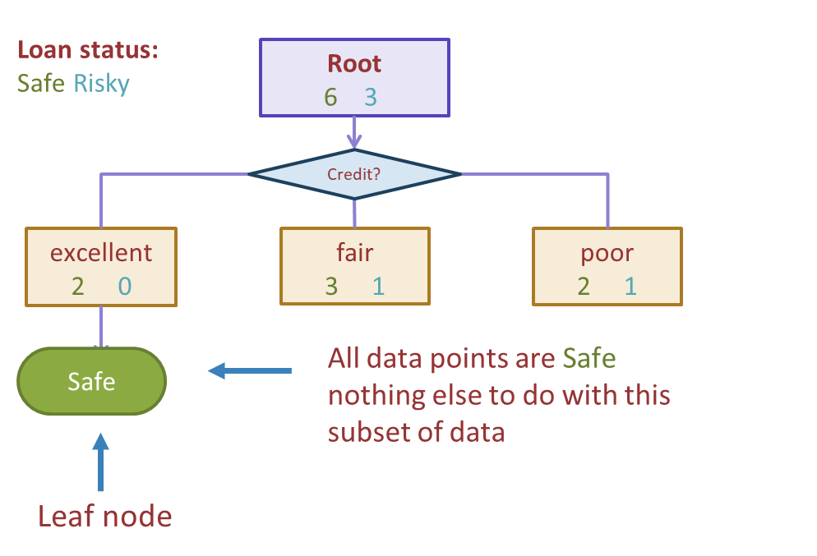
Stopping
For now: Stop when all points are in one class

Slide 49
Tree learning = Recursive stump learning
Loan status:
Safe Risky
Root
6 3
Credit?
excellent
2 0
fair
3 1
poor
2 1
Safe
Build decision stump with subset of data where Credit = fair
Build decision stump with subset of data where Credit = poor

Slide 50
Second level
Loan status:
Safe Risky
Root
6 3
Credit?
excellent
2 0
fair
3 1
poor
1 2
Safe
Term?
Income?
5 years
1 1
high
0 2
Low
1 0
3 years
2 0
Safe
Risky
Safe
Build another stump
these data points

Slide 51
1 min
What predictions should the below decision tree output for the following datapoints?
Loan status:
Safe Risky
Root
6 3
Credit?
excellent
2 0
fair
3 1
poor
1 2
Safe
Term?
Income?
Credit | Term | Income
excellent | 5 yrs | high
fair | 3 yrs | low
poor | 5 yrs | (missing)
5 years
2 1
high
0 2
low
1 0
3 years
1 0
Safe
…
Risky
Safe
Notes:
Point out that I changed the numbers on the term split slightly
Should is written intentionally; if the decision tree algorithm learnt so far wouldn’t output a specific answer, think about what you think it should output.

Slide 52
2 min
What predictions should the below decision tree output for the following datapoints?
Loan status:
Safe Risky
Root
6 3
Credit?
excellent
2 0
fair
3 1
poor
1 2
Safe
Term?
Income?
Credit | Term | Income
excellent | 5 yrs | high
fair | 3 yrs | low
poor | 5 yrs | (missing)
5 years
2 1
high
0 2
low
1 0
3 years
1 0
Safe
…
Risky
Safe
52

Slide 53


Slide 54
Real valued features
Income | Credit | Term | y
$105 K | excellent | 3 yrs | Safe
$112 K | good | 5 yrs | Risky
$73 K | fair | 3 yrs | Safe
$69 K | excellent | 5 yrs | Safe
$217 K | excellent | 3 yrs | Risky
$120 K | good | 5 yrs | Safe
$64 K | fair | 3 yrs | Risky
$340 K | excellent | 5 yrs | Safe
$60 K | good | 3 yrs | Risky

Slide 55
Threshold split
Loan status:
Safe Risky
Root
22 18
Split on Income
Income?
< $60K
8 13
>= $60K
14 5
Subset of data with Income >= $60K

Slide 56
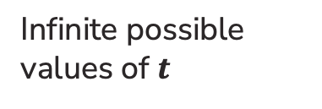



Best threshold?
Similar to our simple, threshold model when discussing Fairness!
Infinite possible values of $t$
Income = $t^{∗}$
Income $< t^{∗}$
Income ${≥t}^{∗}$
Safe
Risky
Income
$10K
$120K

Slide 57

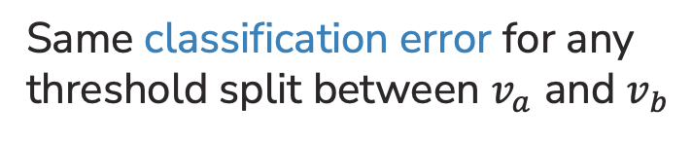

Threshold between points
Same classification error for any threshold split between $v_{a}$ and $v_{b}$
Safe
Risky
Income
$$v_{a}$$
$$v_{b}$$
$10K
$120K

Slide 58
Only need to consider mid-points
Finite number of splits to consider
Safe
Risky
Income
$10K
$120K

Slide 59
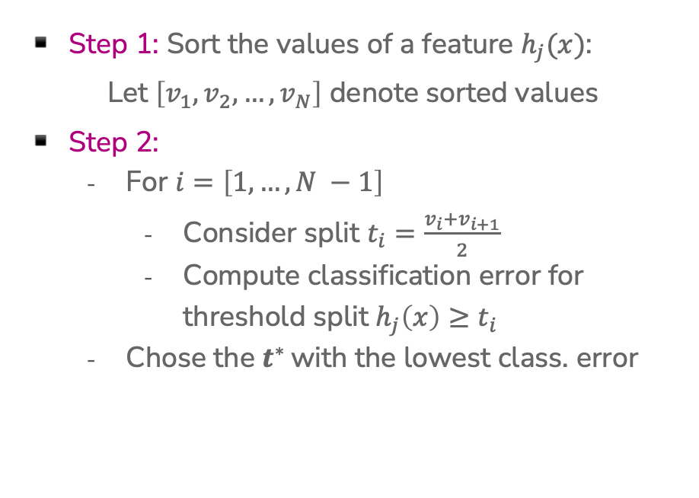
Threshold split selection algorithm
Step 1: Sort the values of a feature $h_{j}(x)$:
Let $\left[v_{1}, v_{2},…, v_{N}\right]$ denote sorted values
Step 2:
  For $i=\left[1, …, N −1\right]$
    Consider split $t_{i}=\frac{v_{i}+v_{i+1}}{2}$
    Compute classification error for threshold split $h_{j}\left(x\right)≥t_{i}$
  Chose the $t^{∗}$ with the lowest class. error

Slide 60
Visualizing the threshold split
Income
Threshold split is the line Age = 38
…
$80K
$40K
$0K
Age
0
10
20
30
40
…

Slide 61
Split on Age >= 38
Income
age < 38
age >= 38
Predict Risky
…
$80K
Predict Safe
$40K
$0K
Age
0
10
20
30
40
…

Slide 62
Each split partitions the 2-D space
Age >= 38
Income >= 60K
Income
Age < 38
…
$80K
$40K
Age >= 38
Income < 60K
$0K
Age
0
10
20
30
40
…

Slide 63
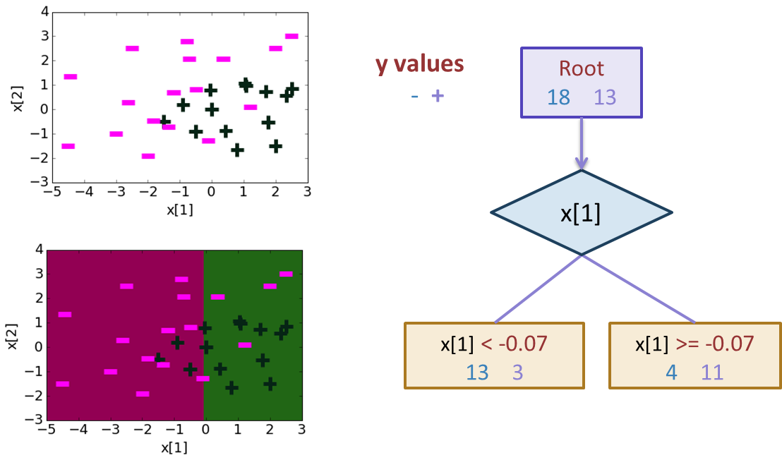
Depth 1: Split on x[1]
Notes:
0.22542207904 + 1.12 x[1] -1.07 x[2]

Slide 64
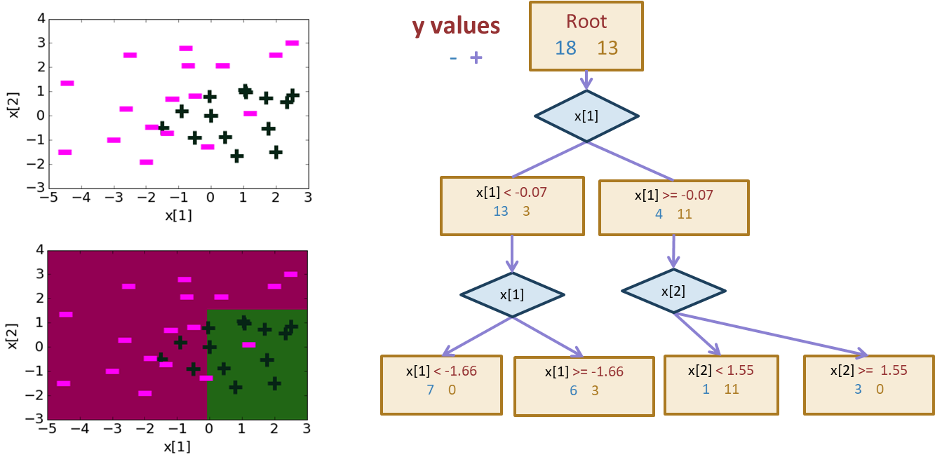
Depth 2
Notes:
0.22542207904 + 1.12 x[1] -1.07 x[2]

Slide 65
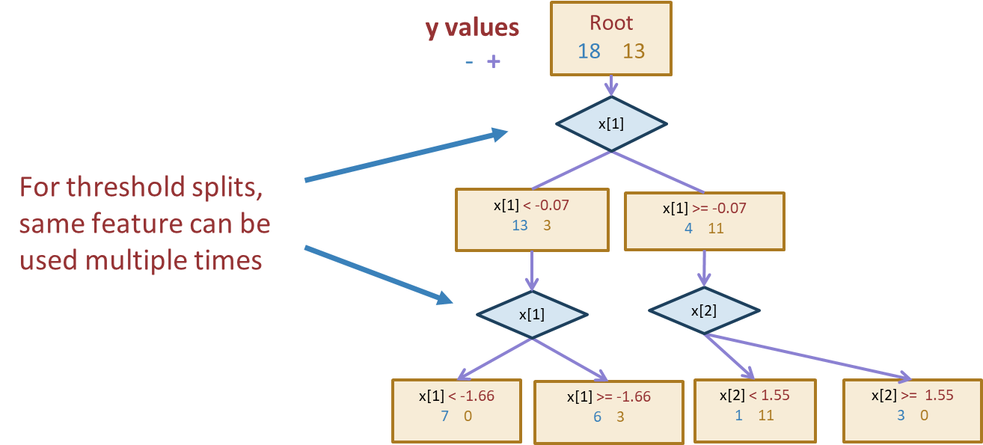
Threshold split caveat
Notes:
0.22542207904 + 1.12 x[1] -1.07 x[2]

Slide 66
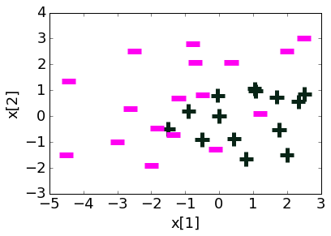
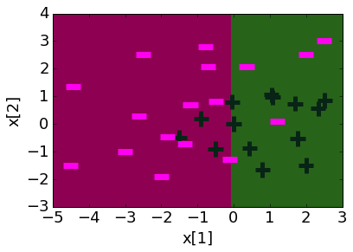
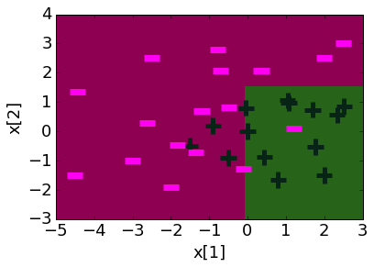
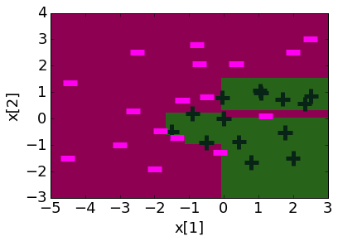
Decision boundaries
Decision boundaries can be complex!
Depth 1 Depth 2 Depth 10
Notes:
0.22542207904 + 1.12 x[1] -1.07 x[2]

Slide 67
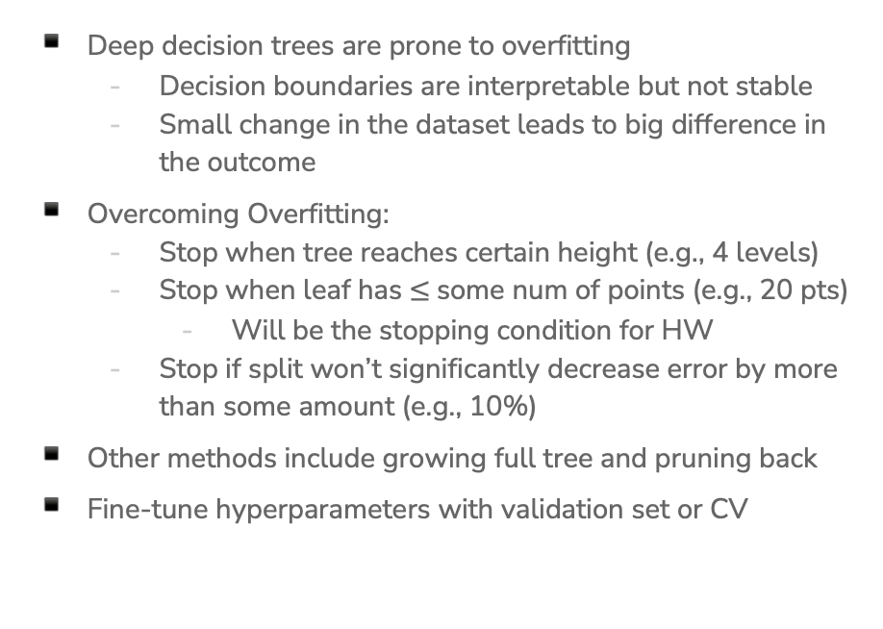
Overfitting
Deep decision trees are prone to overfitting
  Decision boundaries are interpretable but not stable
  Small change in the dataset leads to big difference in the outcome
Overcoming Overfitting:
  Stop when tree reaches certain height (e.g., 4 levels)
  Stop when leaf has $≤$some num of points (e.g., 20 pts)
    Will be the stopping condition for HW
  Stop if split won’t significantly decrease error by more than some amount (e.g., 10%)
Other methods include growing full tree and pruning back
Fine-tune hyperparameters with validation set or CV
Notes:
0.22542207904 + 1.12 x[1] -1.07 x[2]

Slide 68
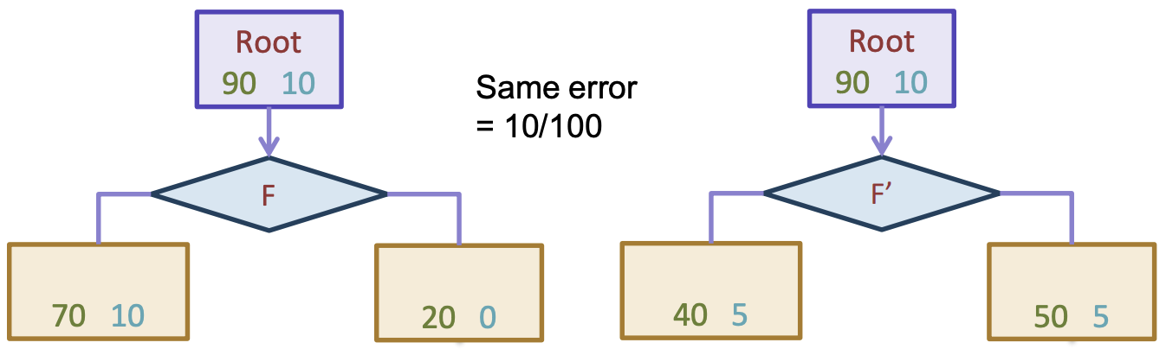
In Practice
Trees can be used for classification or regression (CART)
  Classification: Predict majority class for root node
  Regression: Predict average label for root node
In practice, we don’t minimize classification error but instead some more complex metric to measure quality of split such as Gini Impurity or Information Gain (not covered in 416)
Can also be used to predict probabilities

Slide 69
Predicting probabilities
Root
18 12
Loan status:
Safe Risky
Credit?
excellent
9 2
fair
6 9
poor
3 1
Safe
Risky
Safe
P(y = Safe | x)
= 3 = 0.75
3 + 1

Slide 70
Decision Trees
Overview
Start
excellent
Credit?
poor
fair
Income?
Safe
Term?
high
Low
3 years
5 years
Risky
Safe
Term?
Risky
3 years
5 years
Risky
Safe
Branch/Internal node: splits into possible values of a feature
Leaf node: final decision (the class value)
Notes:
WOS:
An example, have students classify it.

Slide 71
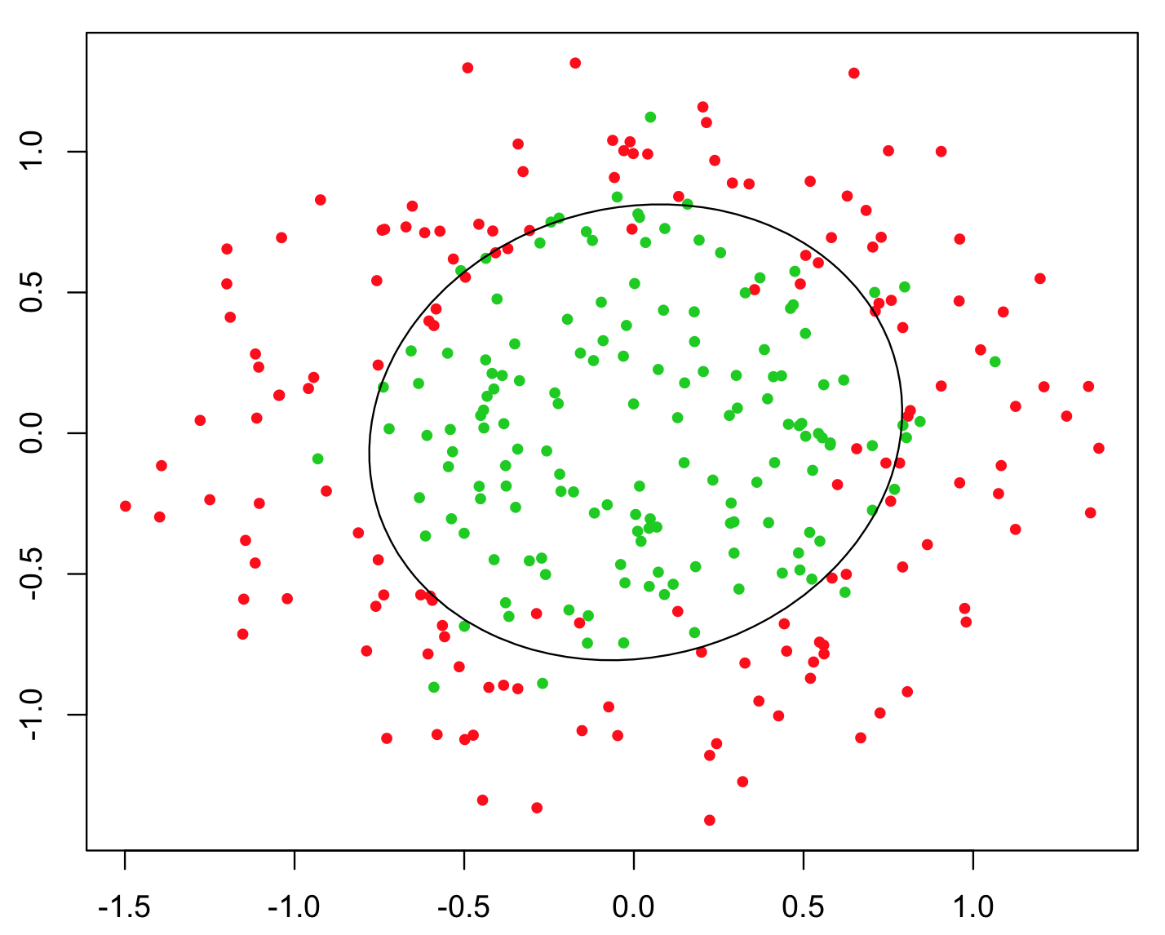
Pros/Cons
Decision Tree
Pros:
  Easy to interpret
  Handles numeric and categorical variables without preprocessing*
    In theory, scikit-learn still requires preprocessing
  No normalization required as it uses rule-based approach
  Can create non-linear decision boundaries
  Can readily do multi-class classification (unlike Logistic Regression)
Cons:
  Deep decision trees are prone to overfitting
  Only allows axis-parallel decision boundaries

Slide 72
Ensemble Method
Instead of switching to a brand new type of model that is more powerful than trees, what if we instead tried to make the tree into a more powerful model.
What if we could combine many weaker models in such a way to make a more powerful model?
A model ensemble is a collection of (generally weak) models that are combined in such a way to create a more powerful model.
There are two common ways this is done with trees
Random Forest (Bagging) [next pre-lecture video]
AdaBoost (Boosting)

Slide 73
AdaBoost
Boosting
Notes:
We are going to talk about another ensemble model (a model that combines many weaker models), but that does it in a completely different way

Slide 74
Background
A weak learner is a model that only does slightly better than random guessing.
Kearns and Valiant (1988, 1989):
“Can a set of weak learners create a single strong learner?”
Schapire (1990)
“Yes!”

Slide 75
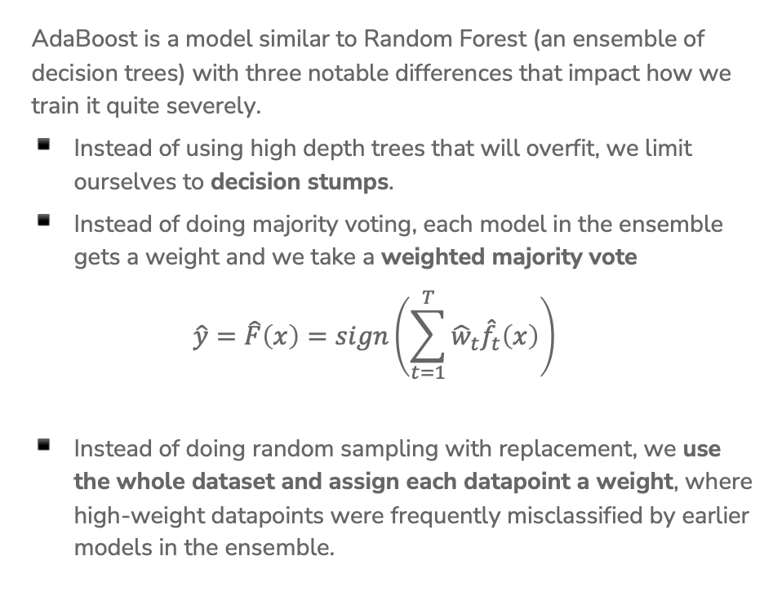
AdaBoost Overview
AdaBoost is a model similar to Random Forest (an ensemble of decision trees) with three notable differences that impact how we train it quite severely.
Instead of using high depth trees that will overfit, we limit ourselves to decision stumps.
Instead of doing majority voting, each model in the ensemble gets a weight and we take a weighted majority vote
$$\hat{y}=\hat{F}\left(x\right)=sign\left(\sum_{t=1}^{T}{{\hat{w}}_{t}{\hat{f}}_{t}\left(x\right)}\right)$$
Instead of doing random sampling with replacement, we use the whole dataset and assign each datapoint a weight, where high-weight datapoints were frequently misclassified by earlier models in the ensemble.
Notes:
Write where hat{f_t} is the t^th tree trained and it predicts +1 or -1 and hat{w} is some weight for that model’s predictions (also learned)

Slide 76


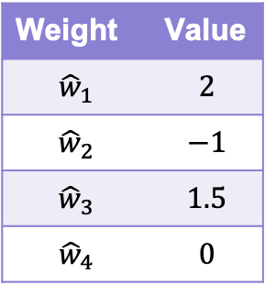



2 min sli.do #cs416
Yes
Income >= 1000
No
Weight | Value
$${\hat{w}}_{1}$$ | $$2$$
$${\hat{w}}_{2}$$ | $$−1$$
$${\hat{w}}_{3}$$ | $$1.5$$
$${\hat{w}}_{4}$$ | $$0$$
SAFE
RISKY
$${\hat{f}}_{1}\left(x\right)= +1$$
Good
Credit History?
Bad
RISKY
SAFE
$${\hat{f}}_{2}\left(x\right)=−1$$
3 Years
Savings >= 100k
5 Years
Recall the prediction rule for weighted majority vote.
$$\hat{y}=\hat{F}\left(x\right)=sign\left(\sum_{t=1}^{T}{{\hat{w}}_{t}{\hat{f}}_{t}\left(x\right)}\right)$$
What label will AdaBoost predict with these trees and weights?
SAFE
RISKY
$${\hat{f}}_{3}\left(x\right)=−1$$
Bad
Good
Market Cond.
RISKY
SAFE
$${\hat{f}}_{4}\left(x\right)= +1$$
Notes:
WOS:
\hat{F}(x) equation
sign(2*1+-1*-1+1.5*-1+0*1)
sign(1.5)
+1
It is possible to have zero weights, that means the ensemble disregards that stump’s predictions
It is possible to have negative weights, that means that whatever the stump votes for, the ensemble will effectively take that to be a vote in the opposite direction

Slide 77
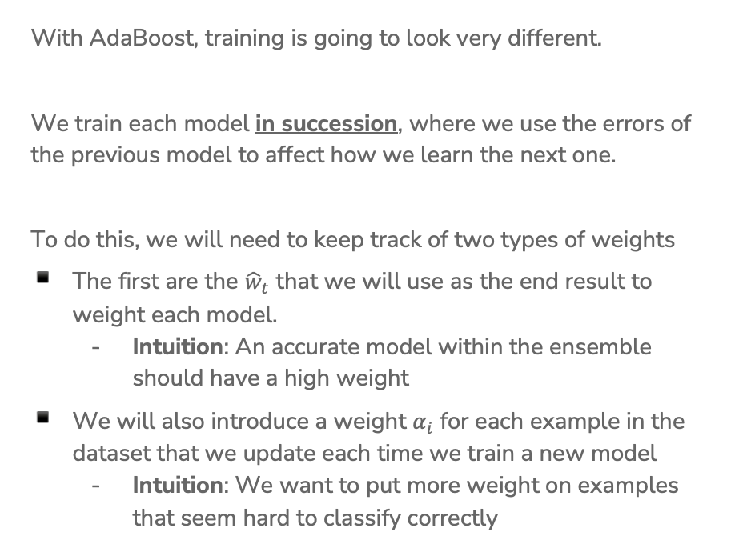
Training AdaBoost
With AdaBoost, training is going to look very different.
We train each model in succession, where we use the errors of the previous model to affect how we learn the next one.
To do this, we will need to keep track of two types of weights
The first are the ${\hat{w}}_{t}$ that we will use as the end result to weight each model.
  Intuition: An accurate model within the ensemble should have a high weight
We will also introduce a weight $α_{i}$ for each example in the dataset that we update each time we train a new model
  Intuition: We want to put more weight on examples that seem hard to classify correctly
Notes:
This is in contrast to random forests, where we trained each model in parallel. Each model was trained on an independently randomly sampled dataset. In AdaBoost, we use the errors from previous models to impact how we train the next model, so we need to train models one at a time.

Slide 78
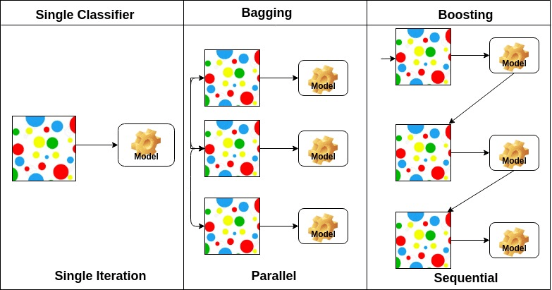
Boosting (AdaBoost) vs. Bagging (Random Forrest)
Notes:
Bagging = Bootstrap aggregation

Slide 79
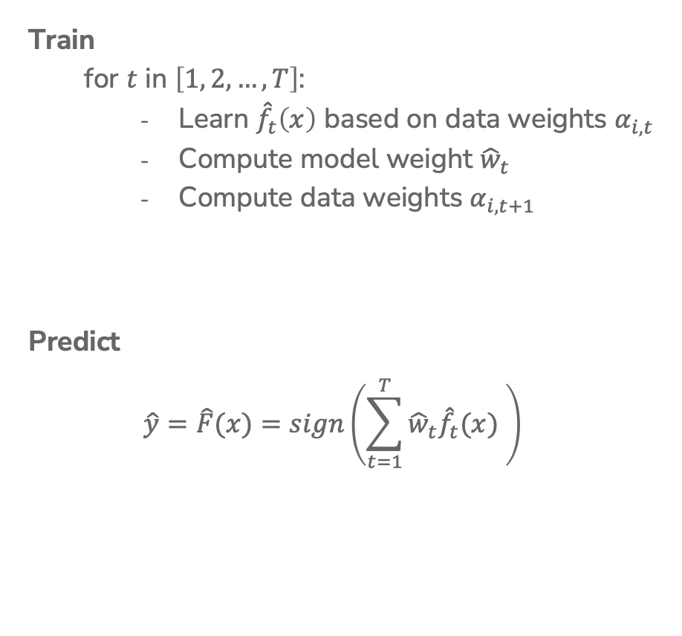
AdaBoost
Ada Glance
Train
  for $t$ in $\left[1, 2, …, T\right]$:
    Learn ${\hat{f}}_{t}\left(x\right)$ based on data weights $α_{i,t}$
    Compute model weight ${\hat{w}}_{t}$
    Compute data weights $α_{i,t+1}$
Predict
$$\hat{y}=\hat{F}(x)=sign\left(\sum_{t=1}^{T}{{\hat{w}}_{t}{\hat{f}}_{t}(x) }\right)$$
Notes:
Write “How much we trust hat{f}_t next to compute hat{w}_t
Write “Pay more attention to examples we got wrong” next to recompute alpha_i
Write “Only used in training” near alpha

Slide 80

Weighted Data $α_{i}$
Start with a dataset and train our first model (a decision stump)
For all the things it gets wrong, increase the weight of that example. For each one that’s right, decrease its weight.
Notes:
WOS:
Point out which ones were correct (underline with one color)
Point out which were wront (underline with another color)
“Reduce weights of correct examples, increase weights of incorrect examples.”

Slide 81
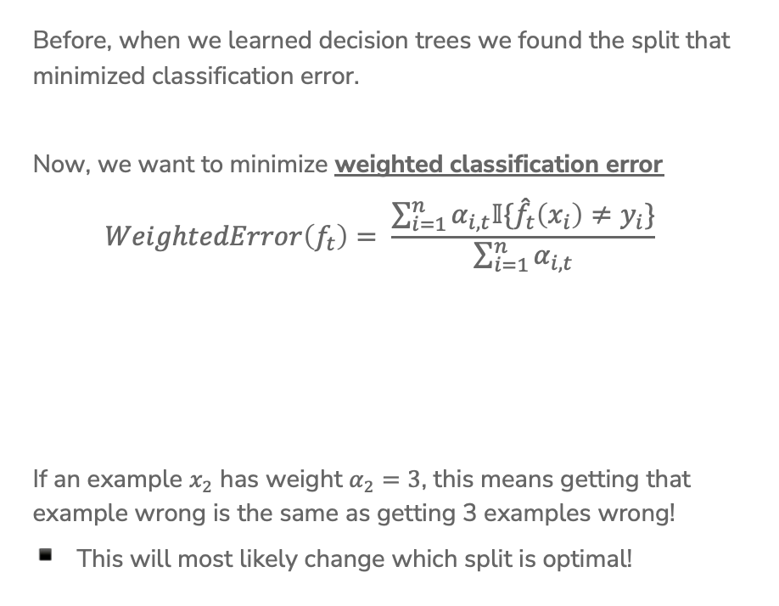
Learning w/ Weighted Data
Before, when we learned decision trees we found the split that minimized classification error.
Now, we want to minimize weighted classification error
$$WeightedError\left(f_{t}\right)= \frac{\sum_{i=1}^{n}{α_{i,t}𝕀\{{\hat{f}}_{t}\left(x_{i}\right)≠y_{i}\}}}{\sum_{i=1}^{n}{α_{i,t}}}$$
If an example $x_{2}$ has weight $α_{2}=3$, this means getting that example wrong is the same as getting 3 examples wrong!
This will most likely change which split is optimal!
Notes:
WOS:
Classification error: # mistakes / # total
Weighted classification error: sum weights of mistakes / total sum weights

Slide 82
Learning w/ Weighted Data
We also set leaf node predictions to be the class with larger total weight, not the class with more instances.
Loan status:
Safe Risky
Root
6 3
Credit | y | weight
excellent | safe | 1.2
fair | risky | 3.0
fair | safe | 0.5
poor | risky | 0.9
excellent | safe | 0.9
fair | safe | 0.7
poor | risky | 1.0
poor | safe | 2.1
fair | safe | 1.2
Credit?
excellent
2 0
fair
3 1
poor
1 2
Notes:
WOS:
Compute weighted predictions (safe, risky, safe)
Write unweighted predictions: (safe, safe, risky)

Slide 83
2 min
Consider the following weighted dataset, what is the weighted classification error of the optimal decision stump (just one split)?
We want to use the TumorSize and IsSmoker to predict if a patient’s tumor is malignant.
TumorSize | IsSmoker | Malignant | Weight
Small | No | No | 0.5
Small | Yes | Yes | 1.2
Large | No | No | 0.3
Large | Yes | Yes | 0.5
Small | Yes | No | 3.3
Notes:
Options
IsSmoker, 3.3
IsSmoker, 1.7
IsSmoker, 2 (just count)
TumorSize, 1.2 + .3 = 1.5
TumorSize, 1+1 (just count)

Slide 84
0 min
TumorSize | IsSmoker | Malignant | Weight
Small | No | No | 0.5
Small | Yes | Yes | 1.2
Large | No | No | 0.3
Large | Yes | Yes | 0.5
Small | Yes | No | 3.3
Notes:
WOS
Tumor Size, Large / Small, 0.5 0.3 / 1.2 3.8, Yes / No, Weighted Error (0.3+1.2)/5.8 ~= 0.26
IsSmoker, Y / N, 1.7 3.3 / 0.0 0.8, No / No, Weighted Error (1.7+0)/5.8 ~= 0.29

Slide 85
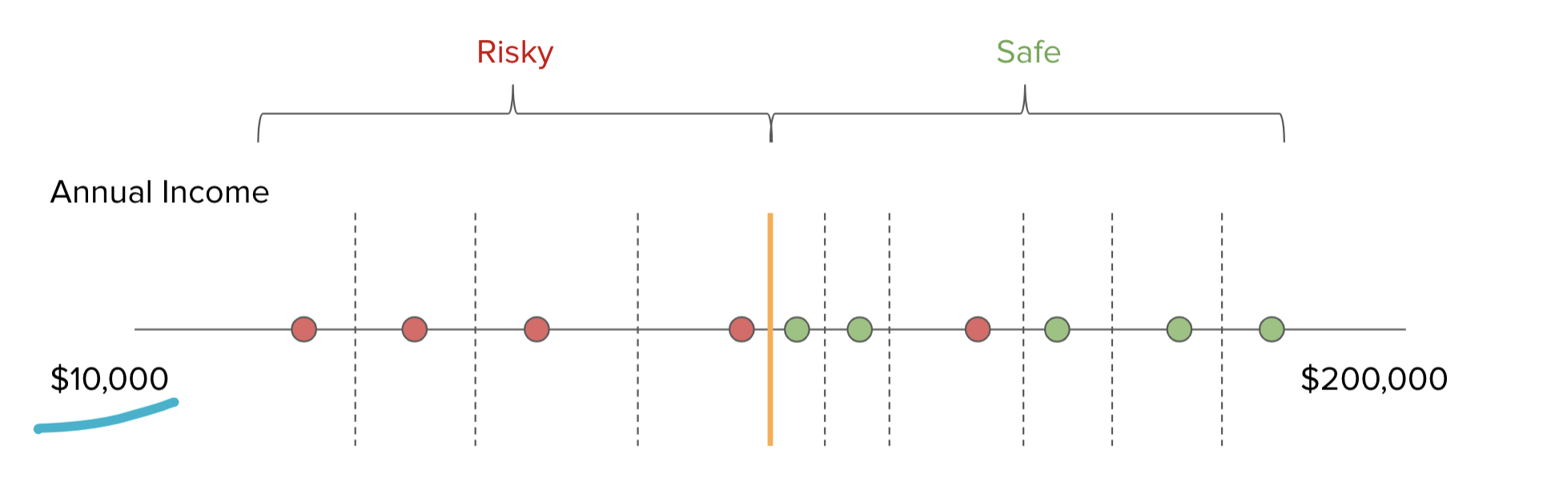
Real Valued Features
The algorithm is more or less the same, but now we need to account for weights
2
5
1
3
2
1
1
2
1
1000
Notes:
WOS:
Best split unweighted
Best split weighted (between 1000 and 3)

Slide 86
Recap
What you can do now:
Define the assumptions and modeling for Naïve Bayes
Define a decision tree classifier
Interpret the output of a decision trees
Learn a decision tree classifier using greedy algorithm
Traverse a decision tree to make predictions
  Majority class predictions
Decision Tree pros/cons
Ensemble methods
AdaBoost intro
Notes:
0.22542207904 + 1.12 x[1] -1.07 x[2]

