Slide 1
CSE/STAT 416 Bias and Fairness in ML Tanmay Shah Paul G. Allen School of Computer Science & Engineering University of Washington July 8, 2024

Slide 2
ML and Society

Slide 3
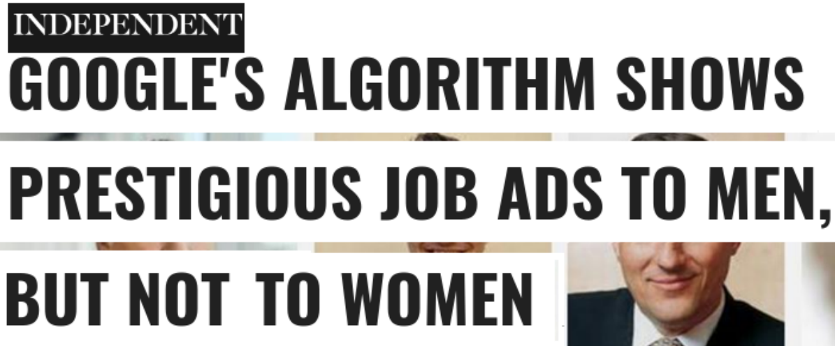
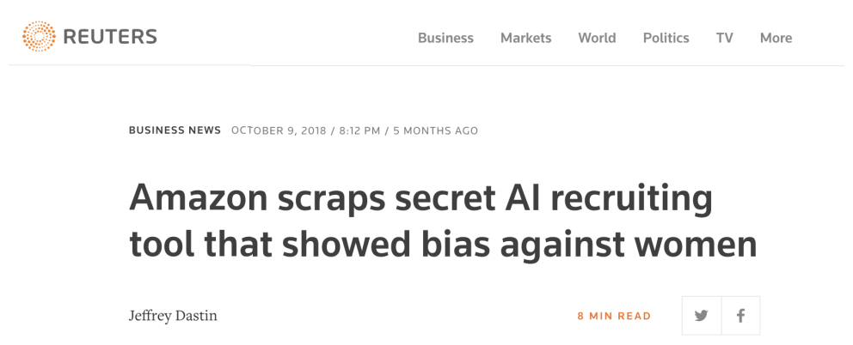
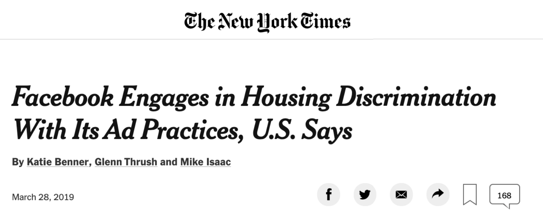
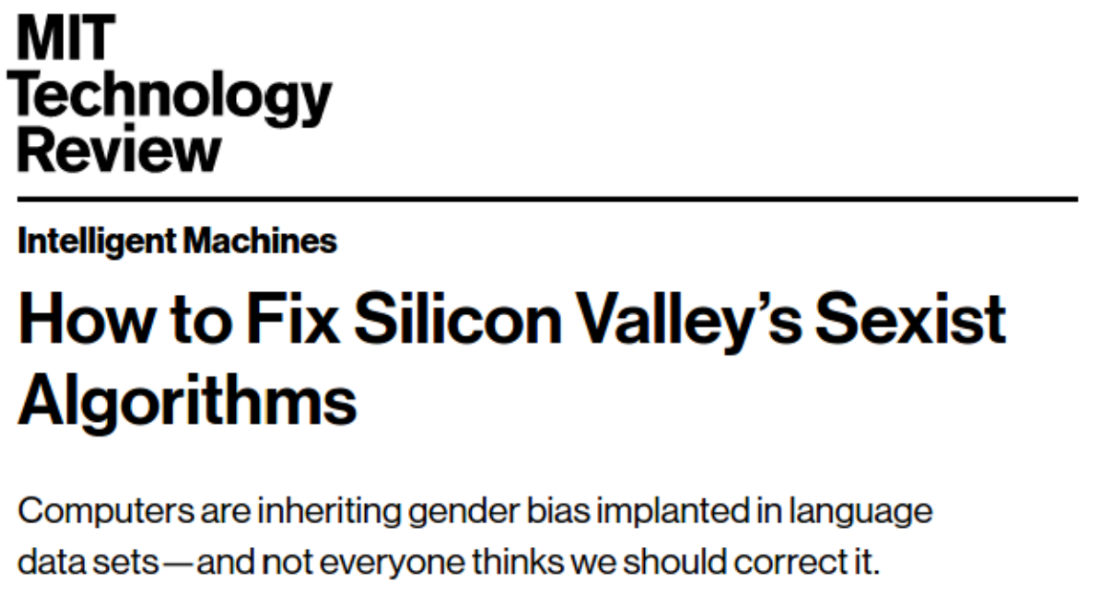
ML Systems Gone Wrong

Slide 4
COMPAS
An ML model created by NorthPointe used to predict likelihood of inmates to “recidivate”. Eventually started use in Florida in judges’ decision for parole
ProPublica (a news org) investigated the model and wrote that the model exhibited biased behavior against people of color. Particularly, they found that the model would predict higher risk scores for black people.
Northpointe countered and claimed that their scores were well calibrated (e.g., when the predict score of 9/10 that person recidivates about 90% of the time).
Interesting follow up from ProPublica
So the question is: Who is right? Is it right to use this model?

Slide 5
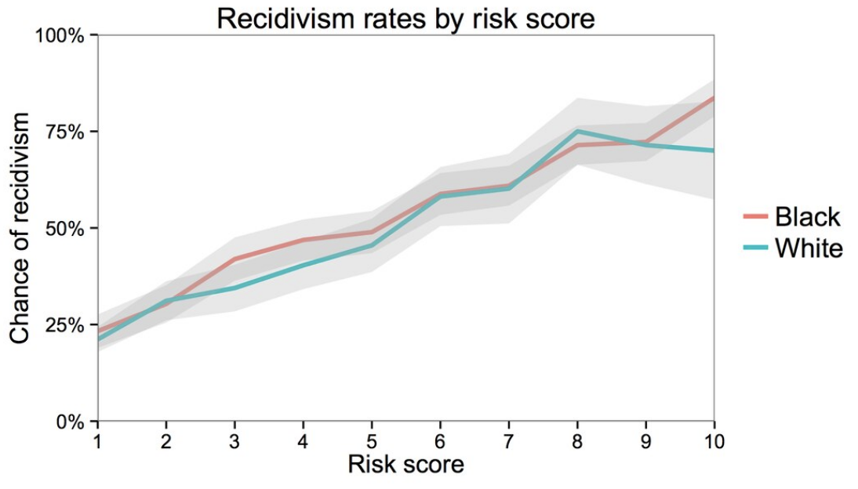
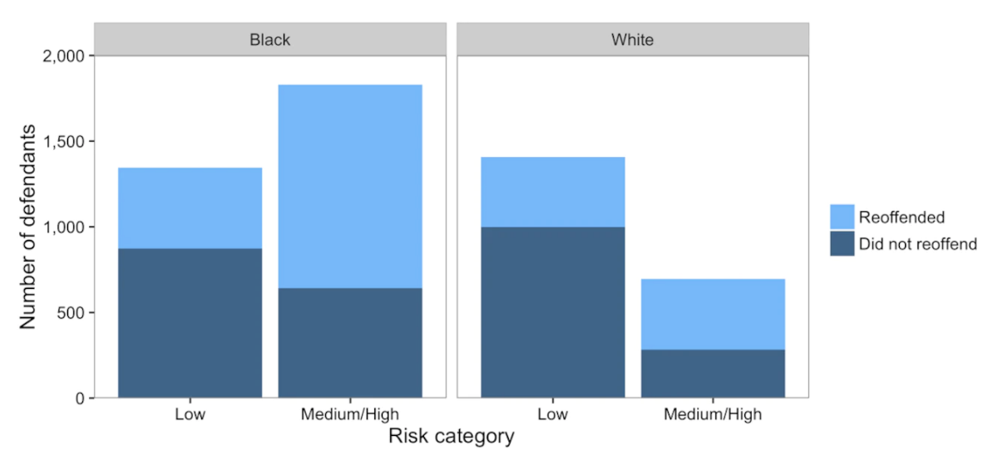
COMPAS

Slide 6
Why Biased Outcomes?
Probably not the case that someone explicitly coded the model to be biased against a particular race. In fact, race was not even a question that was on the survey inmates took!
More often than not, biased outcomes from a model come from the data it learns from rather than some explicit choice from the modeler.
“Garbage in → Garbage out”
“Bias in → Bias out”

Slide 7
Sources of Bias

Slide 8
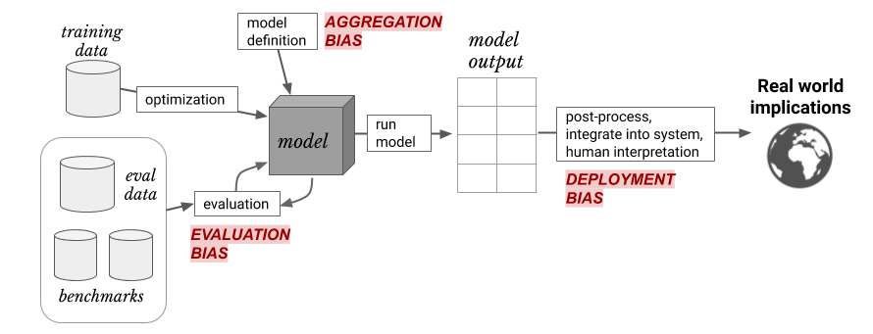
Sources of Bias
Discussion heavily based on Suresh and Guttag (2020)
A FRAMEWORK FOR UNDERSTANDING UNINTENDED CONSEQUENCES OF MACHINE LEARNING, BY HARINI SURESH AND JOHN V. GUTTAG, 2020
Six common sources of bias:
Historical bias
Representation Bias
Measurement Bias
Aggregation Bias
Evaluation Bias
Deployment Bias

Slide 9
Historical Bias
The world we lived in is one that contains biases for/against certain demographics. Even ‘accurate’ data could still be harmful.
Historical bias exists even with perfect sampling or feature measurement (other sources of bias are possible)!
Examples:
In 2018, 5% of Fortune 500 CEOs were women. Should search results for “CEO” match this statistic? Could reflecting the world (even if accurately) perpetuate more harm?

Slide 10
Representation Bias
When the training data we collect does not contain representative samples of the true distribution.
Examples:
If we use data gathered from smart phones, we would likely be underestimating poorer and older populations.
ImageNet (a very popular image dataset) with 1.2 million images. About 45% of these images were taken in the US and the majority of the rest in North America and Western Europe. Only about 1% and 2.1% of the images come from China and India respectively.

Slide 11
Measurement Bias
Often we are gathering data that contains (noisy) proxies of characteristics of interest. Some examples:
Financial responsibility → Credit Score
Crime Rate → Arrest Rate
Intelligence → SAT Score
If these measurements are not measured equally across groups or places (or aren’t relevant to the task at hand), this can be another source of bias.

Slide 12
Measurement Bias (cont.)
Examples:
If factory workers are monitored more often, more errors are spotted. This can result in a feedback loop to encourage more monitoring in the future.
Same principles at play with predictive policing. Minoritized communities were more heavily policed in the past, which causes more instances of documented crime, which then leads to more policing in the future.
Women are more likely to be misdiagnosed (or not diagnosed) for conditions where self-reported pain is a symptom. In this case aspect of our data “diagnosed with X” is a biased proxy for “has condition X”.
The feature we measure is a poor representation of the quality of interest (e.g., SAT score doesn’t actually measure intelligence)

Slide 13
Aggregation Bias
When we use a “one-sized fits all” model that does not accurately serve every group equally.
Examples:
HbA1c levels (used to monitor and diagnose diabetes) differ in very complex ways across ethnicities and sexes. One model for everyone might not be the right choice, even if everyone is represented well in the training data.

Slide 14
Evaluation Bias
Similar to representation bias, but focused more on the data we evaluate or test ourselves against. If the evaluation dataset or benchmark doesn’t represent the world well, we have evaluation bias.
Benchmarks are common datasets used to evaluate models from different researchers.
Examples:
If it is common to report accuracy on a benchmark, this might hide disparate performance on subgroups.
Drastically worse performance for facial recognition software when used on faces of darker-skinned females. Common evaluation datasets for facial recognition only had 5-7% had faces of darker-skinned women.

Slide 15
Deployment Bias
When how a model was intended to be used and how it is actually used when deployed in the real-world.
Examples:
Crime risk prediction models might be evaluated to achieve good calibration, but the model designers might not have evaluated the model’s use in the context of determining prison sentence lengths.
People are complex and when using models to aid their decisions, might make incorrect assumptions about what a model says.

Slide 16
Sources of Bias
Discussion heavily based on Suresh and Guttag (2020)
A FRAMEWORK FOR UNDERSTANDING UNINTENDED CONSEQUENCES OF MACHINE LEARNING, BY HARINI SURESH AND JOHN V. GUTTAG, 2020
Six common sources of bias:
Historical bias
Representation Bias
Measurement Bias
Aggregation Bias
Evaluation Bias
Deployment Bias

Slide 17
Brain Break

Slide 18
Fairness in ML

Slide 19
Fairness
What does it mean for a model to be fair or unfair? Can we come up with a numeric way of measuring fairness?
Lots of work in the field of ML and fairness is looking into mathematical definitions of fairness to help us spot when something might be unfair.
There is not going to be one central definition of fairness, as each definition is a mathematical statement of which behaviors are/aren’t allowed.
Different definitions of fairness can be contradictory!
Today, we will focus on notions of group fairness in an attempt to prevent discriminatory outcomes.

Slide 20
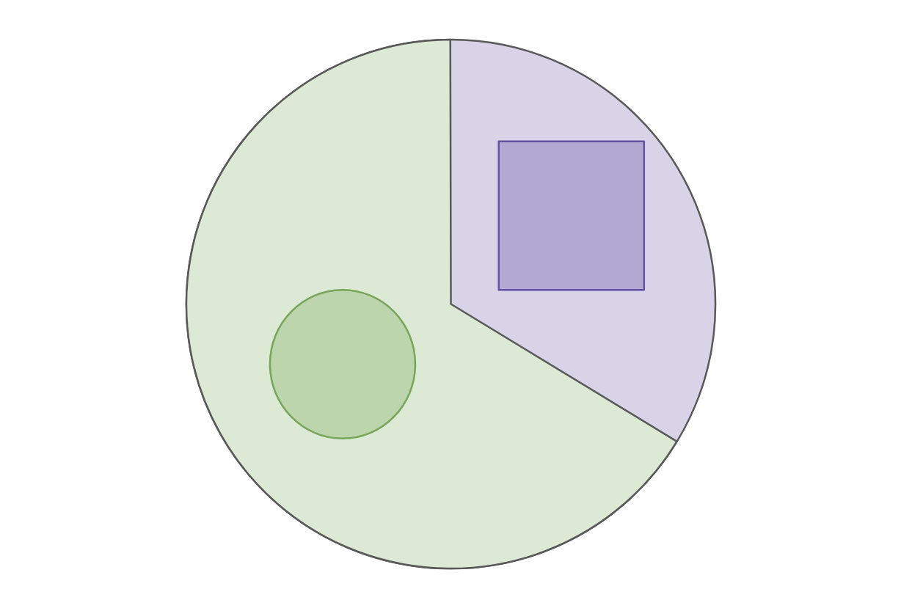
Example: College Admissions
Will use a very simplified example of college admissions. This is not an endorsement of such a system or a statement of how we think the world does/should work. Will make MANY simplifying assumptions (which are unrealistic).
There is a single definition of “success” for college applicants, and the goal of an admissions decision is to predict “success”
The only thing we will use as part of our decision is SAT Score
To talk about group fairness, will assume everyone belongs to exactly one of two races: Circles (66%) or Squares (33%).

Slide 21
Notation
Example: College admission only using SAT Score
$X$ input about a person for prediction
Example: $X$= SAT Score
$A$ variable indicating which group $X$ belongs in
Example: $A=\text{⬜}$or $A=\text{◯}$
$Y$ the “true label”
Example: $Y=+$ if truly successful in college, $Y=−$ if not
$\hat{Y}=\hat{f}(X)$ is our prediction for $Y$ using a learned model $\hat{f}$
Example: $\hat{Y}=+$ if predicted successful, $\hat{Y}=−$ otherwise

Slide 22
Fairness Definition 1: “Shape Blind”
To avoid unfair decisions, prevent the model from every looking at protected attribute (e.g., if the applicant is Circle/Square).
Often called “Fairness through unawareness”
Doesn’t work in practice. This does not prevent historical or measurement bias. Protected attributes can be unintentionally inferred from other, related attributes (e.g., in some cities, zip code can be deeply correlated with race).

Slide 23
Confusion Matrix
For binary classification, there are only two types of mistakes
$\hat{y}=+1, y=−1$
$\hat{y}=−1, y=+1$
Generally we make a confusion matrix to understand mistakes.
Predicted Label
 | True Positive (TP) | False Negative (FN)
 | False Positive (FP) | True Negative (TN)
True Label

Slide 24
Binary Classification Measures
Notation
$C_{TP}=\#TP, C_{FP}=\#FP, C_{TN}=\#TN, C_{FN}=\#FN$
$N=C_{TP}+C_{FP}+C_{TN}+C_{FN}$
$N_{P}=C_{TP}+C_{FN}, N_{N}=C_{FP}+C_{TN}$
Error Rate
$$\frac{C_{FP}+C_{FN}}{N}$$
Accuracy Rate
$$\frac{C_{TP}+C_{TN}}{N}$$
False Positive rate (FPR)
$$\frac{C_{FP}}{N_{N}}$$
False Negative Rate (FNR)
$$\frac{C_{FN}}{N_{P}}$$
True Positive Rate or Recall
$$\frac{C_{TP}}{N_{P}}$$
Precision
$$\frac{C_{TP}}{C_{TP}+C_{FP}}$$
F1-Score
$$2\frac{Precision⋅Recall}{Precison+Recall}$$
See more!

Slide 25
Fairness Definition 2: Statistical Parity
Idea: “Admit decisions are equivalent across groups”
$$\operatorname{Pr}\left(\hat{Y}= +| A=\text{⬜}\right)=\operatorname{Pr}\left(\hat{Y}= +| A=\text{◯}\right)$$
Also phrased as matching demographic statistics (e.g., if 33% of population are Squares, 33% of those admitted should be Square).
Pros:
Aligns with certain legal definitions of equity.
Cons:
A rather weak in fairness requirements. Allows for strategies that might not be desirable (e.g., random selection, self-fulfilling prophecy)

Slide 26
Fairness Definition 3: Equal Opportunity
Idea: True positive rate should be equivalent across groups
$$\operatorname{Pr}\left(\hat{Y}= +| A=\text{⬜}, Y=+\right)=Pr\left(\hat{Y}= +| A=\text{◯}, Y=+\right)$$
Pros:
Better controls for true outcome
Cons:
More complex to explain to non-experts
Only protects for the positive outcome
Note: Equality of true positives is the same as equality of false negatives

Slide 27
Fairness Definition 4: Predictive equality
Idea: True negative rate should be equivalent across groups
$$\operatorname{Pr}\left(\hat{Y}=−| A=\text{⬜}, Y=−\right)=Pr\left(\hat{Y}=−| A=\text{◯}, Y=−\right)$$
Same idea as equal opportunity, but controlling for different statistic. Might be favorable in situations you care more about false positives than a false negative.
Note: Equality of true negatives is the same as equality of false positives

Slide 28
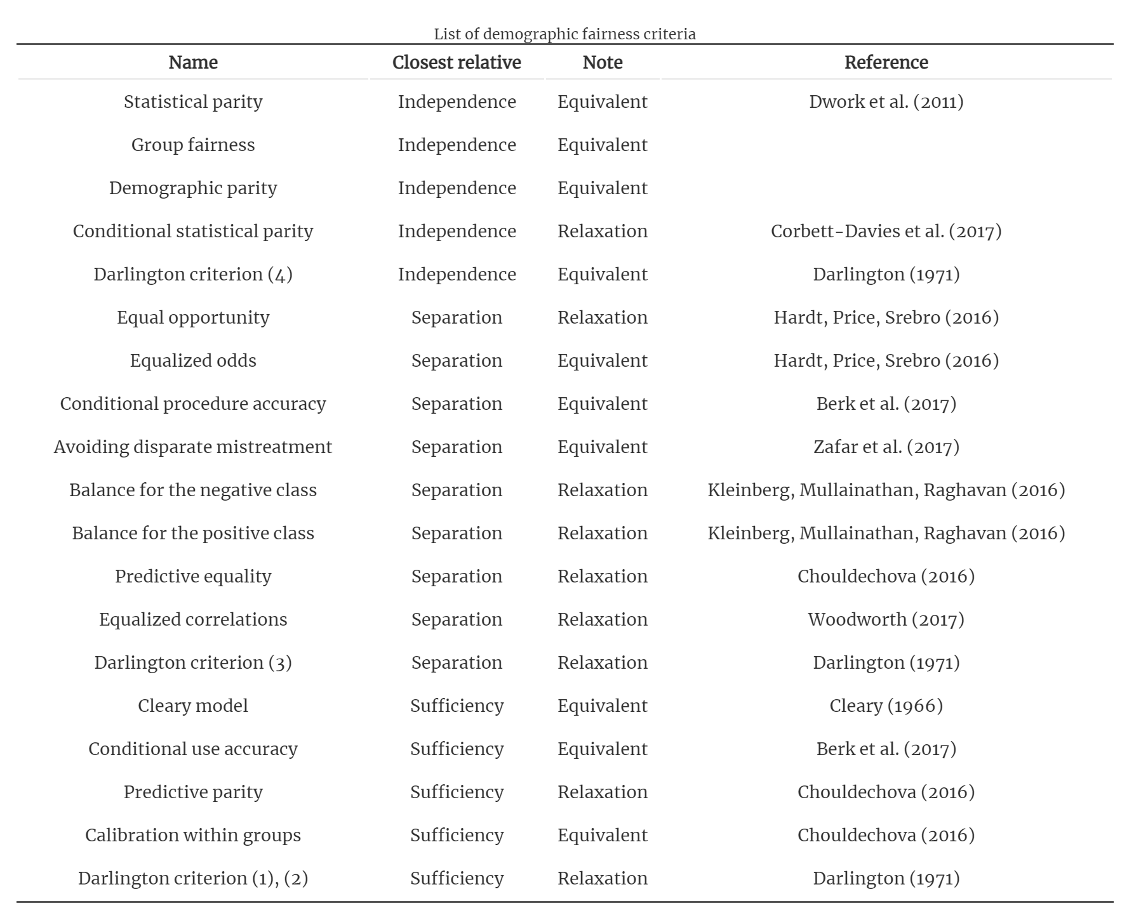
And many, many more
Table from Fairness and machine learning by Barocas, Hardt, Narayanan

Slide 29
Which one to use?
We can’t tell you! Each definition makes its own statement on what fairness means. Choosing a fairness measure is an explicit statement of what values we hold when thinking about fairness.
Takeaway: Discrimination in ML models is a crucial problem we need to work on. It’s not a problem that will only be solved algorithmically. We need people (e.g., policymakers, regulators, philosophers, developers) to be in the loop to determine the values we want to encode into our systems. Let’s discuss some limitations in these definitions (particularly how they contradict) and how we can think about fairness as a philosophy (or worldview).

Slide 30
Fairness
What does it mean for a model to be fair or unfair? Can we come up with a numeric way of measuring fairness?
Lots of work in the field of ML and fairness is looking into mathematical definitions of fairness to help us spot when something might be unfair.
There is not going to be one central definition of fairness, as each definition is a mathematical statement of which behaviors are/aren’t allowed.
Different definitions of fairness can be contradictory!

Slide 31
Group Fairness
Fairness through Unawareness
Statistical Parity
Require admissions match demographics in data
Equal Opportunity
Require false-negative rate to be equal across groups
Predictive Equality
Require false-positive rate to be equal across groups

Slide 32
(Im)possibility of Fairness
Four reasonable conditions we want in a real world ML Model:
Statistical Parity
Equal Opportunity (Equality across false negative rates)
Predictive Equality (Equality across false positive rates)
Good accuracy of the model across subgroups
In general, can’t satisfy all 4 simultaneously unless groups have the exact same underlying distribution.
This condition is rarely met in practice as we mentioned earlier when there are so many places for bias to enter our data collection.

Slide 33
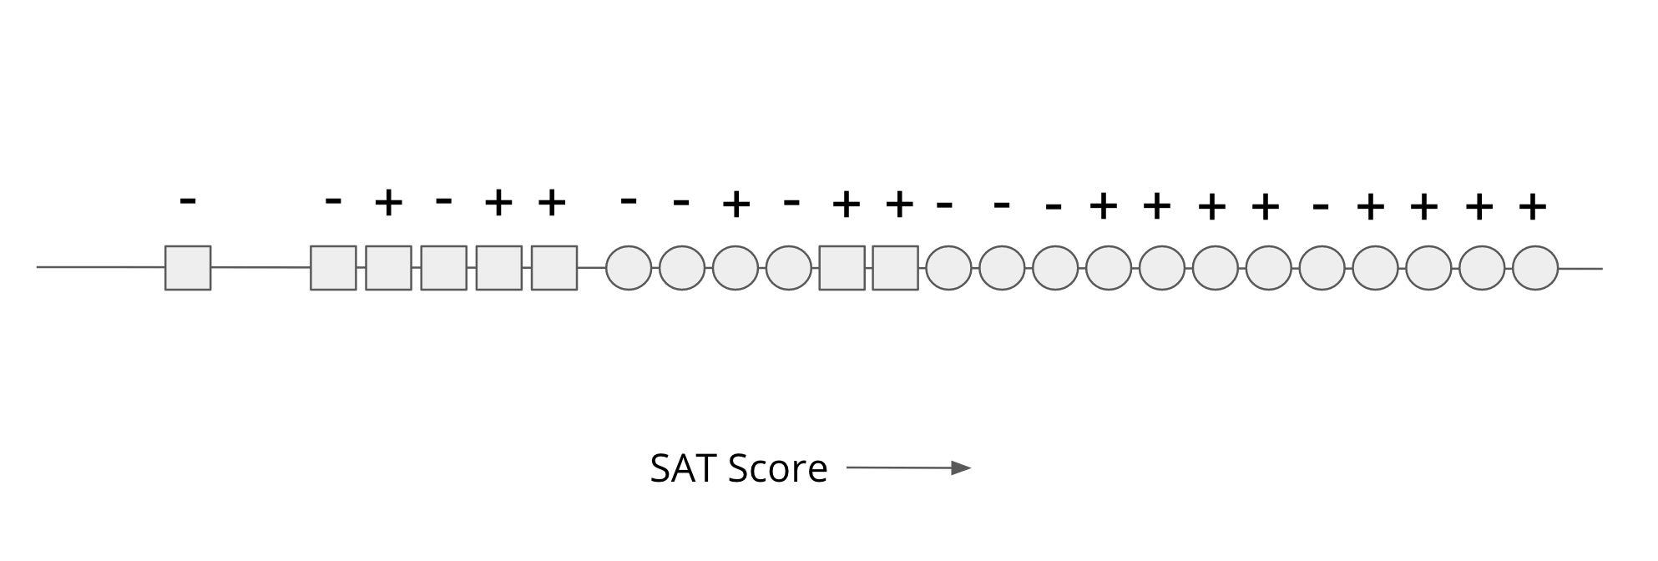
College Admissions - Continued
Continuing overly simplistic college admissions example, with a fake dataset.
Majority (2/3) are Circle, the remaining 1/3 are Square
SAT score for Circles tends to be inflated when compared to Squares. Possibility: Systematic barriers and access to SAT Prep
Even though we see statistical differences between groups in our data, the rate in which they are actually successful is the same.

Slide 34
Accuracy and Fairness
With only one feature, we will consider a simple threshold classifier (a linear classifier with 1 input!).
The most accurate model is not necessarily the most fair.

Slide 35
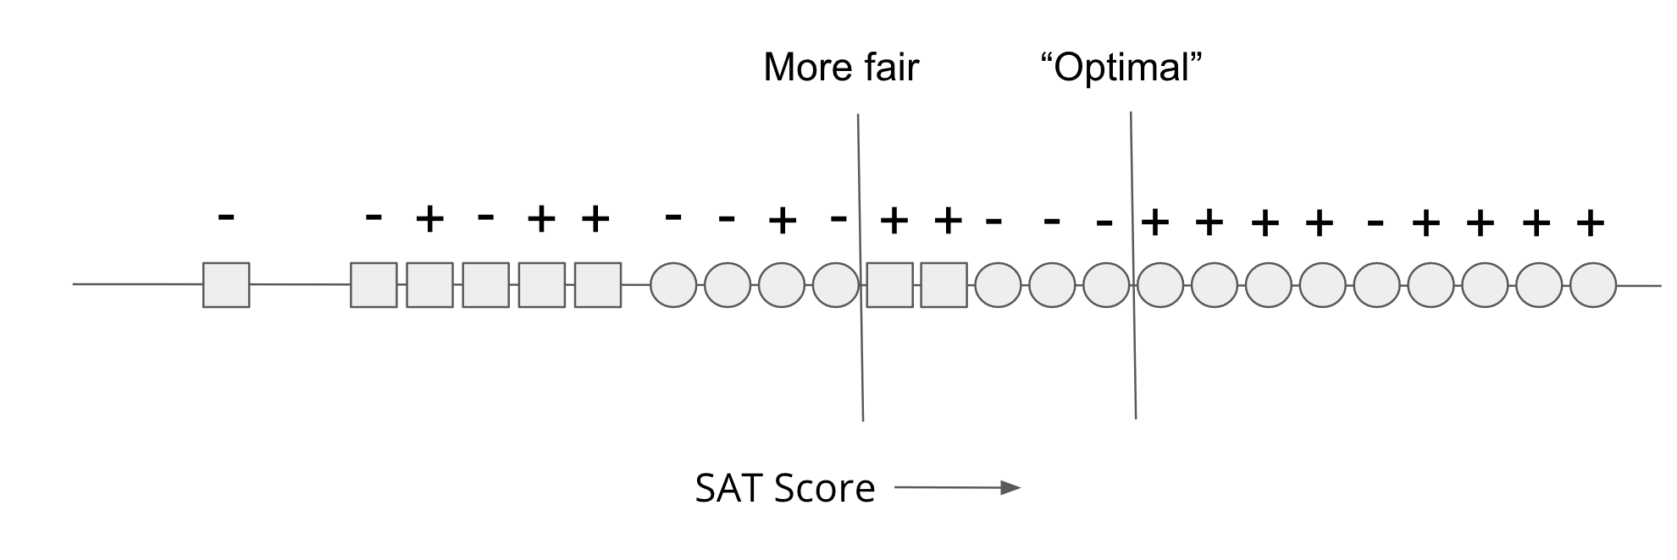
Fairness-Accuracy Tradeoff
In general, we find there is a tradeoff between accurate models and fair models. Making a model more fair tends to decrease accuracy by some amount.

Slide 36
Notes on Tradeoff
Might argue that my example is overly simplistic (it is!), but I’ll claim this is a proof of concept. We saw lots of examples of “accurate” models that were unfair.
This is not a statement that a tradeoff necessarily must exist, it just generally happens in real-world datasets.
Originally just cared about finding the most accurate model, saw unfairness as a byproduct. Controlling for fairness will yield a different model than you found before.
If we recognize data can encode biases and accuracy is determined in terms of that data, trying to achieve fairness will likely hurt accuracy.
In the example before, the artificial difference in SAT scores caused the problem.

Slide 37
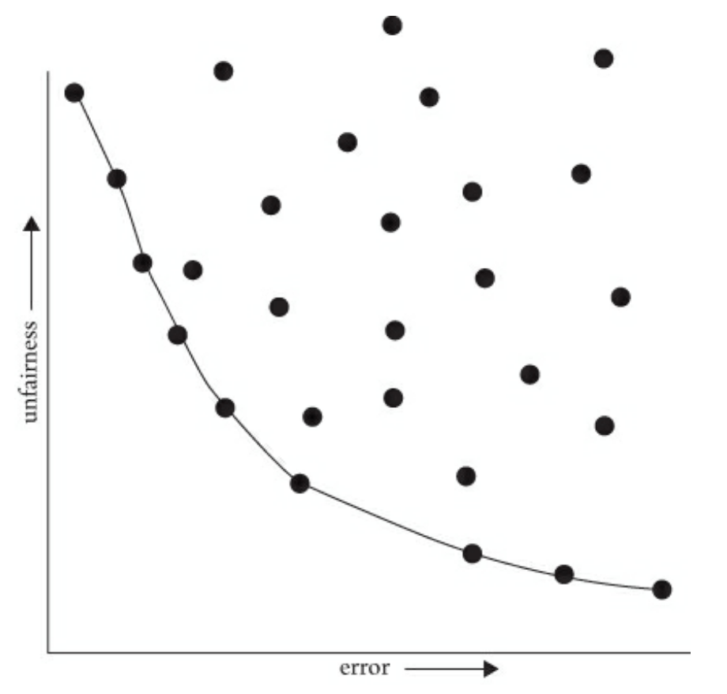
Pareto Frontier
Visualizing the tradeoff between fairness and accuracy
Does not tell you which tradeoff is appropriate!

Slide 38
Thoughts on Pareto Frontier
This feels a bit cold-hearted, it’s okay to like this is weird. Michael Kearns and Aaron Roth write in The Ethical Algorithm
While the idea of considering cold, quantitative trade-offs between accuracy and fairness might make you uncomfortable, the point is that there is simply no escaping the Pareto frontier. Machine learning engineers and policymakers alike can be ignorant of it or refuse to look at it. But once we pick a decision-making model (which might in fact be a human decision-maker), there are only two possibilities. Either that model is not on the Pareto frontier, in which case it’s a “bad” model (since it could be improved in at least one measure without harm in the other), or it is on the frontier, in which case it implicitly commits to a numerical weighting of the relative importance of error and unfairness. Thinking about fairness in less quantitative ways does nothing to change these realities—it only obscures them. Making the trade-off between accuracy and fairness quantitative does not remove the importance of human judgment, policy, and ethics—it simply focuses them where they are most crucial and useful, which is in deciding exactly which model on the Pareto frontier is best (in addition to choosing the notion of fairness in the first place, and which group or groups merit protection under it, […]). Such decisions should be informed by many factors that cannot be made quantitative, including what the societal goal of protecting a particular group is and what is at stake. Most of us would agree that while both racial bias in the ads users are shown online and racial bias in lending decisions are undesirable, the potential harms to individuals in the latter far exceed those in the former. So in choosing a point on the Pareto frontier for a lending algorithm, we might prefer to err strongly on the side of fairness—for example, insisting that the false rejection rate across different racial groups be very nearly equal, even at the cost of reducing bank profits. We’ll make more mistakes this way—both false rejections of creditworthy applicants and loans granted to parties who will default—but those mistakes will not be disproportionately concentrated in any one racial group.

Slide 40
Fairness as Worldview

Slide 41
Context
So far have discussed notions of group fairness, but other notions of fairness exist. Provide a framework for how to approach learning tasks and what assumptions we make. Based on Friedler et al. (2016).
High level ideas:
Data gathering and modeling
Individual fairness vs. group fairness
Common world-views that dictate which fairness is appropriate
How these worldviews can contradict each other

Slide 42
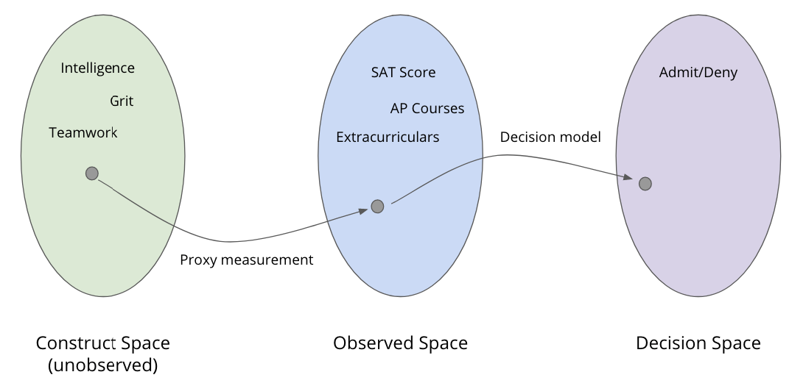
ML and Spaces
Defined modeling as transformation through three spaces
Construct space: True quantities of interest (unobserved)
Observed space: Data gathered to (hopefully) represent constructs. Achieved through measurement of proxies.
Decision space: The decisions of the model. Models take observed data and make decisions.

Slide 43
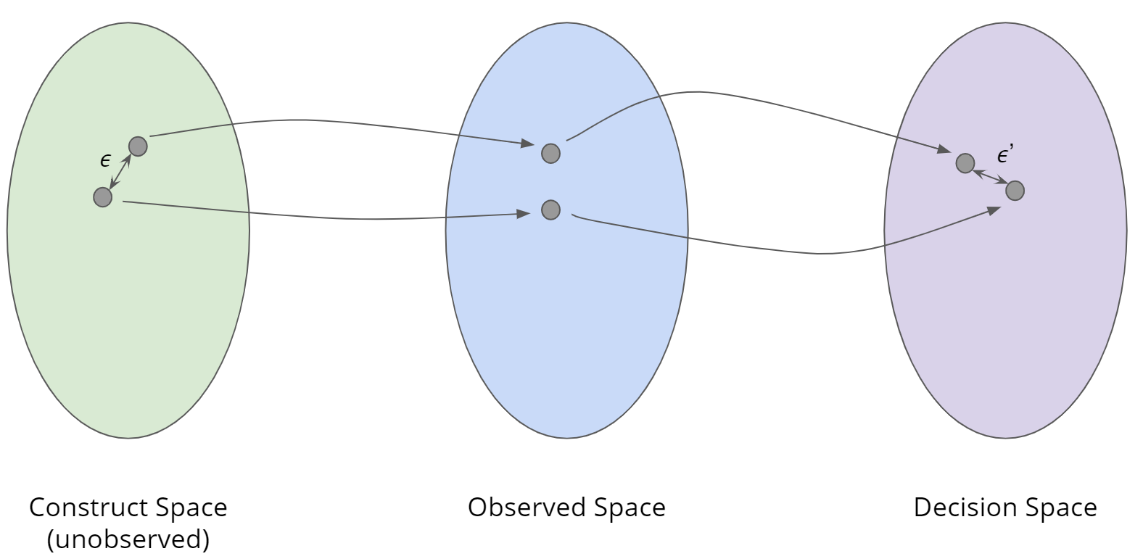
Individual Fairness
Idea: If two people are close in construct space, they should receive similar decisions.
Individual Fairness: A model $f:CS →DS$ is said to be fair if objects close in CS are close in DS. Specifically, it is $\left(ε, ε^{′}\right)$-fair if for any $x, y∈CS$
$$d_{CS}\left(x, y\right)≤ε ⇒ d_{DS}\left(f\left(x\right), f\left(y\right)\right)≤ε′$$

Slide 44
Worldview 1: WYSIWYG
Problem: We can’t tell if two objects are close in CS. So if we want to use individual fairness, we must make an assumption about how the world workds
What You See is What You Get (WYSIWYG): The Observed Space is a good representation of the Construct Space.
Example: For college admissions, things like SAT correlate well with intelligence.
With WYSIWYG, you can ensure fairness by comparing objects in the Observed Space as a good proxy for the Construct Space

Slide 45
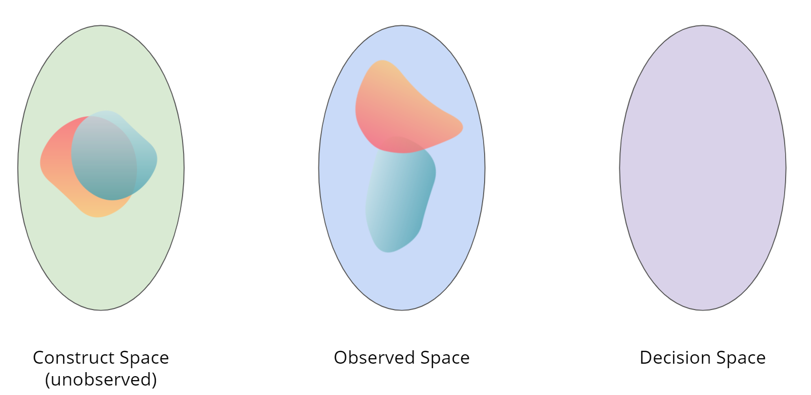
Worldview 2: Structural Bias + WAE
What if we don’t believe the Observed Space represents the Construct Space well? What if there is some structural bias that make people close in the construct space look different in the observed space?
Example: SAT doesn’t just measure intelligence, but also measures ability to afford SAT prep. People who are just as intelligent as someone else, can end up with different observations.

Slide 46
Worldview 2: Structural Bias + WAE
When considering Structural Bias, commonly will also assume We’re All Equal (WAE).
We’re All Equal (WAE): Membership in some protected group (e.g., race) should not be the cause of a meaningful difference for the task at hand (e.g., academic preparation). Not saying every group is exactly equal in all ways, but for the task at hand we are equal enough that it shouldn’t be the cause of difference.
Differences seen in groups in Observed Space are the result of structural bias!
Notions of group fairness make sense with Structural Bias + WAE

Slide 47
Which One?
So which is right? WYSIWYG or Structural Bias + WAE?
No way to know! They are statements of belief!
Which worldview you use determines what you think is fair
If you assume WYSIWYG
Individual fairness is right and easy to achieve
Non-discrimination may violate individual fairness
If you assume Structural Bias + WAE
Non-discrimination is right and is possible (saw group fairness mechanisms)
Attempts to achieve individual fairness may result in discrimination.

Slide 48
Takeaways
Models can have a huge impact on society, both positive and negative.
If we are not careful, our models will at best, perpetuate and at worst, amplify injustice in our society.
Historically, people thought defining things like accuracy was easy but defining what is/isn’t fair was not. Only recently (~10 years) have ML researchers tried to define what fairness might mean and how to enforce it in our models.
It’s clear that defining and enforcing fairness, but what fairness and how is a crucial problem we need humans (and not just ML engineers) in the loop to determine. These are questions of values, and we need humans to make informed decisions of what is right.

Slide 49
Recap I
Theme: It’s important to give terms to abstract notions like bias and fairness so we can have concrete things to look out for. There is not one right perspective though!
Ideas:
Calibration
Impacts of ML Systems on society
Sources of bias
Historical bias
Representation Bias
Measurement Bias
Aggregation Bias
Evaluation Bias
Deployment Bias
Definitions of fairness
Fairness through unawareness
Statistical parity
Equal opportunity
Predictive equality

Slide 50
Recap II
Theme: Thinking about fairness and the limitations of learning as a worldview.
Concepts:
Impossibility to achieve all fairness and accuracy
Fairness-accuracy tradeoff
Pareto Frontier
Modeling Spaces
Construct space
Observed space
Decision space
Individual fairness
What You See is What You Get (WYSIWYG)
Structural Bias + We’re All Equal (WAE)
Conflicting Worldviews

Slide 52
One Slide
Regression
Overfitting
Training, test, and generalization error
Bias-Variance tradeoff
Ridge, LASSO
Cross validation
Gradient descent
Classification
Logistic regression
Bias and Fairness

Slide 53
Decision Trees

Slide 54
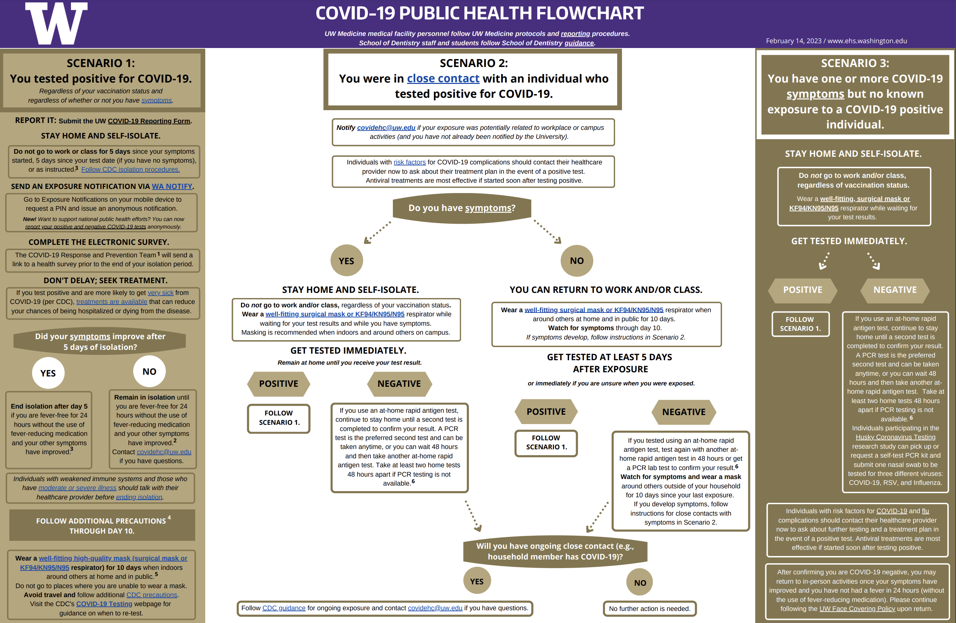
Humans often make decisions based on Flow Charts
or Decision Trees

Slide 55
Compare Models
Generative: defines a model for generating x (e.g. Naïve Bayes)
Discriminative: only cares about defining and optimizing a decision boundary (e.g. Logistic Regression)
Notes:
Generative classifiers
Assume some functional form for P(Y), P(X|Y)
Estimate parameters of P(X|Y), P(Y) directly from training data
Use Bayes rule to calculate P(Y |X)
Discriminative Classifiers
Assume some functional form for P(Y|X)
Estimate parameters of P(Y|X) directly from training data

Slide 56
Parametric vs. Non-Parametric Methods
Parametric Methods: make assumptions about the data distribution
Linear Regression ⇒ assume the data is linear
Logistic Regression ⇒ assume probability has the shape of of a logistic curve and linear decision boundary
Non-Parametric Methods: (mostly) don’t make assumptions about the data distribution
Decision Trees, k-NN (soon)
We’re still learning something, but not the parameters to a function family that we’re assuming describes the data.
Useful when you don’t want to (or can’t) make assumptions about the data distribution.
Those assumptions result in a parameterized function family. Our learning task is to learn the parameters.
Notes:
Mention: Often times with non-parametric rules, you can’t write the prediction equation down as a simple mathematical formula

Slide 57
XOR
A line might not always support our decisions.

Slide 58
What makes a loan risky?
I want to buy a new house!
Credit History ★★★★
Income ★★★
Term ★★★★★
Personal Info ★★★
Loan
Application
Notes:
Notes for Carlos:
Capital : Your capital is comprised of your savings, investments, and other assets that you can use to repay the loan. Capital can be helpful if you lose your job or experience other setbacks.
Capacity : Lenders will gauge your ability to repay the loan you’re applying for based on your current situation, and the amount of debt and expenses you currently have. Lenders will typically calculate your debt-to-income ratio – or how much you owe vs. how much you earn – to gauge your risk. The lower your ratio, the less risky lending to you may seem.
Collateral : With some loans, you’re required to offer an asset (for example, a home or car) that the lender can take possession of in the event that you are unable to make loan payments. Some lenders may require a guarantee in addition to collateral, which means that you or a third party must agree to repay the loan if the collateral cannot cover the amount.
Conditions : These are outside circumstances, such as the economy and job market, that can influence your ability to repay a loan. However, this category also includes how you intend to use the loan. For instance, obtaining a loan to pay for graduate school would seem less risky than a loan being used for a family vacation, since the degree would most likely improve your profitability in the long run.
Credit history : Lenders will check your credit report and score. Together they show lenders your credit accounts, payment history, and level of risk.

Slide 59
Credit history explained
Did I pay previous loans on time?
Example: excellent, good, or fair
Credit History ★★★★
Income ★★★
Term ★★★★★
Personal Info ★★★

Slide 60
Income
What’s my income?
Example: $80K per year
Credit History ★★★★
Income ★★★
Term ★★★★★
Personal Info ★★★

Slide 61
Loan terms
How soon do I need to pay the loan?
Example: 3 years, 5 years,…
Credit History ★★★★
Income ★★★
Term ★★★★★
Personal Info ★★★

Slide 62
Personal information
Credit History ★★★★
Age, reason for the loan, marital status,…
Example: Home loan for a married couple
Income ★★★
Term ★★★★★
Personal Info ★★★

Slide 63
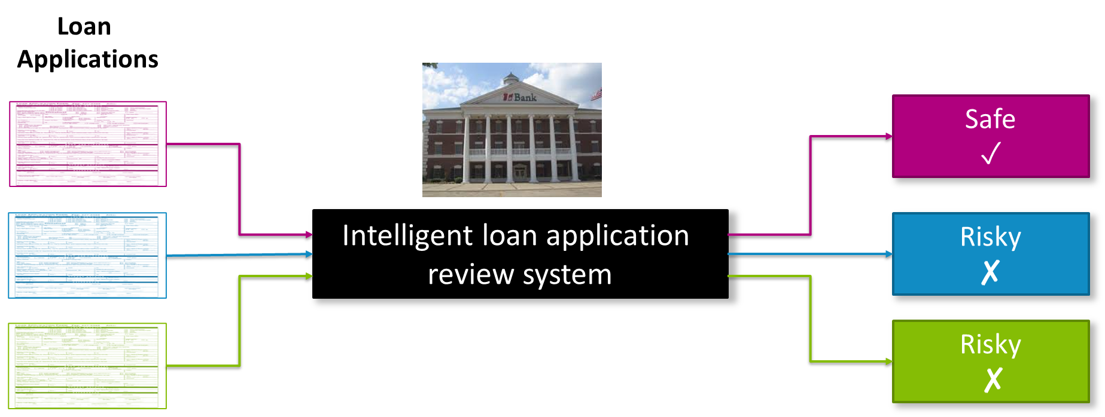
Intelligent application

Slide 64
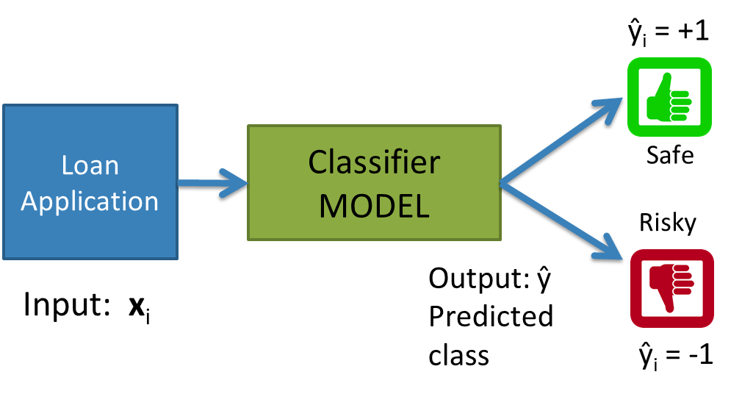
Classifier review

Slide 65
Setup
Data (N observations, 3 features)
Evaluation: classification error
Many possible decisions: number of trees grows exponentially!
Credit | Term | Income | y
excellent | 3 yrs | high | safe
fair | 5 yrs | low | risky
fair | 3 yrs | high | safe
poor | 5 yrs | high | risky
excellent | 3 yrs | low | safe
fair | 5 yrs | low | safe
poor | 3 yrs | high | risky
poor | 5 yrs | low | safe
fair | 3 yrs | high | safe
Notes:
- Switch this to the new figure

Slide 66
2 min
With our discussion of bias and fairness from last week, discuss the potential biases and fairness concerns that might be present in our dataset about loan safety.
No poll

Slide 67
Decision Trees
Start
excellent
Credit?
poor
fair
Income?
Safe
Term?
high
Low
3 years
5 years
Risky
Safe
Term?
Risky
3 years
5 years
Risky
Safe
Branch/Internal node: splits into possible values of a feature
Leaf node: final decision (the class value)

Slide 68
Next time

