Slide 1
CSE/STAT 416
Logistic Regression
Pre-Class Videos
Tanmay Shah
University of Washington
July 3, 2024

Slide 2

Sentiment Classifier
In our example, we want to classify a restaurant review as positive or negative.
Sentence from review
Classifier Model
Input: x
Output: y
Predicted class

Slide 3

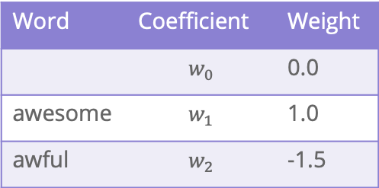
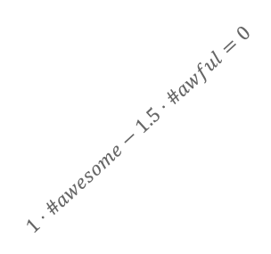


Decision Boundary
Consider if only two words had non-zero coefficients
Word | Coefficient | Weight
 | $$w_{0}$$ | 0.0
awesome | $$w_{1}$$ | 1.0
awful | $$w_{2}$$ | -1.5
$$\hat{s}=1⋅\#awesome−1.5⋅\#awful$$
#awful
0 1 2 3 4 $⋯$
$$1⋅\#awesome−1.5⋅\#awful=0$$
#awesome
0 1 2 3 4 $⋯$

Slide 4

Learning $\hat{w}$

Slide 5








All the Same?
One idea is to just model the processing of finding $\hat{w}$ based on what we discussed in linear regression
$$\hat{w}=\underset{w}{argmin}{\frac{1}{n}\sum_{i=1}^{n}{𝕀}\{y_{i}≠{\hat{y}}_{i}\}}$$
Will this work?
Assume $h_{1}\left(x\right)=\#awesome$ so $w_{1}$ is its coefficient and $w_{2}$ is fixed.
#awful
error
$$1$$
$$1⋅\#awesome−1.5⋅\#awful=0$$
$$0$$
$$w_{1}$$
0 1 2 3 4 $⋯$
#awesome
$$0$$
Notes:
Mark various lines

Slide 6
Minimizing Error
Minimizing classification error is probably the most intuitive thing to do given all we have learned from regression. However, it just doesn’t work in this case with classification.
We aren’t able to use a method like gradient descent here because the function isn’t ”nice” (it’s not continuous, it’s not differentiable, etc.).
We will use a stand-in for classification error that will allow us to use an optimization algorithm. But first, we have to change the problem we care about a bit.
Instead of caring about the classifications, let’s look at some probabilities

Slide 7
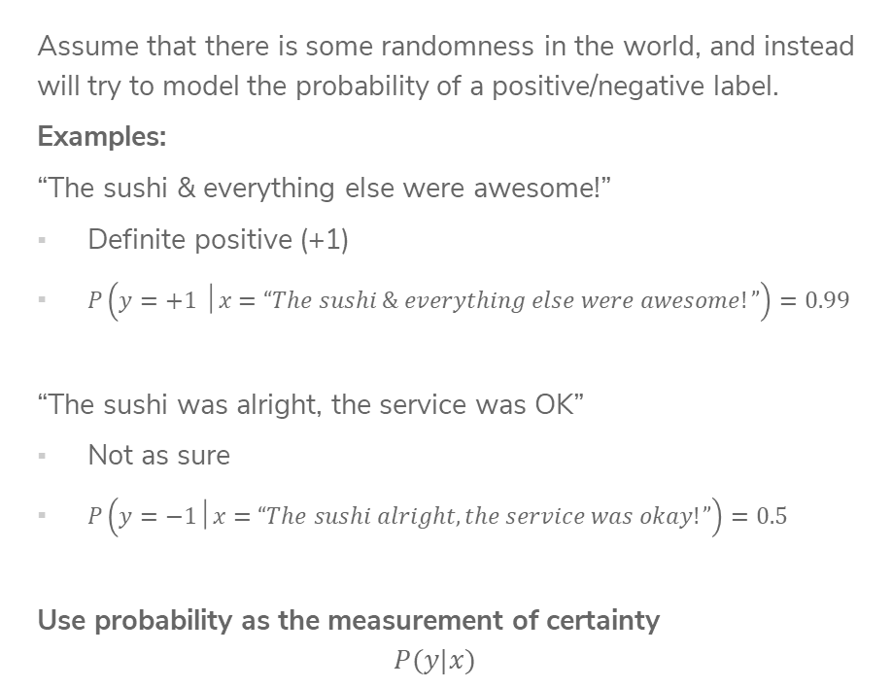
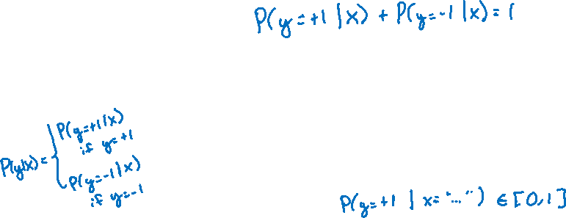
Probabilities
Assume that there is some randomness in the world, and instead will try to model the probability of a positive/negative label.
Examples:
“The sushi & everything else were awesome!”
Definite positive (+1)
$P\left(y=+1 │x=“The sushi \& everything else were awesome!”\right)=0.99$
“The sushi was alright, the service was OK”
Not as sure
$P\left(y=−1│x=“The sushi alright, the service was okay!”\right)=0.5$
Use probability as the measurement of certainty
$$P(y|x)$$

Slide 8
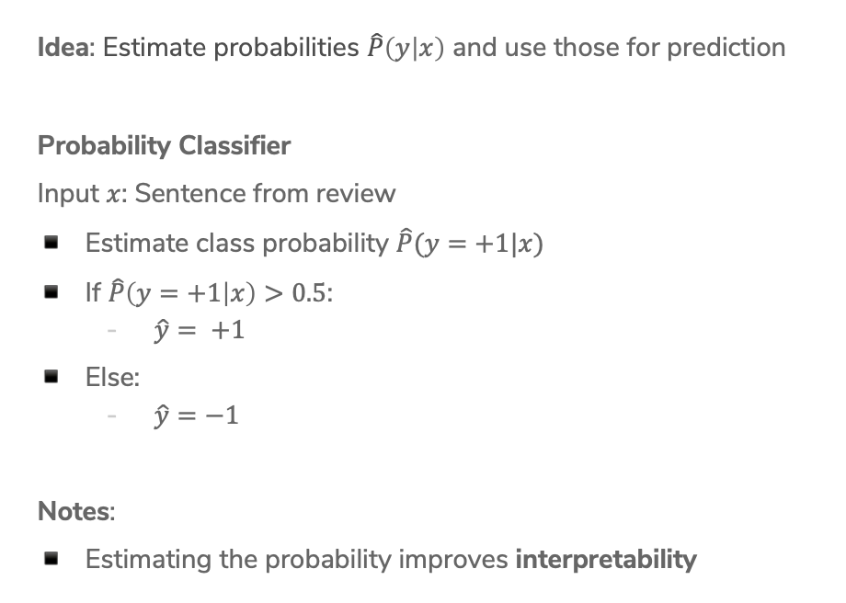
Probability Classifier
Idea: Estimate probabilities $\hat{P}\left(y | x\right)$ and use those for prediction
Probability Classifier
Input $x$: Sentence from review
Estimate class probability $\hat{P}(y=+1|x)$
If $\hat{P}\left(y=+1 | x\right)>0.5$:
  $\hat{y}= +1$
Else:
  $\hat{y}=−1$
Notes:
Estimating the probability improves interpretability

Slide 9

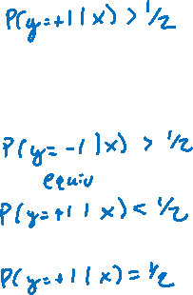


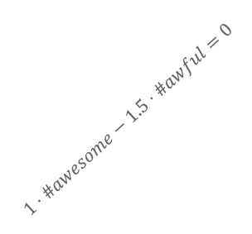
Score Probabilities?
Idea: Let’s try to relate the value of $Score(x)$ to $\hat{P}(y=+1|x)$
#awful
What if $Score\left(x\right)$ is positive?
What if $Score\left(x\right)$ is negative?
What if $Score\left(x\right)$ is 0?
$$1⋅\#awesome−1.5⋅\#awful=0$$
0 1 2 3 4 $⋯$
#awesome

Slide 10















Interpreting Score
$$Score\left(x_{i}\right)=w^{T}h\left(x_{i}\right)$$
$$−∞$$
$${\hat{y}}_{i}=−1$$
$$0$$
$${\hat{y}}_{i}=+1$$
$$∞$$
Very sure
$${\hat{y}}_{i}=−1$$
Not sure if
$${\hat{y}}_{i}=−1 or {\hat{y}}_{i}=+1$$
Very sure
$${\hat{y}}_{i}=+1$$
$$\hat{P}\left(y_{i}=+1|x_{i}\right)=0$$
$$\hat{P}\left(y_{i}=+1|x_{i}\right)=0.5$$
$$\hat{P}\left(y_{i}=+1|x_{i}\right)=1$$
$$0$$
$$\hat{P}(y=+1 |x)$$
$$1$$

Slide 11
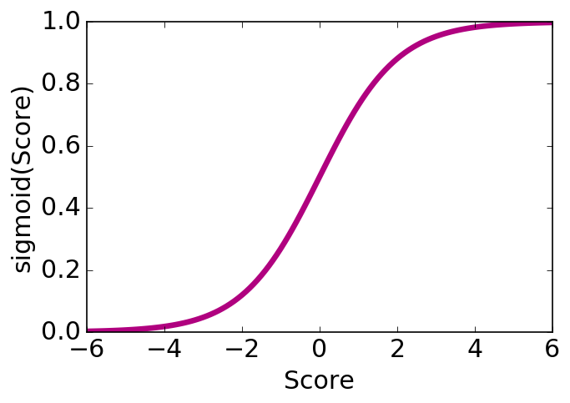

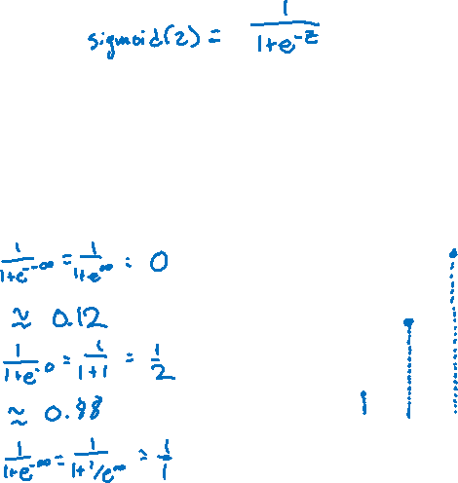
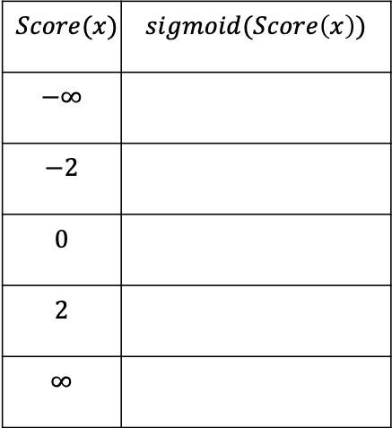
Logistic Function
Use a function that takes numbers arbitrarily large/small and maps them between 0 and 1.
$$sigmoid\left(Score(x)\right)= \frac{1}{1+e^{−Score(x)} }$$
$$Score(x)$$ | $$sigmoid(Score\left(x\right))$$
$$−∞$$
$$−2$$
$$0$$
$$2$$
$$∞$$
Notes:
Mark points on graph

Slide 12

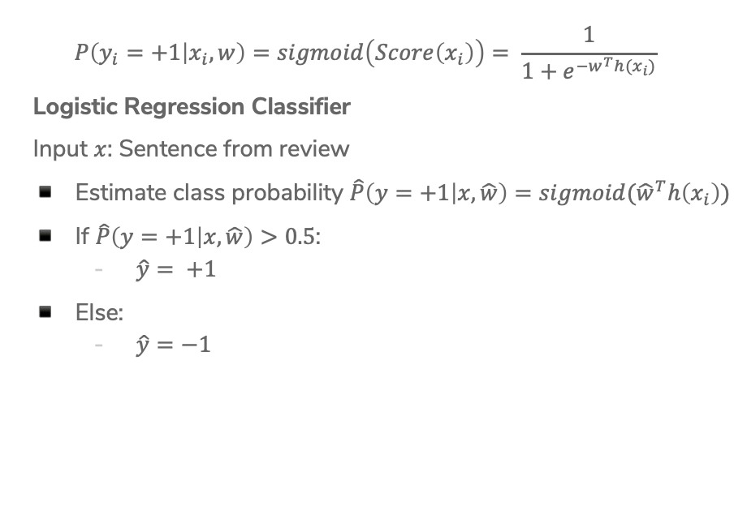

Logistic Regression Model
$$P\left(y_{i}=+1 | x_{i}, w\right)=sigmoid\left(Score\left(x_{i}\right)\right)= \frac{1}{1+e^{−w^{T}h(x_{i})}}$$
Logistic Regression Classifier
Input $x$: Sentence from review
Estimate class probability $\hat{P}\left(y=+1 | x, \hat{w}\right)=sigmoid({\hat{w}}^{T}h\left(x_{i}\right))$
If $\hat{P}\left(y=+1 | x, \hat{w}\right)>0.5$:
  $\hat{y}= +1$
Else:
  $\hat{y}=−1$
Notes:
Mark where predictions change on graph

Slide 13





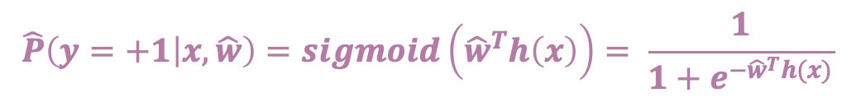

ML Pipeline
$$\hat{P}\left(y=+1 | x, \hat{w}\right)=sigmoid\left({\hat{w}}^{T}h\left(x\right)\right)= \frac{1}{1+e^{−{\hat{w}}^{T}h(x)}}$$
Training
Data
$$x$$
Pre-
Processing
$$h(x)$$
ML
model
$$\hat{y}$$
$$\hat{w}$$
Optimization
algorithm
$$y$$
Quality
metric
13

Slide 14
CSE/STAT 416
Logistic Regression
Tanmay Shah
University of Washington
June 3, 2024
❓ Questions? Raise hand or sli.do #cs416
💬 Before Class: Does a straw have two holes or one?
🎵 Listening to: New Jeans

Slide 15
Administrivia
Coming up
  Week 3: Societal Impacts of ML (Fairness and Bias)
  Week 4: Other ML models for classification
  Week 5: Deep Learning
HW3 released today, due next Tuesday
Midterm
  Released Friday 4/21 at 8:30 am. Due Monday 4/24 at 11:59 pm.
    Untimed, but would be good to time yourself as practice for the final
    Should take ~1 hour if you know the material
  Format: Think longer conceptual assignment from HW
  Covers everything from Module 0 (Regression) to Module 3 (Societal Impact, Bias, Fairness)
  Should follow our normal collaboration policy
    Think of it as a trial run for the final exam

Slide 16

Confusion Matrix
For binary classification, there are only two types of mistakes
$\hat{y}=+1, y=−1$
$\hat{y}=−1, y=+1$
Generally we make a confusion matrix to understand mistakes.
Predicted Label
 | True Positive (TP) | False Negative (FN)
 | False Positive (FP) | True Negative (TN)
True Label
Tip on remembering: complete the sentence “My prediction was a …”
Notes:
So how can we break down the types of errors to think about them in a more detailed fashion? Using a tool called confusion matrices.
WOS: y, \hat{y}

Slide 17
Confusion Matrix Example
Predicted Label
 | True Positive (TP) | False Negative (FN)
 | False Positive (FP) | True Negative (TN)
True Label
Notes:
Write
100 test examples
60 total positive, 40 total negative
TP 50, 10 FN, 5 FP, 35 TN
Compute accuracy (50 + 35 / 100) = 0.85

Slide 18
Which is Worse?
What’s worse, a false negative or a false positive?
It entirely depends on your application!
In almost every case, how treat errors depends on your context.
Detecting Spam
False Negative: Annoying
False Positive: Email lost
Medical Diagnosis
False Negative: Disease not treated
False Positive: Wasteful treatment
Notes:
Spam is the positive label
Mention the COVID example

Slide 19
Errors and Fairness
We mentioned on the first day how ML is being used in many contexts that impact crucial aspects of our lives.
Models making errors is a given, what we do about that is a choice:
Are the errors consequential enough that we shouldn’t use a model in the first place?
Do different demographic groups experience errors at different rates?
  If so, we would hopefully want to avoid that model!
Will talk more about how to define whether or a not a model is fair / discriminatory next week. Will use these notions of error as a starting point!

Slide 20

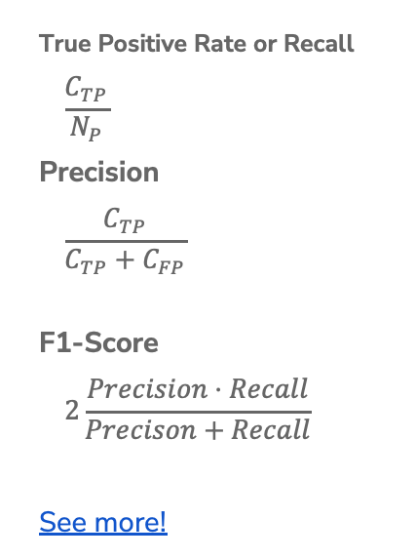
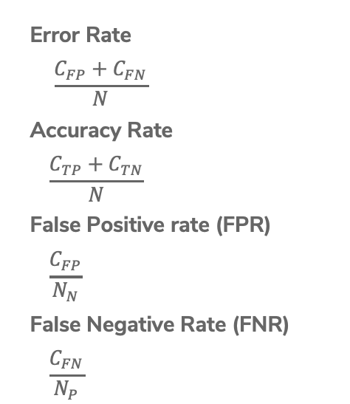
Binary Classification Measures
Notation
$C_{TP}=\#TP, C_{FP}=\#FP, C_{TN}=\#TN, C_{FN}=\#FN$
$N=C_{TP}+C_{FP}+C_{TN}+C_{FN}$
$N_{P}=C_{TP}+C_{FN}, N_{N}=C_{FP}+C_{TN}$
Error Rate
$$\frac{C_{FP}+C_{FN}}{N}$$
Accuracy Rate
$$\frac{C_{TP}+C_{TN}}{N}$$
False Positive rate (FPR)
$$\frac{C_{FP}}{N_{N}}$$
False Negative Rate (FNR)
$$\frac{C_{FN}}{N_{P}}$$
True Positive Rate or Recall
$$\frac{C_{TP}}{N_{P}}$$
Precision
$$\frac{C_{TP}}{C_{TP}+C_{FP}}$$
F1-Score
$$2\frac{Precision⋅Recall}{Precison+Recall}$$
See more!

Slide 21
Multiclass Confusion Matrix
Consider predicting (Healthy, Cold, Flu)
Predicted Label
 | Healthy | Cold | Flu
Healthy | 60 | 8 | 2
Cold | 4 | 12 | 4
Flu | 0 | 2 | 8
True Label
Notes:
WOS:
Circle the diagonal, label “correct”
Mention that you can’t exactly say false positive or false negative here, since there isn’t just a positive or negative, there are more classes.

Slide 22
1 min
Suppose we trained a classifier and computed its confusion matrix on the training dataset. Is there a class imbalance in the dataset and if so, which class has the highest representation?
Predicted Label
 | Pupper | Doggo | Woofer
Pupper | 2 | 27 | 4
Doggo | 4 | 25 | 4
Woofer | 1 | 30 | 2
True Label

Slide 23
2 min
Suppose we trained a classifier and computed its confusion matrix on the training dataset. Is there a class imbalance in the dataset and if so, which class has the highest representation?
Predicted Label
 | Pupper | Doggo | Woofer
Pupper | 2 | 27 | 4
Doggo | 4 | 25 | 4
Woofer | 1 | 30 | 2
True Label

Slide 24
Learning Theory

Slide 25
How much data?
The more the merrier
But data quality is also an extremely important factor
Theoretical techniques can bound how much data is needed
Typically too loose for practical applications
But does provide some theoretical guarantee
In practice
More complex models need more data

Slide 26
Learning Curve
How does the true error of a model relate to the amount of training data we give it?
Hint: We’ve seen this picture before
True error
Amount of training data
Notes:
Draw in difference at end is bias + noise

Slide 27
Learning Curve
What if we use a more complex model?
True error
Amount of training data
Notes:
Write in that curve is model using single words
Draw in curve for bigrams
Smaller bias

Slide 28
Recap of classification so far
Theme: Describe high level idea and metrics for classification
Ideas:
Applications of classification
Linear classifier
Decision boundaries
Classification error / Classification accuracy
Class imbalance
Confusion matrix
Learning theory

Slide 29

All the Same?
One idea is to just model the processing of finding $\hat{w}$ based on what we discussed in linear regression
$$\hat{w}=\underset{w}{argmin}{\frac{1}{n}\sum_{i=1}^{n}{𝕀}\{y_{i}≠{\hat{y}}_{i}\}}$$
Will this work?
Assume $h_{1}\left(x\right)=\#awesome$ so $w_{1}$ is its coefficient and $w_{2}$ is fixed.
#awful
error
$$1$$
$$1⋅\#awesome−1.5⋅\#awful=0$$
$$0$$
$$w_{1}$$
0 1 2 3 4 $⋯$
#awesome
$$0$$
Notes:
Mark various lines

Slide 30
Logistic Regression Model
$$P\left(y_{i}=+1 | x_{i}, w\right)=sigmoid\left(Score\left(x_{i}\right)\right)= \frac{1}{1+e^{−w^{T}h(x_{i})}}$$
Logistic Regression Classifier
Input $x$: Sentence from review
Estimate class probability $\hat{P}\left(y=+1 | x, \hat{w}\right)=sigmoid({\hat{w}}^{T}h\left(x_{i}\right))$
If $\hat{P}\left(y=+1 | x, \hat{w}\right)>0.5$:
  $\hat{y}= +1$
Else:
  $\hat{y}=−1$
Notes:
Mark where predictions change on graph

Slide 31
Demo
Show logistic demo (see course website)

Slide 32

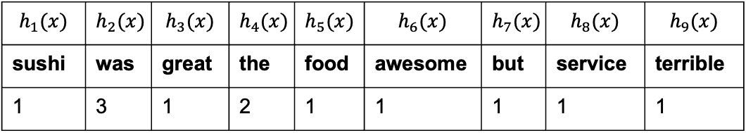
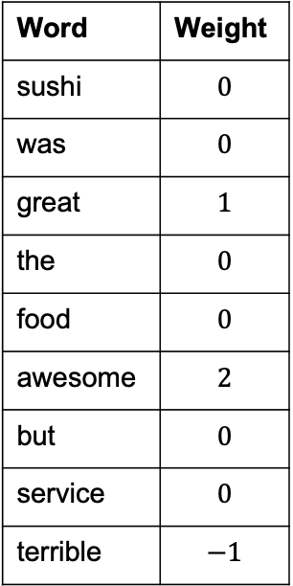
1 min
What would the Logistic Regression model predict for $P\left(y=−1 \right|x,w)$?
”Sushi was great, the food was awesome, but the
service was terrible”
Word | Weight
sushi | $$0$$
was | $$0$$
great | $$1$$
the | $$0$$
food | $$0$$
awesome | $$2$$
but | $$0$$
service | $$0$$
terrible | $$−1$$
$$h_{1}(x)$$ | $$h_{2}(x)$$ | $$h_{3}(x)$$ | $$h_{4}(x)$$ | $$h_{5}(x)$$ | $$h_{6}(x)$$ | $$h_{7}(x)$$ | $$h_{8}(x)$$ | $$h_{9}(x)$$
sushi | was | great | the | food | awesome | but | service | terrible
1 | 3 | 1 | 2 | 1 | 1 | 1 | 1 | 1

Slide 33
2 min
What would the Logistic Regression model predict for $P\left(y=−1 \right|x,w)$?
”Sushi was great, the food was awesome, but the
service was terrible”
Word | Weight
sushi | $$0$$
was | $$0$$
great | $$1$$
the | $$0$$
food | $$0$$
awesome | $$2$$
but | $$0$$
service | $$0$$
terrible | $$−1$$
$$h_{1}(x)$$ | $$h_{2}(x)$$ | $$h_{3}(x)$$ | $$h_{4}(x)$$ | $$h_{5}(x)$$ | $$h_{6}(x)$$ | $$h_{7}(x)$$ | $$h_{8}(x)$$ | $$h_{9}(x)$$
sushi | was | great | the | food | awesome | but | service | terrible
1 | 3 | 1 | 2 | 1 | 1 | 1 | 1 | 1

Slide 34

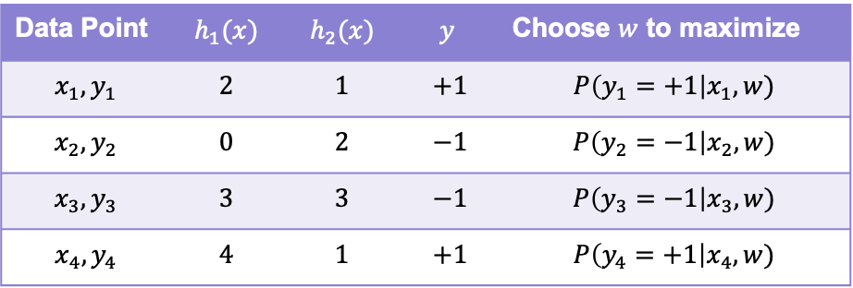
Quality Metric = Likelihood
Want to compute the probability of seeing our dataset for every possible setting for $w$. Find $w$ that makes data most likely! (e.g., maximize this likelihood metric)
Data Point | $$h_{1}(x)$$ | $$h_{2}(x)$$ | $$y$$ | Choose $w$ to maximize
$$x_{1}, y_{1}$$ | $$2$$ | $$1$$ | $$+1$$ | $$P\left(y_{1}=+1\right|x_{1}, w)$$
$$x_{2}, y_{2}$$ | $$0$$ | $$2$$ | $$−1$$ | $$P\left(y_{2}=−1\right|x_{2}, w)$$
$$x_{3}, y_{3}$$ | $$3$$ | $$3$$ | $$−1$$ | $$P\left(y_{3}=−1\right|x_{3}, w)$$
$$x_{4}, y_{4}$$ | $$4$$ | $$1$$ | $$+1$$ | $$P\left(y_{4}=+1\right|x_{4}, w)$$
Notes:
Write P(y=+1|x,w ) = … and P(y=-1|x, w) at top
Write P(y|x, w) = piecewise next to it
Write ell(w) = P(y_1|x_1,w)P(y_2|x_2,w)…
Write product notation

Slide 35


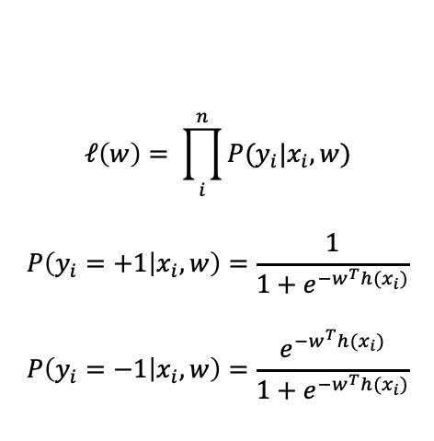

Learn $\hat{w}$
Now that we have our new model, we will talk about how to choose $\hat{w}$ to be the “best fit”.
The choice of $w$ affects how likely seeing our dataset is
#awful
$$ℓ\left(w\right)= \prod_{i}^{n}{P(y_{i}|x_{i}, w)}$$
$$P\left(y_{i}=+1 | x_{i},w\right)=\frac{1}{1+e^{−w^{T}h(x_{i})}}$$
$$P\left(y_{i}=−1 | x_{i},w\right)=\frac{e^{−w^{T}h(x_{i})}}{1+e^{−w^{T}h(x_{i})}}$$
0 1 2 3 4 $⋯$
#awesome

Slide 36
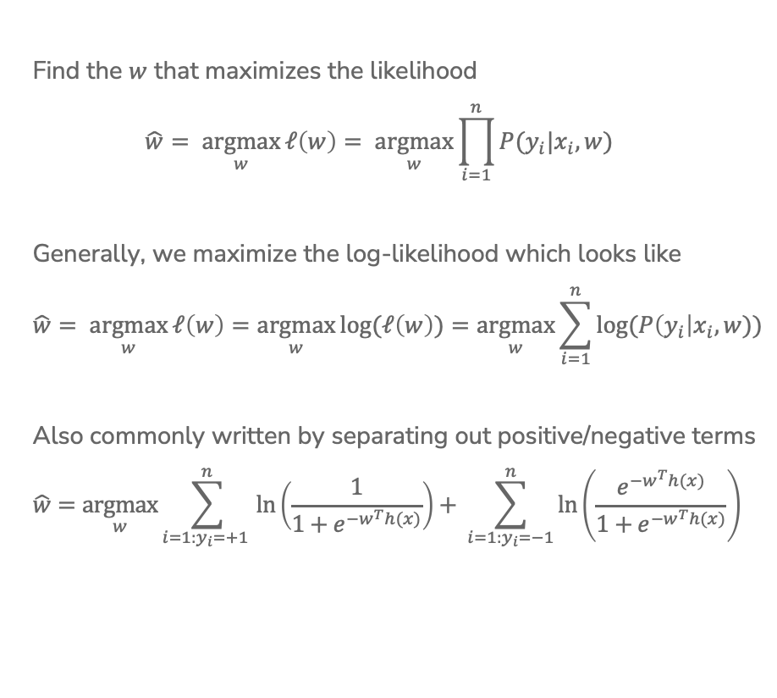
Maximum Likelihood Estimate (MLE)
Find the $w$ that maximizes the likelihood
$$\hat{w}= \underset{w}{argmax}{ℓ\left(w\right)= \underset{w}{argmax}{\prod_{i=1}^{n}{P(y_{i}|x_{i}, w)}}}$$
Generally, we maximize the log-likelihood which looks like
$$\hat{w}= \underset{w}{argmax}{ℓ\left(w\right)}=\underset{w}{argmax}{log⁡(ℓ\left(w\right))}=\underset{w}{argmax}{\sum_{i=1}^{n}{log⁡(P\left(y_{i}\right|x_{i}, w))}}$$
Also commonly written by separating out positive/negative terms
$$\hat{w}=\underset{w}{argmax}{\sum_{i=1:y_{i}=+1 }^{n}{\ln\left(\frac{1}{1+e^{−w^{T}h(x)}}\right)+ \sum_{i=1:y_{i}=−1}^{n}{\ln\left(\frac{e^{−w^{T}h(x)}}{1+e^{−w^{T}h(x)}}\right)} }}$$
Notes:
Write underneath left that this penalizes being wrong on the positive examples (imagine if Score(x) was -\infty)
Write underneath right that this penalizes being wrong on positive examples

Slide 37




1 min
Which setting of $w$ should we use?
#awful
$$ℓ\left(w^{\left(1\right)}\right)={10}^{−5}$$
$$ℓ\left(w^{\left(2\right)}\right)={10}^{−6}$$
$$ℓ\left(w^{\left(3\right)}\right)={10}^{−4}$$
#awesome

Slide 38


Slide 39
Training
Data
$$x$$
Pre-
Processing
$$h(x)$$
ML
model
$$\hat{y}$$
$$\hat{w}$$
Optimization
algorithm
$$y$$
Quality
metric

Slide 40
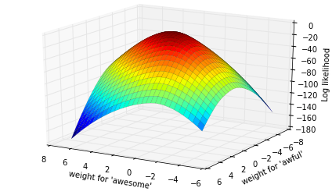


Finding MLE
No closed-form solution, have to use an iterative method.
Since we are maximizing likelihood, we use gradient ascent.
$$\hat{w}=\underset{w}{argmax}{\sum_{i=1}^{n}{\log\left(P\left(y_{i}|x_{i}, w\right)\right)}}$$

Slide 41
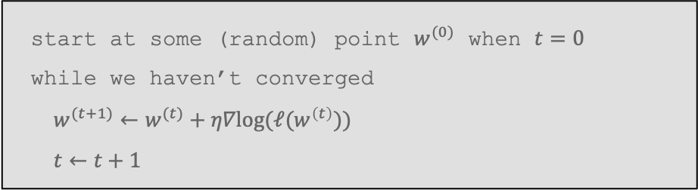

Gradient Ascent
Gradient ascent is the same as gradient descent, but we go ”up the hill”.
This is just describing going up the hill step by step.
$η$ controls how big of steps we take, and picking it is crucial for how well the model you learn does!
start at some (random) point $w^{(0)}$ when $t=0$
while we haven’t converged
$w^{(t+1)}←w^{(t)}+η∇log(ℓ(w^{\left(t\right)}))$
$t←t+1$

Slide 42
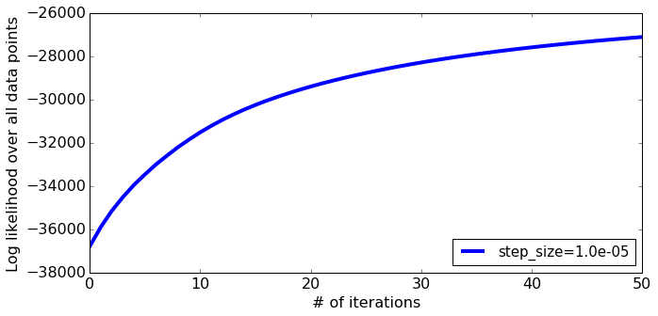
Learning Curve

Slide 43
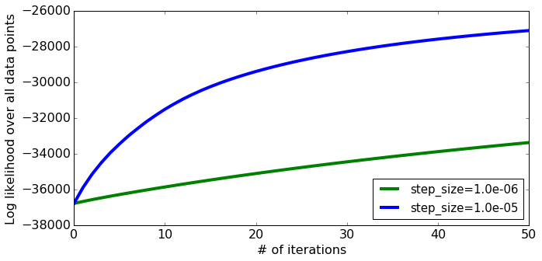

Choosing $η$
Step-size too small
Notes:
Draw hill climbing with tiny steps

Slide 44
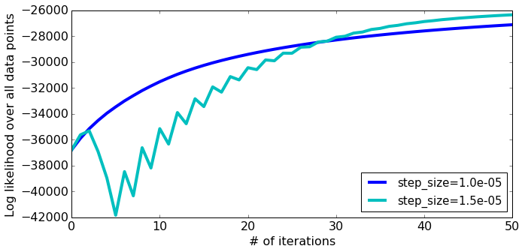
Choosing $η$
What about a larger step-size?
Notes:
Draw bouncing back and forth up the hill

Slide 45
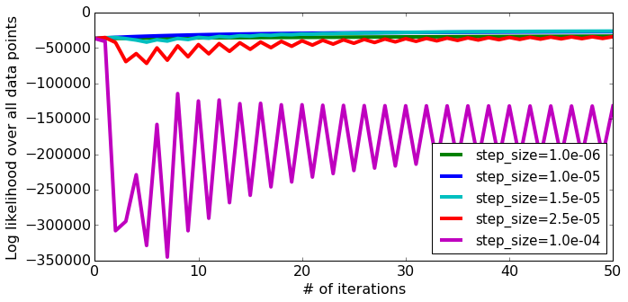
Choosing $η$
What about a larger step-size?
Can cause divergence!
Notes:
Draw bouncing out of the hill

Slide 46
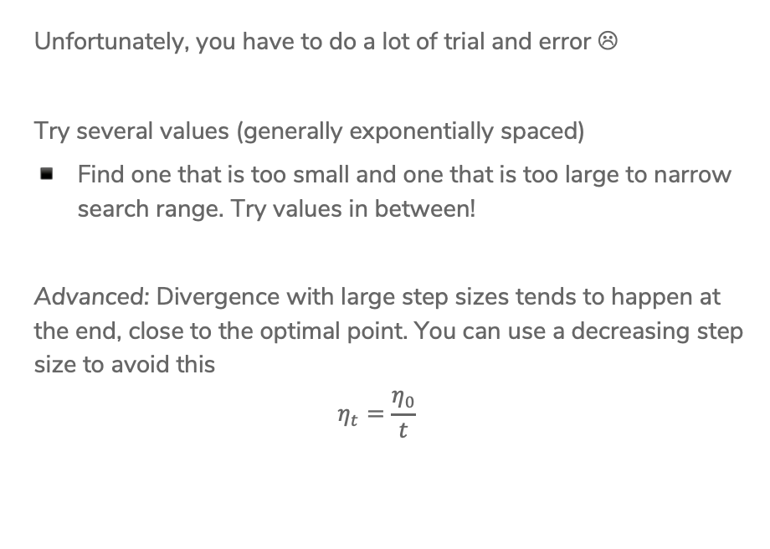
Choosing $η$
Unfortunately, you have to do a lot of trial and error ☹
Try several values (generally exponentially spaced)
Find one that is too small and one that is too large to narrow search range. Try values in between!
Advanced: Divergence with large step sizes tends to happen at the end, close to the optimal point. You can use a decreasing step size to avoid this
$$η_{t}=\frac{η_{0}}{t}$$

Slide 47
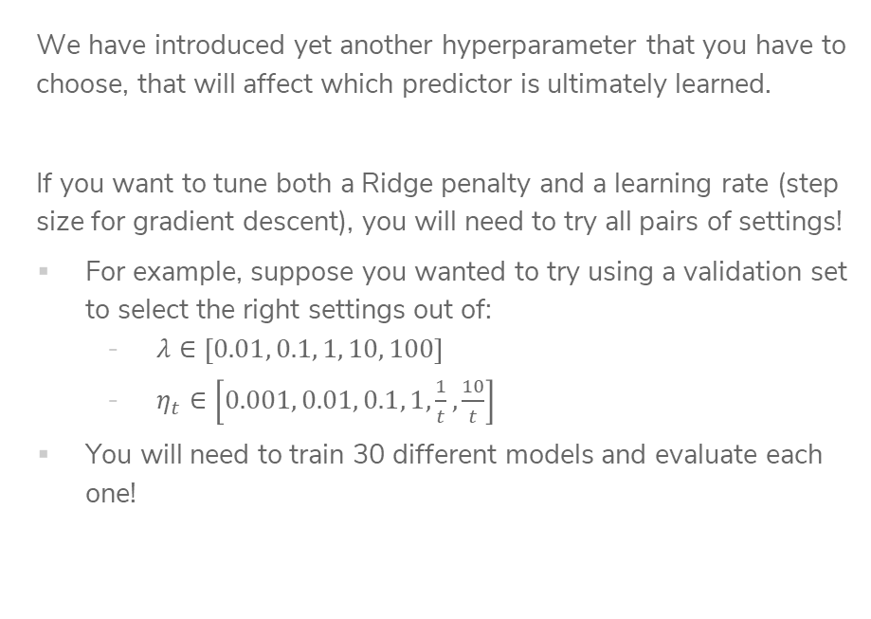
Grid Search
We have introduced yet another hyperparameter that you have to choose, that will affect which predictor is ultimately learned.
If you want to tune both a Ridge penalty and a learning rate (step size for gradient descent), you will need to try all pairs of settings!
For example, suppose you wanted to try using a validation set to select the right settings out of:
  $λ∈\left[0.01, 0.1, 1, 10, 100\right]$
  $η_{t}∈\left[0.001, 0.01, 0.1, 1,\frac{1}{t},\frac{10}{t}\right]$
You will need to train 30 different models and evaluate each one!

Slide 48
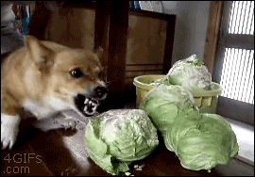

Slide 49
Overfitting - Classification

Slide 50
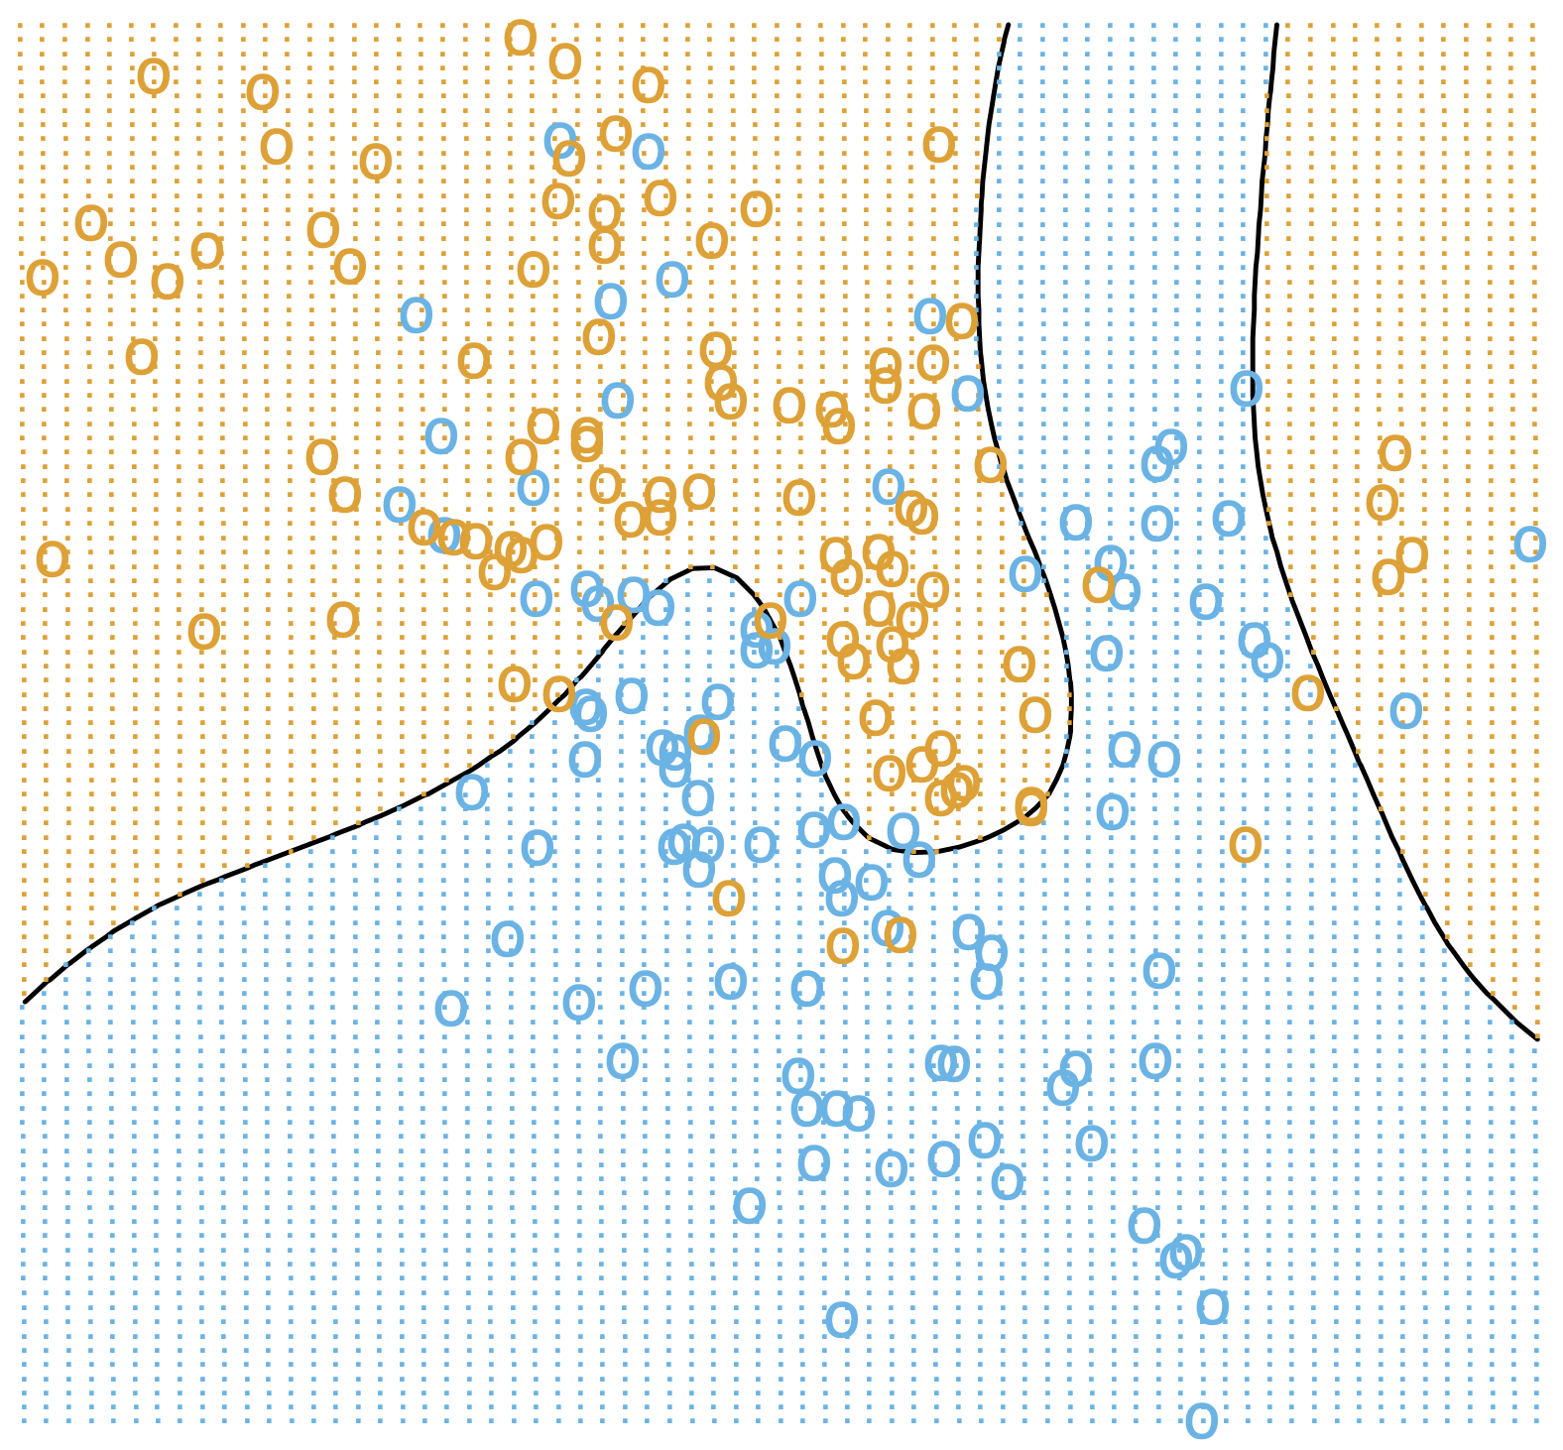
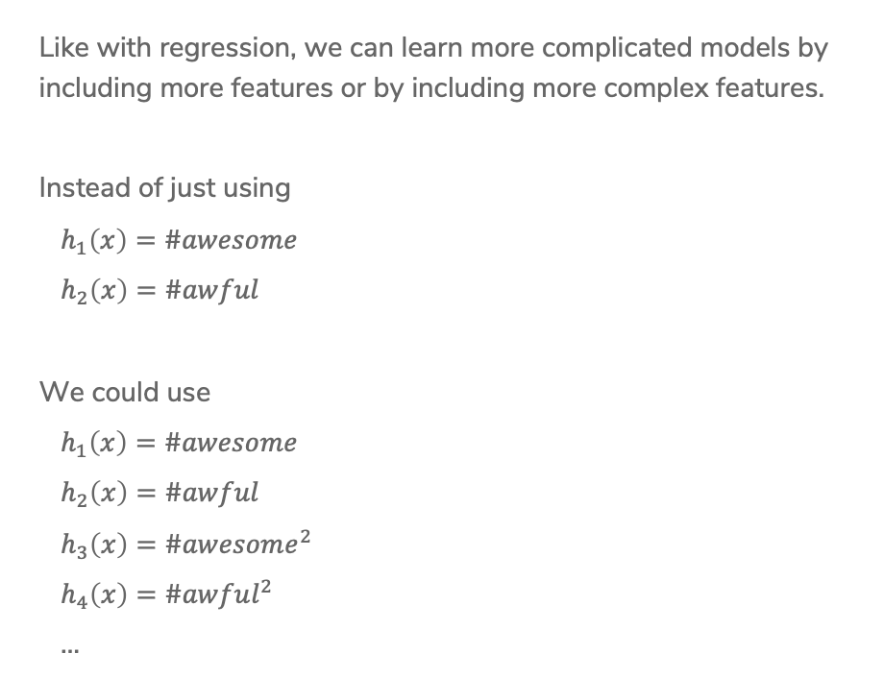
More Features
Like with regression, we can learn more complicated models by including more features or by including more complex features.
Instead of just using
$h_{1}\left(x\right)=\#awesome$
$h_{2}\left(x\right)=\#awful$
We could use
$h_{1}\left(x\right)=\#awesome$
$h_{2}\left(x\right)=\#awful$
$h_{3}\left(x\right)=\#awesome^{2}$
$h_{4}\left(x\right)=\#awful^{2}$
…

Slide 51
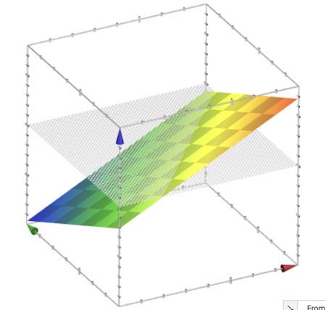
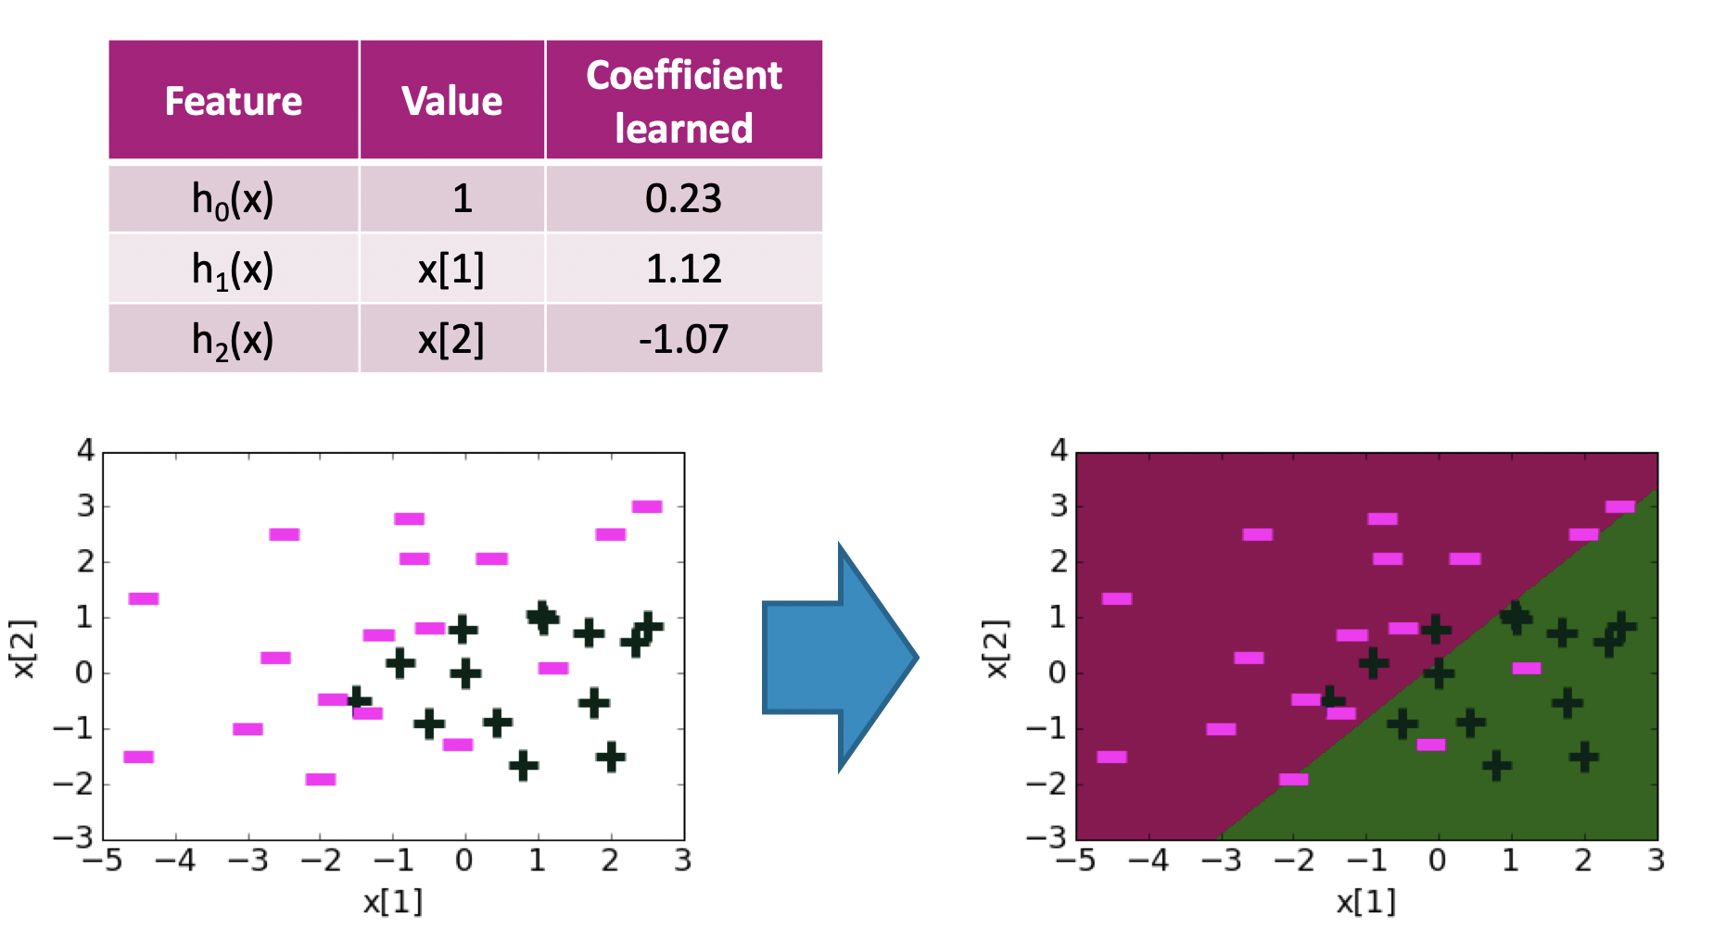

Decision Boundary
$$w^{T}h\left(x\right)=0.23+1.12x\left[1\right]−1.07x[2]$$

Slide 52
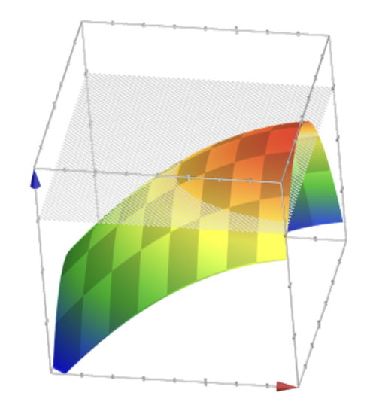
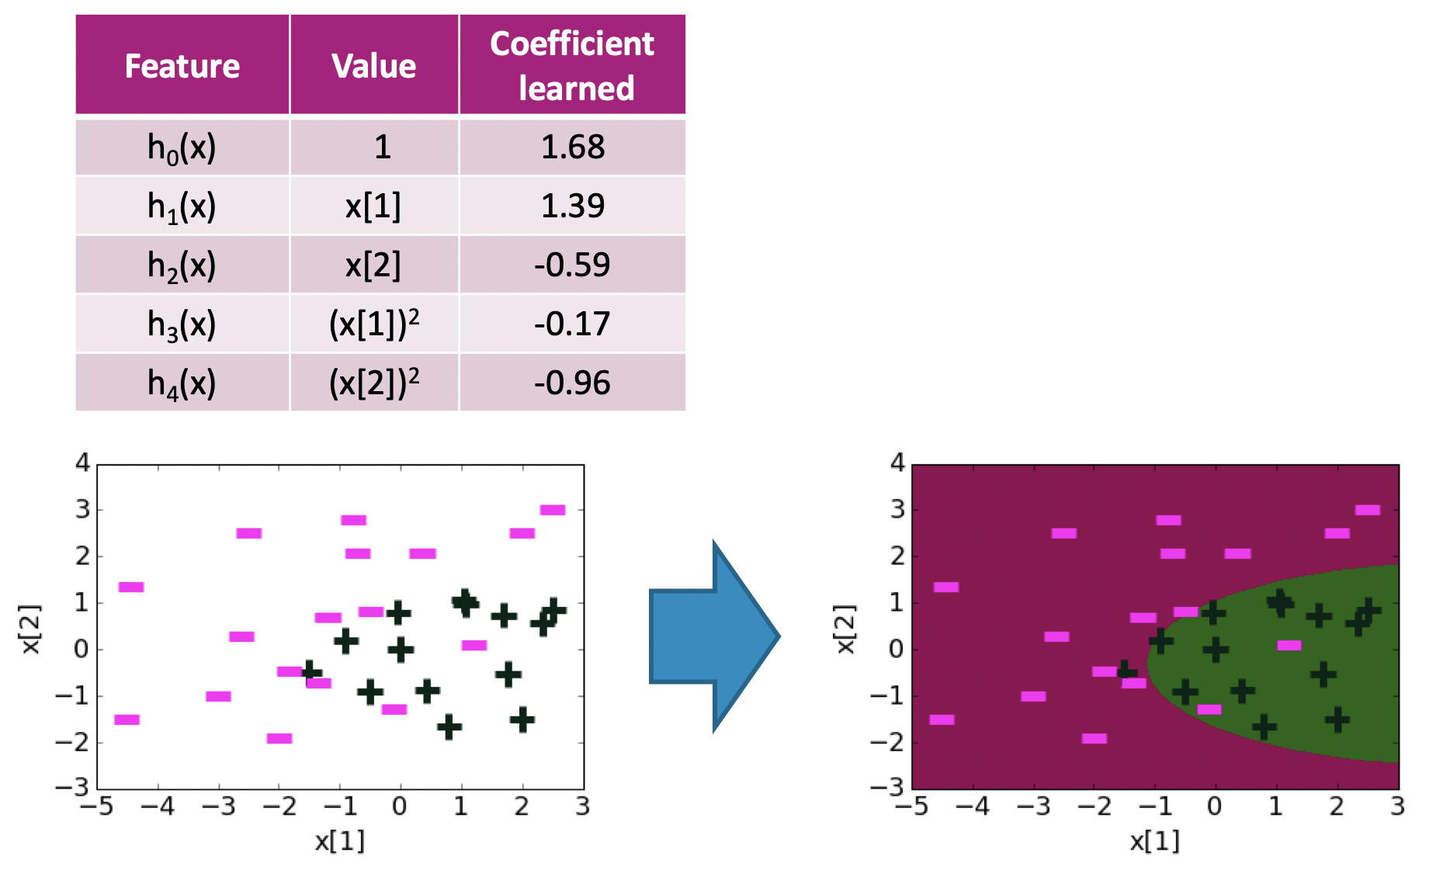

Decision Boundary
$$w^{T}h\left(x\right)=1.68+1.39x\left[1\right]−0.59x\left[2\right]−0.17x{\left[1\right]}^{2}−0.96x{\left[2\right]}^{2}$$

Slide 53



Decision Boundary
$$w^{T}h\left(x\right)=…$$
Notes:
Circle coefficients and say they are getting larger
Point out that the decision boundary is getting a bit more whack

Slide 54

Decision Boundary
$$w^{T}h\left(x\right)=…$$
Notes:
Point out coefficients are huge now!
Decision boundary doesn’t really make sense

Slide 55

Overfitting
Just like with regression, we see a similar pattern with complexity
Classification
Error
True
Error
Train
Error
Low Complexity
High Complexity

Slide 56

Effects of Overfitting
Remember, we say the logistic function become “sharper” with larger coefficients.
What does this mean for our predictions?
Because the $Score(x)$ is getting larger in magnitude, the
probabilities are closer to 0 or 1!
Notes:
Draw for the same point, it gives a higher probability

Slide 57


Plotting Probabilities
$$P\left(y=+1 | x\right)= \frac{1}{1+e^{−{\hat{w}}^{T}h(x)}}$$

Slide 58
Regularization

Slide 59


L2 Regularized Logistic Regression
Just like in regression, can change our quality metric to avoid overfitting when training a model
$$\hat{w}=\underset{w}{argmax}{\log\left(ℓ\left(w\right)\right)−λ{\left|\left|w\right|\right|}_{2}^{2}}$$

Slide 60

Some Details
Why do we subtract the L2 Norm?
$$\hat{w}=\underset{w}{argmax}{\log\left(ℓ\left(w\right)\right)−λ{\left|\left|w\right|\right|}_{2}^{2}}$$
How does $λ$ impact the complexity of the model?
How do we pick $λ$?

Slide 61



Coefficient Path:
L2 Penalty
Coefficient ${\hat{w}}_{j}$
$$λ$$

Slide 62

2 min
Jake wants to find the best Logistic Regression model for a sentiment analysis dataset by tuning the regularization parameter $λ∈[0, {10}^{−2},{10}^{−1},1, 10]$ and the learning rate $η∈[{10}^{−6}, {10}^{−5}, {10}^{−4}, {10}^{−3}]$. He does the following:
  Runs cross-validation on $λ$ to get the best value for the regularization parameter.
  For that value of $λ$, run cross-validation on $η$ to get the best value for the learning rate.
After running this procedure, he is convinced he has the best Logistic Regression model for his dataset, given the hyper-parameter values he wanted to test.
What did Jake do wrong?

Slide 63
Recap
Theme: Details of logistic classification and how to train it
Ideas:
Predict with probabilities
Using the logistic function to turn Score to probability
Logistic Regression
Minimizing error vs maximizing likelihood
Gradient Ascent
Effects of learning rate
Overfitting with logistic regression
  Over-confident (probabilities close to 0 or 1)
  Regularization

