Slide 1
CSE/STAT 416
Regularization – LASSO Regression
Pre-Class Videos
Tanmay Shah
University of Washington
July 1, 2024

Slide 2
Pre-Class Video 1
Ridge Regression

Slide 3
Recap: Number of Features
Overfitting is not limited to polynomial regression of large degree. It can also happen if you use a large number of features!
Why? Overfitting depends on how much data you have and if there is enough to get a representative sample for the complexity of the model.

Slide 4
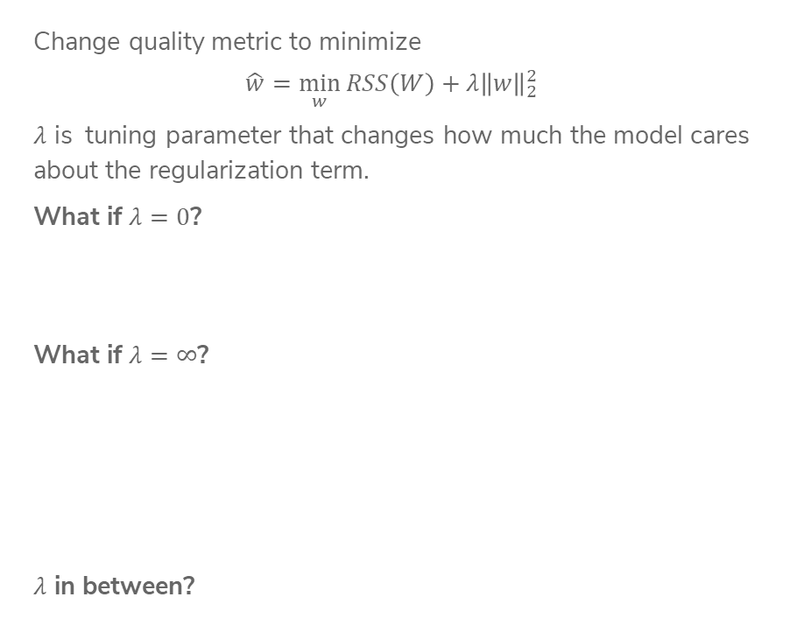
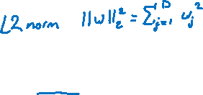
Recap:
Ridge Regression
Change quality metric to minimize
$$\hat{w}=\min_{w}{RSS\left(W\right)+λ{\left\|w\right\|}_{2}^{2}}$$
$λ$ is tuning parameter that changes how much the model cares about the regularization term.
What if $λ=0$?
What if $λ=∞$?
$λ$ in between?
Notes:
TODO, pre-annotate

Slide 5
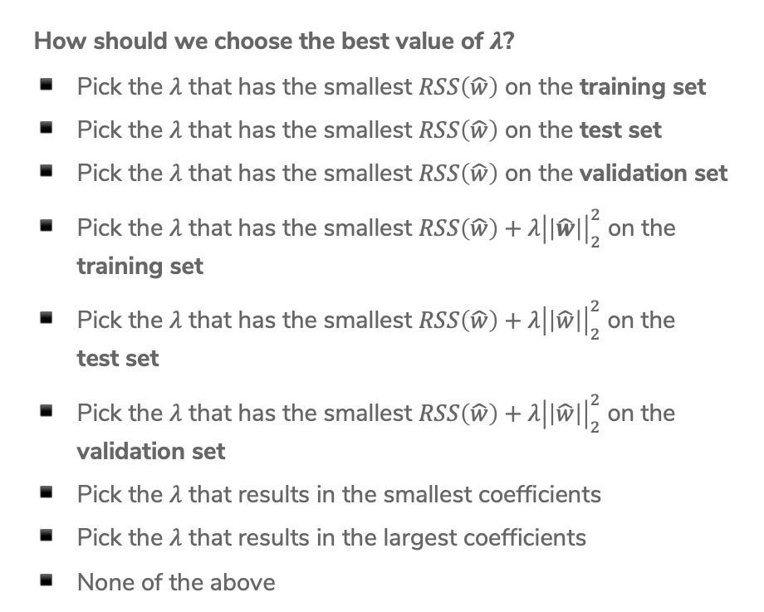
2 min
How should we choose the best value of $λ$?
Pick the $λ$ that has the smallest $RSS\left(\hat{w}\right)$ on the training set
Pick the $λ$ that has the smallest $RSS\left(\hat{w}\right)$ on the test set
Pick the $λ$ that has the smallest $RSS\left(\hat{w}\right)$ on the validation set
Pick the $λ$ that has the smallest $RSS\left(\hat{w}\right)+λ{\left|\left|\hat{w}\right|\right|}_{2}^{2}$ on the training set
Pick the $λ$ that has the smallest $RSS\left(\hat{w}\right)+λ{\left|\left|\hat{w}\right|\right|}_{2}^{2}$ on the
test set
Pick the $λ$ that has the smallest $RSS\left(\hat{w}\right)+λ{\left|\left|\hat{w}\right|\right|}_{2}^{2}$ on the validation set
Pick the $λ$ that results in the smallest coefficients
Pick the $λ$ that results in the largest coefficients
None of the above

Slide 6
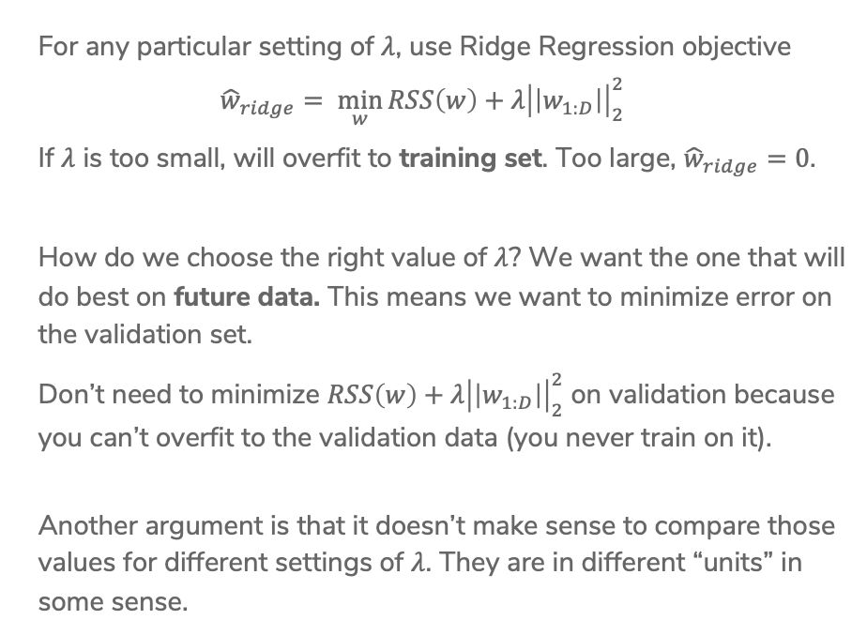
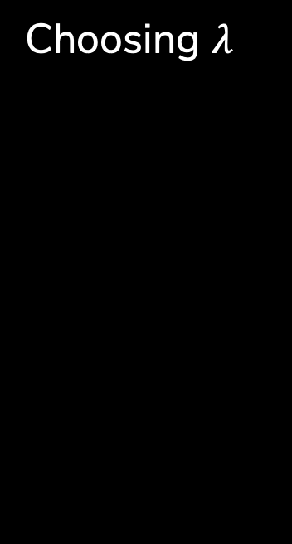
Choosing $λ$
For any particular setting of $λ$, use Ridge Regression objective
$${\hat{w}}_{ridge}= \min_{w}{RSS\left(w\right)+λ{\left|\left|w_{1:D}\right|\right|}_{2}^{2}}$$
If $λ$ is too small, will overfit to training set. Too large, ${\hat{w}}_{ridge}=0$.
How do we choose the right value of $λ$? We want the one that will do best on future data. This means we want to minimize error on the validation set.
Don’t need to minimize $RSS\left(w\right)+λ{\left|\left|w_{1:D}\right|\right|}_{2}^{2}$ on validation because you can’t overfit to the validation data (you never train on it).
Another argument is that it doesn’t make sense to compare those values for different settings of $λ$. They are in different “units” in some sense.

Slide 7

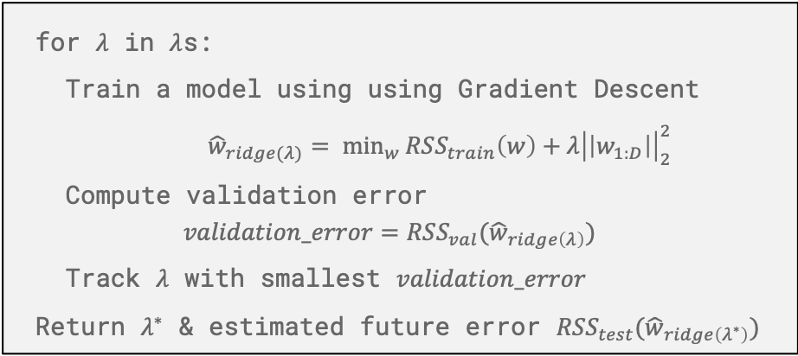
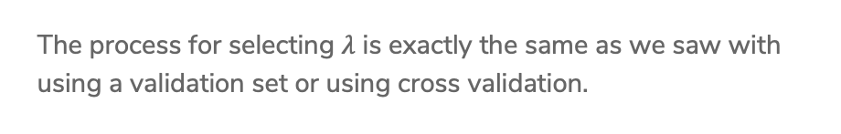
Choosing $λ$
The process for selecting $λ$ is exactly the same as we saw with using a validation set or using cross validation.
for $λ$ in $λ$s:
Train a model using using Gradient Descent
${\hat{w}}_{ridge(λ)}= \min_{w}{RSS_{train}\left(w\right)+λ{\left|\left|w_{1:D}\right|\right|}_{2}^{2}}$
Compute validation error
$$validation_error=RSS_{val}({\hat{w}}_{ridge\left(λ\right)})$$
Track $λ$ with smallest $validation_error$
Return $λ^{∗}$ & estimated future error $RSS_{test}({\hat{w}}_{ridge\left(λ^{∗}\right)})$
There is no fear of overfitting to validation set since you never trained on it! You can just worry about error when you aren’t worried about overfitting to the data.
Notes:
Draw visualization of Ridge coefficient path

Slide 8
Pre-Class Video 2
Feature Selection & All Subsets

Slide 9
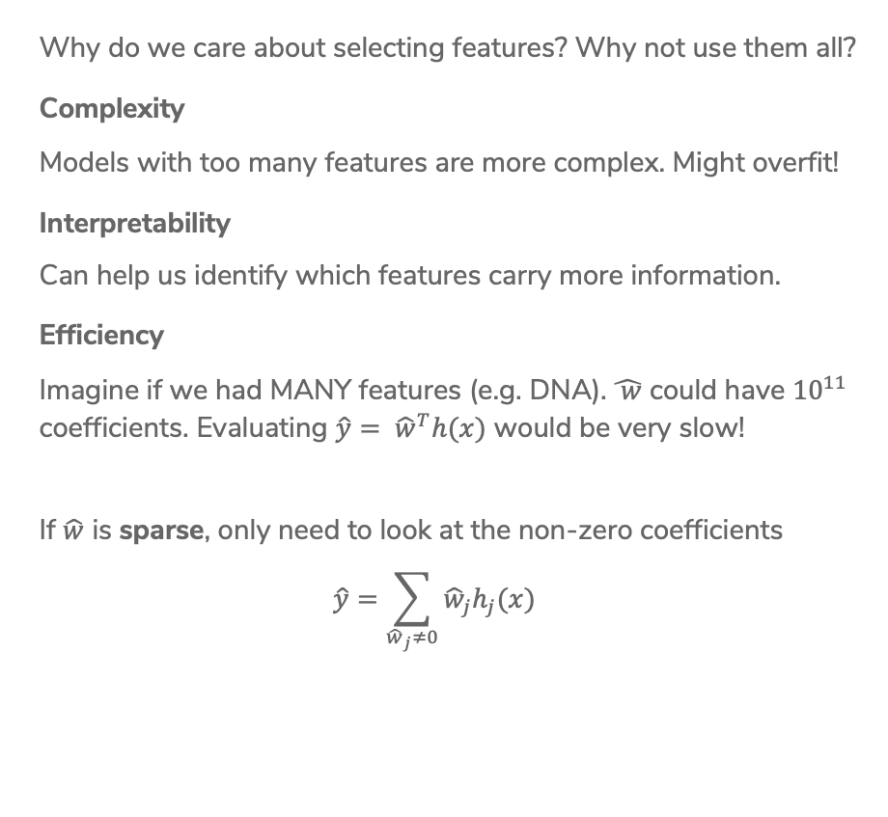
Benefits
Why do we care about selecting features? Why not use them all?
Complexity
Models with too many features are more complex. Might overfit!
Interpretability
Can help us identify which features carry more information.
Efficiency
Imagine if we had MANY features (e.g. DNA). $\hat{ w}$ could have ${10}^{11}$ coefficients. Evaluating $\hat{y}= {\hat{w}}^{T}h(x)$ would be very slow!
If $\hat{w}$ is sparse, only need to look at the non-zero coefficients
$$\hat{y}=\sum_{{\hat{w}}_{j}≠0}{{\hat{w}}_{j}h_{j}(x)}$$

Slide 10
Sparsity: Housing
Might have many features to potentially use. Which are useful?
Lot size Single Family Year built Last sold price Last sale price/sqft Finished sqft Unfinished sqft Finished basement sqft # floors Flooring types Parking type Parking amount Cooling Heating Exterior materials Roof type Structure style | Dishwasher Garbage disposal Microwave Range / Oven Refrigerator Washer Dryer Laundry location Heating type Jetted Tub Deck Fenced Yard Lawn Garden Sprinkler System …

Slide 11



Sparsity:
Reading Minds
How happy are you? What part of the brain controls happiness?
$x$
$y$
10 – Happy ☺
0 – Sad ☹

Slide 12

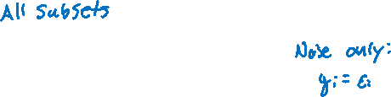
Best Model
Size 0
Features
# bathrooms
# bedrooms
sq.ft. living
sq.ft lot
floors
year built
year renovated
waterfront
$$RSS_{train}(\hat{w})$$
0
# of features

Slide 13
Best Model
Size 1
Features
# bathrooms
# bedrooms
sq.ft. living
sq.ft lot
floors
year built
year renovated
waterfront
$$RSS_{train}(\hat{w})$$
0 1
# of features

Slide 14
Best Model
Size 1
Features
# bathrooms
# bedrooms
sq.ft. living
sq.ft lot
floors
year built
year renovated
waterfront
$$RSS_{train}(\hat{w})$$
0 1
# of features

Slide 15
Best Model
Size 1
Features
# bathrooms
# bedrooms
sq.ft. living
sq.ft lot
floors
year built
year renovated
waterfront
$$RSS_{train}(\hat{w})$$
0 1
# of features

Slide 16
Best Model
Size 1
Features
# bathrooms
# bedrooms
sq.ft. living
sq.ft lot
floors
year built
year renovated
waterfront
$$RSS_{train}(\hat{w})$$
0 1
# of features

Slide 17
Best Model
Size 1
Features
# bathrooms
# bedrooms
sq.ft. living
sq.ft lot
floors
year built
year renovated
waterfront
$$RSS_{train}(\hat{w})$$
0 1
# of features

Slide 18
Best Model
Size 1
Features
# bathrooms
# bedrooms
sq.ft. living
sq.ft lot
floors
year built
year renovated
waterfront
$$RSS_{train}(\hat{w})$$
0 1
# of features

Slide 19
Best Model
Size 1
Features
# bathrooms
# bedrooms
sq.ft. living
sq.ft lot
floors
year built
year renovated
waterfront
$$RSS_{train}(\hat{w})$$
0 1
# of features

Slide 20
Best Model
Size 1
Features
# bathrooms
# bedrooms
sq.ft. living
sq.ft lot
floors
year built
year renovated
waterfront
$$RSS_{train}(\hat{w})$$
0 1
# of features

Slide 21
Best Model
Size 1
Features
# bathrooms
# bedrooms
sq.ft. living
sq.ft lot
floors
year built
year renovated
waterfront
$$RSS_{train}(\hat{w})$$
0 1
# of features

Slide 22
Best Model
Size 2
Not necessarily nested!
Best Model – Size 1: sq.ft living
Best Model – Size 2:
# bathrooms & # bedrooms
Features
# bathrooms
# bedrooms
sq.ft. living
sq.ft lot
floors
year built
year renovated
waterfront
$$RSS_{train}(\hat{w})$$
0 1 2
# of features

Slide 23
Best Model
Size 3
Features
# bathrooms
# bedrooms
sq.ft. living
sq.ft lot
floors
year built
year renovated
waterfront
$$RSS_{train}(\hat{w})$$
0 1 2 3
# of features

Slide 24
Best Model Size 4
Features
# bathrooms
# bedrooms
sq.ft. living
sq.ft lot
floors
year built
year renovated
waterfront
$$RSS_{train}(\hat{w})$$
0 1 2 3 4
# of features

Slide 25
Best Model Size 5
Features
# bathrooms
# bedrooms
sq.ft. living
sq.ft lot
floors
year built
year renovated
waterfront
$$RSS_{train}(\hat{w})$$
0 1 2 3 4 5
# of features

Slide 26
Best Model Size 6
Features
# bathrooms
# bedrooms
sq.ft. living
sq.ft lot
floors
year built
year renovated
waterfront
$$RSS_{train}(\hat{w})$$
0 1 2 3 4 5 6
# of features

Slide 27
Best Model Size 7
Features
# bathrooms
# bedrooms
sq.ft. living
sq.ft lot
floors
year built
year renovated
waterfront
$$RSS_{train}(\hat{w})$$
0 1 2 3 4 5 6 7
# of features

Slide 28

Best Model Size 8
Features
# bathrooms
# bedrooms
sq.ft. living
sq.ft lot
floors
year built
year renovated
waterfront
$$RSS_{train}(\hat{w})$$
0 1 2 3 4 5 6 7 8
# of features

Slide 29
Choose Num Features?
Option 1
Assess on a validation set
Option 2
Cross validation
Option 3+
Other metrics for penalizing model complexity like Bayesian Information Criterion (BIC)

Slide 30
CSE/STAT 416
Regularization – LASSO Regression
Tanmay Shah
University of Washington
July 1, 2024
❓ Questions? Raise hand or sli.do #cs416
💬 Before Class: Favorite food near campus?
🎵 Listening to: Sammy Rae & The Friends

Slide 31
Administrivia
Last lecture in the “Regression” case study!
  Next 2 weeks: Classification
  Following 1 week: Deep Learning
Section Tomorrow:
  Coding up RIDGE and Lasso (helpful for HW1!)
Upcoming Due Dates:
  HW0 Late due date Thurs 4/6 11:59PM (if using 2 late days)
  HW1 out right after class, due Tues 4/11 11:59PM
  Learning Reflection 1 due Fri 11:59PM
OH is a great place to ask your learning reflection questions!
Reminder of resources

Slide 32
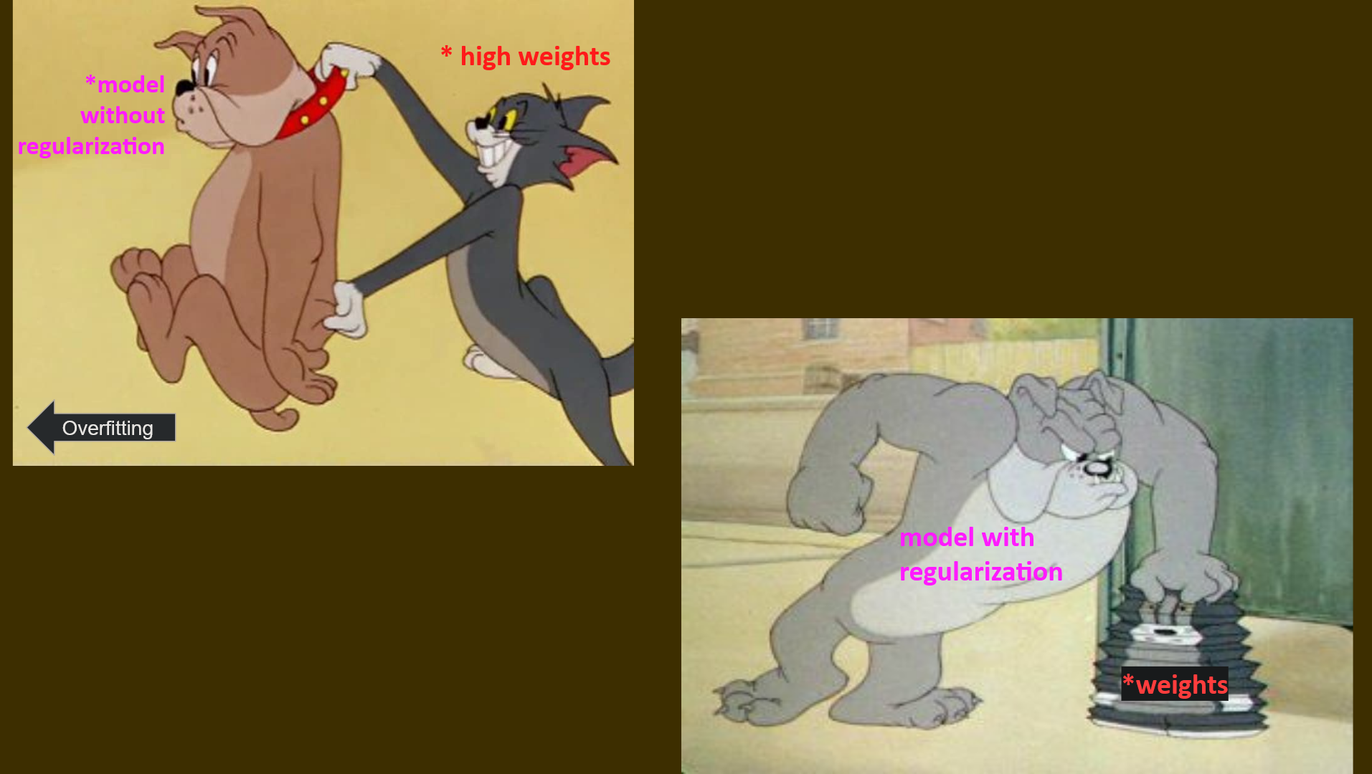
Regularization recap

Slide 33
Recap:
Ridge Regression
Change quality metric to minimize
$$\hat{w}=\min_{w}{RSS\left(W\right)+λ{\left\|w\right\|}_{2}^{2}}$$
$λ$ is tuning parameter that changes how much the model cares about the regularization term.
What if $λ=0$?
What if $λ=∞$?
$λ$ in between?
Notes:
TODO, pre-annotate

Slide 34
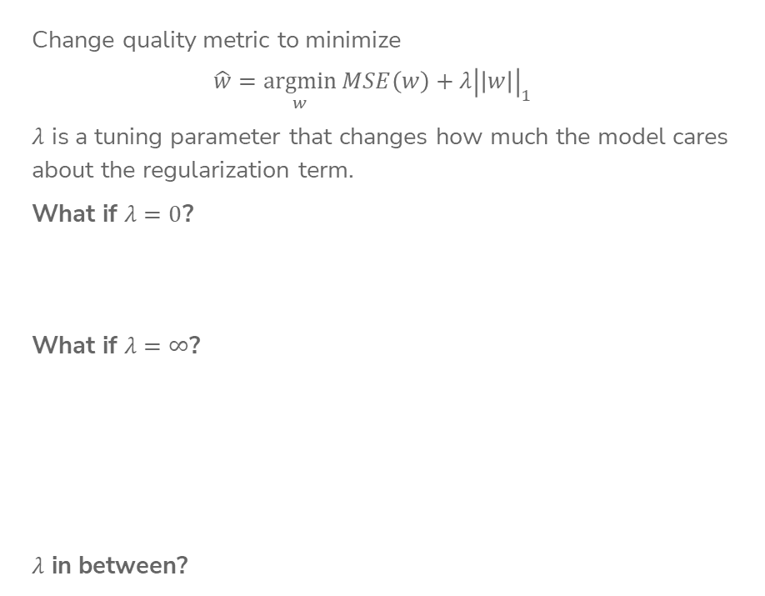
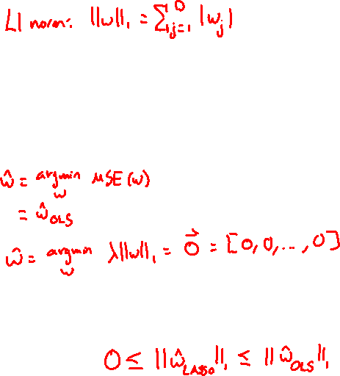
LASSO Regression
Change quality metric to minimize
$$\hat{w}=\underset{w}{argmin}{MSE\left(w\right)+λ{\left|\left|w\right|\right|}_{1}}$$
$λ$ is a tuning parameter that changes how much the model cares about the regularization term.
What if $λ=0$?
What if $λ=∞$?
$λ$ in between?
Notes:
TODO, pre-annotate

Slide 35
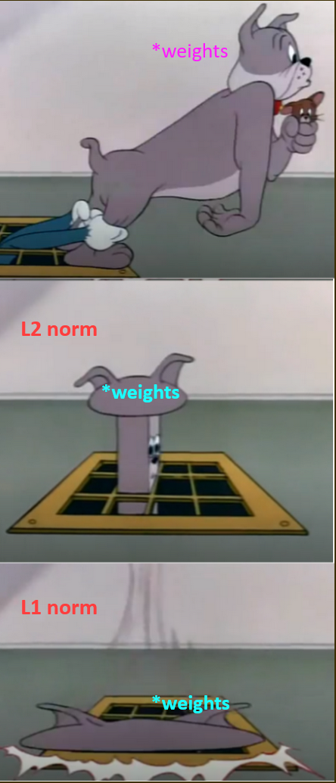
Ridge vs Lasso Regression

Slide 36
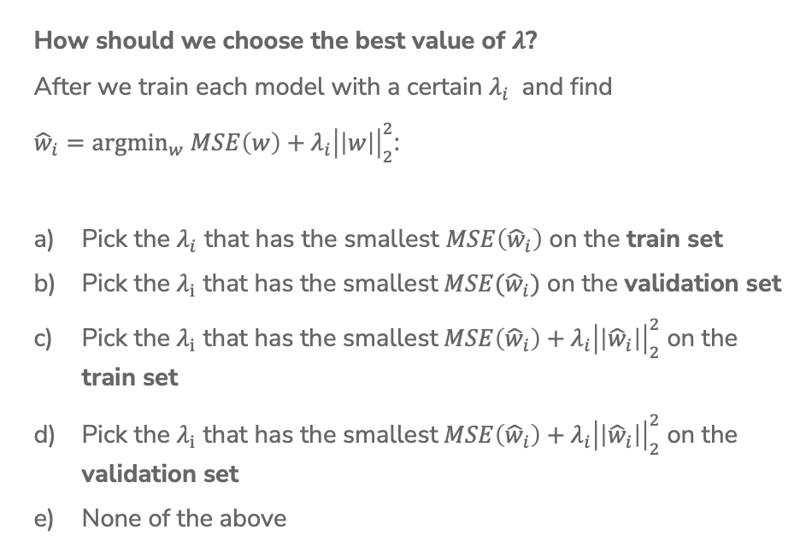
1 min
How should we choose the best value of $λ$?
After we train each model with a certain $λ_{i}$ and find
${\hat{w}}_{i}={argmin}_{w} MSE\left(w\right)\text{ +}{ λ_{i}\left|\left|w\right|\right|}_{2}^{2}$:
Pick the $λ_{i}$ that has the smallest $MSE\left({\hat{w}}_{i}\right)$ on the train set
Pick the $λ_{i}$ that has the smallest$MSE({\hat{w}}_{i})$ on the validation set
Pick the $λ_{i}$ that has the smallest$MSE\left({\hat{w}}_{i}\right)+{ λ_{i}\left|\left|{\hat{w}}_{i}\right|\right|}_{2}^{2}$ on the train set
Pick the $λ_{i}$ that has the smallest$MSE\left({\hat{w}}_{i}\right)+{ λ_{i}\left|\left|{\hat{w}}_{i}\right|\right|}_{2}^{2}$ on the validation set
None of the above

Slide 37
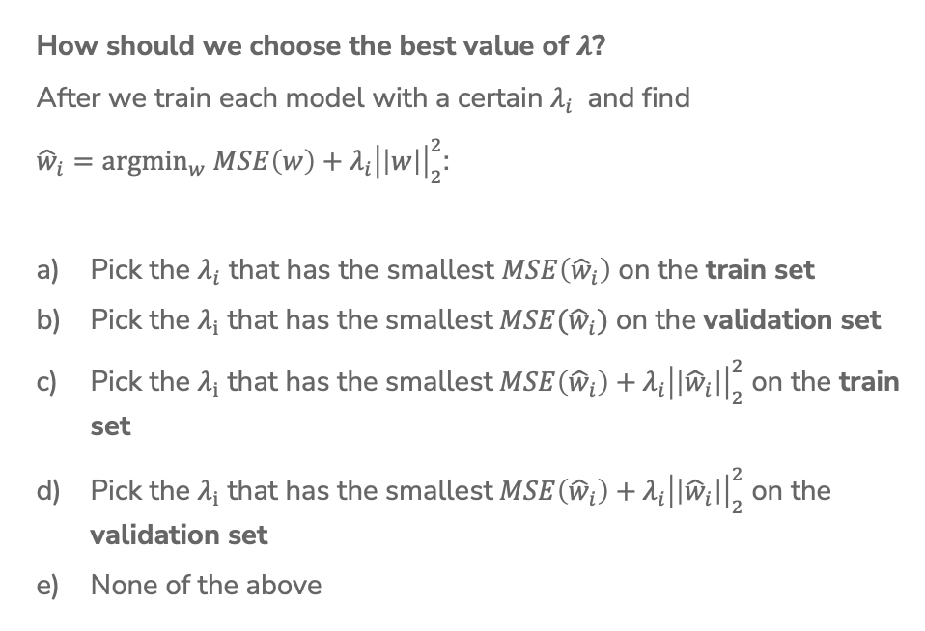
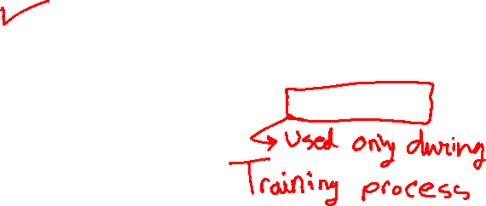
2 min
How should we choose the best value of $λ$?
After we train each model with a certain $λ_{i}$ and find
${\hat{w}}_{i}={argmin}_{w} MSE\left(w\right)\text{ +}{ λ_{i}\left|\left|w\right|\right|}_{2}^{2}$:
Pick the $λ_{i}$ that has the smallest $MSE\left({\hat{w}}_{i}\right)$ on the train set
Pick the $λ_{i}$ that has the smallest$MSE({\hat{w}}_{i})$ on the validation set
Pick the $λ_{i}$ that has the smallest$MSE\left({\hat{w}}_{i}\right)+{ λ_{i}\left|\left|{\hat{w}}_{i}\right|\right|}_{2}^{2}$ on the train set
Pick the $λ_{i}$ that has the smallest$MSE\left({\hat{w}}_{i}\right)+{ λ_{i}\left|\left|{\hat{w}}_{i}\right|\right|}_{2}^{2}$ on the validation set
None of the above

Slide 38
Benefits
Why do we care about selecting features? Why not use them all?
Complexity
Models with too many features are more complex. Might overfit!
Interpretability
Can help us identify which features carry more information.
Efficiency
Imagine if we had MANY features (e.g. DNA). $\hat{ w}$ could have ${10}^{11}$ coefficients. Evaluating $\hat{y}= {\hat{w}}^{T}h(x)$ would be very slow!
If $\hat{w}$ is sparse, only need to look at the non-zero coefficients
$$\hat{y}=\sum_{{\hat{w}}_{j}≠0}{{\hat{w}}_{j}h_{j}(x)}$$

Slide 39

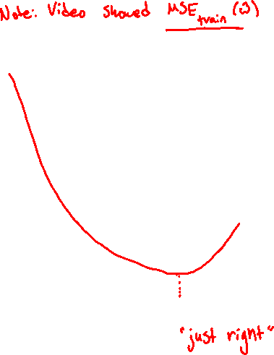
Best Model Size 8
Features
# bathrooms
# bedrooms
sq.ft. living
sq.ft lot
floors
year built
year renovated
waterfront
$$MSE_{val}(\hat{w})$$
0 1 2 3 4 5 6 7 8
# of features

Slide 40

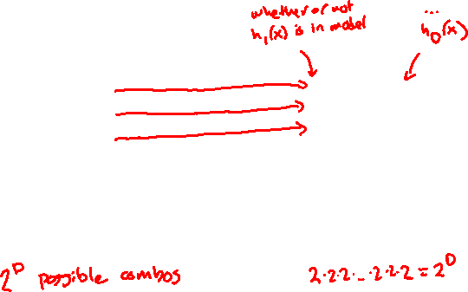
Efficiency of All Subsets
How many models did we evaluate?
$${\hat{y}}_{i}=w_{0}$$
$${\hat{y}}_{i}=w_{0}+w_{1}h_{1}\left(x\right)$$
$${\hat{y}}_{i}=w_{0}+w_{2}h_{2}\left(x\right)$$
…
$${\hat{y}}_{i}=w_{0}+w_{1}h_{1}\left(x\right)+w_{2}h_{2}\left(x\right)$$
…
$${\hat{y}}_{i}=w_{0}+w_{1}h_{1}\left(x\right)+\text{…}+w_{D}h_{D}(x)$$
[0 0 0 … 0 0 0]
[1 0 0 … 0 0 0]
[0 1 0 … 0 0 0]
…
[1 1 0 … 0 0 0]
…
[1 1 1 … 1 1 1]
If evaluating all subsets of 8 features only took 5 seconds, then
16 features would take 21 minutes
32 features would take almost 3 years
100 features would take almost 7.5*10²⁰ years
  50,000,000,000x longer than the age of the universe!

Slide 41

Choose Num Features?
Clearly all subsets is unreasonable. How can we choose how many and which features to include?
Option 1
Greedy Algorithm
Option 2
LASSO Regression (L1 Regularization)

Slide 42
Greedy Algorithms

Slide 43
Greedy Algorithms
Knowing it’s impossible to find exact solution, approximate it!
Forward stepwise
Start from model with no features, iteratively add features as performance improves.
Backward stepwise
Start with a full model and iteratively remove features that are the least useful.
Combining forward and backwards steps
Do a forward greedy algorithm that eventually prunes features that are no longer as relevant
And many many more!
Notes:
Greedy algorithms take locally optimal steps. Local optimum is not the same as global optimum

Slide 44


Example:
Forward Stepwise
Start by selecting number of desired features $k$
Called greedy because it makes choices that look best at the time.
  Greedily optimal !=
min_val = $∞$
$$S_{0}←∅$$
for $i←1..k$:
Find feature $f_{i}$ not in $S_{i−1}$, that when combined
with $S_{i−1}$, minimizes the validation loss the most.
$S_{i}←S_{i−1}∪{\{f}_{i}\}$
if val_loss($S_{i}$) > min_val:
break # No need to look at more features
Notes:
Why are they called greedy? They take the best step at this time, or the best local step, although this may not necessary be the best step globally.

Slide 45
1 min
Say you want to find the optimal two-feature model, using the forward stepwise algorithm. What model would the forward stepwise algorithm choose?
Subsets of Size 1
Subsets of Size 2
Features | Val Loss
# bath | 201
# bed | 300
sq ft | 157
year built | 224
Features (unordered) | Val Loss
(# bath, # bed) | 120
(# bath, sq ft) | 131
(# bath, year built) | 190
(# bed, sq ft) | 137
(# bed, year built) | 209
(sq ft, year built) | 145

Slide 46
1 min
Say you want to find the optimal two-feature model, using the forward stepwise algorithm. What model would the forward stepwise algorithm choose?
Subsets of Size 1
Subsets of Size 2
Features | Val Loss
# bath | 201
# bed | 300
sq ft | 157
year built | 224
Features (unordered) | Val Loss
(# bath, # bed) | 120
(# bath, sq ft) | 131
(# bath, year built) | 190
(# bed, sq ft) | 137
(# bed, year built) | 209
(sq ft, year built) | 145

Slide 47


Slide 48
Option 2
Regularization

Slide 49
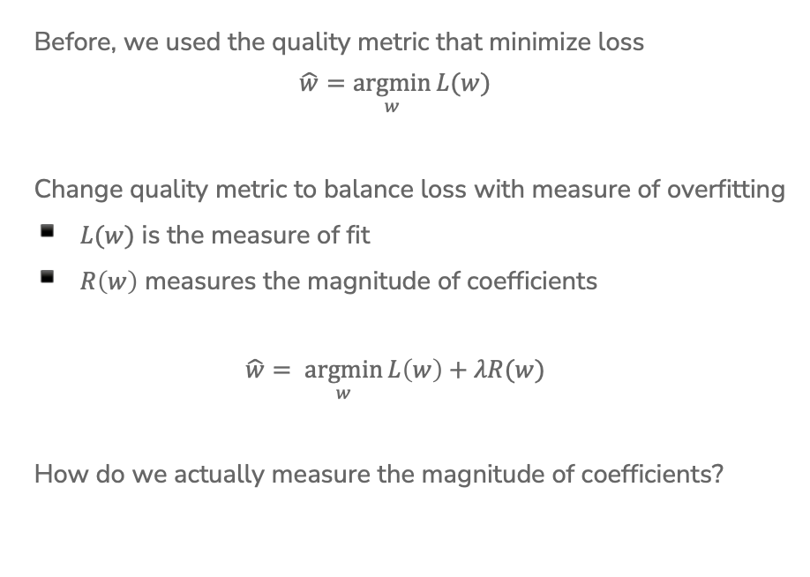
Recap: Regularization
Before, we used the quality metric that minimize loss
$$\hat{w}=\underset{w}{argmin}{L(w)}$$
Change quality metric to balance loss with measure of overfitting
$L(w)$ is the measure of fit
$R\left(w\right)$ measures the magnitude of coefficients
$$\hat{w}= \underset{w}{argmin}{L\left(w\right)+λR(w)}$$
How do we actually measure the magnitude of coefficients?
Notes:
Draw: L(w) = RSS(w)

Slide 50
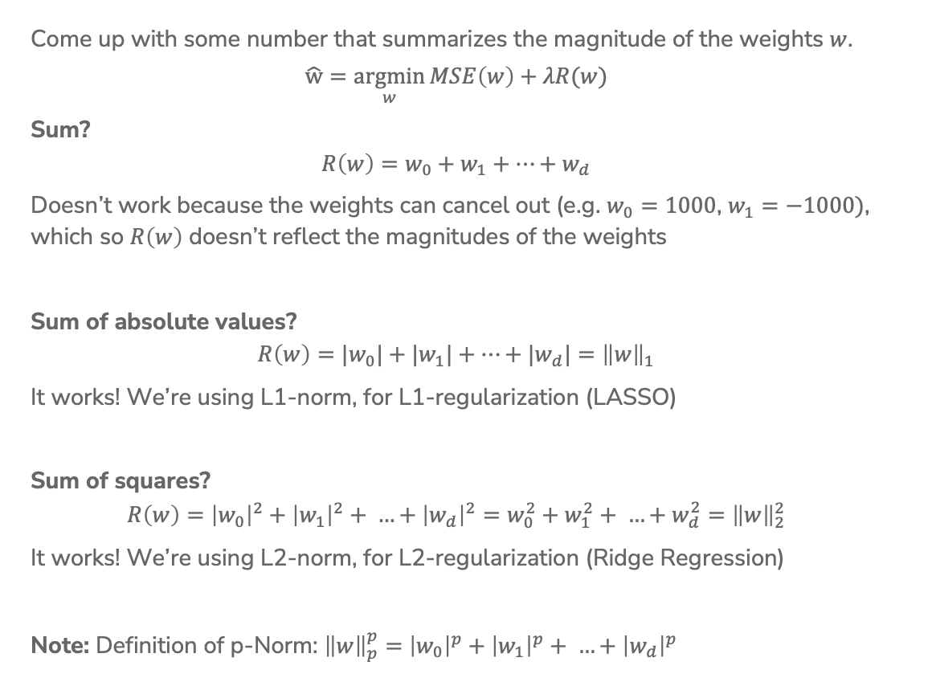
Recap:
Magnitude
Come up with some number that summarizes the magnitude of the weights $w$.
$$\hat{w}=\underset{w}{argmin}{MSE\left(w\right)+λR(w)}$$
Sum?
$$R\left(w\right)=w_{0}+w_{1}+…+w_{d}$$
Doesn’t work because the weights can cancel out (e.g. $w_{0}=1000$, $w_{1}=−1000)$, which so $R\left(w\right)$ doesn’t reflect the magnitudes of the weights
Sum of absolute values?
$$R\left(w\right)={|w}_{0}|+{|w}_{1}|+…+{|w}_{d}|={\left\|w\right\|}_{1}$$
It works! We’re using L1-norm, for L1-regularization (LASSO)
Sum of squares?
$$R\left(w\right)={\left|w_{0}\right|}^{2}+{\left|w_{1}\right|}^{2}+ …+{\left|w_{d}\right|}^{2}=w_{0}^{2}+w_{1}^{2}+ …+w_{d}^{2}={\left\|w\right\|}_{2}^{2}$$
It works! We’re using L2-norm, for L2-regularization (Ridge Regression)
Note: Definition of p-Norm: ${\left\|w\right\|}_{p}^{p}=$ ${\left|w_{0}\right|}^{p}+{\left|w_{1}\right|}^{p}+ …+{\left|w_{d}\right|}^{p}$
Notes:
Draw generic w vector
Draw why sum doesn’t work with an example of w_1 and w_2
Show summation for absolute values and show L1 norm notation
Show sum of squares summation and L2 norm notation
Both L1 and L2 have specific interpretation and practical importance
Talk about norm, notations,

Slide 51
Ridge for Feature Selection
We saw that Ridge Regression shrinks coefficients, but they don’t become 0. What if we remove weights that are sufficiently small?

Slide 52
Ridge for Feature Selection
Instead of searching over a discrete set of solutions, use regularization to reduce coefficient of unhelpful features.
Start with a full model, and then “shrink” ridge coefficients near 0.
Non-zero coefficients would be considered selected as important.
0
sq.ft. living
# bedrooms
# bathrooms
sq.ft. lot
year renovated
floors
cost per sq.ft.
year built
last sales price
heating
# showers
waterfront

Slide 53
1 min
What do you think about this approach to feature selection? Will it work? Why or why not. Use your logic!

Slide 54
Ridge for Feature Selection
Look at two related features #bathrooms and # showers.
Our model ended up not choosing any features about bathrooms!
0
sq.ft. living
# bedrooms
# bathrooms
sq.ft. lot
year renovated
floors
cost per sq.ft.
year built
last sales price
heating
# showers
waterfront

Slide 55
Ridge for Feature Selection
What if we had originally removed the # showers feature?
The coefficient for # bathrooms would be larger since it wasn’t “split up” amongst two correlated features
Instead, it would be nice if there were a regularizer that favors sparse solutions in the first place to account for this…
0
sq.ft. living
# bedrooms
# bathrooms
sq.ft. lot
year renovated
floors
cost per sq.ft.
year built
last sales price
heating
waterfront

Slide 56


Ridge (L2) Coefficient Paths
Coefficients ${\hat{w}}_{j}$
$$λ$$

Slide 57
LASSO (L1) Coefficient Paths
Coefficients ${\hat{w}}_{j}$
$$λ$$

Slide 58
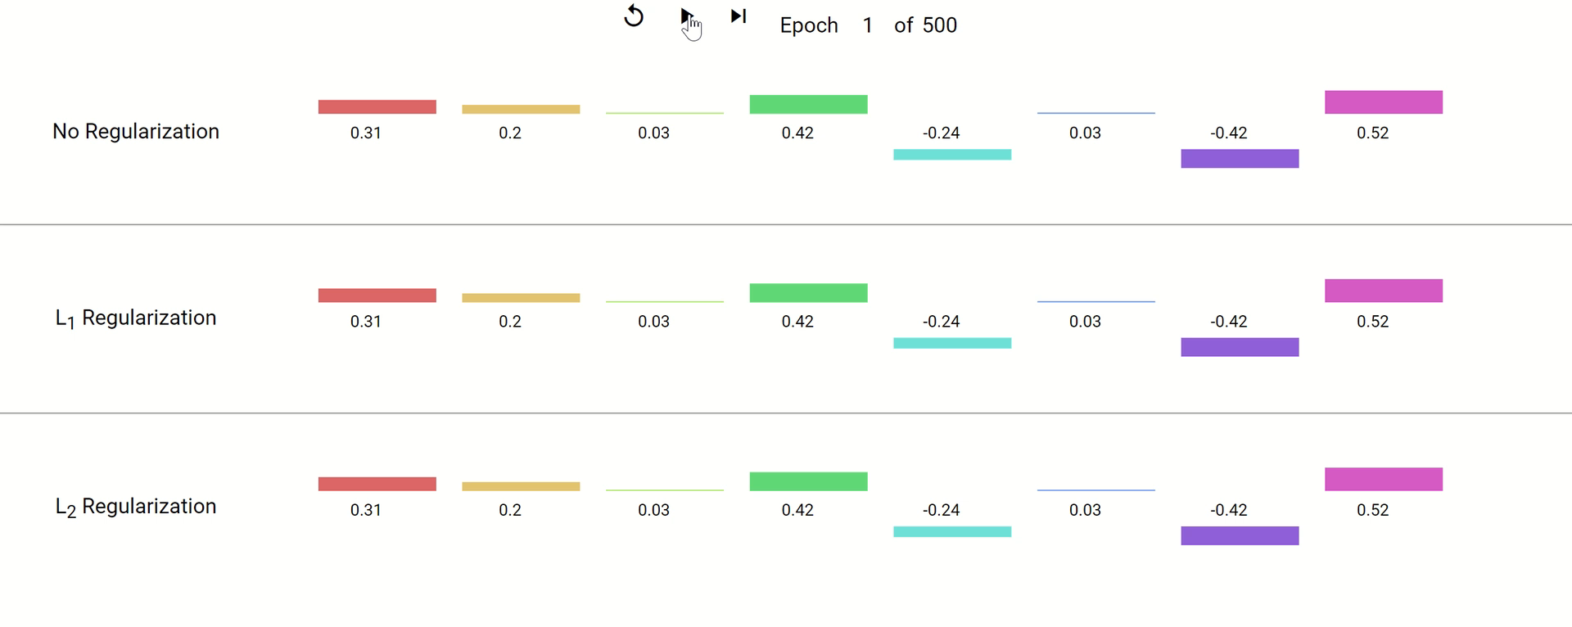
Coefficient Paths – Another View
Example from Google’s Machine Learning Crash Course
Notes:
Think of each epoch as taking one gradient descent step.
They don’t specify what the model is, but the concept of regularization is broader than just regression. Is often also applied to neural networks,
Key takeaways:
Regularized weights are smaller in magnitude.
L1 zeroes out weights, L2 keeps them around at really low values.

Slide 59
Demo
Similar demo to last time’s with Ridge but using the LASSO penalty

Slide 60
2 minutes
Why might the shape of the L1 penalty cause more sparsity than the L2 penalty?
No poll

Slide 61
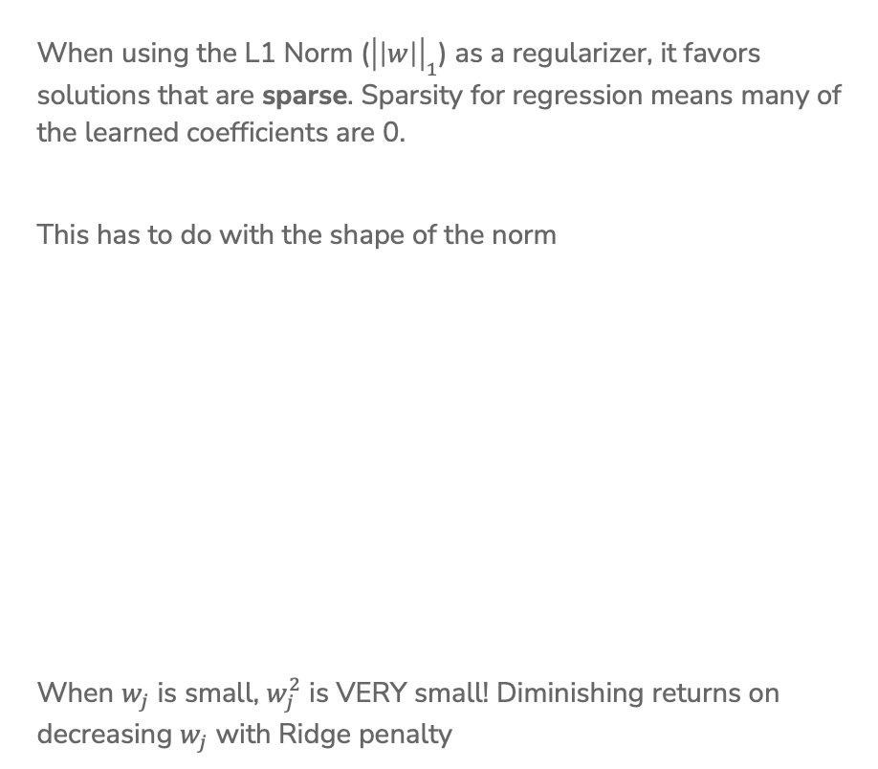
Sparsity
When using the L1 Norm (${\left|\left|w\right|\right|}_{1}$) as a regularizer, it favors solutions that are sparse. Sparsity for regression means many of the learned coefficients are 0.
This has to do with the shape of the norm
When $w_{j}$ is small, $w_{j}^{2}$ is VERY small! Diminishing returns on decreasing $w_{j}$ with Ridge penalty

Slide 62
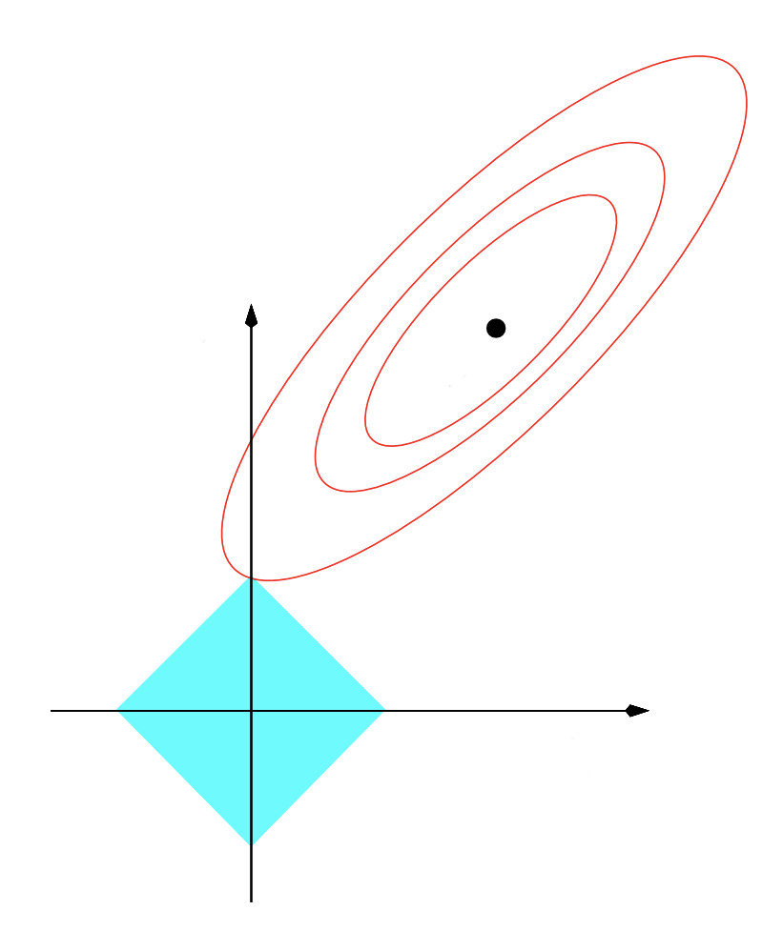







Sparsity Geometry
Another way to visualize why LASSO prefers sparse solutions
The L1 ball has spikes (places where some coefficients are 0)
$$w_{2}$$
$$w_{2}$$
$${\hat{w}}_{LS}$$
$${\hat{w}}_{LS}$$
$$w_{1}$$
$$w_{1}$$
$$L1$$
$$L2$$
Notes:
Another way to think about it: assume that instead of regularization being a soft constraint, it was a hard constraint, where we said that we want to pick the weights with the minimum MSE such that the norm of the coefficients have to be less than or equal to some budget.
In that case, the budgets will form these shapes, and the selected weights will be the ones with the minimum MSE within that shape.
Since L1 norm is diamond-shaped, it ends up being more likely that the minimum point of MSE will be along one of the corners, unlike the L2 which is a circle.
This is very informal intuition, not a formal proof.

Slide 63
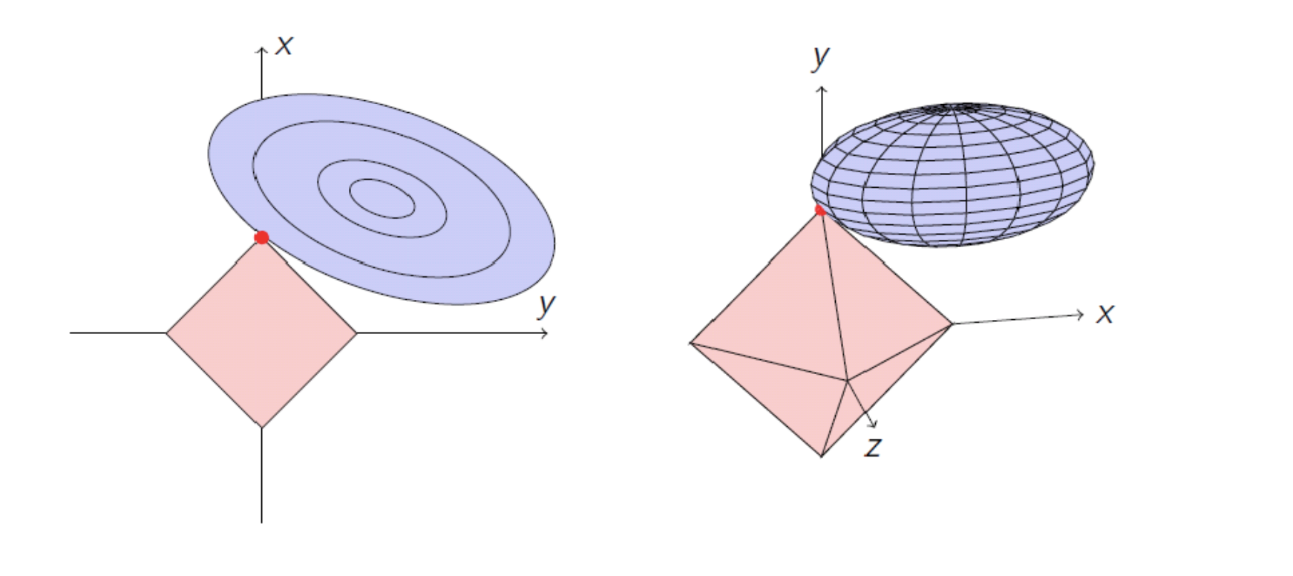


Sparsity Geometry
$L1$ (2 features)
$L1$ (3 features)

Slide 64


Slide 65
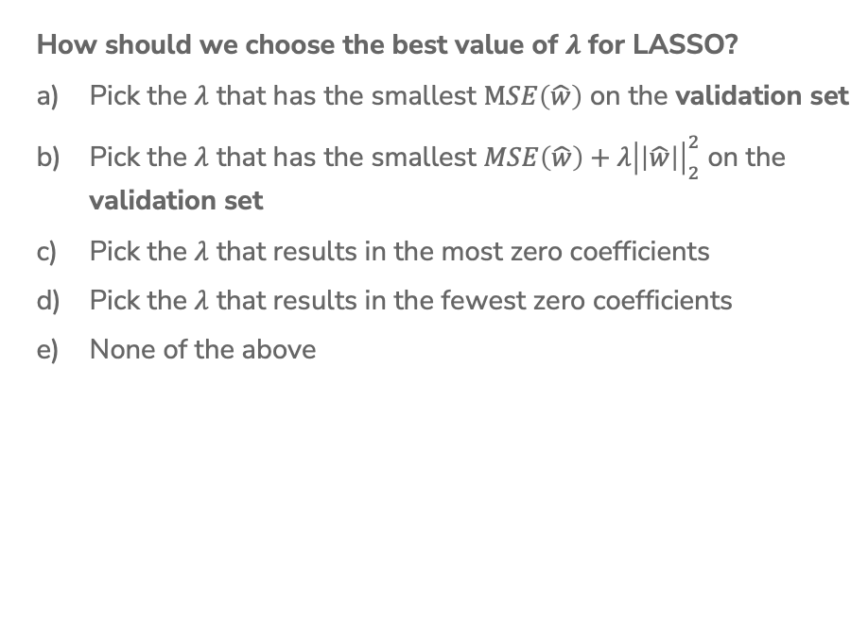
1 min
How should we choose the best value of $λ$ for LASSO?
Pick the $λ$ that has the smallest $MSE\left(\hat{w}\right)$ on the validation set
Pick the $λ$ that has the smallest $MSE\left(\hat{w}\right)+λ{\left|\left|\hat{w}\right|\right|}_{2}^{2}$ on the validation set
Pick the $λ$ that results in the most zero coefficients
Pick the $λ$ that results in the fewest zero coefficients
None of the above

Slide 66
Choosing $λ$
Exactly the same as Ridge Regression :)
This will be true for almost every hyper-parameter we talk about
A hyper-parameter is a parameter you specify for the model that influences which parameters (e.g. coefficients) are learned by the ML aglorithm

Slide 67
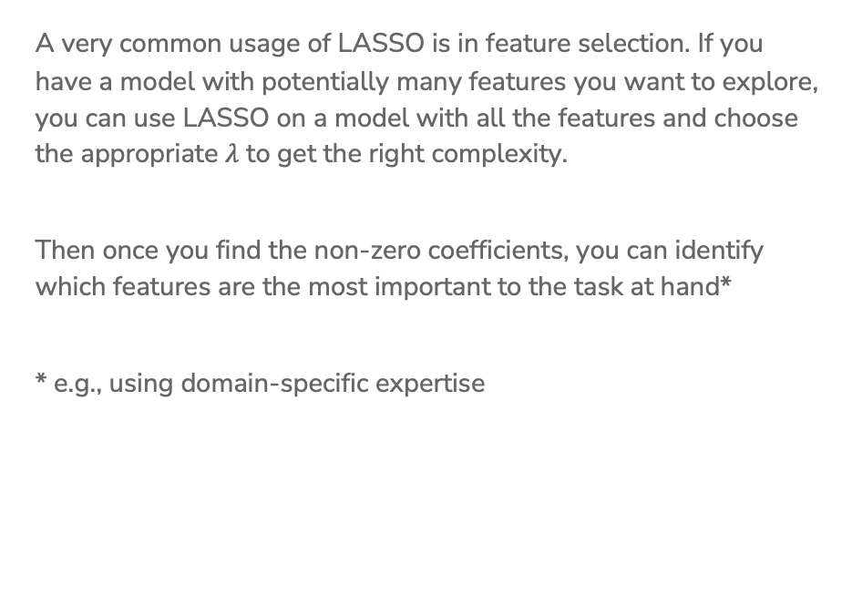
LASSO in Practice
A very common usage of LASSO is in feature selection. If you have a model with potentially many features you want to explore, you can use LASSO on a model with all the features and choose the appropriate $λ$ to get the right complexity.
Then once you find the non-zero coefficients, you can identify which features are the most important to the task at hand*
* e.g., using domain-specific expertise

Slide 68

ML Pipeline
- Deployment Bias
Training
Data
Pre-
Processing
x
ML
model
ŷ
⌃
- Historical Bias
- Representation Bias
- Measurement Bias
f
y
Optimization
algorithm
Quality
metric
68

Slide 69
De-biasing LASSO
LASSO (and Ridge) adds bias to the Least Squares solution (this was intended to avoid the variance that leads to overfitting)
Recall Bias-Variance Tradeoff
It’s possible to try to remove the bias from the LASSO solution using the following steps
Run LASSO to select which features should be used
(those with non-zero coefficients)
Run regular Ordinary Least Squares on the dataset with only those features
Coefficients are no longer shrunk from their true values

Slide 70
LASSO (L1) Coefficient Paths
Coefficients ${\hat{w}}_{j}$
$$λ$$

Slide 71
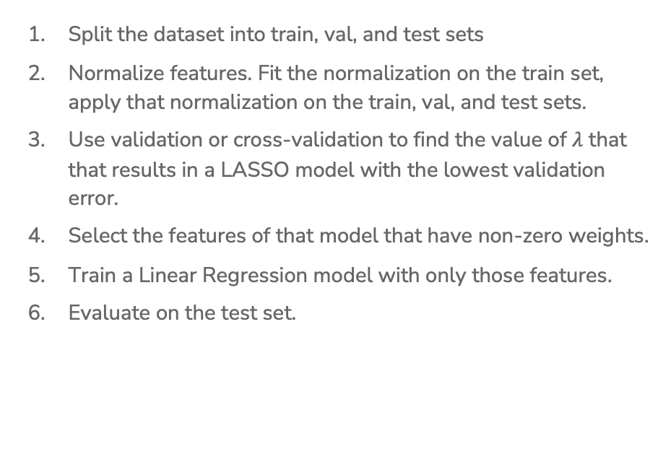
(De-biased) LASSO In Practice
Split the dataset into train, val, and test sets
Normalize features. Fit the normalization on the train set, apply that normalization on the train, val, and test sets.
Use validation or cross-validation to find the value of $λ$ that that results in a LASSO model with the lowest validation error.
Select the features of that model that have non-zero weights.
Train a Linear Regression model with only those features.
Evaluate on the test set.

Slide 72
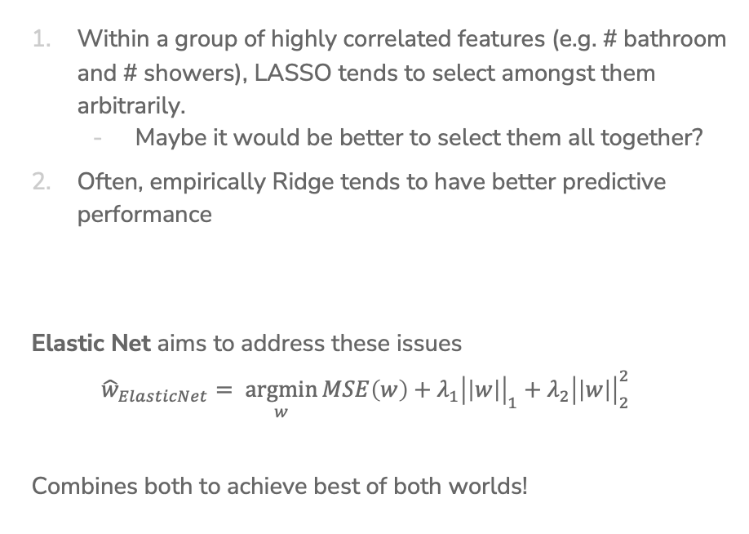
Issues with LASSO
Within a group of highly correlated features (e.g. # bathroom and # showers), LASSO tends to select amongst them arbitrarily.
  Maybe it would be better to select them all together?
Often, empirically Ridge tends to have better predictive performance
Elastic Net aims to address these issues
$${\hat{w}}_{ElasticNet}= \underset{w}{argmin}{MSE\left(w\right)+λ_{1}{\left|\left|w\right|\right|}_{1}+λ_{2}{\left|\left|w\right|\right|}_{2}^{2}}$$
Combines both to achieve best of both worlds!

Slide 73
A Big Grain of Salt
Be careful when interpreting the results of feature selection or feature importance in Machine Learning!
Selection only considers features included
Sensitive to correlations between features
Results depend on the algorithm used!
At the end of the day, the best models combine statistical insights with domain-specific expertise!

Slide 74
Differences between L1 and L2 regularizations
L1 (LASSO):
Introduces more sparsity to the model
Less sensitive to outliers
Helpful for feature selection, making the model more interpretable
More computational efficient as a model (due to the sparse solutions, so you have to compute less dot products)
L2 (Ridge):
Makes the weights small (but not 0)
More sensitive to outliers (due to the squared terms)
Usually works better in practice

Slide 75
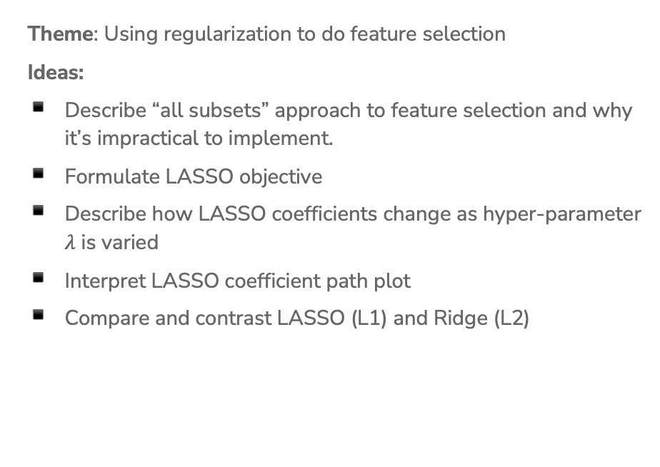
Recap
Theme: Using regularization to do feature selection
Ideas:
Describe “all subsets” approach to feature selection and why it’s impractical to implement.
Formulate LASSO objective
Describe how LASSO coefficients change as hyper-parameter $λ$ is varied
Interpret LASSO coefficient path plot
Compare and contrast LASSO (L1) and Ridge (L2)

Slide 76
ML Pipeline
- Deployment Bias
Training
Data
Pre-
Processing
x
ML
model
ŷ
⌃
- Historical Bias
- Representation Bias
- Measurement Bias
f
y
Optimization
algorithm
Quality
metric
76

Slide 77
CSE/STAT 416
Classification
Tanmay Shah
University of Washington
June 1, 2024
❓ Questions? Raise hand or sli.do #cs416
💬 Before Class: Does a straw have two holes or one?
🎵 Listening to: nothing, enjoy the calm

Slide 78
Roadmap
So Far
Housing Prices - Regression
  Regression Model
  Assessing Performance
  Ridge Regression
  LASSO
Sentiment Analysis – Classification
  Classification Overview
  Logistic Regression

Slide 79
Regression vs. Classification
Regression problems involve predicting continuous values.
  E.g., house price, student grade, population growth, etc.
Classification problems involve predicting discrete labels
  e.g., spam detection, object detection, loan approval, etc.
Notes:
WOS:
Regression: y \in R, Z, [0,1]
Y \in {+1, -1}, y \in {dog, cat}, etc.

Slide 80
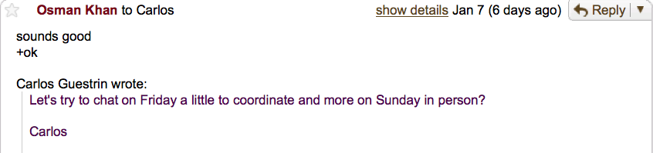
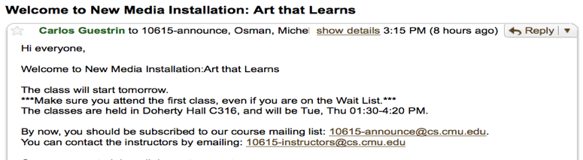
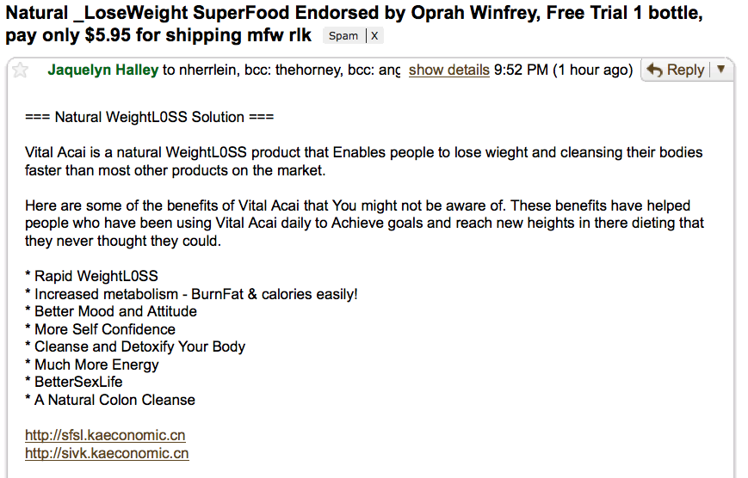
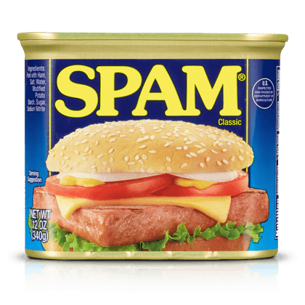
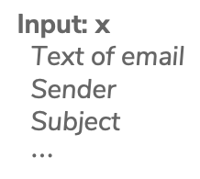
Spam Filtering
Output: y
Spam
Not Spam
(ham)
Input: x
Text of email
Sender
Subject
$⋯$
Notes:
Write binary classification

Slide 81
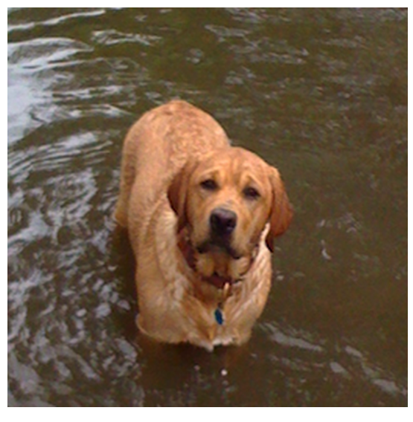
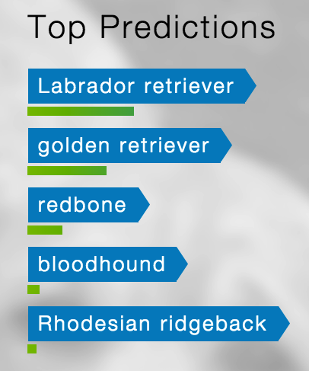
Object Detection
Input: x
Pixels
Output: y
Class
(+ Probability)
Notes:
Write multiclass classification

Slide 82
ML Pipeline
Training
Data
Pre-
Processing
x
ML
model
ŷ
⌃
f
y
Optimization
algorithm
Quality
metric
82

Slide 83
Sentiment Classifier
In our example, we want to classify a restaurant review as positive or negative.
Sentence from review
Classifier Model
Input: x
Output: y
Predicted class
Notes:
Where is sentiment analysis used? One example is marketing or analytics, where companies want to get the average sentiment of different content they put out based on the comments.

Slide 84
Converting Text to Numbers (Vectorizing):
Bag of Words
Idea: One feature per word!
Example: ”Sushi was great, the food was awesome, but the service was terrible”
This has to be too simple, right?
Stay tuned (today and Wed) for issues that arise and how to address them ☺
sushi | was | great | the | food | awesome | but | service | terrible
Notes:
WOS:
1, 3, 1, 2, 1, 1, 1, 1, 1
$$h_1(x)$$, $$h_2(x)$$, …

Slide 85
Pre-Processing: Sample Dataset
Review | Sentiment
“Sushi was great, the food was awesome, but the service was terrible” | +1
… | …
“Terrible food; the sushi was rancid.” | -1
Vectorizer
Sushi | was | great | the | food | awesome | but | service | terrible | rancid | Sentiment
1 | 3 | 1 | 2 | 1 | 1 | 1 | 1 | 1 | 0 | +1
… | … | … | … | … | … | … | … | … | … | …
1 | 1 | 0 | 1 | 1 | 0 | 0 | 0 | 1 | 1 | -1
Notes:
Labels are provided to us in the dataset, but our goal is to develop a model that can go through new reviews and predict the sentiment without it being provided.
WOS:
$$h_1(x)$$, $$h_2(x)$$, …, “label”
“Goal: Given vectorized review, predict sentiment.”

Slide 86
How to Implement Sentiment Analysis?
Attempt 1: Simple Threshold Analysis
Attempt 2: Linear Classifier
Attempt 3 (Wed): Logistic Regression

Slide 87
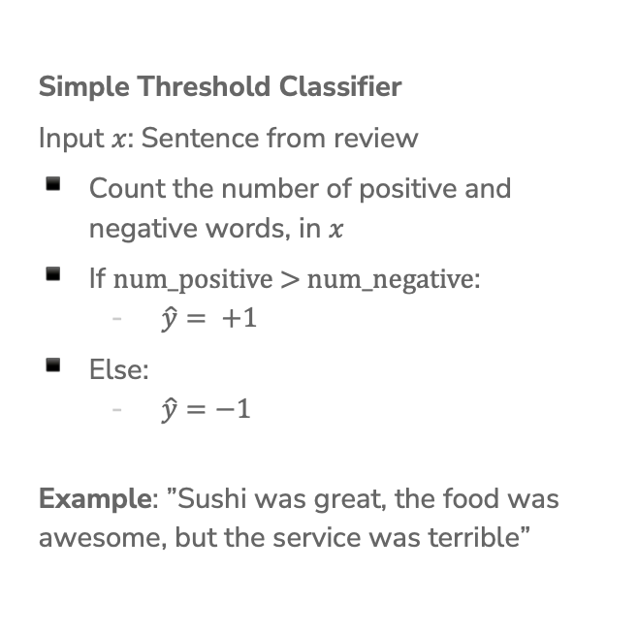
Idea: Use a list of good words and bad words, classify review by the most frequent type of word
Attempt 1:
Simple Threshold
Classifier
Simple Threshold Classifier
Input $x$: Sentence from review
Count the number of positive and negative words, in $x$
If $\text{num}\text{_}\text{positiv}e\text{ > }\text{num}\text{_}\text{negative}$:
  $\hat{y}= +1$
Else:
  $\hat{y}=−1$
Example: ”Sushi was great, the food was awesome, but the service was terrible”
Word | Good?
sushi | None
was | None
great | Good
the | None
food | None
but | None
awesome | Good
service | None
terrible | Bad
rancid | Bad
Notes:
Write positive # = 2, negative # = 1, predict +1
Note that this approach doesn’t involve any learning.

Slide 88
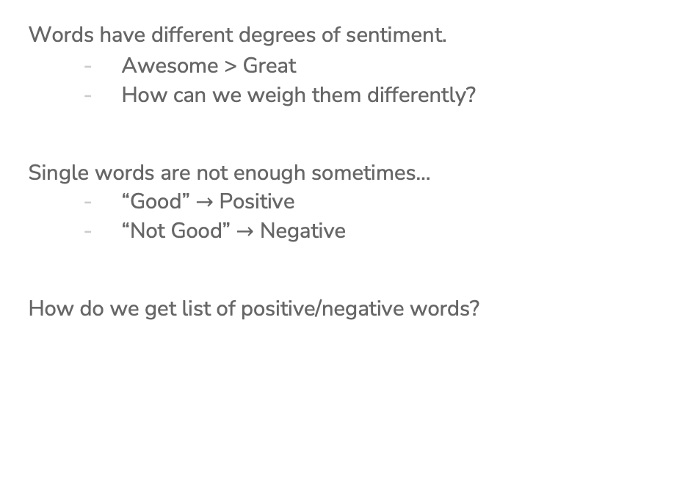
Limitations of Attempt 1 (Simple Threshold Classifier)
Words have different degrees of sentiment.
  Awesome > Great
  How can we weigh them differently?
Single words are not enough sometimes…
  “Good” $→$ Positive
  “Not Good” $→$ Negative
How do we get list of positive/negative words?

Slide 89
Words Have Different Degrees of Sentiments
What if we generalize good/bad to a numeric weighting per word?
Word | Good?
sushi | None
was | None
great | Good
the | None
food | None
but | None
awesome | Good
service | None
terrible | Bad
rancid | Bad
Word | Weight
sushi | 0
was | 0
great | 1
the | 0
food | 0
but | 0
awesome | 2
service | 0
terrible | -1
rancid | -2

Slide 90
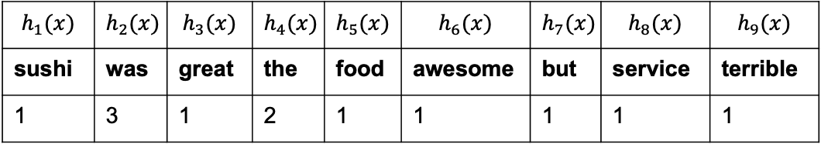
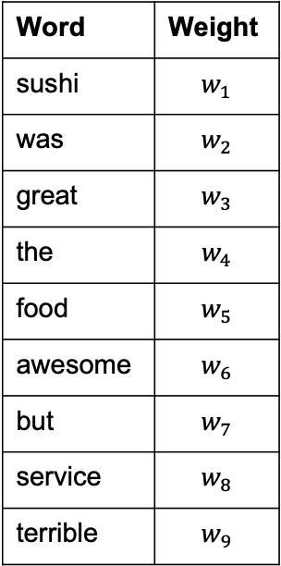
How do we get the word weights?
What if we learn them from the data?
In linear regression we learnt the weights for each feature. Can we do something similar here?
Word | Weight
sushi | $$w_{1}$$
was | $$w_{2}$$
great | $$w_{3}$$
the | $$w_{4}$$
food | $$w_{5}$$
awesome | $$w_{6}$$
but | $$w_{7}$$
service | $$w_{8}$$
terrible | $$w_{9}$$
$$h_{1}(x)$$ | $$h_{2}(x)$$ | $$h_{3}(x)$$ | $$h_{4}(x)$$ | $$h_{5}(x)$$ | $$h_{6}(x)$$ | $$h_{7}(x)$$ | $$h_{8}(x)$$ | $$h_{9}(x)$$
sushi | was | great | the | food | awesome | but | service | terrible
1 | 3 | 1 | 2 | 1 | 1 | 1 | 1 | 1

Slide 91

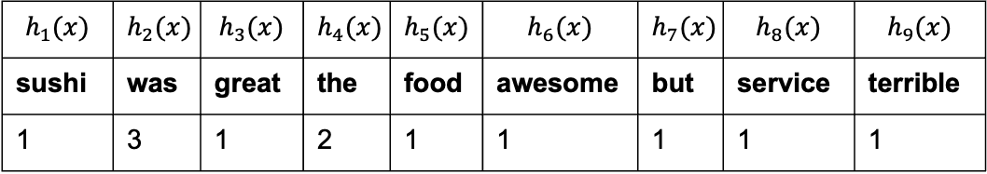
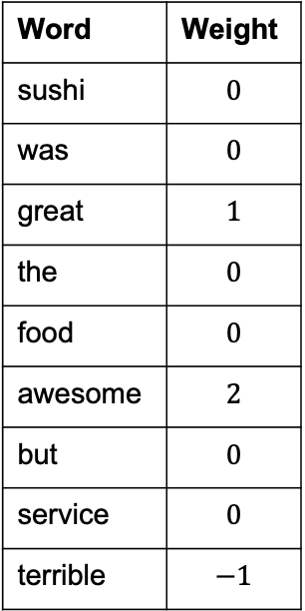
Idea: Use labelled training data to learn a weight for each word. Use weights to score a sentence.
Model:
$${\hat{y}}_{i}=sign\left(Score\left(x_{i}\right)\right)=sign(s_{i})$$
$$=sign\left(\sum_{j=0}^{D}{w_{j}h_{j}(x_{i})}\right)=sign(w^{T}h\left(x_{i}\right))$$
”Sushi was great, the food was awesome, but the
service was terrible”
Attempt 2:
Linear Classifier
Word | Weight
sushi | $$0$$
was | $$0$$
great | $$1$$
the | $$0$$
food | $$0$$
awesome | $$2$$
but | $$0$$
service | $$0$$
terrible | $$−1$$
$$h_{1}(x)$$ | $$h_{2}(x)$$ | $$h_{3}(x)$$ | $$h_{4}(x)$$ | $$h_{5}(x)$$ | $$h_{6}(x)$$ | $$h_{7}(x)$$ | $$h_{8}(x)$$ | $$h_{9}(x)$$
sushi | was | great | the | food | awesome | but | service | terrible
1 | 3 | 1 | 2 | 1 | 1 | 1 | 1 | 1
Notes:
WOS:
$$1*1+1*2+1*(-1) = 2$$

Slide 92
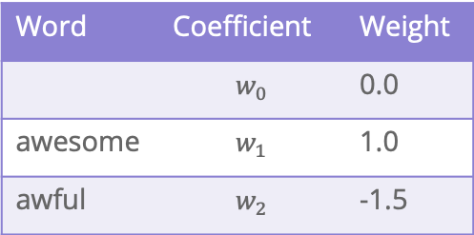
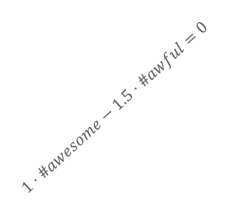



Decision Boundary
Consider if only two words had non-zero coefficients
Word | Coefficient | Weight
 | $$w_{0}$$ | 0.0
awesome | $$w_{1}$$ | 1.0
awful | $$w_{2}$$ | -1.5
$$\hat{s}=1⋅\#awesome−1.5⋅\#awful$$
#awful
0 1 2 3 4 $⋯$
$$1⋅\#awesome−1.5⋅\#awful=0$$
#awesome
0 1 2 3 4 $⋯$
Notes:
Each point represents a sentence
WOS:
Above: Score < 0, predict negative sentiment
Below: Score > 0, predict positive sentiment

Slide 93
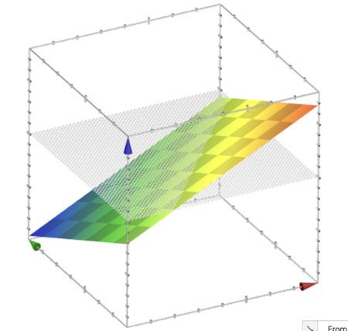

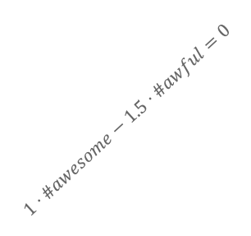

Decision Boundary
$$Score\left(x\right)=1⋅\#awesome−1.5⋅\#awful$$
2-dimensional view
3-dimensional view
#awful
0 1 2 3 4 $⋯$
$$1⋅\#awesome−1.5⋅\#awful=0$$
Score
#awesome
#awful
0 1 2 3 4 $⋯$
#awesome
Generally, with classification we don’t us a plot like the 3d view since it’s hard to visualize, instead use 2d plot with decision boundary
Notes:
WOS:
0 at the cross-section
When you are taking the sign, you’re fundamentally taking a cross-section at score =0, and seeing if the score is above or below that line.

Slide 94


Decision Boundary with Score
$$Score\left(x\right)=1⋅\#awesome−1.5⋅\#awful$$
2-dimensional view
2-d view with score
#awful
#awful
0 1 2 3 4 $⋯$
0 1 2 3 4 $⋯$
$$1⋅\#awesome−1.5⋅\#awful=0$$
$$1⋅\#awesome−1.5⋅\#awful=0$$
#awesome
#awesome
0 1 2 3 4 $⋯$
0 1 2 3 4 $⋯$

Slide 95
ML Pipeline
Scaling / Normalization
Feature Selection
- All Subsets
- Greedy
- LASSO
Train/val/test-split
Linear Regression
Polynomial Regression
Ridge Regression
LASSO Regression
Training
Data
Pre-
Processing
x
ML
model
ŷ
⌃
f
Overarching Concepts:
Overfitting
Bias / Variance
Hyperparameter
Tuning:
- Validation Set
- Cross-validation
y
Optimization
algorithm
Gradient Descent
Quality
metric
MSE / RMSE
L1 Regularization (LASSO)
L2 Regularization (Ridge)
95

Slide 96
Classification

Slide 97
Sentiment Classifier
In our example, we want to classify a restaurant review as positive or negative.
Sentence from review
Classifier Model
Input: x
Output: y
Predicted class
Notes:
Where is sentiment analysis used? One example is marketing or analytics, where companies want to get the average sentiment of different content they put out based on the comments.

Slide 98
Idea: Use a list of good words and bad words, classify review by the most frequent type of word
Attempt 1:
Simple Threshold
Classifier
Simple Threshold Classifier
Input $x$: Sentence from review
Count the number of positive and negative words, in $x$
If $\text{num}\text{_}\text{positiv}e\text{ > }\text{num}\text{_}\text{negative}$:
  $\hat{y}= +1$
Else:
  $\hat{y}=−1$
Example: ”Sushi was great, the food was awesome, but the service was terrible”
Word | Good?
sushi | None
was | None
great | Good
the | None
food | None
but | None
awesome | Good
service | None
terrible | Bad
rancid | Bad
Notes:
Write positive # = 2, negative # = 1, predict +1
Note that this approach doesn’t involve any learning.

Slide 99
Idea: Use labelled training data to learn a weight for each word. Use weights to score a sentence.
Model:
$${\hat{y}}_{i}=sign\left(Score\left(x_{i}\right)\right)=sign(s_{i})$$
$$=sign\left(\sum_{j=0}^{D}{w_{j}h_{j}(x_{i})}\right)=sign(w^{T}h\left(x_{i}\right))$$
”Sushi was great, the food was awesome, but the
service was terrible”
Attempt 2:
Linear
Classifier
Word | Weight
sushi | $$0$$
was | $$0$$
great | $$1$$
the | $$0$$
food | $$0$$
awesome | $$2$$
but | $$0$$
service | $$0$$
terrible | $$−1$$
$$h_{1}(x)$$ | $$h_{2}(x)$$ | $$h_{3}(x)$$ | $$h_{4}(x)$$ | $$h_{5}(x)$$ | $$h_{6}(x)$$ | $$h_{7}(x)$$ | $$h_{8}(x)$$ | $$h_{9}(x)$$
sushi | was | great | the | food | awesome | but | service | terrible
1 | 3 | 1 | 2 | 1 | 1 | 1 | 1 | 1
Notes:
WOS:
$$1*1+1*2+1*(-1) = 2$$

Slide 100
Decision Boundary
Consider if only two words had non-zero coefficients
Word | Coefficient | Weight
 | $$w_{0}$$ | 0.0
awesome | $$w_{1}$$ | 1.0
awful | $$w_{2}$$ | -1.5
$$\hat{s}=1⋅\#awesome−1.5⋅\#awful$$
#awful
0 1 2 3 4 $⋯$
$$1⋅\#awesome−1.5⋅\#awful=0$$
#awesome
0 1 2 3 4 $⋯$
Notes:
Each point represents a sentence
WOS:
Above: Score < 0, predict negative sentiment
Below: Score > 0, predict positive sentiment

Slide 101





1 min
What happens to the decision boundary if we add an intercept?
$$Score\left(x\right)=1.0+1⋅\#awesome−1.5⋅\#awful$$
Which graph shows the new decision boundary (black)?
Describe in English what we are doing in terms of the model’s predictions.
#awful
#awful
0 1 2 3 4 $⋯$
0 1 2 3 4 $⋯$
#awesome
0 1 2 3 4 $⋯$
#awesome
0 1 2 3 4 $⋯$
Notes:
Two parts:
Decide which one of these graphs represents the new score
Explain in English what you are doing here in terms of the model’s actual predictions

Slide 102
2 min
What happens to the decision boundary if we add an intercept?
$$Score\left(x\right)=1.0+1⋅\#awesome−1.5⋅\#awful$$
Which graph shows the new decision boundary (black)?
Describe in English what we are doing in terms of the model’s predictions.
#awful
#awful
0 1 2 3 4 $⋯$
0 1 2 3 4 $⋯$
#awesome
0 1 2 3 4 $⋯$
#awesome
0 1 2 3 4 $⋯$
Notes:
Two parts:
Decide which one of these graphs represents the new score
Explain in English what you are doing here in terms of the model’s actual predictions

Slide 103
Decision Boundary
$$Score\left(x\right)=1⋅\#awesome−1.5⋅\#awful$$
2-dimensional view
3-dimensional view
#awful
0 1 2 3 4 $⋯$
$$1⋅\#awesome−1.5⋅\#awful=0$$
Score
#awesome
#awful
0 1 2 3 4 $⋯$
#awesome
Generally, with classification we don’t us a plot like the 3d view since it’s hard to visualize, instead use 2d plot with decision boundary
Notes:
WOS:
0 at the cross-section
When you are taking the sign, you’re fundamentally taking a cross-section at score =0, and seeing if the score is above or below that line.

Slide 104

Complex Decision Boundaries?
What if we want to use a more complex decision boundary?
  Need more complex model/features! (Come back Wed)

Slide 105
Single Words Are Sometimes Not Enough!
What if instead of making each feature one word, we made it two?
  Unigram: a sequence of one word
  Bigram: a sequence of two words
  N-gram: a sequence of n-words
”Sushi was good, the food was good, the service was not good”
Longer sequences of words results in more context, more features, and a greater chance of overfitting.
sushi | was | good | the | food | service | not
1 | 3 | 3 | 2 | 1 | 1 | 1
sushi was | was good | good the | the food | food was | the service | service was | was not | not good
1 | 2 | 2 | 1 | 1 | 1 | 1 | 1 | 1

Slide 106
Evaluating Classifiers

Slide 107





ML Pipeline
Training
Data
$$x$$
Pre-
Processing
$$h(x)$$
ML
model
$$\hat{y}$$
$$\hat{w}$$
Optimization
algorithm
$$y$$
Quality
metric
107

Slide 108

Classification
Error
Ratio of examples where there was a mistaken prediction
What’s a mistake?
If the true label was positive ($y=+1$),
but we predicted negative ($\hat{y}=−1)$
If the true label was negative ($y=−1$),
but we predicted positive ($\hat{y}=+1$)
Classification Error
Classification Accuracy
Notes:
WOS:
Classification Error: # mistakes / total
$$\sum 1{y-\hat{y}}$$
Classification Accuracy: 1 - error
# correct / total

Slide 109

What’s a good accuracy?
For binary classification:
Should at least beat random guessing…
Accuracy should be at least 0.5
For multi-class classification ($k$ classes):
Should still beat random guessing
Accuracy should be at least: 1 / k
  3-class: 0.33
  4-class: 0.25
  …
Besides that, higher accuracy means better, right?
Notes:
For example, if you’re taking in handwritten digits and classifying what digit they are, you should at least get an accuracy of one-tenth. This is actually an example you’ll be going over in section on Thurs.

Slide 110
Detecting Spam
Imagine I made a “Dummy Classifier” for detecting spam
The classifier ignores the input, and always predicts spam.
This actually results in 90% accuracy! Why?
  Most emails are spam…
This is called the majority class classifier.
A classifier as simple as the majority class classifier can have a high accuracy if there is a class imbalance.
A class imbalance is when one class appears much more frequently than another in the dataset
This might suggest that accuracy isn’t enough to tell us if a model is a good model.

Slide 111
Assessing Accuracy
Always digging in and ask critical questions of your accuracy.
Is there a class imbalance?
How does it compare to a baseline approach?
  Random guessing
  Majority class
  …
Most important: What does my application need?
  What’s good enough for user experience?
  What is the impact of a mistake we make?

Slide 112


Slide 113

Confusion Matrix
For binary classification, there are only two types of mistakes
$\hat{y}=+1, y=−1$
$\hat{y}=−1, y=+1$
Generally we make a confusion matrix to understand mistakes.
Predicted Label
 | True Positive (TP) | False Negative (FN)
 | False Positive (FP) | True Negative (TN)
True Label
Tip on remembering: complete the sentence “My prediction was a …”
Notes:
So how can we break down the types of errors to think about them in a more detailed fashion? Using a tool called confusion matrices.
WOS: y, \hat{y}

Slide 114
Confusion Matrix Example
Predicted Label
 | True Positive (TP) | False Negative (FN)
 | False Positive (FP) | True Negative (TN)
True Label
Notes:
Write
100 test examples
60 total positive, 40 total negative
TP 50, 10 FN, 5 FP, 35 TN
Compute accuracy (50 + 35 / 100) = 0.85

Slide 115
Which is Worse?
What’s worse, a false negative or a false positive?
It entirely depends on your application!
In almost every case, how treat errors depends on your context.
Detecting Spam
False Negative: Annoying
False Positive: Email lost
Medical Diagnosis
False Negative: Disease not treated
False Positive: Wasteful treatment
Notes:
Spam is the positive label
Mention the COVID example

Slide 116
Errors and Fairness
We mentioned on the first day how ML is being used in many contexts that impact crucial aspects of our lives.
Models making errors is a given, what we do about that is a choice:
Are the errors consequential enough that we shouldn’t use a model in the first place?
Do different demographic groups experience errors at different rates?
  If so, we would hopefully want to avoid that model!
Will talk more about how to define whether or a not a model is fair / discriminatory next week. Will use these notions of error as a starting point!

Slide 117



Binary Classification Measures
Notation
$C_{TP}=\#TP, C_{FP}=\#FP, C_{TN}=\#TN, C_{FN}=\#FN$
$N=C_{TP}+C_{FP}+C_{TN}+C_{FN}$
$N_{P}=C_{TP}+C_{FN}, N_{N}=C_{FP}+C_{TN}$
Error Rate
$$\frac{C_{FP}+C_{FN}}{N}$$
Accuracy Rate
$$\frac{C_{TP}+C_{TN}}{N}$$
False Positive rate (FPR)
$$\frac{C_{FP}}{N_{N}}$$
False Negative Rate (FNR)
$$\frac{C_{FN}}{N_{P}}$$
True Positive Rate or Recall
$$\frac{C_{TP}}{N_{P}}$$
Precision
$$\frac{C_{TP}}{C_{TP}+C_{FP}}$$
F1-Score
$$2\frac{Precision⋅Recall}{Precison+Recall}$$
See more!

Slide 118
Multiclass Confusion Matrix
Consider predicting (Healthy, Cold, Flu)
Predicted Label
 | Healthy | Cold | Flu
Healthy | 60 | 8 | 2
Cold | 4 | 12 | 4
Flu | 0 | 2 | 8
True Label
Notes:
WOS:
Circle the diagonal, label “correct”
Mention that you can’t exactly say false positive or false negative here, since there isn’t just a positive or negative, there are more classes.

Slide 119
1 min
Suppose we trained a classifier and computed its confusion matrix on the training dataset. Is there a class imbalance in the dataset and if so, which class has the highest representation?
Predicted Label
 | Pupper | Doggo | Woofer
Pupper | 2 | 27 | 4
Doggo | 4 | 25 | 4
Woofer | 1 | 30 | 2
True Label

Slide 120
2 min
Suppose we trained a classifier and computed its confusion matrix on the training dataset. Is there a class imbalance in the dataset and if so, which class has the highest representation?
Predicted Label
 | Pupper | Doggo | Woofer
Pupper | 2 | 27 | 4
Doggo | 4 | 25 | 4
Woofer | 1 | 30 | 2
True Label

Slide 121
Learning Theory

Slide 122
How much data?
The more the merrier
But data quality is also an extremely important factor
Theoretical techniques can bound how much data is needed
Typically too loose for practical applications
But does provide some theoretical guarantee
In practice
More complex models need more data

Slide 123
Learning Curve
How does the true error of a model relate to the amount of training data we give it?
Hint: We’ve seen this picture before
True error
Amount of training data
Notes:
Draw in difference at end is bias + noise

Slide 124
Learning Curve
What if we use a more complex model?
True error
Amount of training data
Notes:
Write in that curve is model using single words
Draw in curve for bigrams
Smaller bias

Slide 125

Next Time
We will address the issues highlighted with the Linear Classifier approach from today by predicting the probability of a sentiment, rather than the sentiment itself.
$$P\left(y | x\right)$$
Normally assume some structure on the probability (e.g., linear)
$$P\left(y | x, w\right)≈w^{T}x$$
Use machine learning algorithm to learn approximate $\hat{w}$ such that $\hat{P}(y|x)$ is close to $P\left(y | x\right)$, where:
$$\hat{P}\left(y | x\right)=P\left(y | x, \hat{w}\right)$$

Slide 126
Recap
Theme: Describe high level idea and metrics for classification
Ideas:
Applications of classification
Linear classifier
Decision boundaries
Classification error / Classification accuracy
Class imbalance
Confusion matrix
Learning theory

