Slide 1
CSE/STAT 416
Cross Validation; Ridge Regression
Pre-Class Videos (lecture slides below)
Tanmay Shah
University of Washington
June 26, 2024

Slide 2
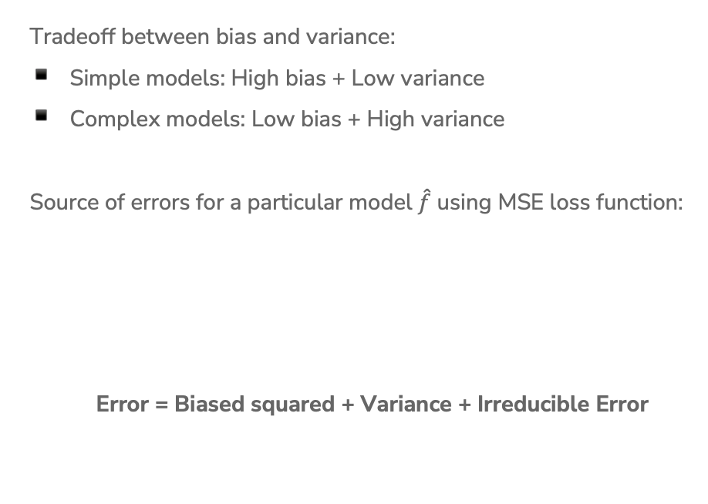
Bias-Variance Tradeoff
Tradeoff between bias and variance:
Simple models: High bias + Low variance
Complex models: Low bias + High variance
Source of errors for a particular model $\hat{f}$ using MSE loss function:
Error = Biased squared + Variance + Irreducible Error

Slide 3
Bias – Variance Tradeoff
Optimal model complexity
True error
Error
Underfitting
Overfitting
Variance
Biased squared
Complexity

Slide 4
Dataset Size
So far our entire discussion of error assumes a fixed amount of data. What happens to our error (true error and training error) as we get more data?
Error
Size of train set
Notes:
WOS: true error, train error
Much easier to overfit smaller training set vs larger training set

Slide 5
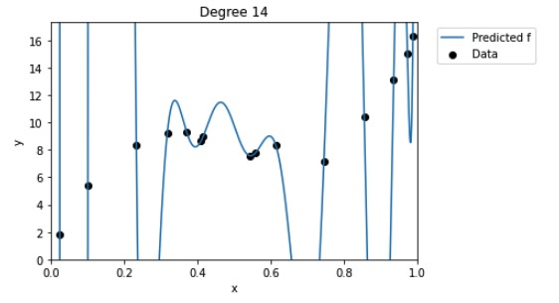
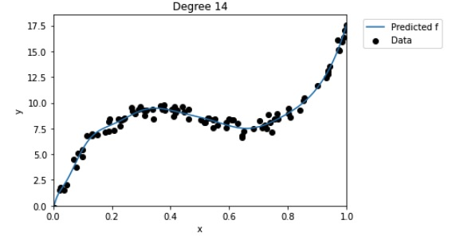
Dataset Size
Model complexity doesn’t depend on the size of the training set
The larger the training set, the lower the variance of the model, thus less overfitting
Notes:
Bias is not impacted by training set size, because in bias calculations we average across several sampled datasets, we don’t consider individual models trained on particular datasets. https://stats.stackexchange.com/a/406782

Slide 6
Demo
Bias-Variance Tradeoff
Training a linear regression model in Python
Observing the effect of the bias-variance tradeoff as compared to model complexity

Slide 7


Slide 8
Choosing Complexity

Slide 9
Choosing Complexity
So far we have talked about the affect of using different complexities on our error. Now, how do we choose the right one?

Slide 10
1 min
Suppose I wanted to figure out the right degree polynomial for my dataset (we’ll try p from 1 to 20). What procedure should I use to do this? Pick the best option
For each possible degree polynomial p:
Train a model with degree p on the training set, pick p that has the lowest test error
Train a model with degree p on the training set, pick p that has the highest test error
Train a model with degree p on the test set, pick p that has the lowest test error
Train a model with degree p on the test set, pick p that has the highest test error
None of the above

Slide 11
2 min
Suppose I wanted to figure out the right degree polynomial for my dataset (we’ll try p from 1 to 20). What procedure should I use to do this? Pick the best option
For each possible degree polynomial p:
Train a model with degree p on the training set, pick p that has the lowest test error
Train a model with degree p on the training set, pick p that has the highest test error
Train a model with degree p on the test set, pick p that has the lowest test error
Train a model with degree p on the test set, pick p that has the highest test error
None of the above

Slide 12
Choosing Complexity
We can’t just choose the model that has the lowest train error because that will favor models that overfit!
It then seems like our only other choice is to choose the model that has the lowest test error (since that is our approximation of the true error)
This is almost right. However, the test set has been tampered, thus is no longer is an unbiased estimate of the true error.
We didn’t technically train the model on the test set (that’s good), but we chose which model to use based on the performance of the test set.
  It’s no longer a stand in for “the unknown” since we probed it many times to figure out which model would be best.
NEVER EVER EVER touch the test set until the end. You only use it ONCE to evaluate the performance of the best model you have selected during training.

Slide 13
Choosing Complexity
We will talk about two ways to pick the model complexity without ruining our test set.
Using a validation set
Doing (k-fold) cross validation

Slide 14
Validation Set
So far we have divided our dataset into train and test
We can’t use Test to choose our model complexity, so instead, break up Train into ANOTHER dataset
We will pick the model that does best on validation. Note that this now makes the validation error of the “best” model a biased estimate of true error. The test error will be an unbiased estimate though since we never looked at it!
Train | Test
Train | Validation | Test

Slide 15
Validation Set
The process generally goes
train, validation, test = random_split(dataset)
for each model complexity p:
model = train_model(model_p, train)
val_err = error(model, validation)
keep track of p and model with smallest val_err
return best p & error(model, test)

Slide 16
Validation Set
Pros
Easy to describe and implement
Pretty fast
Only requires training a model and predicting on the validation set for each complexity of interest
Cons
Have to sacrifice even more training data
Prone to overfitting*

Slide 17
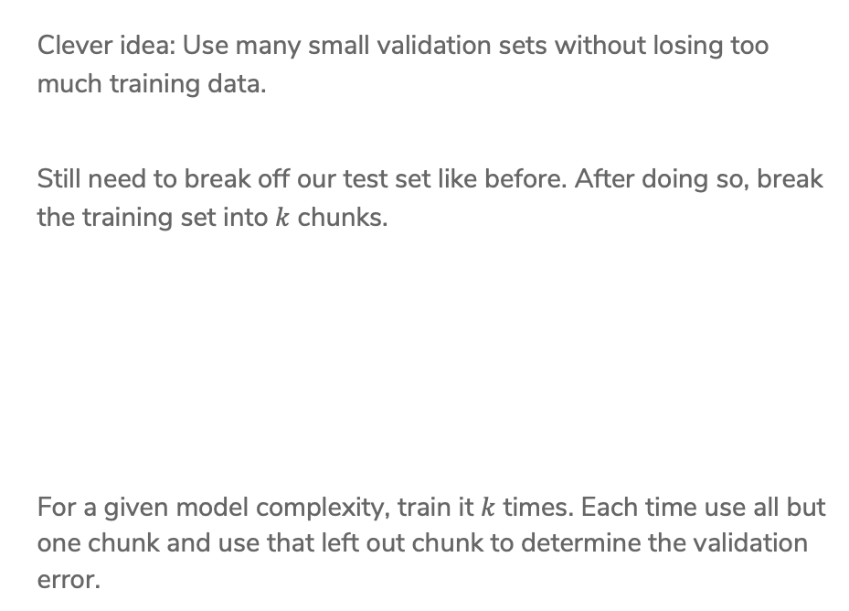
Cross-Validation
Clever idea: Use many small validation sets without losing too much training data.
Still need to break off our test set like before. After doing so, break the training set into $k$ chunks.
For a given model complexity, train it $k$ times. Each time use all but one chunk and use that left out chunk to determine the validation error.
Train | Test
Chunk1 | Chunk2 | Chunk3 | Chunk4 | Test

Slide 18
Cross Validation
For a set of hyperparameters, perform Cross Validation on k folds
Validation
Training
. . .
Error 1
. . .
Error 2
Average
all validation errors
. . .
Error 3
.
.
. . .
Error k
k folds

Slide 19
Cross-Validation
The process generally goes
chunk_1, …, chunk_k, test = random_split(dataset)
for each model complexity p:
for i in [1, k]:
model = train_model(model_p, chunks - i)
val_err = error(model, chunk_i)
avg_val_err = average val_err over chunks
keep track of p with smallest avg_val_err
return model trained on train (all chunks) with best p & error(model, test)

Slide 20
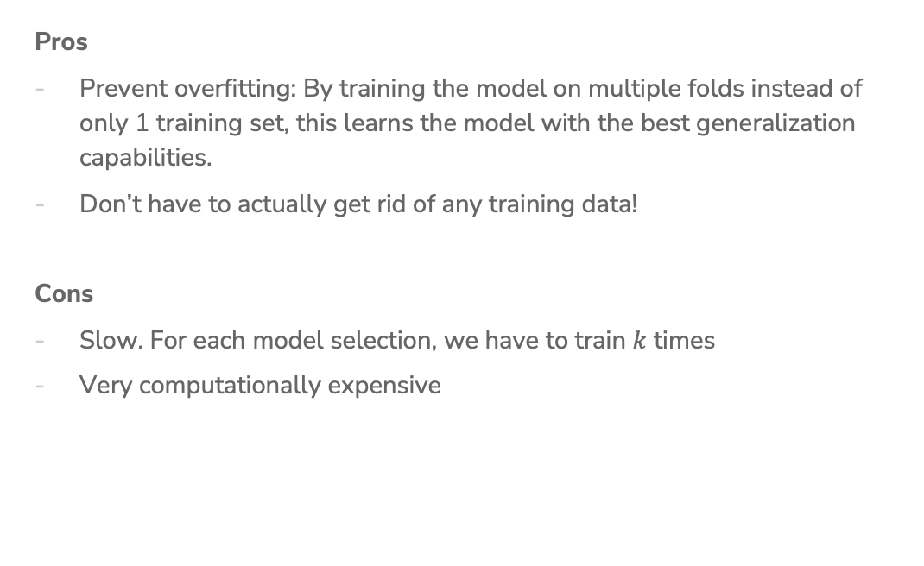
Cross-Validation
Pros
Prevent overfitting: By training the model on multiple folds instead of only 1 training set, this learns the model with the best generalization capabilities.
Don’t have to actually get rid of any training data!
Cons
Slow. For each model selection, we have to train $k$ times
Very computationally expensive

Slide 21

Cross-Validation
Generally, the more folds you use the better as you aren’t relying on the specifics of a single validation fold.
Theoretical best estimator* is to use $k=n$
  Called "Leave One Out Cross Validation” (LOOCV)
In practice, people use $k=5$ to $10$ for computational simplicity

Slide 22
Recap
Theme: Assess the performance of our models
Ideas:
Model complexity
Train vs. Test vs. True error
Overfitting and Underfitting
Bias-Variance Tradeoff
Error as a function of train set size
Choosing best model complexity
  Validation set
  Cross Validation

Slide 23
Pre-Class Video 1: Cross Validation

Slide 24
Validation Set
So far we have divided our dataset into train and test
We can’t use Test to choose our model complexity, so instead, break up Train into ANOTHER dataset
We will pick the model that does best on validation. Note that this now makes the validation error of the “best” model a biased estimate of true error. The test error will be an unbiased estimate though since we never looked at it!
Train | Test
Train | Validation | Test

Slide 25
Validation Set
The process generally goes
train, validation, test = random_split(dataset)
for each model complexity p:
model = train_model(model_p, train)
val_err = error(model, validation)
keep track of p and model with smallest val_err
return best p & error(model, test)

Slide 26
Validation Set
Pros
Easy to describe and implement
Pretty fast
Only requires training a model and predicting on the validation set for each complexity of interest
Cons
Have to sacrifice even more training data
Prone to overfitting*

Slide 27
Cross-Validation
Clever idea: Use many small validation sets without losing too much training data.
Still need to break off our test set like before. After doing so, break the training set into $k$ chunks.
For a given model complexity, train it $k$ times. Each time use all but one chunk and use that left out chunk to determine the validation error.
Train | Test
Chunk1 | Chunk2 | Chunk3 | Chunk4 | Test

Slide 28
Cross Validation
For a set of hyperparameters, perform Cross Validation on k folds
Validation
Training
. . .
Error 1
. . .
Error 2
Average
all validation errors
. . .
Error 3
.
.
. . .
Error k
k folds

Slide 29
Cross-Validation
The process generally goes
chunk_1, …, chunk_k, test = random_split(dataset)
for each model complexity p:
for i in [1, k]:
model = train_model(model_p, chunks - i)
val_err = error(model, chunk_i)
avg_val_err = average val_err over chunks
keep track of p with smallest avg_val_err
return model trained on train (all chunks) with best p & error(model, test)

Slide 30
Cross-Validation
Pros
Prevent overfitting: By training the model on multiple folds instead of only 1 training set, this learns the model with the best generalization capabilities.
Don’t have to actually get rid of any training data!
Cons
Slow. For each model selection, we have to train $k$ times
Very computationally expensive

Slide 31

Cross-Validation
What size of k?
Theoretical best estimator is to use $k=n$
  Called "Leave One Out Cross Validation”
In practice, people use $k=5$ to $10$.
Notes:
LOOCV gives better results because at the end of the day, the model you return is trained on the whole dataset. So you want to return the model that is most likely to perform well when trained on the whole dataset. LOOCV achieves this.
(Recall that smaller dataset size increases the change of overfitting)
In practice, with large datasets smaller k is fine.

Slide 32
Pre-Class Video 1: Cross Validation

Slide 33
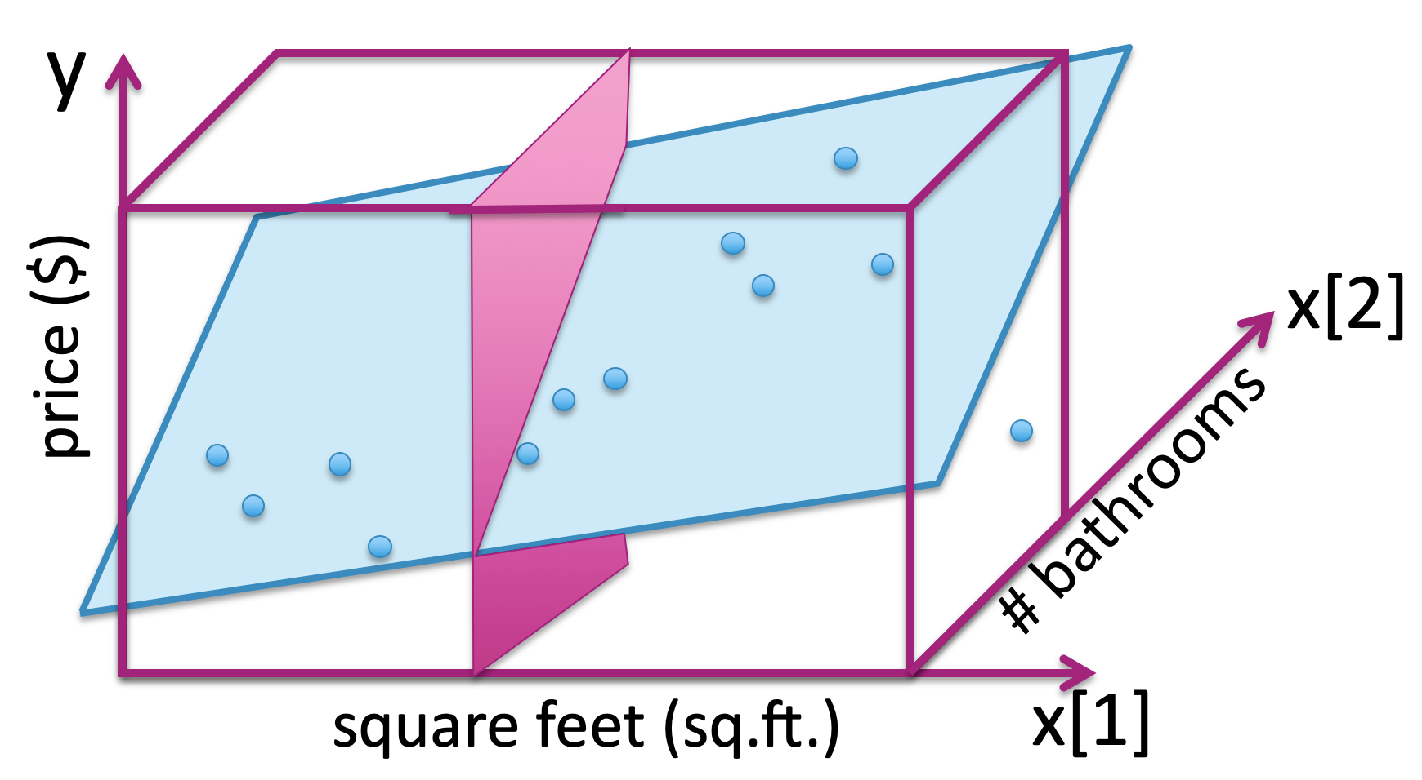
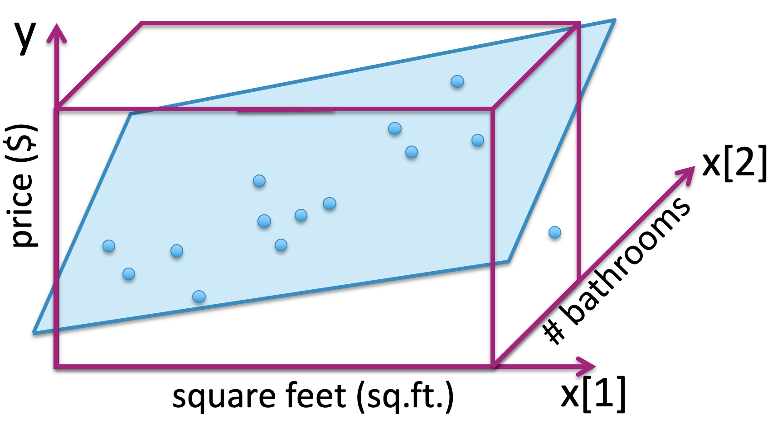
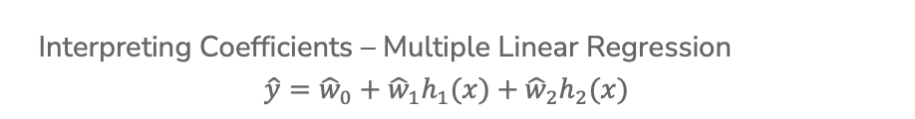
Interpreting Coefficients
Interpreting Coefficients – Multiple Linear Regression
$$\hat{y}={\hat{w}}_{0}+{\hat{w}}_{1}h_{1}(x)+{\hat{w}}_{2}h_{2}(x)$$
Fix
h₂(x)
h₁(x)

Slide 34
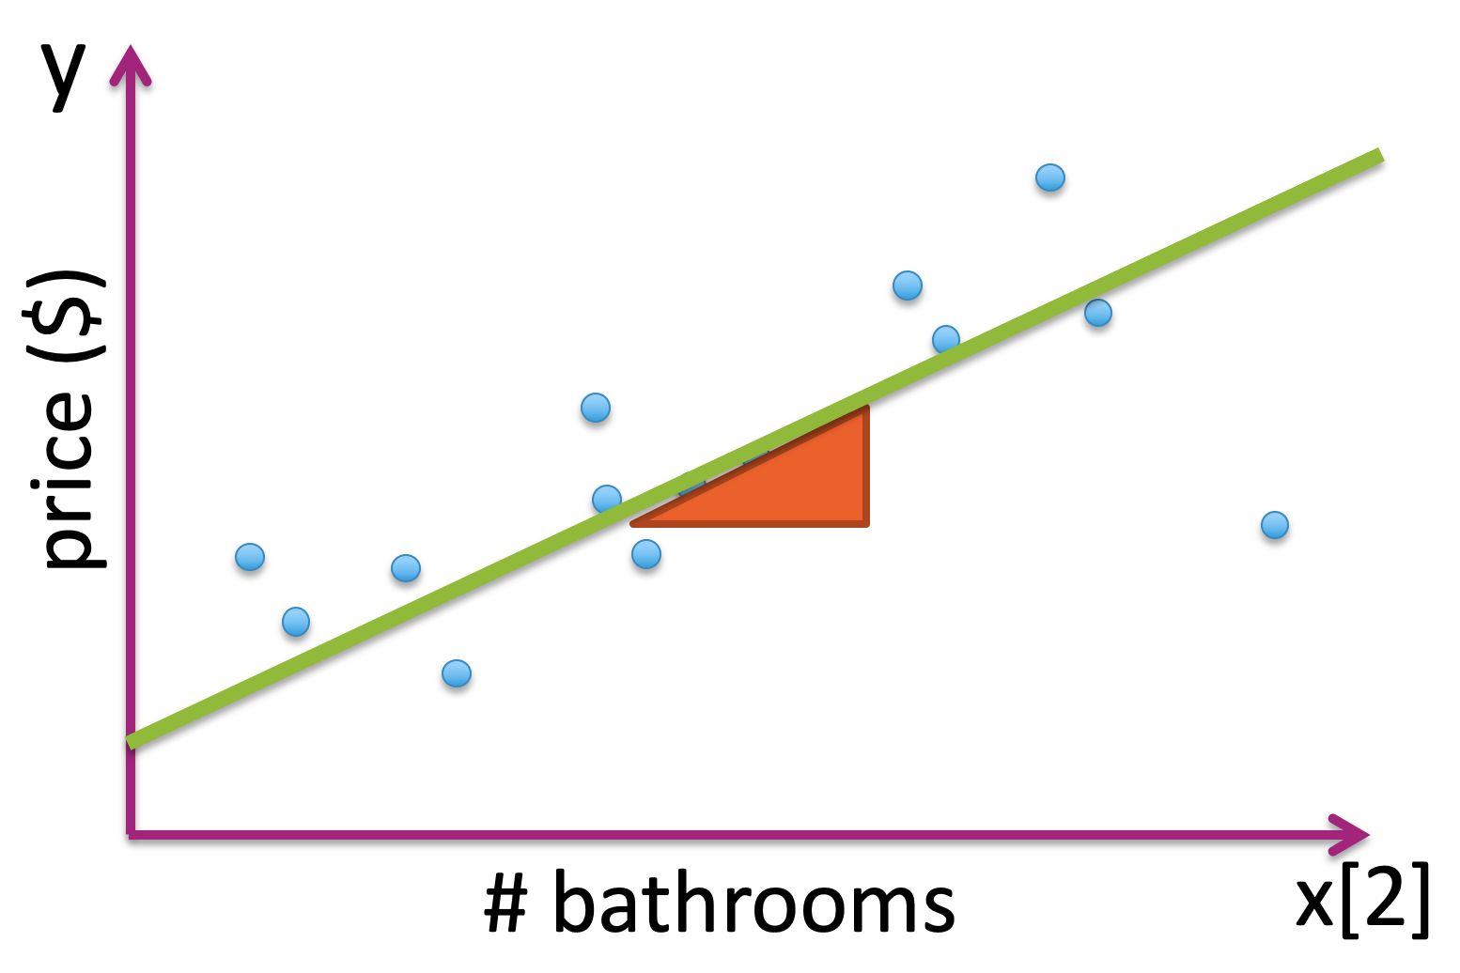
Interpreting Coefficients
Interpreting Coefficients – Multiple Linear Regression
$$\hat{y}={\hat{w}}_{0}+{\hat{w}}_{1}h_{1}(x)+{\hat{w}}_{2}h_{2}(x)$$
Fix
Holding h₁(x) fixed!
h₂(x)

Slide 35
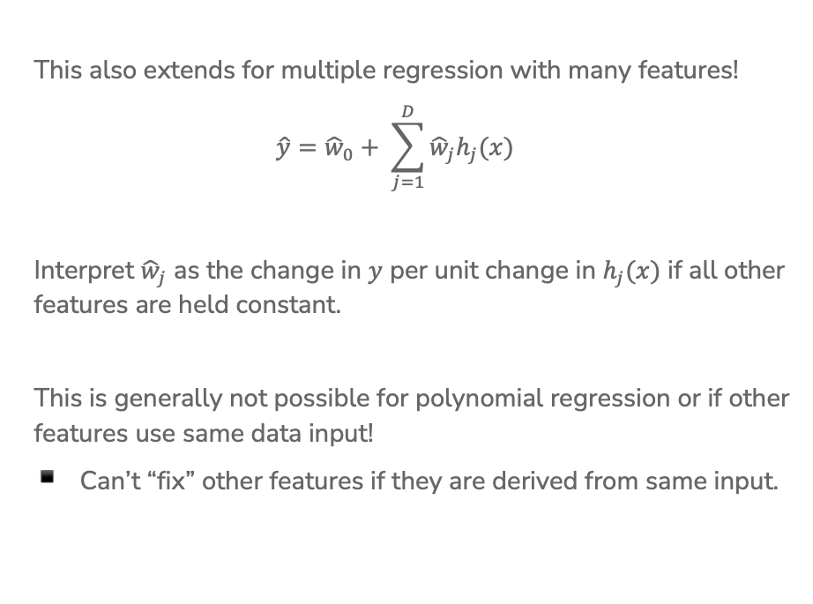
Interpreting Coefficients
This also extends for multiple regression with many features!
$$\hat{y}={\hat{w}}_{0}+ \sum_{j=1}^{D}{{\hat{w}}_{j}h_{j}(x)}$$
Interpret ${\hat{w}}_{j}$ as the change in $y$ per unit change in $h_{j}(x)$ if all other features are held constant.
This is generally not possible for polynomial regression or if other features use same data input!
Can’t “fix” other features if they are derived from same input.

Slide 36

Overfitting
Often, overfitting is associated with very large estimated parameters $\hat{w}$!
Notes:
Demo

Slide 37
Number of Features
Overfitting is not limited to polynomial regression of large degree. It can also happen if you use a large number of features!
Why? Overfitting depends on whether the amount of data you have is large enough to represent the true function’s complexity.

Slide 38

Number of Features
How do the number of features affect overfitting?
1 feature
Data must include representative example of all $\left(h_{1}(x), y\right)$ pairs to avoid overfitting
HARD

Slide 39
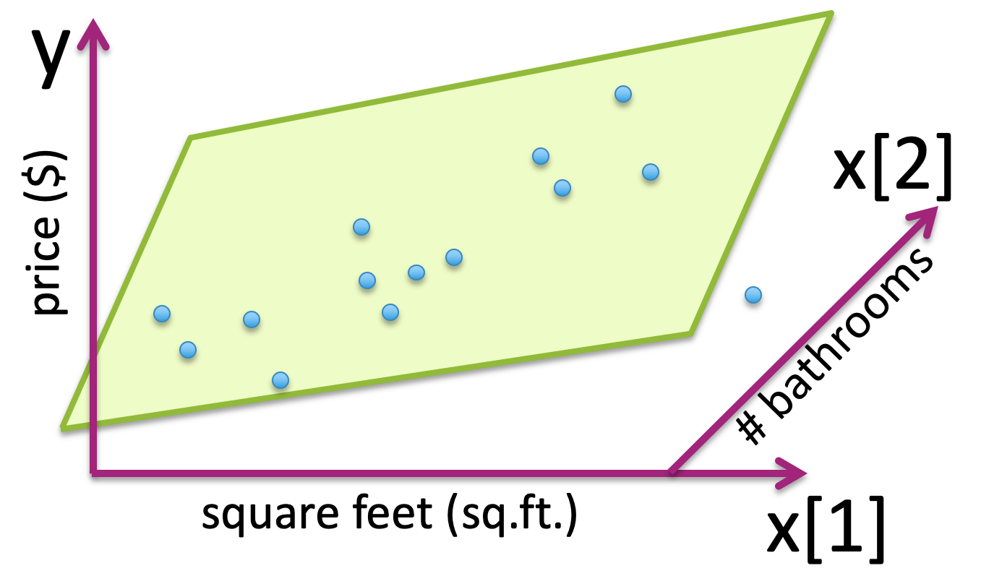

Number of Features
How do the number of features affect overfitting?
D features
Data must include representative example of all $\left(\left(h_{1}(x), h_{2}(x), …,h_{D}(x) \right), y\right)$ combos to avoid overfitting!
h₂(x)
MucH HARDer!!
h₁(x)
Introduction to the Curse of Dimensionality.
We will come back to this later in the quarter!
Notes:
In practice, the amount of data you need to cover the space increases exponentially with the dimension! If you need 100 points to cover 1D, you’d need 100^D points to get similar coverage on D dimentions.

Slide 40
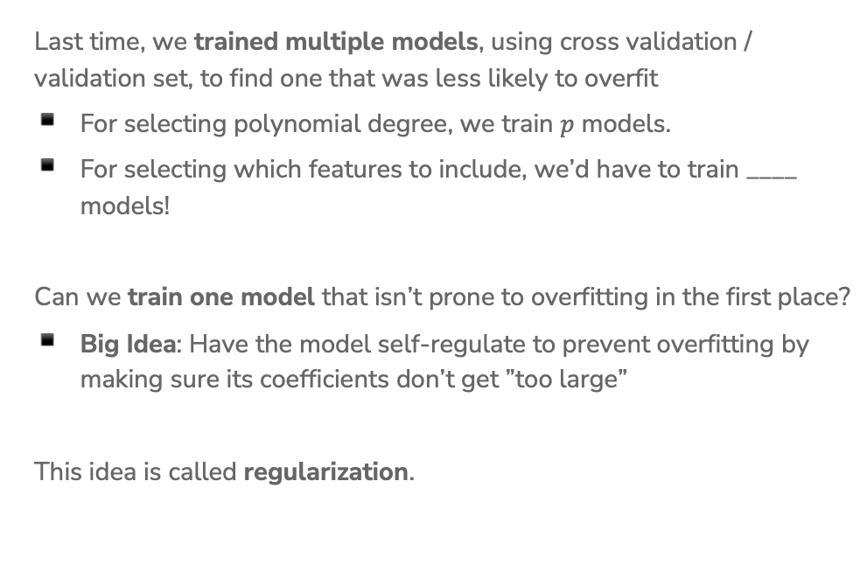
Prevent Overfitting
Last time, we trained multiple models, using cross validation / validation set, to find one that was less likely to overfit
For selecting polynomial degree, we train $p$ models.
For selecting which features to include, we’d have to train ____ models!
Can we train one model that isn’t prone to overfitting in the first place?
Big Idea: Have the model self-regulate to prevent overfitting by making sure its coefficients don’t get ”too large”
This idea is called regularization.

Slide 41
CSE/STAT 416
Cross Validation; Ridge Regression
Tanmay Shah
University of Washington
April 3, 2024
❓ Questions? Raise hand or sli.do #cs416
💬 Before Class: What is your favorite coffee/tea/boba/beverage shop near campus?
🎵 Listening to: Sammy Rae & The Friends

Slide 42
Administrivia
HW0 due today, late due Friday night at 11:59 pm on Ed and Gradescope
  See late day policy if you need more time
Office Hours (see schedule on website) started this week
  make use of those
  Longer wait times closer to assignment due dates
Ed Discussion Board
  Respond to other student’s questions and in Megathread
  Post privately if you’re question is very detailed to your answer
  Do not post solutions to assignments publicly
Learning Reflection specifications are constant week-to-week, so you can start building LR1 now even if the turn in isn’t open yet!

Slide 43
HW1 Walkthrough
Notes:
Mention that we are testing them on a different dataset!
Reminder that we are running a similarity checker! Collaborate on a high-level, don’t show or communicate code directly!

Slide 44
Recap

Slide 45
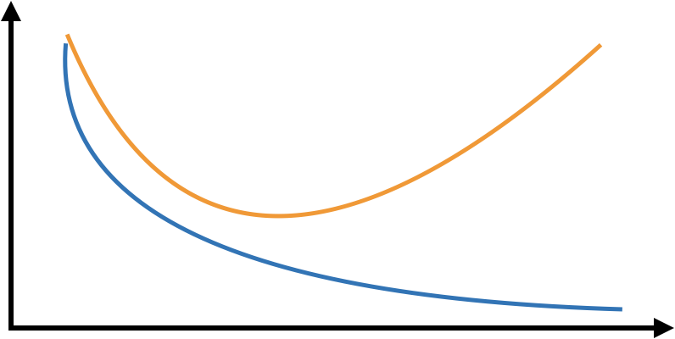
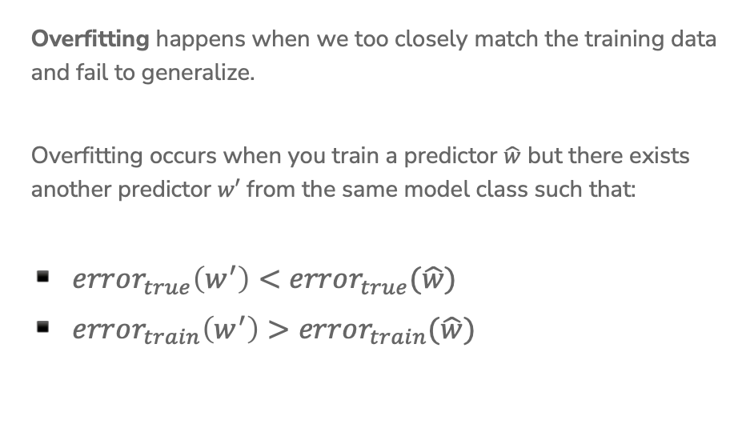
Overfitting
Overfitting happens when we too closely match the training data and fail to generalize.
Overfitting occurs when you train a predictor $\hat{w}$ but there exists another predictor $w′$ from the same model class such that:
$error_{true}\left(w^{′}\right)<error_{true}(\hat{w})$
$error_{train}\left(w^{′}\right)>error_{train}(\hat{w})$
Error
Complexity
Notes:
Remind them that test error is a heuristic for true error.

Slide 46
Bias – Variance Tradeoff
Optimal model complexity
True error
Error
Underfitting
Overfitting
Variance
Biased squared
Complexity

Slide 47
Validation Set
So far we have divided our dataset into train and test
We can’t use Test to choose our model complexity, so instead, break up Train into ANOTHER dataset
We will pick the model that does best on validation. Note that this now makes the validation error of the “best” model a biased estimate of true error. The test error will be an unbiased estimate though since we never looked at it!
Train | Test
Train | Validation | Test

Slide 48
Validation Set
The process generally goes
train, validation, test = random_split(dataset)
for each model complexity p:
model = train_model(model_p, train)
val_err = error(model, validation)
keep track of p and model with smallest val_err
return best p & error(model, test)

Slide 49
Validation Set
Pros
Easy to describe and implement
Pretty fast
Only requires training a model and predicting on the validation set for each complexity of interest
Cons
Have to sacrifice even more training data
Prone to overfitting*

Slide 50
Cross Validation
For a set of hyperparameters, perform Cross Validation on k folds
Validation
Training
. . .
Error 1
. . .
Error 2
Average
all validation errors
. . .
Error 3
.
.
. . .
Error k
k folds

Slide 51
Cross-Validation
The process generally goes
chunk_1, …, chunk_k, test = random_split(dataset)
for each model complexity p:
for i in [1, k]:
model = train_model(model_p, chunks - i)
val_err = error(model, chunk_i)
avg_val_err = average val_err over chunks
keep track of p with smallest avg_val_err
return model trained on train (all chunks) with best p & error(model, test)

Slide 52
Cross-Validation
Pros
Prevent overfitting: By training the model on multiple folds instead of only 1 training set, this learns the model with the best generalization capabilities.
Don’t have to actually get rid of any training data!
Cons
Slow. For each model selection, we have to train $k$ times
Very computationally expensive

Slide 53
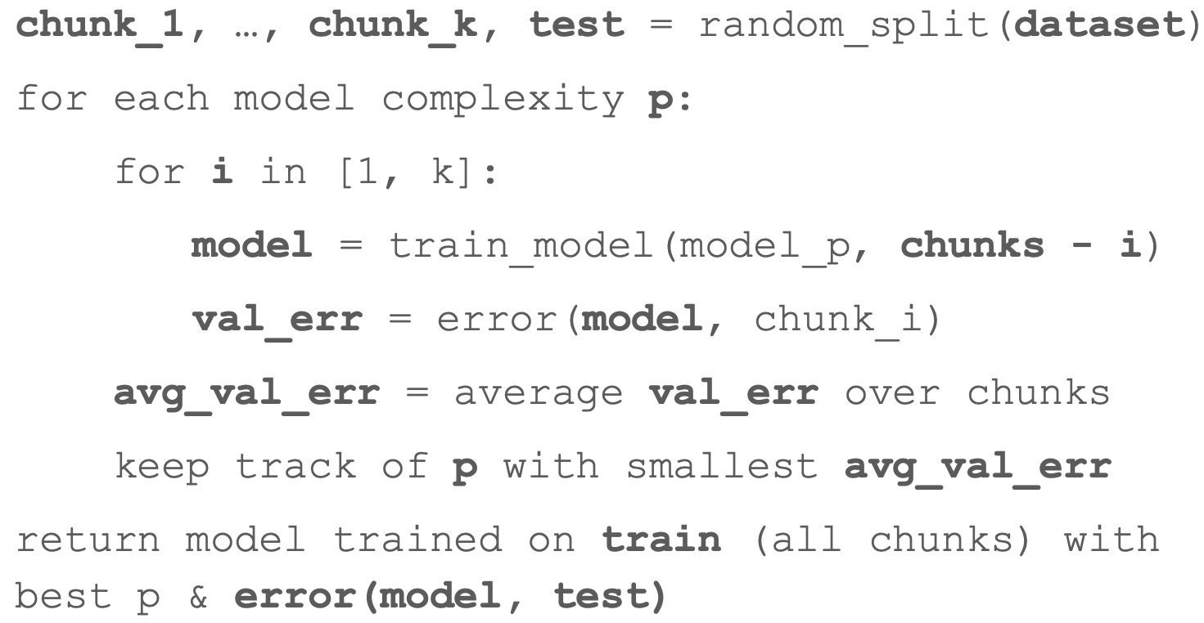
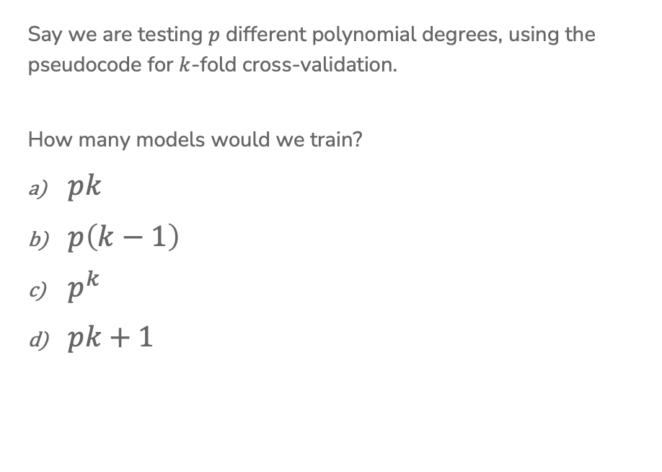
1 min
Say we are testing $p$ different polynomial degrees, using the pseudocode for $k$-fold cross-validation.
How many models would we train?
$pk$
$p\left(k−1\right)$
$p^{k}$
$pk+1$

Slide 54
1 min
Say we are testing $p$ different polynomial degrees, using the pseudocode for $k$-fold cross-validation.
How many models would we train?
$pk$
$p\left(k−1\right)$
$p^{k}$
$pk+1$

Slide 55
Coefficients and Overfitting

Slide 56
Interpreting Coefficients
Interpreting Coefficients – Multiple Linear Regression
$$\hat{y}={\hat{w}}_{0}+{\hat{w}}_{1}h_{1}(x)+{\hat{w}}_{2}h_{2}(x)$$
Fix
h₂(x)
h₁(x)

Slide 57
Overfitting
Often, overfitting is associated with very large estimated parameters $\hat{w}$!
Notes:
Demo

Slide 58
2 Minutes
What characterizes overfitting?
(Low / High) Train Error, (Low / High) Test Error
(Low / High) Bias, (Low / High) Variance
In which scenario is it more likely for a model to overfit?
(Few / Many) Features
(Few / Many) Parameters
(Small / Large) Polynomial Degree
(Small / Large) Dataset
Notes:
Features, parameters, and polynomial degree are all different ways of looking at model complexity

Slide 59
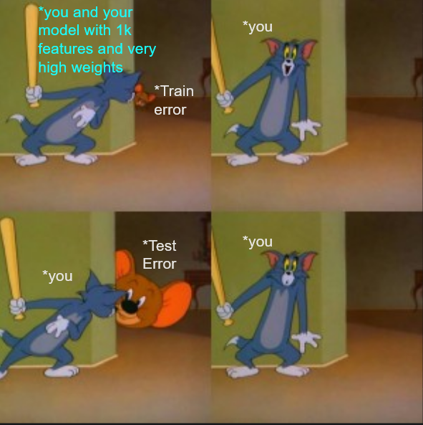
Overfitting in a nutshell

Slide 60
Overfitting in a nutshell

Slide 61
Prevent Overfitting
Last time, we trained multiple models, using cross validation / validation set, to find one that was less likely to overfit
For selecting polynomial degree, we train $p$ models.
For selecting which features to include, we’d have to train ____ models!
Can we train one model that isn’t prone to overfitting in the first place?
Big Idea: Have the model self-regulate to prevent overfitting by making sure its coefficients don’t get ”too large”
This idea is called regularization.

Slide 62
Regularization

Slide 63

ML Pipeline
- Deployment Bias
Training
Data
Pre-
Processing
x
ML
model
ŷ
⌃
- Historical Bias
- Representation Bias
- Measurement Bias
f
y
Optimization
algorithm
Quality
metric
63

Slide 64
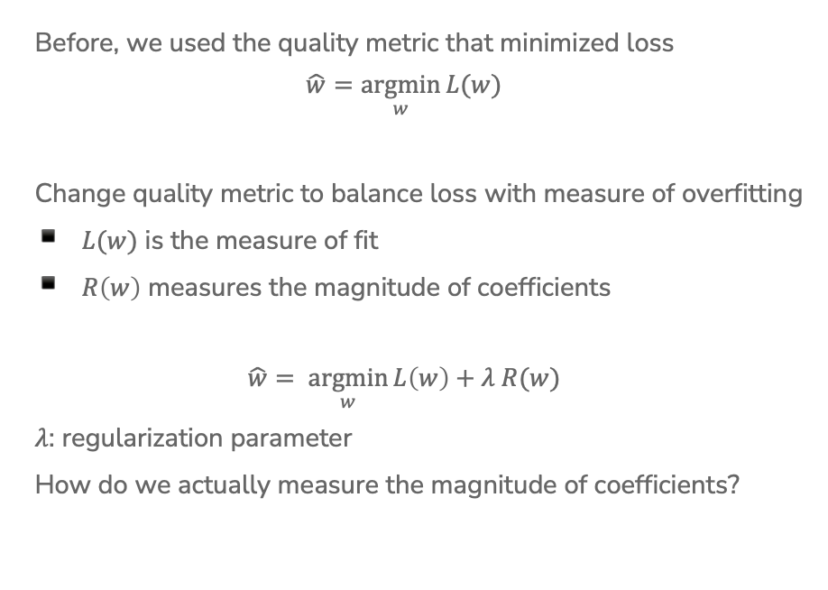
Regularization
Before, we used the quality metric that minimized loss
$$\hat{w}=\underset{w}{argmin}{L(w)}$$
Change quality metric to balance loss with measure of overfitting
$L(w)$ is the measure of fit
$R\left(w\right)$ measures the magnitude of coefficients
$$\hat{w}= \underset{w}{argmin}{L\left(w\right)+λ R(w)}$$
$λ$: regularization parameter
How do we actually measure the magnitude of coefficients?
Notes:
Draw: L(w) = MSE(w)

Slide 65

Magnitude
Come up with some number that summarizes the magnitude of the coefficients in $w$.
Sum?
Sum of absolute values?
Sum of squares?
Notes:
Draw generic w vector
Draw why sum doesn’t work with an example of w_1 and w_2
Show summation for absolute values and show L1 norm notation
Show sum of squares summation and L2 norm notation
Both L1 and L2 have specific interpretation and practical importance
Talk about norm, notations,

Slide 66
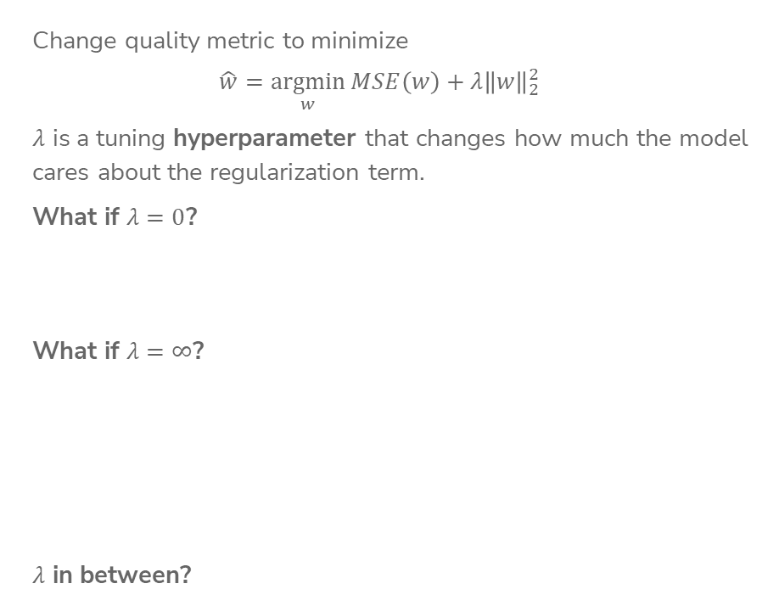
Ridge Regression
Change quality metric to minimize
$$\hat{w}=\underset{w}{argmin}{MSE\left(w\right)+λ{\left\|w\right\|}_{2}^{2}}$$
$λ$ is a tuning hyperparameter that changes how much the model cares about the regularization term.
What if $λ=0$?
What if $λ=∞$?
$λ$ in between?
Notes:
For \lam = 0, write that this is just min RSS(w) which is the same as before
We call this \hat{w_LS} for the least squares solution
Talk about how if \hat{w} != 0, then the cost is infinite
Therefore \hat{w} = 0
In between 0 <= |\hat{w} |_2^2 <= |\hat{w_LS}|_2^2

Slide 67
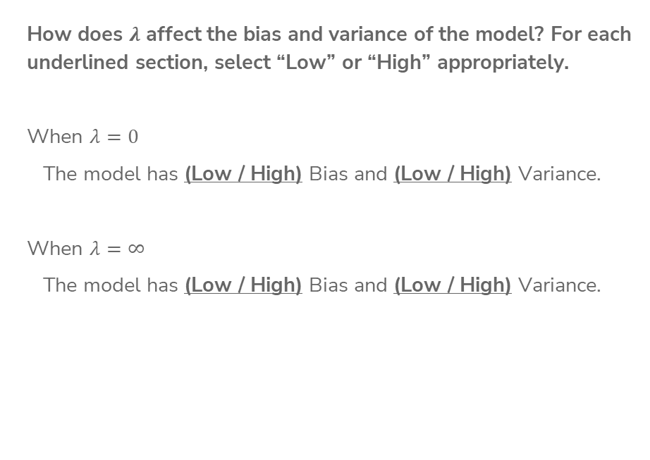
1 Minutes
How does $λ$ affect the bias and variance of the model? For each underlined section, select “Low” or “High” appropriately.
When $λ=0$
The model has (Low / High) Bias and (Low / High) Variance.
When $λ=∞$
The model has (Low / High) Bias and (Low / High) Variance.

Slide 68
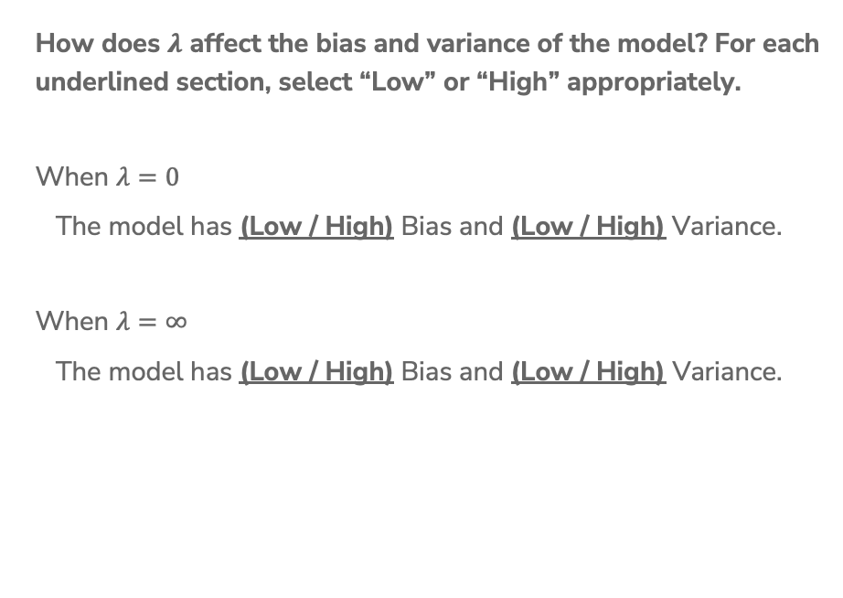
2 Minutes
How does $λ$ affect the bias and variance of the model? For each underlined section, select “Low” or “High” appropriately.
When $λ=0$
The model has (Low / High) Bias and (Low / High) Variance.
When $λ=∞$
The model has (Low / High) Bias and (Low / High) Variance.

Slide 69


Coefficient Paths
Coefficients ${\hat{w}}_{j}$
$$λ$$
Notes:
Each vertical line is the coefficients for a model at different values of lambda

Slide 70
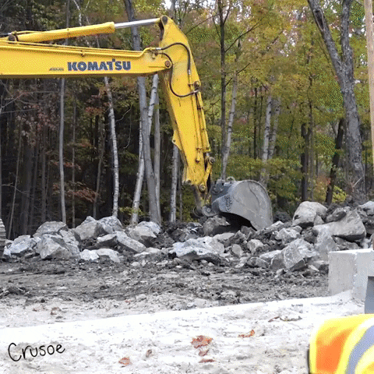

Slide 71
Demo: Ridge Regression
See Jupyter Notebook for interactive visualization.
Shows relationship between
Regression line
Mean Square Error
  Also called Ordinary Least Squares
Ridge Regression Quality Metric
Coefficient Paths

Slide 72

Choosing $λ$

Slide 73
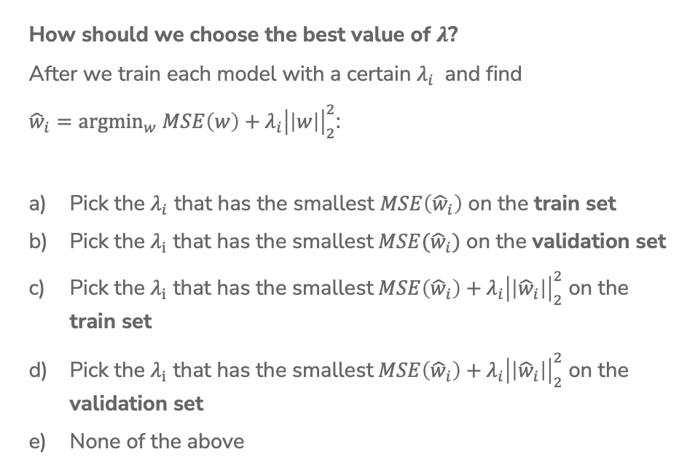
1 min
How should we choose the best value of $λ$?
After we train each model with a certain $λ_{i}$ and find
${\hat{w}}_{i}={argmin}_{w} MSE\left(w\right)\text{ +}{ λ_{i}\left|\left|w\right|\right|}_{2}^{2}$:
Pick the $λ_{i}$ that has the smallest $MSE\left({\hat{w}}_{i}\right)$ on the train set
Pick the $λ_{i}$ that has the smallest$MSE({\hat{w}}_{i})$ on the validation set
Pick the $λ_{i}$ that has the smallest$MSE\left({\hat{w}}_{i}\right)+{ λ_{i}\left|\left|{\hat{w}}_{i}\right|\right|}_{2}^{2}$ on the train set
Pick the $λ_{i}$ that has the smallest$MSE\left({\hat{w}}_{i}\right)+{ λ_{i}\left|\left|{\hat{w}}_{i}\right|\right|}_{2}^{2}$ on the validation set
None of the above

Slide 74
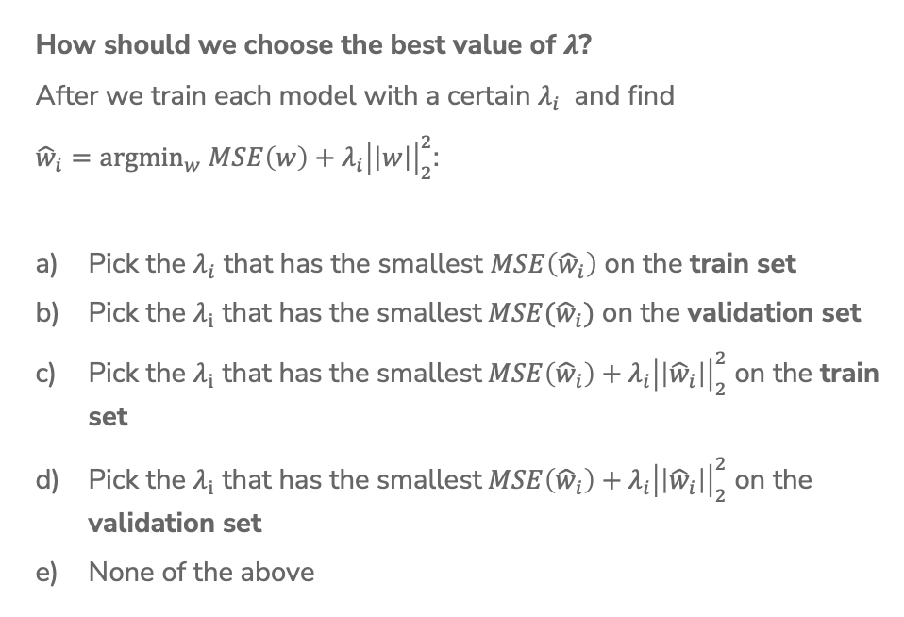
2 min
How should we choose the best value of $λ$?
After we train each model with a certain $λ_{i}$ and find
${\hat{w}}_{i}={argmin}_{w} MSE\left(w\right)\text{ +}{ λ_{i}\left|\left|w\right|\right|}_{2}^{2}$:
Pick the $λ_{i}$ that has the smallest $MSE\left({\hat{w}}_{i}\right)$ on the train set
Pick the $λ_{i}$ that has the smallest$MSE({\hat{w}}_{i})$ on the validation set
Pick the $λ_{i}$ that has the smallest$MSE\left({\hat{w}}_{i}\right)+{ λ_{i}\left|\left|{\hat{w}}_{i}\right|\right|}_{2}^{2}$ on the train set
Pick the $λ_{i}$ that has the smallest$MSE\left({\hat{w}}_{i}\right)+{ λ_{i}\left|\left|{\hat{w}}_{i}\right|\right|}_{2}^{2}$ on the validation set
None of the above

Slide 75
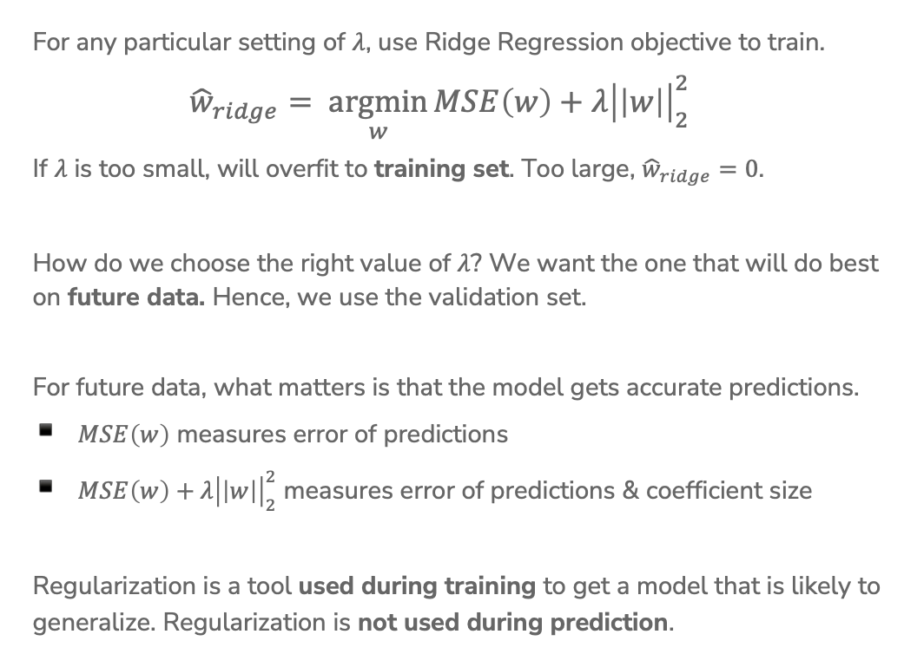
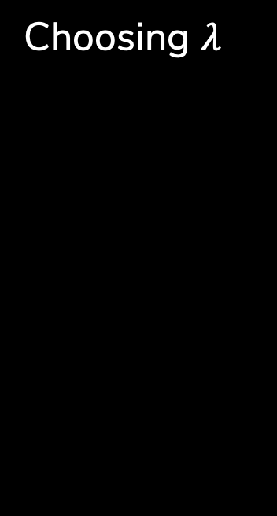
Choosing $λ$
For any particular setting of $λ$, use Ridge Regression objective to train.
$${\hat{w}}_{ridge}= \underset{w}{argmin}{MSE\left(w\right)+λ{\left|\left|w\right|\right|}_{2}^{2}}$$
If $λ$ is too small, will overfit to training set. Too large, ${\hat{w}}_{ridge}=0$.
How do we choose the right value of $λ$? We want the one that will do best on future data. Hence, we use the validation set.
For future data, what matters is that the model gets accurate predictions.
$MSE\left(w\right)$ measures error of predictions
$MSE\left(w\right)+λ{\left|\left|w\right|\right|}_{2}^{2}$ measures error of predictions & coefficient size
Regularization is a tool used during training to get a model that is likely to generalize. Regularization is not used during prediction.

Slide 76
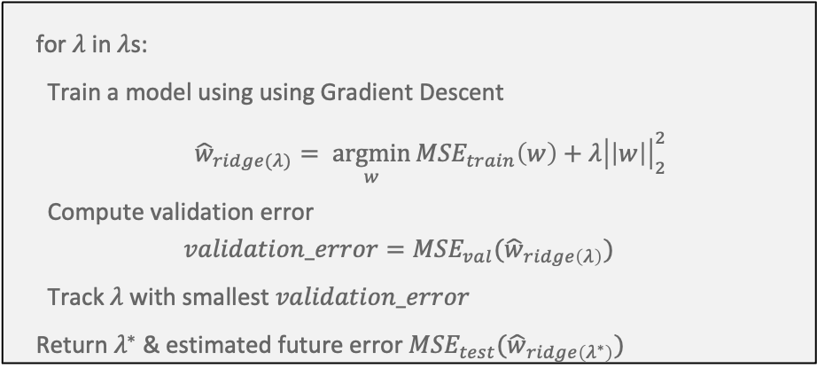
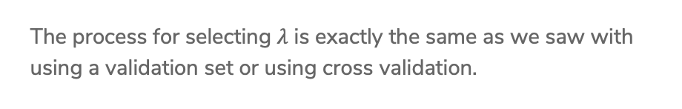
Choosing $λ$
The process for selecting $λ$ is exactly the same as we saw with using a validation set or using cross validation.
for $λ$ in $λ$s:
Train a model using using Gradient Descent
${\hat{w}}_{ridge(λ)}= \underset{w}{argmin}{{MSE}_{train}\left(w\right)+λ{\left|\left|w\right|\right|}_{2}^{2}}$
Compute validation error
$$validation_error={MSE}_{val}({\hat{w}}_{ridge\left(λ\right)})$$
Track $λ$ with smallest $validation_error$
Return $λ^{∗}$ & estimated future error ${MSE}_{test}({\hat{w}}_{ridge\left(λ^{∗}\right)})$

Slide 77

2 minutes
A model parameter is learnt during training (e.g., $\hat{w}$)
A hyperparameter is a parameter that is external to the model, whose value is used to influence the learning process.
What hyperparameters have we learned so far?
Notes:
Learning rate (in Gradient Descent)
Number of iterations (in Gradient Descent)
Regularization parameter
Number of folds (in Cross Validation)
Polynomial degree

Slide 78
Scaling

Slide 79

Regularization
At this point, I’ve hopefully convinced you that regularizing coefficient magnitudes is a good thing to avoid overfitting!
You:
We might have gotten a bit carried away, it doesn’t ALWAYS make sense…

Slide 80
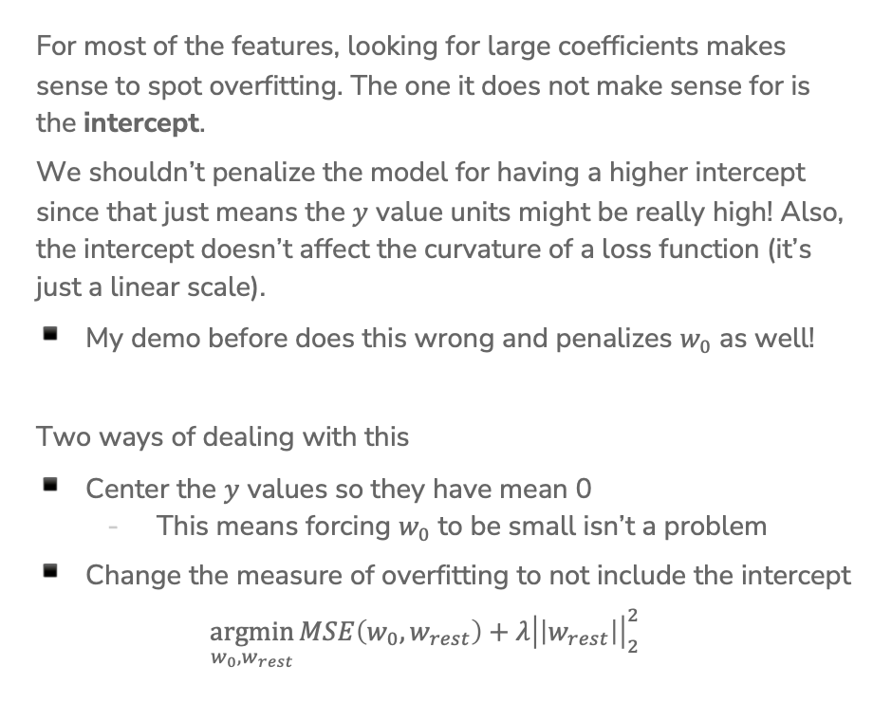
The Intercept
For most of the features, looking for large coefficients makes sense to spot overfitting. The one it does not make sense for is the intercept.
We shouldn’t penalize the model for having a higher intercept since that just means the $y$ value units might be really high! Also, the intercept doesn’t affect the curvature of a loss function (it’s just a linear scale).
My demo before does this wrong and penalizes $w_{0}$ as well!
Two ways of dealing with this
Center the $y$ values so they have mean 0
  This means forcing $w_{0}$ to be small isn’t a problem
Change the measure of overfitting to not include the intercept
$\underset{w_{0}, w_{rest}}{argmin}{MSE\left(w_{0},w_{rest}\right)+λ{\left|\left|w_{rest}\right|\right|}_{2}^{2}}$

Slide 81
Other Coefficients
The L2 penalty penalizes all (non-intercept) coefficients equally
Is that reasonable?

Slide 82
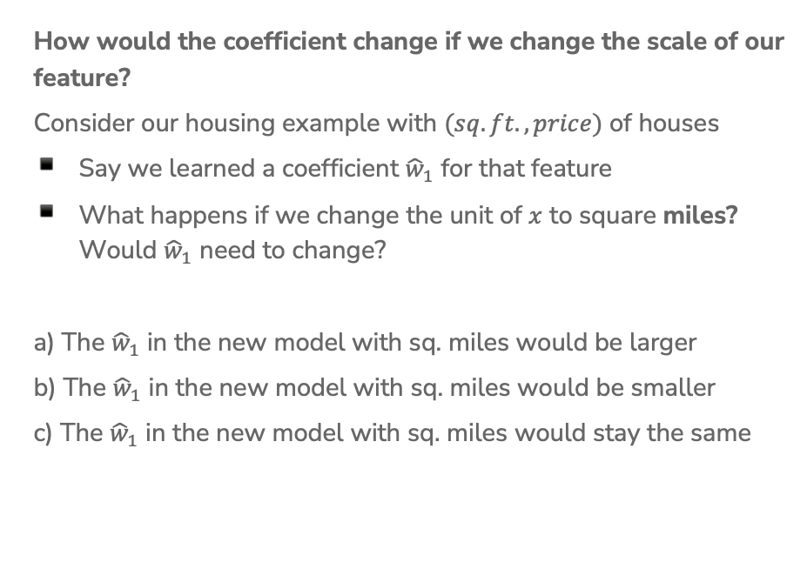
1 Minute
How would the coefficient change if we change the scale of our feature?
Consider our housing example with $(sq. ft., price)$ of houses
Say we learned a coefficient ${\hat{w}}_{1}$ for that feature
What happens if we change the unit of $x$ to square miles? Would ${\hat{w}}_{1}$ need to change?
a) The ${\hat{w}}_{1}$ in the new model with sq. miles would be larger
b) The ${\hat{w}}_{1}$ in the new model with sq. miles would be smaller
c) The ${\hat{w}}_{1}$ in the new model with sq. miles would stay the same

Slide 83
1 Minute
How would the coefficient change if we change the scale of our feature?
Consider our housing example with $(sq. ft., price)$ of houses
Say we learned a coefficient ${\hat{w}}_{1}$ for that feature
What happens if we change the unit of $x$ to square miles? Would ${\hat{w}}_{1}$ need to change?
a) The ${\hat{w}}_{1}$ in the new model with sq. miles would be larger
b) The ${\hat{w}}_{1}$ in the new model with sq. miles would be smaller
c) The ${\hat{w}}_{1}$ in the new model with sq. miles would stay the same

Slide 84
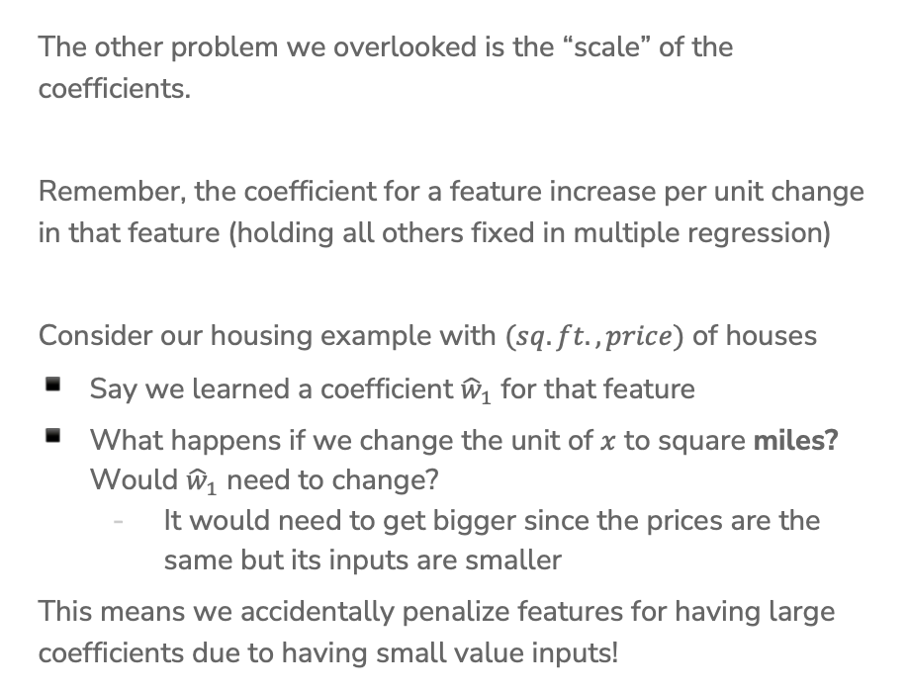
Scaling Features
The other problem we overlooked is the “scale” of the coefficients.
Remember, the coefficient for a feature increase per unit change in that feature (holding all others fixed in multiple regression)
Consider our housing example with $(sq. ft., price)$ of houses
Say we learned a coefficient ${\hat{w}}_{1}$ for that feature
What happens if we change the unit of $x$ to square miles? Would ${\hat{w}}_{1}$ need to change?
  It would need to get bigger since the prices are the same but its inputs are smaller
This means we accidentally penalize features for having large coefficients due to having small value inputs!

Slide 85
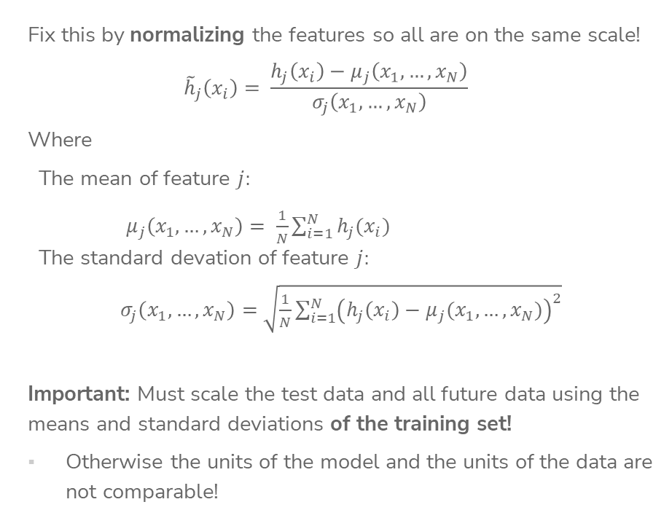
Scaling Features
Fix this by normalizing the features so all are on the same scale!
$${\tilde{h}}_{j}\left(x_{i}\right)= \frac{h_{j}\left(x_{i}\right)−μ_{j}\left(x_{1},…,x_{N}\right)}{σ_{j}\left(x_{1},…, x_{N}\right)}$$
Where
The mean of feature $j:$
$μ_{j}\left(x_{1},…,x_{N}\right)= \frac{1}{N}\sum_{i=1}^{N}{h_{j}(x_{i})}$
The standard devation of feature $j:$
$σ_{j}\left(x_{1},…,x_{N}\right)=\sqrt{\frac{1}{N}\sum_{i=1}^{N}{{\left(h_{j}\left(x_{i}\right)−μ_{j}(x_{1},…, x_{N})\right)}^{2}}}$
Important: Must scale the test data and all future data using the means and standard deviations of the training set!
Otherwise the units of the model and the units of the data are not comparable!

Slide 86
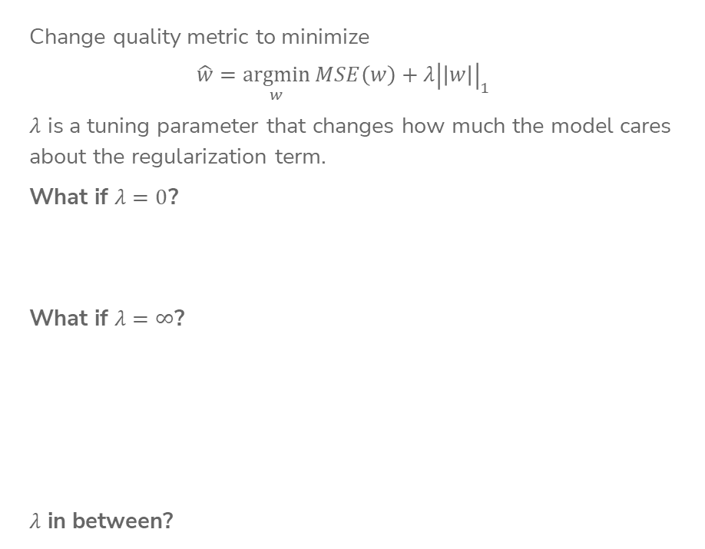
LASSO Regression
Change quality metric to minimize
$$\hat{w}=\underset{w}{argmin}{MSE\left(w\right)+λ{\left|\left|w\right|\right|}_{1}}$$
$λ$ is a tuning parameter that changes how much the model cares about the regularization term.
What if $λ=0$?
What if $λ=∞$?
$λ$ in between?
Notes:
TODO, pre-annotate

Slide 87


Ridge (L2) Coefficient Paths
Coefficients ${\hat{w}}_{j}$
$$λ$$

Slide 88
LASSO (L1) Coefficient Paths
Coefficients ${\hat{w}}_{j}$
$$λ$$

Slide 89
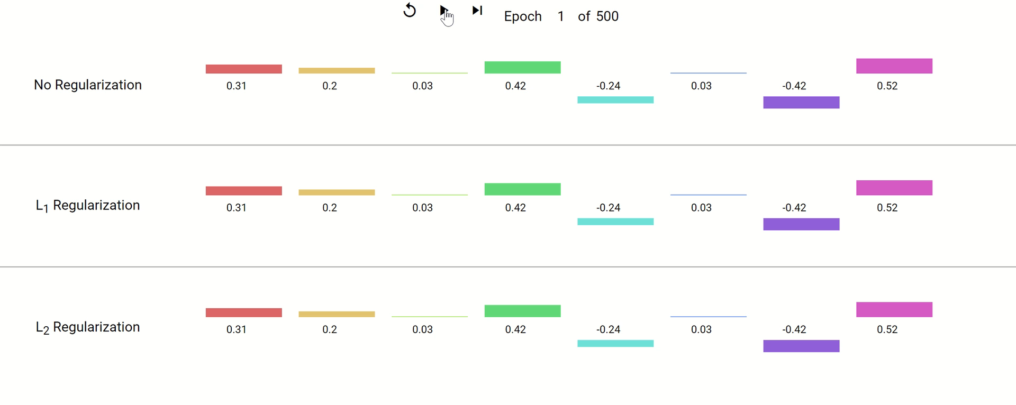
Coefficient Paths – Another View
Example from Google’s Machine Learning Crash Course
Notes:
Think of each epoch as taking one gradient descent step.
They don’t specify what the model is, but the concept of regularization is broader than just regression. Is often also applied to neural networks,
Key takeaways:
Regularized weights are smaller in magnitude.
L1 zeroes out weights, L2 keeps them around at really low values.

Slide 90
Demo
Similar demo to last time’s with Ridge but using the LASSO penalty

Slide 91
2 minutes
Why might the shape of the L1 penalty cause more sparsity than the L2 penalty?
No poll

Slide 92
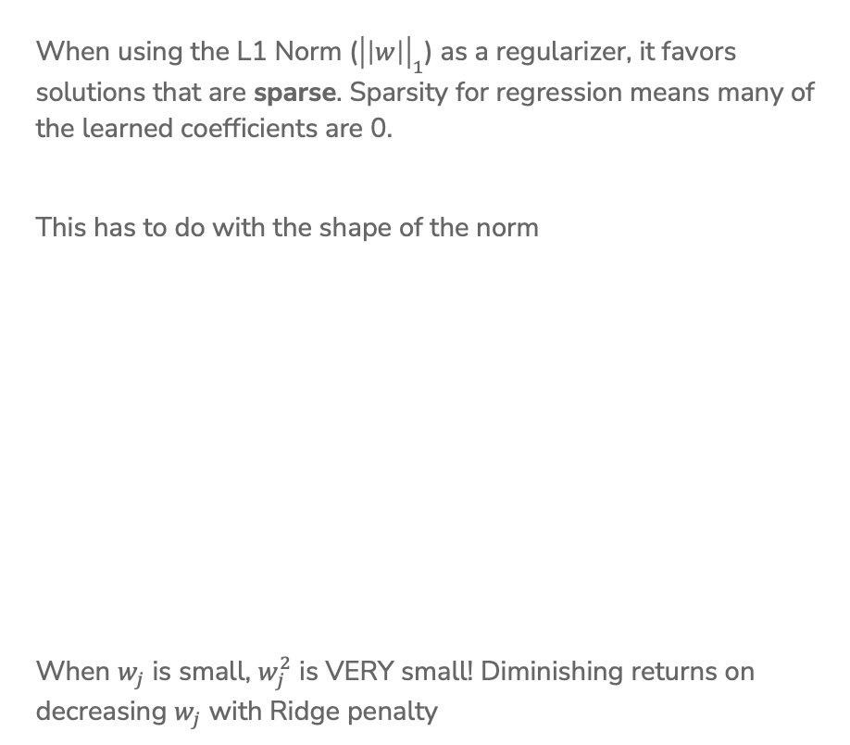
Sparsity
When using the L1 Norm (${\left|\left|w\right|\right|}_{1}$) as a regularizer, it favors solutions that are sparse. Sparsity for regression means many of the learned coefficients are 0.
This has to do with the shape of the norm
When $w_{j}$ is small, $w_{j}^{2}$ is VERY small! Diminishing returns on decreasing $w_{j}$ with Ridge penalty

Slide 93
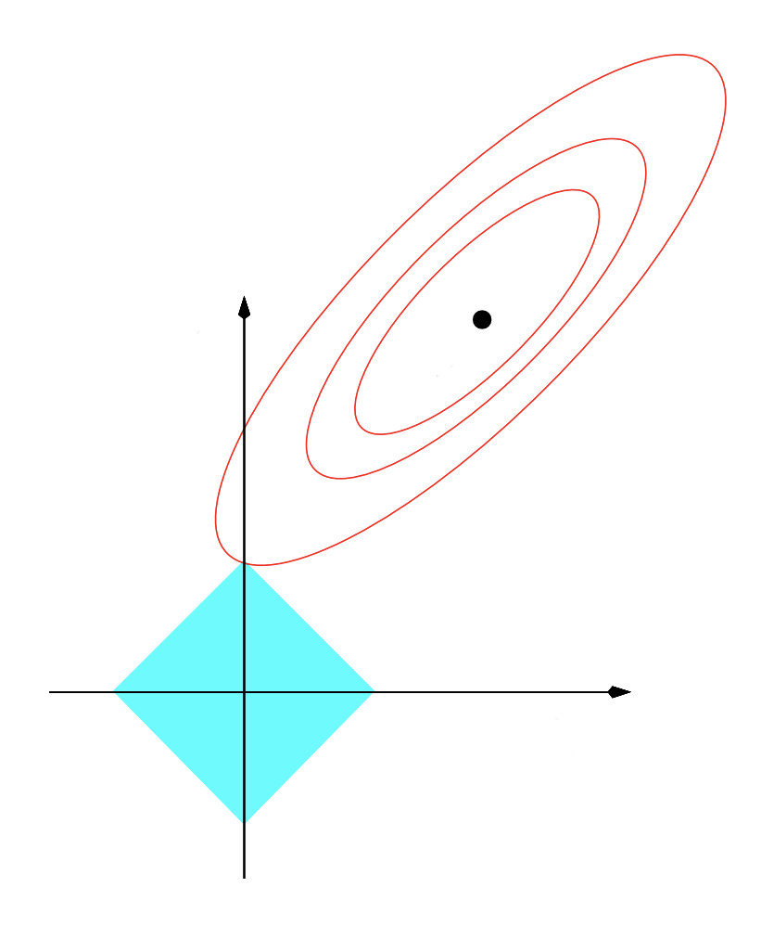







Sparsity Geometry
Another way to visualize why LASSO prefers sparse solutions
The L1 ball has spikes (places where some coefficients are 0)
$$w_{2}$$
$$w_{2}$$
$${\hat{w}}_{LS}$$
$${\hat{w}}_{LS}$$
$$w_{1}$$
$$w_{1}$$
$$L1$$
$$L2$$
Notes:
Another way to think about it: assume that instead of regularization being a soft constraint, it was a hard constraint, where we said that we want to pick the weights with the minimum MSE such that the norm of the coefficients have to be less than or equal to some budget.
In that case, the budgets will form these shapes, and the selected weights will be the ones with the minimum MSE within that shape.
Since L1 norm is diamond-shaped, it ends up being more likely that the minimum point of MSE will be along one of the corners, unlike the L2 which is a circle.
This is very informal intuition, not a formal proof.

Slide 94
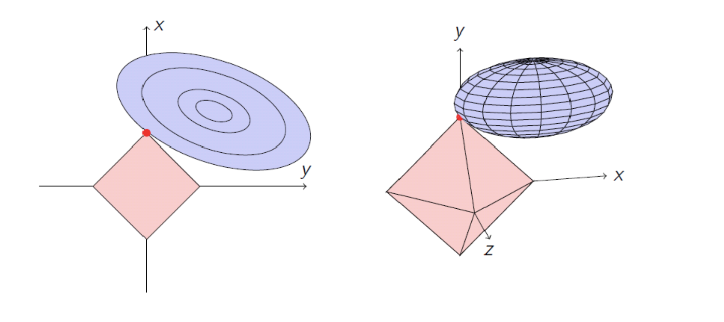


Sparsity Geometry
$L1$ (2 features)
$L1$ (3 features)

Slide 95


Slide 96
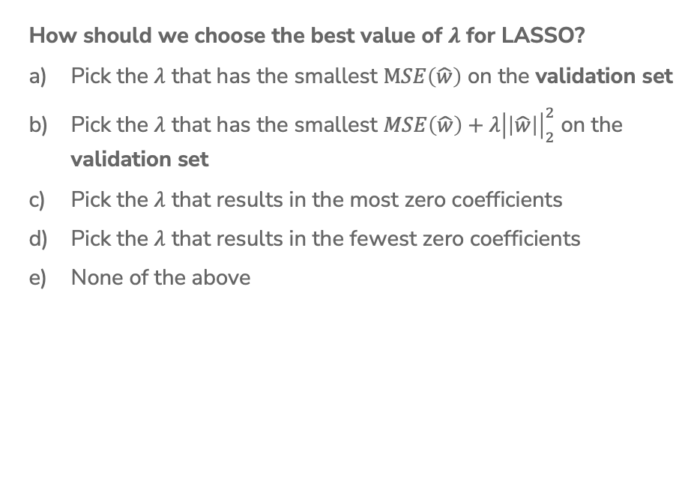
1 min
How should we choose the best value of $λ$ for LASSO?
Pick the $λ$ that has the smallest $MSE\left(\hat{w}\right)$ on the validation set
Pick the $λ$ that has the smallest $MSE\left(\hat{w}\right)+λ{\left|\left|\hat{w}\right|\right|}_{2}^{2}$ on the validation set
Pick the $λ$ that results in the most zero coefficients
Pick the $λ$ that results in the fewest zero coefficients
None of the above

Slide 97
Choosing $λ$
Exactly the same as Ridge Regression :)
This will be true for almost every hyper-parameter we talk about
A hyper-parameter is a parameter you specify for the model that influences which parameters (e.g. coefficients) are learned by the ML aglorithm

Slide 98
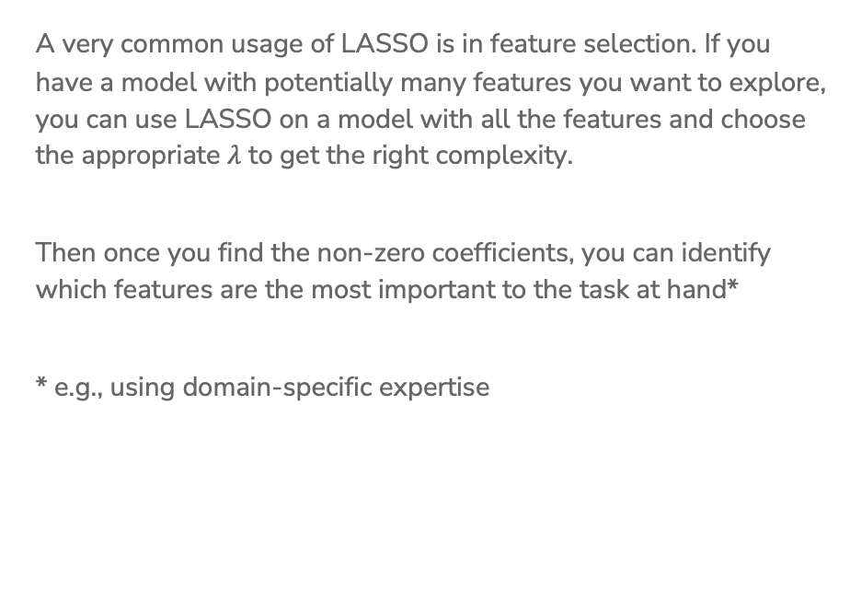
LASSO in Practice
A very common usage of LASSO is in feature selection. If you have a model with potentially many features you want to explore, you can use LASSO on a model with all the features and choose the appropriate $λ$ to get the right complexity.
Then once you find the non-zero coefficients, you can identify which features are the most important to the task at hand*
* e.g., using domain-specific expertise

Slide 99
ML Pipeline
- Deployment Bias
Training
Data
Pre-
Processing
x
ML
model
ŷ
⌃
- Historical Bias
- Representation Bias
- Measurement Bias
f
y
Optimization
algorithm
Quality
metric
99

Slide 100
De-biasing LASSO
LASSO (and Ridge) adds bias to the Least Squares solution (this was intended to avoid the variance that leads to overfitting)
Recall Bias-Variance Tradeoff
It’s possible to try to remove the bias from the LASSO solution using the following steps
Run LASSO to select which features should be used
(those with non-zero coefficients)
Run regular Ordinary Least Squares on the dataset with only those features
Coefficients are no longer shrunk from their true values

Slide 101
LASSO (L1) Coefficient Paths
Coefficients ${\hat{w}}_{j}$
$$λ$$

Slide 102
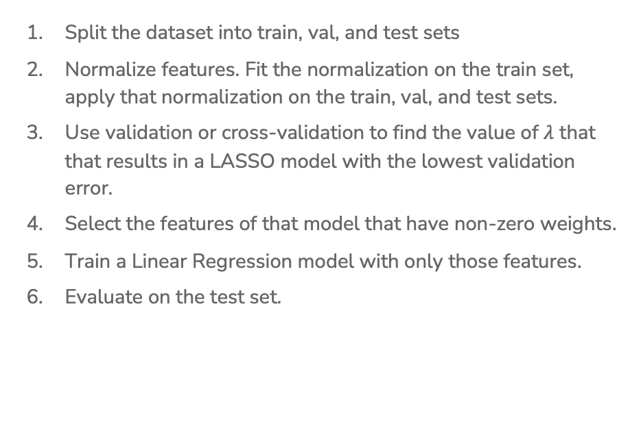
(De-biased) LASSO In Practice
Split the dataset into train, val, and test sets
Normalize features. Fit the normalization on the train set, apply that normalization on the train, val, and test sets.
Use validation or cross-validation to find the value of $λ$ that that results in a LASSO model with the lowest validation error.
Select the features of that model that have non-zero weights.
Train a Linear Regression model with only those features.
Evaluate on the test set.

Slide 103
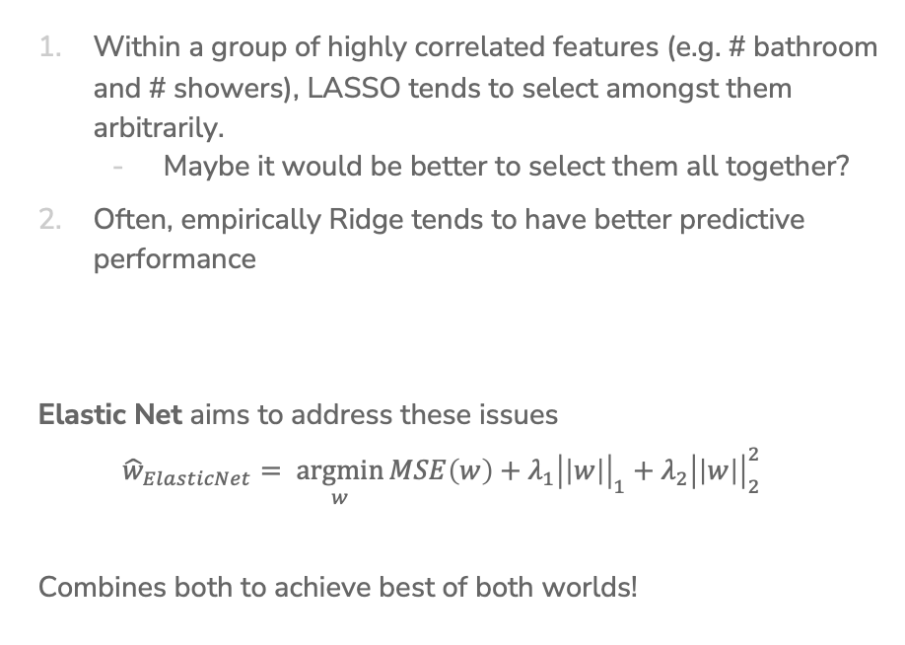
Issues with LASSO
Within a group of highly correlated features (e.g. # bathroom and # showers), LASSO tends to select amongst them arbitrarily.
  Maybe it would be better to select them all together?
Often, empirically Ridge tends to have better predictive performance
Elastic Net aims to address these issues
$${\hat{w}}_{ElasticNet}= \underset{w}{argmin}{MSE\left(w\right)+λ_{1}{\left|\left|w\right|\right|}_{1}+λ_{2}{\left|\left|w\right|\right|}_{2}^{2}}$$
Combines both to achieve best of both worlds!

Slide 104
A Big Grain of Salt
Be careful when interpreting the results of feature selection or feature importance in Machine Learning!
Selection only considers features included
Sensitive to correlations between features
Results depend on the algorithm used!
At the end of the day, the best models combine statistical insights with domain-specific expertise!

Slide 105
Differences between L1 and L2 regularizations
L1 (LASSO):
Introduces more sparsity to the model
Less sensitive to outliers
Helpful for feature selection, making the model more interpretable
More computational efficient as a model (due to the sparse solutions, so you have to compute less dot products)
L2 (Ridge):
Makes the weights small (but not 0)
More sensitive to outliers (due to the squared terms)
Usually works better in practice

Slide 106
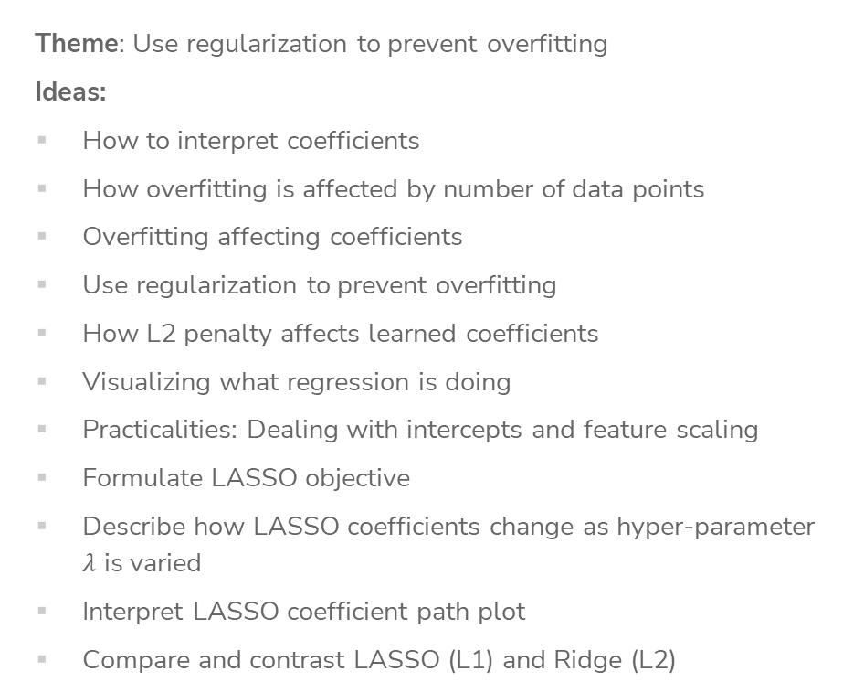
Recap
Theme: Use regularization to prevent overfitting
Ideas:
How to interpret coefficients
How overfitting is affected by number of data points
Overfitting affecting coefficients
Use regularization to prevent overfitting
How L2 penalty affects learned coefficients
Visualizing what regression is doing
Practicalities: Dealing with intercepts and feature scaling
Formulate LASSO objective
Describe how LASSO coefficients change as hyper-parameter $λ$ is varied
Interpret LASSO coefficient path plot
Compare and contrast LASSO (L1) and Ridge (L2)

