Slide 1
CSE/STAT 416
Other Clustering Methods
Pre-Class Videos
Tanmay Shah
Paul G. Allen School of Computer Science & Engineering
University of Washington
July 31, 2024

Slide 2
Pre-Class Video 1
Clustering Recap

Slide 3
Clustering

Slide 4
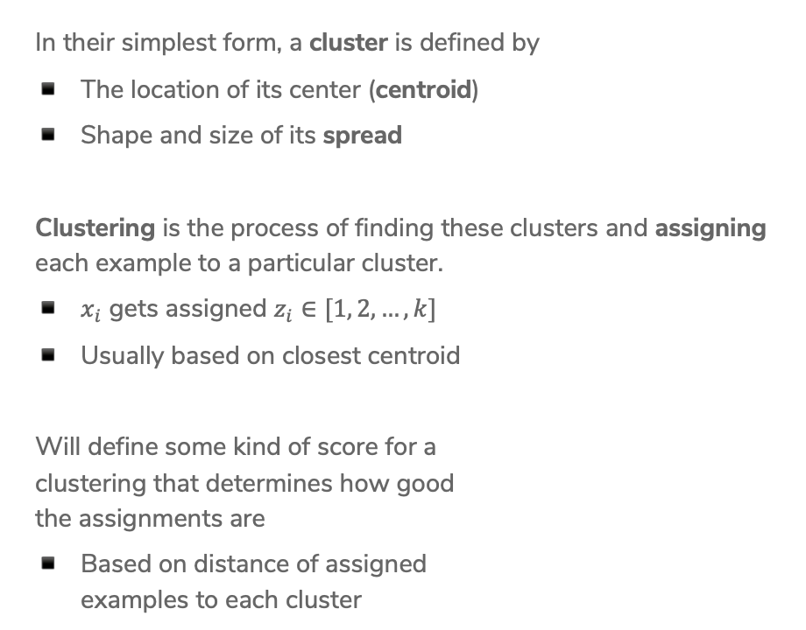
Define Clusters
In their simplest form, a cluster is defined by
The location of its center (centroid)
Shape and size of its spread
Clustering is the process of finding these clusters and assigning each example to a particular cluster.
$x_{i}$ gets assigned $z_{i}∈[1, 2, …,k]$
Usually based on closest centroid
Will define some kind of score for a
clustering that determines how good
the assignments are
Based on distance of assigned
examples to each cluster

Slide 5
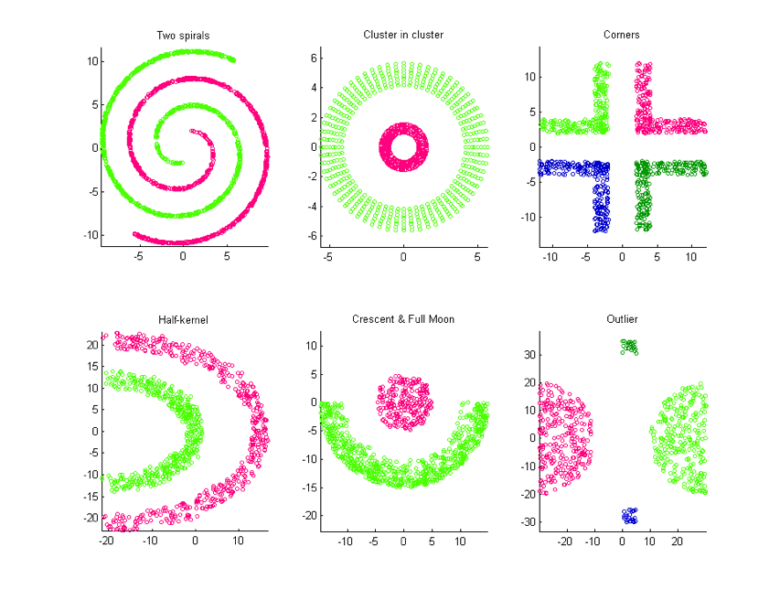
Not Always Easy
There are many clusters that are harder to learn with this setup
Distance does not determine clusters

Slide 6
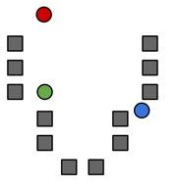



Step 0
Start by choosing the initial cluster centroids
A common default choice is to choose centroids at random
Will see later that there are smarter ways of initializing
$$μ_{2}$$
$$μ_{1}$$
$$μ_{3}$$

Slide 7
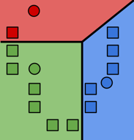

Step 1
Assign each example to its closest cluster centroid
$$z_{i}←\underset{j∈[k]}{argmin}{{\left|\left|μ_{j}−x_{i}\right|\right|}^{2}}$$
Notes:
Draw the distance between green point and all centroids
Looks like a decision boundary, but is inferred without labels!
Write “Voronoi tessellation”

Slide 8
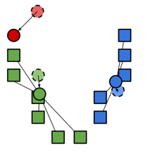

Step 2
Update the centroids to be the mean of all the points assigned to that cluster.
$$μ_{j}←\frac{1}{n_{j}}\sum_{i:z_{i}=j}{x_{i}}$$
Computes center of mass for cluster!

Slide 9
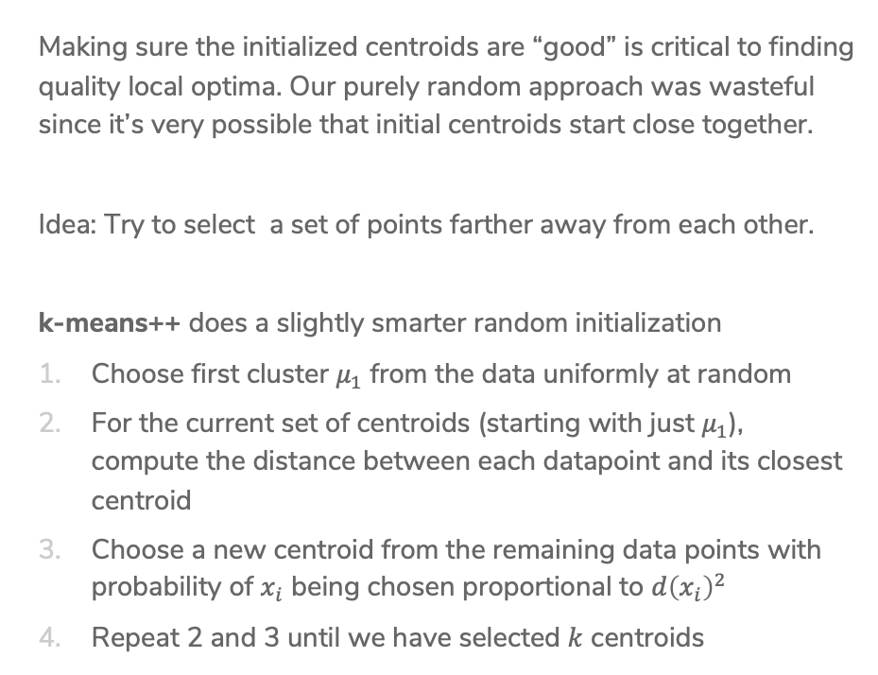
Smart Initializing w/ k-means++
Making sure the initialized centroids are “good” is critical to finding quality local optima. Our purely random approach was wasteful since it’s very possible that initial centroids start close together.
Idea: Try to select a set of points farther away from each other.
k-means++ does a slightly smarter random initialization
Choose first cluster $μ_{1}$ from the data uniformly at random
For the current set of centroids (starting with just $μ_{1}$), compute the distance between each datapoint and its closest centroid
Choose a new centroid from the remaining data points with probability of $x_{i}$ being chosen proportional to $d{\left(x_{i}\right)}^{2}$
Repeat 2 and 3 until we have selected $k$ centroids

Slide 10
Problems with k-means
In real life, cluster assignments are not always clear cut
E.g. The moon landing: Science? World News? Conspiracy?
Because we minimize Euclidean distance, k-means assumes all the clusters are spherical
We can change this with weighted Euclidean distance
Still assumes every cluster is the same shape/orientation

Slide 11
Failure Modes of k-means
If we don’t meet the assumption of spherical clusters, we will get unexpected results

Slide 12
Mixture Models
A much more flexible approach is modeling with a mixture model
Model each cluster as a different probability distribution and learn their parameters
E.g. Mixture of Gaussians
Allows for different cluster shapes and sizes
Typically learned using Expectation Maximization (EM) algorithm
Allows soft assignments to clusters
54% chance document is about world news, 45% science, 1% conspiracy theory, 0% other

Slide 13
Pre-Class Video 2
Divisive Clustering

Slide 14
Hierarchical Clustering

Slide 15
Nouns
Lots of data is hierarchical by nature
https://www.techleer.com/articles/478-insight-into-hierarchical-representations-through-poincare-embedding/

Slide 16
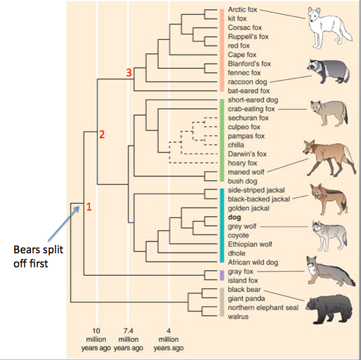
Species
https://www.instituteofcaninebiology.org/how-to-read-a-dendrogram.html

Slide 17
Motivation
If we try to learn clusters in hierarchies, we can
Avoid choosing the # of clusters beforehand
Use dendrograms to help visualize different granularities of clusters
Allow us to use any distance metric
  K-means requires Euclidean distance
Can often find more complex shapes than k-means
Notes:
It turns out that with some other distance functions, k-means may not converge. This reliance on Euclidean distance is also tied up with the heterogeneity bjective, which measures the within-cluster variance. https://stats.stackexchange.com/a/81496

Slide 18
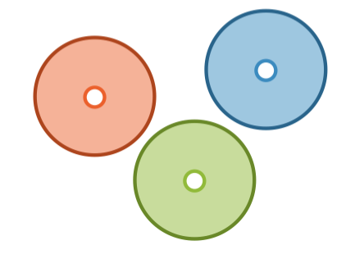
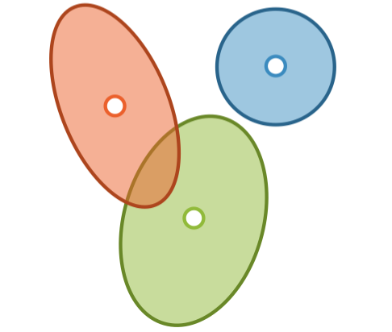
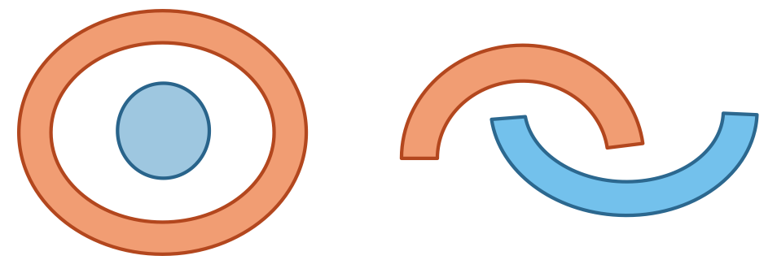
Finding Shapes
k-means
Mixture Models
Hierarchical Clustering
Notes:
Mutually exclusive spherical clusters can be found by both mixture models and hierarchical clustering.

Slide 19
Types of Algorithms
Divisive, a.k.a. top-down
Start with all the data in one big cluster and then recursively split the data into smaller clusters
  Example: recursive k-means
Agglomerative, a.k.a. bottom-up:
Start with each data point in its own cluster. Merge clusters until all points are in one big cluster.
  Example: single linkage clustering

Slide 20
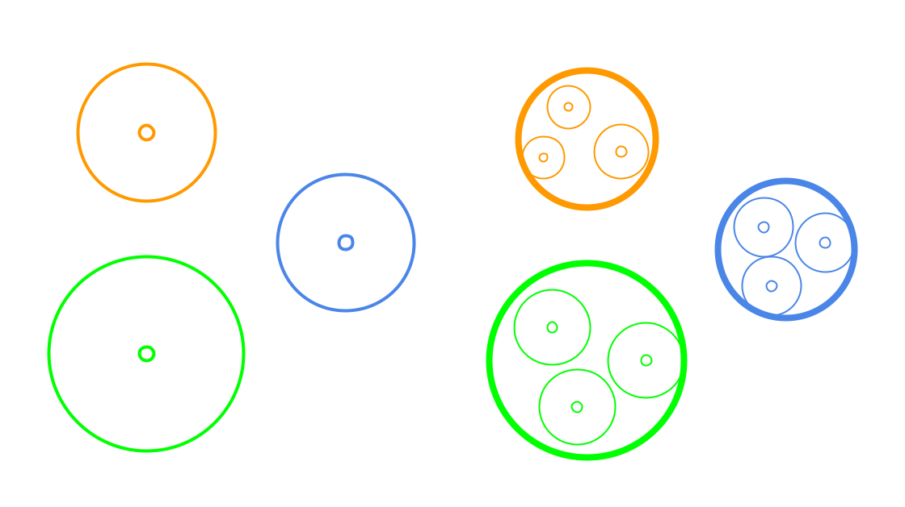
Divisive Clustering
Start with all the data in one cluster, and then repeatedly run k-means to divide the data into smaller clusters. Repeatedly run k-means on each cluster to make sub-clusters.

Slide 21
Example
Using Wikipedia

Slide 22
Choices to Make
For divisive clustering, you need to make the following choices:
Which algorithm to use (e.g., k-means)
How many clusters per split
When to split vs when to stop
  Max cluster size
  Number of points in cluster falls below threshold
  Max cluster radius
  distance to furthest point falls below threshold
  Specified # of clusters
  split until pre-specified # of clusters is reached

Slide 23
CSE/STAT 416
Other Clustering Methods
Tanmay Shah
Paul G. Allen School of Computer Science & Engineering
University of Washington
July 31, 2024
❓ Questions? Raise hand or sli.do #cs416
🎵 Listening to: Still Woozy

Slide 24
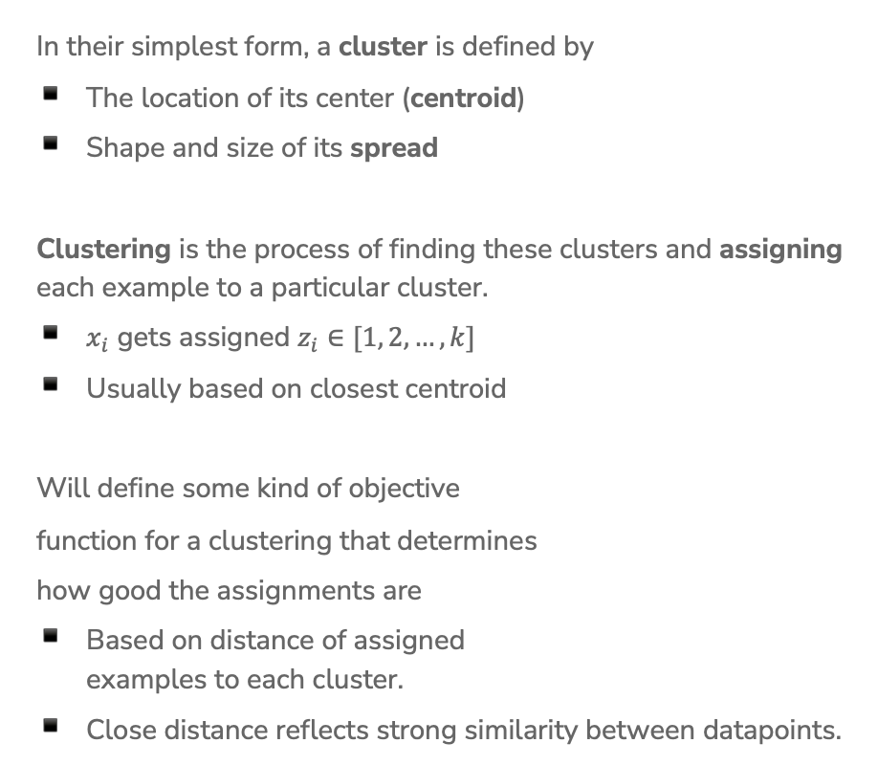
Define Clusters
In their simplest form, a cluster is defined by
The location of its center (centroid)
Shape and size of its spread
Clustering is the process of finding these clusters and assigning each example to a particular cluster.
$x_{i}$ gets assigned $z_{i}∈[1, 2, …,k]$
Usually based on closest centroid
Will define some kind of objective
function for a clustering that determines
how good the assignments are
Based on distance of assigned
examples to each cluster.
Close distance reflects strong similarity between datapoints.

Slide 25
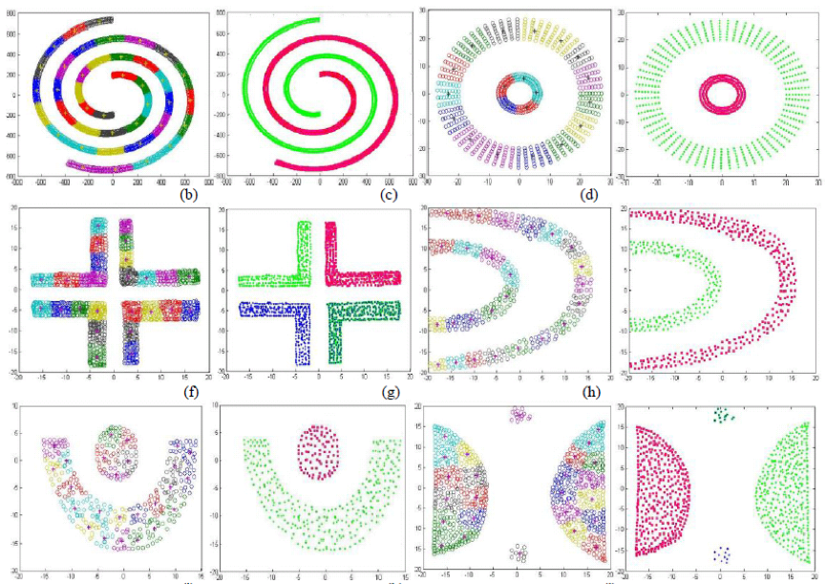
Not Always Easy
There are many clusters that are harder to learn with this setup
Distance does not determine clusters

Slide 26
Visualizing k-means
https://www.naftaliharris.com/blog/visualizing-k-means-clustering/

Slide 27
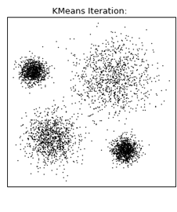
1.5 min
What convergence guarantees do you think we will have with k-means, given a sufficiently large number of iterations?
Converges to the global optimum
Converges to a local optima
None

Slide 28
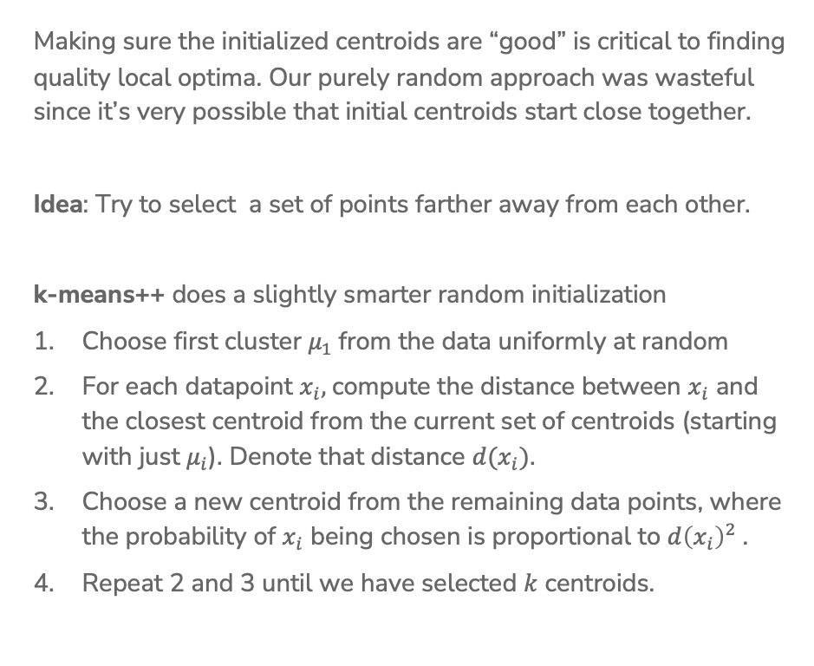
Smart Initializing w/ k-means++
Making sure the initialized centroids are “good” is critical to finding quality local optima. Our purely random approach was wasteful since it’s very possible that initial centroids start close together.
Idea: Try to select a set of points farther away from each other.
k-means++ does a slightly smarter random initialization
Choose first cluster $μ_{1}$from the data uniformly at random
For each datapoint $x_{i},$compute the distance between $x_{i}$ and the closest centroid from the current set of centroids (starting with just $μ_{i}$). Denote that distance $d(x_{i})$.
Choose a new centroid from the remaining data points, where the probability of $x_{i}$ being chosen is proportional to $d{\left(x_{i}\right)}^{2}$.
Repeat 2 and 3 until we have selected $k$ centroids.

Slide 29
Assessing Performance

Slide 30
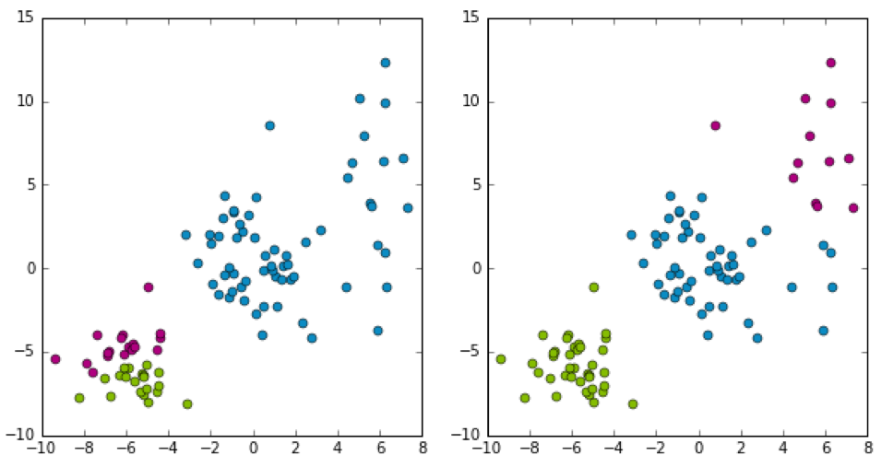
Which Cluster?
Which clustering would I prefer?
Don’t know, there is no “right answer” in clustering 🤷🏾‍♂️ .
Depends on the practitioner’s domain-specific knowledge and interpretation of results!

Slide 31
Which Cluster?
Which clustering does k-means prefer?
k-means is trying to optimize the heterogeneity objective
$$\underset{z,μ}{argmin}\sum_{j=1}^{k}{\sum_{i=1}^{n}{{1\left\{z_{i}=j\right\}\left|\left|μ_{j}−x_{i}\right|\right|}_{2}^{2}}}$$
Notes:
Write sum over clusters
Write sum of distances to centroid
Write lower is better

Slide 32
Coordinate Descent
k-means is trying to minimize the heterogeneity objective
$$\underset{z, μ}{argmin}\sum_{j=1}^{k}{\sum_{i=1}^{n}{{1\left\{z_{i}=j\right\}\left|\left|μ_{j}−x_{i}\right|\right|}_{2}^{2}}}$$
Step 0: Initialize cluster centers
Repeat until convergence:
Step 1: Assign each example to its closest cluster centroid
Step 2: Update the centroids to be the mean of all the points
assigned to that cluster
Coordinate Descent alternates how it updates parameters to find minima. On each of iteration of Step 1 and Step 2, heterogeneity decreases or stays the same.
=> Will converge in finite time

Slide 33
1 min
Consider training k-means to convergence for different values of k. Which of the following graphs shows how the heterogeneity objective will change based on the value of k?
Lowest objective value
Lowest objective value
A
B
Lowest objective value
Lowest objective value
C
D

Slide 34
2 mins
Consider training k-means to convergence for different values of k. Which of the following graphs shows how the heterogeneity objective will change based on the value of k?
Lowest objective value
Lowest objective value
A
B
Lowest objective value
Lowest objective value
C
D

Slide 35
How to Choose k?
No right answer! Depends on your application.
General, look for the “elbow” in the graph
Note: You will usually have to run k-means multiple times for each k
Notes:
Draw in curve
Write: ”In extreme when k=N, heterogeneity will be 0”
Point out elbow

Slide 36
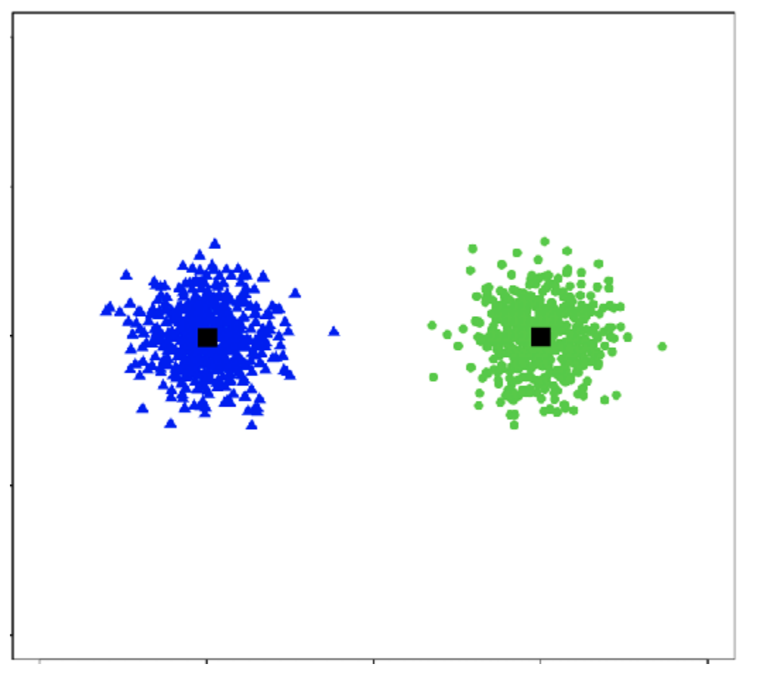
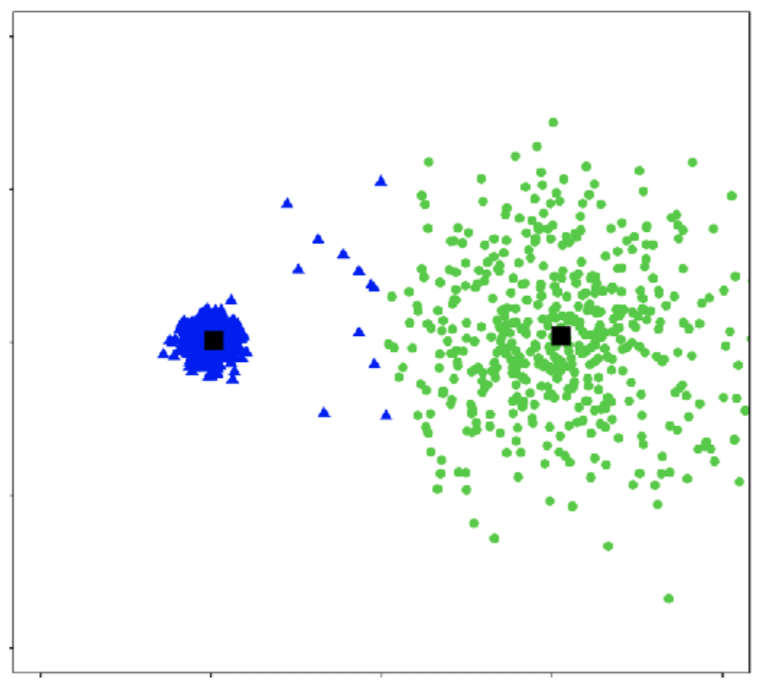
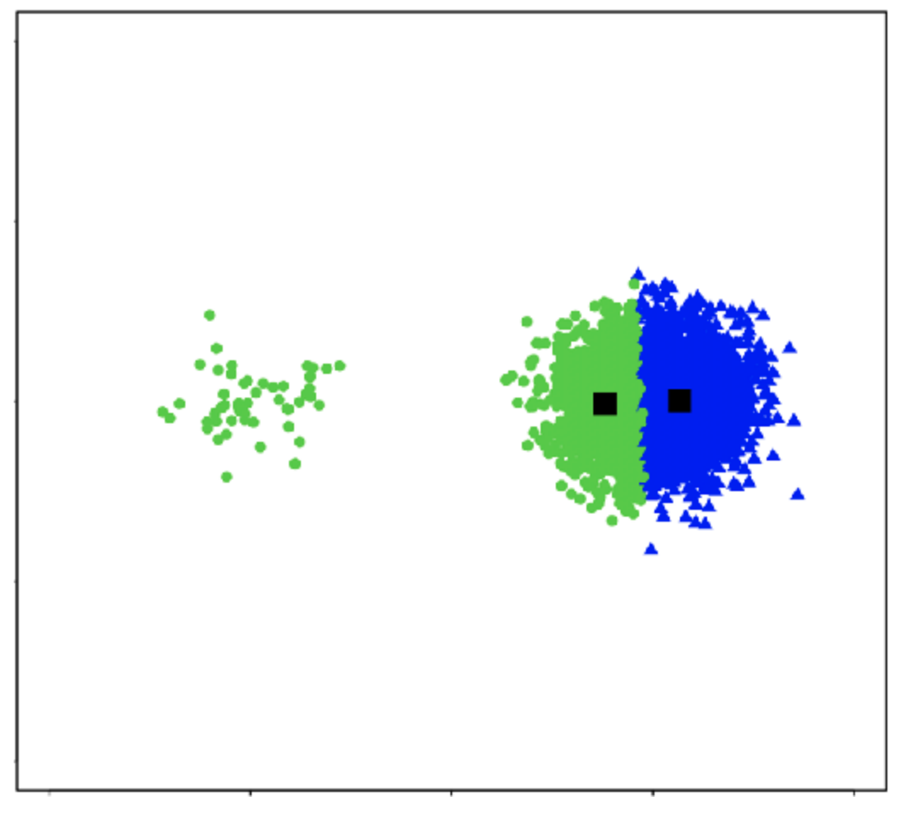
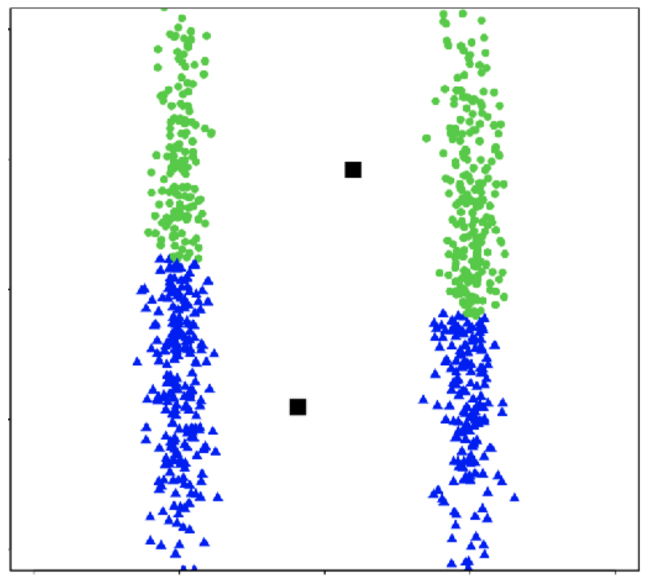
Cluster shape
k-means works well for well-separated hyper-spherical clusters of the same size

Slide 37
Clustering vs
Classification
Clustering looks like we assigned labels (by coloring or numbering different groups) but we didn’t use any labeled data.
In clustering, the “labels” don’t have meaning. To give meaning to the labels, human inputs is required
Classification learns from minimizing the error between a prediction and an actual label.
Clustering learns by minimizing the distance between points in a cluster.
Classification quality metrics (accuracy / loss) do not apply to clustering (since there is no label).
You can’t use validation set / cross-validation to choose the best choice of k for clustering.

Slide 38
Recap
Differences between classification and clustering
What types of clusters can be formed by k-means
K-means algorithm
Convergence of k-means
How to choose k
Better initialization using k-means++

Slide 39
Failure Modes of k-means
If we don’t meet the assumption of spherical clusters, we will get unexpected results
Notes:
WOS:
Soft clustering: allow overlap
Hard clustering: no overlap

Slide 40
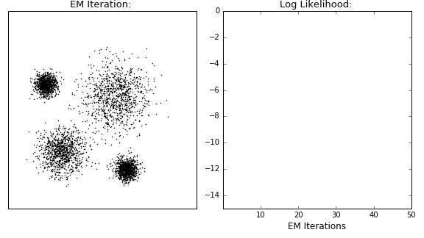
Visualizing Gaussian Mixture Models
Notes:
WOS: MLE

Slide 41
Nouns
Lots of data is hierarchical by nature
https://www.techleer.com/articles/478-insight-into-hierarchical-representations-through-poincare-embedding/

Slide 42
Types of Algorithms
Divisive, a.k.a. top-down
Start with all the data in one big cluster and then recursively split the data into smaller clusters
  Example: recursive k-means
Agglomerative, a.k.a. bottom-up:
Start with each data point in its own cluster. Merge clusters until all points are in one big cluster.
  Example: single linkage clustering

Slide 43
Divisive Clustering
Start with all the data in one cluster, and then repeatedly run k-means to divide the data into smaller clusters. Repeatedly run k-means on each cluster to make sub-clusters.

Slide 44
Example
Using Wikipedia

Slide 45
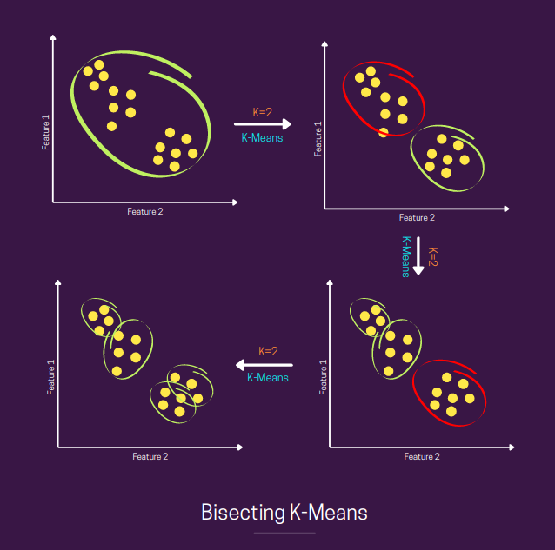
Bisecting K-Means
Notes:
Source: https://towardsdatascience.com/bisecting-k-means-algorithm-clustering-in-machine-learning-1bd32be71c1c

Slide 46
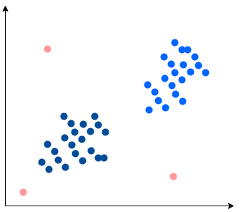
1 min
You want to detect outliers in a dataset (shown below).
  How would you use k-means clustering to detect outliers?
  How would you use divisive clustering to detect outliers?
Notes:
Picture Source: https://www.baeldung.com/cs/ml-outlier-detection-handling

Slide 47
2 min
You want to detect outliers in a dataset (shown below).
  How would you use k-means clustering to detect outliers?
  How would you use divisive clustering to detect outliers?
Notes:
K-means:
For each cluster, find the points that are the farthest away from the centroids. Call them outliers.
Divisive:
Find the points that split off of a big cluster early on, call them outliers.

Slide 48
Agglomerative Clustering

Slide 49
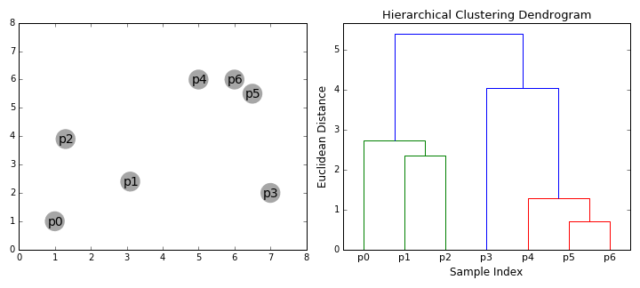
Agglomerative Clustering

Slide 50
Agglomerative Clustering
Algorithm at a glance
Initialize each point in its own cluster
Define a distance metric between clusters
While there is more than one cluster
  Merge the two closest clusters
Notes:
WOS:
N points => n clusters

Slide 51
Step 1

Slide 52
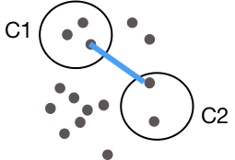

Step 2
2. Define a distance metric between clusters
This formula means we are defining the distance between two clusters as the smallest distance between any pair of points between the clusters.
Single Linkage
$$distance\left(C_{1}^{},C_{2}^{}\right)=\min_{x_{i}^{}∈C_{1}^{},x_{j}^{}∈C_{2}^{}}{d\left(x_{i}^{},x_{j}^{}\right)}$$
Notes:
Write box around min stuff to label “linkage criterion”
Draw arrow to d to point out “specified distance function”

Slide 53

Step 3
Merge closest pair of clusters
Notes:
WOS:
Try all pairs of clusters
Evaluate cluster distance
Min_{x_i\in c_1, x_j\in d_2} dist(x_i, x_j)
Merge closest clusters

Slide 54
Repeat

Slide 55

Repeat
Notice that the height of the dendrogram is growing as we group points farther from each other

Slide 56
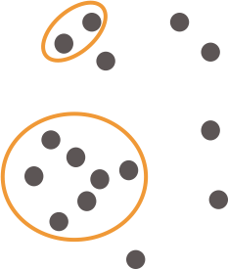

Repeat

Slide 57
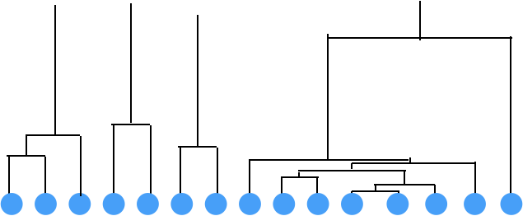
Repeat
Looking at the dendrogram, we can see there is a bit of an outlier!
Can tell by seeing a point join a
cluster with a really large distance.
Notes:
WOS:
Distance between merged clusters

Slide 58
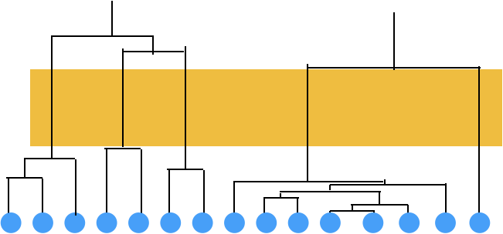
Repeat
The tall links in the dendrogram show us we are merging clusters that are far away from each other

Slide 59
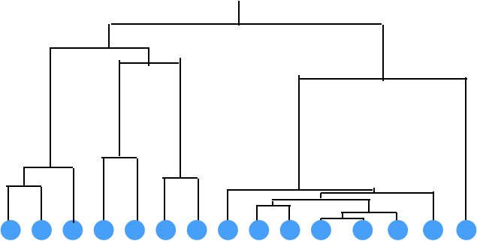
Repeat
Final result after merging all clusters

Slide 60
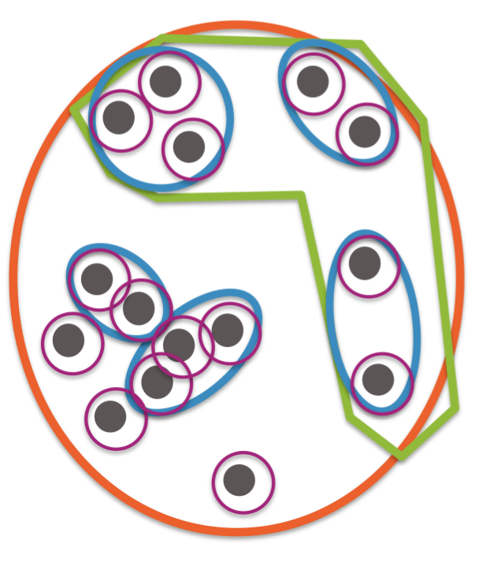
Final Result

Slide 61
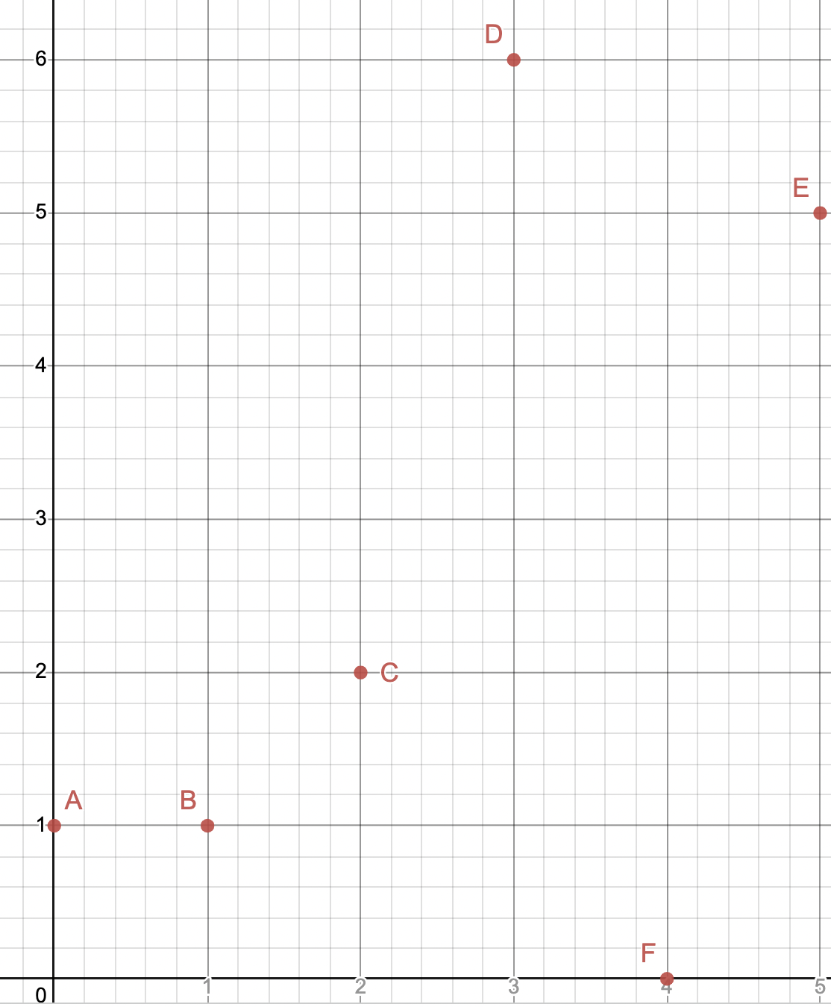
1 min
In what order will the following points get merged into clusters? Use L2 (Euclidean) distance, and the single linkage function.

Slide 62
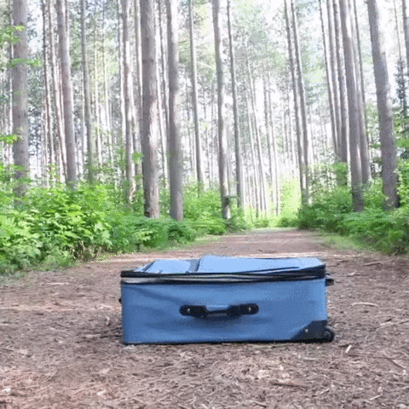

Slide 63
Dendrograms

Slide 64
Agglomerative Clustering
With agglomerative clustering, we are now very able to learn weirder clusterings like
Notes:
Draw small clusters that single linkeabe would merge

Slide 65
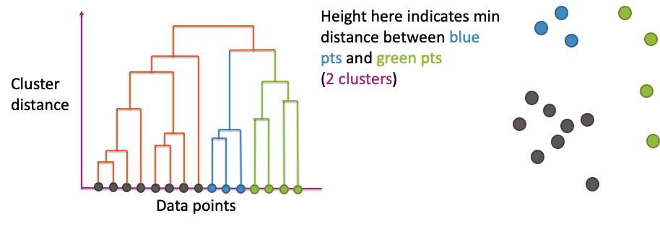
Dendrogram
x-axis shows the datapoints (arranged in a very particular order)
y-axis shows distance between merged clusters
Notes:
WOS:
Show alpha (merging 2 blues), b (merging next blue), and d (merging pairs of green)

Slide 66
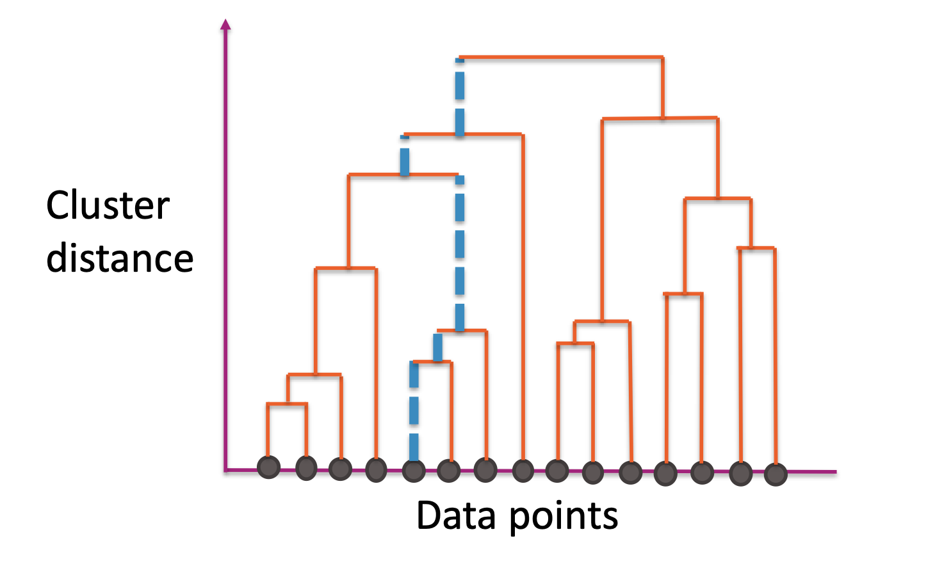
Dendrogram
The path shows you all clusters that a single point belongs and the order in which its clusters merged
Notes:
WOS: Draw the clusters that these points belong to
Given two points, you can find where in the dendogram they merged together

Slide 67
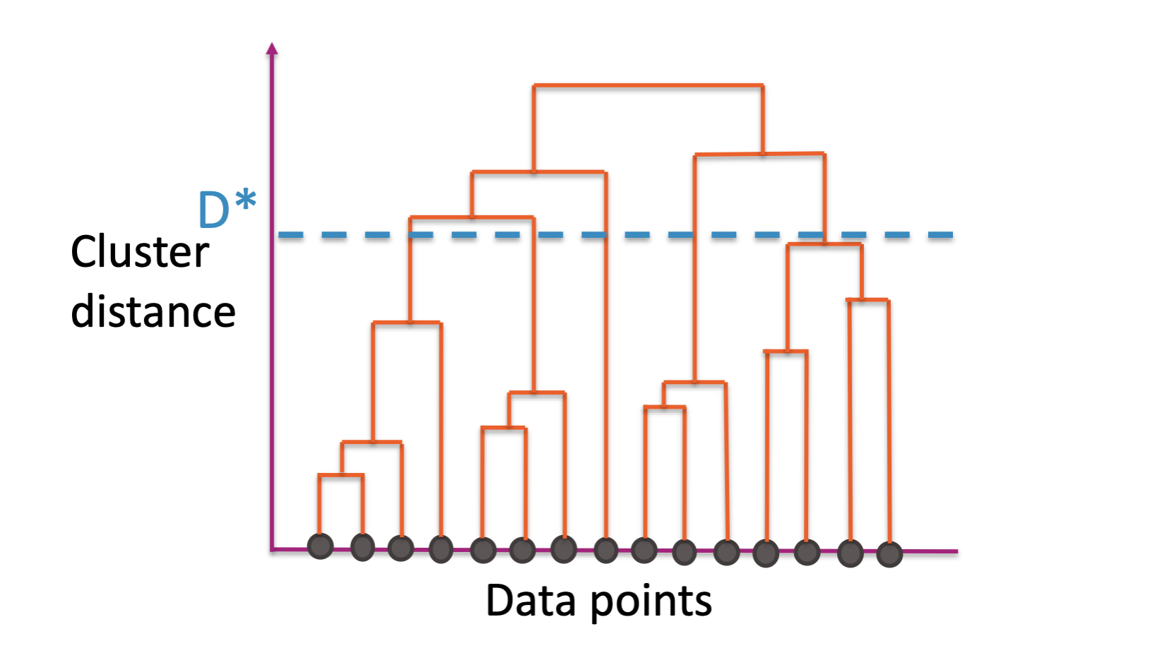

Cut Dendrogram
Choose a distance $D^{∗}$ to “cut” the dendrogram
Use the largest clusters with distance < $D^{∗}$
Usually ignore the idea of the nested clusters after cutting

Slide 68
1 min
How many clusters would we have if we use this threshold?

Slide 69
2 min
How many clusters would we have if we use this threshold?

Slide 70
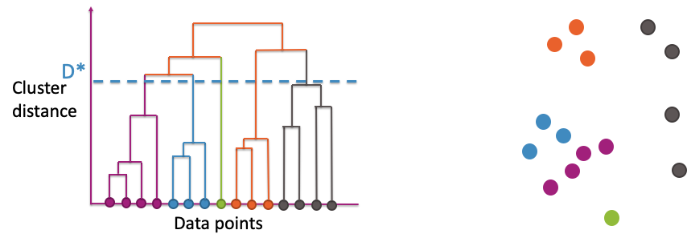

Cut Dendrogram
Every branch that crosses $D^{∗}$ becomes its own cluster
Notes:
Hide this slide when printing

Slide 71
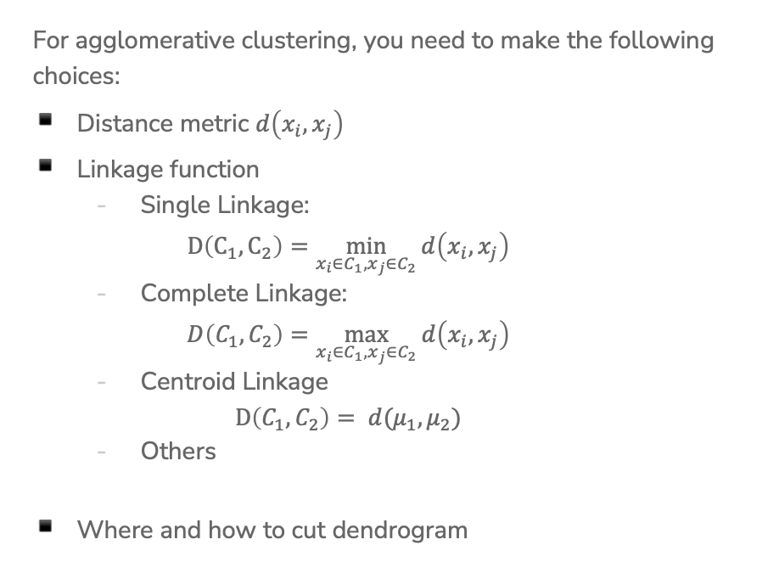
Choices to Make
For agglomerative clustering, you need to make the following choices:
Distance metric $d\left(x_{i}, x_{j}\right)$
Linkage function
  Single Linkage:
  $D\left(C_{1},C_{2}\right)=\min_{x_{i}∈C_{1},x_{j}∈C_{2}}{d\left(x_{i}, x_{j}\right)}$
  Complete Linkage:
  $D\left(C_{1}, C_{2}\right)=\max_{x_{i}∈C_{1},x_{j}∈C_{2}}{d\left(x_{i}, x_{j}\right)}$
  Centroid Linkage
  $D\left(C_{1},C_{2}\right)= d(μ_{1},μ_{2})$
  Others
Where and how to cut dendrogram

Slide 72
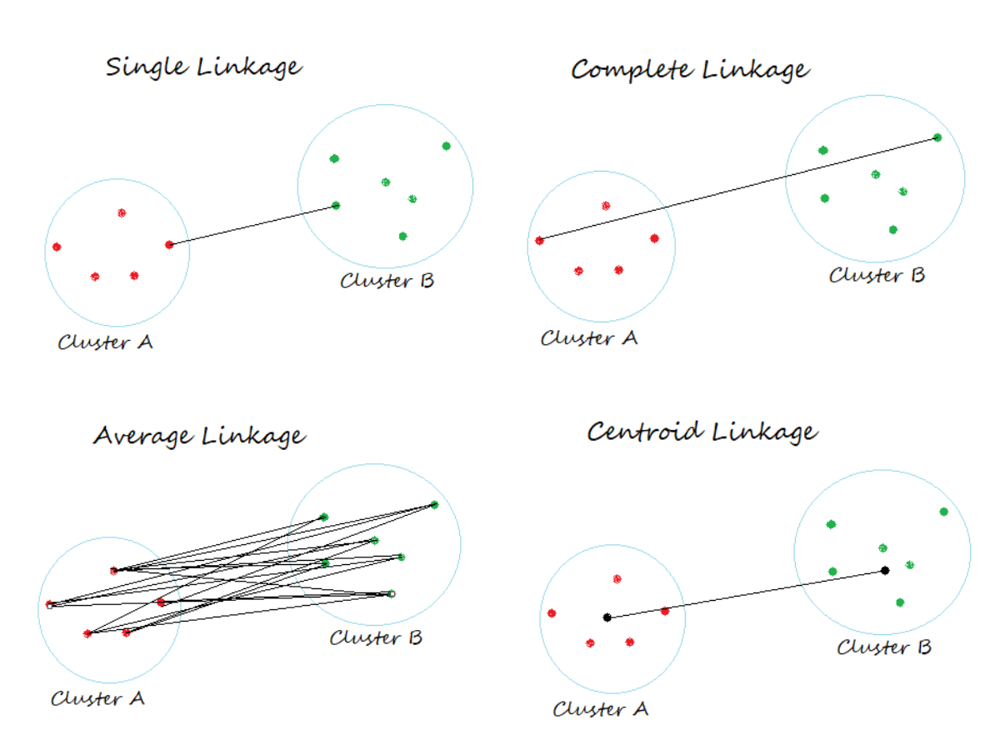
Linkage Functions

Slide 73
Practical Notes
For visualization, generally a smaller # of clusters is better
For tasks like outlier detection, cut based on:
Distance threshold
Or some other metric that tries to measure how big the distance increased after a merge
No matter what metric or what threshold you use, no method is “incorrect”. Some are just more useful than others.

Slide 74
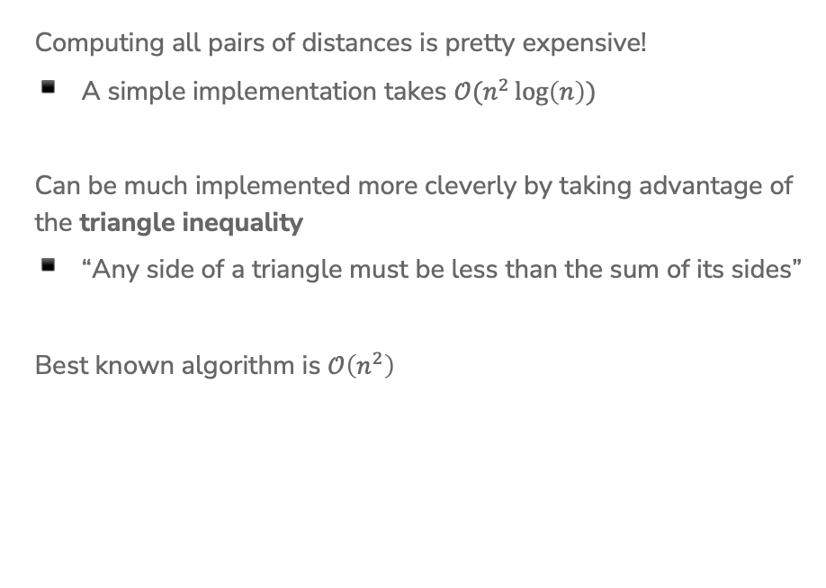
Computational Cost of Agglomerative
Clustering
Computing all pairs of distances is pretty expensive!
A simple implementation takes $𝒪(n^{2}\log\left(n\right))$
Can be much implemented more cleverly by taking advantage of the triangle inequality
“Any side of a triangle must be less than the sum of its sides”
Best known algorithm is $𝒪\left(n^{2}\right)$
Notes:
WOS:
N points => n(n-1)/2 ~ n^2 pairs of points
Draw triangle, C < A+B

Slide 75
k-means vs. Agglomerative
Clustering
K-means is more efficient on big data than hierarchical clustering.
Initialization changes results in k-means, not in agglomerative clustering has reproducible results.
K-means works well only for hyper-spherical clusters, agglomerative clustering can handle more complex cluster shapes.
K-means requires selecting a number of clusters beforehand. In agglomerative clustering, you can decide on the number of clusters afterwards using the dendrogram.
Notes:
K-means is O(nkI), heirarchiccal is O(n^2)

Slide 76
Concept Inventory
This week we want to practice recalling vocabulary. Spend 10 minutes trying to write down all the terms for concepts we have learned in this class and try to bucket them into the following categories.
Regression
Classification
Deep Learning
Document Retrieval
Misc – For things that fit in multiple places or none of the above
You don’t need to define/explain the terms for this exercise, but you should know what they are!
Try to do this for at least 5 minutes from recall before looking at your notes!

Slide 77
Recap
Problems with k-means
Mixture Models
Hierarchical clustering
Divisive Clustering
Agglomerative Clustering
Dendrograms

