Slide 1
CSE/STAT 416 k-means Clustering
Tanmay Shah
Paul G. Allen School of Computer Science & Engineering
University of Washington
July 29, 2024
❓ Questions? Raise hand

Slide 2
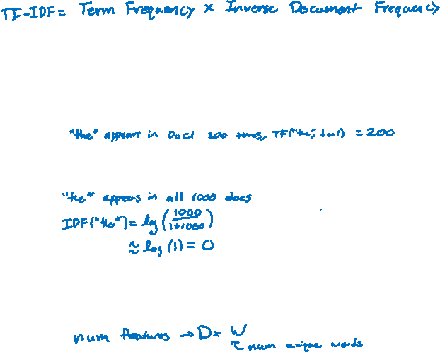
TF-IDF
Goal: Emphasize important words
Appear frequently in the document (common locally)
Appears rarely in the corpus (rare globally)
Do a pair-wise multiplication to compute the TF-IDF for each word
Words that appear in every document will have a small IDF making the TF-IDF small!

Slide 3

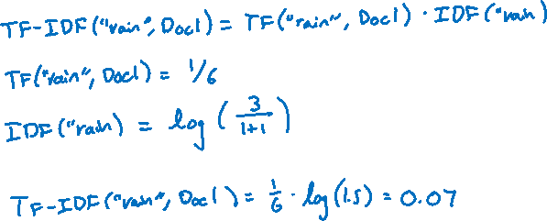
1.5 min
What is the $TF−IDF(“rain”, Doc_{1})$ with the following documents (assume standard pre-processing)
Doc 1: It is going to rain today.
Doc 2: Today I am not going outside.
Doc 3: I am going to watch the season premiere.
Notes:
Full example: https://medium.com/analytics-vidhya/tf-idf-term-frequency-technique-easiest-explanation-for-text-classification-in-nlp-with-code-8ca3912e58c3
Answer: (1/6) * log(3/2) = 0.07

Slide 4
Some Issues
How do we find a good line that divides the data in half?
Potential Errors: Points close together might be split up into separate bins
Large computation cost: Only dividing the points in half doesn’t speed things up that much…

Slide 5
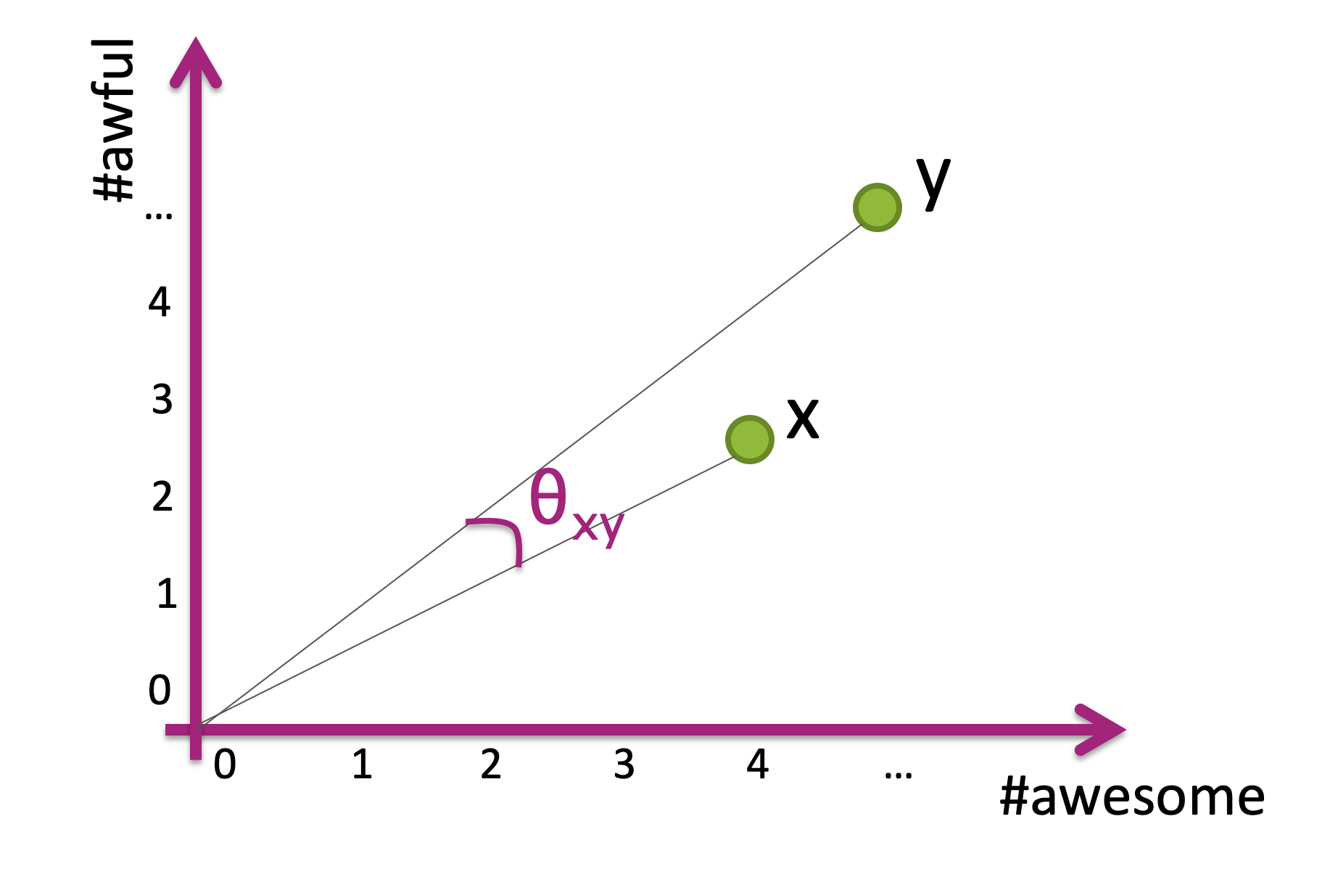
1. How to choose line?
Wild Idea: Choose the line randomly!
Choose a slope randomly between 0 and 90 degrees
How bad can randomly picking it be?
If two points have a small cosine distance, it is unlikely that we will split them into different bins!
Notes:
Draw random lines

Slide 6
Some Issues
How do we find a good line that divides the data in half?
Potential Errors: Points close together might be split up into separate bins
Large computation cost: Only dividing the points in half doesn’t speed things up that much…

Slide 7
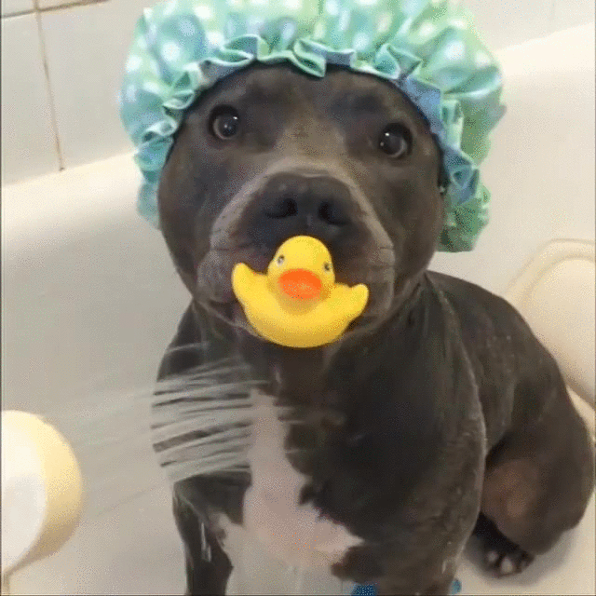

Slide 8
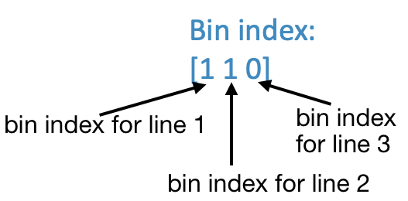
More Bins
Can reduce search cost by adding more lines, increasing the number of bins.
For example, if we use 3 lines, we can make more bins!

Slide 9
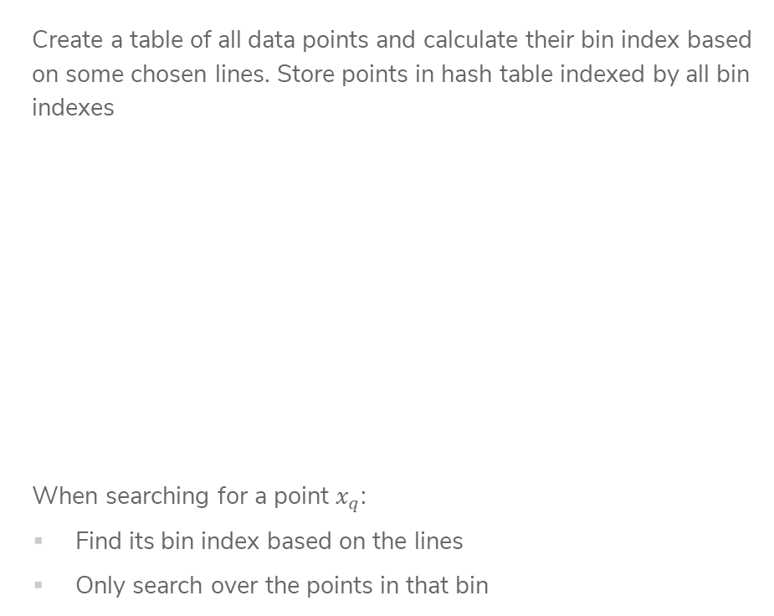
LSH with
Many Bins
Create a table of all data points and calculate their bin index based on some chosen lines. Store points in hash table indexed by all bin indexes
When searching for a point $x_{q}$:
Find its bin index based on the lines
Only search over the points in that bin
Notes:
Note about binary

Slide 10
LSH Example
Imagine my query point was (2, 2)
This has bin index [0 1 0]
By using multiple bins, we have reduced the search time!
However, it’s more likely that we separate points from their true nearest neighbors since we do more splits ☹
Often with approximate methods, there is a tradeoff between speed and accuracy.

Slide 11
Improve Quality
The nice thing about LSH is we can actually tune this tradeoff by looking at nearby bins. If we spend longer searching, we are likely to find a better answer.
What does ”nearby” mean for bins?
In practice, set some time “budget” and
keep searching nearby bins until budget
runs out
Notes:
Draw going out to 2 bits

Slide 12
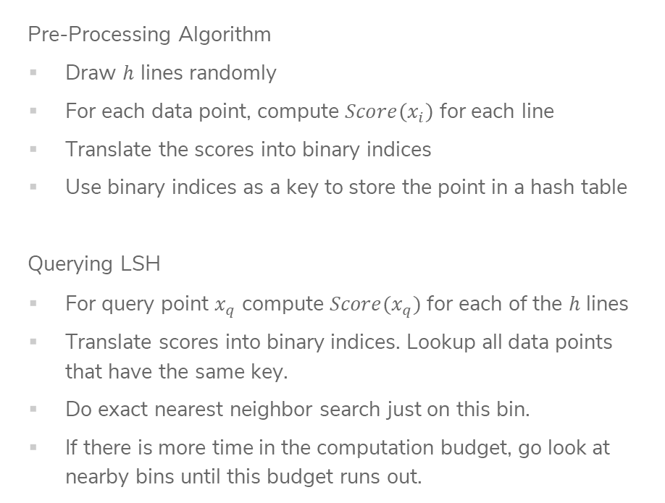
Locality Sensitive Hashing (LSH)
Pre-Processing Algorithm
Draw $h$ lines randomly
For each data point, compute $Score\left(x_{i}\right)$ for each line
Translate the scores into binary indices
Use binary indices as a key to store the point in a hash table
Querying LSH
For query point $x_{q}$ compute $Score(x_{q})$ for each of the $h$ lines
Translate scores into binary indices. Lookup all data points that have the same key.
Do exact nearest neighbor search just on this bin.
If there is more time in the computation budget, go look at nearby bins until this budget runs out.

Slide 13
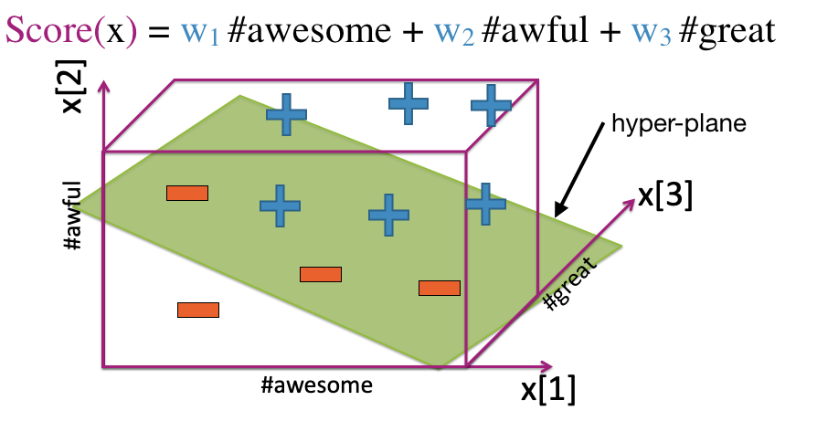

Higher Dimensions
Pick random hyper-plane to separate points for points in higher dimensions.
Unclear how to pick $h$ for LSH and you can’t do cross-validation here (why?)
Generally people use $h≈\log{(d)}$

Slide 14
Recap
Theme: Use local methods for classification and regression and speed up nearest neighbor search with approximation methods.
Ideas:
1-NN Regression and Classification
k-NN Regression and Classification
Weighted k-NN vs Kernel Regression
Locality Sensitive Hashing

Slide 15
Curse of Dimensionality

Slide 16
High Dimensions
Methods like k-NN and k-means that rely on computing distances start to struggle in high dimensions.
As the number of dimensions grow, the data gets sparser!
Need more data to make sure you cover all the space in high dim.
Notes:
To cover 20% of the range, need 20% of the complete population
If we add another feature but still want to cover 20% of the possible space, would need 45% coverage for each feature! (0.45^2 = 0.2)
In 3 dimensions, would need coverage over 58% of each feature
Write down that n approx. O(2^d)

Slide 17
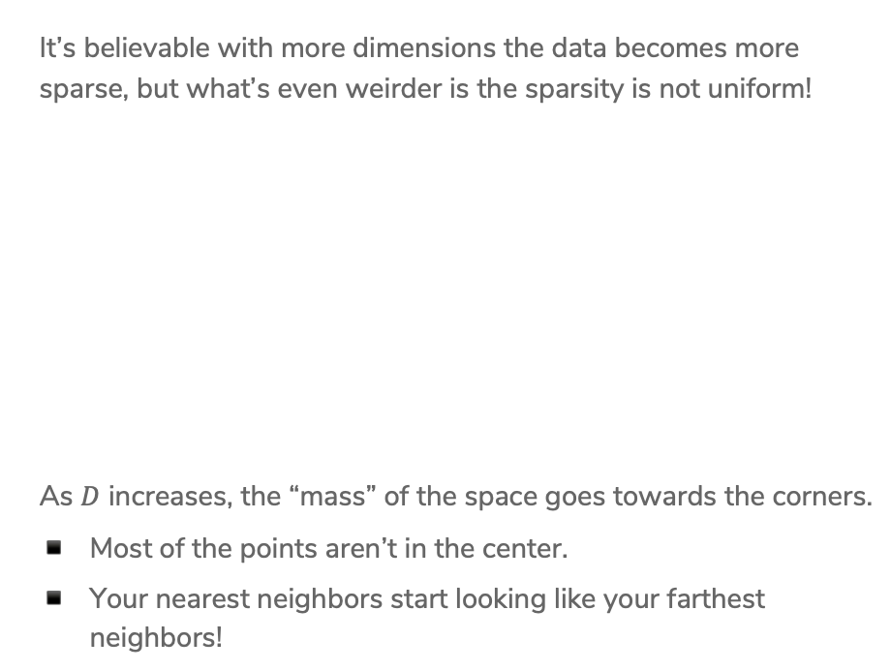
Even Weirder
It’s believable with more dimensions the data becomes more sparse, but what’s even weirder is the sparsity is not uniform!
As $D$ increases, the “mass” of the space goes towards the corners.
Most of the points aren’t in the center.
Your nearest neighbors start looking like your farthest neighbors!
Notes:
For an 8-dimensional hypercube, about 98% of the data is concentrated in its 256 corners.

Slide 18
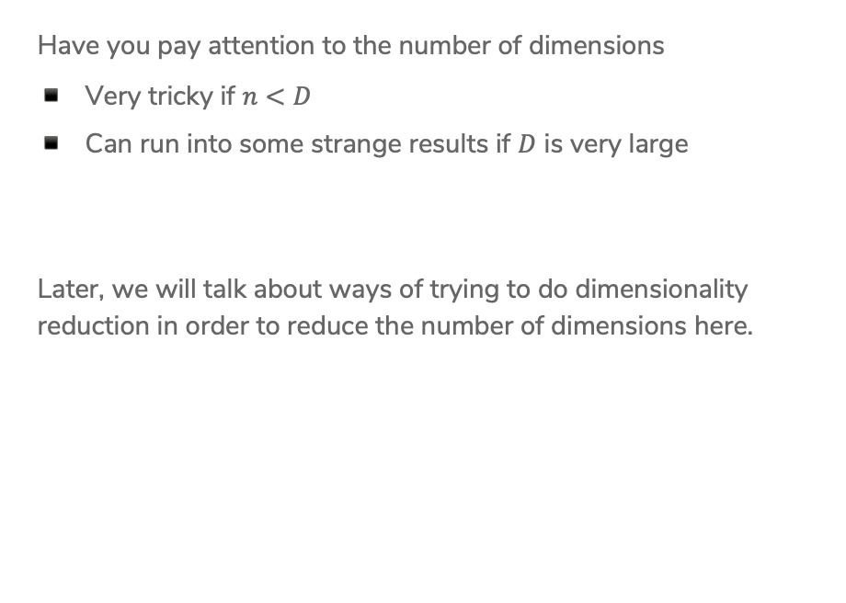
Practicalities
Have you pay attention to the number of dimensions
Very tricky if $n<D$
Can run into some strange results if $D$ is very large
Later, we will talk about ways of trying to do dimensionality reduction in order to reduce the number of dimensions here.

Slide 19
HW5 – ML Practice with Kaggle
Kaggle is a website that hosts ML competitions. Very popular among people trying to learn more about ML! Let’s you practice a lot of real-world ML skills on challenging problems.
About halfway through the course, want to give you a chance to apply what you’ve learned in the real-world! HW5 will be hosted as an internal Kaggle competition.
TAs in section tomorrow will walk through how to do submissions, but all instructions are on the Kaggle website (linked from HW spec).
NOT graded as a competition. The leaderboard is just for fun, and we will provide a small amount of EC to the top 3 teams.

Slide 20
Submission and Grading
You will need to submit three things:
On Kaggle, submit your predictions for the test set
On Gradescope, submit your Jupyter Notebook that trains/evaluates your models and answers some questions we asked you to answer.
On Gradescope, submit concept questions.
Part of your grade will be from the accuracy on the private test set. Will count 95% accuracy on the private test set as full credit for the performance part of the assignment.

Slide 21
Groups
You will be able to work on the Kaggle portion with a team of up to 3 people. You can work alone if you choose, but we recommend working with a team since that’s a great learning experience!
If you work as a team, you can make a team submission on Kaggle and submit your code/report answers on Gradescope together.
Concept portion should be done individually.

Slide 22
Clustering Overview

Slide 23
Recap
For the past 7 weeks, we have covered different supervised learning algorithms
Now, we’re going to explore unsupervised learning methods where don’t have labels / outputs in your datasets anymore.
Note that several of the concepts you learnt for supervised learning, such as cross-validation, overfitting, bias-variance tradeoff, accuracy, error, etc. no longer apply in unsupervised learning!

Slide 24
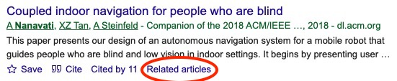
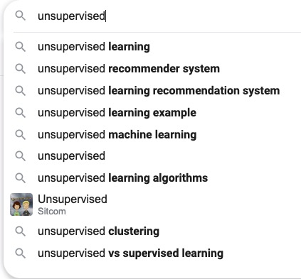
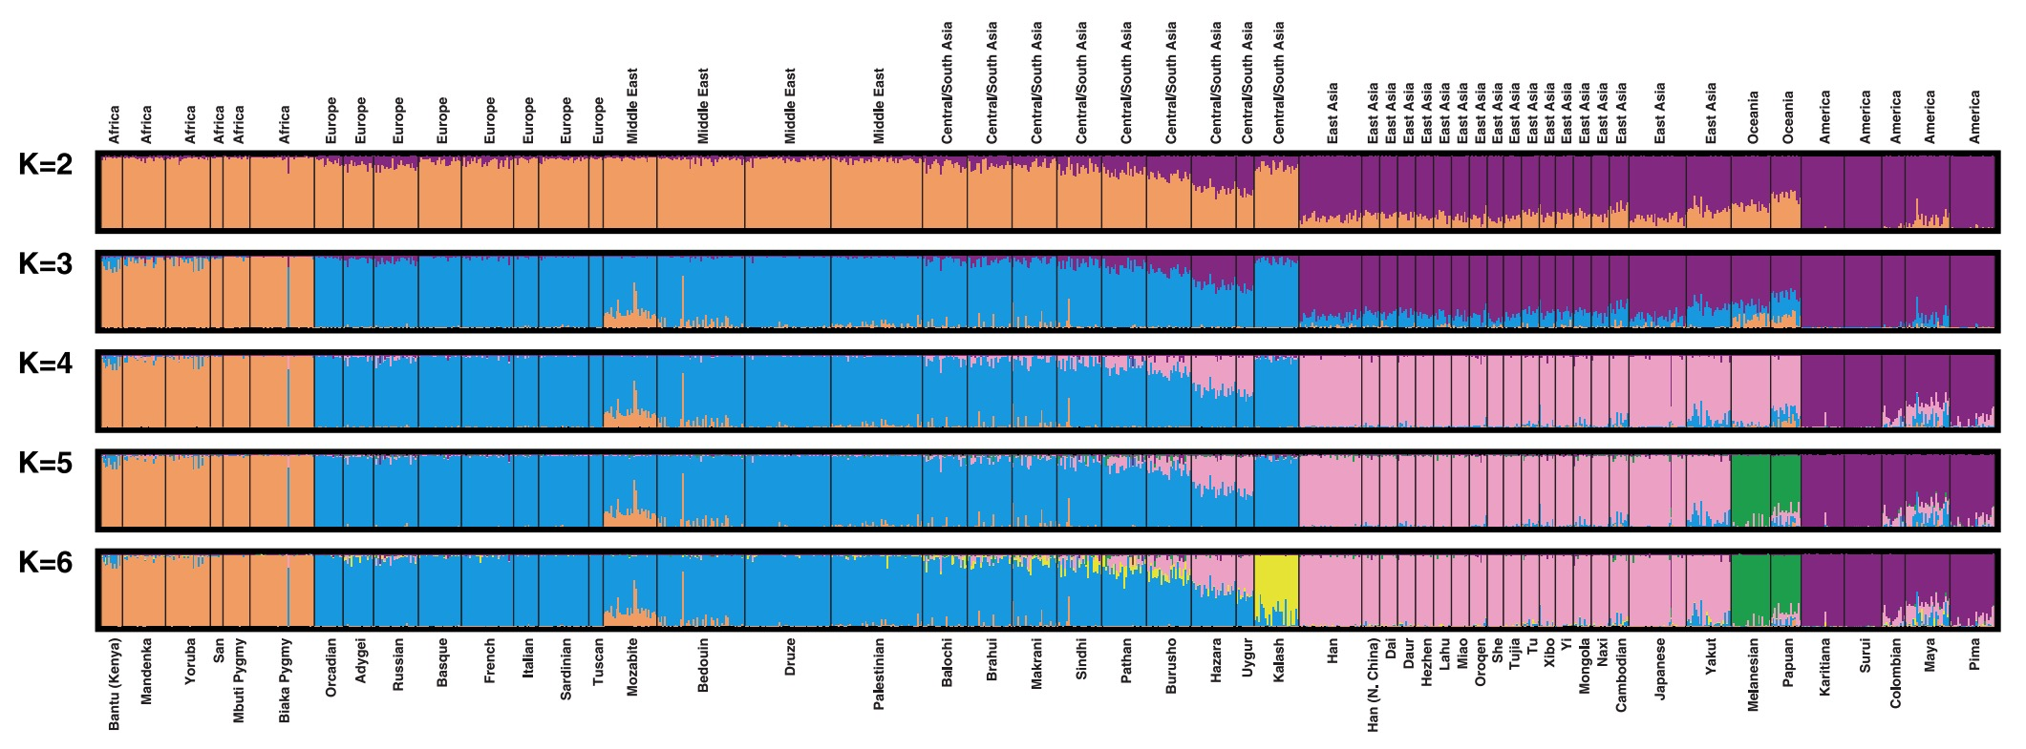
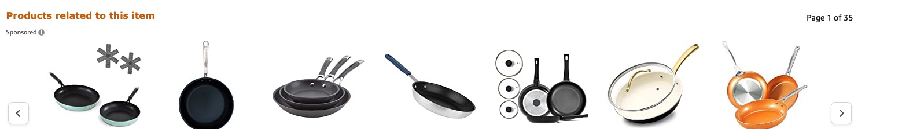
Unsupervised Learning
A type of machine learning that detects underlying patterns in unlabeled data.
Examples of unsupervised learning tasks:
  Cluster similar articles together.
  Cluster gene sequences.
  Recommend items, searches, movies, etc.
Notes:
There are several other examples of unsupervised learning: outlier detection, topic modeling, social network clustering, etc.

Slide 25

ML Pipeline
(Supervised)
Training
Data
Pre-
Processing
x
ML
model
ŷ
⌃
- Historical Bias
- Representation Bias
- Measurement Bias
f
y
Optimization
algorithm
Quality
metric
25

Slide 26
Clustering
Note that we’re not talking about learning user preferences (yet – come back next week ☺ ).
Our case study is document retrieval. Given that someone read a particular article, what similar articles would you recommend (without personalization)?

Slide 27
Labeled Data
What if the labels are known? Given labeled training data.
Can do multi-class classification methods to predict label.
However, not all articles fit cleanly into one label.
Further, oftentimes real-world data doesn’t have labels.

Slide 28
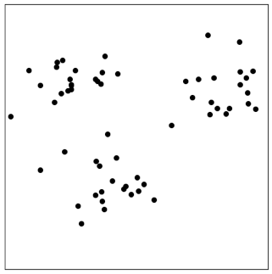



Unlabeled Data
In many real world contexts, there aren’t clearly defined labels so we won’t be able to do classification
We will need to come up with methods that uncover structure from the (unlabeled) input data $X$.
Clustering is an automatic process of trying to find related groups within the given dataset.
$$Input:x_{1}, x_{2},…,x_{n}$$
$$Output:z_{1}, z_{2},…,z_{n}$$
Notes:
Write ”unsupervised learning”
Draw circles around clusters
Write z_i \in [1, …, k]
Show some examples

Slide 29
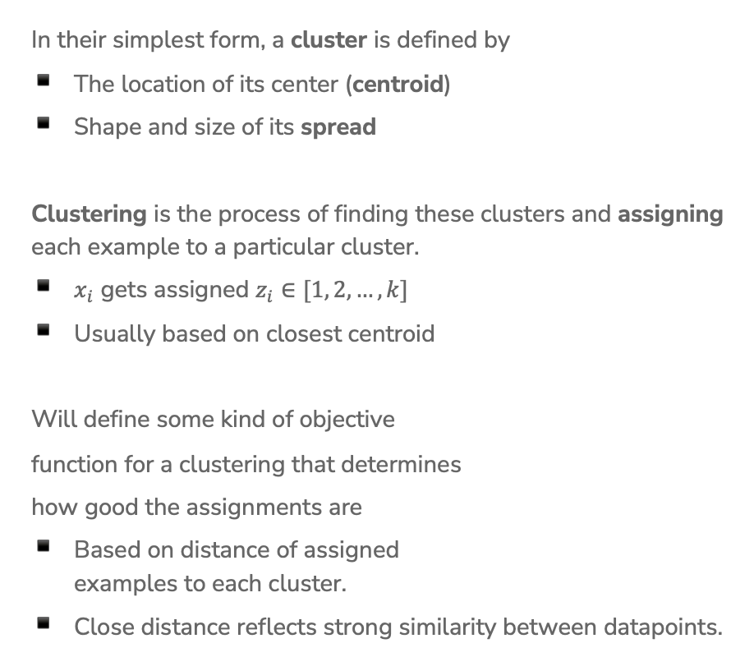
Define Clusters
In their simplest form, a cluster is defined by
The location of its center (centroid)
Shape and size of its spread
Clustering is the process of finding these clusters and assigning each example to a particular cluster.
$x_{i}$ gets assigned $z_{i}∈[1, 2, …,k]$
Usually based on closest centroid
Will define some kind of objective
function for a clustering that determines
how good the assignments are
Based on distance of assigned
examples to each cluster.
Close distance reflects strong similarity between datapoints.

Slide 30
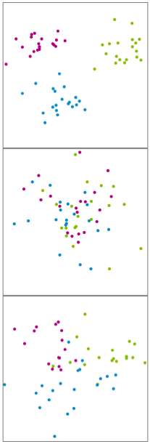
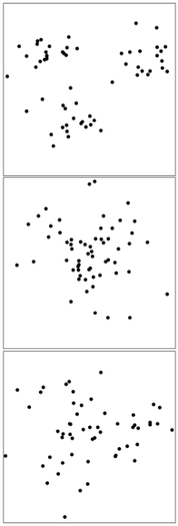
When Might This Work?
Clustering is easy when distance captures the clusters.
Ground Truth (not visible) Given Data
Notes:
Try top draw clustesr
Easy
Impossible
Maybe?

Slide 31
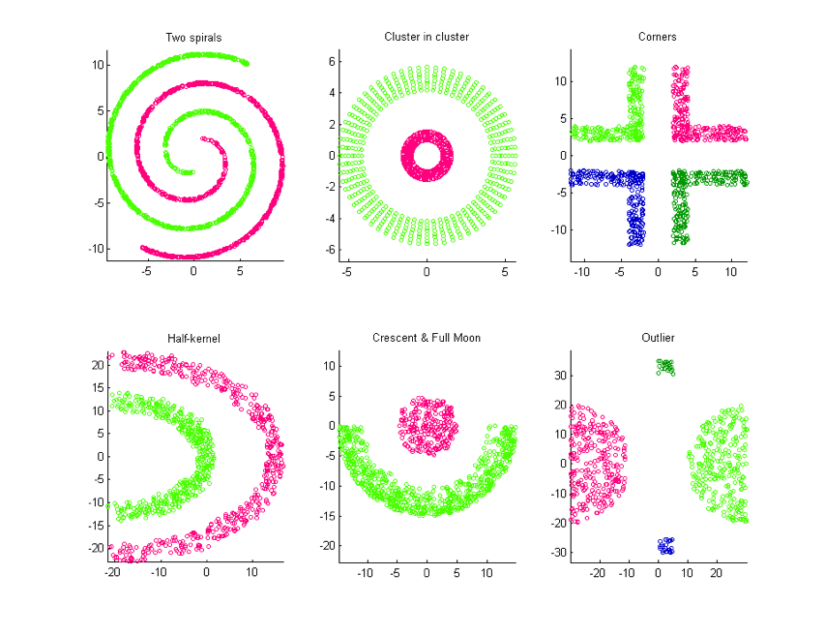
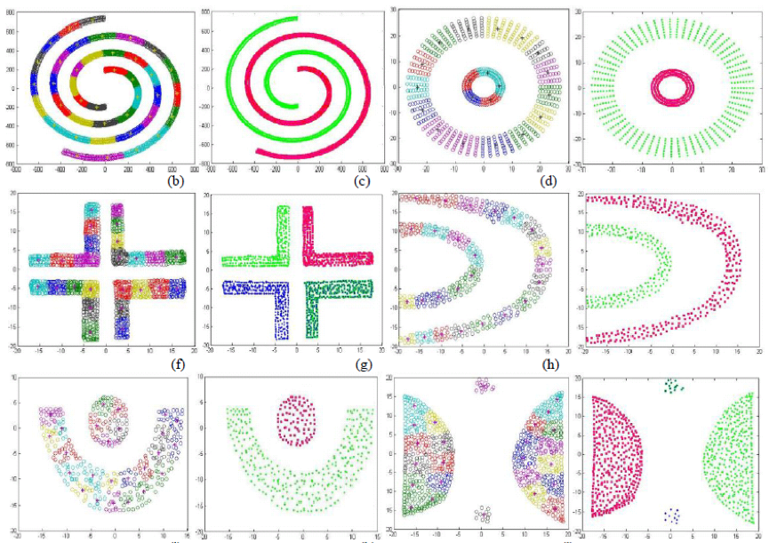
Not Always Easy
There are many clusters that are harder to learn with this setup
Distance does not determine clusters

Slide 32
2 min
Think of 1-2 problems that you might want to use clustering for. For each problem, describe:
  Why unsupervised learning is the right approach.
  What the input features are for the clustering algorithm.
  What clusters you hypothesize would emerge.

Slide 33
K-Means Clustering

Slide 34
K-Means
Clustering
Algorithm
We define the criterion of assigning point to a cluster based on its distance.
Shorter distance => Better Clustering
Algorithm
Given a dataset of n datapoints and a particular choice of k
Step 0: Initialize cluster centroids randomly
Repeat until convergence:
Step 1: Assign each example to its closest cluster centroid
Step 2: Update the centroids to be the average of all the points
assigned to that cluster

Slide 35
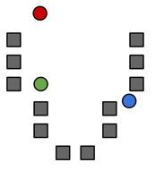




Step 0
Start by choosing the initial cluster centroids
A common default choice is to choose centroids $μ_{1},…,μ_{k}$ randomly
Will see later that there are smarter ways of initializing
$$μ_{2}$$
$$μ_{1}$$
$$μ_{3}$$

Slide 36
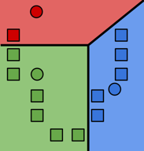

Step 1
Assign each example to its closest cluster centroid
For $i$= 1 to n
$$z_{i}←\underset{j∈[k]}{argmin}{{\left|\left|μ_{j}−x_{i}\right|\right|}_{2}^{2}}$$
Notes:
Draw the distance between green point and all centroids
Looks like a decision boundary, but is inferred without labels!
Write “Voronoi tessellation”

Slide 37
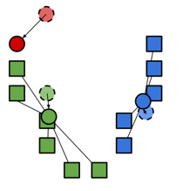

Step 2
Update the centroids to be the mean of points assigned to that cluster.
$$μ_{j}=\frac{\sum_{i=1}^{n}{1}\left\{z_{i}=j\right\}x_{i}}{\sum_{i=1}^{n}{1}\left\{z_{i}=j\right\}}$$
Computes center of mass for cluster!

Slide 38
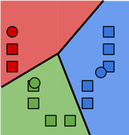
Repeat until convergence
Repeat Steps 1 and 2 until convergence

Slide 39
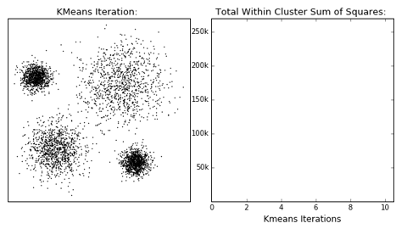
Stopping Conditions
Cluster assignments haven’t changed
Centroids haven’t changed
Some number of max iterations have been passed

Slide 40
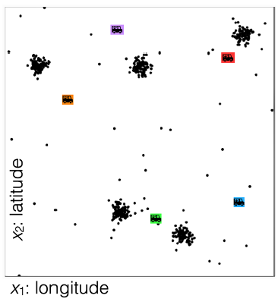
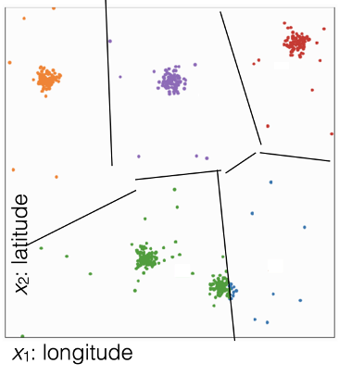
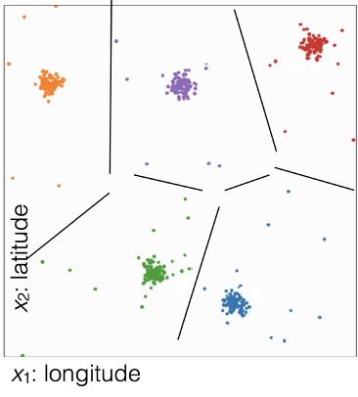
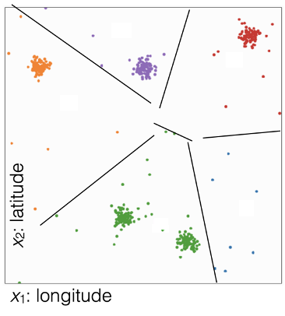
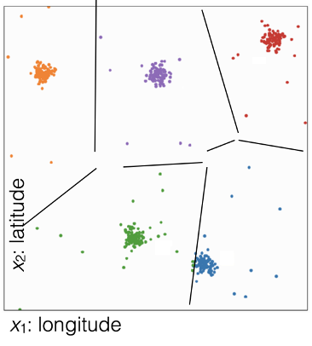
1 min
What cluster assignment would result from these centroids?
Centroids
(D)
(A)
(B)
(C)

Slide 41
1 min
What cluster assignment would result from these centroids?
Centroids
(D)
(A)
(B)
(C)

Slide 42
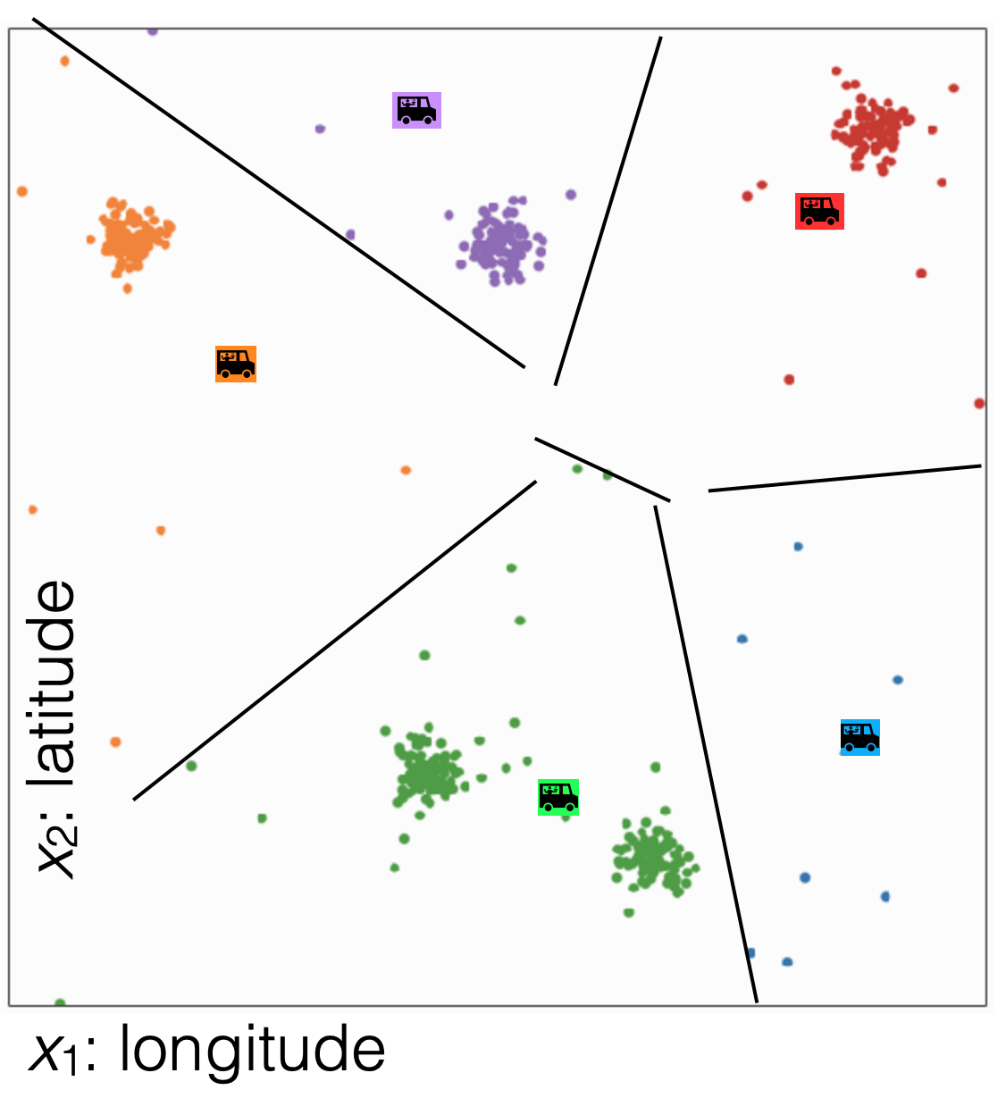
1 min
In what direction would each of the centroids (roughly) move?
Cluster Assignments
(D)
(A)
(B)
(C)

Slide 43
2 min
In what direction would each of the centroids (roughly) move?
Cluster Assignments
(D)
(A)
(B)
(C)

Slide 44
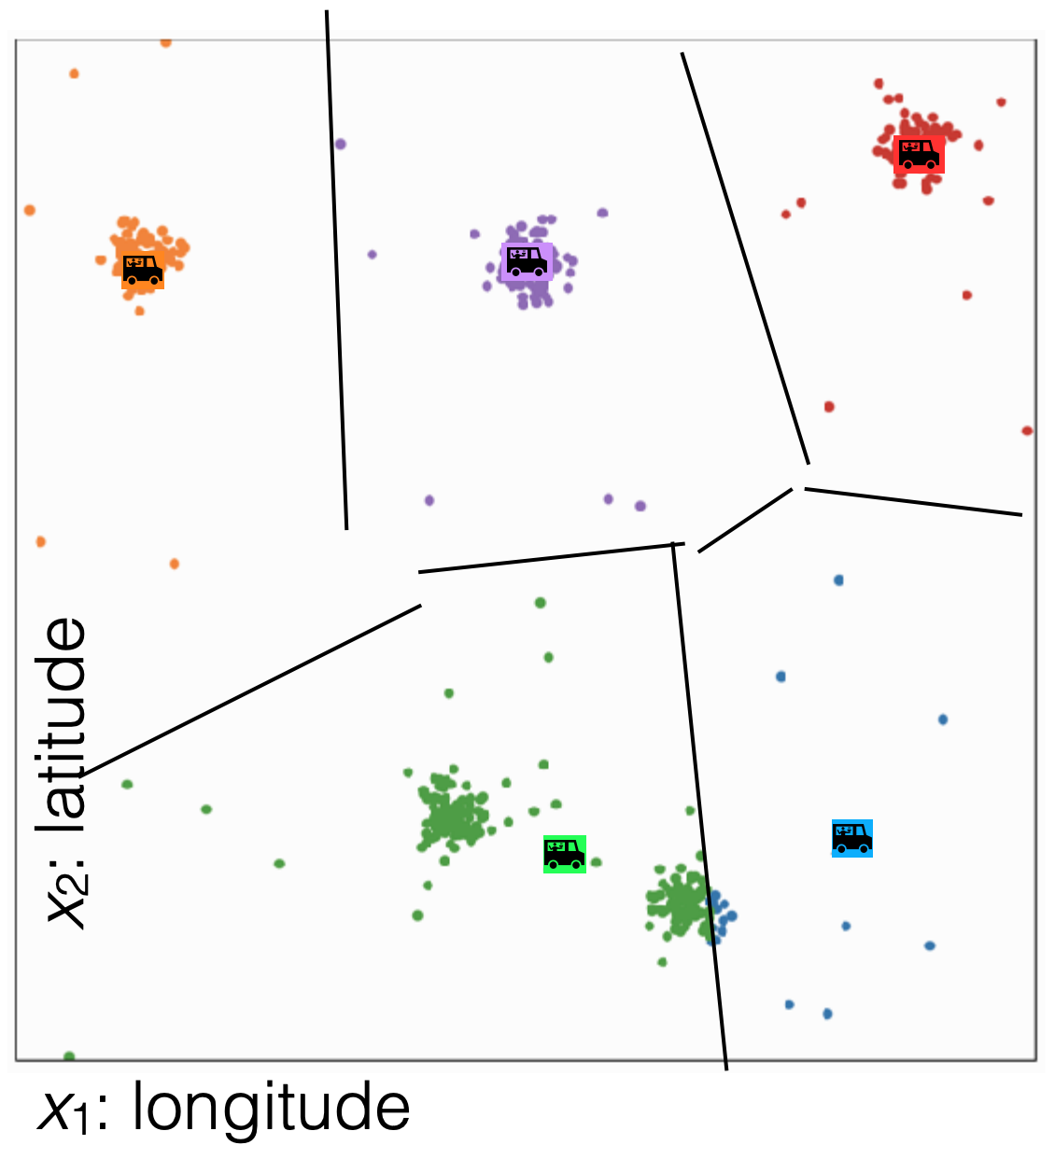
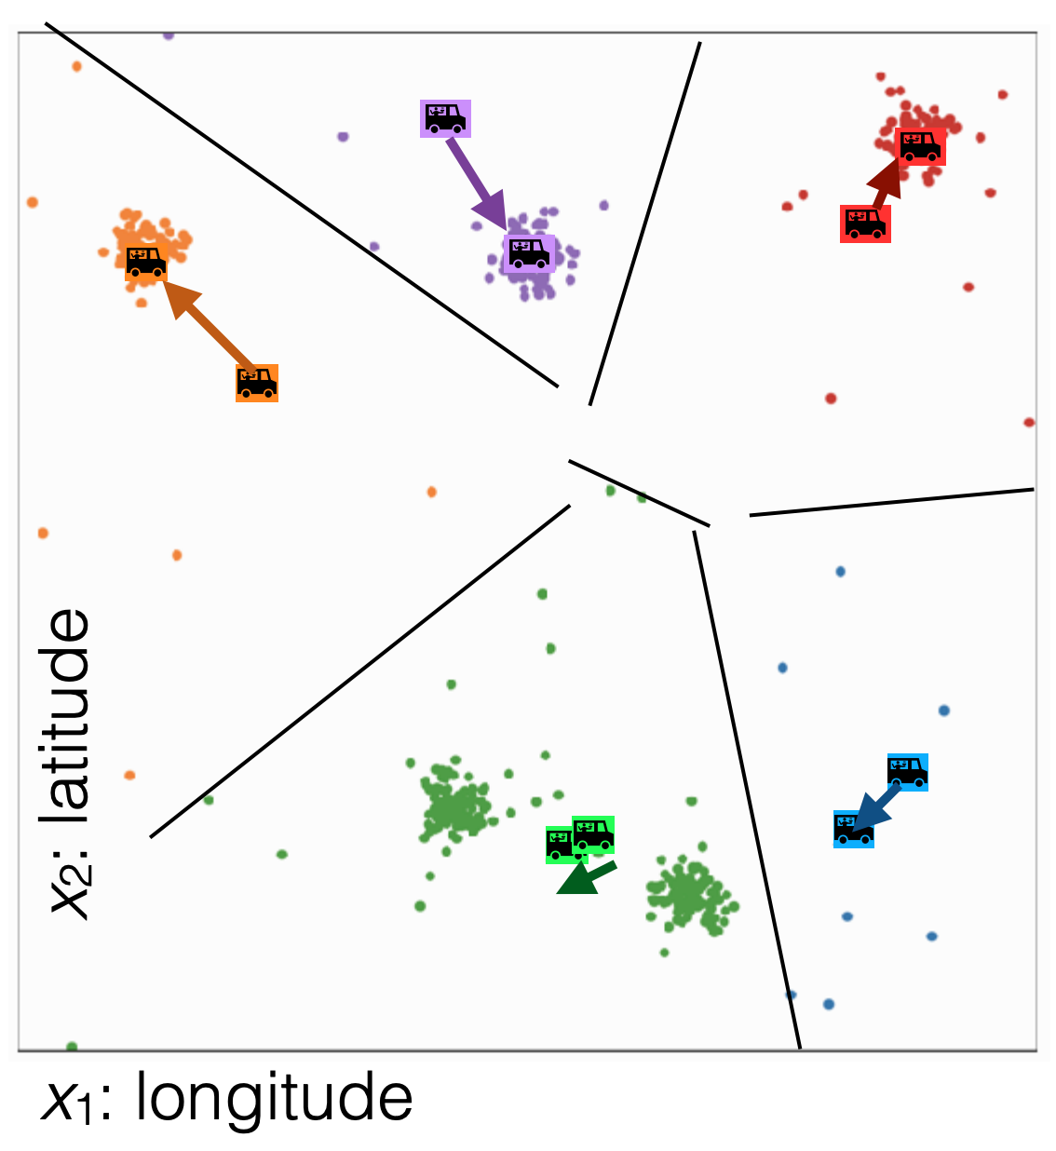
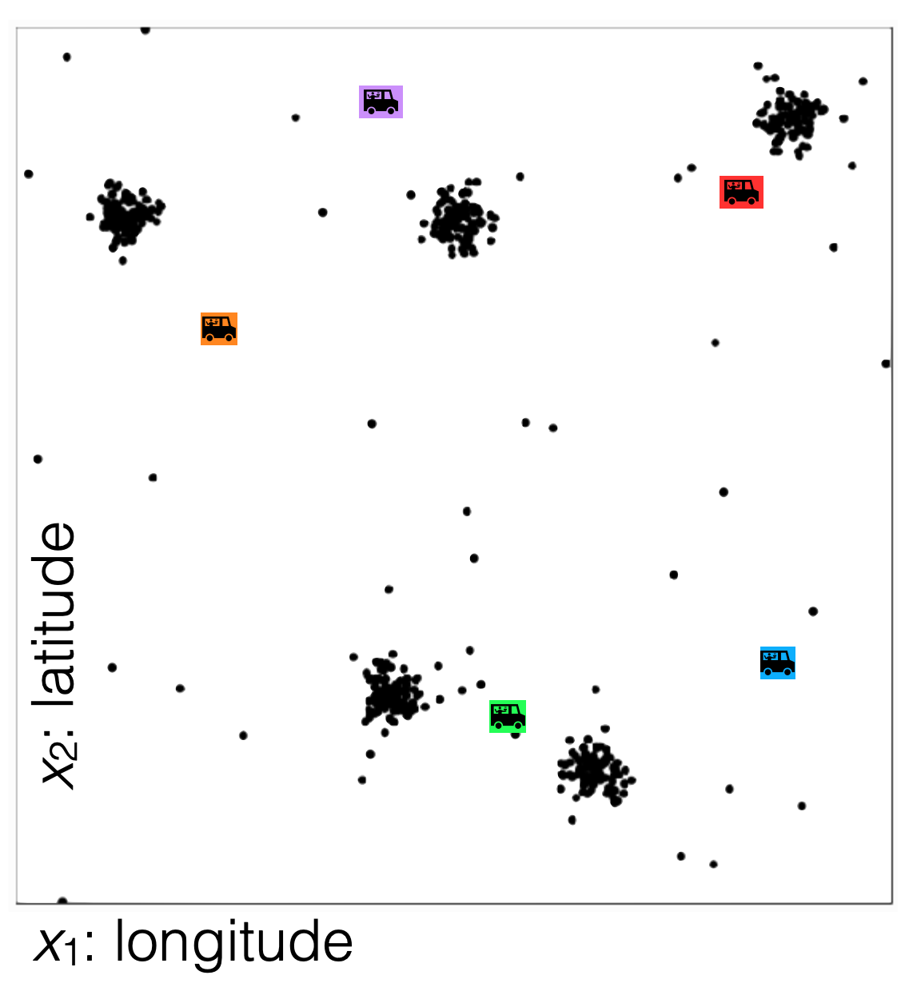
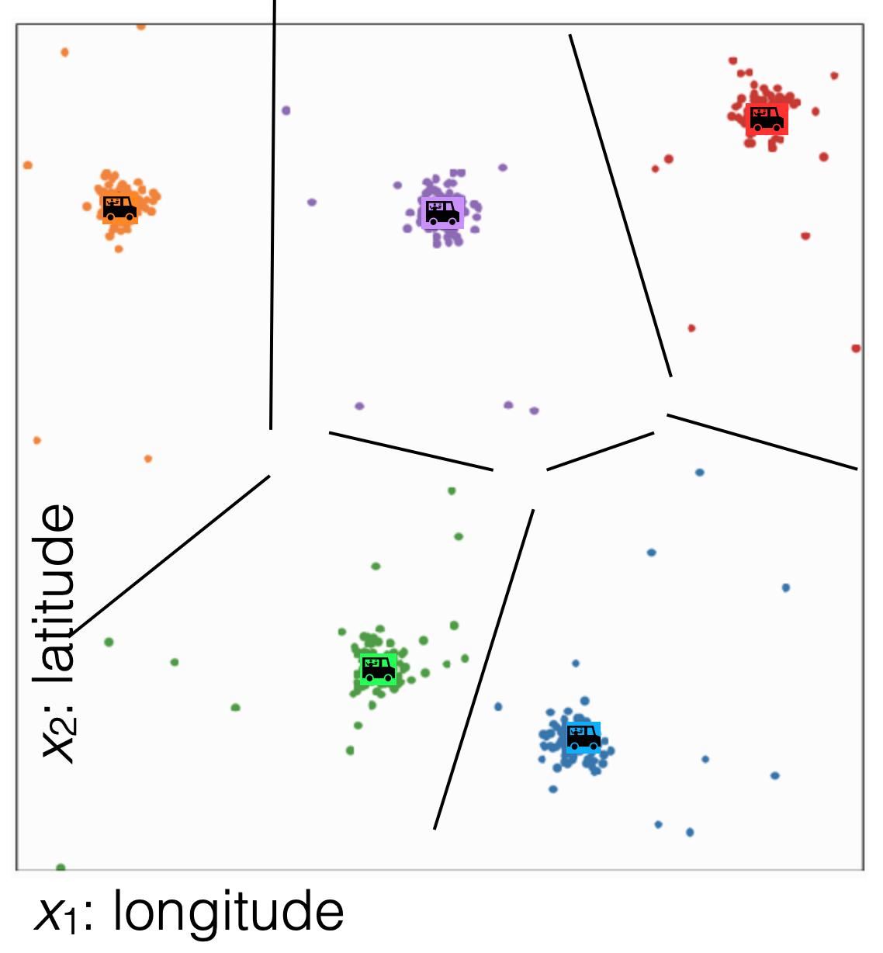
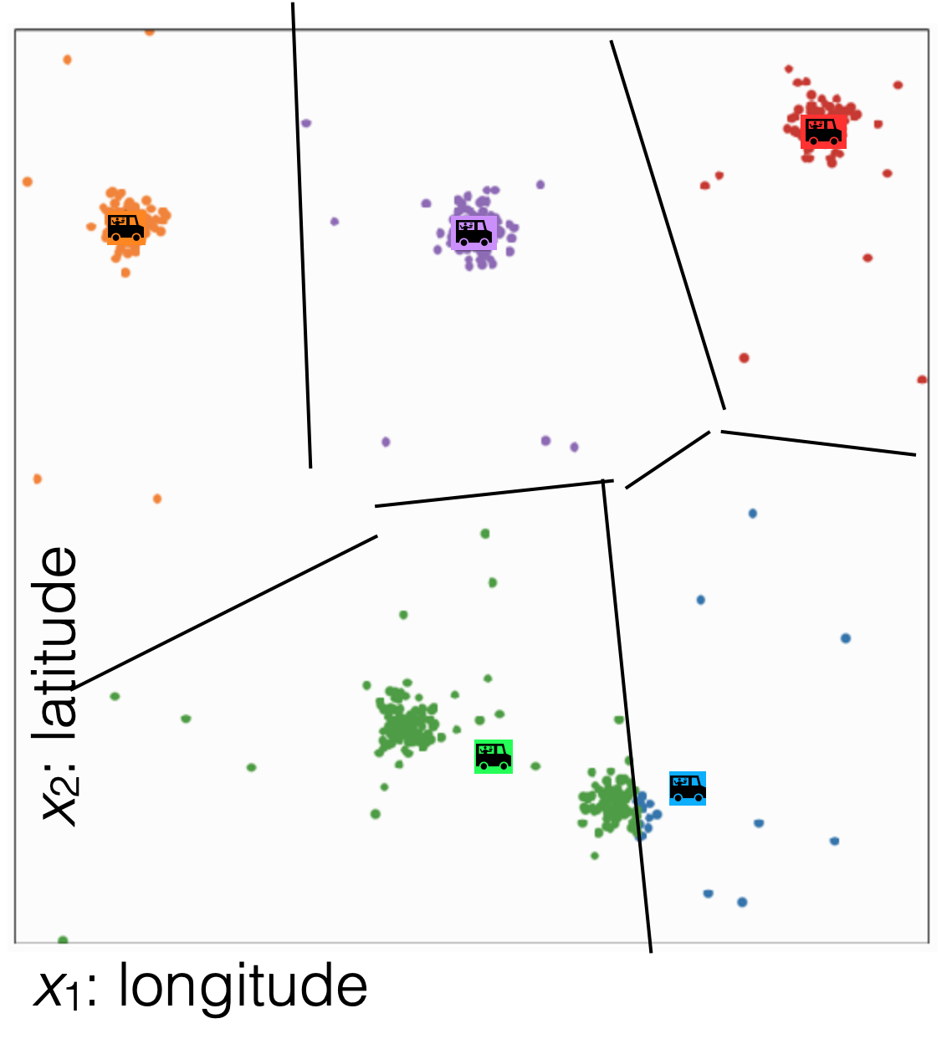
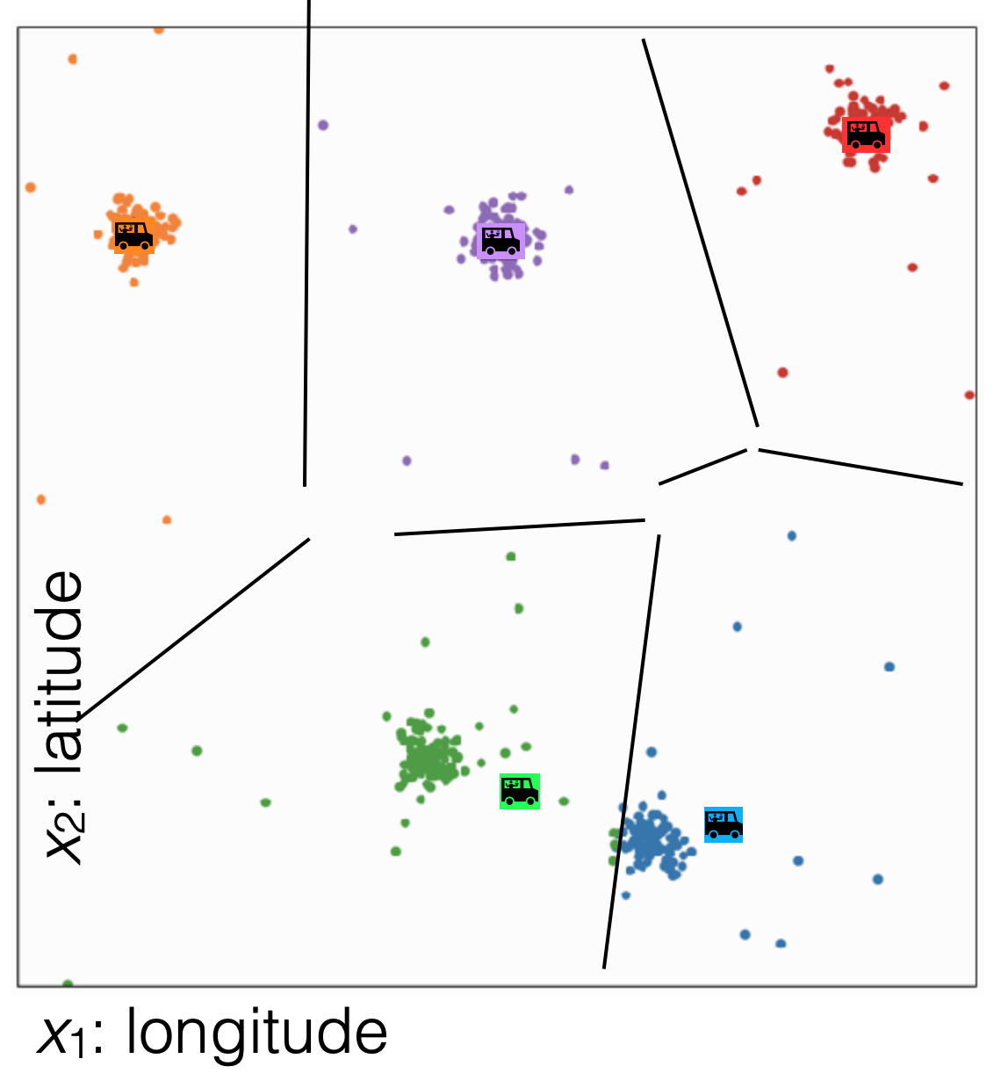
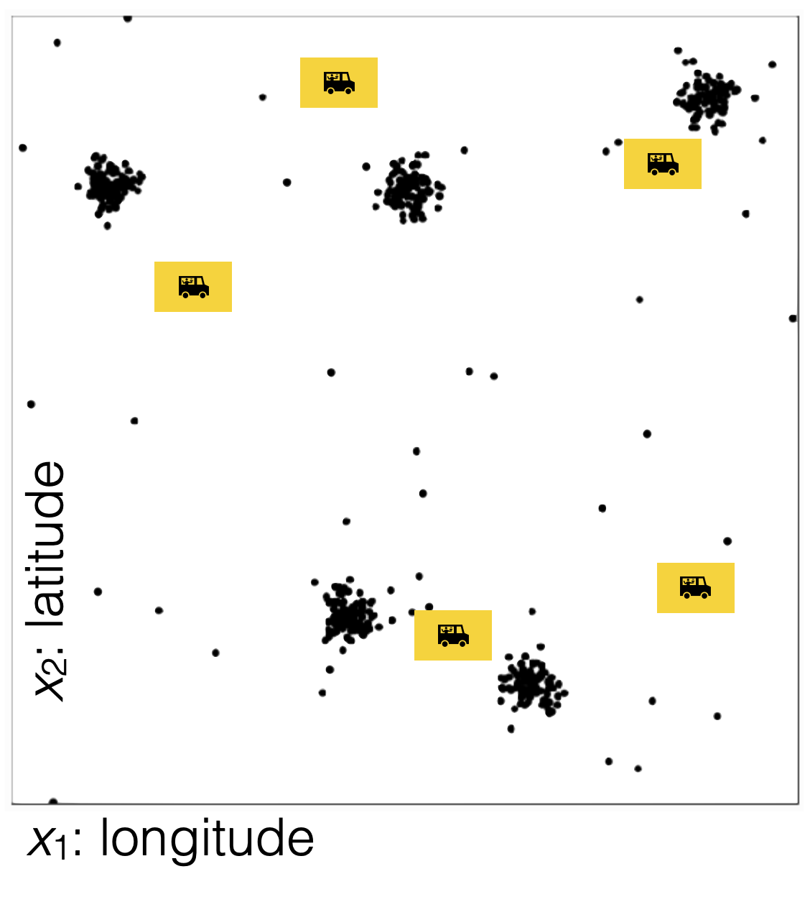
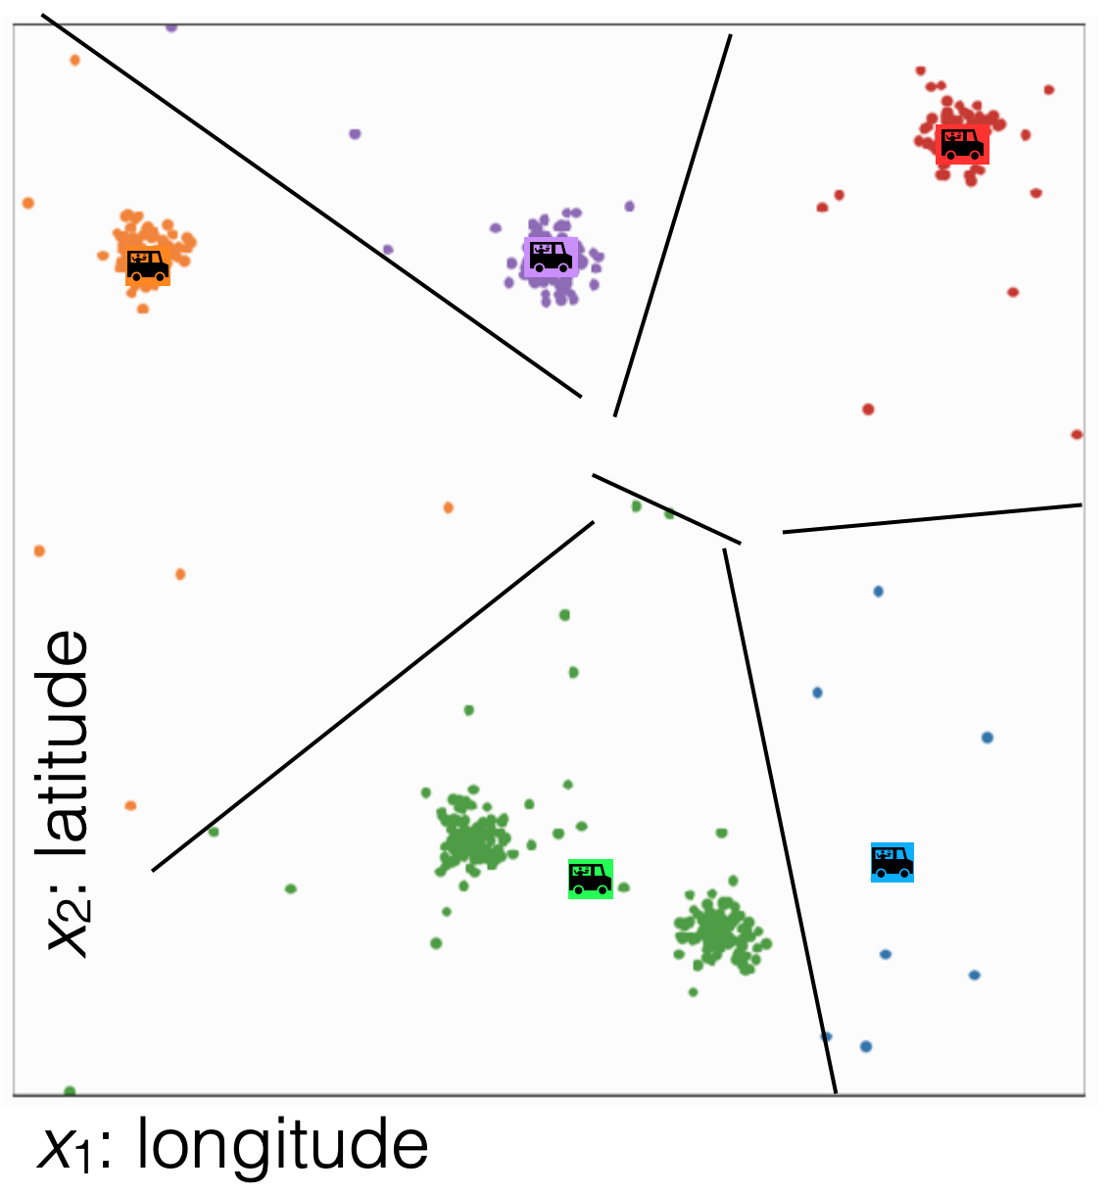
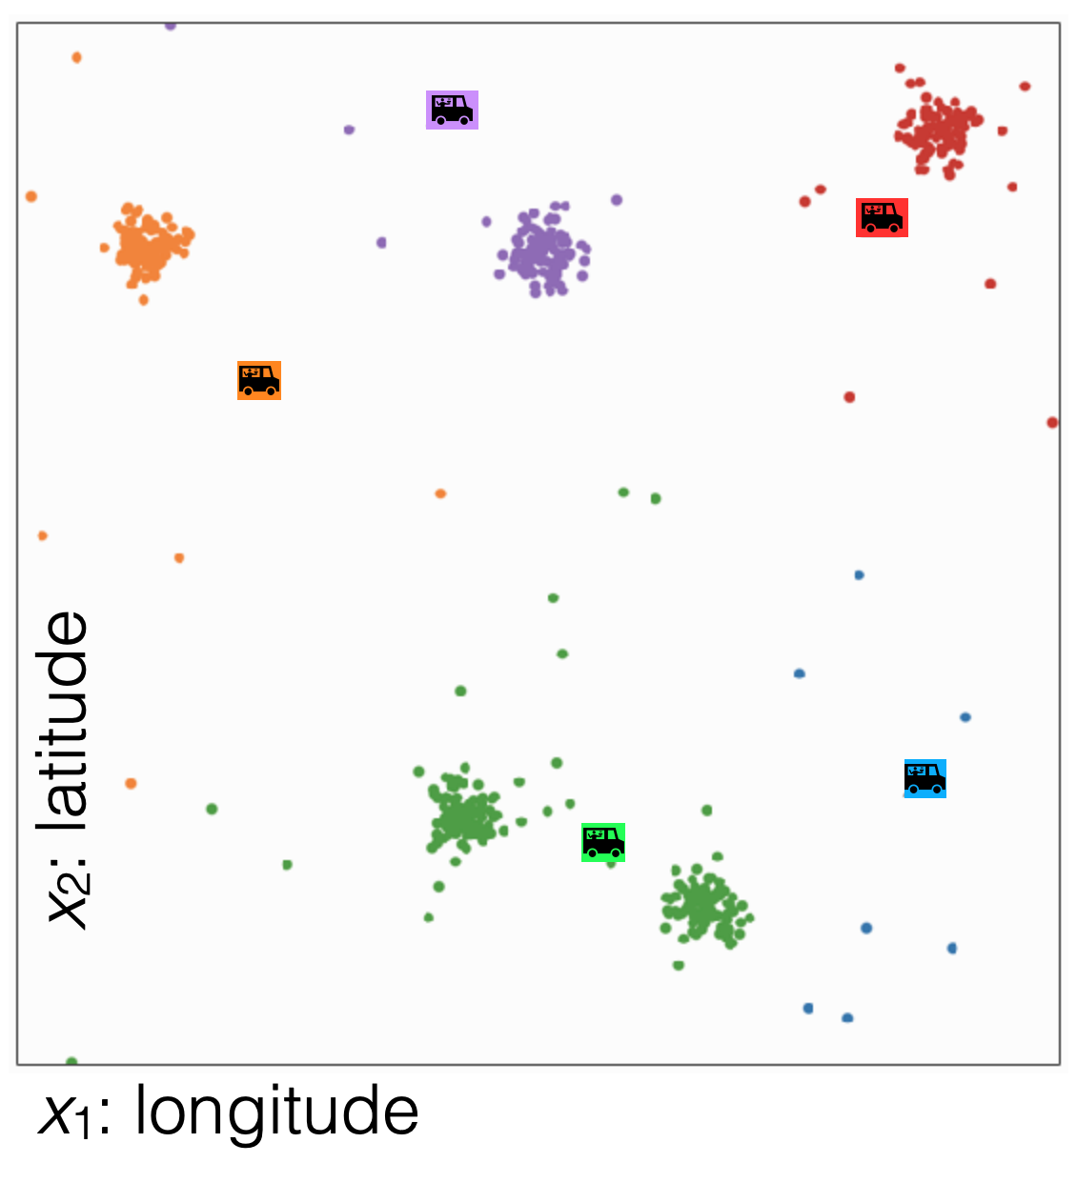
No more changes

Slide 45
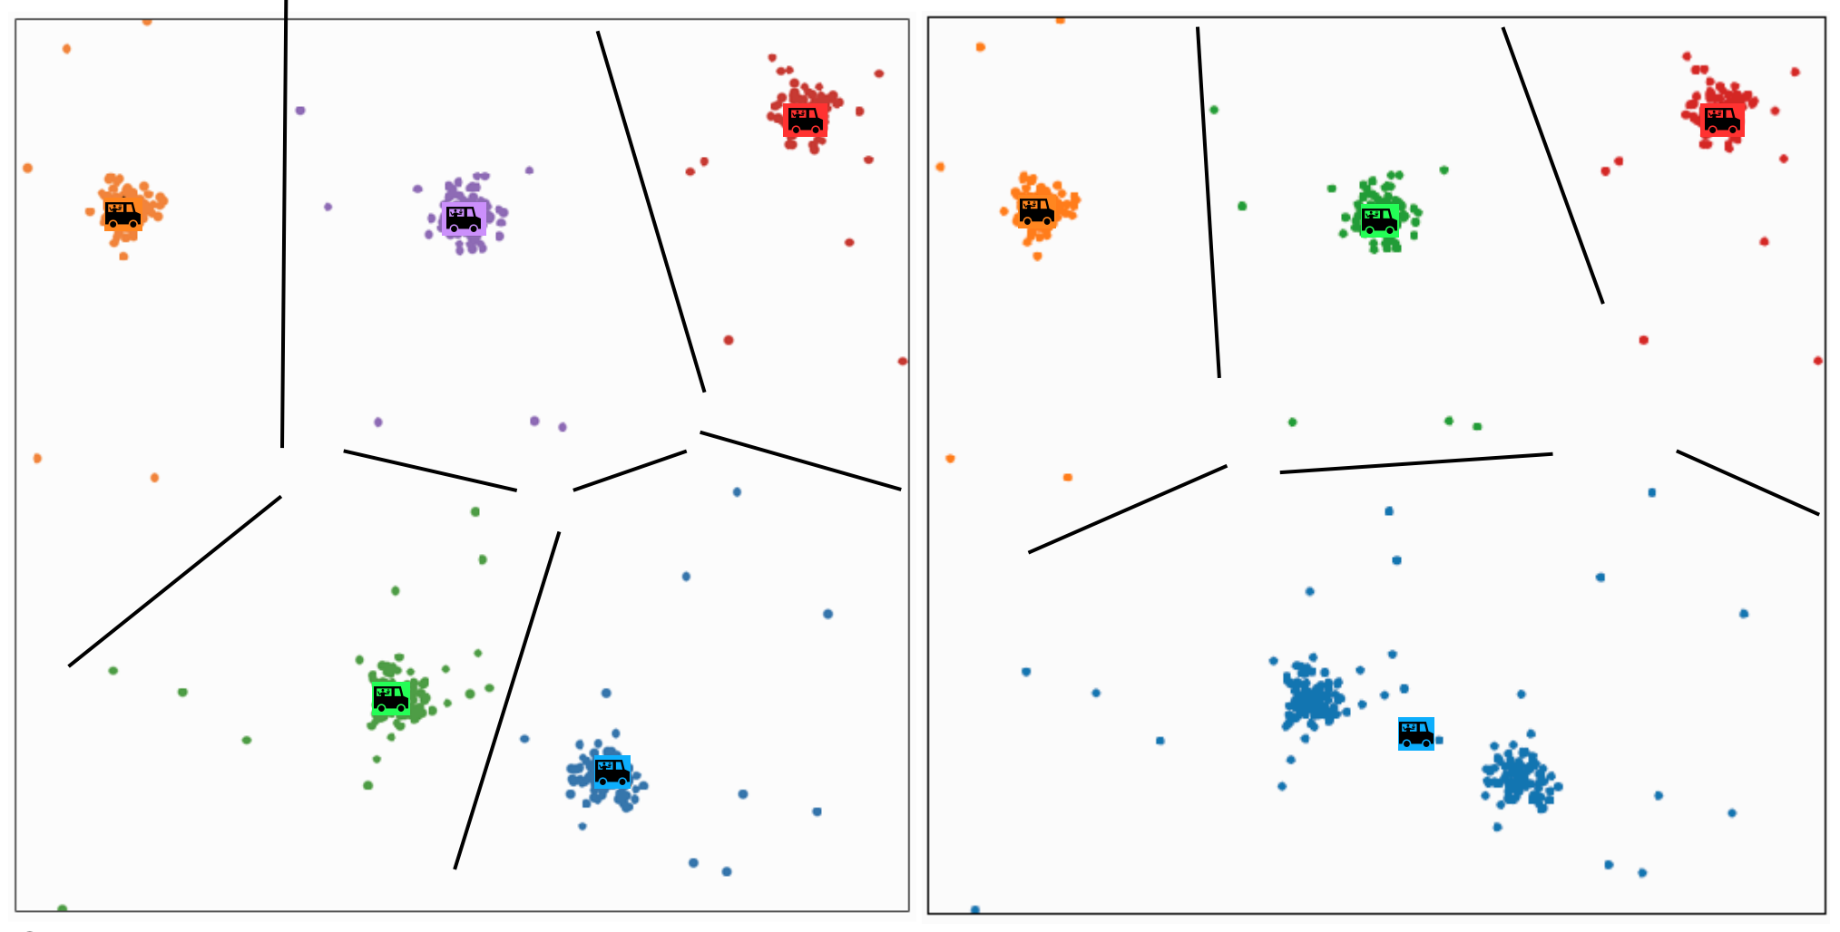
Different k gives different results

Slide 46
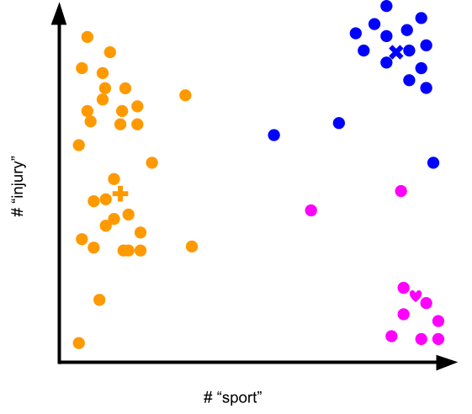
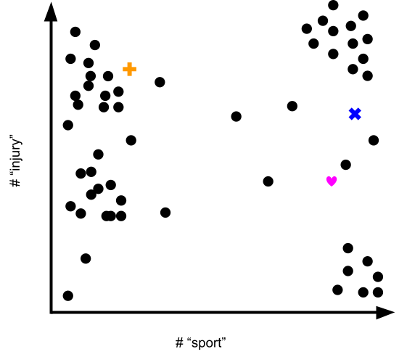
1.5 min
You are clustering news articles using the features “# sport” and “# injury.” How would you interpret these clusters?
“This is a cluster of …[some characterization]… articles.”

Slide 47
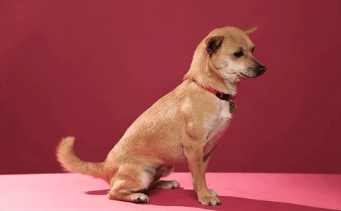

Slide 48
Effect of Initialization

Slide 49
1.5 min
What convergence guarantees do you think we will have with k-means?
Converges to the global optimum
Converges to a local optima
None

Slide 50


Effects of Initialization
Results heavily depend on initial centroids
Initialization
Final Clusters

Slide 51


Effect of initialization
What does it mean for something to converge to a local optima?
Some initialization can be bad and affect the quality of clustering
Initialization will greatly impact results!
Notes:
Notice there is no right answer since there are no labels! There is no true “green cluster”
Mention how we need to run this multiple times

Slide 52

Smart Initializing w/ k-means++
Making sure the initialized centroids are “good” is critical to finding quality local optima. Our purely random approach was wasteful since it’s very possible that initial centroids start close together.
Idea: Try to select a set of points farther away from each other.
k-means++ does a slightly smarter random initialization
Choose first cluster $μ_{1}$from the data uniformly at random
For each datapoint $x_{i},$compute the distance between $x_{i}$ and the closest centroid from the current set of centroids (starting with just $μ_{i}$). Denote that distance $d(x_{i})$.
Choose a new centroid from the remaining data points, where the probability of $x_{i}$ being chosen is proportional to $d{\left(x_{i}\right)}^{2}$.
Repeat 2 and 3 until we have selected $k$ centroids.

Slide 53
k-means++ Example
Start by picking a point at random
Then pick points proportional to their distances to their centroids
This tries to maximize the spread of the centroids!
Notes:
Pick Left Top middle
Pick bottom right
Pick top right

Slide 54
k-means++
Pros / Cons
Pros
Improves quality of local minima
Faster convergence to local minima
Cons
Computationally more expensive at beginning when compared to simple random initialization

Slide 55
Assessing Performance

Slide 56

Which Cluster?
Which clustering would I prefer?
Don’t know, there is no “right answer” in clustering 🤷🏾‍♂️ .
Depends on the practitioner’s domain-specific knowledge and interpretation of results!

Slide 57

Which Cluster?
Which clustering does k-means prefer?
k-means is trying to optimize the heterogeneity objective
$$\underset{z,μ}{argmin}\sum_{j=1}^{k}{\sum_{i=1}^{n}{{1\left\{z_{i}=j\right\}\left|\left|μ_{j}−x_{i}\right|\right|}_{2}^{2}}}$$
Notes:
Write sum over clusters
Write sum of distances to centroid
Write lower is better

Slide 58

Coordinate Descent
k-means is trying to minimize the heterogeneity objective
$$\underset{z, μ}{argmin}\sum_{j=1}^{k}{\sum_{i=1}^{n}{{1\left\{z_{i}=j\right\}\left|\left|μ_{j}−x_{i}\right|\right|}_{2}^{2}}}$$
Step 0: Initialize cluster centers
Repeat until convergence:
Step 1: Assign each example to its closest cluster centroid
Step 2: Update the centroids to be the mean of all the points
assigned to that cluster
Coordinate Descent alternates how it updates parameters to find minima. On each of iteration of Step 1 and Step 2, heterogeneity decreases or stays the same.
=> Will converge in finite time

Slide 59
1 min
Consider training k-means to convergence for different values of k. Which of the following graphs shows how the heterogeneity objective will change based on the value of k?
Lowest objective value
Lowest objective value
A
B
Lowest objective value
Lowest objective value
C
D

Slide 60
2 mins
Consider training k-means to convergence for different values of k. Which of the following graphs shows how the heterogeneity objective will change based on the value of k?
Lowest objective value
Lowest objective value
A
B
Lowest objective value
Lowest objective value
C
D

Slide 61
How to Choose k?
No right answer! Depends on your application.
General, look for the “elbow” in the graph
Note: You will usually have to run k-means multiple times for each k
Notes:
Draw in curve
Write: ”In extreme when k=N, heterogeneity will be 0”
Point out elbow

Slide 62




Cluster shape
k-means works well for well-separated hyper-spherical clusters of the same size

Slide 63
Clustering vs
Classification
Clustering looks like we assigned labels (by coloring or numbering different groups) but we didn’t use any labeled data.
In clustering, the “labels” don’t have meaning. To give meaning to the labels, human inputs is required
Classification learns from minimizing the error between a prediction and an actual label.
Clustering learns by minimizing the distance between points in a cluster.
Classification quality metrics (accuracy / loss) do not apply to clustering (since there is no label).
You can’t use validation set / cross-validation to choose the best choice of k for clustering.

Slide 64
Recap
Differences between classification and clustering
What types of clusters can be formed by k-means
K-means algorithm
Convergence of k-means
How to choose k
Better initialization using k-means++

