Slide 1
CSE/STAT 416
Precision/Recall k-Nearest Neighbors
Pre-Class Video
Tanmay Shah
Paul G. Allen School of Computer Science & Engineering
University of Washington
July 24, 2024

Slide 2
Recap
Deep Learning in Practice

Slide 3
Pros
No need to manually engineer features, enable automated learning of features
Impressive performance gains
Image processing
Natural Language Processing
Speech recognition
Making huge impacts in most fields

Slide 4
Cons
Requires a LOT of data
Computationally really expensive
Environmentally, extremely expensive (Green AI)
Hard to tune hyper-parameters
Choice of architecture (we’ve added even more hyper-parameters)
  Size of kernels, stride, 0 padding, number of conv layers, depth of outputs of conv layers,
Learning algorithm
Still not very interpretable

Slide 5
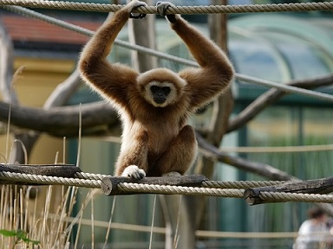
NN Failures
While NNs have had amazing success, they also have some baffling failures.
“No one adds noise to things in real applications”
Not true!
Hackers will hack
Sensors (cameras) are noisy!

Slide 6
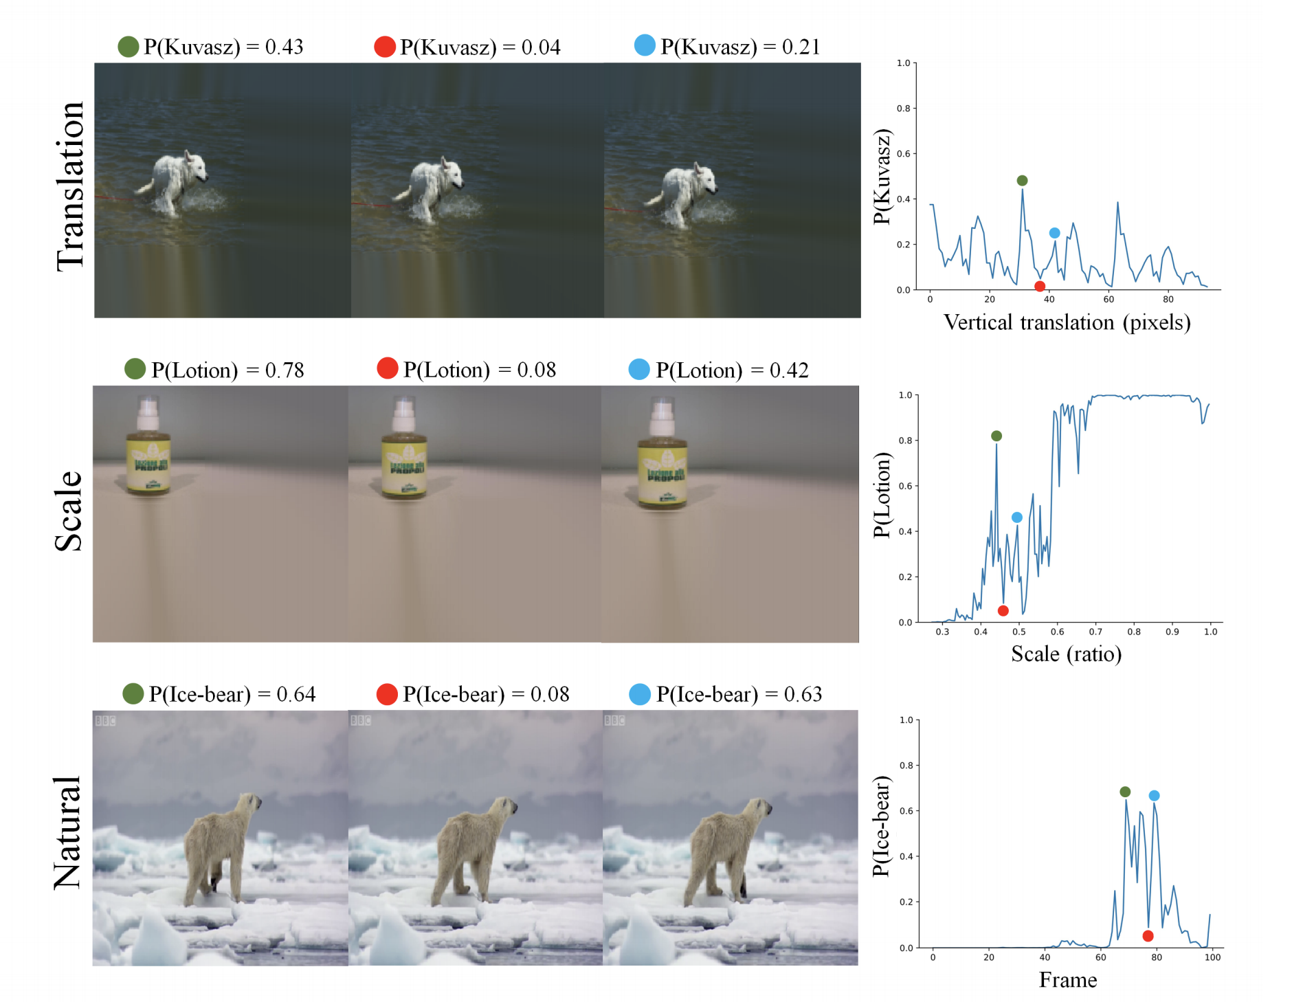
NN Failures
They even fail with “natural” transformations of images
[Azulay, Weiss https://arxiv.org/abs/1805.12177]

Slide 7
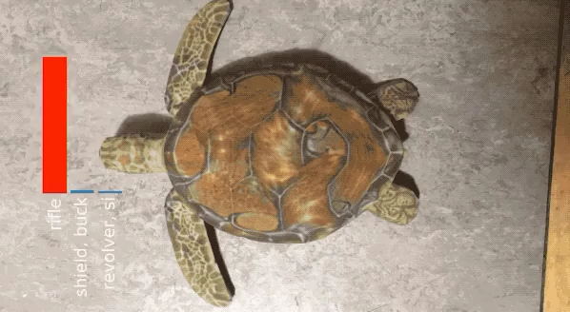

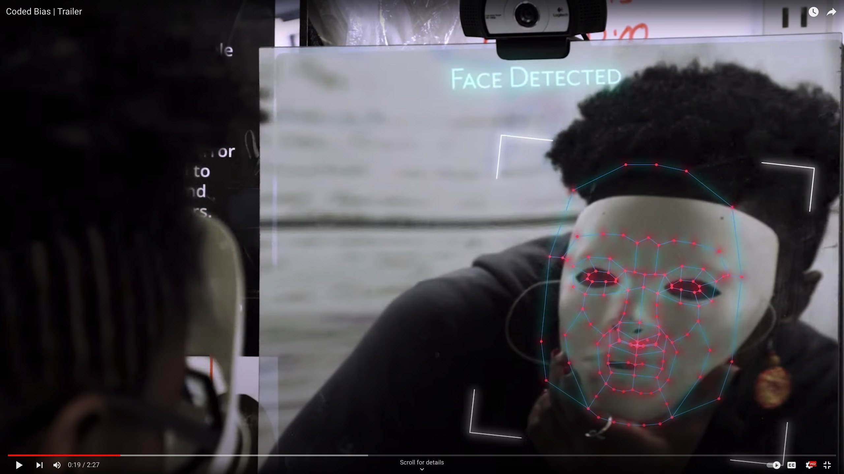
NN Failures
Objects can be created to trick neural networks!

Slide 8
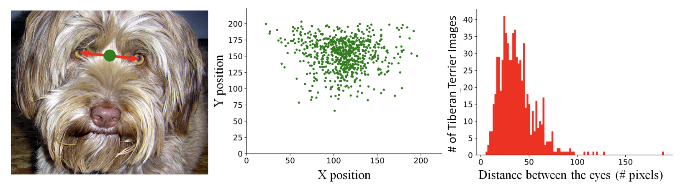
Dataset Bias
Datasets, like ImageNet, are generally biased
One approach is to augment your dataset to add random permutations of data to avoid bias.

Slide 9
Demo: Adversarial Neural Networks to Promote Fairness
https://godatadriven.com/blog/towards-fairness-in-ml-with-adversarial-networks/
Dataset: Adult UCI
Predict whether a person’s income will be > $50K or ≤ $50K based on factors like:
  Age
  Education level
  Marital status
  Served in Armed Services?
  Hours per week worked
  Occupation sector
  Etc.

Slide 10
Further Readings on Deep Learning
Dealing with Variable Length Sequences (e.g. language)
Recurrent Neural Networks (RNNs)
Long Short Term Memory Nets (LSTMs)
http://colah.github.io/posts/2015-08-Understanding-LSTMs/
Reinforcement Learning
Google DeepMind AlphaGo Zero
Generative Adversarial Networks
How to learn synthetic data
Green AI

Slide 11
Pre-Lecture Video

Slide 12
Detecting Spam
Imagine I made a “Dummy Classifier” for detecting spam
The classifier ignores the input, and always predicts spam.
This actually results in 90% accuracy! Why?
  Most emails are spam…
This is called the majority class classifier.
A classifier as simple as the majority class classifier can have a high accuracy if there is a class imbalance.
A class imbalance is when one class appears much more frequently than another in the dataset
This might suggest that accuracy isn’t enough to tell us if a model is a good model.

Slide 13
Assessing Accuracy
Always digging in and ask critical questions of your accuracy.
Is there a class imbalance?
How does it compare to a baseline approach?
  Random guessing
  Majority class
  …
Most important: What does my application need?
  What’s good enough for user experience?
  What is the impact of a mistake we make?

Slide 14

Confusion Matrix
For binary classification, there are only two types of mistakes
$\hat{y}=+1, y=−1$
$\hat{y}=−1, y=+1$
Generally we make a confusion matrix to understand mistakes.
Predicted Label
 | True Positive (TP) | False Negative (FN)
 | False Positive (FP) | True Negative (TN)
True Label

Slide 15

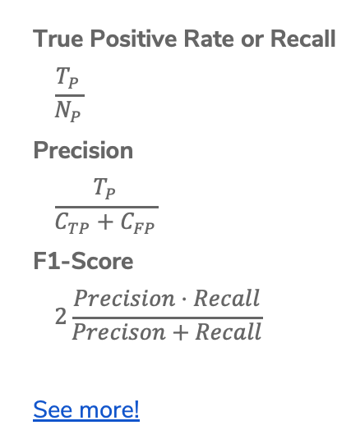
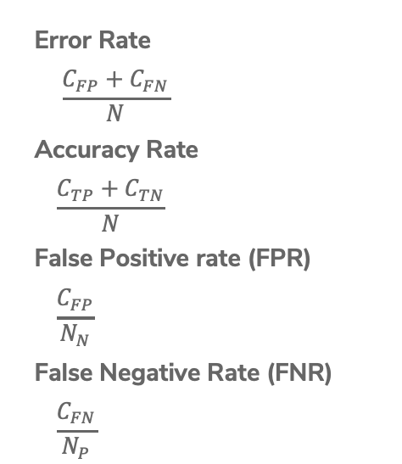
Binary Classification Measures
Notation
$C_{TP}=\#TP, C_{FP}=\#FP, C_{TN}=\#TN, C_{FN}=\#FN$
$N=C_{TP}+C_{FP}+C_{TN}+C_{FN}$
$N_{P}=C_{TP}+C_{FN}, N_{N}=C_{FP}+C_{TN}$
Error Rate
$$\frac{C_{FP}+C_{FN}}{N}$$
Accuracy Rate
$$\frac{C_{TP}+C_{TN}}{N}$$
False Positive rate (FPR)
$$\frac{C_{FP}}{N_{N}}$$
False Negative Rate (FNR)
$$\frac{C_{FN}}{N_{P}}$$
True Positive Rate or Recall
$$\frac{T_{P}}{N_{P}}$$
Precision
$$\frac{T_{P}}{C_{TP}+C_{FP}}$$
F1-Score
$$2\frac{Precision⋅Recall}{Precison+Recall}$$
See more!

Slide 16
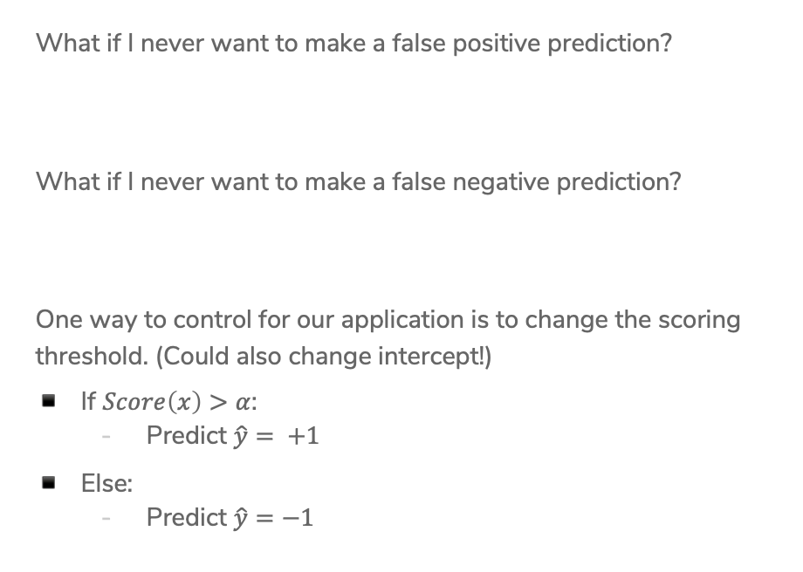
Change Threshold
What if I never want to make a false positive prediction?
What if I never want to make a false negative prediction?
One way to control for our application is to change the scoring threshold. (Could also change intercept!)
If $Score\left(x\right)>α$:
  Predict $\hat{y}= +1$
Else:
  Predict $\hat{y}=−1$

Slide 17
ROC Curve
What happens to our TPR and FPR as we increase the threshold?
TPR
1
0
FPR
0
1

Slide 18
Assessing Accuracy
Often with binary classification, we treat the positive label as being the more important of the two. We then often then focus on these metrics:
Precision: Of the ones I predicted positive, how many of them were actually positive?
Recall: Of all the things that are truly positive, how many of them did I correctly predict as positive?
Notes:
Together, these can tell a more complete story about the models accuracy

Slide 19
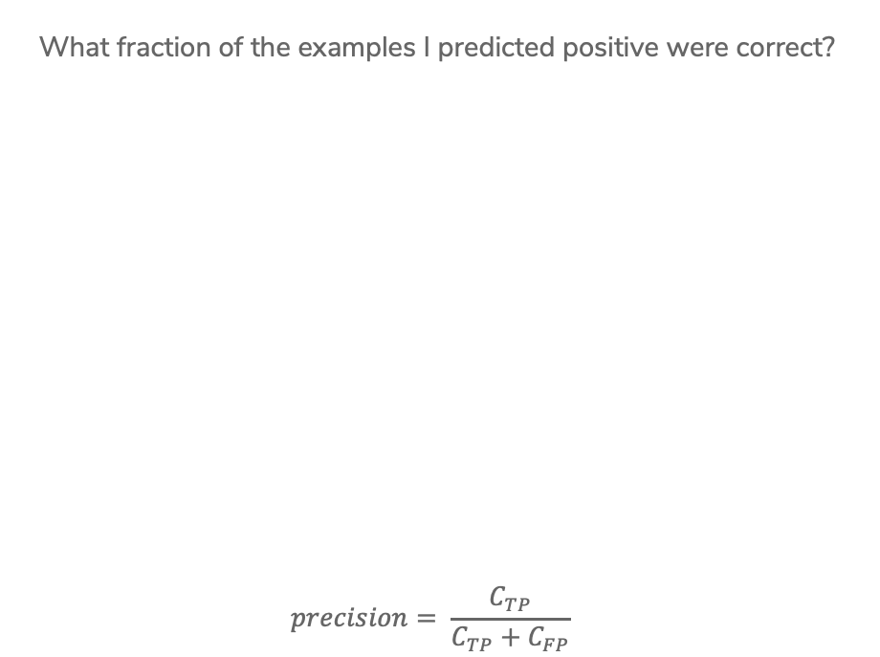

Precision
What fraction of the examples I predicted positive were correct?
$$precision= \frac{C_{TP}}{C_{TP}+C_{FP}}$$
Sentences predicted to be positive:
${\hat{y}}_{i}=+1$
Notes:
Calculate precision (4/ (2 + 4) = 2/3)
High precision means your positive predictions are trustworthy

Slide 20
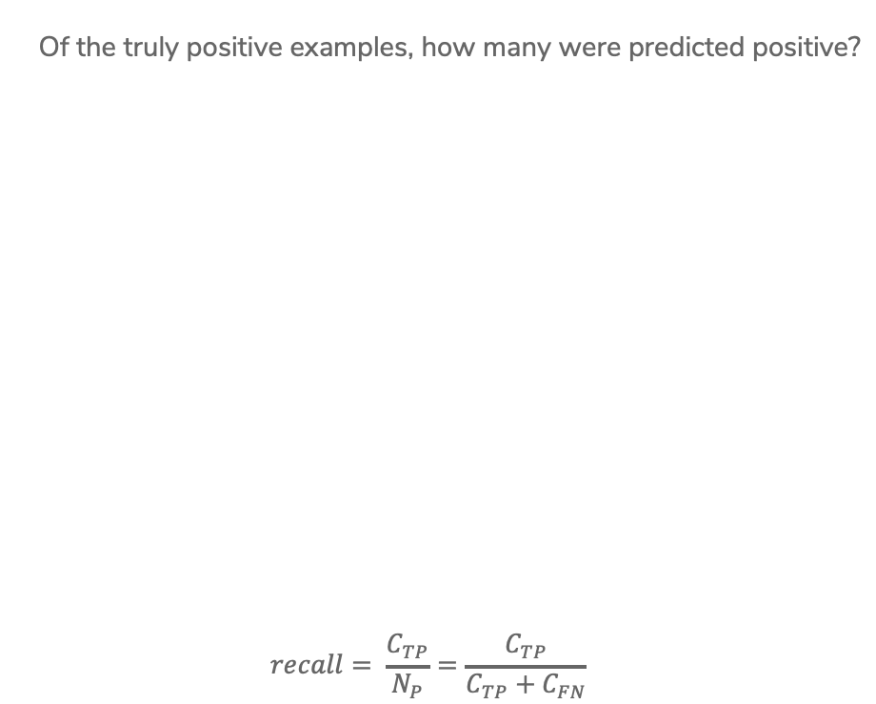
Recall
Of the truly positive examples, how many were predicted positive?
$$recall= \frac{C_{TP}}{N_{P}}=\frac{C_{TP}}{C_{TP}+C_{FN}}$$
Notes:
Calculate recall (4 / (4 + 2) = 2/3)
2 positive examples not shown
High recall means we are likely to “discover” all the positive examples

Slide 21


Precision & Recall
An optimistic model will predict almost everything as positive
High recall, low precision
A pessimistic model will predict almost everything as negative
High precision, low recall

Slide 22
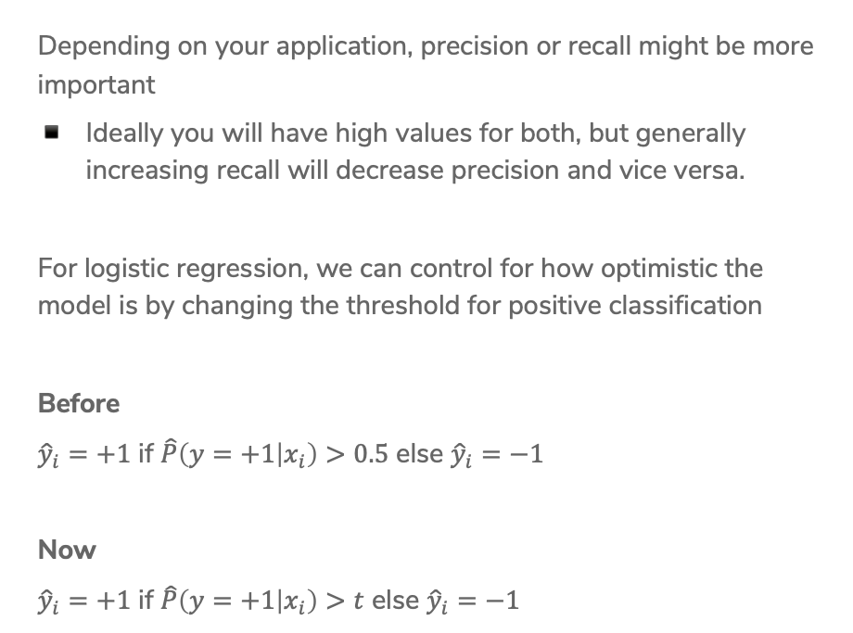
Controlling Precision/Recall
Depending on your application, precision or recall might be more important
Ideally you will have high values for both, but generally increasing recall will decrease precision and vice versa.
For logistic regression, we can control for how optimistic the model is by changing the threshold for positive classification
Before
${\hat{y}}_{i}=+1$ if $\hat{P}\left(y=+1 | x_{i}\right)>0.5$ else ${\hat{y}}_{i}=−1$
Now
${\hat{y}}_{i}=+1$ if $\hat{P}\left(y=+1 | x_{i}\right)>t$ else ${\hat{y}}_{i}=−1$

Slide 23
Precision-Recall Curve
Precision
1
0
Recall
0
1
Notes:
Draw in point for (1, 0) w/ smiley face
Draw in point for (0, 1) w/ frowny face
These are extremes, lets see how we can trade off between them

Slide 24
Precision-Recall Curve
Can try every threshold to get a curve like below

Slide 25
Precision-Recall Curve
Sometimes, Classifier B is strictly better than Classifier A

Slide 26
Precision-Recall Curve
Most times, the classifiers are incomparable

Slide 27
Compare Classifiers
Often come up with a single number to describe it
F1-score, AUC, etc.
Remember, what your application needs is most important
Also common to use precision at k
If you show the top k most likely positive examples, how many of them are true positives

Slide 28
CSE/STAT 416
Precision/Recall k-Nearest Neighbors
Tanmay Shah
Paul G. Allen School of Computer Science & Engineering
University of Washington
July 24, 2024
❓ Questions? Raise hand or sli.do #cs416
🎵 Listening to:

Slide 29
Roadmap
Housing Prices - Regression
  Regression Model
  Assessing Performance
  Ridge Regression
  LASSO
Sentiment Analysis – Classification
  Classification Overview
  Logistic Regression
  Bias / Fairness
  Decision Trees
  Ensemble Methods
Deep Learning
  Neural Networks
  Convolutional Neural
Document Retrieval – Clustering and Similarity
  Precision / Recall
  k-Nearest Neighbor
  Kernel Methods
  Locality Sensitive Hashing
  Clustering
  Hierarchical Clustering

Slide 30
Document Retrieval
Consider you had some time to read a book and wanted to find other books similar to that one.
If we wanted to write an system to recommend books
  How do we measure similarity?
  How do we search over books?
  How do we measure accuracy?
Big Idea: Define an embedding and a similarity metric for the books, and find the “nearest neighbor” to some query book.
Notes:
Could also return set of nearest neighbors (draw circle)

Slide 31
Nearest Neighbors

Slide 32
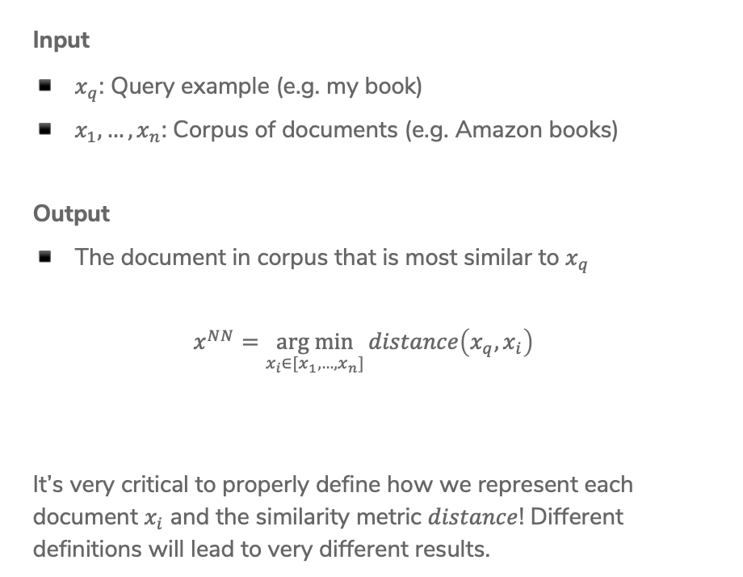
1-Nearest Neighbor
Input
$x_{q}$: Query example (e.g. my book)
$x_{1},…,x_{n}$: Corpus of documents (e.g. Amazon books)
Output
The document in corpus that is most similar to $x_{q}$
$$x^{NN}=\underset{x_{i}∈[x_{1},…,x_{n}]}{arg min}{distance\left(x_{q}, x_{i}\right)}$$
It’s very critical to properly define how we represent each document $x_{i}$ and the similarity metric $distance$! Different definitions will lead to very different results.
Notes:
Note about argmin vs min
Right now, we will use a hand-wavey notion of these documents and similarity, will dive in to how to represent them in a bit

Slide 33


1-Nearest Neighbor
How long does it take to find the 1-NN? About $n$ operations
Input: $x_{q}$
$x^{NN}=∅$
$nn_dist=∞$
$for x_{i}∈\left[x_{1}, …, x_{n}\right]:$
$dist=distance\left(x_{q}, x_{i}\right)$
$if dist<nn_dist:$
$x^{NN}=x_{i}$
$nn_dist=dist$
Output: $x^{NN}$
Notes:
Write O(n) above slide

Slide 34

k-Nearest Neighbors
Input
$x_{q}$: Query example (e.g. my book)
$x_{1},…,x_{n}$: Corpus of documents (e.g. Amazon books)
Output
List of $k$ documents most similar to $x_{q}$
Formally
Notes:
Write
X^k-NN = {x^(NN_1), x^(NN_2), …, x^(NN_k) }
For all x_i not in X^NN, distance(x_i, x_q) >= max_{j in [1,..k]} distance(x_q, x^NN_j)

Slide 35

k-Nearest Neighbors
Same idea as 1-NN algorithm, but maintain list of k-NN
Input: $x_{q}$
$X^{kNN}=[x_{1},…, x_{k}]$
$nn_dists=[dist\left(x_{1}, x_{q}\right), dist\left(x_{2},x_{q}\right), …, dist\left(x_{k}, x_{q}\right)]$
$for x_{i}∈\left[x_{k+1 }, …, x_{n}\right]:$
$dist=distance\left(x_{q}, x_{i}\right)$
$if dist<\max\left(nn_dists\right):$ $remove largest dist from X^{kNN} and nn_dists$
$add x_{i} to X^{kNN}and distance\left(x_{q}, x_{i}\right) to nn_dists$
Output: $X^{kNN}$

Slide 36

k-Nearest Neighbors
Can be used in many circumstances!
Retrieval
Return $X^{k−NN}$
Regression
$${\hat{y}}_{i}=\frac{1}{k}\sum_{j=1}^{k}{x^{NN_{j}}}$$
Classification
$${\hat{y}}_{i}=majority_class(X^{k−NN})$$
Notes:
Wednesday we will talk about classification/regression a bit more in depth

Slide 37
1.5 min
In the regression/classification settings, what is the relationship between k for k-NN and the bias/variance of the model? Each option completes the sentence “As k increases …”
Bias increases, Variance increases
Bias decreases, Variance increases
Bias increases, Variance decreases
Bias decreases, Variance decreases

Slide 38


Slide 39
Embeddings

Slide 40
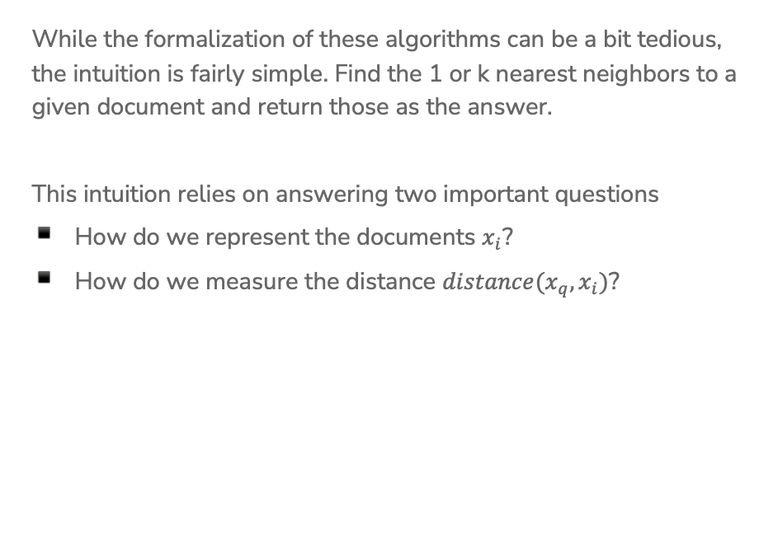
Important Points
While the formalization of these algorithms can be a bit tedious, the intuition is fairly simple. Find the 1 or k nearest neighbors to a given document and return those as the answer.
This intuition relies on answering two important questions
How do we represent the documents $x_{i}$?
How do we measure the distance $distance(x_{q}, x_{i})$?
Notes:
Write “embedding/representation” for first point
Write “distance metric” for second

Slide 41
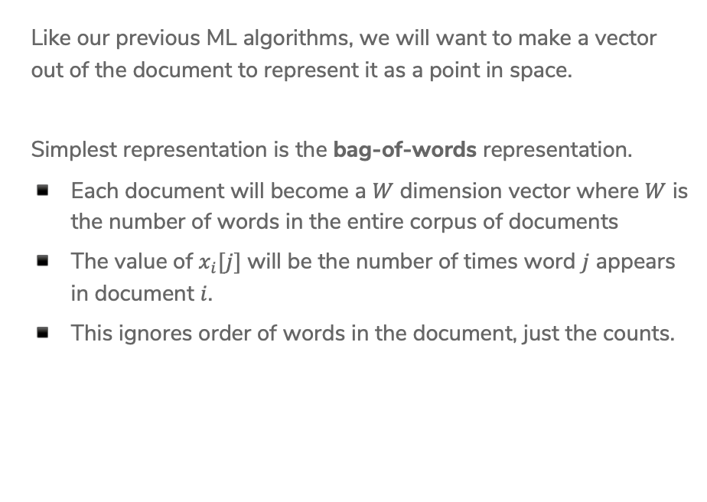
Document Representation
Like our previous ML algorithms, we will want to make a vector out of the document to represent it as a point in space.
Simplest representation is the bag-of-words representation.
Each document will become a $W$ dimension vector where $W$ is the number of words in the entire corpus of documents
The value of $x_{i}[j]$ will be the number of times word $j$ appears in document $i$.
This ignores order of words in the document, just the counts.
Notes:
Example Corpus
“I like dogs” => [1, 1, 1, 0]
“I like cats” => [1, 1, 0, 1]

Slide 42
Bag of Words
Pros
Very simple to describe
Very simple to compute
Cons
Common words like “the” and “a” dominate counts of uncommon words
Often it’s the uncommon words that uniquely define a doc.

Slide 43
TF-IDF
Goal: Emphasize important words
Appear frequently in the document (common locally)
Appears rarely in the corpus (rare globally)
Do a pair-wise multiplication to compute the TF-IDF for each word
Words that appear in every document will have a small IDF making the TF-IDF small!

Slide 44

1.5 min
What is the $TF−IDF(“rain”, Doc_{1})$ with the following documents (assume standard pre-processing)
Doc 1: It is going to rain today.
Doc 2: Today I am not going outside.
Doc 3: I am going to watch the season premiere.
Notes:
Full example: https://medium.com/analytics-vidhya/tf-idf-term-frequency-technique-easiest-explanation-for-text-classification-in-nlp-with-code-8ca3912e58c3
Answer: (1/6) * log(3/2) = 0.07

Slide 45
Distance

Slide 46
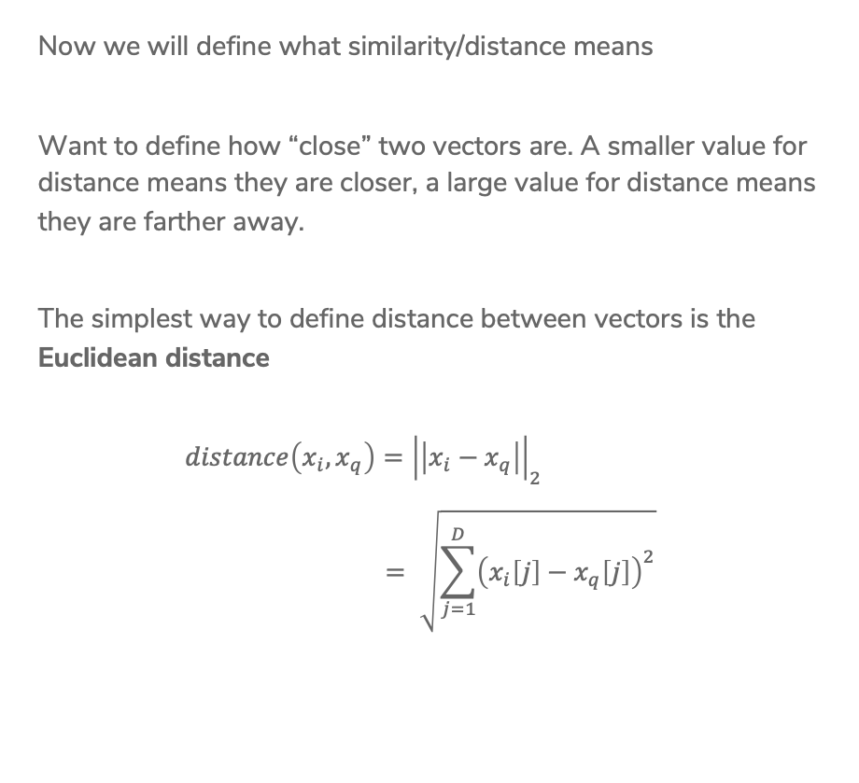
Euclidian Distance
Now we will define what similarity/distance means
Want to define how “close” two vectors are. A smaller value for distance means they are closer, a large value for distance means they are farther away.
The simplest way to define distance between vectors is the Euclidean distance
$$distance\left(x_{i}, x_{q}\right)={\left|\left|x_{i}−x_{q}\right|\right|}_{2} \\ = \sqrt{\sum_{j=1}^{D}{{\left(x_{i}\left[j\right]−x_{q}\left[j\right]\right)}^{2}}}$$
Notes:
Draw picture of this distance metric

Slide 47

Manhattan Distance
Another common choice of distance is the Manhattan Distance
$$distance\left(x_{i}, x_{q}\right)={\left|\left|x_{i}−x_{q}\right|\right|}_{1}$$
$$=\sum_{j=1}^{D}{\left|x_{i}\left[j\right]−x_{q}[j]\right|}$$

Slide 48
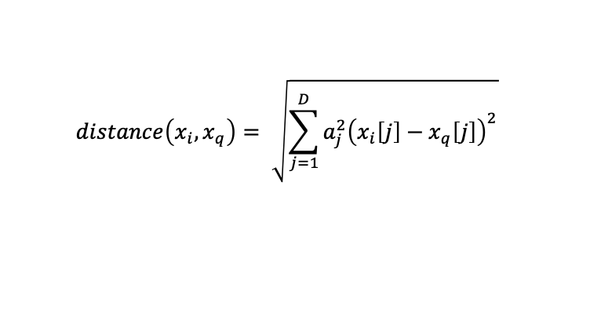
Weighted Distances
Some features vary more than others or are measured in different units. We can weight different dimensions differently to make the distance metric more reasonable.
Weighted Euclidean distance
$$distance\left(x_{i}, x_{q}\right)= \sqrt{\sum_{j=1}^{D}{{a_{j}^{2}\left(x_{i}\left[j\right]−x_{q}\left[j\right]\right)}^{2}}}$$
Notes:
Makes all units cancel out and on the same scale, so we don’t have to worry about one dimension affecting distance too much

Slide 49

Similarity
Another natural similarity measure would use
$x_{i}^{T}x_{q}=\sum_{j=1}^{D}{x_{i}\left[j\right]x_{q}[j]}$
Notice this is a measure of similarity, not distance
This means a bigger number is better

Slide 50
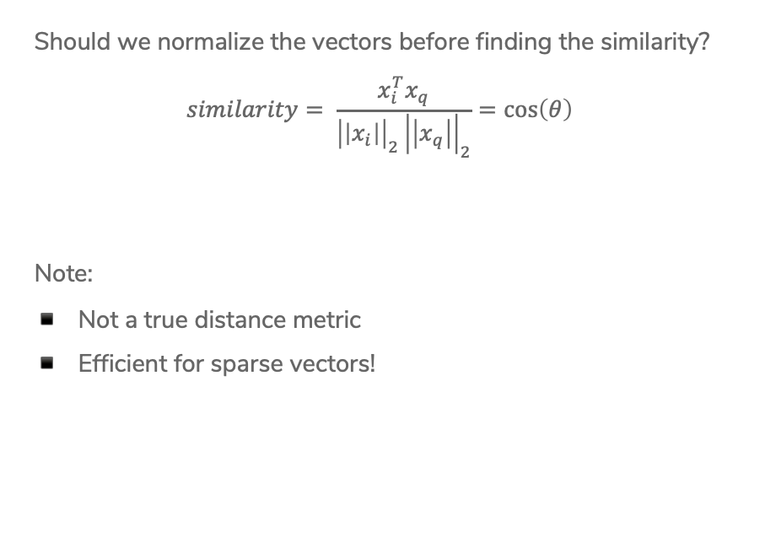
Cosine Similarity
Should we normalize the vectors before finding the similarity?
$$similarity= \frac{x_{i}^{T}x_{q}}{{\left|\left|x_{i}\right|\right|}_{2}{\left|\left|x_{q}\right|\right|}_{2}}=\cos\left(θ\right)$$
Note:
Not a true distance metric
Efficient for sparse vectors!
Notes:
Draw lines with theta

Slide 51

Cosine Similarity
In general
$$−1≤cosine similarity≤1$$
For positive features (like TF-IDF)
$$0≤cosine similarity≤1$$
Define
$$distance=1 −similarity$$
Notes:
Draw three graphs
Two points right next to each other, cos(theta) ~ 1
Two points at 10 and 2, cos(theta) ~ 0
Two points at 2 and 7 , cos(theta) ~-1

Slide 52
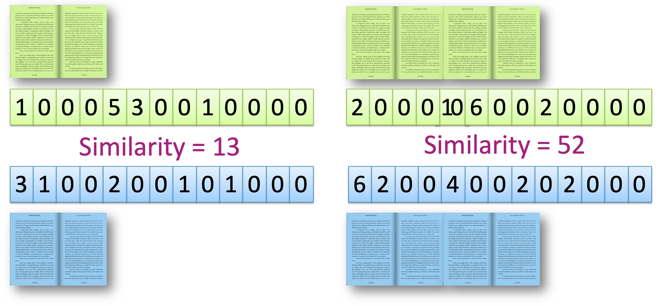
To Normalize or
Not To Normalize?
Not normalized

Slide 53
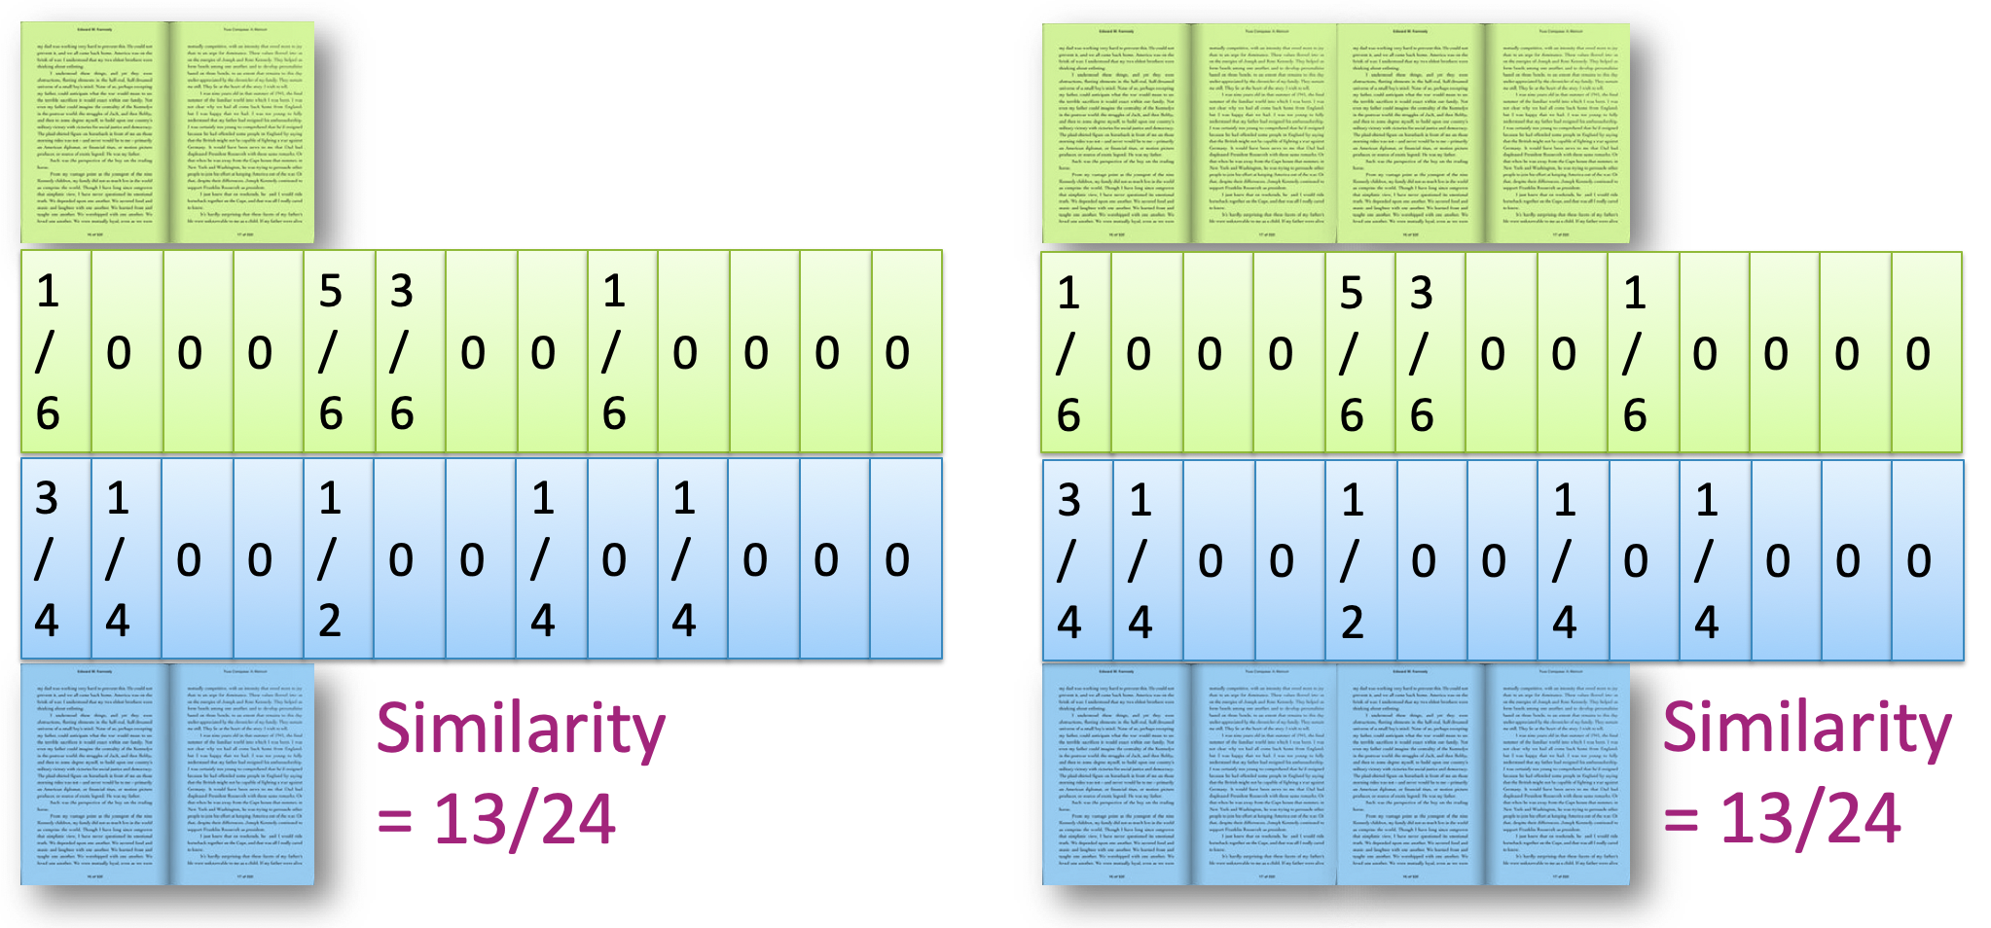
To Normalize or
Not To Normalize?
Normalized

Slide 54
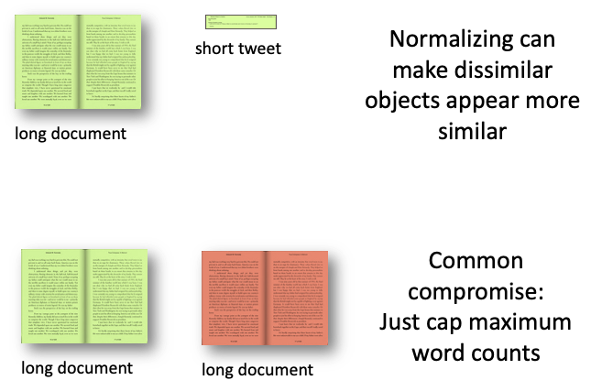
To Normalize or
Not To Normalize?
Normalization is not desired when comparing documents of different sizes since it ignores length.
In practice, can use multiple distance metrics and combine them using some defined weights

Slide 55
3 min
Not a real Poll Everywhere question, just time to work!
For the given documents, what are their Euclidean Distance and Cosine Similarity?
Assume we are using a bag of words representation
Document 1: “I really like dogs”
Document 2: “dogs are really really awesome”
Steps:
Write out bag of words vectors
Compute Euclidean distance
Compute Cosine similarity

Slide 57
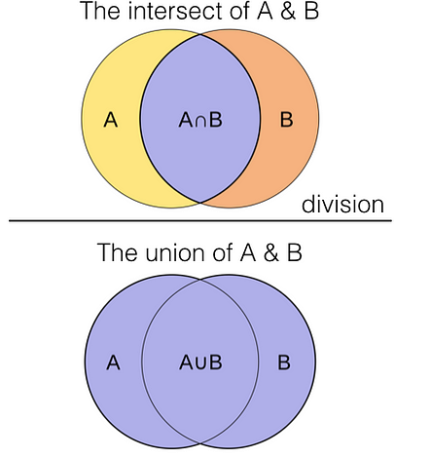
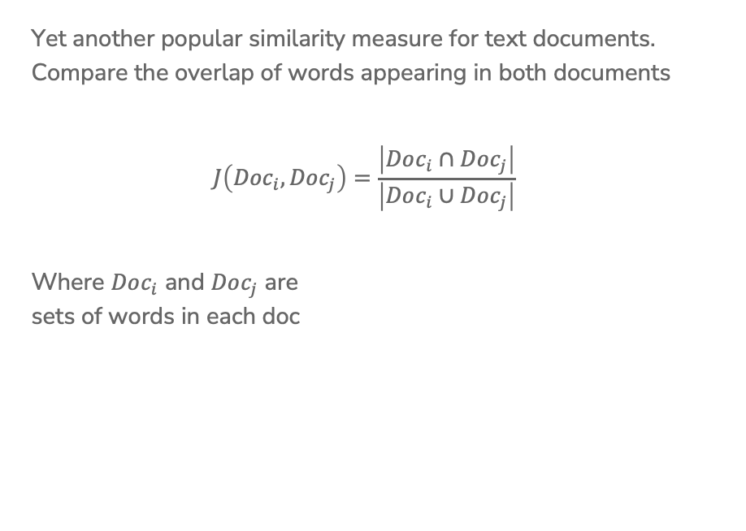
Jaccard Similarity
Yet another popular similarity measure for text documents. Compare the overlap of words appearing in both documents
$$J\left({Doc}_{i}, {Doc}_{j}\right)=\frac{\left|Doc_{i}∩Doc_{j}\right|}{\left|Doc_{i}∪Doc_{j}\right|}$$
Where $Doc_{i}$ and $Doc_{j}$ are
sets of words in each doc
Source: Uniqtech - Medium

Slide 58
Recap
Theme: Use nearest neighbors to recommend documents.
Ideas:
Precision and Recall Curves
Implement a nearest neighbor algorithm
Compare and contrast different document representations
  Emphasize important words with TF-IDF
Compare and contrast different measurements of similarity
  Euclidean and weighted Euclidean
  Cosine similarity and inner-product similarity

Slide 59
CSE/STAT 416
Local Methods
Locality Sensitive Hashing
Pre-Class Video
Tanmay Shah
Paul G. Allen School of Computer Science & Engineering
University of Washington
July 24, 2024

Slide 60
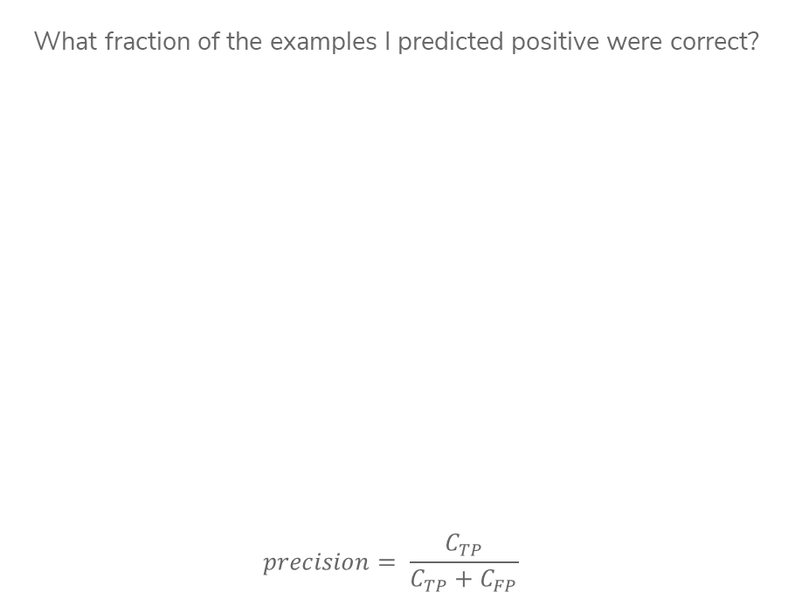
Precision
What fraction of the examples I predicted positive were correct?
$$precision= \frac{C_{TP}}{C_{TP}+C_{FP}}$$
Sentences predicted to be positive:
${\hat{y}}_{i}=+1$
Notes:
Calculate precision (4/ (2 + 4) = 2/3)
High precision means your positive predictions are trustworthy

Slide 61
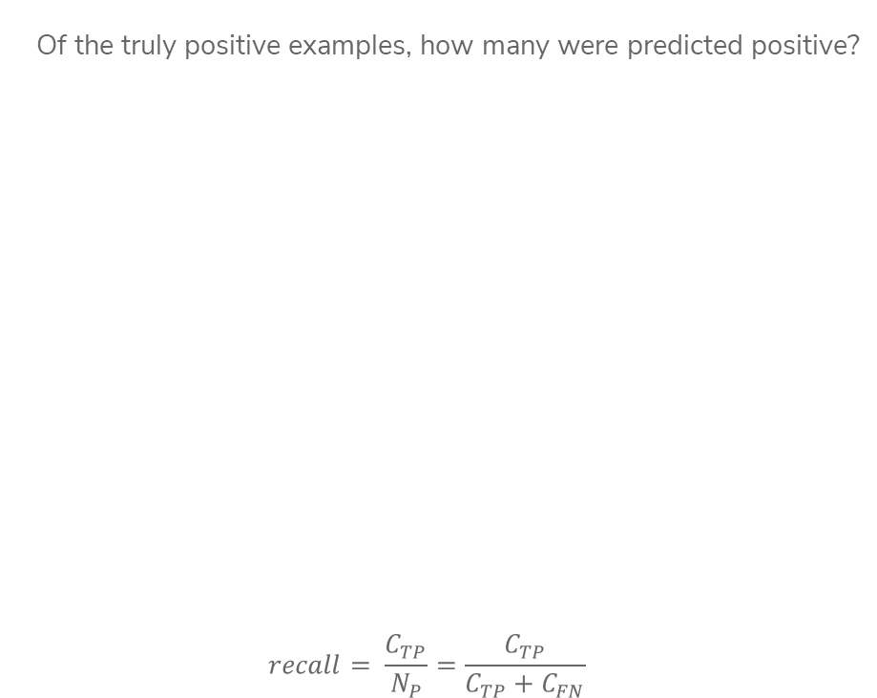
Recall
Of the truly positive examples, how many were predicted positive?
$$recall= \frac{C_{TP}}{N_{P}}=\frac{C_{TP}}{C_{TP}+C_{FN}}$$
Notes:
Calculate recall (4 / (4 + 2) = 2/3)
2 positive examples not shown
High recall means we are likely to “discover” all the positive examples

Slide 62
Document Retrieval
Consider you had some time to read a book and wanted to find other books similar to that one.
If we wanted to write an system to recommend books
  How do we measure similarity?
  How do we search over books?
  How do we measure accuracy?
Big Idea: Define an embedding and a similarity metric for the books, and find the “nearest neighbor” to some query book.
Notes:
Could also return set of nearest neighbors (draw circle)

Slide 63
Predicting House Prices
When we saw regression before, we assumed there was some linear/polynomial function that produced the data. All we had to do was choose the right polynomial degree.
Notes:
Draw curve vs 1-NN line

Slide 64
Predicting House Prices
What if instead, we didn’t try to find the global structure, but instead just tried to infer values using local information instead.
Big Idea: Use 1-nearest neighbor to predict the price of a house.
Not actually a crazy idea, something realtors do sometimes!
Notes:
Draw curve vs 1-NN line

Slide 65

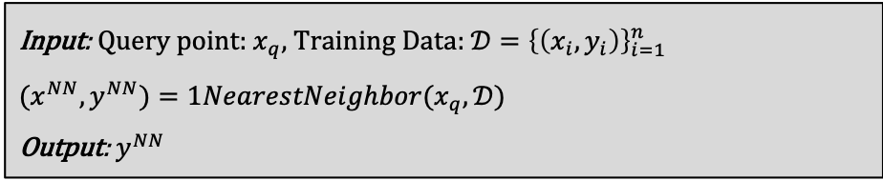
1-NN Regression
Where $1NearestNeighbor$ is the algorithm described yesterday to find the single nearest neighbor of a point.
Input: Query point: $x_{q}$, Training Data: ${𝒟=\left\{\left(x_{i},y_{i}\right)\right\}}_{i=1}^{n}$
${(x}^{NN}, y^{NN})=1NearestNeighbor(x_{q},𝒟)$
Output: $y^{NN}$
Notes:
Write O(n) above slide

Slide 66
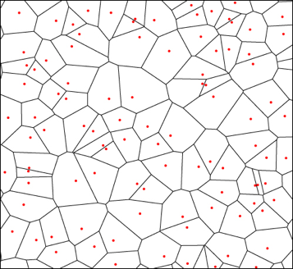
Visualizing 1-NN Regression
The function learned by 1-NN is “locally constant” in each region nearest to each training point.
Can visualize this with a Voronoi Tessellation
Shows all of the points that are “closest” to a particular training point
Not actually computed in practice, but helps understand

Slide 67
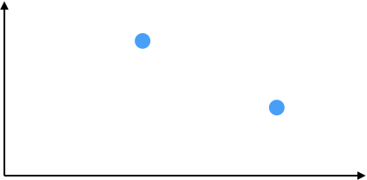


Visualizing 1-NN Regression
Like last time, how you define “closest” changes predictions

Slide 68
1-NN Regression
Weaknesses
Inaccurate if data is sparse
Can wildly overfit

Slide 69
1-NN Classification
Can we use the same algorithm for classification? Yes!
Predict the class of the nearest neighbor. Besides that, exactly the same as regression.

Slide 70
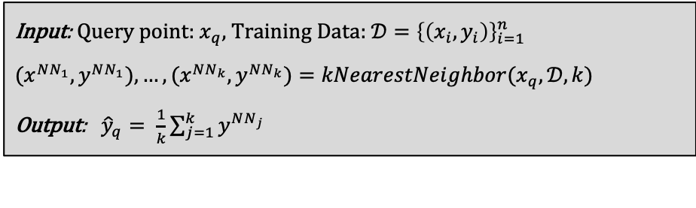
Prevent Overfitting
The downfalls of 1-NN come from it relies too much on a single data point (the nearest neighbor), which makes it susceptible to noise in the data.
More reliable estimate if you look at more than one house!
Input: Query point: $x_{q}$, Training Data: ${𝒟=\left\{\left(x_{i},y_{i}\right)\right\}}_{i=1}^{n}$
${(x}^{NN_{1}}, y^{NN_{1}}), …,(x^{NN_{k}}, y^{NN_{k}})=kNearestNeighbor(x_{q},𝒟, k)$
Output: ${\hat{y}}_{q}= \frac{1}{k}\sum_{j=1}^{k}{y^{NN_{j}}}$

Slide 71

k-NN Regression
By using a larger $k$, we make the function a bit less crazy
Still discontinuous though (neighbor is either in or out)
Boundaries are still sort of a problem

Slide 72
Issues with k-NN
While k-NN can solve some issues that 1-NN has, it brings some more to the table.
Have to choose right value of k.
  If k is too large, model is too simple
Discontinuities matter in many applications
  The error might be good, but would you believe a price jump for a 2640 sq.ft. house to a 2641 sq.ft. house?
Seems to do worse at the boundaries still

Slide 73
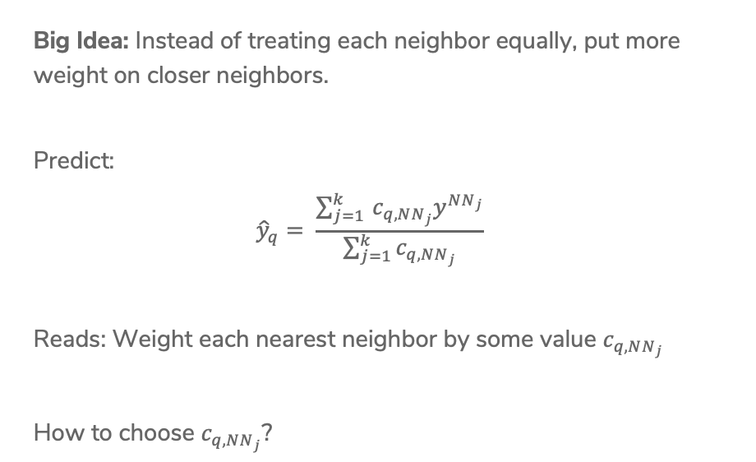
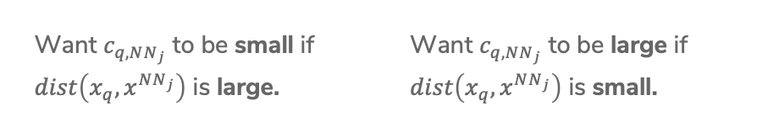
Weighted k-NN
Big Idea: Instead of treating each neighbor equally, put more weight on closer neighbors.
Predict:
$${\hat{y}}_{q}= \frac{\sum_{j=1 }^{k}{c_{q, NN_{j}}y^{NN_{j}}}}{\sum_{j=1}^{k}{c_{q,NN_{j}}}}$$
Reads: Weight each nearest neighbor by some value $c_{q,NN_{j}}$
How to choose $c_{q, NN_{j}}$?
Want $c_{q, NN_{j}}$ to be small if
$dist\left(x_{q}, x^{NN_{j}}\right)$ is large.
Want $c_{q, NN_{j}}$ to be large if
$dist\left(x_{q}, x^{NN_{j}}\right)$ is small.
Notes:
One idea is 1/dist

Slide 74

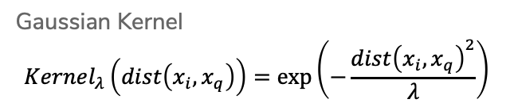

Kernels
Use a function called a kernel to turn distance into weight that satisfies the properties we listed before.
$$c_{q,NN_{j}}=Kernel_{λ}(dist\left(x_{q}, x^{NN_{j}}\right))$$
$−λ$ $0$ $λ$
Gaussian Kernel
$$Kernel_{λ}\left(dist\left(x_{i}, x_{q}\right)\right)=exp⁡\left(−\frac{dist{\left(x_{i}, x_{q}\right)}^{2}}{λ}\right)$$
Notes:
Write \lambda is “bandwidth” (controls “width” of kernel)
Point out Boxcar/triangle/gaussian

Slide 75

Kernel Regression
We can take this one step farther, instead of just using a kernel to weight the k nearest neighbors, can use the kernel to weight all training points! This is called kernel regression.
${\hat{y}}_{q}=\frac{\sum_{i=1}^{n}{c_{q,i}y_{i}}}{\sum_{i=1}^{n}{c_{q,i}}}=\frac{\sum_{i=1}^{n}{Kernel_{λ}\left(dist\left(x_{i}, x_{q}\right)\right)y_{i}}}{\sum_{i=1}^{n}{Kernel_{λ}\left(dist\left(x_{i}, x_{q}\right)\right)}}$

Slide 76

Visualizing Kernel Regression
This kernel has bounded support, only look at values $±λ$ away
Notes:
Write smooth!

Slide 77

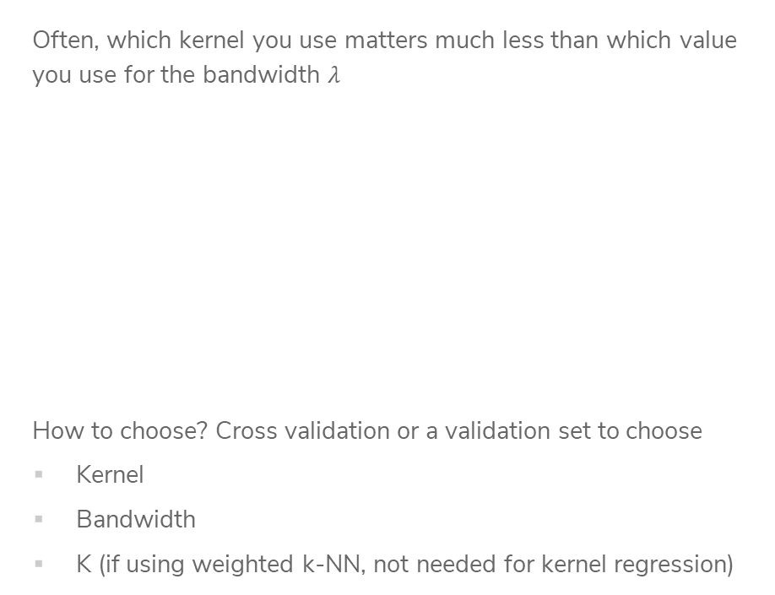
Choose Bandwidth $λ$
Often, which kernel you use matters much less than which value you use for the bandwidth $λ$
How to choose? Cross validation or a validation set to choose
Kernel
Bandwidth
K (if using weighted k-NN, not needed for kernel regression)
Notes:
Point out switch to boxcar in the middle, but fit looks like it’s in between the two

Slide 78
CSE/STAT 416
Local Methods
Locality Sensitive Hashing
Tanmay Shah
Paul G. Allen School of Computer Science & Engineering
University of Washington
July 24, 2024
❓ Questions? Raise hand or sli.do #cs416
🎵 Listening to: Dua Lipa

Slide 79
1-NN Regression
Weaknesses
Inaccurate if data is sparse
Can wildly overfit

Slide 80
Weighted k-NN
Big Idea: Instead of treating each neighbor equally, put more weight on closer neighbors.
Predict:
$${\hat{y}}_{q}= \frac{\sum_{j=1 }^{k}{c_{q, NN_{j}}y^{NN_{j}}}}{\sum_{j=1}^{k}{c_{q,NN_{j}}}}$$
Reads: Weight each nearest neighbor by some value $c_{q,NN_{j}}$
How to choose $c_{q, NN_{j}}$?
Want $c_{q, NN_{j}}$ to be small if
$dist\left(x_{q}, x^{NN_{j}}\right)$ is large.
Want $c_{q, NN_{j}}$ to be large if
$dist\left(x_{q}, x^{NN_{j}}\right)$ is small.
Notes:
One idea is 1/dist

Slide 81
Kernels
Use a function called a kernel to turn distance into weight that satisfies the properties we listed before.
$$c_{q,NN_{j}}=Kernel_{λ}(dist\left(x_{q}, x^{NN_{j}}\right))$$
$−λ$ $0$ $λ$
Gaussian Kernel
$$Kernel_{λ}\left(dist\left(x_{i}, x_{q}\right)\right)=exp⁡\left(−\frac{dist{\left(x_{i}, x_{q}\right)}^{2}}{λ}\right)$$
Notes:
Write \lambda is “bandwidth” (controls “width” of kernel)
Point out Boxcar/triangle/gaussian

Slide 82
Visualizing Kernel Regression
This kernel has bounded support, only look at values $±λ$ away
Notes:
Write smooth!

Slide 83
1.5 min
In a few sentences, compare and contrast the following ML models.
k-Nearest Neighbor Regression
Weighted k-Nearest Neighbor Regression
Kernel Regression

Slide 84
3 min
In a few sentences, compare and contrast the following ML models.
k-Nearest Neighbor Regression
Weighted k-Nearest Neighbor Regression
Kernel Regression

Slide 85
Efficient Nearest Neighbors

Slide 86
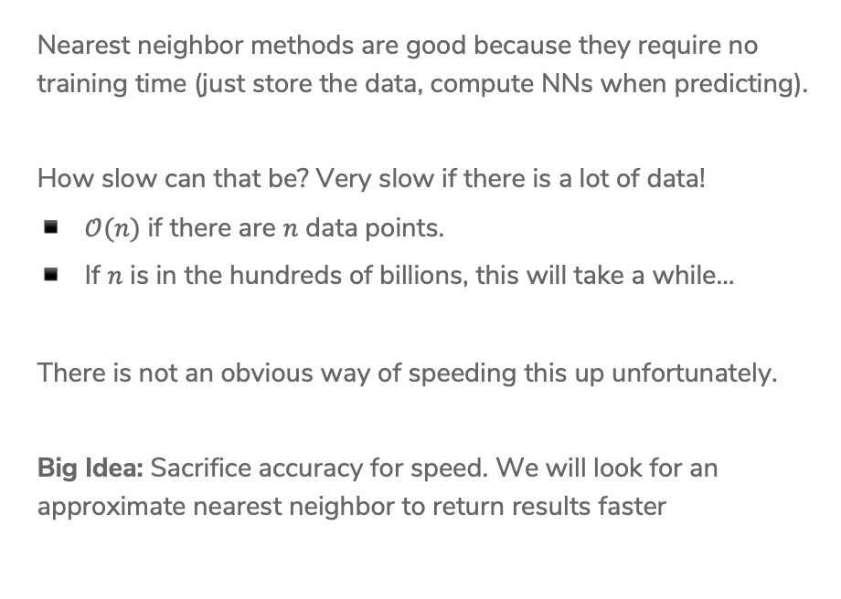
Nearest Neighbor Efficiency
Nearest neighbor methods are good because they require no training time (just store the data, compute NNs when predicting).
How slow can that be? Very slow if there is a lot of data!
$𝒪(n)$ if there are $n$ data points.
If $n$ is in the hundreds of billions, this will take a while…
There is not an obvious way of speeding this up unfortunately.
Big Idea: Sacrifice accuracy for speed. We will look for an approximate nearest neighbor to return results faster

Slide 87
Approximate Nearest Neighbor
Don’t find the exact NN, find one that is “close enough”.
Many applications are okay with approximate answers
The measure of similarity is not perfect
Clients probably can’t tell the difference between the most similar book and a book that’s pretty similar.
We will use locality sensitive hashing to answer this approximate nearest neighbor problem.
High level approach
Design an algorithm that yields a close neighbor with high probability
These algorithms usually come with a “guarantee” of what probability they will succeed, won’t discuss that in detail but is important when making a new approximation algorithm.

Slide 88
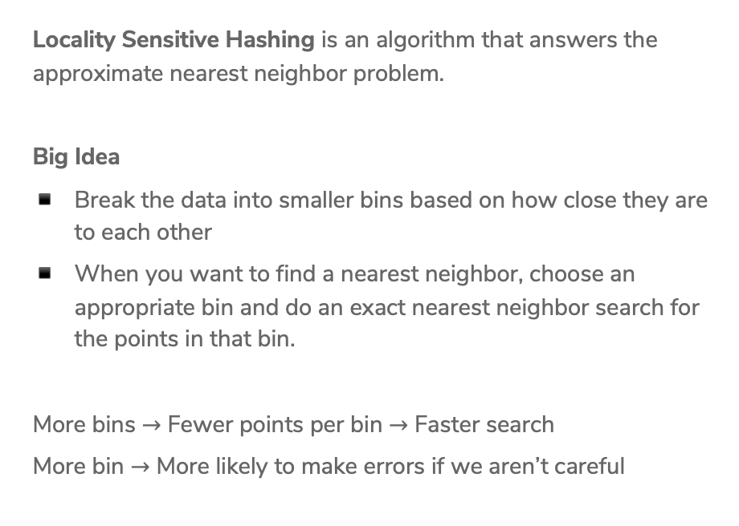
Locality Sensitive Hashing (LSH)
Locality Sensitive Hashing is an algorithm that answers the approximate nearest neighbor problem.
Big Idea
Break the data into smaller bins based on how close they are to each other
When you want to find a nearest neighbor, choose an appropriate bin and do an exact nearest neighbor search for the points in that bin.
More bins $→$ Fewer points per bin $→$ Faster search
More bin $→$ More likely to make errors if we aren’t careful

Slide 89

Binning
How do we make the bins?
What if we pick some line that separates the data and then put them into bins based on the $Score(x)$ for that line?
Looks like classification, but we don’t have labelled data here. Will explain shortly how to find this line.

Slide 90
Binning
Put the data in bins based on the sign of the score (2 bins total)
Call negative score points bin 0, and the other bin 1 (bin index)

Slide 91

Binning
Put the data in bins based on the sign of the score (2 bins total)
Call negative score points bin 0, and the other bin 1 (bin index)
When asked to find neighbor for query point, only search through points in the same bin!
This reduces the search time to $\frac{n}{2}$ if we choose the line right.

Slide 92

LSH with
2 bins
Create a table of all data points and calculate their bin index based on some chosen line
Store it in a hash table for fast lookup
When searching for a point $x_{q}$:
Find its bin index based on that line
Search over the points in that bin

Slide 93










1 min
If we used LSH with this line, what would be the result returned for searching for the nearest neighbor of the green query point?
$$3$$
$$5$$
$$4$$
$$2$$
$$9$$
$1$0
$$1$$
$$6$$
$$8$$
$$7$$

Slide 94
Some Issues
How do we find a good line that divides the data in half?
Potential Errors: Points close together might be split up into separate bins
Large computation cost: Only dividing the points in half doesn’t speed things up that much…

Slide 95

1. How to choose line?
Wild Idea: Choose the line randomly!
Choose a slope randomly between 0 and 90 degrees
How bad can randomly picking it be?
If two points have a small cosine distance, it is unlikely that we will split them into different bins!
Notes:
Draw random lines

Slide 96
Some Issues
How do we find a good line that divides the data in half?
Potential Errors: Points close together might be split up into separate bins
Large computation cost: Only dividing the points in half doesn’t speed things up that much…

Slide 97


Slide 98

More Bins
Can reduce search cost by adding more lines, increasing the number of bins.
For example, if we use 3 lines, we can make more bins!

Slide 99

LSH with
Many Bins
Create a table of all data points and calculate their bin index based on some chosen lines. Store points in hash table indexed by all bin indexes
When searching for a point $x_{q}$:
Find its bin index based on the lines
Only search over the points in that bin
Notes:
Note about binary

Slide 100
LSH Example
Imagine my query point was (2, 2)
This has bin index [0 1 0]
By using multiple bins, we have reduced the search time!
However, it’s more likely that we separate points from their true nearest neighbors since we do more splits ☹
Often with approximate methods, there is a tradeoff between speed and accuracy.

Slide 101
Improve Quality
The nice thing about LSH is we can actually tune this tradeoff by looking at nearby bins. If we spend longer searching, we are likely to find a better answer.
What does ”nearby” mean for bins?
In practice, set some time “budget” and
keep searching nearby bins until budget
runs out
Notes:
Draw going out to 2 bits

Slide 102

Locality Sensitive Hashing (LSH)
Pre-Processing Algorithm
Draw $h$ lines randomly
For each data point, compute $Score\left(x_{i}\right)$ for each line
Translate the scores into binary indices
Use binary indices as a key to store the point in a hash table
Querying LSH
For query point $x_{q}$ compute $Score(x_{q})$ for each of the $h$ lines
Translate scores into binary indices. Lookup all data points that have the same key.
Do exact nearest neighbor search just on this bin.
If there is more time in the computation budget, go look at nearby bins until this budget runs out.

Slide 103


Higher Dimensions
Pick random hyper-plane to separate points for points in higher dimensions.
Unclear how to pick $h$ for LSH and you can’t do cross-validation here (why?)
Generally people use $h≈\log{(d)}$

Slide 104
Recap
Theme: Use local methods for classification and regression and speed up nearest neighbor search with approximation methods.
Ideas:
1-NN Regression and Classification
k-NN Regression and Classification
Weighted k-NN vs Kernel Regression
Locality Sensitive Hashing

Slide 105
Curse of Dimensionality

Slide 106
High Dimensions
Methods like k-NN and k-means that rely on computing distances start to struggle in high dimensions.
As the number of dimensions grow, the data gets sparser!
Need more data to make sure you cover all the space in high dim.
Notes:
To cover 20% of the range, need 20% of the complete population
If we add another feature but still want to cover 20% of the possible space, would need 45% coverage for each feature! (0.45^2 = 0.2)
In 3 dimensions, would need coverage over 58% of each feature
Write down that n approx. O(2^d)

Slide 107

Even Weirder
It’s believable with more dimensions the data becomes more sparse, but what’s even weirder is the sparsity is not uniform!
As $D$ increases, the “mass” of the space goes towards the corners.
Most of the points aren’t in the center.
Your nearest neighbors start looking like your farthest neighbors!
Notes:
For an 8-dimensional hypercube, about 98% of the data is concentrated in its 256 corners.

Slide 108

Practicalities
Have you pay attention to the number of dimensions
Very tricky if $n<D$
Can run into some strange results if $D$ is very large
Later, we will talk about ways of trying to do dimensionality reduction in order to reduce the number of dimensions here.

Slide 109
HW5 – ML Practice with Kaggle
Kaggle is a website that hosts ML competitions. Very popular among people trying to learn more about ML! Let’s you practice a lot of real-world ML skills on challenging problems.
About halfway through the course, want to give you a chance to apply what you’ve learned in the real-world! HW6 will be hosted as an internal Kaggle competition.
TAs in section tomorrow will walk through how to do submissions, but all instructions are on the Kaggle website (linked from HW spec).
NOT graded as a competition. The leaderboard is just for fun, and we will provide a small amount of EC to the top 3 teams.

Slide 110
Submission and Grading
You will need to submit three things:
On Kaggle, submit your predictions for the test set
On Gradescope, submit your Jupyter Notebook that trains/evaluates your models and answers some questions we asked you to answer.
On Gradescope, submit concept questions.
Part of your grade will be from the accuracy on the private test set. Will count 95% accuracy on the private test set as full credit for the performance part of the assignment.

Slide 111
Groups
You will be able to work on the Kaggle portion with a team of up to 3 people. You can work alone if you choose, but we recommend working with a team since that’s a great learning experience!
If you work as a team, you can make a team submission on Kaggle and submit your code/report answers on Gradescope together.
Concept portion should be done individually.

