Slide 1
CSE/STAT 416
Introduction + Regression
Tanmay Shah
University of Washington
March 27, 2024
💬 Before Class: Introduce yourself to your neighbors! What are you excited to learn about this quarter?
🎵 Listening to: The Golf Club

Slide 2
Machine Learning is changing the world.

Slide 3
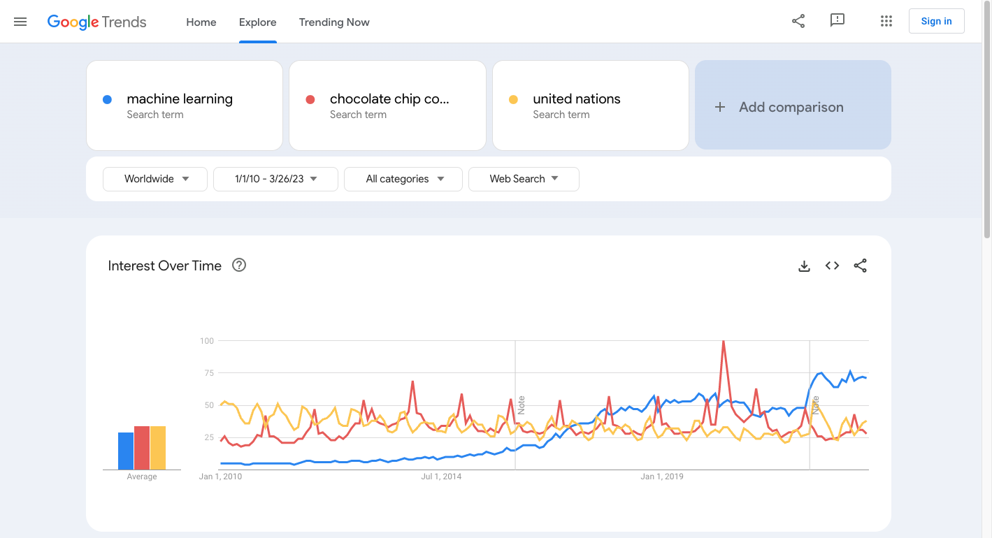

Slide 4
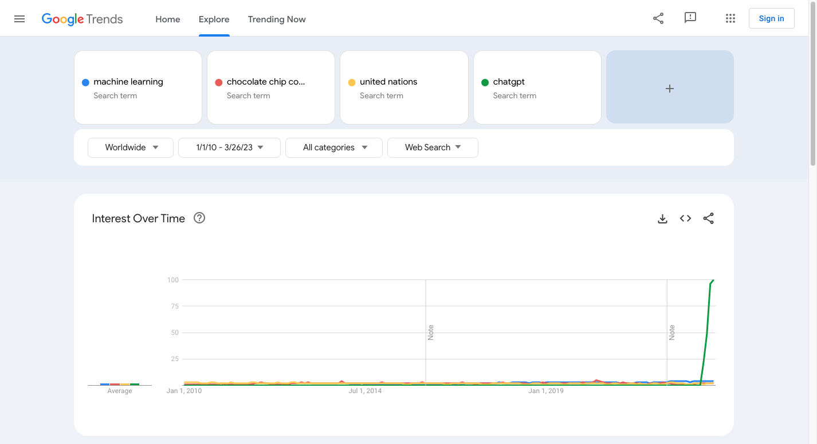

Slide 5














It’s Everywhere!
Retail
Coupons
Search
Movie Distribution
Campaigning
Real Estate
Legal Advice
Advertising
Human Resources
Dating
Networking
Disruptive companies
differentiated by
INTELLIGENT
APPLICATIONS
using
Machine Learning
CRM
Music
Wearables
Notes:
Source: https://makemeanalyst.com/list-of-disruptive-companies-differentiated-by-intelligent-applications-using-machine-learning/ (2017)

Slide 6
It’s Everywhere…

Slide 7
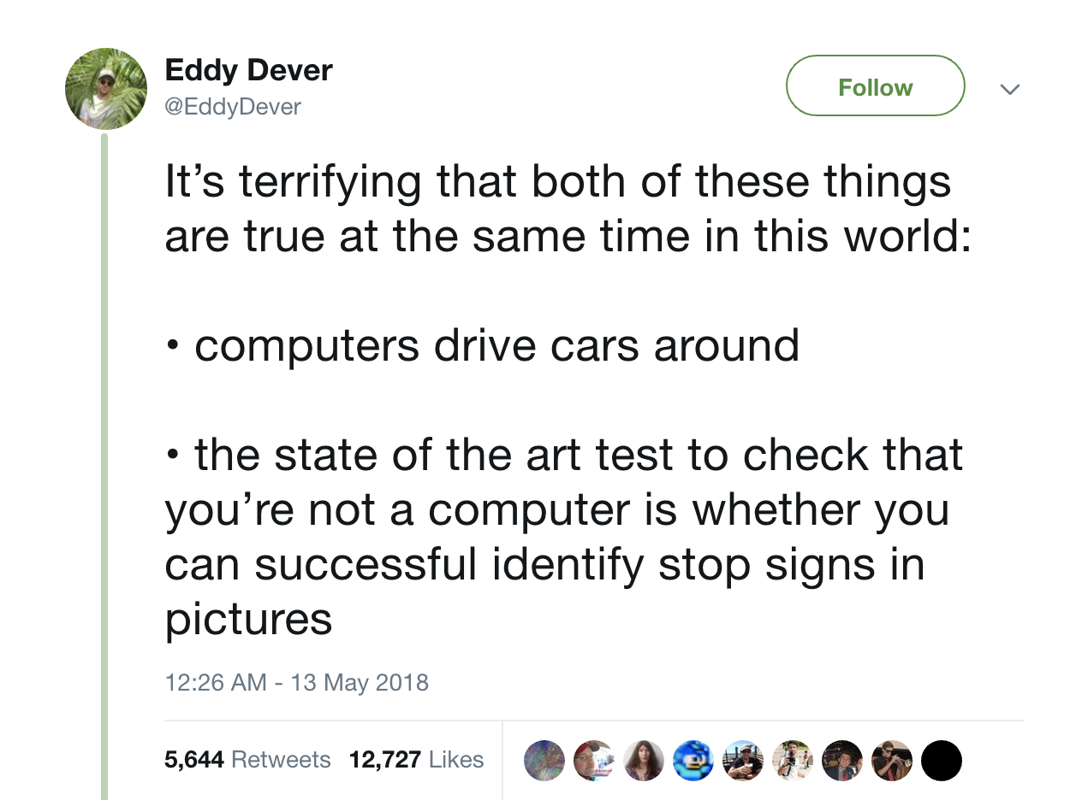
It’s Everywhere…

Slide 8

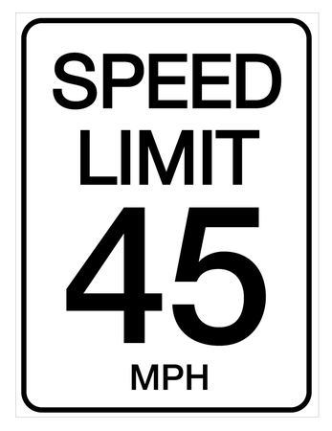
It’s Everywhere…
Object Detection
Notes:
Source: https://www.caranddriver.com/news/a15340148/researchers-find-a-malicious-way-to-meddle-with-autonomous-cars/

Slide 9
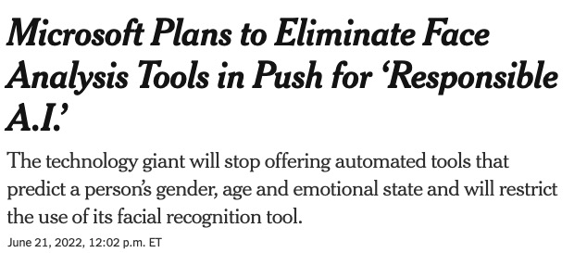
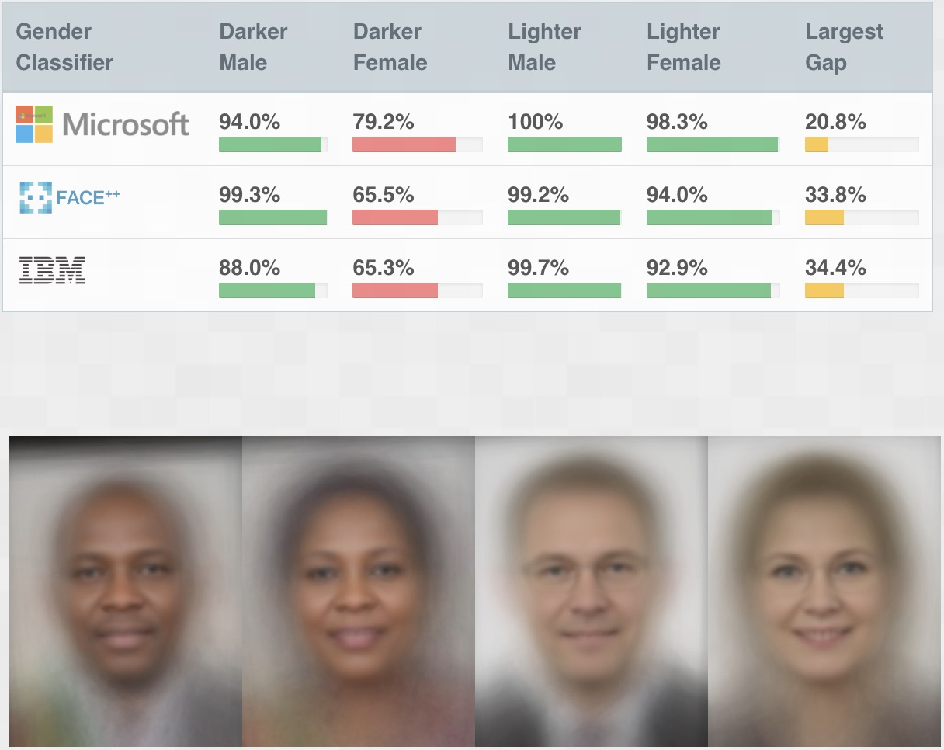
It’s Everywhere…
Face Detection
Notes:
Landmark 2018 paper, Joy Buolamwini, Timnit Gebru
Why? Datasets were not diverse.
Big real-world implications: fake account detection, dating apps, photo-matching for criminal investigations, etc.
Doesn’t begin to cover the reality that gender expression is much more diverse than the binary.

Slide 10
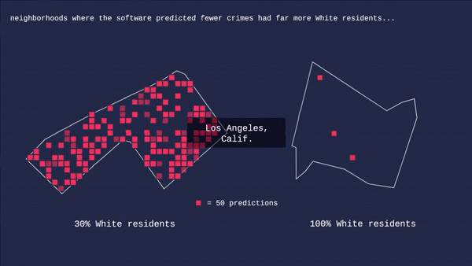
It’s Everywhere…
Predictive Policing
Notes:
PredPol, used by dozens of cities across the US
Neighborhoods that they deploy police in are disproportionally Black, Latino, and/or poor
Not only is the dataset biased, but that bias becomes self-reinforcing when police are disproportionately deployed in marginalized communities.
Source: https://gizmodo.com/how-we-determined-predictive-policing-software-dispropo-1848139456

Slide 11
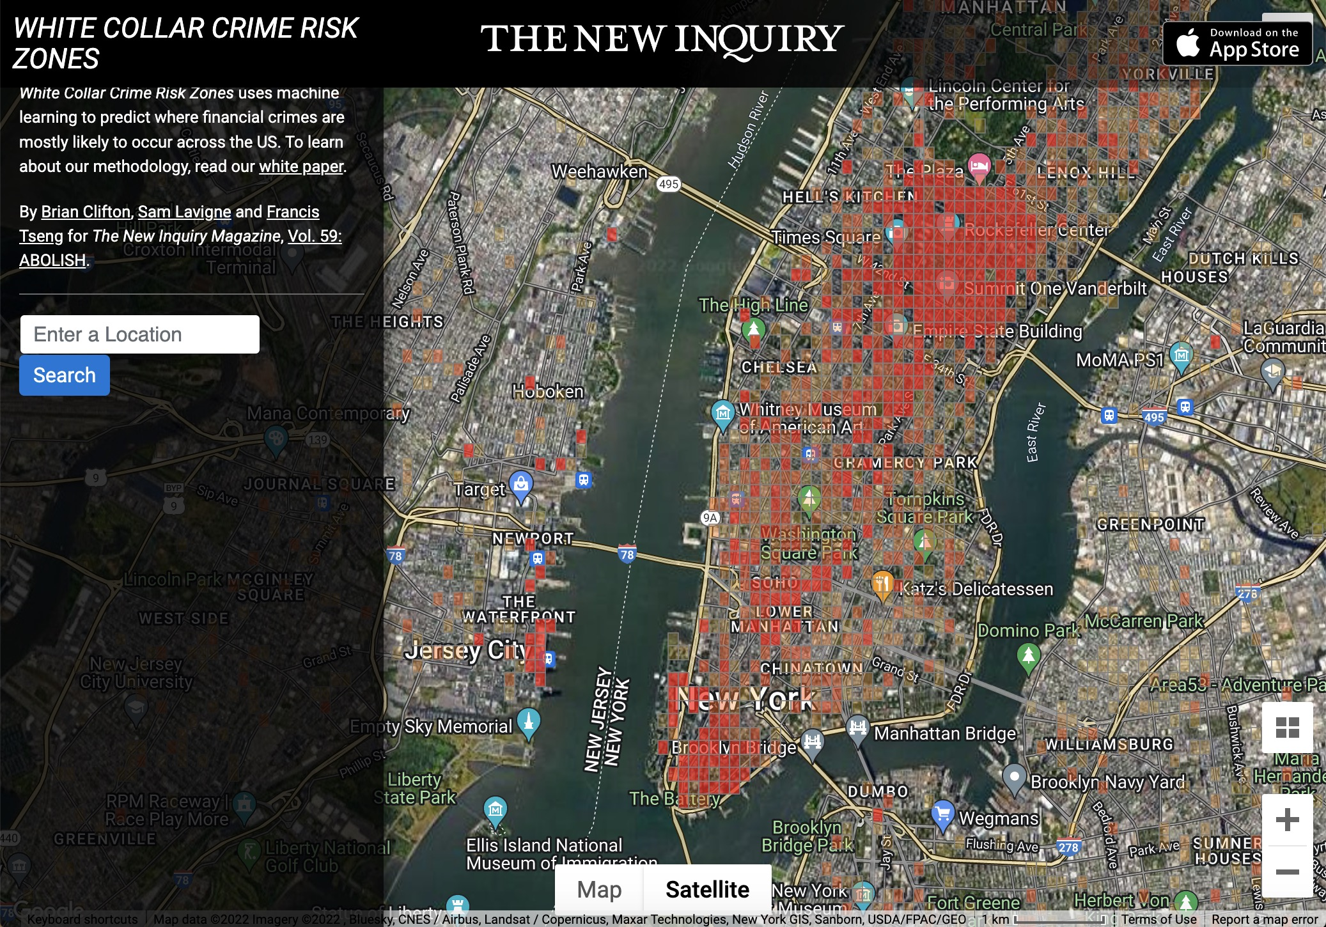
It’s Everywhere…
Predictive Policing
Notes:
But even the way we define crime is socially determined. When we think of crime maps, we often think of bulgaries, battery, car break-ins, etc. And that is what these predictive policing apps also focus on. But this is actually a map that uses machine learning to predict white-collar crime, which costs the US more than $300B annually. Using a tool like this would result in very different outcomes in terms of where and how law enforcement is deployed.
So even how we define the output of the models, as well as the types of problems we focus on, have the potential to perpetuate or create biases.
Source: https://whitecollar.thenewinquiry.com/ , https://www.law.cornell.edu/wex/white-collar_crime

Slide 12

What is Machine Learning?
Generically (and vaguely)
Machine Learning (ML) is the study of algorithms that
improve their performance at some task with experience.
Tom Mitchell (1998): a computer program is said to learn from experience E with respect to some class of tasks T and performance measure P, if its performance at tasks in T, as measured by P, improves with experience E.
Data
ML
Algorithm
Intelligence

Slide 13
Taxonomy of Machine Learning
(Based on tasks)
SUPERVISED
LEARNING
UNSUPERVISED
LEARNING
REINFORCEMENT
LEARNING

Slide 14
Taxonomy of Machine Learning
(Based on tasks)
Supervised Learning
  Training data is labeled, where inputs are paired with correct outputs
  Infers a mapping function from the inputs to outputs
  Examples: image classification, stock price predictions
Unsupervised Learning
  Analyze and cluster unlabeled datasets
  Discover patterns or data categorization without the need for human intervention
  Examples: DNA clustering, anomaly detection
Reinforcement Learning
  Not covered in this class (you can learn this in CSE 415 / 473 (Introduction to Artificial Intelligence)
  Agents learn the optimal behaviors to obtain maximum reward through interactions with the environment and observations of how they responds.
Notes:
“supervised” learning originates from the idea that training this type of algorithm is like having a teacher supervise the whole process.

Slide 15
Course Overview
This course is broken up into 5 main case studies to explore ML in various contexts/applications.
Regression
  Predicting housing prices
Classification
  Positive/Negative reviews (Sentiment analysis)
Document Retrieval + Clustering
  Find similar news articles
Recommender Systems
  Given past purchases, what do we recommend to you?
Deep Learning
  Recognizing objects in images

Slide 16
Course Topics
Models
Linear regression, regularized approaches (ridge, LASSO)
Algorithms
Gradient descent
Concepts
Loss functions, bias-variance tradeoff, cross-validation
Linear classifiers: logistic regression
Nearest neighbors, clustering
Boosting
K-means
Deep learning
Sparsity, overfitting, model selection
Decision boundaries
Point estimation, MLE
Non-linear models: decision trees
Recommender systems

Slide 17
ML Course Landscape
CSE 446
CSE majors
Very technical course
STAT 435
STAT majors
Very technical course
CSE/STAT 416
Everyone else!
  This is a super broad audience!
Give everyone a strong foundational understanding of ML
  More breadth than other courses, a little less depth
CSE
446
STAT
435
CSE/STAT
416

Slide 18
Level of Course
Our Motto
Everyone should be able to learn machine learning, so our job is to make tough concepts intuitive and applicable.
This means…
Minimize pre-requisite knowledge
Focus on important ideas, avoid getting bogged down by math
Maximize ability to develop and deploy
Use pre-written libraries to do many tasks
Learn concepts in case studies
Does not mean course isn’t fast paced! There are a lot of concepts to cover!

Slide 19
Course Logistics

Slide 20

Who am I?
Tanmay Shah
  BS/MS candidate, Paul G. Allen School for Computer Science & Engineering (CSE)
Office Hours
  10 AM – 11 AM, Sundays
  Location: Allen 204
Contact
  Course Content + Logistics: EdStem
  Personal Matters: tanmay@cs.washington.edu

Slide 21






Who are the TAs?
Alex Liu
He/him
xllegion@uw
Anna
Spiro
she/her
aspiro17@uw
Zhaoxing
Wu
she/her
zwu363@uw
Wenhao Pan
he/him
wenhaop@uw
Zhenman Yuan
she/her
yzhenman@uw
Pavan Kumar Anand
he/him
pka4@uw

Slide 22
Learning Reflections
Recap broader context of the past week.
Homework
With the scaffolding from 1 and 2, you are probably now capable to tackle the homework. These will be complex and challenging, but you’ll continue to learn by doing.
3
Sections
Practice material covered in 1 in a
context where a TA can help you.
The emphasis is still on you learning by doing.
2
Lectures
Introduced to material for the first time.
Mixed with activities and demos to give you a chance to learn by doing.
No where near mastery yet!
Checkpoints
Test your understanding of the last concept
1

Slide 23

Mon
Tue
Wed
Thur
Fri
Nothing
Nothing
Lecture
Section
Lecture
Learning Refl. Due
Previous CP Due
Pre-Class Completed
Previous CP Due
Pre-Class Completed
Next HW Released
HW Due
We happen to not record attendance in lectures and section, but attending these sessions is expected
Panopto for Lecture (on Canvas)

Slide 24
Assessment
Weekly Homework Assignments (55%)
  Number: Approximately 8
  Each Assignment has two parts that contribute to your grade separately:
    Programming (35%) - Autograded
    Conceptual (20%) – Manually Graded
Checkpoints (5%)
  Number: Approximately 20 (each lecture, drop 2)
Learning Reflections (10%)
  Number: Approximately 10 (each week, drop 1)
Midterm (10%)
  Format: Take-Home, online
Final Exam (20%)
  Date: Thursday, June 8 at 8:30 am
  Format: In-person, paper exam. Can bring cheat sheet.

Slide 25
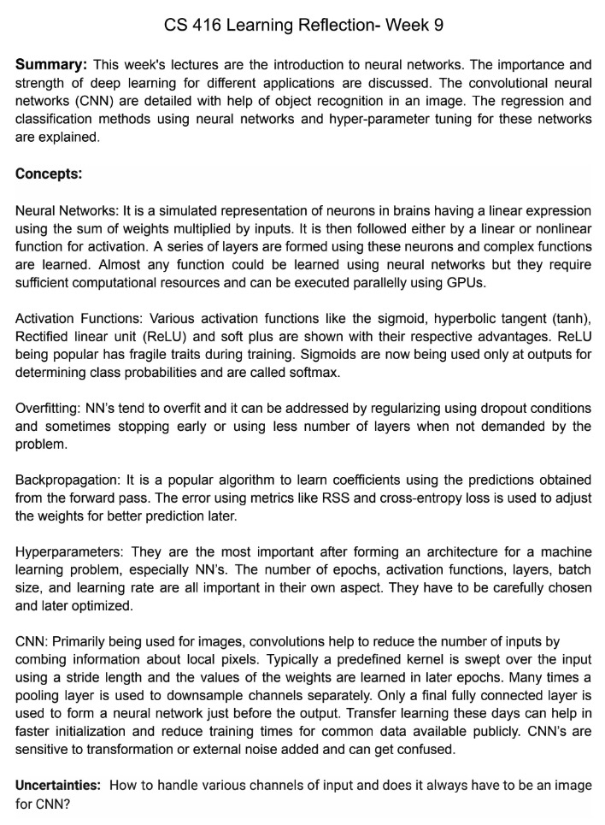
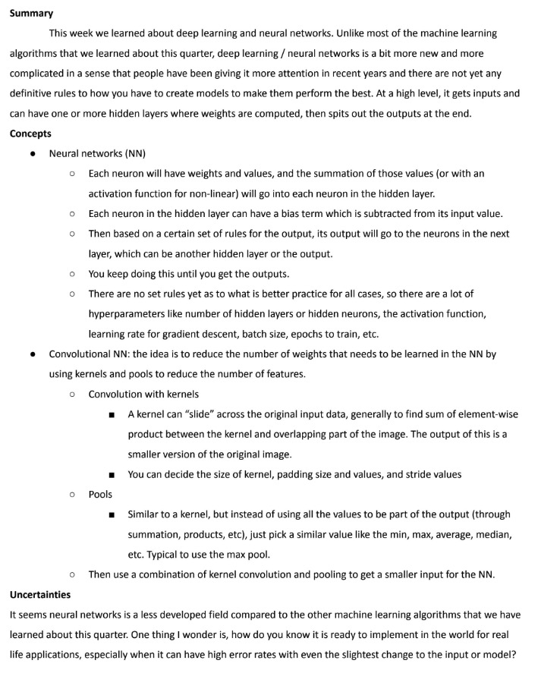
Learning Reflections
Summary: 2-4 sentences
List of key concepts (≥ 5)
Uncertainties
Notes:
Make it easy for the TAs to read!
Resource for you. Do what works best: add images, do visual notes, etc.

Slide 26
Homework Logistics
Late Days
  6 Free Late Days for the whole quarter.
  Can use up to 2 Late Days on any assignment.
  Each Late Day used after the 6 Free Late Days results in a -10% on that assignment
  Learning reflections and checkpoints – no late days.
  Can be turned in up to a week later for 50% credit.
Collaboration
  You are encouraged to discuss assignments and concepts at a high level
    If you are reading off parts of your solution, it’s likely not high level
    Discuss process, not answers!
  All code and answers submitted must be your own
Turn In
  Concept portions and Learning reflections are turned in on Gradescope
  Everything else (Programming portion and checkpoints) are turned in on EdStem

Slide 27
Getting Help
The best place to get asynchronous help is EdStem. You can post questions (publicly or privately) to get help from peers or members of the course staff.
  You’re encouraged to respond with your ideas to other posts!
The best place to get synchronous help is office hours or to form a study group.
  The synchronous nature of office hours is the best for back-and-forth conversations like clarifying confusing topics or helping you learn the process of debugging your assignment.

Slide 28
Case Study 1
Regression:
Housing Prices

Slide 29
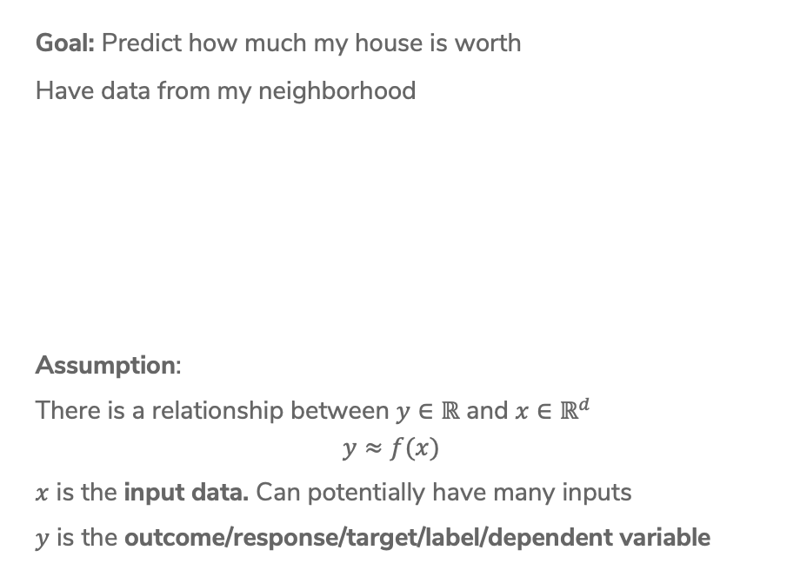
Fitting Data
Goal: Predict how much my house is worth
Have data from my neighborhood
Assumption:
There is a relationship between $y∈ℝ$ and $x∈ℝ^{d}$
$$y≈f(x)$$
$x$ is the input data. Can potentially have many inputs
$y$ is the outcome/response/target/label/dependent variable

Slide 30
Model
A model is how we assume the world works
Regression model:
“Essentially, all models are wrong, but some are useful.”
- George Box, 1987
Notes:
Write the model $y_i = f(x_i) + \eps_i$ and $E[\eps_i] = 0$

Slide 31
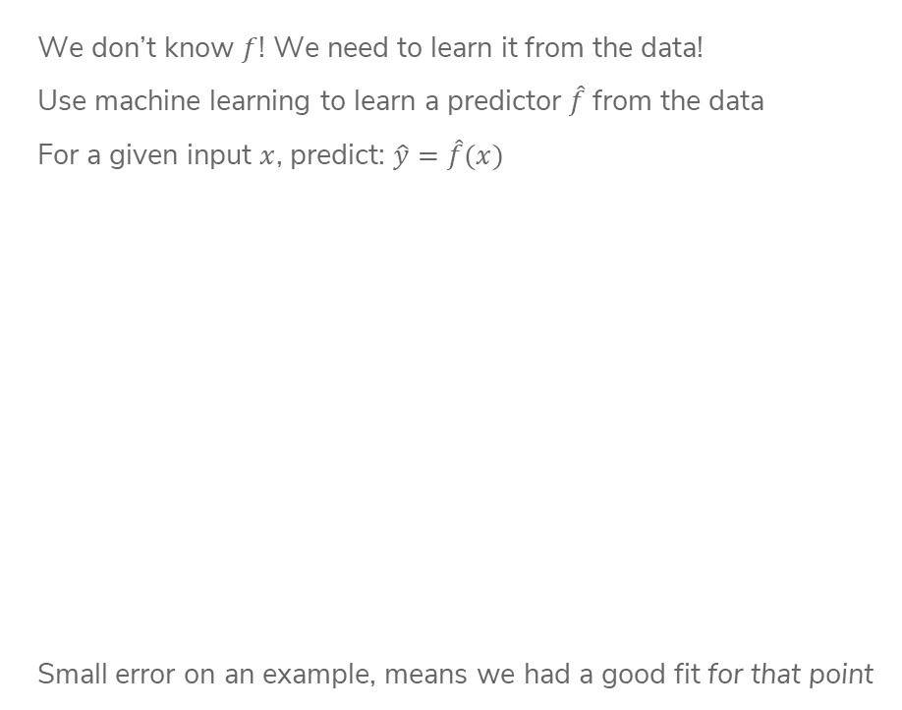
Predictor
We don’t know $f$! We need to learn it from the data!
Use machine learning to learn a predictor $\hat{f}$from the data
For a given input $x$, predict: $\hat{y}=\hat{f}(x)$
Small error on an example, means we had a good fit for that point
Notes:
Draw line and visually draw error

Slide 32

ML Pipeline
- Deployment Bias
Training
Data
Pre-
Processing
x
ML
model
ŷ
⌃
- Historical Bias
- Representation Bias
- Measurement Bias
f
y
Optimization
algorithm
Quality
metric
32
Notes:
Another way to look at ML is to consider the pipeline of actually developing and deploying an ML model. What does it look like when you’re an ML practitioner?
It is really crucial to understand that ML models start and end with the world. The data we use for machine learning is collected from the world, and the ML models are deployed in, and therefore shape, the world.
We then gather training data from the world. The process of gathering training data is not something we’ll go in-depth into in this class, but this can be done by running experiments, having people fill out surveys, scraping images and labels from news articles online, etc.
It’s important to note that even just in the data collection phase, several biases can arise. We’ll get more practice thinking about these biases later in the course, but we have actually seen all of these before. An example of historical bias is in the predictive policing data, because police arrests and criminal charges tend to be disproportionately applied on Black people and other people of color. To be clear, that is not to say the bias is only in the past – in this case it is very much an ongoing bias – but rather that the data itself was collected from the past and therefore this bias is embedded in the data.
Representation bias is where the dataset does not adequately represent the diversity of the population. For example, in the gender shades data you saw, light men were represented in the dataset disproportionately more than dark women, which impacted the bias of the algorithm.
Finally, measurement bias is where what you are measuring itself is biased, like in PredPol where how you define a crime, and what crimes you focus on, inherently has biases in it. Another aspect of this is whether the data you collect is for police arrests, or for convictions by a jury, which are very different processes in the real world and will impact what type of biases get internalized into the model.
We also have bias in how the model is deployed in the real world. An example of this is how PredPol creates a feedback loop that results in finding more crime in the neighborhoods it recommends, perpetuating the very bias it was trained on.
You then take the training data and preprocess it, which includes cleaning up the data and extracting meaningful features for the model to train on. We’ll go in more detail into this later.
You then have an ML model, which learns a pattern form the training data. However, how does it actually learn?
That is where the training loop, or optimization loop, comes in. In this loop, you have a machine learning model which takes in the data and generates predictions. You then have a quality metric which checks how good those predictions are relative to the actual data. And you then have an optimization algorithm that slightly improves the model to get the predictions slightly closer to the reality, and we keep going in this loop.
I understand that this is quite abstract now. We’ll delve into a case study that will make this concrete later in this lecture.
And finally, I’ll add the mathematical notation that is typically associated with these different steps. Your input data, or features, is typically represented by x, and the outputs is represented by y. y-hat is the output of your model, or the predicted output, and f-hat is the optimal model that emerges from the training loop.
And there you have it! This is the ML pipeline, which is a diagram we’ll keep referring back to throughout the course, and that we’ll use to ground out study of Machine Learning. As I’d mentioned, I know it’s a bit abstract right now, and we’ll get more concrete about it later in this lecture.

Slide 33
Linear Regression

Slide 34
ML Pipeline
- Deployment Bias
Training
Data
Pre-
Processing
x
ML
model
ŷ
⌃
- Historical Bias
- Representation Bias
- Measurement Bias
f
y
Optimization
algorithm
Quality
metric
34

Slide 35
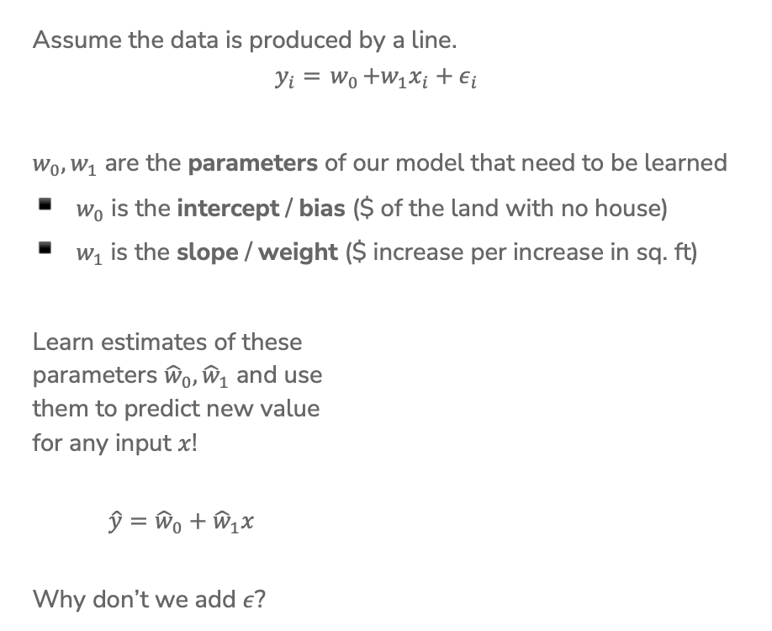
Linear Regression Model
Assume the data is produced by a line.
$$y_{i}={ w}_{0}+w_{1}x_{i}+ε_{i}$$
$w_{0}, w_{1}$ are the parameters of our model that need to be learned
$w_{0}$ is the intercept / bias ($ of the land with no house)
$w_{1}$ is the slope / weight ($ increase per increase in sq. ft)
Learn estimates of these
parameters ${\hat{w}}_{0}, {\hat{w}}_{1}$ and use
them to predict new value
for any input $x$!
$\hat{y}={\hat{w}}_{0}+{\hat{w}}_{1}x$
Why don’t we add $ε$?
Notes:
Talk about what happens if w_1 is 0

Slide 36
Basic Idea
Try a bunch of different lines and see which one is best!
What does best even mean here?

Slide 37
ML Pipeline
- Deployment Bias
Training
Data
Pre-
Processing
x
ML
model
ŷ
⌃
- Historical Bias
- Representation Bias
- Measurement Bias
f
y
Optimization
algorithm
Quality
metric
37

Slide 38
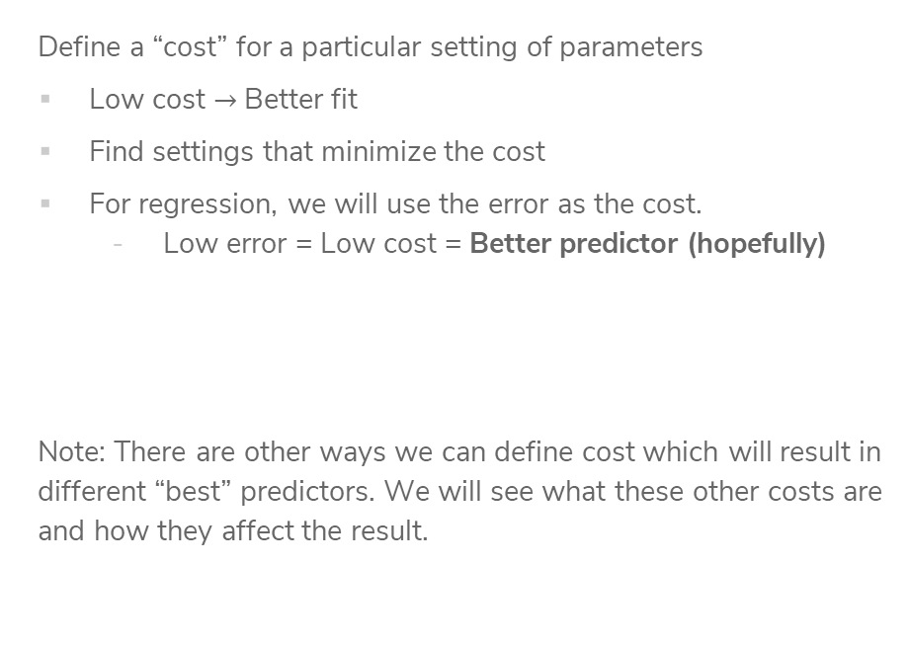
“Cost” of predictor
Define a “cost” for a particular setting of parameters
Low cost $→$ Better fit
Find settings that minimize the cost
For regression, we will use the error as the cost.
  Low error = Low cost = Better predictor (hopefully)
Note: There are other ways we can define cost which will result in different “best” predictors. We will see what these other costs are and how they affect the result.
Notes:
Write out definition of RSS(w_0, w_1)

Slide 39
Mean Squared Error (MSE)
How to define error? Mean squared error (MSE)
Notes:
Write definition of MSE out, first as individual sum and then sigma notation

Slide 40
1 min
Goal: Get you actively participating in your learning
Typical Activity
  Question is posed
  Think (1 min): Think about the question on your own
  Pair (2 min): Talk with your neighbor to discuss question
    If you arrive at different conclusions, discuss your logic and figure out why you differ!
    If you arrived at the same conclusion, discuss why the other answers might be wrong!
  Share (1 min): We discuss the conclusions as a class
During each of the Think and Pair stages, you will respond to the question via a sli.do poll
  Not worth any points, just here to help you learn!

Slide 41
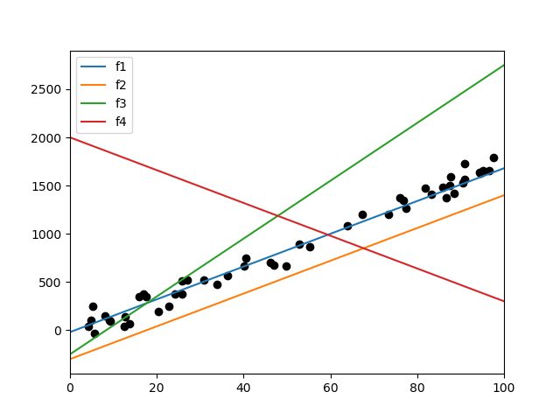
1 min
Sort the following lines by their MSE on the data, from smallest to largest. (estimate, don’t actually compute)

Slide 42
2 min
Sort the following lines by their MSE on the data, from smallest to largest. (estimate, don’t actually compute)

Slide 43
ML Pipeline
- Deployment Bias
Training
Data
Pre-
Processing
x
ML
model
ŷ
⌃
- Historical Bias
- Representation Bias
- Measurement Bias
f
y
Optimization
algorithm
Quality
metric
43

Slide 44
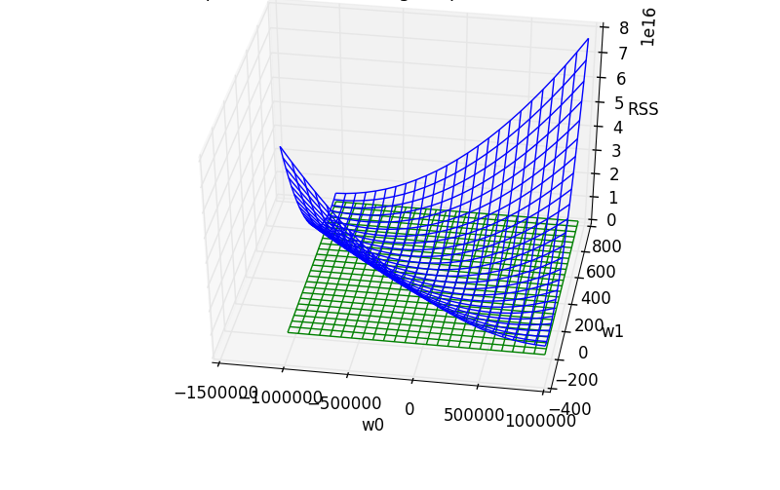

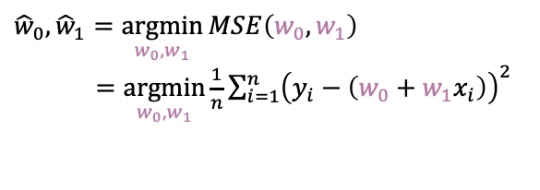
Minimizing Cost
MSE is a function with inputs $w_{0}, w_{1}$, different settings have different MSE for a dataset
$${\hat{w}}_{0}, {\hat{w}}_{1}=\underset{w_{0}, w_{1}}{argmin}{MSE\left(w_{0}, w_{1}\right)}$$
$=\underset{w_{0}, w_{1}}{argmin}{\frac{1}{n}\sum_{i=1}^{n}{{\left(y_{i}−\left(w_{0}+w_{1}x_{i}\right)\right)}^{2}}}$
Unfortunately, we can’t try it out on all possible settings ☹

Slide 45
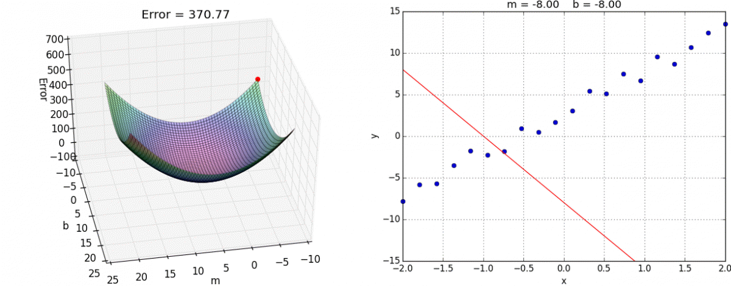

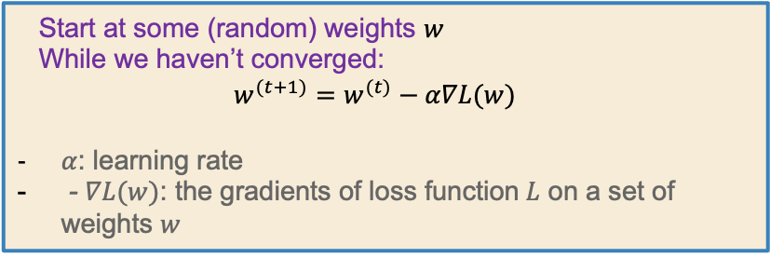
Gradient Descent
Instead of computing all possible points to find the minimum,
just start at one point and “roll” down the hill. Use the gradient (slope) to determine which direction is down.
Start at some (random) weights $w$
While we haven’t converged:
$$w^{(t+1)}=w^{(t)}−α∇L(w)$$
$α$: learning rate
- $∇L(w)$: the gradients of loss function$L$ on a set of weights $w$

Slide 46


Slide 47
ML Pipeline
- Deployment Bias
Training
Data
Pre-
Processing
x
ML
model
ŷ
⌃
- Historical Bias
- Representation Bias
- Measurement Bias
f
y
Optimization
algorithm
Quality
metric
47

Slide 48

Higher Order Features
This data doesn’t look exactly linear, why are we fitting a line instead of some higher-degree polynomial?
We can! We just have to use a slightly different model!
$$y_{i}=w_{0}+w_{1}x_{i}+w_{2}x_{i}^{2}+w_{3}x_{i}^{3}+ε_{i}$$

Slide 49
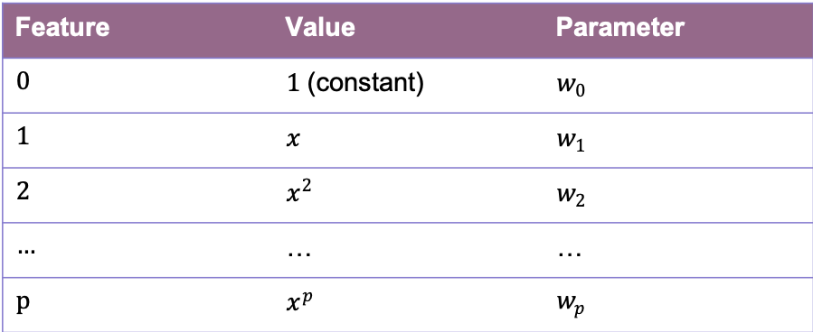
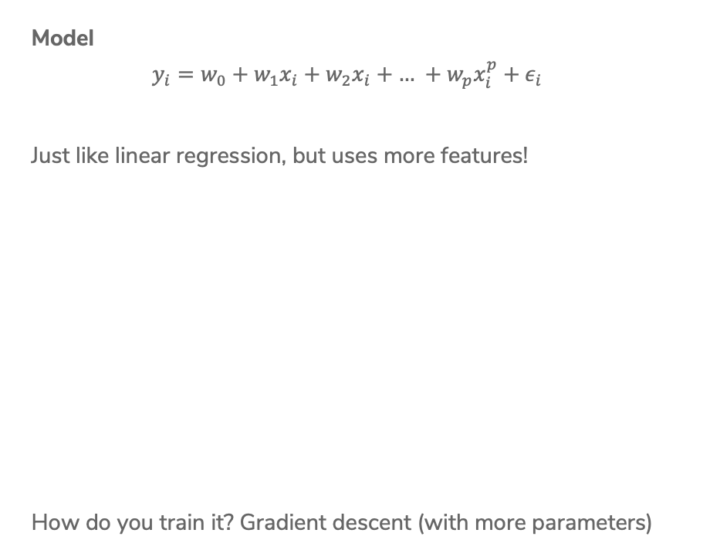
Polynomial Regression
Model
$$y_{i}=w_{0}+w_{1}x_{i}+w_{2}x_{i}+\text{…} +w_{p}x_{i}^{p}+ε_{i}$$
Just like linear regression, but uses more features!
How do you train it? Gradient descent (with more parameters)
Feature | Value | Parameter
0 | $1$ (constant) | $w_{0}$
1 | $x$ | $w_{1}$
2 | $x^{2}$ | $w_{2}$
… | … | …
p | $x^{p}$ | $w_{p}$

Slide 50
Polynomial Regression
How to decide what the right degree? Come back Wednesday!
Notes:
Draw different values of p in different colors
Max p = 32

Slide 51
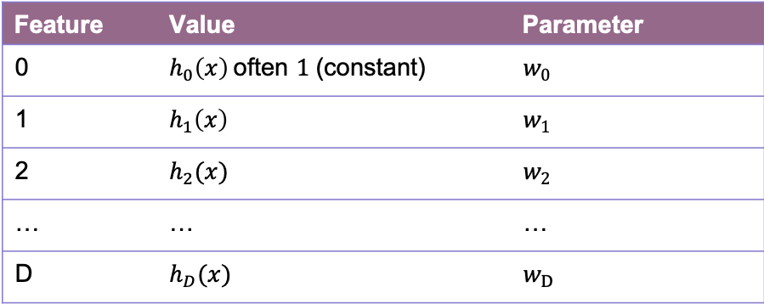

Features
Features are the values we select or compute from the data inputs to put into our model. Feature extraction is the process of turning the data into features.
Model
$$y_{i}=w_{0}h_{0}\left(x_{i}\right)+w_{1}h_{1}\left(x_{i}\right)+\text{…}+w_{D}h_{D}\left(x_{i}\right)+ε_{i} \\ = \sum_{j=0}^{D}{w_{j}h_{j}\left(x_{i}\right)+ε_{i}}$$
Feature | Value | Parameter
0 | $h_{0}\left(x\right)$often $1$ (constant) | $w_{0}$
1 | $h_{1}\left(x\right)$ | $w_{1}$
2 | $h_{2}(x)$ | $w_{2}$
… | … | …
D | $h_{D}(x)$ | $w_{D}$

Slide 52
Adding Other Inputs
Generally we are given a data table of values we might look at that include more than one value per house.
Each row is a single house.
Each column (except Value) is a data input.
sq. ft. | # bathrooms | owner’s age | … | value
1400 | 3 | 47 | … | 70,800
700 | 3 | 19 | … | 65,000
… | … | … | … | …
1250 | 2 | 36 | … | 100,000

Slide 53
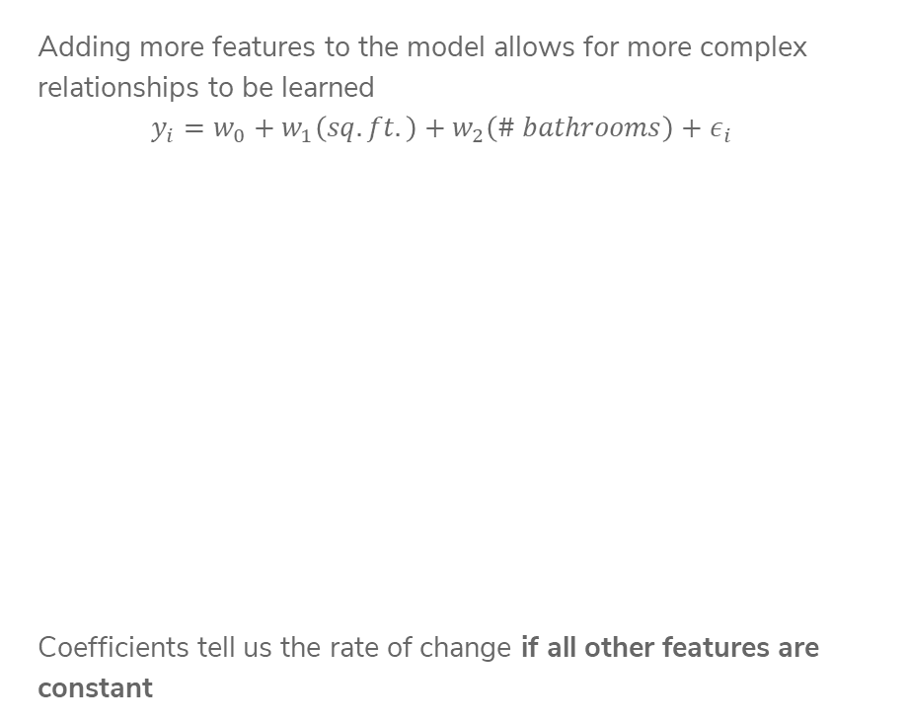
More Inputs - Visually
Adding more features to the model allows for more complex relationships to be learned
$$y_{i}=w_{0}+w_{1}\left(sq. ft.\right)+w_{2}\left(\# bathrooms\right)+ε_{i}$$
Coefficients tell us the rate of change if all other features are constant

Slide 54
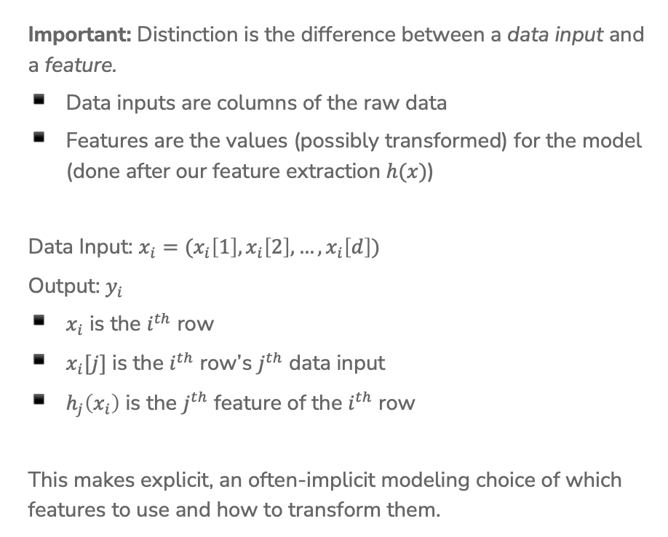
Notation
Important: Distinction is the difference between a data input and a feature.
Data inputs are columns of the raw data
Features are the values (possibly transformed) for the model (done after our feature extraction $h(x)$)
Data Input: $x_{i}=(x_{i}\left[1\right], x_{i}\left[2\right], …, x_{i}\left[d\right])$
Output: $y_{i}$
$x_{i}$ is the $i^{th}$ row
$x_{i}[j]$ is the $i^{th}$ row’s $j^{th}$ data input
$h_{j}\left(x_{i}\right)$ is the $j^{th}$ feature of the $i^{th}$ row
This makes explicit, an often-implicit modeling choice of which features to use and how to transform them.

Slide 55
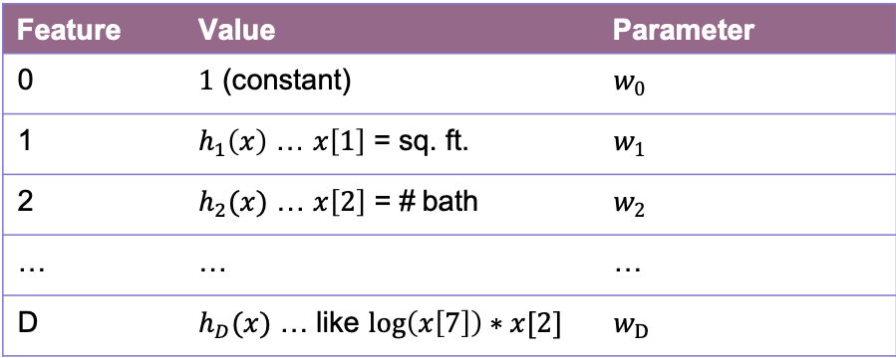
Features
You can use anything you want as features and include as many of them as you want!
Generally, more features means a more complex model. This might not always be a good thing!
Choosing good features is a bit of an art.
Feature | Value | Parameter
0 | $1$ (constant) | $w_{0}$
1 | $h_{1}\left(x\right)$ … $x\left[1\right]$ = sq. ft. | $w_{1}$
2 | $h_{2}(x)$ … $x\left[2\right]$ = # bath | $w_{2}$
… | … | …
D | $h_{D}(x)$ … like $\log\left(x\left[7\right]\right)∗x[2]$ | $w_{D}$

Slide 56
Term recap
Supervised learning: The machine learning task of learning a function that maps an input to an output based on example input-output pairs.
Regression: A supervised learning task where the outputs are continuous values.
Feature:
  An attribute that we’re selecting for our model
  Can come from the original dataset, or through some transformations (feature extraction)
Parameter: The weight or bias associated with a feature. The goal of machine learning is to adjust the weights to optimize the loss functions on training data.
Loss function: A function that computes the distance between the predicted output from a machine learning model and the actual output.
Machine learning model: An algorithm that combs through an amount of data to find patterns, make predictions, or generate insights
Optimization algorithm: An algorithm used to minimize the loss during training. The most common one is Gradient Descent.

Slide 57
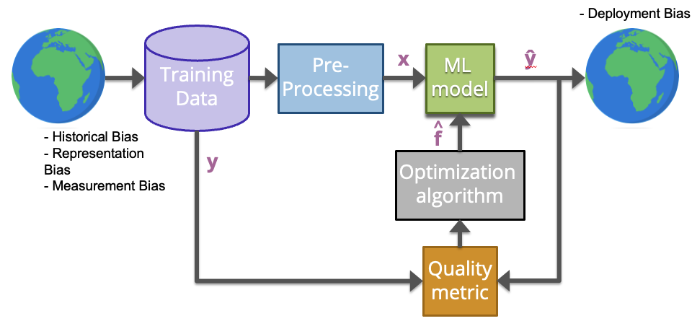

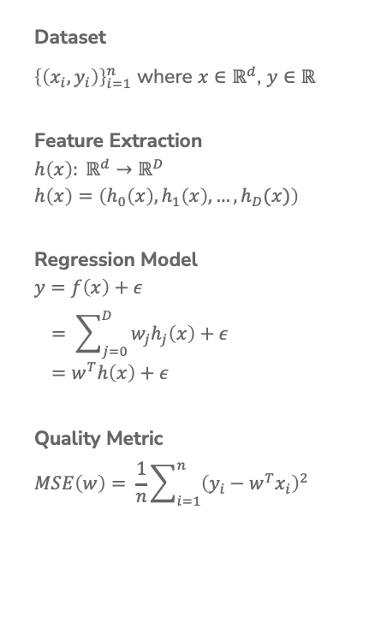
Linear Regression Recap
Dataset
${\left\{\left(x_{i}, y_{i}\right)\right\}}_{i=1}^{n}$ where $x∈ℝ^{d}$, $y∈ℝ$
Feature Extraction
$$h\left(x\right): ℝ^{d}→ℝ^{D}$$
$$h\left(x\right)=\left(h_{0}\left(x\right), h_{1}\left(x\right), …, h_{D}(x)\right)$$
Regression Model
$$y=f\left(x\right)+ε \\ = \sum_{j=0}^{D}{w_{j}h_{j}\left(x\right)+ε} \\ =w^{T}h\left(x\right)+ε$$
Quality Metric
$$MSE\left(w\right)= \frac{1}{n}\sum_{i=1}^{n}{{\left(y_{i}−w^{T}x_{i}\right)}^{2}}$$
Predictor
$$\hat{w}= \underset{w}{argmin}{MSE(w)}$$
ML Algorithm
Optimized using Gradient Descent
Prediction
$$\hat{y}={\hat{w}}^{T}h(x)$$

Slide 58
This Week
Complete Pre-Course Training as soon as you can
Before Friday
  Checkpoint 0 due before next class (EdStem)
  Pre-Class 1 should be watched before class
Coming up soon
  First Quiz Section on Thursday
  Learning Reflection 0: Due Monday 11:59 pm
  HW0 Released on Wednesday
Please check EdStem regularly for the latest updates on course logistics.

