Slide 1
CSE/STAT 416
Ensemble Methods
Tanmay Shah
Paul G. Allen School of Computer Science & Engineering
University of Washington
April 26 , 2024

Slide 2
Decision Trees Recap
Video 1

Slide 3
Roadmap
So Far
Housing Prices - Regression
  Regression Model
  Assessing Performance
  Ridge Regression
  LASSO
Sentiment Analysis – Classification
  Classification Overview
  Logistic Regression
  Naïve Bayes
  Decision Trees
  Ensemble Methods

Slide 4

ML Pipeline
Training
Data
Pre-
Processing
x
ML
model
ŷ
⌃
f
y
Optimization
algorithm
Quality
metric
4
Notes:
Another way to look at ML is to consider the pipeline of actually developing and deploying an ML model. What does it look like when you’re an ML practitioner?
It is really crucial to understand that ML models start and end with the world. The data we use for machine learning is collected from the world, and the ML models are deployed in, and therefore shape, the world.
We then gather training data from the world. The process of gathering training data is not something we’ll go in-depth into in this class, but this can be done by running experiments, having people fill out surveys, scraping images and labels from news articles online, etc.
It’s important to note that even just in the data collection phase, several biases can arise. We’ll get more practice thinking about these biases later in the course, but we have actually seen all of these before. An example of historical bias is in the predictive policing data, because police arrests and criminal charges tend to be disproportionately applied on Black people and other people of color. To be clear, that is not to say the bias is only in the past – in this case it is very much an ongoing bias – but rather that the data itself was collected from the past and therefore this bias is embedded in the data.
Representation bias is where the dataset does not adequately represent the diversity of the population. For example, in the gender shades data you saw, light men were represented in the dataset disproportionately more than dark women, which impacted the bias of the algorithm.
Finally, measurement bias is where what you are measuring itself is biased, like in PredPol where how you define a crime, and what crimes you focus on, inherently has biases in it. Another aspect of this is whether the data you collect is for police arrests, or for convictions by a jury, which are very different processes in the real world and will impact what type of biases get internalized into the model.
We also have bias in how the model is deployed in the real world. An example of this is how PredPol creates a feedback loop that results in finding more crime in the neighborhoods it recommends, perpetuating the very bias it was trained on.
You then take the training data and preprocess it, which includes cleaning up the data and extracting meaningful features for the model to train on. We’ll go in more detail into this later.
You then have an ML model, which learns a pattern form the training data. However, how does it actually learn?
That is where the training loop, or optimization loop, comes in. In this loop, you have a machine learning model which takes in the data and generates predictions. You then have a quality metric which checks how good those predictions are relative to the actual data. And you then have an optimization algorithm that slightly improves the model to get the predictions slightly closer to the reality, and we keep going in this loop.
I understand that this is quite abstract now. We’ll delve into a case study that will make this concrete later in this lecture.
And finally, I’ll add the mathematical notation that is typically associated with these different steps. Your input data, or features, is typically represented by x, and the outputs is represented by y. y-hat is the output of your model, or the predicted output, and f-hat is the optimal model that emerges from the training loop.
And there you have it! This is the ML pipeline, which is a diagram we’ll keep referring back to throughout the course, and that we’ll use to ground out study of Machine Learning. As I’d mentioned, I know it’s a bit abstract right now, and we’ll get more concrete about it later in this lecture.

Slide 5
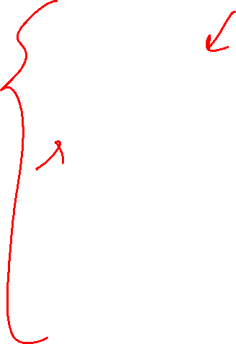
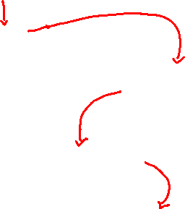
Decision Trees
Start
excellent
Credit?
poor
fair
Income?
Safe
Term?
high
Low
3 years
5 years
Risky
Safe
Term?
Risky
3 years
5 years
Risky
Safe
Branch/Internal node: splits into possible values of a feature
Leaf node: final decision (the class value)
Notes:
WOS:
An example, have students classify it.

Slide 6
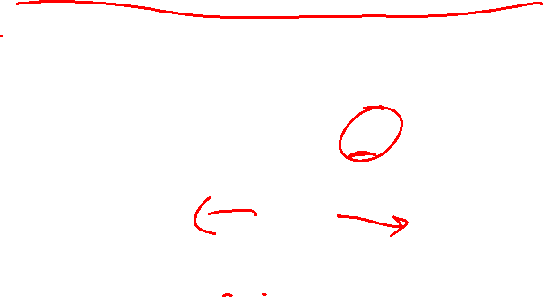
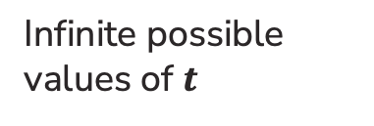



Best threshold?
Similar to our simple, threshold model when discussing Fairness!
Infinite possible values of $t$
Income = $t^{∗}$
Income $< t^{∗}$
Income ${≥t}^{∗}$
Safe
Risky
Income
$10K
$120K

Slide 7
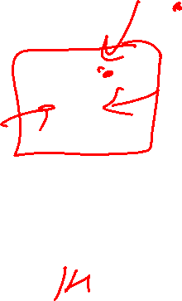
Predicting probabilities
Root
18 12
Loan status:
Safe Risky
Credit?
excellent
9 2
fair
6 9
poor
3 1
Safe
Risky
Safe
P(y = Safe | x)
= 3 = 0.75
3 + 1

Slide 8
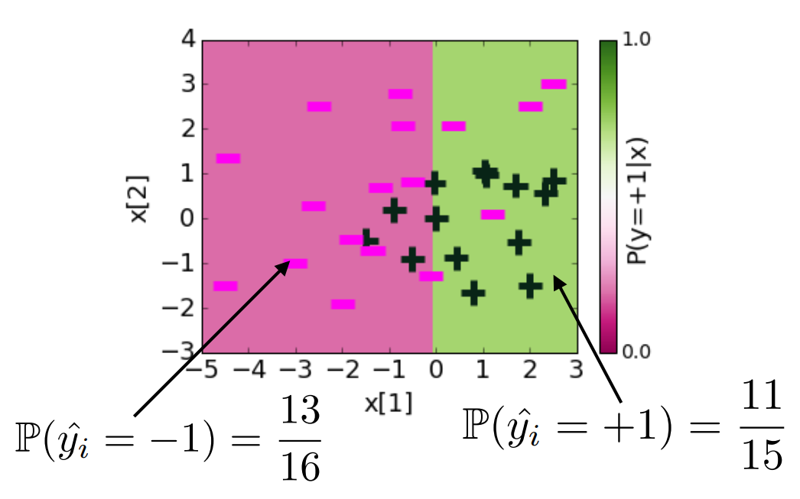
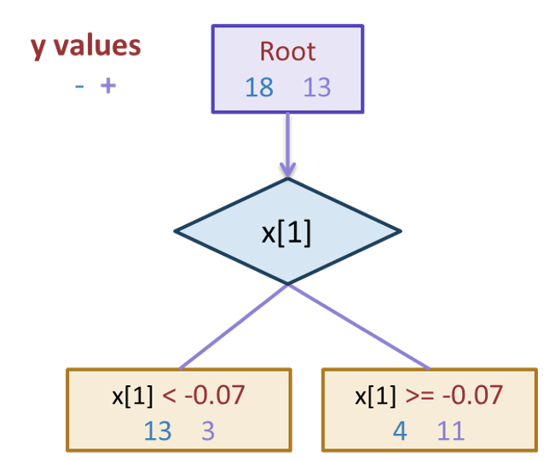
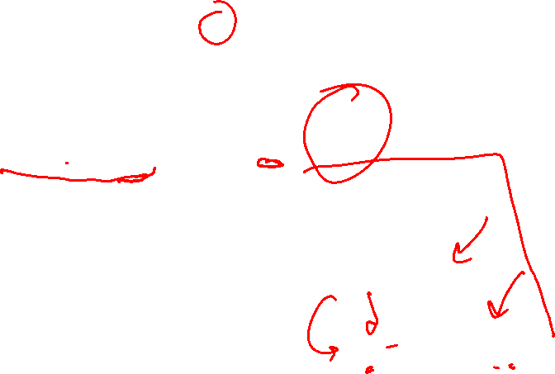
Probabilities (Depth 1)
Notes:
0.22542207904 + 1.12 x[1] -1.07 x[2]

Slide 9
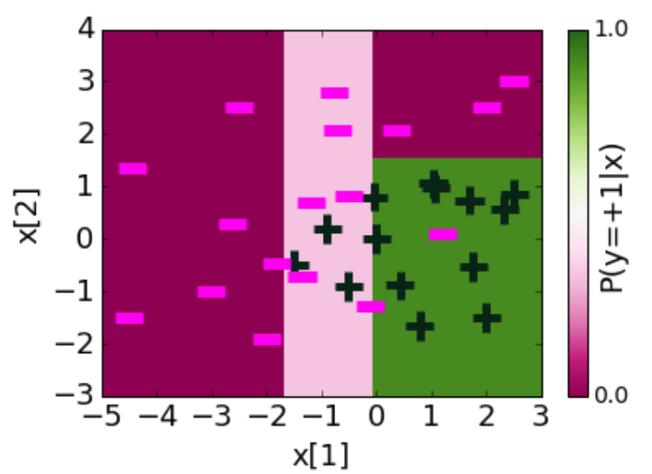
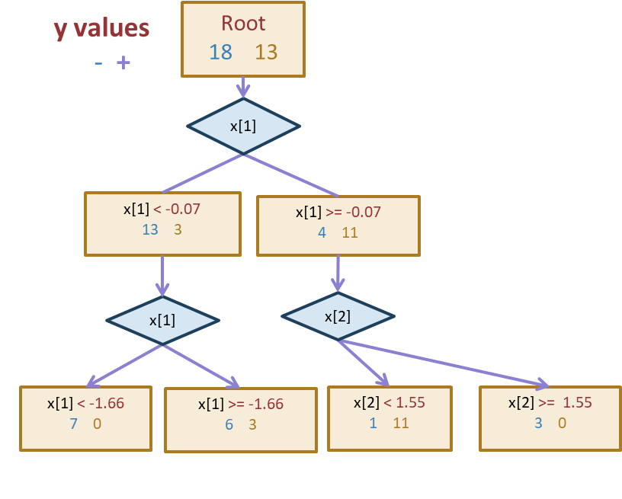
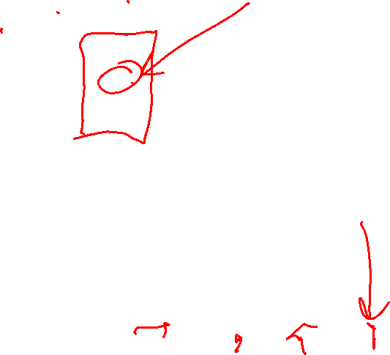
Depth 2
Notes:
0.22542207904 + 1.12 x[1] -1.07 x[2]

Slide 10
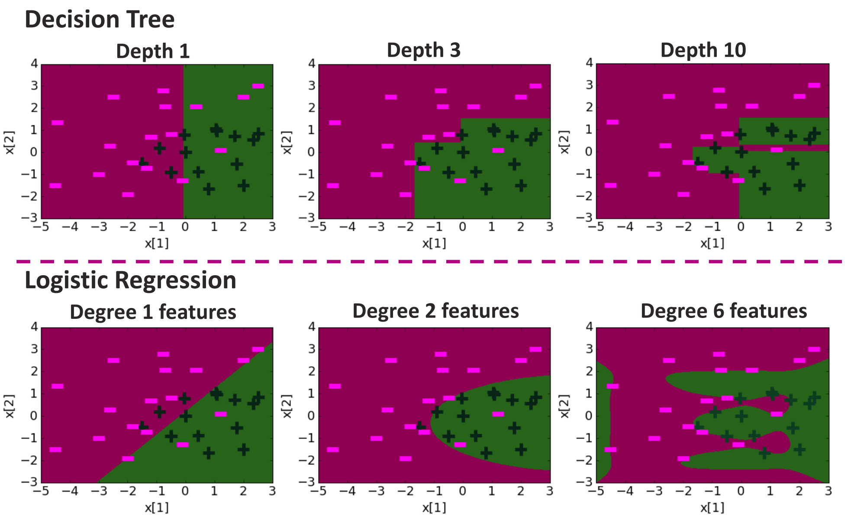
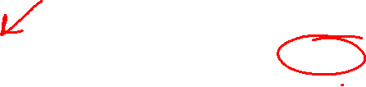
Compare Decision Boundaries

Slide 11
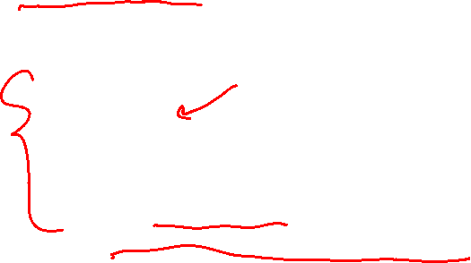
Overfitting
Deep decision trees are prone to overfitting
  Decision boundaries are interpretable but not stable
  Small change in the dataset leads to big difference in the outcome
Overcoming Overfitting:
  Early stopping
    Fixed length depth
    Stop if error does not considerably decrease
  Pruning
    Grow full length trees
    Prune nodes to balance a complexity penalty
Notes:
0.22542207904 + 1.12 x[1] -1.07 x[2]

Slide 12
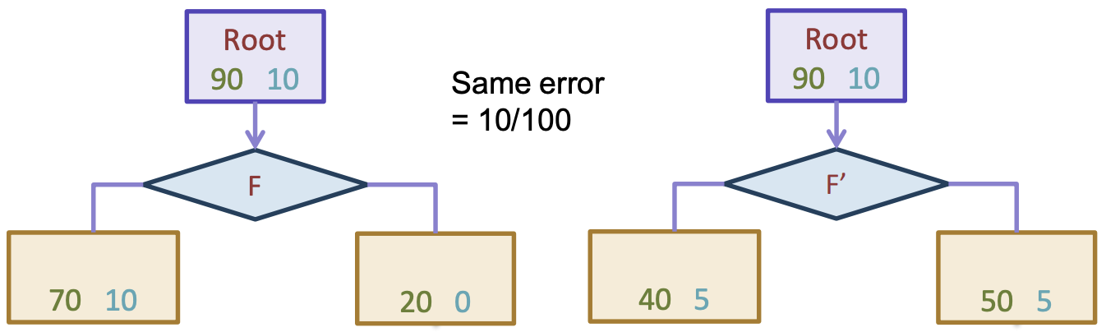
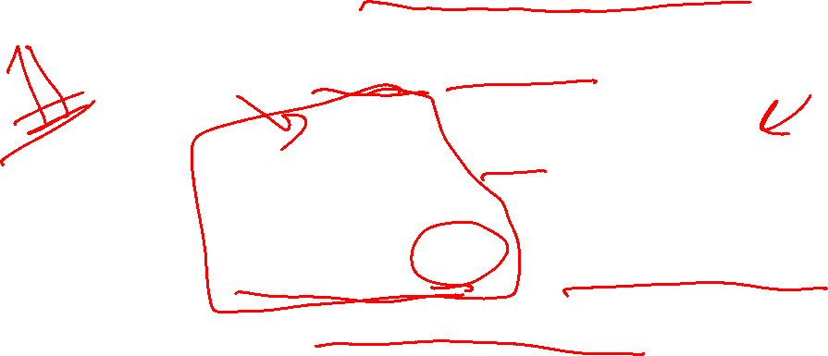
In Practice
Trees can be used for classification or regression (CART)
  Classification: Predict majority class for root node
  Regression: Predict average label for root node
In practice, we don’t minimize classification error but instead some more complex metric to measure quality of split such as Gini Impurity or Information Gain (not covered in 416)
Can also be used to predict probabilities

Slide 13
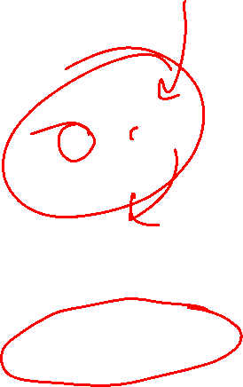
Predicting probabilities
Root
18 12
Loan status:
Safe Risky
Credit?
excellent
9 2
fair
6 9
poor
3 1
Safe
Risky
Safe
P(y = Safe | x)
= 3 = 0.75
3 + 1

Slide 14
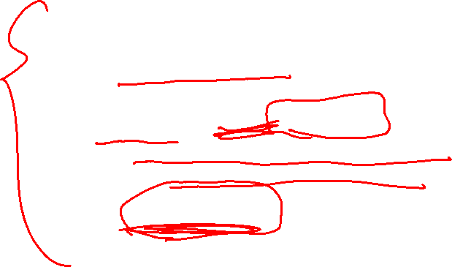
Early Stopping
Stopping Rules:
  1) All data in the subset have the same label
  2) No more features left to split
Early Stopping Rule
  Only grow up to a max depth hyperparameter (choose via validation)
  Don’t split if there is not a sufficient decrease in error
  Require a minimum number of examples in a leaf node
    Will use this on HW

Slide 15
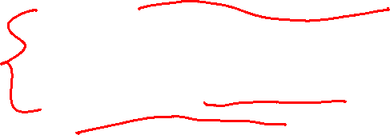
Decision Tree Overview
Super Simple: Interpretable model that is understandable by people without too much ML experience.
Very Efficient: It actually isn’t too hard to train a tree
Depth Matters
  Too small, it is too weak to learn the function (high bias)
  Too tall, it is likely to overfit to the data (high variance)
  Even by choosing depth appropriately, trees tend to not be the best performing models

Slide 16
Random Forests
Video 2

Slide 17
ML Pipeline
Training
Data
Pre-
Processing
x
ML
model
ŷ
⌃
f
y
Optimization
algorithm
Quality
metric
17
Notes:
Another way to look at ML is to consider the pipeline of actually developing and deploying an ML model. What does it look like when you’re an ML practitioner?
It is really crucial to understand that ML models start and end with the world. The data we use for machine learning is collected from the world, and the ML models are deployed in, and therefore shape, the world.
We then gather training data from the world. The process of gathering training data is not something we’ll go in-depth into in this class, but this can be done by running experiments, having people fill out surveys, scraping images and labels from news articles online, etc.
It’s important to note that even just in the data collection phase, several biases can arise. We’ll get more practice thinking about these biases later in the course, but we have actually seen all of these before. An example of historical bias is in the predictive policing data, because police arrests and criminal charges tend to be disproportionately applied on Black people and other people of color. To be clear, that is not to say the bias is only in the past – in this case it is very much an ongoing bias – but rather that the data itself was collected from the past and therefore this bias is embedded in the data.
Representation bias is where the dataset does not adequately represent the diversity of the population. For example, in the gender shades data you saw, light men were represented in the dataset disproportionately more than dark women, which impacted the bias of the algorithm.
Finally, measurement bias is where what you are measuring itself is biased, like in PredPol where how you define a crime, and what crimes you focus on, inherently has biases in it. Another aspect of this is whether the data you collect is for police arrests, or for convictions by a jury, which are very different processes in the real world and will impact what type of biases get internalized into the model.
We also have bias in how the model is deployed in the real world. An example of this is how PredPol creates a feedback loop that results in finding more crime in the neighborhoods it recommends, perpetuating the very bias it was trained on.
You then take the training data and preprocess it, which includes cleaning up the data and extracting meaningful features for the model to train on. We’ll go in more detail into this later.
You then have an ML model, which learns a pattern form the training data. However, how does it actually learn?
That is where the training loop, or optimization loop, comes in. In this loop, you have a machine learning model which takes in the data and generates predictions. You then have a quality metric which checks how good those predictions are relative to the actual data. And you then have an optimization algorithm that slightly improves the model to get the predictions slightly closer to the reality, and we keep going in this loop.
I understand that this is quite abstract now. We’ll delve into a case study that will make this concrete later in this lecture.
And finally, I’ll add the mathematical notation that is typically associated with these different steps. Your input data, or features, is typically represented by x, and the outputs is represented by y. y-hat is the output of your model, or the predicted output, and f-hat is the optimal model that emerges from the training loop.
And there you have it! This is the ML pipeline, which is a diagram we’ll keep referring back to throughout the course, and that we’ll use to ground out study of Machine Learning. As I’d mentioned, I know it’s a bit abstract right now, and we’ll get more concrete about it later in this lecture.

Slide 18
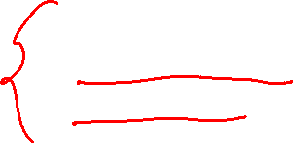
Ensemble Method
Instead of switching to a brand new type of model that is more powerful than trees, what if we instead tried to make the tree into a more powerful model.
What if we could combine many weaker models in such a way to make a more powerful model?
A model ensemble is a collection of (generally weak) models that are combined in such a way to create a more powerful model.
There are two common ways this is done with trees
Random Forest (Bagging)
AdaBoost (Boosting)

Slide 19
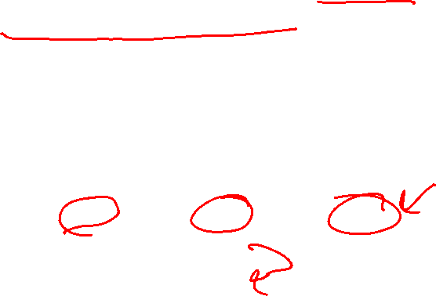

Overview
A Random Forest is a collection of $T$ Decision Trees. Each decision tree casts a “vote” for a prediction and the ensemble predicts the majority vote of all of its trees.
Notes:
Will first explain how we learn each tree, and then I’ll try to explain why this works!

Slide 20
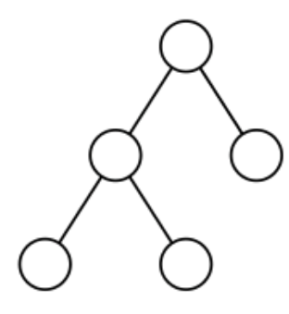
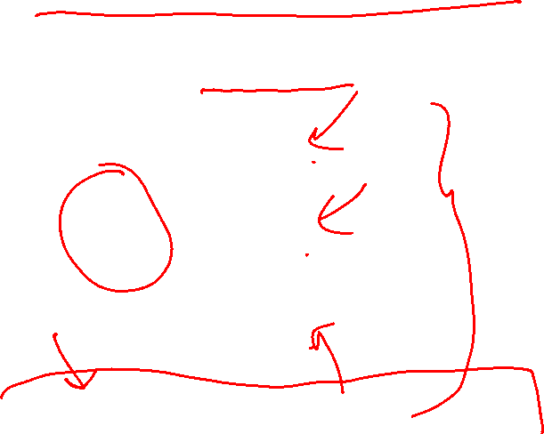
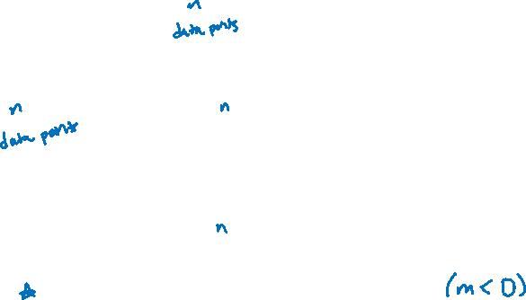
Training Trees
If I just have one dataset, how could I learn more than one tree?
Solve this with bootstrapping! Can create many similar datasets by randomly sampling with replacement.
Technically, you also randomly select features too!

Slide 21
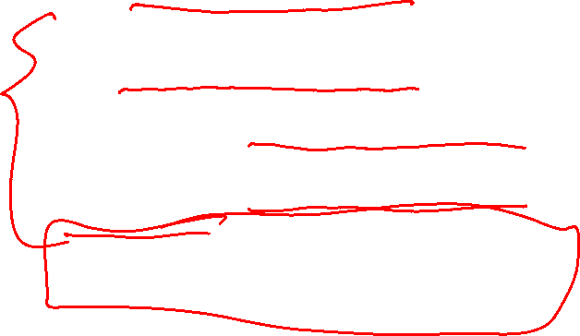
Details
The Random Forest model is a specific type of ensemble model that uses bagging (bootstrapped aggregation).
When training the trees on the bootstrapped samples, we actually want to use very deep trees that overfit!
That sounds bad at first, but we are trying to take advantage of what it means to have a high variance model (low bias).
Remember that high variance models have low bias because if you “average out” over all the models you could learn, they will not have bias.
That is exactly what we are doing here! If we average over a bunch of high variance (overfit) models, to get an ensemble that has low bias and lower variance (if we add more trees)!

Slide 22
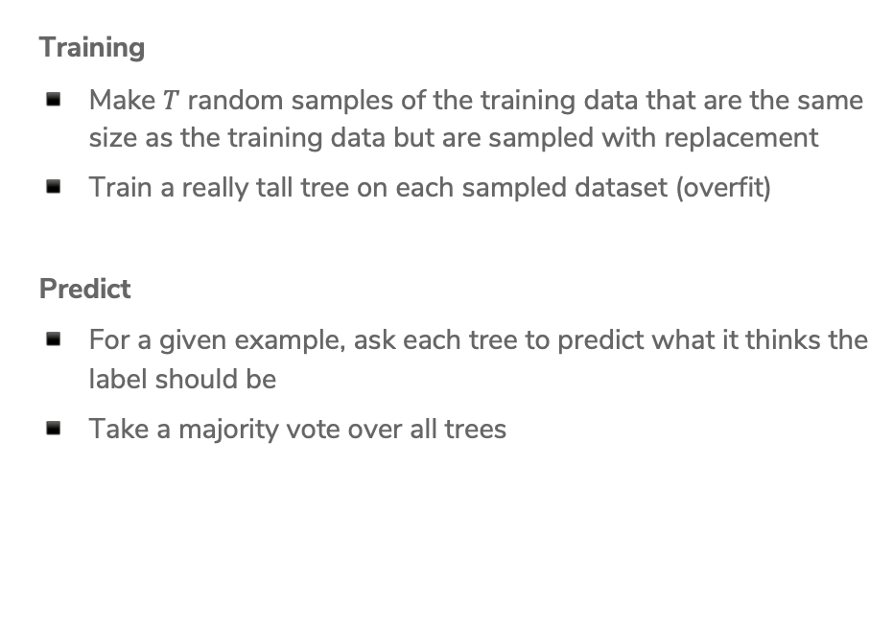

Random Forest Algorithm
Training
Make $T$ random samples of the training data that are the same size as the training data but are sampled with replacement
Train a really tall tree on each sampled dataset (overfit)
Predict
For a given example, ask each tree to predict what it thinks the label should be
Take a majority vote over all trees

Slide 23
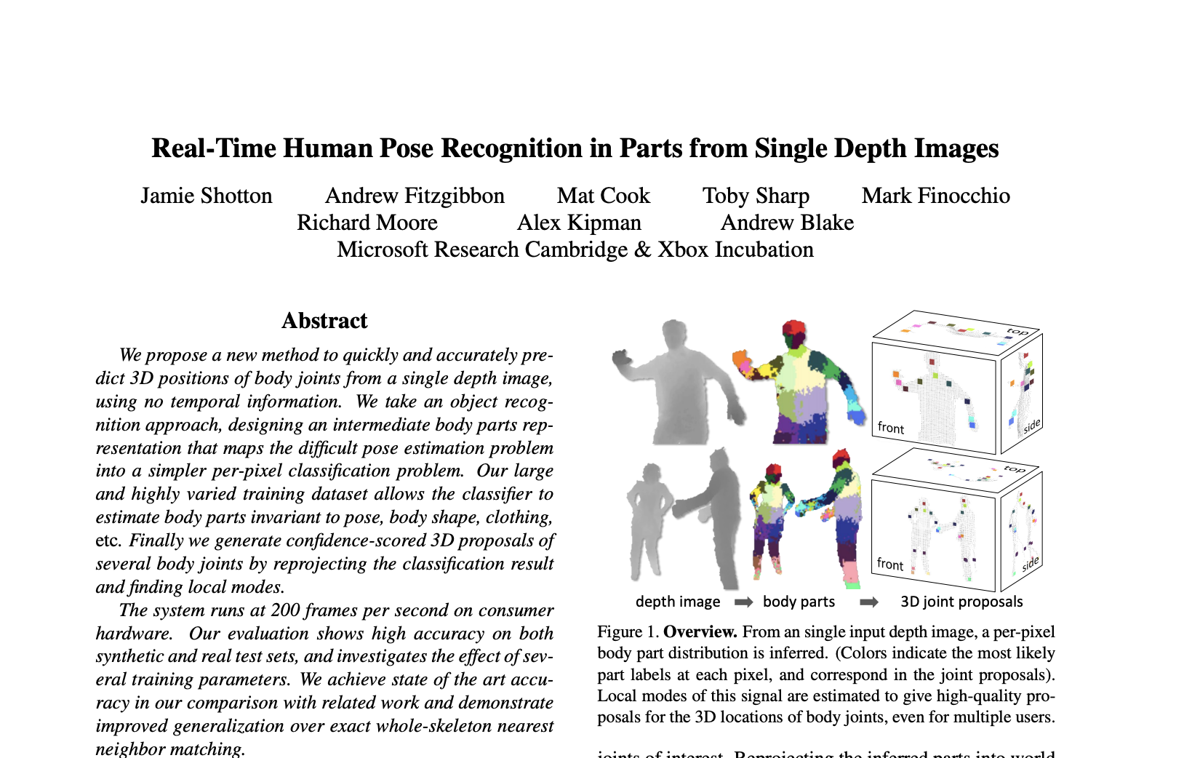
Application
Microsoft used Random Forests in their Kinect system to identify the “pose” of a person from the depth camera.

Slide 24
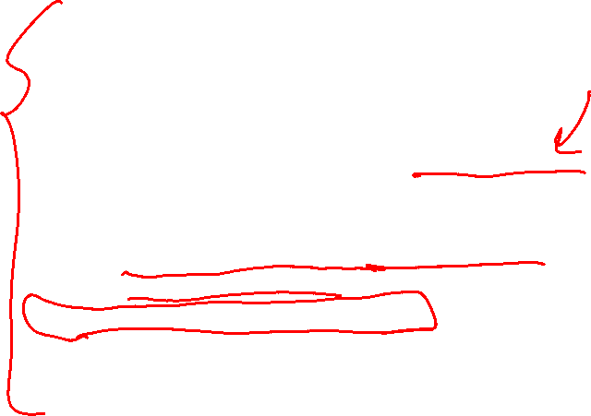
Random Forest Overview
Use overfitting to our advantage! Averaging overfit models can help make a strong model.
Versatile: Works pretty well in a lot of cases and can serve many different purposes.
  Classification, regression, clustering, feature importance
Low Maintenance: Tends to require less hyper-parameter tuning. Good “out of the box” model.
  More trees is always better here (but takes longer).
  Some other hyperparameters, but they tend to have a small affect on performance.
Efficient: Trees can be learned in parallel!

Slide 25


Slide 26
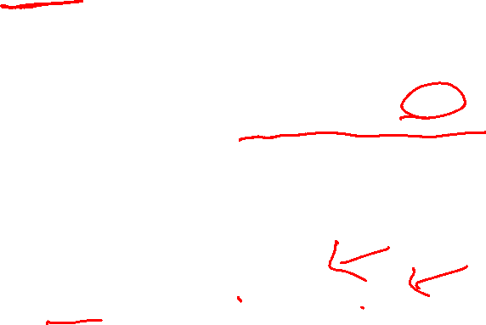
Types of Features
Numeric: data described by a number (quantitative)
  Discrete: cannot be subdivided
    e.g., number of bedrooms
  Continuous: can be subdivided
    e.g., area of the house
  Tricky Case: house price? (don’t divide further than penny)
    Rule of Thumb: if the discreteness is caused by units of measurement, as opposed to the quantity being measured, treat it as continuous!
Categorical: data described by a category (qualitative)
  Ordinal: has an order
    e.g., school quality (good / okay / poor)
    e.g., survey response (agree / neutral / disagree)
  Nominal: doesn’t have an order
    e.g., nearest school type (public / private / charter)
Notes:
Before we discuss how to define distance, it’s important to discuss the different types of features we might have in a machine learning task.

Slide 27
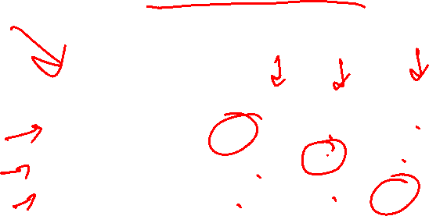
Data Encodings
All ML models we’ve learnt so far require input features to be numbers!
Ordinal: Assign each value to a number:
  e.g., good = 1, okay = 0, poor = -1
Nominal: One-hot encoding, make each value its own binary feature!
  In section, you saw a one-hot encoding of “County”
School | House Price
Public | $500K
Private | $750K
Charter | $600K
Public | $700K
School - Public | School - Private | School - Charter | House Price
1 | 0 | 0 | $500K
0 | 1 | 0 | $750K
0 | 0 | 1 | $600K
1 | 0 | 0 | $700K

Slide 28
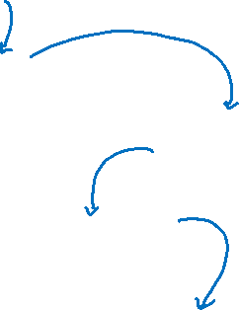
Decision Trees
Start
excellent
Credit?
poor
fair
Income?
Safe
Term?
high
Low
3 years
5 years
Risky
Safe
Term?
Risky
3 years
5 years
Risky
Safe
Branch/Internal node: splits into possible values of a feature
Leaf node: final decision (the class value)
Notes:
WOS:
An example, have students classify it.

Slide 29
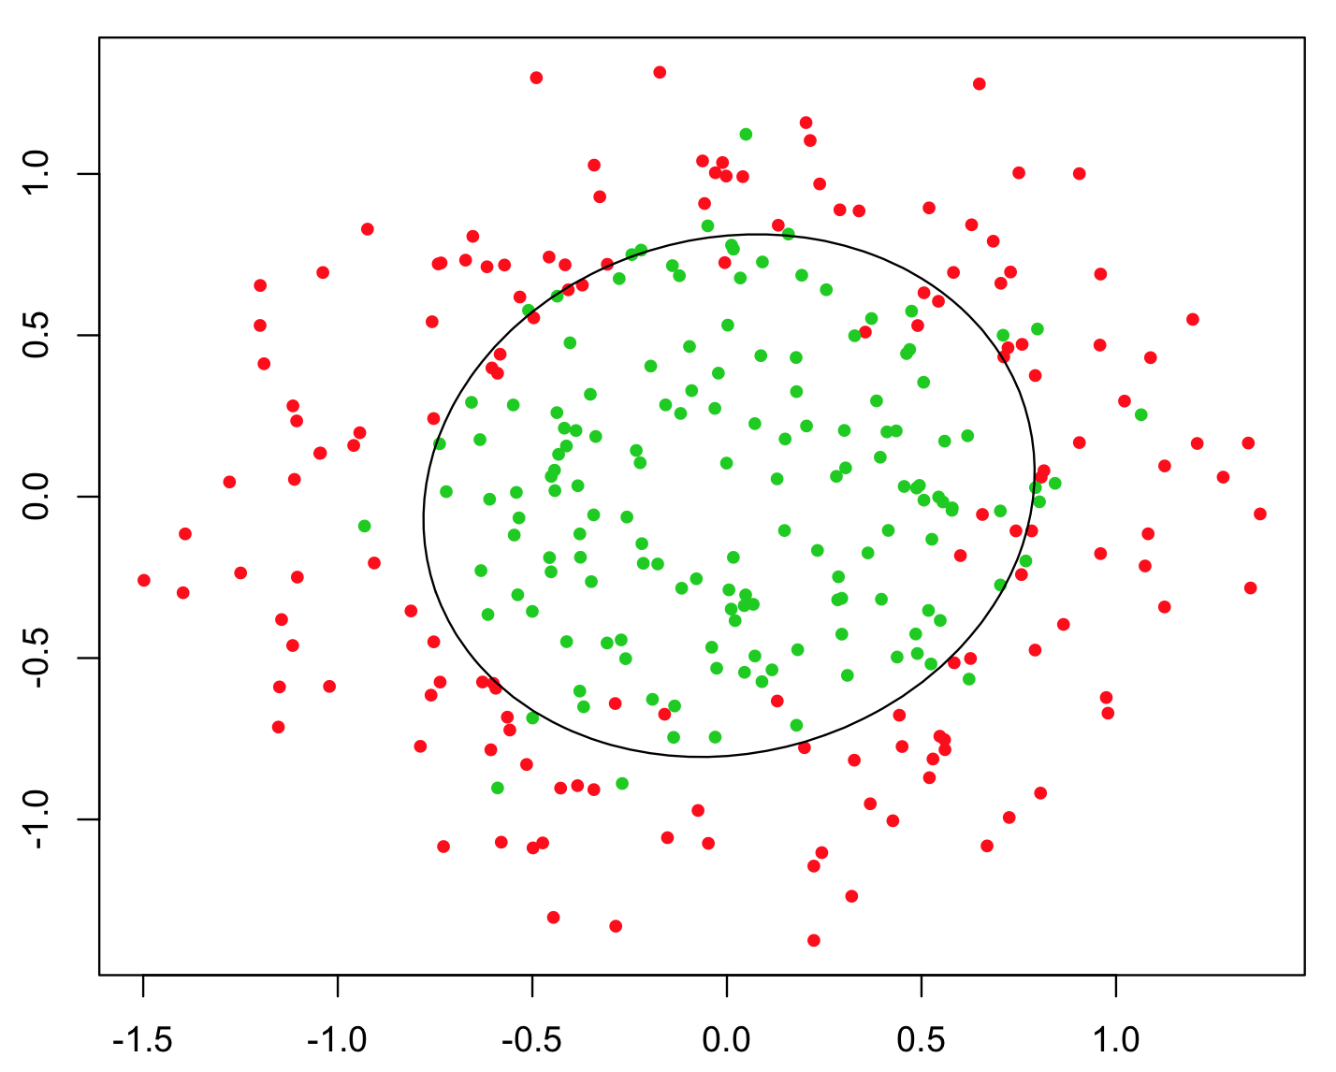
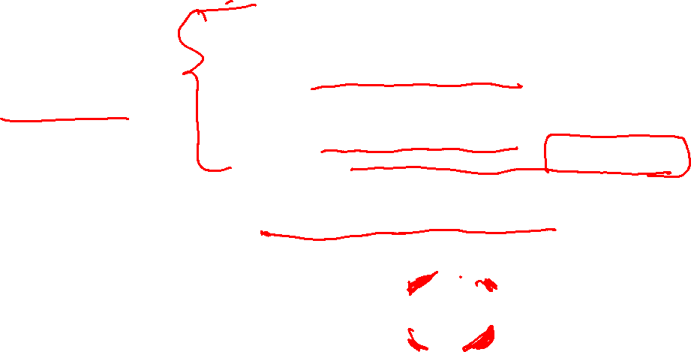
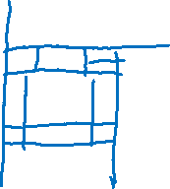
Pros/Cons
Decision Tree
Pros:
  Easy to interpret
  Handles numeric and categorical variables without preprocessing*
    In theory, scikit-learn still requires preprocessing
  No normalization required as it uses rule-based approach
  Can create non-linear decision boundaries
  Can readily do multi-class classification (unlike Logistic Regression)
Cons:
  Deep decision trees are prone to overfitting
  Only allows axis-parallel decision boundaries

Slide 30
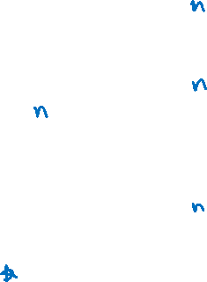
Training Trees
If I just have one dataset, how could I learn more than one tree?
Solve this with bootstrap sampling! Can create many similar datasets by randomly sampling with replacement.
Technically, you also randomly select features too!

Slide 31
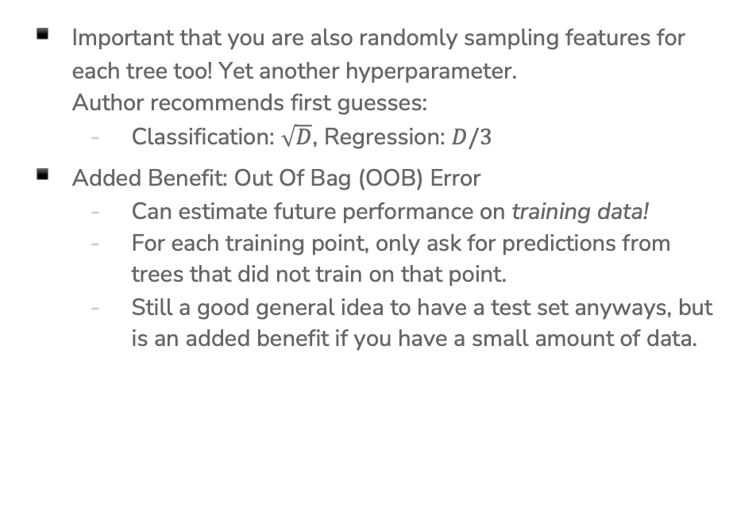
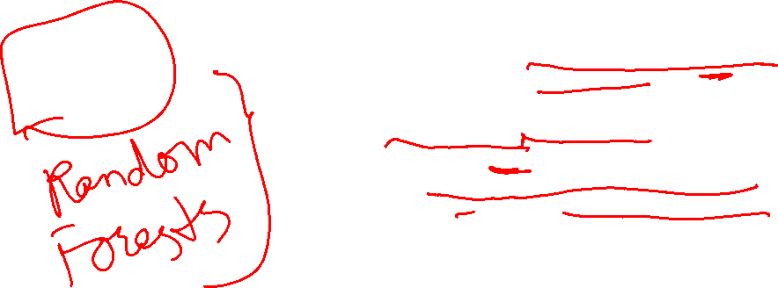
Practical Details
Important that you are also randomly sampling features for each tree too! Yet another hyperparameter.
Author recommends first guesses:
  Classification: $\sqrt{D}$, Regression: $D/3$
Added Benefit: Out Of Bag (OOB) Error
  Can estimate future performance on training data!
  For each training point, only ask for predictions from trees that did not train on that point.
  Still a good general idea to have a test set anyways, but is an added benefit if you have a small amount of data.

Slide 32
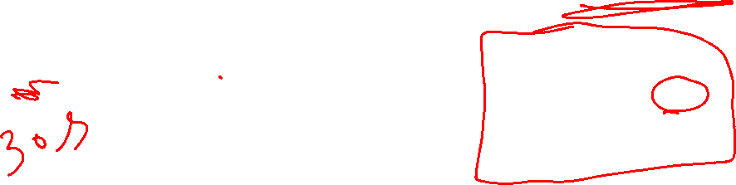
1 min
Which of the following graphs do you think shows the training/true error curves for random forests as you increase # trees (general trend)?
true
Sou
Sou
error
error
true
train
train
# trees
# trees
true
Sou
Sou
true
error
error
train
train
# trees
# trees

Slide 33
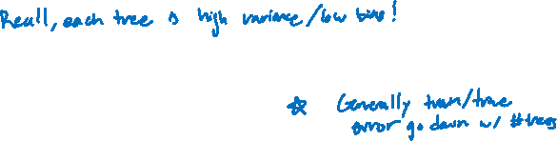
2 min
Which of the following graphs do you think shows the training/true error curves for random forests as you increase # trees (general trend)?
true
Sou
Sou
error
error
true
train
train
# trees
# trees
true
Sou
Sou
true
error
error
train
train
# trees
# trees

Slide 35
AdaBoost
Boosting
Notes:
We are going to talk about another ensemble model (a model that combines many weaker models), but that does it in a completely different way

Slide 36
Background
A weak learner is a model that only does slightly better than random guessing.
Kearns and Valiant (1988, 1989):
“Can a set of weak learners create a single strong learner?”
Schapire (1990)
“Yes!”

Slide 37
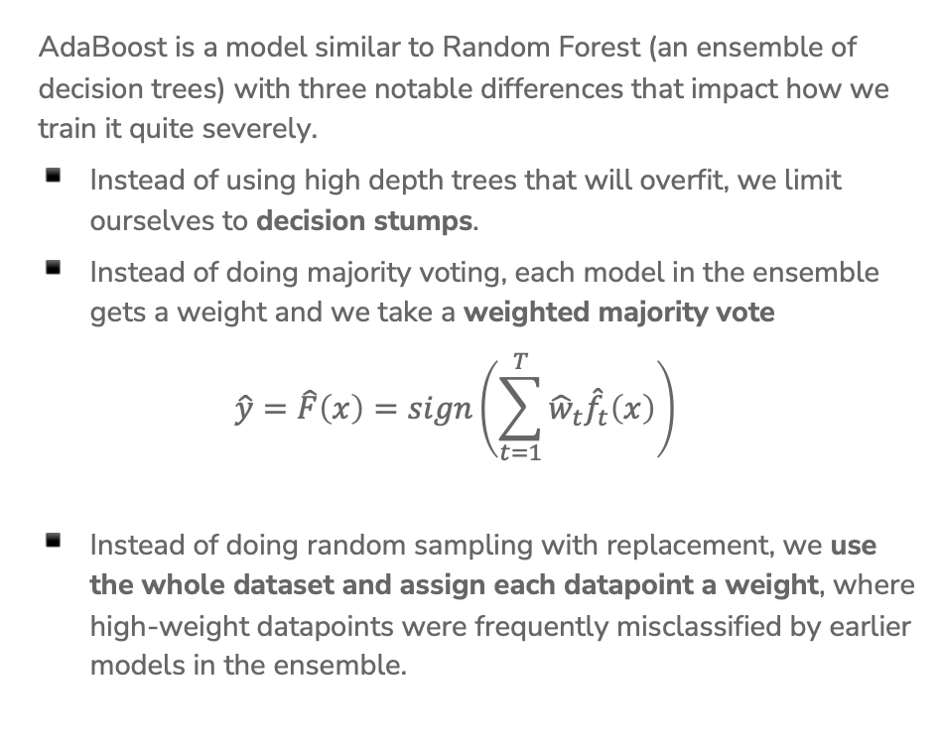
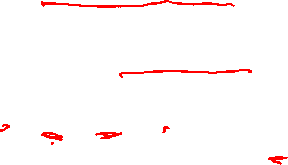
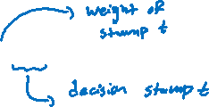
AdaBoost Overview
AdaBoost is a model similar to Random Forest (an ensemble of decision trees) with three notable differences that impact how we train it quite severely.
Instead of using high depth trees that will overfit, we limit ourselves to decision stumps.
Instead of doing majority voting, each model in the ensemble gets a weight and we take a weighted majority vote
$$\hat{y}=\hat{F}\left(x\right)=sign\left(\sum_{t=1}^{T}{{\hat{w}}_{t}{\hat{f}}_{t}\left(x\right)}\right)$$
Instead of doing random sampling with replacement, we use the whole dataset and assign each datapoint a weight, where high-weight datapoints were frequently misclassified by earlier models in the ensemble.
Notes:
Write where hat{f_t} is the t^th tree trained and it predicts +1 or -1 and hat{w} is some weight for that model’s predictions (also learned)

Slide 38
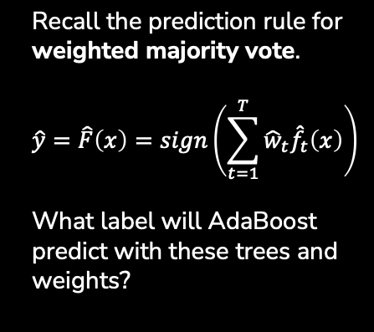

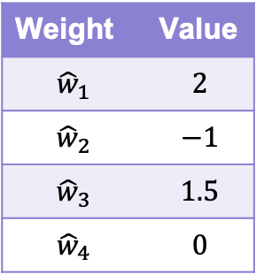


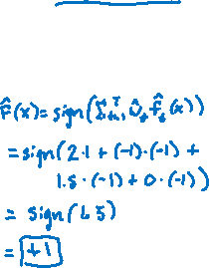

2 min sli.do #cs416
Yes
Income >= 1000
No
Weight | Value
$${\hat{w}}_{1}$$ | $$2$$
$${\hat{w}}_{2}$$ | $$−1$$
$${\hat{w}}_{3}$$ | $$1.5$$
$${\hat{w}}_{4}$$ | $$0$$
SAFE
RISKY
$${\hat{f}}_{1}\left(x\right)= +1$$
Good
Credit History?
Bad
RISKY
SAFE
$${\hat{f}}_{2}\left(x\right)=−1$$
3 Years
Savings >= 100k
5 Years
Recall the prediction rule for weighted majority vote.
$$\hat{y}=\hat{F}\left(x\right)=sign\left(\sum_{t=1}^{T}{{\hat{w}}_{t}{\hat{f}}_{t}\left(x\right)}\right)$$
What label will AdaBoost predict with these trees and weights?
SAFE
RISKY
$${\hat{f}}_{3}\left(x\right)=−1$$
Bad
Good
Market Cond.
RISKY
SAFE
$${\hat{f}}_{4}\left(x\right)= +1$$
Notes:
WOS:
\hat{F}(x) equation
sign(2*1+-1*-1+1.5*-1+0*1)
sign(1.5)
+1
It is possible to have zero weights, that means the ensemble disregards that stump’s predictions
It is possible to have negative weights, that means that whatever the stump votes for, the ensemble will effectively take that to be a vote in the opposite direction

Slide 39
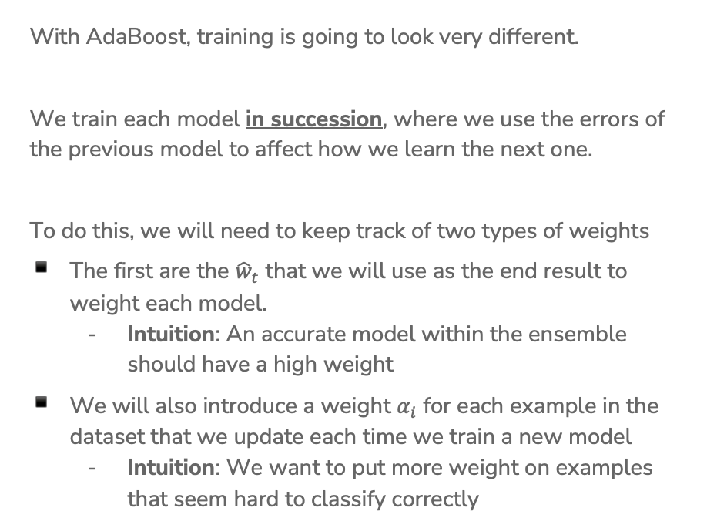
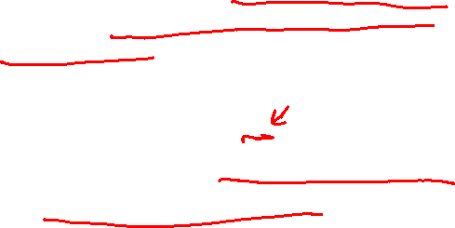
Training AdaBoost
With AdaBoost, training is going to look very different.
We train each model in succession, where we use the errors of the previous model to affect how we learn the next one.
To do this, we will need to keep track of two types of weights
The first are the ${\hat{w}}_{t}$ that we will use as the end result to weight each model.
  Intuition: An accurate model within the ensemble should have a high weight
We will also introduce a weight $α_{i}$ for each example in the dataset that we update each time we train a new model
  Intuition: We want to put more weight on examples that seem hard to classify correctly
Notes:
This is in contrast to random forests, where we trained each model in parallel. Each model was trained on an independently randomly sampled dataset. In AdaBoost, we use the errors from previous models to impact how we train the next model, so we need to train models one at a time.

Slide 40
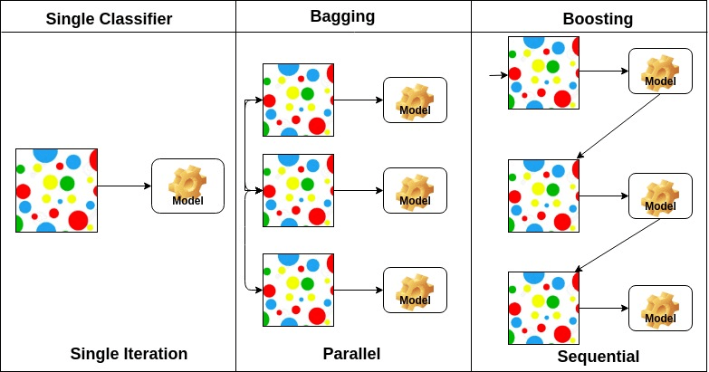
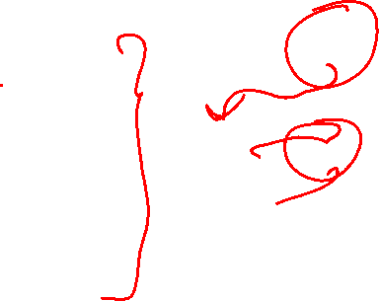
Boosting (AdaBoost) vs. Bagging (Random Forrest)
Notes:
Bagging = Bootstrap aggregation

Slide 41



AdaBoost
Ada Glance
Train
  for $t$ in $\left[1, 2, …, T\right]$:
    Learn ${\hat{f}}_{t}\left(x\right)$ based on data weights $α_{i,t}$
    Compute model weight ${\hat{w}}_{t}$
    Compute data weights $α_{i,t+1}$
Predict
$$\hat{y}=\hat{F}(x)=sign\left(\sum_{t=1}^{T}{{\hat{w}}_{t}{\hat{f}}_{t}(x) }\right)$$
Notes:
Write “How much we trust hat{f}_t next to compute hat{w}_t
Write “Pay more attention to examples we got wrong” next to recompute alpha_i
Write “Only used in training” near alpha

Slide 42



Weighted Data $α_{i}$
Start with a dataset and train our first model (a decision stump)
For all the things it gets wrong, increase the weight of that example. For each one that’s right, decrease its weight.
Notes:
WOS:
Point out which ones were correct (underline with one color)
Point out which were wront (underline with another color)
“Reduce weights of correct examples, increase weights of incorrect examples.”

Slide 43




Learning w/ Weighted Data
Before, when we learned decision trees we found the split that minimized classification error.
Now, we want to minimize weighted classification error
$$WeightedError\left(f_{t}\right)= \frac{\sum_{i=1}^{n}{α_{i,t}𝕀\{{\hat{f}}_{t}\left(x_{i}\right)≠y_{i}\}}}{\sum_{i=1}^{n}{α_{i,t}}}$$
If an example $x_{2}$ has weight $α_{2}=3$, this means getting that example wrong is the same as getting 3 examples wrong!
This will most likely change which split is optimal!
Notes:
WOS:
Classification error: # mistakes / # total
Weighted classification error: sum weights of mistakes / total sum weights

Slide 44


Learning w/ Weighted Data
We also set leaf node predictions to be the class with larger total weight, not the class with more instances.
Loan status:
Safe Risky
Root
6 3
Credit | y | weight
excellent | safe | 1.2
fair | risky | 3.0
fair | safe | 0.5
poor | risky | 0.9
excellent | safe | 0.9
fair | safe | 0.7
poor | risky | 1.0
poor | safe | 2.1
fair | safe | 1.2
Credit?
excellent
2 0
fair
3 1
poor
1 2
Notes:
WOS:
Compute weighted predictions (safe, risky, safe)
Write unweighted predictions: (safe, safe, risky)

Slide 45
2 min
Consider the following weighted dataset, what is the weighted classification error of the optimal decision stump (just one split)?
We want to use the TumorSize and IsSmoker to predict if a patient’s tumor is malignant.
TumorSize | IsSmoker | Malignant | Weight
Small | No | No | 0.5
Small | Yes | Yes | 1.2
Large | No | No | 0.3
Large | Yes | Yes | 0.5
Small | Yes | No | 3.3
Notes:
Options
IsSmoker, 3.3
IsSmoker, 1.7
IsSmoker, 2 (just count)
TumorSize, 1.2 + .3 = 1.5
TumorSize, 1+1 (just count)

Slide 46

0 min
TumorSize | IsSmoker | Malignant | Weight
Small | No | No | 0.5
Small | Yes | Yes | 1.2
Large | No | No | 0.3
Large | Yes | Yes | 0.5
Small | Yes | No | 3.3
Notes:
WOS
Tumor Size, Large / Small, 0.5 0.3 / 1.2 3.8, Yes / No, Weighted Error (0.3+1.2)/5.8 ~= 0.26
IsSmoker, Y / N, 1.7 3.3 / 0.0 0.8, No / No, Weighted Error (1.7+0)/5.8 ~= 0.29

Slide 47




Real Valued Features
The algorithm is more or less the same, but now we need to account for weights
2
5
1
3
2
1
1
2
1
1000
Notes:
WOS:
Best split unweighted
Best split weighted (between 1000 and 3)

Slide 48


Slide 49



AdaBoost
Ada Glance
Train
  for $t$ in $\left[1, 2, …, T\right]$:
    Learn ${\hat{f}}_{t}\left(x\right)$ based on data weights $α_{i,t}$
    Compute model weight ${\hat{w}}_{t}$
    Compute data weights $α_{i,t+1}$
Predict
$$\hat{y}=\hat{F}(x)=sign\left(\sum_{t=1}^{T}{{\hat{w}}_{t}{\hat{f}}_{t}(x) }\right)$$
Notes:
We’ve learnt how to learn a decision stump based on weights, and we’ve learnt how to make the final AdaBoost prediction by taking the weighted average of trees. Now, let’s discuss how to compute the model weights and the datapoint weights.

Slide 50




Model Weights ${\hat{w}}_{t}$
Goal: Want to have high weight for models that are very accurate, and low weight for models that are not.
The specific formula used for AdaBoost
$${\hat{w}}_{t}=\frac{1}{2}\ln\left(\frac{1−WeightedError\left({\hat{f}}_{t}\right)}{WeightedError({\hat{f}}_{t})}\right)$$
Great classifier ($WeightedError\left({\hat{f}}_{t}\right)=0.01$)
  ${\hat{w}}_{t}=\frac{1}{2}\ln\left(\frac{1−0.01}{0.01}\right)=\frac{1}{2}\ln\left(99\right)=2.3$
Meh classifier ($WeightedError\left({\hat{f}}_{t}\right)=0.5$)
  ${\hat{w}}_{t}=\frac{1}{2}\ln\left(\frac{1−0.5}{0.5}\right)=\frac{1}{2}\ln\left(1\right)=0$
Awful classifier ($WeightedError\left({\hat{f}}_{t}\right)=0.99$)
  ${\hat{w}}_{t}=\frac{1}{2}\ln\left(\frac{1−0.99}{0.99}\right)=\frac{1}{2}\ln\left(\frac{1}{99}\right)=−2.3$
Notes:
WOS:
Great Classifier: If WeightedError(f_t) = 0.01 => 1-0.01 / 0.01 = 99 => \hat{w}_t = 2.3
Okay Classifier: If WeightedError(f_t) = 0.5 => 0.5/0.5 = 1 => \hat{w}_t = 0
Awful Classifier: If WeightedError(f_t) = 0.99 => 1-0.99 / 0.99 = 0.01 => \hat{w}_t = -2.3
You can have negative weights. In that case, your ensemble is effectively learning to do the opposite of what that stump predicts.

Slide 51




Computing $α_{i,t+1}$
Goal: Increase the weights of data examples that were hard to classify. If we got it wrong, increase the weight, otherwise decrease it.
$$α_{i,t+1}←\left\{\begin{aligned}α_{i,t}e^{−{\hat{w}}_{t}}, if {\hat{f}}_{t}\left(x_{i}\right)=y_{i} \\ α_{i,t}e^{{\hat{w}}_{t}}, if {\hat{f}}_{t}\left(x_{i}\right)≠y_{i} \end{aligned}\right.$$
Notes:
WOS:
Start with old weight
Downweight if tree t correctly predicts
Upweight if tree t wrongly predicts
e^{-1} < 1, e^{0} = 1, e^1 > 1
How much to up- or down-weight depends on how important that tree is for our ensemble.

Slide 52




AdaBoost
Ada Glance
$${\hat{w}}_{t}=\frac{1}{2}\ln\left(\frac{1−WeightedError\left({\hat{f}}_{t}\right)}{WeightedError({\hat{f}}_{t})}\right)$$
Train
  for $t$ in $\left[1, 2, …, T\right]$:
    Learn ${\hat{f}}_{t}\left(x\right)$ based on data weights $α_{i,t}$
    Compute model weight ${\hat{w}}_{t}$
    Compute data weights $α_{i,t+1}$
Predict
$$\hat{y}=\hat{F}(x)=sign\left(\sum_{t=1}^{T}{{\hat{w}}_{t}{\hat{f}}_{t}(x) }\right)$$
$$α_{i,t+1}←\left\{\begin{aligned}α_{i,t}e^{−{\hat{w}}_{t}}, if {\hat{f}}_{t}\left(x_{i}\right)=y_{i} \\ α_{i,t}e^{{\hat{w}}_{t}}, if {\hat{f}}_{t}\left(x_{i}\right)≠y_{i} \end{aligned}\right.$$

Slide 53



Normalizing $α_{i,t}$
Generally, the weights for some points get really large/small in magnitude due to how the data is laid out.
Numbers in wildly different scales can often cause problems due to finite precision of computers when it comes to real numbers.
Generally, we normalize the data weights so they sum to 1 to prevent them from getting too small or too big.
$$α_{i,t+1}←\frac{α_{i,1+1}}{\sum_{j=1}^{n}{α_{j,t+1}}}$$

Slide 54




AdaBoost
Ada Glance
$${\hat{w}}_{t}=\frac{1}{2}\ln\left(\frac{1−WeightedError\left({\hat{f}}_{t}\right)}{WeightedError({\hat{f}}_{t})}\right)$$
Train
  for $t$ in $\left[1, 2, …, T\right]$:
    Learn ${\hat{f}}_{t}\left(x\right)$ based on data weights $α_{i,t}$
    Compute model weight ${\hat{w}}_{t}$
    Compute data weights $α_{i,t+1}$
Predict
$$\hat{y}=\hat{F}(x)=sign\left(\sum_{t=1}^{T}{{\hat{w}}_{t}{\hat{f}}_{t}(x) }\right)$$
$$α_{i,t+1}←\left\{\begin{aligned}α_{i,t}e^{−{\hat{w}}_{t}}, if {\hat{f}}_{t}\left(x_{i}\right)=y_{i} \\ α_{i,t}e^{{\hat{w}}_{t}}, if {\hat{f}}_{t}\left(x_{i}\right)≠y_{i} \end{aligned}\right.$$
$$α_{i,t+1}←\frac{α_{i,t+1}}{\sum_{j=1}^{n}{α_{j,t+1}}}$$

Slide 55
Visualizing AdaBoost

Slide 56




$t=1$
Learn a Classifier
Start with all data having same weight. $α_{i,1}=1/n$
Learn a decision stump that minimizes weighted error
With all the same weights, this is the same as before!
${\hat{f}}_{ 1}\left(x\right)=…$
Calculate ${\hat{w}}_{1}≈0.61$
Notes:
WOS:
Circle misclassified points

Slide 57




$t=1$
Update Data Weights
Compute new weights $α_{i,2}$ based on the errors of ${\hat{f}}_{1}$
The points with more weight are drawn larger
$$α_{i,2}$$
$$α_{i,2}$$
Notes:
Circle ones that are incorrect

Slide 58





$t=2$
Learn a Classifier
Now use new weights to learn best stump that minimizes weighted classification error.
${\hat{f}}_{ 2}\left(x\right)=…$
Calculate ${\hat{w}}_{2}≈0.53$
Then update weights based on errors.
$$α_{i,2}$$
Notes:
WOS:
Circle misclassified points

Slide 59


AdaBoost Ensemble
If we plot what the predictions would be for each point, we get something that looks like this:
Notes:
Write out \hat{y}_i = sign(\hat{w}_1\hat{f}_1(x) +\hat{w}_1\hat{f}_1(x) )
Where the thing inside the sign is Score(x)
Graph is showing the score/confidence
Right now the first classifier outweighs the second one, but with more you get a much more interesting picture

Slide 60




1 min
Say AdaBoost learned the below classifier at time $t=1$.
Which of the following images represent the reweighted points for time $t=2$?
(A)
(B)
(C)
Notes:
WOS:
Circle incorrect examples
Source: https://nycdatascience.com/blog/student-works/capstone/a-closer-look-at-tree-boosting-methods/

Slide 61


1 min
Say AdaBoost learned the below classifier at time $t=2$.
Which of the following images represent the reweighted points for time $t=3$?
(A)
(B)
(C)
Notes:
WOS:
Circle incorrect examples
Correctly classified points got smaller
Source: https://nycdatascience.com/blog/student-works/capstone/a-closer-look-at-tree-boosting-methods/

Slide 62


30 sec
Say AdaBoost learned the below classifier at time $t=3$.
Which of the following images represent the reweighted points for time $t=4$?
(A)
(B)
(C)
Notes:
Source: https://nycdatascience.com/blog/student-works/capstone/a-closer-look-at-tree-boosting-methods/

Slide 63





AdaBoost
Example
You have now worked through a complete example of training AdaBoost!
What about predicting?
$${\hat{w}}_{1}=0.42$$
$$α_{i,2}=…$$
$${\hat{w}}_{2}=0.65$$
$$α_{i,3}=…$$
$${\hat{w}}_{3}=0.92$$
$$α_{i,4}=…$$

Slide 64





1 min
Consider the following ensemble and weights from the AdaBoost example we’ve been working through.
Which of the following is the final decision boundary?
(B)
(C)
(D)
(A)

Slide 65


2 min
Consider the following ensemble and weights from the AdaBoost example we’ve been working through.
Which of the following is the final decision boundary?
(B)
(C)
(D)
(A)

Slide 66





$${\hat{w}}_{1}=0.42$$
$$α_{i,2}=…$$
$${\hat{w}}_{2}=0.65$$
$$α_{i,3}=…$$
$${\hat{w}}_{3}=0.92$$
$$α_{i,4}=…$$

Slide 68
AdaBoost Overfitting

Slide 69

AdaBoost
Ada Glance
$${\hat{w}}_{t}=\frac{1}{2}\ln\left(\frac{1−WeightedError\left({\hat{f}}_{t}\right)}{WeightedError({\hat{f}}_{t})}\right)$$
Train
  for $t$ in $\left[1, 2, …, T\right]$:
    Learn ${\hat{f}}_{t}\left(x\right)$ based on data weights $α_{i,t}$
    Compute model weight ${\hat{w}}_{t}$
    Compute data weights $α_{i,t+1}$
Predict
$$\hat{y}=\hat{F}(x)=sign\left(\sum_{t=1}^{T}{{\hat{w}}_{t}{\hat{f}}_{t}(x) }\right)$$
$$α_{i,t+1}←\left\{\begin{aligned}α_{i,t}e^{−{\hat{w}}_{t}}, if {\hat{f}}_{t}\left(x_{i}\right)=y_{i} \\ α_{i,t}e^{{\hat{w}}_{t}}, if {\hat{f}}_{t}\left(x_{i}\right)≠y_{i} \end{aligned}\right.$$
$$α_{i,t+!}←\frac{α_{i,t+1}}{\sum_{j=1}^{n}{α_{j,t+1}}}$$
Notes:
For other models, we saw that increasing the complexity of the model increases the likelihood of overfitting. However, AdaBoost is just a collection of really weak learners – is there really a chance of it overfitting?

Slide 70


AdaBoost when $t=30$
Can eventually get 0 training error with a set of weak learners!
This is most likely overfit

Slide 71

AdaBoost Theorem
Technical condition: The weak learner can do at least slightly better than complete random guessing

Slide 72


Compare
Decision Tree
AdaBoost
Notes:
Best test error is around 34% which is worse than the best test error for boosting

Slide 73


Overfitting?
Boosting tends to be robust to overfitting
But will eventually overfit
Notes:
Choose with cross validation

Slide 74



Choose $T$?
How do you end up choosing the number of trees $T$ for boosting?
Like always
Find $T$ that minimizes validation error
Do cross validation
You can’t
Find $T$ that minimizes training error
Find $T$ that minimizes test error

Slide 75

Application
Boosting, AdaBoost and other variants like gradient boosting, are some of the most successful models to date.
They are extremely useful in computer vision
  The standard for face detection
Used by most winners of ML competitions (Kaggle, KDD Cup, …)
Most industry ML systems use a model ensembles
  Some with boosting, some with bagging
  Many times just use 6 different types of models and hand specify their weights.

Slide 76

AdaBoost Overview
Powerful! One of the most powerful set of models for many real world datasets.
  Typically does better than random forest with the same number of trees.
Higher Maintenance: You do have to tune hyper-parameters
  AdaBoost: Number of trees is technically important, but the model tends to be robust to overfitting in practice.
  Gradient Boosting: MANY hyper-parameters (all important)
Expensive: Boosting is inherently sequential which means its slow to learn ensembles with many trees.
  Can be made faster with optimized software like XGBoost (UW)

Slide 77

Recap
Theme: Compare two different ways of making ensembles
Ideas:
Describe what an ensemble model is
Explain what a random forest is and why adding trees improves accuracy.
Formalize how AdaBoost combines weighted votes from simple classifiers (weak learners) and how those classifiers are learned.
Compare/contrast bagging and boosting.
Describe the steps of the AdaBoost algorithm.

