Slide 1
CSE/STAT 416 Naïve Bayes and Decision Trees Tanmay Shah Paul G. Allen School of Computer Science & Engineering University of Washington April 24, 2024 ❓ Questions? Raise hand or sli.do #cs416 💬 Before Class: Pro-rain or anti-rain person? 🎵 Listening to: lecture

Slide 2
Administrivia
Midterm due tonight
- Post questions on Edstem (Private post as needed)
- HW3 out Friday

Slide 3
Probability Classifier
Idea: Estimate probabilities $\hat{P}\left(y | x\right)$ and use those for prediction
Probability Classifier
Input $x$: Sentence from review
Estimate class probability $\hat{P}(y=+1|x)$
If $\hat{P}\left(y=+1 | x\right)>0.5$:
$\hat{y}= +1$
Else:
$\hat{y}=−1$
Notes:
Estimating the probability improves interpretability

Slide 4
Interpreting Score
$$Score\left(x_{i}\right)=w^{T}h\left(x_{i}\right)$$
$$−∞$$
$${\hat{y}}_{i}=−1$$
$$0$$
$${\hat{y}}_{i}=+1$$
$$∞$$
Very sure
$${\hat{y}}_{i}=−1$$
Not sure if
$${\hat{y}}_{i}=−1 or {\hat{y}}_{i}=+1$$
Very sure
$${\hat{y}}_{i}=+1$$
$$\hat{P}\left(y_{i}=+1|x_{i}\right)=0$$
$$\hat{P}\left(y_{i}=+1|x_{i}\right)=0.5$$
$$\hat{P}\left(y_{i}=+1|x_{i}\right)=1$$
$$0$$
$$\hat{P}(y=+1 |x)$$
$$1$$

Slide 5
$$\hat{P}\left(y=+1 | x, \hat{w}\right)=sigmoid\left({\hat{w}}^{T}h\left(x\right)\right)= \frac{1}{1+e^{−{\hat{w}}^{T}h(x)}}$$
Training
Data
$$x$$
Feature extraction
$$h(x)$$
ML model
$$y$$
$$\hat{w}$$
ML algorithm
Quality metric

Slide 6
Naïve Bayes

Slide 7
Idea: Naïve Bayes
$$x=“The sushi \& everything else was awesome!”$$
$P\left(y=+1│x=“The sushi \& everything else was awesome!”\right)$?
$P\left(y=−1│x=“The sushi \& everything else was awesome!”\right)$?
Idea: Select the class that is the most likely!
Bayes Rule:
$$P\left(y=+1 | x_{ }\right)=\frac{P\left(x\right|y=+1)P\left(y=+1\right) }{P(x)}$$
Example
$$\frac{P\left(“The sushi \&everything else was awesome!”│y=+1\right) P(y=+1) }{P(“The sushi \& everything else was awesome!”)}$$
Since we’re just trying to find out which class has the greater probability, we can discard the divisor.

Slide 8
Naïve Assumption
Idea: Select the class with the highest probability!
Problem: We have not seen the sentence before.
Assumption: Words are independent from each other.
$$x=“The sushi \& everything else was awesome!”$$
$$\frac{P\left(“The sushi \& everything else was awesome!” | y=+1\right) P(y=+1) }{P(“The sushi \& everything else was awesome!”)}$$
$$P\left(“The sushi \&everything else was awesome!” |y=+1\right)=P\left(\text{The}\text{ | }\text{y}\text{=+1) ∗ }\text{P}\text{(}sushi |y=+1\right)∗P(\&|y=+1) \\ ∗P\left(everything|y=+1\right)∗P\left(else|y=+1\right)∗P\left(was|y=+1\right)$$ $∗P\left(awesome|y=+1\right)$

Slide 9
Compute Probabilities
How do we compute something like
$$P\left(y=+1\right)?$$
How do we compute something like
$$P\left(“awesome” |y=+1\right)?$$

Slide 10
Zeros
If a feature is missing in a class everything becomes zero.
$$P\left(“The sushi \&everything else was awesome!” |y=+1\right)=P\left(\text{The}\text{ | }\text{y}\text{=+1) ∗ }\text{P}\text{(}sushi |y=+1\right)∗P(\&|y=+1) \\ ∗P\left(everything|y=+1\right)∗P\left(else|y=+1\right)∗P\left(was|y=+1\right) \\ ∗P\left(awesome|y=+1\right)$$
Solutions?
Take the log (product becomes a sum).
Generally define $\log\left(0\right)=0$ in these contexts
Laplacian Smoothing (adding a constant to avoid multiplying by zero)

Slide 11
Compare Models
Logistic Regression:
$$P\left(y=+1 | x,w\right)=\frac{1}{1+e^{−w^{T}h(x)}}$$
Naïve Bayes:
$$P\left(y | x_{1}, x_{2}\text{,}…, x_{d}\right)=\prod_{j=1}^{d}{P(x_{j}|y)} P(y)$$
Based on counts of words/classes
Laplace Smoothing

Slide 12
Compare Models
Generative: defines a model for generating x (e.g. Naïve Bayes)
Discriminative: only cares about defining and optimizing a decision boundary (e.g. Logistic Regression)
Notes:
Generative classifiers
Assume some functional form for P(Y), P(X|Y)
Estimate parameters of P(X|Y), P(Y) directly from training data
Use Bayes rule to calculate P(Y |X)
Discriminative Classifiers
Assume some functional form for P(Y|X)
Estimate parameters of P(Y|X) directly from training data

Slide 13
2 min
Recap: What is the predicted class for this sentence assuming we have the following training set (no Laplace Smoothing). “he is not cool”
Sentence | Label
this dog is cute | Positive
he does not like dogs | Negative
he is not bad he is cool | Positive
Notes:
P(y=+1|x) \prop P(x | y=+1)P(y=+1)
P(y=+1) = 2/3
P(x|y=+1) = (2/11)(3/11)(1/11)(1/11)

Slide 14
Decision Trees

Slide 15
Humans often make decisions based on Flow Charts
or Decision Trees

Slide 16
Parametric vs. Non-Parametric Methods
Parametric Methods: make assumptions about the data distribution
Linear Regression ⇒ assume the data is linear
Logistic Regression ⇒ assume probability has the shape of of a logistic curve and linear decision boundary
Non-Parametric Methods: (mostly) don’t make assumptions about the data distribution
Decision Trees, k-NN (soon)
We’re still learning something, but not the parameters to a function family that we’re assuming describes the data.
Useful when you don’t want to (or can’t) make assumptions about the data distribution.
Those assumptions result in a parameterized function family. Our learning task is to learn the parameters.
Notes:
Mention: Often times with non-parametric rules, you can’t write the prediction equation down as a simple mathematical formula

Slide 17
XOR
A line might not always support our decisions.

Slide 18
What makes a loan risky?
I want to buy a new house!
Credit History ★★★★
Income ★★★
Term ★★★★★
Personal Info ★★★
Loan
Application
Notes:
Notes for Carlos:
Capital : Your capital is comprised of your savings, investments, and other assets that you can use to repay the loan. Capital can be helpful if you lose your job or experience other setbacks.
Capacity : Lenders will gauge your ability to repay the loan you’re applying for based on your current situation, and the amount of debt and expenses you currently have. Lenders will typically calculate your debt-to-income ratio – or how much you owe vs. how much you earn – to gauge your risk. The lower your ratio, the less risky lending to you may seem.
Collateral : With some loans, you’re required to offer an asset (for example, a home or car) that the lender can take possession of in the event that you are unable to make loan payments. Some lenders may require a guarantee in addition to collateral, which means that you or a third party must agree to repay the loan if the collateral cannot cover the amount.
Conditions : These are outside circumstances, such as the economy and job market, that can influence your ability to repay a loan. However, this category also includes how you intend to use the loan. For instance, obtaining a loan to pay for graduate school would seem less risky than a loan being used for a family vacation, since the degree would most likely improve your profitability in the long run.
Credit history : Lenders will check your credit report and score. Together they show lenders your credit accounts, payment history, and level of risk.

Slide 19
Credit history explained
Did I pay previous loans on time?
Example: excellent, good, or fair
Credit History ★★★★
Income ★★★
Term ★★★★★
Personal Info ★★★

Slide 20
Income
What’s my income?
Example: $80K per year
Credit History ★★★★
Income ★★★
Term ★★★★★
Personal Info ★★★

Slide 21
Loan terms
How soon do I need to pay the loan?
Example: 3 years, 5 years,…
Credit History ★★★★
Income ★★★
Term ★★★★★
Personal Info ★★★

Slide 22
Personal information
Credit History ★★★★
Age, reason for the loan, marital status,…
Example: Home loan for a married couple
Income ★★★
Term ★★★★★
Personal Info ★★★

Slide 23
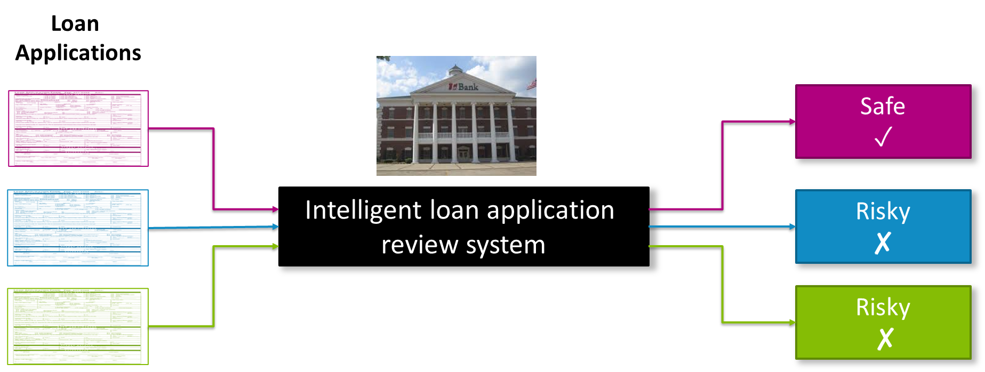
Intelligent application

Slide 24
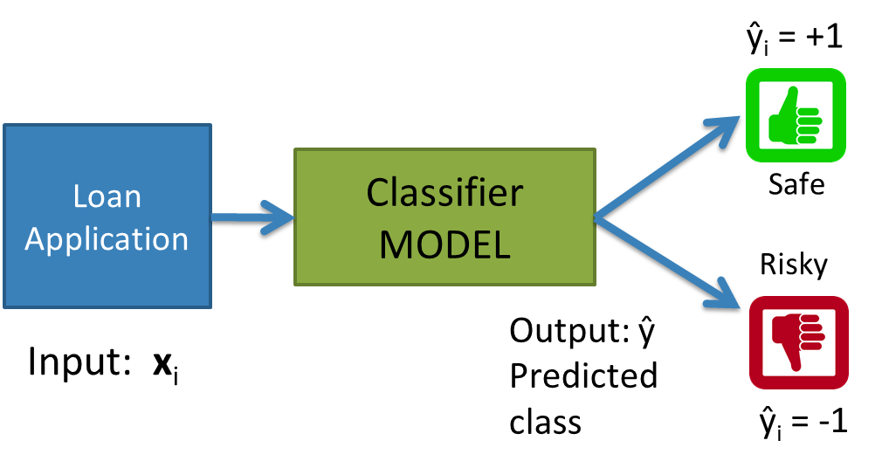
Classifier review

Slide 25
Setup
Data (N observations, 3 features)
Evaluation: classification error
Many possible decisions: number of trees grows exponentially!
Credit | Term | Income | y
excellent | 3 yrs | high | safe
fair | 5 yrs | low | risky
fair | 3 yrs | high | safe
poor | 5 yrs | high | risky
excellent | 3 yrs | low | safe
fair | 5 yrs | low | safe
poor | 3 yrs | high | risky
poor | 5 yrs | low | safe
fair | 3 yrs | high | safe
Notes:
- Switch this to the new figure

Slide 26
2 min
With our discussion of bias and fairness from last week, discuss the potential biases and fairness concerns that might be present in our dataset about loan safety.
No poll

Slide 27
Decision Trees
Start
excellent
Credit?
poor
fair
Income?
Safe
Term?
high
Low
3 years
5 years
Risky
Safe
Term?
Risky
3 years
5 years
Risky
Safe
Branch/Internal node: splits into possible values of a feature
Leaf node: final decision (the class value)

Slide 29
Growing Trees
Notes:
WOS:
Start with root, add one split at a time.
Which features are “good”?
When to stop growing the tree?

Slide 30
Visual Notation
Loan status: Safe Risky
Root
6 3
# of Risky loans
# of Safe loans
N = 9 examples
Notes:
Relate this to histogram

Slide 31
Decision stump: 1 level
Loan status:
Safe Risky
Root
6 3
Split on Credit
Credit | Term | Income | y
excellent | 3 yrs | high | safe
fair | 5 yrs | low | risky
fair | 3 yrs | high | safe
poor | 5 yrs | high | risky
excellent | 3 yrs | low | safe
fair | 5 yrs | low | safe
poor | 3 yrs | high | risky
poor | 5 yrs | low | safe
fair | 3 yrs | high | safe
Credit?
excellent
2 0
fair
3 1
poor
1 2
Subset of data with Credit = excellent
Subset of data with Credit = fair
Subset of data with Credit = poor
Notes:
Split on credit

Slide 32
Making predictions
For each leaf node, set $\hat{y}$ = majority value
Loan status:
Safe Risky
Root
6 3
credit?
excellent
2 0
fair
3 1
poor
1 2
Safe
Safe
Risky

Slide 33
How do we select the best feature?
Select the split with lowest classification error
Choice 1: Split on Credit
Choice 2: Split on Term
Loan status:
Safe Risky
Loan status:
Safe Risky
Root
6 3
Root
6 3
Credit?
Term?
excellent
2 0
fair
3 1
poor
1 2
3 years
4 1
5 years
2 1

Slide 34
Calculate the node values.
Choice 2: Split on Term
Credit | Term | Income | y
excellent | 3 yrs | high | safe
fair | 5 yrs | low | risky
fair | 3 yrs | high | safe
poor | 5 yrs | high | risky
excellent | 3 yrs | low | safe
fair | 5 yrs | low | safe
poor | 3 yrs | high | risky
poor | 5 yrs | low | safe
fair | 3 yrs | high | safe
Loan status:
Safe Risky
Root
6 3
Term?
3 years
5 years
Notes:
4 1, 2 2

Slide 35
How do we select the best feature? Select the split with lowest classification error
Choice 1: Split on Credit
Choice 2: Split on Term
Loan status:
Safe Risky
Loan status:
Safe Risky
Root
6 3
Root
6 3
Credit?
Term?
excellent
2 0
fair
3 1
poor
1 2
3 years
4 1
5 years
2 2

Slide 36
How do we measure effectiveness of a split?
Loan status:
Safe Risky
Root
6 3
Idea: Calculate classification error of this decision stump
Credit?
Error = # mistakes
# data points
excellent
2 0
fair
3 1
poor
1 2

Slide 37
Calculating classification error
Step 1: $\hat{y}$ = class of majority of data in node
Step 2: Calculate classification error of predicting $\hat{y}$ for this data
Loan status:
Safe Risky
Error =
=
Root
6 3
6 correct
3 mistakes
Safe
Tree | Classification error
(root) | 0.33
$\hat{y}$ = majority class
Notes:
error = 18
22 + 18
= 0.45

Slide 38
Choice 1: Split on Credit history?
Choice 1: Split on Credit
Does a split on Credit reduce classification error below 0.33?
Loan status:
Safe Risky
Root
6 3
Credit?
excellent
2 0
fair
3 1
poor
1 2

Slide 39
Split on Credit: Classification error
Choice 1: Split on Credit
Loan status:
Safe Risky
Root
6 3
Error = .
=
Credit?
excellent
2 0
fair
3 1
poor
1 2
Tree | Classification error
(root) | 0.33
Split on credit | 0.22
Safe
Safe
Risky
0 mistakes
1 mistake
1 mistake
Notes:
error = 2
9
= 0.22

Slide 40
Choice 2: Split on Term?
Choice 2: Split on Term
Loan status:
Safe Risky
Root
6 3
Term?
3 years
4 1
5 years
2 2
Safe
Risky

Slide 41
Evaluating the split on Term
Choice 2: Split on Term
Loan status:
Safe Risky
Root
6 3
Error = .
=
Term?
3 years
4 1
5 years
2 2
Tree | Classification error
(root) | 0.33
Split on credit | 0.22
Split on term | 0.33
Safe
Risky
1 mistake
2 mistakes

Slide 42
Choice 1 vs Choice 2: Comparing split on credit vs term
Tree | Classification error
(root) | 0.33
split on credit | 0.22
split on loan term | 0.33
Choice 1: Split on Credit
Choice 2: Split on Term
Loan status:
Safe Risky
Root
6 3
Loan status:
Safe Risky
Root
6 3
Credit?
Term?
excellent
2 0
fair
3 1
poor
1 2
3 years
4 1
5 years
2 2
WINNER

Slide 43
Split Selection
Split(node)
Given $M$, the subset of training data at a node
For each (remaining) feature $h_{j}(x)$ :
Split data $M$ on feature $h_{j}(x)$
Compute the classification error for the split
Chose feature $h_{j}^{∗}(x)$ with the lowest classification error

Slide 44
Greedy & Recursive Algorithm
BuildTree(node)
If termination criterion is met:
Stop
Else:
Split(node)
For child in node:
BuildTree(child)
Notes:
WOS:
Greedy = take the best action in the moment
Recursive = a function that calls itself

Slide 45
Decision stump: 1 level
Loan status:
Safe Risky
Root
6 3
Split on Credit
Credit?
excellent
2 0
fair
3 1
poor
1 2
Subset of data with Credit = excellent
Subset of data with Credit = fair
Subset of data with Credit = poor
Notes:
Split on credit

Slide 46
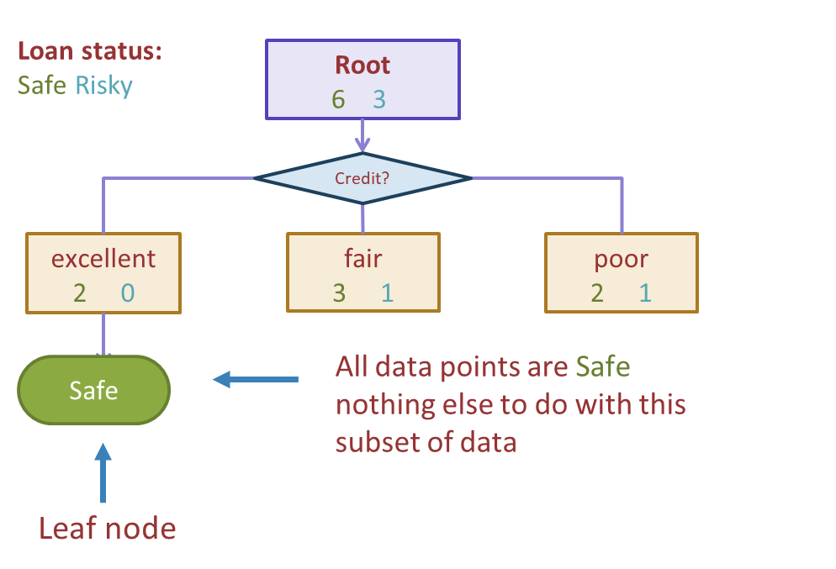
Stopping
For now: Stop when all points are in one class

Slide 47
Tree learning = Recursive stump learning
Loan status:
Safe Risky
Root
6 3
Credit?
excellent
2 0
fair
3 1
poor
2 1
Safe
Build decision stump with subset of data where Credit = fair
Build decision stump with subset of data where Credit = poor

Slide 48
Second level
Loan status:
Safe Risky
Root
6 3
Credit?
excellent
2 0
fair
3 1
poor
1 2
Safe
Term?
Income?
5 years
1 1
high
0 2
Low
1 0
3 years
2 0
Safe
Risky
Safe
Build another stump these data points

Slide 49
1 min
What predictions should the below decision tree output for the following datapoints?
Loan status:
Safe Risky
Root
6 3
Credit?
excellent
2 0
fair
3 1
poor
1 2
Safe
Term?
Income?
Credit | Term | Income
excellent | 5 yrs | high
fair | 3 yrs | low
poor | 5 yrs | (missing)
5 years
2 1
high
0 2
low
1 0
3 years
1 0
Safe
…
Risky
Safe
Notes:
Point out that I changed the numbers on the term split slightly
Should is written intentionally; if the decision tree algorithm learnt so far wouldn’t output a specific answer, think about what you think it should output.

Slide 50
2 min
What predictions should the below decision tree output for the following datapoints?
Loan status:
Safe Risky
Root
6 3
Credit?
excellent
2 0
fair
3 1
poor
1 2
Safe
Term?
Income?
Credit | Term | Income
excellent | 5 yrs | high
fair | 3 yrs | low
poor | 5 yrs | (missing)
5 years
2 1
high
0 2
low
1 0
3 years
1 0
Safe
…
Risky
Safe
50

Slide 52
Real valued features
Income | Credit | Term | y
$105 K | excellent | 3 yrs | Safe
$112 K | good | 5 yrs | Risky
$73 K | fair | 3 yrs | Safe
$69 K | excellent | 5 yrs | Safe
$217 K | excellent | 3 yrs | Risky
$120 K | good | 5 yrs | Safe
$64 K | fair | 3 yrs | Risky
$340 K | excellent | 5 yrs | Safe
$60 K | good | 3 yrs | Risky

Slide 53
Threshold split
Loan status:
Safe Risky
Root
22 18
Split on Income
Income?
< $60K
8 13
>= $60K
14 5
Subset of data with Income >= $60K

Slide 54
Best threshold?
Similar to our simple, threshold model when discussing Fairness!
Infinite possible values of $t$
Income = $t^{∗}$
Income $< t^{∗}$
Income ${≥t}^{∗}$
Safe
Risky
Income
$10K
$120K

Slide 55
Threshold between points
Same classification error for any threshold split between $v_{a}$ and $v_{b}$
Safe
Risky
Income
$$v_{a}$$
$$v_{b}$$
$10K
$120K

Slide 56
Only need to consider mid-points
Finite number of splits to consider
Safe
Risky
Income
$10K
$120K

Slide 57
Threshold split selection algorithm
Step 1: Sort the values of a feature $h_{j}(x)$:
Let $\left[v_{1}, v_{2},…, v_{N}\right]$ denote sorted values
Step 2:
For $i=\left[1, …, N −1\right]$
Consider split $t_{i}=\frac{v_{i}+v_{i+1}}{2}$
Compute classification error for threshold split $h_{j}\left(x\right)≥t_{i}$
Chose the $t^{∗}$ with the lowest class. error

Slide 58
Visualizing the threshold split
Income
Threshold split is the line Age = 38
…
$80K
$40K
$0K
Age
0
10
20
30
40
…

Slide 59
Split on Age >= 38
Income
age < 38
age >= 38
Predict Risky
…
$80K
Predict Safe
$40K
$0K
Age
0
10
20
30
40
…

Slide 60
Each split partitions the 2-D space
Age >= 38
Income >= 60K
Income
Age < 38
…
$80K
$40K
Age >= 38
Income < 60K
$0K
Age
0
10
20
30
40
…

Slide 61
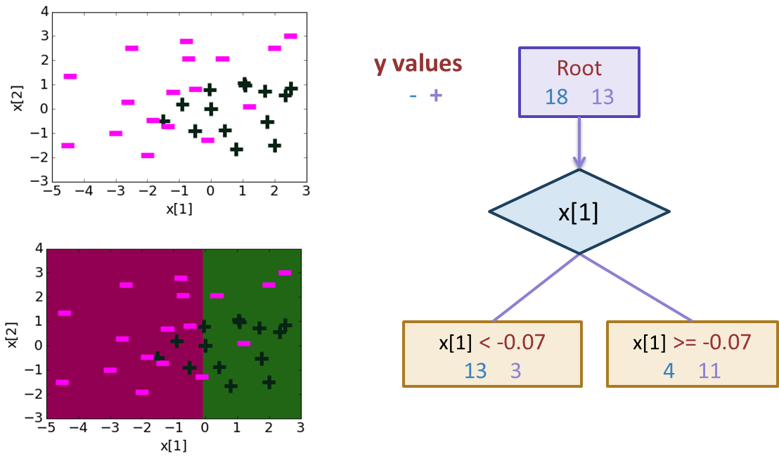
Depth 1: Split on x[1]
Notes:
0.22542207904 + 1.12 x[1] -1.07 x[2]

Slide 62
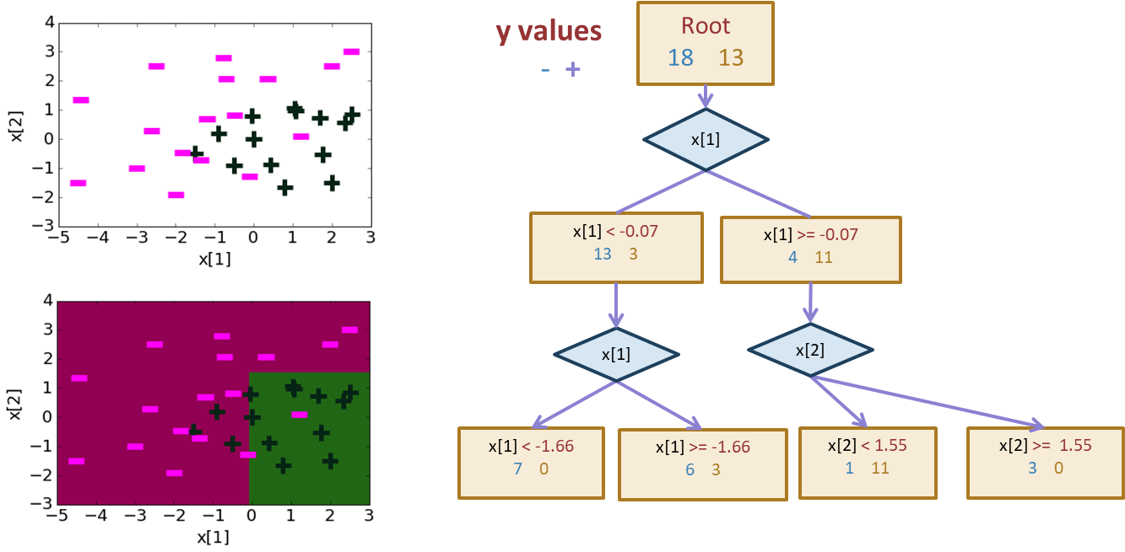
Depth 2
Notes:
0.22542207904 + 1.12 x[1] -1.07 x[2]

Slide 63
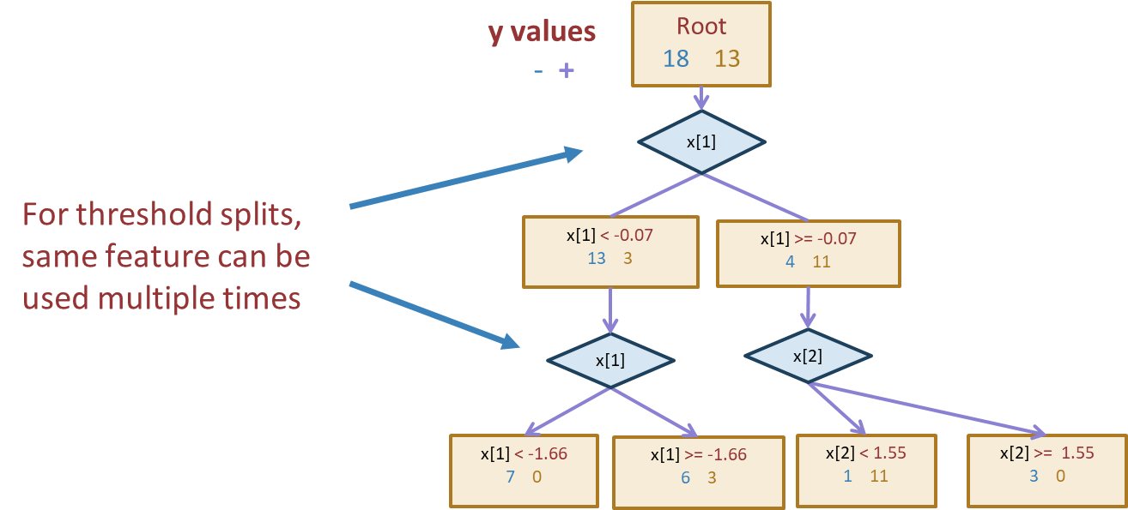
Threshold split caveat
Notes:
0.22542207904 + 1.12 x[1] -1.07 x[2]

Slide 64
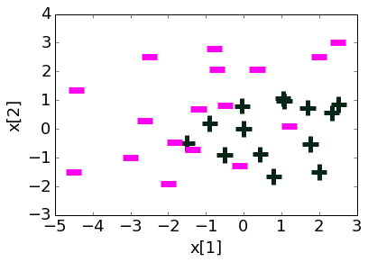
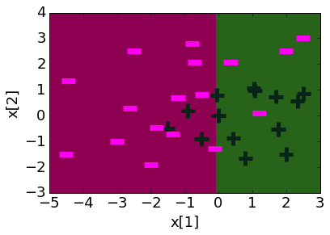
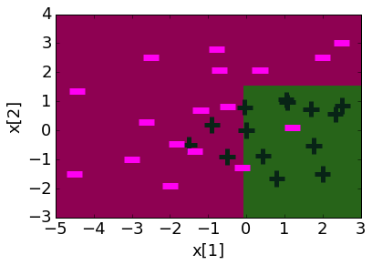
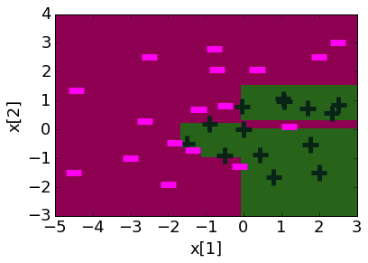
Decision boundaries
Decision boundaries can be complex!
Depth 1 Depth 2 Depth 10
Notes:
0.22542207904 + 1.12 x[1] -1.07 x[2]

Slide 65
Overfitting
Deep decision trees are prone to overfitting
Decision boundaries are interpretable but not stable
Small change in the dataset leads to big difference in the outcome
Overcoming Overfitting:
Stop when tree reaches certain height (e.g., 4 levels)
Stop when leaf has $≤$some num of points (e.g., 20 pts)
Will be the stopping condition for HW
Stop if split won’t significantly decrease error by more than some amount (e.g., 10%)
Other methods include growing full tree and pruning back
Fine-tune hyperparameters with validation set or CV
Notes:
0.22542207904 + 1.12 x[1] -1.07 x[2]

Slide 66
In Practice
Trees can be used for classification or regression (CART)
Classification: Predict majority class for root node
Regression: Predict average label for root node
In practice, we don’t minimize classification error but instead some more complex metric to measure quality of split such as Gini Impurity or Information Gain (not covered in 416)
Can also be used to predict probabilities

Slide 67
Predicting probabilities
Root
18 12
Loan status:
Safe Risky
Credit?
excellent
9 2
fair
6 9
poor
3 1
Safe
Risky
Safe
P(y = Safe | x)
= 3 = 0.75
3 + 1

Slide 68
Recap
What you can do now:
Define the assumptions and modeling for Naïve Bayes
Define a decision tree classifier
Interpret the output of a decision trees
Learn a decision tree classifier using greedy algorithm
Traverse a decision tree to make predictions
Majority class predictions
Notes:
0.22542207904 + 1.12 x[1] -1.07 x[2]

