Slide 1
CSE/STAT 416
Fairness and Tradeoffs
Tanmay Shah
Paul G. Allen School of Computer Science & Engineering
University of Washington
April 19, 2024

Slide 2
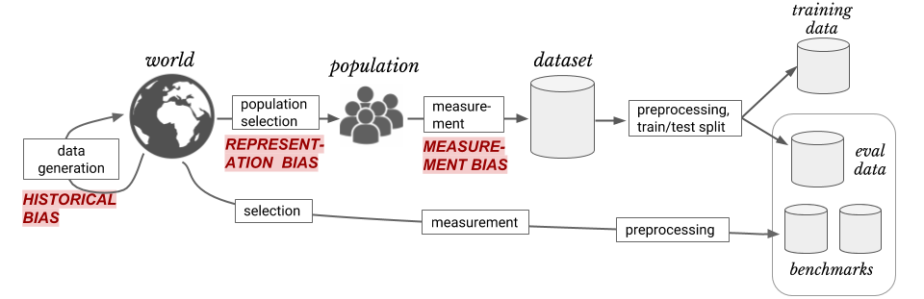
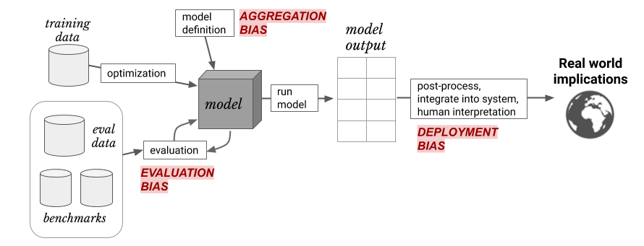
Sources of Bias
Discussion heavily based on Suresh and Guttag (2020)
A FRAMEWORK FOR UNDERSTANDING UNINTENDED CONSEQUENCES OF MACHINE LEARNING, BY HARINI SURESH AND JOHN V. GUTTAG, 2020
Six common sources of bias:
Historical bias
Representation Bias
Measurement Bias
Aggregation Bias
Evaluation Bias
Deployment Bias

Slide 3
Fairness
What does it mean for a model to be fair or unfair? Can we come up with a numeric way of measuring fairness?
Lots of work in the field of ML and fairness is looking into mathematical definitions of fairness to help us spot when something might be unfair.
There is not going to be one central definition of fairness, as each definition is a mathematical statement of which behaviors are/aren’t allowed.
Different definitions of fairness can be contradictory!

Slide 4
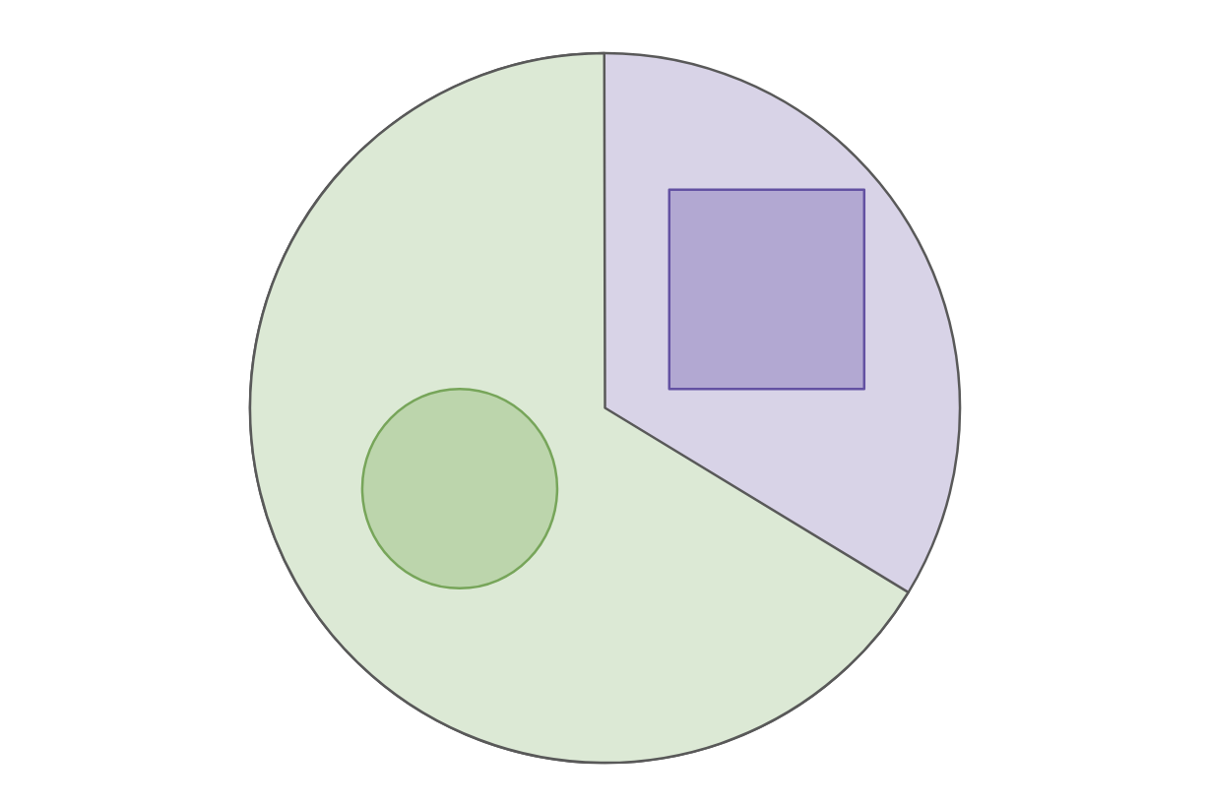
Example: College Admissions
Will use a very simplified example of college admissions. This is not an endorsement of such a system or a statement of how we think the world does/should work. Will make MANY simplifying assumptions (which are unrealistic).
There is a single definition of “success” for college applicants, and the goal of an admissions decision is to predict “success”
The only thing we will use as part of our decision is SAT Score
To talk about group fairness, will assume everyone belongs to exactly one of two races: Circles (66%) or Squares (33%).

Slide 5
Group Fairness
Fairness through Unawareness
Statistical Parity
  Require admissions match demographics in data
Equal Opportunity
  Require false-negative rate to be equal across groups
Predictive Equality
  Require false-positive rate to be equal across groups

Slide 6
(Im)possibility of Fairness
Four reasonable conditions we want in a real world ML Model:
  Statistical Parity
  Equal Opportunity (Equality across false negative rates)
  Predictive Equality (Equality across false positive rates)
  Good accuracy of the model across subgroups
In general, can’t satisfy all 4 simultaneously unless groups have the exact same underlying distribution.
This condition is rarely met in practice as we mentioned earlier when there are so many places for bias to enter our data collection.

Slide 7
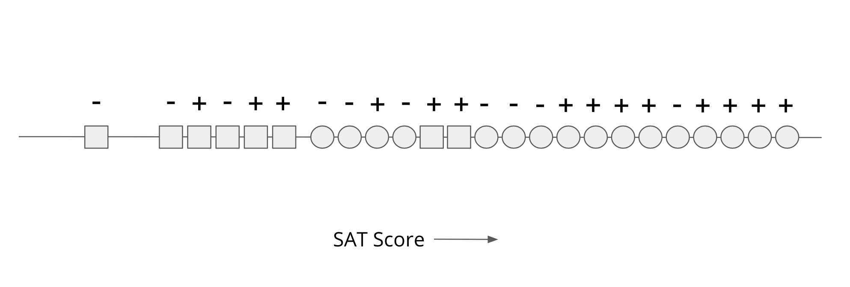
College Admissions - Continued
Continuing overly simplistic college admissions example, with a fake dataset.
Majority (2/3) are Circle, the remaining 1/3 are Square
SAT score for Circles tends to be inflated when compared to Squares. Possibility: Systematic barriers and access to SAT Prep
Even though we see statistical differences between groups in our data, the rate in which they are actually successful is the same.

Slide 8
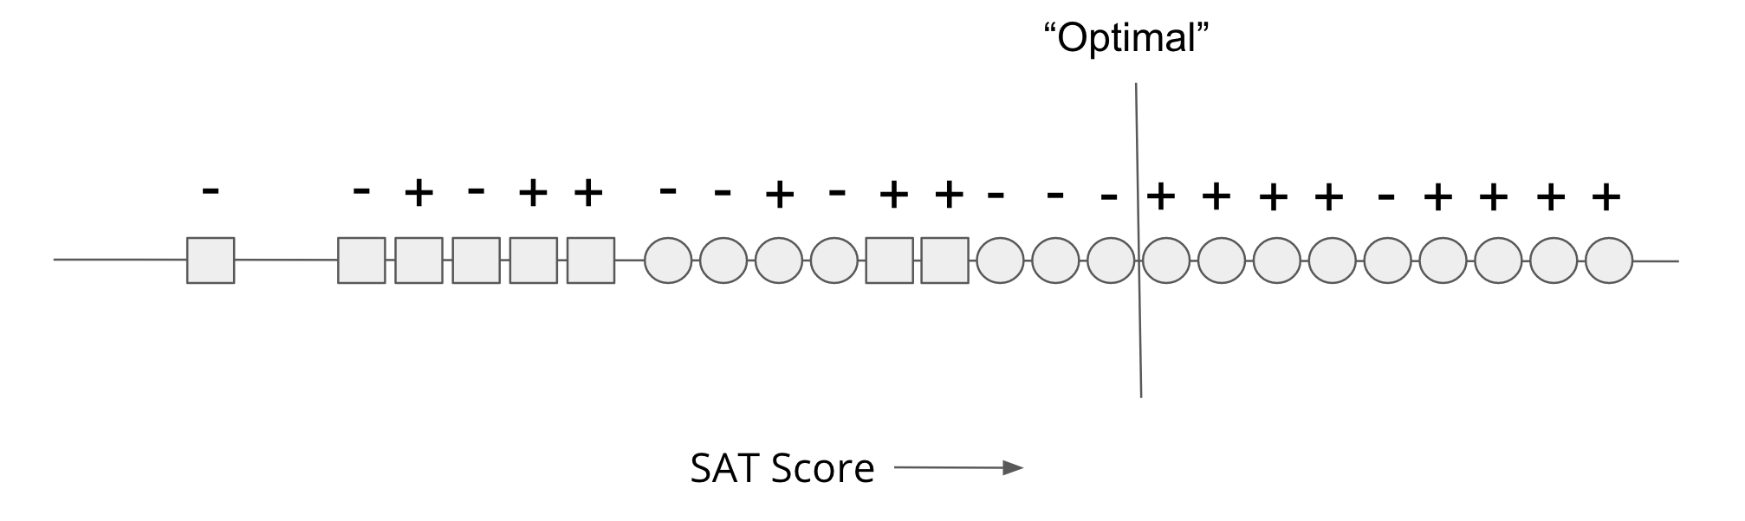
Accuracy and Fairness
With only one feature, we will consider a simple threshold classifier (a linear classifier with 1 input!).
The most accurate model is not necessarily the most fair.

Slide 9
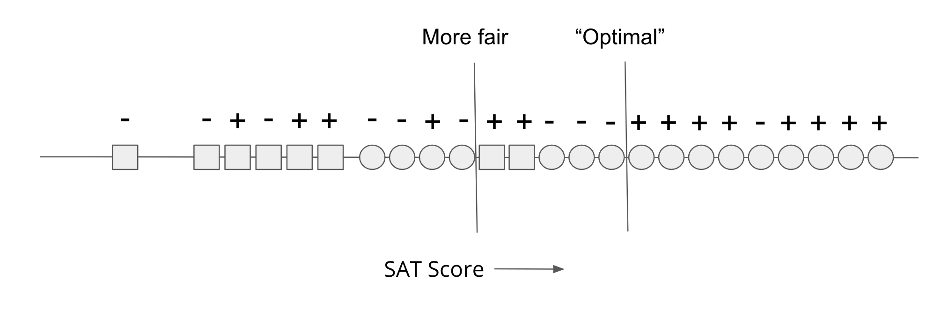
Fairness-Accuracy Tradeoff
In general, we find there is a tradeoff between accurate models and fair models. Making a model more fair tends to decrease accuracy by some amount.

Slide 10
Notes on Tradeoff
Might argue that my example is overly simplistic (it is!), but I’ll claim this is a proof of concept. We saw lots of examples of “accurate” models that were unfair.
This is not a statement that a tradeoff necessarily must exist, it just generally happens in real-world datasets.
Originally just cared about finding the most accurate model, saw unfairness as a byproduct. Controlling for fairness will yield a different model than you found before.
If we recognize data can encode biases and accuracy is determined in terms of that data, trying to achieve fairness will likely hurt accuracy.
  In the example before, the artificial difference in SAT scores caused the problem.

Slide 11
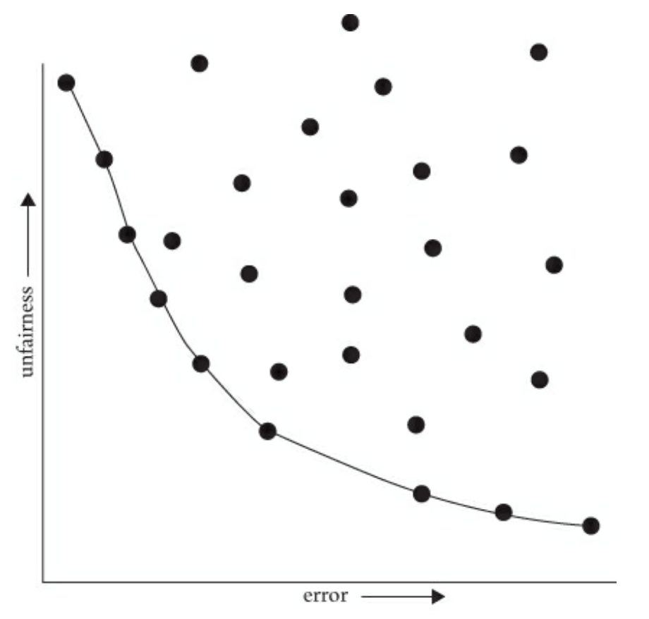
Pareto Frontier
Visualizing the tradeoff between fairness and accuracy
Does not tell you which tradeoff is appropriate!

Slide 12
Thoughts on Pareto Frontier
This feels a bit cold-hearted, it’s okay to like this is weird. Michael Kearns and Aaron Roth write in The Ethical Algorithm
While the idea of considering cold, quantitative trade-offs between accuracy and fairness might make you uncomfortable, the point is that there is simply no escaping the Pareto frontier. Machine learning engineers and policymakers alike can be ignorant of it or refuse to look at it. But once we pick a decision-making model (which might in fact be a human decision-maker), there are only two possibilities. Either that model is not on the Pareto frontier, in which case it’s a “bad” model (since it could be improved in at least one measure without harm in the other), or it is on the frontier, in which case it implicitly commits to a numerical weighting of the relative importance of error and unfairness. Thinking about fairness in less quantitative ways does nothing to change these realities—it only obscures them.
Making the trade-off between accuracy and fairness quantitative does not remove the importance of human judgment, policy, and ethics—it simply focuses them where they are most crucial and useful, which is in deciding exactly which model on the Pareto frontier is best (in addition to choosing the notion of fairness in the first place, and which group or groups merit protection under it, […]). Such decisions should be informed by many factors that cannot be made quantitative, including what the societal goal of protecting a particular group is and what is at stake. Most of us would agree that while both racial bias in the ads users are shown online and racial bias in lending decisions are undesirable, the potential harms to individuals in the latter far exceed those in the former. So in choosing a point on the Pareto frontier for a lending algorithm, we might prefer to err strongly on the side of fairness—for example, insisting that the false rejection rate across different racial groups be very nearly equal, even at the cost of reducing bank profits. We’ll make more mistakes this way—both false rejections of creditworthy applicants and loans granted to parties who will default—but those mistakes will not be disproportionately concentrated in any one racial group.

Slide 14
Fairness as Worldview

Slide 15
Context
So far have discussed notions of group fairness, but other notions of fairness exist. Provide a framework for how to approach learning tasks and what assumptions we make. Based on Friedler et al. (2016).
High level ideas:
Data gathering and modeling
Individual fairness vs. group fairness
Common world-views that dictate which fairness is appropriate
How these worldviews can contradict each other

Slide 16
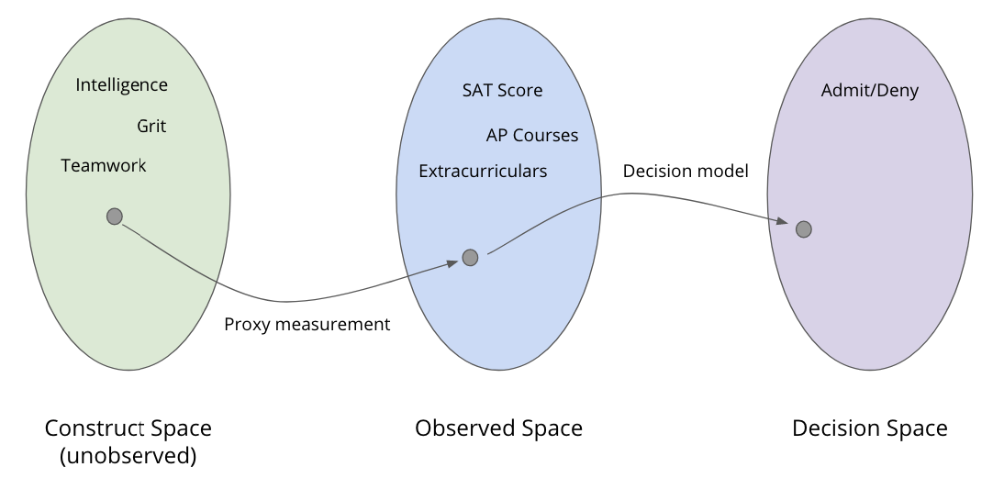
ML and Spaces
Defined modeling as transformation through three spaces
Construct space: True quantities of interest (unobserved)
Observed space: Data gathered to (hopefully) represent constructs. Achieved through measurement of proxies.
Decision space: The decisions of the model. Models take observed data and make decisions.

Slide 17
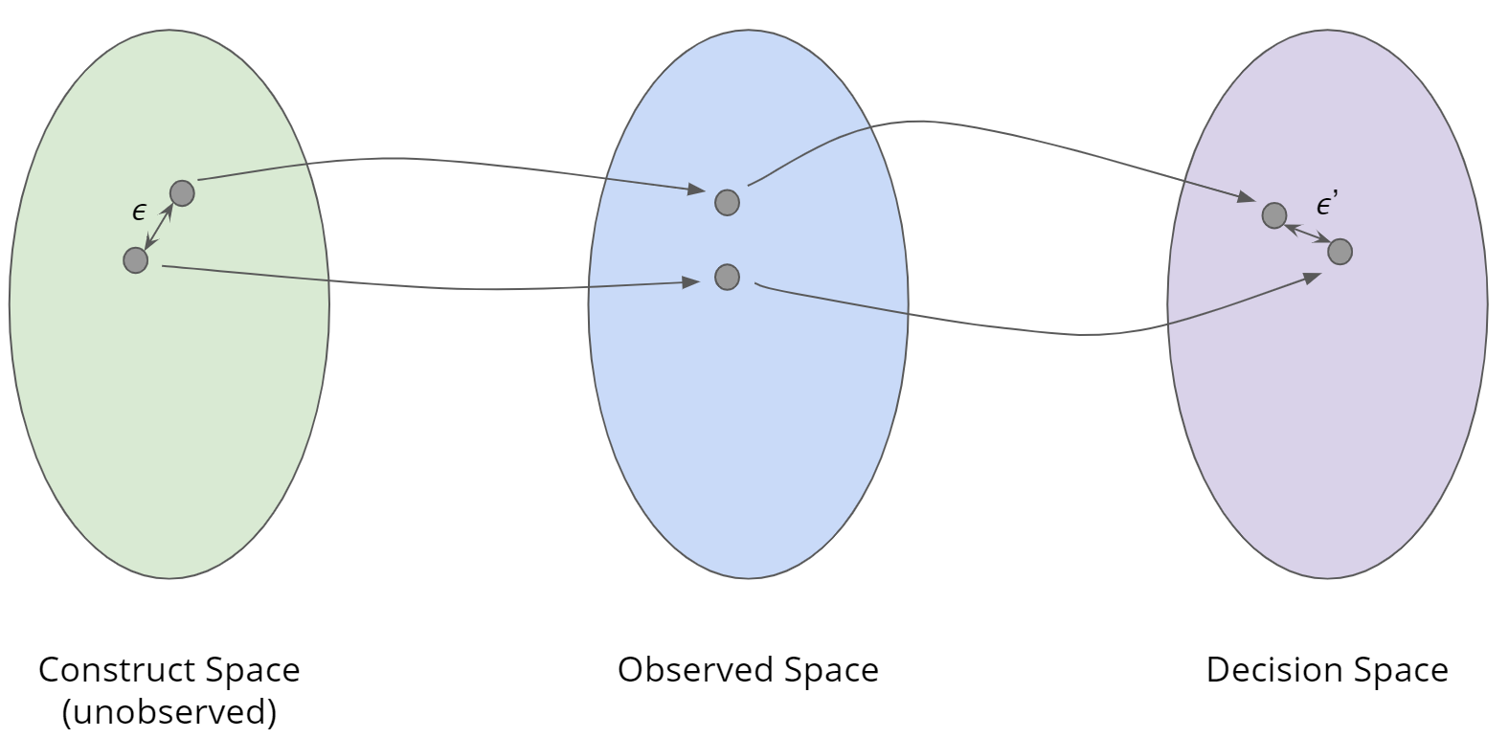

Individual Fairness
Idea: If two people are close in construct space, they should receive similar decisions.
Individual Fairness: A model $f:CS →DS$ is said to be fair if objects close in CS are close in DS. Specifically, it is $\left(ε, ε^{′}\right)$-fair if for any $x, y∈CS$
$$d_{CS}\left(x, y\right)≤ε ⇒ d_{DS}\left(f\left(x\right), f\left(y\right)\right)≤ε′$$

Slide 18
Worldview 1: WYSIWYG
Problem: We can’t tell if two objects are close in CS. So if we want to use individual fairness, we must make an assumption about how the world workds
What You See is What You Get (WYSIWYG): The Observed Space is a good representation of the Construct Space.
Example: For college admissions, things like SAT correlate well with intelligence.
With WYSIWYG, you can ensure fairness by comparing objects in the Observed Space as a good proxy for the Construct Space

Slide 19
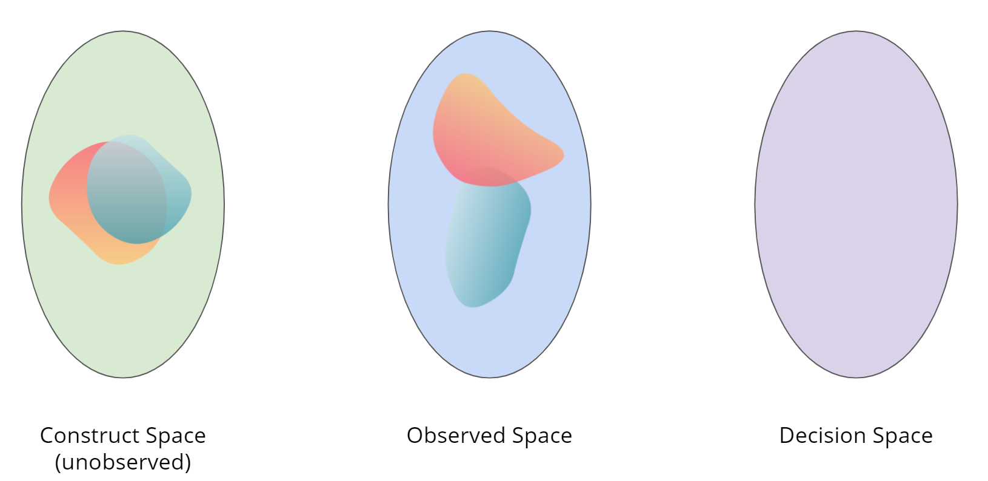
Worldview 2: Structural Bias + WAE
What if we don’t believe the Observed Space represents the Construct Space well? What if there is some structural bias that make people close in the construct space look different in the observed space?
Example: SAT doesn’t just measure intelligence, but also measures ability to afford SAT prep. People who are just as intelligent as someone else, can end up with different observations.

Slide 20
Worldview 2:
Structural Bias + WAE
When considering Structural Bias, commonly will also assume We’re All Equal (WAE).
We’re All Equal (WAE): Membership in some protected group (e.g., race) should not be the cause of a meaningful difference for the task at hand (e.g., academic preparation). Not saying every group is exactly equal in all ways, but for the task at hand we are equal enough that it shouldn’t be the cause of difference.
Differences seen in groups in Observed Space are the result of structural bias!
Notions of group fairness make sense with Structural Bias + WAE

Slide 21
Which One?
So which is right? WYSIWYG or Structural Bias + WAE?
No way to know! They are statements of belief!
Which worldview you use determines what you think is fair
If you assume WYSIWYG
Individual fairness is right and easy to achieve
Non-discrimination may violate individual fairness
If you assume Structural Bias + WAE
Non-discrimination is right and is possible (saw group fairness mechanisms)
Attempts to achieve individual fairness may result in discrimination.

Slide 22
Takeaways
Models can have a huge impact on society, both positive and negative.
  If we are not careful, our models will at best, perpetuate and at worst, amplify injustice in our society.
Historically, people thought defining things like accuracy was easy but defining what is/isn’t fair was not. Only recently (~10 years) have ML researchers tried to define what fairness might mean and how to enforce it in our models.
It’s clear that defining and enforcing fairness, but what fairness and how is a crucial problem we need humans (and not just ML engineers) in the loop to determine. These are questions of values, and we need humans to make informed decisions of what is right.

Slide 23
Recap
Theme: Thinking about fairness and the limitations of learning as a worldview.
Concepts:
Impossibility to achieve all fairness and accuracy
Fairness-accuracy tradeoff
Pareto Frontier
Modeling Spaces
  Construct space
  Observed space
  Decision space
Individual fairness
What You See is What You Get (WYSIWYG)
Structural Bias + We’re All Equal (WAE)
Conflicting Worldviews

Slide 25
One Slide
Regression
Overfitting
Training, test, and generalization error
Bias-Variance tradeoff
Ridge, LASSO
Cross validation
Gradient descent
Classification
Logistic regression
Bias and Fairness

Slide 27
Notes:
Write regression model
Write LASSO => Sparse

Slide 28
Notes:
Write out RSS def

