Slide 1
CSE/STAT 416 Bias and Fairness in ML Tanmay Shah Paul G. Allen School of Computer Science & Engineering University of Washington April 17, 2024

Slide 2
Administrivia
- HW2 due Tomorrow
- LR3 out Friday
- Midterm
- Released on gradescope upcoming Monday, due Wednesday
- Timed
- Make Ed post for any questions

Slide 3
ML and Society

Slide 4
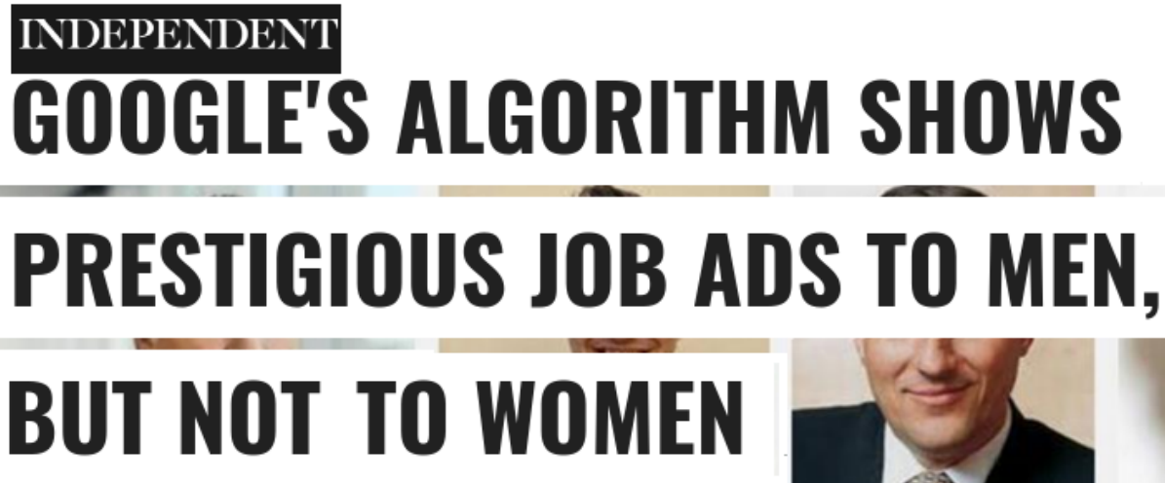
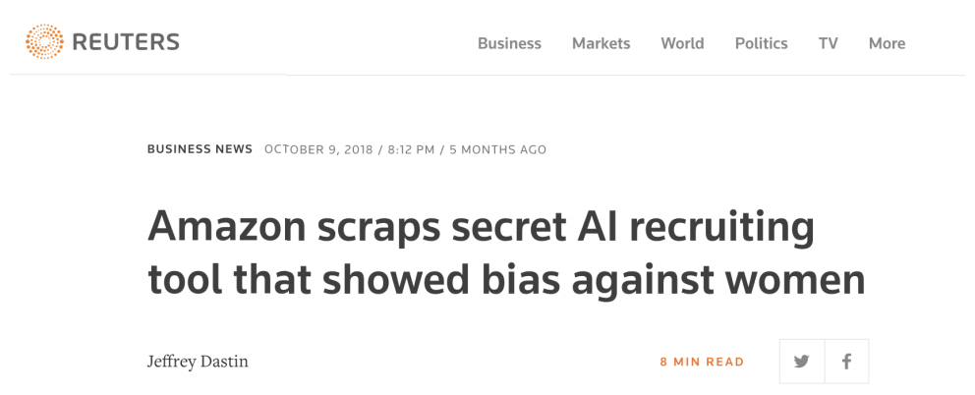
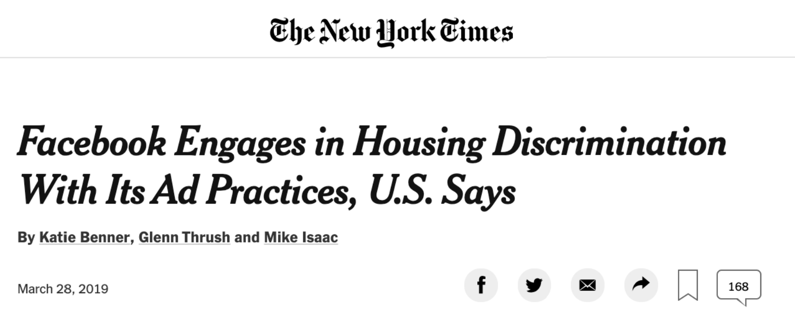
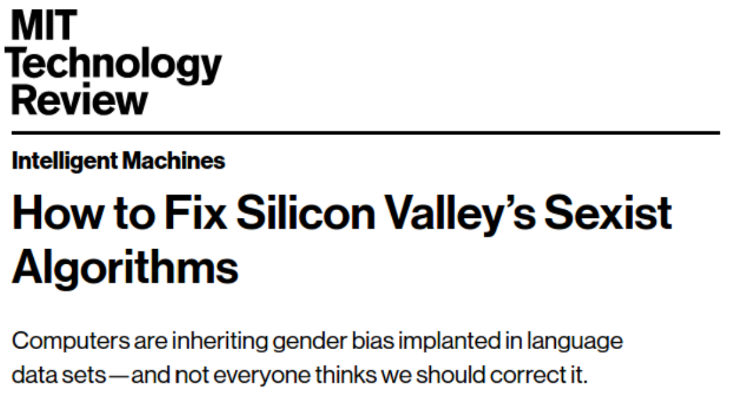
ML Systems Gone Wrong

Slide 5
COMPAS
An ML model created by NorthPointe used to predict likelihood of inmates to “recidivate”. Eventually started use in Florida in judges’ decision for parole
ProPublica (a news org) investigated the model and wrote that the model exhibited biased behavior against people of color. Particularly, they found that the model would predict higher risk scores for black people.
Northpointe countered and claimed that their scores were well calibrated (e.g., when the predict score of 9/10 that person recidivates about 90% of the time).
Interesting follow up from ProPublica
So the question is: Who is right? Is it right to use this model?

Slide 6
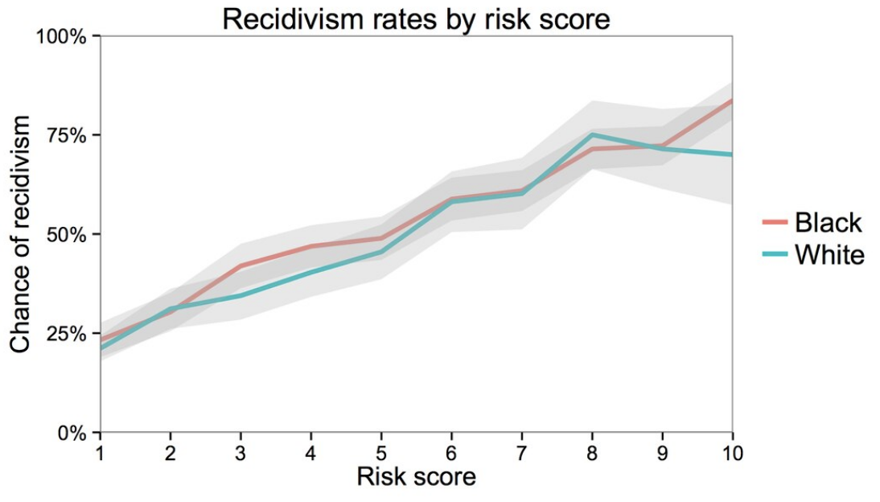
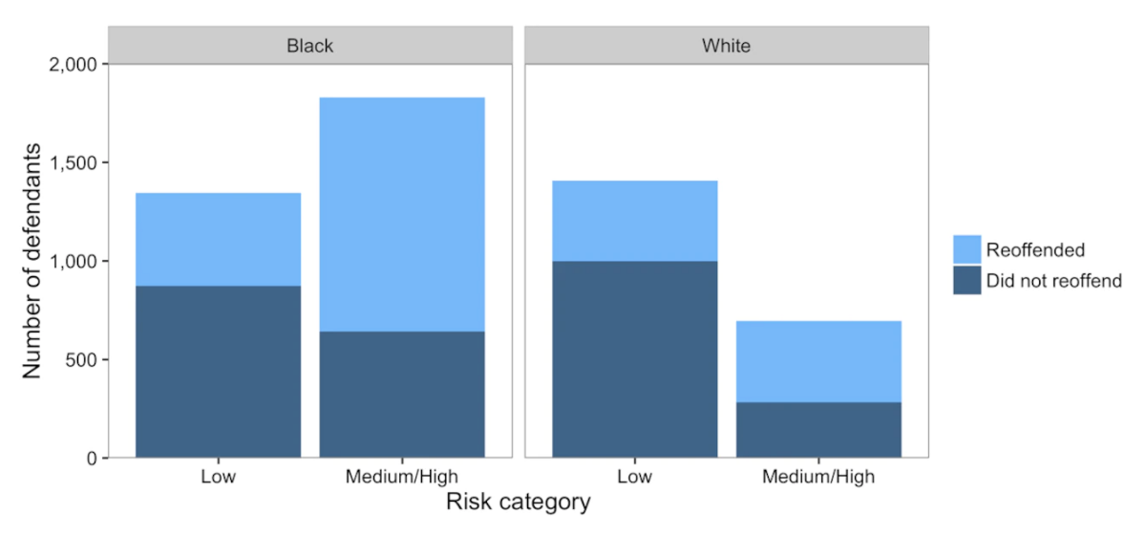
COMPAS

Slide 7
Why Biased Outcomes?
Probably not the case that someone explicitly coded the model to be biased against a particular race. In fact, race was not even a question that was on the survey inmates took!
More often than not, biased outcomes from a model come from the data it learns from rather than some explicit choice from the modeler.
“Garbage in → Garbage out”
“Bias in → Bias out”

Slide 8
Sources of Bias

Slide 9
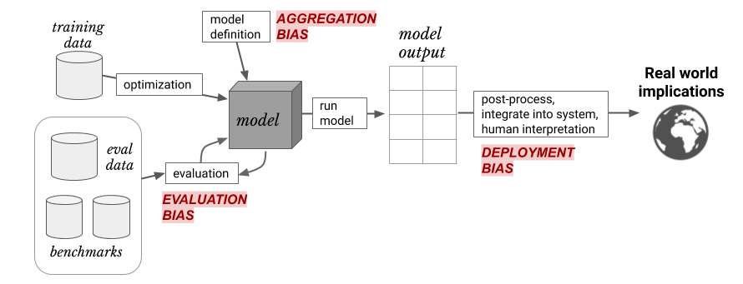
Sources of Bias
Discussion heavily based on Suresh and Guttag (2020)
A FRAMEWORK FOR UNDERSTANDING UNINTENDED CONSEQUENCES OF MACHINE LEARNING, BY HARINI SURESH AND JOHN V. GUTTAG, 2020
Six common sources of bias:
Historical bias
Representation Bias
Measurement Bias
Aggregation Bias
Evaluation Bias
Deployment Bias

Slide 10
Historical Bias
The world we lived in is one that contains biases for/against certain demographics. Even ‘accurate’ data could still be harmful.
Historical bias exists even with perfect sampling or feature measurement (other sources of bias are possible)!
Examples:
In 2018, 5% of Fortune 500 CEOs were women. Should search results for “CEO” match this statistic? Could reflecting the world (even if accurately) perpetuate more harm?

Slide 11
Representation Bias
When the training data we collect does not contain representative samples of the true distribution.
Examples:
If we use data gathered from smart phones, we would likely be underestimating poorer and older populations.
ImageNet (a very popular image dataset) with 1.2 million images. About 45% of these images were taken in the US and the majority of the rest in North America and Western Europe. Only about 1% and 2.1% of the images come from China and India respectively.

Slide 12
Measurement Bias
Often we are gathering data that contains (noisy) proxies of characteristics of interest. Some examples:
Financial responsibility → Credit Score
Crime Rate → Arrest Rate
Intelligence → SAT Score
If these measurements are not measured equally across groups or places (or aren’t relevant to the task at hand), this can be another source of bias.

Slide 13
Measurement Bias (cont.)
Examples:
If factory workers are monitored more often, more errors are spotted. This can result in a feedback loop to encourage more monitoring in the future.
Same principles at play with predictive policing. Minoritized communities were more heavily policed in the past, which causes more instances of documented crime, which then leads to more policing in the future.
Women are more likely to be misdiagnosed (or not diagnosed) for conditions where self-reported pain is a symptom. In this case aspect of our data “diagnosed with X” is a biased proxy for “has condition X”.
The feature we measure is a poor representation of the quality of interest (e.g., SAT score doesn’t actually measure intelligence)

Slide 14
Aggregation Bias
When we use a “one-sized fits all” model that does not accurately serve every group equally.
Examples:
HbA1c levels (used to monitor and diagnose diabetes) differ in very complex ways across ethnicities and sexes. One model for everyone might not be the right choice, even if everyone is represented well in the training data.

Slide 15
Evaluation Bias
Similar to representation bias, but focused more on the data we evaluate or test ourselves against. If the evaluation dataset or benchmark doesn’t represent the world well, we have evaluation bias.
Benchmarks are common datasets used to evaluate models from different researchers.
Examples:
If it is common to report accuracy on a benchmark, this might hide disparate performance on subgroups.
Drastically worse performance for facial recognition software when used on faces of darker-skinned females. Common evaluation datasets for facial recognition only had 5-7% had faces of darker-skinned women.

Slide 16
Deployment Bias
When how a model was intended to be used and how it is actually used when deployed in the real-world.
Examples:
Crime risk prediction models might be evaluated to achieve good calibration, but the model designers might not have evaluated the model’s use in the context of determining prison sentence lengths.
People are complex and when using models to aid their decisions, might make incorrect assumptions about what a model says.

Slide 17
Sources of Bias
Discussion heavily based on Suresh and Guttag (2020)
A FRAMEWORK FOR UNDERSTANDING UNINTENDED CONSEQUENCES OF MACHINE LEARNING, BY HARINI SURESH AND JOHN V. GUTTAG, 2020
Six common sources of bias:
Historical bias
Representation Bias
Measurement Bias
Aggregation Bias
Evaluation Bias
Deployment Bias

Slide 18
Brain Break

Slide 19
Fairness in ML

Slide 20
Fairness
What does it mean for a model to be fair or unfair? Can we come up with a numeric way of measuring fairness?
Lots of work in the field of ML and fairness is looking into mathematical definitions of fairness to help us spot when something might be unfair.
There is not going to be one central definition of fairness, as each definition is a mathematical statement of which behaviors are/aren’t allowed.
Different definitions of fairness can be contradictory!
Today, we will focus on notions of group fairness in an attempt to prevent discriminatory outcomes.

Slide 21
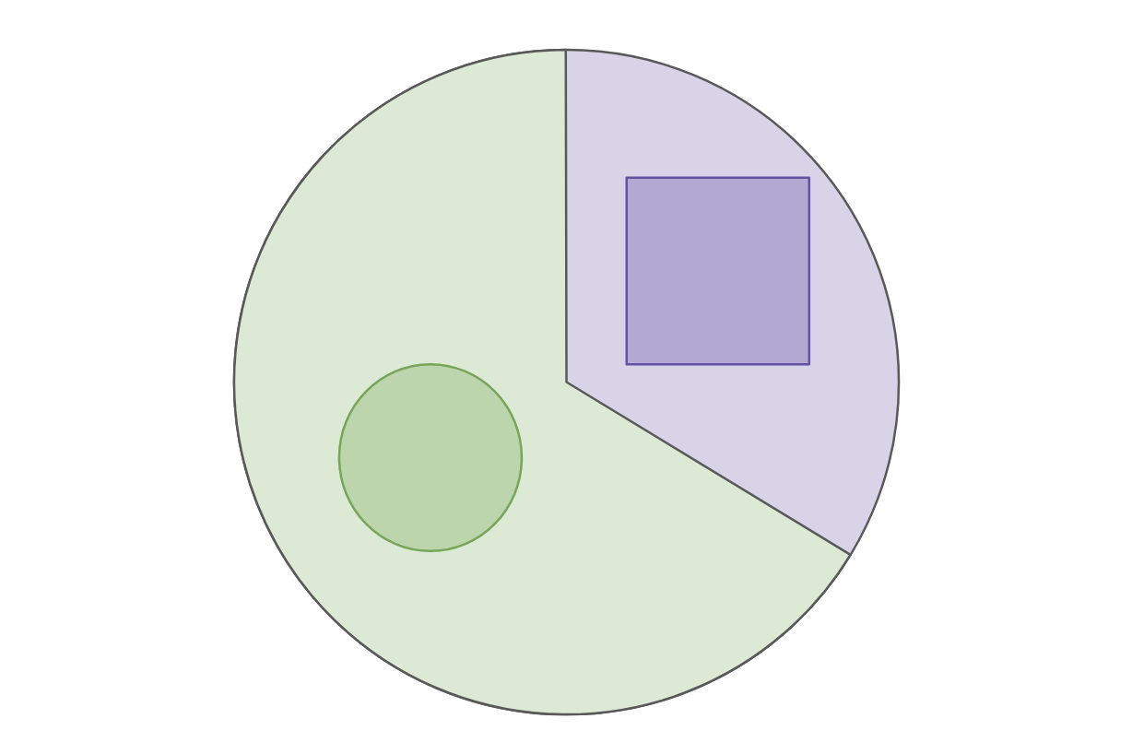
Example: College Admissions
Will use a very simplified example of college admissions. This is not an endorsement of such a system or a statement of how we think the world does/should work. Will make MANY simplifying assumptions (which are unrealistic).
There is a single definition of “success” for college applicants, and the goal of an admissions decision is to predict “success”
The only thing we will use as part of our decision is SAT Score
To talk about group fairness, will assume everyone belongs to exactly one of two races: Circles (66%) or Squares (33%).

Slide 22
Notation
Example: College admission only using SAT Score
$X$ input about a person for prediction
Example: $X$= SAT Score
$A$ variable indicating which group $X$ belongs in
Example: $A=\text{⬜}$or $A=\text{◯}$
$Y$ the “true label”
Example: $Y=+$ if truly successful in college, $Y=−$ if not
$\hat{Y}=\hat{f}(X)$ is our prediction for $Y$ using a learned model $\hat{f}$
Example: $\hat{Y}=+$ if predicted successful, $\hat{Y}=−$ otherwise

Slide 23
Fairness Definition 1: “Shape Blind”
To avoid unfair decisions, prevent the model from every looking at protected attribute (e.g., if the applicant is Circle/Square).
Often called “Fairness through unawareness”
Doesn’t work in practice. This does not prevent historical or measurement bias. Protected attributes can be unintentionally inferred from other, related attributes (e.g., in some cities, zip code can be deeply correlated with race).

Slide 24
Confusion Matrix
For binary classification, there are only two types of mistakes
$\hat{y}=+1, y=−1$
$\hat{y}=−1, y=+1$
Generally we make a confusion matrix to understand mistakes.
Predicted Label
 | True Positive (TP) | False Negative (FN)
 | False Positive (FP) | True Negative (TN)
True Label

Slide 25
Binary Classification Measures
Notation
$C_{TP}=\#TP, C_{FP}=\#FP, C_{TN}=\#TN, C_{FN}=\#FN$
$N=C_{TP}+C_{FP}+C_{TN}+C_{FN}$
$N_{P}=C_{TP}+C_{FN}, N_{N}=C_{FP}+C_{TN}$
Error Rate
$$\frac{C_{FP}+C_{FN}}{N}$$
Accuracy Rate
$$\frac{C_{TP}+C_{TN}}{N}$$
False Positive rate (FPR)
$$\frac{C_{FP}}{N_{N}}$$
False Negative Rate (FNR)
$$\frac{C_{FN}}{N_{P}}$$
True Positive Rate or Recall
$$\frac{C_{TP}}{N_{P}}$$
Precision
$$\frac{C_{TP}}{C_{TP}+C_{FP}}$$
F1-Score
$$2\frac{Precision⋅Recall}{Precison+Recall}$$
See more!

Slide 26
Fairness Definition 2: Statistical Parity
Idea: “Admit decisions are equivalent across groups”
$$\operatorname{Pr}\left(\hat{Y}= +| A=\text{⬜}\right)=\operatorname{Pr}\left(\hat{Y}= +| A=\text{◯}\right)$$
Also phrased as matching demographic statistics (e.g., if 33% of population are Squares, 33% of those admitted should be Square).
Pros:
Aligns with certain legal definitions of equity.
Cons:
A rather weak in fairness requirements. Allows for strategies that might not be desirable (e.g., random selection, self-fulfilling prophecy)

Slide 27
Fairness Definition 3: Equal Opportunity
Idea: True positive rate should be equivalent across groups
$$\operatorname{Pr}\left(\hat{Y}= +| A=\text{⬜}, Y=+\right)=Pr\left(\hat{Y}= +| A=\text{◯}, Y=+\right)$$
Pros:
Better controls for true outcome
Cons:
More complex to explain to non-experts
Only protects for the positive outcome
Note: Equality of true positives is the same as equality of false negatives

Slide 28
Fairness Definition 4: Predictive equality
Idea: True negative rate should be equivalent across groups
$$\operatorname{Pr}\left(\hat{Y}=−| A=\text{⬜}, Y=−\right)=Pr\left(\hat{Y}=−| A=\text{◯}, Y=−\right)$$
Same idea as equal opportunity, but controlling for different statistic. Might be favorable in situations you care more about false positives than a false negative.
Note: Equality of true negatives is the same as equality of false positives

Slide 29
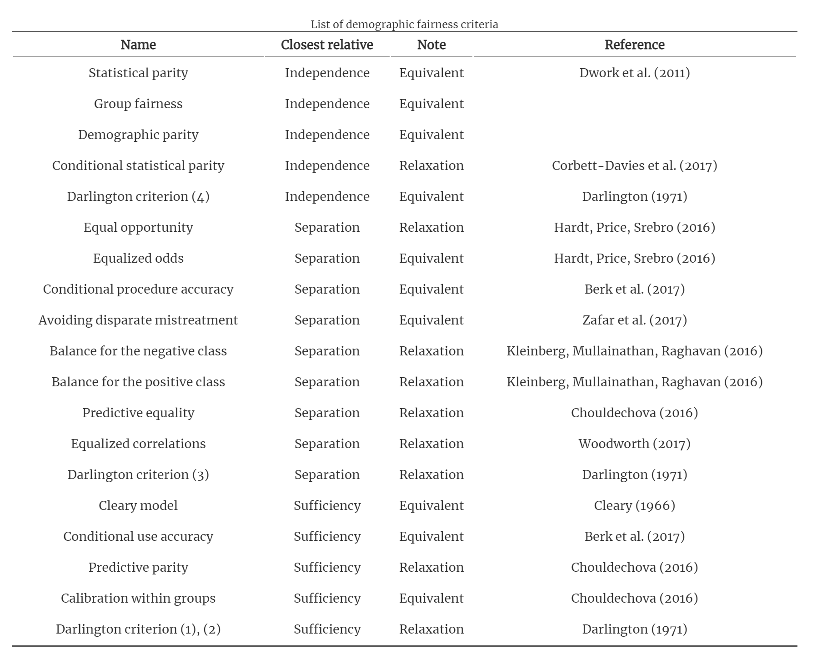
And many, many more
Table from Fairness and machine learning by Barocas, Hardt, Narayanan

Slide 30
Which one to use?
We can’t tell you! Each definition makes its own statement on what fairness means. Choosing a fairness measure is an explicit statement of what values we hold when thinking about fairness.
Takeaway: Discrimination in ML models is a crucial problem we need to work on. It’s not a problem that will only be solved algorithmically. We need people (e.g., policymakers, regulators, philosophers, developers) to be in the loop to determine the values we want to encode into our systems.

Slide 31
Next time
Will discuss some limitations in these definitions (particularly how they contradict) and how we can think about fairness as a philosophy (or worldview).

Slide 32
Recap
Theme: It’s important to give terms to abstract notions like bias and fairness so we can have concrete things to look out for. There is not one right perspective though!
Ideas:
Calibration
Impacts of ML Systems on society
Sources of bias
Historical bias
Representation Bias
Measurement Bias
Aggregation Bias
Evaluation Bias
Deployment Bias
Definitions of fairness
Fairness through unawareness
Statistical parity
Equal opportunity
Predictive equality

