Slide 1
CSE/STAT 416
Logistic Regression
Tanmay Shah
University of Washington
April 12, 2024
❓ Questions? Raise hand or sli.do #cs416
💬 Before Class: Does a straw have two holes or one?
🎵 Listening to: your chatter which leaks into Panopto recordings

Slide 2
Administrivia
Coming up
  Week 3: Societal Impacts of ML (Fairness and Bias)
  Week 4: Other ML models for classification
  Week 5: Deep Learning
HW3 released today, due next Tuesday
Midterm
  Released Monday 4/22 at 9:00 AM am. Due Wednesday 4/24 at 11:59 pm.
    More logistics announcements later
  Format: Think longer conceptual assignment from HW
  Covers everything from Module 0 (Regression) to Module 3 (Societal Impact, Bias, Fairness)
  Should follow our normal collaboration policy
    Think of it as a trial run for the final exam

Slide 3
Sentiment Classifier
In our example, we want to classify a restaurant review as positive or negative.
Sentence from review
Classifier Model
Input: x
Output: y
Predicted class

Slide 4

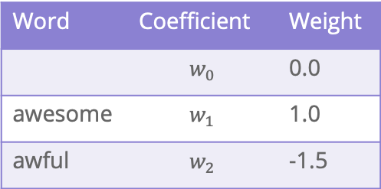
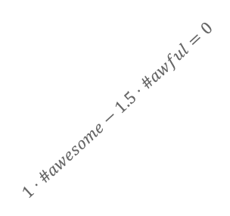


Decision Boundary
Consider if only two words had non-zero coefficients
Word | Coefficient | Weight
 | $$w_{0}$$ | 0.0
awesome | $$w_{1}$$ | 1.0
awful | $$w_{2}$$ | -1.5
$$\hat{s}=1⋅\#awesome−1.5⋅\#awful$$
#awful
0 1 2 3 4 $⋯$
$$1⋅\#awesome−1.5⋅\#awful=0$$
#awesome
0 1 2 3 4 $⋯$

Slide 5

Learning $\hat{w}$

Slide 6







All the Same?
One idea is to just model the processing of finding $\hat{w}$ based on what we discussed in linear regression
$$\hat{w}=\underset{w}{argmin}{\frac{1}{n}\sum_{i=1}^{n}{𝕀}\{y_{i}≠{\hat{y}}_{i}\}}$$
Will this work?
Assume $h_{1}\left(x\right)=\#awesome$ so $w_{1}$ is its coefficient and $w_{2}$ is fixed.
#awful
error
$$1$$
$$1⋅\#awesome−1.5⋅\#awful=0$$
$$0$$
$$w_{1}$$
0 1 2 3 4 $⋯$
#awesome
$$0$$
Notes:
Mark various lines

Slide 7
Minimizing Error
Minimizing classification error is probably the most intuitive thing to do given all we have learned from regression. However, it just doesn’t work in this case with classification.
We aren’t able to use a method like gradient descent here because the function isn’t ”nice” (it’s not continuous, it’s not differentiable, etc.).
We will use a stand-in for classification error that will allow us to use an optimization algorithm. But first, we have to change the problem we care about a bit.
Instead of caring about the classifications, let’s look at some probabilities

Slide 8
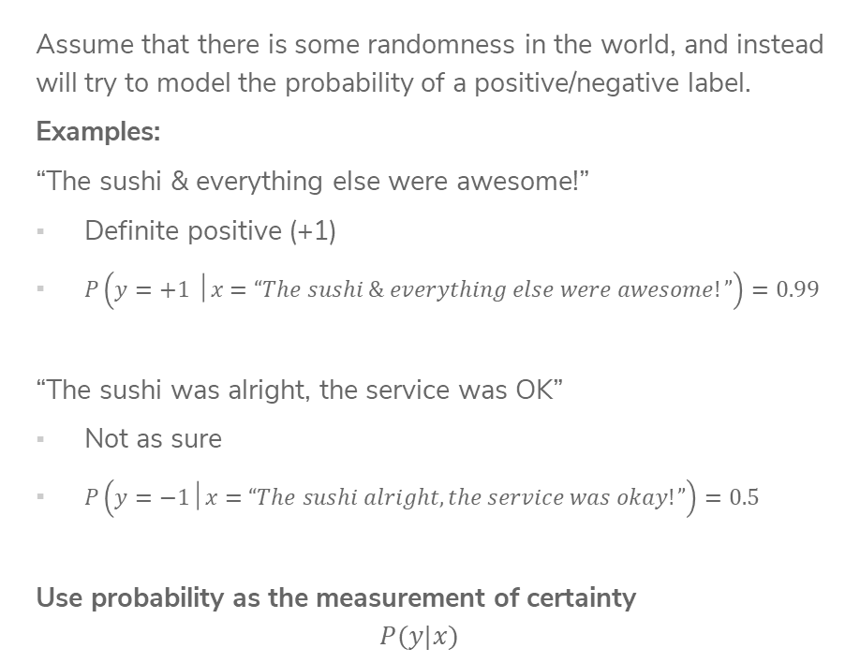
Probabilities
Assume that there is some randomness in the world, and instead will try to model the probability of a positive/negative label.
Examples:
“The sushi & everything else were awesome!”
Definite positive (+1)
$P\left(y=+1 │x=“The sushi \& everything else were awesome!”\right)=0.99$
“The sushi was alright, the service was OK”
Not as sure
$P\left(y=−1│x=“The sushi alright, the service was okay!”\right)=0.5$
Use probability as the measurement of certainty
$$P(y|x)$$

Slide 9
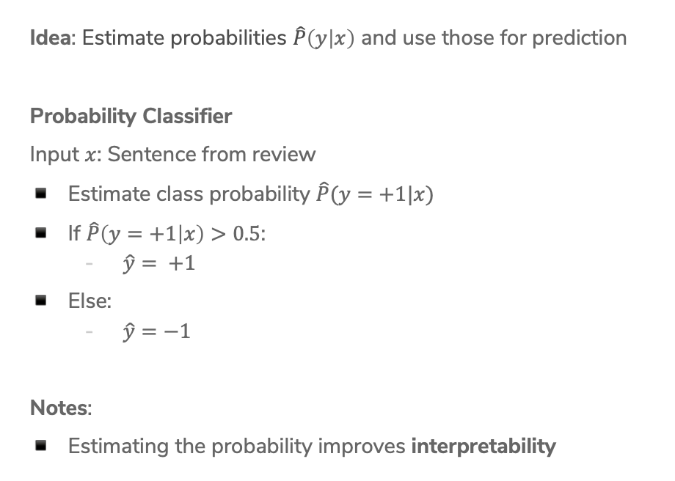
Probability Classifier
Idea: Estimate probabilities $\hat{P}\left(y | x\right)$ and use those for prediction
Probability Classifier
Input $x$: Sentence from review
Estimate class probability $\hat{P}(y=+1|x)$
If $\hat{P}\left(y=+1 | x\right)>0.5$:
  $\hat{y}= +1$
Else:
  $\hat{y}=−1$
Notes:
Estimating the probability improves interpretability

Slide 10
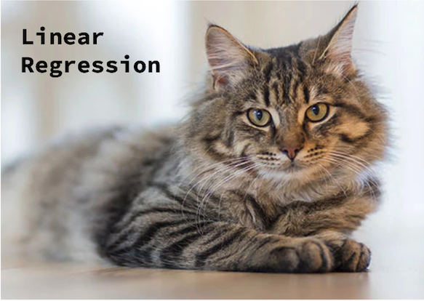
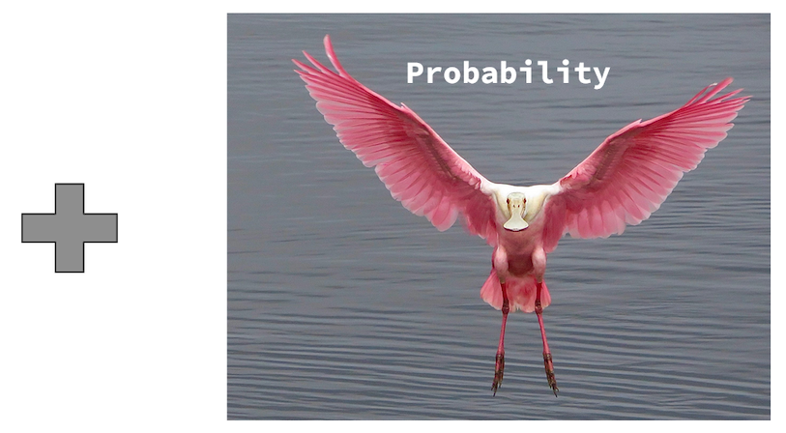
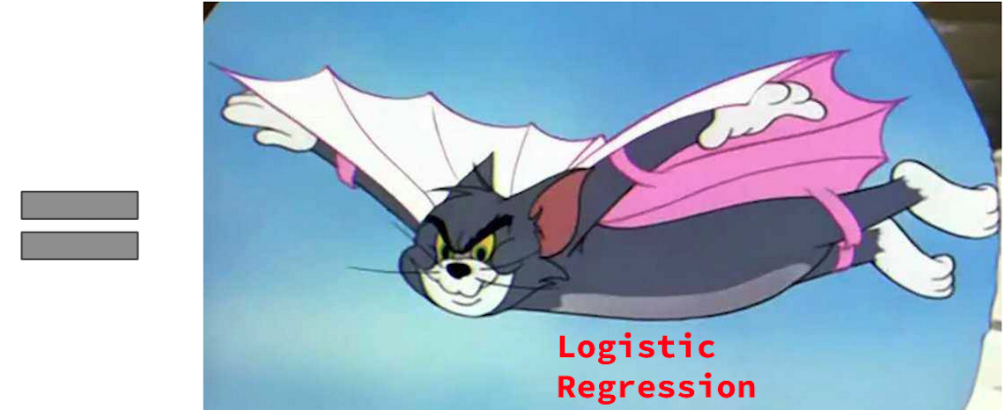

Slide 11

It’s Powerful

Slide 12



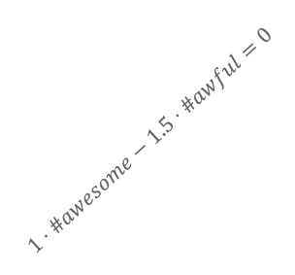
Score Probabilities?
Idea: Let’s try to relate the value of $Score(x)$ to $\hat{P}(y=+1|x)$
#awful
What if $Score\left(x\right)$ is positive?
What if $Score\left(x\right)$ is negative?
What if $Score\left(x\right)$ is 0?
$$1⋅\#awesome−1.5⋅\#awful=0$$
0 1 2 3 4 $⋯$
#awesome

Slide 13















Interpreting Score
$$Score\left(x_{i}\right)=w^{T}h\left(x_{i}\right)$$
$$−∞$$
$${\hat{y}}_{i}=−1$$
$$0$$
$${\hat{y}}_{i}=+1$$
$$∞$$
Very sure
$${\hat{y}}_{i}=−1$$
Not sure if
$${\hat{y}}_{i}=−1 or {\hat{y}}_{i}=+1$$
Very sure
$${\hat{y}}_{i}=+1$$
$$\hat{P}\left(y_{i}=+1|x_{i}\right)=0$$
$$\hat{P}\left(y_{i}=+1|x_{i}\right)=0.5$$
$$\hat{P}\left(y_{i}=+1|x_{i}\right)=1$$
$$0$$
$$\hat{P}(y=+1 |x)$$
$$1$$

Slide 14
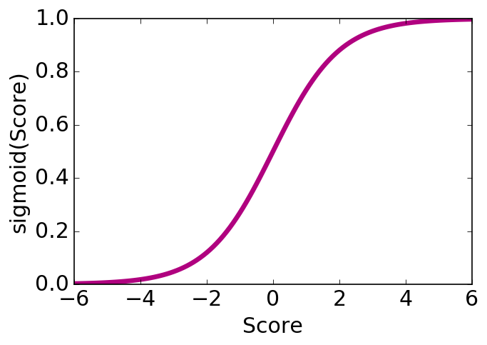

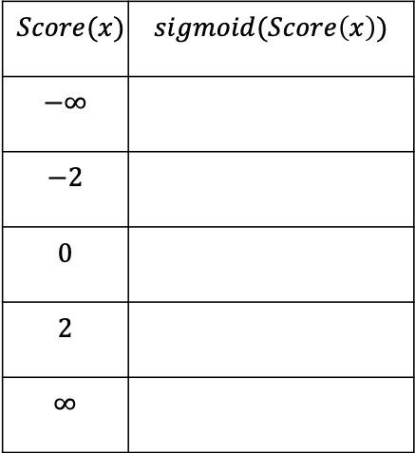
Logistic Function
Use a function that takes numbers arbitrarily large/small and maps them between 0 and 1.
$$sigmoid\left(Score(x)\right)= \frac{1}{1+e^{−Score(x)} }$$
$$Score(x)$$ | $$sigmoid(Score\left(x\right))$$
$$−∞$$
$$−2$$
$$0$$
$$2$$
$$∞$$
Notes:
Mark points on graph

Slide 15
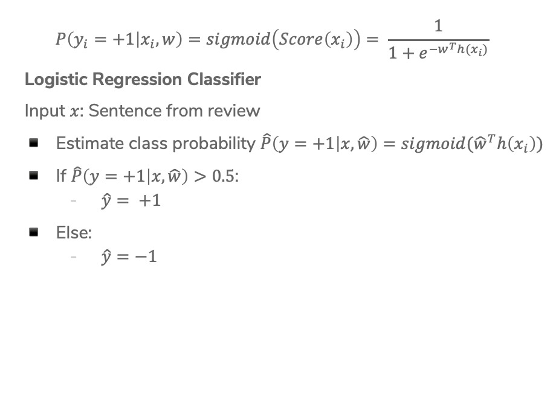
Logistic Regression Model
$$P\left(y_{i}=+1 | x_{i}, w\right)=sigmoid\left(Score\left(x_{i}\right)\right)= \frac{1}{1+e^{−w^{T}h(x_{i})}}$$
Logistic Regression Classifier
Input $x$: Sentence from review
Estimate class probability $\hat{P}\left(y=+1 | x, \hat{w}\right)=sigmoid({\hat{w}}^{T}h\left(x_{i}\right))$
If $\hat{P}\left(y=+1 | x, \hat{w}\right)>0.5$:
  $\hat{y}= +1$
Else:
  $\hat{y}=−1$
Notes:
Mark where predictions change on graph

Slide 16





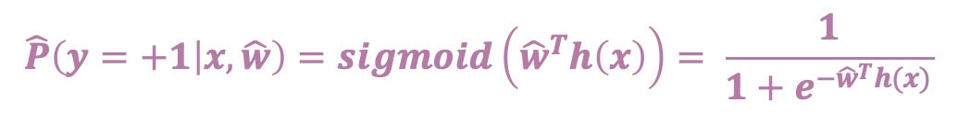

ML Pipeline
$$\hat{P}\left(y=+1 | x, \hat{w}\right)=sigmoid\left({\hat{w}}^{T}h\left(x\right)\right)= \frac{1}{1+e^{−{\hat{w}}^{T}h(x)}}$$
Training
Data
$$x$$
Pre-
Processing
$$h(x)$$
ML
model
$$\hat{y}$$
$$\hat{w}$$
Optimization
algorithm
$$y$$
Quality
metric
16

Slide 17
Demo
Show logistic demo (see course website)

Slide 18

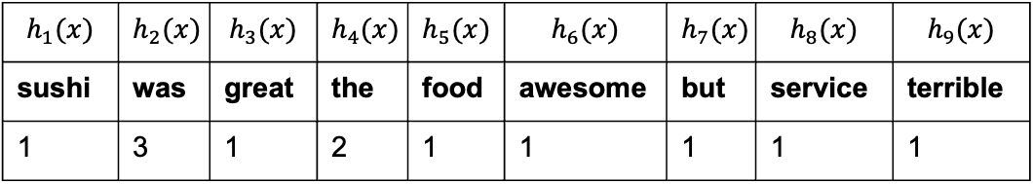
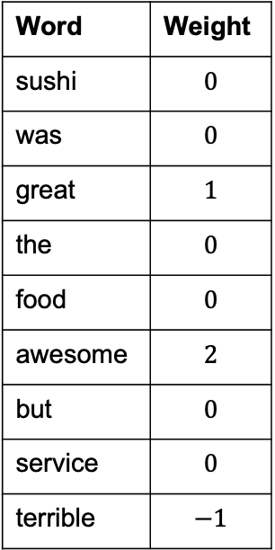
1 min
What would the Logistic Regression model predict for $P\left(y=−1 \right|x,w)$?
”Sushi was great, the food was awesome, but the
service was terrible”
Word | Weight
sushi | $$0$$
was | $$0$$
great | $$1$$
the | $$0$$
food | $$0$$
awesome | $$2$$
but | $$0$$
service | $$0$$
terrible | $$−1$$
$$h_{1}(x)$$ | $$h_{2}(x)$$ | $$h_{3}(x)$$ | $$h_{4}(x)$$ | $$h_{5}(x)$$ | $$h_{6}(x)$$ | $$h_{7}(x)$$ | $$h_{8}(x)$$ | $$h_{9}(x)$$
sushi | was | great | the | food | awesome | but | service | terrible
1 | 3 | 1 | 2 | 1 | 1 | 1 | 1 | 1

Slide 19
2 min
What would the Logistic Regression model predict for $P\left(y=−1 \right|x,w)$?
”Sushi was great, the food was awesome, but the
service was terrible”
Word | Weight
sushi | $$0$$
was | $$0$$
great | $$1$$
the | $$0$$
food | $$0$$
awesome | $$2$$
but | $$0$$
service | $$0$$
terrible | $$−1$$
$$h_{1}(x)$$ | $$h_{2}(x)$$ | $$h_{3}(x)$$ | $$h_{4}(x)$$ | $$h_{5}(x)$$ | $$h_{6}(x)$$ | $$h_{7}(x)$$ | $$h_{8}(x)$$ | $$h_{9}(x)$$
sushi | was | great | the | food | awesome | but | service | terrible
1 | 3 | 1 | 2 | 1 | 1 | 1 | 1 | 1

Slide 20

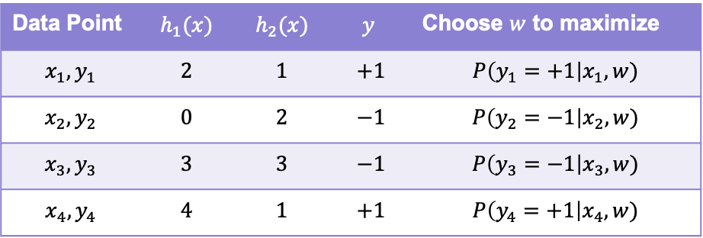
Quality Metric = Likelihood
Want to compute the probability of seeing our dataset for every possible setting for $w$. Find $w$ that makes data most likely! (e.g., maximize this likelihood metric)
Data Point | $$h_{1}(x)$$ | $$h_{2}(x)$$ | $$y$$ | Choose $w$ to maximize
$$x_{1}, y_{1}$$ | $$2$$ | $$1$$ | $$+1$$ | $$P\left(y_{1}=+1\right|x_{1}, w)$$
$$x_{2}, y_{2}$$ | $$0$$ | $$2$$ | $$−1$$ | $$P\left(y_{2}=−1\right|x_{2}, w)$$
$$x_{3}, y_{3}$$ | $$3$$ | $$3$$ | $$−1$$ | $$P\left(y_{3}=−1\right|x_{3}, w)$$
$$x_{4}, y_{4}$$ | $$4$$ | $$1$$ | $$+1$$ | $$P\left(y_{4}=+1\right|x_{4}, w)$$
Notes:
Write P(y=+1|x,w ) = … and P(y=-1|x, w) at top
Write P(y|x, w) = piecewise next to it
Write ell(w) = P(y_1|x_1,w)P(y_2|x_2,w)…
Write product notation

Slide 21


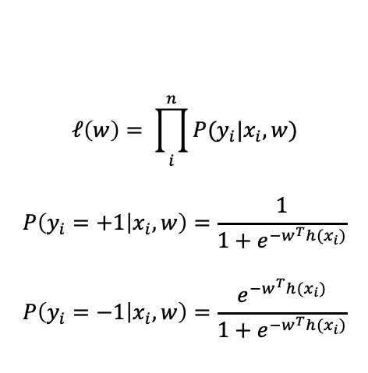

Learn $\hat{w}$
Now that we have our new model, we will talk about how to choose $\hat{w}$ to be the “best fit”.
The choice of $w$ affects how likely seeing our dataset is
#awful
$$ℓ\left(w\right)= \prod_{i}^{n}{P(y_{i}|x_{i}, w)}$$
$$P\left(y_{i}=+1 | x_{i},w\right)=\frac{1}{1+e^{−w^{T}h(x_{i})}}$$
$$P\left(y_{i}=−1 | x_{i},w\right)=\frac{e^{−w^{T}h(x_{i})}}{1+e^{−w^{T}h(x_{i})}}$$
0 1 2 3 4 $⋯$
#awesome

Slide 22
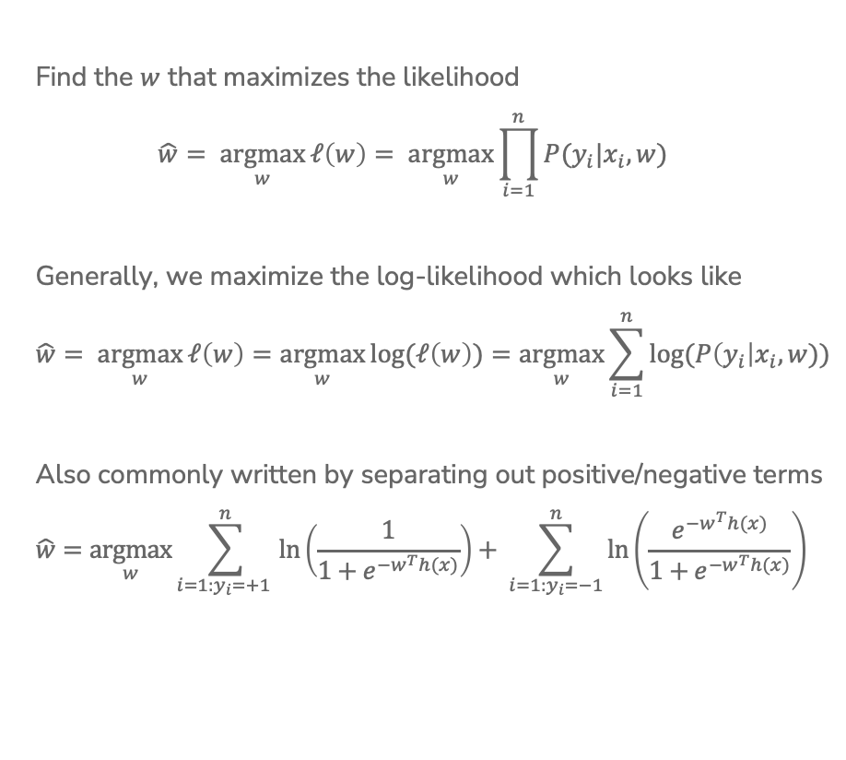
Maximum Likelihood Estimate (MLE)
Find the $w$ that maximizes the likelihood
$$\hat{w}= \underset{w}{argmax}{ℓ\left(w\right)= \underset{w}{argmax}{\prod_{i=1}^{n}{P(y_{i}|x_{i}, w)}}}$$
Generally, we maximize the log-likelihood which looks like
$$\hat{w}= \underset{w}{argmax}{ℓ\left(w\right)}=\underset{w}{argmax}{log⁡(ℓ\left(w\right))}=\underset{w}{argmax}{\sum_{i=1}^{n}{log⁡(P\left(y_{i}\right|x_{i}, w))}}$$
Also commonly written by separating out positive/negative terms
$$\hat{w}=\underset{w}{argmax}{\sum_{i=1:y_{i}=+1 }^{n}{\ln\left(\frac{1}{1+e^{−w^{T}h(x)}}\right)+ \sum_{i=1:y_{i}=−1}^{n}{\ln\left(\frac{e^{−w^{T}h(x)}}{1+e^{−w^{T}h(x)}}\right)} }}$$
Notes:
Write underneath left that this penalizes being wrong on the positive examples (imagine if Score(x) was -\infty)
Write underneath right that this penalizes being wrong on positive examples

Slide 23




1 min
Which setting of $w$ should we use?
#awful
$$ℓ\left(w^{\left(1\right)}\right)={10}^{−5}$$
$$ℓ\left(w^{\left(2\right)}\right)={10}^{−6}$$
$$ℓ\left(w^{\left(3\right)}\right)={10}^{−4}$$
#awesome

Slide 24


Slide 25
Training
Data
$$x$$
Pre-
Processing
$$h(x)$$
ML
model
$$\hat{y}$$
$$\hat{w}$$
Optimization
algorithm
$$y$$
Quality
metric

Slide 26
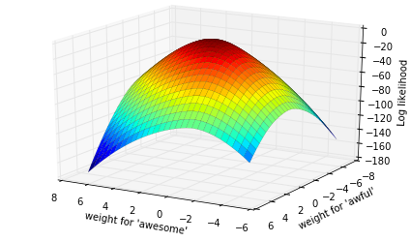


Finding MLE
No closed-form solution, have to use an iterative method.
Since we are maximizing likelihood, we use gradient ascent.
$$\hat{w}=\underset{w}{argmax}{\sum_{i=1}^{n}{\log\left(P\left(y_{i}|x_{i}, w\right)\right)}}$$

Slide 27
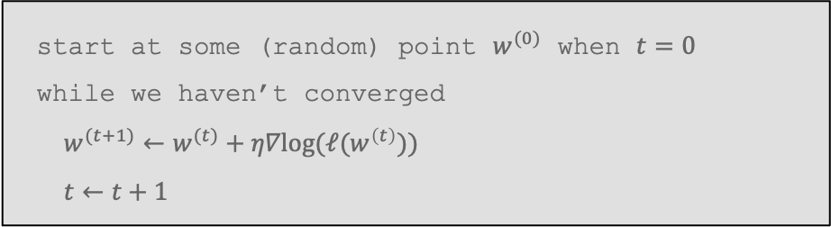

Gradient Ascent
Gradient ascent is the same as gradient descent, but we go ”up the hill”.
This is just describing going up the hill step by step.
$η$ controls how big of steps we take, and picking it is crucial for how well the model you learn does!
start at some (random) point $w^{(0)}$ when $t=0$
while we haven’t converged
$w^{(t+1)}←w^{(t)}+η∇log(ℓ(w^{\left(t\right)}))$
$t←t+1$

Slide 28
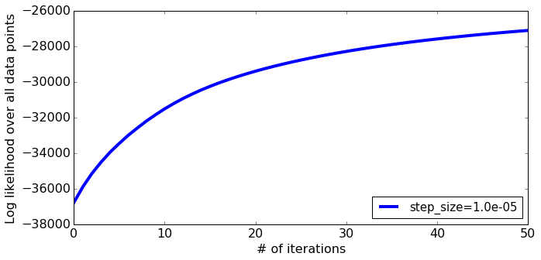
Learning Curve

Slide 29
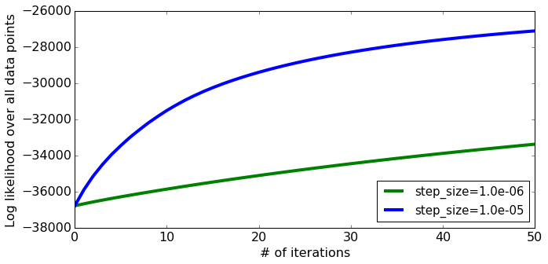

Choosing $η$
Step-size too small
Notes:
Draw hill climbing with tiny steps

Slide 30
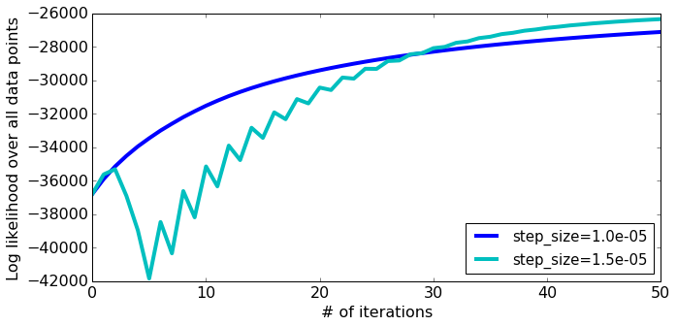
Choosing $η$
What about a larger step-size?
Notes:
Draw bouncing back and forth up the hill

Slide 31
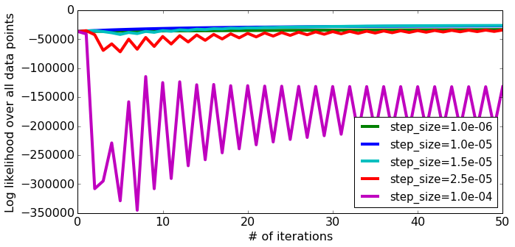
Choosing $η$
What about a larger step-size?
Can cause divergence!
Notes:
Draw bouncing out of the hill

Slide 32
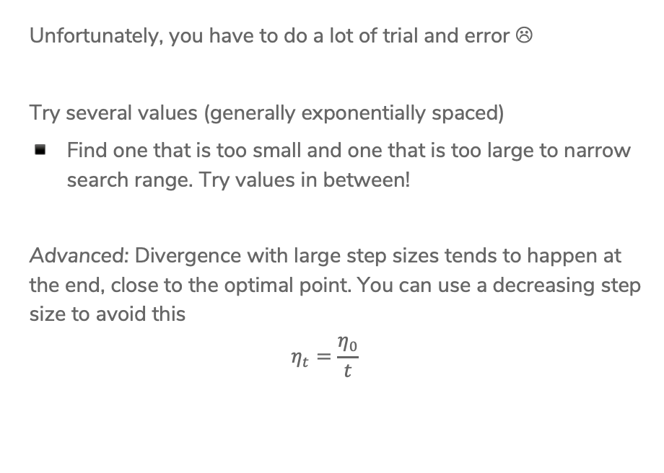
Choosing $η$
Unfortunately, you have to do a lot of trial and error ☹
Try several values (generally exponentially spaced)
Find one that is too small and one that is too large to narrow search range. Try values in between!
Advanced: Divergence with large step sizes tends to happen at the end, close to the optimal point. You can use a decreasing step size to avoid this
$$η_{t}=\frac{η_{0}}{t}$$

Slide 33
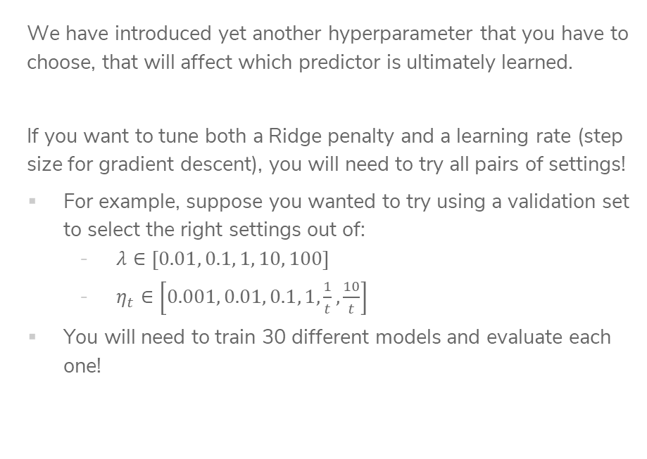
Grid Search
We have introduced yet another hyperparameter that you have to choose, that will affect which predictor is ultimately learned.
If you want to tune both a Ridge penalty and a learning rate (step size for gradient descent), you will need to try all pairs of settings!
For example, suppose you wanted to try using a validation set to select the right settings out of:
  $λ∈\left[0.01, 0.1, 1, 10, 100\right]$
  $η_{t}∈\left[0.001, 0.01, 0.1, 1,\frac{1}{t},\frac{10}{t}\right]$
You will need to train 30 different models and evaluate each one!

Slide 34


Slide 35
Overfitting - Classification

Slide 36
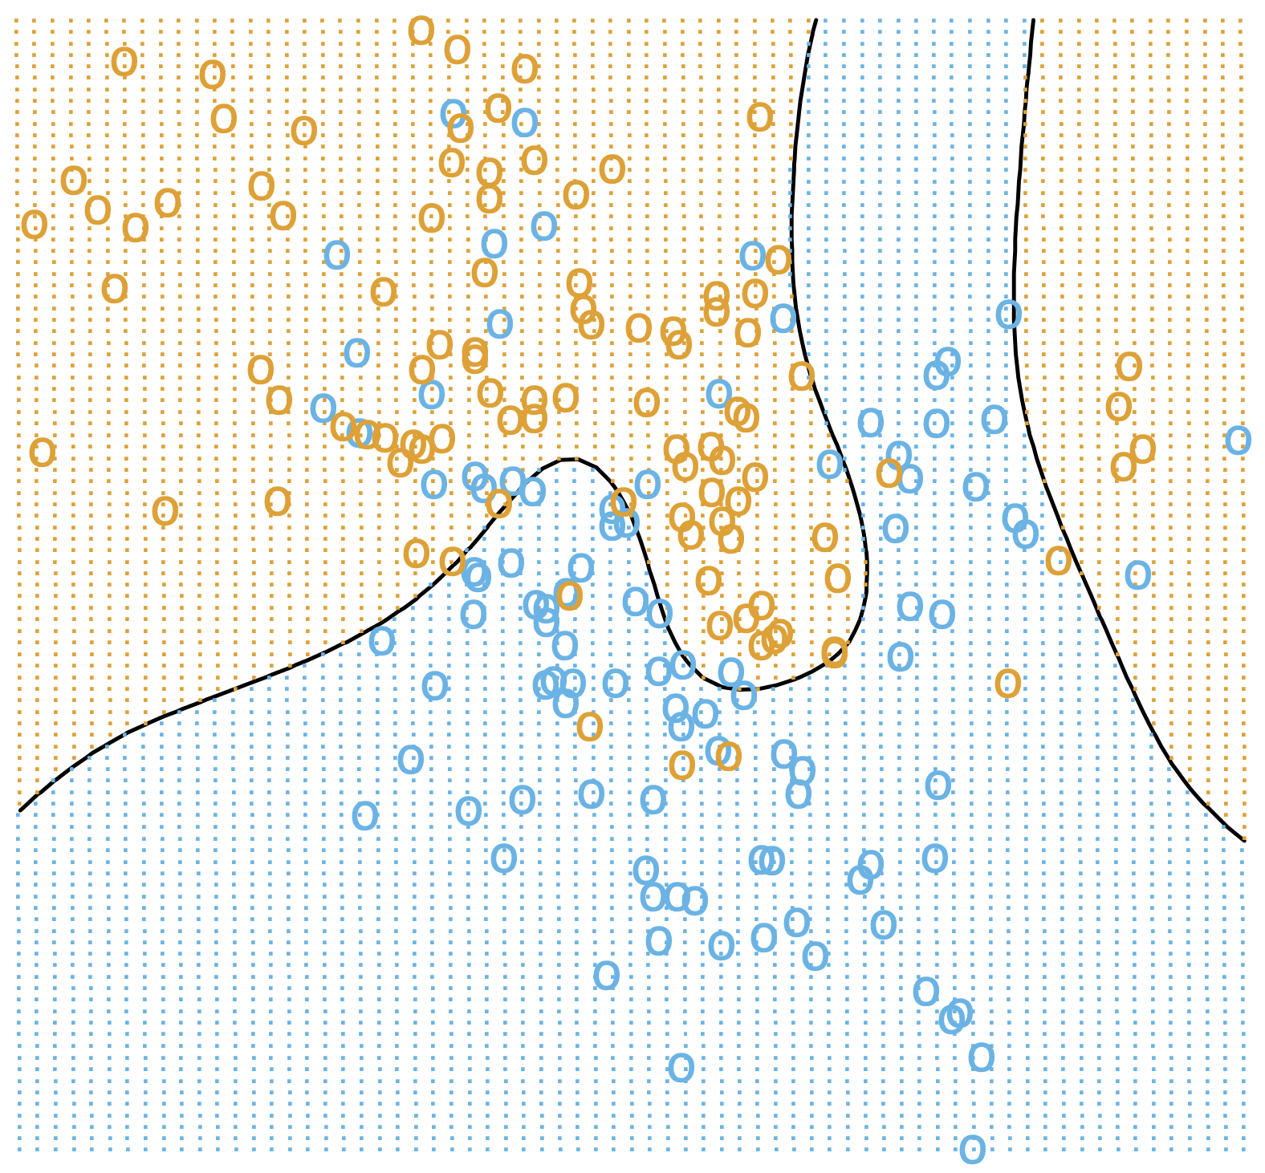
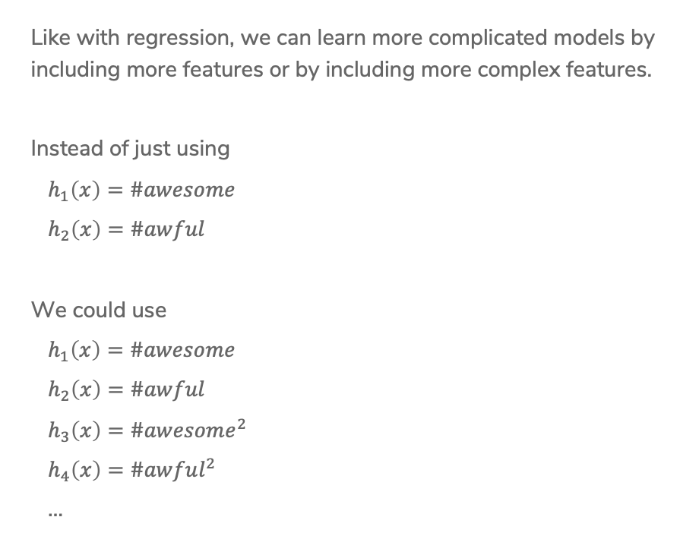
More Features
Like with regression, we can learn more complicated models by including more features or by including more complex features.
Instead of just using
$h_{1}\left(x\right)=\#awesome$
$h_{2}\left(x\right)=\#awful$
We could use
$h_{1}\left(x\right)=\#awesome$
$h_{2}\left(x\right)=\#awful$
$h_{3}\left(x\right)=\#awesome^{2}$
$h_{4}\left(x\right)=\#awful^{2}$
…

Slide 37
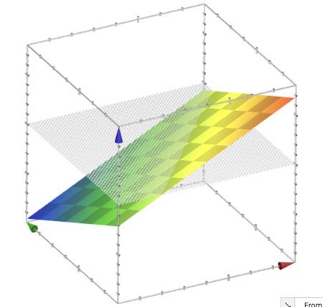
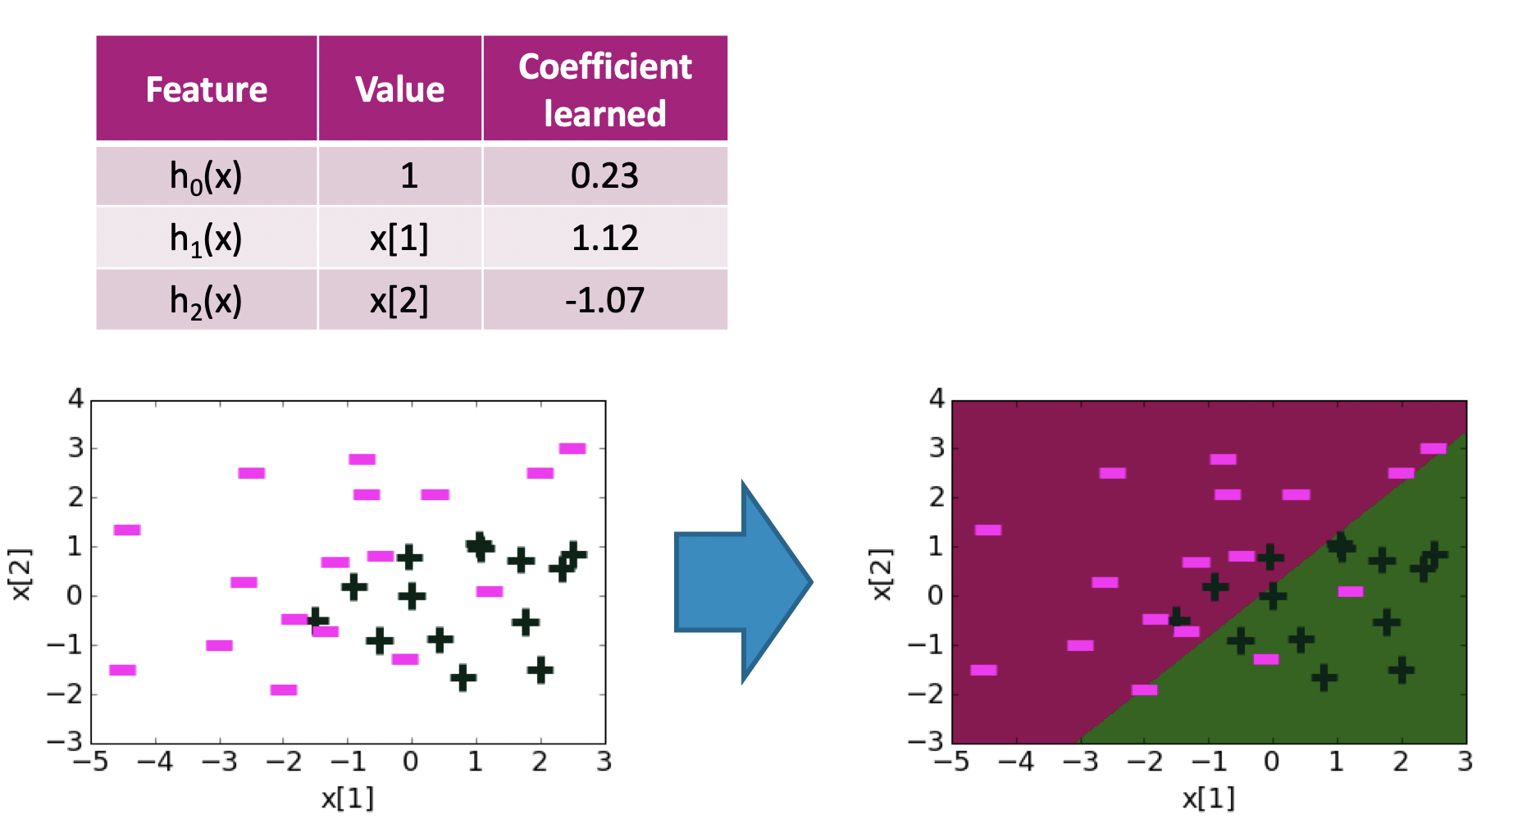

Decision Boundary
$$w^{T}h\left(x\right)=0.23+1.12x\left[1\right]−1.07x[2]$$

Slide 38
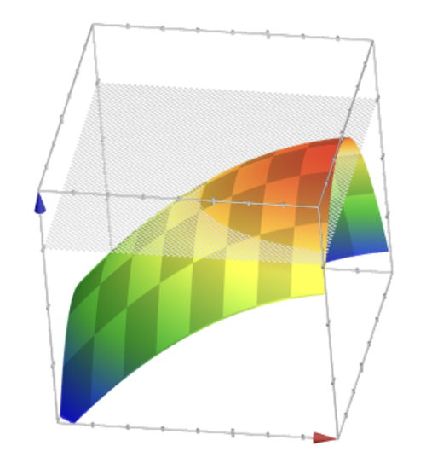
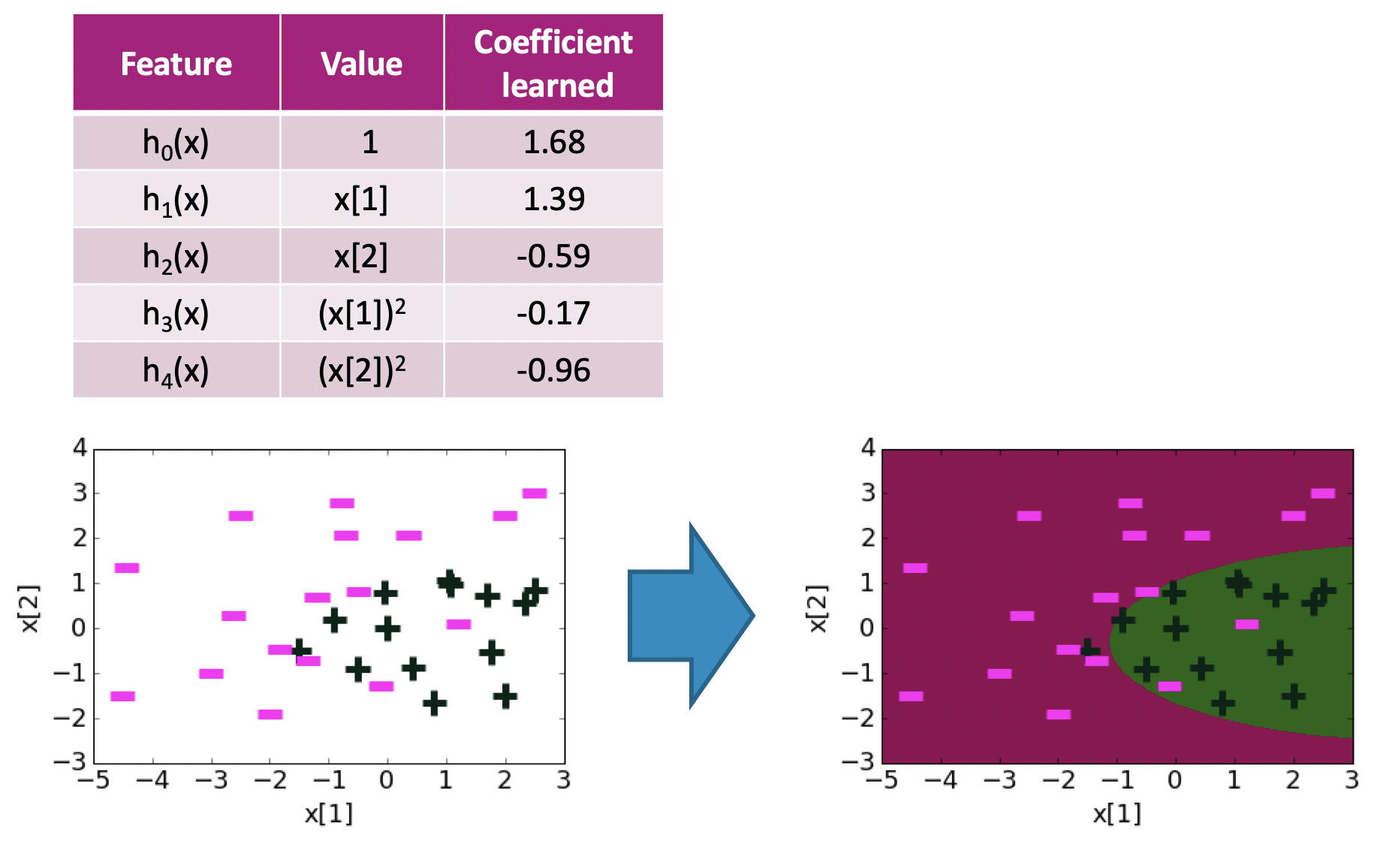

Decision Boundary
$$w^{T}h\left(x\right)=1.68+1.39x\left[1\right]−0.59x\left[2\right]−0.17x{\left[1\right]}^{2}−0.96x{\left[2\right]}^{2}$$

Slide 39
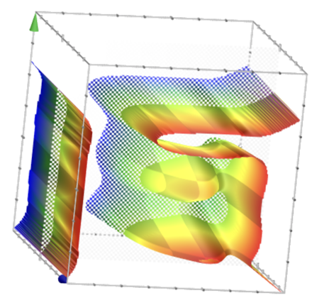
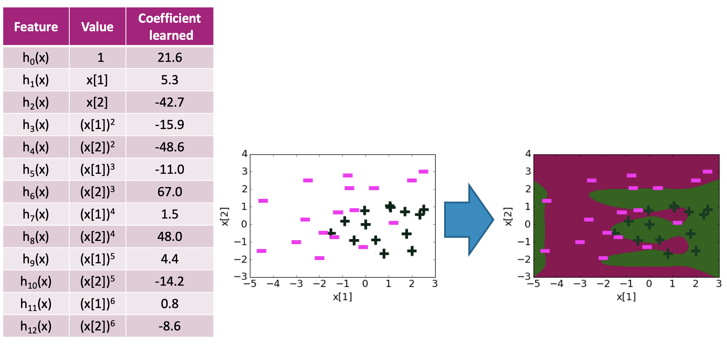

Decision Boundary
$$w^{T}h\left(x\right)=…$$
Notes:
Circle coefficients and say they are getting larger
Point out that the decision boundary is getting a bit more whack

Slide 40
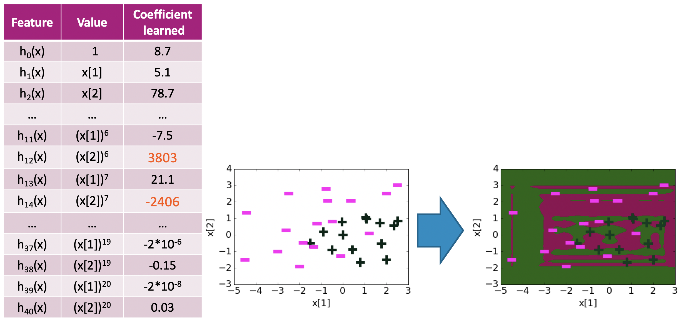
Decision Boundary
$$w^{T}h\left(x\right)=…$$
Notes:
Point out coefficients are huge now!
Decision boundary doesn’t really make sense

Slide 41
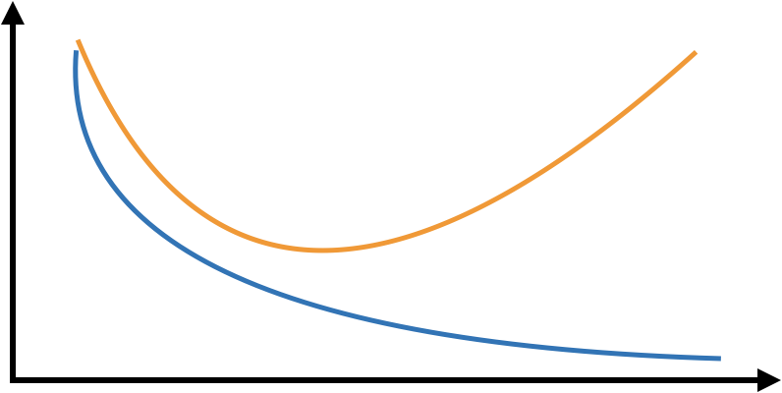
Overfitting
Just like with regression, we see a similar pattern with complexity
Classification
Error
True
Error
Train
Error
Low Complexity
High Complexity

Slide 42
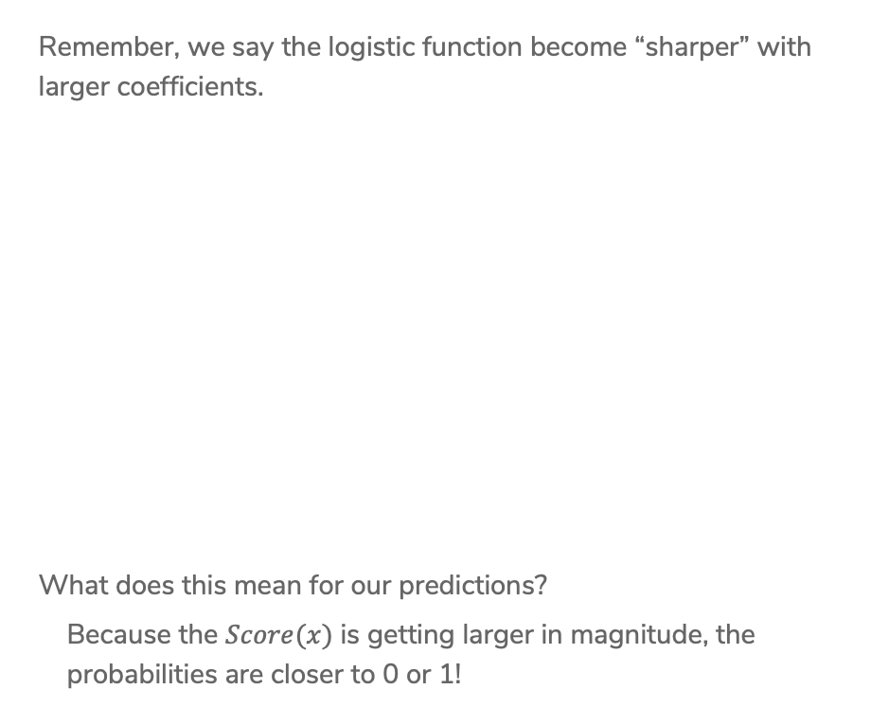
Effects of Overfitting
Remember, we say the logistic function become “sharper” with larger coefficients.
What does this mean for our predictions?
Because the $Score(x)$ is getting larger in magnitude, the
probabilities are closer to 0 or 1!
Notes:
Draw for the same point, it gives a higher probability

Slide 43
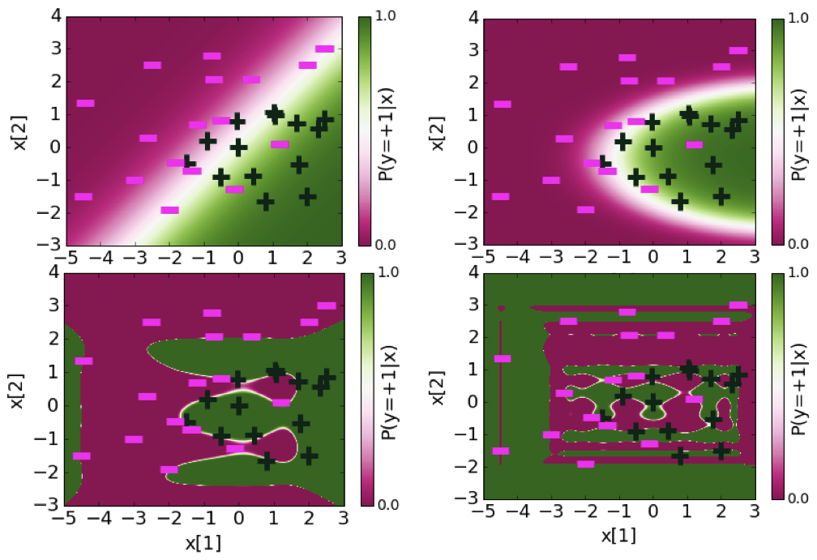

Plotting Probabilities
$$P\left(y=+1 | x\right)= \frac{1}{1+e^{−{\hat{w}}^{T}h(x)}}$$

Slide 44
Regularization

Slide 45


L2 Regularized Logistic Regression
Just like in regression, can change our quality metric to avoid overfitting when training a model
$$\hat{w}=\underset{w}{argmax}{\log\left(ℓ\left(w\right)\right)−λ{\left|\left|w\right|\right|}_{2}^{2}}$$

Slide 46

Some Details
Why do we subtract the L2 Norm?
$$\hat{w}=\underset{w}{argmax}{\log\left(ℓ\left(w\right)\right)−λ{\left|\left|w\right|\right|}_{2}^{2}}$$
How does $λ$ impact the complexity of the model?
How do we pick $λ$?

Slide 47



Coefficient Path:
L2 Penalty
Coefficient ${\hat{w}}_{j}$
$$λ$$

Slide 48

2 min
Jake wants to find the best Logistic Regression model for a sentiment analysis dataset by tuning the regularization parameter $λ∈[0, {10}^{−2},{10}^{−1},1, 10]$ and the learning rate $η∈[{10}^{−6}, {10}^{−5}, {10}^{−4}, {10}^{−3}]$. He does the following:
  Runs cross-validation on $λ$ to get the best value for the regularization parameter.
  For that value of $λ$, run cross-validation on $η$ to get the best value for the learning rate.
After running this procedure, he is convinced he has the best Logistic Regression model for his dataset, given the hyper-parameter values he wanted to test.
What did Jake do wrong?

Slide 49
Recap
Theme: Details of logistic classification and how to train it
Ideas:
Predict with probabilities
Using the logistic function to turn Score to probability
Logistic Regression
Minimizing error vs maximizing likelihood
Gradient Ascent
Effects of learning rate
Overfitting with logistic regression
  Over-confident (probabilities close to 0 or 1)
  Regularization

