Slide 1
CSE/STAT 416 Classification Tanmay Shah University of Washington April 10, 2024 ❓ Questions? Raise hand or sli.do #cs416 💬 Before Class: Does a straw have two holes or one? 🎵 Listening to: nothing, enjoy the calm

Slide 2
Administrivia
We have now finished the “Regression” component of the course!
Next two weeks (4 lectures): Classification
HW1 due tomorrow 11:59PM
Up to Sat 4/13 11:59PM if you use late days
HW2 released Fri

Slide 3
Roadmap So Far
Housing Prices - Regression
Regression Model
Assessing Performance
Ridge Regression
LASSO
Sentiment Analysis – Classification
Classification Overview
Logistic Regression

Slide 4
Regression vs. Classification
Regression problems involve predicting continuous values.
E.g., house price, student grade, population growth, etc.
Classification problems involve predicting discrete labels
e.g., spam detection, object detection, loan approval, etc.
Notes:
WOS:
Regression: y \in R, Z, [0,1]
Y \in {+1, -1}, y \in {dog, cat}, etc.

Slide 5
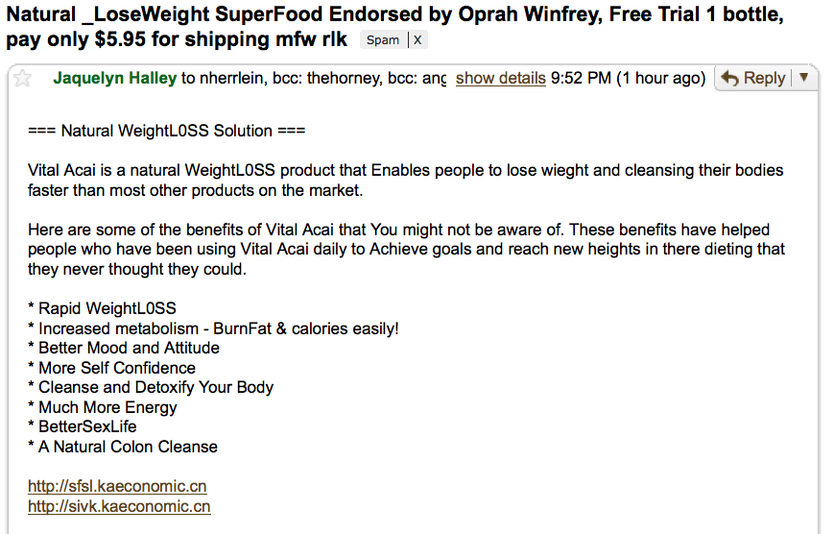
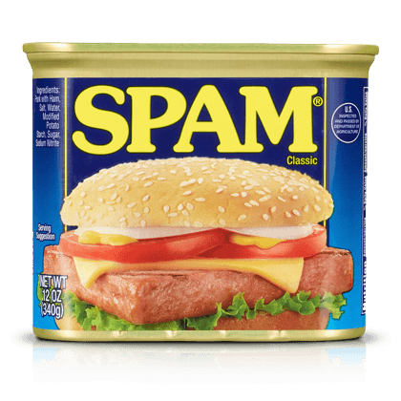
Spam Filtering
Output: y
Spam
Not Spam (ham)
Input: x
Text of email
Sender
Subject $⋯$
Notes:
Write binary classification

Slide 6
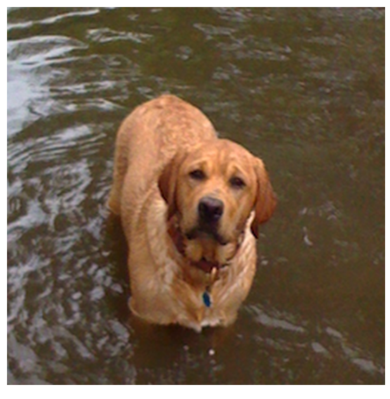
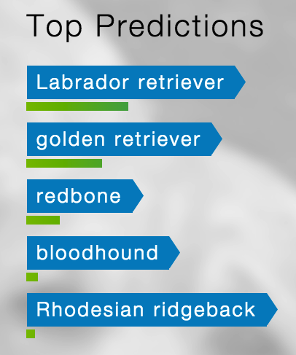
Object Detection
Input: x
Pixels
Output: y
Class
(+ Probability)
Notes:
Write multiclass classification

Slide 7
ML Pipeline
Training
Data
Pre-
Processing
x
ML model
ŷ
⌃
f
y
Optimization
algorithm
Quality metric
7

Slide 8
Sentiment Classifier
In our example, we want to classify a restaurant review as positive or negative.
Sentence from review
Classifier Model
Input: x
Output: y
Predicted class
Notes:
Where is sentiment analysis used? One example is marketing or analytics, where companies want to get the average sentiment of different content they put out based on the comments.

Slide 9
Converting Text to Numbers (Vectorizing): Bag of Words
Idea: One feature per word!
Example: ”Sushi was great, the food was awesome, but the service was terrible”
This has to be too simple, right?
Stay tuned (today and Wed) for issues that arise and how to address them ☺
sushi | was | great | the | food | awesome | but | service | terrible
Notes:
WOS:
1, 3, 1, 2, 1, 1, 1, 1, 1
$$h_1(x)$$, $$h_2(x)$$, …

Slide 10
Pre-Processing: Sample Dataset
Review | Sentiment
“Sushi was great, the food was awesome, but the service was terrible” | +1
… | …
“Terrible food; the sushi was rancid.” | -1
Vectorizer
Sushi | was | great | the | food | awesome | but | service | terrible | rancid | Sentiment
1 | 3 | 1 | 2 | 1 | 1 | 1 | 1 | 1 | 0 | +1
… | … | … | … | … | … | … | … | … | … | …
1 | 1 | 0 | 1 | 1 | 0 | 0 | 0 | 1 | 1 | -1
Notes:
Labels are provided to us in the dataset, but our goal is to develop a model that can go through new reviews and predict the sentiment without it being provided.
WOS:
$$h_1(x)$$, $$h_2(x)$$, …, “label”
“Goal: Given vectorized review, predict sentiment.”

Slide 11
How to Implement Sentiment Analysis?
Attempt 1: Simple Threshold Analysis
Attempt 2: Linear Classifier
Attempt 3 (Wed): Logistic Regression

Slide 12
Idea: Use a list of good words and bad words, classify review by the most frequent type of word
Attempt 1: Simple Threshold Classifier
Simple Threshold Classifier
Input $x$: Sentence from review
Count the number of positive and negative words, in $x$
If $\text{num}\text{_}\text{positiv}e\text{ > }\text{num}\text{_}\text{negative}$:
$\hat{y}= +1$
Else:
$\hat{y}=−1$
Example: ”Sushi was great, the food was awesome, but the service was terrible”
Word | Good?
sushi | None
was | None
great | Good
the | None
food | None
but | None
awesome | Good
service | None
terrible | Bad
rancid | Bad
Notes:
Write positive # = 2, negative # = 1, predict +1
Note that this approach doesn’t involve any learning.

Slide 13
Limitations of Attempt 1 (Simple Threshold Classifier)
Words have different degrees of sentiment.
Awesome > Great
How can we weigh them differently?
Single words are not enough sometimes…
“Good” $→$ Positive
“Not Good” $→$ Negative
How do we get list of positive/negative words?

Slide 14
Words Have Different Degrees of Sentiments
What if we generalize good/bad to a numeric weighting per word?
Word | Good?
sushi | None
was | None
great | Good
the | None
food | None
but | None
awesome | Good
service | None
terrible | Bad
rancid | Bad
Word | Weight
sushi | 0
was | 0
great | 1
the | 0
food | 0
but | 0
awesome | 2
service | 0
terrible | -1
rancid | -2

Slide 15
How do we get the word weights?
What if we learn them from the data?
In linear regression we learnt the weights for each feature. Can we do something similar here?
Word | Weight
sushi | $$w_{1}$$
was | $$w_{2}$$
great | $$w_{3}$$
the | $$w_{4}$$
food | $$w_{5}$$
awesome | $$w_{6}$$
but | $$w_{7}$$
service | $$w_{8}$$
terrible | $$w_{9}$$
$$h_{1}(x)$$ | $$h_{2}(x)$$ | $$h_{3}(x)$$ | $$h_{4}(x)$$ | $$h_{5}(x)$$ | $$h_{6}(x)$$ | $$h_{7}(x)$$ | $$h_{8}(x)$$ | $$h_{9}(x)$$
sushi | was | great | the | food | awesome | but | service | terrible
1 | 3 | 1 | 2 | 1 | 1 | 1 | 1 | 1

Slide 16
Idea: Use labelled training data to learn a weight for each word. Use weights to score a sentence.
Model:
$${\hat{y}}_{i}=sign\left(Score\left(x_{i}\right)\right)=sign(s_{i})$$
$$=sign\left(\sum_{j=0}^{D}{w_{j}h_{j}(x_{i})}\right)=sign(w^{T}h\left(x_{i}\right))$$
”Sushi was great, the food was awesome, but the
service was terrible”
Attempt 2: Linear Classifier
Word | Weight
sushi | $$0$$
was | $$0$$
great | $$1$$
the | $$0$$
food | $$0$$
awesome | $$2$$
but | $$0$$
service | $$0$$
terrible | $$−1$$
$$h_{1}(x)$$ | $$h_{2}(x)$$ | $$h_{3}(x)$$ | $$h_{4}(x)$$ | $$h_{5}(x)$$ | $$h_{6}(x)$$ | $$h_{7}(x)$$ | $$h_{8}(x)$$ | $$h_{9}(x)$$
sushi | was | great | the | food | awesome | but | service | terrible
1 | 3 | 1 | 2 | 1 | 1 | 1 | 1 | 1
Notes:
WOS:
$$1*1+1*2+1*(-1) = 2$$

Slide 17
Decision Boundary
Consider if only two words had non-zero coefficients
Word | Coefficient | Weight
 | $$w_{0}$$ | 0.0
awesome | $$w_{1}$$ | 1.0
awful | $$w_{2}$$ | -1.5
$$\hat{s}=1⋅\#awesome−1.5⋅\#awful$$
#awful
0 1 2 3 4 $⋯$
$$1⋅\#awesome−1.5⋅\#awful=0$$
#awesome
0 1 2 3 4 $⋯$
Notes:
Each point represents a sentence
WOS:
Above: Score < 0, predict negative sentiment
Below: Score > 0, predict positive sentiment

Slide 18
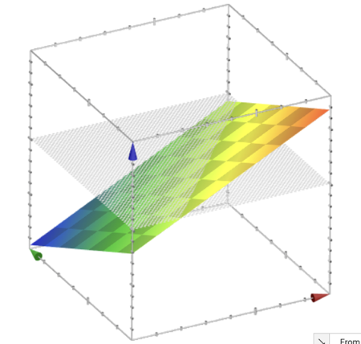
Decision Boundary
$$Score\left(x\right)=1⋅\#awesome−1.5⋅\#awful$$
2-dimensional view
3-dimensional view
#awful
0 1 2 3 4 $⋯$
$$1⋅\#awesome−1.5⋅\#awful=0$$
Score
#awesome
#awful
0 1 2 3 4 $⋯$
#awesome
Generally, with classification we don’t us a plot like the 3d view since it’s hard to visualize, instead use 2d plot with decision boundary
Notes:
WOS:
0 at the cross-section
When you are taking the sign, you’re fundamentally taking a cross-section at score =0, and seeing if the score is above or below that line.

Slide 19
Decision Boundary with Score
$$Score\left(x\right)=1⋅\#awesome−1.5⋅\#awful$$
2-dimensional view
2-d view with score
#awful
#awful
0 1 2 3 4 $⋯$
0 1 2 3 4 $⋯$
$$1⋅\#awesome−1.5⋅\#awful=0$$
$$1⋅\#awesome−1.5⋅\#awful=0$$
#awesome
#awesome
0 1 2 3 4 $⋯$
0 1 2 3 4 $⋯$

Slide 20
ML Pipeline
Scaling / Normalization
Feature Selection
- All Subsets
- Greedy
- LASSO
Train/val/test-split
Linear Regression
Polynomial Regression
Ridge Regression
LASSO Regression
Training
Data
Pre-
Processing
x
ML model
ŷ
⌃
f
Overarching Concepts:
Overfitting
Bias / Variance
Hyperparameter Tuning:
- Validation Set
- Cross-validation
y
Optimization
algorithm
Gradient Descent
Quality metric
MSE / RMSE
L1 Regularization (LASSO)
L2 Regularization (Ridge)
20

Slide 21
Classification

Slide 22
Sentiment Classifier
In our example, we want to classify a restaurant review as positive or negative.
Sentence from review
Classifier Model
Input: x
Output: y
Predicted class
Notes:
Where is sentiment analysis used? One example is marketing or analytics, where companies want to get the average sentiment of different content they put out based on the comments.

Slide 23
Idea: Use a list of good words and bad words, classify review by the most frequent type of word
Attempt 1: Simple Threshold Classifier
Simple Threshold Classifier
Input $x$: Sentence from review
Count the number of positive and negative words, in $x$
If $\text{num}\text{_}\text{positiv}e\text{ > }\text{num}\text{_}\text{negative}$:
$\hat{y}= +1$
Else:
$\hat{y}=−1$
Example: ”Sushi was great, the food was awesome, but the service was terrible”
Word | Good?
sushi | None
was | None
great | Good
the | None
food | None
but | None
awesome | Good
service | None
terrible | Bad
rancid | Bad
Notes:
Write positive # = 2, negative # = 1, predict +1
Note that this approach doesn’t involve any learning.

Slide 24
Idea: Use labelled training data to learn a weight for each word. Use weights to score a sentence.
Model:
$${\hat{y}}_{i}=sign\left(Score\left(x_{i}\right)\right)=sign(s_{i})$$
$$=sign\left(\sum_{j=0}^{D}{w_{j}h_{j}(x_{i})}\right)=sign(w^{T}h\left(x_{i}\right))$$
”Sushi was great, the food was awesome, but the
service was terrible”
Attempt 2: Linear
Classifier
Word | Weight
sushi | $$0$$
was | $$0$$
great | $$1$$
the | $$0$$
food | $$0$$
awesome | $$2$$
but | $$0$$
service | $$0$$
terrible | $$−1$$
$$h_{1}(x)$$ | $$h_{2}(x)$$ | $$h_{3}(x)$$ | $$h_{4}(x)$$ | $$h_{5}(x)$$ | $$h_{6}(x)$$ | $$h_{7}(x)$$ | $$h_{8}(x)$$ | $$h_{9}(x)$$
sushi | was | great | the | food | awesome | but | service | terrible
1 | 3 | 1 | 2 | 1 | 1 | 1 | 1 | 1
Notes:
WOS:
$$1*1+1*2+1*(-1) = 2$$

Slide 25
Decision Boundary
Consider if only two words had non-zero coefficients
Word | Coefficient | Weight
 | $$w_{0}$$ | 0.0
awesome | $$w_{1}$$ | 1.0
awful | $$w_{2}$$ | -1.5
$$\hat{s}=1⋅\#awesome−1.5⋅\#awful$$
#awful
0 1 2 3 4 $⋯$
$$1⋅\#awesome−1.5⋅\#awful=0$$
#awesome
0 1 2 3 4 $⋯$
Notes:
Each point represents a sentence
WOS:
Above: Score < 0, predict negative sentiment
Below: Score > 0, predict positive sentiment

Slide 26
1 min
What happens to the decision boundary if we add an intercept?
$$Score\left(x\right)=1.0+1⋅\#awesome−1.5⋅\#awful$$
Which graph shows the new decision boundary (black)?
Describe in English what we are doing in terms of the model’s predictions.
#awful
#awful
0 1 2 3 4 $⋯$
0 1 2 3 4 $⋯$
#awesome
0 1 2 3 4 $⋯$
#awesome
0 1 2 3 4 $⋯$
Notes:
Two parts:
Decide which one of these graphs represents the new score
Explain in English what you are doing here in terms of the model’s actual predictions

Slide 27
2 min
What happens to the decision boundary if we add an intercept?
$$Score\left(x\right)=1.0+1⋅\#awesome−1.5⋅\#awful$$
Which graph shows the new decision boundary (black)?
Describe in English what we are doing in terms of the model’s predictions.
#awful
#awful
0 1 2 3 4 $⋯$
0 1 2 3 4 $⋯$
#awesome
0 1 2 3 4 $⋯$
#awesome
0 1 2 3 4 $⋯$
Notes:
Two parts:
Decide which one of these graphs represents the new score
Explain in English what you are doing here in terms of the model’s actual predictions

Slide 28
Decision Boundary
$$Score\left(x\right)=1⋅\#awesome−1.5⋅\#awful$$
2-dimensional view
3-dimensional view
#awful
0 1 2 3 4 $⋯$
$$1⋅\#awesome−1.5⋅\#awful=0$$
Score
#awesome
#awful
0 1 2 3 4 $⋯$
#awesome
Generally, with classification we don’t us a plot like the 3d view since it’s hard to visualize, instead use 2d plot with decision boundary
Notes:
WOS:
0 at the cross-section
When you are taking the sign, you’re fundamentally taking a cross-section at score =0, and seeing if the score is above or below that line.

Slide 29
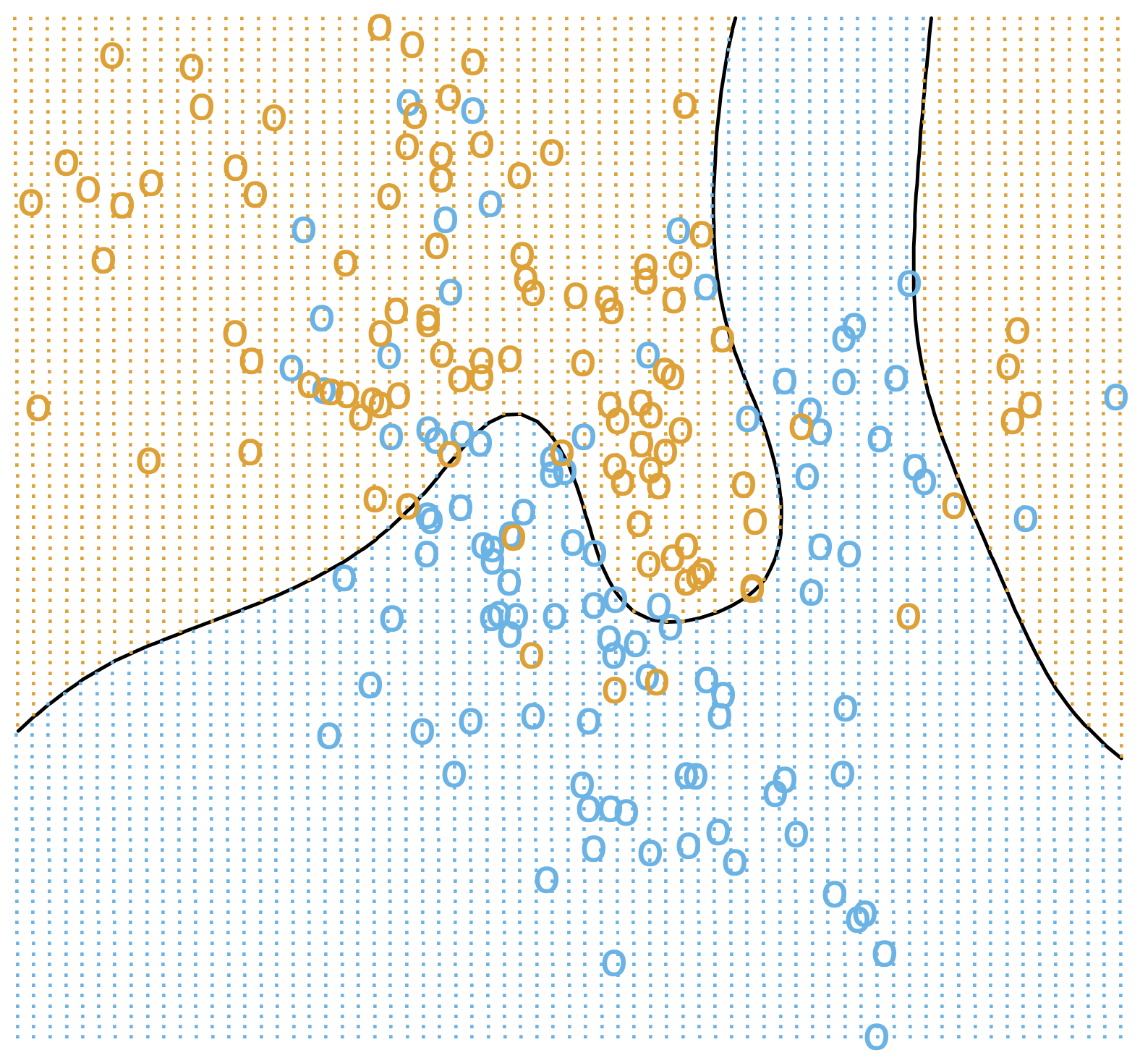
Complex Decision Boundaries?
What if we want to use a more complex decision boundary?
Need more complex model/features! (Come back Wed)

Slide 30
Single Words Are Sometimes Not Enough!
What if instead of making each feature one word, we made it two?
Unigram: a sequence of one word
Bigram: a sequence of two words
N-gram: a sequence of n-words
”Sushi was good, the food was good, the service was not good”
Longer sequences of words results in more context, more features, and a greater chance of overfitting.
sushi | was | good | the | food | service | not
1 | 3 | 3 | 2 | 1 | 1 | 1
sushi was | was good | good the | the food | food was | the service | service was | was not | not good
1 | 2 | 2 | 1 | 1 | 1 | 1 | 1 | 1

Slide 31
Evaluating Classifiers

Slide 32
ML Pipeline
Training
Data
$$x$$
Pre-
Processing
$$h(x)$$
ML model
$$\hat{y}$$
$$\hat{w}$$
Optimization
algorithm
$$y$$
Quality metric
32

Slide 33
Classification Error
Ratio of examples where there was a mistaken prediction
What’s a mistake?
If the true label was positive ($y=+1$), but we predicted negative ($\hat{y}=−1)$
If the true label was negative ($y=−1$), but we predicted positive ($\hat{y}=+1$)
Classification Error
Classification Accuracy
Notes:
WOS:
Classification Error: # mistakes / total
$$\sum 1{y-\hat{y}}$$
Classification Accuracy: 1 - error
# correct / total

Slide 34
What’s a good accuracy?
For binary classification:
Should at least beat random guessing…
Accuracy should be at least 0.5
For multi-class classification ($k$ classes):
Should still beat random guessing
Accuracy should be at least: 1 / k
3-class: 0.33
4-class: 0.25
…
Besides that, higher accuracy means better, right?
Notes:
For example, if you’re taking in handwritten digits and classifying what digit they are, you should at least get an accuracy of one-tenth. This is actually an example you’ll be going over in section on Thurs.

Slide 35
Detecting Spam
Imagine I made a “Dummy Classifier” for detecting spam
The classifier ignores the input, and always predicts spam.
This actually results in 90% accuracy! Why?
Most emails are spam…
This is called the majority class classifier.
A classifier as simple as the majority class classifier can have a high accuracy if there is a class imbalance.
A class imbalance is when one class appears much more frequently than another in the dataset
This might suggest that accuracy isn’t enough to tell us if a model is a good model.

Slide 36
Assessing Accuracy
Always digging in and ask critical questions of your accuracy.
Is there a class imbalance?
How does it compare to a baseline approach?
Random guessing
Majority class
…
Most important: What does my application need?
What’s good enough for user experience?
What is the impact of a mistake we make?

Slide 37
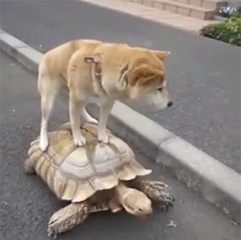

Slide 38
Confusion Matrix
For binary classification, there are only two types of mistakes
$\hat{y}=+1, y=−1$
$\hat{y}=−1, y=+1$
Generally we make a confusion matrix to understand mistakes.
Predicted Label
 | True Positive (TP) | False Negative (FN)
 | False Positive (FP) | True Negative (TN)
True Label
Tip on remembering: complete the sentence “My prediction was a …”
Notes:
So how can we break down the types of errors to think about them in a more detailed fashion? Using a tool called confusion matrices.
WOS: y, \hat{y}

Slide 39
Confusion Matrix Example
Predicted Label
 | True Positive (TP) | False Negative (FN)
 | False Positive (FP) | True Negative (TN)
True Label
Notes:
Write
100 test examples
60 total positive, 40 total negative
TP 50, 10 FN, 5 FP, 35 TN
Compute accuracy (50 + 35 / 100) = 0.85

Slide 40
Which is Worse?
What’s worse, a false negative or a false positive?
It entirely depends on your application!
In almost every case, how treat errors depends on your context.
Detecting Spam
False Negative: Annoying
False Positive: Email lost
Medical Diagnosis
False Negative: Disease not treated
False Positive: Wasteful treatment
Notes:
Spam is the positive label
Mention the COVID example

Slide 41
Errors and Fairness
We mentioned on the first day how ML is being used in many contexts that impact crucial aspects of our lives.
Models making errors is a given, what we do about that is a choice:
Are the errors consequential enough that we shouldn’t use a model in the first place?
Do different demographic groups experience errors at different rates?
If so, we would hopefully want to avoid that model!
Will talk more about how to define whether or a not a model is fair / discriminatory next week. Will use these notions of error as a starting point!

Slide 42
Binary Classification Measures
Notation
$C_{TP}=\#TP, C_{FP}=\#FP, C_{TN}=\#TN, C_{FN}=\#FN$
$N=C_{TP}+C_{FP}+C_{TN}+C_{FN}$
$N_{P}=C_{TP}+C_{FN}, N_{N}=C_{FP}+C_{TN}$
Error Rate
$$\frac{C_{FP}+C_{FN}}{N}$$
Accuracy Rate
$$\frac{C_{TP}+C_{TN}}{N}$$
False Positive rate (FPR)
$$\frac{C_{FP}}{N_{N}}$$
False Negative Rate (FNR)
$$\frac{C_{FN}}{N_{P}}$$
True Positive Rate or Recall
$$\frac{C_{TP}}{N_{P}}$$
Precision
$$\frac{C_{TP}}{C_{TP}+C_{FP}}$$
F1-Score
$$2\frac{Precision⋅Recall}{Precison+Recall}$$
See more!

Slide 43
Multiclass Confusion Matrix
Consider predicting (Healthy, Cold, Flu)
Predicted Label
 | Healthy | Cold | Flu
Healthy | 60 | 8 | 2
Cold | 4 | 12 | 4
Flu | 0 | 2 | 8
True Label
Notes:
WOS:
Circle the diagonal, label “correct”
Mention that you can’t exactly say false positive or false negative here, since there isn’t just a positive or negative, there are more classes.

Slide 44
1 min
Suppose we trained a classifier and computed its confusion matrix on the training dataset. Is there a class imbalance in the dataset and if so, which class has the highest representation?
Predicted Label
 | Pupper | Doggo | Woofer
Pupper | 2 | 27 | 4
Doggo | 4 | 25 | 4
Woofer | 1 | 30 | 2
True Label

Slide 45
2 min
Suppose we trained a classifier and computed its confusion matrix on the training dataset. Is there a class imbalance in the dataset and if so, which class has the highest representation?
Predicted Label
 | Pupper | Doggo | Woofer
Pupper | 2 | 27 | 4
Doggo | 4 | 25 | 4
Woofer | 1 | 30 | 2
True Label

Slide 46
Learning Theory

Slide 47
How much data?
The more the merrier
But data quality is also an extremely important factor
Theoretical techniques can bound how much data is needed
Typically too loose for practical applications
But does provide some theoretical guarantee
In practice
More complex models need more data

Slide 48
Learning Curve
How does the true error of a model relate to the amount of training data we give it?
Hint: We’ve seen this picture before
True error
Amount of training data
Notes:
Draw in difference at end is bias + noise

Slide 49
Learning Curve
What if we use a more complex model?
True error
Amount of training data
Notes:
Write in that curve is model using single words
Draw in curve for bigrams
Smaller bias

Slide 50
Next Time
We will address the issues highlighted with the Linear Classifier approach from today by predicting the probability of a sentiment, rather than the sentiment itself.
$$P\left(y | x\right)$$
Normally assume some structure on the probability (e.g., linear)
$$P\left(y | x, w\right)≈w^{T}x$$
Use machine learning algorithm to learn approximate $\hat{w}$ such that $\hat{P}(y|x)$ is close to $P\left(y | x\right)$, where:
$$\hat{P}\left(y | x\right)=P\left(y | x, \hat{w}\right)$$

Slide 51
Recap
Theme: Describe high level idea and metrics for classification
Ideas:
Applications of classification
Linear classifier
Decision boundaries
Classification error / Classification accuracy
Class imbalance
Confusion matrix
Learning theory

