Slide 1
CSE/STAT 416
Regularization – LASSO Regression
Pre-Class Videos
Tanmay Shah
University of Washington
April 5, 2024

Slide 2
Administrivia
Last lecture in the “Regression” case study!
  Next 2 weeks: Classification
  Following 1 week: Deep Learning
Section this week:
  Coding up RIDGE and Lasso (helpful for HW1!)
  Section Handouts due on Monday 11 PM, graded on completion
Upcoming Due Dates:
  HW0 Late due date Sat 4/6 11:59PM (if using 2 late days)
  HW1 out today, due Thu 4/11 11:59PM
  Learning Reflection 1 due Monday 11:59PM
OH is a great place to ask your learning reflection questions!
Reminder of resources

Slide 3
Pre-Class Video 1
Ridge Regression

Slide 4
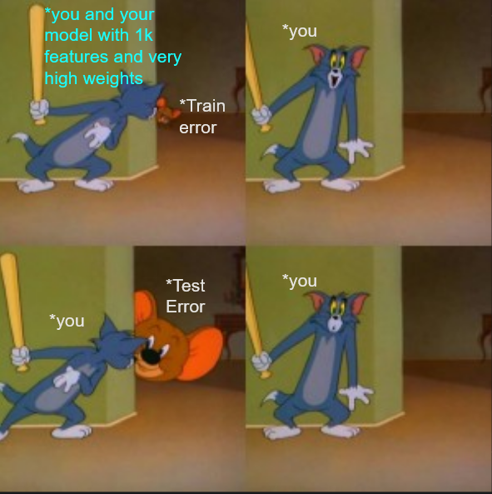
Overfitting in a nutshell

Slide 5
Recap: Number of Features
Overfitting is not limited to polynomial regression of large degree. It can also happen if you use a large number of features!
Why? Overfitting depends on how much data you have and if there is enough to get a representative sample for the complexity of the model.

Slide 6
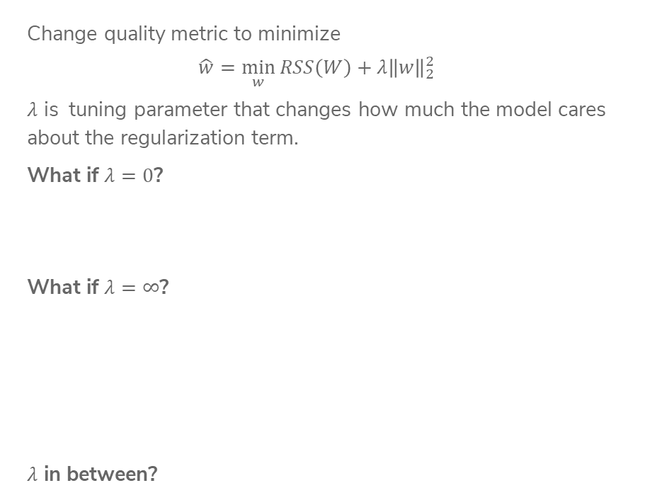
Recap:
Ridge Regression
Change quality metric to minimize
$$\hat{w}=\min_{w}{RSS\left(W\right)+λ{\left\|w\right\|}_{2}^{2}}$$
$λ$ is tuning parameter that changes how much the model cares about the regularization term.
What if $λ=0$?
What if $λ=∞$?
$λ$ in between?
Notes:
TODO, pre-annotate

Slide 7
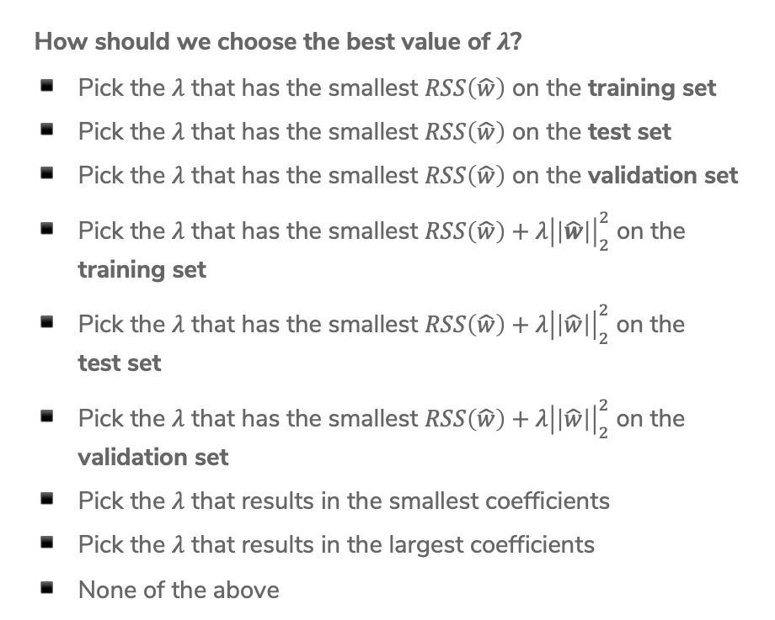
2 min
How should we choose the best value of $λ$?
Pick the $λ$ that has the smallest $RSS\left(\hat{w}\right)$ on the training set
Pick the $λ$ that has the smallest $RSS\left(\hat{w}\right)$ on the test set
Pick the $λ$ that has the smallest $RSS\left(\hat{w}\right)$ on the validation set
Pick the $λ$ that has the smallest $RSS\left(\hat{w}\right)+λ{\left|\left|\hat{w}\right|\right|}_{2}^{2}$ on the training set
Pick the $λ$ that has the smallest $RSS\left(\hat{w}\right)+λ{\left|\left|\hat{w}\right|\right|}_{2}^{2}$ on the
test set
Pick the $λ$ that has the smallest $RSS\left(\hat{w}\right)+λ{\left|\left|\hat{w}\right|\right|}_{2}^{2}$ on the validation set
Pick the $λ$ that results in the smallest coefficients
Pick the $λ$ that results in the largest coefficients
None of the above

Slide 8
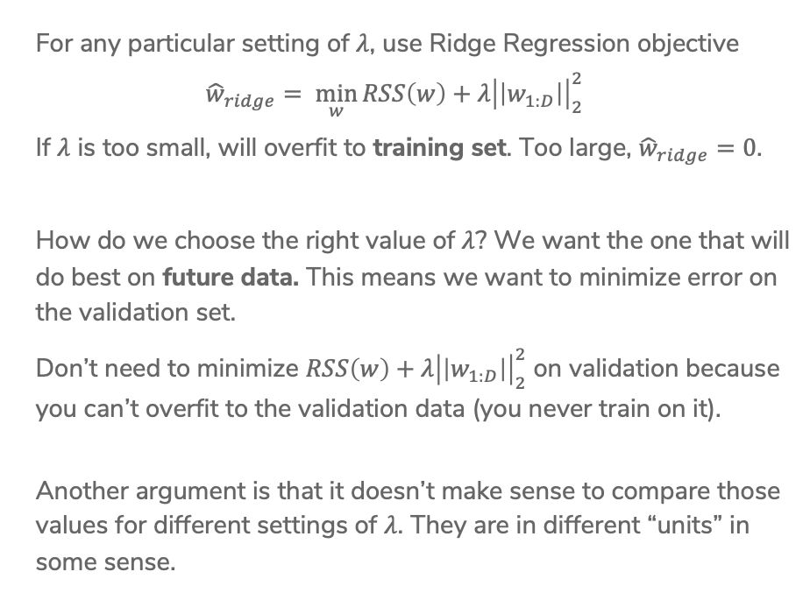

Choosing $λ$
For any particular setting of $λ$, use Ridge Regression objective
$${\hat{w}}_{ridge}= \min_{w}{RSS\left(w\right)+λ{\left|\left|w_{1:D}\right|\right|}_{2}^{2}}$$
If $λ$ is too small, will overfit to training set. Too large, ${\hat{w}}_{ridge}=0$.
How do we choose the right value of $λ$? We want the one that will do best on future data. This means we want to minimize error on the validation set.
Don’t need to minimize $RSS\left(w\right)+λ{\left|\left|w_{1:D}\right|\right|}_{2}^{2}$ on validation because you can’t overfit to the validation data (you never train on it).
Another argument is that it doesn’t make sense to compare those values for different settings of $λ$. They are in different “units” in some sense.

Slide 9
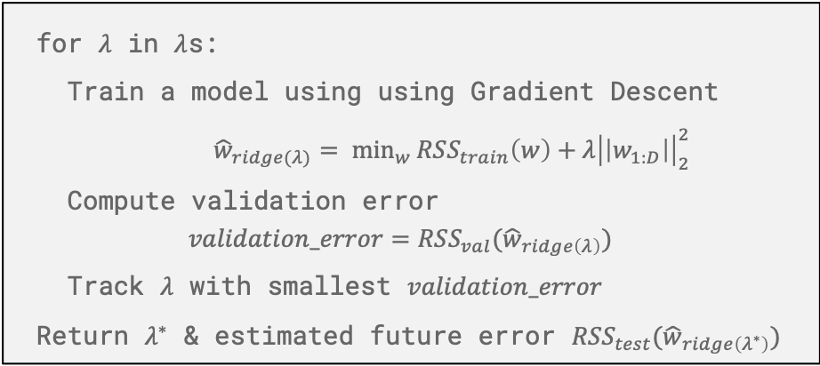
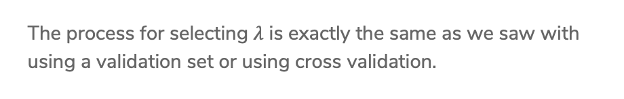
Choosing $λ$
The process for selecting $λ$ is exactly the same as we saw with using a validation set or using cross validation.
for $λ$ in $λ$s:
Train a model using using Gradient Descent
${\hat{w}}_{ridge(λ)}= \min_{w}{RSS_{train}\left(w\right)+λ{\left|\left|w_{1:D}\right|\right|}_{2}^{2}}$
Compute validation error
$$validation_error=RSS_{val}({\hat{w}}_{ridge\left(λ\right)})$$
Track $λ$ with smallest $validation_error$
Return $λ^{∗}$ & estimated future error $RSS_{test}({\hat{w}}_{ridge\left(λ^{∗}\right)})$
There is no fear of overfitting to validation set since you never trained on it! You can just worry about error when you aren’t worried about overfitting to the data.
Notes:
Draw visualization of Ridge coefficient path

Slide 10
Pre-Class Video 2
Feature Selection & All Subsets

Slide 11
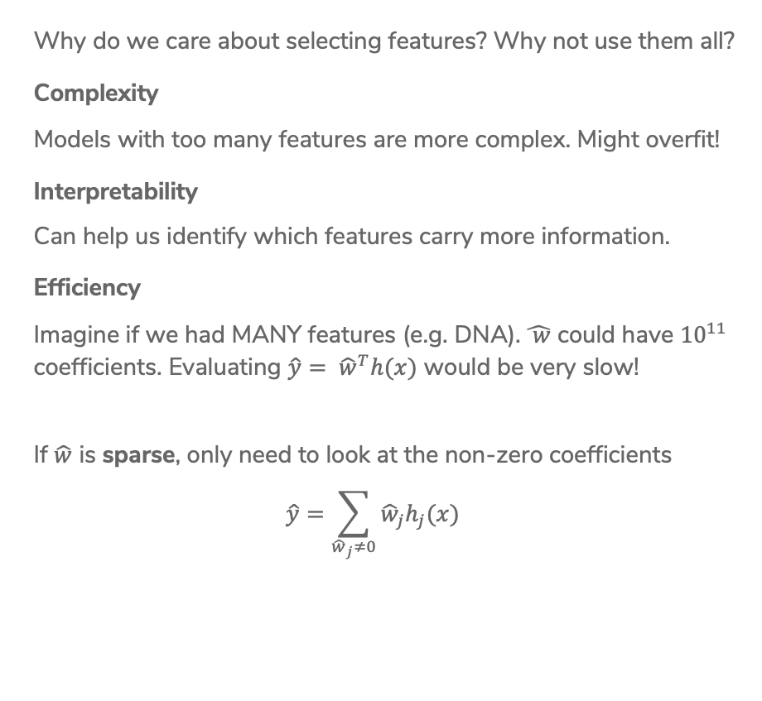
Benefits
Why do we care about selecting features? Why not use them all?
Complexity
Models with too many features are more complex. Might overfit!
Interpretability
Can help us identify which features carry more information.
Efficiency
Imagine if we had MANY features (e.g. DNA). $\hat{ w}$ could have ${10}^{11}$ coefficients. Evaluating $\hat{y}= {\hat{w}}^{T}h(x)$ would be very slow!
If $\hat{w}$ is sparse, only need to look at the non-zero coefficients
$$\hat{y}=\sum_{{\hat{w}}_{j}≠0}{{\hat{w}}_{j}h_{j}(x)}$$

Slide 12
Sparsity: Housing
Might have many features to potentially use. Which are useful?
Lot size Single Family Year built Last sold price Last sale price/sqft Finished sqft Unfinished sqft Finished basement sqft # floors Flooring types Parking type Parking amount Cooling Heating Exterior materials Roof type Structure style | Dishwasher Garbage disposal Microwave Range / Oven Refrigerator Washer Dryer Laundry location Heating type Jetted Tub Deck Fenced Yard Lawn Garden Sprinkler System …

Slide 13



Sparsity:
Reading Minds
How happy are you? What part of the brain controls happiness?
$x$
$y$
10 – Happy ☺
0 – Sad ☹

Slide 14

Best Model
Size 0
Features
# bathrooms
# bedrooms
sq.ft. living
sq.ft lot
floors
year built
year renovated
waterfront
$$RSS_{train}(\hat{w})$$
0
# of features

Slide 15
Best Model
Size 1
Features
# bathrooms
# bedrooms
sq.ft. living
sq.ft lot
floors
year built
year renovated
waterfront
$$RSS_{train}(\hat{w})$$
0 1
# of features

Slide 16
Best Model
Size 1
Features
# bathrooms
# bedrooms
sq.ft. living
sq.ft lot
floors
year built
year renovated
waterfront
$$RSS_{train}(\hat{w})$$
0 1
# of features

Slide 17
Best Model
Size 1
Features
# bathrooms
# bedrooms
sq.ft. living
sq.ft lot
floors
year built
year renovated
waterfront
$$RSS_{train}(\hat{w})$$
0 1
# of features

Slide 18
Best Model
Size 1
Features
# bathrooms
# bedrooms
sq.ft. living
sq.ft lot
floors
year built
year renovated
waterfront
$$RSS_{train}(\hat{w})$$
0 1
# of features

Slide 19
Best Model
Size 1
Features
# bathrooms
# bedrooms
sq.ft. living
sq.ft lot
floors
year built
year renovated
waterfront
$$RSS_{train}(\hat{w})$$
0 1
# of features

Slide 20
Best Model
Size 1
Features
# bathrooms
# bedrooms
sq.ft. living
sq.ft lot
floors
year built
year renovated
waterfront
$$RSS_{train}(\hat{w})$$
0 1
# of features

Slide 21
Best Model
Size 1
Features
# bathrooms
# bedrooms
sq.ft. living
sq.ft lot
floors
year built
year renovated
waterfront
$$RSS_{train}(\hat{w})$$
0 1
# of features

Slide 22
Best Model
Size 1
Features
# bathrooms
# bedrooms
sq.ft. living
sq.ft lot
floors
year built
year renovated
waterfront
$$RSS_{train}(\hat{w})$$
0 1
# of features

Slide 23
Best Model
Size 1
Features
# bathrooms
# bedrooms
sq.ft. living
sq.ft lot
floors
year built
year renovated
waterfront
$$RSS_{train}(\hat{w})$$
0 1
# of features

Slide 24
Best Model
Size 2
Not necessarily nested!
Best Model – Size 1: sq.ft living
Best Model – Size 2:
# bathrooms & # bedrooms
Features
# bathrooms
# bedrooms
sq.ft. living
sq.ft lot
floors
year built
year renovated
waterfront
$$RSS_{train}(\hat{w})$$
0 1 2
# of features

Slide 25
Best Model
Size 3
Features
# bathrooms
# bedrooms
sq.ft. living
sq.ft lot
floors
year built
year renovated
waterfront
$$RSS_{train}(\hat{w})$$
0 1 2 3
# of features

Slide 26
Best Model Size 4
Features
# bathrooms
# bedrooms
sq.ft. living
sq.ft lot
floors
year built
year renovated
waterfront
$$RSS_{train}(\hat{w})$$
0 1 2 3 4
# of features

Slide 27
Best Model Size 5
Features
# bathrooms
# bedrooms
sq.ft. living
sq.ft lot
floors
year built
year renovated
waterfront
$$RSS_{train}(\hat{w})$$
0 1 2 3 4 5
# of features

Slide 28
Best Model Size 6
Features
# bathrooms
# bedrooms
sq.ft. living
sq.ft lot
floors
year built
year renovated
waterfront
$$RSS_{train}(\hat{w})$$
0 1 2 3 4 5 6
# of features

Slide 29
Best Model Size 7
Features
# bathrooms
# bedrooms
sq.ft. living
sq.ft lot
floors
year built
year renovated
waterfront
$$RSS_{train}(\hat{w})$$
0 1 2 3 4 5 6 7
# of features

Slide 30
Best Model Size 8
Features
# bathrooms
# bedrooms
sq.ft. living
sq.ft lot
floors
year built
year renovated
waterfront
$$RSS_{train}(\hat{w})$$
0 1 2 3 4 5 6 7 8
# of features

Slide 31
Choose Num Features?
Option 1
Assess on a validation set
Option 2
Cross validation
Option 3+
Other metrics for penalizing model complexity like Bayesian Information Criterion (BIC)

Slide 32
Recap:
Ridge Regression
Change quality metric to minimize
$$\hat{w}=\min_{w}{RSS\left(W\right)+λ{\left\|w\right\|}_{2}^{2}}$$
$λ$ is tuning parameter that changes how much the model cares about the regularization term.
What if $λ=0$?
What if $λ=∞$?
$λ$ in between?
Notes:
TODO, pre-annotate

Slide 33
Benefits
Why do we care about selecting features? Why not use them all?
Complexity
Models with too many features are more complex. Might overfit!
Interpretability
Can help us identify which features carry more information.
Efficiency
Imagine if we had MANY features (e.g. DNA). $\hat{ w}$ could have ${10}^{11}$ coefficients. Evaluating $\hat{y}= {\hat{w}}^{T}h(x)$ would be very slow!
If $\hat{w}$ is sparse, only need to look at the non-zero coefficients
$$\hat{y}=\sum_{{\hat{w}}_{j}≠0}{{\hat{w}}_{j}h_{j}(x)}$$

Slide 34

Best Model Size 8
Features
# bathrooms
# bedrooms
sq.ft. living
sq.ft lot
floors
year built
year renovated
waterfront
$$MSE_{val}(\hat{w})$$
0 1 2 3 4 5 6 7 8
# of features

Slide 35

Efficiency of All Subsets
How many models did we evaluate?
$${\hat{y}}_{i}=w_{0}$$
$${\hat{y}}_{i}=w_{0}+w_{1}h_{1}\left(x\right)$$
$${\hat{y}}_{i}=w_{0}+w_{2}h_{2}\left(x\right)$$
…
$${\hat{y}}_{i}=w_{0}+w_{1}h_{1}\left(x\right)+w_{2}h_{2}\left(x\right)$$
…
$${\hat{y}}_{i}=w_{0}+w_{1}h_{1}\left(x\right)+\text{…}+w_{D}h_{D}(x)$$
[0 0 0 … 0 0 0]
[1 0 0 … 0 0 0]
[0 1 0 … 0 0 0]
…
[1 1 0 … 0 0 0]
…
[1 1 1 … 1 1 1]
If evaluating all subsets of 8 features only took 5 seconds, then
16 features would take 21 minutes
32 features would take almost 3 years
100 features would take almost 7.5*10²⁰ years
  50,000,000,000x longer than the age of the universe!

Slide 36
Choose Num Features?
Clearly all subsets is unreasonable. How can we choose how many and which features to include?
Option 1
Greedy Algorithm
Option 2
LASSO Regression (L1 Regularization)

Slide 37
Greedy Algorithms

Slide 38
Greedy Algorithms
Knowing it’s impossible to find exact solution, approximate it!
Forward stepwise
Start from model with no features, iteratively add features as performance improves.
Backward stepwise
Start with a full model and iteratively remove features that are the least useful.
Combining forward and backwards steps
Do a forward greedy algorithm that eventually prunes features that are no longer as relevant
And many many more!

Slide 39


Example:
Forward Stepwise
Start by selecting number of desired features $k$
Called greedy because it makes choices that look best at the time.
  Greedily optimal !=
min_val = $∞$
$$S_{0}←∅$$
for $i←1..k$:
Find feature $f_{i}$ not in $S_{i−1}$, that when combined
with $S_{i−1}$, minimizes the validation loss the most.
$S_{i}←S_{i−1}∪{\{f}_{i}\}$
if val_loss($S_{i}$) > min_val:
break # No need to look at more features
Notes:
Why are they called greedy? They take the best step at this time, or the best local step, although this may not necessary be the best step globally.

Slide 40
1 min
Say you want to find the optimal two-feature model, using the forward stepwise algorithm. What model would the forward stepwise algorithm choose?
Subsets of Size 1
Subsets of Size 2
Features | Val Loss
# bath | 201
# bed | 300
sq ft | 157
year built | 224
Features (unordered) | Val Loss
(# bath, # bed) | 120
(# bath, sq ft) | 131
(# bath, year built) | 190
(# bed, sq ft) | 137
(# bed, year built) | 209
(sq ft, year built) | 145

Slide 41
1 min
Say you want to find the optimal two-feature model, using the forward stepwise algorithm. What model would the forward stepwise algorithm choose?
Subsets of Size 1
Subsets of Size 2
Features | Val Loss
# bath | 201
# bed | 300
sq ft | 157
year built | 224
Features (unordered) | Val Loss
(# bath, # bed) | 120
(# bath, sq ft) | 131
(# bath, year built) | 190
(# bed, sq ft) | 137
(# bed, year built) | 209
(sq ft, year built) | 145

Slide 42


Slide 43
Option 2
Regularization

Slide 44
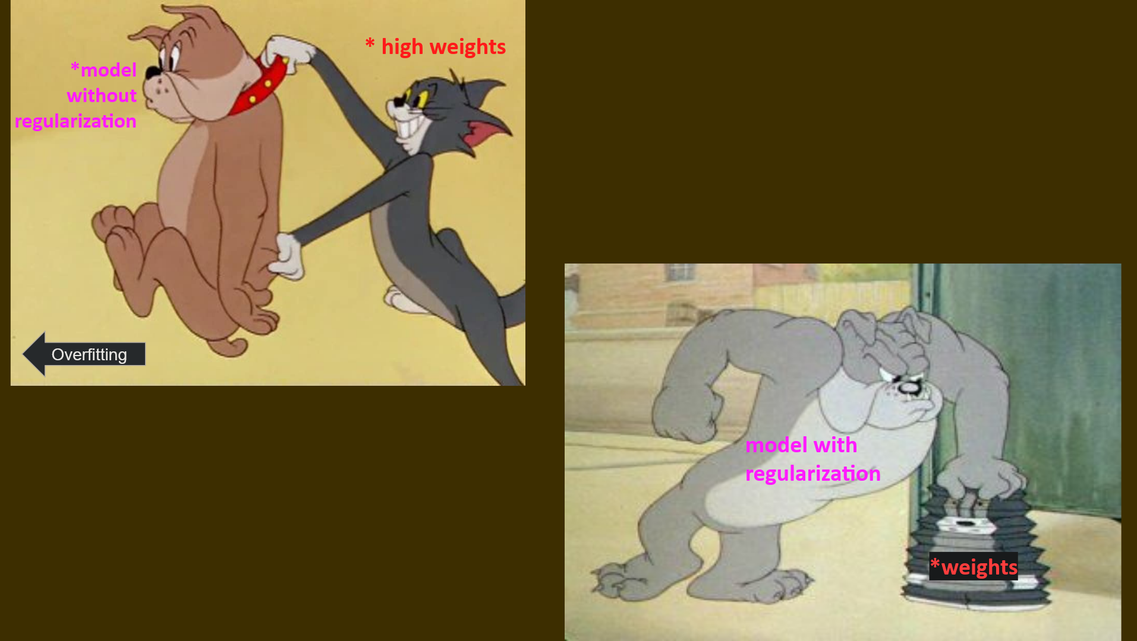
Regularization in a nutshell

Slide 45
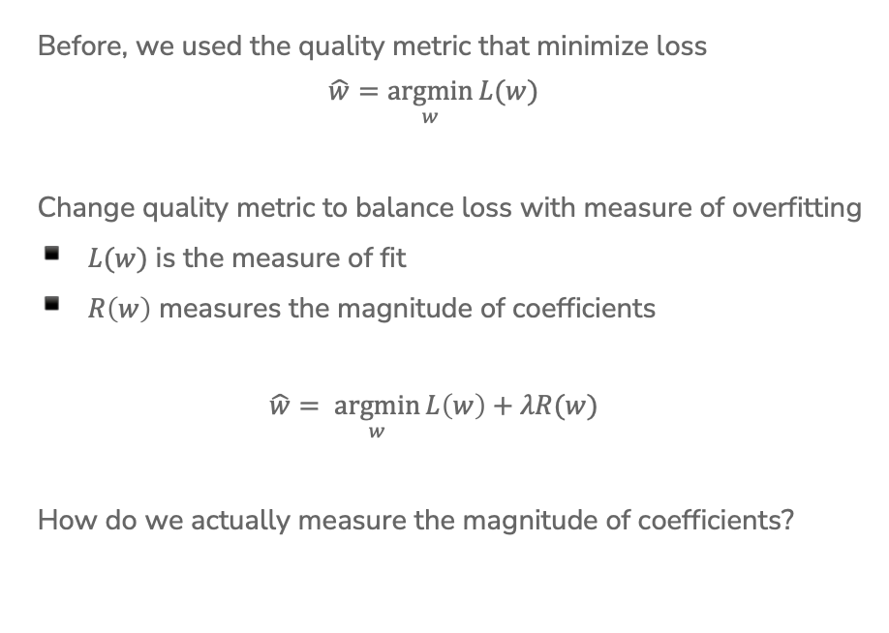
Recap: Regularization
Before, we used the quality metric that minimize loss
$$\hat{w}=\underset{w}{argmin}{L(w)}$$
Change quality metric to balance loss with measure of overfitting
$L(w)$ is the measure of fit
$R\left(w\right)$ measures the magnitude of coefficients
$$\hat{w}= \underset{w}{argmin}{L\left(w\right)+λR(w)}$$
How do we actually measure the magnitude of coefficients?
Notes:
Draw: L(w) = RSS(w)

Slide 46
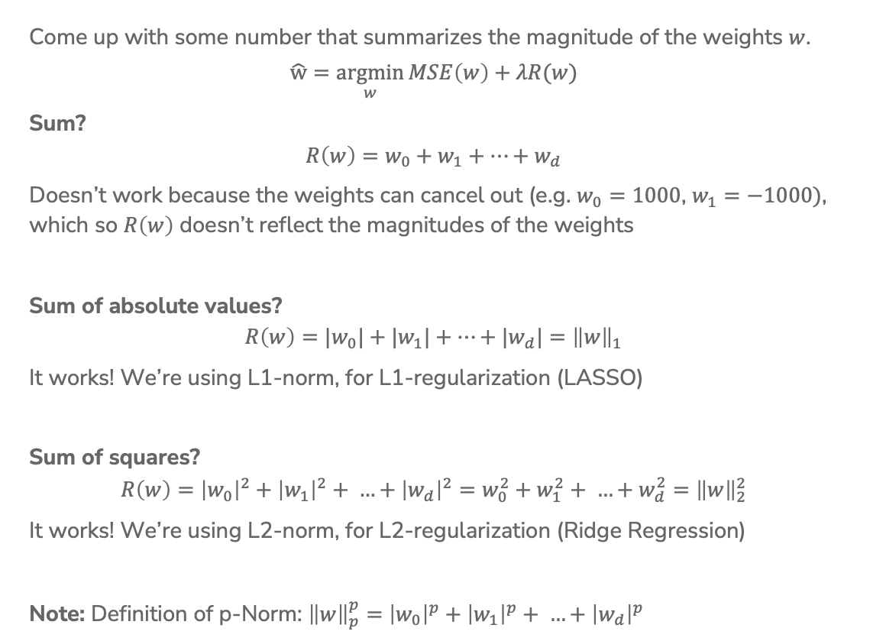
Recap:
Magnitude
Come up with some number that summarizes the magnitude of the weights $w$.
$$\hat{w}=\underset{w}{argmin}{MSE\left(w\right)+λR(w)}$$
Sum?
$$R\left(w\right)=w_{0}+w_{1}+…+w_{d}$$
Doesn’t work because the weights can cancel out (e.g. $w_{0}=1000$, $w_{1}=−1000)$, which so $R\left(w\right)$ doesn’t reflect the magnitudes of the weights
Sum of absolute values?
$$R\left(w\right)={|w}_{0}|+{|w}_{1}|+…+{|w}_{d}|={\left\|w\right\|}_{1}$$
It works! We’re using L1-norm, for L1-regularization (LASSO)
Sum of squares?
$$R\left(w\right)={\left|w_{0}\right|}^{2}+{\left|w_{1}\right|}^{2}+ …+{\left|w_{d}\right|}^{2}=w_{0}^{2}+w_{1}^{2}+ …+w_{d}^{2}={\left\|w\right\|}_{2}^{2}$$
It works! We’re using L2-norm, for L2-regularization (Ridge Regression)
Note: Definition of p-Norm: ${\left\|w\right\|}_{p}^{p}=$ ${\left|w_{0}\right|}^{p}+{\left|w_{1}\right|}^{p}+ …+{\left|w_{d}\right|}^{p}$
Notes:
Draw generic w vector
Draw why sum doesn’t work with an example of w_1 and w_2
Show summation for absolute values and show L1 norm notation
Show sum of squares summation and L2 norm notation
Both L1 and L2 have specific interpretation and practical importance
Talk about norm, notations,

Slide 47
Ridge for Feature Selection
We saw that Ridge Regression shrinks coefficients, but they don’t become 0. What if we remove weights that are sufficiently small?

Slide 48
Ridge for Feature Selection
Instead of searching over a discrete set of solutions, use regularization to reduce coefficient of unhelpful features.
Start with a full model, and then “shrink” ridge coefficients near 0.
Non-zero coefficients would be considered selected as important.
0
sq.ft. living
# bedrooms
# bathrooms
sq.ft. lot
year renovated
floors
cost per sq.ft.
year built
last sales price
heating
# showers
waterfront

Slide 49
1 min
What do you think about this approach to feature selection? Will it work? Why or why not. Use your logic!

Slide 50
Ridge for Feature Selection
Look at two related features #bathrooms and # showers.
Our model ended up not choosing any features about bathrooms!
0
sq.ft. living
# bedrooms
# bathrooms
sq.ft. lot
year renovated
floors
cost per sq.ft.
year built
last sales price
heating
# showers
waterfront

Slide 51
Ridge for Feature Selection
What if we had originally removed the # showers feature?
The coefficient for # bathrooms would be larger since it wasn’t “split up” amongst two correlated features
Instead, it would be nice if there were a regularizer that favors sparse solutions in the first place to account for this…
0
sq.ft. living
# bedrooms
# bathrooms
sq.ft. lot
year renovated
floors
cost per sq.ft.
year built
last sales price
heating
waterfront

Slide 52
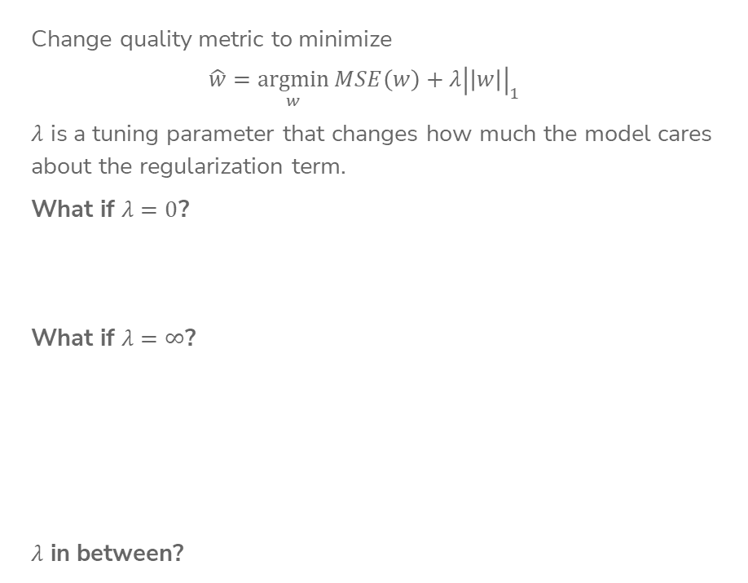
LASSO Regression
Change quality metric to minimize
$$\hat{w}=\underset{w}{argmin}{MSE\left(w\right)+λ{\left|\left|w\right|\right|}_{1}}$$
$λ$ is a tuning parameter that changes how much the model cares about the regularization term.
What if $λ=0$?
What if $λ=∞$?
$λ$ in between?
Notes:
TODO, pre-annotate

Slide 53


Ridge (L2) Coefficient Paths
Coefficients ${\hat{w}}_{j}$
$$λ$$

Slide 54
LASSO (L1) Coefficient Paths
Coefficients ${\hat{w}}_{j}$
$$λ$$

Slide 55
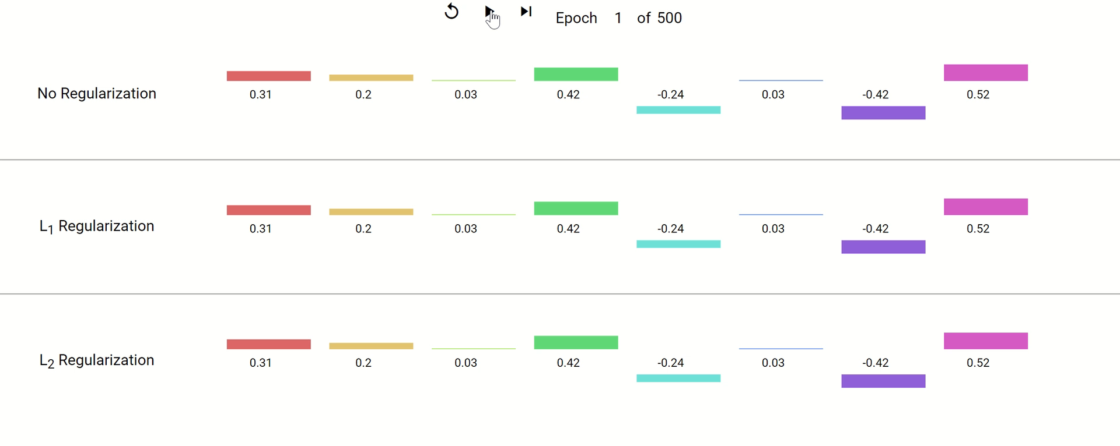
Coefficient Paths – Another View
Example from Google’s Machine Learning Crash Course
Notes:
Think of each epoch as taking one gradient descent step.
They don’t specify what the model is, but the concept of regularization is broader than just regression. Is often also applied to neural networks,
Key takeaways:
Regularized weights are smaller in magnitude.
L1 zeroes out weights, L2 keeps them around at really low values.

Slide 56
Demo
Similar demo to last time’s with Ridge but using the LASSO penalty

Slide 57
2 minutes
Why might the shape of the L1 penalty cause more sparsity than the L2 penalty?
No poll

Slide 58
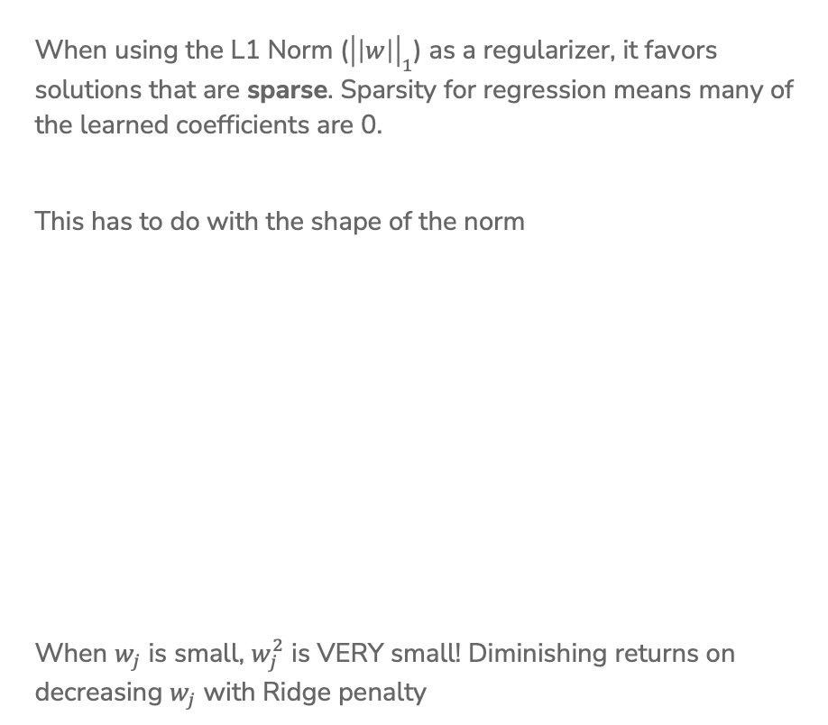
Sparsity
When using the L1 Norm (${\left|\left|w\right|\right|}_{1}$) as a regularizer, it favors solutions that are sparse. Sparsity for regression means many of the learned coefficients are 0.
This has to do with the shape of the norm
When $w_{j}$ is small, $w_{j}^{2}$ is VERY small! Diminishing returns on decreasing $w_{j}$ with Ridge penalty

Slide 59
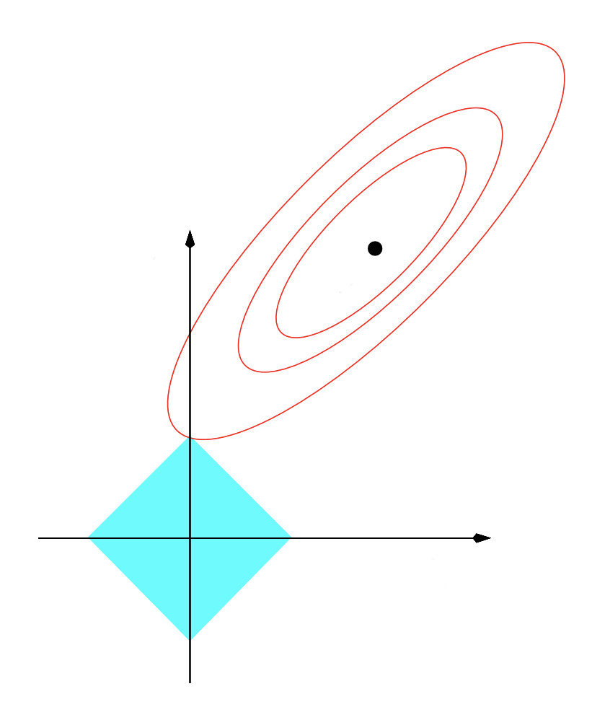







Sparsity Geometry
Another way to visualize why LASSO prefers sparse solutions
The L1 ball has spikes (places where some coefficients are 0)
$$w_{2}$$
$$w_{2}$$
$${\hat{w}}_{LS}$$
$${\hat{w}}_{LS}$$
$$w_{1}$$
$$w_{1}$$
$$L1$$
$$L2$$
Notes:
Another way to think about it: assume that instead of regularization being a soft constraint, it was a hard constraint, where we said that we want to pick the weights with the minimum MSE such that the norm of the coefficients have to be less than or equal to some budget.
In that case, the budgets will form these shapes, and the selected weights will be the ones with the minimum MSE within that shape.
Since L1 norm is diamond-shaped, it ends up being more likely that the minimum point of MSE will be along one of the corners, unlike the L2 which is a circle.
This is very informal intuition, not a formal proof.

Slide 60
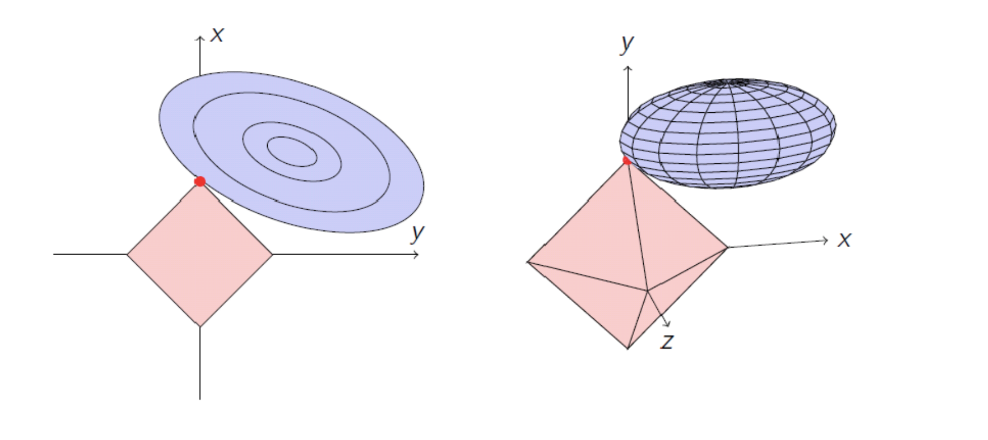


Sparsity Geometry
$L1$ (2 features)
$L1$ (3 features)

Slide 61


Slide 62
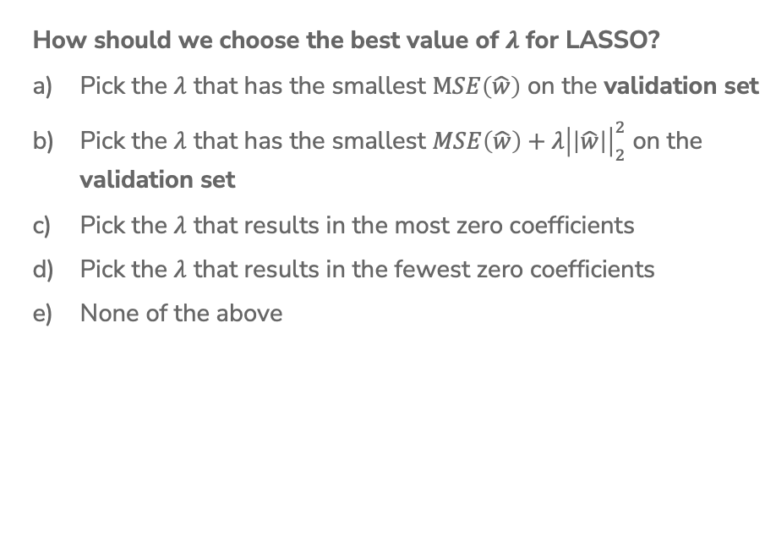
1 min
How should we choose the best value of $λ$ for LASSO?
Pick the $λ$ that has the smallest $MSE\left(\hat{w}\right)$ on the validation set
Pick the $λ$ that has the smallest $MSE\left(\hat{w}\right)+λ{\left|\left|\hat{w}\right|\right|}_{2}^{2}$ on the validation set
Pick the $λ$ that results in the most zero coefficients
Pick the $λ$ that results in the fewest zero coefficients
None of the above

Slide 63
Choosing $λ$
Exactly the same as Ridge Regression :)
This will be true for almost every hyper-parameter we talk about
A hyper-parameter is a parameter you specify for the model that influences which parameters (e.g. coefficients) are learned by the ML aglorithm

Slide 64

LASSO in Practice
A very common usage of LASSO is in feature selection. If you have a model with potentially many features you want to explore, you can use LASSO on a model with all the features and choose the appropriate $λ$ to get the right complexity.
Then once you find the non-zero coefficients, you can identify which features are the most important to the task at hand*
* e.g., using domain-specific expertise

Slide 65

ML Pipeline
- Deployment Bias
Training
Data
Pre-
Processing
x
ML
model
ŷ
⌃
- Historical Bias
- Representation Bias
- Measurement Bias
f
y
Optimization
algorithm
Quality
metric
65

Slide 66
De-biasing LASSO
LASSO (and Ridge) adds bias to the Least Squares solution (this was intended to avoid the variance that leads to overfitting)
Recall Bias-Variance Tradeoff
It’s possible to try to remove the bias from the LASSO solution using the following steps
Run LASSO to select which features should be used
(those with non-zero coefficients)
Run regular Ordinary Least Squares on the dataset with only those features
Coefficients are no longer shrunk from their true values

Slide 67
LASSO (L1) Coefficient Paths
Coefficients ${\hat{w}}_{j}$
$$λ$$

Slide 68
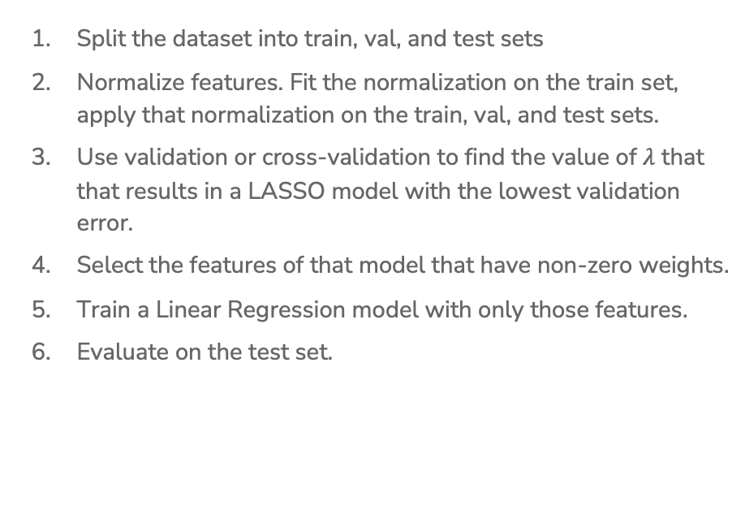
(De-biased) LASSO In Practice
Split the dataset into train, val, and test sets
Normalize features. Fit the normalization on the train set, apply that normalization on the train, val, and test sets.
Use validation or cross-validation to find the value of $λ$ that that results in a LASSO model with the lowest validation error.
Select the features of that model that have non-zero weights.
Train a Linear Regression model with only those features.
Evaluate on the test set.

Slide 69
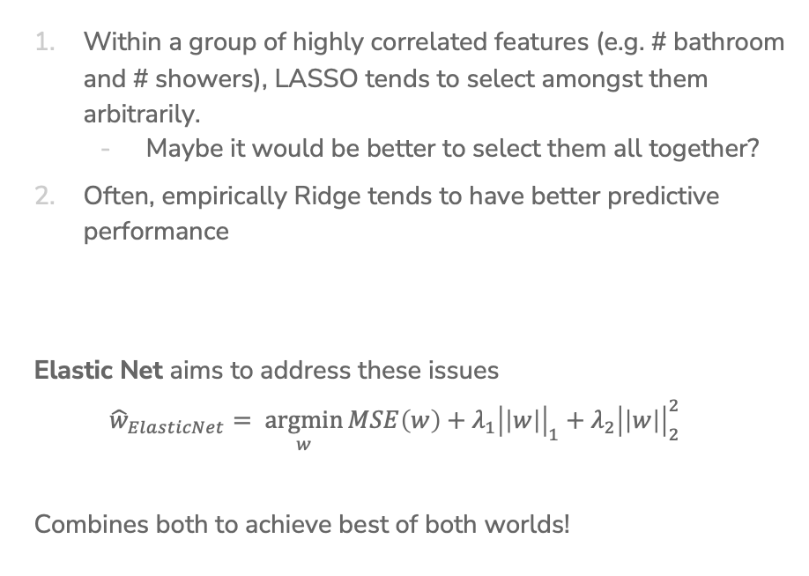
Issues with LASSO
Within a group of highly correlated features (e.g. # bathroom and # showers), LASSO tends to select amongst them arbitrarily.
  Maybe it would be better to select them all together?
Often, empirically Ridge tends to have better predictive performance
Elastic Net aims to address these issues
$${\hat{w}}_{ElasticNet}= \underset{w}{argmin}{MSE\left(w\right)+λ_{1}{\left|\left|w\right|\right|}_{1}+λ_{2}{\left|\left|w\right|\right|}_{2}^{2}}$$
Combines both to achieve best of both worlds!

Slide 70
A Big Grain of Salt
Be careful when interpreting the results of feature selection or feature importance in Machine Learning!
Selection only considers features included
Sensitive to correlations between features
Results depend on the algorithm used!
At the end of the day, the best models combine statistical insights with domain-specific expertise!

Slide 71
Differences between L1 and L2 regularizations
L1 (LASSO):
Introduces more sparsity to the model
Less sensitive to outliers
Helpful for feature selection, making the model more interpretable
More computational efficient as a model (due to the sparse solutions, so you have to compute less dot products)
L2 (Ridge):
Makes the weights small (but not 0)
More sensitive to outliers (due to the squared terms)
Usually works better in practice

Slide 72
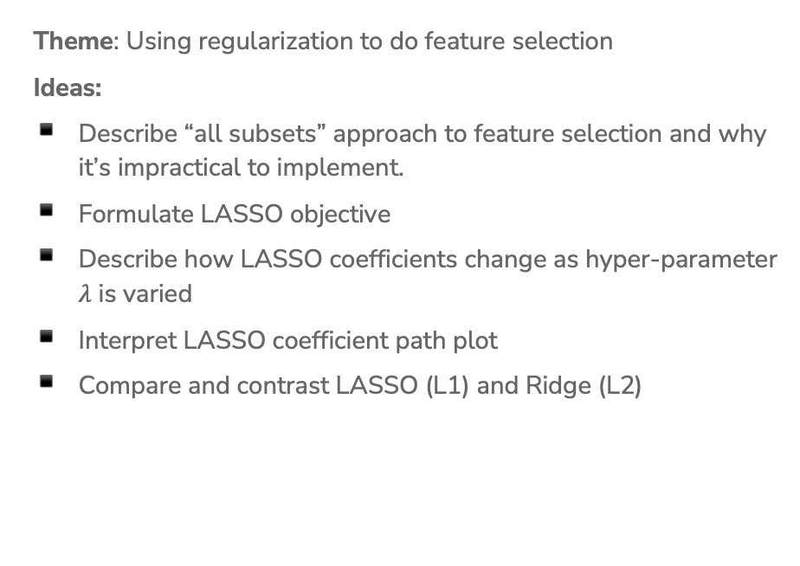
Recap
Theme: Using regularization to do feature selection
Ideas:
Describe “all subsets” approach to feature selection and why it’s impractical to implement.
Formulate LASSO objective
Describe how LASSO coefficients change as hyper-parameter $λ$ is varied
Interpret LASSO coefficient path plot
Compare and contrast LASSO (L1) and Ridge (L2)

Slide 73
ML Pipeline
- Deployment Bias
Training
Data
Pre-
Processing
x
ML
model
ŷ
⌃
- Historical Bias
- Representation Bias
- Measurement Bias
f
y
Optimization
algorithm
Quality
metric
73

