Slide 1
CSE/STAT 416 k-means Clustering
Tanmay Shah
Paul G. Allen School of Computer Science & Engineering
University of Washington
May 15, 2024
❓ Questions? Raise hand

Slide 2
Clustering Overview

Slide 3
Recap
For the past 7 weeks, we have covered different supervised learning algorithms
Now, we’re going to explore unsupervised learning methods where don’t have labels / outputs in your datasets anymore.
Note that several of the concepts you learnt for supervised learning, such as cross-validation, overfitting, bias-variance tradeoff, accuracy, error, etc. no longer apply in unsupervised learning!

Slide 4
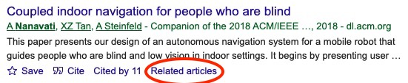
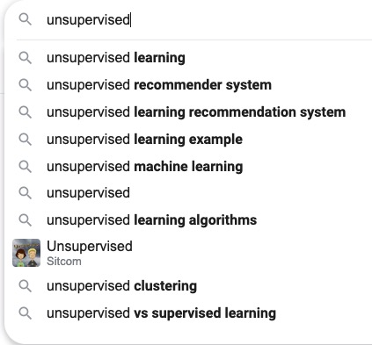
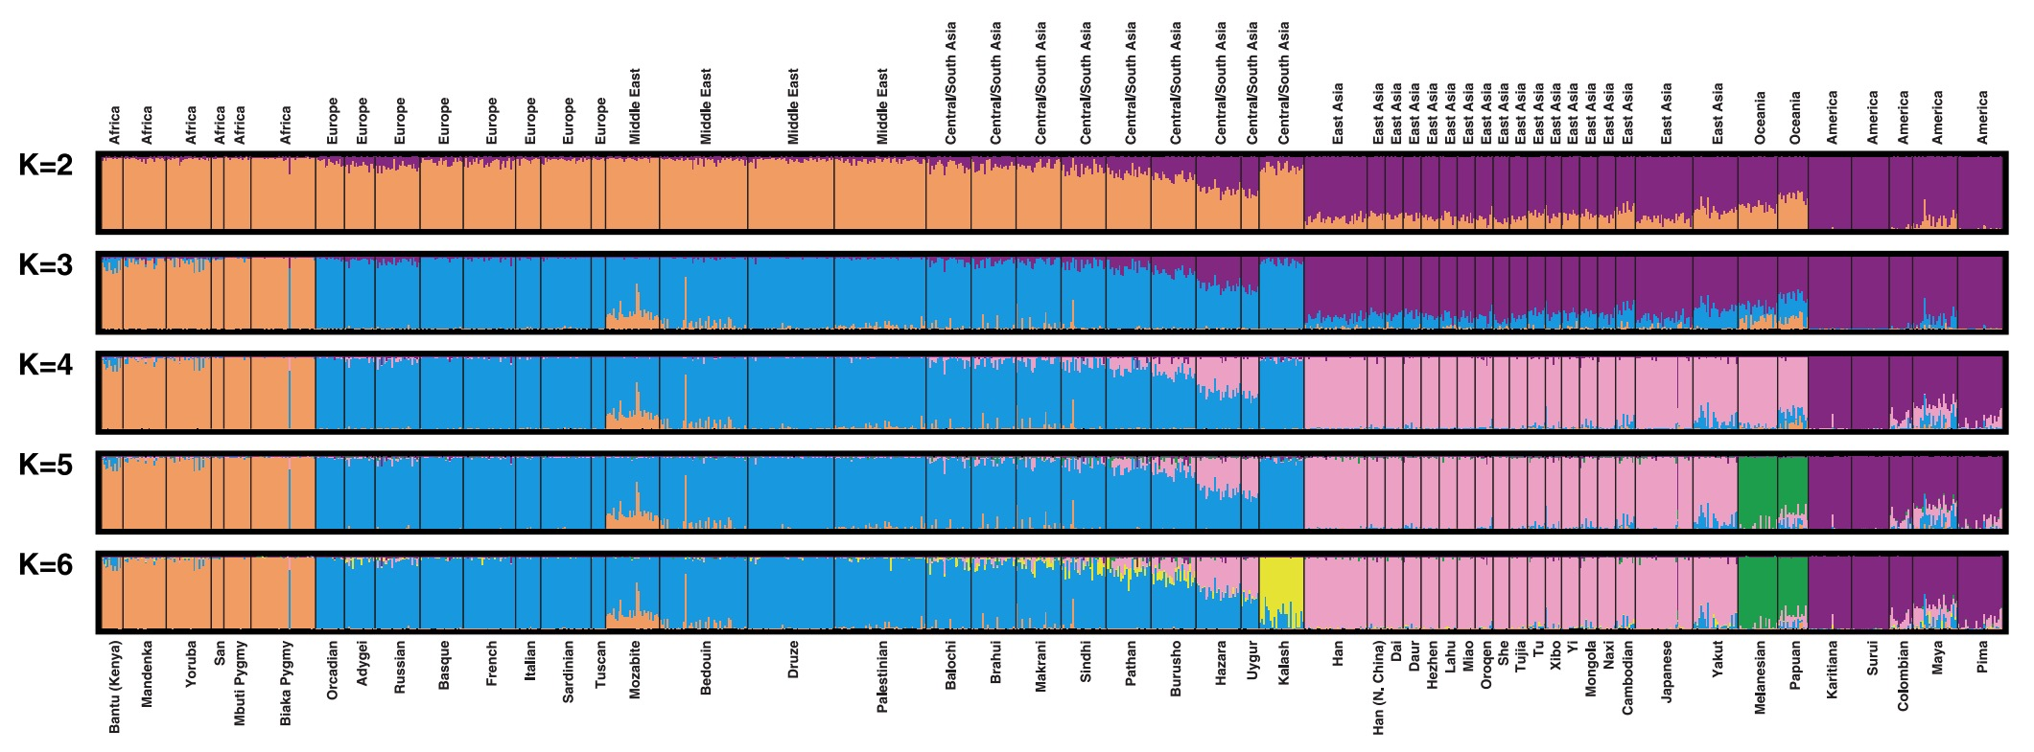
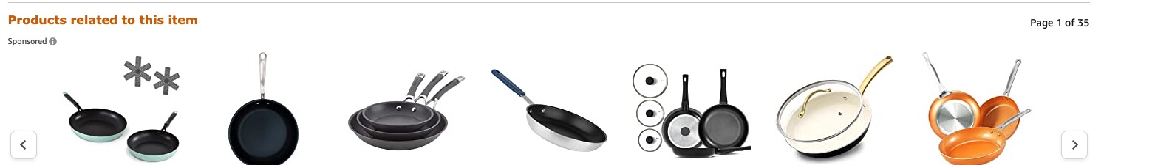
Unsupervised Learning
A type of machine learning that detects underlying patterns in unlabeled data.
Examples of unsupervised learning tasks:
  Cluster similar articles together.
  Cluster gene sequences.
  Recommend items, searches, movies, etc.
Notes:
There are several other examples of unsupervised learning: outlier detection, topic modeling, social network clustering, etc.

Slide 5

ML Pipeline
(Supervised)
Training
Data
Pre-
Processing
x
ML
model
ŷ
⌃
- Historical Bias
- Representation Bias
- Measurement Bias
f
y
Optimization
algorithm
Quality
metric
5

Slide 6
Clustering
Note that we’re not talking about learning user preferences (yet – come back next week ☺ ).
Our case study is document retrieval. Given that someone read a particular article, what similar articles would you recommend (without personalization)?

Slide 7
Labeled Data
What if the labels are known? Given labeled training data.
Can do multi-class classification methods to predict label.
However, not all articles fit cleanly into one label.
Further, oftentimes real-world data doesn’t have labels.

Slide 8
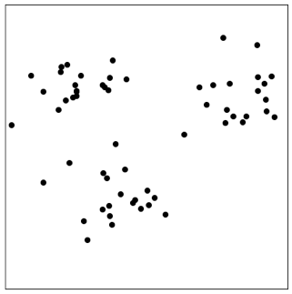



Unlabeled Data
In many real world contexts, there aren’t clearly defined labels so we won’t be able to do classification
We will need to come up with methods that uncover structure from the (unlabeled) input data $X$.
Clustering is an automatic process of trying to find related groups within the given dataset.
$$Input:x_{1}, x_{2},…,x_{n}$$
$$Output:z_{1}, z_{2},…,z_{n}$$
Notes:
Write ”unsupervised learning”
Draw circles around clusters
Write z_i \in [1, …, k]
Show some examples

Slide 9
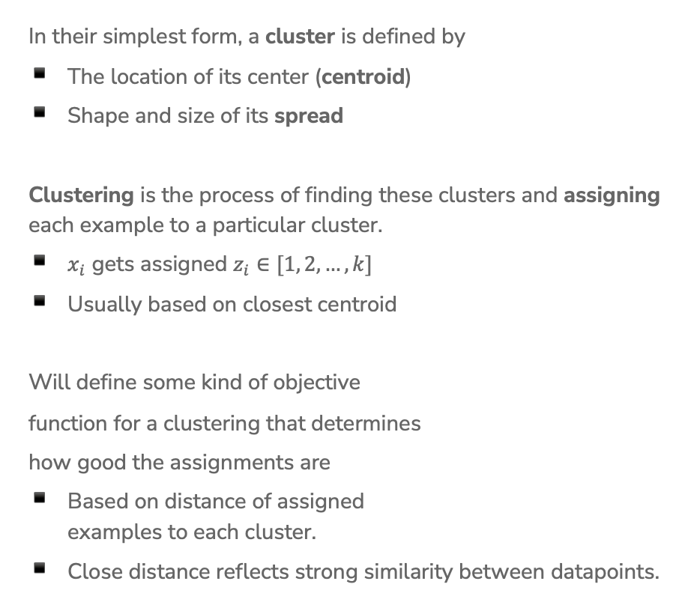
Define Clusters
In their simplest form, a cluster is defined by
The location of its center (centroid)
Shape and size of its spread
Clustering is the process of finding these clusters and assigning each example to a particular cluster.
$x_{i}$ gets assigned $z_{i}∈[1, 2, …,k]$
Usually based on closest centroid
Will define some kind of objective
function for a clustering that determines
how good the assignments are
Based on distance of assigned
examples to each cluster.
Close distance reflects strong similarity between datapoints.

Slide 10
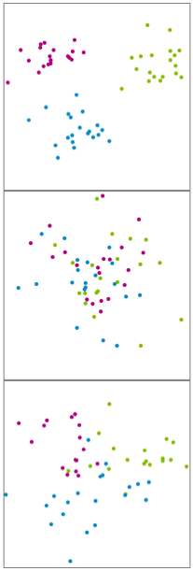
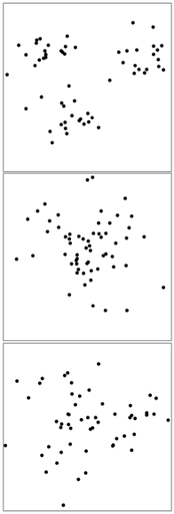
When Might This Work?
Clustering is easy when distance captures the clusters.
Ground Truth (not visible) Given Data
Notes:
Try top draw clustesr
Easy
Impossible
Maybe?

Slide 11
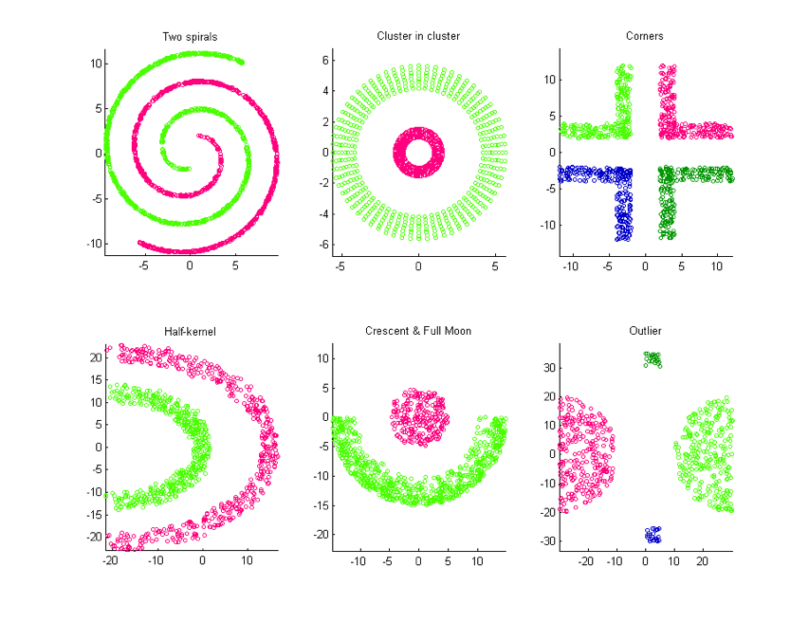
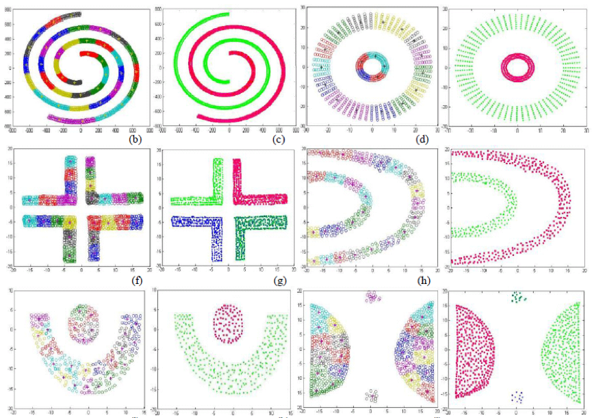
Not Always Easy
There are many clusters that are harder to learn with this setup
Distance does not determine clusters

Slide 12
2 min
Think of 1-2 problems that you might want to use clustering for. For each problem, describe:
  Why unsupervised learning is the right approach.
  What the input features are for the clustering algorithm.
  What clusters you hypothesize would emerge.

Slide 13
K-Means Clustering

Slide 14
K-Means
Clustering
Algorithm
We define the criterion of assigning point to a cluster based on its distance.
Shorter distance => Better Clustering
Algorithm
Given a dataset of n datapoints and a particular choice of k
Step 0: Initialize cluster centroids randomly
Repeat until convergence:
Step 1: Assign each example to its closest cluster centroid
Step 2: Update the centroids to be the average of all the points
assigned to that cluster

Slide 15
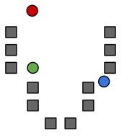




Step 0
Start by choosing the initial cluster centroids
A common default choice is to choose centroids $μ_{1},…,μ_{k}$ randomly
Will see later that there are smarter ways of initializing
$$μ_{2}$$
$$μ_{1}$$
$$μ_{3}$$

Slide 16
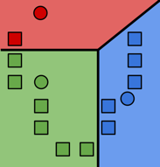

Step 1
Assign each example to its closest cluster centroid
For $i$= 1 to n
$$z_{i}←\underset{j∈[k]}{argmin}{{\left|\left|μ_{j}−x_{i}\right|\right|}_{2}^{2}}$$
Notes:
Draw the distance between green point and all centroids
Looks like a decision boundary, but is inferred without labels!
Write “Voronoi tessellation”

Slide 17
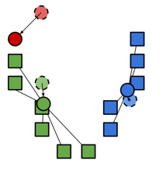

Step 2
Update the centroids to be the mean of points assigned to that cluster.
$$μ_{j}=\frac{\sum_{i=1}^{n}{1}\left\{z_{i}=j\right\}x_{i}}{\sum_{i=1}^{n}{1}\left\{z_{i}=j\right\}}$$
Computes center of mass for cluster!

Slide 18
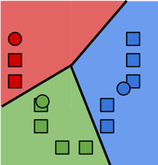
Repeat until convergence
Repeat Steps 1 and 2 until convergence

Slide 19
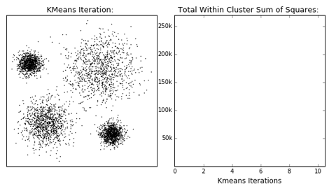
Stopping Conditions
Cluster assignments haven’t changed
Centroids haven’t changed
Some number of max iterations have been passed

Slide 20
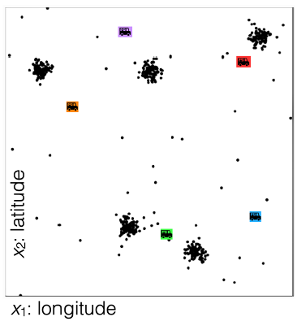
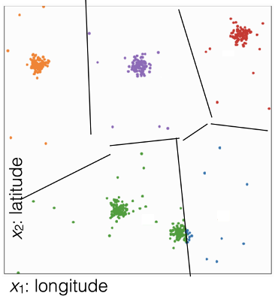
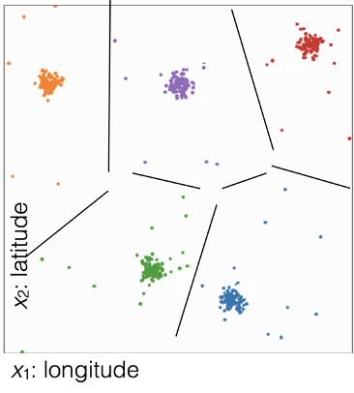
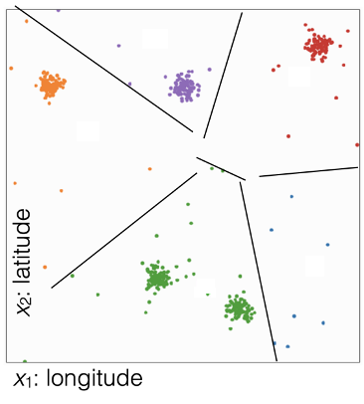
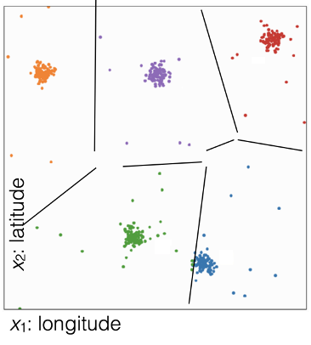
1 min
What cluster assignment would result from these centroids?
Centroids
(D)
(A)
(B)
(C)

Slide 21
1 min
What cluster assignment would result from these centroids?
Centroids
(D)
(A)
(B)
(C)

Slide 22
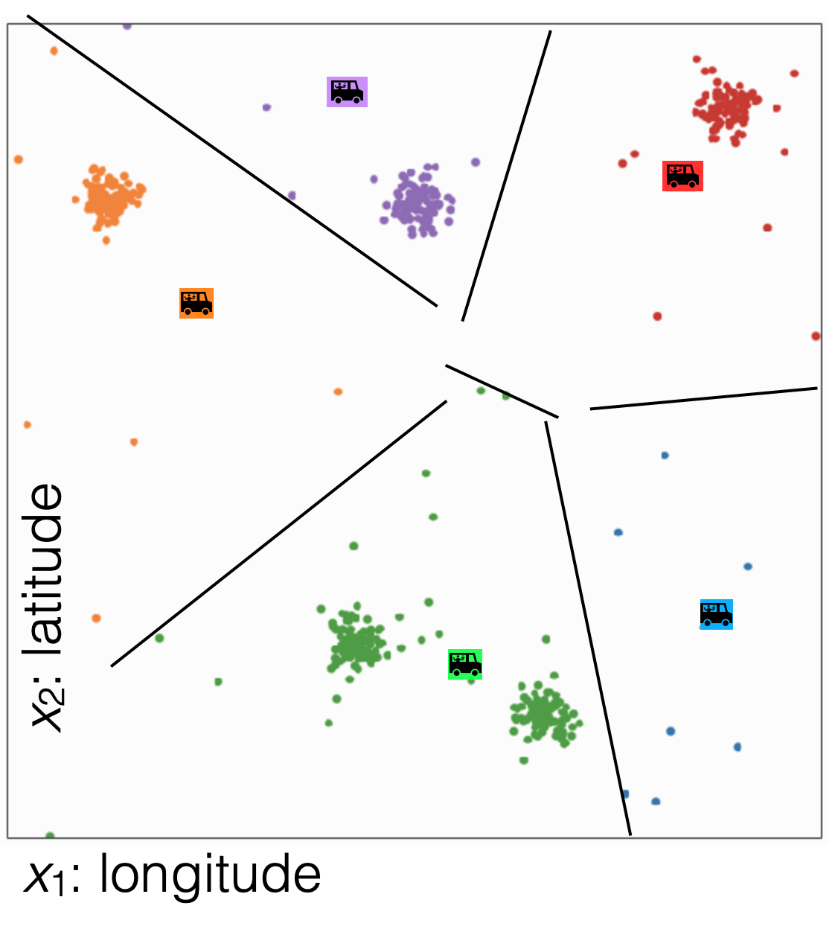
1 min
In what direction would each of the centroids (roughly) move?
Cluster Assignments
(D)
(A)
(B)
(C)

Slide 23
2 min
In what direction would each of the centroids (roughly) move?
Cluster Assignments
(D)
(A)
(B)
(C)

Slide 24
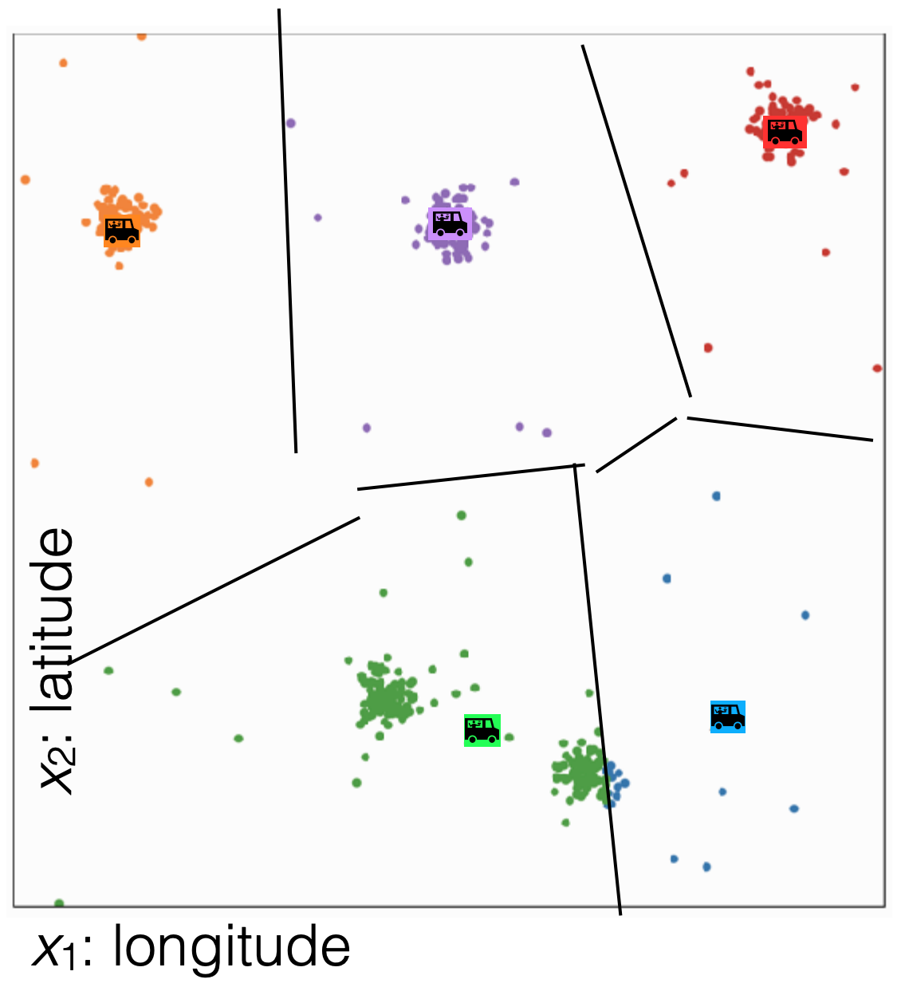
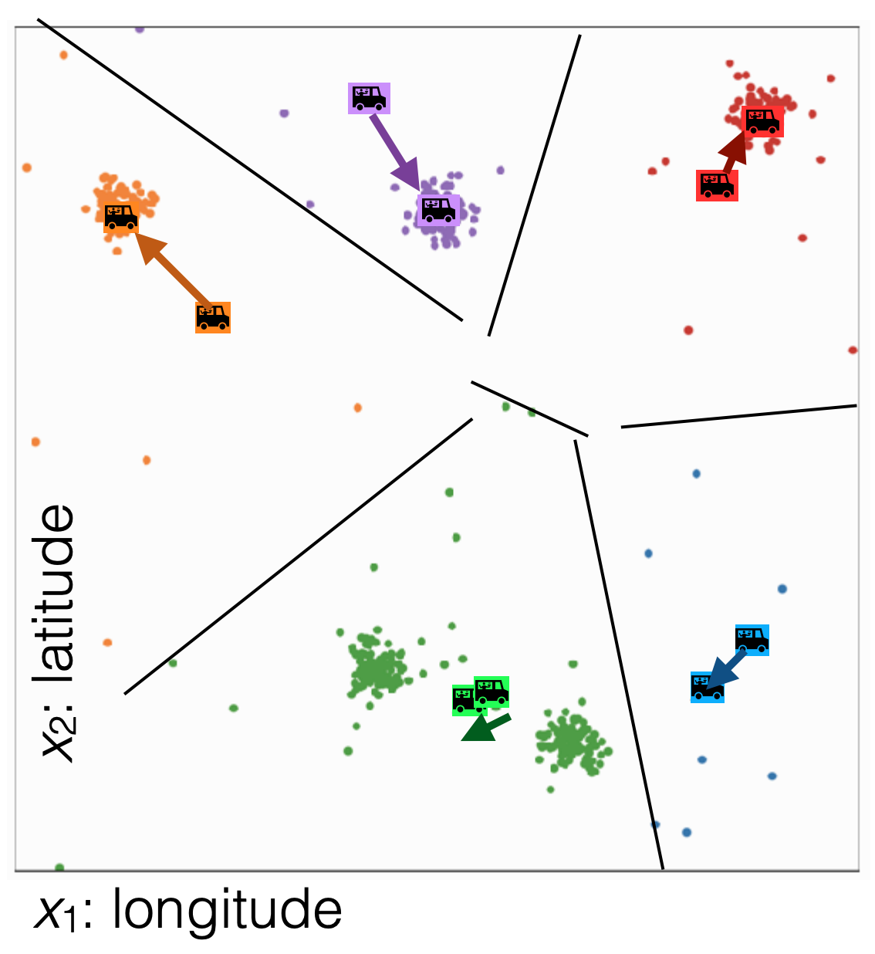
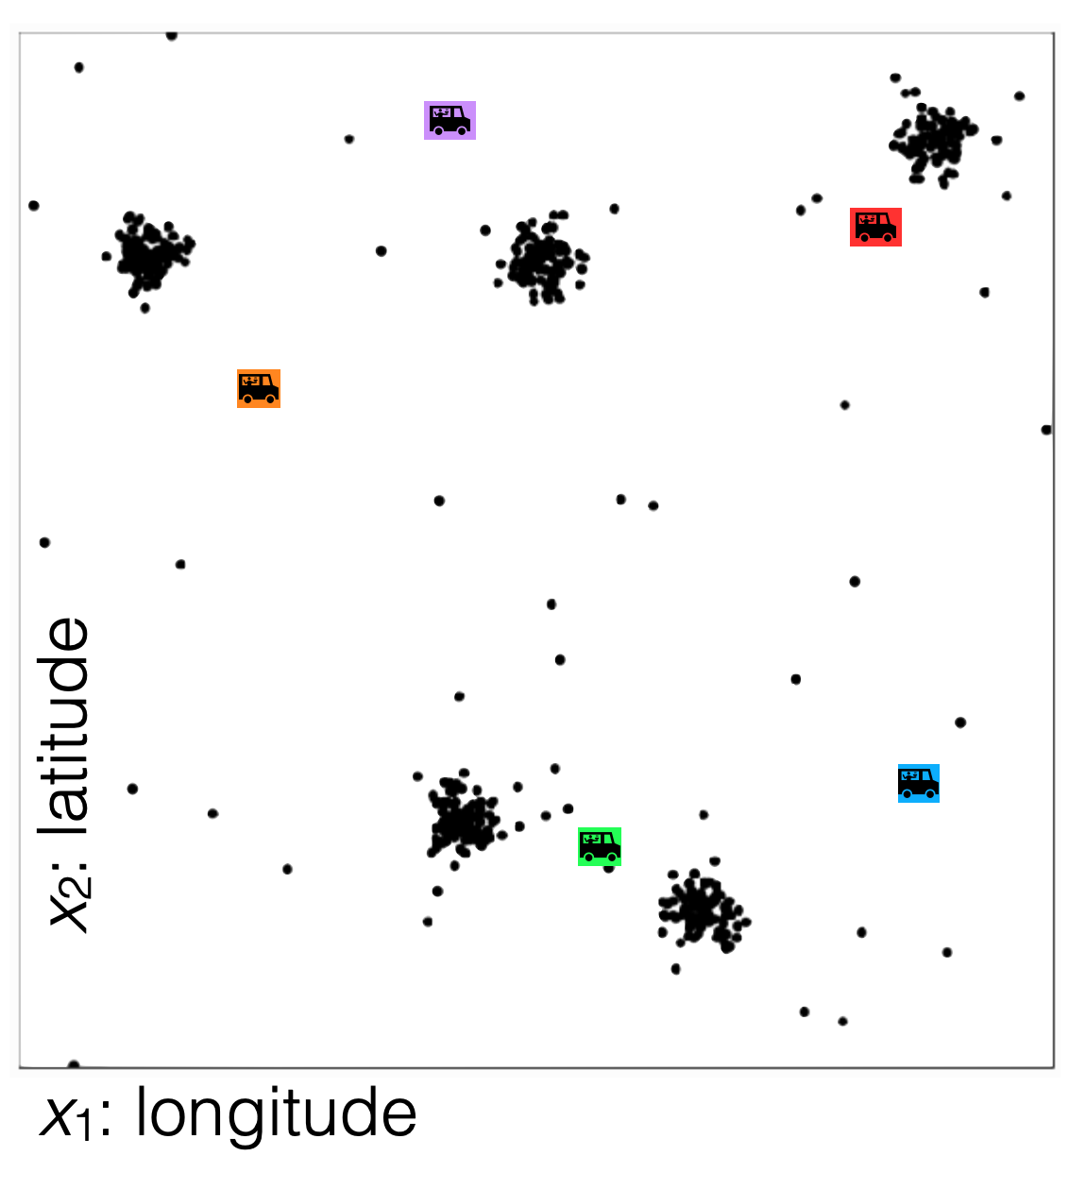
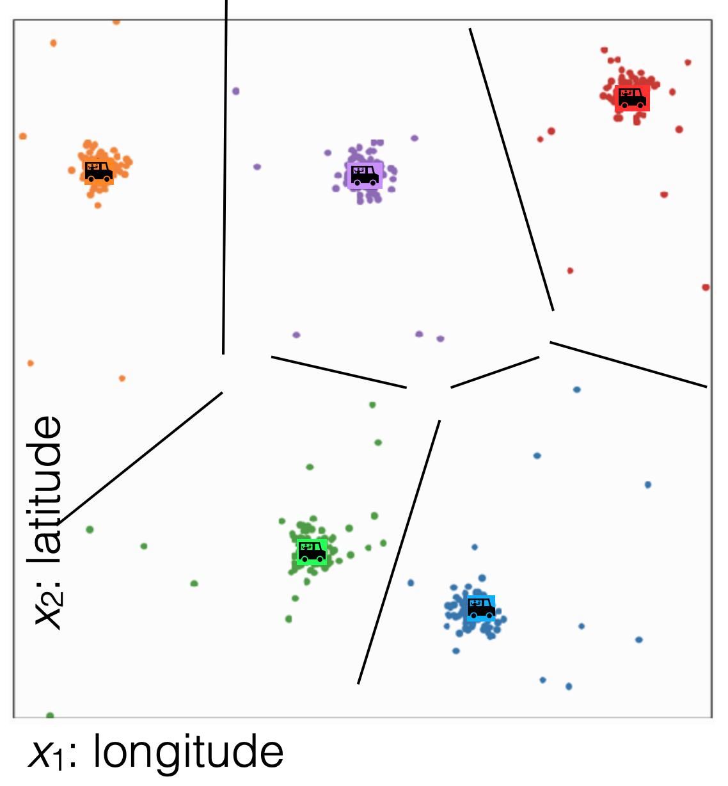
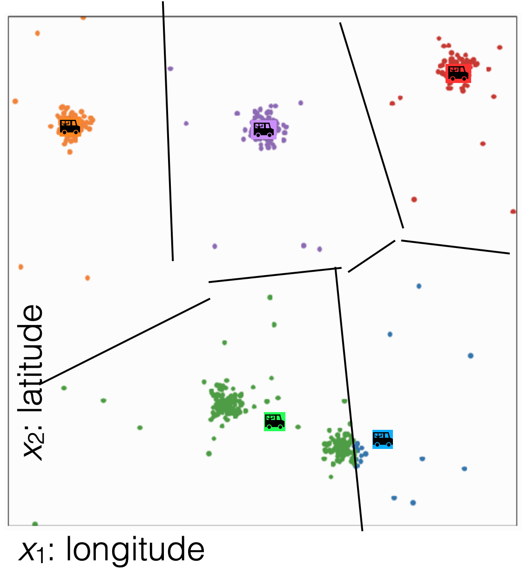
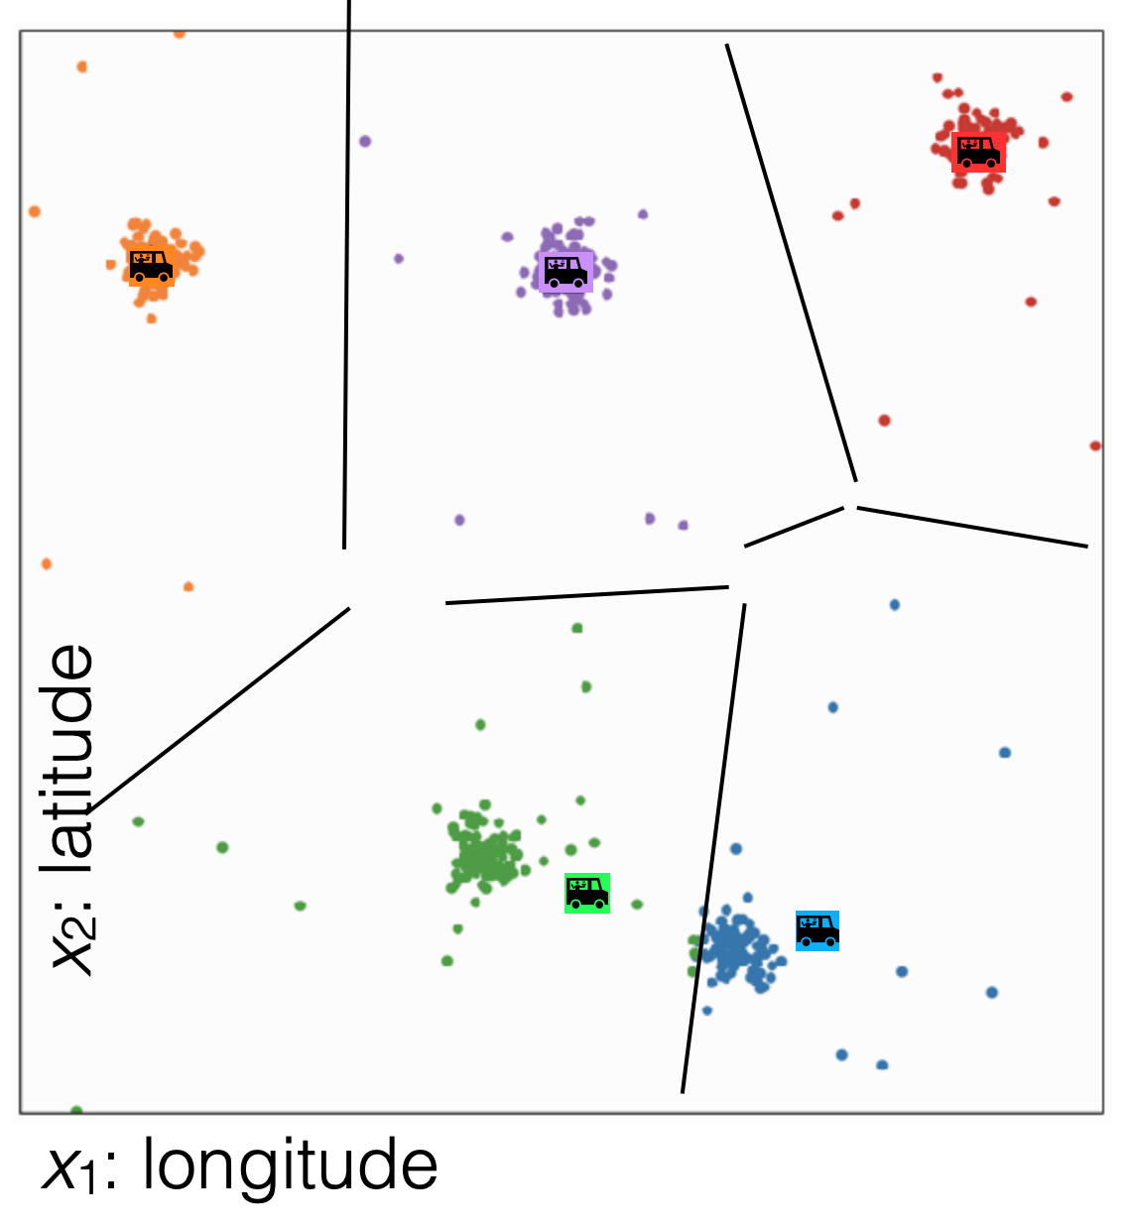
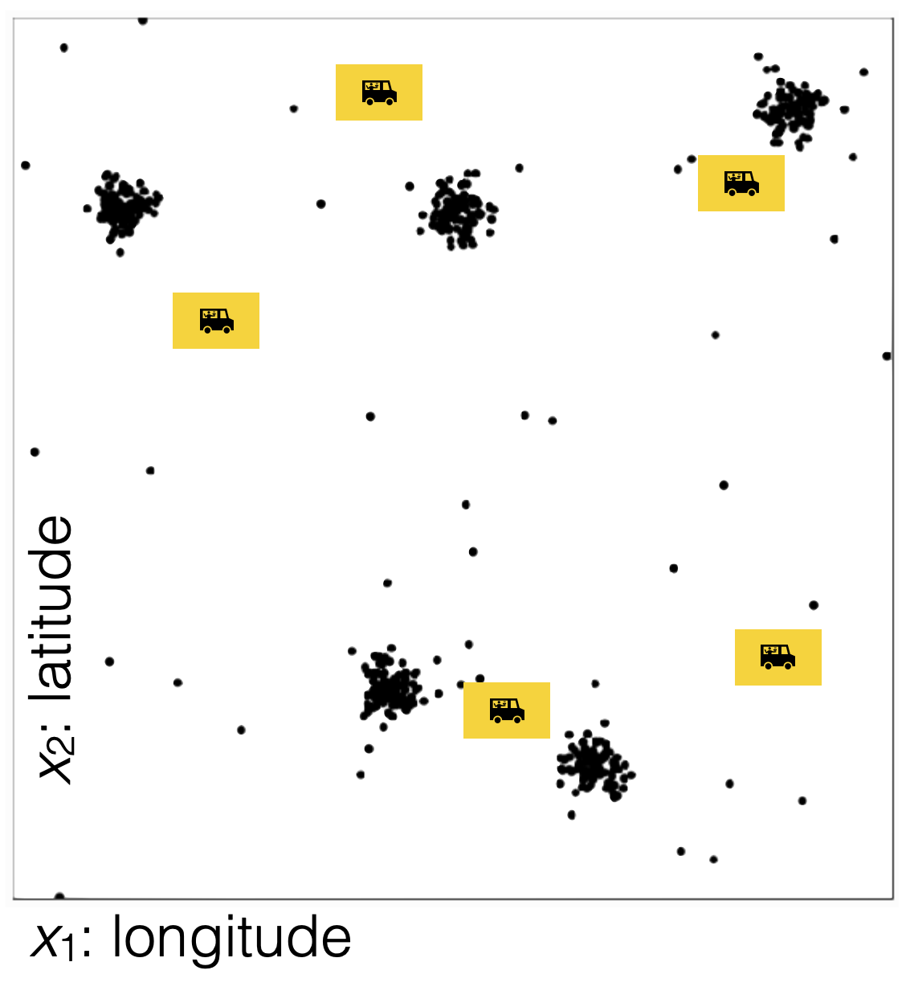
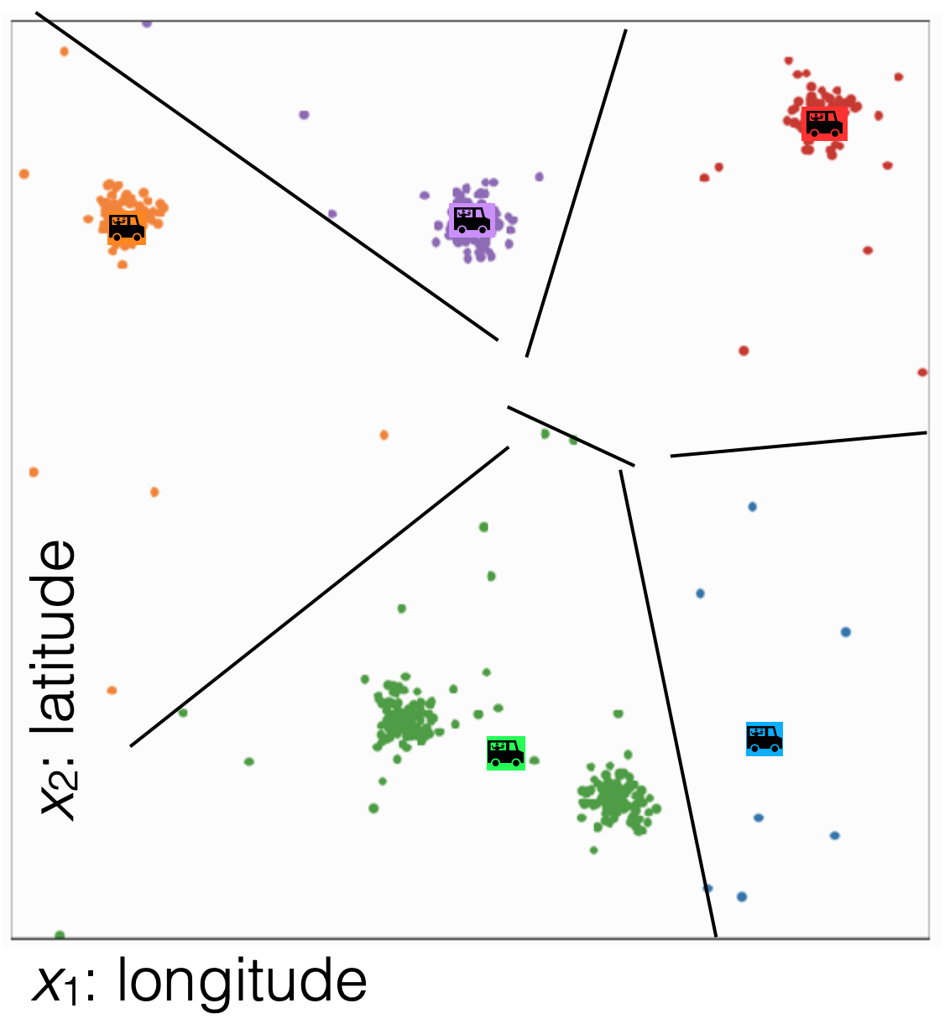
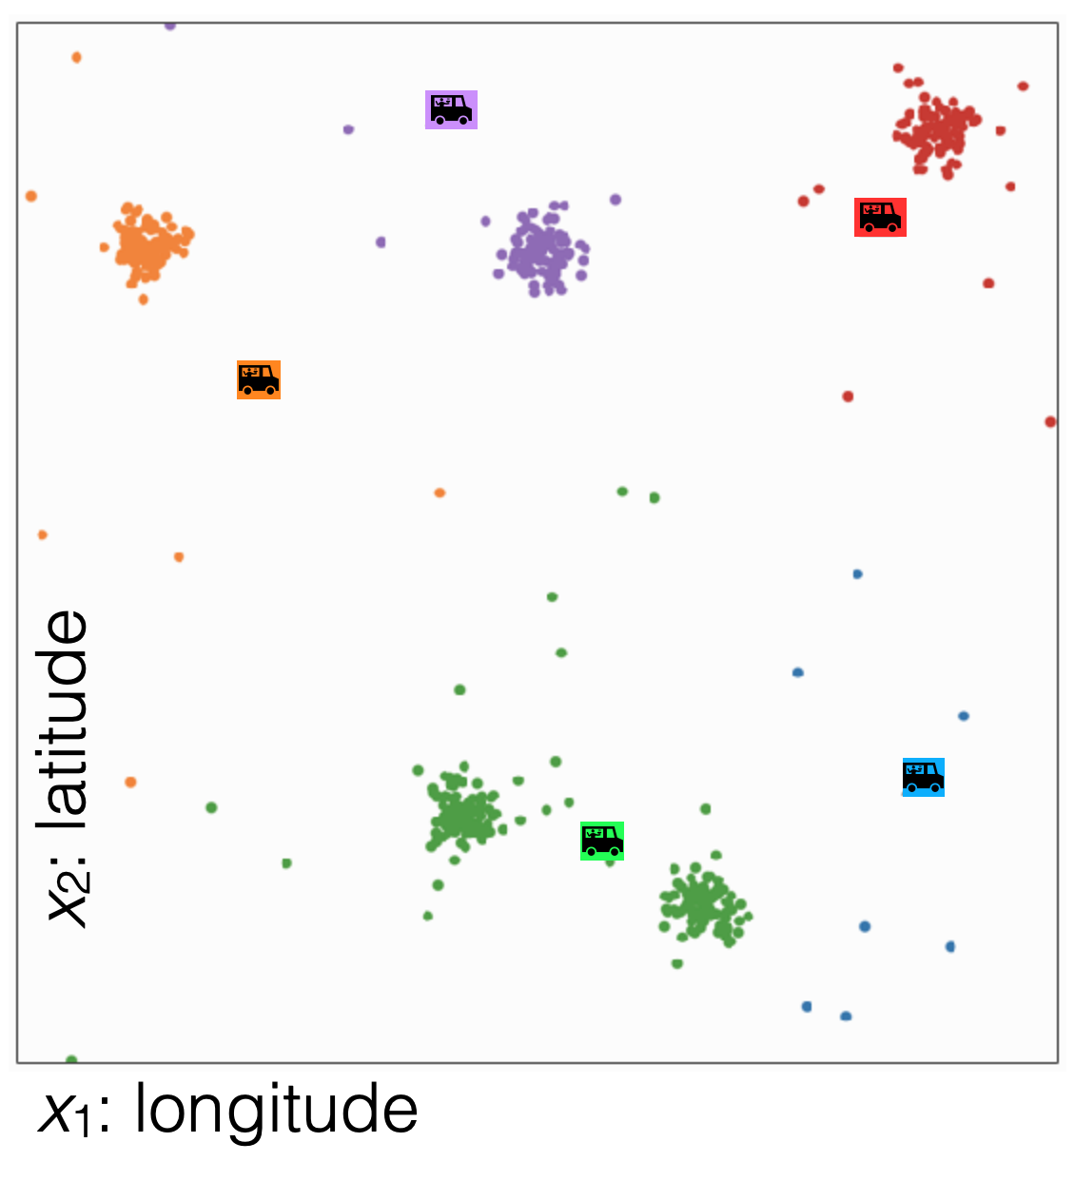
No more changes

Slide 25
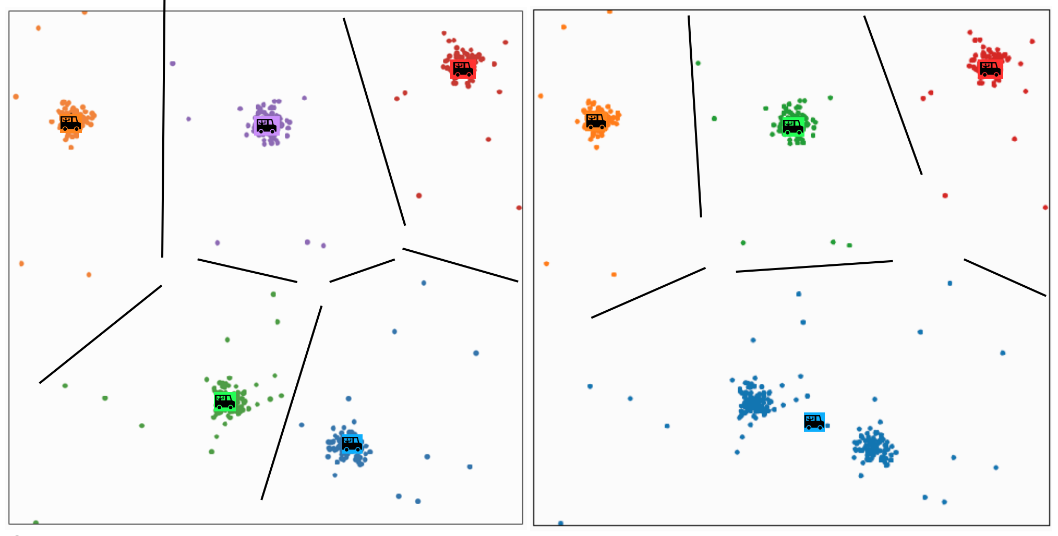
Different k gives different results

Slide 26
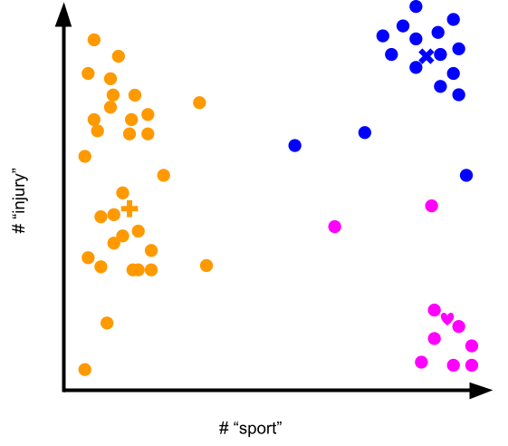
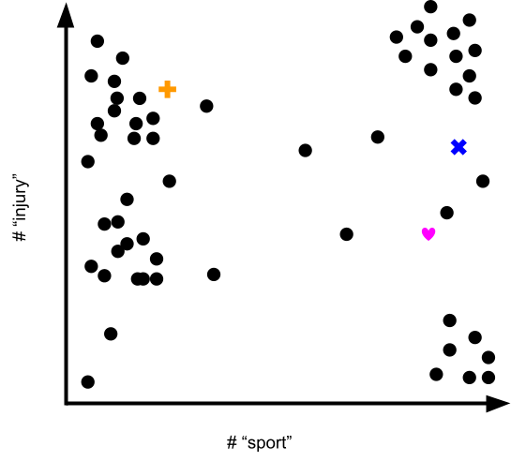
1.5 min
You are clustering news articles using the features “# sport” and “# injury.” How would you interpret these clusters?
“This is a cluster of …[some characterization]… articles.”

Slide 27
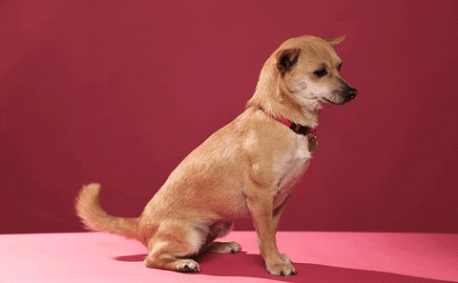

Slide 28
Effect of Initialization

Slide 29
1.5 min
What convergence guarantees do you think we will have with k-means?
Converges to the global optimum
Converges to a local optima
None

Slide 30
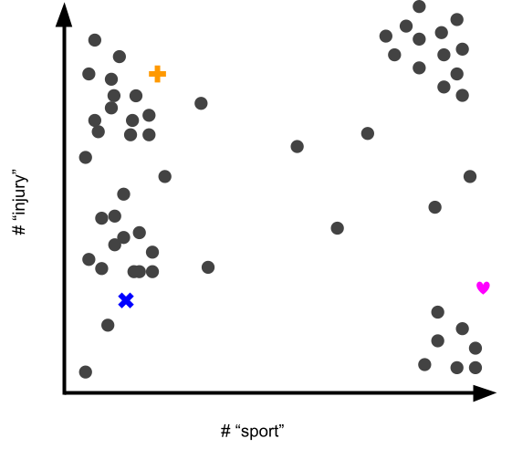
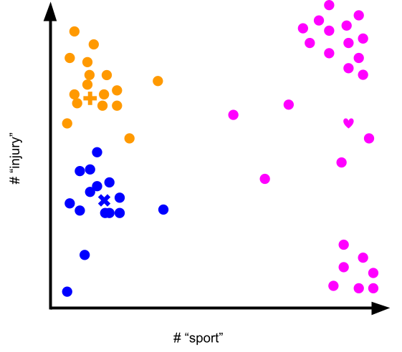
Effects of Initialization
Results heavily depend on initial centroids
Initialization
Final Clusters

Slide 31
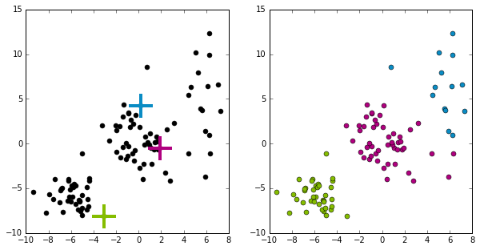
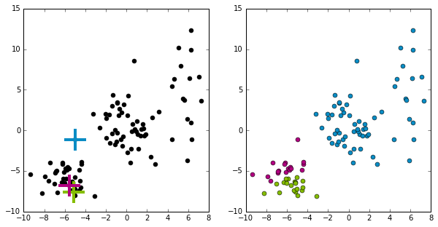
Effect of initialization
What does it mean for something to converge to a local optima?
Some initialization can be bad and affect the quality of clustering
Initialization will greatly impact results!
Notes:
Notice there is no right answer since there are no labels! There is no true “green cluster”
Mention how we need to run this multiple times

Slide 32
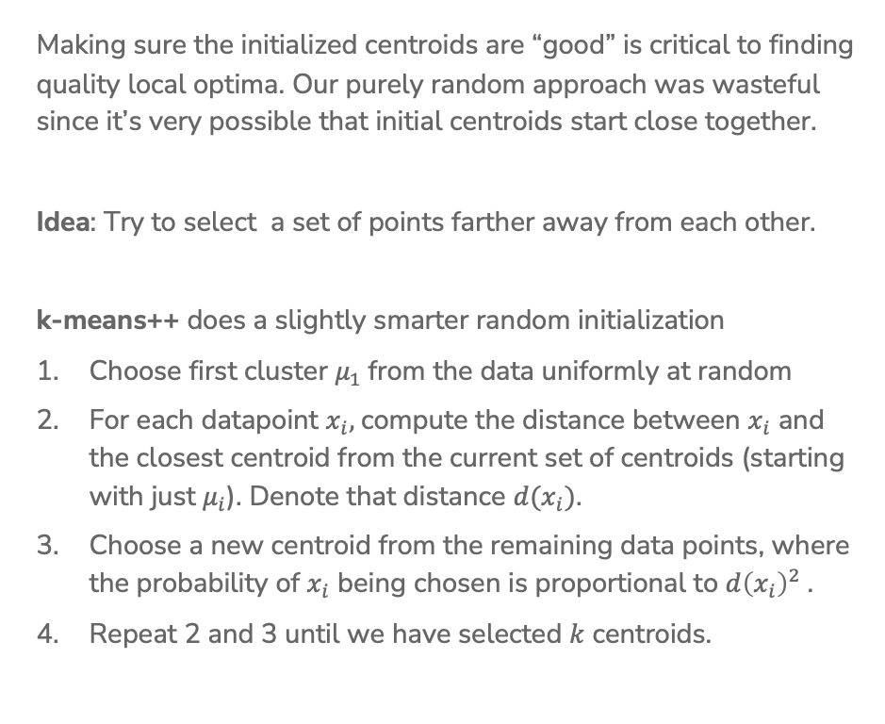
Smart Initializing w/ k-means++
Making sure the initialized centroids are “good” is critical to finding quality local optima. Our purely random approach was wasteful since it’s very possible that initial centroids start close together.
Idea: Try to select a set of points farther away from each other.
k-means++ does a slightly smarter random initialization
Choose first cluster $μ_{1}$from the data uniformly at random
For each datapoint $x_{i},$compute the distance between $x_{i}$ and the closest centroid from the current set of centroids (starting with just $μ_{i}$). Denote that distance $d(x_{i})$.
Choose a new centroid from the remaining data points, where the probability of $x_{i}$ being chosen is proportional to $d{\left(x_{i}\right)}^{2}$.
Repeat 2 and 3 until we have selected $k$ centroids.

Slide 33
k-means++ Example
Start by picking a point at random
Then pick points proportional to their distances to their centroids
This tries to maximize the spread of the centroids!
Notes:
Pick Left Top middle
Pick bottom right
Pick top right

Slide 34
k-means++
Pros / Cons
Pros
Improves quality of local minima
Faster convergence to local minima
Cons
Computationally more expensive at beginning when compared to simple random initialization

Slide 35
Assessing Performance

Slide 36
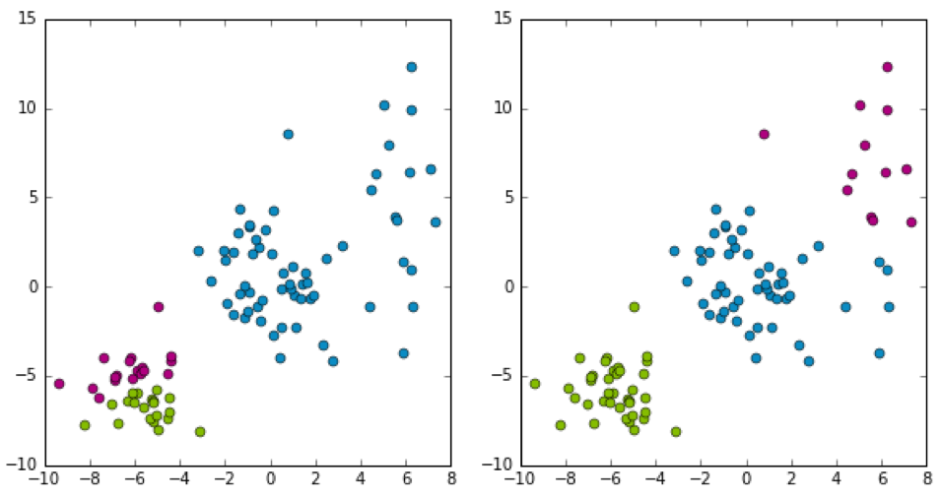
Which Cluster?
Which clustering would I prefer?
Don’t know, there is no “right answer” in clustering 🤷🏾‍♂️ .
Depends on the practitioner’s domain-specific knowledge and interpretation of results!

Slide 37
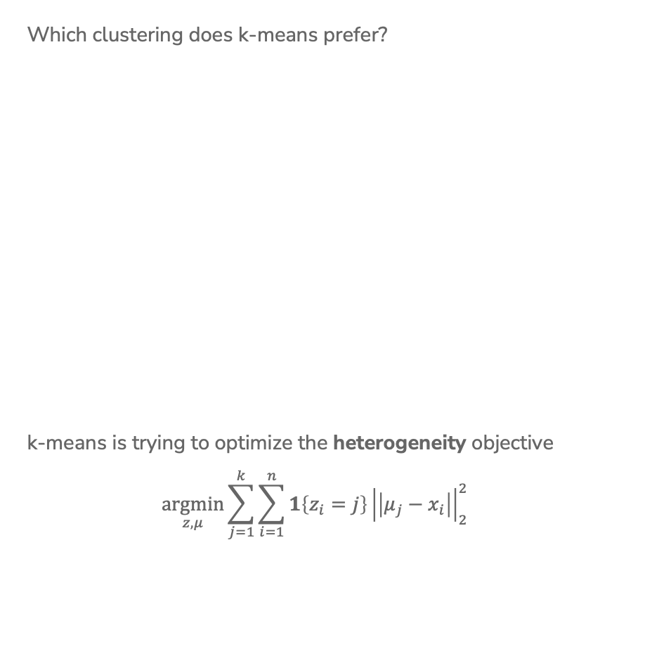
Which Cluster?
Which clustering does k-means prefer?
k-means is trying to optimize the heterogeneity objective
$$\underset{z,μ}{argmin}\sum_{j=1}^{k}{\sum_{i=1}^{n}{{1\left\{z_{i}=j\right\}\left|\left|μ_{j}−x_{i}\right|\right|}_{2}^{2}}}$$
Notes:
Write sum over clusters
Write sum of distances to centroid
Write lower is better

Slide 38
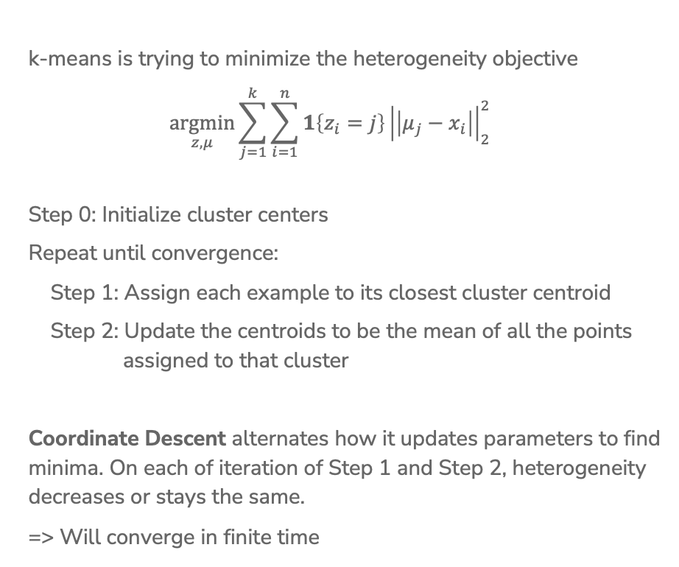
Coordinate Descent
k-means is trying to minimize the heterogeneity objective
$$\underset{z, μ}{argmin}\sum_{j=1}^{k}{\sum_{i=1}^{n}{{1\left\{z_{i}=j\right\}\left|\left|μ_{j}−x_{i}\right|\right|}_{2}^{2}}}$$
Step 0: Initialize cluster centers
Repeat until convergence:
Step 1: Assign each example to its closest cluster centroid
Step 2: Update the centroids to be the mean of all the points
assigned to that cluster
Coordinate Descent alternates how it updates parameters to find minima. On each of iteration of Step 1 and Step 2, heterogeneity decreases or stays the same.
=> Will converge in finite time

Slide 39
1 min
Consider training k-means to convergence for different values of k. Which of the following graphs shows how the heterogeneity objective will change based on the value of k?
Lowest objective value
Lowest objective value
A
B
Lowest objective value
Lowest objective value
C
D

Slide 40
2 mins
Consider training k-means to convergence for different values of k. Which of the following graphs shows how the heterogeneity objective will change based on the value of k?
Lowest objective value
Lowest objective value
A
B
Lowest objective value
Lowest objective value
C
D

Slide 41
How to Choose k?
No right answer! Depends on your application.
General, look for the “elbow” in the graph
Note: You will usually have to run k-means multiple times for each k
Notes:
Draw in curve
Write: ”In extreme when k=N, heterogeneity will be 0”
Point out elbow

Slide 42
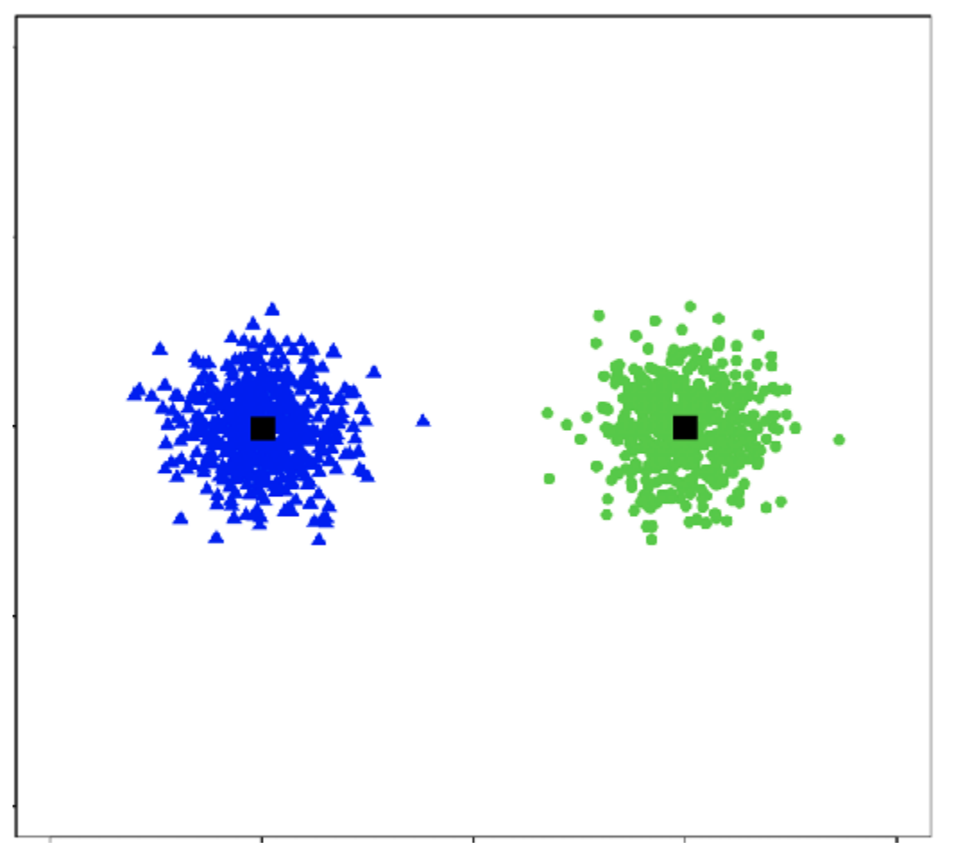
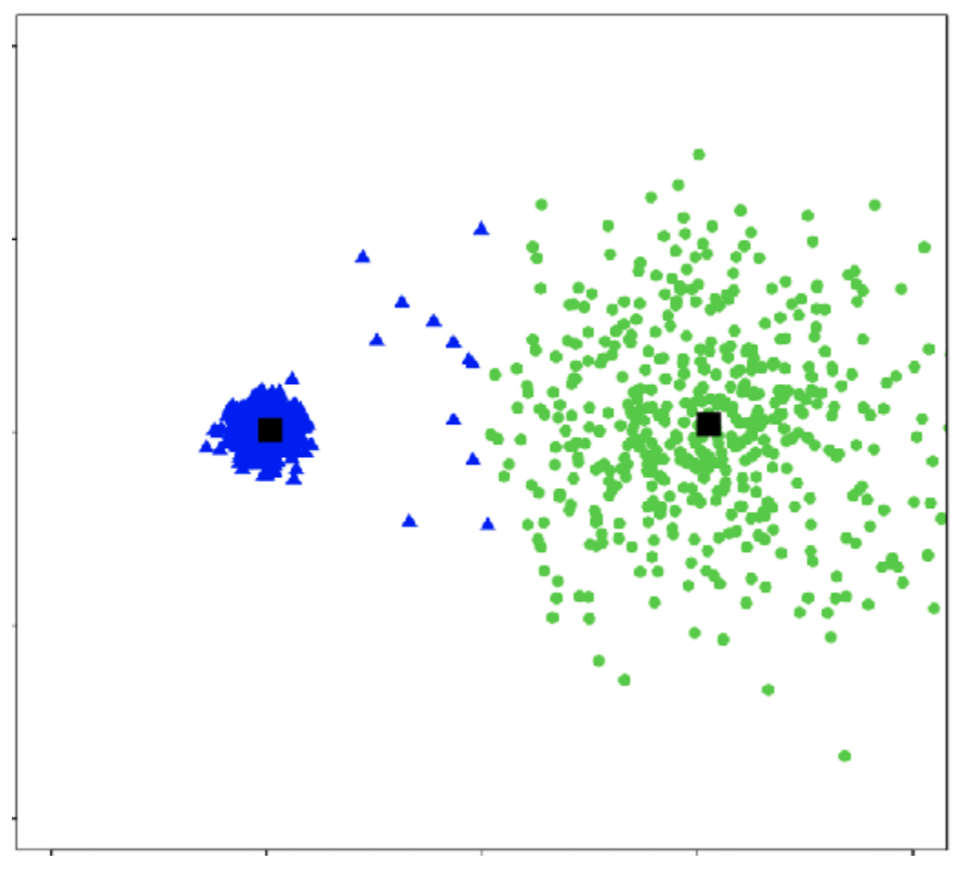
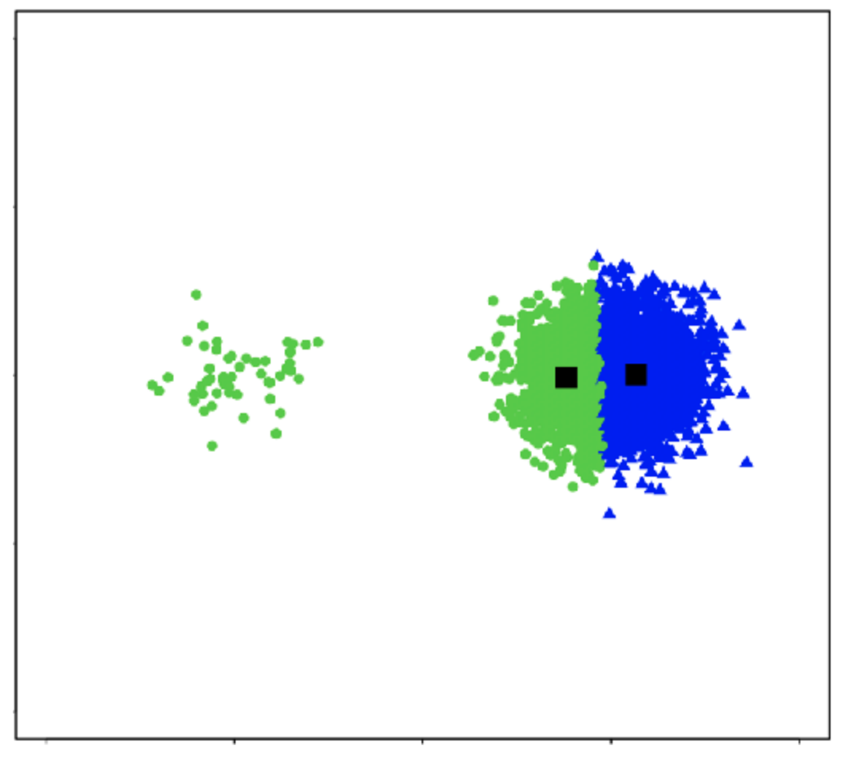
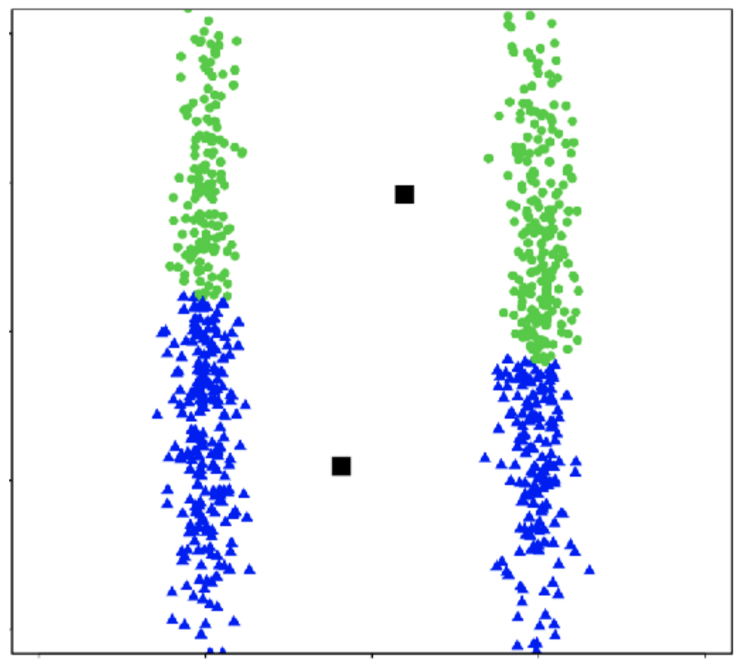
Cluster shape
k-means works well for well-separated hyper-spherical clusters of the same size

Slide 43
Clustering vs
Classification
Clustering looks like we assigned labels (by coloring or numbering different groups) but we didn’t use any labeled data.
In clustering, the “labels” don’t have meaning. To give meaning to the labels, human inputs is required
Classification learns from minimizing the error between a prediction and an actual label.
Clustering learns by minimizing the distance between points in a cluster.
Classification quality metrics (accuracy / loss) do not apply to clustering (since there is no label).
You can’t use validation set / cross-validation to choose the best choice of k for clustering.

Slide 44
Recap
Differences between classification and clustering
What types of clusters can be formed by k-means
K-means algorithm
Convergence of k-means
How to choose k
Better initialization using k-means++

