Slide 1
CSE/STAT 416
Local Methods
Locality Sensitive Hashing
Pre-Class Video
Tanmay Shah
Paul G. Allen School of Computer Science & Engineering
University of Washington
May 10, 2024

Slide 2
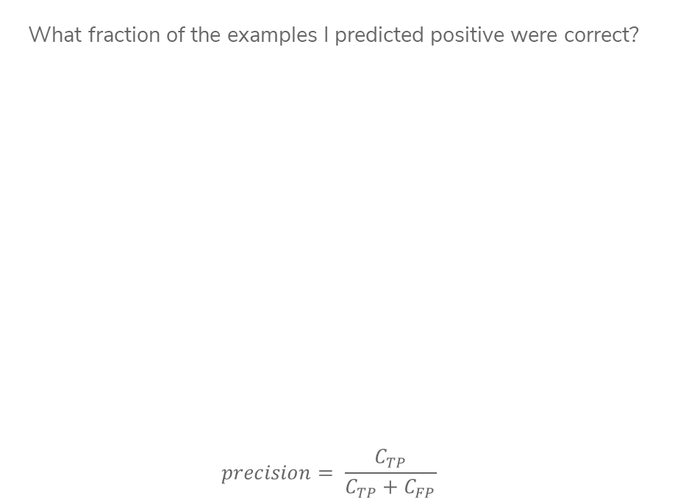

Precision
What fraction of the examples I predicted positive were correct?
$$precision= \frac{C_{TP}}{C_{TP}+C_{FP}}$$
Sentences predicted to be positive:
${\hat{y}}_{i}=+1$
Notes:
Calculate precision (4/ (2 + 4) = 2/3)
High precision means your positive predictions are trustworthy

Slide 3
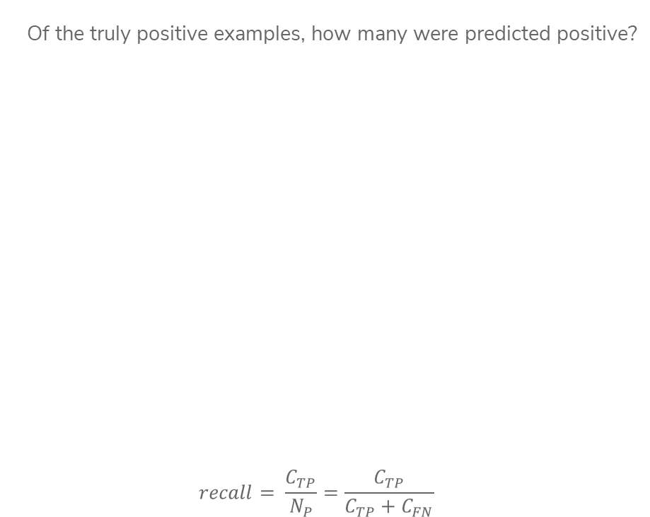
Recall
Of the truly positive examples, how many were predicted positive?
$$recall= \frac{C_{TP}}{N_{P}}=\frac{C_{TP}}{C_{TP}+C_{FN}}$$
Notes:
Calculate recall (4 / (4 + 2) = 2/3)
2 positive examples not shown
High recall means we are likely to “discover” all the positive examples

Slide 4
Document Retrieval
Consider you had some time to read a book and wanted to find other books similar to that one.
If we wanted to write an system to recommend books
  How do we measure similarity?
  How do we search over books?
  How do we measure accuracy?
Big Idea: Define an embedding and a similarity metric for the books, and find the “nearest neighbor” to some query book.
Notes:
Could also return set of nearest neighbors (draw circle)

Slide 5
Predicting House Prices
When we saw regression before, we assumed there was some linear/polynomial function that produced the data. All we had to do was choose the right polynomial degree.
Notes:
Draw curve vs 1-NN line

Slide 6
Predicting House Prices
What if instead, we didn’t try to find the global structure, but instead just tried to infer values using local information instead.
Big Idea: Use 1-nearest neighbor to predict the price of a house.
Not actually a crazy idea, something realtors do sometimes!
Notes:
Draw curve vs 1-NN line

Slide 7

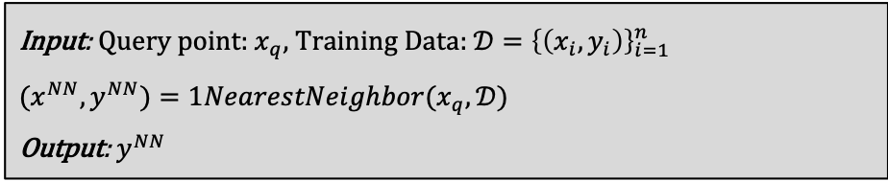
1-NN Regression
Where $1NearestNeighbor$ is the algorithm described yesterday to find the single nearest neighbor of a point.
Input: Query point: $x_{q}$, Training Data: ${𝒟=\left\{\left(x_{i},y_{i}\right)\right\}}_{i=1}^{n}$
${(x}^{NN}, y^{NN})=1NearestNeighbor(x_{q},𝒟)$
Output: $y^{NN}$
Notes:
Write O(n) above slide

Slide 8
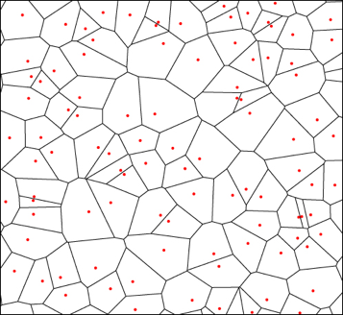
Visualizing 1-NN Regression
The function learned by 1-NN is “locally constant” in each region nearest to each training point.
Can visualize this with a Voronoi Tessellation
Shows all of the points that are “closest” to a particular training point
Not actually computed in practice, but helps understand

Slide 9
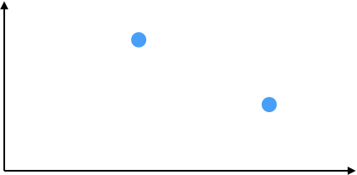


Visualizing 1-NN Regression
Like last time, how you define “closest” changes predictions

Slide 10
1-NN Regression
Weaknesses
Inaccurate if data is sparse
Can wildly overfit

Slide 11
1-NN Classification
Can we use the same algorithm for classification? Yes!
Predict the class of the nearest neighbor. Besides that, exactly the same as regression.

Slide 12
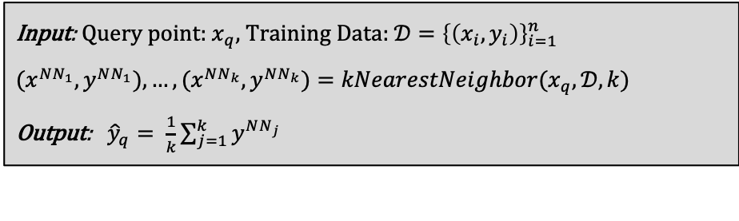
Prevent Overfitting
The downfalls of 1-NN come from it relies too much on a single data point (the nearest neighbor), which makes it susceptible to noise in the data.
More reliable estimate if you look at more than one house!
Input: Query point: $x_{q}$, Training Data: ${𝒟=\left\{\left(x_{i},y_{i}\right)\right\}}_{i=1}^{n}$
${(x}^{NN_{1}}, y^{NN_{1}}), …,(x^{NN_{k}}, y^{NN_{k}})=kNearestNeighbor(x_{q},𝒟, k)$
Output: ${\hat{y}}_{q}= \frac{1}{k}\sum_{j=1}^{k}{y^{NN_{j}}}$

Slide 13

k-NN Regression
By using a larger $k$, we make the function a bit less crazy
Still discontinuous though (neighbor is either in or out)
Boundaries are still sort of a problem

Slide 14
Issues with k-NN
While k-NN can solve some issues that 1-NN has, it brings some more to the table.
Have to choose right value of k.
  If k is too large, model is too simple
Discontinuities matter in many applications
  The error might be good, but would you believe a price jump for a 2640 sq.ft. house to a 2641 sq.ft. house?
Seems to do worse at the boundaries still

Slide 15
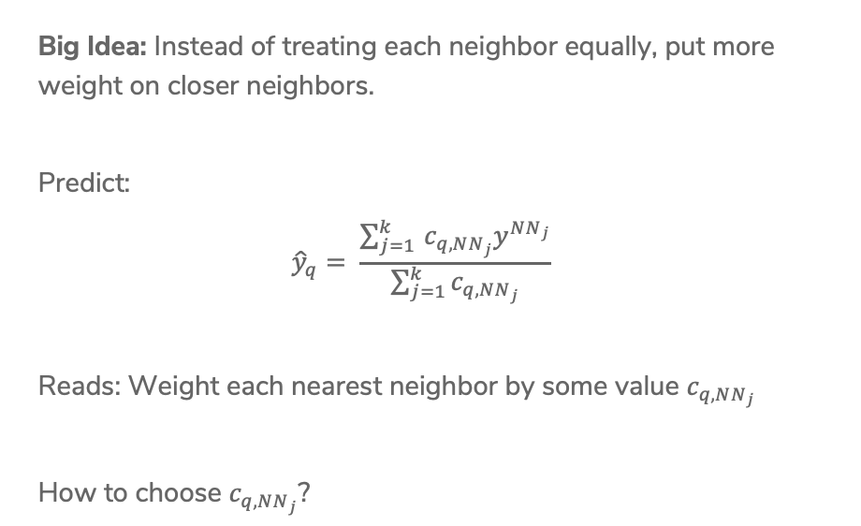
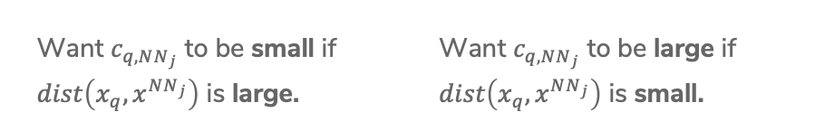
Weighted k-NN
Big Idea: Instead of treating each neighbor equally, put more weight on closer neighbors.
Predict:
$${\hat{y}}_{q}= \frac{\sum_{j=1 }^{k}{c_{q, NN_{j}}y^{NN_{j}}}}{\sum_{j=1}^{k}{c_{q,NN_{j}}}}$$
Reads: Weight each nearest neighbor by some value $c_{q,NN_{j}}$
How to choose $c_{q, NN_{j}}$?
Want $c_{q, NN_{j}}$ to be small if
$dist\left(x_{q}, x^{NN_{j}}\right)$ is large.
Want $c_{q, NN_{j}}$ to be large if
$dist\left(x_{q}, x^{NN_{j}}\right)$ is small.
Notes:
One idea is 1/dist

Slide 16

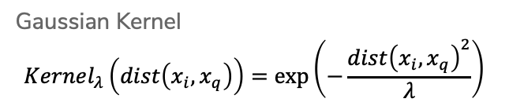

Kernels
Use a function called a kernel to turn distance into weight that satisfies the properties we listed before.
$$c_{q,NN_{j}}=Kernel_{λ}(dist\left(x_{q}, x^{NN_{j}}\right))$$
$−λ$ $0$ $λ$
Gaussian Kernel
$$Kernel_{λ}\left(dist\left(x_{i}, x_{q}\right)\right)=exp⁡\left(−\frac{dist{\left(x_{i}, x_{q}\right)}^{2}}{λ}\right)$$
Notes:
Write \lambda is “bandwidth” (controls “width” of kernel)
Point out Boxcar/triangle/gaussian

Slide 17

Kernel Regression
We can take this one step farther, instead of just using a kernel to weight the k nearest neighbors, can use the kernel to weight all training points! This is called kernel regression.
${\hat{y}}_{q}=\frac{\sum_{i=1}^{n}{c_{q,i}y_{i}}}{\sum_{i=1}^{n}{c_{q,i}}}=\frac{\sum_{i=1}^{n}{Kernel_{λ}\left(dist\left(x_{i}, x_{q}\right)\right)y_{i}}}{\sum_{i=1}^{n}{Kernel_{λ}\left(dist\left(x_{i}, x_{q}\right)\right)}}$

Slide 18

Visualizing Kernel Regression
This kernel has bounded support, only look at values $±λ$ away
Notes:
Write smooth!

Slide 19

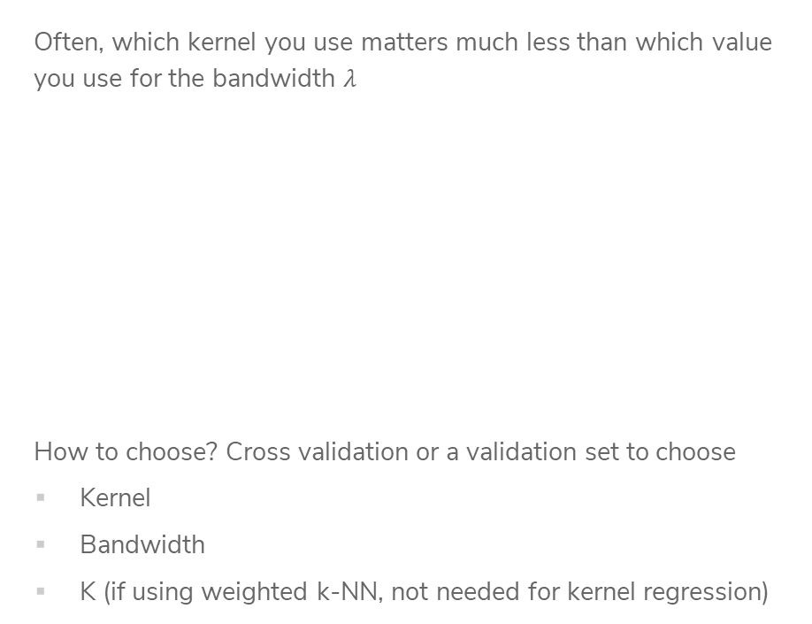
Choose Bandwidth $λ$
Often, which kernel you use matters much less than which value you use for the bandwidth $λ$
How to choose? Cross validation or a validation set to choose
Kernel
Bandwidth
K (if using weighted k-NN, not needed for kernel regression)
Notes:
Point out switch to boxcar in the middle, but fit looks like it’s in between the two

Slide 20
CSE/STAT 416
Local Methods
Locality Sensitive Hashing
Tanmay Shah
Paul G. Allen School of Computer Science & Engineering
University of Washington
May 10, 2024
❓ Questions? Raise hand

Slide 21
1-NN Regression
Weaknesses
Inaccurate if data is sparse
Can wildly overfit

Slide 22
Weighted k-NN
Big Idea: Instead of treating each neighbor equally, put more weight on closer neighbors.
Predict:
$${\hat{y}}_{q}= \frac{\sum_{j=1 }^{k}{c_{q, NN_{j}}y^{NN_{j}}}}{\sum_{j=1}^{k}{c_{q,NN_{j}}}}$$
Reads: Weight each nearest neighbor by some value $c_{q,NN_{j}}$
How to choose $c_{q, NN_{j}}$?
Want $c_{q, NN_{j}}$ to be small if
$dist\left(x_{q}, x^{NN_{j}}\right)$ is large.
Want $c_{q, NN_{j}}$ to be large if
$dist\left(x_{q}, x^{NN_{j}}\right)$ is small.
Notes:
One idea is 1/dist

Slide 23
Kernels
Use a function called a kernel to turn distance into weight that satisfies the properties we listed before.
$$c_{q,NN_{j}}=Kernel_{λ}(dist\left(x_{q}, x^{NN_{j}}\right))$$
$−λ$ $0$ $λ$
Gaussian Kernel
$$Kernel_{λ}\left(dist\left(x_{i}, x_{q}\right)\right)=exp⁡\left(−\frac{dist{\left(x_{i}, x_{q}\right)}^{2}}{λ}\right)$$
Notes:
Write \lambda is “bandwidth” (controls “width” of kernel)
Point out Boxcar/triangle/gaussian

Slide 24
Visualizing Kernel Regression
This kernel has bounded support, only look at values $±λ$ away
Notes:
Write smooth!

Slide 25
1.5 min
In a few sentences, compare and contrast the following ML models.
k-Nearest Neighbor Regression
Weighted k-Nearest Neighbor Regression
Kernel Regression

Slide 26
3 min
In a few sentences, compare and contrast the following ML models.
k-Nearest Neighbor Regression
Weighted k-Nearest Neighbor Regression
Kernel Regression

Slide 27
Efficient Nearest Neighbors

Slide 28
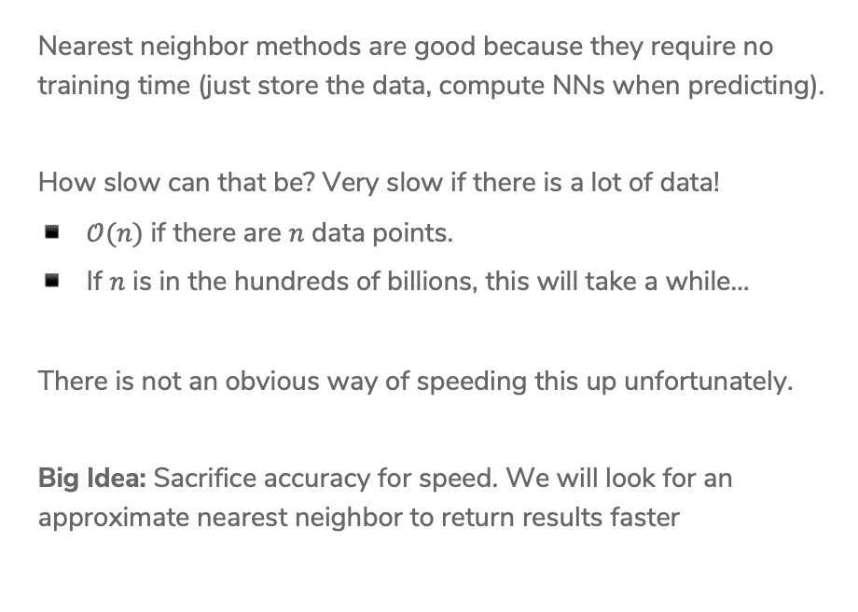
Nearest Neighbor Efficiency
Nearest neighbor methods are good because they require no training time (just store the data, compute NNs when predicting).
How slow can that be? Very slow if there is a lot of data!
$𝒪(n)$ if there are $n$ data points.
If $n$ is in the hundreds of billions, this will take a while…
There is not an obvious way of speeding this up unfortunately.
Big Idea: Sacrifice accuracy for speed. We will look for an approximate nearest neighbor to return results faster

Slide 29
Approximate Nearest Neighbor
Don’t find the exact NN, find one that is “close enough”.
Many applications are okay with approximate answers
The measure of similarity is not perfect
Clients probably can’t tell the difference between the most similar book and a book that’s pretty similar.
We will use locality sensitive hashing to answer this approximate nearest neighbor problem.
High level approach
Design an algorithm that yields a close neighbor with high probability
These algorithms usually come with a “guarantee” of what probability they will succeed, won’t discuss that in detail but is important when making a new approximation algorithm.

Slide 30
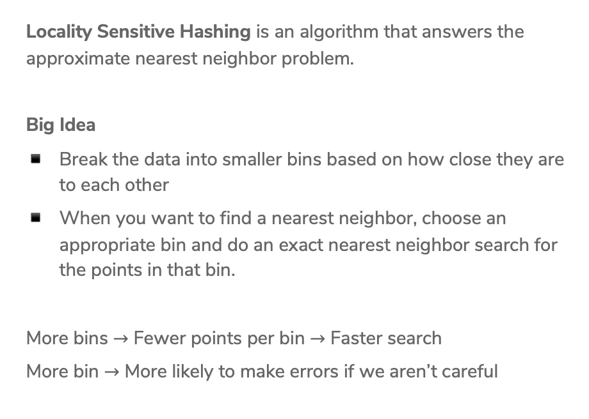
Locality Sensitive Hashing (LSH)
Locality Sensitive Hashing is an algorithm that answers the approximate nearest neighbor problem.
Big Idea
Break the data into smaller bins based on how close they are to each other
When you want to find a nearest neighbor, choose an appropriate bin and do an exact nearest neighbor search for the points in that bin.
More bins $→$ Fewer points per bin $→$ Faster search
More bin $→$ More likely to make errors if we aren’t careful

Slide 31
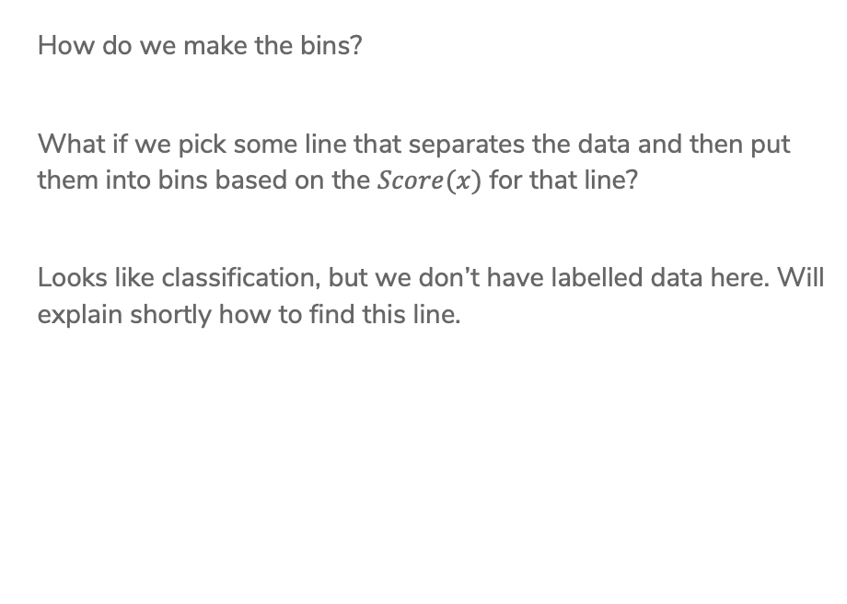
Binning
How do we make the bins?
What if we pick some line that separates the data and then put them into bins based on the $Score(x)$ for that line?
Looks like classification, but we don’t have labelled data here. Will explain shortly how to find this line.

Slide 32
Binning
Put the data in bins based on the sign of the score (2 bins total)
Call negative score points bin 0, and the other bin 1 (bin index)

Slide 33

Binning
Put the data in bins based on the sign of the score (2 bins total)
Call negative score points bin 0, and the other bin 1 (bin index)
When asked to find neighbor for query point, only search through points in the same bin!
This reduces the search time to $\frac{n}{2}$ if we choose the line right.

Slide 34
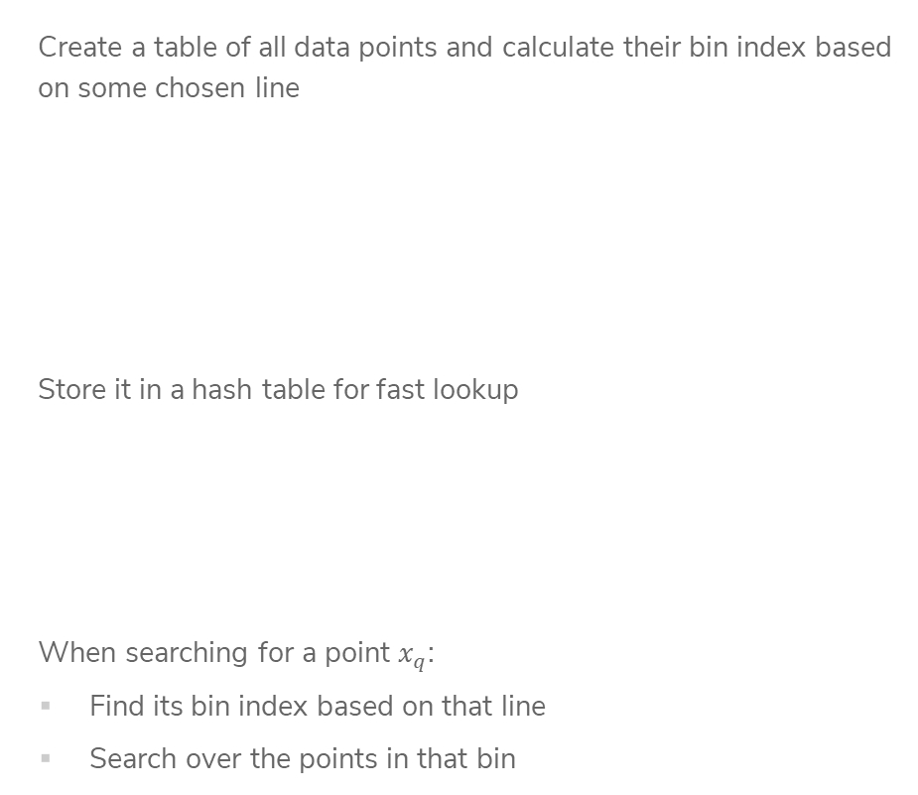
LSH with
2 bins
Create a table of all data points and calculate their bin index based on some chosen line
Store it in a hash table for fast lookup
When searching for a point $x_{q}$:
Find its bin index based on that line
Search over the points in that bin

Slide 35










1 min
If we used LSH with this line, what would be the result returned for searching for the nearest neighbor of the green query point?
$$3$$
$$5$$
$$4$$
$$2$$
$$9$$
$1$0
$$1$$
$$6$$
$$8$$
$$7$$

Slide 36
Some Issues
How do we find a good line that divides the data in half?
Potential Errors: Points close together might be split up into separate bins
Large computation cost: Only dividing the points in half doesn’t speed things up that much…

Slide 37
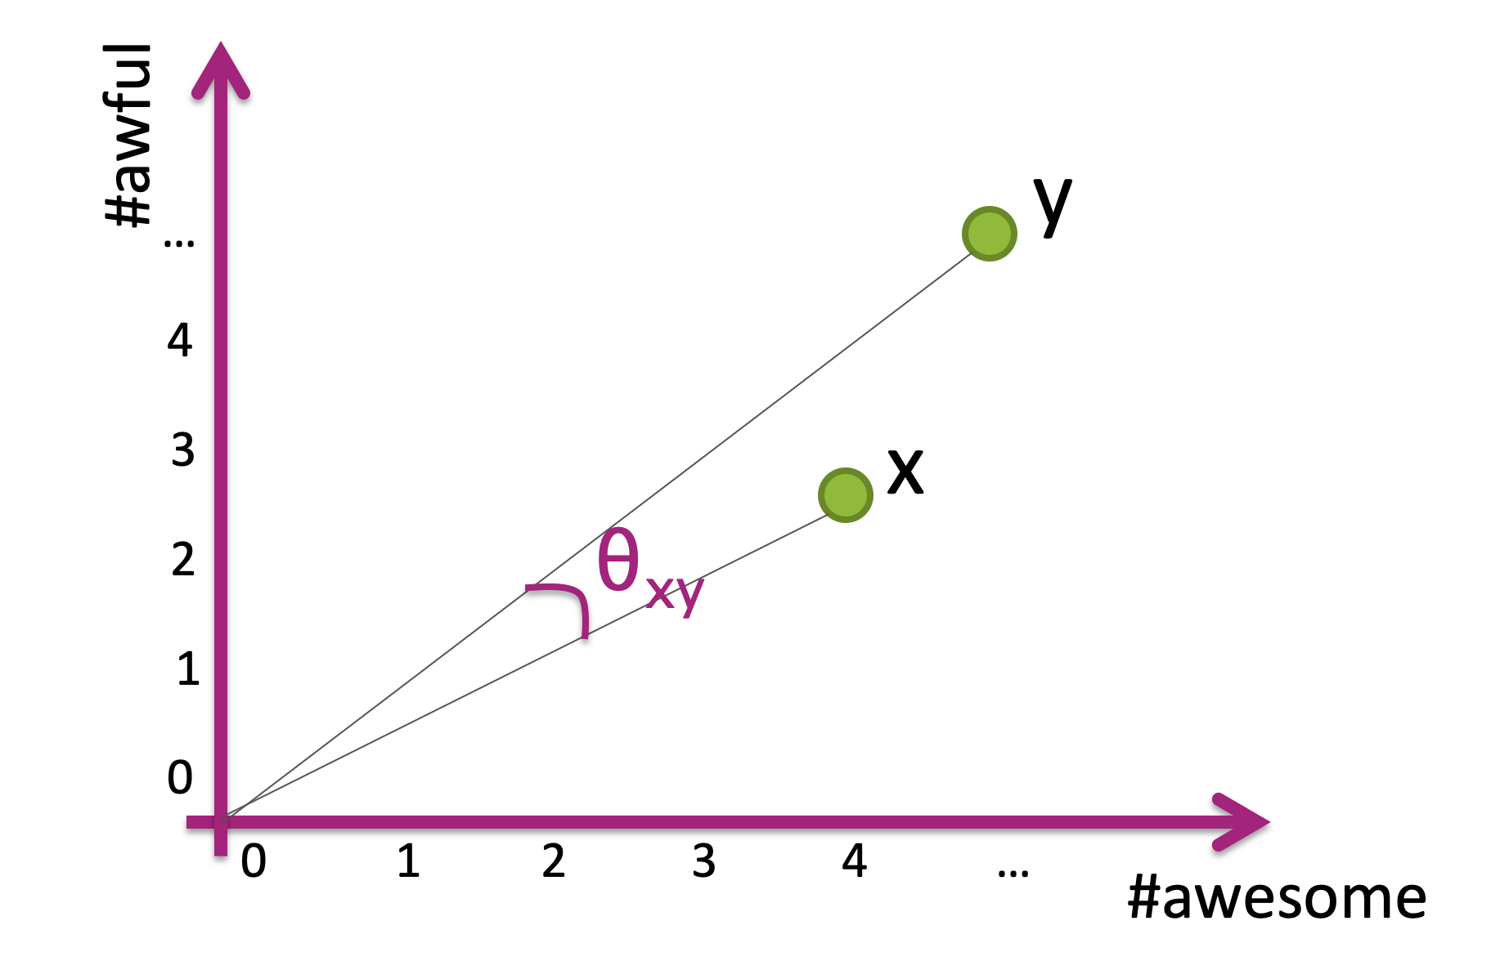
1. How to choose line?
Wild Idea: Choose the line randomly!
Choose a slope randomly between 0 and 90 degrees
How bad can randomly picking it be?
If two points have a small cosine distance, it is unlikely that we will split them into different bins!
Notes:
Draw random lines

Slide 38
Some Issues
How do we find a good line that divides the data in half?
Potential Errors: Points close together might be split up into separate bins
Large computation cost: Only dividing the points in half doesn’t speed things up that much…

Slide 39


Slide 40
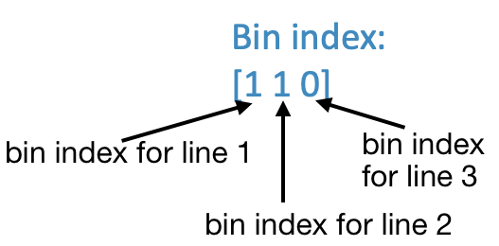
More Bins
Can reduce search cost by adding more lines, increasing the number of bins.
For example, if we use 3 lines, we can make more bins!

Slide 41
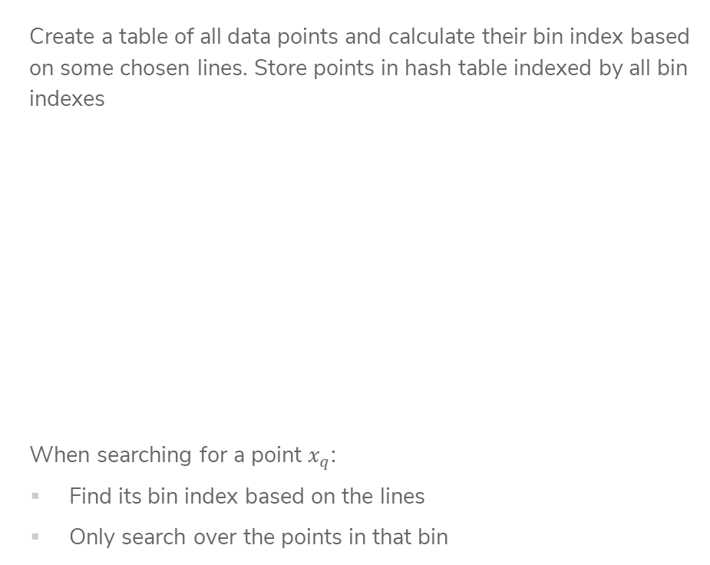
LSH with
Many Bins
Create a table of all data points and calculate their bin index based on some chosen lines. Store points in hash table indexed by all bin indexes
When searching for a point $x_{q}$:
Find its bin index based on the lines
Only search over the points in that bin
Notes:
Note about binary

Slide 42
LSH Example
Imagine my query point was (2, 2)
This has bin index [0 1 0]
By using multiple bins, we have reduced the search time!
However, it’s more likely that we separate points from their true nearest neighbors since we do more splits ☹
Often with approximate methods, there is a tradeoff between speed and accuracy.

Slide 43
Improve Quality
The nice thing about LSH is we can actually tune this tradeoff by looking at nearby bins. If we spend longer searching, we are likely to find a better answer.
What does ”nearby” mean for bins?
In practice, set some time “budget” and
keep searching nearby bins until budget
runs out
Notes:
Draw going out to 2 bits

Slide 44
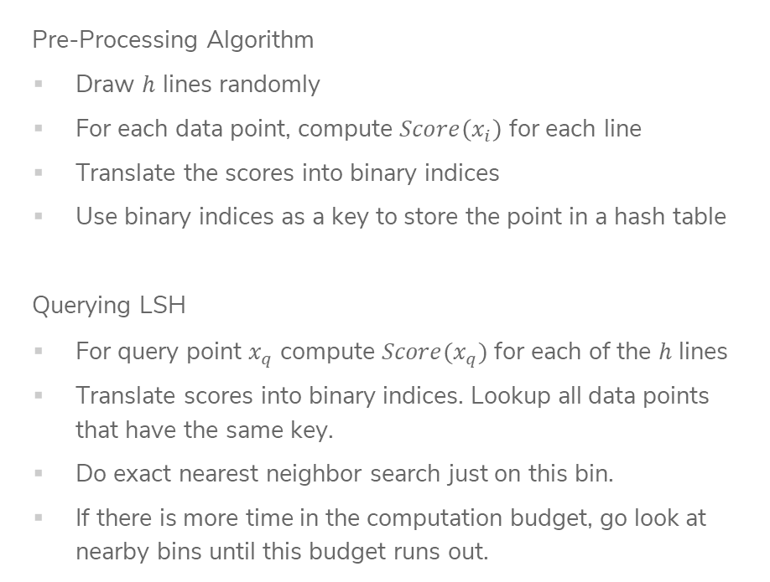
Locality Sensitive Hashing (LSH)
Pre-Processing Algorithm
Draw $h$ lines randomly
For each data point, compute $Score\left(x_{i}\right)$ for each line
Translate the scores into binary indices
Use binary indices as a key to store the point in a hash table
Querying LSH
For query point $x_{q}$ compute $Score(x_{q})$ for each of the $h$ lines
Translate scores into binary indices. Lookup all data points that have the same key.
Do exact nearest neighbor search just on this bin.
If there is more time in the computation budget, go look at nearby bins until this budget runs out.

Slide 45
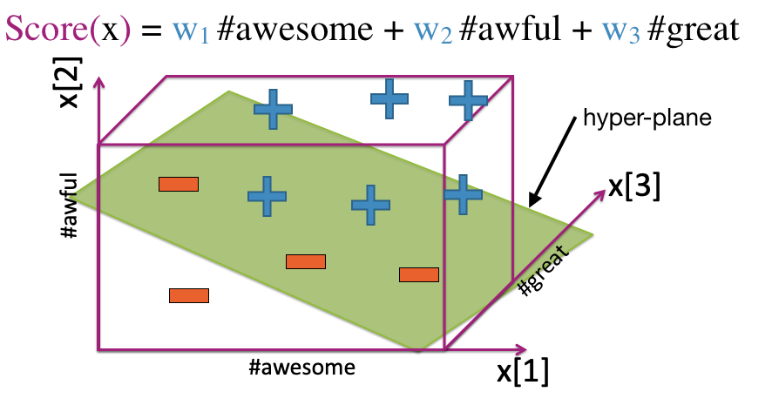

Higher Dimensions
Pick random hyper-plane to separate points for points in higher dimensions.
Unclear how to pick $h$ for LSH and you can’t do cross-validation here (why?)
Generally people use $h≈\log{(d)}$

Slide 46
Recap
Theme: Use local methods for classification and regression and speed up nearest neighbor search with approximation methods.
Ideas:
1-NN Regression and Classification
k-NN Regression and Classification
Weighted k-NN vs Kernel Regression
Locality Sensitive Hashing

Slide 47
Curse of Dimensionality

Slide 48
High Dimensions
Methods like k-NN and k-means that rely on computing distances start to struggle in high dimensions.
As the number of dimensions grow, the data gets sparser!
Need more data to make sure you cover all the space in high dim.
Notes:
To cover 20% of the range, need 20% of the complete population
If we add another feature but still want to cover 20% of the possible space, would need 45% coverage for each feature! (0.45^2 = 0.2)
In 3 dimensions, would need coverage over 58% of each feature
Write down that n approx. O(2^d)

Slide 49
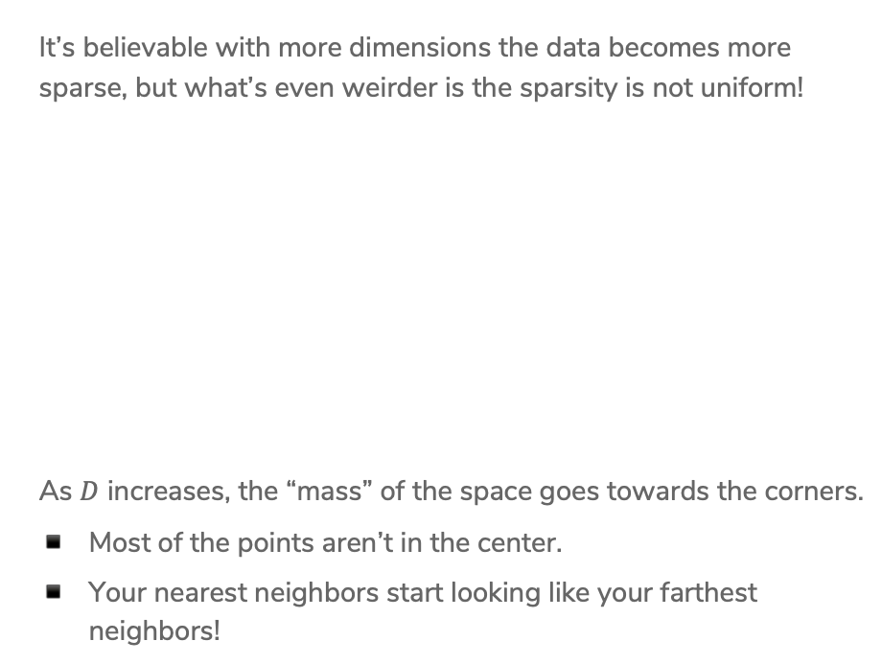
Even Weirder
It’s believable with more dimensions the data becomes more sparse, but what’s even weirder is the sparsity is not uniform!
As $D$ increases, the “mass” of the space goes towards the corners.
Most of the points aren’t in the center.
Your nearest neighbors start looking like your farthest neighbors!
Notes:
For an 8-dimensional hypercube, about 98% of the data is concentrated in its 256 corners.

Slide 50
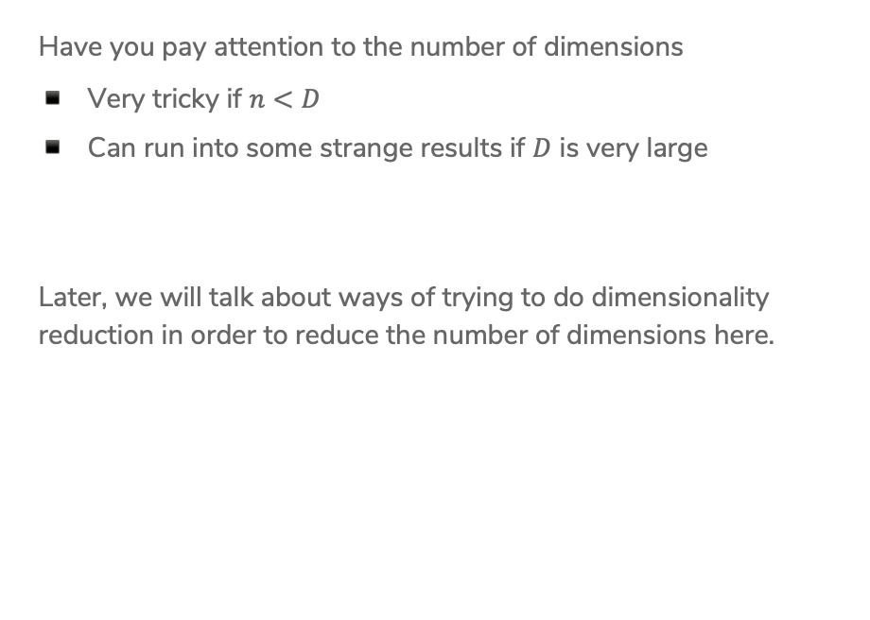
Practicalities
Have you pay attention to the number of dimensions
Very tricky if $n<D$
Can run into some strange results if $D$ is very large
Later, we will talk about ways of trying to do dimensionality reduction in order to reduce the number of dimensions here.

Slide 51
HW5 – ML Practice with Kaggle
Kaggle is a website that hosts ML competitions. Very popular among people trying to learn more about ML! Let’s you practice a lot of real-world ML skills on challenging problems.
About halfway through the course, want to give you a chance to apply what you’ve learned in the real-world! HW6 will be hosted as an internal Kaggle competition.
TAs in section tomorrow will walk through how to do submissions, but all instructions are on the Kaggle website (linked from HW spec).
NOT graded as a competition. The leaderboard is just for fun, and we will provide a small amount of EC to the top 3 teams.

Slide 52
Submission and Grading
You will need to submit three things:
On Kaggle, submit your predictions for the test set
On Gradescope, submit your Jupyter Notebook that trains/evaluates your models and answers some questions we asked you to answer.
On Gradescope, submit concept questions.
Part of your grade will be from the accuracy on the private test set. Will count 95% accuracy on the private test set as full credit for the performance part of the assignment.

Slide 53
Groups
You will be able to work on the Kaggle portion with a team of up to 3 people. You can work alone if you choose, but we recommend working with a team since that’s a great learning experience!
If you work as a team, you can make a team submission on Kaggle and submit your code/report answers on Gradescope together.
Concept portion should be done individually.

